Slide 1
Introduction to NCELP for Early Career Teachers of MFL
Notes:
Welcome. My name is Jenny Hopper. As you may have seen from the course details, I’m Head of MFL at Sir William Borlase’s Grammar School in Marlow, Buckinghamshire. I teach German, French and some KS3 Spanish. I was MFL Hub lead and NCELP specialist teacher at school and am now a course leader and CPD associate with NCELP. I’m also ITTCo here at school and MFL subject and visiting tutor for our local Teaching School Hub SCITT. In addition I’m part of the course facilitator team for ECT colleagues in our Teaching school hub, so familiar with the CPD that you are about to start (Year 1) ,or are half way through as Early Career Teachers. So far your ECT training will have covered the generic requirements of the framework.
Today I aim to contextualise those generic requirements within the specific context of MFL to build on your subject specific training within your Initial Teacher Training framework and/or your experience after your ECT first teaching year.

Slide 2
Overview
NCELP alignment with wider policy
1. NCELP – pedagogy and the new GCSE Subject Content
NCELP alignment with the 6 standards of the Early Career Framework to include
a closer look at the NCELP Schemes of work
a review of individual lesson resources
examples of adaptive teaching
NCELP approach to assessment
3. Next steps and further NCELP training opportunities
Notes:
So, just to outline what we’re planning to cover today:
Firstly I’ll give an overview to position the role of NCELP, its pedogogy and its alignment with the new GCSE Subject Content.
Then we’ll look at the first 6 key standards of the ECF (but elements of these 6 standards will of course contribute to standards 7 and 8 on managing behaviour and professional behaviours).
As you can see, we’ll take a closer look at the NCELP Schemes of Work, and some individual lesson resources as we go through, plus opportunities to review examples of adaptive teaching and NCELP’s approach to assessment. We’ll also signpost you to additional materials on the NCELP resource portal. https://resources.ncelp.org/
Finally we’ll have an opportunity at the end to discuss next steps for you and your schools, as well as look at further training opportunities provided by NCELP.
The link at the top of the slide gives you access to an NCELP collection with documents to outline how the NCELP principles and approach align with wider policy initiatives, including the ECF, OFSTED and Rosenshine’s Principles. We’ll go into detail on the ECF now, but do look at the other documents too for further reference and information.

Slide 3
Overview
Develops CPD tools, teaching resources and workshops to improve language pedagogy at KS3 and now to support the implementation of the new GCSE Subject Content (DfE, 2022)
1. NCELP, pedagogy and the new GCSE Subject Content
Notes:
So, to begin, what exactly is NCELP? The centre is funded by the Department for Education and works in partnership with university researchers, expert practitioners and specialist teachers to:
Connect classroom practice and research
Develop pedagogy, with resources to deliver it
Improve intrinsic motivation and increase GCSE uptake
Currently, NCELP is involved in creating teaching materials and delivering CPD to support teaching at KS3, and the new GCSE subject content at KS4. Let’s take a closer look at the origins and development of NCELP through 2 key documents which you may be familiar with, either through your Initial Teacher Training (ITT) courses or through your in-school training and personal research.

Slide 4
Key background
Notes:
The two key documents concerned are:
Cue animation
the MFL Pedagogy Review &
Cue animation
the languages Ofsted curriculum research review.

Slide 5
Key Recommendations
Teaching Schools Council (2016), MFL Pedagogy Review.
1) vast majority should take GCSE (75% in Y10 by 2022, 90% by 2025; now in Ofsted framework)
2) phonics, vocabulary, grammar taught systematically, with extensive practice
3) stimulating content without compromising vocab and grammar
4) materials selected for how well they support a planned teaching of phonics, vocab and grammar
5) focus on detail through translation, extend vocabulary through short texts and literature, interact with native speakers
6) know and build on KS2 grammar
Teaching Schools Council (2016), MFL Pedagogy Review.
Notes:
In terms of the MFL Pedagogy Review in November 2016, the Teaching Schools Council commissioned a review of evidence about current teaching and effective pedagogy of foreign languages at, specifically, secondary school level in Key Stages 3 and 4. The results and a set of recommendations were published in the ‘Modern Foreign Languages Pedagogy Review’
NCELP is funded by the Department for Education (DfE) to take forward these recommendations and implement them in schools.
Let’s take a look at the 13 key recommendations
Cue animation
vast majority should take GCSE (75% in Y10 by 2022, 90% by 2025; now in Ofsted framework) Just to clarify, that this means that 90% of students starting Y10 in 2025)
phonics, vocabulary, grammar taught systematically, with extensive practice
stimulating content without compromising vocab and grammar
materials selected for how well they support a planned teaching of phonics, vocab and grammar
focus on detail through translation, extend vocabulary through short texts and literature, interact with native speakers
know and build on KS2 grammar

Slide 6
Key Recommendations
Teaching Schools Council (2016), MFL Pedagogy Review.
7. know and build on the KS2 languages teaching in feeder schools
8. plan own and students’ TL use carefully, to reinforce taught language
9. use errors to inform teaching, without discouragement
10. integrated teaching of L, S, R, W (they share common knowledge)
11. 2-3 hrs teaching time, in lessons of 40-60 minutes (GCSE = 10% curriculum time)
12. meet needs of all learners across the ability range
13. assessment should focus specifically on Phonics, Vocabulary, Grammar taught (achievement tests), with some tasks to compose own sentences and give own oral presentations
Notes:
7. know and build on the KS2 languages teaching in feeder schools
8. plan own and students’ TL use carefully, to reinforce taught language
9. use errors to inform teaching, without discouragement
10. integrated teaching of L, S, R, W (they share common knowledge)
11. 2-3 hrs teaching time, in lessons of 40-60 minutes (GCSE = 10% curriculum time)
12. meet needs of all learners across the ability range
13. assessment should focus specifically on Phonics, Vocabulary, Grammar taught (achievement tests), with some tasks to compose own sentences and give own oral presentations

Slide 7
Pillars of progression
Curriculum research review series: languages
Notes:
[Image: Steve Clarke]
And so now the Ofsted Curriculum Research Review for Languages which echoes the MFL PR. I’ll highlight a few key excerpts here.

Slide 8
Pillars of progression
A language curriculum needs to be planned carefully for pupils’ progress by considering the building blocks of the subject (in languages, the sounds, words and rules about how these connect to create sentences and meanings) and the sequence of these blocks.
Notes:
A language curriculum needs to be planned carefully for pupils’ progress by considering the building blocks of the subject (in languages, the sounds, words and rules about how these connect to create sentences and meanings) and the sequence of these blocks.

Slide 9
Pillars of progression
This is not a reductive approach. The goals of having pupils broaden their horizons, converse fluently with others, fully explore cultures and strengthen their economic prospects can only be reached if we build firm foundations of language learning. Only by mastering the basics can pupils engage fully in the process of language learning, which they can then use to communicate about an increasingly wide range of themes. With increasing linguistic ability, cultural awareness can become ever more refined. To improve learners’ understanding and production of language, a steady development in understanding of phonics, vocabulary, grammar and their interplay is needed.
Notes:
This is not a reductive approach. The goals of having pupils broaden their horizons, converse fluently with others, fully explore cultures and strengthen their economic prospects can only be reached if we build firm foundations of language learning.
Only by mastering the basics can pupils engage fully in the process of language learning, which they can then use to communicate about an increasingly wide range of themes.
With increasing linguistic ability, cultural awareness can become ever more refined.
To improve learners’ understanding and production of language, a steady development in understanding of phonics, vocabulary, grammar and their interplay is needed.

Slide 10
Pillars of progression
Typically, language assessment systems incorporate these three ‘pillars’:
the system of the sounds of a language and how these are represented in written words (or scripts other than Roman),
vocabulary, and
grammar, including inflectional and/or derivational features (the systems for changing the form of a word and for creating new words, respectively) and syntax.
We refer to these three pillars as phonics, vocabulary and grammar throughout this review.
Notes:
Typically, language assessment systems incorporate these 3 ‘pillars’:
the system of the sounds of a language and how these are represented in written words (or scripts other than Roman)
vocabulary
grammar, including inflectional and/or derivational features (the systems for changing the form of a word and for creating new words, respectively) and syntax^{[footnote 54]}
We refer to these 3 pillars as phonics, vocabulary and grammar throughout this review.
You’ll see that whilst OFSTED use the terminology of 3 pillars, at NCELP we use the image and metaphor of a braid.
Each of the separate ‘strands’ represents phonics, vocabulary and grammar, but we show these here as closely intertwined to illustrate how each support and strengthens the other. However, note that the ends of the braid are loose – to signify that, each of the individual strands is subject to decay or ‘fraying’ if you like, if it is not regularly and systematically revisited.
When we review the NCELP SOW, you’ll see just how consistent and ‘relentless’ (and hence effective) this systematic revisiting is.

Slide 11
GCSE briefings
Understanding the new GCSE Subject Content for GCSE French, German and Spanish
Running on various dates from either 3.30-4.30pm / 4.00-5.00pm during the summer term.
Click on the link to see the outline, schedule and how to register:
https://ncelp.org/summer-briefings-on-the-new-gcse-subject-content/
Notes:
As mentioned at the beginning, NCELP is also involved not only in designing resources for KS3, but also in supporting the implementation of the new GCSE Subject content, including the development of exemplar Schemes of Work for Years 10 and 11 by the end of this year.
Time today doesn’t permit us to review the new GCSE subject content in detail, but, if you want to find out more specifically about the new GCSE, we have a series of briefings running. There are still courses available after this session on 29th June, and 6th and 13th July. (The link is on the slides, but I’ll post it in the chat line now for easy reference.) https://ncelp.org/summer-briefings-on-the-new-gcse-subject-content/.
…………………………………………………………………………………………………………………………………………………………………………………….
DESCRIPTION
Attendees will be provided with a detailed overview of the new subject content for GCSE French, German and Spanish.
The foci for the session will be:
the background and rationale for the changes
the main similarities and differences between the current (2015) and the new (2022) GCSE Subject Content documents
the implications for teaching and assessment
answers to key questions to inform curriculum development planning going forward.
The briefings will offer an invaluable opportunity for teachers to engage in relevant discussions and return to school with practical knowledge to guide their next steps.
If you have any questions about these briefings, please contact: enquiries@ncelp.org
BRIEFING TIMETABLE
The briefings will be held on the following dates and times:
Briefing dates/times:
Wed 4 May 22, 3.30-4.30pm
Wed 11 May 22, 4-5pm
Wed 18 May 22, 3.30-4.30pm
Wed 25 May 22, 4-5pm
Wed 8 Jun 22, 3.30-4.30pm
Wed 15 Jun 22, 4-5pm
Wed 22 Jun 22, 3.30-4.30pm
Wed 29 Jun 22, 4-5pm
Wed 6 Jul 22, 3.30-4.30pm
Wed 13 Jul 22, 4-5pm

Slide 12
Overview
1. NCELP – pedagogy and the new GCSE Subject Content
NCELP alignment with the 6 standards of the Early Career Framework to include
a closer look at the NCELP Schemes of work
a review of individual lesson resources
examples of adaptive teaching
NCELP approach to assessment
3. Next steps and further NCELP training opportunities
3. A closer look at the NCELP Schemes of Work
4. Further training opportunities and next steps
Notes:
So, now let’s move on from the background to more details on the ECF and NCELP alignment with it.

Slide 13
Overview
NCELP alignment with the Early Career Framework
1. High expectations
2. How pupils learn
3. Subject and curriculum
4. Classroom practice
5. Adaptive teaching
6. Assessment
Notes:
If you are about to embark on Year 1 as an Early Career Teacher, you will be familiar with the shape of the Early Career Framework via your completion of the Initial Teacher Training Core Content Framework. And for those of you about to embark on the 2nd year as an ECT, I trust that today’s session will give you an opportunity to investigate in more depth the wealth of resources to support your developing practice.
Cue animation x 2
We’re going to look in turn at high expectations – standard 1 (setting high expectations).
Cue animation
How pupils learn – standard 2 – promote good progress.
Cue animation
Subject and curriculum – standard 3 – demonstrate good subject and curriculum knowledge.
Once we’ve reviewed these first 3, we’ll take a closer look at the NCELP SOW design, so that you can see the key features of these first three standards exemplified.
Cue animation
Classroom practice – standard 4 – plan and teach well-structured lessons. Here you’ll have a chance to examine and discuss a full week’s lesson resource to see how the features of the SOW design come together in practice in the classroom.
Cue animation
Adaptive teaching – standard 5 – Again, we’ll have some examples of adaptive teaching for lower and higher proficiency learners as well as an opportunity to review and discuss adaptations that schools have already introduced in their own specific contexts.
Cue animation
Assessment – standard 6 – make accurate and productive use of assessment. Here we’ll touch briefly on NCELP’s assessment approaches with a couple of examples and then signpost further resources for you to explore.

Slide 14
ECF 1: High expectations
NCELP’s SOW and resources develop pedagogy that is research informed and practice informed.
Practice in phonics, vocabulary and grammar is:
frequent
spaced
meaning and form-focused
involves a desired degree of difficulty and challenge
The SOW avoid introducing too much material too fast to:
facilitate initial practice followed by regular and spaced revisiting of material
allow for ‘overlearning’ and ‘automaticity to occur
reduce perception of difficulty, increase success and aid students’ motivation
Imaginative use of literary and authentic texts and the interweaving of cultural aspects in language lessons promotes character development, global citizenship, understanding and appreciation of diversity.
Notes:
So let’s now take a look at the first ECF standard of High expectations.
Underpinning NCELP Schemes Of Work (SOW) and resources is a very significant body of research which informs the Centre’s work and the rationale to improve MFL pedagogy in order to strengthen language development and learners’ sense of progression, and thereby improve self-efficacy. A key aim here is to increase intrinsic motivation to study languages at GCSE.
Cue animation
NCELP’s SOW and resources develop pedagogy that is research-informed and practice-informed. This evidence is included in all training reference materials, on the OASIS database, (Open Accessible Summaries in Language Studies and as part of the Rationales, research and guidance collection.
Cue animation
Practice in phonics, vocabulary and grammar is frequent, spaced, meaning and form-focused, and involves a desired degree of difficulty and challenge. The resources aim to provide frequent, spaced, meaning and form-focused, structured practice with an element of struggle, making every moment of practice count, providing a range of types of practice that revisit the same language in different contexts (different themes, different linguistic contexts).
Cue animation
However, the SOW avoid introducing too much new material too fast and ensure that initial practice followed by regular and spaced revisiting of material is built into the SOW to allow for ‘overlearning’ and ‘automaticity’ to occur. This reduces the perception of difficulty and aids students’ motivation. . For the majority of learners aged 11-13, introducing no more than one new main grammatical function every two weeks is considered to set a sufficient amount of ‘desirable difficulty’
The phonics, vocabulary and grammar focus of every lesson, detailed on the title slide of the lesson materials (available in both powerpoint an google slides), allows the teacher to establish clear and attainable goals for the students. The structure of each lesson, involving systematic and sequenced activities allows for constant practice and progress, helping support progression and self-efficacy.
Cue animation
NCELP resources include rich literary and authentic texts from Y7. Research indicates that intrinsic interest in learning about the language and its associated culture is an important reason for continuing with language study. The study of such texts can enhance the personal relevance of language learning, and may also provoke personal, emotional and imaginative responses, which have been shown to be linked to enjoyment. Such texts and inclusion of cultural aspects in lesson resources (an example of which we’ll see later) can therefore motivate students. This all contributes towards the ECF principles of ensuring that high quality teaching has a long-term positive effect on pupils’ life chances, (particularly for children from disadvantaged backgrounds)
NCELP resources promote:
character development (resilience, confidence and independence)
global citizenship
understanding & appreciation of diversity
openness towards and acceptance of others and otherness
If you’d like to review NCELP resources in relation to the last 4 points I’ve mentioned on character development through to openness towards and acceptance of others and otherness, I’d encourage you to explore the NCELP Diversity, Inclusion and Representation Collection on the NCELP resource portal.
-----------------------------------------------------------------------------------------------------------------------------------------------------------------------------
OASIS
The Open Accessible Summaries In Language Studies (OASIS) initiative aims to make research findings on language learning and teaching available and accessible to a wide audience.
Wherever possible, each resource within our Research Portal is linked to accessible summaries of the research underpinning the principles of the pedagogy, held on OASIS.
OASIS is funded by the Economic and Social Research Council (ESRC).

Slide 15
ECF 2: How pupils learn
Learning is carefully planned to support progression for the vast majority of learners at KS3 within our low exposure foreign language setting.
The SOW are examples of how languages knowledge and practice can be sequenced and revisited systematically to support progression.
Systematic revisiting and recycling of language in different contexts with progressive levels of challenge over KS3 helps students to know more, remember more and do more.
Notes:
Turning now to standard 2 on How pupils learn and its 9 sub-points ranging from learning involving a lasting change in pupils’ capabilities through the elements of working and long term memory, regular scaffolding, spaced and retrieval practice.:
Cue animation
In the NCELP SOW, learning is carefully planned to support progression for the vast majority of learners at KS3 within a low exposure foreign language setting. The focus of practice is mainly to establish the knowledge of phonics, vocabulary and grammar that is required to understand or express meaning and embed these in long-term memory.
Cue animation
The NCELP SOW are examples of how languages knowledge and practice can be sequenced and revisited systematically to support progression.
Guiding principles in the SOW are that revisiting must be: frequent enough to prevent forgetting; spaced enough so that recall is challenging; and systematically planned into the SOW so that it happens. Grammar features are recycled in new semantic fields (e.g. themes, clusters of related vocabulary) and different contexts, which strengthens the knowledge base. This recycling and revisiting of grammar (as well as phonics and vocabulary which is re-encountered about every month, term and year) improves and consolidates the quality of prior knowledge, reduces the likelihood of misconceptions and strengthens recall.
Cue animation
In line with both ECT and OFSTED frameworks, the systematic revisiting and recycling of material in different contexts with increasing levels of challenge over the KS3 SOW, does help students to know more, member more and do more.

Slide 16
ECF 3: Subject and curriculum
There is a clearly defined body of knowledge to be learnt, explicitly detailing phonics, vocabulary and grammar that:
builds on KS2 learning,
fulfils KS3 National Curriculum PoS requirements, and
leads to KS4 new GCSE subject content.
Resources support teachers in delivering high quality lessons – and developing/enhancing teaching methods.
Lesson content and teacher notes support teachers’ subject knowledge together with CPD powerpoints and screencasts on the Resource Portal.
Notes:
Let’s now review ECF Standard 3, Subject and curriculum.
Cue animation
The phonics, vocabulary and grammar-based SOW which we provide set out the curriculum in detail in a way which teachers can use to describe the content pupils will be covering.
Our SOW, resources, and CPD align with a wide range of policy and infrastructure documents that lay out the basis for a coherent wider vision for successful learning. As well as being based on the recommendations of the MFL Pedagogy Review and informed by practice and peer-reviewed academic research they are also aligned to the Ofsted framework of ‘Intent, Implementation, Impact…’. As mentioned earlier, NCELP’s focus on phonics, vocabulary, and grammar also informs the new GCSE MFL Subject Content. In addition, the National Curriculum (2014) emphasises the use of (adapted) authentic texts, including literary sources in GCSE and A levels. The study of such texts is included in NCELP resources from Y7.
Cue animation
Resources (which are free and fully editable) support teachers in delivering high quality lessons and developing and enhancing their teaching methods, driven by the need to explicitly teach, practise and eventually master the most frequent (and therefore the most useful) components of phonics, vocabulary and grammar.
Cue animation
Lesson content and teacher notes support teachers’ subject knowledge, as do the CPD PowerPoints and screencasts on the Resource Portal. The pedagogy is research and practice-informed and engagement with it therefore strengthens teachers’ subject knowledge.

Slide 17
Overview
1. NCELP – pedagogy and the new GCSE Subject Content
NCELP alignment with the 6 standards of the Early Career ( ) Framework to include
a closer look at the NCELP Schemes of work
a review of individual lesson resources
examples of adaptive teaching
NCELP approach to assessment
3. Next steps and further training opportunities
3. A closer look at the NCELP Schemes of Work
4. Further training opportunities and next steps
Notes:
So having examined the first 3 standards of the ECF, let’s take a look at an NCELP SOW to see how the principles I’ve already outlined are exemplified.

Slide 18
Explore one SOW in detail
“an example of how language knowledge and practice can be sequenced and re-visited systematically to support progression in the early stages of language development within a low exposure foreign language setting.”
Teaching is carefully planned…
…to compel thinking,
thinking drives learning, and…
success in learning is motivational.
A teacher described the approach as ‘empowering.’
Notes:
NCELP has planned and fully resourced schemes of work for Years 7 to 9 French, German and Spanish driven by the Scheme of Work principles. These are available on the NCELP resource portal.
Years 10 and 11 Schemes of Work with some exemplar resources will also be completed by December of this year. It’s important to say that the SOW are an example of the principles in practice. It’s not an accident that the documents are fully editable, as are the resources. Teachers are of course adapting the SOW and resources for their classes, just like they have always done with textbooks. This is how we describe the SOW on the NCELP resource portal [cue animation]: “an example of how language knowledge and practice can be sequenced and re-visited systematically to support progression in the early stages of language development within a low exposure foreign language setting.”
[Cue animation]
The overriding impression that I hope you take away from this walk through a SOW is the depth of thinking in its planning, [cue animation] and a sense of the implications this has for student progress [cue animation] and therefore [cue animation] their intrinsic motivation for language learning. [Cue animation] One of the teachers involved in the project described the approach as empowering, and I hope that also comes through.

Slide 19
Explore one SOW in detail
Think of a SOW you are currently using…
Layout?
Column headings?
Language content?
Notes:
5 minutes + feedback. Screen annotation available
[Cue animation]
Before we start, it will be useful for us all to visualise a scheme of work. Think about one that you know well. [Cue animation] How is it laid out? in columns?
[Cue animation] What headings does each column have?
[Cue animation] What detail is included – about the language content?

Slide 20
Tabs in the NCELP SOW
The grammar tracking tab is a week-by-week overview of the grammar spine, listing the new and revisited grammar features.
Notes:
We are now going to walk through the Y8 French Scheme of Work. All the NCELP SOW share the same design features and are written in Excel. If you look at the bottom of the SOW Excel document you can see a number of useful tabs. We are going to explore the five main tabs of a Year 8 SOW:
Y8 Grammar tracking
Y8 SOW
Y8 Resources
Y8 Vocabulary List
Y8 multiple senses
[Cue animation]
Let’s take this opportunity to look in detail at the first two tabs, beginning with the grammar tracking tab.

Slide 21
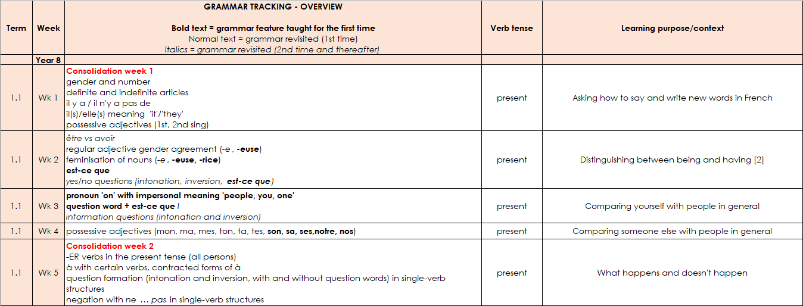
Grammar tracking tab
This column denotes the focus tense for that week.
This column gives the learning context.
A consolidation week revises vocabulary from Y7 and grammar features from either Y7 or Y8.
New grammar features are in bold type.
Features for 1st time revisiting are in normal type.
2nd and subsequent revisits are in italics.
Extended text exploitation weeks are in blue type.
Notes:
As you can see the grammar tracking tab is a week-by-week overview of the grammar spine, listing the new and revisited grammar features.
[Click to bring up the explanations and narrate accordingly]

Slide 22
Tabs in the NCELP SOW
The Y8 SOW tab is the detailed planning document for each week, with grammar, vocabulary, sounds of the language, and lesson overviews.
Notes:
[Cue animation]
The Y8 SOW tab is the detailed planning document for each week, with grammar, vocabulary, sounds of the language, and lesson overviews.

Slide 23
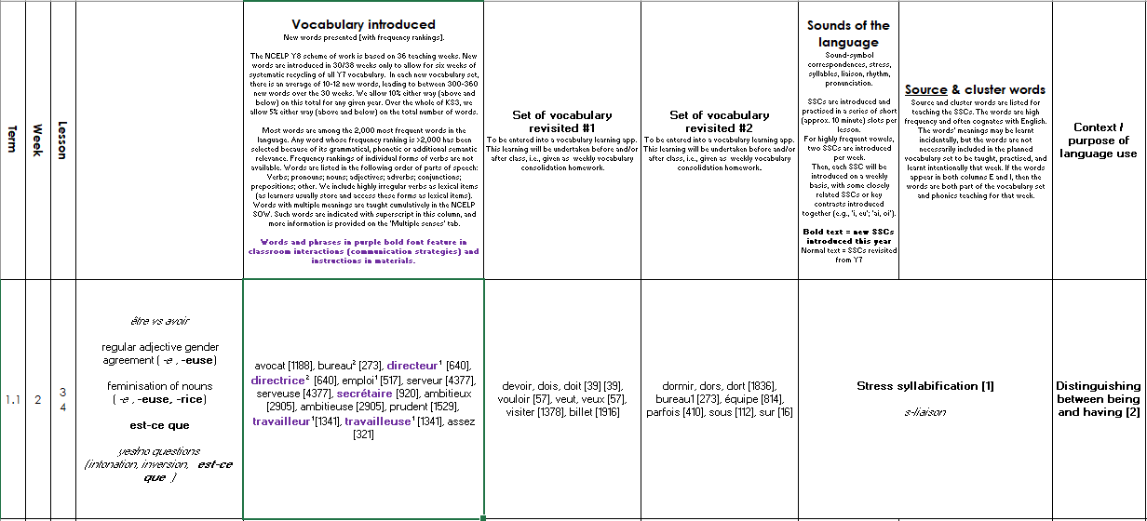
Y8 SOW
Sounds of the language practice in every lesson.
The grammar column reproduces the
information from the grammar tracking tab.
Mixed vocabulary sets introduced each week, vocabulary frequency shown in each case.
new | revisit | revisit
Systematic revisiting of vocabulary every 3 weeks and 9 weeks.
Additional notes detailing the context of each lesson.
Notes:
This is what the layout of the Y8 French SOW looks like – this is from week two of the first term.
[Cue animation]
It starts with grammar introduced – here ‘est-ce que’ – in addition it references the grammar to be revisited, regular adjective gender agreement and the feminisation of nouns. Revisited for the second or subsequent time are yes/no and intonation questions (in italics).
[Cue animation]
Then we see new vocabulary introduced as well as vocabulary to be revisited – we revisit two sets of vocabulary every lesson from three and nine weeks ago - you can see that the sets differ a little in the number of words in each – the vocabulary is integrated as much as possible, but there are also stand-alone vocabulary tasks, where needed.
[Cue animation]
Then the sounds of the language, such as sound-symbol correspondences (phonics) but also beginning in Year 8, additional sounds of the language such as stress, syllables, liaison, rhythm, pronunciation.
In this week we are doing stress syllabification and a 2nd revisiting of s-liaison.
Specifically in terms of phonics, one difference between the languages is that new SSCs continue to be introduced in Year 8 French. There are a very few additional SSC in Y8 German (four in total; two new [pf], [kn] and two alternative spellings of existing SSC ([ai] added to [ei], and [y] added to [ü]. For Spanish, all target SSCs are covered in Year 7.
[Cue animation]
There is still a context – no traditional topic but a context for language use, here it is ‘Distinguishing between being and having’. This particular week is a typical SOW week. In addition, at regular intervals there are weeks set aside for some revision and consolidation, assessment (in term 2 and 3) and also for work on “rich” texts or authentic text exploitation, as we saw on the grammar tracking tab.

Slide 24
Tabs in the NCELP SOW
The RESOURCES tab is a page of individual links to each SOW resource.
Notes:
[Cue animation]
Just to say before we finish that the resources tab is a page of individual links to each SOW resource.

Slide 25
Resources
Notes:
For the lesson resources, each hyperlink takes you to the resource on the Portal. Each week’s resource contains 2X50 minute resourced lessons which carefully and thoughtfully integrate the three strands of phonics, vocabulary and grammar.
You will find links to the Quizlet sets for vocabulary introduced and also links to the vocabulary learning homework sheets, along with relevant links to Gaming Grammar.

Slide 26
Overview
PAUSE FOR THOUGHT
1. NCELP – pedagogy and the new GCSE Subject Content
NCELP alignment with the 6 standards of the Early Career ( ) Framework to include
a closer look at the NCELP Schemes of work
a review of individual lesson resources
examples of adaptive teaching
NCELP approach to assessment
3. Next steps and further training opportunities
Notes:
Before we move to the next section, jut a brief pause for thought here, should anyone have any immediate questions.
So now that we’ve covered the Schemes of Work, lets now visit ECF standard 4 before a chance for you to review individual lesson resources.

Slide 27
ECF 4: Classroom Practice
Fully resourced teaching materials at individual lesson level enable the SOW aims to translate effectively into classroom practice.
The 3 strands of phonics, vocabulary and grammar are increasingly integrated.
Ample meaningful practice is provided.
Use of the target language is carefully planned and cumulative.
Built-in planned revisiting of language (PVG)
Each classroom resource aims to explicitly recognise the language required to undertake it, including the language:
which will/should be familiar
which requires brief revisiting
which is new, hence requiring thorough introduction and practice
Planned revisiting facilitates regular low-stakes knowledge checks, supported by strategic use of Computer Assisted Language Learning (CALL) tools, pre- and post-lesson.
Notes:
I think you can appreciate from our SOW overview, just how well planned and integrated the 3 knowledge strands are. And now we’ll turn to ECF Standard 4, Classroom Practice, to understand how well these strands then translate into classroom practice.
Cue animation
As we’ve seen, the PVG strands are present in each lesson, but as the SOW progress the strands become more closely and effectively integrated through meaningful practice, with students increasingly able to practise recall and develop productive skills (writing and speaking) for real and creative communication.
After clear simple explanation slides, the activities that follow provide many more worked examples and scaffolds, as well as repeated opportunities to practise the targeted language, to assist with the understanding of the students before they need to produce the features in spoken or written form.
For example, lessons feature paired speaking activities, whether focused on the specific SSC or grammar feature of the lesson that are the culmination of the systematic practice of the lesson’s grammar feature and vocabulary.
This guided lesson structure means that the activities are more likely to be completed successfully and with greater confidence.
These types of production tasks sit on a continuum from structured to freer practice, with more opportunities for open- ended and creative tasks as the course progresses.
Cue animation
The SOW explicitly builds in planned revisiting of language (PVG). Each classroom resource aims to explicitly recognise the language required to undertake it
which language will/should be familiar
which requires brief revisiting
which is new, hence requiring introduction and support
Cue animation
NCELP creates audio recordings, worksheets and Quizlet sets as homework for students to learn and practise new vocabulary. This vocabulary set is always used in the following lesson’s activities, alongside revisited sets of vocabulary from the last month and term. CALL resources are used only when technology is useful and benefits language learning: Quizlet, for example, provides automatic, immediate, and individualised feedback to learners about their knowledge and also encourages independent learning.

Slide 28
A full lesson resource
A hands-on opportunity to see the SOW principles in action in a 2-lesson resource for French (with Spanish and German options for review after the session.
Examples are taken from Year 9 SOW for French.
By Year 9, the elements of PVG are becoming more integrated in terms of meaningful practice and freer production opportunities.
Notes:
In a moment, you will get the chance to review individually a sample set of lesson resources for one week of the SOW, and then we can discuss your findings. For this purpose we’ve chosen a resource from the Year 9 SOW for French, but you will also have links to resources from German and Spanish to review after the session. I’d also suggest that you also look at the suggested resources for a language you don’t teach, as this will give you an impression from the learners’ viewpoint.
As you would expect, and will see in the resources, by Year 9, the elements of PVG are becoming increasingly integrated in terms of meaningful practice with more in the way of freer production opportunities.
I’d just like to clarify what NCELP means here in terms of meaningful practice. Our conception of ‘meaningful’ here relies on ‘contingency’ and ‘desirable difficulty’, whereas those who may not know the methodology might assume that ‘meaningful’ is in the sense of thematic coherence and communication as conversation. The NCELP early Y7 speaking tasks, for example, are meaningful practice in the sense that pupils can only complete them by attending to both form and meaning, and because they a relying on their own linguistic resources to do so. You’ll see from the Year 9 resources we’re giving you to review that both the attention to form and meaning and the thematic coherence and communication come together in some very rich integrated learning resources.
But just quickly before we review the resources, here’s a very quick recap of the core principles for the three strands of the SOW, so that you can appreciate how the students’ knowledge has been built up from individual elements to create an integrated whole.

Slide 29
Grammar principles
practise with ‘pairs’ of features (not whole paradigms)
compel thinking about form and meaning
include a brief explanation followed by input practice, then scaffolded production
design revisiting that leads to freer production activities
promote true manipulation of language
Notes:
The grammar principles are as follows:
The SOW is planned so that pairs of grammar features are practised. For example, two verb endings with contrasting meanings (or functions) can be juxtaposed. Practising a whole new set of features together, e.g., a full range of verb endings, is unlikely to be effective, as it is beyond what most learners can pay attention to at any one time.
The practice itself should require attention to form and meaning. We might need to strip out other language in order to make attention to the grammar essential for task completion.
After a brief explanation, students are given plenty of practice, initially in reading and listening, with the new features before scaffolded production.
When features are revisited, they can be used more freely.
There is an emphasis on true manipulation of language (as opposed to chunks) as this gives students the best chance of being able to communicate meaning themselves.
The SOW provides gradual progression, facilitating a systematic, step-by step approach to learning, practising, and mastering the new grammar.

Slide 30
Vocabulary principles
use frequency to inform vocabulary selection
create mixed word class vocabulary sets – allowing for sentence creation
use word selection to support grammar practice
teach one new meaning at a time (e.g., rico – rich, tasty)
build in systematic revisiting
Notes:
Up until now we’ve had to rely on intuition about which words might be useful to learn. However, there is now data available from corpora (large electronic collections of oral and written language) on the frequency with which words occur in the language. As high-frequency words can be used across contexts (rather than for a single topic), they are particularly useful in a time-limited teaching context.
The new GCSE subject content requires that 85% of words used are among the 2000 most frequent in the language.
Other principles for vocabulary teaching include:
combining different word classes in a each vocabulary set. This offers greater potential for sentence building than, say, a list of nouns used to fill a slot after a verb.
choosing words that are closely related to the grammar being practised – again, this is the cohesion between different language components that I mentioned on the last slide.
teaching each meaning of a word separately to avoid unnecessary difficulty. High-frequency words often have more than one meaning – e.g. rico for rich and tasty.
systematically revisiting previously taught words. This is the crucial factor leading to long-term retention.

Slide 31
Phonics principles
explicitly teach the key sound-spelling correspondences (SSCs)
include transcription and read aloud activities at SSC level, word level, sentence level and paragraph level
combine two/three SSCs in ‘minimal pairs’ activities
develop fluency with timed exercises
integrate with vocabulary and grammar strands
Interweave cultural aspects
continue to practise single SSCs into Year 9 – this is key as phonics knowledge is prone to decay if not regularly revisited
Notes:
The third component is phonics teaching: explicit teaching of the relationships between the letters of written words and their sounds.
Research has found that this improves students’ phonological decoding ability (their ability to sound out unknown words).
There are also many related benefits in terms of motivation and confidence in oral and written production.
And this also supports errorless learning – avoiding inaccurate representations regarding how the new language sounds and is spelt.
[Cue animation]
Speaking and listening activities develop in complexity over the Scheme of Work – from individual SSC level, through to word, sentence and paragraph level. This regular revisiting and extended practising (often without the students actively realising this) helps cement fluency and automaticity of SSC knowledge.
[Cue animation]
Practice often takes the form of combining two/three SSCs in ‘minimal pairs’ activities, where one or two previously taught SSCs are combined in an activity with a newly taught SSC that is close in proximity.
[Cue animation]
There is a variety of teaching activities for SSC teaching, including timed activities with the aim of developing students’ fluent application of knowledge.
[Cue animation]
Consolidation takes a variety of different and engaging approaches such as:
The integration of SSC with vocabulary and grammar strands. This is a key element of meaningful practice- for example German singular and plural a and ä (umlaut for plural) or French feminine adjective agreement. This serves to illustrate the ‘braid’ metaphor in action, where all three elements of phonics, vocabulary and grammar come together as one within a lesson.
[Cue animation]
Consolidation often can be found to interweave cultural aspects too – for example Argentinian Christmas customs, biographies of culture figures from the Spanish speaking world, geography of the French speaking world and German music bands.
[Cue animation]
Single SSCs continue to be practised into Year 9 – this really is key. Research* shows that phonics knowledge can fade if not regularly revisited.
*Porter, A.M. (2014) An early start to French literacy: Learning the spoken and written word simultaneously in English primary schools. PhD thesis, University of Southampton.

Slide 32
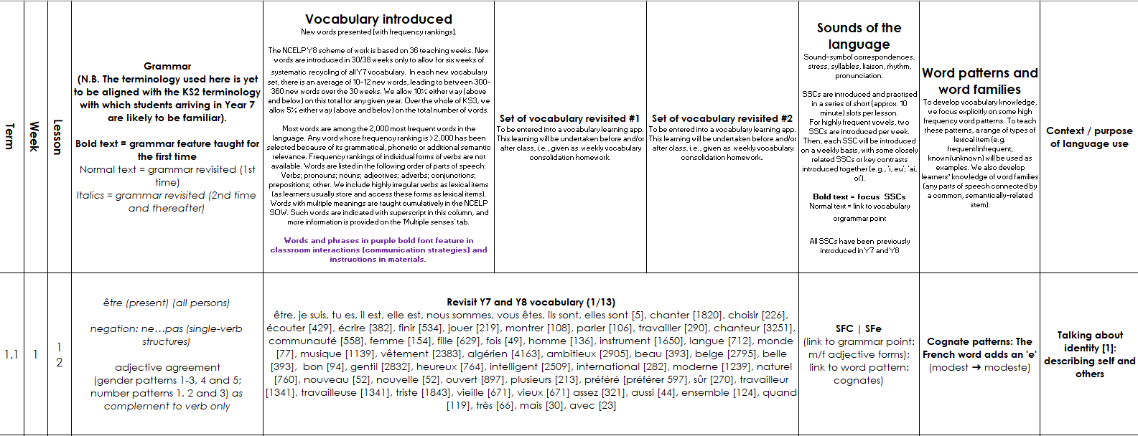
Full, integrated lesson
Compiling an integrated lesson
Year 9, Term 1.1, Week 1
Notes:
Here’s how the full double lesson resource looks on the Scheme of Work – two separate lessons of 50 minutes – on the theme of identity, created using the ideas and the processes that we’ve talked about in today’s session. It's the first lesson in French year 9.
You'll see that the grammar points, the phonics point, the vocabulary set and the semantic context all interrelate, and this is very typical of the year 9 NCELP Schemes of Work.
Year 9 is about bringing together all the building blocks introduced in years 7 and 8 in new ways.
In the first lesson of the year, we're recapping the verb être along with the ne…pas negation structure, and revising adjective agreement patterns.
These are grammar features that align well with the theme of identity and talking about yourself and others.
The phonics for the week are the ‘silent final consonant’ and the ‘silent final E’ that is often added in the feminine form of adjectives to ‘undo’ the ‘silent final consonant’, so you can see how that's a useful phonics pairing to recap within the context of identity.
The vocabulary set is informed by both the grammatical and semantic context – several of the semantic category headings we saw early apply here.
So, now you have a chance for yourselves to look at how this structure translates into a lesson. Spend 10 minutes looking through the double lesson sequence. Do look at the slides in slide show mode to get a feel for what the students experience and do remember that the under slide notes will give you a lot of information about the aims of the activity, as well as the procedure for the tasks.
[Give participants 10 minutes individually to look through the double lesson sequence]
[Clarify the time you will resume]

Slide 33
Options for further review
PAUSE FOR THOUGHT
Year 9 French Term 1.1 week 1
Talking about identity
Notes:
[Elicit participant views on resource.]
Meaningful practice and integration of PVG strands
Draw attention to additional supporting information on each lesson resources in portal, e.g vocabulary pre-learning exercises, quizlet links etc.

Slide 34
A full lesson resource- views
Year 9 French Term 1.1 week 1
Talking about identity
Year 9 Spanish Term 3.2 week 2:
Talking about traits and states
Year 9 German Term 2.1 week 4:
Berühmte Leute und ihre Sprachen
Notes:
Of course you now have the opportunity to explore any of the lesson resources on the portal, ranging from the Year 7 SOW through to Year 9.
I’ve simply highlighted 2 examples here from German and Spanish, both of which also come from the Y9 SOW.
The Spanish example revisits ‘ser’ and ‘estar’ and adjective agreements but in a whole new way which enriches cultural knowledge, also links in the very popular film ‘Encanto’ and gives excellent examples of meaningful practice and integration of the PVG strands.
The German example also revisits and deepens knowledge of grammar and vocabulary covered. (e.g perfect tense with ‘sein’, and cardinal and ordinal numbers) but is also rich in cultural heritage, with reference to famous German poets, authors and composers, and looks at language and identity.
All three resources are excellent examples of how high frequency vocabulary can be reused in different contexts, free of the thematic ‘stovepipes’ which often restrict vocabulary development within the current textbook and GCSE contexts.

Slide 35
Overview
1. NCELP – pedagogy and the new GCSE Subject Content
NCELP alignment with the 6 standards of the Early Career ( ) Framework to include
a closer look at the NCELP Schemes of work
a review of individual lesson resources
examples of adaptive teaching
NCELP approach to assessment
3. Next steps and further NCELP training opportunities
Notes:
Now let’s move to ECF standard 5 on Adaptive teaching.

Slide 36
ECF 5: Adaptive teaching
NCELP provides lesson templates and exemplar activities that can be adapted by teachers to suit the learners in their classroom.
Different versions of individual activities are often provided within resources.
All resources are adaptable by all teachers.
Teacher notes on slides often suggest ways to adapt activities.
Further resources include:
CALL examples: Quizlet, Vocaroo, homework support sheets
a differentiation collection with examples of differentiation for lower and higher proficiency learners
Individual examples from specific schools – language guides, knowledge organisers, vocabulary booklets, use of Google Classroom and equivalent
Notes:
The NCELP SOW and resources are fully adaptable, indeed, as shown earlier, they are an example of how language knowledge and practice can be sequenced and revisited, and it is expected that teachers would adapt the resources to suit their context.
[Cue animation for each of following points]
NCELP provides lesson templates and exemplar activities that can be adapted by teachers to suit the learners in their classroom.
Different versions of individual activities are often provided within resources.
All resources are adaptable by all teachers.
Teacher notes on slides often suggest ways to adapt activities.
CALL examples: Quizlet, Vocaroo, homework support sheets are often used ad referred to in NCELP rsources, but of course many schools use their own VLE. Many schools integrate the resoucrces on Microsoft Teams or Goggle classroom, and many use other popular CALL software to support learning, for example Blooket.
I’d also like to draw your attention to the differentiation training materials which provides examples of differentiation for lower and higher proficiency learners. These show useful, practical ways to adapt resources for Lower Proficiency Learners.
There are individual examples from specific schools – language guides, knowledge organisers, vocabulary booklets, use of Google Classroom and equivalent. The number of these examples of adaptation is increasing as more and more schools adopt and adapt the NCELP SOW in their context.
Let’s take an opportunity now to explore some of these options.

Slide 37
Adaptive teaching examples
Examples of differentiation for lower and higher proficiency learners
Exemplar collections for phonics, vocabulary and grammar
Quizlet, Vocaroo and homework support sheets plus Individual examples from specific schools
Notes:
I’d like to point out just three examples of adaptive teaching resources
[Cue animation]
Firstly, there is a series of PowerPoints with examples of differentiation for lower proficiency learners. These are drawn from a CPD collection on differentiation available on the portal.
Secondly there are some exemplar collections for phonics, vocabulary and grammar on the portal, which effectively provide an example of a resource and then a template to adapt for each language.
Thirdly there are Quizlet, Vocaroo and homework support sheets plus individual examples from specific schools.
You will have access to a document giving links to examples of all of the above for you to explore after this session. Over the next 10 minutes, however, I’d like to invite you to review the PowerPoint resources showing differentiation within the Scheme of Work for the languages you teach. The links will be shared with you in the meeting Chat.
Differentiation within the French SOW Y7 Term 1.2 weeks 3-7
Differentiation within the German SOW Y7 Term 2.2 weeks 3-5
Differentiation within the Spanish SOW Y7 Term 3.2 weeks 4-5 + 7
[Clarify time you will resume]
[Take feedback as appropriate to bring this section to its conclusion]

Slide 38
Overview
1. NCELP – pedagogy and the new GCSE Subject Content
NCELP alignment with the 6 standards of the Early Career ( ) Framework to include
a closer look at the NCELP Schemes of work
a review of individual lesson resources
examples of adaptive teaching
NCELP approach to assessment
3. Next steps and further training opportunities
Notes:
Now let’s move to ECF standard 6 on Assessment.

Slide 39
ECF 6: Assessment
For all years at KS3 there are two assessment weeks
Achievement (two) and Applying your knowledge tests (one only)
Filmed assessment lessons work through two examples of each question type
More detail on assessment principles available here: Phonics, Vocabulary, Grammar
Notes:
When it comes to assessment, I wanted to give you a brief overview at this point, though please be aware that there is more detail on assessment in our 5-part CPD, plus a dedicated module 6 is also available as self study, looking specifically at the principles of assessment.
[Cue animation]
For all years at KS3 there are two assessment weeks.
NCELP provides two types of test which, between them, assess the full range of knowledge and skills students should have developed each assessment point.
[Cue animation]
The first is the ‘achievement’ test, which is designed to assess students' knowledge of a principled sample of phonics, vocabulary, and grammar (PVG) features. This ‘syllabus-based’ test is trying to find out to what extent students have actually learnt what we are trying to teach them up to the point of testing. The mid-year tests* follow this model.
The second assessment type is the 'applying your knowledge' test, which brings together the PVG strands in a more holistic assessment of listening, reading, writing and speaking. This aims to assess students' ability to apply their knowledge in a fuller context through listening comprehension, oral picture description, and short translation tasks. There is one of these in the summer term for Years 7&8 and spring term for Year 9, in addition to a second achievement test. [Cue animation]
In addition, there are filmed assessment lessons that work through two examples of each question type. These are on the Oak academy website.
[Cue animation]
If you do want to take a closer look, more detail on assessment principles can be found by clicking on the hyperlinks, which you can access once the slides are shared with you.

Slide 40
NCELP Assessment
Notes:
You can access the assessment for each subject on the Resource Portal as shown here.
At this stage I just want to give you a couple more tips on assessments, in particular a sort of taster as to what the new ‘read aloud’ test in the new GCSE subject content might look like.

Slide 41
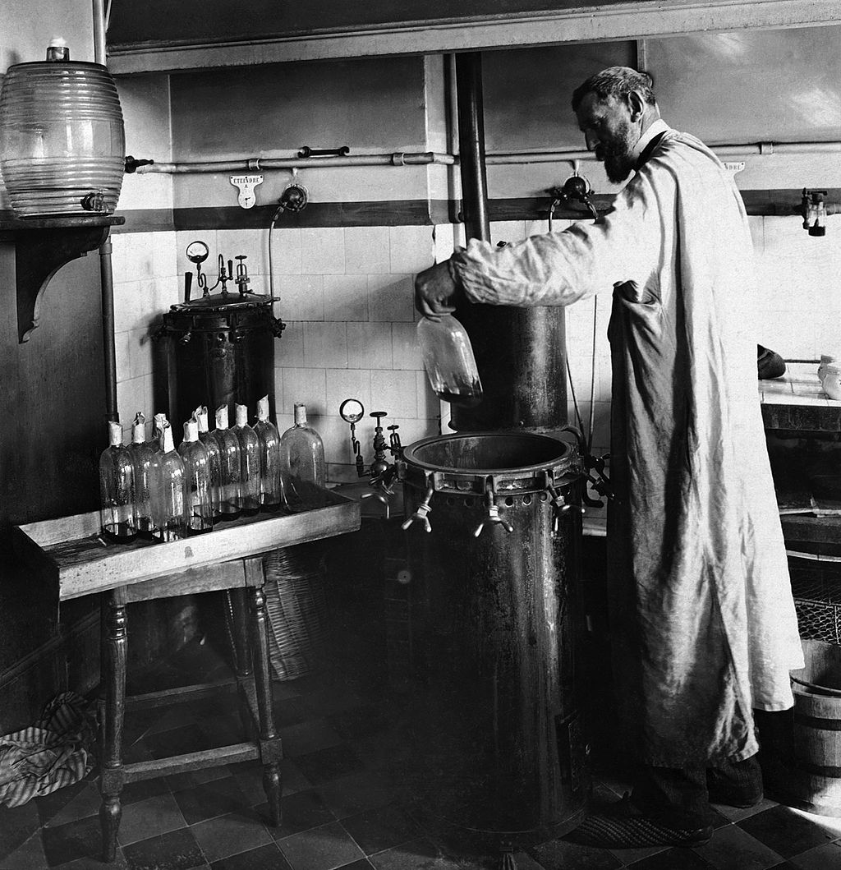
Y8 French Applying your knowledge
Read the following text aloud. You won’t know some of the words – don’t worry! Just do your best to read them aloud as you think they should sound in French.
You will get marks for understandable and fluent pronunciation.
Louis Pasteur est un scientifique français très important dans l'histoire.
Il trouve une solution pour conserver des produits périssables.
Comme résultat, on achète le lait ‘pasteurisé’ au magasin aujourd’hui.
Il crée aussi le premier vaccin contre une maladie dangereuse.
C'est pourquoi on dit qu'il est ‘le père de la médecine moderne’.
Louis Pasteur (1822-1895) dans son laboratoire
Notes:
In achievement tests in Year 7 and 8, Phonics assessments looks at individual SSCs. But here is an example of Y8 French Applying your knowledge test: Read aloud- where the knowledge of SSCs is brought together in sentence and paragraph-length utterances.
There are 5 ‘ideational units’ (sentences of similar length and complexity, containing roughly similar proportions of known vs unfamiliar words 80% of words in the text are in the SOW.
To be a valid test of sounds of language we have to use some language unlikely to have been met yet.
2 marks / sentence = max. 10 marks in total
…………………………………………………………………………………………………………………………………………………………………………………..
Original teacher notes
Image information: By Unknown author - Britannica Kids, Public Domain, https://commons.wikimedia.org/w/index.php?curid=28583466
https://en.wikipedia.org/wiki/Louis_Pasteur#/media/File:Louis_Pasteur_experiment.jpg

Slide 42
Y8 French Applying your knowledge
1 mark awarded where words are pronounced very clearly and comprehensibly, with all or most of the features (SSCs, liaison, stress patterns) accurately produced.
Plus 1 mark awarded where the sentence is read very fluently (with few hesitations and/or self-corrections)
Plus 0.5 mark awarded where the sentence is read quite fluently (with some hesitations and/or self-corrections).
0.5 mark awarded where words are pronounced quite clearly and comprehensibly, with most of the features (SSCs, liaison, stress patterns) accurately produced.
Plus 1 mark awarded where the sentence is read very fluently (with few hesitations and/or self-corrections).
Plus 0.5 mark awarded where the sentence is read quite fluently (with some hesitations and/or self-corrections).
0 marks awarded where words are pronounced neither clearly nor comprehensibly, with few of the features (SSCs, liaison, stress patterns) accurately produced.
0 marks awarded for fluency where the unit is not awarded any marks for comprehensibility.
Notes:
Here we have the suggested mark scheme for the ‘Applying your knowledge’ test.
It is detailed but you can already see the importance of both individual SSCs and additional features of liaison, stress patterns and fluency for example.
[Use indicator/highlighter/mouse to show the key words in mark scheme]

Slide 43
Assessment examples
A self-study opportunity to reflect on achievement tests
A reminder of more detail on assessment principles available here: Phonics, Vocabulary, Grammar
Notes:
At this point I’d like to direct you to some opportunities for further self-study on assessment principles.
The task on ECF standard 6 reflection is an opportunity to review the Achievement tests for Year 7 in the language(s) you teach, and gives you the chance to reflect on how the NCELP SOW principles are reflected in the assessments, and how these compare to:
a) your own classroom/department practice at KS3 and 4,
b) the distinction between formative and summative assessment (e.g. weekly vocab tests vs end of year exams)
c) any textbook assessment packs you’re familiar with, and
d) the current GCSE

Slide 44
Overview
1. NCELP – pedagogy and the new GCSE Subject Content
NCELP alignment with the 6 standards of the Early Career ( ) Framework to include
a closer look at the NCELP Schemes of work
a review of individual lesson resources
examples of adaptive teaching
NCELP approach to assessment
3. Next steps and further NCELP training opportunities

Slide 45
Next steps
Explore the resources on the portal, those mentioned so far, and a more general look at the resource collections
Take a closer look at the Schemes of Work for the language(s) you teach
Reflect on this session and your review of NCELP resources in the light of both the new GCSE subject content and the ‘learn that’ and ‘learn how to’ elements of ECF
Sign up for NCELP CPD
Notes:
In terms of next steps after today’s session:
Can I encourage you to:
[Animate each point]
Explore the resources on the portal, those mentioned so far, and a more general look at the resource collections
Take a closer look at the Schemes of Work for the language(s) you teach
Reflect on this session and your review of NCELP resources in the light of both the new GCSE subject content and the ‘learn that’ and ‘learn how to’ elements of ECF
Sign up for NCELP CPD, which I’ll explain in the next slide.

Slide 46
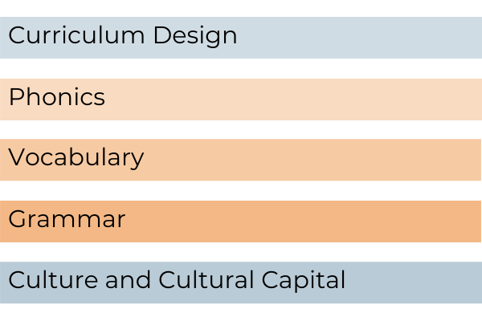
CPD offer
CPD course is free
Content is research-informed languages teaching at KS3 and KS4
5 remote learning sessions of 2.5 hours
Course leaders are NCELP Specialist Teachers
Additional online peer and instructor support
An online self-study version of the course is available for anyone to access for free (and to facilitate a cascade model)
There is a link to register for the course here: www.ncelp.org/cpd
Notes:
So, finally, just to say that I hope that the session has been interesting and useful.
Time in one session is obviously limited and I would therefore really strongly encourage you to sign up for our next round of CPD course taking place in the autumn term. (And don’t forget the GCSE subject content briefing which I mentioned earlier)
The NCELP CPD course is free to schools that receive public funding from the government.
The content is research-informed languages teaching at KS3 and KS4. The central purpose of the Centre’s work is to bring teachers and teaching and researchers and research into closer collaboration.
The Centre’s pedagogy aligns strongly with the new GCSE, the Ofsted Framework, the ECF and Rosenshine principles.
As much as possible, participants will be assigned to courses regionally - led by an NCELP Course Leader near them, with other participants from their region. This offers the potential to make the most of local networking and peer support, both online and potentially also face-to-face. We also have a self-study version of the course (with certification) as shown here, which could be useful to facilitate a cascade model.
(Finally please kindly complete the feedback poll/evaluation.)

Slide 47
Overview
1. NCELP – pedagogy and the new GCSE Subject Content
NCELP alignment with the 6 standards of the Early Career ( ) Framework to include
a closer look at the NCELP Schemes of work
a review of individual lesson resources
examples of adaptive teaching
NCELP approach to assessment
3. Next steps and further training opportunities
3. A closer look at the NCELP Schemes of Work
4. Further training opportunities and next steps

Slide 48
QUESTIONS?
Notes:
[Keep an eye on time, manage as appropriate, including signposting where relevant to the Resource Portal]
(Finally please kindly complete the feedback poll/evaluation.)

Slide 49
Evaluation
Thank you for your participation this afternoon. Just before you go…
Kindly take a few moments to complete the short evaluation which is linked in the Chat.
Notes:
[Post the link to the evaluation in the Chat]
[Thanks and goodbyes.]

