Slide 1
Refugees in France [2]
Reflexive pronoun se
SSCs closed [o/ô], open [o], [au]
Y9 French
Term 3.2 - Week 4 - Lesson 65
Catherine Salkeld / Louise Bibbey / Mary Richardson
Artwork by: Chloé Motard
Date updated: 08/08/22
Notes:
Artwork by Chloé Motard. All additional pictures selected are available under a Creative Commons license, no attribution required.
Native teacher feedback provided by Stéphanie Schmitt.
With thanks to Rachel Hawkes for her input on the lesson material.
Learning outcomes (lesson 1):
Consolidation of SSCs closed [o/ô], open [o], and [au]
Introduction of reflexive pronoun se
Word frequency (1 is the most frequent word in French):
9.3.2.4: (se) laver [3503], (s’)appeler [157], (se) présenter [209], (se) réveiller [2199], accord [496], journée [587], membre [390], paix [579], efficace [1243], fier [1331], officiel [996]
9.3.2.1 (revisit): établir [529], fournir [731], grandir [1936], réussir2 (à) [279], ressentir [1593], servir [177], armée [1011], début [364], état/État [333], fin [111], gouvernement [160], est [4603], nord [1090], ouest [1690], soldat [1098], sud [1242]
9.2.2.2 (revisit): construire [793], réagir (à) [1052], réfléchir (à) [1058], an [76], clé [1200], club [1860], comportement [1489], enfance [2207], habitude [1221], ancien [392], familial [1622], libre [344], quotidien [1318], responsable [511], il y a2 [13/36/8]
Source: Lonsdale, D., & Le Bras, Y. (2009). A Frequency Dictionary of French: Core vocabulary for learners London: Routledge.
The frequency rankings for words that occur in this PowerPoint which have been previously introduced in NCELP resources are given in the NCELP SOW and in the resources that first introduced and formally re-visited those words.
For any other words that occur incidentally in this PowerPoint, frequency rankings will be provided in the notes field wherever possible.
The additional English meanings of the following words have been added to Quizlet since the creation of this resource:
efficace – effective, efficient

Slide 2
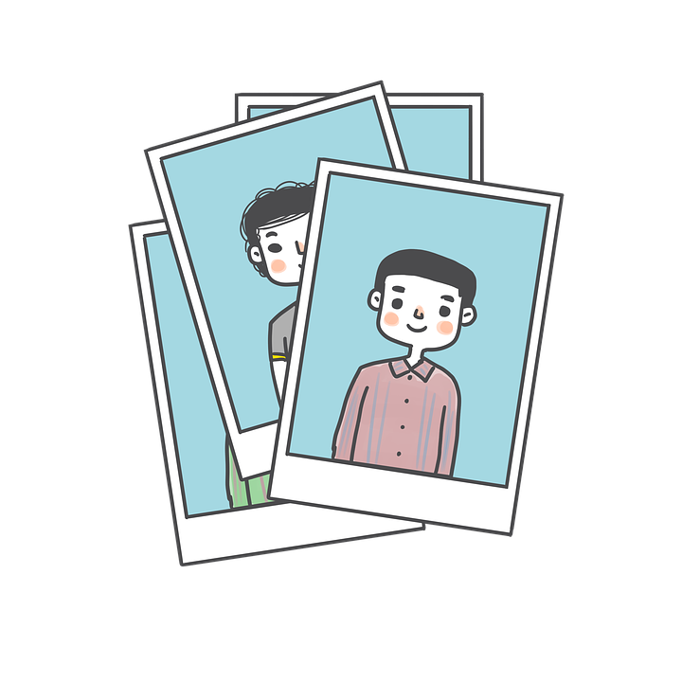
closed o/ô
photo
Notes:
Timing: 1 minute
Aim: To consolidate SSC closed [o/ô]
Procedure: 1. Present the letter(s) and say the closed [o/ô] sound first, on its own. Students repeat it with you. 2. Bring up the word ”photo” on its own, say it, students repeat it, so that they have the opportunity to focus all of their attention on the connection between the written word and its sound.
3. A possible gesture for this would be to mime opening and closing a door. 4. Roll back the animations and work through 1-3 again, but this time, dropping your voice completely to listen carefully to the students saying the closed [o/ô] sound, pronouncing ”photo” and, if using, doing the gesture.
Word frequency (1 is the most frequent word in French):
photo [1412] Source: Lonsdale, D., & Le Bras, Y. (2009). A Frequency Dictionary of French: Core vocabulary for learners London: Routledge.

Slide 3
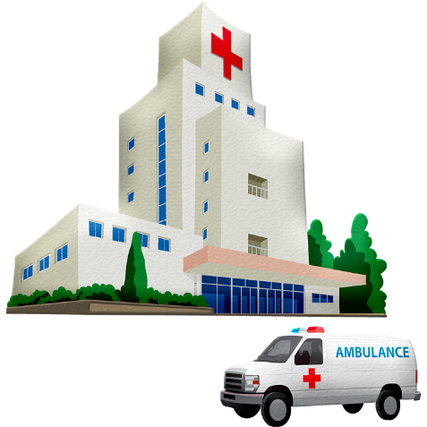
closed o/ô
contrôle
hôpital
[test]
photo
drôle
mot
[funny]
chose
[word]
[thing]
Notes:
Timing: 1 minute
Aim: To consolidate SSC closed [o/ô]
Procedure:
1. Introduce and elicit the pronunciation of the individual SSC closed [o/ô] and then the source word again ‘photo’ (with gesture, if using). 2. Then present and elicit the pronunciation of the five cluster words.
The cluster words have been chosen for their high-frequency, from a range of word classes, with the SSC (where possible) positioned within a variety of syllables within the words (e.g. initial, 2nd, final etc.). Additionally, we have tried to use words that build cumulatively on previously taught SSCs (see the Phonics Teaching Sequence document) and do not include new SSCs. Where new SSCs are used, they are often consonants which have a similar symbol-sound correspondence in English.
Word frequency (1 is the most frequent word in French): photo [1412], mot [220], hôpital [1310], chose [125], contrôle [662], drôle [2166] Source: Lonsdale, D., & Le Bras, Y. (2009). A Frequency Dictionary of French: Core vocabulary for learners London: Routledge.

Slide 4
au
[au/eau]
gauche
Notes:
Timing: 1 minute
Aim: To consolidate SSC [au]
Procedure: 1. Present the letter(s) and say the [au] sound first, on its own. Students repeat it with you. 2. Bring up the word ”gauche” on its own, say it, students repeat it, so that they have the opportunity to focus all of their attention on the connection between the written word and its sound.
3. A possible gesture for this would be to point to the students’ left (teacher’s right!) to indicate this direction. 4. Roll back the animations and work through 1-3 again, but this time, dropping your voice completely to listen carefully to the students saying the [au] sound, pronouncing ”gauche” and, if using, doing the gesture.
Word frequency (1 is the most frequent word in French):
gauche [607].
Source: Lonsdale, D., & Le Bras, Y. (2009). A Frequency Dictionary of French: Core vocabulary for learners London: Routledge.

Slide 5
au
faux
bateau
[au/eau]
beau
eau
gauche
aussi
[also]
Notes:
Timing: 1 minute
Aim: To consolidate SSC [au]
Procedure:
1. Introduce and elicit the pronunciation of the individual SSC [au] and then the source word again ‘gauche’ (with gesture, if using). 2. Then present and elicit the pronunciation of the five cluster words.
The cluster words have been chosen for their high-frequency, from a range of word classes, with the SSC (where possible) positioned within a variety of syllables within the words (e.g. initial, 2nd, final etc.). Additionally, we have tried to use words that build cumulatively on previously taught SSCs (see the Phonics Teaching Sequence document) and do not include new SSCs. Where new SSCs are used, they are often consonants which have a similar symbol-sound correspondence in English.
Word frequency (1 is the most frequent word in French): gauche [607]; aussi [44]; faux [555] bateau [1278]; beau [393]; eau [475] Source: Lonsdale, D., & Le Bras, Y. (2009). A Frequency Dictionary of French: Core vocabulary for learners London: Routledge.

Slide 6
open o
porte
Notes:
Timing: 1 minute
Aim: To consolidate SSC open [o]
Procedure: 1. Present the letter(s) and say the open [o] sound first, on its own. Students repeat it with you. 2. Bring up the word ”porte” on its own, say it, students repeat it, so that they have the opportunity to focus all of their attention on the connection between the written word and its sound.
3. A possible gesture for this would be to mime opening and closing a door. 4. Roll back the animations and work through 1-3 again, but this time, dropping your voice completely to listen carefully to the students saying the [o] sound, pronouncing ”porte” and, if using, doing the gesture.
Word frequency (1 is the most frequent word in French):
porte [696]. Source: Lonsdale, D., & Le Bras, Y. (2009). A Frequency Dictionary of French: Core vocabulary for learners London: Routledge.

Slide 7
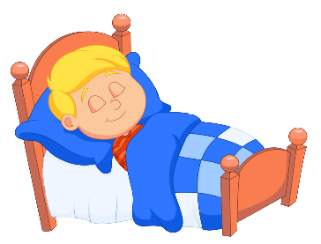
open o
école
poste
porte
d’accord
dormir
[okay]
personne
[person]
Notes:
Timing: 1 minute
Aim: To consolidate SSC open [o]
Procedure:
1. Introduce and elicit the pronunciation of the individual SSC open [o] and then the source word again ‘porte’ (with gesture, if using). 2. Then present and elicit the pronunciation of the five cluster words.
The cluster words have been chosen for their high-frequency, from a range of word classes, with the SSC (where possible) positioned within a variety of syllables within the words (e.g. initial, 2nd, final etc.). Additionally, we have tried to use words that build cumulatively on previously taught SSCs (see the Phonics Teaching Sequence document) and do not include new SSCs. Where new SSCs are used, they are often consonants which have a similar symbol-sound correspondence in English.
Word frequency (1 is the most frequent word in French): porte [696]; d’accord [736]; personne [84]; dormir [39]; école [477]; poste [489]. Source: Lonsdale, D., & Le Bras, Y. (2009). A Frequency Dictionary of French: Core vocabulary for learners London: Routledge.

Slide 8
Phonétique
Open [o] and closed [ô/o]/[au] are tricky for English speakers. Try saying the source words porte (open) and photo (closed) /gauche to match with the SSC you hear.
écouter
Écoute. Les mots ont-ils la SSC open [o] ou closed [ô/o]/[au] ?
Q | mot | en anglais | open [o] | closed [ô/o]/[au]
 | au cune | [none]
 | s o l | [ground]
 | fant ô me | [ghost]
 | c ô te | [coast]
 | c o lle | [glue]
 | v o leur | [thief]
 | pauvre | [poor]
 | r o be | [dress]
1
_
2
_
3
_
4
_
5
_
6
_
7
_
8
_
Notes:
Timing: 5 minutes
Aim: Aural recognition of SSCs [o], [ô] and [au] in single words
Procedure:
1. Click to play the audio.
2. Students tick whether they hear [o],[ô] or [au].
3. Click to reveal the answers.
Transcript:
1. aucune
2. sol
3 fantôme
4. côte
5. colle
6. voleur
7. pauvre
8. robe
Word frequency of unknown words used (1 is the most frequent word in French):
aucun [63], fantôme [4075], côte [1385], voleur [3163], robe [2864]
Source: Lonsdale, D., & Le Bras, Y. (2019). A Frequency Dictionary of French: Core vocabulary for learners London: Routledge.

Slide 9
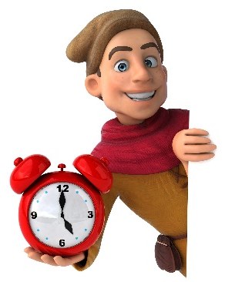
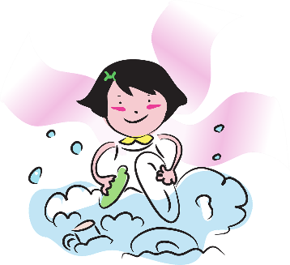
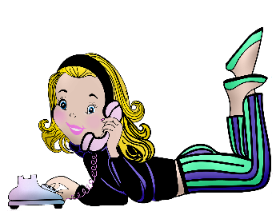
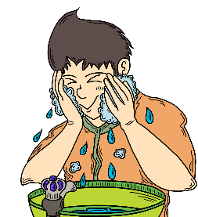
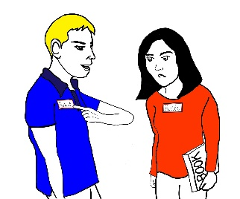
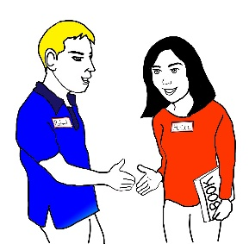
Vocabulaire
écouter / parler
laver
to call, calling
4
5
8
3
le membre
présenter
to present, presenting
officiel/officielle
réveiller
fier/
fière
to wash, washing
day (duration)
member
to wake, waking
proud (m/f)
1
la journée
6
7
2
appeler
official (m/f)
la paix
s’appeler
to be called
to introduce oneself
11
se présenter
to wake up
to wash oneself
13
se laver
peace
effective/efficient
se réveiller
l’accord
9
agreement
10
efficace
14
15
12
Notes:
Timing: 4 minutes
Aim: Aural recognition and oral production of new vocabulary
Procedure:
Click the pictures to hear the vocabulary. Elicit the English from students chorally.
Click after each one to reveal the English.
Students work in pairs to ask each other for the French.
Click to reveal the French as a final check.
Transcript:
laver
la journée
appeler
le membre
présenter
officiel/officielle
réveiller
fier/fière
se laver
la paix
s’appeler
efficace
se présenter
se réveiller
l’accord

Slide 10
L’Afghanistan
Lis le texte et répond aux questions en anglais.
lire
Les gouvernements du monde réfléchissent à une solution efficace à la crise actuelle. En 2021, l’armée des États-Unis a quitté l’Afghanistan, et les talibans ont réagi avec un comportement violent. L’armée afghane n’a pas réussi à empêcher le début d’une nouvelle crise. Les talibans ont vite établi un nouveau gouvernement. Ce gouvernement veut construire une société comme l’ancien régime des années 90, où les femmes et beaucoup de groupes minoritaires* ne sont pas libres de participer à la vie quotidienne. Par exemple, il ne fournit pas d’éducation aux filles de plus d’onze ans, et le pays est dangereux pour les membres de la communauté LGBT.
*minoritaire = minority
What happened in 2021? (two things)
Did the Afghan army manage to stop the violence?
What did the Taliban do quickly?
What does the new government want?
How does this affect women and girls?
What is it like for LGBT people in Afghanistan?
The US army left Afghanistan and the Taliban reacted with violence.
No.
established a new government
a society like the old regime in the 90s
Women aren’t free and there’s no education for girls over 11.
dangerous
Notes:
Timing: 8 minutes
Aim: Written comprehension of new and revisited vocabulary in context
Procedure:
1. Students read the text and answer the comprehension questions in English.
2. Click to check answers.
Word frequency of unknown words used (1 is the most frequent word in French):
minoritaire [4271]
Word frequency of cognates used (1 is the most frequent word in French): violent [1119], Taliban [>5000], société [295], régime [543], éducation [995]
Source: Lonsdale, D., & Le Bras, Y. (2009). A Frequency Dictionary of French: Core vocabulary for learners London: Routledge.

Slide 11
Saying it, him, and her
grammaire
Remember, we use le and la to mean it. We use le to refer to a masculine noun, and la to refer to a feminine noun. Direct object pronouns like le and la usually go before the verb.
Le nord du pays ? Je le connais bien.
The north of the country? I know it well.
La clé ? Je la donne au professeur.
The key? I’m giving it to the teacher.
Remember, le and la are shortened to l’ before a verb that begins with a vowel or h muet.
We can also use le to mean him and la to mean her.
Le garçon qui a tort ? Je le corrige.
Je l’aide.
The boy who is wrong ? I’m correcting him.
I’m helping him.
La femme du club ? Je la connais.
The woman from the club? I know her.
Notes:
Timing: 2 minutes
Aim: Recap of direct object pronouns le and la
Procedure:
1. Click to reveal explanations and examples. Elicit English where possible.
2. Ensure understanding.

Slide 12
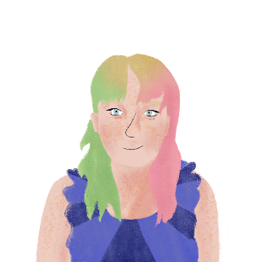
La vie de Max et Nina
lire
Stéphanie écrit des messages sur la vie de Max et sa petite soeur, Nina. Choisis Max ou Nina pour chaque message.
Max | Nina
supports him when he has problems | corrects her
introduces him to the others when he goes to school | finds her in the garden when she’s sad
looks for him when he leaves school | watches her when she plays football and is proud
finds him very responsible when he helps her mother | doesn’t leave her in her bedroom when she feels afraid
1. Quand Nina parle français, je la corrige.
5. Quand Max sort de l’école, je le cherche.
2. Quand Max a des problèmes, je le soutiens.
6. Quand Nina joue au foot, je la regarde et je suis fière.
3. Quand Max va à l’école, je le présente aux autres.
7. Quand Nina ressent de la peur, je ne la laisse pas dans sa chambre.
4. Quand Nina est triste, je la trouve dans le jardin.
8. Quand Max aide ma mère, je le trouve très responsable.
Notes:
Timing: 5 minutes
Aim: Written recognition of direct object pronouns le and la, and connecting these with meaning.
Procedure:
1. Students read the messages and decide whether each refers to Max or Nina.
2. Click to reveal answers.
3. Students list in English what Stéphanie does to Max and Nina.
4. Click to check answers.

Slide 13
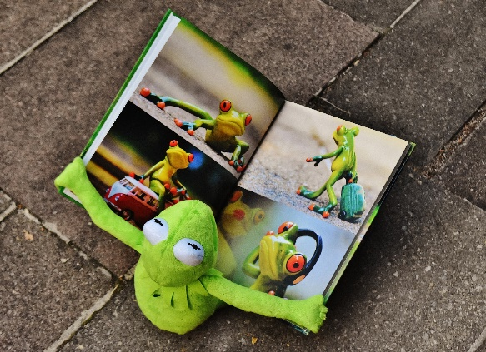
Saying what somebody does to himself/herself
grammaire
As you know, we can use me and te as reflexive pronouns to mean myself and yourself.
Je me regarde dans la photo.
I look at myself in the photo.
Tu te demandes.
You ask yourself./You wonder.
The reflexive pronoun for himself and herself is se.
Like me and te, se is shortened to s’ before a verb that begins with a vowel or h muet.
He washes himself.
Il se lave.
Elle se réveille.
She wakes (herself) up.
Il s’appelle Max.
He calls himself Max./ He is called Max.
Notes:
Timing: 2 minutes
Aim: Recap of reflexive pronouns me and te and introduction of reflexive pronoun se
Procedure:
1. Click to reveal explanations and examples. Elicit English where possible.
2. Ensure understanding.

Slide 14
Les cousins de Stéphanie
écouter
Max aide sa petite sœur. Stéphanie décrit leurs habitudes quotidiennes.
Q | A | B | verbe en anglais | R
 | tôt | le sac de Nina | gets up
 | Nina | à six heures | wakes up
 | vite | Nina | gets washed
 | Max | Nina du jardin | calls
 | lentement | Nina pour aller au parc | prepares
 | pour un jeu de foot | les vêtements de Nina | gets organised
 | s’il a besoin d’un manteau | à Nina de jouer | wonders
 | pour pratiquer | avec Nina | speaks French to himself
1
1
2
2
3
3
4
4
5
5
6
6
7
7
8
8
Notes:
Timing: 8 minutes
Aim: Aural recognition of reflexive pronoun se
Procedure:
1. Click buttons on the left to play audio.
2. Students listen and decide which phrase the beep is covering.
3. Click to reveal answers.
4. Click buttons on the right to play full audio.
5. Students listen again and note the verb in English.
6. Click to check answers.
Transcript:
Il se lève [tôt].
Il réveille [Nina].
Il se lave [vite].
Il appelle [Nina du jardin].
Il prépare [Nina pour aller au parc].
Il s’organise [pour un jeu de foot].
Il se demande [s’il a besoin d’un manteau].
Il se parle en français [pour pratiquer].

Slide 15
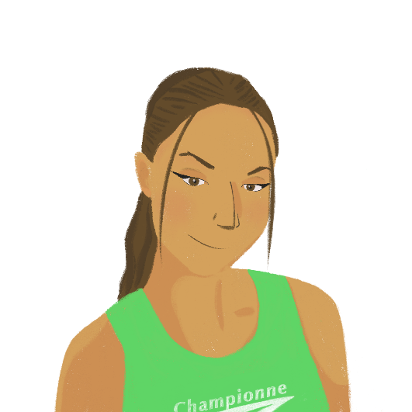
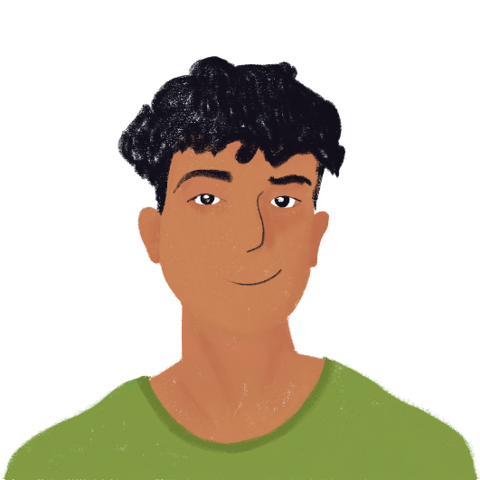
La vie de Max et Nina
parler
Tu poses des questions à Max sur sa vie en France avec Nina.
Tu te t’appelles comment ?
Je m’appelle Max.
what he is called
Max
We use comment to ask what people are called – literally, ‘You call yourself how ?’. Literally, the answer is ‘I myself call…’.
Notes:
Timing: 10 minutes
Aim: Oral production of reflexive pronouns me, te, and se
Procedure:
1. Print role cards.
2. Partner A takes the role of Max. Partner B asks Max about how he and Nina are settling in. (Students will use intonation questions, as inversion questions with reflexive verbs haven’t been covered.)
3. Partners swop roles.

Slide 16
La vie de Max et Nina
parler
Partner A
Your partner is taking the role of Max. Ask questions to find out:
what he is called
what time he wakes up
what time his sister gets up
if she introduces herself to his friends
if she gets ready quickly in the morning
Now you are Max. Answer your partner’s questions in full sentences.
yes, at six o’clock
seven o’clock
Nina
yes, often
quite happy, but also a bit sad
Partner B
You are Max. Answer your partner’s questions in full sentences.
Max
six o’clock
seven o’clock
yes, sometimes
not always
Now your partner is taking the role of Max. Ask questions to find out:
if he gets up early
what time he gets washed
what his sister is called
if she corrects herself in French
if she feels happy in France
Notes:
Timing: 10 minutes
Aim: Oral production of reflexive pronouns me, te, and se
Procedure:
1. Print role cards.
2. Partner A takes the role of Max. Partner B asks Max about how he and Nina are settling in. (Students will use intonation questions, as inversion questions with reflexive verbs haven’t been covered.)
3. Partners swop roles.

Slide 17
La vie de Max et Nina
parler
Partner A
Tu t’appelles comment ?
Tu te réveilles à quelle heure ?
Ta sœur se lève à quelle heure ?
Elle se présente à tes amis ?
Elle se prépare vite le matin ?
Oui, je me lève à six heures.
Je me lave à sept heures.
Elle s’appelle Nina.
Oui, elle se corrige souvent.
Elle se sent assez contente, mais un peu triste aussi.
Partner B
Je m’appelle Max.
Je me réveille à six heures.
Elle se lève à sept heures.
Oui, quelquefois elle se présente à mes amis.
Elle ne se prépare pas toujours vite le matin !
Tu te lèves tôt ?
Tu te laves à quelle heure ?
Ta sœur s’appelle comment ?
Elle se corrige en français ?
Elle se sent contente en France ?
Notes:
SUGGESTED ANSWERS

Slide 18
Refugees in France [2]
Reflexive pronoun se
SSCs closed [o/ô], open [o], [au]
Y9 French
Term 3.2 - Week 4 - Lesson 66
Author name: Catherine Salkeld / Louise Bibbey /
Mary Richardson
Artwork by: Chloé Motard
Date updated: 08/08/22
Notes:
Artwork by Chloé Motard. All additional pictures selected are available under a Creative Commons license, no attribution required.
Native teacher feedback provided by Stéphanie Schmitt.
With thanks to Rachel Hawkes for her input on the lesson material.
Learning outcomes (lesson 1):
Consolidation of SSCs closed [o/ô], open [o], [au]
Consolidation of reflexive pronoun se
Word frequency (1 is the most frequent word in French):
9.3.2.4: (se) laver [3503], (s’)appeler [157], (se) presenter [209], (se) réveiller [2199], accord [496], journée [587], membre [390], paix [579], efficace [1243], fier [1331], officiel [996]
9.3.2.1 (revisit): établir [529], fournir [731], grandir [1936], réussir2 (à) [279], ressentir [1593], servir [177], armée [1011], début [364], état/État [333], fin [111], gouvernement [160], est [4603], nord [1090], ouest [1690], soldat [1098], sud [1242]
9.2.2.2 (revisit): construire [793], réagir (à) [1052], réfléchir (à) [1058], an [76], clé [1200], club [1860], comportement [1489], enfance [2207], habitude [1221], ancien [392], familial [1622], libre [344], quotidien [1318], responsable [511], il y a2 [13/36/8]
Source: Lonsdale, D., & Le Bras, Y. (2009). A Frequency Dictionary of French: Core vocabulary for learners London: Routledge.
The frequency rankings for words that occur in this PowerPoint which have been previously introduced in NCELP resources are given in the NCELP SOW and in the resources that first introduced and formally re-visited those words.
For any other words that occur incidentally in this PowerPoint, frequency rankings will be provided in the notes field wherever possible.
The additional English meanings of the following words have been added to Quizlet since the creation of this resource:
efficace – effective, efficient

Slide 19
La crise des réfugiés*
*la crise des réfugiés = the refugee crisis
lire/parler
Practise reading the open/closed [o/ô] and [au] sounds.
1
Le nombre de réfugiés augmente en raison de la guerre en cours .
[The number of refugees is increasing due to ongoing war.]
2
Leur réalité devient un cauchemar car leur vie change du jour au lendemain.
[Their reality becomes a nightmare as their life changes overnight.]
3
Les hôpitaux des zones de guerre offrent soins et protection même dans des circonstances difficiles.
[Hospitals in war zones offer care and protection even in difficult circumstances .]
4
Les réfugiés doivent parfois rester à long terme dans des logements temporaires.
[Refugees sometimes have to stay in temporary accommodation on a long term basis.]
Notes:
Timing: 4 minutes
Aim: To practise identifying words with open [o], closed [o/ô] [(e)au] through reading/speaking.
Procedure:
Click to reveal each sentence with its translation.
Ask individual students to read a sentence, focusing on the correct pronunciation of the closed [o/ô], open [o], [au]
Click on the numbers to hear the sentences spoken by a native speaker to verify pronunciation.
Transcript:
Le nombre de réfugiés augmente en raison de la guerre en cours
Leur réalité devient un cauchemar car leur vie change du jour au lendemain
3. Les hôpitaux des zones de guerre offrent soins et protection même dans des circonstances difficiles.
4. Les réfugiés doivent parfois rester à long terme dans des logements temporaires.
Word frequency of unknown words (1 is the most frequent word in French): nombre [249], augmenter [823], cauchemar [3689], car [176], lendemain [1258], offrir [224], circonstance [1054], logement [1849], temporaire [2885]
Word frequency of cognates (1 is the most frequent word in French): réfugié [>5000], réalité [532], zone [860], protection [953], terme [311]

Slide 20
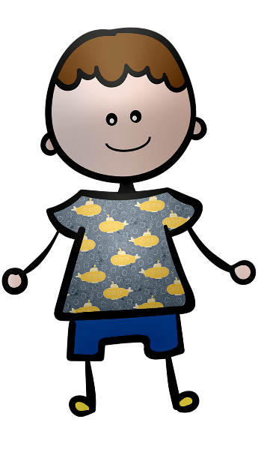
Vocabulaire
Traduis l’anglais en français
lire/écrire
Je m’appelle Max. Je suis fier de ma sœur, Nina.
le membre
une journée
am called
proud
Notre voyage de l’Afghanistan à la France dure
une journée.
se laver
se présenter
a day
Avant le voyage, il faut se réveiller tôt, et il faut réveiller les membres de la famille.
appeler
réveiller
wake up
wake
members
efficace
la paix
Après le voyage, il faut laver les vêtements, et
il faut se laver.
wash
wash oneself
s’appeler
l’accord
Quand on arrive, il faut se présenter à une personne officielle, et il faut présenter un passeport.
introduce oneself
présenter
fier/fière
official
present
On va appeler les amis en Afghanistan tous les jours.
se réveiller
officiel/
officielle
call
On veut un accord efficace entre les talibans et les autres Afghans. On veut la paix.
agreement
effective
laver
peace
Notes:
Timing: 5 minutes
Aim: Written production of new vocabulary
Procedure:
Students write the correct French translations for the English in each sentence.
This can be done on mini whiteboards.
Point out that forms of verbs, nouns and adjectives may have to be changed to fit the English.
Click to reveal answers.
Word frequency of cognates (1 is the most frequent word in French): passeport [3507], taliban [>5000]
Source: Lonsdale, D., & Le Bras, Y. (2009). A Frequency Dictionary of French: Core vocabulary for learners London: Routledge.

Slide 21
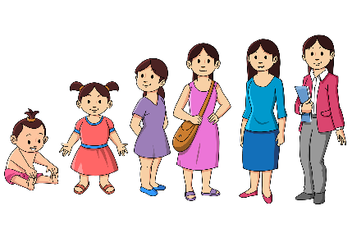
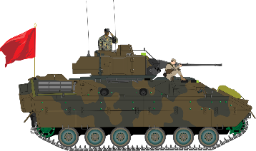
Le Grand Prix vocabulaire
Dis les mots plus vite que ton/ta partenaire pour gagner !
parler
ressentir
to feel + noun
fournir
to supply, supplying
réussir
to pass an exam,
to make a success of
2.
4.
établir
6.
to set up, setting up;
to establish, establishing
1.
servir
to serve, serving
7.
3.
grandir
to grow up, growing up
to succeed in, succeeding in
réussir à
5.
soldier
le soldat
12.
13.
le nord
north
16.
east
l’est
la fin
end
le début
17.
beginning, start
8.
le gouvernement
government
l’état (m)
10.
state
l’ouest
west
le sud
15.
army
south
9.
l’armée
14.
11.
Notes:
Timing: 3 minutes
Aim: Oral speed recall of this week’s revisited vocabulary.
Procedure:
1. Students compete against a partner to be the quickest to recall the words in this week’s vocabulary set.
2. Students time each other and check their partner’s translations. If they spot a mistake, the partner must repeat the correct translation three times, thereby incurring a time penalty!
3. The student who completes the track in the fastest time (or gets furthest along the track in the available time) is the winner.

Slide 22
Time periods: quantity vs. duration
info
As you already know, un an and une année both mean ‘a year’.
Un an is used to indicate a specific unit of time or quantity.
Je suis arrivée en France il y a 5 ans.
We can apply the same rules to other periods of time…
Une année is used for a description or duration.
Je vais passer l’année prochaine en France.
I arrived one day ago.
The journey lasted
one day.
I am going to arrive on Wednesday morning.
I am going to spend a morning at the park.
a day
an evening
a morning
I went to the theatre yesterday evening.
I spent an evening at
the theatre.
un jour
un soir
un matin
une journée
une soirée
une matinée
- Je suis arrivé il y a
un jour.
- Je suis allé au théâtre hier soir.
- Je vais arriver
mercredi matin.
- Le voyage a duré une journée.
- J’ai passé une soirée au théâtre.
- Je vais passer une matinée au parc.
Notes:
Timing: 3 minutes
Aim: To consolidate understanding of the difference between un an and une année and introduce other time periods which follow the same pattern (une journée is new vocabulary this week).
Procedure:
1. Click to bring up information and examples.
2. Check students’ understanding.

Slide 23
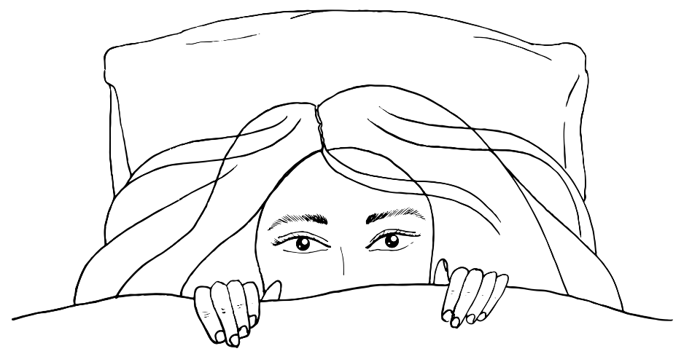
Reflexive pronouns vs direct object pronouns
grammaire
As you know, we use the reflexive pronoun se when somebody is doing the action of the verb to himself or herself.
Nina se réveille.
Nina wakes (herself) up.
If somebody is doing the action to somebody else, we use the direct object pronouns le and la for the receiver of the action.
Stéphanie réveille Nina.
Elle la réveille.
Stéphanie wakes Nina up.
She wakes her up.
Notes:
Timing: 2 minutes
Aim: Explanation of reflexive pronouns vs direct object pronouns
Procedure:
1. Click to reveal explanations and examples.
2. Ensure understanding.

Slide 24
L’élève afghan
Stéphanie écrit un article sur Max et Nina pour le blog scolaire.
lire
Traduis les phrases en anglais:
Je le présente
il se prépare
ils se corrige
Sa sœur s’appelle Nina.
Elle se présente
Nous l’aidons
nous l’encourageons
Elle se sent triste
elle se sent fière
Nous le respectons beaucoup
Who is the object of the verbs?
Mon cousin Max est arrivé à notre collège cette semaine. [1] Je le présente. Il a 15 ans et [2] il se prépare pour une nouvelle vie en France. Il a passé son enfance dans le sud de l’Afghanistan, mais son père a grandi en France. Max parle français très bien, et [3] il se corrige quand il fait des erreurs. [4] Sa soeur s’appelle Nina. [5] Elle se présente à l’école primaire cette semaine. [6] Nous l’aidons avec son français [7] et nous l’encourageons quand elle a des difficultés. [8] Elle se sent triste parce que son père est soldat dans l’armée afghane, mais [9] elle se sent fière aussi. [10] Nous le respectons beaucoup. Ils sont assez heureux ici, mais ils veulent retourner à leur vie familiale dans un Afghanistan libre.
I introduce him
he is getting ready
he corrects himself
His sister is called Nina
She is introducing herself
We help her
we encourage her
she feels sad
she feels proud
We respect him a lot
 | self | somebody else
1
2
3
4
5
6
7
8
9
10
Notes:
Timing: 8 minutes
Aim: Written recognition of reflexive pronouns se vs direct object pronouns le and la and connecting these with meaning
Procedure:
1. Students read the text and decide whether each verb is done to himself/herself or somebody else.
2. Click to reveal answers.
3. Translate the phrases with reflexive pronouns and direct object pronouns.
4. Click to check answers.
Word frequency of cognates used (1 is the most frequent word in French): cousin [3387]
Source: Lonsdale, D., & Le Bras, Y. (2009). A Frequency Dictionary of French: Core vocabulary for learners London: Routledge.

Slide 25
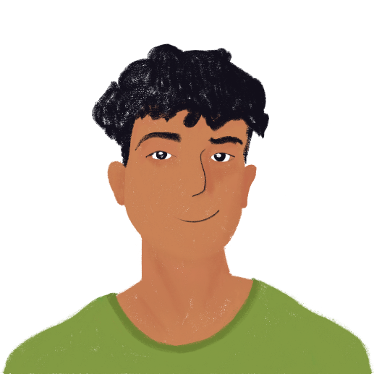
La vie de la mère de Max
parler
Partenaire A est Max et Partenaire B est la mère de Max. Partenaire A pose des question sur sa vie.
Tu le prépares ?
Non, je ne le prépare jamais.
if she gets her father ready
no, never
Notes:
Timing: 10 minutes
Aim: Oral production of reflexive pronouns me, te, and se and direct object pronouns me, te, le, and la
Procedure:
1. Print the role cards.
2. Partner A takes the role of Max, who is on the phone to his mother in Ukraine. Partner B is Max’s mother. Partner A asks questions to find out the information on the card, and Partner B answers accordingly.
3. Partners swap roles.

Slide 26
La vie de la mère de Max
parler
Partner A
You are Max, and your partner is Max’s mother, who is looking after her elderly parents. Ask questions to find out:
if she gets her mother up
if her mother washes herself
if her mother calls her to the garden
if she feeds her mother
if her mother wakes her up at night
Now you are Max’s mother, and your partner is Max. Answer your partner’s questions in full sentences.
yes, at eight o’clock
yes, quickly
yes, slowly
yes, sometimes
yes, always
Partner B
You are Max’s mother, who is looking after her elderly parents, and your partner is Max. Answer your partner’s questions in full sentences.
yes, every day
yes, slowly
yes, often
no, never
yes, sometimes
Now you are Max, and your partner is Max’s mother. Ask questions to find out:
if she wakes her father up
if he gets himself up
if he gets himself ready
if he helps her with the cooking
if she watches him in the garden
Notes:
Timing: 10 minutes
Aim: Oral production of reflexive pronouns me, te, and se and direct object pronouns me, te, le, and la
Procedure:
1. Print the role cards.
2. Partner A takes the role of Max, who is on the phone to his mother in Ukraine. Partner B is Max’s mother. Partner A asks questions to find out the information on the card, and Partner B answers accordingly.
3. Partners swap roles.

Slide 27
La vie de la mère de Max
parler
Partner A
Tu la lèves ?
Elle se lave ?
Elle t’appelle du jardin ?
Tu la nourris ?
Elle te réveille la nuit ?
Oui, je le réveille à huit heures.
Oui, il se lève vite.
Oui, il se prépare lentement.
Oui, quelquefois il m’aide avec la cuisine.
Oui, je le regarde toujours dans le jardin.
Partner B
Oui, je la lève tous les jours.
Oui, elle se lave lentement.
Oui, elle m’appelle souvent du jardin.
Non, je ne la nourris jamais.
Oui, quelquefois elle me réveille la nuit.
Tu le réveilles ?
Il se lève ?
Il se prépare ?
Il t’aide avec la cuisine ?
Tu le regardes dans le jardin ?
Notes:
SUGGESTED ANSWERS

Slide 28
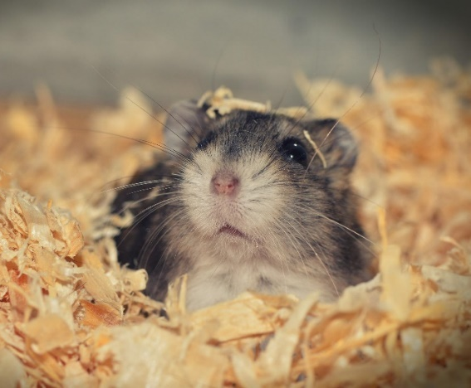
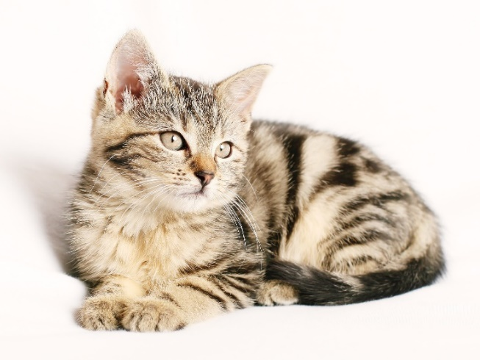
L’animal de mes rêves
écrire
Write about how you look after your pet. You can invent a pet if you like!
Say what you do for your pet and what he/she does for himself/herself. Mention:
what your pet is called
who wakes up whom
who washes your pet
who feeds your pet
if you leave your pet alone in the house
Notes:
Timing: 12 minutes
Aim: Written production of reflexive pronoun se and direct object pronouns me and le/la
Procedure:
Students use the prompts to write about how they look after a pet.

Slide 29
Devoirs
Vocabulary Learning Homework (Y9, Term 3.2, Week 5)
Quizlet link
Quizlet QR code:
Student worksheet
Notes:
The answer sheet for the 9.3.2.5 vocabulary learning homework is here: Resource | French SOW Y9 Term 3.2 Week 5 - vocabulary learning homework answers | ID: k3569658b | NCELP

