Slide 1
Vocabulary
Y7 German
Term 1.2 - Week 6
Inge Alferink / Rachel Hawkes

Slide 2
Vokabeln
V
der __ater
w
___issen
i
n__e
i
e
das T__er
s__hr
l
das Spie__
e
tanz__n
e
die Numm__r
W
i
e
v
i
e
l
e
?
Notes:
This starter task revises items of Week 5 vocabulary and two items from this week. By working out which letters are missing and putting them in order into the spaces below, they create the question ‘Wie viele?’, which is the context for this week’s lessons, so the activity does the task of ‘sharing the context learning objective’ with students. Elicit the English translation of this question from students to ensure that they are all clear about its meaning.
Frequency rankings (1 is the most common word in German):
es gibt [14, 57] wünschen [684] Wie viele? [28, 60] der Zug [613] der Platz [344] der Arzt [614] das Spiel [500] der Grund [230] das Stück [417] grün [556] auch [16]
Revisit 1.2.3: tanzen [2011] gehen [69] hören [1557] jeden Tag [88/108] einmal die Woche [136 / 209] nie [196] kaum [259] manchmal [394] sehr [70] oft [215])
Revisit 1.1.4: du bist [52/3] wissen [79] weiß [79] kein [50] die Farbe [929] die Sache [251] die Nummer [1048] das Tier [670] der Ort [383] aber [32] ich weiß nicht [8/79/12] wie sagt man [28/48/36] wie schreibt man [28/247/48]
V = not in any of this week’s vocab or revisited vocab so Vater used, here.

Slide 3
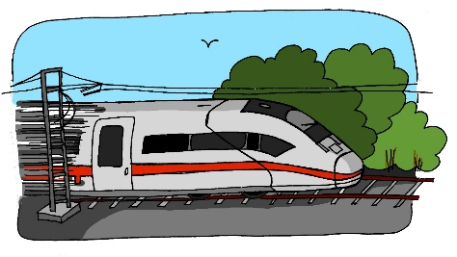
der Zug
Notes:
The vocab has been pre-learnt, so the pictures appear first, to elicit responses, if known, using standard ‘Was ist das?’ prompt. The text appears on the 2nd click, and can be practised by all, as necessary.
Frequency rankings (1 is the most common word in German):
es gibt [14, 57] wünschen [684] Wie viele? [28, 60] der Zug [613] der Platz [344] der Arzt [614] das Spiel [500] der Grund [230] das Stück [417] grün [556] auch [16]

Slide 4
der Arzt

Slide 5
grün

Slide 6
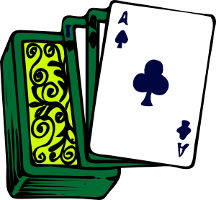
das Spiel

Slide 7
auch

Slide 8
das Stück

Slide 9
wünschen

Slide 10
der Grund
[reason]

Slide 11
der Platz

Slide 12
es gibt
[there is / there are]
Notes:
Es gibt

Slide 13
Vokabeln
Notes:
Vocab activity: students write down 1-8 in their notebooks and write down the German version of each word before it disappears (3 seconds). When checking their answers (before feedback) they should include the correct definite article.

Slide 14
Antworten
der Zug
auch
grün
der Arzt
das Stück
der Platz
das Spiel
wünschen
Notes:
ANSWER SLIDE Pictures appear one by one to focus attention and avoid cognitive overload. Teacher can elicit the answers orally, providing the text on the next click, and asking students to check their own answers (I wouldn’t suggest asking them to score their work, as for a vocabulary test, but to make any corrections). Students might take even greater care if they are asked to swap books and correct a peer’s work. Ask them to pay particular attention to the presence or absence of ‘ü’, this week’s SSC.

Slide 15
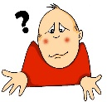
Vokabeln
lesen und schreiben
?
A. Nur am Montags
B. Blau, gelb, rot
C. Übersetze ‘never’
D. oder
E. Am Sontag, Montag, Dienstag, etc.
F. Übersetze ‘hardly’
G. Übersetze ‘thing, issue’
H. Schreiben, sprechen, lesen, und …
I. Nicht selten
J. Wo?
K. Ehm?
E | I | N | M | A | L |  | D | I | E |  | W | O | C | H | E
 |  |  | D | I | E |  | F | A | R | B | E | N
 |  |  |  |  |  |  |  |  |  | N | I | E
 |  |  |  |  |  |  | D | A | S |  | H | A | U | S | T | I | E | R
 |  |  |  |  |  |  | J | E | D | E | N |  | T | A | G
 |  |  |  |  |  |  |  |  |  | K | A | U | M
 |  |  |  |  | D | I | E |  | S | A | C | H | E
 |  |  |  |  |  |  |  |  |  |  | H | Ö | R | E | N
 |  |  |  |  |  |  |  |  | O | F | T
 |  |  |  |  |  |  |  |  |  | D | E | R |  | O | R | T
W | I | E |  | S | A | G | T | - | M | A | N | ?
Notes:
Starter
This starter task revises 11 items of vocabulary (shown in bold below) drawn from 1.1.4 and 1.2.3 (the two weeks students were set to revisit this week).
By working out the answers to the clues and spelling out the words correctly, students create the word ‘Weihnachten’, which is the loose theme we use for this lesson. So the activity does the task of ‘sharing the context learning objective’ with students. Students have not learned ‘Weihnachten’ and the teacher could use this as an intro to the vocab introduced in the enxt slides.
Note: The clues relate to the words directly to their right. This slide is then animated to provide the ANSWERS and give additional alphabet practice, as per the routine below:
1. Teacher asks question / gives clue in German as per A – L on slide. 2. Student(s) volunteer(s) the answer (e.g. einmal die Woche).
3. Teacher asks ‘wie schreibt man das?’ 4. Students in chorus (slowly and steadily) respond to spell out the answer: E-I-N-M-A-L D-I-E W-O-C-H-E) Note: If students are practising for the Spelling Bee, then they will have learnt the term ‘Abstand’ for indicating a space between words. They could be prompted to use that, here.
5. As students spell the word, teacher reveals each letter on a click. This will enable the teacher to pick up on any of the trickier letters, and do some remedial practice in the moment.
Note: There is a more challenging version of the same task on the next slide, which has only the first letter of each word.
T1.2 Week 3
tanzen [2011] gehen [69] hören [1557] jeden Tag [88/108] einmal die Woche [136 / 209] nie [196] kaum [259] manchmal [394] sehr [70] oft [215])
T1.1 Week 4
du bist [52/3] wissen [79] weiß [79] kein [50] die Farbe [929] die Sache [251] die Nummer [1048] das Haustier [670] der Ort [383] aber [32] ich weiß nicht [8/79/12] wie sagt man [28/48/36] wie schreibt man [28/247/48]

Slide 16
Vokabeln
lesen und schreiben
?
A. Nur am Montags
B. Blau, gelb, rot
C. Übersetze ‘never’
D. oder
E. Am Sontag, Montag, Dienstag, etc.
F. Übersetze ‘hardly’
G. Übersetze ‘thing’
H. Schreiben, sprechen, lesen, und …
I. Nicht selten
J. Wo?
K. Ehm?
E | I | N | M | A | L |  | D | I | E |  | W | O | C | H | E
 |  |  | D | I | E |  | F | A | R | B | E | N
 |  |  |  |  |  |  |  |  |  | N | I | E
 |  |  |  |  |  |  | D | A | S |  | H | A | U | S | T | I | E | R
 |  |  |  |  |  |  | J | E | D | E | N |  | T | A | G
 |  |  |  |  |  |  |  |  |  | K | A | U | M
 |  |  |  |  | D | I | E |  | S | A | C | H | E
 |  |  |  |  |  |  |  |  |  |  | H | Ö | R | E | N
 |  |  |  |  |  |  |  |  | O | F | T
 |  |  |  |  |  |  |  |  |  | D | E | R |  | O | R | T
W | I | E |  | S | A | G | T | - | M | A | N | ?
Notes:
Starter - more challenging version, which gives only the first letter of each word.
This slide is then animated to provide the answers and give additional alphabet practice, as per the routine below:
1. Teacher asks question / gives clue in German as per A – L on slide. 2. Student(s) volunteer(s) the answer (e.g. einmal die Woche).
3. Teacher asks ‘wie schreibt man das?’ 4. Students in chorus (slowly and steadily) respond to spell out the answer: E-I-N-M-A-L D-I-E W-O-C-H-E) Note: If students are practising for the Spelling Bee, then they will have learnt the term ‘Abstand’ for indicating a space between words. They could be prompted to use that, here.
5. As students spell the word, teacher reveals each letter on a click. This will enable the teacher to pick up on any of the trickier letters, and do some remedial practice in the moment.
T1.2 Week 3
tanzen [2011] gehen [69] hören [1557] jeden Tag [88/108] einmal die Woche [136 / 209] nie [196] kaum [259] manchmal [394] sehr [70] oft [215])
T1.1 Week 4
du bist [52/3] wissen [79] weiß [79] kein [50] die Farbe [929] die Sache [251] die Nummer [1048] das Haustier [670] der Ort [383] aber [32] ich weiß nicht [8/79/12] wie sagt man [28/48/36] wie schreibt man [28/247/48]

Slide 17
lesen / sprechen
der Engel
Notes:
Presentation of new vocabulary
Practise reading aloud and applying SSC knowledge - Key SSC recapped here are: short E, IE, EI, W, CH, Z
Present single word + picture and ask students to read aloud using their knowledge of phonics.
These are thematic words chosen to illustrate SSCs and plurals. They are not part of the vocabulary set for the week, but are introduced to fit with seasonal themes.

Slide 18
der Stern

Slide 19
der Stiefel
Notes:
The reason for including a boot as a Christmassy items might need a little cultural aside explaining that children leave a boot or shoe outside their bedroom door on the evening of 5th December for St Nikolaus. When they wake up in the morning of 6th December, they hopefully find them full of delicious goodies if they’ve been good. St Nikolaus is not the same tradition as Father Christmas (der Weihnachtsmann). Read more, here:
https://www.thelocal.de/20131206/15915

Slide 20
der Baum

Slide 21
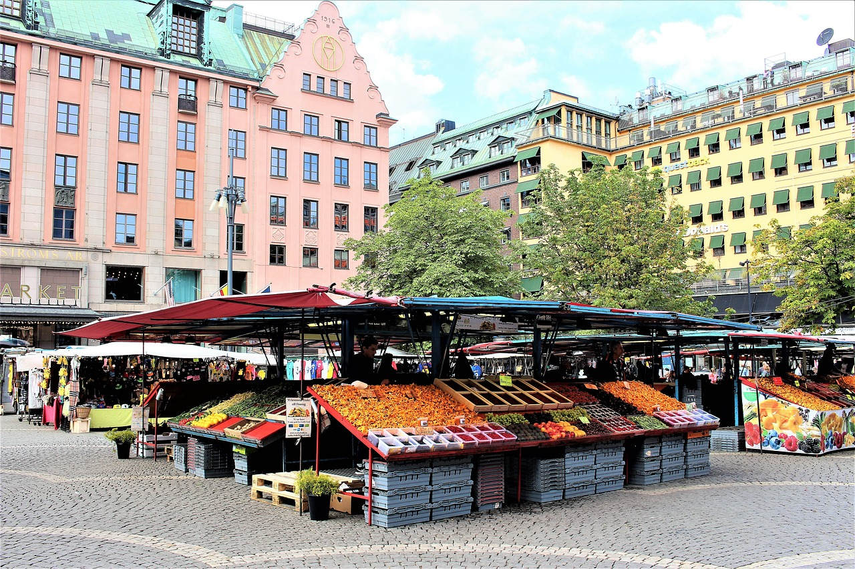
der Marktplatz

Slide 22
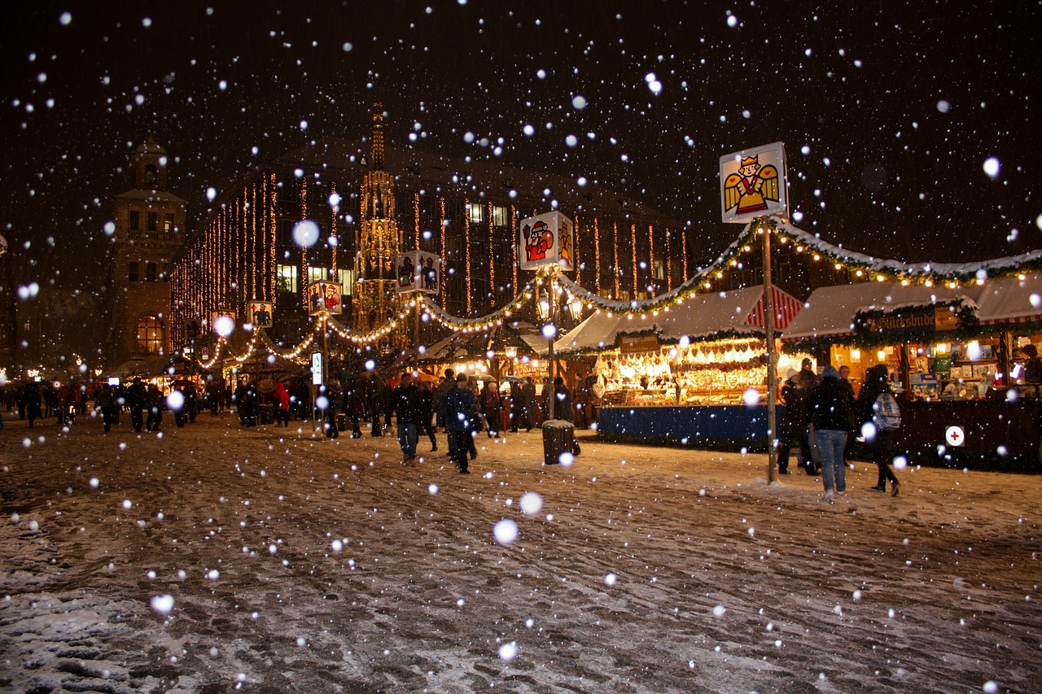
der Weihnachtsmarkt

Slide 23
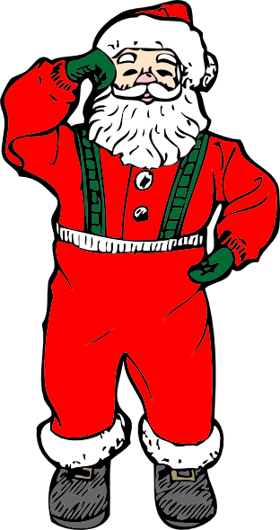
der Weihnachtsmann

Slide 24
Vokabeln
der Stern
star
der Stiefel
boot
der Baum
tree
Sekunden
der Marktplatz
market square
der Weihnachtsmarkt
Christmas market
der Engel
angel
der Weihnachtsmann
Father Christmas
ANFANG
Notes:
Quick Vocab re-cap – students see how many words they can translate into English in a minute

