Slide 1
Vocabulary
Nick Avery & Rachel Hawkes
Date updated: 06/02/2020

Slide 2
Vocabulary introduction
Vocabulario
usar
to use
Which ones are the same type of word as these?
una camisa
a shirt
una cosa
a thing
hablar
comprar
llevar
to take, carry, wear
una bolsa
a bag
olvidar
escuchar
necesitar
to need
un zapato
a shoe
usar
bailar
llegar
un producto
a product
un vaso
a glass
llevar
necesitar
Notes:
Vocabulary frequency rankings (1 is the most common word in Spanish):
zapato [1477]; producto [394]; camisa [1873]; llevar [75]; vaso [1609]; bolsa [1581]; cosa [69]; necesitar [276]; usar [317].
Source: Davies, M. & Davies, K. (2018). A frequency dictionary of Spanish: Core vocabulary for learners (2nd ed.). London: Routledge.

Slide 3
llevo
[I carry | I wear]
lleva
[s/he carries | s/he wears]
Notes:
Introducing the verb ‘llevar’ more explicitly. ‘Llevar’ is one of the 25 most frequently used verbs in Spanish. The 1st and 2nd person singular are introduced here in order to familiarise students with the two verb forms taught this week.
Bring up the word ‘llevo’ on its own, say it, students repeat it, and remind them of the phonics. Draw attention to the SSC [LL].
Try to elicit the meaning from the students.
Then bring up the English translations. Emphasise the two meanings for the infinitive.
Bring up the 3rd person singular form ‘lleva’, say it, students repeat it. Draw attention to the SSC [LL].
Try to elicit the meaning from the students. Emphasise the two meanings.

Slide 4
llevo
[I carry | I wear]
lleva
[s/he carries | s/he wears]
Notes:
Cycle through ‘llevo’ and ‘lleva’ again.

Slide 5
llevo
[I carry | I wear]
Llevo una bolsa.
[I carry a bag.]
Notes:
Introduce ‘llevo’ in a sentence.

Slide 6
lleva
[s/he carries| s/he wears]
Sara lleva zapatos.
[Sarah wears shoes.]
Notes:
Introduce ‘lleva’ in a sentence.

Slide 7
llevo
[ I carry | I wear ]
Llevo
______ una bolsa.
[I carry a bag.]
Notes:
Cycle through ‘llevo’ in context again.

Slide 8
lleva
[s/he carries| s/he wears]
lleva
Sara ______ zapatos.
[Sarah wears trainers.]
Notes:
Cycle through ‘lleva’ in context again.

Slide 9
Juan tiene unas cosas.
Juan ________________
has some things.
Pero, ¿qué tiene?
Notes:
Elicit the translation of ‘some things’.
The following slides revisit vocabulary from a previous week.

Slide 10
¿Qué tiene?
Tiene…
un vaso

Slide 11
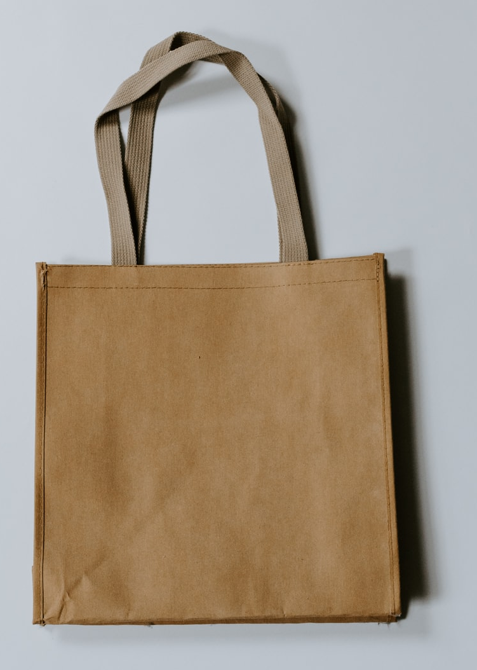
¿___ ______?
______…
una bolsa
Notes:
From here the written prompts are removed, and the teacher can split the class in half to elicit question ¿qué tiene? and answer ‘Tiene…’ from different halves of the class, alternating roles with each new slide.

Slide 12
¿___ _____?
_____…
un zapato

Slide 13
¿___ _____?
_____…
una camisa

Slide 14
¿___ _____?
_____…
[a product]
un producto

Slide 15
Vocab recap
to use
to arrive
necesitar
to speak
to carry, to wear
bailar
escuchar
llevar
to buy
to listen
llegar
to need
to dance
comprar
usar
hablar
Notes:
Vocabulary recap
Only 3 new verbs were taught last lesson, so they are revised with 5 others from last week here.
The English verbs appear. Learners need to match them to one of the Spanish verbs.
Teacher can ask ¿Cómo se dice en español? as each English verb appears.

