Slide 1
Describing events in the present
Present continuous for events in progress
Y9 Spanish
Term 2.2 - Week 3 - Lesson 43
Amanda Izquierdo, Louise Caruso Artwork: Mark Davies
Date updated: 30/11/21
Notes:
Artwork by Mark Davies. All additional pictures selected are available under a Creative Commons license, no attribution required.
With thanks to Rachel Hawkes for her input on the lesson material and Blanca Román for native teacher feedback.
Learning outcomes (lesson 1):
Consolidation of ‘b’ and ‘v’.
Consolidation of present continuous.
Consolidation of ‘estos’ and ‘estas’
Consolidation of the relative pronoun ‘que’.
Introduction of the relative pronoun ‘cuando’.
Word frequency (1 is the most frequent word in Spanish):
9.2.2.3 (introduce): animar [1630]; anunciar [785]; cerrar [521]; charlar [2968]; llover [2134]; notar [696]; (prestar) atención [atención-489]; regresar [573]; boda [2473]; espectáculo [1622]; golpe [746]; llegada [1604]; olor [1070]; sabor [2108]; enseguida [2866]; mundial [572]; en este momento [momento-121]; de repente [repente-1805]
9.2.1.5 (revisit): encender [1431]; promover [1601]; resolver [867]; sobrevivir [1908]; producir [245]; prohibir [1641]; proteger [1107]; morir [212]; planeta [1496]; vidrio [1905]; bosque [1444]; recursos [1149]; plástico [1965]; futuro [719]; consumo [1424]; uso [471]; efecto [309]; terrible [1246]; esencial [1872]; grave [901]; medio ambiente [ambiente-729]; gobierno [185]
9.2.1.2 (revisit): aceptar [433]; dedicar [430]; echar de menos [echar-462]; lograr [287]; nadar [3605]; soportar [1508]; aventura [1773]; desafío [2839]; sol [383]; humano [243]; organización [531]; diferente [293]; tiempo² [80]; peligroso [1572]; pobre [492]; Alemania [N/A] todavía [264]; a través de [través - 270]
Source: Davies, M. & Davies, K. (2018). A frequency dictionary of Spanish: Core vocabulary for learners (2nd ed.). Routledge: London
The frequency rankings for words that occur in this PowerPoint which have been previously introduced in NCELP resources are given in the NCELP SOW and in the resources that first introduced and formally re-visited those words.
For any other words that occur incidentally in this PowerPoint, frequency rankings will be provided in the notes field wherever possible.

Slide 2
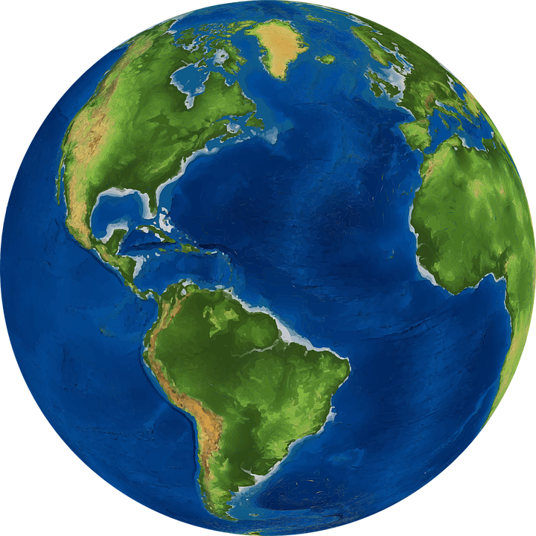
Vocabulario
hablar
7
Segundos
[planet]
[forest]
[to switch on]
el planeta
el bosque
encender
0
INICIO
Notes:
[1/8]
Timing: 3 min Aim: To practise productive (oral) recall of three words from this week’s revisited set of Y7 and Y8 vocabulary within a given time.
Procedure:
1. Say all three words before three seconds elapse.
2. Click to reveal answers.
3. Repeat if additional practice needed.

Slide 3
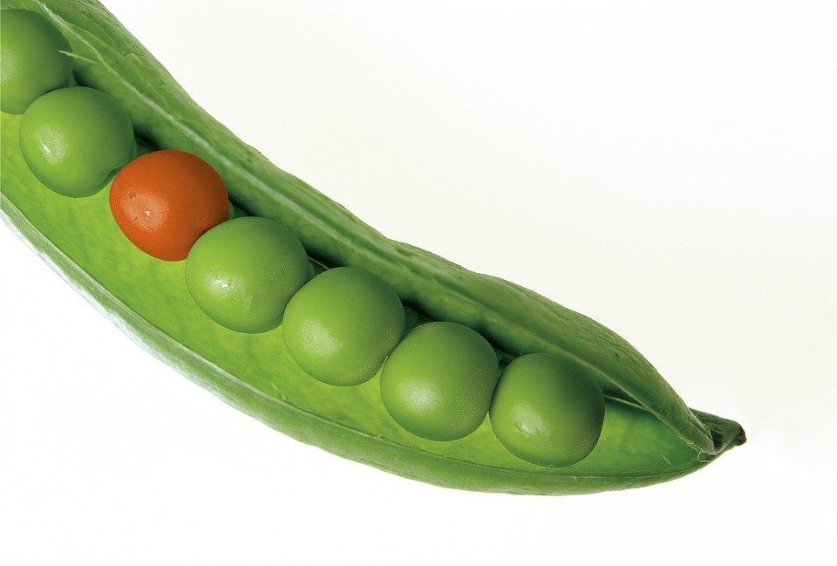
Vocabulario
hablar
7
to endure, to stand
Segundos
[glass]
[different]
el vidrio
diferente
soportar
0
INICIO
Notes:
[2/8]

Slide 4
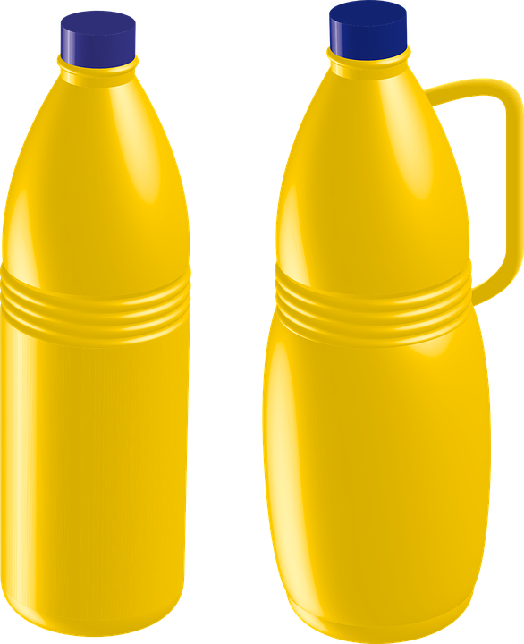
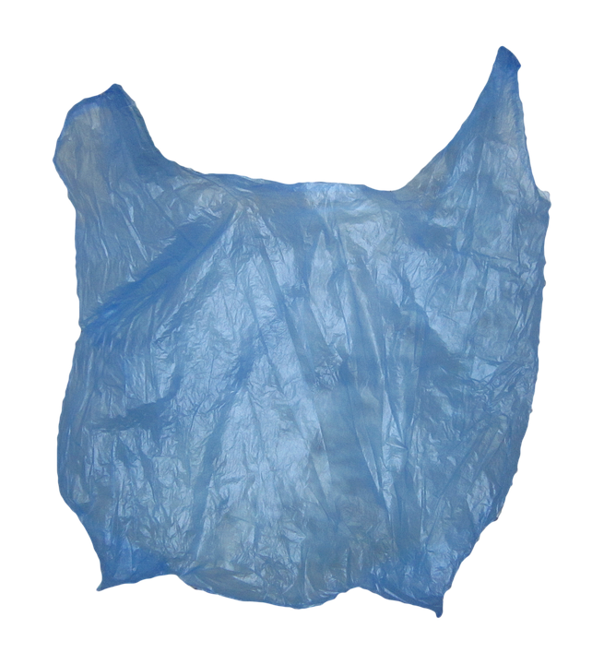
Vocabulario
hablar
7
to manage to, managing to
Segundos
[Germany]
[plastic]
lograr
Alemania
plástico
0
INICIO
Notes:
[3/8]

Slide 5
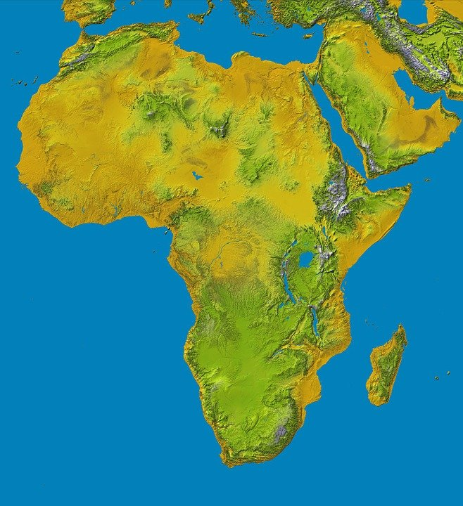
Vocabulario
hablar
7
Segundos
[sun]
[organisation]
[through, across]
la organización
a través de
el sol
0
INICIO
Notes:
[4/8]

Slide 6
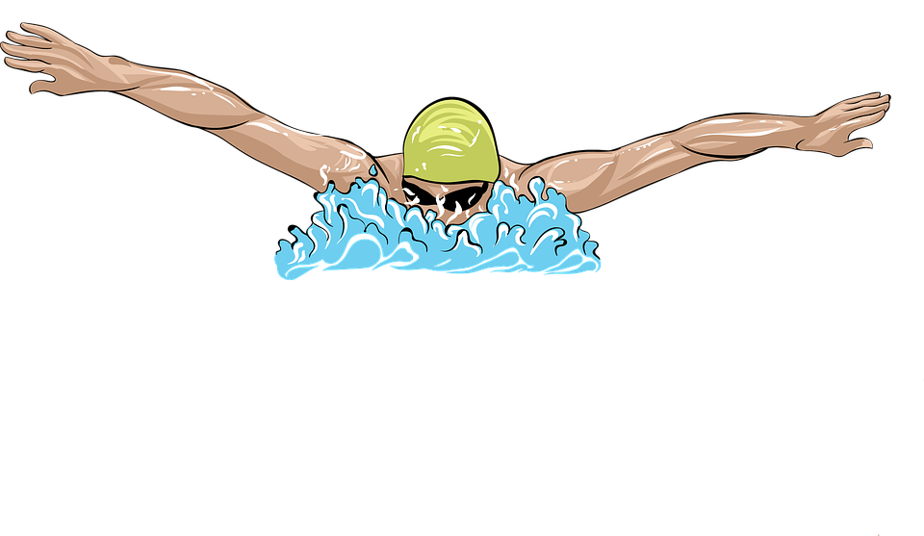
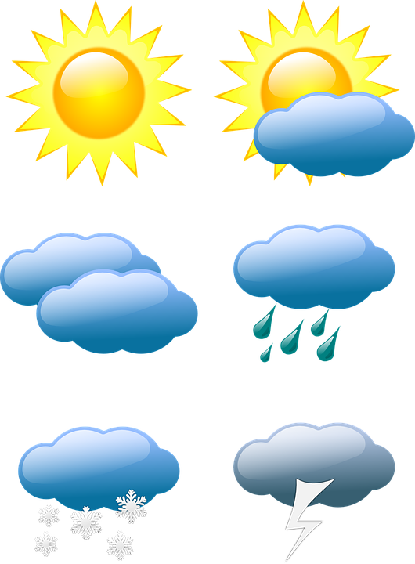
Vocabulario
hablar
7
to dedicate, dedicating
Segundos
[to swim]
[to weather]
nadar
el tiempo
dedicar
0
INICIO
Notes:
[5/8]

Slide 7
Vocabulario
hablar
7
resources
Segundos
[dangerous]
[to protect]
los recursos
peligroso
proteger
0
INICIO
Notes:
[6/8]

Slide 8
Vocabulario
hablar
7
Segundos
to survive
[to miss]
[to accept]
echar de menos
sobrevivir
aceptar
0
INICIO
Notes:
[7/8]

Slide 9
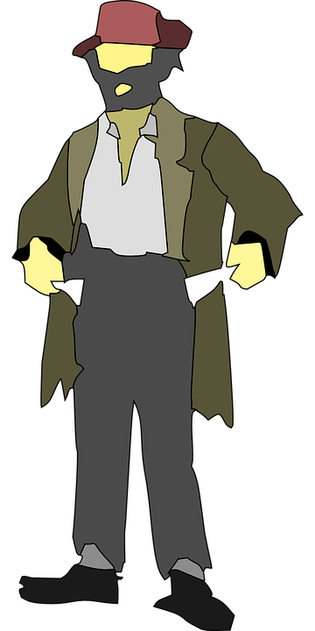
Vocabulario
hablar
7
adventure
Segundos
[to prohibit]
[poor]
pobre
aventura
prohibir
0
INICIO
Notes:
[8/8]

Slide 10
Recuerda que la letra ‘b’ y la letra ‘v’ tienen la misma pronunciación en español. Escucha las palabras:
escuchar
1
grave
2
gobierno
Escucha las frases. Marca cada vez que hay una ‘b’ o una ‘v.’ Luego, escribe la frase en español.
 | ¿cuántas veces? v/b | Frases
jóvenes
ver
1
Las chicas __________ quieren __________ un partido.
2
buscando
aventuras
bosque
Está ____________ ____________ en el __________.
3
viajando
barco
través
Estoy __________ en _________ a _______ del Mar Mediterráneo.
Envía
botella
4
__________ un mensaje en una __________.
5
grabar
vídeo
boda
Quiere __________ un __________ de la __________.
Notes:
Timing: 5 minutes
Aim: to recognise the sound for letters ‘b’ and ‘v’.
Procedure:
Students listen to each phrase contaning the letters ‘b’ and ‘v’ and tally the number of times they hear the sound.
Students listen to each phrase again and write the missing words.
Teacher shows the answers one by one.
Transcript:
Las chicas jóvenes quieren ver un partido.
Está buscando aventuras en el bosque.
Está viajando en barco a través del Mar Mediterráneo.
Envía un mensaje en una botella.
Quiere grabar un vídeo de la boda.

Slide 11
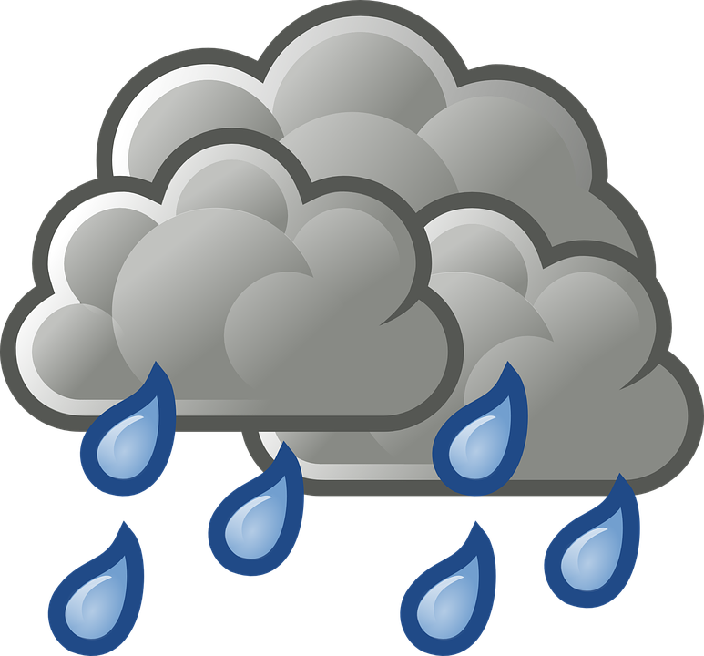
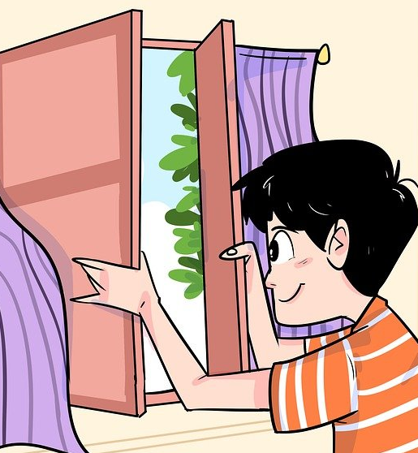
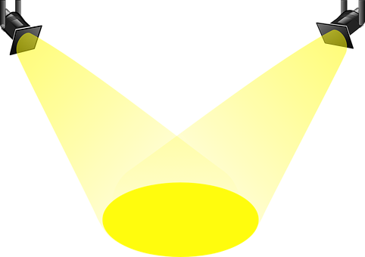
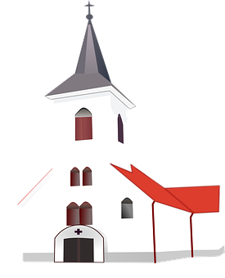
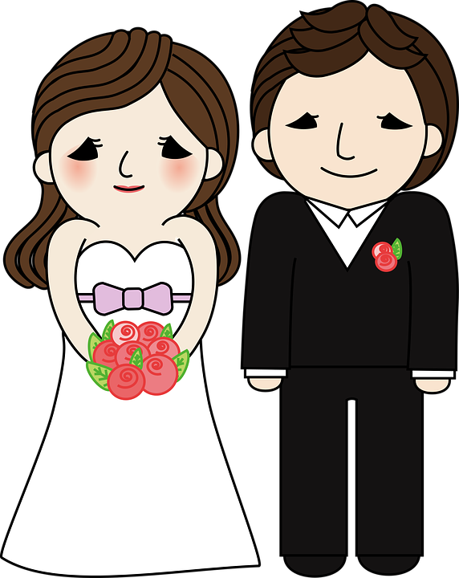
Vocabulario
leer / hablar
charlar
llover
[to chat]
In English, we say, ’pay’ attention to something or somebody but in Spanish we use the verb ’to lend’ (prestar).
to cheer up, encourage
animar
[to rain]
cerrar
to pay attention, paying attention
(prestar) atención
[to close]
en este momento
right now
el espectáculo
[show]
to return, returning
regresar
la boda
[wedding]
Notes:
Vocabulary introduction and practice slide
Timing: 3 minutes
Aim: to introduce new vocabulary
Procedure 1. Pupils either work by themselves or in pairs, reading out the words and recapping their English meaning (1 minute). 2. Then the teacher removes the English words or pictures (one by one) and they try to recall the English orally (chorally), looking at the Spanish (1 minute). 3. Then the Spanish meanings are removed (one by one) and they try to recall them orally (again, chorally), looking at the English (1 minute) 4. Optionally, further rounds of learning can be facilitated by one pupil turning away from the board, and his/her partner asking him/her the meanings (‘¿Cómo se dice X en español?’). This activity can work from L2 → L1 or L1 → L2.
Mages free to use from Pixabay.

Slide 12
Saying what someone is doing now Present continuous
gramática
The –ando/-iendo ending (and –ing in English) is called the ‘present participle’.
As you know, we can use estar with present participle to talk about ongoing events.
For -ar verbs we remove the infinitive ending and add ‘-ando’.
Estoy animando a Hugo a hacer su trabajo.
I’m encouraging Hugo to do his work
Estás cerrando la puerta.
You are closing the door.
Está prestando atención.
He is paying attention.
For -er and –ir verbs, remove the infinitive ending and add ‘-iendo’.
Estoy protegiendo mis cosas.
I’m protecting my things.
¿Estás sobreviviendo?
Are you surviving?
Está lloviendo.
It is raining.
Notes:
Timing: 3 minutes
Aim: to recap the meaning, use and formation of the present continuous tense with –ar and –er/–ir verbs.
Procedure:
Click to go through the explanation and examples on this slide.
Elicit the English for the Spanish examples.

Slide 13
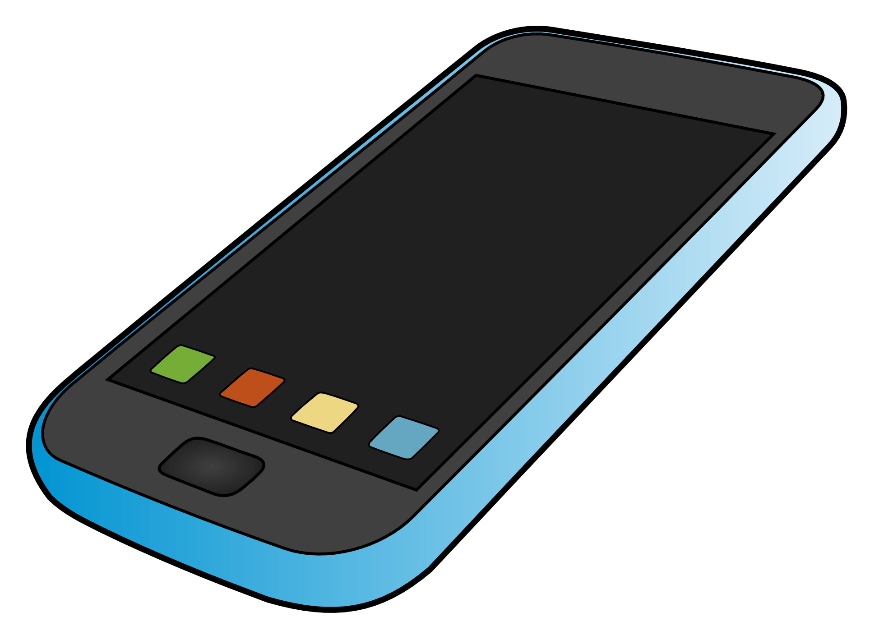
Lucía está en la boda de su tío. Daniel no está allí porque está enfermo, así que Lucía le escribe mensajes sobre el evento.Busca ejemplos de ”estar + present participle”¿Qué significa cada frase?
leer
Español | Inglés
¡Hola, Daniel! Estoy esperando a la novia en la iglesia. ¿Estás descansando? 🤨
1. Estoy esperando
I am waiting
2. ¿Estás descansando?
Are you resting?
Sí, estoy viendo una película. La abuela me está preparando una bebida caliente.☕️
3. Estoy viendo
I am watching
¡Muy bien! Pues la novia* ya está aquí pero está corriendo hasta la puerta…¡dicen que olvidó sus flores en casa! 😱
4. Está preparando
(She) is preparing
5. Está corriendo
She is running
¿En serio? ¡Ja, ja, ja! 😅
6. Estoy disfrutando
I am enjoying
7. ¿Estás prestando atención?
Are you paying attention?
Bueno*, ahora estoy disfrutando la fiesta. ¿Y tú? ¿Estás prestando atención a tu temperatura? 🤒 ¿Está todavía alta?
8. Está mejorando
(It) is improving
Creo que mi salud está mejorando ya.
¿Estás saliendo* de la fiesta?
9. ¿Estás saliendo?
Are you leaving...?
10. Está charlando
(She) is chatting
Mamá está charlando con unas amigas.🙄 Pero papá está regresando a casa ahora.😀
11. Está regresando
(He) is returning
*bueno = well
*novia = bride
*salir = to leave
Notes:
Timing: 6 minutes
Aim: to identify and understand the meaning of phrases using the present continous in the 1st, 2nd and 3rd person.
Procedure:
Students read the text messages and try to identify 11 examples of the present continuous. Note that some speech bubbles contain more than one example.
Students write each example of the present continuous (‘estoy/estás/está’ + –ando/–iendo) in a table and write the equivalent in Eglish.
The teacher reveals the answers one by one. First, students will see the location of each phrase in the dialogue, then the Spanish and the English equivalent.
Notes:
1. Students are familiar with the words with an asterisk, but they won’t be familiar with the meanings used in this text.
Frequency of unknown words:
bueno [98]; novia [1996]; salir [114]

Slide 14
How to say ‘these’ Demonstrative adjectives
gramática
estos
To say ‘these’ for plural masculine noun we use ______ .
these shows
estos espectáculos
estas
To say ‘these’ for plural feminine noun we use ______ .
these organisations
estas organizaciones
¡Ojo! Accents matter!
estas = these (feminine, plural)
Estas chicas están prestando atención.
These girls are paying attention.
1
1b
estás = you are
2b
¿Estás prestando atención?
Are you paying attention?
2
Notes:
Timing: 1 minute
Aim: to revisit demonstrative adjectives and distinguish these from similarly spelt forms of estar.
Procedure:
1. Teachers click to go through the slide. Gaps are left for teachers to elicit answers from students.
2. In the section on stress positions, teachers can click the speaker icon to listen to the difference in stress position of the demonstratives, and the forms of estar.
Transcript:
Estas.
Estás
1b. Estas chicas están prestando atención.
2b. ¿Estás prestando atención?

Slide 15
Completa las frases con ’estos’, ‘estas’ o ‘estás’.
noun
Remember, ‘estas’ and ‘estos’ are used before a plural ______ to mean ‘these’.
leer
verb
‘Estás’ may be used before a ______ ending in ‘–ando’ to express ongoing events (events in progress).
Estas / Estos organizaciones quieren dedicar más recursos a los países pobres.
Estás / Estas dedicando tu tiempo a una organización que ayuda a la gente pobre.
¿ Estás / Estas encendiendo todas las luces?
Estos / Estas luces son todas de colores diferentes.
4
1
2
Estos / Estas días de calor tienen un efecto terrible sobre el planeta.
Estas / Estás soportando el calor .
Estás / Estas aventuras son peligrosas.
¿Estás / Estas sobreviviendo tus aventuras en el bosque?
5
3
¿Estás / Estas cerrando la tienda ahora?
Estas / Estás tiendas son nuevas.
¿Estas / Estás echando de menos a tu famila?
Estas / estás familias tienen menos recursos.
6
Notes:
Timing: 6 minutes
Aim: reading activity to practise distinguishing between ‘estos;, ‘estas’ and ‘estás’, depending on the part of speech of the word that follows.
Procedure:
1. Students write down the correct two options for each number. For example, 1 = estás, estas.
2. Answers are revealed by clicking, question by question. Encourage students to accurately stress the word when they give their answers.
3. Students can be asked to translate each sentence orally into English as part of the feedback.

Slide 16
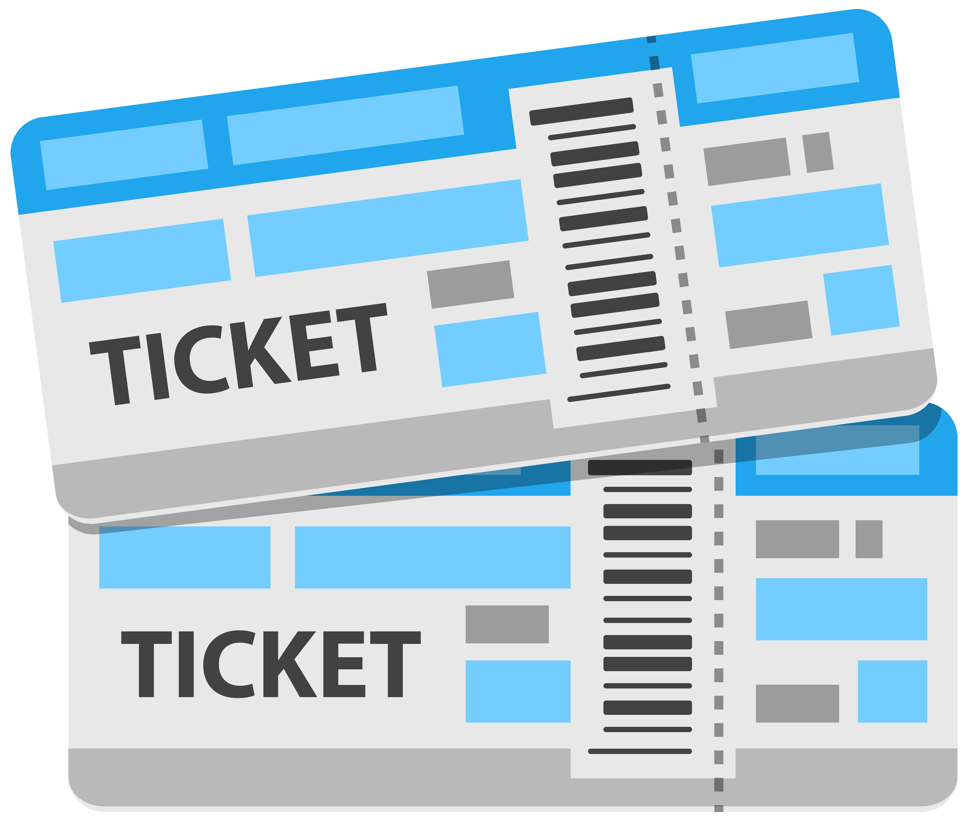
Nadia y Lucía van a un espectáculo con sus amigos. Escucha. ¿Cómo debe continuar la frase? Elige la opción correcta. ¿Qué significa? Escribe el significado.
escuchar
 | Opciones | ¿Qué significa? En inglés
 | a) ... charlando con unas amigas? b) ... chicas son tus amigas?
 | a) ... animando a tu hermano? b) ... jugadoras apoyan a tu hermano?
 | a) ... entradas son para el espectáculo? b) ... billetes son para el autobús?
 | a) ... gafas son para la fiesta? b) ... zapatos son para la fiesta?
1
1
Are these girls your friends?
2
2
Are you cheering your brother up?
3
3
Are these the tickets for the bus?
4
4
Are these shoes for the party?
Notes:
[1/2]
Timing: 7 minutes
Aim: listening activity to practise understanding ‘estos’, ‘estas’ and ‘estás’ by paying attention to the part of speech of the word that follows.
Procedure:
Students write 1 to 8 in their books.
Teacher plays the recording by clicking on the number buttons.
Students decide which is the correct continuation depending on the one word they hear: ‘estos’ would be followed by a masculine noun, ‘estas’ by a feminine noun and ‘estás’ by a verb in present participle (–ando).
Students listen to the full sentence (click the beige action button) to check if they got the correct answer.
They then translate the correct sentence into English.
Answers are shown by clicking.
Transcript:
Estas...
Estás...
Estos...
Estos...

Slide 17
Daniel y Lucía van a un concierto con sus amigos. Escucha. ¿Cómo debe continuar la frase? Elige la opción correcta. ¿Qué significa? Escribe el significado.
escuchar
 | Opciones | ¿Qué significa? En inglés
 | a) ... sillas están libres? b) ... vasos están limpios?
 | a) ... canciones son mis favoritas. b) ... chicos son muy simpáticos.
 | a) ... bebidas son nuestras? b) ... dulces están deliciosos.
 | a) ... bolsas son para llevar a casa? b) ... regresando a casa ahora?
5
5
Are these glasses clean?
6
6
These songs are my favourites.
7
7
These sweets are delicious.
8
8
Are you returning home now?
Notes:
[2/2]
Continued from the previous slide
Transcript:
Estos...
Estas...
Estos...
Estás...

Slide 18
Giving information about something Relative pronouns ‘que’ and ‘donde’
In Spanish, you can use the word ‘que’ to mean both ‘who’ and ‘that’.
Estoy escuchando una cancion que me gusta mucho.
Enrique es el estudiante que quiere prohibir el uso de plástico en la escuela.
These words are called relative pronouns.
In English, we use who/that for people and which/that for animals and things.
We are used to using ’dónde’ as a question. We can also use the word ‘donde’ as a relative pronoun, to add another clause to a sentence, in order to give more information.
Notice that ‘donde’ as a relative pronoun does not have an accent.
Hay un café donde puedes probar la comida cubana.
Sevilla es una ciudad donde hace mucho calor.
Notes:
Timing: 2 minutes
Aim: to recap use of the relative pronoun ‘que’ and to introduce ‘donde’ as a relative pronoun with its function and meanings.
Procedure:
Click through the animation sequence to display a recap of ‘que’ followed by the introduction of ’donde’ as a relative pronoun.

Slide 19
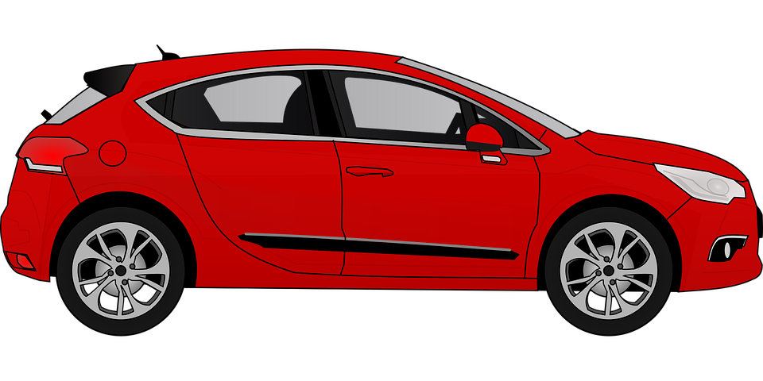
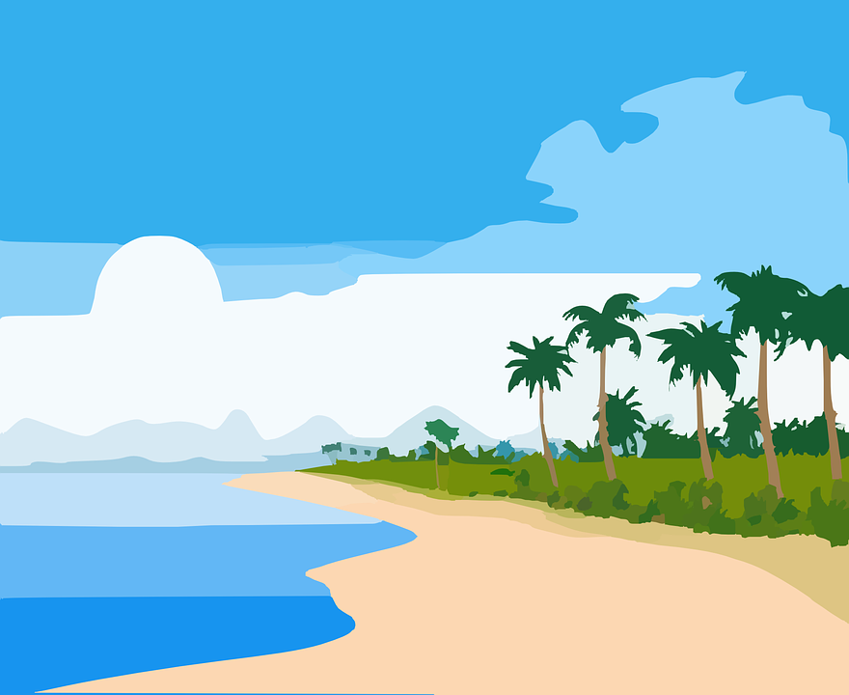
Un grupo de personas está haciendo actividades diferentes. ¿Cuál es el mejor final para cada frase? Solo hay una opción correcta.
leer
1. Está viajando a una ciudad que... | ... llueve mucho. ... tiene buen ambiente.
2. Estoy nadando en una playa donde... | ... hay poca gente. ... considero especial.
3. Está regresando al pueblo que... | ... está en el norte. ... vive su amigo.
4. Estás corriendo en el bosque donde... | ... está cerca de un río. ... puedes ver animales.
5. Estoy visitando el museo donde... | ... mi hermano trabaja. ... abre los lunes.
6. Está entrando a la tienda que... | ... es muy cara. ... hago la compra.
7. Está viendo un espectáculo en el teatro que... | ... personas famosos cantan. ... Diego dirige.
Notes:
Timing: 6 minutes
Aim: to understand the use of ‘que’ and ‘cuando’ in relative clauses.
Procedure:
1. Students read the beginning of each sentence and decide which is the correct ending depending on the relative clause pronoun used.
2. Teachers show the answers one by one.

Slide 20
Describimos actividades y eventos
escuchar / hablar
Estudiante A: mira su carta y lee la frase en español a su pareja.
Estudiante B: escucha. ¿es ‘yo’, ‘tú’ o ‘él/ella’? Luego, escribe la acción en inglés.
Estoy disfrutando estos espectáculos.
Estudiante A
Estudiante B
 | Yo | Tú | Él/Ella | ¿Qué acción? En inglés
1
 | Lee cada frase en español
1 | I am enjoying these shows.
enjoying these shows
Notes:
Timing: 10 min
Aim: to practise oral production and aural recognition of:
estoy/estás/está + –ando/–iendo
demonstrative adjectives estas/estos
use of the relative pronoun ‘donde’
Procedure:
Students work in pairs.
Hand out the cards and use this slide to explain the activity with an example.
Student A looks at their card and translates the phrase into Spanish. Student B listens and decides whether they heard ‘estoy’, ‘estás’ or ‘está’ and tick the correct column. Then, they will write the action in English.
After the 6 sentences have been completed, students swap roles.

Slide 21
Persona A
hablar
 | Lee cada frase en español
1 | It’s raining where I live.
2 | Are you paying attention to these shows?
3 | She’s chatting with these friends (f).
4 | Are you preparing these flowers for the wedding?
5 | I am looking for the shop where they sell chocolate from Germany.
6 | I am cheering up these players (m).
 | Yo | Tú | Él/Ella | ¿Qué acción? En inglés
1
2
3
4
5
6
Notes:
STUDENT CARD FOR PERSONA A
DO NOT SHOW DURING THE ACTIVITY
These cards can be downloaded and printed off from a separate word document.

Slide 22
Persona B
hablar
 | Lee cada frase en español
1 | Are you closing these doors?
2 | He is walking to the house where there is a party.
3 | I am returning to the theatre where the shows are great.
4 | I am producing these films.
5 | He is promoting these concerts.
6 | Are you enjoying these matches?
 | Yo | Tú | Él/Ella | ¿Qué acción? En inglés
1
2
3
4
5
6
Notes:
STUDENT CARD FOR PERSONA B
DO NOT SHOW DURING THE ACTIVITY
These cards can be downloaded and printed off from a separate word document.

Slide 23
Respuestas
Persona A
Persona B
hablar
 | Lee cada frase en español:
1 | Está lloviendo donde vivo.
2 | ¿Estás prestando atención a estos espectáculos?
3 | Está charlando con estas amigas.
4 | ¿Estás preparando estas flores para la boda?
5 | Estoy buscando la tienda donde venden chocolate de Alemania.
6 | Estoy animando a estos jugadores.
 | Lee cada frase en español:
1 | ¿Estás cerrando estas puertas?
2 | Está caminando a la casa donde hay una fiesta.
3 | Estoy regresando al teatro donde los espectáculos son geniales.
4 | Estoy produciendo estas películas.
5 | Está promoviendo estos conciertos.
6 | ¿Estás disfrutando estos partidos?
Notes:
ANSWER SLIDE FOR SPEAKING / LISTENING ACTIVITY
Do not show during the exercise.

Slide 24
Describing events in the past
Imperfect continuous for events in progress in the past
Y9 Spanish
Term 2.2 - Week 3 - Lesson 44
Amanda Izquierdo, Louise Caruso Artwork: Mark Davies
Date updated: 30/11/21
Notes:
Artwork by Mark Davies. All additional pictures selected are available under a Creative Commons license, no attribution required.
With thanks to Rachel Hawkes for her input on the lesson material and Blanca Román for native teacher feedback.
Learning outcomes (lesson 2):
Consolidation of ‘b’ and ‘v’.
Consolidation of ‘estar’ in the imperfect tense (singular forms).
Consolidation of the preterite and its use to express interruptions (singular and regular forms).
Introduction of the imperfect estar + present participle for events in progress.
Word frequency (1 is the most frequent word in Spanish):
9.2.2.3 (introduce): animar [1630]; anunciar [785]; cerrar [521]; charlar [2968]; llover [2134]; notar [696]; (prestar) atención [atención-489]; regresar [573]; boda [2473]; espectáculo [1622]; golpe [746]; llegada [1604]; olor [1070]; sabor [2108]; enseguida [2866]; mundial [572]; en este momento [momento-121]; de repente [repente-1805]
9.2.1.5 (revisit): encender [1431]; promover [1601]; resolver [867]; sobrevivir [1908]; producir [245]; prohibir [1641]; proteger [1107]; morir [212]; planeta [1496]; vidrio [1905]; bosque [1444]; recursos [1149]; plástico [1965]; futuro [719]; consumo [1424]; uso [471]; efecto [309]; terrible [1246]; esencial [1872]; grave [901]; medio ambiente [ambiente-729]; gobierno [185]
9.2.1.2 (revisit): aceptar [433]; dedicar [430]; echar de menos [echar-462]; lograr [287]; nadar [3605]; soportar [1508]; aventura [1773]; desafío [2839]; sol [383]; humano [243]; organización [531]; diferente [293]; tiempo² [80]; peligroso [1572]; pobre [492]; Alemania [N/A] todavía [264]; a través de [través - 270]
Source: Davies, M. & Davies, K. (2018). A frequency dictionary of Spanish: Core vocabulary for learners (2nd ed.). Routledge: London
The frequency rankings for words that occur in this PowerPoint which have been previously introduced in NCELP resources are given in the NCELP SOW and in the resources that first introduced and formally re-visited those words.
For any other words that occur incidentally in this PowerPoint, frequency rankings will be provided in the notes field wherever possible.

Slide 25
Vocabulario
hablar
Completa las frases en español y inglés.
efecto
terrible
1
El ________ sobre el medio ambiente es ____________.
The effect on the ____________ is terrible.
Todavía los _________ tienen que hacer más, si no, muchos animales van a morir.
_______ humans have to do more, if not, many animals are going to ________.
Es _________ resolver los problemas __________ como el consumo alto de plástico.
It’s essential ___________ the most serious problems like the high ______________ of plastic.
El __________ tiene que promover el _____ del transporte público.
The government has to __________ the use of public *transport.
environment
2
humanos
Still
die
3
esencial
graves
to resolve
consumption
4
gobierno
uso
promote
Notes:
Timing: 4 minutes Aim: to practise oral production of some of this week’s revisited vocabulary in short phrases and sentences. Note: this is similar to part of the speaking achievement tests. Procedure: 1. Students produce the answers, chorally.
2. Teacher clicks to give item-by-item feedback.
3. Students repeat the task with all items 1-12 to develop fluent recall.
4. Teachers click to provide feedback again.
Frequency of unknown vocabulary:
transporte [1997]

Slide 26
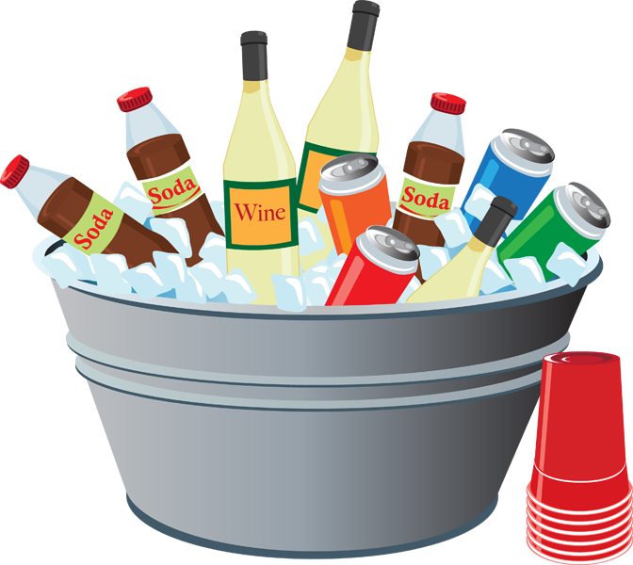
Un mensaje
hablar / escuchar / escribir
Persona A: Lee el texto a tu compañero.
Persona B: Sin mirar la pizarra*, escucha y escribe cada palabra con [b] o [v].
*board
Persona A
Persona B
Hola Luis. ¿Cómo estáis tu y tu hermana? Vosotros vais a venir a mi casa este sábado para la fiesta, ¿verdad? ¡Tenemos bastante comida y bebidas para todos en el barrio!
Hola Diego. Estamos bien, gracias. Ayer vimos la última película de Icíar Bollaín ¡Es muy buena! Sí, vamos a ir a la fiesta. También quiero invitar a mi novia. ¡Baila genial!
Notes:
[1/2]
Timing: 5 minutes
Aim: a paired read aloud and transcription task to practise oral production and recognition of words containing the SSCs [v] and [b] at text level.
Procedure:
1. Ask the students to read the instructions and check their understanding. At this point, advise student B to turn away from the board.
2. Click to bring up the text for student A.
3. Student A reads the text to student B who writes all the words containing SSC [v] or [b] .
4. Click again to hide the text that was just used.
5. Students then swap roles.
6. Teachers can use the answer slide (next slide) to bring the activity to a close. Elicit the meanings of the target words in English.
7. Teachers may also want to ask students to consider the meanings of the texts as a whole before moving on. Give pairs a minute per text and then take feedback.
Frequency of unknown vocabulary:
pizarra [>5000]

Slide 27
Solución
hablar / escuchar / escribir
Persona A
Persona B
vosotros
bastante
bien
invitar
vais
bebidas
vimos
novia
venir
barrio
Bollaín
baila
sábado
buena
verdad
vamos
Notes:
[2/2]
Answer slide.

Slide 28
Vocabulario
hablar
We can create nouns in Spanish by adding –idad to singular adjectives ending in a consonant:
All –idad words in Spanish are feminine, so use ‘la’ for ‘the’ and ‘una’ for ‘a, an’.
All –idad words have final syllable stress.
real
idad
realidad
personal
idad
personalidad
We can also create nouns ending in –idad by removing the final vowel.
curioso
idad
curiosidad
Note that these words end in –ity in English: curiosity, security.
seguro
idad
seguridad
Notes:
Timing: 1 min.
Aim: to explain the ‘–idad’ suffix in Spanish, how it is formed and its correspondence to ‘–ity’ in English.
Procedure:
The teacher elicits the Spanish for ‘real’ + –idad and for ‘personal’ + –idad.
The teacher reads through the follow-up explanations.
Frequency of unknown words:
realidad [260]; personalidad [1550]; curiosidad [1830]; seguridad [538]

Slide 29
Vocabulario
hablar
Note that the word for ‘especial’ in English has no 'e' at the start.
especial
total
activo
humano
especialidad
totalidad
actividad
humanidad
formal
formalidad
tranquilidad
original
tranquilo
claridad
claro
originalidad
Notes:
Timing: 2 min.
Aim: to introduce examples of words with the ‘–idad’ suffix and to reinforce the connection with ‘–ity’ in English.
Procedure:
1. Students are given one minute in pairs to think about how to create 8 words ending in –idad in Spanish (–ity in English).
2. The teacher asks students to say each noun ending in –idad (this can be in any order).
3. Answers are revealed by clicking on each text box.
4. The teacher encourages students to say the English word for each of these words in Spanish.
Notes:
Note that a further click will bring up a callout reminding students of the absence of e- at the beginning of the word ‘especial’ in English. This will also happen in the derived word ‘especialidad’ (‘speciality’).
The teacher can draw attention to the fact that these are all feminine nouns.

Slide 30
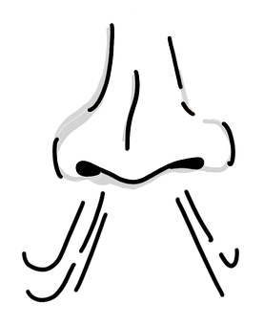
Vocabulario
leer / hablar
mundial
[worldwide]
anunciar
arrival
la llegada
[to announce, announcing]
to notice, noticing
notar
el olor
[the smell]
straight away
enseguida
el golpe
el sabor
[hit, bang]
suddenly
de repente
[taste]
Notes:
Vocabulary introduction and practice slide
Timing: 3 minutes
Aim: to introduce new vocabulary
Procedure 1. Pupils either work by themselves or in pairs, reading out the words and recapping their English meaning (1 minute). 2. Then the teacher removes the English words or pictures (one by one) and they try to recall the English orally (chorally), looking at the Spanish (1 minute). 3. Then the Spanish meanings are removed (one by one) and they try to recall them orally (again, chorally), looking at the English (1 minute) 4. Optionally, further rounds of learning can be facilitated by one pupil turning away from the board, and his/her partner asking him/her the meanings (‘¿Cómo se dice X en español?’). This activity can work from L2 → L1 or L1 → L2.

Slide 31
Talking about how people felt ESTAR in the imperfect tense
gramática
As you know, to describe how or where someone was at a particular time, you need to use a different form of ESTAR.
estaba
To say ‘I was’ for a state or location, use __________.
Estaba preocupada por el futuro.
I was worried for the future.
The same verb form is used for ‘I’ and ‘s/he’!
estabas
To say ‘you were’ for a state or location, use __________.
Estabas contento por el buen tiempo.
You were happy about the good weather.
estaba
To say ‘s/he was’ or ‘it was’ for a state or location, use __________.
Estaba emocionado por el espectáculo.
He was excited about the show.
Notes:
Timing: 1 minute
Aim: to revisit the 1st, 2nd and 3rd person singular forms of the verb ‘estar’ (estaba, estabas, estaba).
Procedure:
1. Go through the grammar explanation with students, revealing each new sentence on a mouse click.

Slide 32
Saying what someone was doing ESTAR in the imperfect tense + ’–ando/–iendo’
gramática
As you know, we can use estar with present participle to talk about ongoing events. We can use estar in the imperfect tense to talk about what someone was doing.
Estaba anunciando el espectáculo.
I or s/he or it was announcing the show.
Estabas aceptando el dinero.
You were accepting the money.
Estaba lloviendo.
It was raining.
Remember that to form the present participle with an –ar verb we add –ando. We add –iendo for –er/ir verbs.
Notes:
Timing: 3 minutes
Aim: to revisit the meaning, use and formation of the present continuous tense with –ar verbs.
Procedure:
Go through the grammar explanation with students, revealing each new sentence on a mouse click.
Elicit English translations of the Spanish sentences.

Slide 33
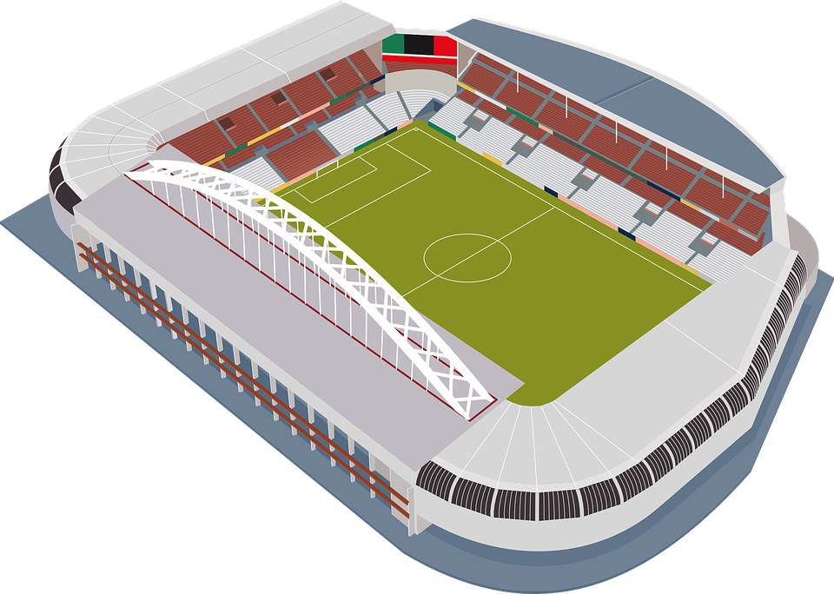
Lucía fue al estadio con Nadia y Hugo ayer por la tarde. Ahora está hablando con Hugo. ¿Qué estaba haciendo cada uno?
leer
 |  | Could be ‘I’ or ‘she’ | You | ¿Qué acción? en inglés
1 | Estaba animando a su equipo.
2 | Estabas charlando con los jugadores.
3 | Estaba corriendo en el campo
4 | Estabas esperando la llegada de un amigo.
5 | Estabas prestando atención al partido.
6 | Estaba regresando del trabajo.
7 | ¡Estaba disfrutando el sabor de la victoria!
cheering on the team
chatting with the other players
running on the pitch
waiting for the arrival of a friend
paying attention to the match
returning from work
enjoying the taste of victory.
Notes:
Timing: 6 minutes
Aim: to practise understanding of the imperfect continuous ‘estaba’ (for ‘I’ and ‘s/he’), ‘estabas’ (for ‘you’) + –ando/–iendo.
Procedure:
Students read each phrase and decide who the sentence refers to, ‘I’/’s/he’ or ‘you’.
Then, students write the action in English.
Teacher shows answers one by one.

Slide 34
Describing completed events in the past -ar verbs in the preterite
gramática
Remember that you need different verb endings depending on when the action takes place.
These verb endings change depending on who the verb refers to.
For completed events in the past, remove –ar and:
–é
I announced
To mean ‘I’ add ____.
Anuncié = ____________
you noticed
–aste
Notaste = ____________
To mean ‘you’ add ______.
–ó
s/he returned
To mean ‘s/he’ add ____.
Regresó = ____________
Notes:
Timing: 1 minute
Aim: to recap 1st , 2nd and 3rd person singular forms of preterite tense for –ar verbs (-é, -aste, -ó).
Procedure:
Go through the grammar explanation with students, revealing each new sentence on a mouse click.

Slide 35
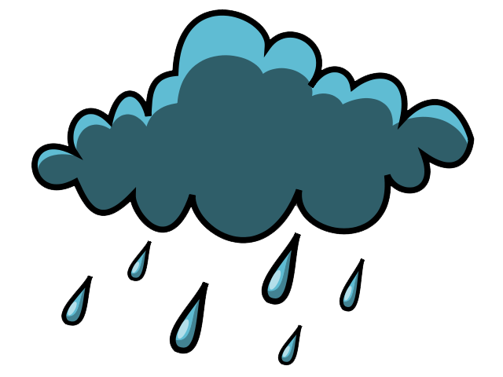
Unas personas hablan sobre eventos en el pasado. Lee las frases, ¿quién es la persona?
leer
 | ¿Quién es la persona?
 | I | you | s/he, it
1. De repente escuché un golpe muy fuerte y noté un olor raro. Miré por la ventana y pude ver el fuego.
2. Un viernes fui al centro y encontré a mi hija allí. Yo estaba enojada porque ella no estaba en la escuela.
3. Entonces anunció la muerte del futbolista.
4. ¿Miraste el partido de baloncesto* de los Estados Unidos?
5. Llegó al país con aproximadamente 1000 personas: su familia, políticos, jugadores de béisbol* y los Rolling Stones.
6. Notaste la alegría de la pareja a pesar de la lluvia.
*baloncesto = basketball
*béisbol = baseball
Notes:
Timing: 6 minutes
Aim: to recognise the use of –ar singular verb endings in the preterite (–é, –aste, –ó).
Procedure:
Students read each sentence and tick the correct column.
Teacher encourages to provide the meaning of each sentence in English orally.
Teacher shows answers one by one.
Frequency of unknown words and cognates:
béisbol [>5000]; baloncesto [>5000]

Slide 36
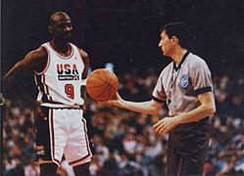
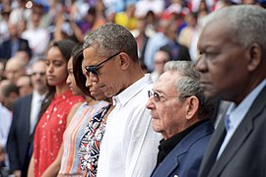
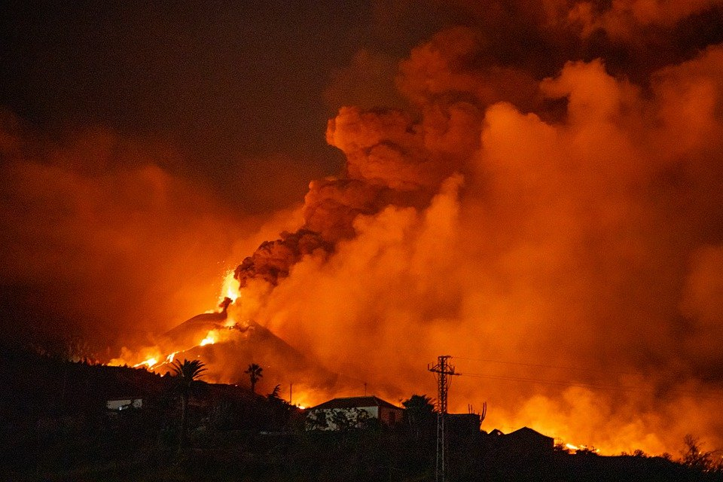
Lee las acciones (1-6) otra vez y busca el evento correcto (a-f).
leer
¿Qué letra?
a
1992
b
2016
1. De repente escuché un golpe muy fuerte y noté un olor raro. Miré por la ventana y pude ver el fuego.
2. Un viernes fui al centro y encontré a mi hija allí. Yo estaba enojada porque ella no estaba en la escuela.
3. Entonces anunció la muerte del futbolista.
4. ¿Miraste el partido de baloncesto* de los Estados Unidos?
5. Llegó al país con aproximadamente 1000 personas: su familia, políticos, jugadores de béisbol* y los Rolling Stones.
6. Notaste la alegría de la pareja a pesar de la lluvia.
e
Juegos Olímpicos de Barcelona
Llegada de Obama a Cuba
f
c
1960-2020
d
2004
c
a
Funeral de Maradona
Boda de los Reyes de España
e
2021
f
2019
b
d
Erupción de un volcán - La Palma
Manifestación de estudiantes
*baloncesto = basketball
*béisbol = baseball
Notes:
Timing: 4 minutes
Aim: to identify the event each sentence is referring to.
Procedure:
Students read each sentence again and decide which is the corresponding letter for each sentence.
Teacher shows the answers one by one.
Identifying features:
In picture A, there is basketball.
In picture B, there is a Cuban flag and there are many more people.
In picture C, there is Maradona in his football shirt.
In picture D, the King and Queen of Spain are stood together as a couple.
In picture E, there is lava, fire and smoke.
In picture F, there are students.
Frequency of unknown words and cognates:
béisbol [>5000]; baloncesto [>5000]
Photos from wikipedia.org
Olympics. Image by Gapvenezia usable by Creative Commons Attribution-Share Alike 3.0 Unported. Image available at: https://commons.wikimedia.org/wiki/File:Cazzaro_Jordan.jpg
Obama in Cuba with Raul Castro. This image is a work of a United States Department of State employee, taken or made as part of that person's official duties. As a work of the U.S. federal government, the image is in the public domain per 17 U.S.C. § 101 and § 105 and the Department Copyright Information. https://commons.wikimedia.org/wiki/File:President_Obama,_the_First_Lady,_and_Cuban_President_Castro_Observe_Moment_of_Silence_in_Respect_to_Victims_of_Terrorist_Attack_on_Brussels_(25903928701).jpg
Maradona Funeral. Image by PapiPijuan usable by CC BY-SA 4.0 and available at https://commons.wikimedia.org/wiki/File:Dibujo_de_Diego_Maradona.jpg
Royal wedding. Image by Daniel Virgili usable by CC BY-SA 4.0 and available at https://commons.wikimedia.org/wiki/File:SSMM_Los_Reyes.jpg
La Palma eruption. Image by VP68 and free to use from Pixabay.
Climate Protest. Image by CleoGrimalid usable by CC BY-SA 4.0 and available at https://commons.wikimedia.org/wiki/File:Climate_Strike_-_Misi%C3%B3n_Planeta_2019_-_Strike.jpg

Slide 37
Giving information about something Relative pronoun ‘cuando’
As you know, we can give extra information about something using relative pronouns ’que’ and ‘donde’.
Greta Thunberg es la chica que empezó las manifestaciones de los estudiantes.
Greta Thunberg is the girl who started the student protests.
Es la iglesia donde celebraron la boda de los reyes.
Note that ‘cuando’ does not have an accent when used as a relative pronoun.
It is the church where they celebrated the wedding of the king and queen.
We have used ‘cuándo’ in questions already, but we can also use ‘cuando’ as a relative pronoun to give additional information in a sentence.
Estaba comiendo en un café en La Habana cuando Obama entró.
I was eating in a café in Havana when Obama walked in.
Notes:
Timing: 2 minutes
Aim: to introduce the relative pronoun ‘cuando’ with its function and meanings
Procedure:
1. Go through the grammar explanation with students, revealing each new sentence on a mouse click.

Slide 38
Escucha y completa cada frase. ¿Qué estaba haciendo cada persona?
escuchar
1
Estaba charlando con mi madre
________________________________ cuando de repente escuché un ruido muy fuerte y miré por la ventana.
_____________________________ cuando un periodista anunció la muerte del futbolista.
________________________________ cuando encontré a mi hija allí. Yo estaba enojada porque ella no estaba en la escuela.
¿_________________________________________________ cuando miraste el partido de baloncesto de los Estados Unidos?
_______________________________ cuando Obama llegó al país con aproximadamente 1000 personas.
_____________________________________________ cuando notaste la alegría de la pareja a pesar de la lluvia.
2
Estabas escuchando la radio
3
Estaba caminando por el centro
4
Estaba jugando la estrella mundial Michael Jordan
5
Estabas viviendo en La Habana
6
Estabas prestando mucha atención a la boda
Notes:
Timing: 7 minutes
Aims:
to practise understanding of singular forms in imperfect continuous (‘estaba’/’estabas’ + –ando/–iendo).
to understand the sentences in their entirety.
Procedure:
Students listen to each recording and transcribe the missing parts.
Students are encouraged to provide an oral translation of each missing part.
Teacher shows answers one by one.
Frequency of unknown words and cognates:
béisbol [>5000]; baloncesto [>5000]
Transcript:
Estaba charlando con mi madre cuando de repente escuché un ruido muy fuerte y miré por la ventana.
Estabas escuchando la radio cuando un periodista anunció la muerte del futbolista.
Estaba caminando por el centro cuando encontré a mi hija allí. Yo estaba enojada porque ella no estaba en la escuela.
Estaba jugando la estrella mundial Michael Jordan cuando miraste el partido de baloncesto de los Estados Unidos?
Estabas viviendo en La Habana cuando llegó al país con aproximadamente 1000 personas.
Estabas prestando mucha atención a la boda cuando notaste la alegría de la pareja a pesar de la lluvia.

Slide 39
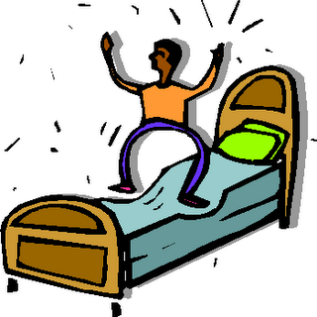
Una página web publica experiencias divertidas, raras y diferentes. Ahora tú las escribes en español.
escribir
I was eating at a café when I noticed a weird taste. I found an insect* on my plate!
I was resting in my bedroom with my eyes closed when my brother jumped on my bed and shouted.
I started to cry straight away!
I was playing a game with my family in the lounge when I heard a loud noise. I looked through the window and... a very big animal was going in our garden!
Remember that in Spanish we use the articles ‘el/los/la/las’ with body parts.
The other day I was taking out the rubbish when I found fifty euros on the floor!
I was walking to the centre when I received a message. I was looking at the phone when all of a sudden I felt a pain in my head. I didn’t see the tree!
*insect = (el) insecto
Notes:
[1/2]
Timing: 6 minutes
Aim: to practise singular forms in both imperfect continuous and preterite in writing.
Procedure:
Students write the Spanish for each little story.
Answers can be shown in the next slide.
Notes:
1. Note that a call out message appears with a click reminding students of the use of articles instead of possessives to talk about body parts. The call out will dissappear with a further click.
Frequency of unknown words and cognates:
insecto [>5000]

Slide 40
Una página web publica experiencias divertidas.
escribir
I was eating at a café when I noticed a weird taste. I found an insect on my plate!
Estaba comiendo en un café cuando noté un sabor raro. ¡Encontré un insecto en mi plato!
I was resting in my bedroom with my eyes closed when my brother jumped on my bed and shouted. I started to cry straight away!
Estaba descansando en mi dormitorio cuando mi hermano saltó en la cama y gritó. ¡Empecé a llorar enseguida!
I was walking to the centre when I received a message. I was looking at the message when all of a sudden I felt a pain in my head. I didn’t see the tree!
Estaba caminando al centro cuando recibí un mensaje. Estaba mirando el móvil cuando de repente sentí un dolor en la cabeza. ¡No vi el árbol!
The other day I was taking out the rubbish when I found fifty euros on the floor!
El otro día estaba sacando la basura cuando ¡encontré cincuenta euros en el suelo!
I was playing a game with my family in the lounge when I heard a hoise. I looked through the window and... a very big animal was going in our garden!
Estaba jugando a un juego con mi familia en la sala cuando oí un ruido. Miré por la ventana y... ¡un animal muy grande estaba entrando en nuestro jardín!
Notes:
[2/2]

Slide 41
Deberes
Vocabulary Learning Homework (Y9, Term 2.2, Week 4)
Student worksheet
Quizlet link
Notes:
Note that this week’s homework revisits vocabulary from Year 7 and Year 8. https://resources.ncelp.org/concern/resources/br86b532j?locale=en

