Slide 1
Phonics are for all
Teaching symbol-sound correspondences
Notes:
All pictures selected are available under a Creative Common license, no attribution required.
The recent MFL Pedagogy Review recommendations include (amongst others) principles for teaching phonics, vocabulary, grammar and their combination in meaningful practice. In this workshop we focus on research-informed practice for explicitly teaching, consolidating and applying the sound-writing relationship in secondary language learning. The session includes (freely available) resources for teaching phonics in French, German and Spanish.

Slide 2
https://resources.ncelp.org/
Notes:
Slide 2 will be a brief introduction to NCELP – fusing research and practice more closely than has previously been possible. Stress the importance of both practitioner knowledge and research – one is no substitute for the other, both are necessary and complementary.
In November 2016, the Teaching Schools Council published the Report of the MFL Pedagogy Review .
The report noted that only a third of pupils achieves a languages GCSE at grade 4 or above and that less than a half of pupils even takes a language GCSE.
Research has shown that poor motivation in studying a language is partly due to pupils feeling that they do not know the language and feeling that they are not making progress.
The National Centre for Excellence for Language Pedagogy (NCELP)’ s approach to FL pedagogy is both research-led and practice-informed, taking into account the time-poor context of curriculum FL learning in English classrooms.
The pedagogy helps pupils establish, early in their course, a robust knowledge of basic vocabulary, grammar, and the sound and spelling systems (phonics). The pedagogy then reinforces this knowledge via planned practice in using the knowledge during meaningful activities Anon. 2016. Modern Foreign Languages Pedagogy Review. A review of modern foreign languages teaching practice in key stage 3 and key stage 4. (Chair: Ian Bauckham). Teaching Schools Council

Slide 3
10 little changes that make a BIG difference
Phonics
high-frequency ‘source’ words
staged roll out with more intensive practice activities (and systematic revisiting)
much more time for French
Vocabulary
the frequency principle
the verb lexicon
mixed word class vocabulary sets
developing depth (e.g. through information gaps)
Grammar
verb paradigms (staging / minimal pairs)
input processing
output activities (trapping the forms)
Notes:
I’m starting from the point of view of our practice where it is currently, and what the recent work with NCELP suggests might be areas for development. From my own trust’s perspective, and remembering that we have been embedding phonics, focusing on vocabulary learning, retention and recall, and teaching grammar in a sustained way for a long time. So what are the key messages from research that suggest we develop what we do?

Slide 4
PHONICS
high-frequency ‘source’ words
staged roll out with more intensive practice activities (and systematic revisiting)
much more time for French
Erler, L. and Macaro, E. (2012) ‘Decoding Ability in French as a Foreign Language and Language Learning Motivation’. The Modern Language Journal, 95(4): 496-518.
Porter, A.M. (2014) An early start to French literacy: Learning the spoken and written word simultaneously in English primary schools. PhD thesis, University of Southampton.
Woore, R. (2007) ‘“Weisse Maus in Meinem Haus”: Using Poems and Learner Strategies to Help Learners Decode the Sounds of the L2’. Language Learning Journal, vol. 35, no. 2, pp. 175-188.
Woore, R. (2009) ‘Beginners’ progress in decoding L2 French: some longitudinal evidence from English Modern Foreign Languages classrooms’. Language Learning Journal, vol. 37, no. 1, pp. 3-18.
Woore, R. (2010) ‘Thinking aloud about L2 decoding: an exploration into the strategies used by beginner learners when pronouncing unfamiliar French words’. Language Learning Journal, vol. 38, no. 1, pp. 3-17.
Woore, R. (2011) Investigating and developing beginner learners’ decoding proficiency in second language French: an evaluation of two programmes of instruction. Unpublished PhD thesis, University of Oxford.
Woore, R. (2014) ‘Beginner learners’ progress in decoding L2 French: transfer effects in typologically similar L1-L2 writing systems’. Writing Systems Research, volume 4(2): 167-189.
Woore, R (2018) ‘Learners’ pronunciations of familiar and unfamiliar French words: what can they tell us about phonological decoding in an L2?’ The Language Learning Journal, 46(4):456-69.
Woore, R., Graham, S., Porter, A., Courtney, L. and Savory, C. (2018) Foreign Language Education: Unlocking Reading (FLEUR) - A study into the teaching of reading to beginner learners of French in secondary school. https://ora.ox.ac.uk/objects/uuid:4b0cb239-72f0-49e4-8f32-3672625884f0
Notes:
Important to keep flagging the use of research findings (within the UK classroom context, wherever possible) to inform the pedagogy
Erler, L. and Macaro, E. (2012) ‘Decoding Ability in French as a Foreign Language and Language Learning Motivation’. The Modern Language Journal, 95(4): 496-518.
Porter, A.M. (2014) An early start to French literacy: Learning the spoken and written word simultaneously in English primary schools. PhD thesis, University of Southampton.
Woore, R. (2007) ‘“Weisse Maus in Meinem Haus”: Using Poems and Learner Strategies to Help Learners Decode the Sounds of the L2’. Language Learning Journal, vol. 35, no. 2, pp. 175-188.
Woore, R. (2009) ‘Beginners’ progress in decoding L2 French: some longitudinal evidence from English Modern Foreign Languages classrooms’. Language Learning Journal, vol. 37, no. 1, pp. 3-18.
Woore, R. (2010) ‘Thinking aloud about L2 decoding: an exploration into the strategies used by beginner learners when pronouncing unfamiliar French words’. Language Learning Journal, vol. 38, no. 1, pp. 3-17.
Woore, R. (2011) Investigating and developing beginner learners’ decoding proficiency in second language French: an evaluation of two programmes of instruction. Unpublished PhD thesis, University of Oxford.
Woore, R. (2014) ‘Beginner learners’ progress in decoding L2 French: transfer effects in typologically similar L1-L2 writing systems’. Writing Systems Research, volume 4(2): 167-189.
Woore, R (2018) ‘Learners’ pronunciations of familiar and unfamiliar French words: what can they tell us about phonological decoding in an L2?’ The Language Learning Journal, 46(4):456-69.
Woore, R., Graham, S., Porter, A., Courtney, L. and Savory, C. (2018) Foreign Language Education: Unlocking Reading (FLEUR) - A study into the teaching of reading to beginner learners of French in secondary school. https://ora.ox.ac.uk/objects/uuid:4b0cb239-72f0-49e4-8f32-3672625884f0

Slide 5
Why teach phonics?
https://resources.ncelp.org/concern/resources/kd17cs85f?locale=en
Teaching phonics develops phonological decoding
Without explicit phonics teaching, decoding may be limited
The ability to decode is associated positively with motivation
Decoding enables learners to access new language autonomously and accurately
Phonics teaching supports vocabulary learning, which is key to making progress in language learning
The time spent on teaching phonics does not seem to delay progress in other areas, i.e. reading comprehension
https://resources.ncelp.org/concern/resources/ng451h51g?locale=en

Slide 6
How to teach phonics?
Introducing and practising
Applying the knowledge
Increasing independence
Assessing

Slide 7
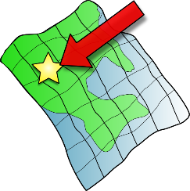
SFC
a
i
eu
e
au
 |  |  |  |  | Francophoniques
X
midi
je
gauche
dans
animal
deux
u
ou
SFE
é
en/an
on
tu
nous
timide
écrire
X
enfant
Non!
ain/in
ê/è
ai
oi
ch
ç/c
train
tête
vrai
voir
chercher
ici
qu
-tion
ien
un
?
j
X
question
jour
Attention!
bien
un
Stephen Owen / Rachel Hawkes

Slide 8
Target SSC in French
Teaching order | Frequency order | SSC | Teaching order | Frequency order | SSC
1 | 1 | SFC | 13 | 12 | -in / -ain
2 | 2 | a | 14 | 13 | è / ê
3 | 3 | i | 15 | 13 | ai (ais / ait)
4 | 5 | eu | 16 | 15 | oi
5 | 5 | e | 17 | 19 | ch
6 | 8 | o /eau / au | 18 | 20 | ç (and soft -c)
7 | 9 | u | 19 | 14 | qu
8 | 11 | ou | 20 | 17 | j
9 | 4 | SFe | 21 | 18 | -tion
10 | 6 | é | 22 | 21 | -ien
11 | 7 | en / an | 23 | 16 | un
12 | 10 | on
Stephen Owen / Robert Woore
Notes:
A ‘bang for buck’ principle was implemented to achieve the maximum improvement in decoding within a time-limited teaching context. The SSC were chosen based on their difficulty for L1 English speakers, their frequency of occurrence in the language and teacher knowledge.
The notion is that one SSC would be the focus each week in Y7, with time also built in for revisiting/recycling. 10-12 minutes per lesson might be spent on introducing the new SSC and recapping one or more previously learnt SSC. Phonics work is likely to continue in Y8, too.

Slide 9
Source words in French
Teaching order | SSC | Source word | Frequency | Teaching order | SSC | Source word | Frequency
1 | SFC | dans | 11 | 13 | -in / -ain | train | 232
2 | a | animal | 1002 | 14 | è / ê | tête | 343
3 | i | midi | 2483 | 15 | ai (ais / ait) | vrai | 292
4 | eu | deux | 41 | 16 | oi | voir | 69
5 | e | je | 22 | 17 | ch | chercher | 336
6 | o /eau / au | gauche | 607 | 18 | ç (and soft -c) | ici | 167
7 | u | tu | 112 | 19 | qu | question | 144
8 | ou | nous | 31 | 20 | j | jour | 78
9 | SFe | timide | 3835 | 21 | -tion | Attention! | 482
10 | é | écrire | 382 | 22 | -ien | bien | 47
11 | en / an | enfant | 126 | 23 | un | un | 3
12 | on | non! | 72
Stephen Owen / Robert Woore
Notes:
This table includes the frequency so people can see the rationale for the selection of the words
Source words were chosen for frequency, but also for their simplicity in terms of the pronunciation of the word in terms of the other phonemes apart from the target SSC.
We use a cumulative principle too, to ensure that later SSCs are not used before they have been learnt.
This was more important than whether the word could be easily depicted in an image or linked to a gesture, although we wanted also to achieve these things.

Slide 10
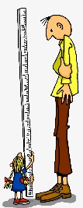
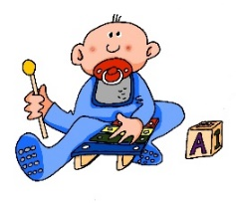
a
e
ei
w
z
sagen
geben
frei
Welt
Zug
i
ie
ch
sch
wir
Liebe
ich
Buch
schreiben
o
u
er
r
v
s
ß
wo?
du
er
reden
vor
sollen
groß
ü
ö
ä
au
eu
äu
Tür
schön
spät
Haus
Mäuse
Deutschland
-d
-ig
st-
sp-
j
th
und
richtig
stark
spielen
ja
Theater
Rachel Hawkes

Slide 11
Target SSC in German
Teaching order | SSC
Group 1 | a (long), a (short) e (long), e (short) ei w z
Group 2 | i (long), i (short) ie ch sch
Group 3 | o (long), o (short) u (long), u (short)
Group 4 | er (stressed) er (unstressed) r (vocalic), r (consonantal) v
Teaching order | SSC
Group 5 | s (start/middle) ss / ß / -s
Group 6 | ü (long), ü (short) ö (long), ö (short) ä (long), ä (short)
Group 7 | au eu äu
Group 8 | -d -ig st-, sp- j th
1) The long vowels a,e,i,o,u in German are less straightforward than the short vowels. They are presented together for contrast purposes. Later they can be contrasted with the trickier ä, ö, ü. 2) Likewise the ‘er’ unstressed sound is very similar to the –er at the end of ‘mother’, but the ‘er’ stressed is a rather different sound, so the two are presented together. 3. A tentative, suggested time frame might be to spend 10-12 minutes each lesson on phonics. So, for example, a / e would be lesson 1, ei/w/z in lesson 2. The following week would revisit all of these, before starting in Week 3 with Group 2. This would put the initial introduction and practice phase at 16 weeks, just over one term. After that, specific contrasts would be practised regularly: u/ü, o/ö, a,ä, ei/ie, z/s-, sch/st/sp, v/w and sch/ch, as well as other tasks that combine several SSCs. This would run over the spring term. The summer term of Y1 would continue to develop and apply SSC knowledge, including through the use of more extended, authentic texts. 4) Diagnostic assessment of pupils’ development would also inform the re-visiting of specifically challenging SSCs.
Rachel Hawkes

Slide 12
Source words in German
Order | SSC | Source word | FQ | Order | SSC | Source word | FQ
G1 | a (long), a (short) e (long), e (short) ei w z | sagen, kalt geben,denken frei Welt Zug | 46, 875 57, 124 318 190 613 | G5 | s (start/middle) ss / ß / -s | sollen groß | 63 74
G2 | i (long), i (short) ie ch sch | wir, finden Liebe ich, Buch schreiben | 31, 110 843 8, 195 245 | G6 | ü (long), ü (short) ö (long), ö (short) ä (long), ä (short) | Tür, fünf schön,plötzlich spät, lächeln | 400, 272 164, 459 171,793
G3 | o (long), o (short) u (long), u (short) | Wo?, Kopf du, Punkt | 94, 279 52, 427 | G7 | au eu äu | Haus Deutschland Mäuse | 159 *105/146 3757
G4 | er (stressed) er (unstressed) r (vocalic), r (consonantal) v | er, wieder Uhr, reden vor | 20, 75 349,356 55 | G8 | -d, -ig st-, sp- j th | und, richtig stark, spielen ja Theater | 2, 211 207,197 27 725
Rachel Hawkes
Notes:
FQ for Deutschland combined from ‘Deutsch’ 105 and ‘Land’ 146 This table includes the frequency so people can see the rationale for the selection of the words

Slide 13
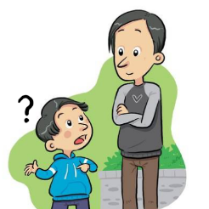
a
e
i
o
u
ll
l
yo
libro
alto
elefante
idea
universo
llamar
ca
co
cu
ce
ci
z
MADRID 1KM
casa
comer
cuerpo
cerca
cierto
zona
ga
go
gu
ge
gi
j
ganar
gol
preguntar
gente
imaginar
ojo
n
v
r
que
gue
rr
h
qui
gui
ñ
b
mano
celebrar
porque
guerra
pero
español
ver
perro
hablar
quiero
guitarra
Nick Avery / Rachel Hawkes
Notes:
Phonics

Slide 14
Target SSC in Spanish
Teaching order | SSC
Group 1 vocales | a e i o u
Group 2 LL/L * | ll vs l
Group 3 C/Z *** | ca, co, cu vs ce, ci, z
Group 4 | que, qui
Teaching order | SSC
Group 5 | ga, go, gu vs j, ge, gi (gue, gui)
Group 6* | n vs ñ
Group 7** | v, b
Group 8* | rr vs r
Group 9 | h
1) Spanish is clearly a much shallower language, phonetically. The pace of introduction and practice is likely to be somewhat quicker than in French, as a result. 2) * Note that some straightforward SSCs are introduced, predominantly to contrast with other less straightforward ones (ll/l, n/ñ, r/rr). 3) ** B is presented with V because these are the same sound – different spelling pair. 4) A tentative, suggested time frame for teaching might be to spend 10-12 minutes each lesson on phonics. So, for example, each group would be introduced and practised in lesson 1, and further practised in lesson 2. In week 2, we would present and practise group 2. After that, specific contrasts would be practised regularly, as well as other tasks that combine several SSCs. This fairly controlled introduction/practice would probably run until the end of the spring term. The summer term of Y1 would continue to develop and apply SSC knowledge, including through the use of more extended and richer texts. 5) Diagnostic assessment of pupils’ development would also inform the re-visiting of specifically challenging SSCs.
6) Seseo / ceceo. Whether the ce / ci/ z are pronounced seseo (e.g., as in Latin America/the Canary Islands) or ceceo (e.g., as in most parts of Spain) does not make a difference to meaning or to the SSCs, but learners should be exposed to and understand both versions at later stages. Given GCSE requirements, currently, ‘ceceo’ is probably the most sensible starting point.
Nick Avery / Rachel Hawkes
Notes:
Phonics

Slide 15
Source words in Spanish
Order | SSC | Source word | FQ | Order | SSC | Source word | FQ
G1 | a e I o u | alto elefante idea yo universo | 231 >5000 248 28 1603 | G5 | ga go gu j ge gi (gue/gui) | ganar gol preguntar ojo gente imaginar (guerra/guitarra) | 295 2069 219 169 137 500 283/2706
G2 | ll, l | llamar, libro | 122, 230 | G6 | ñ, n | español, mano | 202, 135
G3 | ca co cu ce ci z | casa comer cuerpo cerca cierto zona | 106 347 232 1042 159 359 | G7 | v b | ver celebrar | 64 886
G4 | que, qui | porque, quiero | 40, 58 | G8 | rr, r | perro, pero | 888, 30
 |  |  |  | G9 | h | hablar | 90
Nick Avery / Rachel Hawkes
Notes:
This table includes the frequency so people can see the rationale for the selection of the words

Slide 16
How to teach phonics?
Introducing and practising
Applying the knowledge
Increasing independence
Assessing

Slide 17
Introducing and practising
focus on specific sound-symbol correspondences (SSCs)
practise connecting the sound to the symbol, initially: with the symbol alone; in a source word, with source word picture, with source word gesture
practise listening to and recognising the new SSCs in words; in sentences; in short passages

Slide 18
French SSC teaching sequence
SFC (Silent final consonant)

Slide 19
Silent final consonant
dans
X
Rachel Hawkes
Notes:
AUDIO x 2: on appearance of X and of the visual for ‘in’.
Explanation in English, if desired: Something that makes French sounds very different from English is that some consonants at the ends of words are silent. This means you don’t pronounce/sound them out at all. As in the word ‘dans’ in French. Say and repeat the word. Ensure pupils know the meaning (use usual routine for this – e.g. C’est quoi en anglais ‘dans’? ‘In’, oui, c’est ça. A possible gesture to accompany this SSC would be to hold ones finger to ones lips to indicate ‘Shhhh!’

Slide 20
Silence!
prix
petit
dans
X
mot
grand
mais
Rachel Hawkes
Notes:
Elicit pronunciation of ‘dans’ again before clicking to animate the ‘X’
Possible explanation, in English, if desired: Let’s see which other final consonants are silent in French. Lead class repetition of the five CLUSTER words.
Word frequency rankings (1 is the most common word in French): dans [11]; petit [138]; prix[310] mot [220]; grand [59]; mais [30] Source: Londsale, D., & Le Bras, Y. (2009). A Frequency Dictionary of French: Core vocabulary for learners London: Routledge.

Slide 21
petit
prix
grand
€15.95
mot
mais
Rachel Hawkes
Notes:
With this round of repetition, ensure that pupils are clear about the meaning of each of these high-frequency words. NB: pictures can, at best, only suggest meaning. Many high-frequency words less concrete than other words, and less easy to communicate unequivocally in pictures. Therefore, teachers should not shy away from giving the English meaning to students, to prevent any erroneous representations taking root in memory. With these words, however, it is expected that pupils will know several of them already. Lead class repetition of the five CLUSTER words.

Slide 22
… except for
c r f l
Be c a r e f u l with these!
Rachel Hawkes
Notes:
Some consonants work differently. CRFL are often pronounced.

Slide 23
60
petit
prix
Secondes
grand
mais
0
mot
DÉBUT
Rachel Hawkes
Notes:
Pairwork ‘tennis’ – pupils say the words alternately out loud with a partner, building up speed, over 1 minute’s intensive practice. They call in any order they like, pupils are not allowed to repeat the one they said in their last turn. Teacher can circulate to listen into their SSC knowledge. Click on Début to start a one minute timer on the screen.

Slide 24
60
petit
prix
Secondes
grand
mot
mais
0
DÉBUT
Rachel Hawkes
Notes:
Alphabetical read aloud Individually (but all at once) pupils read out the words but in alphabetical order. They keep going for one minute.
Teacher can circulate to listen into their SSC knowledge.

Slide 25
petit
prix
€15.95
grand
mot
mais
Rachel Hawkes
Notes:
Whole class: SFC, with the rest of the word obscured, allows the teacher to cue elicitation, the cue being the SFC plus the picture at this stage, which also acts as memorisation practice. Note that the final letter is still a different colour but the strikethrough has been removed.

Slide 26
How to teach phonics?
Introducing and practising
Applying the knowledge
Increasing independence
Assessing

Slide 27
Applying the knowledge
sound out new and familiar words with the same SSCs
apply knowledge of one or more SSCs (in read aloud tasks, segmentation tasks, writing/transcription tasks
re-cycle previously taught SSCs
spot patterns in words with common spellings and/or pronunciations

Slide 28
French SSC teaching sequence
SFC (Silent final consonant) [2]

Slide 29
Silence!
petit
prix
dans
X
mot
grand
mais
Rachel Hawkes
Notes:
WITHOUT AUDIO Elicit pronunciation of ‘dans’ again before clicking to animate the ‘X’
Possible explanation, in English, if desired: Let’s see which other final consonants are silent in French. Lead class repetition of the five CLUSTER words.

Slide 30
petit grand mot mais prix
60
Secondes
0
DÉBUT
Rachel Hawkes
Notes:
Pair work: Pupils try to recall the words together, prompted just by the SFC Plenary: Elicit the words chorally from the class, but listening in carefully

Slide 31
€15.95
Rachel Hawkes
Notes:
Elicit the words from pupils from picture prompts (NB – clearly this is NOT decoding the SFC SSC, but it is reinforcing the explicit knowledge of the cluster words – remember these are high-frequency words)

Slide 32
1
J’habite dans le nord de la France.
2
Je suis petit mais Nicolas, mon frère, est assez grand.
3
Mes frères Louis et Gaspard adorent les serpents.
4
Mes mots favoris sont ‘prix’ et ‘beaucoup’.
5
Gaspard fait du sport; il joue au foot, au basket, et au tennis.
Rachel Hawkes
Notes:
WITH AUDIO [Click on numbers]
Further SSC practice: Using language that pupils already know well (from first two terms of Y7) have a short read aloud (single sentences or short dialogue or short text), showing the silent letters in a different colour. NB: Teachers should adapt this slide to language pupils have met before but include a few SFC words that are unfamiliar, as this is the way to assess if pupils are applying their SSC knowledge, as opposed to recalling the pronunciations of whole words that they already know.

Slide 33
1
J’habite dans le nord de la France.
2
Je suis petit mais Nicolas, mon frère, est assez grand.
3
Mes frères Louis et Gaspard adorent les serpents.
4
Mes mots favoris sont ‘prix’ et ‘beaucoup’.
5
Gaspard fait du sport; il joue au foot, au basket, et au tennis.
Rachel Hawkes
Notes:
WITH AUDIO [Click on numbers]
Teachers will want to use suitable sentences for their own classes.
These sentences model a mixture of known/unknown words. NB – a way to include unknown words without affecting pupils’ ability to understand the language is to use proper nouns, place or people names, as done here. NNB – sentence two includes an inevitable ‘liaison’ NNNB - sentence five includes three very common exceptions – it’s important for pupils to realise that there are some high-frequency words that do not obey the SFE rules. Here, I’ve used examples which pupils will know if they have learnt to talk about sports already – if not, use some different examples, like numbers – cinq, six, sept, huit, dix

Slide 34
How to teach phonics?
Introducing and practising
Applying the knowledge
Increasing independence
Assessing

Slide 35
Increasing independence
sound out new written words to ask for their meaning
sound out words as part of vocabulary learning in class
show increasing confidence when pronouncing from written text, writing down spoken language, speaking in the target language

Slide 36
French phonics activity
Read aloud, peer dictation, errorless dictatation, dictogloss Sound-symbol correspondences: SFC, ien (jɛ̃), in ('æ̃), é, u (y), en/an (ɑ̃), o/au/eau (o)

Slide 37
Un poème – full text
1
Où est Adrien ?
Il est dans le magasin.
Comment dit-on ‘champ’ en anglais ?
Où est Nicolas ?
Il est dans le cinéma.
Où est Artus ?
Il est dans la rue.
Où est Chloé ?
Elle est dans le marché.
Ask your teacher or your peers for any meanings you don’t know.
Où est Laurent ?
Il est dans le champ.
Où est Hugo ?
Il est dans le bureau!
Rachel Hawkes
Notes:
There are different activities that can be done with this poem, as suggested on the following slides. 1) Read aloud Students could simply try to read it aloud, applying their SSC knowledge in trying to decode (read aloud) the text accurately and also to ask their teacher about any vocabulary they don’t know. To do this, they will need to be able to pronounce the unknown words.
In addition, teacher leads a whole class check of comprehension at the end.
Word frequency rankings (1 is the most common word in French): où [48]; être [5]; dans [11]; magasin [1736]; cinéma [1623]; rue [598] marché [280]; champ [847]; bureau [273] Source: Londsale, D., & Le Bras, Y. (2009). A Frequency Dictionary of French: Core vocabulary for learners London: Routledge.

Slide 38
Un poème
2a
Où est Adrien ?
Il est dans ………………………
le bureau
le cinéma
Où est Nicolas ?
Il est dans ……………………...
le marché
Où est Artus ?
Il est dans ………………………
la rue
Où est Chloé?
Elle est dans …………………..
le champ
le magasin
Où est Laurent ?
Il est dans ……………………..
Où est Hugo ?
Il est dans ……………………..
Rachel Hawkes
Notes:
There are different activities that can be done with this poem:
2) Read aloud and gap-fill Students have to decode accurately in order to work out how to fill the gaps. Names and places have been chosen for sounds where different spellings for the same sound are possible. This ensures that learners are not just able to match written letter strings, without engaging with how the pronounce the words.
In addition, teacher leads a whole class check of comprehension at the end.

Slide 39
Un poème
2b
Où est Adrien ?
Il est dans le ………………………
salle de bains
bureau
cinéma
Où est Nicolas ?
Il est dans le ……………………...
rue
marché
Où est Artus ?
Il est dans la ………………………
salle à manger
photo
Où est Chloé?
Elle est dans le …………………..
gare
banque
Où est Laurent ?
Il est dans le ……………………..
champ
magasin
Où est Hugo ?
Il est dans le ……………………..
musée de statues
Rachel Hawkes
Notes:
VERSION 2 (greater challenge and dual purpose)
2) Read aloud and gap-fill With this version the articles are given, and then two plausible rhyming options are provided (NB: where there are not two possible options with the same sound, a similarly written word has been chosen to at least make learners weigh up the different sounds, e.g., magasin / cuisine. Students must select not only a place noun that has the correct sound, but also one that matches the gender article provided in the poem. It is NOT expected that students will know the gender of all of these nouns. It is to make them stop and notice that gender is significant, that they can’t proceed without knowing the gender. So they will need to use reference resources to check the genders, where not known.
In addition, teacher leads a whole class check of comprehension at the end.
Word frequency rankings (1 is the most common word in French): où [48]; être [5]; dans [11]; magasin [1736]; cinéma [1623]; rue [598] marché [280]; champ [847]; bureau [273] PLUS:
photo [1412]; gare [2581]; banque [774]; musée [2216]; statue [4020]; salle [812]; manger [1338]; bain [3458] Source: Londsale, D., & Le Bras, Y. (2009). A Frequency Dictionary of French: Core vocabulary for learners London: Routledge.

Slide 40
3
Student A
Student B
Où est Adrien ?
Il est dans ………………………
Où est Adrien ?
Il est dans le magasin.
Où est Nicolas ?
Il est dans ……………………...
Où est Nicolas ?
Il est dans le cinéma.
Où est Artus ?
Il est dans ………………………
Où est Artus ?
Il est dans la rue.
Où est Chloé?
Elle est dans …………………..
Où est Chloé ?
Elle est dans le marché.
Où est Laurent ?
Il est dans ……………………..
Où est Laurent ?
Il est dans le champ.
Où est Hugo ?
Il est dans le bureau.
Où est Hugo ?
Il est dans ……………………..
Rachel Hawkes
Notes:
3) Peer dictation [DO NOT DISPLAY THIS SLIDE TO THE CLASS] One pupil has the full version of the poem and reads aloud. The other student has the gapped version and has to write in the missing words. As there are several plausible spellings of each word, it is the feedback from this task that is the most important. Any plausible phonetic spellings of each word will be acknowledged as good SSC knowledge, but the correct spellings will be established in feedback.
In addition, teacher leads a whole class check of comprehension at the end.

Slide 41
4
Students
Comment dit-on ‘XXX’ en anglais ?
…………………………………... ?
…………….………………………
…………………………………... ?
…………….………………………
…………………………………... ?
…………….………………………
Ask your teacher for any meanings or spellings.
…………………………………... ?
…………….………………………
‘XXX’, comment ça s’écrit ?
…………………………………... ?
…………….………………………
…………………………………... ?
…………….………………………
Rachel Hawkes
Notes:
4) Errorless whole class dictation Teacher dictates the whole (or just part) of the poem. This tasks proceeds slowly and carefully, and learners are encouraged to ask for clarification, as needed.
In addition, teacher leads a whole class check of comprehension at the end.

Slide 42
5
Students
Comment dit-on ‘XXX’ en anglais ?
…………………………………... ?
…………….………………………
…………………………………... ?
…………….………………………
…………………………………... ?
…………….………………………
Ask your teacher for any meanings or spellings.
…………………………………... ?
…………….………………………
‘XXX’, comment ça s’écrit ?
…………………………………... ?
…………….………………………
…………………………………... ?
…………….………………………
Rachel Hawkes
Notes:
5) (Interactive) Dictogloss Teacher reads the whole poem several times, too quickly for students to transcribe, at a suitable speed for them to write notes, which might be in a mixture of English and French. Students then work in pairs or small groups to reconstruct the poem. They should be encouraged to ask questions of the teacher, to clarify word meanings on spellings. This gives them an opportunity to put their SSC knowledge into practice, as they have to decode/read aloud what they have noted down in order to ask the teacher about meaning. When they ask for spellings of particular words, the teacher will note whether there are several plausible spellings for those words (eg. the é sound) or whether it’s a case of students needing more practice to establish the knowledge of a particular SSC.
In addition, teacher leads a whole class check of comprehension at the end.

Slide 43
Spanish phonics activity
Interactive ‘zero error’ dictation

Slide 44
Interactive ‘zero error’ dictation
This activity is an interactive ‘zero error’ dictation. It brings together a wide range of sound-spelling correspondences (SSCs) previously taught in NCELP Spanish phonics materials.
Procedure
• The teacher reads each sentence segment aloud (as indicated by forward slashes) and asks students to write what they hear.
• Depending on the time available and the ability of the group, students can either be asked to write the whole text or to complete the scaffolded text (see below).
• Students are allowed to questions about spelling and meaning as they listen.
• The teacher may repeat an individual segment multiple times to increase students’ chances of getting the correct answer without corrective feedback.
Alternative activities:
The teacher may also decide to use the text below for a phoneme monitoring activity (tallying how many times a certain phoneme is heard in the passage) or for a dictogloss (note taking, either in Spanish or English, and text reconstruction in small groups).
Nick Avery

Slide 45
Scaffolded text
Me _ _ amo _uan / y soy de Ar_ _ntina. / En mi _ _le_ _o, / ten_ _ una bue_a ami_ _, / _ _bi. _ _bi _abla / muchos idiomas: / fran_ _s, ingl_s, /espa_ol y portu_ _ _s. / Siempre _ _eva / un _ibro amari_ _o / al cole_ _o. / Cuando es_ _cha / _ue_as pala_ras / las escribe / en su libro. Escribe entre _ _nco y _ _ _nce / al d_a. / Para m_, / estas pala_ras / son muy dif_ciles de escribir / (por e_emplo, / “pe_o” y “pe_ _o”, / “_ablar” y “_brir”), / pe_o, pa_a __bi, / ¡son muy fá_ _les!
Nick Avery

Slide 46
Full text
Note. Bold highlights an SSC or phoneme used for contrast with an SSC, e.g. RR vs R.
Me llamo Juan / y soy de Argentina. / En mi colegio, / tengo una buena amiga, / Gabi. Gabi habla / muchos idiomas: / francés, inglés, /español y portugués. / Siempre lleva / un libro amarillo / al colegio. / Cuando escucha / nuevas palabras / las escribe / en su libro. Escribe entre cinco y quince / al día. / Para mí, / estas palabras / son muy difíciles de escribir / (por ejemplo, / “pero” y “perro”, / “hablar” y “abrir”), / pero, para Gabi, / ¡son muy fáciles!
SSCs in this activity:
1. ‘Soft G’ vs. ‘hard G’; 2. ‘soft C’ vs ‘hard C’; 3. GUE; 4. Ñ (with N to contrast); 5. LL (with L to contrast); 6. RR (with R to contrast); 7. Silent H (with ‘vowel only’ to contrast); 8. Vowels with tilde (Á, É, Í); 9. QUI; 10. J; 11. V (with B for contrast).
Nick Avery

Slide 47
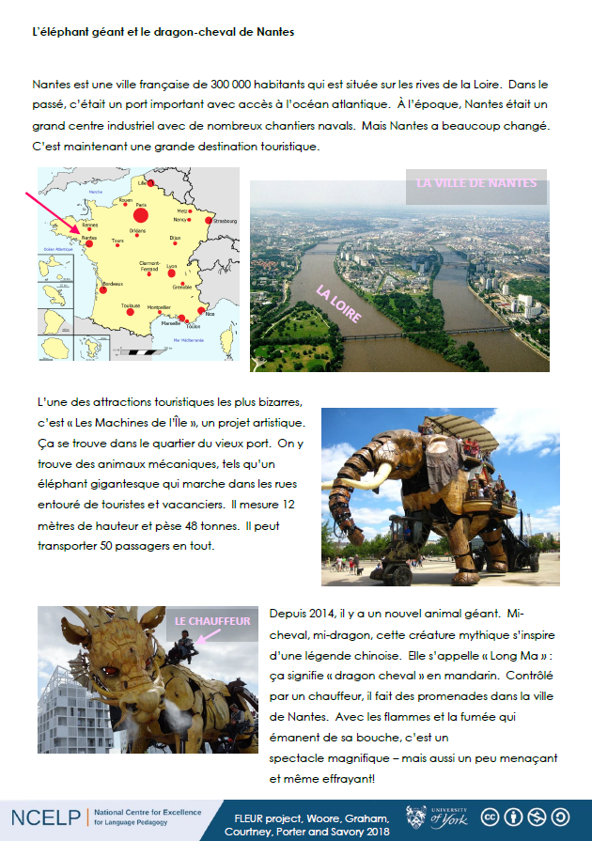
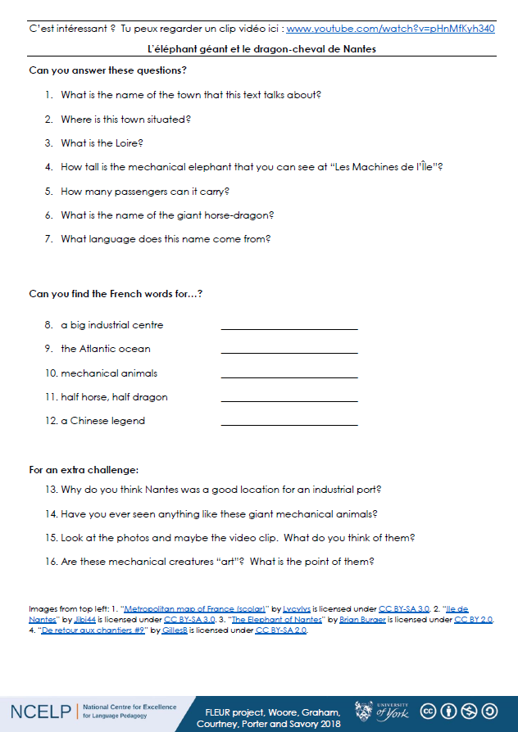
Notes:
Any extended reading text offers the opportunity for integrated phonics work, alongside vocabulary and grammar development.

Slide 48
How to teach phonics?
Introducing and practising
Applying the knowledge
Increasing independence
Assessing
Notes:
Clearly, if it’s important to teach phonics, it’s also important to know how well pupils have acquired the knowledge and are able to apply, so assessment is also part of NCELP’s development work.

Slide 49
Assessing
providing moment-by-moment feedback about SSCs to learners
assess progress in SSCs in reading aloud and writing down spoken language

Slide 50
Notes:
It’s important for pupils to apply their SSC knowledge to unfamiliar / unknown words. There are many useful contexts for this, and it is possible to theme these tasks and make them interesting, giving pupils an opportunity to encounter more unusual words, not for the purpose of memorising as ‘core knowledge’ but for interest, for their sound, and knowing that it’s important to offer variety to students. Where a student is particularly taken by a particular word (for its sound or meaning) s/he is more likely to notice and then also learn it.
Here is an example, using place names in France. People names, city names are also useful for this type of task, but equally with beginner learners, there will be sets of words in every semantic field that students don’t know, e.g. sports, animals, instruments etc..

Slide 51
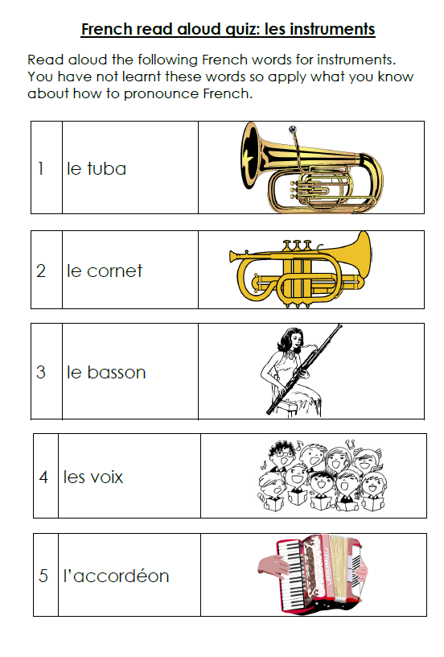
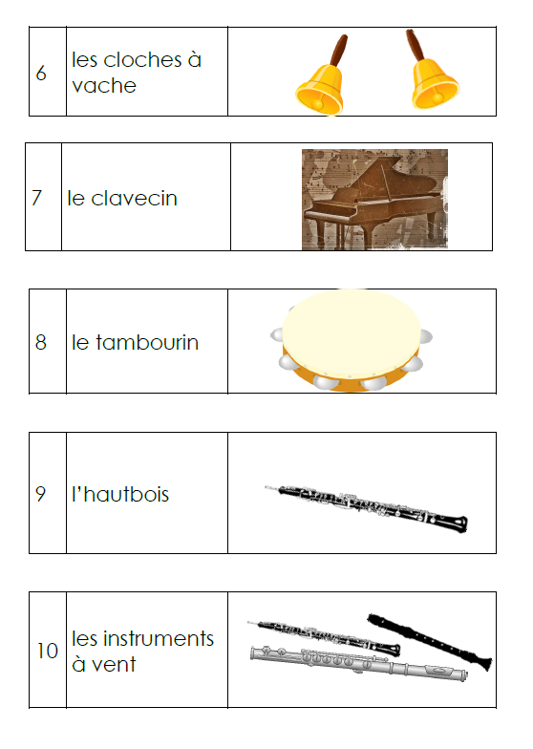
Notes:
They can be done as speaking homeworks – and ‘sampled’ to inform next teaching steps rather than every one marked to give individual feedback.
We are also exploring how Sanako might

Slide 52
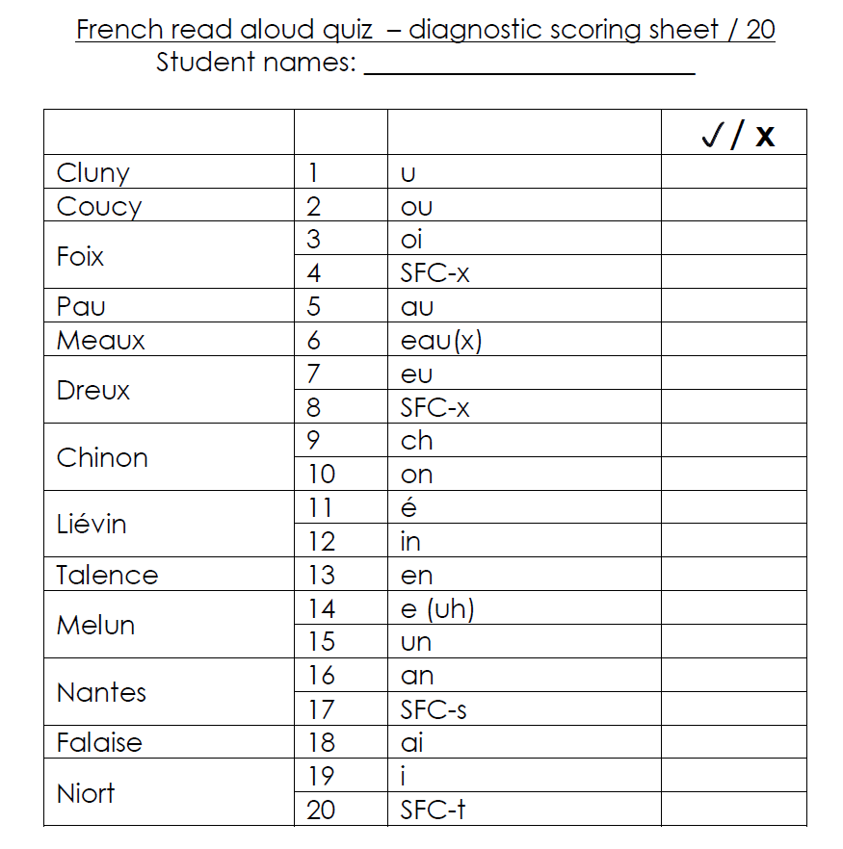

Slide 53
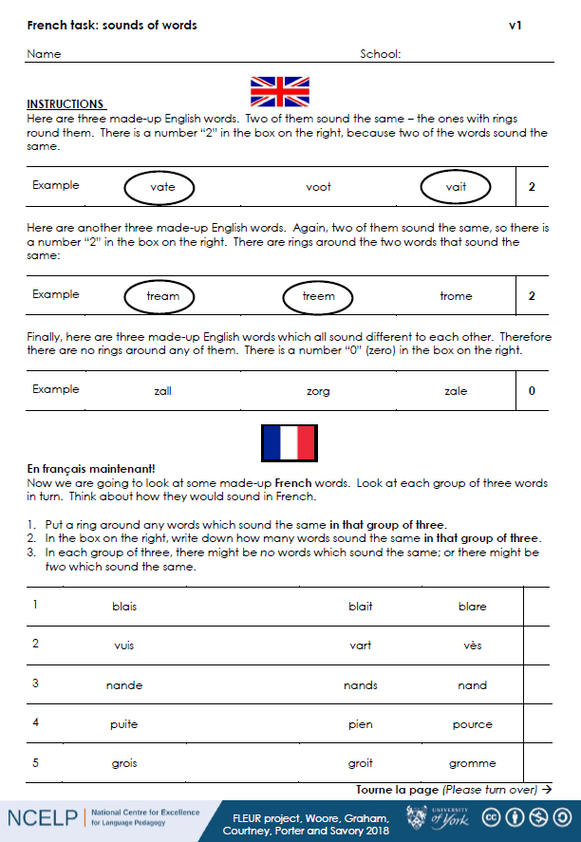
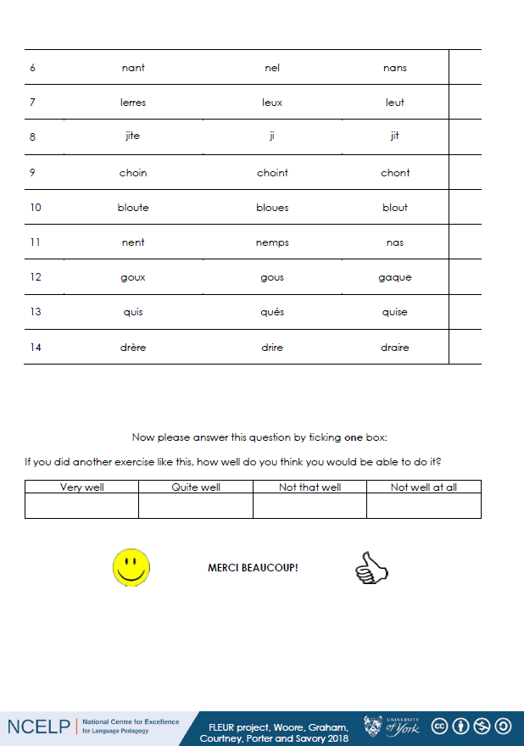
Notes:
Written phonics tests are easier and quicker but not as reliable as read aloud tasks.

Slide 54
Phonics are for all
Teaching symbol-sound correspondences
Notes:
All pictures selected are available under a Creative Common license, no attribution required.
The recent MFL Pedagogy Review recommendations include (amongst others) principles for teaching phonics, vocabulary, grammar and their combination in meaningful practice. In this workshop we focus on research-informed practice for explicitly teaching, consolidating and applying the sound-writing relationship in secondary language learning. The session includes (freely available) resources for teaching phonics in French, German and Spanish.

