Slide 1
Cultural Collection
Y7 Spanish Term 3
Author name(s): Pete Watson
Date updated: 29/03/21

Slide 2
7.3.1.1
Slides 5-6: Phonics, listening. [z] SSC, pronunciation differences between Spain and Latin America.
Slide 20: Phonics [z], listening (as above).
Slide 34-35: listening and writing including a callout about flamenco.

Slide 3
Remember there are different ways to pronounce ‘z’.
In most of Spain, ‘z’ is pronounced like the ‘th’ in English (as you just heard).
In the Canary Islands and Latin America, this ‘z’ is often pronounced like an ‘s’.
Compare:
naturaleza
(mainland Spain)
1
naturaleza
(Canaries & Latin America)
2
Notes:
Click on the orange number to hear the word.
In this slide students are reminded of the two possible pronunciations of ’z’ in the Spanish speaking world (as discussed in 1.2 Week 1). In this case, a word from the vocabulary to be revisited this week is being used.

Slide 4
Escucha.
¿Dónde está la persona?
Escucha otra vez y escribe la frase. ¿Qué significa?
 | España | Latinoamérica / Canarias
Frase | ¿Qué significa?
1
Hay pájaros azules en los árboles de la zona.
There are blue birds in the trees of the area.
2
Debo organizar los zapatos.
I must organise the shoes.
3
La plaza está a la izquierda.
The square is on the left.
Debes empezar un dibujo de la naturaleza.
You must start a drawing of nature.
4
Tiene diez ideas en la cabeza.
S/he has ten ideas in the head.
5
Notes:
Transcript:
Hay pájaros azules en los árboles de la zona;
Debo organizar los zapatos;
La plaza está a la izquierda;
Debes empezar un dibujo de la naturaleza;
Tiene diez ideas en la cabeza;
All of the phonics source and cluster words have been used, here, plus some of the vocabulary to be revisited this week has been used: T2.2 Week 3: deber [71]; debo; debes; organizar [1053] T2.1 Week 3: naturaleza [712]; pájaro [1607]; azul [811]; árbol [748]
Image with creative commons public domain licence
https://mycsres.com/freesheet/spanish-speaking-world-map-18.html.html

Slide 5
escuchar
How many times in each sentence do you hear the sound ‘z’? Tally each time. Write the words in Spanish if you can.
z | palabras
1
naturaleza
La persona, ¿está en España o en Latinoamérica / Canarias?
2
zona
plaza
3
organizan
zapatos
izquierda
4
Zara
diez
5
cabeza
azul
Notes:
TRANSCRIPT
Pasa tiempo en la naturaleza.
En la zona hay una plaza.
Organizan los zapatos a la izquierda.
Zara compra diez camisas.
La cabeza del pájaro es azul.
The person speaking pronounces with ‘distinción’ in all sentences – “La persona está en España”.
All vocabulary here has been seen by students either as source/cluster words (as per lesson 1 in this sequence) or in previous vocab sets.

Slide 6
Buscas unas vacaciones en España. Lee este texto.
escuchar / escribir
¿ ¿Está clara la información? Escucha y completa las frases.
¿Quieres viajar a España y estudiar español? ¡Es posible! Organizamos vacaciones en España. Ejemplo de una semana de vacaciones:
El lunes los chicos y chicas _______________ al aeropuerto. Por la tarde _______________ tiempo juntos en la playa y _______________ con compañeros españoles. El martes, el miércoles y el jueves por la mañana _______________ en la escuela. El profesor ______________ cosas en español y _________________ otras actividades. Por la tarde, las familias _________________ la comida. _______________ ayuda: sólo debes lavar los platos, aunque los chicos y chicas normalmente también __________________ la basura y _______________ el suelo.
El viernes y el sábado _______________ en bicicleta, _________________ y _________________ flamenco… El domingo el profesor _________________ con los chicos y chicas a la estación para decir adiós. ¡Unas vacaciones fantásticas!
[1] arrive
[2] they spend
[3] they speak
[4] they study
[5] asks
[6] he organises
[7] prepare
[8] They need
[9] take out
[10] clean
[11] they ride
[12] they dance
[13] they sing
[14] travels
Notes:
This text aims to practise conjugation for –ar verbs in 3rd person, singular and plural.
The text includes revisited vocabulary from Term 2.2 week 3.

Slide 7
Buscas unas vacaciones en España. Lee este texto.
escuchar / escribir
¿Está clara la información? Escucha y completa las frases.
¿Quieres viajar a España y estudiar español? ¡Es posible! Organizamos vacaciones en España. Ejemplo de una semana de vacaciones:
El lunes los chicos y chicas _______________ al aeropuerto. Por la tarde _______________ tiempo juntos en la playa y _______________ con compañeros españoles. El martes, el miércoles y el jueves por la mañana _______________ en la escuela. El profesor ______________ cosas en español y _________________ otras actividades. Por la tarde, las familias _________________ la comida. _______________ ayuda: sólo debes lavar los platos, aunque los chicos y chicas normalmente también ____________ la basura y _______________ el suelo.
El viernes y el sábado _______________ en bicicleta, _________________ y _________________ flamenco… El domingo el profesor _________________ con los chicos y chicas a la estación para decir adiós. ¡Unas vacaciones fantásticas!
[1] llegan
[2] pasan
[3] hablan
[4] estudian
[5] pregunta
¿Qué es el flamenco?
Es una música típica del sur de España.
[6] organiza
[7] preparan
[8] Necesitan
[9] sacan
[10] limpian
[11] montan
[12] bailan
[13] cantan
[14] viaja
Notes:
Key answers
This text aims to practise conjugation for –ar verbs in 3rd person, singular and plural.
The text includes revisited vocabulary from Term 2.2 week 3.
With a further click students can read a short definition of what flamenco is in Spanish.
Picture of flamenco dancer by rauschenberger in pixabay.com

Slide 8
7.3.1.2
Series of activities across the two lessons about ‘Un hombre sin cabeza’ by Armando José Sequera (adapted poem)
Slides 6-18 various speaking, listening, reading, writing exercises and opportunities for creativity and translation.

Slide 9
¿Qué es?
Es una cabeza
Es una ca_ _ _ _
La cabeza no sólo es una parte del cuerpo.
¿Qué cosas tenemos en la cabeza?
Notes:
Pre-reading/listening activity 1: activating knowledge of concepts and ideas relevant to the text.
Elicit ‘cabeza’ (a previously taught phonics word) from students and the meaning of the sentence below it.
Ask them to consider the different senses of ‘cabeza’ (a physical body part, but also the human mind). They may wish to use words that they have not yet learned, so encourage use of ‘¿Cómo se dice ____ en inglés?
Possible suggestions here could include cognates/near-cognates: emociones, ideas, imaginación. The Spanish for thought (pensamiento) and feeling (sentimiento) might also come up. The key point here is to focus on the ideas and concepts.
Use of L1 could be useful in pointing out cross-linguistic similarity – in English we use literal and figurative and literal language with ‘head’: ‘he’s keeping a cool head’ (fig), ‘she shook her head’ (lit). In Spanish, cabeza is used in both senses too.
Previously taught language on this slide
Sólo (2.1.3)
Qué (1.1.4)
Cosa (1.1.7)
Tenemos (2.2.2)
En (1.1.1)
Cuerpo is a previously taught phonics cluster word.
Images from http://clipart-library.com/

Slide 10
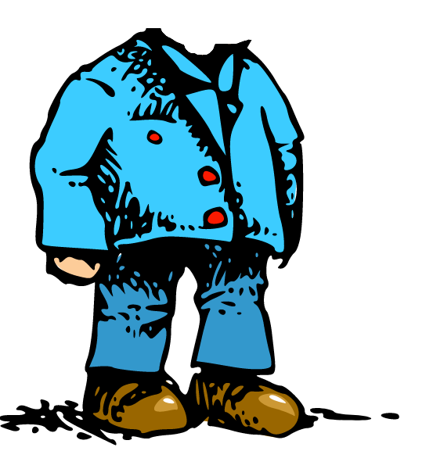
Escucha la frase. ¿Cuál es la persona?
escuchar
El texto de hoy es un poema.
¿Qué NO puede usar?
1
2
un sombrero
A
B
un hombre con cabeza
un hombre sin cabeza
Notes:
Hover mouse over the audio symbol (top right of the slide) and click on the ‘play’ icon to listen to the first line of the poem.
Students hear the beginning of the poem and decide whether the poem is about character A or B. Then, students answer the question ’¿Qué no puede usar?’ (B).
The aim of this slide is to work with the vocabulary in the poem and facilitate its introduction, clarifying the meaning of ‘sin’ as opposed to ‘con’. Also, we are practising with the previously taught question word ’quién’ (also a cluster word from the SCC ‘qui’, which is revisited this week).
Previously taught vocabulary items words:
con (1.1.6)
puede (2.2.2)
usar (1.1.7)
quién (1.1.6)
no (1.2.1)
cuál (2.1.4) – revisited in the scheme of work this week
persona (1.2.3)
Cabeza [1.2.1] and sin [1.1.2] are previously taught phonics words.
Clipart from clker.com

Slide 11
Poema: «Un hombre sin cabeza»
Un hombre sin cabeza no puede hacer unas cosas. ¿Qué otras actividades no puede hacer? En parejas, escribe otros verbos.
Un hombre sin cabeza
no puede usar sombrero.
Pero éste no es
su mayor problema:
no puede pensar,
no puede leer,
no puede cantar,
no puede comer,
no puede escuchar,
ni puede entender,
que para amar y besar
cabeza debes tener.
think
Palabras importantes:
éste = this (m.)
mayor = biggest
ni = nor
que = that
para = in order to
pensar
El autor: Armando José Sequera
Notes:
Students brainstorm in pairs all the possible infinitives that they think could be in the poem. Tell them that they will get points for anticipating correctly, but also (a different number of) points for coming up with infinitives that no other group has. After 8 minutes to work on their list, ask the class to read the poem aloud up to the first gap. Then reveal each infinitive, one by one, telling students to mark off any that they have in common with the poem. When finished, tell them they get 3 points for every infinitive they’ve matched. Bonus points: Then ask for any additional infinitives that they had. Ask for one from each group. If no other group has it, the group gets 5 points. If other groups have it, those that do get 1 point each. Keep going until all the verbs are accounted for. There will then be a count up to identify the winning team. Original source of the poem: http://www.doslourdes.net/Un%20hombre%20sin%20cabeza.htm
Taken from: http://all-literature.wikidot.com/
Clipart from clker.com

Slide 12
Escucha y lee el poema completo. Identifica el verbo en cada imagen.
leer / escuchar
Puedes usar el diccionario si quieres. Escucha y comprueba.
Un hombre sin cabeza
no puede usar sombrero.
Pero éste no es
su mayor problema:
no puede pensar,
no puede leer,
no puede cantar,
no puede comer
no puede escuchar,
ni puede entender,
que para amar y besar
cabeza debes tener.
[think]
1
2
3
4
[understand]
5
6
7
8
Notes:
Students now hear full poem in full and can read it at the same time. Hover over the grey icon in the top right hand corner, then press ‘play’.
The activity here aims to make sure that students understand all the verb infinitives in the poem. Ask students to write 1-8 in their books and write the Spanish verb corresponding to the each numbered image. Teachers can click each orange number to hear the correct verb so that students can check their answers.
NB ‘Besar’ and ‘entender’ haven’t been previously taught (though ‘entiendo’ has), but students might be able to work out these two meanings by process of elimination.
If students already have experience in using bilingual dictionaries, they can look up any word they don’t fully understand. The NCELP dictionary skills training will come in lesson 2 of this teaching sequence.
Cantar
Comer
Pensar
Besar
Escuchar
Amar
Entender
Leer
Clipart from clker.com

Slide 13
Escucha las 8 verbos. ¿Cuál es la imagen correcta?
Escribe la letra.
escuchar
1
E
A
B
C
2
B
3
C
D
E
D
F
4
5
F
6
G
[understand]
G
H
7
H
[think]
8
A
Notes:
OPTIONAL
This activity also focuses on the establishing/consolidating the meanings of the verb infinitives. However, this time students can only hear each verb (no text displayed), so it is more challenging. This additional verb recognition practice will help to prepare students for production activities that appear later in this lesson.
Students write 1-8 in their books. Students hear each of the eight verb infinitives in the poem and write the letter of the correct picture.
NB The order of audio items and pictures is different from that on slide 9, so the activities could be done one after the other.
Answers: 1=E; 2=B; 3=C; 4=D; 5=F; 6=G; 7=H; 8=A
Transcript
Amar
Leer
Escuchar
Entender
Cantar
Pensar
Comer
Besar

Slide 14
¿Cómo se dice en español? Lee el poema en parejas.
leer / hablar
Un hombre sin cabeza
no puede usar sombrero.
Pero éste no es
su mayor problema:
no puede to think,
no puede to read,
no puede to sing,
no puede to eat
no puede to listen,
ni puede to understand,
que para to love y to kiss
cabeza debes tener.
¿Cómo está la pronunciación?
r _ _ _
o j o
a_ _ _ _ _ _ _
m a r i l l o
v _ _ _ _
e r d e
Notes:
In this activity students do a paired read aloud, taking it in turns to read the text. The English verbs serve as prompts for students to recall the Spanish translation while reading aloud. At the end the partner who was listening rates his/her partner (verde, amarillo, rojo) like a traffic light for his/her pronunciation, and then they swap roles. Teachers can elicit the name of the colours before doing this activity, as they were taught [2.1.3] and revisited [2.2.5] - answers for colours are animated to appear on clicks.
Clipart from clker.com

Slide 15
Otra versión del poema
leer / hablar
Someone decided that the original version was repetitive, with too many ‘no puede’s. She changed it so that sometimes it just has ‘no’ and a short form verb. The difference in meaning is: 1) no puede cantar – s/he cannot sing 2) no canta – s/he doesn’t sing The difference in verb form is: 1) … cantar – infinitive 2) … canta – 3rd person singular [s/he form] Your partner will read an adapted version of this poem to you. Every time s/he stops, complete the line with either the infinitive OR the 3rd person singular form of the verb. Then swap and read your version to your partner.

Slide 16
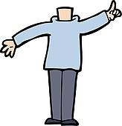
hablar / escuchar
A
B
Un hombre sin cabeza
1 Un hombre sin cabeza
2 no puede usar sombrero.
3 Pero éste no es
4 su mayor problema:
5 no puede hablar,
6 no puede estudiar,
7 no canta,
8 no pregunta,
9 no escucha,
10 ni puede creer,
11 que para amar y besar
12 cabeza debes tener.
Un hombre sin cabeza
1 Un hombre sin cabeza
2 no puede usar sombrero.
3 Pero éste no es
4 su mayor problema:
5 no … [hablar / habla],
6 no … [estudiar / estudia],
7 no … [cantar / canta],
8 no … [preguntar / pregunta],
9 no …[escuchar / escucha],
10 ni …[creer / cree],
11 que para amar y besar
12 cabeza debes tener.
Armando José Sequera
Armando José Sequera
Notes:
Do not display in class.
Partner A reads but stops short and doesn’t say the words in orange (they are there so that s/he is 100% sure which form it should be and can give feedback) Partner B has to complete the incomplete utterances with either the long or short form of the verb, whichever is correct.
Printer-friendly speaking cards in Word format accompany this resource.
Clipart from clker.com

Slide 17
hablar / escuchar
A
B
Un hombre sin cabeza
1 Un hombre sin cabeza
2 no puede usar sombrero.
3 Pero éste no es
4 su mayor problema:
5 no … [llamar / llama],
6 no … [saber / sabe],
7 no … [decir / dice],
8 no … [cambiar / cambia],
9 no …[querer/ quiere],
10 ni …[ser / es],
11 que para amar y besar
12 cabeza debes tener.
Un hombre sin cabeza
1 Un hombre sin cabeza
2 no puede usar sombrero.
3 Pero éste no es
4 su mayor problema:
5 no puede llamar,
6 no sabe,
7 no puede decir
8 no puede cambiar,
9 no quiere,
10 ni puede ser,
11 que para amar y besar
12 cabeza debes tener.
Armando José Sequera
Armando José Sequera
Notes:
Do not display in class.
This time
Partner B reads but stops short and doesn’t say the words in orange (they are there so that s/he is 100% sure which form it should be and can give feedback) Partner A has to complete the incomplete utterances with either the long or short form of the verb, whichever is correct.
Printer-friendly speaking cards in Word format accompany this resource.
Clipart from clker.com

Slide 18
Escribe un poema similar. Puedes usar un diccionario.
escribir
Una persona sin respeto
no quiere decir ’gracias’.
Pero este no es su mayor problema:
no quiere _____________
no quiere _____________
no quiere _____________
no quiere _____________
no quiere _____________
ni quiere entender que cada persona
respeto debe tener.
Notes:
Students write their own poem following the structure provided, which uses another modal verb (‘querer’). Querer (including quiere) was taught in Term 1.2, week 7. The SSC ‘que’ is also the phonics focus for this week.
If students already have experience in using bilingual dictionaries, they can look up any word they don’t fully understand. The NCELP dictionary skills training will come in lesson 2 of this teaching sequence.
Clipart from clker.com

Slide 19
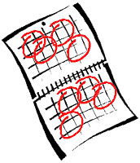
Escribe un poema similar. Puedes usar un diccionario.
escribir
Una persona sin ayuda
debe hacer cosas sola.
Pero este no es su mayor problema:
no _____________
no _____________
no _____________
no _____________
no _____________
pero puede entender que para _____________ y _____________
ayuda debes tener.
Notes:
Alternative context. This version has been left more open in terms of the structures that students can use. They could use any of puede + infinitive, quiere + infinitive, debe + infinitive or 3rd person singular. These structures could even be varied within the poem, following the examples on slides 13 and 14.
Note the slight difference on the 3rd last line, where ‘pero’ is used and the verb is affirmative (as opposed to negative with ‘ni’). This conjunction seemed appropriate in context. (A person without help often knows and understands the consequences / what it might be like if they did have help.)
‘Ayuda’ was taught in 1.1.7
Hacer was taught in 2.1.4 (revisited this week)
If students already have experience in using bilingual dictionaries, they can look up any word they don’t fully understand. The NCELP dictionary skills training will come in lesson 2 of this teaching sequence.
Clipart from http://clipart-library.com/

Slide 20
Escribe el poema «Un hombre sin cabeza» en inglés.
Español | Inglés
Un hombre sin cabeza
no puede usar sombrero.
Pero éste no es
su mayor problema:
no puede pensar,
no puede leer,
no puede cantar,
no puede comer,
no puede escuchar,
ni puede entender,
que para amar y besar
cabeza debes tener.
A man without a head…
su = his
ni = nor
que = that
Notes:
OPTIONAL
In this activity students are challenged to provide a full translation in English. There is a gloss with those words that students will probably not know.

Slide 21
Escribe el poema «Un hombre sin cabeza» en inglés.
Español | Inglés
Un hombre sin cabeza
no puede usar sombrero.
Pero éste no es
su mayor problema:
no puede pensar,
no puede leer,
no puede cantar,
no puede comer,
no puede escuchar,
ni puede entender,
que para amar y besar
cabeza debes tener.
A man without a head…
can't wear a hat.
But this is not
his biggest problem:
he can't think
he can’t read,
he can’t sing,
he can’t eat
he can’t listen,
nor can he understand,
that to love and to kiss
you must have a head.
Notes:
This slide shows a translation of the poem.

Slide 22
Which side is it?
A paper dictionary (i.e. a real book!) has two sections:
for a Spanish dictionary, these are Spanish to English and English to Spanish.
Can you say in which section of the dictionary you would look for the words below?
bread
delante
Spanish to English
English to Spanish
happy
with
tren
fuera
we
detrás
Notes:
This slide explains the fact that there are two ‘sides’ to a paper dictionary, something which often causes beginner dictionary users problems. Students are challenged to allocate the words in the centre – a mix of English and Spanish words – to one side or the other. Though this should not be too difficult a task, it ‘trains’ the student in the correct first step to be taken upon consulting a paper dictionary (the ‘from’ and ‘to’ languages settings also being a consideration, of course, with online dictionaries and translation websites).
The answers are animated, and the words ‘fly’ to the correct side.
Vocabulary revisiting: Term 2.2 Week 4 – delante, fuera, tren and detrás are revisited in the scheme of work this week

Slide 23
Alphabetical order
In a paper dictionary, words are listed in alphabetical order.
Put these English words into the order in which they would appear in the dictionary:
before
bold
because
ball
befriend
1
2
3
4
5
So we had to go as far as the fourth letter to sort words 3 and 4 into alphabetical order!
Notes:
Alphabetical ordering is something which can also cause beginner dictionary users problems – particularly when they are required to look beyond the initial letter. This slide therefore attempts to provide some practice in this skill, essential for the second step in locating the word to be looked up in the dictionary. It is necessary to look as far as the fourth letter to sort two of the words!
The answers are animated, and the words ‘fly’ into their correct position in the order.

Slide 24
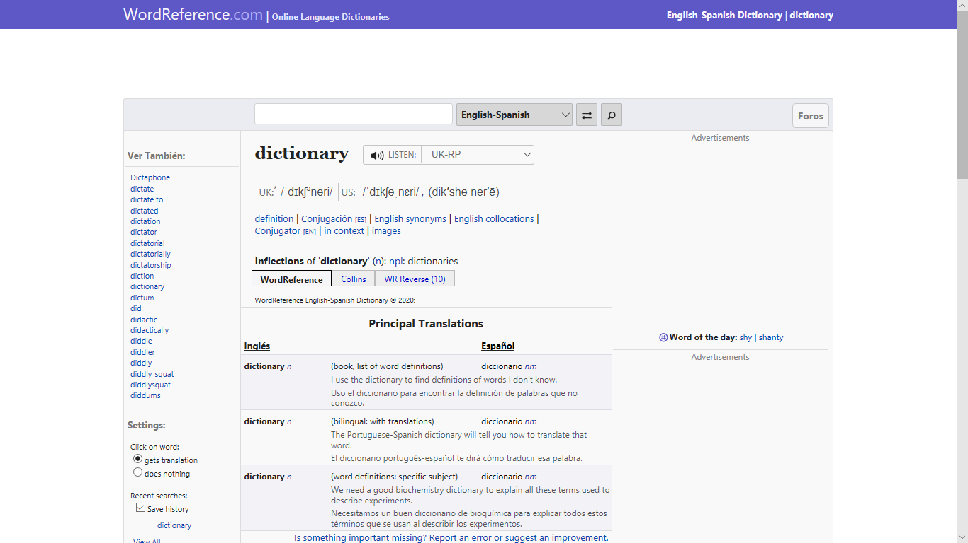
Online dictionary
These days, you don’t have to use a paper dictionary: online dictionaries are available. A good one for Spanish is WordReference
It looks like this:
You type the word you want to look up here (make sure it is in the right language!)
You swap between the
English to Spanish and Spanish to English sections here
Notes:
Having practised two of the skills required for paper dictionary use, the students are now introduced to our choice of online dictionary for Spanish. It is recommended that they bookmark this on their own devices.

Slide 25
Parts of speech
Assuming we can find our word we also need to know what type of word it is, in the context in which we need to use it. Can you match the words on the left below with their type (in orange), on the right?
Sometimes, the same word can be both a noun and a verb – take the English word ‘lead’, for example (something you use to walk the dog, and something you do when others follow you!)
happy
adjective
article (determiner)
bread
with
adverb
verb
the
pronoun
we
preposition
quickly
make
conjunction
noun
but
Notes:
This slide prompts learners to consider the part of speech of a word, an essential part of wider word knowledge, which informs the correct grammatical usage of that word. The activity challenges students to match some English words with their part of speech.
Explain to students that some words can be both a noun or a verb – as in the animated example of ‘lead’ – which has implications when searching for the correct translation of a given word in a particular context!
The answers are animated on the next slide; this slide should be displayed whilst students attempt the task.

Slide 26
Answers
Did you match the words and their word types correctly?
bread
noun
happy
adjective
make
verb
quickly
adverb
the
article (determiner)
we
pronoun
with
preposition
but
conjunction
Types of word are called ‘parts of speech’.
Notes:
The answers to the activity on the previous slide are animated on this one. The term ‘parts of speech’ is explained.

Slide 27
Abbreviations used
Dictionaries give the type of word (part of speech) using abbreviations (often in italics and sometimes in a different colour) after the word itself.
Can you find the abbreviations used in WordReference for each part of speech?
nm or nf
noun
adj
adjective
vtr or vi
verb
adv
adverb
def art or indef art
article (determiner)
pron
pronoun
prep
preposition
conj
conjunction
Similar abbreviations are used in paper dictionaries, too.
Notes:
Students are now challenged to find the abbreviations used on the recommended Spanish dictionary site for the parts of speech listed; the answers are animated. A similar exercise could be done with any paper bilingual dictionaries in use.

Slide 28
Un hombre sin cabeza (adapted poem)
Un hombre sin cabeza
no puede usar sombrero.
Pero éste no es
su mayor problema:
no puede pensar,
no puede leer,
no puede cantar,
no puede comer
No puede escuchar,
ni puede entender,
que para amar y besar
cabeza debes tener.
Y como tiene dos pares de ojos
mira de frente y baja la mirada
todo al mismo tiempo
y no nos enteramos.
Armando José Sequera
You are studying the poem opposite in Spanish this week. You have learnt many of the words it contains previously, but some others are new.
Can you look up the words highlighted in orange in the dictionary (or using WordReference) and list their
English meaning and part of speech?
sin prep without
mayor adj biggest
pensar vi to think
mirada nf look
Notes:
In Week 2 of Term 3.2 of the Spanish scheme of work, students are working with the text Un hombre sin cabeza. Note that this is a slightly extended version (the final four lines were not in the version that students worked on in lesson 1).
Many of the words in this text have been previously introduced and learnt (this was one factor in the choice of this text for this point in the scheme of work).
However, some words have not been encountered previously. Four words are thus highlighted for students to look up, practising the skills introduced earlier in this sequence.
The answers are animated and appear upon successive clicks of the mouse.

Slide 29
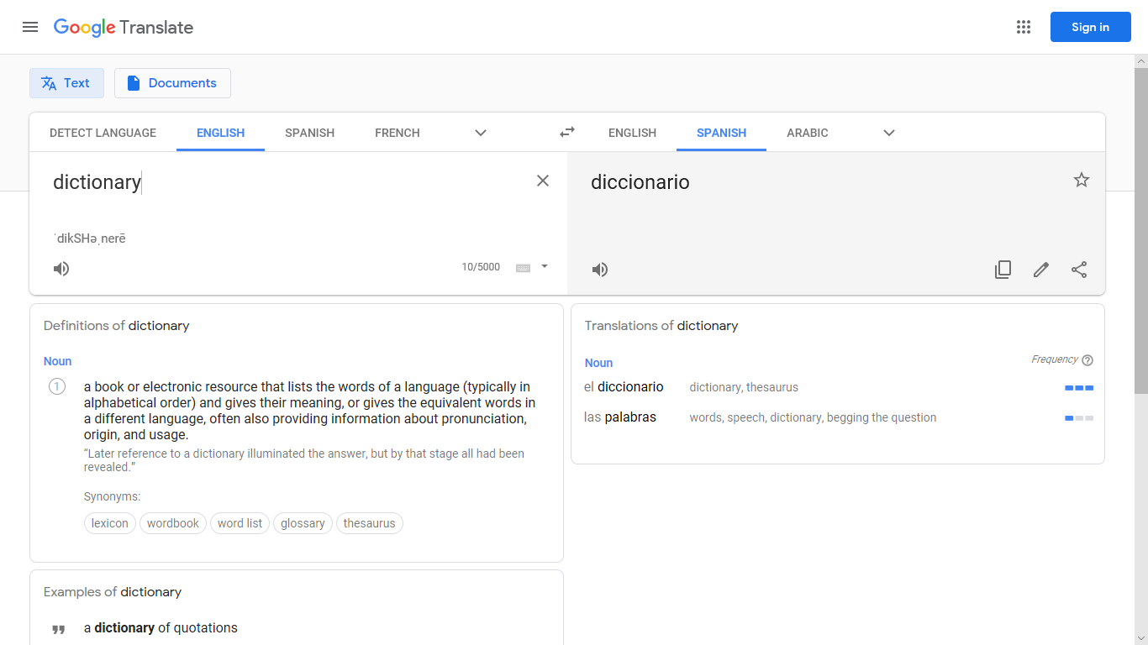
Translation websites
You can reverse the direction of translation (English to Spanish or Spanish to English), here.
Some people like to use translation websites, such as Google Translate.
It looks like this:
You select the ‘from’ and ‘to’ languages, here.
You type the word you want to look up here (make sure it is in the right language!)
Notes:
This slide introduces translation websites (using the example of Google Translate) – a popular alternative to dictionaries for many students. These sites are extremely simple to use, but are often very basic in the amount of information offered, at least initially.
The relative lack of exemplification of correct word usage can lead to a mis-translation of the intended concept being adopted by the student.
The next slide will invite students to consider the benefits offered by the dictionary, as compared with these sites.

Slide 30
Comparing options
Compare below the amount of information about correct Spanish usage given by the online dictionary (on the left) and the translation website (on the right).
Which is likely to be the most useful?
Notes:
This slide invites students to consider the benefits offered by the dictionary, as compared with translation sites. As can be seen from the screenshots, the dictionary often provides greater detail and, in particular, exemplification of correct word usage in a variety of contexts, thus better enabling the student to select the correct word to express the meaning desired.

Slide 31
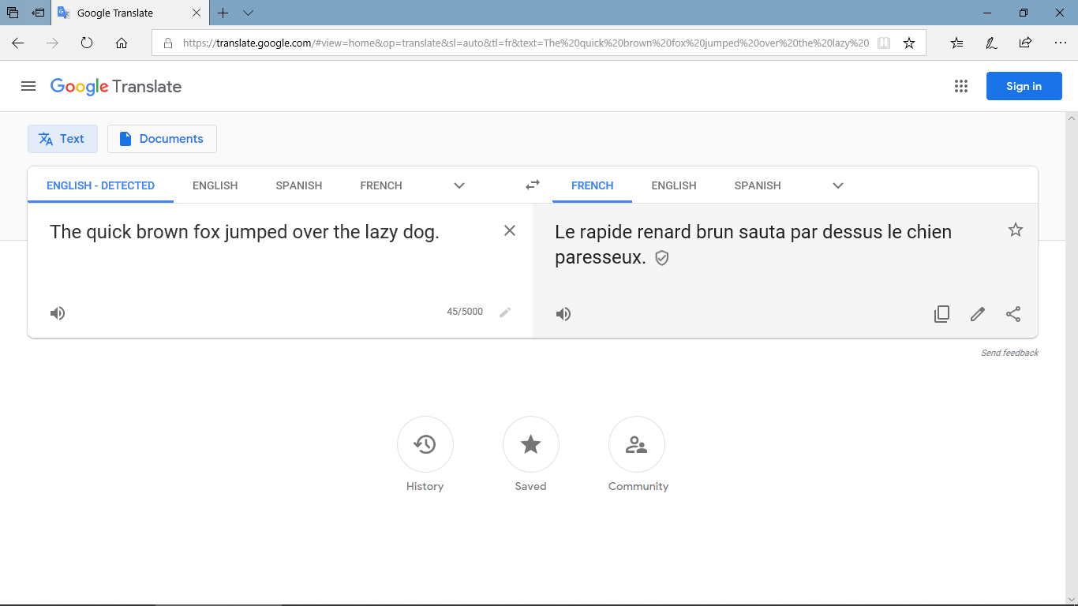
Watch what happens as you go round a few languages translating this well-known sentence. First, from the English into French:
You haven’t learnt any past tense yet, but it’s worth knowing that google translate often selects the simple past in French and German, when this is seldom / never (!) what you need.

Slide 32
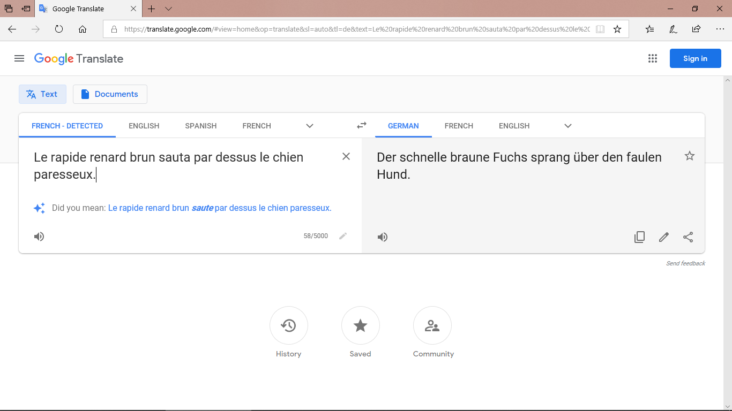
Then from the French into German:
The past simple in German, too!

Slide 33
Then the German into Spanish:

Slide 34
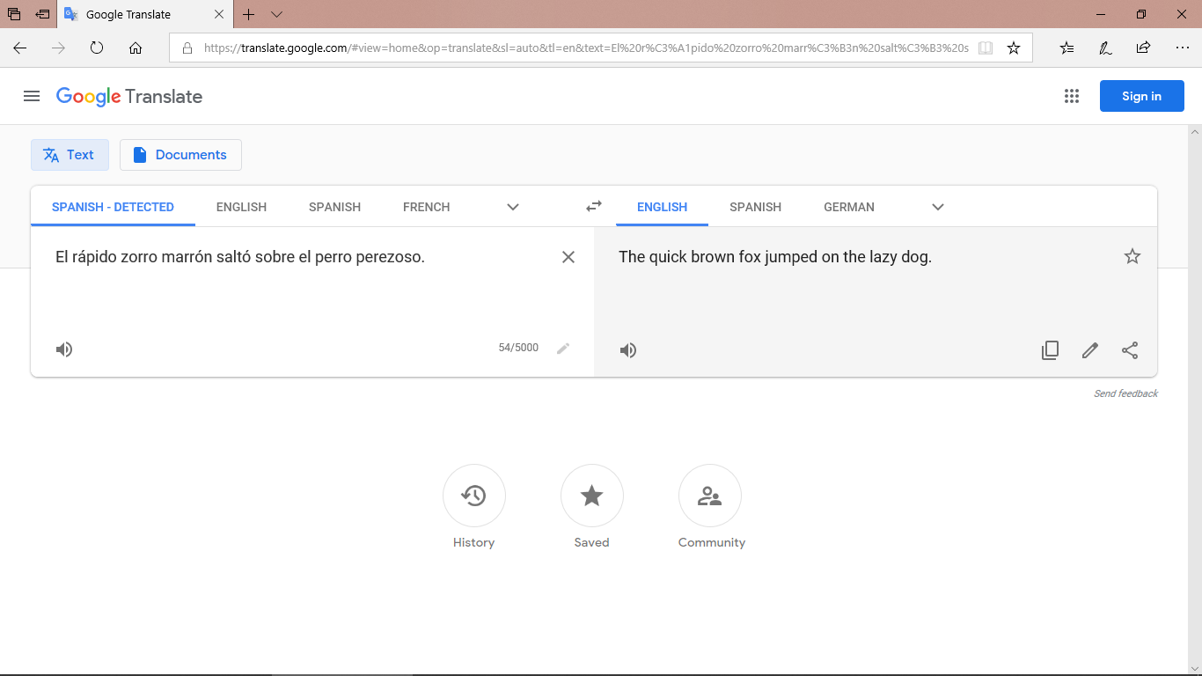
... and finally from the Spanish back into English:
So we have gone from:
‘The quick brown fox jumped over the lazy dog.’
to:
The quick brown fox jumped on the lazy dog.
Quite a difference for the dog! Sometimes these small errors make a big difference to the intended meaning (e.g., whether there was a fox-dog fight!)

Slide 35
7.3.1.4
Slide 56: reading with a callout about Colombian athlete Caterine Ibargüen.

Slide 36
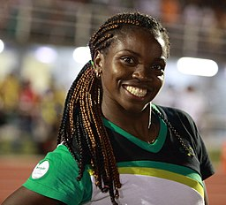
leer
En una revista hablan sobre los hábitos de unas personas famosas. Some of the verbs are referring to the Colombian athlete Caterine Ibargüen. Which ones are they?
 |  | The action in general | Referring to the athlete
1 | Beber agua es importante.
2 | Vivir fuera de la ciudad es interesante.
3 | Lee periódicos en línea* y es práctico.
4 | Vive entre dos montañas y es perfecto.
5 | Hace ejercicio cada día con otras mujeres.
6 | Nunca bebe Coca Cola por la noche.
7 | Comer fruta es bueno.
8 | Leer revistas puede ser informativo.
9 | Hacer deporte es difícil.
10 | A veces come carne. ¡Es una comida rica!
Caterine Ibargüen is a Colombian Olympic gold-winning triple jumper, and was World Athlete of the Year in 2019
* online
Notes:
The title has been written using previously taught language, except for ‘sobre’. Clarify the meaning of this word if needed.
Several near-cognates have been included: práctico [2141], perfecto [1115] and informativo [4002]. The main reason for the inclusion of a range of adjectives is to avoid an incongruence between infinitive sentences, which often end in ‘es + adjective’, and the sentences with 3rd person singular. The risk would otherwise be that students rely on this part of the sentence, rather than the verb, to decide on the answer.
This task aims to help learners understand the difference in meaning between 3rd person singular and the infinitive form whilst recapping ‘es’ in infinitive sentences contextualised with this week’s vocabulary set or with previously learnt words.

Slide 37
7.3.1.5
Slides 26 and 27: Phonics [ge], [gi] based on ‘La familia de Maradona’.

Slide 38
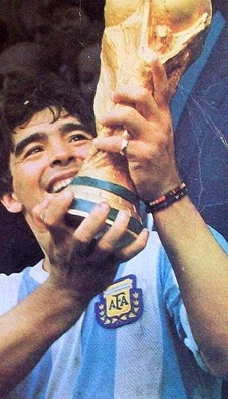
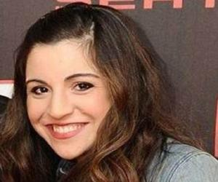
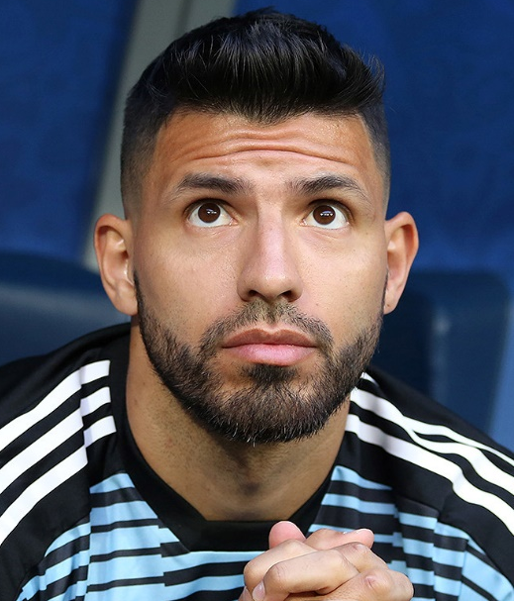
Una familia argentina famosa
ge
gi
leer
Diego Armando Maradona es un exfutbolista argentino.
Ahora, dirige* a Gimnasia de la Plata, un equipo de la Superliga Argentina.
Tiene una hija, Giannina.
Names can be exceptions! The ‘gi’ in Giannina is pronounced a bit like ‘hee’ or ‘yee’, depending on the Spanish-speaking country.
Giannina tiene un hijo con Sergio Agüero, otro futbolista argentino.
Maradona con la Copa del Mundo de 1986.
* manages
Notes:
Non-audio version of the texts on this slide – see next slide for audio version. This could be used as a read aloud task by students.
Teachers should encourage students to think about the translations into English to see if they can arrive at a full comprehension. Words are either from previous vocab sets or source/cluster words, plus some cognates and names, however, dirige is given in a gloss as this is unknown to students.
A note on pronunciation: Giannina is an exception to the ‘gi’ SSC, explained in the speech bubble. The name has Italian origins (62.5% of Argentinians have Italian heritage), but the pronunciation is not 100% Italian either. Click on Giannina’s picture to hear the name pronounced by an Argentinian.
Facts from Wikipedia, true to best of our knowledge as at April 2020. Source:
https://es.wikipedia.org/wiki/Diego_Armando_Maradona
Images:
https://es.wikipedia.org/wiki/Diego_Armando_Maradona#/media/Archivo:Maradona-Mundial_86_con_la_copa.JPG
https://www.thefamouspeople.com/profiles/giannina-maradona-36246.php
https://en.wikipedia.org/wiki/Sergio_Ag%C3%BCero

Slide 39
Una familia argentina famosa
ge
gi
escuchar
Diego Armando Maradona es un exfutbolista ar___ntino.
Ahora, diri___* a ___mnasia de la Plata, un equipo de la Superliga Ar___ntina.
Tiene una hija, Giannina.
ge
ge
Gi
Names can be exceptions! The ‘gi’ in Giannina is pronounced a bit like ‘hee’ or ‘yee’.
Giannina tiene un hijo con Ser__o Agüero, otro futbolista ar___ntino.
ge
gi
Maradona con la Copa del Mundo de 1986.
‘Argentino’ is an adjective. The ending can change, depending on the gender and number of the noun.
* manages
ge
Notes:
Listen and complete the texts with the target SSCs ‘GI’ and ‘GE’
These texts can also be used for a dictation or for a read aloud in pairs. Students will have to recall the ‘gi’ and ‘ge’ SSCs, which are missing.
A note on pronunciation: Giannina is an exception to the ‘gi’ SSC, explained in the speech bubble. It is a popular name in Latin America. The name has Italian origins (62.5% of Argentinians have Italian heritage), but the pronunciation is not 100% Italian either. Click on Giannina’s picture to hear the name pronounced by an Argentinian (pronounced like ‘hee’). The audio embedded in the three action buttons was recorded by a Spanish native speaker from the Canary Islands who naturally pronounces this as a ‘yee’.
Facts from Wikipedia, true to best of our knowledge as at April 2020. Source:
https://es.wikipedia.org/wiki/Diego_Armando_Maradona
Images:
https://es.wikipedia.org/wiki/Diego_Armando_Maradona#/media/Archivo:Maradona-Mundial_86_con_la_copa.JPG
https://www.thefamouspeople.com/profiles/giannina-maradona-36246.php
https://en.wikipedia.org/wiki/Sergio_Ag%C3%BCero

Slide 40
7.3.2.1
Slide 2: Phonics [si] vs [ci] Spain and Latin America pronunciation differences
Slides 13-14 and 17 reading including Argentinian cities
Slides 18-21: reading and writing exercises based on attractions in Barcelona and Valencia, including callouts.

Slide 41
¿CI o SI?
escuchar / escribir
En las Islas Canarias y en Latinoamérica, ‘ci’ y ‘si’ tienen la misma pronunciación.
Escucha. Habla una persona de las Islas Canarias. Escribe la palabra.
siete
cierto
1
5
decir
diciembre
2
6
cine
silencio
3
7
silla
siempre
4
8
Notes:
Estimated time: 3 minutes
As ‘ci’ and ‘si’ are usually pronounced identically outside of mainland Spain, correct spelling may require word knowledge, rather than SSC knowledge. We practise this here with words that have been previously taught as vocabulary items or used for phonics practice.
‘Mismo’ [55] will be taught early in Year 8, so is likely to be unfamiliar. Ensure that its meaning is clear in these instructions.
Students might be reassured to know that Spanish native speakers frequently make mistakes in their spelling of letters with more than one sound, particularly v and b.
Weeks when taught/used in phonics practice:
siete – 1.2.2
decir – SSC practice in 1.1.7 & 2.2.5
cine – SSC practice in 2.2.5
silla – 1.2.3
cierto – SSC practice in 1.1.7 & 2.2.5
dicimbre – SSC practice in 2.2.5
silencio – 1.2.1
siempre – 3.1.5

Slide 42
leer
La familia López está de vacaciones en Argentina. Daniel describe cada ciudad.
Lee las descripciones y escribe las opciones correctas. [1/2]
Ciudades de Argentina
lunes
Estamos en la capital, Buenos Aires. Tiene [1] las / unas tiendas y [2] unos / los restaurantes. ¡Son muy buenos!
miércoles
Córdoba es otra ciudad bonita. Tiene [5] unas / las escuelas y [6] unos / los colegios. Son excelentes.
martes
Hoy estamos en Mendoza. Hay unos museos famosos y unas iglesias.[3] Los / unos museos de historia son muy interesantes, pero [4] las / unas iglesias son aburridas.
jueves
En Tucumán hay [7] unos / los teatros y [8] las / unas universidades. Es una ciudad con mucha cultura.
Notes:
Time estimated: 7 minutes
This activity is over two slides. Students complete it by writing 1-15 in their books, and the correct plural article each time.
Students choose between the plural definite and indefinite article in each instance. The choice is always between articles of the same gender.
The idea is that students to pay attention to whether the nouns have been mentioned before (in which case definite article is needed) or not (in which indefinite article is needed).
All vocabulary used is known to students, apart from the cognates universidad [387] / restaurante [2636] / cafeteria [>5000] / bar [1938] / histórico [830].
(Other cognates used in previous weeks: excelente / centros culturales / turista)
Students completed a similar exercise for definite and indefinite articles in the singular in Term 1.2 week 5.

Slide 43
leer
[2/2]
Ciudades de Argentina
viernes
Estoy con Diego en Rosario. Hay unos edificios hermosos y unas plazas históricas. Muchos turistas visitan [9] las / unas plazas.
domingo
Estamos todos en Santa Fe. Tiene unos bares y unas cafeterías. [12] Unos / Los bares son bastante caros, pero [13] las / unas cafeterías son baratas.
sábado
Estoy solo en La Plata. Es una ciudad pequeña, pero muy interesante. Hay [10] unos / los parques y [11] unos / los centros culturales.
Quiero visitar San Juan. Hay unas montañas y unos pueblos cerca. Puedes visitar [14] los / unos pueblos, aunque es difícil visitar [15] unas / las montañas.

Slide 44
leer
1 | Buenos Aires y Mendoza son | muy lejos.
 |  | ciudades muy grandes.
2 | Córdoba y Santa Fe están | históricos y populares.
 |  | en el centro de Argentina.
3 | San Juan y Tucumán están | en las montañas.
 |  | antiguos y hermosos.
4 | Rosario y Buenos Aires son | muy interesantes.
 |  | muy cerca.
5 | San Juan y Mendoza están | en el oeste.
 |  | antiguos y históricos.
6 | Tucuman y La Plata son | populares con los turistas.
 |  | bastante lejos.
7 | Buenos Aires y La Plata están | lugares muy famosos.
 |  | cerca del mar.
8 | Mendoza y San Juan son | en Los Andes.
 |  | ciudades muy importantes.
Daniel da más información sobre las ciudades de Argentina.
Completa cada frase con la opción correcta.
Notes:
Estimated time: 5 minutes
The aim here is to practise distinguishing between ‘ser’ for permanent traits and ‘estar’ for location.

Slide 45
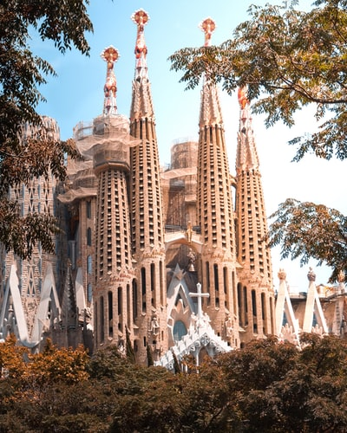
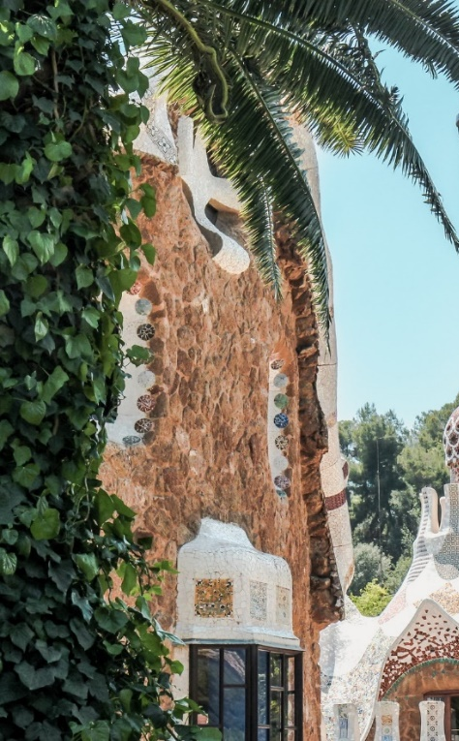
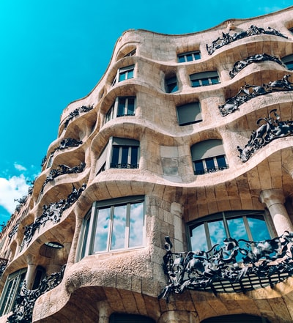
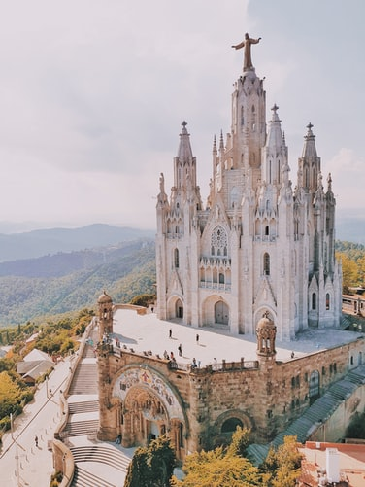
leer / escribir
Completa las frases.
Casa Batlló y Casa Milá
[are important]
[are in the centre]
En Barcelona hay unos edificios y unas iglesias. Los edificios _____ ____________ y las iglesias _____ ____________.
son
importantes
están
La Sagrada Familia (izquierda) y el Templo Expiatorio del Sagrado Corazón (derecha)
en el centro.
Notes:
Time estimated: 4 minutes
The next four slides offer the opportunity for students to see further exemplified sentences of the target features (plural definite and indefinite articles) plus the chance to practise son vs están and adjective agreement (where needed). This will be needed in the speaking production activity. Students could either write their answers on mini-whiteboards or in their exercise books. Teachers can then elicit the English translations, either orally or written.
Photo by Florencia Potter on Unsplash
Photo by Kristijan Arsov on Unsplash
Photo by Tomáš Nožina on Unsplash
Photo by Louisa Schaad on Unsplash

Slide 46
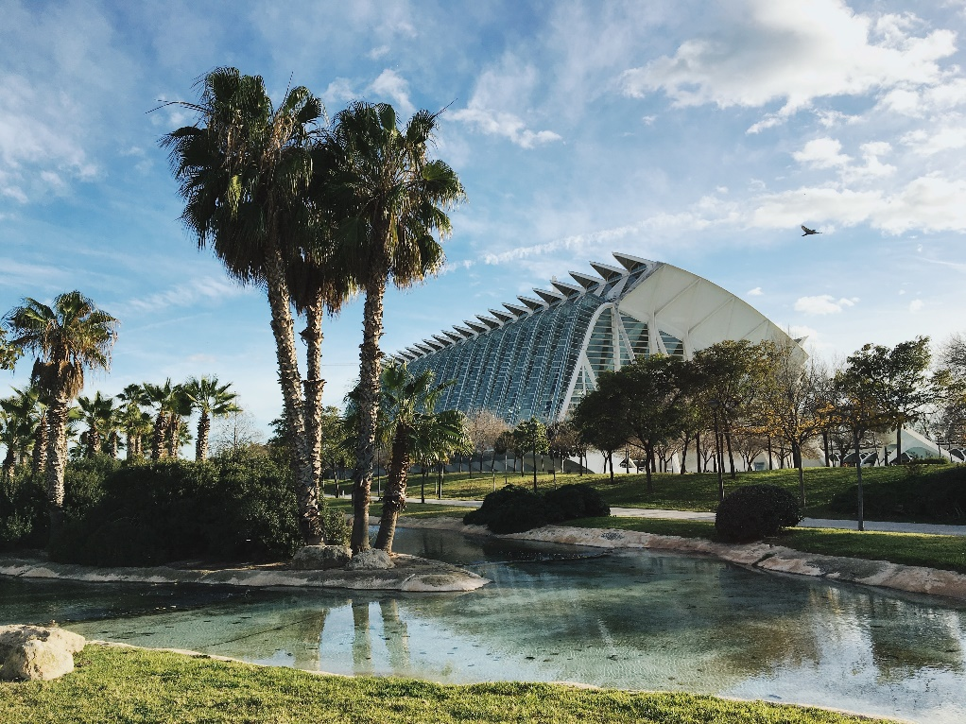
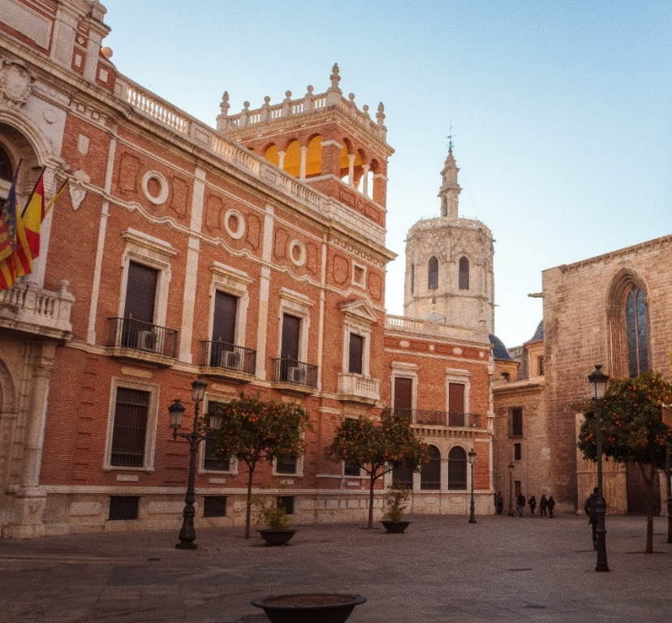
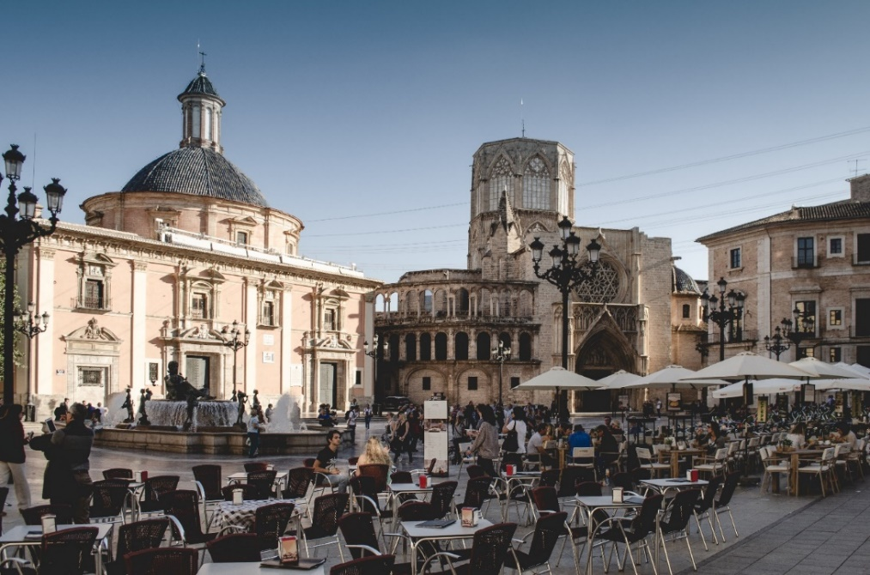
leer / escribir
Completa las frases.
[are modern]
A la izquierda: dos fotos de la Ciudad de las Artes y las Ciencias
Debajo: la Plaza de la Virgen (izquierda) y la Plaza de la Reina
En Valencia hay unos museos y unas plazas. Los museos _____ ____________ y las plazas ______ ____________.
[are old]
son
modernos
son
antiguas.
Notes:
Photo by Juan Gomez on Unsplash
Photo by Paul Povoroznuk on Unsplash
Photo by Jonny James on Unsplash
Photo by William Carletti on Unsplash

Slide 47
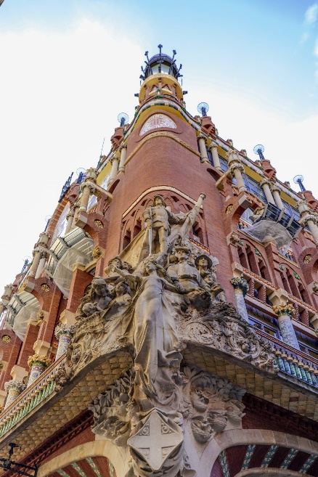
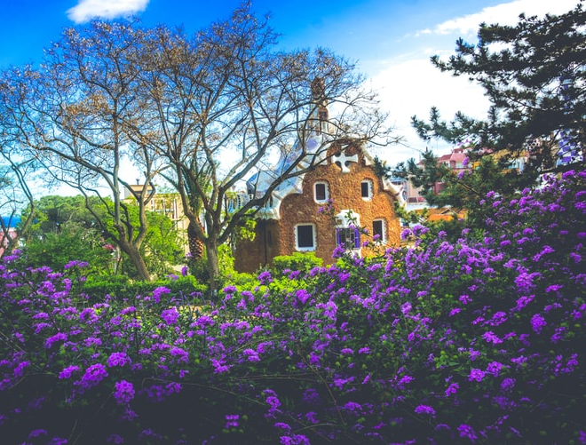
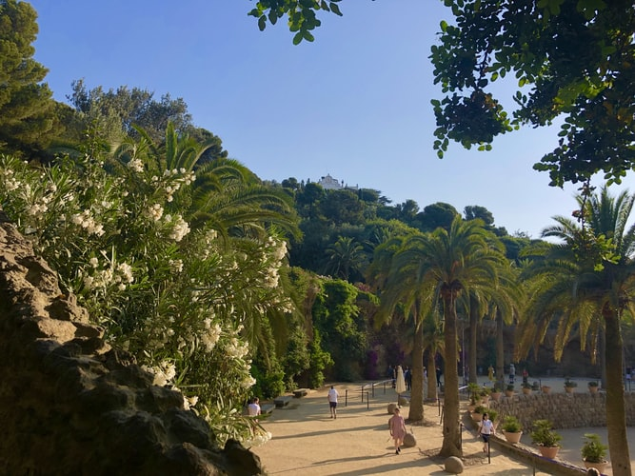
leer / escribir
Completa las frases.
[are nearby]
[are big]
Parque Güell
En Barcelona hay unas torres y unos parques. Las torres ____ __________ y los parques _____ ________.
son
grandes
están
cerca
Notes:
Photo by Fikri Rasyid on Unsplash
Photo by Biel Morro on Unsplash
Photo by Bianca Berg on Unsplash
Photo by Adora Goodenough on Unsplash
Photo by Derek Story on Unsplash

Slide 48
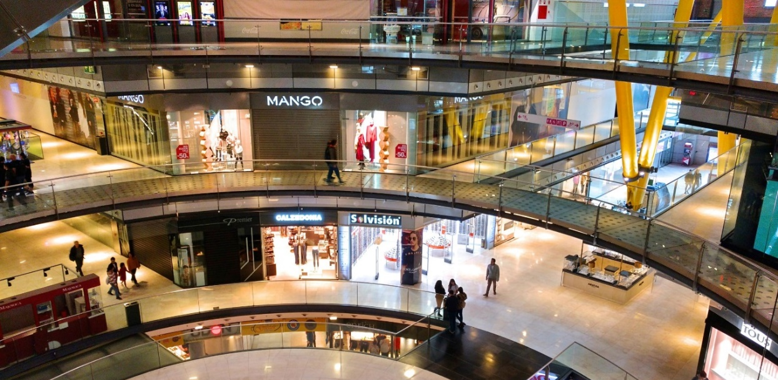
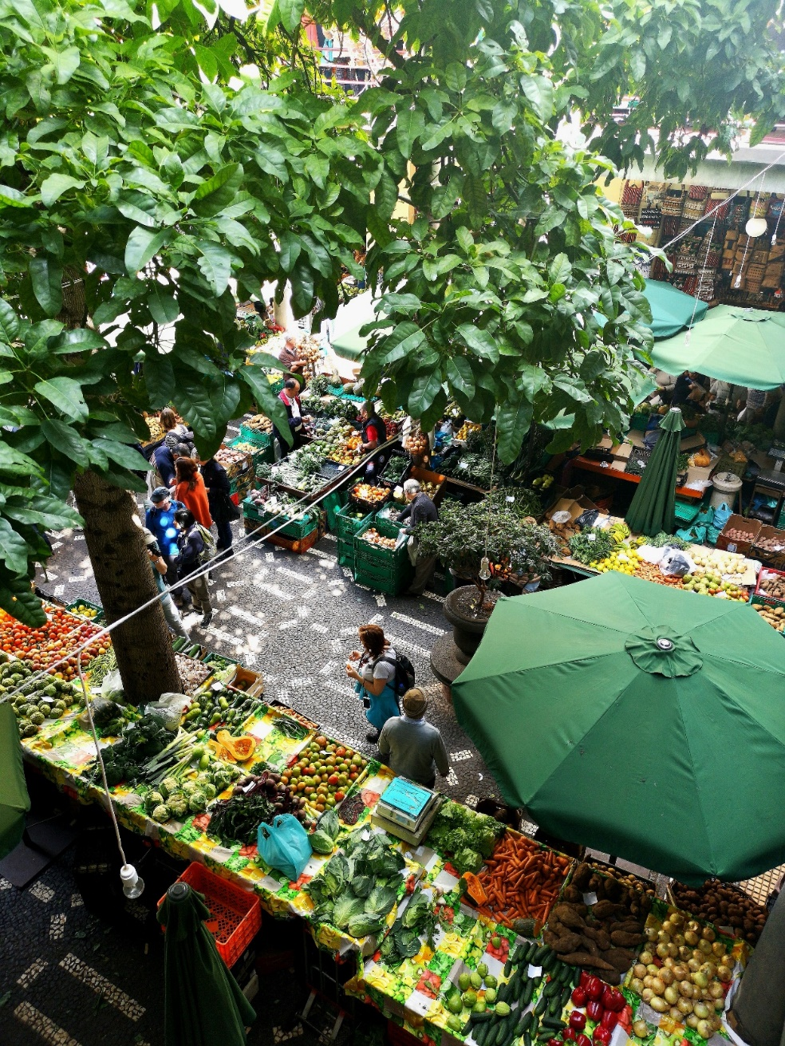
leer / escribir
Completa las frases.
[are expensive]
[are outside]
En las dos ciudades hay unas tiendas y unos mercados. Las tiendas ______ _______ y los mercados ______ _________.
son
caras
están
fuera
Notes:
Photo by WeLoveBarcelona.de on Unsplash
Photo by Juan Gomez on Unsplash
Photo by Theme Inn on Unsplash

Slide 49
7.3.2.6
Series of activities in lessons based around ‘La playa’ by Juan Guinea Díaz
Slides 11-19 Various activities around the poem, raising interest,, reading, listening, writing
Slide 24: writing, more verses of the poem
Slides 41-43: speaking, listening, writing, creating a similar poem

Slide 50
Escucha: ¿qué palabra corresponde?
la calle | la montaña
la playa | el campo
Notes:
Introduction/scene-setting
Timing: 2 min
Aim:
To engage students’ interest in the theme of the poem and reactivate understanding of several previously taught words.
Procedure:
Click on the orange sound icon to hear a ‘beach/sea/coast’ sound effect. Elicit from students which word best matches what they hear. Note: All four words are recycled from the SOW , but clarify their meanings with students, as necessary.
Word frequencies:
playa [1475]; campo [342]; montaña [1464]; calle [269] (those in bold were taught in Term 3.2, Week 3, which is revisited in the scheme of work this week)

Slide 51
Lee y escucha. ¿Qué tipo de texto es?
leer / escuchar
La playa en verano Las olas del mar
¿Un artículo?
¿Una novela?
¿Un poema?
La brisa, un helado Saltar y nadar
¿Por qué?
Porque tiene rima y ritmo.
Notes:
Introduction/identification of text type
Timing: 2 minutes
Aim: to reactivate students’ knowledge of text types and engage their interest in today’s text.
Procedure: ask students to listen and then read the first four lines of the text. Then, ask them to identify its type and why they think so.
Teachers can show a suggested answer with a further click.
Note: This is an opportunity to reuse the question word ‘¿Por qué?’, which was introduced the previous week (3.2.5).
Revisited vocabulary from 3.1.1: ‘de’ [2]

Slide 52
La playa
el cielo
la costa
predicción
¿Estas palabras están en el poema? ¿Sí/No?
el mar
el cielo
la costa
la arena
el mar
la ola
el sol
la ola
el sol
la arena
Notes:
Vocabulary introduction/prediction
Timing: 5 min
Aim: to introduce some of the new vocabulary, prompting students to think about the meaning of the words by considering whether or not they will be in the poem.
Note: it is not important whether they get the answers right! This is a first step to learning these new words and another way of engaging their interest in the text.
Procedure:
Tell students ‘El título del poema es ‘la playa’.
Ask ¿Estas palabras están en el poema? ¿Sí/No?
Ask students, in pairs, to ask each other ¿Qué significa? to check each other’s understanding of each word. Where there is any doubt, students should be in the habit of checking with the teacher, asking ‘¿Cómo se dice ‘ola’ en inglés? or ¿Qué significa ‘ola’ en inglés?
Note on vocabulary: ‘El cielo’ hasn’t been taught but has appeared with gloss in 2.2.5. ‘Costa’ may already be familiar as it has been used for phonics practice. The completely new words here are: ‘arena’ and ‘ola’. Vocabulary frequencies: sol [383]; playa [1475]; costa [896]; mar [480]; arena [1672]; cielo [620], ola [2425]
Note on use of pictures: pictures (even of concrete nouns) can be misleading, and one of the key aspects of the teacher role in target language use in the classroom is to ensure comprehensibility and to establish the ethos of the importance of clarity – i.e. if students don’t know they must ask. Teachers will never want to take this for granted, of course – they can elicit meanings to check, BUT the teacher is not always there, and they should instil in students the urge to know meaning and curiosity to ask!
Pictures:
Beach – Photo by Matt Read from Pexels

Slide 53
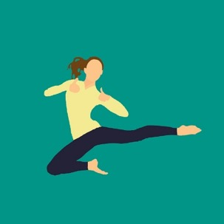
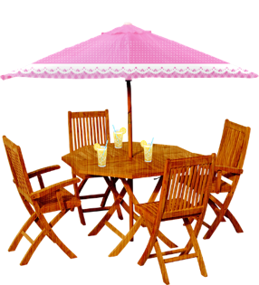
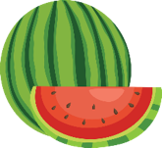
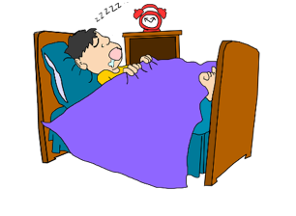
Escucha. Escribe las palabras.
escuchar / escribir
verano
La playa en _________
Las _______ del mar
La brisa, un _________
________ y nadar
Comida en el ________
Melón y ________
Papá con su radio
________ al mediodía
olas
helado
saltar
patio
sandía
Siesta
De la obra "El príncipe Zeta" de Juan Guinea Díaz, A Fortiori Editoria, 2010.
¿La mayoría de las palabras son nombres, adjetivos o verbos?
Hay sólo dos verbos. ¿Cuáles son?
Notes:
Transcription and vocabulary practice
Timing: 10 min
Aim: to consolidate existing SSC knowledge with ‘v’, ‘a/o’, ‘silent h’, ‘e/i’ and further embed the meaning of new vocabulary.
Procedure:
Play the audio
Ask students to write the missing words.
Elicit the answers from students, to ascertain if they can decode their own written answers confidently, too.
4. Provide the meaning after each answer. The pictures are to support understanding, but as always, ensure that students are clear what the new words mean.
4. Give students the opportunity to read it through in pairs, line by line, and to orally translate it to each other, line by line.
5. Ask them what they notice about the type of words in this poem. Are the majority nouns, adjectives or verbs? See if they can identify the only two verbs.
Transcript:
La playa en verano Las olas del mar La brisa, un helado Saltar y nadar Comida en el patio Melón y sandía Papá con su radio Siesta al mediodía
Additional word frequencies: verano [1139]; brisa [3805]; helado [3024]; saltar [1140]; nadar [3604]; comida [906]; patio [1197]; papá [865]; melón [>5000] sandía [>5000]; radio [933]; siesta [3410]; mediodía [2647]

Slide 54
leer
El poema describe un día en la playa. ¿Puedes poner los versos en orden?
Decide cuándo es. Luego escucha.
A
C
¿Cuándo?
La playa en verano Las olas del mar La brisa, un helado Saltar y nadar
La ventana abierta Dormir con la abuela La playa desierta Cubierta de estrellas*.
A
1 |  | por la mañana
2 |  | la hora de comer
3 |  | por la tarde
4 |  | la hora de cenar
5 |  | la hora de ir a la cama
D
B
E
E
El pelo enredado La arena y la sal Dedos arrugados Cenar en el bar
C
‘Hora’ literally means ‘hour’, but in some English phrases translates as ‘time’:
B
D
El cubo y la pala Enormes castillos Paseo por la playa El cielo amarillo
Comida en el patio Melón y sandía Papá con su radio Siesta al mediodía
la hora de comer = lunch time
la hora de cenar = dinner time
la hora de ir a la cama = bed time
De la obra "El príncipe Zeta" de Juan Guinea Díaz, A Fortiori Editoria, 2010.
*estrella = star
Notes:
Text-level reading comprehension (with audio to check answers)
Timing: 8 min
Aim: to understand the gist of the stanzas by deciding what time of day each stanza refers to.
Procedure:
1. Tell students that the poem describes a day on the beach. They need to put the verses in chronological order.
2. Make sure that the meaning of time phrases is understood (particularly ‘E’ as ‘cenar’ [3087] has not been previously taught). Students have not yet met ‘hora’ [160], so its meaning is explained.
3. Give them time to make their decisions. Then play the whole poem so that students can check their answers.
Note 1: remember that students have worked intensively with the first two verses before (A and D). They do not need to understand the new stanzas fully, they just need to get the gist of them. They will be able to study the vocabulary in these three other stanzas in lesson 2 in more detail.
Note 2: Students should already be familiar with these previously taught vocabulary items: mañana [402]; tarde [392]; noche [164]; comer [347]; cama [609]; día [65]; comida [906], ventana [725]; amarillo [1381]; playa [1475].
Note 3: a gloss is given for ‘estrella’ [974] as there is no other familiar word in the stanza that connotes ‘bed time’. Transcript:
La playa en verano Las olas del mar La brisa, un helado Saltar y nadar Comida en el patio Melón y sandía Papá con su radio Siesta al mediodía El cubo y la pala Enormes castillos Paseo por la playa El cielo amarillo
El pelo enredado La arena y la sal Dedos arrugados Cenar en el bar
La ventana abierta Dormir con la abuela La playa desierta Cubierta de estrellas.

Slide 55
-amos and -an [revisited]
In Spanish, verb endings change depending on who the verb refers to.
–amos
To mean ‘we’ with an –ar verb, remove –ar and add _________to the stem.
We buy an ice cream.
Compramos un helado.
We swim in the sea.
Nadamos en el mar.
To mean ‘they’ with an –ar verb, remove –ar and add ______to the stem.
–an
They listen to the radio.
Escuchan la radio.
Normally they ride bikes.
Normalmente montan en bici/bicicleta.
Notes:
Timing: 2 minutes
Aim: to give students a quick recap of these endings and their meanings ahead of the next activity
Procedure:
Elicit the verb forms and Spanish translations from students
Note: in the examples, the English phrases will appear first to elicit the Spanish translation from the students. The target words to elicit include some of the words from the poem (helado, mar, radio) to encourage further consolidation. These words will also appear in the next activity.
Words from 3.1.1: montar [1446], normalmente [1696]; mar [480]

Slide 56
Escucha. ¿Quién es? Marca la opción correcta.
escuchar
Luego, escucha otra vez. Escribe el verbo en español.
Finalmente, escribe la frase completa en inglés.
we
they
Llegan
1
2
3
4
5
6
7
8
9
1 __________ a la playa en verano 2 __________ en las olas del mar 3 __________ la brisa, __________ un helado 4 __________ saltar y nadar 5 __________ comida en el patio 6 __________ melón y sandía 7 __________ a Papá con su radio 8 __________ una siesta al mediodía
1
Jugamos
2
4
3
Escuchamos
compran
5
Quieren
6
Preparan
7
Sacamos
8
Miramos
9
Necesitan
De la obra "El príncipe Zeta" de Juan Guinea Díaz, A Fortiori Editoria, 2010.
Notes:
Timing: 10-12 minutes (slides 17-18)
Aims: to practise distinguishing the ‘we’ and ‘they’ forms of –ar verbs in listening and to knowledge of 9 regular –ar verbs
Procedure:
Explain that students will now hear a version of the poem with some different verbs (e.g., ‘Vamos a escuchar otra version del poema / vamos a cambiar los verbos del poema.’).
Students write 1-8 in their books.
Listen to each line and decide whether the verb means ’we’ or ‘they’.
3. After going through the answers on the table, students listen to the poem again and write the verbs in Spanish.
4. They can then check answers by clicking on the blue boxes.
5. Finally, translate each line into English (see answers on next slide). Given that this task is recycling verbs from some time ago, plus using newly encountered language, it would make sense for students to have some time to translate these 8 lines of text into English. This will ensure that they have to make sure they know the meanings of all of the verbs.
Notes:
1. All verbs are recycled from the Y7 scheme of work: Word frequency: llegar [75]; jugar [356]; escuchar [281]; comprar [361]; querer [58]; preparar [570]; sacar [273]; mirar [125]; necesitar [276]; 2. A very few additional words have been needed – ‘a’ / ‘en’ / ‘una’. Draw students attention to these during feedback.
3. ‘Querer’ has been included in one item. Although it isn’t an –ar verb, it allows two new –ar verbs (saltar, nadar) to be included in the activity. See if students notice the –en ending and, if not, draw their attention to it, asking them which type of verb ends in –en.
Transcript:
Llegan a la playa en verano.
Jugamos en las olas del mar.
Escuchamos la brisa,
Compran un helado
Quieren saltar y nadar
Preparan comida en el patio
Sacamos melón y sandía
Miramos a Papá con su radio
Necesitan una siesta al mediodía

Slide 57
El poema en inglés
1
They arrive at the beach in summer
2
We play in the sea waves
4
3
We listen to the breeze,
they buy an ice cream
5
They want to jump and swim
6
They prepare food on the patio
7
We take out melon and watermelon
8
We look at dad with his radio
9
They need a siesta at midday
De la obra "El príncipe Zeta" de Juan Guinea Díaz, A Fortiori Editoria, 2010.
Notes:
Answer slide for the L2->L1 translation activity suggested on previous slide.
Note: audio is included for further reinforcement, if needed.

Slide 58
¿Cuáles son tus palabras favoritas de hoy?
escribir
Escribe una lista de 5 palabras relacionadas con ‘la playa’.
Notes:
OPTIONAL
Timing: 5 minutes
Procedure:
1. Ask students to write their favourite five words from today’s lesson.
Notes:
1. There is no expectation that students will now have understood all of the words in the poem – their engagement with the last 3 verses in particular has been shallow so far. However, it’s useful to conclude this first lesson by seeing which words have stuck in their mind. The reason they recall a word might be because it’s something that they associate particularly with trips to the beach/beach holidays. A follow up question would be to ask them to think of their top five words that they associate with going to the beach – in Spanish or English.
The words they only know in English could then be homework to look up in preparation for the next lesson.

Slide 59
escribir
tangled
Estos versos del poema tienen adjetivos.
¿Qué significan?
enredado/a
9 El cubo y la pala 10 Enormes castillos 11 Paseo por la playa 12 El cielo amarillo 13 El pelo enredado 14 La arena y la sal 15 Dedos arrugados 16 Cenar en el bar 17 La ventana abierta 18 Dormir con la abuela 19 La playa desierta 20 Cubierta de estrellas.
wrinkled
covered
arrugado/a
cubierto/a
[a walk]
deserted
open
desierto/a
abierto/a
yellow
enormous
amarillo/a
enorme
Strategies:
1. Look out for any cognates. 2. Look at the word(s) before the adjective. If you know it, decide which word would best describe it.
Extension: - Choose three more nouns in the poem and three adjectives to describe them. - Make sure your adjective agrees with the noun.
De la obra "El príncipe Zeta" de Juan Guinea Díaz, A Fortiori Editoria, 2010.
Notes:
Timing: 10 min
Aim: to understand other verses of the poem in more detail, focusing in particular on the adjectives and nouns they describe.
Procedure:
1. Ask them to work out what each of the adjectives means. Share the strategies box with them. And bring up the extension opportunity. 2. Feed answers back. 3. Ask for any contributions from the extension work to be shared with the class.
Notes:
1. Students have learnt adjectival agreement and usual position after noun. All of these adjectives follow the agreement pattern except enorme and students have encountered ‘alegre’ already as an exception.
2. If time allows, ask students to notice that in line 10 the adjective is in front of the noun. Ask them to suggest why this is. Elicit the understanding that grammatical rules are stretched in poetry, e.g. in sentence structure (missing verbs) and adjectival position. Here it may have been to achieve the rhyme – castillos / amarillo.
Additional vocabulary frequencies: cubo [>5000]; pala [>5000] castillo [2545]; paseo [2126]; pelo [873]; sal [4232]; dedo [716]; cenar [3087]; bar [1938]; ventana [725]; abierto [654]; dormir [403]; abuela [783]; desierto [4544]; cubierto [3775]; estrella [974] Words in bold have already been encountered.

Slide 60
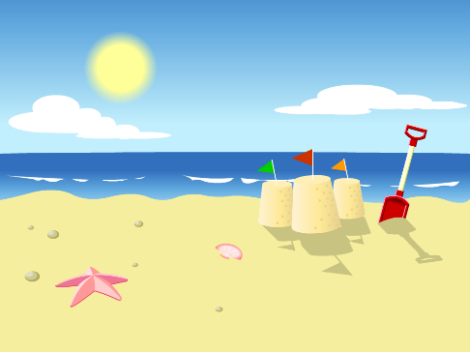
Escribir un poema nuevo
hablar / escuchar / escribir
Vamos a usar verbos en –ar y escribir un poema nuevo.
Persona A: Lee el poema. ¡Debes interpretar las imágenes!
Ejemplo:
Persona B: Escucha y escribe el poema. Luego, compara.
Luego, Persona B habla y Persona A escucha y escribe.
Jugamos en la playa en verano.
[We play] en la en verano.
De la obra "El príncipe Zeta" de Juan Guinea Díaz, A Fortiori Editoria, 2010.
Notes:
There are two options for the final activity. We recommend doing ONE of the these. The two options are summarised below.
Slides 56-58: Paired speaking/listening/writing, using an scaffolded text that allows for a new, alternative version of the poem in Spanish to be written. This poem is designed to elicit –ar verbs in 1st person plural and 3rd person plural, plus vocabulary items from the poem.
OR
Slides 59-63: Paired speaking/listening/writing, using speaking cards. This activity focuses on the same grammar features and also allows for productive practice of vocabulary from the poem.

Slide 61
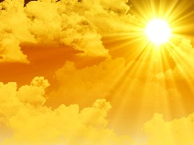
Persona A
Persona B
1 [We walk] en la en verano 2 [They look at] las del mar 3 [We listen to] la brisa, [we take out] un
4 [They jump] y [they swim] 5 [We prepare] en el patio 6 [They carry] melón y 7 [They listen to] la 8 [We need] una siesta al mediodía 9 [They buy] un cubo y una pala 10 [We play] con enormes castillos
11 [They enjoy] un paseo por la 12 [We look at] el amarillo 13 [They have] el enredado 14 [They rest] en la y la sal 15 [We play] con los arrugados 16 [We have dinner] en el bar 17 [They sing] con la ventana abierta 18 [We speak] con la 19 [They dance] en la playa desierta 20 en el cielo todas las
[sky]
[sand]
Notes:
Timing: 10-12mins
Aim: for students to a) produce the target grammar features (-ar verbs with –amos and –an) and vocabulary in oral production; b) write the Spanish they hear accurately.
Procedure:
Person A first reads out his/her 10 lines of the poem, using the English words and images as prompts to say the Spanish. These include –ar verbs in the 1st person and 3rd person plural. Person B listens and writes.
The two students swap roles. Person B reads out lines 11-20. Person A listens and writes.
Check against the answers on slide 58.
Note: In this task students can see the English so it works to consolidate their understanding of the sound of the word and its meaning. This prepares students for the more challenging listening and speaking task that follows (if these are both done). However, should teachers want to increase the challenge for students, they could print and cut this slide, so that students additionally have to translate into English (orally, back to their partner) the lines they have written down.

Slide 62
Persona A
El poema completo
Persona B
1 Caminamos en la playa en verano 2 Miran las olas del mar 3 Escuchamos la brisa, sacamos un helado
4 Saltan y nadan
5 Preparamos comida en el patio 6 Llevan melón y sandía 7 Escuchan la radio 8 Necesitamos una siesta al mediodía 9 Compran un cubo y una pala 10 Jugamos con enormes castillos
11 Disfrutan un paseo por la playa 12 Miramos el cielo amarillo 13 Tienen el pelo enredado 14 Descansan en la arena y la sal 15 Jugamos con los dedos arrugados 16 Cenamos en el bar 17 Cantan con la ventana abierta 18 Hablamos con la abuela 19 Bailan en la playa desierta 20 en el cielo todas las estrellas
Notes:
ANSWERS

Slide 63
7.3.2.7
Slides 31-32: phonics and listening, [ce], [ci], [z], Colombian map
Listening and reading activities about attractions in Colombia, including the Gold Museum.

Slide 64
SSCs [CE], [CI] y [Z]
escuchar
Remember, there are different ways to pronounce CE and CI.
In most of Spain, the ‘c’ before ‘e’ or ‘i’ is pronounced
like _____ in English. The same is true of ‘z’ before a vowel.
‘th’
In the Canary Islands and Latin America, this ‘c’ is often pronounced like an ____. The same is true of ‘z’ before a vowel.
‘s’
Escucha. Es ¿España o Canarias / Latinoamérica?
ciencias
España
1
________________________________
ciencias
Canarias / Latinoamérica
2
________________________________
cabeza
Canarias / Latinoamérica
3
________________________________
cabeza
España
4
________________________________
Notes:
Phonics recap slide
Timing: 3 minutes
Aim: to revisit the SSCs [CE, [CI] and [Z] and raise awareness of the different ways in which they are pronounced in the Spanish-speaking world.
Procedure:
Read explanation, eliciting the answers from students where prompted by gaps.
Play the audio and ask where the person is from (‘¿La persona es de…?’)
Ask students which other words they can recall from Y7 which have [ce], [ci] and [z]. This will help to prepare them for the next activity.
Anticipate, for [Z], voz, cabeza, empezar, zapato, zona, diez, naturaleza,
Anticipate, for [CI], cine, diciembre, decir, cierto
Anticipate, for [CE], ciudad, centro, necesitar, cerca
Notes:
Individual teachers may also find it useful to consider the information from exam board specifications below:
AQA : “The [listening] test will be studio recorded using native speakers speaking Castilian in clearly articulated, standard speech at near normal speed. Different types of spoken language will be used, using familiar language across a range of contemporary and cultural themes. (p. 82)
EdExcel : “For listening and reading assessments, the majority of contexts are based on the culture and countries where the assessed language is spoken. […] It is, therefore, important that students are exposed to materials relating to Spanish-speaking countries throughout the course.” (p. 7)
WJEC : “This GCSE specification in Spanish for use in Wales is based on a conviction that learners studying a modern foreign language will develop their desire and ability to communicate with and understand speakers of Spanish in a variety of contexts and for a variety of purposes.” (p. 3)
Image attribution:
Image with creative commons public domain licence
https://mycsres.com/freesheet/spanish-speaking-world-map-18.html.html

Slide 65
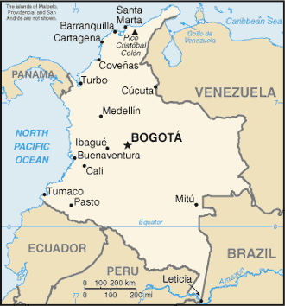
¿De dónde son las personas?
escuchar
Latin America / Canaries | Mainland Spain
Estás de vacaciones en Colombia. Hay mucha gente en la plaza en Bogotá, la capital.
1
cine
2
plaza
Escucha las voces diferentes. Decide si la persona (probablemente) es de España o Latinoamérica.
3
empezar
4
ciudad
5
centro
Marca la opción correcta y escribe las palabras con [ce], [ci] y [z] en español.
6
necesito
naturaleza
7
zona
cerca
8
cierto
Notes:
Phonics practice activity
Timing: 6 minutes
Aim: to raise awareness of the different ways in which the SSCs [CE, [CI] and [Z] and are pronounced in the Spanish-speaking world.
Procedure:
Play the audio and ask students to tick the right column and write the word(s) with the target SSCs.
Check answers, including spelling, in feedback
Note:
Some students may be able to write the entire sentence.
Ensure understanding of ‘de dónde’. Both words have been taught, but separately, and theword order is different here from English (‘where….from’).
Transcript:
¿Dónde está el cine?
La plaza es muy antigua.
¿Cuándo va a empezar la clase de baile?
En la ciudad hay muchos restaurantes muy buenos.
Las tiendas en el centro son muy caras.
Necesito comprar un regalo barato.
La naturaleza aquí en esta zona es hermosa.
El teatro famoso está cerca, ¿cierto?

Slide 66
leer
Ana escribe sobre los viajes a Colombia. ¿Quién es, Ana (‘I’) o Ana y los primos (‘we’)? Decide si es cada año o en agosto (el futuro).
Disfruto las vacaciones en Colombia porque es un país hermoso. Como soy de allí, voy a la casa de mis primos. Viven en la capital, Bogotá. Vamos juntos a las tiendas en el centro. İEs super divertido! Tambien, voy a viajar allí con mi familia en verano.
Los museos de Bogotá, como el Museo del Oro*, son increíbles. Voy porque quiero descubrir la historia, pero no voy a ir con mi familia (para Lucía, ¡es aburrido!).
La costa es espectacular. Mis primos y yo vamos a ir a la playa - ¡estoy segura!
Además, vamos a montar a caballo en las montañas. ¡Los viajes activos son geniales!
Ana (‘I’)
Ana y las primos (‘we’)
Cada año
Cada año
goes to cousins’ house
go together to the shops in the centre (it’s really fun).
goes to the gold museum (because she wants to discover the history)
En agosto (futuro)
En agosto (futuro)
are going to go to the beach (Ana is sure)
is going to travel there with all the family
is not going to go to gold museum with the family
are going to go horse riding in the mountains
*el oro = gold
*además = in addition
Notes:
Timing: 10 minutes
Aim: to practise distinguishing between ‘ir’ for future plans and habitual actions in reading.
NB A secondary aim to encourage reflection about whether the verb refers to Ana (‘voy’) or Ana and cousins (‘vamos’). For this reason, we have divided the responses into columns for ‘I’ and ‘we’. As this is an extended text, however, the task is not intended to be strictly referential (i.e. it doesn’t always require attending to the verb to decide who is referred to).
Procedure:
Ask students, working individually or in pairs, to complete the two boxes for ‘Ana’ and ‘Ana y los primos’ in English.
Check answers
Note:
Although there is use of a time indicator (‘en verano’) within this text to signal a future tense, it has not yet been taught to students and therefore they will need to rely on the verbs which are the target features to arrive at the answers.
All language has been previously taught apart from ‘además’ (which will be taught in Year 8, Term 1) and ‘oro’ [863].

Slide 67
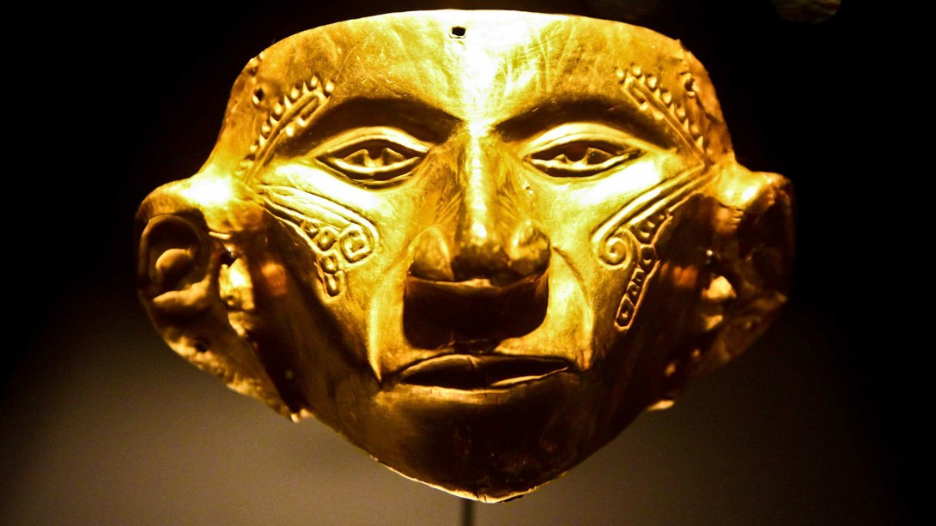
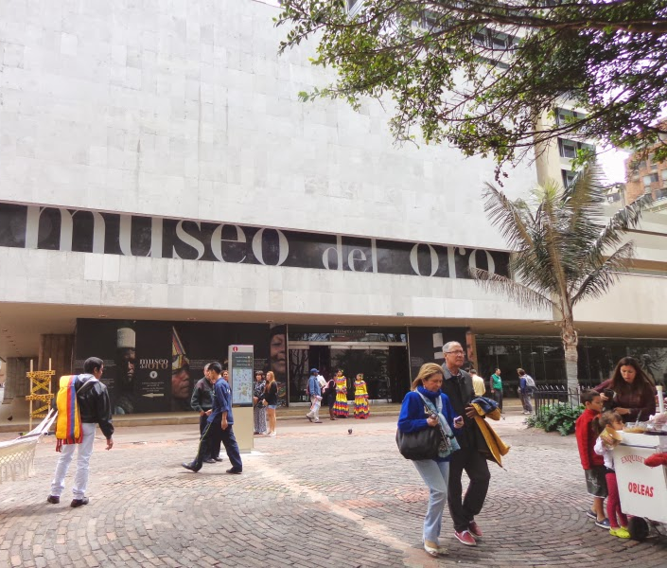
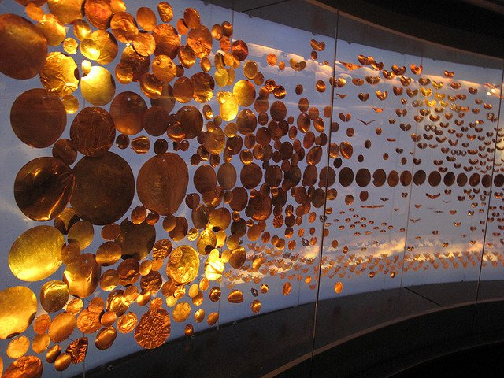
El museo del oro, Bogotá
El museo está en el centro de Bogotá.
Recibe muchos visitantes cada año.
Notes:
Image source
https://watsontravels.blogspot.com/2014/01/gold-museum-bogota-colombia.html
https://www.colombia.co/wp-content/uploads/2015/05/museos.jpg
https://wsimag.com/es/arte/22805-el-museo-del-oro

