Slide 1
Cultural Collection
Y7 Spanish Term 2
Author name(s): Pete Watson
Date updated: 29/03/21

Slide 2
7.2.1.1
Series of slides and activities on ‘La plaza tiene una torre’ by Antonio Machado, across both lessons.
Slides 11-22: listening, reading, vocabulary, phonics
Slides 24-29: grammar, vocabulary
Slides 32-38: speaking, listening

Slide 3
leer
Lee el texto. ¿Qué tipo de texto es?
leer
La plaza tiene una torre,
la torre tiene un balcón,
¿Un artículo?
¿Una novela?
¿Un poema?
El balcón tiene una dama,
La dama una blanca flor…
Notes:
Timing: 1 minute
Aim: Introductory slide to challenging text that is the focus of this lesson for students to anticipate what they might be about to work on.
Procedure:
Ask students to read aloud the first four lines of the text and then identify its type. ‘Artículo’, ‘novela’ and ‘poema’ haven’t been taught in the scheme of work but should be recognisable as cognates.
Teachers could prompt certain reasons why they may suggest a poem: frases cortas, repetición

Slide 4
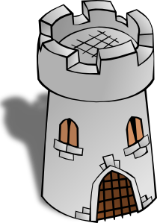
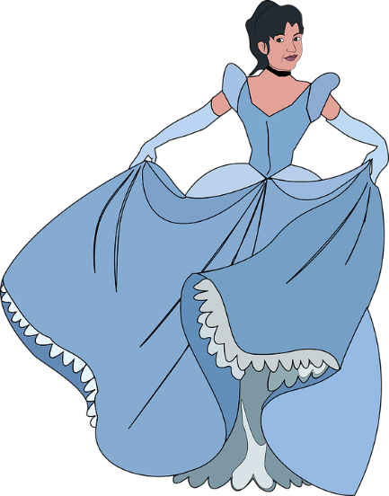
La plaza tiene una torre,
la torre tiene un balcón,
El balcón tiene una dama,
La dama una blanca flor…
Notes:
Timing: 1 minute
Aim: slide to remind students of the use of ‘tiene’ . This begins to foster an approach to challenging texts of searching for words that are familiar.
Procedure:
1. Teachers elicit from students the meaning of ‘tiene’, which they first learnt in term 1.1 week 4. Since it was introduced, there have been several opportunities to revisit parts of ‘TENER’ in the scheme of work.
2. Teachers ask students why they think ‘tiene’ is missing from line 4 of the poem (i.e. to maintain the rhythm/flow), and where it would have gone, if the writer had included it.
Notes Images are animated to support the meaning.

Slide 5
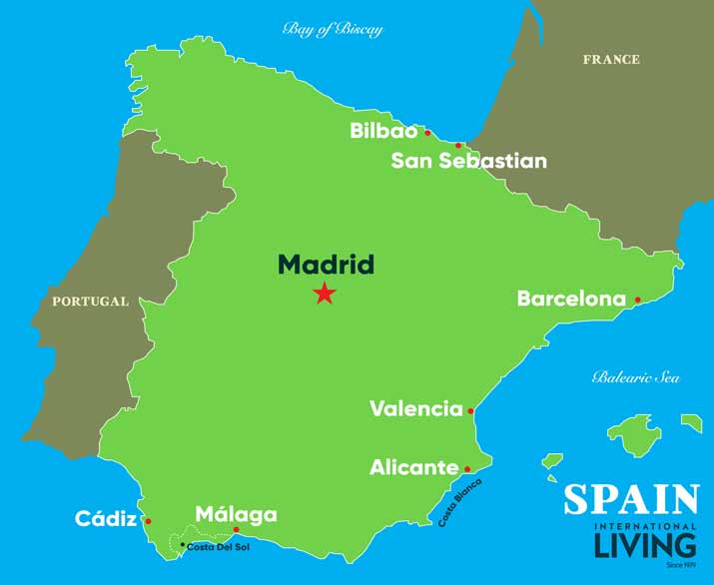
El autor: Antonio Machado (1875-1913)
Biografía
Nace en Valencia.
Estudia en Madrid.
Viaja mucho a Francia.
Habla francés.
viajar = to travel
Intereses
La memoria
La reflexión
El romance
Notes:
Timing: 3 minutes
Aim: Introductory details of the author of the poem, using familiar language and some cognates.
Procedure:
Teachers click to go through the slide. We can give details of his life in the present tense. Students can read aloud (whole class) to practise SSC knowledge.
Students could be asked to guess what ‘nace’ means. In the context of ‘biografía’, they may be able to guess this.
Students could also be asked:
1/ where Valencia and Madrid are (‘¿Dónde está…?) to elicit ‘Está en el sur’ or ‘Está en el centro’. Note: ‘centro’ has been taught as a phonics word.
2/ yes-no questions with raised intonation (e.g. ‘¿Valencia está en el norte?’). Encourage full answers here (‘No, está en el sur’).
Frequency of unknown words/cognates:
nacer [426]; viajar [902]; memoria [827]; reflexión [1909]; romance [4541]

Slide 6
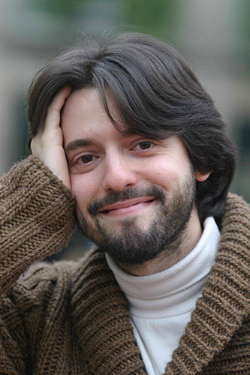
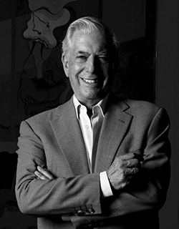
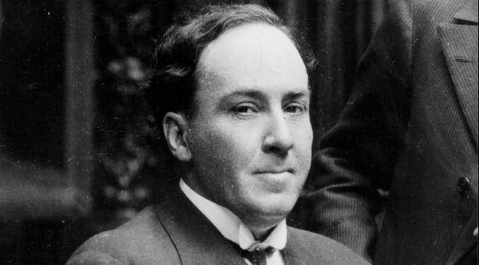
¿Quién es Antonio Machado?
A
C
B
Notes:
Timing: 1 minute
Aim: another short activity to whet the interest of the students in the text
Procedure:
Ask students, e.g., ‘Es la persona en A?’. Elicit the correct answer (B).
Photo A too young, too recent (colour photo!). Photo B and C both black and white, so might be options. Students might look at their clothes to guess this.
In B (the correct photo) he also seems calm and composed, which is in tune with the interests mentioned on the last slide.
Image sources:
A: Photo by Luis Angelis licensed under CC BY-SA 4.0 and retrieved from https://www.worldliteraturetoday.org/blog/news-and-events/award-winning-argentinean-spanish-writer-speak-ou
B: Photo by EFE, is licensed under CC BY-SA 4.0 and retrieved from http://www.spainisculture.com/en/artistas_creadores/antonio_machado.html
C: Photo by US library of Congress is licensed under CC BY-SA 4.0 and retrieved from https://www.loc.gov/item/n79079153/mario-vargas-llosa-peru-1936/

Slide 7
¿Cómo está en la foto?
Está serio.
Está alegre.
Está raro.
Notes:
Timing: 1 minute
Aim: to revisit some adjectives with ‘estar’ for temporary state.
Procedure:
Ask students to translate the 3 phrases. Ask for other potential descriptions of how he looks, or doesn’t look.
Other adjectives previously taught in the Spanish scheme of work could be revisited here: guapo [4192]; feo [2373]; bonito [891]; tranquilo [1073]; tonto [2379]; nervioso [1521].
Photo by EFE, is licensed under CC BY-SA 4.0 and retrieved from http://www.spainisculture.com/en/artistas_creadores/antonio_machado.html

Slide 8
Palabras importantes
la plaza | square
el balcón | balcony
la dama | lady
blanco | white
la flor | flower
torre | tower
el caballero | gentleman, knight
su | his/her/its
quién | who
saber | to know, knowing
pasar | to pass, passing
llevar | to carry, to wear
Notes:
Timing: 4 minutes
Aim: Introduce (and recap) vocabulary involved with the poem.
Procedure:
Teachers click to reveal the English meanings of the words. First you could ask students what the words mean.
Ask students to familiarise themselves with these words, using a usual routine (read aloud, ask and answer L2 → L1 meanings in pairs etc..)
Notes: Students have been taught blanco, flor, quién, la plaza, and llevar. Revisiting them here within a new set of words will challenge their recall and deepen vocabulary knowledge. It’s encouraging for students to realise that a poem text contains words they have already learnt, as well as unfamiliar words.

Slide 9
Escucha el poema.
escuchar
¿Cómo está la narradora?
tonta
rara
alegre
nerviosa
tranquila
seria
Notes:
Timing: 3 minutes
Aim: First listen of the poem (in two tones), potential dictogloss activity
Procedure:
There are two versions here – one in a happy-sounding voice (alegre) and one in a serious voice (seria).
Students could be encouraged to write down any words they hear and understand in the poem to practise their SSC knowledge.
Note: Later in the lesson, after students have had more receptive practice (reading and listening to the poem), they could listen to again and see if they can reform any full lines from the poem (in a dictogloss style task).
Alternative, additional version:
https://www.youtube.com/watch?v=fgcyPadvZjA

Slide 10
Escucha. Organiza las 5 partes del poema.
escuchar
La plaza tiene una torre, la torre tiene un balcón,
A
Order
Part
el balcón tiene una dama, la dama una blanca flor.
B
#1
C
ha pasado un caballero -¡ quién sabe por qué pasó !-,
#2
E
C
#3
A
y se ha llevado la plaza, con su torre y su balcón,
D
#4
D
con su balcón y su dama,
su dama y su blanca flor.
#5
B
E
Notes:
Timing: 4 minutes
Aim: listening activity to help students recognise SSCs and words.
Procedure:
Students have just heard the poem in full on the previous slide. This time, teachers click on the number buttons to play fragments of the poem. Students listen and write down the letter that the fragment corresponds to
The answers can be checked item by item by clicking. This makes it less difficult than listening to all 5 parts and then checking answers.
Frequency of unknown words/cognates: Organizar [1053] is a cognate that usefully includes the SSC ‘z’, which students practised in Term 1.2 Week 1.

Slide 11
Lee el poema. Completa la tabla con la letra correcta.
leer
La plaza tiene una torre, la torre tiene un balcón,
A
What the pair of lines describes
el balcón tiene una dama, la dama una blanca flor.
B
Tells us that a man goes past
C
Tells us who is on the balcony
B
ha pasado un caballero -¡ quién sabe por qué pasó !-,
C
Tells us what happens as the man goes past.
D, E
y se ha llevado la plaza, con su torre y su balcón,
Tells us what the square has.
A
D
con su balcón y su dama, su dama y su blanca flor.
E
leer
Notes:
Timing: 3 minutes
Aim: reading activity to begin to think more closely about the meaning of each couplet of the poem
Procedure:
Teachers click to reveal a couplet of the poem out of order. Students fill in the table with the letters of the couplet.
Answers are shown by clicking.
Notes:
The poem appears out of order so that students think more carefully about the meaning of different parts of the poem. This way, they can’t simply rely on a predictable order of events to complete the task.

Slide 12
Los sonidos
 | plaza, una, blanca, dama, ha, pasado, sabe, caballero
A
A
 | con, blanca, balcón, caballero
CA/CO
CA/CO
Notes:
Timing: 4 minutes
Aim: activity to revisit SSCs [A], [CA] and [CO]
Procedure:
Go back to the previous slide and ask students to find words with the listed SSCs.
Once done, return to this slide and click on the boxes to reveal the words with the appropriate SSC.
Ask them to find examples of other SSCs. For example, you could also ask them to find an example of RR (torre). What other words can they think of that have this SSC? (Inglaterra, correcto – which they’ve seen before in target language instructions). SSC ‘r’ and ‘rr’ will be the phonics focus next week.
Notes:
Learners will be most familiar with [A], having seen it in Term 1.1, Week 1.
They have also seen [CA]/[CO]/[CU] in Term 1.1, Week 5.

Slide 13
En parejas. Lee el poema en alta voz.
hablar / escuchar
La plaza tiene una torre,
la torre tiene un balcón,
el balcón tiene una dama,
la dama una blanca flor.
Ha pasado un caballero
- ¡quién sabe por qué pasó! -,
y se ha llevado la plaza,
con su torre y su balcón,
con su balcón y su dama,
su dama y su blanca flor.
¿Cómo está el narrador / la narradora?
tonto/a
raro/a
alegre
nervioso/a
tranquilo/a
serio/a
Notes:
Timing: 5 minutes
Aim: Speaking and pronunciation practice, involving some ‘acting’ of tones
Procedure:
Check understanding of ‘pareja’ and ‘en alta voz’ in the instructions.
Students take turns to read the text to each other in pairs and the speaker decides how (i.e. with what tone) they will narrate the text. The partner listens and then asks the partner, e.g., ‘¿Estás serio?’. Remind students of the need to use ‘estás’ to speak directly to ‘you’ (singular).

Slide 14
La plaza tiene una torre
Notes:
https://www.youtube.com/watch?v=Z6jD2xUiea4
Alternative version on YouTube (includes audio and text).

Slide 15
Completa la frase con LA o UNA.
escribir
La plaza tiene ____ torre, ____ torre tiene un balcón,
una
La
Notes:
Timing: 3 minutes (for slides 24-26)
Aim: Recap of meaning of definite and indefinite articles.
Procedure:
Teachers draw out and make explicit the difference in meaning between the definite and indefinite article ‘la’ and ‘una’, eliciting an English translation of each of the lines from this and the next two slides. Answers are revealed by clicking.
Repeat the procedure on slides 25 and 26.
An active choice between the definite and indefinite articles is needed in each instance. We have separated parts of the poem to ask for a choice between definite and indefinite (rather than between masculine and feminine) so that students only have to focus on article usage.

Slide 16
Completa la frase con LA o UNA.
escribir
La torre tiene ___ balcón, ___ balcón tiene una dama,
un
El

Slide 17
Completa la frase con LA o UNA.
escribir
el balcón tiene ____ dama, ____ dama una blanca flor.
una
La

Slide 18
La dama describe una ciudad. ¿Qué hay?
un mercado
un m_ _ _ _ _ _
a market
un c_ _ _ _ _ de arte
un centro de arte
an art centre
laza
Hay una p_____ ,
un t_ _ _ _ _
a theatre
un teatro
una t____ y…
orre
un b_ _ _ _. Está c_ _ _ _.
a bank. It’s near.
un banco. Está cerca.
un m_ _ _ _
a museum
un museo
una tienda. Está lejos.
a shop. It’s far.
una t_ _ _ _ _. Está l_ _ _ _.
una iglesia
a church
una i_ _ _ _ _ _
una escuela. Está entre dos parques.
una e_ _ _ _ _ _. Está e_ _ _ _ dos parques.
a school. It’s between two parks.
Notes:
Timing: 3 minutes
Aim: vocabulary revision activity for vocabulary set 7.1.2.5.
Procedure:
Teachers ask students for the missing words. A choral response can be sought, or teachers could ask students to work in pairs first to remember the vocabulary.
Teachers click to reveal the answers.

Slide 19
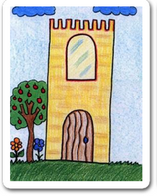
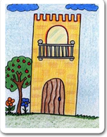
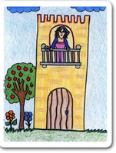
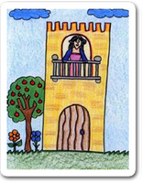
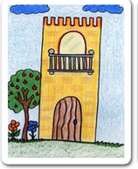
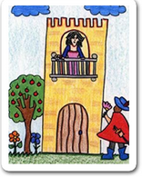
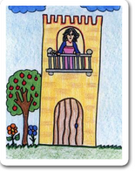
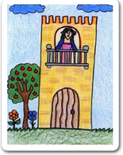
escribir/hablar
__ _______ tiene ___ ______, __ ______ tiene __ ______, __ ______ tiene ___ ____, __ ____ ___ blanca ____. ha pasado un caballero -¡ quién sabe por qué pasó !-, y se ha llevado __ _____, con su _____ y su ______, con su _____ y su ____
su ____ y su _____ ____.
Notes:
Timing: 8 minutes
Aim: Writing / speaking exercise using pictures to practice articles and nouns
Procedure:
Two possible tasks: (1) Writing: students have to complete the text with both definite and indefinite articles, plus the nouns or (2) Speaking: students do a read aloud, aided by the picture prompts
The next slide shows the answers
Image attribution: Images by Colegio de Educación Infantil y Primaria Vista Alegre
Licensed under CC BY-SA 4.0
http://literaturalunalunera.blogspot.com/2014/03/la-plaza-tiene-una-torre.html

Slide 20
Answers
__ ______ tiene ____ ____, __ _____ tiene ___ _______, __ ______ tiene ____ ______, __ _____ ____ blanca ____. ha pasado un caballero -¡ quién sabe por qué pasó !-, y se ha llevado __ _____, con su _____ y su ________, con su _______ y su _______
su _______ y su _______ ___.
La plaza
una torre
la torre
un balcón
el balcón
una dama
La dama una
flor
la plaza
torre
balcón
balcón
dama
dama
blanca flor

Slide 21
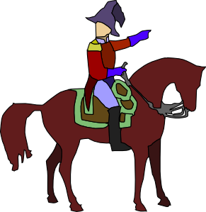
El caballero y su caballo
hablar / escuchar
Persona A: eres el caballero.
Use the prompt cards to say
what you want.
what your horse wants.
Importante!
‘Quiero’ es ‘I want’.
‘Quiere’ es ‘it wants’.
Persona B: escucha y completa la tabla.
¿Quién es, el caballero o el caballo?
Notes:
Timing: 6 minutes (for slides 32-34)
Aim: This is a two-part speaking/listening activity to practise spoken production of DAR and QUERER in 1st and 3rd person singular.
Procedure
Teachers click to go through the instructions. Teachers should elicit the meaning of ‘eres’ in the instructions.
One student uses the speaking cards to say sentences, while the other completes the grid. Students will swap roles half-way through.
Picture source: http://clipart-library.com/ (free to use)

Slide 22
Persona A
1
2
3
4
[I want]
[I want]
[it wants]
[I want]
a glass of Coca-Cola
a chair
some products
a shirt
5
6
7
8
[it wants]
[I want]
[it wants]
[it wants]
a plate a broccoli
a glass of
Fanta
some shoes
a bed
Notes:
DO NOT SHOW DURING THE ACTIVITY
Student A speaking card
‘Vaso’, ‘camisa’, ‘zapato’, ‘producto’ are words from the Term 1.1, Week 7 vocabulary set, which is revisited this week.

Slide 23
Persona B
Answers
El caballero (‘I want’)
El caballo (‘it wants’)
un vaso de Coca-Cola
unos productos
una silla
un plato de brócoli
una camisa
un vaso de Fanta
unos zapatos
una cama
Notes:
Students can copy the grid into their books.
Ask students if it’s normal for a horse to want those things (!)

Slide 24
La dama y su hermano
hablar / escuchar
Importante!
‘Doy’ es ‘I give’.
‘Da’ es ‘s/he gives’.
Persona B: eres la dama.
Use the prompt cards to say
what you give to someone in the square.
what your brother gives to someone in the square.
Persona A: escucha y completa la tabla.
¿Quién es, la dama o el hermano?
Notes:
Timing: 6 minutes (slides 35-37)
Aim: This is a two-part speaking/listening activity to practice spoken production of dar and querer in 1st and 3rd person singular.
Procedure:
1. Students B and A now swap roles. Student B speaks, while Student A listens and completes the grid.
Image attribution: http://www.clker.com/and http://clipart-library.com/

Slide 25
Persona B
1
2
3
4
[I give]
[he gives]
[I give]
[I give]
a book
money
a shirt
some shoes
5
6
7
8
[he gives]
[I give]
[he gives]
[he gives]
a glass of Coca-Cola
a plate of broccoli
a bag
some products
Notes:
DO NOT SHOW DURING THE ACTIVITY
Student B speaking cards
‘Vaso’, ‘camisa’, ‘zapato’, ‘producto’ are words from the Term 1.1, Week 7 vocabulary set, which is revisited this week.

Slide 26
Persona A
Answers
La dama (‘I give’)
El hermano (‘he gives’)
un libro
dinero
unos zapatos
una bolsa
una camisa
un vaso de Coca-Cola
unos productos
un plato de brócoli
Notes:
Students can copy the grid into their books.

Slide 27
una versión adaptada
Notes:
https://www.youtube.com/watch?v=VpvQxBlKDRc
Additional material that teachers could exploit to work with ‘La plaza tiene una torre’.

Slide 28
7.2.1.3
Slide 9: listening based around the Guggenheim Museum).
Slide 37: reading involving descriptions of Spain and Peru.
Slide 38-40: reading, listening, speaking about Caños Cristales in Colombia.

Slide 29
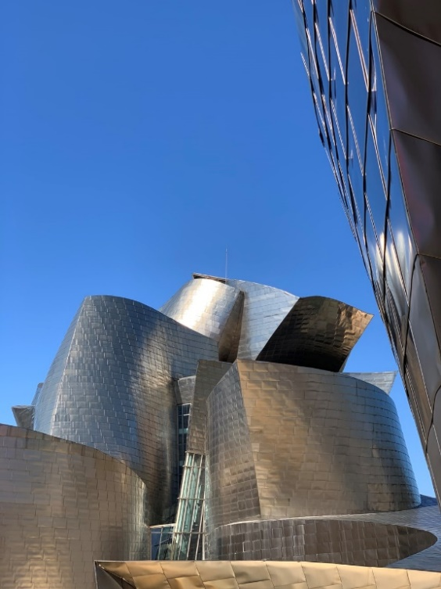
escuchar
Hay ocho personas allí.
En Bilbao, hay un museo famoso.
escuchar
Escucha. ¿Quiénes son las personas, y cómo son?
Escribe la persona y el adjetivo en inglés.
1
_______
5
________________
A tall mother
An important female author
2
_______
6
_________________
A short father
An interesting male teacher
3
_______
7
_________
A silly sister
A nervous male director/headteacher
El Guggenheim, Bilbao
________
___________
4
8
A cheerful female director/headteacher
A nice brother
Notes:
Timing: 6 minutes
Aim: to practise both retrieval of vocabulary and processing of the word order change from Spanish to English.
Procedure:
1. Ask the students to write 1-8 in their books and to write down in English the noun and the adjective that they hear. Each sentence of the instructions is revealed with a click.
2. The teacher clicks the number button to play the short recording.
3. Clicking will reveal the answers in turn in English.
Transcript:
una madre alta
un padre bajo
una hermana tonta.
un hermano simpático
una autora importante
un profesor interesante
un director nervioso
una directora alegre
Notes:
1. All nouns here are recycled from vocabulary sets revisited this week in the NCELP Y7 Spanish SoW.
2. Teachers could give a quick description of the Guggenheim museum here, and maybe where Bilbao is, for background cultural knowledge.
Answers:
1/ a tall mother; 2/ a short father; 3/ a silly sister; 4/ a nice brother; 5/ an important (female) author; 6/ an interesting (male) teacher; 7/ a nervous (male) director, headteacher; 8/ a cheerful (female) director

Slide 30
Daniel talks to a friend from his country, Spain, about the beautiful things they have there.
leer
He also says what his Peruvian friends have in theirs.
They have
We have
Escribe la frase completa en inglés.
“Tenemos ríos hermosos.”
We have beautiful rivers.
“Tienen muchas flores rojas.”
They have a lot of red flowers.
“Tienen unas ciudades grandes.”
They have some big cities.
“Tenemos naturaleza diversa.”
We have diverse nature.
“Tienen pájaros verdes.”
They have green birds.
“Tenemos lugares interesantes.”
We have interesting places.
“Tienen árboles bastante antiguos.”
They have quite old trees.
“Tenemos montañas altas”
We have high mountains.
“Tenemos playas muy grandes”
We have very big beaches.
“Solo tienen islas bonitas”
They only have pretty islands.
Notes:
Timing: 8 minutes
Aim: to revisit ‘tenemos’ and ‘tienen’ and also focus students on the word order change from Spanish to English when translating adjectives that follow nouns.
Procedure:
Students should either copy the grid, or just write out ‘we have’ or ‘they have’ for each question before translating the sentence into English.
The teacher clicks to show the tick in either the ‘we have’ or ‘they have’ column, before clicking again to reveal the translation, allowing them to elicit each answer from students.
Notes:
In addition to the new vocabulary, several previously taught words and phonics words are included: montaña [1464], alto [231], isla [810], bonito [891], hermoso [980], flor [739], playa [1475].
‘Diversa’ was chosen as it is an English-Spanish cognate.

Slide 31
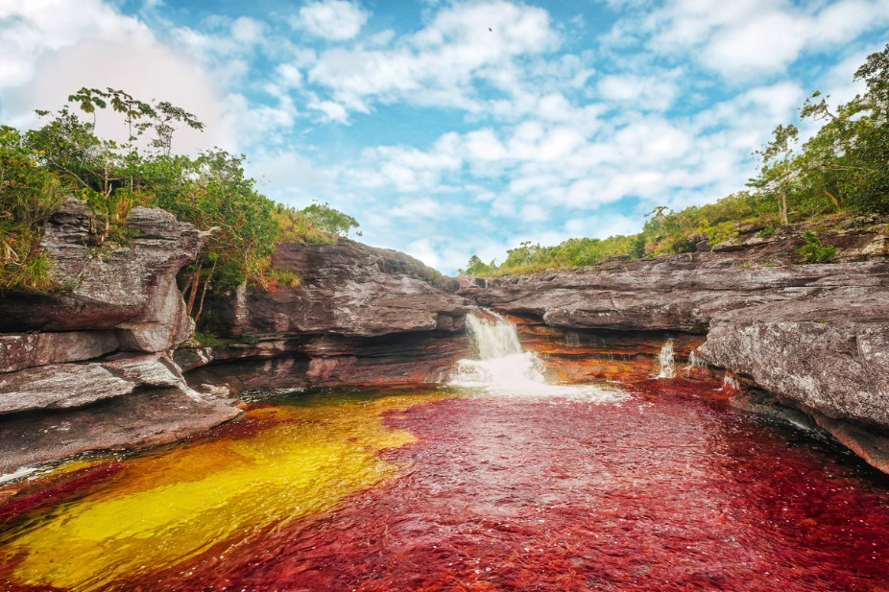
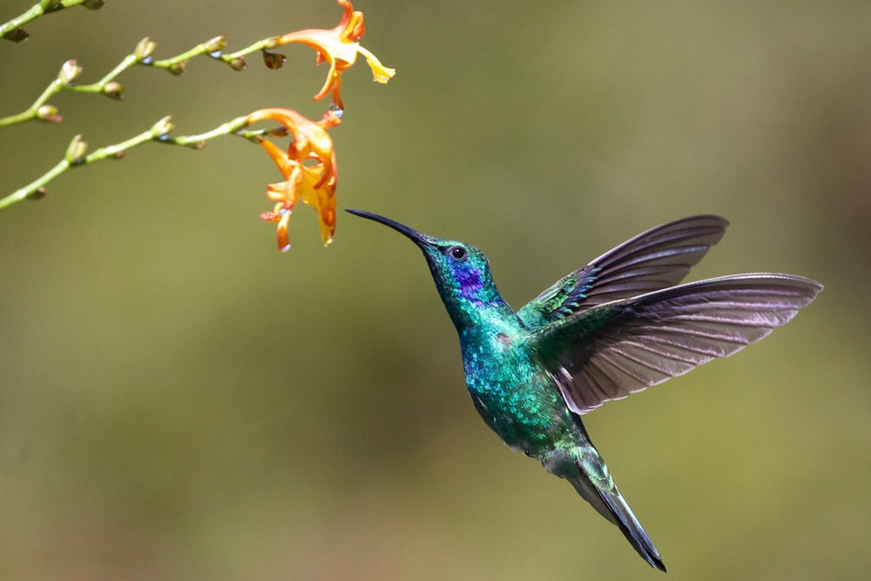
Caño Cristales: un lugar espectacular
leer
Caño Cristales es un río hermoso en el centro de Colombia. Está en un parque nacional cerca de Los Andes y lejos de las ciudades grandes.
El río es muy especial porque es de cinco colores: rojo, verde, azul, amarillo, y negro. Es un lugar perfecto para* tomar fotos de la naturaleza.
No hay cosas feas allí; solo plantas, flores, árboles, animales, y también pájaros pequeños.
El pájaro azul y verde en la imagen es una especie nativa: el ‘colibrí’. ¿Cómo se dice en inglés? Hummingbird!
* para = for
* la especie = species
Notes:
Timing: 10-12 minutes
Aim: different options depending on teacher decisions. Opportunities for grammatical adjective/noun awareness and practice, phonics revision
Procedure:
This text can be exploited in different ways, choose either to do the activity on this slide, slide 39, or slide 40.
Grammatical awareness – students read text and identify how many examples of the ‘adjective following noun’ they can find.
Answer: 7 (río hermoso, parque nacional, ciudad grande, lugar perfecto, cosas feas, pájaro azul y verde; especie nativa). The title ‘un lugar espectacular’ includes another example of this.
Slide 39
3) Phonics revision – The teacher clicks the speaker button. Students listen to the text and write the missing words, which contain words with challenging SSCs.
Slide 40
4) Paired read aloud with prompts to force production of post-nominal adjective (see this slide for procedure)
After each activity the text can be translated in class.
Notes
Teachers could tell students that for many years it was very dangerous and almost impossible for many people to visit Caño Cristales as it was ‘no-go territory’ in the middle of the Colombian Civil War. It was only in recent years due to the peace process that it has been easier to visit for Colombians and foreign tourists alike.
Two words that haven’t been previously taught are included as a gloss: ‘para and ‘especie’. Students will be taught the basic meaning of ‘para’ in next week’s class. They will learn ‘para’ + infinitive in the Year 8 Spanish scheme of work

Slide 32
Caño Cristales: un lugar espectacular
escuchar
Caño Cristales es un río _________
en el centro de Colombia. Está en un parque nacional cerca de Los Andes y ______ de las ciudades grandes.
El río es muy especial porque es de cinco colores: rojo, verde, _____, _______, y negro. Es un lugar perfecto para tomar fotos de la naturaleza.
No hay cosas feas allí; solo plantas, flores, árboles, animales, y también pájaros _____________.
El pájaro en la ____________ es una especie nativa: el ‘colibrí’. ¿Cómo se dice en inglés? Hummingbird!
Notes:
Timing: 10-12 minutes
Aim: Phonics revision
Procedure:
The teacher clicks the speaker button to play the text. Students write the missing words. The text has been adapted slightly to not give away the answers by repeating key words.
Answers are as follows: (these do not appear on the slide)
hermoso – SSC [silent ‘h’]
lejos – SSC [j]
azul – SSC [z]
amarillo – SSC [ll]
pequeños – SSC [ñ]
imagen – SSC [ge]
Notes:
The missing words were selected because they contain a range of previously taught SSCs that can sometimes be challenging for students.

Slide 33
En parejas.
Read the text aloud to your partner, translating into Spanish when necessary.
hablar
Caño Cristales es un ………………………….en el centro de Colombia. Está en un ……………………….. cerca de Los Andes y lejos de las ciudades grandes.
El río es muy especial porque es de cinco colores: rojo, verde, azul, amarillo, y negro. Es un ……………………………para tomar fotos de la naturaleza.
No hay………………..…..allí; solo plantas, flores, árboles, animales, y también pájaros pequeños.
El …………………………….en la imagen es una ………..…………..: el ‘colibrí’. ¿Cómo se dice en inglés? Hummingbird!
beautiful river
national park
perfect place
ugly things
blue and green bird
native species
* nacional = national
* especie = species
Notes:
Timing: 10 minutes
Aim: to practise production of post-nominal adjective in Spanish.
Procedure:
1: Students take it in turns to read out the text, adding the missing words, remembering the change in word order from English to Spanish with nouns and adjectives.
Notes:
Students haven’t previously learnt ‘especie’, ‘nativa’ or ‘nacional’ as vocabulary items so make sure these words are understood from the original text. All 3 are near-cognates but students might not be sure of the spoken form. ‘Especie’ and ‘nacional’ are provided as a gloss to support practice.

Slide 34
7.2.1.4
Slide 42: Writing about the Chinese New Year

Slide 35
escribir
İFeliz año nuevo chino!
Chinese families living in Spain are enjoying the Chinese New Year.
escribir
Escribe la pregunta correcta y la frase completa en inglés :
1) ¿ ___________ dinero tiene Tao?
2) ¿ ___________ son los regalos para Kai?
3) ¿ ___________ regalos tiene Ju?
4) ¿ ___________ es la familia con once regalos?
5) ¿ ___________ está alegre?
6) ¿ ___________ son las personas ricas?
Cuánto
How much money does Tao have?
Cuáles
Which are the presents for Kai?
Cuántos
How many presents does Ju have?
Cuál
Which is the family with eleven presents?
Quién
Who is cheerful?
Quiénes
Who are the rich people?
Note. Su = his/her
Notes:
Timing: 5 minutes
Aim: Writing exercise practising question words
Procedure:
Students should write the correct question word in Spanish that is missing, and then translate the sentence into English.
Answers are shown individually by clicking. Ensure students have remembered the accent.
Teachers can ask students why in 5), ‘está’ is used, rather than ‘es’. (In the context of an event, we’re referring to a state, rather than a trait.)
Notes:
The meaning of ‘su’ is provided as a gloss as this hasn’t yet been taught.

Slide 36
7.2.2.3
Slides 19-20: writing and listening with a callout about paella.

Slide 37
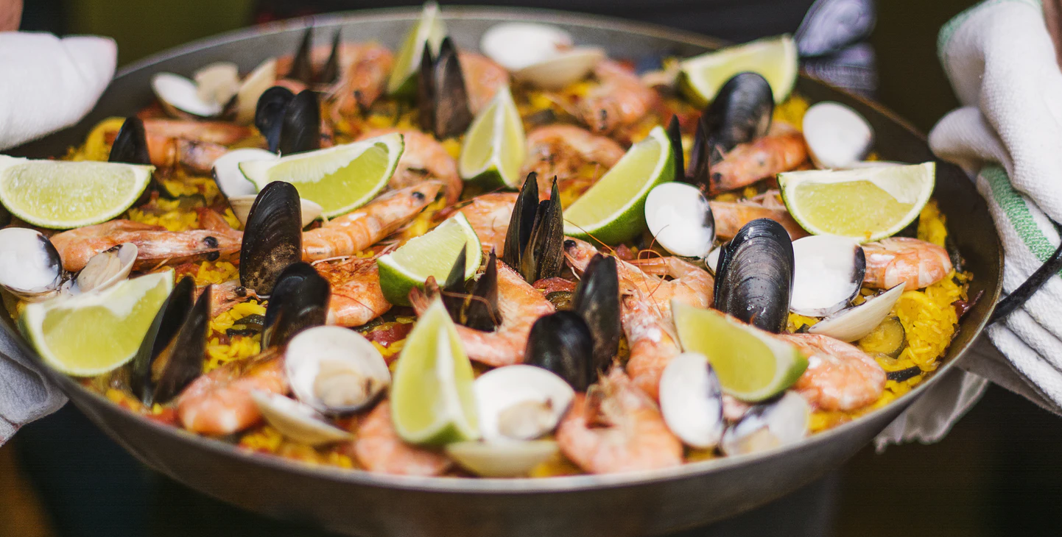
First, complete the text by translating the English words in gaps. Then, listen and check.
Your friend Elvira has left a voicemail.
escribir / escuchar
escribir / escuchar
party
“¡Hola! ¿Cómo estás?
[1] to organize
[2] on Saturday
Quiero _____________ una fiesta _____________ con mi hermana, Sara.
[3] I must speak
[4] help
[5] to participate
______________ con amigos y pedir ____________. ¿Quieres _______________?
¿Qué es una paella?
Es un plato español, tradicional y muy famoso.
[6] I must buy
[7] must carry
____________ comida y Sara _____________ vasos.
[8] I must clean
También ______________ la casa.
[9] to prepare
¿Puedes _____________ una paella? ¡Hasta luego!”
Notes:
[1/2]
Timing: 7 minutes
Aim: to produce the forms ‘debo’ and ‘debe’ in writing; to practise with this week’s vocabulary.
Procedure:
Students read the text and translate the English phrases into Spanish.
Teacher plays the recording and students check their answers.
Teacher shows the answers in the next slide.
Notes:
There is no need for students to copy the whole text or to print it for them – they can just write 1-9 in their books and write the word missing in each gap.
Notice that in the conversation other recently taught modal verbs (quiero, puedes) are also used. Students could be asked to translate these, as they are revisited in the scheme of work this week.
Teachers can also ask students if they know what a paella is and to say what’s in it by looking at the picture (this would be in English).

Slide 38
First, complete the text by translating the English words in gaps. Then, listen and check.
Your friend Elvira has left a voicemail.
escribir / escuchar
escribir / escuchar
party
“¡Hola! ¿Cómo estás?
[1] organizar
[2] el sábadó
Quiero _____________ una fiesta _____________ con mi hermana, Sara.
[3] Debo hablar
[4] ayuda
[5] participate
______________ con amigos y pedir ____________. ¿Quieres _______________?
¿Qué es una paella?
Es un plato español, tradicional y muy famoso.
[6] Debo comprar
[7] debo llevar
_______________ comida y Sara _____________ vasos.
[8] debo limpiar
También ______________ la casa.
[9] preparar
¿Puedes _____________ una paella? ¡Hasta luego!”
Notes:
[2/2]
Answers for the previous activity.

Slide 39
7.2.2.4
Slide 26: reading / grammar based on places in Madrid.
Slides 28-32: speaking and listening based on places in Madrid.

Slide 40
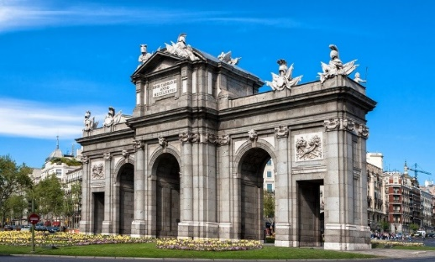
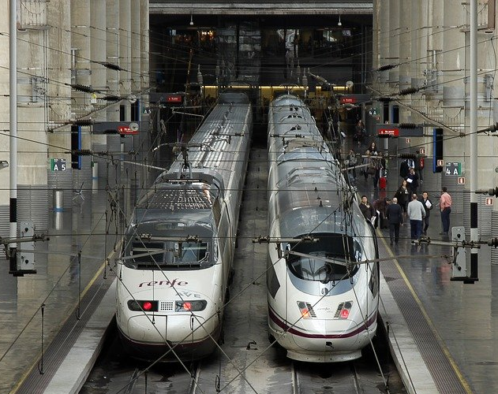
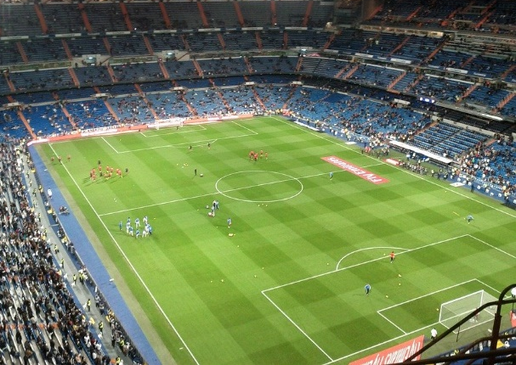
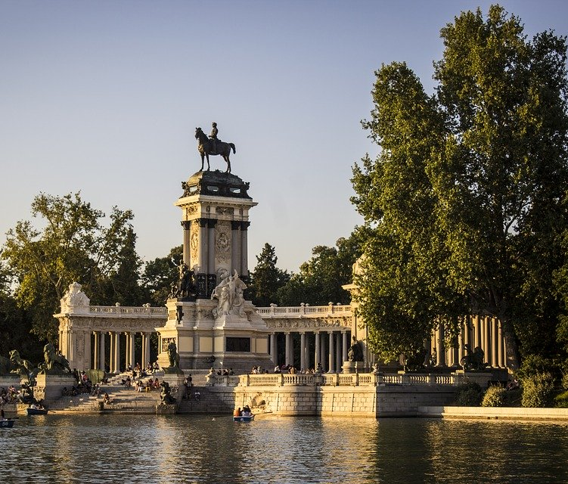
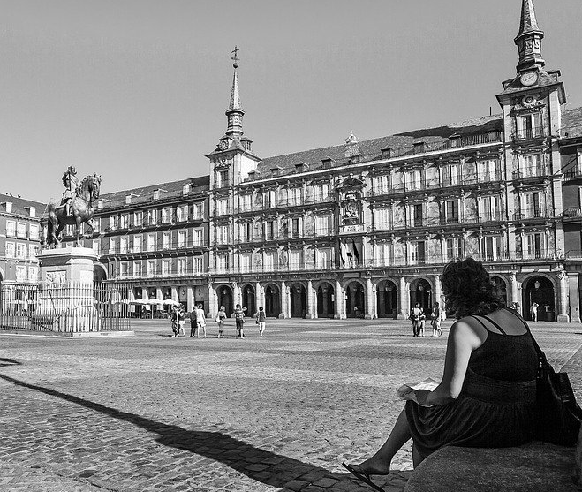
Pep is texting someone. He’s saying where he and his friends are in Madrid. He also says where other friends are.
Puerta de Alcalá (f)
Marca ‘del’ o ‘de la’.
Luego, marca ‘we’ o ‘they’.
Estación Atocha (f)
Estadio Bernabéu (m)
 |  |  | ‘we’ | ‘they’
1. Estamos debajo | de la | Puerta de Alcalá.
 | del
2. Están cerca | del | Parque del Retiro.
 | de la
3. Estamos delante | de la | Estadio Bernabéu.
 | del
4. Están fuera | de la | Estación Atocha.
 | del
5. Estamos detrás | del | Plaza Mayor.
 | de la
Parque del Retiro (m)
Plaza Mayor (f)
Notes:
Timing: 6 minutes
Aim: to consolidate the use of ‘del’ and ‘de la’; to practise linking ‘estamos’ and ‘están’ to the meanings ‘we’ and ‘they’.
Procedure:
Students read each sentence and write ‘del’ or ‘de la’ depending on the gender of the following word.
Students tick the corresponding column, ‘we’ or ‘they’, depending on the verb.
Students translate the sentences to check understanding of the adverbs.
Notes:
The gender of all nouns is given to allow students to focus all their attention on connecting gender with the use of ‘del and ‘de la’. However, teachers could remove the (f) and (m) to increase the challenge for their students, as appropriate.
Teachers might like to prompt students to reflect on the gender of the nouns and to ask them, if needed. E.g., ‘parque, ¿es masculino o femenino?

Slide 41
hablar / escuchar
Un ejemplo
hablar / escuchar
Estamos cerca del....
Persona A (habla):
We are near the [Parque del Retiro]
Don’t say the crossed out part!
Persona B (completa la tabla):
near
Plaza Mayor (f) Parque del Retiro (m)
Notes:
[1/5]
Timing: 12 minutes
Aim: to practise the use of ‘estoy’ and ‘estamos’ , the use of adverbs and the use of ‘del’ or ‘de la’ in oral production.
Procedure:
1. Students work in pairs. Student A reads the the English prompt and translates into Spanish for student B, without showing the card. However, s/he must not say the crossed out word.
2. Student B will listen and complete the grid. S/he has to
choose between ‘I am’ vs ‘we are’, based on the form of ‘estar’ that they hear. Student A’s correct use of ‘estoy’ and ‘estamos’ is needed in order to complete the task.
write the adverb of location (e.g., near)
choose between place A or B, which juxtapose masculine and feminine nouns. Person A’s correct use of ‘del’ and ‘de la’ is needed in order to complete this part of the task.
Note: It is perfectly fine for student A to repeat the sentence, given that there are several pieces of information for Person B to write down.

Slide 42
hablar / escuchar
Persona A
hablar / escuchar
We are near the..
We are below the…
I am in front of the...
Parque del Retiro (m)
Plaza Mayor (f)
Estadio Bernabéu (m)
We are far from the…
I am behind the...
I am outside…
Puerta de Alcalá (f)
Estación Atocha (f)
Museo del Prado (m)
Notes:
[2/5]
Speaking cards – Person A
Do not display during the activity

Slide 43
hablar / escuchar
Persona B
hablar / escuchar
I am outside…
I am behind the...
We are far from the…
Plaza Mayor (f)
Museo del Prado (m)
Estación Atocha (f)
I am in front of the...
We are near the..
We are below the…
Puerta de Alcalá (f)
Estadio Bernabéu (m)
Museo del Prado (m)
Notes:
[3/5]
Speaking cards – Person B
Do not display during the activity

Slide 44
escuchar
Persona B
Escucha. Completa la tabla.
escuchar
‘I am’ | ‘we are’ | near? far? under? behind? outside? in front of? | ¿Dónde? ¿Es ‘A’ o ‘B’?
A
B
1
near
Plaza Mayor (f) Parque del Retiro (m)
2
below
Museo del Prado (m) Plaza Mayor (f)
3
in front of
Estadio Bernabéu (m) Estación Atocha (f)
4
far from
Parque del Retiro (m) Puerta de Alcalá (f)
5
behind
Estación Atocha (f) Estadio Bernabéu (m)
6
outside
Museo del Prado (m) Puerta de Alcalá (f)
Notes:
[4/5]
Answers – Show during feedback

Slide 45
escuchar
Persona A
Escucha. Completa la tabla.
escuchar
‘I am’ | ‘we are’ | near? far? under? behind? outside? in front of? | ¿Dónde? ¿Es ‘A’ o ‘B’?
A
B
1
outside
Plaza Mayor (f) Parque del Retiro (m)
2
behind
Museo del Prado (m) Plaza Mayor (f)
3
far from
Estadio Bernabéu (m) Estación Atocha (f)
4
in front of
Parque del Retiro (m) Puerta de Alcalá (f)
5
near
Estación Atocha (f) Estadio Bernabéu (m)
6
below
Museo del Prado (m) Puerta de Alcalá (f)
Notes:
[5/5]
Answers – Show during feedback

