Slide 1
Cultural Collection
Y7 Spanish Term 1
Author name(s): Pete Watson
Date updated: 29/03/21

Slide 2
Spanish Year 7 Term 1.1 Week 1
Slides 5 (and 7): Phonics
Slides 13-22: Speaking
Slides: 23-30: Listening
Slides: 33-34: Reading and listening
Slides include various Spanish cities and a map situating them.

Slide 3
está
está
[is] (location, state)
Madrid está en España.
[Madrid is in Spain.]
Notes:
Introduce the short form in a sentence.
Note: this is unlikely to cause students any difficulty and is like to be confidence-building for them to translate the meaning so easily. Of course, should learners find it difficult, simply provide the English. The aim here is to provide concrete examples of ESTAR forms in use.

Slide 4
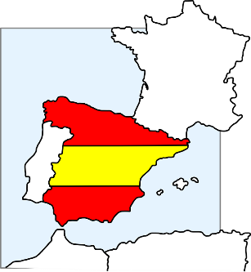
hablar
Está en Inglaterra.
¿Dónde está Granada?
Está en España.
Notes:
Timing: 5 minutes
Aim: 1) To extend practice of SSC [a] to names of cities; 2) to introduce the meaning of ‘está’ as used for ‘it is’ (see note below); 3) to introduce the two new vocabulary items ‘Inglaterra’ and ‘España’
Procedure:
This is a teacher-fronted activity. Teachers can respond chorally.
Ask the group ‘¿Dónde está…?’, with the name of the city. Answer will either be Inglaterra or España.
Note:
You could ask students to pronounce the English towns in a Spanish way - see what they come up with (a good way to assess some prior knowledge of phonics/Spanish).
A couple of the places aren't obvious, so there is genuinely new/surprising info added in here.
We need to deal explicitly with the fact that 'está' stands for two words in English, here - it and is. In the verb slides, we translate 'está' as 'is' and then show it with subjects Madrid and Pablo. Here we see it for the first time meaning 'it is‘.
Note that ‘rr’ and ‘ñ’ are new SSC. Some brief attention will need to be given to RR in Inglaterra and Ñ in España, before they are more formally introduced and practised. It can be quite fun for students to practise rolling the RR! And if students can say ‘lasagne’ they can say ‘España’.

Slide 5
hablar
¿Dónde está Córdoba?
Está en Inglaterra.
Está en España.

Slide 6
hablar
Está en Inglaterra.
¿Dónde está Camborne?
Está en España.
Notes:
After revealing the answer, ask students to pronounce Camborne in a Spanish way - see what they come up with (a good way to assess some prior knowledge of phonics/Spanish).

Slide 7
hablar
¿Dónde está Córdoba?
Está en Inglaterra.
Está en España.

Slide 8
hablar
Está en Inglaterra.
¿Dónde está Kendal?
Está en España.

Slide 9
hablar
Está en Inglaterra.
¿Dónde está Salamanca?
Está en España.

Slide 10
hablar
Está en Inglaterra.
¿Dónde está Aspatria?
Está en España.

Slide 11
hablar
Está en Inglaterra.
¿Dónde está Maldon?
Está en España.

Slide 12
hablar
Está en Inglaterra.
¿Dónde está Soria?
Está en España.

Slide 13
hablar
Está en Inglaterra.
¿Dónde está Cantabria?
Está en España.

Slide 14
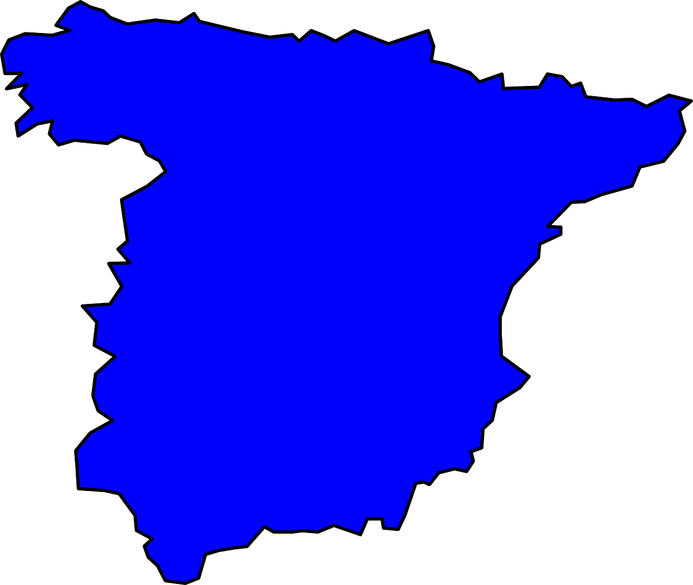
¿Dónde está el palacio Miramar?
Bilbao
San Sebastián
el museo Guggenheim
el palacio Miramar
Barcelona
Madrid
el camp Nou
el museo del Prado
la Sagrada Familia
el Bernabeu
Córdoba
la Mezquita-Catedral
Está en San Sebastián.
Granada
la Alhambra
Notes:
Timing: 5 minutes (slides 23-30)
Aim: for students to produce sentences with ‘está’ (with the meaning ‘it is’) and to develop further confidence and accuracy in producing [a]
Procedure:
1. Teacher reads aloud the question (which appears on click)
2. Students then have to identify the city and try to pronounce it, focusing on the ‘a’ sound. 3. Elicit choral responses (all students speaking at the same time) to give them more confidence
4. Reinforce the phonic awareness by re-stating the answer yourself when it appears.
Notes:
1. This activity also familiarises students with the landmarks which are referred to in the later listening and reading activities which follow.
2. Students may also want to tell you if they have visited these places and this task offers an independent learning opportunity for students to find out more about these (and other) famous places in Spain after the lesson.

Slide 15
¿Dónde está la Alhambra?
Bilbao
San Sebastián
el museo Guggenheim
el palacio Miramar
Barcelona
Madrid
el camp Nou
el museo del Prado
la Sagrada Familia
el Bernabeu
Córdoba
la Mezquita-Catedral
Está en Granada.
Granada
la Alhambra

Slide 16
¿Dónde está el Bernabeu?
Bilbao
San Sebastián
el museo Guggenheim
el palacio Miramar
Barcelona
Madrid
el camp Nou
el museo del Prado
la Sagrada Familia
el Bernabeu
Córdoba
la Mezquita-Catedral
Está en Madrid.
Granada
la Alhambra

Slide 17
¿Dónde está el museo Guggenheim?
Bilbao
San Sebastián
el museo Guggenheim
el palacio Miramar
Barcelona
Madrid
el camp Nou
el museo del Prado
la Sagrada Familia
el Bernabeu
Córdoba
la Mezquita-Catedral
Está en Bilbao.
Granada
la Alhambra

Slide 18
¿Dónde está el museo del Prado?
Bilbao
San Sebastián
el museo Guggenheim
el palacio Miramar
Barcelona
Madrid
el camp Nou
el museo del Prado
la Sagrada Familia
el Bernabeu
Córdoba
la Mezquita-Catedral
Está en Madrid.
Granada
la Alhambra

Slide 19
¿Dónde está el camp Nou?
Bilbao
San Sebastián
el museo Guggenheim
el palacio Miramar
Barcelona
Madrid
el camp Nou
el museo del Prado
la Sagrada Familia
el Bernabeu
Córdoba
la Mezquita-Catedral
Está en Barcelona.
Granada
la Alhambra

Slide 20
¿Dónde está la Mezquita-Catedral?
Bilbao
San Sebastián
el museo Guggenheim
el palacio Miramar
Barcelona
Madrid
el camp Nou
el museo del Prado
la Sagrada Familia
el Bernabeu
Córdoba
la Mezquita-Catedral
Está en Córdoba.
Granada
la Alhambra

Slide 21
¿Dónde está la Sagrada Familia?
Bilbao
San Sebastián
el museo Guggenheim
el palacio Miramar
Barcelona
Madrid
el camp Nou
el museo del Prado
la Sagrada Familia
el Bernabeu
Córdoba
la Mezquita-Catedral
Está en Barcelona.
Granada
la Alhambra

Slide 22
Gramática
leer
4)
1)
I am
I am
Está en el palacio
Miramar.
Estoy en el museo del
Prado.
s/he is
s/he is
2)
I am
5)
I am
Estoy en el museo
Guggenheim.
Estoy en el Bernabeu.
s/he is
s/he is
3)
I am
6)
I am
Está en La Alhambra.
Está en el Campo
Nou.
s/he is
s/he is
Notes:
Timing: 6 minutes
Aim: to practise attending to the meanings of the verbs ‘estoy’ and ‘está’ in reading comprehension
Procedure:
1. Ask students to write 1-6 in exercise books.
2. Ask them to read the sentence on each postcard and decide which person it must refer to. In their books they should write ‘I am’ or ‘s/he is’
3. Check answers item by item.

Slide 23
Gramática
escuchar
Sofia misses her boyfriend! She explains why.
Listen. Write ‘I am’ or ‘he is’
Listen again and write the city name.
I am | he is | City
1
Granada
2
Madrid
3
Barcelona
4
San Sebastián
5
Bilbao
6
Córdoba
7
Madrid
8
Barcelona
Notes:
Timing: 8 minutes
Aim: to practise attending to the meanings of the verbs ‘estoy’ and ‘está’ in listening comprehension and to practise transcribing city/place names with SSC [a]
Procedure:
1. Ask students to write 1-8 in their books.
2. Tell them that they will sentences using the verbs ‘estoy’ and ‘está’.
3. The first time they listen, they should write ‘I am’ or ‘he is’, depending on the verb.
4. The second time they listen, they should write the city.
Transcript:
Está en la Alhambra
Estoy en el museo del Prado
Estoy en el campo Nou
Está en el palacio Miramar
Estoy en el museo Guggenheim
Está en la Mesquita-Catedral
Está en el Bernabeu
Estoy en la Sagrada Familia

Slide 24
¡A hablar!
hablar
Partner A
(verb) + (city)
Granada
Está
en Granada.
Partner B
translation
He is in Granada.
Notes:
Speaking activity
Timing: 10 minutes
Aim: to use sentences with ‘estoy’ and ‘está’ in oral production
Procedure:
See separate set of cards (word doc) Students play the game as described below:
1 Separate the cards into two piles – verbs and cities.
2 Partner A picks a verb and then a city, says the Spanish sentence. 3 Partner B translates into English. 4 Players then swap roles. If pairs time themselves, they can then repeat the activity to see how quickly they can complete all the sentences and translations. With each new game, different sentences will be generated.
Note: Students could make these cards themselves i.e. fold A4 paper so it makes 12 rectangles - write 'I' x 3, he/she x 3, (this will be a cue/prompt to recall the correct verb in Spanish), then 6 cities that they remember. They could all do this so that they have 24 playing cards in total, when put together. This is good practice for spelling / memory / sounding out city names as they write them.

Slide 25
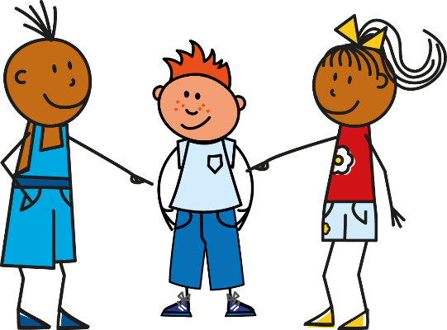
¡A hablar!
leer / hablar
Bilbao
Madrid
Barcelona
Valencia
Granada
San Sebastián
[I am]
[He is]
Está en Granada.
Está en Bilbao.
Estoy en Barcelona.
Estoy en San Sebastián.
Estoy en Valencia.
Está en Madrid.
Notes:
OPTIONAL - alternative speaking activity
Timing: 5 minutes
Aim: to correctly use the verbs ‘estoy’ and ‘está’ in oral production and further practise SSC [a]
Procedure:
Each click brings up a combination of prompts (one for the verb, one for the city)
Elicit the correct sentence from students.
In total, there are six sentences to produce.
Notes:
1. This may be more suitable for more remote learning than the previous activity as it does not require printing or a partner.

Slide 26
7.1.1.2
Slides 29-31 Spanish names

Slide 27
Gramática
hablar / escuchar
Partner A
Partner B
Estoy (+ adjective)
(Name!)
İSí! / İNo!
Notes:
Grammar speaking activity (speaking)
Timing: 10-12 mins (slides 29-31)
Aim: to practise, the use of ‘estar’ for temporary states and adjective gender agreement in speaking and listening
Procedure:
Display slide 31 for the whole class
Give students time to individually choose and write down 8 names. These are the characters that they will then describe.
Players take it in turns describe a person using adjectives, whilst the other player has to identify who is being described from the adjective (-o, -a used)
Note:
1. The person describing who they are must not say the name of the person as this gives away the answer! The idea here is to make the gender agreement on the adjective essential to completion of the task.

Slide 28
Gramática
hablar / escuchar
Marco
Helena
Clara
Felipe
(nervous)
(nervous)
(pale)
(pale)
Lucía
Paulo
Emilio
Ema
(serious)
(serious)
(strange)
(strange)
Chloe
Oscar
Ela
Chloe
Luca
(calm)
(calm)
(silly)
(silly)
Diego
Ana
María
Felix
(ready)
(ready)
(ill)
(ill)
enfermo = ill
Notes:
PROMPT CARDS – DISPLAY FOR WHOLE CLASS DURING ACTIVITY
An alternative model for carrying out the activity is provided on the next slide.

Slide 29
Gramática
hablar / escuchar
(nervous)
Marco
Clara
(pale)
(serious)
Lucía
Ema
(strange)
(calm)
Luca
Ela
(silly)
(crazy)
Diego
(ready)
Felix
Notes:
The activity can either be done using the previous slide only (displayed for the whole class) OR you can print this and the next slide (32-33) and follow the instructions below:
Partner A prompt cards
Procedure:
1. Bring up the main master slide (31)
2. Cut up these cards into 8 separate cards and put them into a small envelope/bag.
3. Partner A picks out a card and gives a sentence to describe it (WITHOUT using the name!)
e.g. ‘Está rara’
4. Partner B would then look at the board and give the correct name, in this case ’Ema’
Partner A would reply ‘Sí ‘ if correct or ‘No’ if incorrect. For each correct identification players could tally their scores.
The same procedure will apply for the speaking cards on the next slide. These will be the cards for Partner B to pick out.

Slide 30
Gramática
hablar / escuchar
Helena
(nervous)
Felipe
(pale)
Paulo
(serious)
Emilio
(strange)
Chloe
(calm)
Oscar
(silly)
Ana
(crazy)
María
(ill)
Notes:
Partner B prompt cards
Cut up these cards into 8 separate cards and put them into a small envelope/plastic bag.
Partner B picks out a card and gives a sentence to describe the card (WITHOUT using the name!)
e.g. ‘Está raro’
Partner A would then look at the master and give the correct name, in this case ‘Emilio’
Partner B would reply ‘Sí ‘ if correct or ‘No’ if incorrect. For each correct identification players could tally their scores.

Slide 31
7.1.1.3
Slides 34-37: Speaking activity with Spanish names

Slide 32
¿Quién soy?
hablar / escuchar
Partner A
Partner B
Soy (+ adjective)
¿Eres (+ name)?
Sí / No
Notes:
Speaking/listening activity
Aim: to work with a partner to identify the characters as quickly as possible; to practise use of adjective agreement and question intonation
Procedure:
1. Explain the title of the slide – who am I? Explain the two component parts of the phrase.
2. Use this slide to model the instructions for the pair work before displaying the master (next slide).
3. Give students 30 seconds to write down 8 names (mixture of boys/girls). Alternatively, use the final slide in this PPT to allocate 8 names to each student.
3. Work in pairs. Partners take it in turns to select a name from their own list. They give a sentence to describe themselves (Soy…).
4. The other player has to identify who is being described, using raised question intonation.
Explain to the pupils that they have to pronounce the adjective correctly, with the correct ending, otherwise their partner cannot know who they might be.
Students put their hands up when they have finished.
At the end of the game, point out to them that grammar features (in this case masc/fem adjective endings) often help us to pinpoint the correct meaning more quickly, but not always!
Note:
1. Students have been using flat intonation of statements in their speaking tasks so far, for I am, you are and s/he is. Here they use the same word order but raised intonation to turn the statement into a question. Model this with the class a few times, contrasting flat/raised intonation. In subsequent weeks, yes/no questions using intonation will continue to be used.
2. alegre and interesante have been included deliberately here. Students may have to guess twice to get this identity.
3. the pronunciation of names gives an opportunity for phonological decoding. Names have been chosen for revising vowels and a few consonants that students have met in passing, J, R.
Word frequency (1 is the most frequent word in Spanish): simpatico [3350], alegre [2082], guapo [4193], alto [232], bajo [237], tranquilo [1073], famoso [997], interesante [617]
Source: Davies, M. & Davies, K. (2018). A frequency dictionary of Spanish: Core vocabulary for learners (2nd ed.). Routledge: London

Slide 33
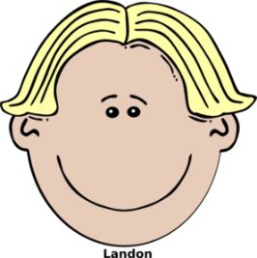
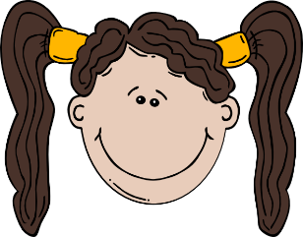
Paco
Elena
Clara
Pablo
(quiet, calm)
(quiet, calm)
(famous)
(interesting)
Irene
David
Serena
Rafa
(tall)
(short)
(tall)
(good-looking)
Juan
Carlos
Arturo
(short)
(nice)
(cheerful)
(famous)
Clementina
Fidelia
Alma
Raúl
Belén
(interesting)
(nice)
(good-looking)
(cheerful)
Notes:
Quién soy? - Who am I?
Display this on the board whilst the speaking activity is taking place.

Slide 34
¡A escribir!
escribir
The following characters will also appear in the school play. You can decide their characters. Write a description of each. Pay attention to adjective spellings.
1 | Señora Fuentes
2 | Señor Gris
3 | Rafaela
4 | Sofía
5 | Diego
6 | Mía
7 | Roberto
8 | Ernesto
e.g. 1) Es alta y alegre.
Notes:
Writing activity
Timing: 7 minutes
Aim: to write more freely using adjective agreement
Procedure:
1. Students write a sentence for each character.
2. They will need to write using the correct form of the adjective, depending on the person (male/female)
3. Ask students to volunteer example sentences for each person

Slide 35
Name tables
Carlos Serena Juan Arturo Fidelia Elena David Clementina
Carlos Serena Juan Arturo Fidelia Elena David Clementina
Carlos Serena Juan Arturo Fidelia Elena David Clementina
Carlos Serena Juan Arturo Fidelia Elena David Clementina
Carlos Serena Juan Arturo Fidelia Elena David Clementina
Carlos Serena Juan Arturo Fidelia Elena David Clementina
Carlos Serena Juan Arturo Fidelia Elena David Clementina
Carlos Serena Juan Arturo Fidelia Elena David Clementina
Carlos Serena Juan Arturo Fidelia Elena David Clementina
Carlos Serena Juan Arturo Fidelia Elena David Clementina
Carlos Serena Juan Arturo Fidelia Elena David Clementina
Carlos Serena Juan Arturo Fidelia Elena David Clementina
Carlos Serena Juan Arturo Fidelia Elena David Clementina
Carlos Serena Juan Arturo Fidelia Elena David Clementina
Carlos Serena Juan Arturo Fidelia Elena David Clementina
Carlos Serena Juan Arturo Fidelia Elena David Clementina
Clara Pablo Paco Alma Irene Raúl Rafa Belén
Clara Pablo Paco Alma Irene Raúl Rafa Belén
Clara Pablo Paco Alma Irene Raúl Rafa Belén
Clara Pablo Paco Alma Irene Raúl Rafa Belén
Clara Pablo Paco Alma Irene Raúl Rafa Belén
Clara Pablo Paco Alma Irene Raúl Rafa Belén
Clara Pablo Paco Alma Irene Raúl Rafa Belén
Clara Pablo Paco Alma Irene Raúl Rafa Belén
Clara Pablo Paco Alma Irene Raúl Rafa Belén
Clara Pablo Paco Alma Irene Raúl Rafa Belén
Clara Pablo Paco Alma Irene Raúl Rafa Belén
Clara Pablo Paco Alma Irene Raúl Rafa Belén
Clara Pablo Paco Alma Irene Raúl Rafa Belén
Clara Pablo Paco Alma Irene Raúl Rafa Belén
Clara Pablo Paco Alma Irene Raúl Rafa Belén
Clara Pablo Paco Alma Irene Raúl Rafa Belén
Notes:
Slide that can optionally be used as part of the ‘who am I’ activity to allocate names to students. This would be printed and cut up.
These cards are split into two sets (divided by the orange line). A card from each set would be given to each pair of students.

Slide 36
7.1.1.5
Slide 14: vocabulary with callout about El País

Slide 37
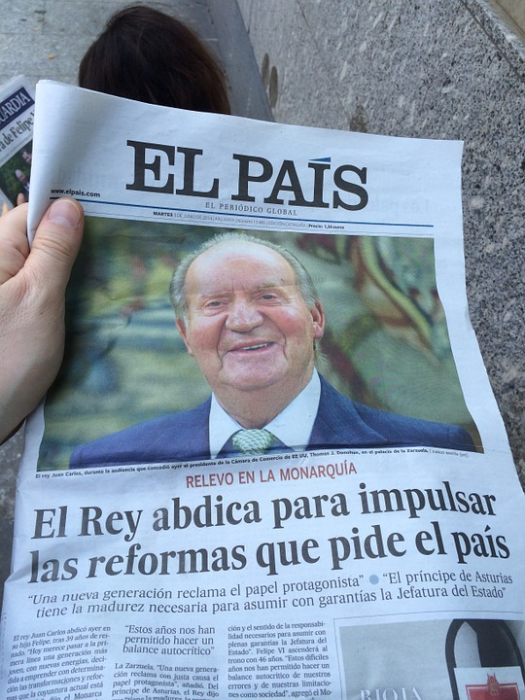
periódico
Vocabulario
El País is one of the most important Spanish national newspapers.
un
una
Notes:
Image retrieved from https://unsplash.com/ (freely usable images)

Slide 38
7.1.1.6
Slides 49-57 Speaking and listening, involving various countries and photos with callouts
Slide 61: Writing that could be exploited for research on Latin American Spanish-speaking countries.

Slide 39
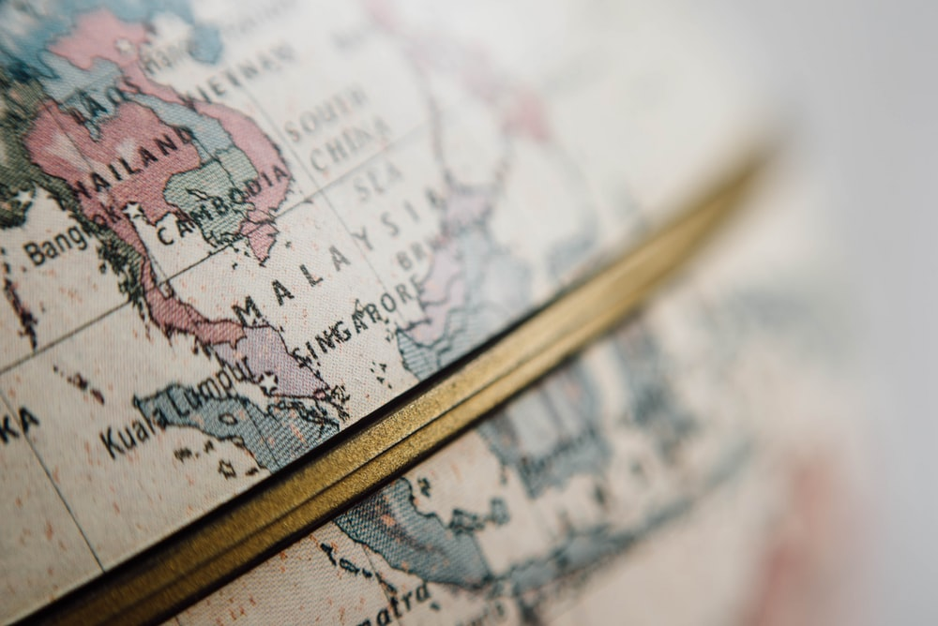
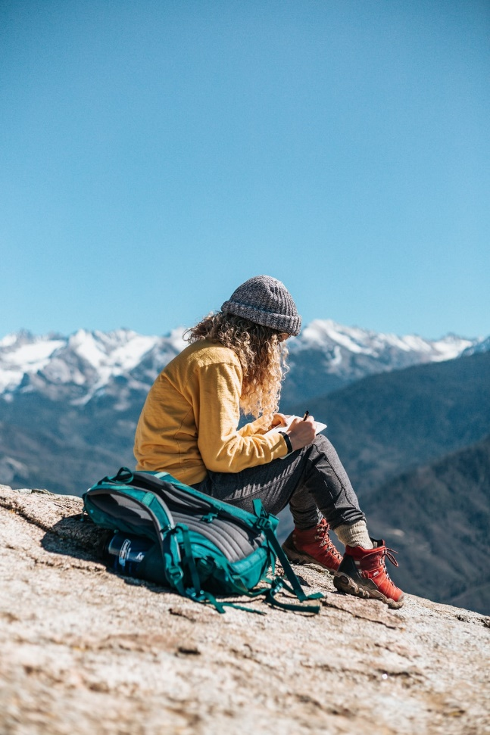
La gran aventura de Paula
Notes:
Pictures from https://unsplash.com/ (freely usable images)

Slide 40
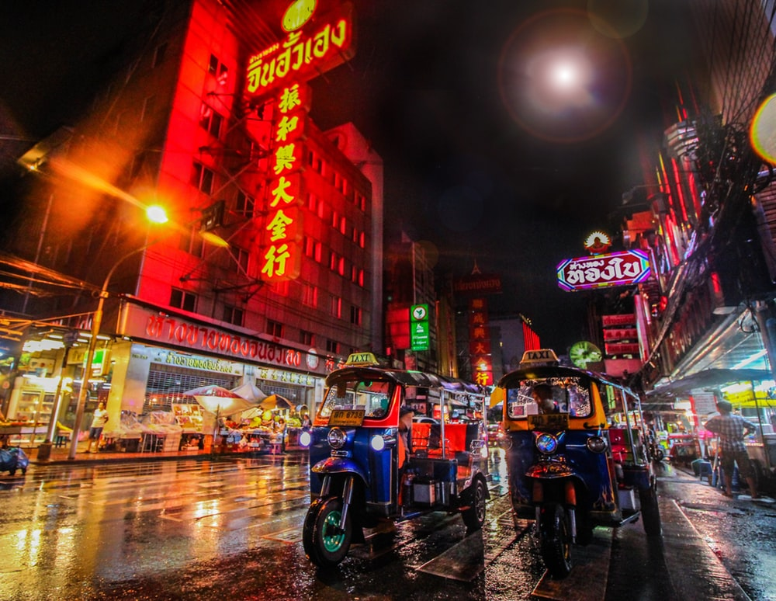
Bangkok
¿Dónde está…?
Tailandia
Malasia
China
Notes:
This mini-quiz activates world knowledge before the main narration activity.
Encourage students to answer in full sentences here – ‘Bangkok está en Tailandía’
Note: these three destinations have either previously-taught SSC OR SSC which are similar to English, therefore we can simply ask the question here and students apply their SSC knowledge when reading their answer aloud.

Slide 41
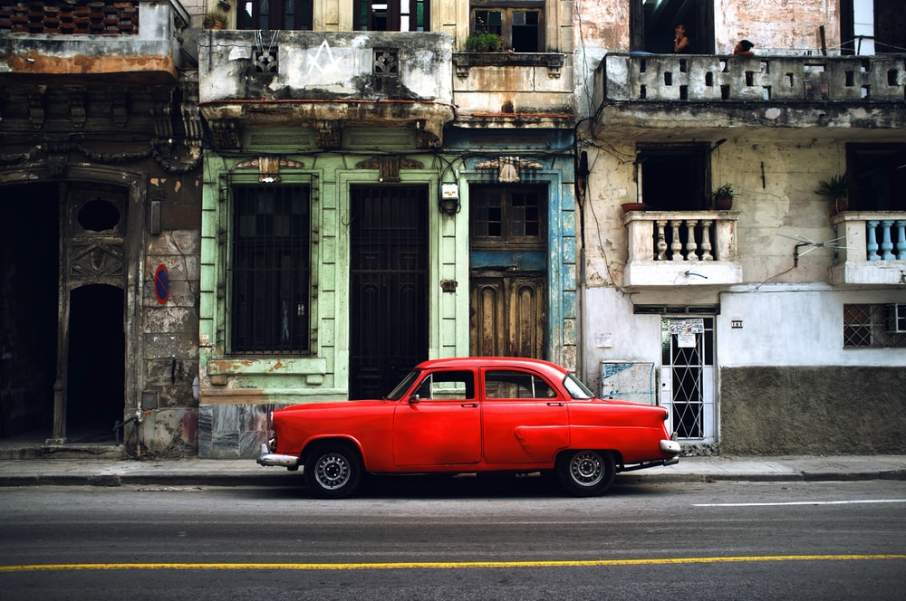
La Habana
¿Dónde está…?
El Salvador
Cuba
Guatemala
Notes:
Note: these three destinations have either previously-taught SSC OR SSC which are similar to English, therefore we can simply ask the question here and students apply their SSC knowledge when reading their answer aloud.

Slide 42
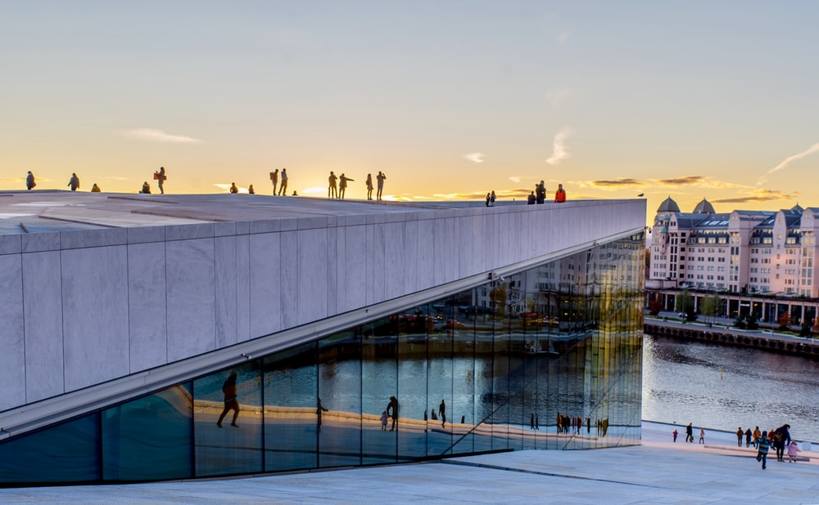
Oslo
¿Dónde está…?
Noruega
Polonia
Finlandia
Notes:
Note: these three destinations have either previously-taught SSC OR SSC which are similar to English, therefore we can simply ask the question here and students apply their SSC knowledge when reading their answer aloud.

Slide 43
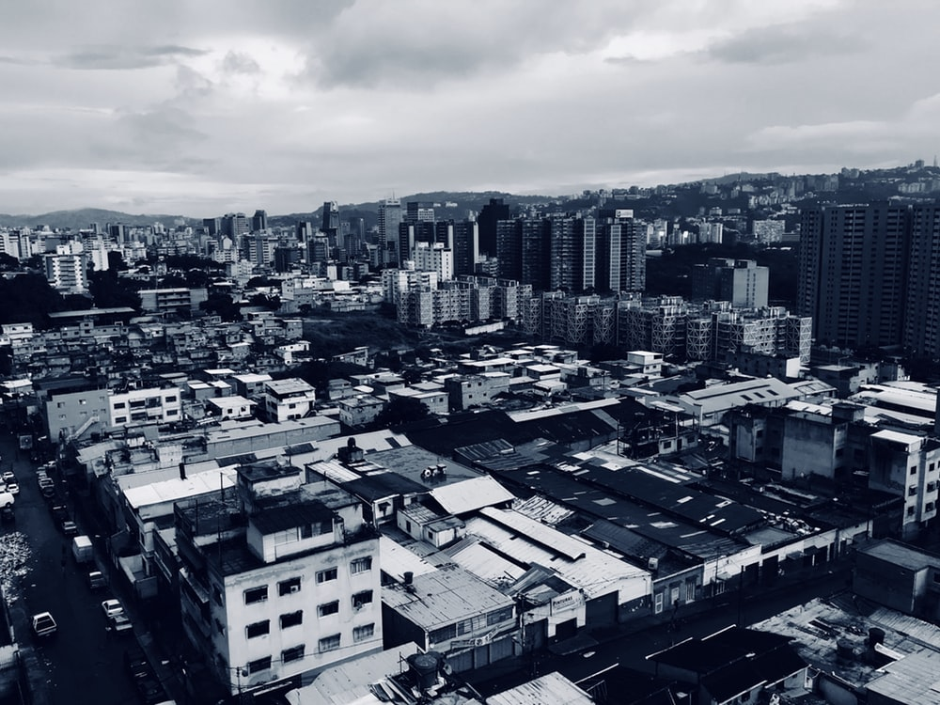
Caracas
¿Dónde está…?
Brasil
Venezuela
Chile
Notes:
Note: There are some new SSC included in the destinations, so we will want to give options to students, so that they can hear a strong model in the input, before selecting and repeating the word in their answer.
E.g. ¿Dónde está Caracas…? Brasil, Venezuela o Chile?

Slide 44
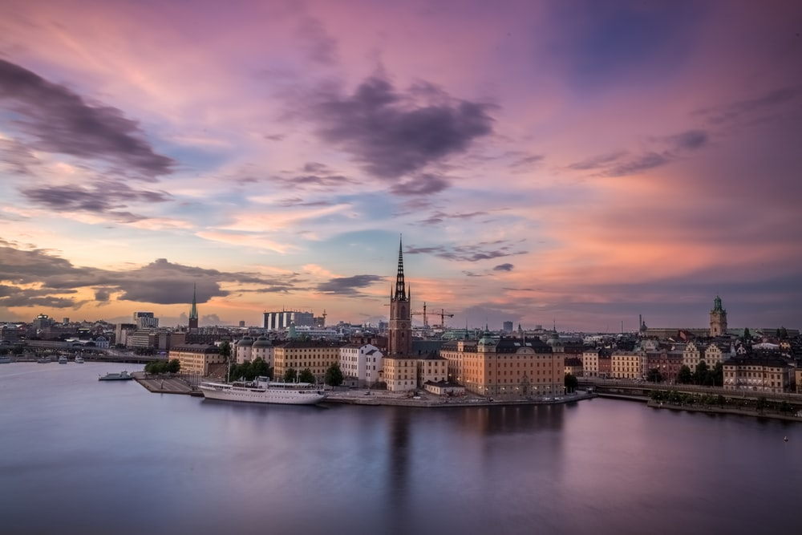
Estocolmo
¿Dónde está…?
Finlandia
Suecia
Francia
Notes:
Note: There are some new SSC included in the destinations, so we will want to give options to students, so that they can hear a strong model in the input, before selecting and repeating the word in their answer.
E.g. ¿Dónde está Estocolmo…? Finlandia, Suecia or Francia?

Slide 45
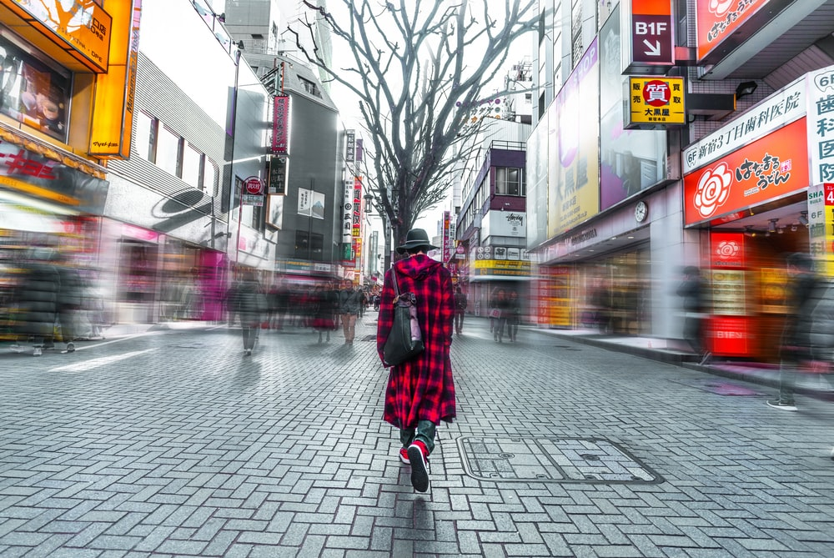
Tokio
¿Dónde está…?
Inglaterra
Francia
Japón
Notes:
Note: There are some new SSC included in the destinations, so we will want to give options to students, so that they can hear a strong model in the input, before selecting and repeating the word in their answer.
E.g. ¿Dónde está Tokio…? Inglaterra, Francia o Japón?

Slide 46
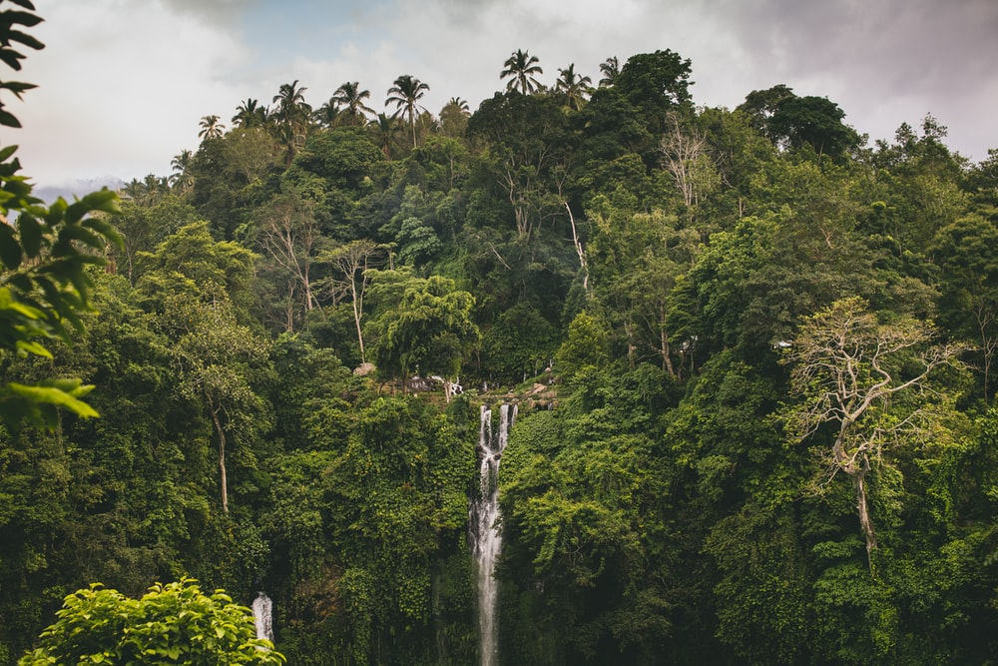
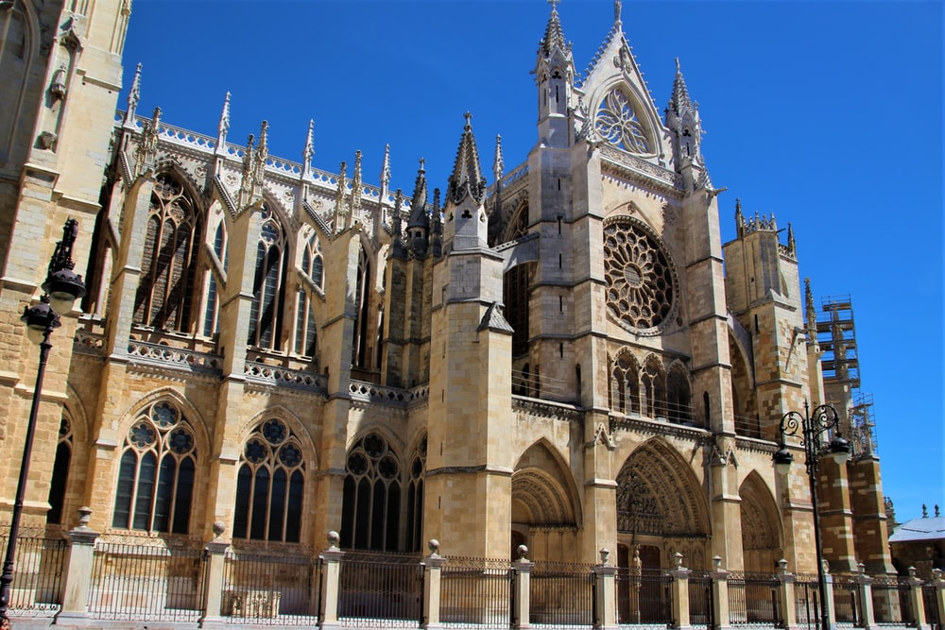
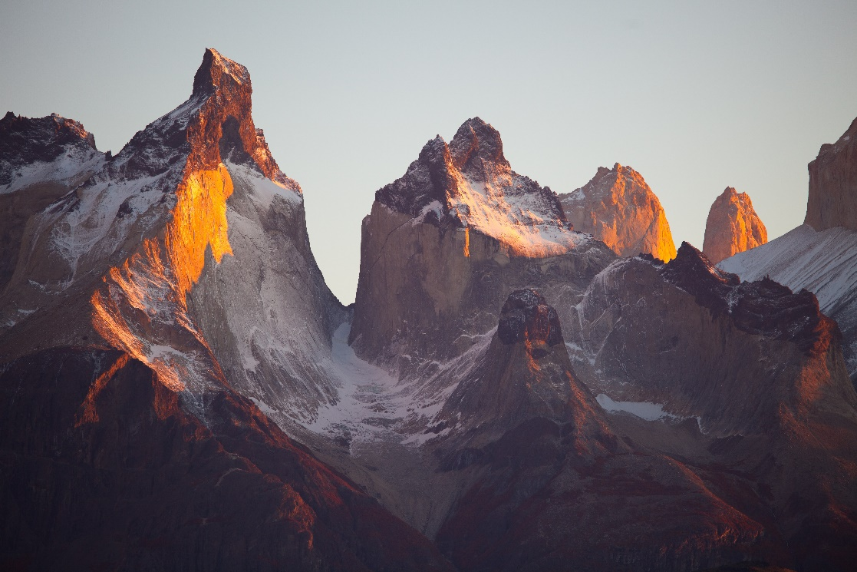
¿León?
B
A
Brasil
C
España
Chile
Notes:
Ask students to guess if it’s picture A, B, or C. Pictures from https://unsplash.com/ (freely usable images)

Slide 47
escuchar
What does she do?
In La Habana she
1
speaks with a (female) friend.
In Bangkok she
2
dances with a (male) friend.
buys a house.
3
In Caracas she
In Stockholm she
4
listens to music.
In Los Llanos she
5
arrives late.
In Tokio she
6
has a party.
In Oslo she
7
forgets a book
In California she
8
buys a boat
Notes:
Listening activity (pre-narration)
Timing: 6 minutes
Aim: to recognise the meanings of previously taught vocabulary items
Procedure:
1. Click on each orange button to play audio
2. Complete the sentence in English
3. Multiple repetitions may be needed
Note:
1. Make sure that students are aware that, when referring to a destination, Spanish uses ‘llegar A’ (‘en’ would refer to the means of arriving).
Transcript:
Habla con una amiga en La Habana.
Baila con un amigo en Bangkok.
Compra una casa en Caracas.
Escucha música en Estocolmo.
Llega tarde a Los Llanos.
Tiene una fiesta en Toledo.
Olvida un libro en Oslo.
Compra un barco en California.
Word frequency (1 is the most frequent word in Spanish): escuchar [281], comprar [361], llegar [75], hablar [90], bailar [1323], tener [19], olvidar [415]
Source: Davies, M. & Davies, K. (2018). A frequency dictionary of Spanish: Core vocabulary for learners (2nd ed.). Routledge: London

Slide 48
Deberes: una tarea escrita
Write the story of someone’s world trip. Use the present tense.
Use the verbs hablar, bailar, comprar, escuchar, olvidar, llegar.
Remember to use the –a verb ending for s/he.
City and country names are sometimes different in Spanish! Check this in a dictionary.
Notes:
OPTIONAL HOMEWORK TASK

Slide 49
7.1.1.7
Slides 8-9: Phonics, listening mentioning pronunciation differences between Spain, the Canaries and Latin America.
Slides 29-30 Phonics, listening
Slide 39: reading including a callout about Federico García Lorca.

Slide 50
There are different ways to pronounce CE and CI.
Fonética
In most of Spain, the ‘c’ before ‘e’ or ‘i’ is pronounced like the ‘th’ in English (as you just heard).
In the Canary Islands and Latin America, this ‘c’ is often pronounced like an ‘s’.
Compare:
ciencias
(mainland Spain)
1
ciencias
(Canaries & Latin America)
2
Notes:
Phonics introduction slide
Timing: 2 minutes
Aim: to raise awareness of variation in sound-spelling correspondences within the Spanish-speaking world
Procedure:
Click to bring up each new part of the explanation
Click on the orange action buttons to hear the difference in pronunciation modelled by a native speaker.
Notes:
1. Teachers may find it useful to consider the information from exam board specifications below:
AQA: “The [listening] test will be studio recorded using native speakers speaking Castilian in clearly articulated, standard speech at near normal speed. Different types of spoken language will be used, using familiar language across a range of contemporary and cultural themes. (p. 82)
EdExcel/Pearson : “For listening and reading assessments, the majority of contexts are based on the culture and countries where the assessed language is spoken. […] It is, therefore, important that students are exposed to materials relating to Spanish-speaking countries throughout the course.” (p. 7)
WJEC : “This GCSE specification in Spanish for use in Wales is based on a conviction that learners studying a modern foreign language will develop their desire and ability to communicate with and understand speakers of Spanish in a variety of contexts and for a variety of purposes.” (p. 3)

Slide 51
escuchar
Latin America/Canaries | Mainland Spain
1
2
Is the pronunciation more likely to be mainland Spain or Latin America / Canaries?
3
4
5
Listen and tick the most likely answer.
6
7
8
9
10
Notes:
Listening activity - phonics
Timing: 6 minutes
Aim: to help students to recognize pronunciation of [ce] and [ci] in different parts of the Spanish-speaking world
Procedure:
Click on each action button to hear the audio.
Note: you could additionally ask students to listen again and write the word
Transcript:
Doce
Ciencias
Decir
Necesario
Cine
Diciembre
Necesitar
Centro
Ciudad
Cierto
Image with creative commons public domain licence
https://mycsres.com/freesheet/spanish-speaking-world-map-18.html.html
Word frequency (1 is the most frequent word in Spanish): doce [1138], centro [ 316], necesitar [276], cierto [159], ciudad [178], decir [31], ciencia [738], necesario [362], cine [952], diciembre [1165]
Source: Davies, M. & Davies, K. (2018). A frequency dictionary of Spanish: Core vocabulary for learners (2nd ed.). Routledge: London

Slide 52
Fonética
escuchar / escribir
Escucha y escribe las letras.
¿CE o CI?
ci
__udad
ce
do__
1
6
___ntro
ce
ne___sario
ce
2
7
ci
ci
de__r
di__embre
3
8
ce
Escucha la pronunciación.
Where is the person more likely to be from?
mainland Spain
Latin America / Canaries
ne___sitar
4
__en__as
ci
ci
5
Notes:
Phonics practice activity
Timing: 5 minutes
Aim: to practise mapping sound to spelling
Procedure:
1. Play the word.
2. Complete the missing letters.
3. Check answers.
Notes: To challenge students further, ask them to turn away from the board to complete the task and write the whole word independently. This allows for differentiation through more/less support. If the whole class is high attaining, then the prompts can be removed from the slide, of course, as per the following slide.
Transcript:
Ciudad
Centro
Decir
Necesitar
Ciencias
Doce
Necesario
Diciembre
Word frequency (1 is the most frequent word in Spanish): doce [1138], centro [ 316], necesitar [276], ciudad [178], decir [31], ciencia [738], necesario [362], diciembre [1165]
Source: Davies, M. & Davies, K. (2018). A frequency dictionary of Spanish: Core vocabulary for learners (2nd ed.). Routledge: London

Slide 53
Fonética
escuchar / escribir
Escucha y escribe la palabra.
¿CE o CI?
ciudad
doce
1
6
centro
necesario
2
7
decir
diciembre
3
8
necesitar
Escucha la pronunciación.
Where is the person more likely to be from?
mainland Spain
Latin America / Canaries
4
ciencias
5
Notes:
Same task, but answers appear as a whole word, rather than just the target graphemes.
Transcript:
Ciudad
Centro
Decir
Necesitar
Ciencias
Doce
Necesario
Diciembre
Word frequency (1 is the most frequent word in Spanish): doce [1138], centro [ 316], necesitar [276], ciudad [178], decir [31], ciencia [738], necesario [362], diciembre [1165]
Source: Davies, M. & Davies, K. (2018). A frequency dictionary of Spanish: Core vocabulary for learners (2nd ed.). Routledge: London

Slide 54
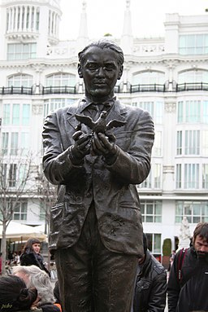
leer
Your class is doing a Spanish play by Federico García Lorca.
Your teacher gives you and a friend stage directions.
Federico García Lorca was a famous Spanish poet and playwright. This statue is in Madrid.
Choose the correct sentence starter and translate the rest.
1. “Llevas unos vasos en una bolsa.”
You carry…
You carry some glasses in a bag.
S/he carries…
2. “Escuchas una conversación.”
S/he listens…
You listen to a conversation.
You listen…
3. “Usa un bolígrafo. Es blanco.”
You use…
S/he uses a pen. It’s white.
S/he uses…
4. “Compra una botella de Pepsi.”
S/he buys…
S/he buys a bottle of Coca-Cola.
You buy…
5. “Necesitas un periódico.”
S/he needs…
You need a newspaper.
You need…
Notes:
Grammar practice activity (reading)
Timing: 5 minutes
Aim: to practise attending to the meanings of present tense –ar verbs in 2nd and 3rd person singular
Procedure:
1. Write 1-5.
2. Read the sentence.
3. For each sentence, write ‘you’ or ‘she’.
Notes:
A callout about Lorca appears after the first line of the slide and then disappears on the next click.
Word frequency (1 is the most frequent word in Spanish): necesitar [276]; usar [317]; llevar¹ [75]; comprar [361]; escuchar [281]; vaso [1609]; bolsa [1581]; conversación [989]; bolígrafo [>5000]; blanco [372]; botella [1878]; periódico [1026]
Source: Davies, M. & Davies, K. (2018). A frequency dictionary of Spanish: Core vocabulary for learners (2nd ed.). Routledge: London
Lorca statue picture from: https://commons.wikimedia.org/wiki/File:Monumento_A_Federico_Garcia_Lorca_(1)_(11982757065)_(2).jpg from someone10x. This image is licensed under the Creative Commons Attribution 2.0 Generic license

Slide 55
7.1.2.1
Slides 5-6: Phonics with details about pronunciation differences between Spain, the Canaries and Latin America.
Slides 23-24: Phonics

Slide 56
There are different ways to pronounce ‘z’.
Fonética
In most of Spain, ‘z’ is pronounced like the ‘th’ in English (as you just heard).
In the Canary Islands and Latin America, this ‘z’ is often pronounced like an ‘s’.
Compare:
zapato
(mainland Spain)
1
zapato
(Canaries & Latin America)
2
Notes:
Phonics introduction slide
Timing: 2 minutes
Aim: to introduce two ways in which [z] may be pronounced
Procedure: Click on the orange number to hear the word.
Notes:
1. Teachers may also find it useful to consider the information from exam board specifications below:
AQA : “The [listening] test will be studio recorded using native speakers speaking Castilian in clearly articulated, standard speech at near normal speed. Different types of spoken language will be used, using familiar language across a range of contemporary and cultural themes. (p. 82)
EdExcel : “For listening and reading assessments, the majority of contexts are based on the culture and countries where the assessed language is spoken. […] It is, therefore, important that students are exposed to materials relating to Spanish-speaking countries throughout the course.” (p. 7)
WJEC : “This GCSE specification in Spanish for use in Wales is based on a conviction that learners studying a modern foreign language will develop their desire and ability to communicate with and understand speakers of Spanish in a variety of contexts and for a variety of purposes.” (p. 3)

Slide 57
Fonética
escuchar / escribir
Escribe 1-8.
Escucha.
¿Dónde está la persona?
Escribe ‘España’ o ‘Latinoamérica / Canarias’.
1
España
2
Latinoamérica / Canarias
3
España
4
Latinoamérica / Canarias
5
Latinoamérica / Canarias
6
España
7
Latinoamérica / Canarias
8
España
Notes:
Phonics practice activity
Timing: 7 minutes
Aim: to practise recognising pronunciation of [z] and the geographical area in which it is typically used
Procedure:
1. Students write 1-8.
2. Click on the orange box to play the audio.
3. Students listen and write down where they think it is more likely to be Spain or Latin America / Canaries.
Notes:
We include two additional high-frequency words (plaza, azul) in the activity for further practice. Both will be taught during Year 7.
Transcript:
Zona
Voz
Cabeza
Diez
Empezar
Zapato
Plaza
Azul
Word frequency (1 is the most frequent word in Spanish): zona [359]; cabeza [265]; voz [252]; diez [449]; zapato [1477]; empezar [175]; plaza [806]; azul [811]
Source: Davies, M. & Davies, K. (2018). A frequency dictionary of Spanish: Core vocabulary for learners (2nd ed.). Routledge: London
Image with creative commons public domain licence
https://mycsres.com/freesheet/spanish-speaking-world-map-18.html.html

Slide 58
escuchar / escribir
¿CE, CI o ZA?
za
Escribe 1-10.
Escucha.
1
__pato
__udad
2
ci
Completa la palabra.
ce
3
do__
ce
¿Dónde está la persona?
4
ne___sitar
ci
5
__erto
za
¿España?
6
cabe__
za
7
empe___r
¿Latinoamérica / Canarias?
__en__as
8
ci
ci
ci
9
de__r
__rca
10
ce
Notes:
Phonics practice task
Timing: 6 minutes
Aim: to correctly transcribe the missing letters from the words
Procedure:
1. Students write 1-10.
2. Students listen and write the missing letters in each case.
3. Teacher asks students, based on pronunciation, whether they think the person is from mainland Spain or Latin America / Canaries.
Notes:
See next slide for variation of the activity where students write the whole of the missing word.
All words are pronounced with Castilian ‘distinción’ (with /θ/ phoneme). [CE] and [CI] are revisited in this activity.
Transcript:
Zapato
Ciudad
Doce
Necesitar
Cierto
Cabeza
Empezar
Ciencias
Decir
Cerca
Word frequency (1 is the most frequent word in Spanish): cabeza [265]; zapato [1477]; empezar [175]; ciudad [178]; doce [1138]; necesitar [276]; cierto [159]; ciencia [738]; decir [31]; cerca [1042]
Source: Davies, M. & Davies, K. (2018). A frequency dictionary of Spanish: Core vocabulary for learners (2nd ed.). Routledge: London

Slide 59
escuchar / escribir
¿CE, CI o ZA?
zapato
Escribe 1-10.
Escucha.
1
ciudad
Completa la palabra.
2
doce
3
necesitar
4
cierto
5
¿Dónde está la persona?
cabeza
6
empezar
¿España?
7
ciencias
8
¿Latinoamérica / Canarias?
decir
9
cerca
10
Notes:
Variation of previous slide: students have to write the whole word
Transcript:
Zapato
Ciudad
Doce
Necesitar
Cierto
Cabeza
Empezar
Ciencias
Decir
Cerca
Word frequency (1 is the most frequent word in Spanish): cabeza [265]; zapato [1477]; empezar [175]; ciudad [178]; doce [1138]; necesitar [276]; cierto [159]; ciencia [738]; decir [31]; cerca [1042]
Source: Davies, M. & Davies, K. (2018). A frequency dictionary of Spanish: Core vocabulary for learners (2nd ed.). Routledge: London

Slide 60
7.1.2.4
Slides 17-19: listening and reading including description of Spanish cities.
Slide 21: writing alongside a map of Spain and city description.

Slide 61
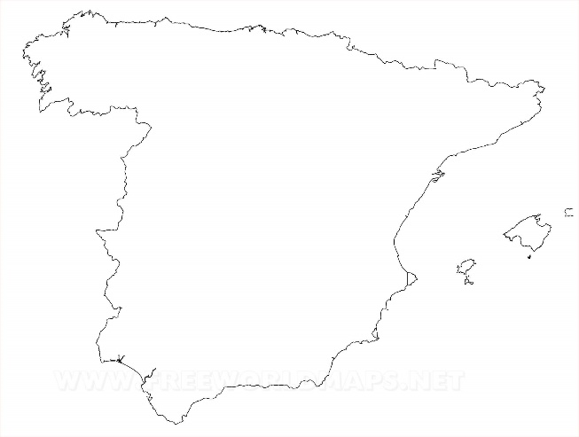
escuchar
Amanda está en España.
Describe tres ciudades: Toledo, Oviedo y León.
Marca la opción correcta.
Escucha otra vez.
 | Toledo (‘it is’) | Oviedo y León (‘they are’)
Escribe el adjetivo en inglés.
1
pretty
2
small, little
Oviedo
3
expensive
León
4
ugly
Toledo
5
old, ancient
6
cheap
7
famous
8
good
9
strange
10
calm, tranquil
Notes:
Listening activity
Timing: 7 minutes
Aim: to practise distinguishing between ‘es’ and ‘son’; to consolidate understanding of the new adjectives
Procedure:
1. Students write 1-10.
2. They listen to each item and write ‘it is’ or ‘they are’.
3. They listen again. This time, they write the adjective in English.
4. Teacher checks answers.
Notes:
Ciudad’ has been practised as a phonics word (T1.1, Week 7).
Transcript:
Es bonito.
Es pequeño.
Son caros.
Son feos.
Es antiguo.
Son baratos.
Es famoso.
Son buenos.
Es raro.
Son tranquilos.
Image free to use. Retrieved from https://www.freeworldmaps.net/europe/spain/political.html
Word frequency (1 is the most frequent word in Spanish): bonito [891]; pequeño [202]; caro [2179]; feo [2373]; antiguo [446]; barato [2164]; famoso [997]; bueno [98]; raro [1005]; tranquilo [1073]
Source: Davies, M. & Davies, K. (2018). A frequency dictionary of Spanish: Core vocabulary for learners (2nd ed.). Routledge: London

Slide 62
leer
Amanda está en España.
Describe diez ciudades.
Lee la segunda frase.
Marca la opción correcta.
Marca la opción correcta.
1
2
3
4
5
Es muy antiguo.
Son muy antiguos.
No son muy bonitos.
No es muy bonito.
Son muy pequeñas.
Es muy pequeña.
Es bueno.
Son buenos.
Es cara.
Son caras.
Madrid
En Madrid
hay un monumento.
León
En León
tiene unos parques.
En Mallorca
Mallorca
hay una escuela.
En Málaga
Málaga
hay unos coches.
San Sebastián
En San Sebastián
tiene unas casas.
Notes:
Reading activity [1/2]
Timing: 8 minutes
Aim: to consolidate understanding of the difference between ‘hay’ and ‘tiene’; to continue distinguishing between the meanings of ‘es’ and ‘son’.
Procedure:
1. Students first decide which sentence starter is correct, based on whether the ending includes ‘hay’ or ‘tiene’.
2. They then decide if the following sentence uses ‘es’ or ‘son’, based on the noun in the preceding sentence.
3. Once items 1-5 are done, go to next slide for 6-10.
Notes:
1. Check that ‘segunda’ is clear – this was introduced as a phonics practice word earlier in the lesson.
2. Differentiation: higher-achieving groups may be able to complete both parts of the task as they read each item.
Word frequency (1 is the most frequent word in Spanish): monumento [3149]; parque [1354]; escuela [424]; coche [1190]; casa [106]; bonito [891]; pequeño [202]; caro [2179]; antiguo [446]; bueno [98]
Source: Davies, M. & Davies, K. (2018). A frequency dictionary of Spanish: Core vocabulary for learners (2nd ed.). Routledge: London

Slide 63
leer
Amanda está en España.
Describe diez ciudades.
Lee la segunda frase.
Marca la opción correcta.
Marca la opción correcta.
6
7
8
9
10
Es feo.
Son feos.
Son ricas.
Es rica.
Son muy famosas.
Es muy famosa.
Es malo.
Son malos.
Es muy barato.
Son baratos.
Granada
En Granada
tiene un bar.
En Oviedo
Oviedo
hay unas personas.
Santiago de Compostela
En Santiago de Compostela
tiene una catedral.
En Santander
Santander
hay un barco.
Barcelona
En Barcelona
tiene unos teatros.
.
Notes:
Reading activity [2/2]
Notes: ‘Teatro’, ‘bar’ and ‘catedral’ are cognates/near-cognates that were included as they fit the context of the activity. ‘Teatro’ will also be formally introduced next week.
Word frequency (1 is the most frequent word in Spanish): bar [1938]; persona [108]; catedral [2679]; barco [1384]; teatro [605]; feo [2373]; barato [2164]; famoso [997]; rico¹ [398]; malo [368];
Source: Davies, M. & Davies, K. (2018). A frequency dictionary of Spanish: Core vocabulary for learners (2nd ed.). Routledge: London

Slide 64
escribir
old
cheap
strange
¿Cómo es España?
Completa las frases.
beautiful
calm
small
famous
old
expensive
beautiful
Barcelona y San Sebastián son
1) _______________________________ bonitos.
Bilbao es
2) ____________________ barato.
Bilbao y Barcelona son
3) __________________________ antiguos.
famous
calm
strange
San Sebastián es
4) ________________________ pequeño.
Zaragoza y San Sebastián son
5) ______________________________ tranquilos.
Bilbao y Zaragoza son
6) ________________________ raros.
Notes:
Writing activity
Timing: 5 minutes
Aim: to practise identifying the meanings of adjectives and using ‘es’ and ‘son’ in written production
Procedure:
1. Teacher asks students to translate the title as it contains core vocabulary introduced this week (¿Cómo es?)
2. Students look at the pictures and decide which city to write and whether to use ‘es’ or ‘son’.
Notes:
1. Notice that the Spanish adjectives are already provided. In lesson 1 we want students to focus on the correct use of es/son and the meaning of the new adjectives. In lesson 2, students will focus on manipulating their endings to reflect number (and gender) agreement.
Image courtesy www.pinterest.com (no author found).
Word frequency (1 is the most frequent word in Spanish): bonito [891]; pequeño [202]; antiguo [446]; barato [2164]; raro [1005]; tranquilo [1073]
Source: Davies, M. & Davies, K. (2018). A frequency dictionary of Spanish: Core vocabulary for learners (2nd ed.). Routledge: London

Slide 65
7.1.2.5
Slides 13-14: Vocabulary activity with Plaza del Sol and Museo del Prado callouts.
Slides 31-33: Listening involving a description of Girona.

Slide 66
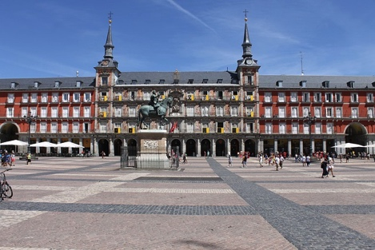
plaza
el
la
La Plaza del Sol es una plaza en el
centro de Madrid.
Notes:
Vocabulary introduction
Aim: to introduce new nouns and their gender
Timing: 4 minutes (slides 12-20)
Procedure:
Bring up noun and picture
Elicit the gender from students (all nouns have regular gender marking)
Photo made freely availble by Hiram Abiff downloaded from Pixabay.com (https://pixabay.com/es/photos/espa%C3%B1a-plaza-madrid-arquitectura-5314946/)

Slide 67
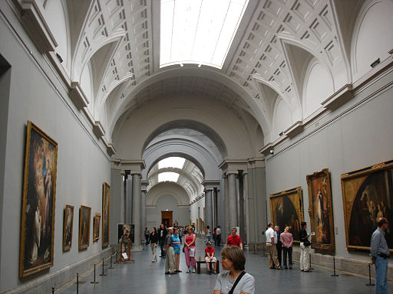
museo
el
la
El Museo del Prado es un museo de arte en Madrid
Notes:
Photo by losmininos from https://commons.wikimedia.org/wiki/File:Museo_del_Prado_(Madrid)_15.jpg
This file is made freely available and licensed under the Creative Commons Attribution-Share Alike 2.0 Generic License

Slide 68
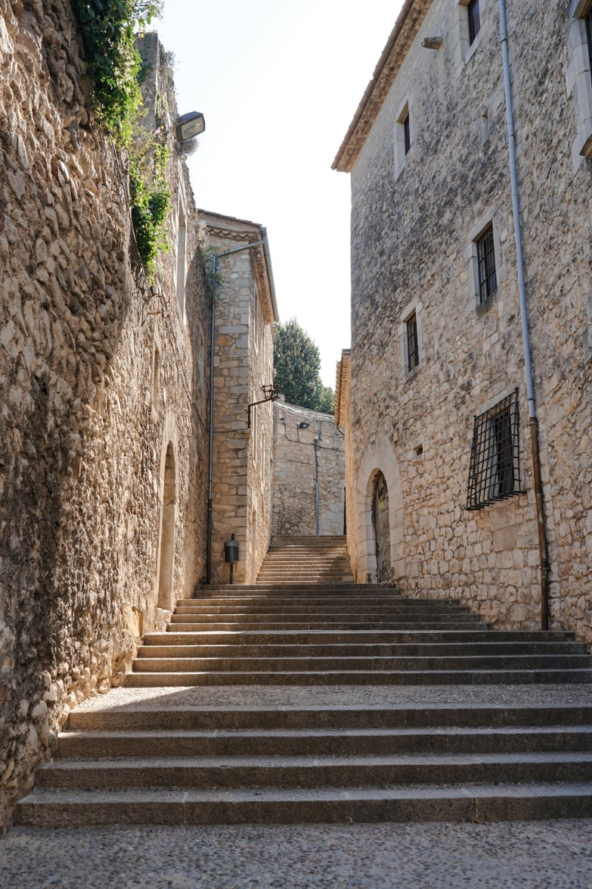
escuchar / escribir
Una conversación entre amigos
¿Dónde está Tomás?
Está en ___rona. Estudia allí.
¿___rona?
Sí, es una ciudad en España. Tengo una ima___n – ¡aquí!
Ah, ¡es una ciudad antigua!
Muy antigua. Tiene tres iglesias y una plaza en el centro.
Y la ___nte, ¿cómo es?
Es inteli____nte. Lee libros y estudia mucho.
¿Qué estudia?
Estudia de todo - ciencias, inglés, español, arte, y reli___ón.
Girona
Notes:
Phonics activity
Timing: 6 minutes
Aim: to practise mapping sound to spelling in a longer text; to revisit previously taught vocabulary
Procedure:
Students listen and complete the dialogue with the target SSCs ‘GI’ and ‘GE’
See next slide for completed version (with all the missing SSCs)
Notes:
This dialogue can also be used for a dictation or for a read aloud in pairs.
The fully readable text (i.e., a text that includes 100% or near to 100% previously taught language) could be used for a dictation. All words except ‘de todo’ have previously been encountered as vocabulary items or phonics practice words.
To help students understand ‘de’ todo’, use slightly exaggerated intonation here and when listing the subjects that follow. This should be sufficient to elicit the meaning from students.
Photo by Fikri Rasyid on Unsplash
Transcript:
¿Dónde está Tomás? Está en Girona. Estudia allí. ¿Girona? Sí, es una ciudad en España. Tengo una imagen – ¡aquí! Ah, ¡es una ciudad antigua! Muy antigua. Tiene tres iglesias y una plaza en el centro. Y la gente, ¿cómo es? Es inteligente. Lee libros y estudia mucho. ¿Qué estudia? Estudia de todo - ciencias, inglés, español, arte, y religión.
Word frequency (1 is the most frequent word in Spanish): centro [316]; plaza [806]; iglesia [437]; ciudad [178]; gente [137]; imagen [384]; estudiar [281]; español¹ [262]; inglés¹ [583]; arte [208]; ciencia(s) [738]; religión [1338]
Source: Davies, M. & Davies, K. (2018). A frequency dictionary of Spanish: Core vocabulary for learners (2nd ed.). Routledge: London

Slide 69
Una conversación entre amigos
¿Dónde está Tomás?
Está en Girona. Estudia allí.
¿Girona?
Sí, es una ciudad en España. Tengo una imagen – ¡aquí!
Ah, ¡es una ciudad antigua!
Muy antigua. Tiene tres iglesias y una plaza en el centro.
Y la gente, ¿cómo es?
Es inteligente. Lee libros y estudia mucho.
¿Qué estudia?
Estudia de todo - ciencias, inglés, español, arte, y religión.
Girona
Notes:
Full text of the conversation on the previous slide.
Photo by Fikri Rasyid on Unsplash

Slide 70
escuchar
A. Y la gente, ¿cómo es?
B. Estudia de todo – ciencias, inglés, español, arte, y religión.
1
D
2
J
C. Muy antigua. Tiene tres iglesias y una plaza en el centro.
3
F
D. ¿Dónde está Tomás?
E. Es inteligente. Lee libros y estudia mucho.
4
H
5
G
F. ¿Girona?
G. Ah, ¡es una ciudad antigua!
6
C
7
A
H. Sí, es una ciudad en España. Tengo una imagen – ¡aquí!
8
E
I. ¿Qué estudia?
9
I
10
B
J. Está en Girona. Estudia allí.
Notes:
OPTIONAL
Procedure:
Students listen again and put the sentences in order
Teacher brings up answers
Note: This could also be used as a reading-only task to challenge higher achieving students.
Word frequency (1 is the most frequent word in Spanish): centro [316]; plaza [806]; iglesia [437]; ciudad [178]; gente [137]; imagen [384]; estudiar [281]; español¹ [262]; inglés¹ [583]; arte [208]; ciencia(s) [738]; religión [1338]
Source: Davies, M. & Davies, K. (2018). A frequency dictionary of Spanish: Core vocabulary for learners (2nd ed.). Routledge: London

