Slide 1
Vocabulary
Y7 French
Term 1.2 - Week 6
Victoria Hobson / Emma Marsden
Date updated: 24/04/20

Slide 2
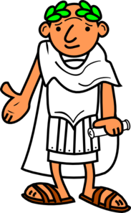
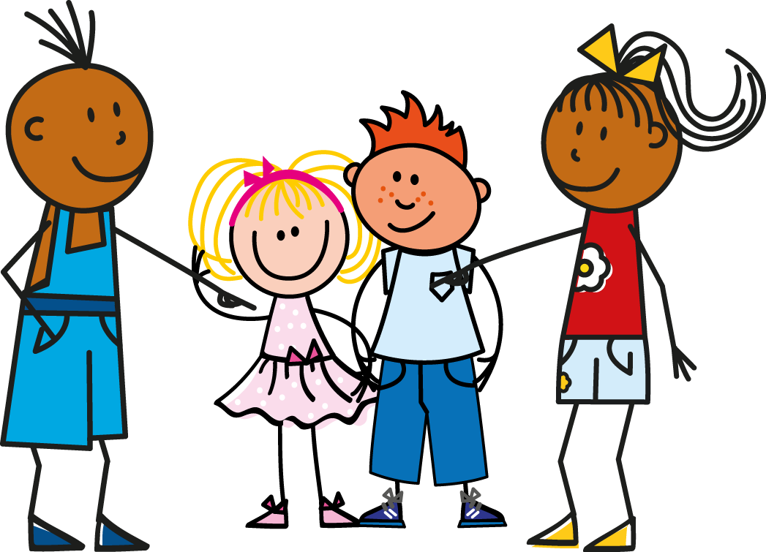
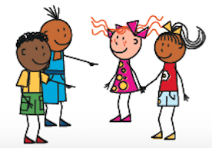
jouer
écouter
chanter
manger
étudier
la radio
le fruit
l’histoire
ils
elles
Notes:
Students should be familiar with this vocabulary, as it will have been practised in the vocabulary learning homework from the week before. This slide is, therefore, a whole class check on whether students have done their homework.
Draw students’ attention to the SFC of ils and elles and reinforce pronunciation of the words if necessary.

