Slide 1
Lexical content:
selection, teaching, learning, and testing
Emma Marsden
Amber Dudley
Nick Avery
Natalie Finlayson
Rachel Hawkes
Stephen Owen
Peter Watson
Last updated: 13 January 2022

Slide 2
Contents
Number and frequency of word families used to create current GCSE and A level papers
Number and frequency of word families on the AOs’ word lists
Which words? What is it like now, without a statutory word list?
How much coverage do AOs’ current GCSE word lists and a 85:15 ‘new’ GCSE word lists have over GCSE and A level papers?
Proportions of ‘high frequency’ words usually found in texts (oral and written)
Doesn’t calling words “high frequency” depend heavily on which corpus you use?
How many words is it reasonable to expect to be known at GCSE?

Slide 3
Number of word families used to create current GCSE and A levels and how many of them are among the most frequent 2,000 words
For the Reading and Listening components of exams only
(as vocabulary used in production is almost always a subset of knowledge needed for reading & listening)

Slide 4
AQA GCSE: Number of different word families used
in Listening & Reading tests combined
AQA GCSE: Number of different word families used
in Listening & Reading tests combined
(% in top 2,000 most frequent words)
 |  | 2018 | 2019 | 2020 | sample | 2018 + 2019 | 2018 + 2019 + 2020 | 2018 + 2019 + 2020 + sample
French | F | 675 (73%) | 612 (74%) | 667 (73%) | 676 (77%) | 982 (69%) | 1260 (66%) | 1467 (66%)
 | H | 870 (70%) | 823 (75%) | 752 (74%) | 866 (73%) | 1298 (62%) | 1591 (63%) | 1880 (61%)
Spanish | F | 612 (74%) | 630 (74%) | 657 (70%) | 677 (76%) | 959 (68%) | 1242 (65%) | 1480 (63%)
 | H | 803 (75%) | 827 (74%) | 880 (72%) | 832 (77%) | 1259 (69%) | 1631 (64%) | 1907 (62%)
German | F | 632 (69%) | 620 (71%) | 562 (68%) | 540 (74%) | 956 (63%) | 1166 (59%) | 1342 (57%)
 | H | 790 (66%) | 793 (68%) | 809 (65%) | 696 (70%) | 1230 (61%) | 1589 (56%) | 1829 (53%)
Notes:
AQA used up about 1600 different word families to create 3 years of Higher tier exams, COMBINED
Each year, students would know every single word in the Listening and Reading if they knew about 650 words for Foundation and 820 words for Higher.
These analyses treat proper nouns as though they are ‘in’ the most frequent 2,000, by ‘extending’ the list in the MultlingProfiler (this is because in the recently revised subject content, proper nouns could be glossed).
Each year, about 600-650 word families used in tests, across both L & R – combined – at Foundation. And about 800-850 word families used in Higher papers
What is not shown here, because L & R are joined together, is that a substantial part of the vocab tested in the listening is the same as the vocab used in the reading – that is, the total word families used in those two tests ‘combined to make one’ is much less than if you were to just add the individual papers together.
Only L & R were analysed here. This is for several reasons:
Receptive knowledge is larger than productive (e.g., vocabulary researchers use receptive measures to ascertain the maximum words ‘known’), so the words elicited in productive tests are likely to be a subset of those known for reading and listening
Strictly speaking, ‘model answers’ in production should be put through the profiler too. But it is hard / impossible to know (reliably or validly) what these model answers would be. Both currently and in the recently revised subject content, equivalent credit would be given for producing any word that fulfilled the task requirement, of course.
It is good practice to test the same words in different modes, modalities, grammatical forms (different inflections), and in different contexts – so testing/targeting at least some of the same words in both receptive and productive tasks is a good thing, if there is an expectation that the words are known both receptively and productive
We did not put the instructions/rubrics/questions for production tasks through the profiler – such words are likely to be a subset of the words used in the listening and reading texts, so would be unlikely to lead to an underestimation of the words used in creating the papers in total. (The recently revised GCSE Subject Content stipulates that instructions/rubrics would be in English)
Accurate as of 27 July 2021.

Slide 5
Number of word families used and % in 2,000 most frequent
Edexcel GCSE: Number of different word families used
in Listening & Reading tests combined
(% in top 2,000 most frequent words)
 |  | 2018 | 2019 | 2020 | sample | 2018 + 2019 | 2018 + 2019 + 2020 | 2018 + 2019 + 2020 + sample
French | F | 604 (72%) | 510 (73%) | 618 (70%) | 569 (74%) | 832 (69%) | 1086 (66%) | 1258 (66%)
 | H | 803 (74 %) | 650 (72%) | 797 (71%) | 764 (74%) | 1103 (69%) | 1449 (66%) | 1725 (64%)
Spanish | F | 629 (78%) | 527 (80%) | 624 (76%) | 644 (78%) | 873 (74.34) | 1125 (71%) | 1326 (69%)
 | H | 806 (75%) | 626 (77%) | 786 (72%) | 836 (74%) | 1111 (71%) | 1470 (66%) | 1792 (63%)
German | F | 639 (71%) | 559 (74%) | 636 (72%) | 630 (71%) | 930 (67%) | 1184 (63%) | 1410 (60%)
 | H | 839 (67%) | 746 (71%) | 858 (69%) | 843 (70%) | 1229 (63%) | 1634 (59%) | 1974 (56%)
Notes:
Edexcel used up just over 1700 word families after creating 4 years of creating Higher tier papers, COMBINED
Just sitting one year’s exam, a student would need about 750-800 words to know every single word in Listening and Reading papers at Higher tier.
Accurate as of 27 July 2021.

Slide 6
Average % of 2,000 most frequent word families across four years of GCSE papers (incl. sample)
Mean % of word families from the 2,000 most frequent
Edexcel Foundation | 65
Edexcel Higher | 61
Average for Edexcel | 63
AQA Foundation | 62
AQA Higher | 59
Average for AQA | 60
Average for all AOs | 62
Notes:
These are the means, collapsing across languages.
The average overall, across awarding bodies, tiers, languages, years is 61.6% (62%).
Accurate as of 27 July 2021.

Slide 7
In GCSEs year on year, the less frequent words change (are ‘new’) much more often
than high frequency words (AQA only)
Frequency of words in GCSE papers to date: AQA
In GCSEs year on year, the less frequent words change (are ‘new’) much more often than high frequency words
(preliminary analysis for AQA)
AQA | Tier | Freq high freq < 2,000 less freq > 2,000 | 2018+2019+2020+Sample; number of word families used over all 4 years | Variability index across years
French | F | high freq | 961 | 49 %
 | F | less freq | 506 | 75 %
 | H | high freq | 1138 | 47 %
 | H | less freq | 742 | 83 %
Spanish | F | high freq | 936 | 49 %
 | F | less freq | 544 | 81 %
 | H | high freq | 1181 | 48 %
 | H | less freq | 726 | 85 %
German | F | high freq | 771 | 47 %
 | F | less freq | 571 | 82 %
 | H | high freq | 976 | 47 %
 | H | less freq | 853 | 84 %
Notes:
Without a fixed list of low frequency words, they naturally don’t appear very often (as might be expected)
Of course, there is nothing ‘wrong’ with low frequency words per se but because they are low frequency they are extremely unpredictable and don’t recur very often in the papers. So, when compiling a vocabulary list that includes some low frequency words, it is important to be careful about which low frequency words are chosen – which will be most relevant to those taking the GCSEs? These will then be the ones that could then appear in different papers, more often than currently.
To date, how has frequency played out in terms of revisiting the high frequency words in relation to the low frequency words?
The data show that:
For Foundation Tier: about 950 high frequency word families are used over four years of papers, in French, Spanish and German.
For Higher Tier: about 1150 high frequency word families are used over four years of papers, in French, Spanish and German.
Less frequent words* change much more often, between papers, than high frequency words. This is intuitive and expected. High frequency words occur more, year in year out.
But the extent to which this has happened could pose a challenge for test-takers. The less frequent words are likely to be less well known (because the chances that they have been encountered one or more times in books, classrooms or interactions is much less than the high frequency words) AND as they change more between years, relative to the high frequency words, it is less possible to predict which of these less frequent words would be used in an exam paper year on year. Arguably, therefore, this puts a relatively heavy weight on knowing low frequency words and/or the sub-competence of ‘lexical inferencing’.
Variability index: Percentage of “word families used across all years as though one combined exam paper” out of “word families used in each year added together”. This shows that test-takers are exposed to a higher degree of variability in ‘less frequent’ words relative to ‘high frequency’ words
The more repeated the words are, the smaller this percentage is.
Higher percentages mean that words are ‘less repeated’ – they change more often between years.
‘less freq’ = those less frequent than the 2,000 most frequent words in a language
Accurate as of 27 July 2021.

Slide 8
Frequency of words in GCSE papers to date: Edexcel
In GCSEs year on year, the less frequent words change (are ‘new’) much more often than high frequency words
(preliminary analysis for Edexcel)
Edexcel | Tier | Freq high freq < 2,000 less freq > 2,000 | 2018+2019+2020+Sample; number of word families used over all 4 years | Variability index across years
French | F | high freq | 825 | 50 %
 | F | less freq | 433 | 67 %
 | H | high freq | 1109 | 51 %
 | H | less freq | 616 | 75 %
Spanish | F | high freq | 912 | 48 %
 | F | less freq | 414 | 77 %
 | H | high freq | 1129 | 50 %
 | H | less freq | 663 | 84 %
German | F | high freq | 842 | 47 %
 | F | less freq | 567 | 83 %
 | H | high freq | 1095 | 48 %
 | H | less freq | 878 | 88 %
Notes:
The data here suggest that:
For Foundation Tier: about 860 high frequency word families are used over four years of paperes, in French, Spanish and German.
For Higher Tier: about 1110 high frequency word families are used over four years of papers, in French, Spanish and German.
Variability index: The more repeated the words are between exam papers, the smaller this percentage is.
Higher percentages mean that words are ‘less repeated’ – they change more often between years.
Variability index: Percentage of “word families used across all years as though one combined exam paper” out of “word families used in each year added together”. This shows that test-takers are exposed to a higher degree of variability in ‘less frequent’ words relative to ‘high frequency’ words.
Accurate as of 27 July 2021.

Slide 9
AQA A level: Number of different word families used
in the Listening & Reading papers combined
(% in top 2,000 most frequent words)
 | 2018 | 2019 | 2020 | Sample 1 | Sample 2 | 2018 + 2019 | 2018 + 2019 + 2020 | 2018 + 2019 + 2020 + samples
French | 1042 (69%) | 867 (74%) | 892 (73%) | 931 (73%) | 1006 (70%) | 1520 (66%) | 1931 (63%) | 2660 (56%)
Spanish | 916 (71%) | 921 (69%) | 898 (71%) | 865 (74%) | 977 (72%) | 1438 (65%) | 1855 (62%) | 2551 (58%)
German | 1001 (65%) | 1058 (66% | 1009 (66%) | 935 (69%) | 996 (62%) | 1641 (58%) | 2142 (54%) | 2972 (48%)
Notes:
If you know about 2,600 words, you would know every single word used in Listening and Reading papers for A level, for a total of five years of exam papers.
Just sitting one year’s exam, you need about 955 words to know every single word in Listening and Reading papers.
Accurate as of 27 July 2021.

Slide 10
Edexcel A level: Number of different word families used
in the Listening & Reading papers combined
(% in top 2,000 most frequent words)
 | 2018 | 2019 | 2020 | Sample | 2018 + 2019 | 2018 + 2019 + 2020 | 2018 + 2019 + 2020 + sample
French | 827 (72%) | 845 (75%) | 832 (73%) | 861 (72%) | 1336 (69%) | 1761 (64%) | 2118 (62%)
Spanish | 759 (76%) | 816 (74%) | 808 (74%) | 763 (76%) | 1299 (69%) | 1638 (65%) | 1928 (63%)
German | 969 (56%) | 910 (61%) | 880 (64%) | 900 (64%) | 1583 (51%) | 2080 (49%) | 2544 (47%)
Notes:
If you know about 2,200 words, you would know every single word used in Listening and Reading papers for A level, for a total of four years of exam papers.
Just sitting one year’s exam, you need about 850 words to know every single word in Listening and Reading papers.
Accurate as of 27 July 2021.

Slide 11
Average % of 2,000 most frequent words across three years of A level papers. Similar % to the current GCSE
 | Language | incl. sample paper | excl. sample paper
Edexcel | French | 62 | 64
 | Spanish | 63 | 65
 | German | 47 | 49
AQA | French | 56 | 63
 | Spanish | 58 | 62
 | German | 48 | 54
Overall Mean |  | 56 | 60
Notes:
This suggests that the proportions of rarer words are similar in GCSE and A level papers.
In fact, one might expect an increase in the proportion of rarer words at A level, relative to GCSE, as students are expected to be more familiar with mid- and some low frequency words.
Accurate as of 27 July 2021.

Slide 12
In GCSEs year on year, the less frequent words change (are ‘new’) much more often
than high frequency words (AQA only)
s
In A-Levels year on year, the less frequent words change (are ‘new’) much more often than high frequency words (AQA only).
This is similar to the rate at GCSE
 | word frequency | 2018+2019+2020+samples number of word families used over all 5 papers | variability index across years
French | high freq | 1502 | 44%
 | less freq | 1158 | 85%
Spanish | high freq | 1478 | 45%
 | less freq | 1073 | 83%
German | high freq | 1428 | 44%
 | less freq | 1544 | 90%
Notes:
The low frequency items change in A level papers at a similar rate to those in GCSE papers. That is, the rate of unpredictability of low frequency items is about the same in A level and GCSE papers. It might be expected that the variability of low frequency items would be higher in A level papers relative to GCSE, as learners get better at being able to make lexical inferences and other compensatory strategies, and a higher premium is put on being able to infer meaning from context and deal with unfamiliar language. However, currently, the low frequency items change at a similar rate in GCSE as at A level.
The data suggest that that:
Variability index: Percentage of “word families used across all years as though one combined exam paper’” out of “word families used in each year added together”. This shows that test-takers are exposed to a higher degree of variability in ‘less frequent’ words relative to ‘high frequency’ words
The more repeated the words are, the smaller this percentage is.
Higher percentages mean that words are ‘repeated less’ – they change more often between years.
The data here also suggest that:
About 1500 high frequency word families are used over four years of exam papers, in French, Spanish and German
‘less freq’ = those less frequent than the 2,000 most frequent words in a language
Accurate as of 27 July 2021.

Slide 13
In GCSEs year on year, the less frequent words change (are ‘new’) much more often
than high frequency words (AQA only)
s
In A-Levels year on year, the less frequent words change (are ‘new’) much more often than high frequency words (Edexcel only)
This is similar to the rate at GCSE
 | word frequency | 2018+2019+2020+sample number of word families used over all 4 papers | variability index across years
French | high freq | 1304 | 53%
 | less freq | 814 | 89%
Spanish | high freq | 1212 | 51%
 | less freq | 716 | 91%
German | high freq | 1195 | 54%
 | less freq | 1349 | 94%
Notes:
The low frequency items change in A level papers at a similar rate to those in GCSE papers. That is, the rate of unpredictability of low frequency items is about the same in A level and GCSE papers. It might be expected that the variability of low frequency items would be higher in A level papers relative to GCSE, as learners get better at being able to make lexical inferences and other compensatory strategies, and a higher premium is put on being able to infer meaning from context and deal with unfamiliar language. However, currently, the low frequency items change at a similar rate in GCSE as at A level.
The data suggest that that:
Variability index: Percentage of “word families used across all years as though one combined exam paper’” out of “word families used in each year added together”. This shows that test-takers are exposed to a higher degree of variability in ‘less frequent’ words relative to ‘high frequency’ words
The more repeated the words are, the smaller this percentage is.
Higher percentages mean that words are ‘repeated less’ – they change more often between years.
The data here also suggest that:
About 1200 high frequency word families are used over four years of exam papers, in French, Spanish and German
‘less freq’ = those less frequent than the 2,000 most frequent words in a language
Accurate as of 27 July 2021.

Slide 14
Number and frequency of word families on the awarding organisations’ word lists

Slide 15
Number of word families used in the AOs’ current word lists
 |  |  | Mean no. of word families used in the AOs’ word lists
French | Foundation | AQA | 1061
 |  | Edexcel | 1817
 | Higher | AQA | 1326
 |  | Edexcel | 2082
Spanish | Foundation | AQA | 1311
 |  | Edexcel | 1796
 | Higher | AQA | 1545
 |  | Edexcel | 2031
German | Foundation | AQA | 1467
 |  | Edexcel | 1925
 | Higher | AQA | 1670
 |  | Edexcel | 2205
Notes:
This slide shows the number of word families used in the awarding organisations’ CURRENT GCSE word lists.
The proposed GCSE subject content expects students to know 1,200 lexical items for the foundation tier, and 1,700 lexical items for higher tier. This does not differ substantially from AQA’s current GCSE word lists.
Accurate as of 26 November 2021.

Slide 16
Frequency of word families on the AOs’ word lists
Averages across four exam papers (2018, 2019, 2020, sample)
 | French |  |  |  | Spanish |  |  |  | German
 | Foundation |  | Higher |  | Foundation |  | Higher |  | Foundation |  | Higher
 | AQA | Edexcel | AQA | Edexcel | AQA | Edexcel | AQA | Edexcel | AQA | Edexcel | AQA | Edexcel
high freq. 1 – 2000 | 552 (52%) | 798 (44%) | 651 (49%) | 872 (42%) | 751 (57%) | 892 (50%) | 820 (53%) | 962 (47%) | 670 (46%) | 827 (43%) | 717 (43%) | 881 (40%)
mid freq. 2001 – 5000 | 296 (28%) | 518 (29%) | 378 (29%) | 587 (28%) | 304 (23%) | 451 (25%) | 379 (25%) | 519 (26%) | 386 (26%) | 494 (26%) | 423 (25%) | 564 (26%)
low freq. > 5000 | 213 (20%) | 501 (28%) | 297 (22%) | 623 (30%) | 256 (20%) | 453 (25%) | 346 (22%) | 550 (27%) | 411 (28%) | 604 (31%) | 530 (32%) | 760 (34%)
Total | 1061 | 1817 | 1326 | 2082 | 1311 | 1796 | 1545 | 2031 | 1467 | 1925 | 1670 | 2205
Notes:
This analysis shows that approximately half of all the word families on the AOs’ current word lists are part of the top 2,000 most frequent word families. Note that these analyses include the frequency of each constituent word families in multi-word units. So, the ‘true’ frequency of entries on the list will be lower than that presented here, as there are lots of multi-word entries in each list which are less frequent as a holistic ‘multi-word unit’ than their constituent words
Frequency lists used (for rationales of this choice, see NCELP Resources Portal)
Davies, M., & Davies, K. (2018). A frequency dictionary of Spanish: Core vocabulary for learners (2nd ed.). London: Routledge
Lonsdale, D. & Le Bras. Y. (2009). A frequency dictionary of French: Core vocabulary for learners. London: Routledge
Tschirner, L. & Möhring., J. (2020). A frequency dictionary of German: Core vocabulary for learners. London: Routledge
Accurate as of 26 November 2021.

Slide 17

Frequency of word families on the AOs’ word lists: 1000 frequency bands
 | French |  |  |  | Spanish |  |  |  | German
 | Foundation |  | Higher |  | Foundation |  | Higher |  | Foundation |  | Higher
 | AQA | Edexcel | AQA | Edexcel | AQA | Edexcel | AQA | Edexcel | AQA | Edexcel | AQA | Edexcel
1-1000 | 387 (36%) | 510 (28%) | 428 (32%) | 539 (26%) | 523 (40%) | 591 (33%) | 548 (35%) | 619 (30%) | 439 (30%) | 548 (28%) | 460 (28%) | 548 (25%)
1001-2000 | 165 (16%) | 288 (16%) | 223 (17%) | 333 (16%) | 228 (17%) | 301 (17%) | 272 (18%) | 343 (17%) | 231 (16%) | 279 (14%) | 257 (15%) | 333 (15%)
2001-3000 | 142 (13%) | 232 (13%) | 175 (13%) | 265 (13%) | 139 (11%) | 193 (11%) | 171 (11%) | 229 (11%) | 173 (12%) | 216 (11%) | 183 (11%) | 231 (10%)
3001-4000 | 81 (8%) | 161 (9%) | 107 (8%) | 175 (8%) | 94 (7%) | 143 (8%) | 108 (7%) | 167 (8%) | 134 (9%) | 180 (9%) | 148 (9%) | 207 (9%)
4000-5000 | 73 (7%) | 125 (7%) | 96 (7%) | 147 (7%) | 71 (5%) | 115 (6%) | 100 (6%) | 123 (6%) | 79 (5%) | 98 (5%) | 92 (6%) | 126 (6%)
>5000 | 213 (20%) | 501 (28%) | 297 (22%) | 623 (30%) | 256 (20%) | 453 (25%) | 346 (22%) | 550 (27%) | 411 (28%) | 604 (31%) | 530 (32%) | 760 (34%)
Total | 1061 | 1817 | 1326 | 2082 | 1311 | 1796 | 1545 | 2031 | 1467 | 1925 | 1670 | 2205

Slide 18
Which words to use?
What is it like now, without a statutory word list?

Slide 19
What is it like now, without a statutory word list?
On average*,
49% of the words on the current word lists have never been used over four L & R exams
* across tiers (foundation, higher), AOs (AQA, Edexcel), and languages (French, Spanish, and German)
Average number of words used
in every paper (excl. sample):
Foundation: 178 (214)
Higher: 221 (268)
of which about 20% are not on current wordlists
On average*,
21% of the words on the current word lists have been used only once over four L & R papers
* across tiers (foundation, higher), AOs (AQA, Edexcel), and languages (French, Spanish, and German)
Lower frequency words change at a much greater rate year on year than the high frequency words
Notes:
Here are in brief some of the consequences of not working to a set word list.
About half of the words that are on the list have not appeared over the years.
About 1 in 5 of the words on the list have have been used just once. Also, though not shown here, of the words that have only ever been used once over the four papers, 42% are on the word list, meaning that 58% of them are not.
There is a relatively low number of words that definitely will appear every year and 1 in 5 of them are not on the current lists (as the subject content states that some words must be tested off the list).
The lower frequency words change year on year much more often than the high frequency words – this is to some extent inevitable – but it adds an extra layer of unpredictability. Not only are the words low frequency, so they are less likely to have turned up in books or in lessons, trips abroad, they are also not likely to turn up again in another paper. So, whilst some low frequency words are of course useful and needed, a word list would allow us to identify these words, making the connection a bit more reliable between what is being taught and what is tested.
That is, with the current requirement to test words off the list and that the use of the words on the list is not obligatory, there has, necessarily to meet the current subject content requirements, been a very high degree of unpredictability for teachers and pupils and therefore an emphasis on the skill of lexical inferencing – working out words from the words around them. This is an important component of language competence, particularly once you reach intermediate proficiencies and beyond. This should, of course, be tested, and you will see this in the revised subject content. But whilst also recognising that to do lexical inferencing, a really solid grasp of the core vocabulary is needed first.
Accurate as of 26 November 2021.

Slide 20
Average number of word families used in each paper
The lexical content of the receptive (listening and reading) components of GCSE papers in 2018, 2019, 2020, and the sample paper. |  |  | Mean no. of word families used in each exam paper
French | Foundation | AQA | 652
 |  | Edexcel | 564
 | Higher | AQA | 820
 |  | Edexcel | 736
Spanish | Foundation | AQA | 623
 |  | Edexcel | 588
 | Higher | AQA | 808
 |  | Edexcel | 724
German | Foundation | AQA | 585
 |  | Edexcel | 617
 | Higher | AQA | 769
 |  | Edexcel | 767
Notes:
Accurate as of 26 November 2021.

Slide 21
Which words from current lists have been used in every paper so far?
(incl. sample)
We analysed the lexical content of the receptive (listening and reading) components of GCSE exam papers in 2018, 2019, 2020, and the sample year. | French |  |  |  | Spanish |  |  |  | German
 | Foundation |  | Higher |  | Foundation |  | Higher |  | Foundation |  | Higher
 | AQA | Edexcel | AQA | Edexcel | AQA | Edexcel | AQA | Edexcel | AQA | Edexcel | AQA | Edexcel
No. (%) of word families used in every exam paper across the four papers | 185 | 181 | 229 | 208 | 166 | 173 | 233 | 201 | 174 | 186 | 216 | 235
of which are in the 2000 most frequent words* | 164 (89%) | 151 (83%) | 205 (90%) | 179 (86%) | 159 (96%) | 162 (94%) | 222 (95%) | 192 (96%) | 168 (97%) | 177 (95%) | 208 (96%) | 220 (94%)
of which appear on the AO wordlist | 142 (77%) | 161 (89%) | 175 (76%) | 187 (90%) | 133 (80%) | 150 (87%) | 182 (78%) | 178 (89%) | 115 (66%) | 163 (88%) | 152 (70%) | 205 (87%)
*word family = jouer, joue, jouons, jouent, etc.
Notes:
We examined consistency in the words that appear each year in AQA and Edexcel exam papers.
Unsurprisingly, the vast majority of those words that are used every year, over 90%, are within the top 2000 most frequent words.
(About 1 in 5 words in exam papers were not on the AOs lists, probably because it has been assumed that they have been covered in KS2 or 3).
------
Notes:
Average for Foundation and Higher are aggregated across AOs (AQA, Edexcel) and languages (French, Spanish, German).
The % in the top 2000 and not on the AO’s lists are aggregated across tier (foundation, higher), AOs (AQA, Edexcel), and languages (French, Spanish, German).
The “about 1 in 5” is precisely 17-18%.
Accurate as of 26 November 2021.

Slide 22
How many words on the current lists have been used in every exam so far (excl. sample)?
We analysed the lexical content of the receptive (listening and reading) components of GCSE exam papers in 2018, 2019, and 2020. | French |  |  |  | Spanish |  |  |  | German
 | Foundation |  | Higher |  | Foundation |  | Higher |  | Foundation |  | Higher
 | AQA | Edexcel | AQA | Edexcel | AQA | Edexcel | AQA | Edexcel | AQA | Edexcel | AQA | Edexcel
No. (%) of word families used in the actual exam papers (2018, 2019, and 2020) | 214 | 215 | 270 | 255 | 198 | 205 | 285 | 236 | 223 | 231 | 277 | 284
of which are in the 2000 most frequent words* | 185 (86%) | 176 (82%) | 237 (88%) | 209 (82%) | 186 (94%) | 190 (93%) | 269 (94%) | 222 (94%) | 210 (94%) | 212 (92%) | 259 (94%) | 261 (92%)
of which appear on the AO wordlist | 161 (76%) | 190 (88%) | 201 (74%) | 223 (87%) | 159 (80%) | 174 (85%) | 216 (76%) | 208 (88%) | 149 (67%) | 204 (88%) | 193 (70%) | 248 (87%)
*word family = jouer, joue, jouons, jouent, etc.
Notes:
Accurate as of 26 November 2021.

Slide 23
Which words from the current lists have AOs never used so far in a paper (2018, 2019, 2020, and sample)?
 | French |  |  |  | Spanish |  |  |  | German
 | Foundation |  | Higher |  | Foundation |  | Higher |  | Foundation |  | Higher
 | AQA | Edexcel | AQA | Edexcel | AQA | Edexcel | AQA | Edexcel | AQA | Edexcel | AQA | Edexcel
No. of different word families that appear on the AO wordlists | 1061 | 1817 | 1326 | 2083 | 1311 | 1796 | 1545 | 2031 | 1466 | 1925 | 1669 | 2205
No. (%) of word families that were never used in any exam papers | 413 (39%) | 1022 (56%) | 522 (39%) | 1118 (54%) | 580 (44%) | 963 (54%) | 613 (40%) | 1065 (52%) | 814 (56%) | 1034 (54%) | 846 (51%) | 1156 (52%)
Notes:
We analysed the words that you have never used in any exam paper across the four years.
There is a lot of detail here, but here is a summary of the findings.
Without a defined word list, we see a misfit between what is being taught (put into textbooks) and what is being tested. Of course, due to the lost lessons due to the pandemic, the AOs are going to only include words that are on their lists for this coming year 11 cohort.
----------------
This analysis has isolated the words given in multi-word units listed in the AOs lists – so this is ‘unique’ word families – not MWUs.
Accurate as of 26 November 2021.

Slide 24
Which words from the current lists have the AOs used once, over four papers?
 | French |  |  |  | Spanish |  |  |  | German
 | Foundation |  | Higher |  | Foundation |  | Higher |  | Foundation |  | Higher
 | AQA | Edexcel | AQA | Edexcel | AQA | Edexcel | AQA | Edexcel | AQA | Edexcel | AQA | Edexcel
No. of word families that appear only once over the total of four papers (%, out of the word families that have been used only once) | 799 | 647 | 1016 | 949 | 747 | 673 | 974 | 963 | 704 | 739 | 981 | 1070
of which are not cognates or proper nouns | 523 (65%) | 369 (57%) | 694 (68%) | 611 (64%) | 599 (80%) | 517 (77%) | 838 (86%) | 780 (81%) | 516 (73%) | 545 (74%) | 783 (80%) | 801 (75%)
of which are not in the top 2000 most frequent words | 465 (58%) | 398 (62%) | 618 (61%) | 567 (60%) | 419 (56%) | 354 (53%) | 565 (58%) | 559 (58%) | 439 (62%) | 452 (61%) | 652 (66%) | 701 (66%)
of which do not appear on the AO wordlist | 559 (70%) | 323 (50%) | 703 (69%) | 539 (57%) | 448 (60%) | 320 (48%) | 612 (63%) | 556 (58%) | 409 (58%) | 335 (45%) | 632 (64%) | 621 (58%)
Notes:
Here is an analysis of the words that have been used once over the four papers.
Again, there is a lot of detail, so here are some headline findings.
between 45% and 70% of those words are NOT on the AOs lists.
between 53% and 66% of are not high frequency words
between 57% - 86% are words that cannot easily be guessed – they are NOT exact cognates and they are not proper nouns.
In sum: The chances of understanding the words are low, meaning that the bar is set very high. This is another consequence of having a word list that is only an optional guide.
Students are simultaneously trying to learn too many words (which are rarely tested), and too few words (as they are being tested on words they have never encountered).
Accurate as of 26 November 2021.

Slide 25
How much coverage do ‘new’ 85:15 GCSE word lists have over GCSE papers?

Slide 26
How much coverage do word lists have over a typical GCSE exam under the current AOs’ exam specifications?
Comparing the coverage given by:
Current GCSE word lists
Lists following the recently announced new GCSE Subject Content parameters 85% high freq:15% other (a working example, created by NCELP)
Notes:
For the third analysis of coverage, we followed the revised subject content’s recommendation of a 85%:15% ratio of high frequency words to other words, and created a word list that aligns with all of the details given in the grammar annexes about what should go in the word lists (including highly irregular verbs listed as lexical items).

Slide 27
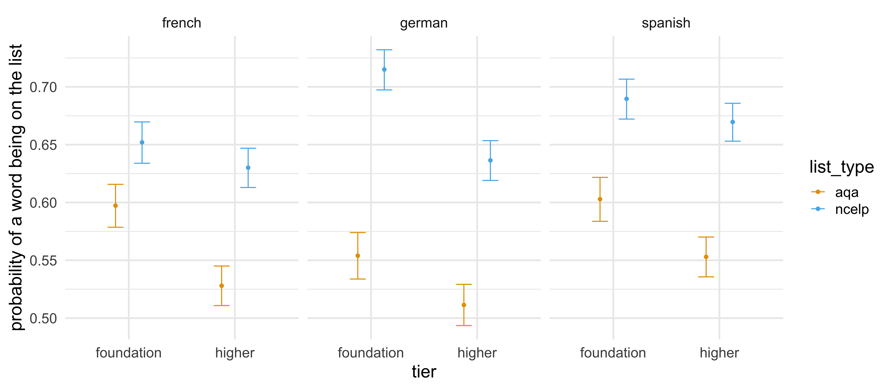
A 85:15 ‘new GCSE’ word list* prepare students better for a typical GCSE exam than AQA’s current word list.
* a working example created by NCELP
Notes:
This graph shows that NCELP’s working example of a word list that follows the 85:15 parameters, as described in the recently introduced GCSE Subject Content, provides greater coverage of a typical AQA GCSE exam under the current exam specification than AQA’s own word list.
For example, if a pupil studying French at the Foundation tier knew every word from AQA’s current word list, they would know approximately 60% of all the word (families) used in a typical exam paper. However, if the same pupil knew every word from a 85:15 ‘new GCSE’ word list, they would know approximately 65% of all the word (families) used in a typical exam paper.
In other words, a 85:15 ‘new GCSE’ word list prepares students better for a typical GCSE exam under the current specification than a word list develop by AQA specifically as part of their exam specification.
Note that these probabilities account for the fact that the individual word lists differ in terms of the number of word (families) that they include.
Accurate as of 13 January 2022.

Slide 28
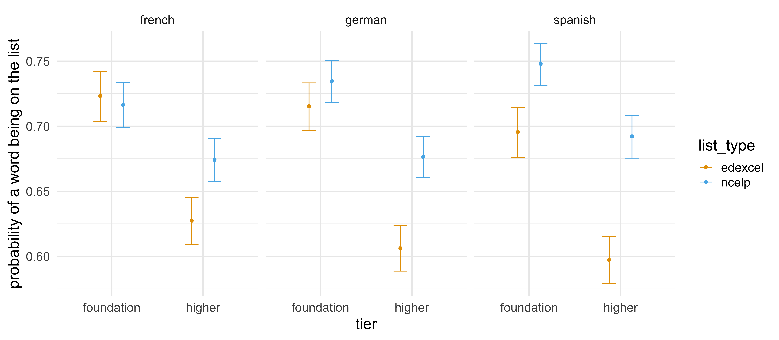
A 85:15 ‘new GCSE’ word list* prepare students as well, if not better, for a typical GCSE exam as Edexcel’s current word list.
* a working example created by NCELP
Notes:
This graph shows that NCELP’s working example of a word list that follows the 85:15 parameters, as described in the recently introduced GCSE Subject Content, provides equal, and in most cases greater, coverage of a typical AQA GCSE exam under the current exam specification than Edexcel’s own word list.
For example, a pupil studying French at Foundation tier, regardless of the word list that they learn, would understand approximately 72% of all the word (families) included in a typical exam paper. However, a pupil studying French at Higher tier, would understand approximately 4% more of the word families included in a typical exam paper if they learnt all the word (families) from a 85:15 ‘new GCSE’ word list than if they learnt all the word (families) from Edexcel’s current GCSE word list.
In other words, a 85:15 ‘new GCSE’ word list prepares students as well, if not better, for a typical GCSE exam under the current specification than a word list develop by AQA specifically as part of their exam specification.
Note that these probabilities account for the fact that the individual word lists differ in terms of the number of word (families) that they include.
Accurate as of 13 January 2022.

Slide 29
How much coverage do AOs’ current GCSE word lists and ‘new’ 85:15 GCSE word lists have over A level papers?

Slide 30
How much coverage do word lists have over current A level exams?
Comparing the coverage given by:
Current GCSE word lists
A list with an equivalent number of words based solely on frequency
Lists following the recently introduced new GCSE Subject Content parameters 85% high freq:15% other (a working example, created by NCELP)
Notes:
For the fourth analysis of coverage, we followed the revised subject content’s recommendation of a 85%:15% ratio of high frequency words to other words, and created a word list that aligns with all of the details given in the grammar annexes about what should go in the word lists (including highly irregular verbs listed as lexical items).

Slide 31
French: AQA
 | Number (%) of word families on A level papers that are on …
Word families from A level papers that have been used in… | Current GCSE word list (n = 1326) | High frequency* word list (n = 1326) | A ‘new GCSE’ Higher word list** (n = 1555)
… every paper (2018, 2019, 2020, sample 1, sample 2) (196 different word families) | 134 (68%) | 184 (94%) | 176 (90%)
… every actual exam (2018, 2019, 2020 – excluding samples) (261 different word families) | 167 (64%) | 236 (90%) | 222 (85%)
… only one individual paper ever (1517 different word families) | 239 (16%) | 321 (21%) | 368 (24%)
… a typical exam paper (averaged across the five exam papers) (934 word families) | 367 (39%) | 542 (58%) | 526 (56%)
… all papers combined to make ‘one big A level text’ (2562 different word families) | 713 (28%) | 1050 (41%) | 1061 (41%)
* The most frequent 1326 words
** a ‘working example’, created by NCELP
Notes:
First, you might wonder why the new GCSE list only has 1555 words. Not 1700. This is because there are about 145 irregular verb forms that are on the GCSE word list, which actually belong to a high frequency word family. So, suis counts as one separate word on the actual GCSE list, that is so there is sufficient curriculum time given to it. But of course for profiling a text, suis just fits in with its family – être.
So, as we can see, of course the high frequency word list provides more coverage – the same number of words as the current AO’s list, but all very high frequency.
The current AQA word list has 229 fewer words than a new GCSE word list. There are 229 MORE words on the NCELP-created new GCSE list, so this is in favour of new GCSE list: It should provide more coverage, which it does. But quite considerably more. This list has more bang for its buck.
**The ‘new GCSE’ Higher word list has 17% more words, but provides 44% more coverage of a typical A level exam paper**
And also remember that the current GCSE assumes knowledge of other words too - from KS3 - so the exams test words off the list, using words every year in their exams which were not on the list. So this makes up the difference between the NCELP lists and the current GCSE word lists, thus making the comparison fair: with the same number of words essentially on both lists, the frequency informed list, with 85% from the top 2000, provides better preparation for the words used on current A levels.
Even the rare words – those words that are only ever used in one exam – perhaps the really unpredictable ones that help us to distinguish between the top grades- even with those words, a frequency informed list provides more coverage.
Accurate as of 26 November 2021.

Slide 32
French: Edexcel
French: Edexcel
 | Number (%) of word families on A level papers that are on …
Word families from A level papers that have been used in… | GCSE word list (n = 2082) | High frequency* word list (n = 2082) | A ‘new GCSE’ word list (n = 1555)
… every paper (2018, 2019, 2020, sample 1) (183 different word families) | 152 (83%) | 172 (94%) | 161 (88%)
… every actual exam (2018, 2019, 2020 – excluding sample) (242 different word families) | 184 (76%) | 225 (93%) | 206 (85%)
… only one individual paper ever (1343 different word families) | 378 (28%) | 568 (42%) | 401 (30%)
… a typical exam paper (averaged across the four exam papers) (834 word families) | 413 (50%) | 578 (69%) | 479 (57%)
… all papers combined to make ‘one big A level text’ (2072 different word families) | 816 (39%) | 1192 (58%) | 949 (45%)
* The most frequent 2082 words
Notes:
For Edexcel, the bias is in favour of the Edexcel lists – they have more words – about 527 more words – so coverage of any text should in theory be better – you have more words, the chances are that you will ‘hit’ more of the words in the text you are looking at.
**The ‘new GCSE’ Higher word list has 25% fewer words, but provides 16% more coverage of a typical A level exam paper**
As you might expect, the same number of words but from a list made up only of the highest frequency words – you get better coverage.
Yet, even though the new GCSE list has fewer words, they provide more coverage of the A level texts. The difference is less pronounced this time.
In this case, however, the list just based on high frequency and the same length as the GCSE lists, in this case, the HF lists provide more coverage.
But still, the NCELP lists provide better coverage than a list that is not informed, systematically, by frequency.
Accurate as of 26 November 2021.

Slide 33
German: AQA
 | Number (%) of word families on A level papers that are on …
Word families from A level papers that have been used in… | GCSE word list (n = 1670) | High frequency* word list (n = 1670) | A new GCSE word list (n = 1716)
… every paper (2018, 2019, 2020, sample 1, sample 2) (222 different word families) | 143 (64%) | 203 (91%) | 207 (93%)
… every actual exam (2018, 2019, 2020 – excluding samples) (318 different word families) | 190 (60%) | 287 (90%) | 291 (92%)
… only one individual paper ever (1860 different word families) | 278 (15%) | 410 (22%) | 412 (22%)
… a typical exam paper (averaged across the five exam papers) (999 word families) | 381 (38%) | 585 (59%) | 587 (59%)
… all papers combined to make ‘one big A level text’ (2847 different word families) | 748 (26%) | 1157 (41%) | 1152 (40%)
* The most frequent 1670 words
Notes:
Back to AQA with shorter lists than the new GCSE – 46 words fewer than the proposed length of new lists.
But the new GCSE list provides a much greater coverage - nearly 30% greater coverage.
**The ‘new GCSE’ Higher word list has 3% more words, but provides 54% more coverage of a typical A level exam paper**
Accurate as of 26 November 2021.

Slide 34
German: Edexcel
 | Number (%) of word families on A level papers that are on …
Word families from A level papers that have been used in… | GCSE word list (n = 2205) | High frequency* word list (n = 2205) | A new GCSE word list (n = 1716)
… every paper (2018, 2019, 2020, sample) (173 different word families) | 148 (86%) | 168 (97%) | 164 (95%)
… every actual exam (2018, 2019, 2020 – excluding sample) (212 different word families) | 168 (79%) | 203 (96%) | 198 (93%)
… only one individual paper ever (1767 different word families) | 373 (21%) | 577 (33%) | 430 (24%)
… a typical exam paper (averaged across the four exam papers) (923 word families) | 399 (43%) | 558 (60%) | 505 (55%)
… all papers combined to make ‘one big A level text’ (2474 different word families) | 785 (32%) | 1164 (47%) | 990 (40%)
* The most frequent 2205 words
Notes:
Back to Edexcel, and the same patterns emerge.
The Edexcel list is longer than the proposed list, but a new GCSE list provides more coverage.
**The ‘new GCSE’ Higher word list has 22% fewer words, but provides 27% more coverage of a typical A level exam paper**
Accurate as of 26 November 2021.

Slide 35
Spanish: AQA
Spanish AQA
 | Number (%) of word families on A level papers that are on …
Word families from A level papers that have been used in… | GCSE word list (n = 1545) | High frequency* word list (n = 1545) | A new GCSE word list (n = 1475)
… every paper (2018, 2019, 2020, sample 1, sample 2) (201 different word families) | 150 (75%) | 189 (94%) | 181 (90%)
… every actual exam (2018, 2019, 2020, excluding samples) (284 different word families) | 190 (67%) | 259 (91%) | 250 (83%)
… only one individual A level paper ever (1387 different word families) | 283 (20%) | 401 (29%) | 376 (27%)
… a typical exam paper (averaged across the five exam papers) (879 word families) | 385 (44%) | 563 (64%) | 532 (61%)
… all papers combined to make ‘one big A level text’ (2336 different word families) | 753 (32%) | 1114 (48%) | 1048 (45%)
* The most frequent 1,545 words
Notes:
**The ‘new GCSE’ Higher word list has 5% fewer words, but provides 38% more coverage of a typical A level exam paper**
Accurate as of 26 November 2021.

Slide 36
Spanish: Edexcel
 | Number (%) of word families on A level papers that are on …
Word families from A level papers that have been used in… | GCSE word list (n = 2031) | High frequency* word list (n = 2031) | A new GCSE word list (n = 1475)
… every paper (2018, 2019, 2020, sample 1) (199 different word families) | 160 (80%) | 189 (95%) | 183 (92%)
… every actual exam (2018, 2019, 2020 – excluding sample) (239 different word families) | 186 (78%) | 228 (95%) | 218 (91%)
… only one individual paper ever (1124 different word families) | 349 (31%) | 517 (46%) | 377 (34%)
… a typical exam paper (averaged across the four exam papers) (761 word families) | 410 (54%) | 563 (74%) | 493 (65%)
… all papers combined to make ‘one big A level text’ (1800 different word families) | 780 (43%) | 1119 (62%) | 919 (51%)
* The most frequent 2,031 words
Notes:
**The ‘new GCSE’ Higher word list has 27% fewer words, but provides 20% more coverage in a typical exam paper**
Accurate as of 26 November 2021.

Slide 37
Averages – Across Languages (AQA)
 | Number (%) of word families on A level papers that are on …
Word families from A level papers that have been used in… | GCSE word list (n = 1514) | High frequency* word list (n = 1514) | A new GCSE word list (n = 1582)
… every paper (2018, 2019, 2020, sample 1, sample 2) (206 different word families) | 142 (69%) | 192 (93%) | 188 (91%)
… every actual exam (2018, 2019, 2020 – excluding samples) (288 different word families) | 182 (63%) | 261 (91%) | 254 (88%)
… only one individual paper ever (1588 different word families) | 267 (17%) | 377 (24%) | 385 (24%)
… a typical exam paper (averaged across the five exam papers) (937 word families) | 377 (40%) | 563 (60%) | 549 (59%)
… all papers combined to make ‘one big A level text’ (2582 different word families) | 738 (29%) | 1107 (43%) | 1087 (42%)
On average, a new GCSE list has 5% more words, but provides 45% more coverage of a typical A level exam, relative to a current GCSE list.
Notes:
The new GCSE word lists: more bang for their buck.
**The ‘new GCSE’ Higher word list has 5% more words, but provides 45% more coverage in a typical exam paper**
There are 1582 words in the new GCSE word list column because this is an average across the three languages.
We also must remember that the current GCSE assumes knowledge of other words too (from KS3) so the exams use words every year in their exams which were not on the list. This makes up - or even over-compensates for - the difference in size between the NCELP lists and the current GCSE word lists, making the comparison fair: with the same number of words, essentially, on both lists, the frequency informed list, with 85% from the top 2000, provides better preparation for the words used on current A levels.
Accurate as of 26 November 2021.

Slide 38
Averages – Across Languages (Edexcel)
 | Number (%) of word families on A level papers that are on …
Word families from A level papers that have been used in… | GCSE word list (n = 2106) | High frequency* word list (n = 2106) | A new GCSE word list (n = 1582)
… every paper (2018, 2019, 2020, sample 1) (185 different word families) | 153 (83%) | 176 (95%) | 169 (92%)
… every actual exam (2018, 2019, 2020 – excluding sample) (231 different word families) | 179 (78%) | 219 (95%) | 207 (90%)
… only one individual paper ever (1411 different word families) | 367 (26%) | 554 (39%) | 403 (29%)
… a typical exam paper (averaged across the four exam papers) (839 word families) | 407 (49%) | 566 (67%) | 492 (59%)
… all papers combined to make ‘one big A level text’ (2115 different word families) | 794 (38%) | 1158 (55%) | 953 (45%)
On average, a new GCSE list has 25% fewer words, but provides 21% more coverage of a typical A level exam, relative to a current GCSE list.
Notes:
New GCSE word lists: more bang for their buck.
**The ‘new GCSE’ Higher word list has 25% fewer words, but provides 21% more coverage in a typical exam paper**
We also must remember that the current GCSE assumes knowledge of other words too (from KS3) so the exams use words every year in their exams which were not on the list. This makes up the difference between the NCELP lists and the current GCSE word lists, making the comparison fair: with the same number of words essentially on both lists, the frequency informed list, with 85% from the top 2000, provides better preparation for the words used on current A levels.
There are 1582 words in the new GCSE word list column because this is an average across the three languages.
Accurate as of 26 November 2021.

Slide 39
Averages – Across Languages and AOs (AQA & Edexcel)
 | Number (%) of word families on A level papers that are on …
Word families from A level papers that have been used in… | GCSE word list (n = 1810) | High frequency* word list (n = 1810) | A new GCSE word list (n = 1582)
… every paper (2018, 2019, 2020, sample(s)) (196 different word families) | 148 (76%) | 184 (94%) | 179 (91%)
… every actual exam (2018, 2019, 2020 – excluding sample(s)) (259 different word families) | 181 (70%) | 240 (92%) | 231 (89%)
… only one individual paper ever (1500 different word families) | 317 (21%) | 466 (31%) | 394 (26%)
… a typical exam paper (averaged across all exam papers) (894 word families) | 391 (44%) | 565 (63%) | 523 (59%)
… all papers combined to make ‘one big A level text’ (2349 different word families) | 766 (33%) | 1133 (48%) | 1020 (43%)
On average, a new GCSE list has 13% fewer words, but provides 34% more coverage of a typical A level exam, relative to current word lists (across AQA and Edexcel).
Notes:
New GCSE word lists: more bang for their buck.
**The ‘new GCSE’ Higher word list has 13% fewer words, but provides 34% more coverage in a typical exam paper**
There are 1582 words in the new GCSE word list column because this is an average across the three languages.
We also must remember that the current GCSE assumes knowledge of other words too (from KS3) so the exams use words every year in their exams which were not on the list. This makes up the difference between the NCELP lists and the current GCSE word lists, making the comparison fair: with the same number of words essentially on both lists, the frequency informed list, with 85% from the top 2000, provides better preparation for the words used on current A levels.
Accurate as of 26 November 2021.

Slide 40
Proportions of ‘high frequency’ words usually found in texts (oral and written)

Slide 41
'According to standard frequency lists, the first 1000 words make up approximately 75% word tokens of a text, and the first 2000 approximately 85%’
(Meara, 2005, cited in Häcker, 2008:215).
The 2,000 most common words cover 80-87% of written text
(Nation, 2001; Nation & Waring, 1997).
and 90+% of words in informal conversation
(Nation, 2001)
Notes:
Häcker, M. (2008). Eleven pets and 20 ways to express one's opinion: the vocabulary learners of German acquire at English secondary schools. Language Learning Journal, 36:2, 215-226.
Meara, P. (2005) Lexical Frequency Profiles: A Monte Carlo Analysis, Applied Linguistics 26/1: 32–47
Nation, I. S. P. (2001). Learning Vocabulary in Another Language. Cambridge: Cambridge University Press.
Nation, P. and Waring, R. (1997) Vocabulary Size, Text Coverage and Word Lists. In: Schmitt, N. and McCarthy, M., Eds., Vocabulary: Description, Acquisition, and Pedagogy, Cambridge University Press, Cambridge, 6-19.

Slide 42
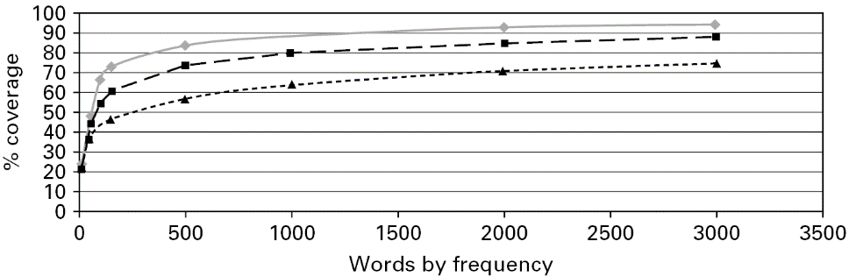
Usefulness of words
What proportion of words in any spoken or written text do you know if you know about 1,500 of the most frequent 2,000 words?
◆ General conversation
■ More formal speech – e.g. lectures
❐ Written language
Work by Paul Nation, cited by Milton, J. (2009) Measuring second language vocabulary acquisition (p. 58). Multilingual Matters.
Notes:
Of course, knowing a word does not mean understanding a text – but knowing more words of a text gives you a high chance of understanding more of the text
This visual demonstrates the importance of high frequency words. It is based on data about English.
The findings come 100 million of words collected from a wide range of texts from different contexts. The information was reproduced in a book by Jim Milton.
The x axis along the bottom is ‘words by frequency’ – so, 1,000 means the most frequent 1000 words in a language.
The y axis is called ‘coverage’ – this is the proportion of word families in a text (from a conversation, formal speech, or written language) that you will understand if you know the 500, 1,000, 1,500, or 2,000 most frequent words etc.
The top grey line is the estimation for general conversation – very high frequency vocabulary is the most important for this
The middle line is the estimation for more formal speech – the media, educational contexts,
The bottom line is the estimation for written language – you tend to get rarer words being used in written texts – though this massively varies according to context and genre (type of text)
We highlight three things about this visual:
First – you will see that knowing just the most frequent 200-300 words gives you a massive boost – you can see a really, really steep curve here – knowing these words gives you access to between 50% and 75% of any input you hear or read
Second – If you know somewhere around 1,700 of the most frequent words you can probably understand between 70% and 92% of things you read and hear.
Third - This very clear value of knowing really high frequency words tends to almost completely plateau after about the 1,700 to 2,000 most frequent words; but this plateauing *starts* even earlier, at between 1,000 and 1,500 most frequent words. So, after knowing about the 1,500 most frequent words, how much you understand depends on whether you happen to know those other, rarer words. We need to know A LOT of words to be able to be sure that we will understand any more of a text.
To date, the choice of which words we teach has had to be driven by intuition about which topics might come up in a child’s experience. Now, with the use of large corpora and the frequency information derived from them, we have hard evidence that can guide these choices.
But of course, we don’t need to stick to this slavishly. We still need to add in some words about the kinds of things that we *think* might be of special interest and use to our kinds of learners. It is hard to know which ‘rarer words’ a learner might need to know.
When time is limited and we have to make hard choices about the words we teach and revisit to ensure they are really known, then we are in with a good shout of motivating children, by showing them that they can ‘crack’ a language, if we provide them with a booster pack of ‘super-vocabulary’.
--------------

Slide 43
So, how does the frequency profile of the GCSE exam texts compare to these general, expected frequency profiles?
From the previous section, we saw that in the body of language used in the GCSEs as a whole - i.e., over the years - the proportion of high frequency words used is an average of 62%
  with wide variation, 53% - 71%, between languages, papers, and awarding bodies
A more expected range might be 75%-95%, and perhaps nearer the higher end for language content/curriculum that is aimed towards communicative proficiency
  because the more informal the language, e.g. spoken interaction, the more often high frequency words occur.

Slide 44
Doesn’t calling words “high frequency” depend heavily on which corpus you use?
Analyses for: English, French, German, Spanish

Slide 45
Comparing overlap of high frequency words in English corpora
(Cobb, T., in progress, personal communication)
Comparing two massive corpora of English: COCA and BNC (The British National Corpus)
They have key differences → good testing ground for checking whether 'very high frequency' vocabulary differs across corpora:
What counts as a word: COCA includes proper nouns, BNC does not; plus other arbitrary inclusion choices e.g., how they handle compounds, days of the week, etc
Size: COCA is 560-million words, BNC is 100-million
Time: COCA is 2015-, BNC is -1986
Place: COCA is US English, BNC is UK English
“+ probably more differences...”
The 1-3k COCA headwords were compared using Lextutor (TEXT_LEX_COMPARE) against the 1-3k BNC headwords list (both counting ‘lemmas’)
89% overlap in the most frequent words
Notes:
This is in progress work by Prof Tom Cobb, sent in a personal communication, about evidence that the highest frequency words really don't vary much regardless of which corpora you use (e.g, when the corpus was compiled, who spoke/wrote the language, the sources drawn on, how you count what is a 'word’).
He told me that this was a very intuitive and well accepted 'truth' among vocabulary researchers, but he admitted he couldn't think of research to cite. So he kindly did some analysis on English, shown here.

Slide 46
Comparing overlap of high frequency words in English corpora
Brezina and Gablasova (2015) compared four English language corpora (The Lancaster-Oslo-Bergen Corpus (LOB), The British National Corpus (BNC), The BE06 Corpus of British English (BE06), and EnTenTen12) to see how much overlap between corpora there was in the first 3000 most frequent vocabulary items.
All four wordlists included similar proportions of the individual word classes.
They represented a variety of corpus sizes and approaches to sampling and representativeness.
  Size: LOB (1 million), BNC (100 million), BE06 (1 million), EnTenTen12 (12 billion)
  Time: LOB (1961), BNC (1990s), BE06 (2005-7), EnTenTen12 (2021)
  Variety of English: LOB (British), BNC (British), BE06 (British), EnTenTen12 (12 International)
  Other differences include: spoken component, sample size, no. of texts, sampled text-types
The study found that the number of shared items was very high with a 78 to 84% overlap and that the shared words were distributed similarly in the wordlists.
In other words, the top 3000 most frequency vocabulary items do not significantly differ across corpora.
Notes:
Brezina, V. & Gablasova, D. (2015) Is There a Corpus General Vocabulary? Introducing the New General Service List. Applied Linguistics. 36(1): 1-22. doi:10.1093/applin/amt018.

Slide 47
Comparing highest frequency words from two large corpora of French
Words from French Web 2017 (FrTenTen17) also in top 2,000 from Lonsdale & LeBras (2009)
Texts only from internet; many varieties of French language – European, Canadian & African
5.8 billion words
of 2,000 most frequent: 1,635 (82%), more than the 1,530 high freq words that would be needed for new Higher
of top 1,500 most frequent: 1,341 (89%)
of top 1,000 most frequent: 952 (95%)
Comparing with French highly specialised corpus purely of literature
of 2,000: 1,332 (67%), even though specialised, this is more than 1,080 needed for Foundation
of 1,500: 1,136 (76%)
of 1,000: 853 (85%)
Notes:
These figures show the proportions of words in the various frequency bands from ‘other corpora’ that are ALSO in the most frequent 2000 words in the frequency lists currently mentioned in the DfE recently revised Subject Content.

Slide 48
German
Comparing highest frequency words from two large corpora of German
Words from ‘German Web 2013 (deTenTen13)’ that are also in top 2000 from Jones & Tschirner (2019).
DeTenTen13 = Texts only from the internet
16.5 billion words
of 2,000 most frequent: 1,627 (81%)
of 1,500 most frequent: 1,360 (91%)
of 1,000 most frequent: 971 (97%)
Another comparison: A specialised corpus of German spoken language (speech)
of 2,000 most frequent: 1,431 (72%)
of 1,500 most frequent: 1,119 (75%)
of 1,000 most frequent: 856 (86%)

Slide 49
Comparing highest frequency words from two large corpora of Spanish
Most frequent words from Spanish Web 2013 (esTenTen13) that are also in top 2,000 in Davies (2017)
EsTenTen13 = Texts only from the internet
Many varieties of the Spanish language, incl. sub-corpora of European Spanish and American Spanish
17.5 billion words
of 2,000 most frequent words: 1,612 (81%)
of 1,500 most frequent words: 1,348 (90%)
of 1,000 most frequent words: 974 (97%)
Another comparison: Spanish timestamped corpus (all language from 2005)
of 2,000 most frequent words: 1,647 (82%)
of 1,500 most frequent words: 1,393 (93%)
of 1,000 most frequent words: 985 (99%)

Slide 50
Information about ‘frequency’ also gives rich cultural & linguistic information
Different languages have different high frequency words.
This reflects their cultural, geographical, historical etc makeup
And it reflects their linguistic makeup
  differences of syntax, morphology and word-formation between languages, as well as synonymy (particularly that involving cognates), homonymy and polysemy.
A frequency-informed approach can reflect these features of a language
  equipping learners for interacting with of users of that language
Whereas a heavily topic-based approach to vocabulary selection tends towards the ‘same words’ across different languages, on the assumption that the same words will be needed
Kilgarriff, A., Charalabopoulou, F., Gavrilidou, M. et al. Corpus-based vocabulary lists for language learners for nine languages. Lang Resources & Evaluation 48, 121–163 (2014). https://doi.org/10.1007/s10579-013-9251-2

Slide 51
How many words is it reasonable to expect to be known at GCSE?

Slide 52
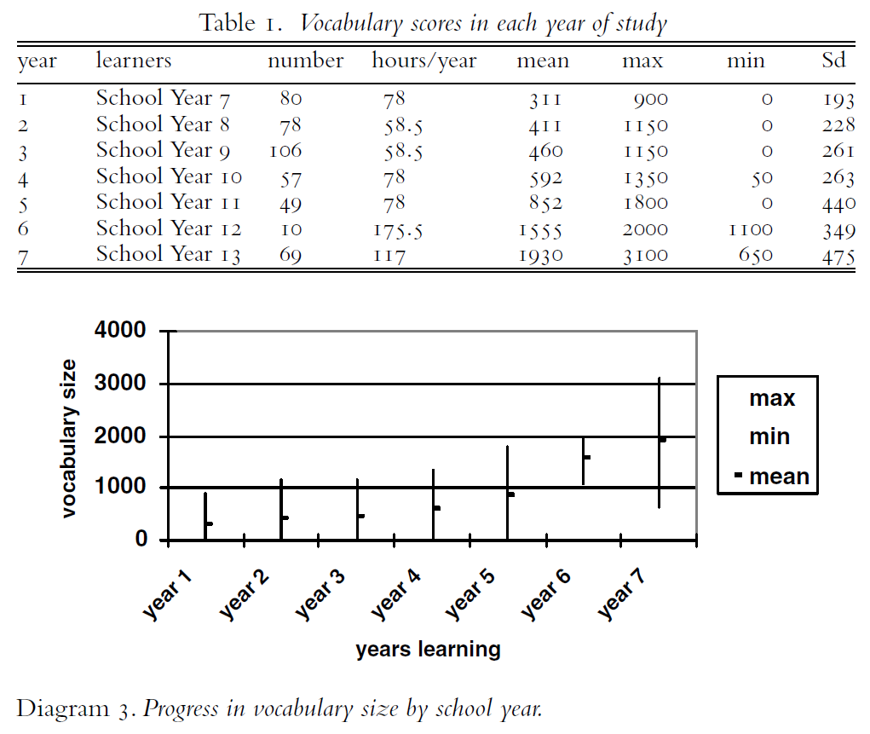
How many words does a GCSE student know, receptively?
How many words does a GCSE student know, receptively?
Milton (2006). Language Lite? Learning French Vocabulary in School, Journal of French Language Studies, 16, 187-205
Notes:
This is receptive knowledge. NB Data gathered in summer term of 2004 and study was cross-sectional, not longitudinal, so progress is to be inferred rather than evidenced
Of the Y11 students, the largest vocabulary size was 1800
Notice how the number of words known by the end of year 11 is remarkably close to the number of words used in each year of current GCSE in reading + listening paper (combined)= about 850 words (this is even though Milton’s study was entirely different and independent from our count of words in GCSE exams – the two studies were done at different times - 2021 and 2004 - and under different GCSE specifications).
Table and the graph in the slide are based on the same data.

Slide 53
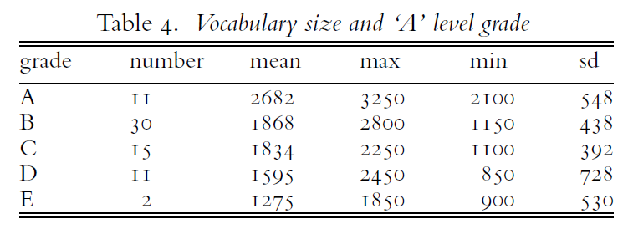
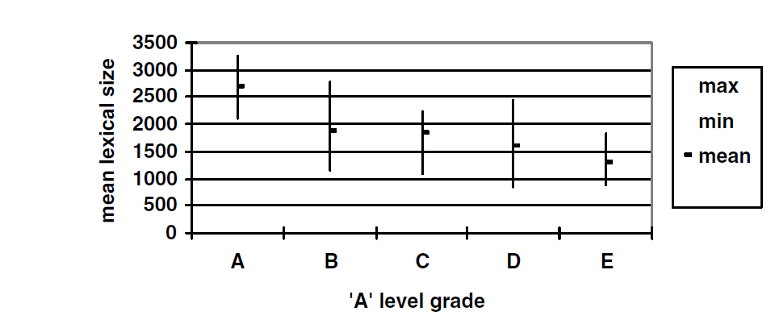
How many words does an A level student know, receptively?
How many words does an A level student know, receptively?
Language Lite? Learning French Vocabulary in School,
Milton (2006). Journal of French Lanuage Studies, 16, 187-205
Notes:
Study done in a UK grammar school with 69 French A level learners.
The vocabulary knowledge of learners who take ‘A’ level appears to be an average (mean) of a little fewer than 2000 words.
Table and the graph in the slide are based on the same data.
No student achieved an A without an indicative vocabulary size of more than 2000 words.
No-one with more than 2,750 words failed to get an A at A level.
However, vocab size isn’t everything of course: students with vocabularies of more than 2000 words (in some cases, substantially more) achieved B, C and D grades, too…And one student (at least) achieved a B grade at A level with a little over 1150 words!

Slide 54
2. Designing a vocabulary strand
How many words is it reasonable to expect at GCSE?
Average curriculum time realistically available = 168 weeks
(36 weeks/year over 5 years, minus one term in year 11)
Based on acquisition of approx. 10 new words/week (e.g. Schmitt 2004), -> approx. 1680 words (about 4 per lesson, using data from Milton, 2006)
10 words per week realistic, if we acknowledge that …
  words are best known when both understood and produced
    and practically, in the classroom, separating teaching and resources into words that ‘only need to be known receptively’ is very difficult!
  lots of systematic revisiting, practice, and testing is needed
  complex, highly irregular grammar items need to be learnt like “words”
NB Students can pass a GCSE with receptive knowledge of 852 words (Milton, 2006) or perhaps even 564 words (David, 2008)
Notes:
Annabelle David (2008) Vocabulary breadth in French L2 learners, The Language Learning Journal, 36:2, 167-180, DOI: 10.1080/09571730802389991
Milton, J. (2006). Language lite? Learning French vocabulary in school. Journal of French Language Studies 16, no. 2: 187–205.

Slide 55
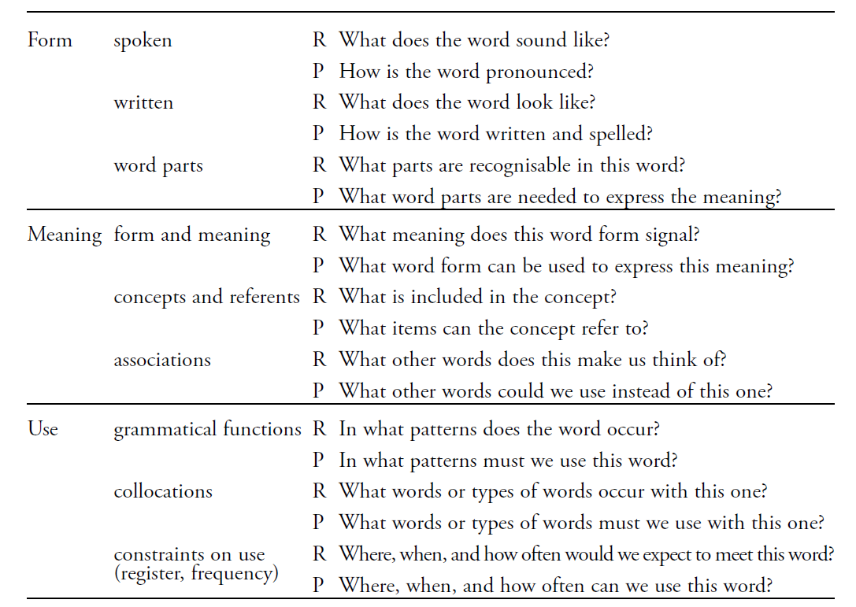
When we say ‘know’ a word, you really need to know …
When we say ‘know’ a word, you really need to know …
Establishing this knowledge needs plenty of practice, in lots of different and engaging contexts
(Nation 2001:27)
Notes:
Nation, I. S. P. (2001). Learning Vocabulary in Another Language. Cambridge:
Cambridge University Press.

Slide 56
You need to keep revisiting words –> this takes up curriculum time! Vocabulary experts say…
“the 1500 words contained in the GCSE specification would, if learned, bring these learners of this exam to a level of threshold understanding and put them somewhere near B1 level French learners in other countries”. (Milton, 2015: 117)
Multiple exposures and use are important to consolidate knowledge and develop fluency, anywhere between 5 – 20 encounters. (Nation, 2001:81)
spaced repetition, 10+ encounters (e.g., Webb 2007)
‘Recycling is necessary, and if it is neglected, many partially learned words will be forgotten, wasting all the effort already put into learning them ... Recycling has to be consciously built into vocabulary learning programs, and teachers must guard against presenting lexical items once and then forgetting about them, or else their students will likely do the same.’ (Schmitt, 2008:343)
Notes:
Nation, I. S. P. (2001). Learning Vocabulary in Another Language. Cambridge: Cambridge University Press.
Schmitt, N. (2008). Review Article. Instructed second language vocabulary learning. Language Teaching Research, 12(3), 329–363. https://doi.org/10.1177/1362168808089921
Milton, J (2015) "French lexis and formal exams in the British foreign language classroom", Revue française de linguistique appliquée, 2015/1 (Vol. XX), p. 107-119. DOI: 10.3917/rfla.201.0107
Webb, S. (2007) The Effects of Repetition on Vocabulary Knowledge, Applied Linguistics, 28 (1) 46–65, https://doi.org/10.1093/applin/aml048
Information about CEFR work from the 1980s and early 90s.
https://www.llas.ac.uk/resources/paper/2715 from Jim Milton’s presentation at the conference: Crossing frontiers: languages and the international dimension, 6-7 July 2006.
said:
The original Threshold level materials (Van Ek and Trim, 1990; Coste et al 1987) contained wordlists for French, and other languages at B1 level. The French list contains just under 2000 words, and the EFL list just over 2000 words, for example. The A2, Waystage materials for French and English (for example, Van Ek, 1990) both contain wordlists of about 1000 words.
Coste, D., Courtillon, J., Ferenczi, V., Martins-Baltar, M. and Papo, E. (1987) Un Niveau Seuil. Paris; Editions Didier
Van Ek, J.A. and Trim, J.L.M. (1990) Threshold 1990. Strasbourg: Council of Europe Publishing.
Van Ek, J.A. (1990) Waystage English. London; Pergamon Press

