Slide 1
Instructions for printing
Before printing, go to File - Export - Create pdf/xps Document and save it as a pdf. Then open the PDF in chrome and print from there. This way you will get a small and uniform border around the slide.

Slide 2
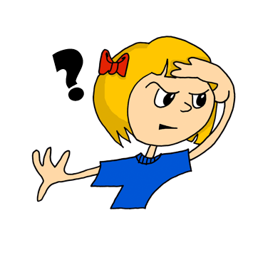
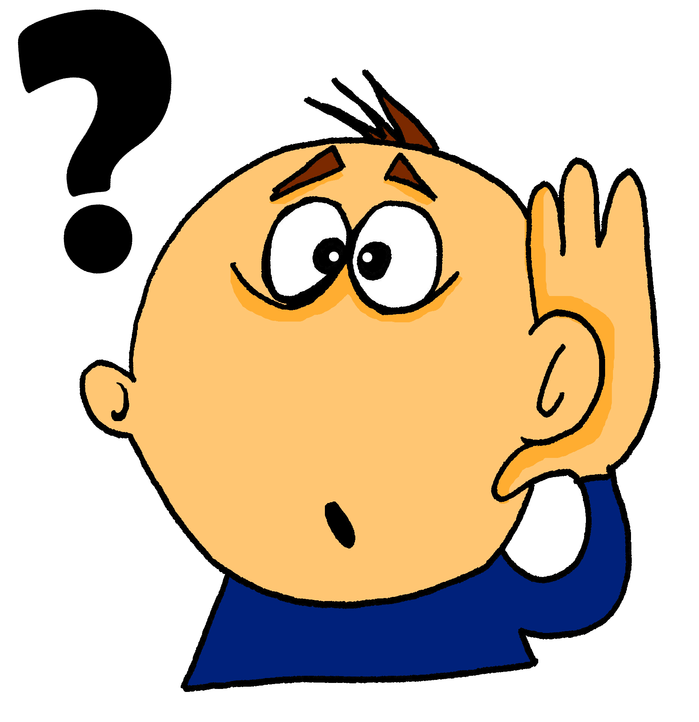
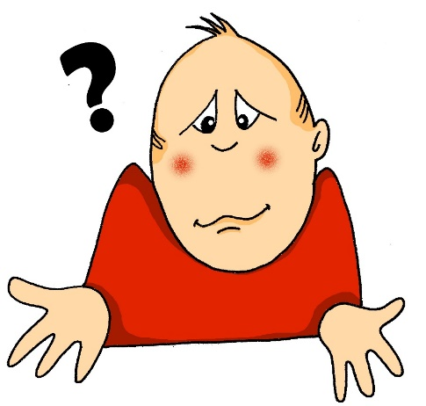
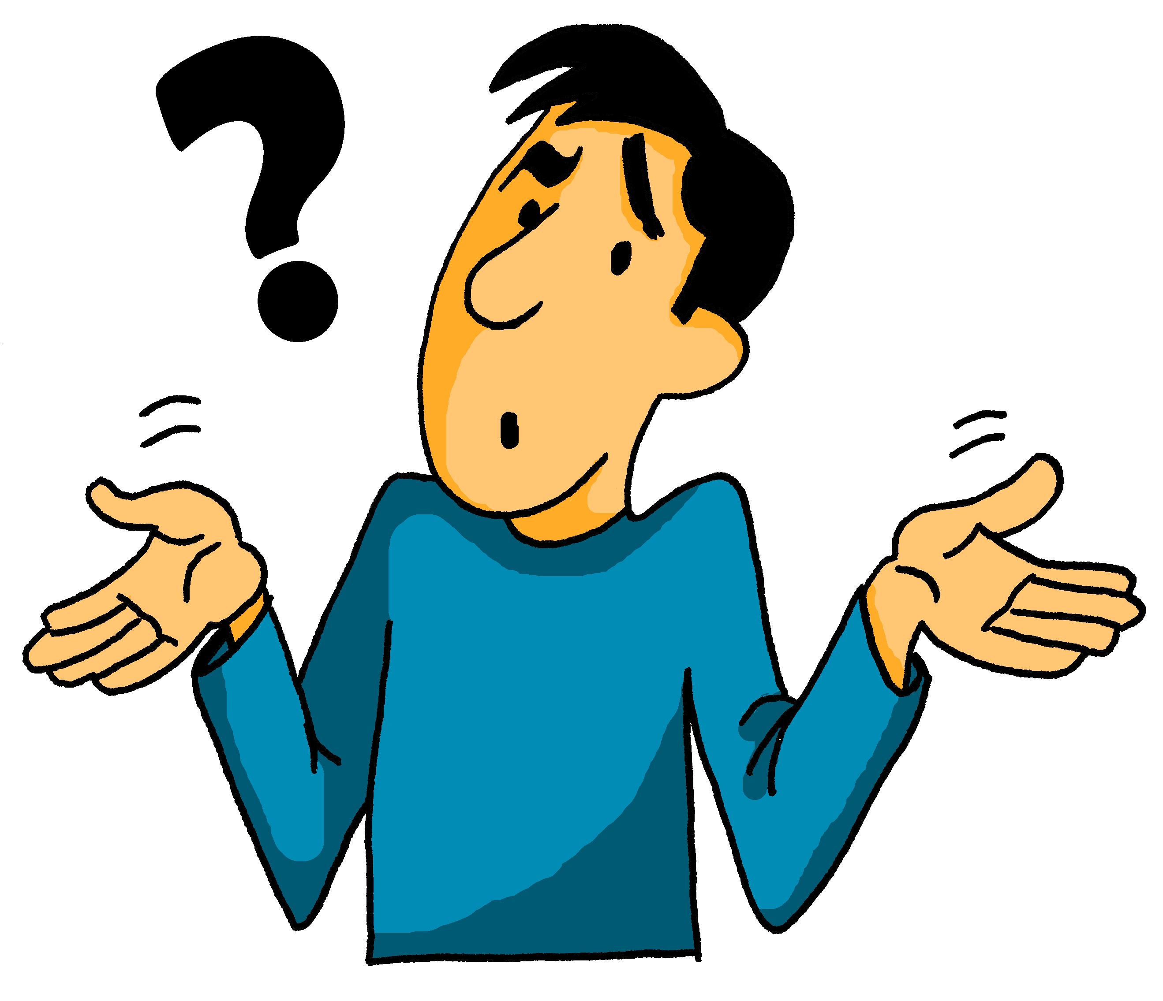
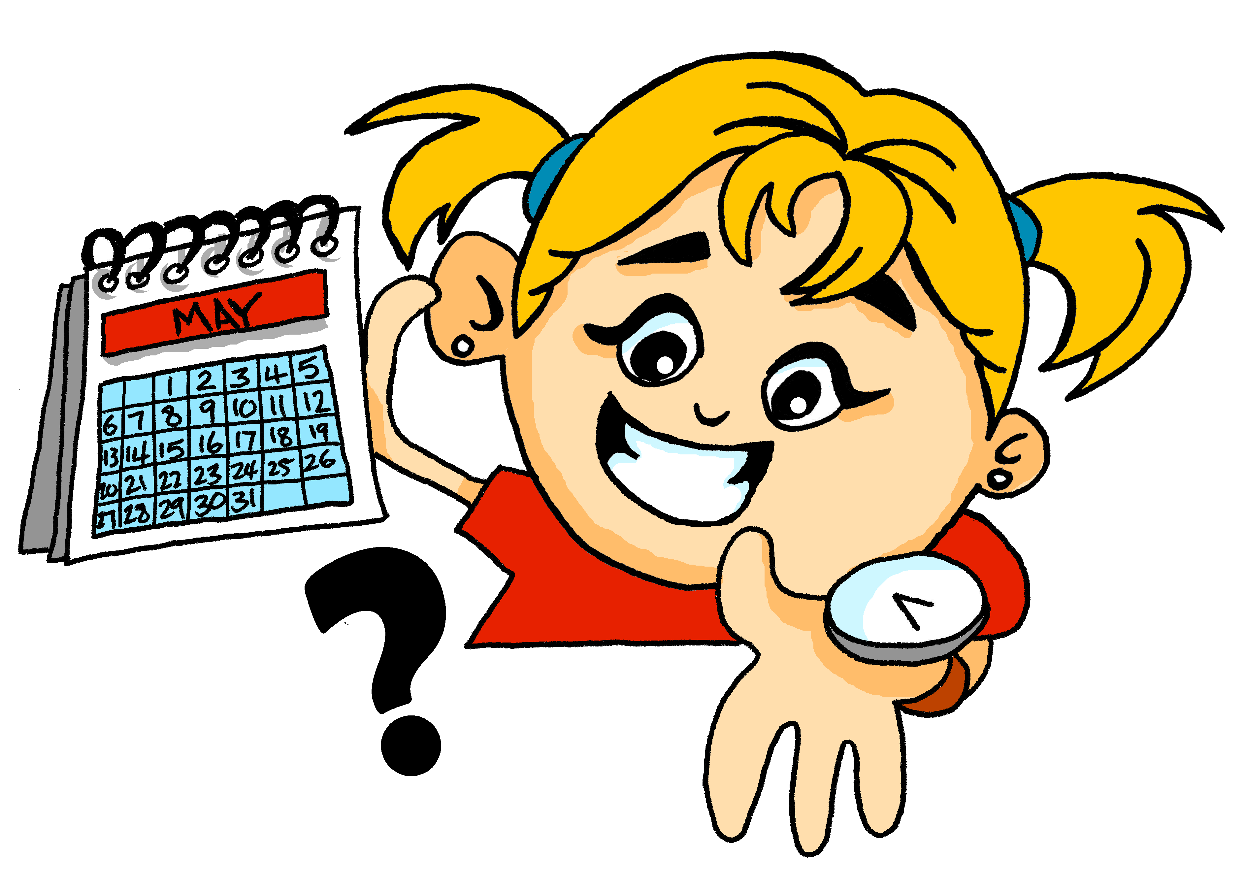
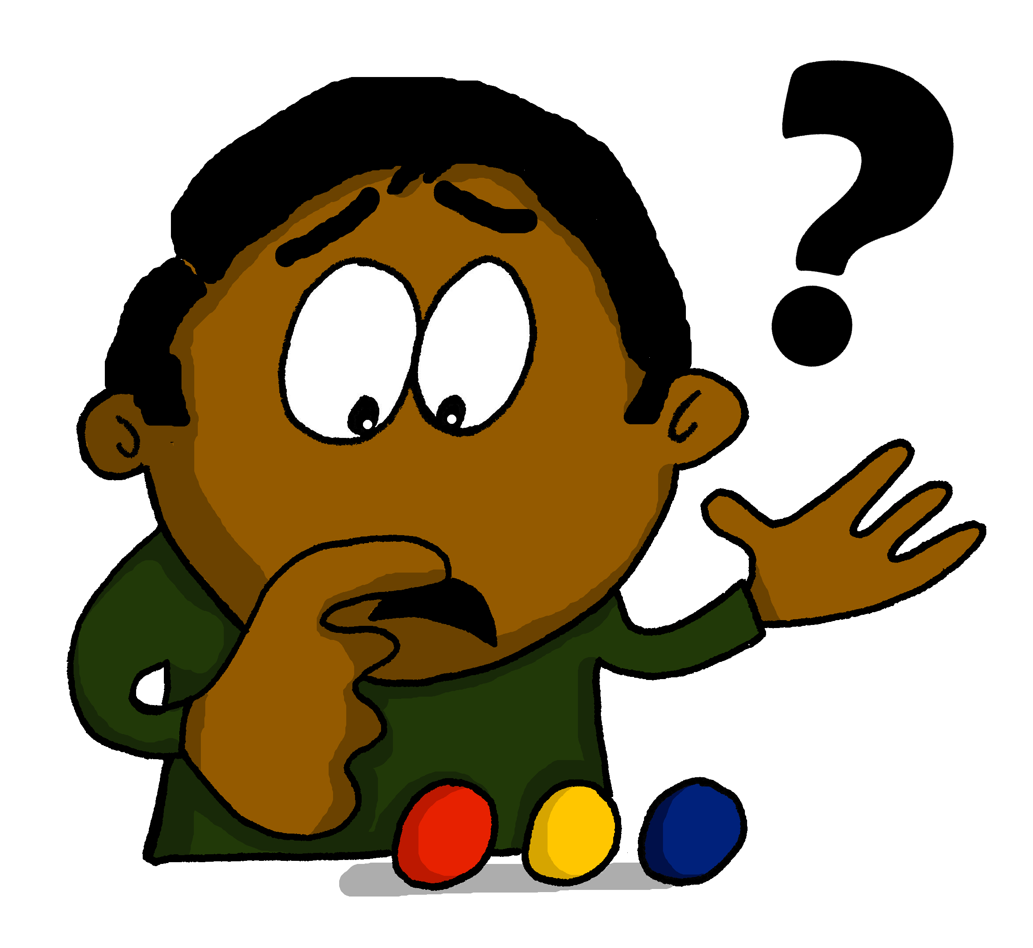
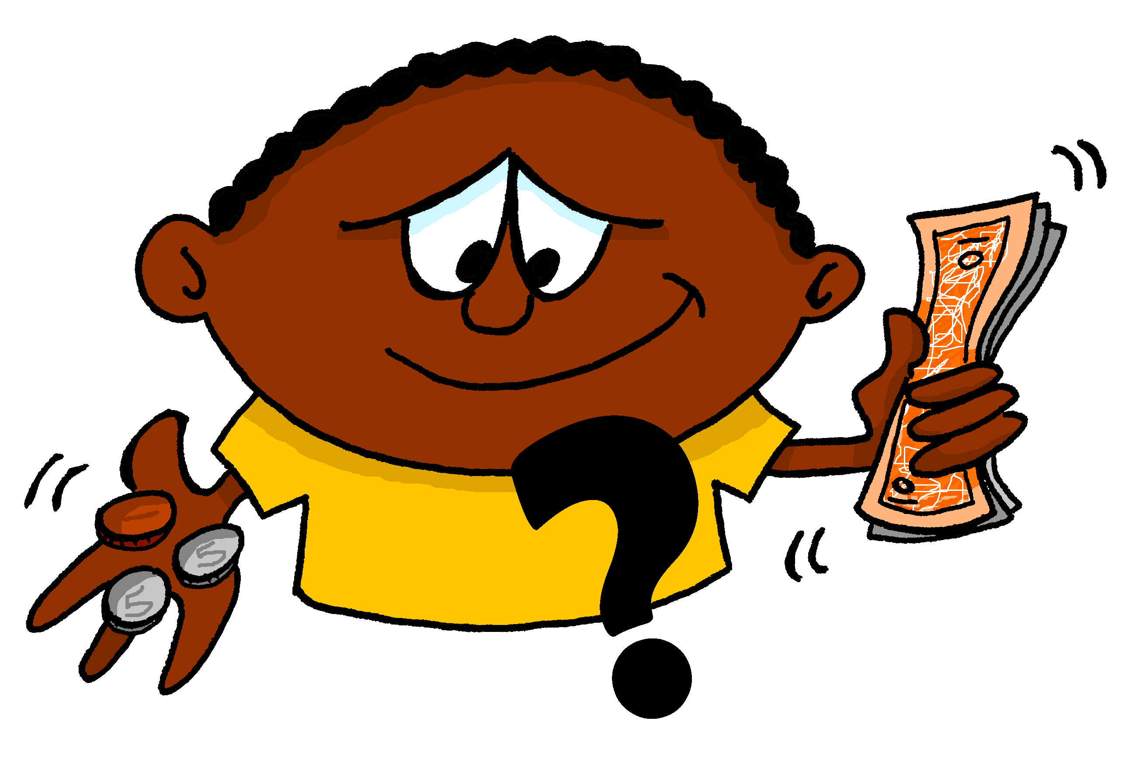
Images: Steve Clarke
Notes:
Vocabulary frequency rankings (1 is the most common word in German): wo (94); wer (173); was (39); wann (583); wie (283); warum (246); welcher (138); wie viel (28/60); wie viele (28/60)* Source: Jones, R.L., & Tschirner, E. (2006 ). A Frequency Dictionary of German. Routledge
* wie + viel: frequencies listed separately for each word

Slide 3
[94]
[173]
[39]
wo?
wer?
was?
[583]
[28]
[246]
wann?
wie?
warum?
[138]
[28/60]
[28/60]
welcher ?
wie viel?
wie viele?
Images: Steve Clarke
Source: Jones, R.L. & Tschirner, E. (2006). A frequency dictionary of German: core vocabulary for learners. Routledge.
Notes:
Vocabulary frequency rankings (1 is the most common word in German): wo (94); wer (173); was (39); wann (583); wie (283); warum (246); welcher (138); wie viel (28/60); wie viele (28/60)* Source: Jones, R.L., & Tschirner, E. (2006 ). A Frequency Dictionary of German. Routledge
* wie + viel: frequencies listed separately for each word

Slide 4
wo?
[94]
Images: Steve Clarke
Source: Jones, R.L. & Tschirner, E. (2006). A frequency dictionary of German: core vocabulary for learners. Routledge.
Notes:
Vocabulary frequency rankings (1 is the most common word in German): wo (94); wer (173); was (39); wann (583); wie (283); warum (246); welcher (138); wie viel (28/60); wie viele (28/60)* Source: Jones, R.L., & Tschirner, E. (2006 ). A Frequency Dictionary of German. Routledge
* wie + viel: frequencies listed separately for each word

Slide 5
wer?
[173]
Images: Steve Clarke
Source: Jones, R.L. & Tschirner, E. (2006). A frequency dictionary of German: core vocabulary for learners. Routledge.
Notes:
Vocabulary frequency rankings (1 is the most common word in German): wo (94); wer (173); was (39); wann (583); wie (283); warum (246); welcher (138); wie viel (28/60); wie viele (28/60)* Source: Jones, R.L., & Tschirner, E. (2006 ). A Frequency Dictionary of German. Routledge
* wie + viel: frequencies listed separately for each word

Slide 6
was?
[39]
Images: Steve Clarke
Source: Jones, R.L. & Tschirner, E. (2006). A frequency dictionary of German: core vocabulary for learners. Routledge.
Notes:
Vocabulary frequency rankings (1 is the most common word in German): wo (94); wer (173); was (39); wann (583); wie (283); warum (246); welcher (138); wie viel (28/60); wie viele (28/60)* Source: Jones, R.L., & Tschirner, E. (2006 ). A Frequency Dictionary of German. Routledge
* wie + viel: frequencies listed separately for each word

Slide 7
wann?
[583]
Images: Steve Clarke
Source: Jones, R.L. & Tschirner, E. (2006). A frequency dictionary of German: core vocabulary for learners. Routledge.
Notes:
Vocabulary frequency rankings (1 is the most common word in German): wo (94); wer (173); was (39); wann (583); wie (283); warum (246); welcher (138); wie viel (28/60); wie viele (28/60)* Source: Jones, R.L., & Tschirner, E. (2006 ). A Frequency Dictionary of German. Routledge
* wie + viel: frequencies listed separately for each word

Slide 8
wie?
[283]
Images: Steve Clarke
Source: Jones, R.L. & Tschirner, E. (2006). A frequency dictionary of German: core vocabulary for learners. Routledge.
Notes:
Vocabulary frequency rankings (1 is the most common word in German): wo (94); wer (173); was (39); wann (583); wie (283); warum (246); welcher (138); wie viel (28/60); wie viele (28/60)* Source: Jones, R.L., & Tschirner, E. (2006 ). A Frequency Dictionary of German. Routledge
* wie + viel: frequencies listed separately for each word

Slide 9
warum?
[246]
Images: Steve Clarke
Source: Jones, R.L. & Tschirner, E. (2006). A frequency dictionary of German: core vocabulary for learners. Routledge.
Notes:
Vocabulary frequency rankings (1 is the most common word in German): wo (94); wer (173); was (39); wann (583); wie (283); warum (246); welcher (138); wie viel (28/60); wie viele (28/60)* Source: Jones, R.L., & Tschirner, E. (2006 ). A Frequency Dictionary of German. Routledge
* wie + viel: frequencies listed separately for each word

Slide 10
welcher?
[138]
welche? / welches?
Images: Steve Clarke
Source: Jones, R.L. & Tschirner, E. (2006). A frequency dictionary of German: core vocabulary for learners. Routledge.
Notes:
Vocabulary frequency rankings (1 is the most common word in German): wo (94); wer (173); was (39); wann (583); wie (283); warum (246); welcher (138); wie viel (28/60); wie viele (28/60)* Source: Jones, R.L., & Tschirner, E. (2006 ). A Frequency Dictionary of German. Routledge
* wie + viel: frequencies listed separately for each word

Slide 11
wie viel?
[28/60]
Images: Steve Clarke
Source: Jones, R.L. & Tschirner, E. (2006). A frequency dictionary of German: core vocabulary for learners. Routledge.
Notes:
Vocabulary frequency rankings (1 is the most common word in German): wo (94); wer (173); was (39); wann (583); wie (283); warum (246); welcher (138); wie viel (28/60); wie viele (28/60)* Source: Jones, R.L., & Tschirner, E. (2006 ). A Frequency Dictionary of German. Routledge
* wie + viel: frequencies listed separately for each word

Slide 12
wie viele?
[28/60]
Images: Steve Clarke
Source: Jones, R.L. & Tschirner, E. (2006). A frequency dictionary of German: core vocabulary for learners. Routledge.
Notes:
Vocabulary frequency rankings (1 is the most common word in German): wo (94); wer (173); was (39); wann (583); wie (283); warum (246); welcher (138); wie viel (28/60); wie viele (28/60)* Source: Jones, R.L., & Tschirner, E. (2006 ). A Frequency Dictionary of German. Routledge
* wie + viel: frequencies listed separately for each word

