Slide 1
Asking questions about others
Verbs like sortir (present) (je, tu, il/elle), verbs like venir (present) (je, tu, il/elle)
Inversion questions (two-verb structures)
SSC [è/ê] [revisited]
Y7 French
Term 3.1 - Week 2 - Lesson 51
Stephen Owen / Kirsten Somerville / Adeline Charlton
Artwork by: Chloé Motard
Date updated: 04/08/2022
Notes:
Artwork by Chloé Motard. All additional pictures selected are available under a Creative Commons license, no attribution required.
Learning outcomes (lesson 1):
Revisiting SSC [è/ê]
Introducing first, second and third person singular forms of verbs like sortir and verbs like venir (devenir, revenir)
Introducing inversion questions with double verb structures (aimer)
Word frequency (1 is the most frequent word in French):
7.3.1.2 (introduce) devenir [162], revenir [184], sors [309], sort [309], sortir [309], venir [88], viens [88], vient [88], de² [2], important [215], algérien [4163], algérienne [4163], Algérie [n/a], Alger [n/a]
7.2.2.4 (revisit) allons [53], allez [53], vont [53], année [102], mois [178], vacances [1726], ville [260], Écosse [n/a], Angleterre [n/a], France [n/a], chez¹ [206], en³ [3]
7.2.1.3 (revisit) avons [8], avez [8], ont [8], enfant [126], famille [172], problème [188], difficile [296], ici [167], très [66], aussi [44], pour¹ [10], dans [11]
Source: Londsale, D., & Le Bras, Y. (2009). A Frequency Dictionary of French: Core vocabulary for learners London: Routledge.
The frequency rankings for words that occur in this PowerPoint which have been previously introduced in NCELP resources are given in the NCELP SOW and in the resources that first introduced and formally re-visited those words.
For any other words that occur incidentally in this PowerPoint, frequency rankings will be provided in the notes field wherever possible.
The additional English meanings of the following words have been added to Quizlet since the creation of this resource:
revenir: to come back, coming back; to return, returning
sortir: to go out, going out; to exit, exiting

Slide 2
ê/è
[head]
tête
Notes:
Timing: 1 minute
Aim: To consolidate SSC [ê/è]
Procedure: 1. Present the letter(s) and say the [ê/è] sound first, on its own. Students repeat it with you. 2. Bring up the word ”tête” on its own, say it, students repeat it, so that they have the opportunity to focus all of their attention on the connection between the written word and its sound.
3. A possible gesture for this would be to point to one’s head.
4. Roll back the animations and work through 1-3 again, but this time, dropping your voice completely to listen carefully to the students saying the [ê/è] sound, pronouncing ” tête” and, if using, doing the gesture.
Word frequency (1 is the most frequent word in French):
tête [343]. Source: Londsale, D., & Le Bras, Y. (2009). A Frequency Dictionary of French: Core vocabulary for learners London: Routledge.

Slide 3
ê/è
tête
Notes:
With sound and no pictures to focus all attention on the sound-symbol correspondence.

Slide 4
ê/è
[head]
tête
Notes:
Without sound to elicit pronunciation (without first hearing the teacher).
Teacher to elicit pronunciation by asking “Comment dit-on …"

Slide 5
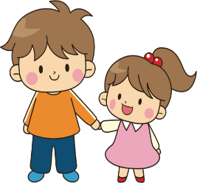
ê/è
fête
frère
[head]
collège
tête
être
[to be]
problème
Notes:
Timing: 2 minutes
Aim: To consolidate SSC [ê/è]
Procedure:
1. Introduce and elicit the pronunciation of the individual SSC [ê/è] and then the source word again ‘tête’ (with gesture, if using). 2. Then present and elicit the pronunciation of the five cluster words.
The cluster words have been chosen for their high-frequency, from a range of word classes, with the SSC (where possible) positioned within a variety of syllables within the words (e.g. initial, 2nd, final etc.). Additionally, we have tried to use words that build cumulatively on previously taught SSCs (see the Phonics Teaching Sequence document) and do not include new SSCs. Where new SSCs are used, they are often consonants which have a similar symbol-sound correspondence in English.
Word frequency (1 is the most frequent word in French): fête [1490]; frère [1043] collège [2116]; problème [188]; être[5]; tête [343]. Source: Londsale, D., & Le Bras, Y. (2009). A Frequency Dictionary of French: Core vocabulary for learners London: Routledge.

Slide 6
ê/è
fête
frère
collège
tête
être
problème
Notes:
With sound and no pictures to focus all attention on the sound-symbol correspondence.

Slide 7
ê/è
fête
frère
collège
tête
être
problème
Notes:
Without sound to elicit pronunciation (without first hearing the teacher).
Teacher to elicit pronunciation by asking “Comment dit-on …"

Slide 8
[è], [ê] ou [é]?
[ê/è] ou [é] ?
écouter
è, ê
é
cream
1
✔
crème
_
café
2
café
✔
_
ideal
3
idéal
✔
Écoute et coche (✔)
_
pupil
4
✔
élève
✔
_
_
huge
5
énorme
✔
_
behind
6
✔
derrière
_
Some words may contain both [é] and [ê/è]
clothes
7
✔
vêtements
_

different
8
différent
✔
_
pleasant
9
agréable
✔
_
famous
10
✔
célèbre
✔
_
_
Notes:
Timing: 5 minutes
Aim: Aural distinction between SSCs [ê/è] and [é]. Connecting different types of accent on letter e with sound.
Procedure:
Students write 1-8.
Click on the numbers to hear the words said aloud.
Students tick the column containing the missing letter.
Click to show answers.
Play audio again. Students repeat.
Transcript:
crème
café
idéal
élève NB: é + è
énorme
derrière **first [e] doesn’t accent due to double-consonant although sounds like [é]
vêtements
différent
agréable
célèbre NB: é + è
Word frequency (1 is the most frequent word in French):
crème [4748], café [1886], idéal [1429], élève [1068], énorme [663], derrière [805], vêtements [2383], différent [350], agréable [2841], célèbre [1689]
Source: Londsale, D., & Le Bras, Y. (2009). A Frequency Dictionary of French: Core vocabulary for learners London: Routledge.

Slide 9
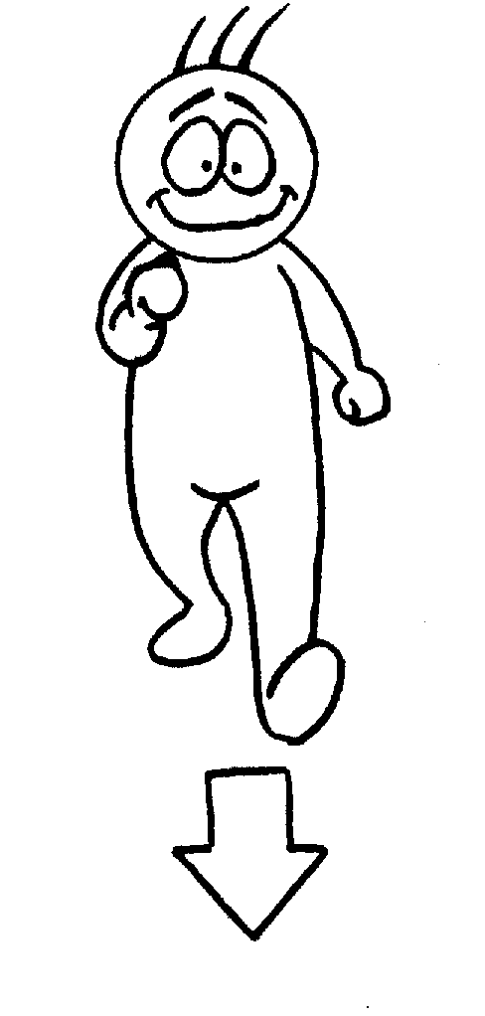
venir
[to come | coming]
vient
[comes | is coming]
Notes:
Timing: 3 minutes for sequence of six verbs
Aim to introduce the verb [venir] more explicitly. [Venir] is one of the 25 most frequently used verbs in French. All 25 most frequent verbs will be introduced early on using the same format. Both long form (infinitive) and short form (3rd person singular) are introduced in order to familiarise students with various forms of the same verb.
Procedure
Bring up the word [venir] on its own, say it, students repeat it, and remind them of the phonics.
Try to elicit the meaning from the students. Students have had explicit teaching that the present tense in French communicates two different present tense meanings in English. This reinforces that learning. Emphasise the two meanings for the short form, reminding students that French only has one form and does not have a direct equivalent of the grammar for ‘is + ing’, the continuous form (as covered in previous weeks).
Bring up the picture, and, if using gestures, a possible gesture would be [to mime beckoning someone to you].
Then bring up the English translations. Emphasise the two meanings for the infinitive.
Bring up the short form [vient], say it, students repeat it.
Try to elicit the meaning from the students. Emphasise the two meanings for the short form.

Slide 10
venir
[to come | coming]
vient
[comes | is coming]
Notes:
Cycle through the long and short form again.

Slide 11
vient
[comes | is coming]
Elle vient ici.
[She comes | is coming here.]
Notes:
Introduce the short form in a sentence.

Slide 12
venir
[to come | coming]
Elle aime venir ici.
[She likes to come | coming French.]
Notes:
Introduce the long form in a sentence.

Slide 13
vient
[comes | is coming]
Elle ici.
vient
[She comes | is coming here.]
Notes:
Cycle through the short form in context again.

Slide 14
venir
[to come | coming]
venir
Elle aime ici.
[She likes to come | coming here.]
Notes:
Cycle through the long form in context again.

Slide 15
The verb ‘venir’ – to come
The verb ‘venir’ – to come
grammaire
This is the pattern of endings for the first, second and third person singular forms of venir :
Notice also the change from e to ie in the stem (first part of the verb)
je viens
I come / I am coming
tu viens
you come / you are coming
These verb forms all sound the same!
The –s on the je and tu forms is a silent final consonant (SFC)
il vient
he comes / he is coming
elle vient
she comes / she is coming
Notes:
Timing: 1 minute
Aim: Introduce pattern of verb endings
Procedure
The first three persons singular of the verb venir are now presented.
Point out to students that all three of these verb forms sound the same in French.

Slide 16
The verbs ‘devenir’ and ‘revenir’
The verb ‘devenir’ – to become
grammaire
The pattern is the same as for venir – just add the prefix de-:
je deviens
I become / I am becoming
tu deviens
you become / you are becoming
il devient
he becomes / he is becoming
These verb forms all sound the same!
The –s on the je and tu forms is a silent final consonant (SFC)
elle devient
she becomes / she is becoming
Remember, the stem (first part of the verb) changes from e to ie.
Notes:
Timing: 1 minute
The first three persons singular of the verb devenir are now presented. Highlight that all forms sound the same due to the SFC.

Slide 17
The verbs ‘devenir’ and ‘revenir’
The verb ‘revenir’ – to come back
grammaire
The pattern is the same as for venir – just add the prefix re-:
je reviens
I come back (return) / I am coming back (returning)
tu reviens
you come back (return) / you are coming back (returning)
il revient
These verb forms all sound the same!
The –s on the je and tu forms is a silent final consonant (SFC)
he comes back / he is coming back
elle revient
she comes back / she is coming back
Remember, the stem (first part of the verb) changes from e to ie.
Notes:
Timing: 1 minute
The first three persons singular of the verb devenir are now presented. Highlight that all forms sound the same due to the SFC.

Slide 18
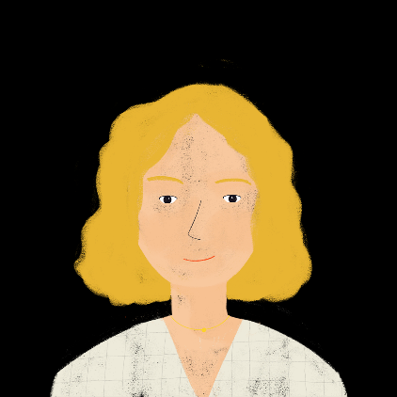
La mère de Léa
La mère de Léa
lire
La mère de Léa écrit dans un journal chaque jour.
Qui fait quoi ? Écris je (Aurélie) ou elle (Léa).
Je reviens d’Angleterre aujourd’hui. Je reviens à la maison en ce moment, mais elle ne vient pas. Elle revient d’une fête. Je pense que je deviens malade.
En ce moment, elle devient ami avec un garçon. Elle devient une jeune femme. Je deviens triste. Où est ma petite enfant ?!
Aurélie
[1]
[6]
[2]
[7]
[8]
[3]
[4]
[5]
Notes:
Timing: 5 minutes
Aim: Written recognition of singular forms of revenir, devenir and venir and connecting these with meaning.
Procedure:
1. Students read the sentences and use the form of the verb in each sentence to work out the subject pronoun.
2. Students write 1-8 and je/tu or il/elle.
3. Answers appear on clicks.
Word frequency of cognates used (1 is the most frequent word in French): journal [520]
Source: Londsale, D., & Le Bras, Y. (2009). A Frequency Dictionary of French: Core vocabulary for learners London: Routledge.

Slide 19
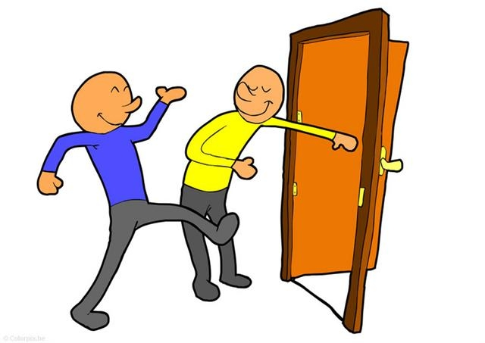
sortir
[to go out (exit) | going out (exiting)]
sort
[goes out (exits)| is going out (is exiting)]
Notes:
Timing: 3 minutes for sequence of six verbs
Aim: to introduce the verb [sortir] more explicitly. Sortir is one of the NCELP 15 prototypical verbs in French. Prototypical verbs are common verbs that illustrate the typical characteristics of a class of verb – the French prototypical verbs contain examples of regular/weak verbs, but also common examples of changes to the stem. All 15 prototypical verbs will be introduced early on using the same format. Both long form (infinitive) and short form (3rd person singular) are introduced in order to familiarise students with various forms of the same verb.
Procedure
Bring up the word [sortir] on its own, say it, students repeat it, and remind them of the phonics.
Try to elicit the meaning from the students. Students have had explicit teaching that the present tense in French communicates two different present tense meanings in English. This reinforces that learning. Emphasise the two meanings for the short form, reminding students that French only has one form and does not have a direct equivalent of the grammar for ‘is + ing’, the continuous form (as covered in previous weeks).
Bring up the picture, and, if using gestures, a possible gesture would be [point to the door].
Then bring up the English translations. Emphasise the two meanings for the infinitive.
Bring up the short form [sort], say it, students repeat it.
Try to elicit the meaning from the students. Emphasise the two meanings for the short form.

Slide 20
sortir
[to go out (exit) | going out (exiting)]
sort
[goes out (exits)| is going out (is exiting)]
Notes:
Cycle through the long and short form again.

Slide 21
sort
[goes out | is going out]
Il sort avec des amis.
[He goes out | is going out with friends.]
Notes:
Introduce the short form in a sentence.

Slide 22
sortir
[to go out (exit) | going out (exiting)]
Il aime sortir en ville.
[He likes to go out | going out in town.]
Notes:
Introduce the long form in a sentence.

Slide 23
sort
[goes out | is going out]
Il avec des amis.
sort
[He goes out | is going out with friends.]
Notes:
Cycle through the short form in context again.

Slide 24
sortir
[to go out (exit) | going out (exiting)]
sortir
Il aime en ville.
[He likes to go out | going out in town.]
Notes:
Cycle through the long form in context again.

Slide 25
The verb ‘sortir’ – to go out
The verb ‘sortir’ – to go out
grammaire
The pattern of endings is the same for sortir:
This -s, -s, -t pattern for je, tu and il/elle is common in verbs like sortir!
je sors
I go out (exit) / I am going out (exiting)
tu sors
you go out (exit) / you are going out (exiting)
il sort
These verb forms all sound the same!
The –s on the je and tu forms is a silent final consonant (SFC)
he goes out (exits) / he is going out (is exiting)
elle sort
she goes out (exits) / she is going out (is exiting)
Notes:
Timing: 1 minute
Aim: Introduce pattern of verb endings
Procedure:
The first three persons singular of the verb sortir are now presented
Point out to students that all three of these verb forms sound the same in French.

Slide 26
C’est qui ?
C’est qui ?
lire
Écris 1-8 et je/tu ou il/elle. C’est quoi en anglais?
 |  | je/ tu | il/ elle
1
2
3
4
 |  | je/ tu | il/ elle
5
6
7
8
sors chaque samedi.
sort le week-end.
viens dehors.
viens chez Amir.
sort souvent.
sort en ville.
viens à Alger.
vient en Algérie.
Notes:
Timing: 5 minutes
Aim: Written recognition of singular forms of venir and sortir and connecting these with meaning.
Procedure:
1. Students read the sentences and use the form of the verb in each sentence to work out the subject pronoun in each case - je/tu or il/elle - ticking the appropriate column.
2. Students write 1-8 and je/tu or il/elle.
3. Answers appear on clicks.
4. Possible translations to be elicited from students. It is not always possible to translate in both the present simple and present continuous. Prompting students to consider why this is and to suggest how to change the sentence to make both possible will help to deepen their knowledge. e.g. 1. only present simple. Change ‘chaque samedi’ to ‘en ce moment’ OR ‘avec des amis’ to make both possible.
Word frequency (1 is the most frequent word in French): week-end [2475]
Source: Londsale, D., & Le Bras, Y. (2009). A Frequency Dictionary of French: Core vocabulary for learners London: Routledge.

Slide 27
C’est quoi la différence?
C’est quoi la difference ?
écouter
Do they ‘do it’ or ‘like doing it’? What is missing? Just a pronoun (je, tu, il or elle) or a pronoun + aime(s)?
 | je/tu/il/elle | j’aime
 | je/tu/il/elle | j’aime
1
5
2
6
3
7
4
8
Notes:
Timing: 5 minutes
Aim: aural recognition of singular and infinitive forms of sortir and venir and connecting these with meaning.
Procedure:
Click on a number to hear a sentence with the pronoun or pronoun + aime obscured.
Students write 1-8 and use their knowledge of single- and two-verb structures to decide whether the sentence starts with ‘j’aime’, or with a subject pronoun alone.
Since the form of the verb for the first three persons singular sounds the same for all verbs presented this week, students are not able to say which person would have been in the sentence - this task will help students to understand this point
The answers are animated and appear upon successive mouse clicks.
Transcript
1) [J’aime] sortir en ville.
2) [Je/tu] sors aujourd’hui.
3) [Il/elle] vient samedi.
4) [J’aime] venir en France.
5) [Je/tu] comprends la question.
6) [J’aime] apprendre le français.
7) [Il/elle] prend le train.
8) [J’aime] prendre le bateau.

Slide 28
C’est quoi la différence?
C’est quoi la difference ?
écouter
Do they ‘do it’ or ‘like doing it’? What is missing? Just a pronoun (je, tu, il or elle) or a pronoun + aime(s)?
 | je/tu/il/elle | j’aime
 | je/tu/il/elle | j’aime
1
5
2
6
3
7
4
8
Notes:
Answers for the activity on the previous slide. Full audio (including pronouns and pronoun + aime) plays on number clicks.
Transcript [audio currently missing; recording in progress]
1) J’aime sortir en ville.
2) Je/tu sors aujourd’hui.
3) Il/elle vient samedi.
4) J’aime venir en France.
5) Je/tu comprends la question.
6) J’aime apprendre le français.
7) Il/elle prend le train.
8) J’aime prendre le bateau.

Slide 29
Questions with two verbs
Questions with two verbs
grammaire
We known that we can ask a yes/no question by swapping the subject and verb:
Tu sors.
You are going out.
Sors-tu ?
Are you going out?
The subject goes before the infinitive verb.
If the sentence has two verbs, we swap the order of the subject and the first verb (in short form):
Tu aimes sortir.
You like going out.
Aimes-tu sortir ?
Do you like going out?
Notes:
Timing: 2 minutes
Aim: Introduce inversion questions with double verb structures.

Slide 30
Un robot à la maison !
Un robot à la maison !
lire
My printer is malfunctioning! The punctuation is missing, and some of the questions are incomplete.
The robot is new to Earth. He is interviewing people about the things they do. Is he asking if they do it or if they like doing it?
 |  | do it ? | like doing it ?
 | sors tu avec tes amis
 | fais tu les courses
 | aimes tu aller en vacances
 | vas tu chez le médecin
 | aimes tu deviens intéressant
 | aimes tu sortir en ville
 | viens tu à la maison
 | aimes tu revenir ici
1
2
3
4
5
6
7
8
Notes:
Timing: 5 minutes
Aim: Written recognition of word order with two-verb questions.
Procedure:
1. Students write 1-8 and use their knowledge of word order with two-verb questions and statements to decide if the questions are missing a first verb aimer.
2. Answers (and the full questions) are revealed on clicks.

Slide 31
Habiter à Alger
Habiter à Alger
écrire
Amir écrit à Abdel. Lis la réponse d’Abdel. Amir dit quoi ? Écris les questions.
>> RE : Habiter à Alger, c’est comment ?
Salut Amir,
Oui, [1] j’aime habiter à Alger ! [2] J’aime étudier à l’université, et [3] j’aime mes professeurs. Souvent, [4] je parle français en classe. [5] Je travaille aussi, et [6] je sors chaque week-end. [7] Oui, j’aime devenir adulte. Rarement, [8] je vais à l’étranger. [9] Je prends la voiture. [10] Je reviens en France, mais c’est cher !
Abdel
Objet : Habiter à Alger, c’est comment ?
Salut Abdel,
[1] Aimes-tu habiter à Alger ?
[2] Aimes-tu étudier à l’université ?
[3] Aimes-tu tes professeurs ?
[4] Parles-tu français en classe ?
[5] Travailles-tu aussi ?
[6] Sors-tu chaque week-end ?
[7] Aimes-tu devenir adulte ?
[8] Vas-tu à l’étranger ?
[9] Prends-tu la voiture?
[10] Reviens-tu en France ?
Notes:
Timing: 10 minutes
Aim: Written production of one- and two-verb inversion questions.
Procedure:
Students write 1-10 and write a question for each statement in bold.
Answers appear on clicks.
Word frequency of cognates used (1 is the most frequent word in French): adulte [1580]
Source: Londsale, D., & Le Bras, Y. (2009). A Frequency Dictionary of French: Core vocabulary for learners London: Routledge.

Slide 32
Asking questions about others
Inversion questions (il/elle)
SSC [ê/è] [revisited]
Y7 French
Term 3.1 - Week 2 - Lesson 52
Stephen Owen / Kirsten Somerville / Natalie Finlayson
Artwork by: Chloé Motard
Date updated: 04/08/2022
Notes:
Artwork by Chloé Motard. All additional pictures selected are available under a Creative Commons license, no attribution required.
Learning outcomes (lesson 1):
Revisit SSC [ê/è]
Introduction of [inversion questions with il/elle]
Word frequency (1 is the most frequent word in French):
7.3.1.2 (introduce) devenir [162], revenir [184], sors [309], sort [309], sortir [309], venir [88], viens [88], vient [88], de² [2], important [215], algérien [4163], algérienne [4163], Algérie [n/a], Alger [n/a]
7.2.2.4 (revisit) allons [53], allez [53], vont [53], année [102], mois [178], vacances [1726], ville [260], Écosse [n/a], Angleterre [n/a], France [n/a], chez¹ [206], en³ [3]
7.2.1.3 (revisit) avons [8], avez [8], ont [8], enfant [126], famille [172], problème [188], difficile [296], ici [167], très [66], aussi [44], pour¹ [10], dans [11]
Source: Londsale, D., & Le Bras, Y. (2009). A Frequency Dictionary of French: Core vocabulary for learners London: Routledge.
The frequency rankings for words that occur in this PowerPoint which have been previously introduced in NCELP resources are given in the NCELP SOW and in the resources that first introduced and formally re-visited those words.
For any other words that occur incidentally in this PowerPoint, frequency rankings will be provided in the notes field wherever possible.
The additional English meanings of the following words have been added to Quizlet since the creation of this resource:
revenir: to come back, coming back; to return, returning
sortir: to go out, going out; to exit, exiting

Slide 33
Phonétique
collège
parler
Phonétique
problème
45
fête
théorie
désert
Secondes
étoile
célèbre
sévère
tête
[famous]
rêver
pêche
0
[head]
DÉBUT
[to dream, dreaming]
Notes:
Timing: 4 minutes for 3 slides.
Aim: Oral production of SSCs [ê/è] and [é]. Connecting different types of accent on letter e with sound.
Procedure:
1. Prepare students for the task by giving them the pronunciation tips below:
for [ê/è]: check mouth open/lip down
for [é]: bottom jaw down/mouth open, smiley lips/more closed than for [ê/è]
2. Working in pairs, students take it in turns to try to read out the words in alphabetical order in thirty seconds. The listening student makes sure that their partner’s pronunciation is consistent with the accent. If a mistake is noticed, the speaking partner must repeat the word correctly three times before moving on.
3. Teacher circulates to monitor their SSC production.
4. The student who has said the most words in 30 seconds is the winner! 5. Click on words to hear them pronounced by a native speaker. Students repeat.
Word frequency rankings (1 is the most frequent word in French): fête [1490], collège [2116], problème [188], tête [343], pêche [1790], théorie [1773], rêver [1678], étoile [2776], sévère [1733], désert [2382], célèbre [1689] Source: Londsale, D., & Le Bras, Y. (2009). A Frequency Dictionary of French: Core vocabulary for learners London: Routledge.

Slide 34
Phonétique
collège
parler
Phonétique
problème
30
fête
théorie
désert
Secondes
étoile
célèbre
sévère
tête
[famous]
rêver
pêche
0
[head]
DÉBUT
[to dream, dreaming]
Notes:
As previous, but with 15 fewer seconds on the timer.

Slide 35
Phonétique
collège
parler
Phonétique
problème
15
fête
théorie
désert
Secondes
étoile
célèbre
sévère
tête
[famous]
rêver
pêche
0
[head]
DÉBUT
[to dream, dreaming]
Notes:
As previous, but with 15 fewer seconds on the timer still.

Slide 36
-ien ou –ienne ?
-ien ou –ienne ?
écouter / parler
French is widely spoken in several countries in North and West Africa, including Algeria, Tunisia, Niger and Mali.
Les Nationalités
algérien
algérienne
tunisienne
tunisien
tunisien
tunisienne
nigérien
nigérienne
malien
nigérienne
nigérien
nigérienne
nigerien
nigérienne
malien
malien
malienne
malien
malien
malien
malien
malien
malienne
malienne
nigérien
malienne
malienne
malienne
malienne
malienne
A
C
E
G
I
K
M
O
B
D
F
H
J
L
N
P
Notes:
Timing: 5 minutes
Aim: Oral recognition of SSC [ien] in masculine adjective endings and SSC [è/ê] in feminine adjective endings.
Procedure:
Teacher to highlight the SSC change between masculine and feminine endings.
Then, the teacher reads aloud a ‘path’ between the two forms of each nationality, ending at a letter from A-P – check that students have arrived at the correct letter.
This can be repeated with different paths, before handing over to students to read aloud (in pairs and/or to the whole class).

Slide 37
Vocabulaire
écrire/écouter / parler
Vocabulaire
écouter / parler
de France
ici
souvent
Écris 5 phrases différentes.
en Écosse
chaque mois
en ville
Use a different verb each time
en Angleterre
d’Algérie
chaque année
revenir
chez Léa
aujourd’hui
Use each pronoun
viens
sort
vient
chez Amir
sortir
venir
je
sors
devenir
rarement
tu
reviens
en vacances
il
revient
j’aime
devient
le week-end
elle
deviens
Use at least one of these words in each sentence
Notes:
Timing: 5 minutes
Aim: Practise the different forms of the verbs like sortir and verbs like venir introduced in lesson 1, in combination with some of this week’s new and revisited vocabulary.
Procedure:
Students compose 5 sentences by picking from the three word pools.
They then read their sentences to a partner, who translates them into English.

Slide 38
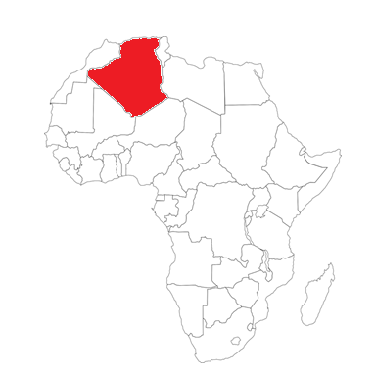
Saying ‘of’ and ‘from’ in French
grammaire
Saying ‘of’ and ‘from’
Remember! To say ‘of’ in French, we use the preposition de:
Je travaille à l’université de Paris.
Alger
I work at the University of Paris.
This preposition can also mean ‘from’:
de → d’ before a vowel
Je reviens d’Algérie.
I’m coming back from Algeria.
Notes:
Timing: 1 minute
Aim: Introduce the second meaning of the preposition de in French.

Slide 39
Saying ‘of’ and ‘from’ in French
lire
Saying ‘of’ and ‘from’
Lis les phrases. Coche la réponse correcte.
de → d’ before a vowel
 |  | ‘of’ | ‘from’
1. | Je vais à l’île de Wight.
2. | Il écoute un message de Jacques.
3. | Tu prends le bateau de Nice.
4. | Tu apprends l’histoire de l’Algérie.
 |  | ‘of’ | ‘from’
5. | Je reviens d’Alger en train.
6. | Elle est une amie de Léa.
7. | Il fait un tour de Bruxelles.
8. | L’idée vient de Marie.
Notes:
Timing: 5 minutes
Aim: Recognise the meaning of de in two different contexts.
Procedure:
Students read sentences and use context to decide whether de means ‘of’ or ‘from’.
Attention should be drawn to the fact that the same preposition can be translated differently depending on the context.
Answers revealed on clicks

Slide 40
Un robot à la maison !
écouter
Un robot à la maison !
Un robot passe une semaine avec une famille humaine. Il parle de l’experience avec un ami. C’est une description (D) de l’expérience, ou une question (Q) pour l’ami?
1
D
D
5
I haven’t learned to use intonation yet! Pay attention to the word order.
Q
Q
2
6
D
Q
3
7
D
Q
4
8
Notes:
Timing: 5 minutes
Aim: To revise last week’s work on subject-verb inversion questions with one of this week’s revisted vocabulary sets. This primes students for the new information about inversion questions introduced this lesson.
Procedure:
Students write 1-8 and the letter ‘Q’ or ‘D’.
Students may need help decoding « fais-je » as this follows a different syllable pattern by combining the verb and subject into one.
Elicit oral translations from students. If time permits, they could translate the sentences in written form. Suggested solutions to this are provided on the next slide.
Transcript:
1. Nous avons un problème.
2. Aimez-vous habiter dans la famille ?
3. Je trouve ça très difficile.
4. Les frères sont méchants.
5. La sœur est triste aussi. [audio missing – recording in progress]
6. Avez-vous une solution ?
7. Fais-je un cadeau pour les enfants ?
8. Ont-ils un ordinateur ?
Word frequency (1 is the most frequent word in French):
expérience [679]
Source: Londsale, D., & Le Bras, Y. (2009). A Frequency Dictionary of French: Core vocabulary for learners London: Routledge.

Slide 41
Un robot à la maison !
écouter
Un robot à la maison !
Traduis les phrases en anglais.
1
5
We have a problem.
The sister is sad, too.
2
6
Do you like living in the family?
Do you have a solution?
3
7
Do I make a present for the children?
I find it very difficult.
4
8
The brothers are mean.
Do they have a computer?
Notes:
OPTIONAL EXTENSION
Timing: 5 minutes
Aim: L2-L1 translation
Procedure:
Students listen again to translate the sentences into English.
Answers revealed on clicks

Slide 42
Subject-verb inversion with ‘il’ and ‘elle’
grammaire
Subject-verb inversion (il/elle)
As you know, the verb and subject can swap places to make a question:
In questions with ‘il’/‘elle’, we pronounce the last letter of the verb as ‘t’.
Silent ‘t’
(SFC)
Elle revient de Paris.
She’s coming back from Paris.
Revient-elle de Paris ?
Is she coming back from Paris ?
Pronounce the ‘t’
The sound is always ‘t’, even if the verb ends with the letter ‘d’:
Prend-elle le train ?
Does she take the train?
Notes:
Timing: 1 minute
This slide reviews subject-verb inversion and presents the pronunciation change associated with questions in the third person.

Slide 43
Subject-verb inversion with ‘il’ and ‘elle’
grammaire
Subject-verb inversion (il/elle)
If the verb ends with a vowel, we need to add a ‘t’ before ‘il’/’elle’.
Now, we need two hyphens, to connect the verb, the ‘t’ and the subject.
Elle a une voiture.
She has a car.
A-t-elle une voiture ?
Does she have a car?
Il prépare le déjeuner.
He is preparing lunch.
Prépare-t-il le déjeuner ?
Is he preparing lunch?
Adding a ‘t’ makes this easier to pronounce.
Notes:
Timing: 1 minute
Introduce the need to add a ‘t’ if the verb ends with a vowel. This will be practised in the next slides.

Slide 44
Vocabulaire
Subject-verb inversion (il/elle)
écrire/écouter / parler
Subject-verb inversion with ‘il’ and ‘elle’
Va-t-il à l’hôtel aujourd’hui ?
Is he going to the hotel today?
Notes:
Timing 3 minutes for six slides
Aim: Pronunciation practice with vowels and inversion. For each slide, draw attention to the fact that there is always a ‘t’ sound between the verb and subject (regardless of whether a –t- is inserted or not; sometimes there is liaison).
Procedure:
1. Listen and repeat.
2. Ask students to translate the sentence. A time phrase is included so that it is clear which English tense (simple or continuous) is required.
3. Reveal picture on a click, ask students to check their translations.
4. Reveal English translation on click.

Slide 45
Vocabulaire
Subject-verb inversion (il/elle)
écrire/écouter / parler
Subject-verb inversion with ‘il’ and ‘elle’
Subject-verb inversion with ‘il’ and ‘elle’
Vocabulaire
Comprend-il la question ?
Does he understand the question?
Notes:
Pronunciation practice with vowels and inversion. (French to English)
NB: Teacher to flag the pronunciation of the –d in comprend, which is pronounced like a –t. All questions in the il/elle forms contain a ‘t’ sound of some kind between the verb and the pronoun.

Slide 46
Vocabulaire
Subject-verb inversion (il/elle)
écrire/écouter / parler
Subject-verb inversion with ‘il’ and ‘elle’
Subject-verb inversion with ‘il’ and ‘elle’
Vocabulaire
Donne-t-il un cadeau à Léa chaque année ?
Does he give a present to Léa every year?
Notes:
Pronunciation practice with vowels and inversion. (This slide and the 3 that follow: French to English)

Slide 47
Vocabulaire
Subject-verb inversion (il/elle)
écrire/écouter / parler
Subject-verb inversion with ‘il’ and ‘elle’
Subject-verb inversion with ‘il’ and ‘elle’
Vocabulaire
Est-il grand ?
Is he tall?
Notes:
Pronunciation practice with vowels and inversion. (French to English)

Slide 48
Vocabulaire
Subject-verb inversion (il/elle)
écrire/écouter / parler
Subject-verb inversion with ‘il’ and ‘elle’
Subject-verb inversion with ‘il’ and ‘elle’
Vocabulaire
Joue-t-elle à l’ordinateur en ce moment ?
Is she playing on the computer at the moment?
Notes:
Pronunciation practice with vowels and inversion. (French to English)

Slide 49
Vocabulaire
Subject-verb inversion (il/elle)
écrire/écouter / parler
Subject-verb inversion with ‘il’ and ‘elle’
Subject-verb inversion with ‘il’ and ‘elle’
Vocabulaire
Sort-elle en ville chaque week-end ?
Does she go out in town every weekend?
Notes:
Pronunciation practice with vowels and inversion. (French to English)

Slide 50
Vocabulaire
C’est quoi le verbe ?
lire
C’est quoi le verbe ?
Écris 1-8 et le verbe correct.
1) | Parle-t-elle français ? | comprend | 5) | Étudie-t-il l’histoire ? | apprend
 |  | parle |  |  | étudie
2) | Est-elle une fille ? | est | 6) | Mange-t-elle une pizza ? | mange
 |  | aime |  |  | prend
3) | Fait-il un modèle ? | fait | 7) | Va-t elle à Paris ? | vient
 |  | demande |  |  | va
4) | Écrit-il une lettre ? | a | 8) | Revient -il souvent ? | revient
 |  | écrit |  |  | chante
Notes:
Timing: 5 minutes
Aim: Written recognition of verbs which do and don’t require the addition of a ‘t’ in questions with ‘il’ and ‘elle’.
Procedure:
Students read and select the verb they think fills the gap, based on their knowledge of inversion question formation with and without –t–.
Answers revealed on clicks.

Slide 51
Qui est-ce ?
parler
Qui est-ce ?
Christophe
Martine
François
Coralie
Azzedine
Aïsha
Paul
Rachida
Jean
Annette
Notes:
Timing: 5 minutes
Aim: Oral production of subject-verb inversion questions with ‘il/elle’.
Procedure:
Students choose one of the characters and take turns asking questions to guess who their partner has chosen, forming subject-verb inversion questions with ‘il/elle’ and answering ‘oui /‘non’.
Students can work from the board. Partner A chooses a girl and Partner B chooses a boy (to maximise the number of possible questions per pair). It may be helpful for students to begin by writing down descriptions and/or questions for each character. Stronger groups could form the questions spontaneously by looking at the images. Pairs who finish quickly can move onto a second choice of character.
QUESTIONS:
Christophe: Parle-t-il français ?
Martine: A-t-elle un chien ?
François: Aime-t-il les voitures ?
Coralie: A-t-elle des livres ?
Azzedine: Chante-t-il ?
Aïsha: Porte-t-elle un uniforme ? [Va-t-elle au collège?]
Paul: A-t-il un portable ?
Rachida: Regarde-t-elle la télé ?
Jean: A-t-il une règle ?
Annette: Mange-t-elle un sandwich ?
Frequency rankings (1 is the most frequent word in French):
sandwich [>5000]
Source: Londsale, D., & Le Bras, Y. (2009). A Frequency Dictionary of French: Core vocabulary for learners London: Routledge.

Slide 52
Questions with a named subject
grammaire
Questions with a named subject
We have seen how to form questions using subject pronouns (je, tu, il/elle).
If the subject is a name or a noun with an article, we repeat the subject.
The name/noun goes before the inverted verb and pronoun:
Paul devient professeur.
Paul is becoming a teacher.
Paul devient-il professeur?
Is Paul becoming a teacher?
La fille prend le train.
The girl takes the train.
La fille prend-elle le train ?
Does the girl take the train?
Notes:
Timing: 2 minutes
Introducing subject repetition in inversion questions with named subjects.

Slide 53
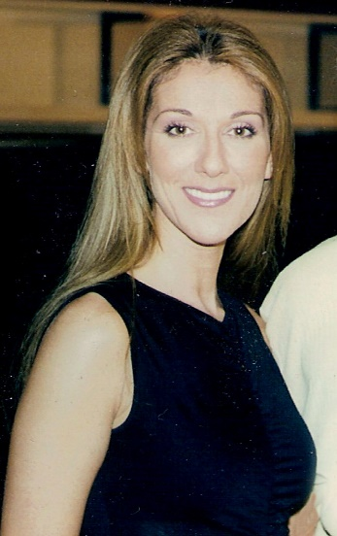
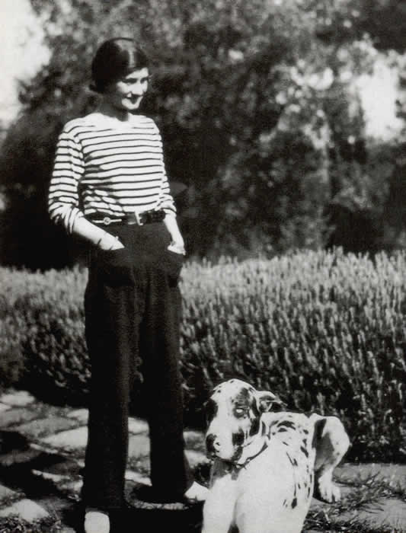
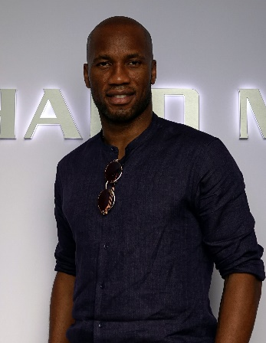
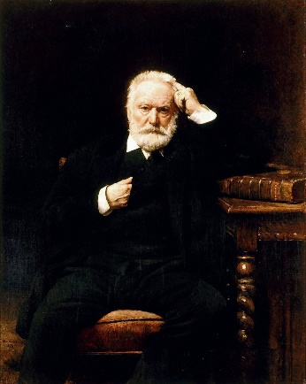
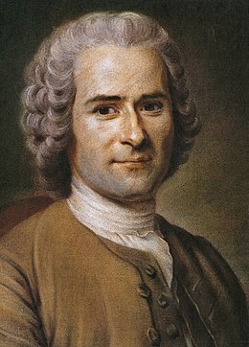
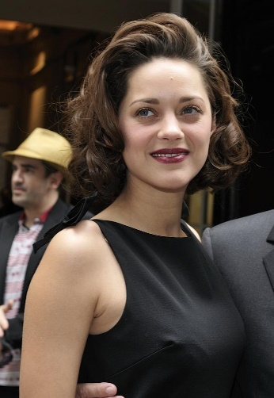
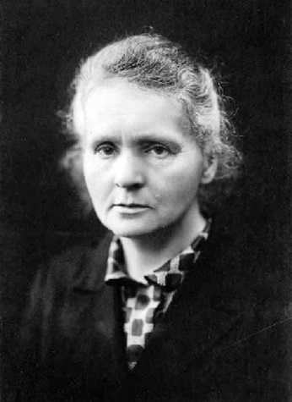
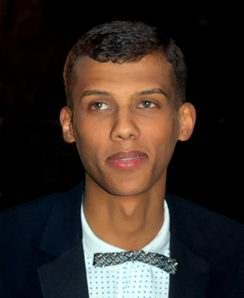
Qui fait quoi ?
Qui fait quoi ?
Exemple
Coco Chanel est-elle française ?
écouter / parler
Fais des questions avec:
être
venir
habiter
travailler
aimer
créer
changer
gagner
jouer
écrire
étudier
chanter
parler
…
Coco Chanel
Didier Drogba
Victor Hugo
Céline Dion
Jean-Jacques
Rousseau
Marion Cotillard
Marie Curie
Stromae
Notes:
Timing: 8 minutes
Aim: Oral production of subject repetition in inversion questions
Procedure:
Students ask yes/no questions in the 3rd person to try and recall as many facts as possible about the figures.
Having printed the bios single-sided (see 7.2.2.5 resource), distribute page 1 (the top row on this slide) to Partner A, and page 2 (the bottom row on this slide) to Partner B. Partner A asks a yes/no question about one of Partner B’s famous francophones. Partner B responds ‘oui’ if the question matches the information in the bio, or ‘non’ if it contradicts the bio, or if the information is not given in the bio. Swap roles after each question, moving onto a different celebrity each time. Each correct guess gets 1 point.
The level of difficulty can be varied according to the needs of the class, eg:
Students work purely from guesswork / their memory of the figures from 7.2.2.5.
Students have a limited amount of time to read the other partner’s bios (without taking notes) before the questioning stage.
Students have a limited amount of time to read the bios and take notes before the questioning stage.
4. The questioning stage could also be carried out in different ways, eg:
In groups, with two or more students sharing the ‘Partner A’ / ‘Partner B’ role.
In teams, with teams of students asking questions to the teacher and competing for points.
As a class, with all students asking questions to the teacher, non-competitively, to recall as much information as possible.
Images from: https://fr.wikipedia.org/

Slide 54
Gaming Grammar
Gaming Grammar
Relevant mini game(s):
Verbs (present): 1st person singular/plural (Verb agreement (present))
Verbs (present): 2nd person singular/plural (Verb agreement (present))
Verbs (present): 3rd person singular/plural (Verb agreement (present))
Questions: subject-verb inversion (Question formation)
Notes:
This slide links to Gaming Grammar login screen. The appropriate mission can then be selected from the menu page.
Students will progress through the game at their own rate; teachers should use the teacher interface to check progress. This will help to inform future lesson planning.

Slide 55
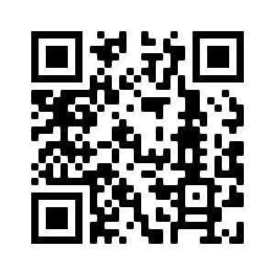
Devoirs
Vocabulary Learning Homework (Term 3.1, Week 3)
Audio file
Audio file QR code:
Student worksheet
Quizlet link
In addition, revisit: Term 2.2 Week 5
Term 2.1 Week 4

