Slide 1
Grammar
Other uses of the verb faire
Y7 French
Term 1.2 - Week 2
Stephen Owen / Emma Marsden
Date updated: 27/04/20

Slide 2
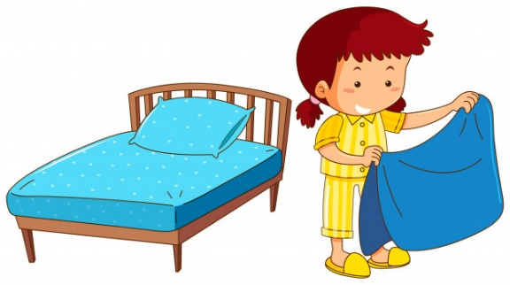
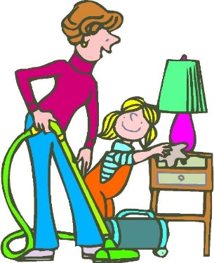
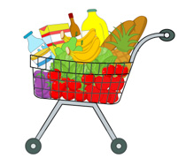
Exercise-faire
faire le lit
faire le modèle
faire le ménage
faire la cuisine
faire l’activité
faire les courses
faire les devoirs
Victoria Hobson & Stephen Owen
Notes:
These images remind students of the two previously-learnt translations of faire as ‘make’ and ‘do’.
Teachers can use this slide to revise the previously-presented vocabulary in a listen and repeat style.

Slide 3
The verb ‘faire’ – other meanings
However, faire is used with many other meanings in French:
faire un voyage
to go on a journey
faire une promenade
to go for a walk/ride
faire un tour
to go on a tour
faire les magasins
to go shopping
faire beau
to be nice weather
faire mauvais
to be bad weather
Victoria Hobson & Stephen Owen
Stephen Owen
Notes:
Some alternative meanings of ‘faire’ are now introduced. It is important to point out that the verb can variously be rendered as ‘go (on/for)’ and ‘be’ across these examples, the verb ‘faire’ in French covering all of these different meanings in these common collocations. The weather terms are covered with the infinitive for now, as they can of course be encountered in this form in natural language: e.g., ‘il va faire beau’. The impersonal use of ‘faire’ in these expressions will be discussed later. Instead of blanking out each term in turn to challenge learners to recall them (as has been done at times previously), a different set of activities designed to practise this vocabulary follows on the next sequence of slides.
As with all vocabulary sets in this scheme of work, ideally these terms will have been learned prior to the lesson with the aid of Quizlet, or similar.
Vocabulary
voyage [904], promenade [>5000], tour [523], magasin [1736], bateau [1287], beau [393], mauvais [274]
Source: Londsale, D., & Le Bras, Y. (2009). A Frequency Dictionary of French: Core vocabulary for learners London: Routledge.

Slide 4
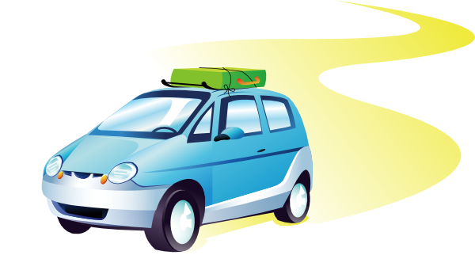
Exercise-faire
faire un voyage
faire une promenade
faire beau
faire les magasins
faire mauvais
faire un tour
faire une promenade en bateau
Victoria Hobson & Stephen Owen
Notes:
This slide presents the new and alternative uses of ‘faire’.
Teachers can use this slide to practise this vocabulary in a listen and repeat style.

Slide 5
Talking about the weather
Faire is used impersonally (only with il – meaning ‘it’) with weather expressions:
il fait beau
it is nice weather
il fait mauvais
it is bad weather
Stephen Owen
Stephen Owen
Notes:
The impersonal use of ‘faire’ in weather expressions is now explained, since activities follow involving the conjugated forms of the verb, rather than just the infinitive and so ‘il’ is necessary.

Slide 6
Écris le numéro !
Écouter
Number the pictures below in the order that you hear them mentioned.
a |  |  | e
b |  |  | f
c |  |  | g
d |  |  | h
1
2
3
4
5
6
7
8
Stephen Owen
Notes:
The input activities relating to the first, second and third person singular forms of ‘faire’ having taken place in 1.1 Week 7, the listening task in this current week’s sequence involves new vocabulary recognition (though exemplifying all three conjugated forms that had previously been learned). This slide could be printed off for learners to note their responses or they could do this in their exercise books. Teachers should click on the numbers at the bottom of the slide in the order given to activate the sound files. The students then write in the number next to the correct picture.
Transcript
Je fais les magasins.
Elle fait le ménage.
Je fais un voyage.
Il fait une promenade.
Il fait mauvais.
Il fait beau.
Elle fait un tour.
Elle fait une promenade en bateau.

Slide 7
Écouter, Parler, Écrire
Solution:
 |  | 6 |  |  | 5
 |  | 4 |  |  | 3
 |  | 1 |  |  | 8
 |  | 7 |  |  | 2
a
e
b
f
c
g
d
h
Stephen Owen
Notes:
The answers to the listening task are provided on this slide. Teachers should click on the letters this time, working either in alphabetical or in number order as desired, to activate the sound files.
Learners could be asked to (a) reconstruct the sentence as heard in the transcript and / or then b) create a similar sentence which could fit the picture.
They could do either of these first orally, then in writing (i.e. transcribe or adapt what they hear) in the space available on the sheet, or in their exercise books.
Transcript
Je fais les magasins.
Elle fait le ménage.
Je fais un voyage.
Il fait une promenade.
Il fait mauvais.
Il fait beau.
Elle fait un tour.
Elle fait une promenade en bateau.

Slide 8
Lire
Écris en français ! Which sentence goes with each picture below?
1 |  |  | 5
2 |  |  | 6
3 |  |  | 7
4 |  |  | 8
a) elle fait un voyage
d) tu fais les magasins
g) je fais une promenade
b) je fais le ménage
e) elle fait un tour
h) il fait mauvais
c) il fait beau
f) tu fais une promenade en bateau
Stephen Owen
Notes:
This practices the recognition of forms and practices the links between the nouns/adjectives (voyage, beau) with pictures.
The input activities relating to the first, second and third person singular forms of ‘faire’ having taken place in 1.1 Week 7, the reading task in this week’s sequence (like the listening previously) involves vocabulary recognition (though including all three conjugated verb forms previously learned).
This activity could be done orally, the learners reading out the sentence to go with each picture, after allowing a period for them to work out the answers; alternatively, it could be printed out for learners to do as a written task (or they could complete it in their exercise books). The next slide provides the answers.

Slide 9
Lire
Solution:
1 |  |  | 5
2 |  |  | 6
3 |  |  | 7
4 |  |  | 8
c) il fait beau
h) il fait mauvais
g) je fais une promenade
e) elle fait un tour
d) tu fais les magasins
f) tu fais une promenade en bateau
e) elle fait un tour
b) je fais le ménage
Stephen Owen
Notes:
The answers to the reading task are provided on this slide.
Learners could be asked to read the sentences, rather than merely answering by letter. This is practising SSCs (phonics).

Slide 10
Lire
Écris en anglais ! Now translate the sentences into English.
1 |  | c | 5 |  | h
2 |  | g | 6 |  | e
3 |  | d | 7 |  | f
4 |  | e | 8 |  | b
a) elle fait un voyage
d) tu fais les magasins
g) je fais une promenade
b) je fais le ménage
e) elle fait un tour
h) il fait mauvais
c) il fait beau
f) tu fais une promenade en bateau
Stephen Owen
Notes:
This L2>L1 translation task checks understanding of the new vocabulary AND of the person of the verb used in each sentence, engaging the learners again with the grammar feature.
The slide could be printed out for learners to insert their translations.

Slide 11
Écrire, Parler
Solution:
1 |  | The weather is nice. | 5 |  | The weather is bad.
2 |  | I go for a walk. | 6 |  | She goes on a journey.
3 |  | You do the shopping. | 7 |  | You go on a boat ride.
4 |  | She goes on a tour. | 8 |  | I do the housework.
Stephen Owen & Emma Marsden
Notes:
The answers to the translation task are provided on this slide.
Then, learners should now be asked to convert the sentences back into French orally once the translation is confirmed.
As an extension activity, they could then do this in writing in their exercise books.
We need to bear in mind that learners are not at the moment ‘actively’ choosing to use (produce) faire for all these different English meaning. Because this task focusses only on faire, this is a ‘given’ in this series of activities! In a later series of activities in the Scheme of Work, we will provide opportunities for students to actively ‘choose’ to produce ‘faire’ for this set of activities (versus aller or être).

Slide 12
Parler
Use the pictures below to describe to your partner in FRENCH what normally happens on a holiday. Use the verb faire, e.g. “je fais un voyage”; “il fait beau”, etc. Your partner will write them down in the order in which you say them, so put a number next to each picture as you say it.
Check afterwards to see if your partner was correct!
Stephen Owen
Notes:
This slide is for both Partner A and B (for the person speaking each time).
Learners are now challenged to produce sentences using the first person singular form of faire in response to the pictures, in order to narrate an imaginary day to their partner. Make it clear to learners that they are doing this in the present tense, i.e. saying what they do as it happens, rather than recounting past events.
The fact that the learners select their own order (numbering on the sheet, if printed out for them, as they go) means that this sheet must be re-used with the partners’ having swapped roles.

Slide 13
Parler
Écris en anglais !
Write down your partner’s description of the events, in ENGLISH, in the order in which they say them.
Order | Description (in ENGLISH)
1
2
3
4
5
6
7
8
Stephen Owen
Notes:
This slide is for both Partner A and B (for the person speaking each time).
Partners are challenged to note down the description of events in the order in which they hear them, translating these into English at the same time, in order to check understanding of the vocabulary.
Partners A & B now swap roles (it may be necessary to print a second set of cards).

Slide 14
Écrire
Écris en français !
Now use the pictures below to write 8 sentences in FRENCH to describe what normally happens on a holiday, using the verb faire, e.g. “je fais un voyage”; “il fait beau”, etc.
Stephen Owen & Emma Marsden
Notes:
Learners are now challenged to produce sentences in writing using the first person singular form in response to the pictures, in order to narrate what normally happens in an imaginary weekend.
Make it clear to learners that they are writing in the present tense, i.e. saying what happens normally (Note to teacher: we will cover the present continuous in a later week, I am doing, I am playing).
For an additional challenge, learners could then be asked to do this using the second person singular form – i.e. writing about what ‘you’ do – or the third person singular form – i.e. writing about what s/he does.
Remind learners that the weather expressions are always used impersonally – i.e. with ‘il’.

