Slide 1
Phonics
SSC /ä/
Y7 German
Term 1.2 - Week 37
Author name(s): Inge Alferink / Rachel Hawkes
Date updated: 02/10/2019

Slide 2
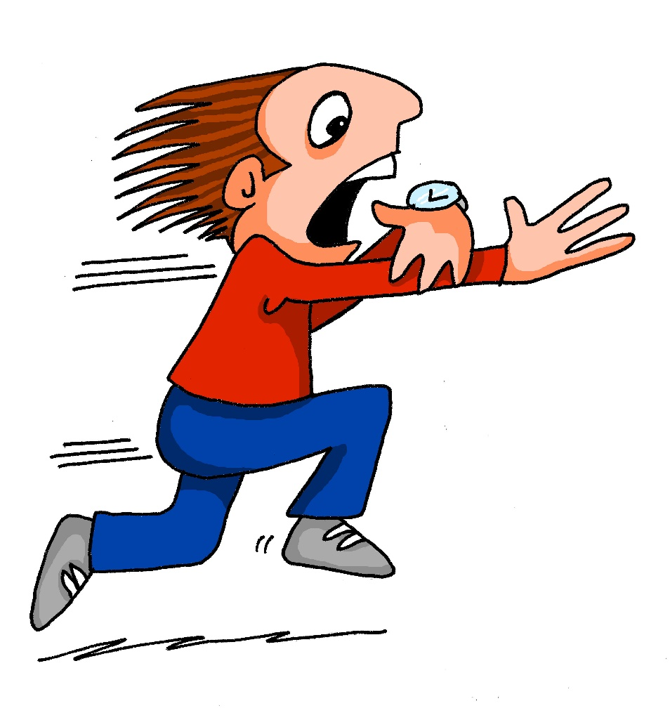
ä
[ɛ:]
spät
Notes:
Timing: 1 minute
Aim: To introduce/consolidate SSC [ä]
Procedure: 1. Present the letter(s) and say the [ä] sound first, on its own. Students repeat it with you. 2. Bring up the word ”spät” on its own, say it, students repeat it, so that they have the opportunity to focus all of their attention on the connection between the written word and its sound.
3. A possible gesture for this would be to bring your left arm up to mime suddenly looking at your watch.
4. Roll back the animations and work through 1-3 again, but this time, dropping your voice completely to listen carefully to the students saying the [ä] sound, pronouncing ”spät’” and, if using, doing the gesture. Word frequency (1 is the most frequent word in German): spät [171]
Source: Jones, R.L. & Tschirner, E. (2006). A frequency dictionary of German: core vocabulary for learners. Routledge

Slide 3
ä
[ɛ:]
spät
Notes:
With sound and no pictures to focus all attention on the sound-symbol correspondence.

Slide 4
ä
[ɛ:]
spät
Notes:
Without sound to elicit pronunciation (without first hearing the teacher).
Teacher to elicit pronunciation by asking “Wie sagt man…”

Slide 5
ä
zählen
ähnlich
1, 2, 3, …100
spät
Nähe
wählen
Berlin 1KM
erklären
[to explain]
Notes:
Timing: 1 minute
Aim: To introduce/consolidate SSC [ä]
Procedure:
Introduce and elicit the pronunciation of the individual SSC [ä] and then the source word again ‘spät’ (with gesture, if using).
Then present and elicit the pronunciation of the five cluster words.
The cluster words have been chosen for their high-frequency, from a range of word classes, with the SSC (where possible) positioned within a variety of syllables within the words (e.g. initial, 2nd, final etc.). Additionally, we have tried to use words that build cumulatively on previously taught SSCs (see the Phonics Teaching Sequence document) and do not include new SSCs. Where new SSCs are used, they are often consonants which have a similar symbol-sound correspondence in English.
Word frequency (1 is the most frequent word in German): spät [171]; zählen [680] ähnlich [429]; Nähe [795]; erklären [250]; wählen [64]. Source: Jones, R.L. & Tschirner, E. (2006). A frequency dictionary of German: core vocabulary for learners. Routledge

Slide 6
ä
zählen
ähnlich
spät
Nähe
wählen
erklären
Notes:
With sound and no pictures to focus all attention on the sound-symbol correspondence.

Slide 7
ä
zählen
ähnlich
spät
Nähe
wählen
erklären
Notes:
Without sound to elicit pronunciation (without first hearing the teacher).
Teacher to elicit pronunciation by asking “Wie sagt man…”

Slide 8
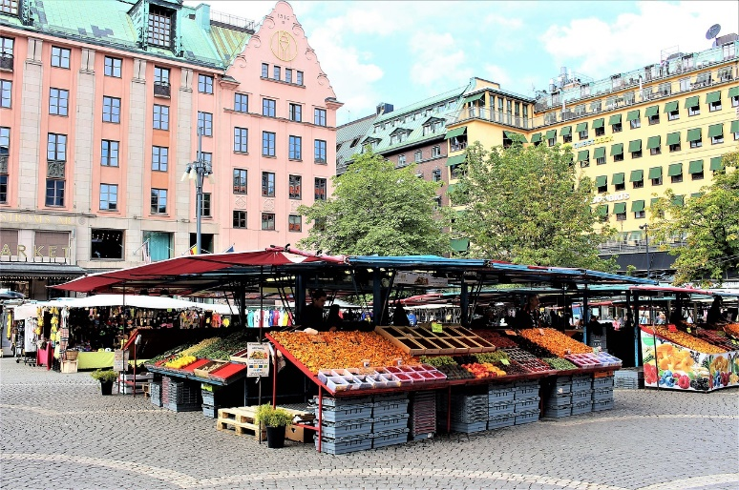
Sag es!
hören und sprechen
die Marktplätze
der Marktplatz
Notes:
1a. Phonics practice
This activity involves plurals learnt previous week with ä sounds (Platz / Plätze, Markt / Märkte, Arzt / Ärzte, Mann / Männer, Garten / Gärten, Nacht / Nächte). The last 3 are exceptions to the plural rules - good for them to hear and practise the difference between singular / plural even when they don't follow the rule.
Whole class saying out loud activity, contrasting the pairs.
NB: sprechen is on the list of words to repeat for this week, so this could be an opportunity to elicit the meaning from students.

Slide 9
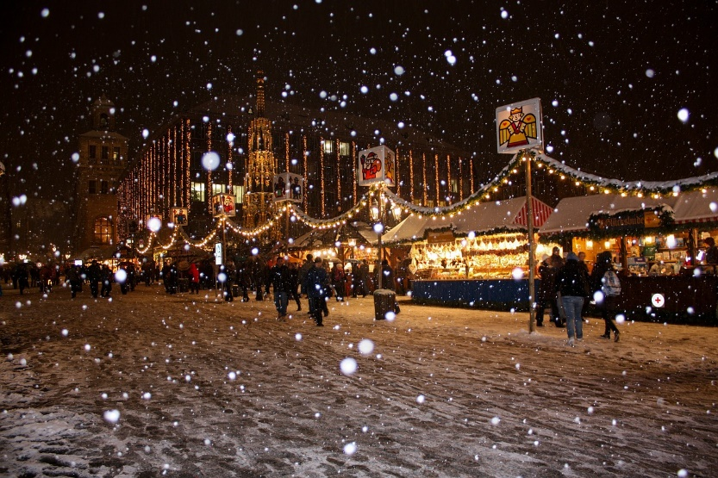
Sag es!
hören und sprechen
der Weihnachtsmarkt
die Weihnachtsmärkte

Slide 10
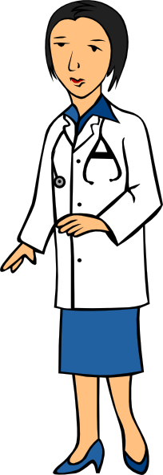
Sag es!
hören und sprechen
der Arzt
die Ärzte

Slide 11
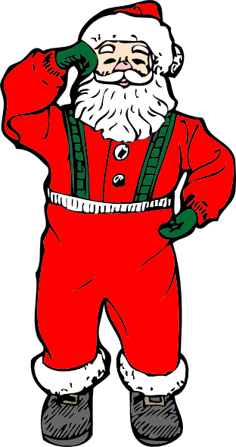
Sag es!
hören und sprechen
die Männer
der Mann

Slide 12
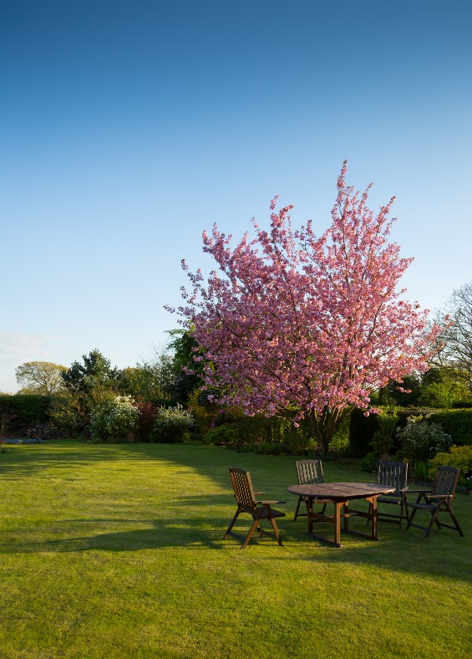
Sag es!
hören und sprechen
der Garten
die Gärten

Slide 13
Sag es!
hören und sprechen
die Nacht
die Nächte

Slide 14
Sag es und schreib es!
hören und sprechen und schreiben
PERSON A
1. Mann
2. Plätze
3. Gärten
4. Nächte
5. Arzt
6. Markt
PERSON B
1. Märkte
2. Männer
3. Arzt
4. Plätze
5. Gärten
6. Nacht
Notes:
1b. Phonics practice
Pair work → 1 person reads out loud and the other person writes down the word paying particular attention to the vowel. Then they swap roles.
NB: there is associated information (i.e. + umlaut is often also +e), so students could rely on that
NB: this slide can be shown as an example to model with the class. There is a word doc to print out for this activity, so that students cannot see each others’ words.

Slide 15
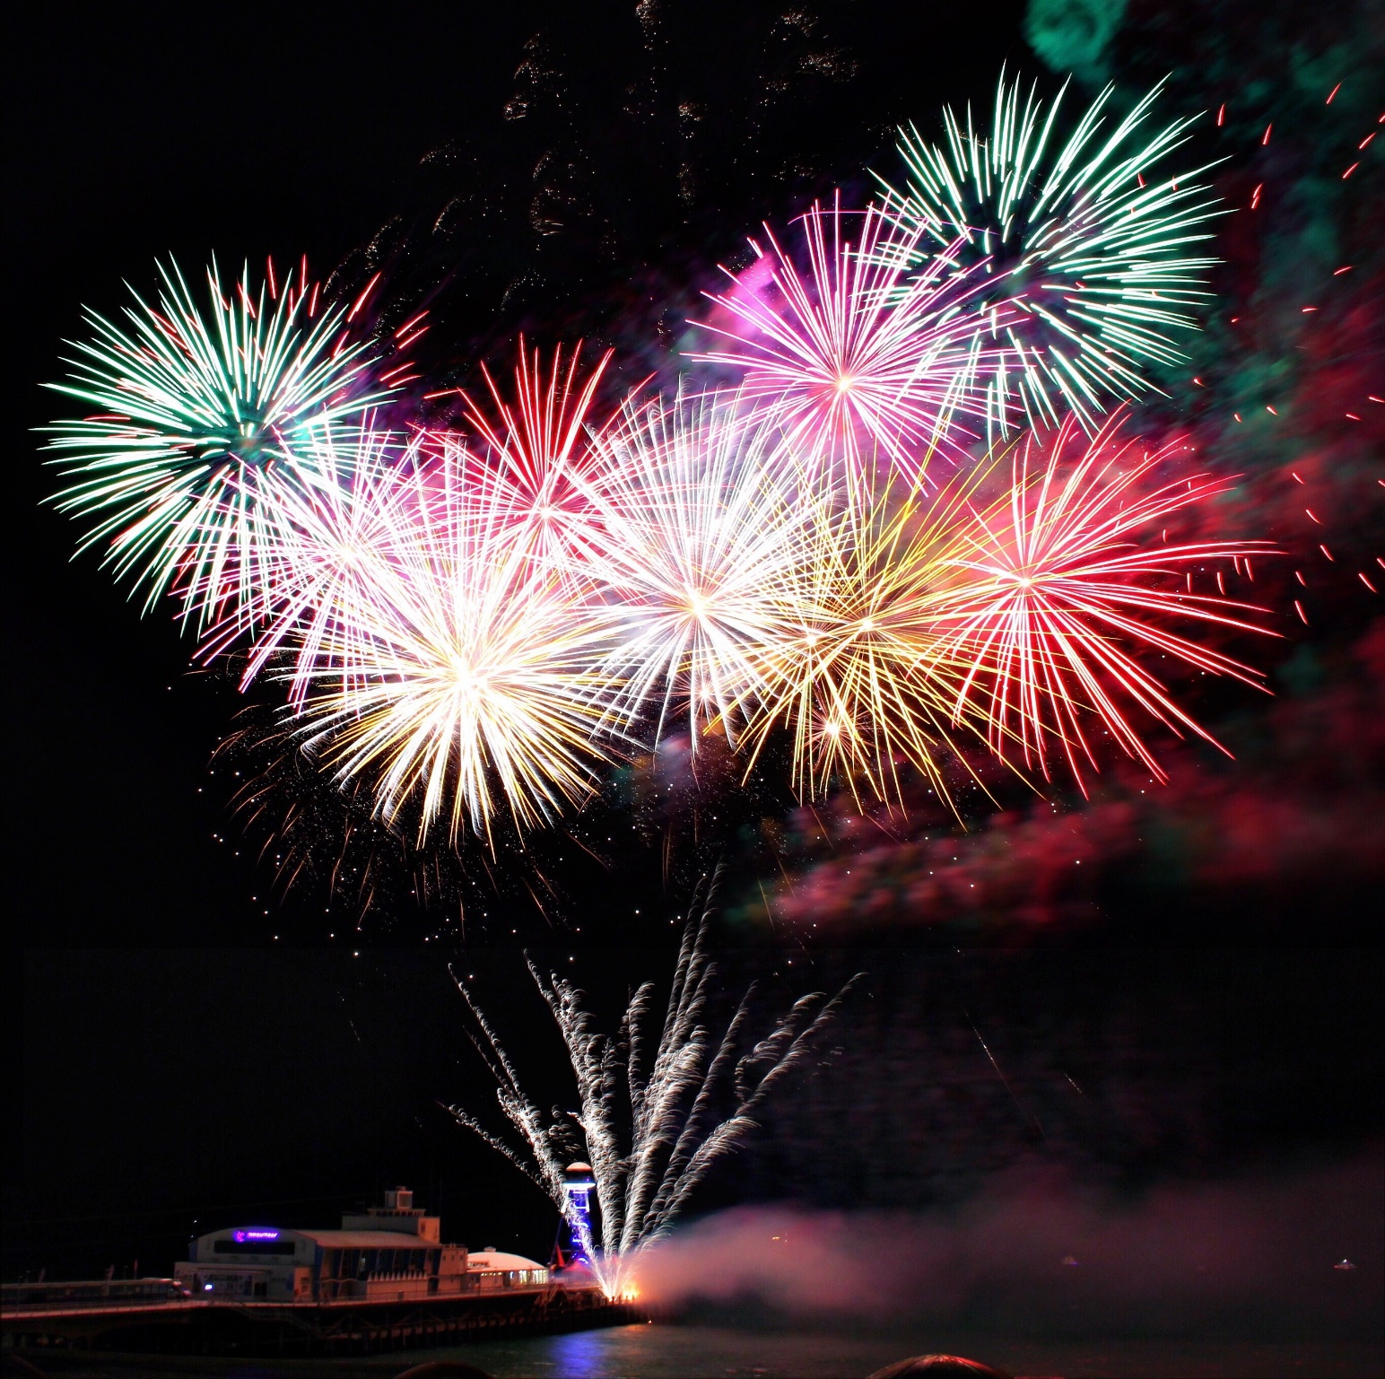
Sag es!
sprechen
Wir wünschen dir frohe Weihnacht,
wir wünschen dir frohe Weihnacht,
wir wünschen dir frohe Weihnacht
und ein glücklich’ Neujahr!
Notes:
Phonics practice
Read out loud line by line. Neu is a new sound and needs to be modelled.
Alternatively or additionally, sing to the tune of ‘We wish you a merry Christmas’.

