Slide 1
Phonics: ‘GE’, ‘GI’ SSCs
Nick Avery & Rachel Hawkes
Date updated: 21/11/2019

Slide 2
ge
imagen
recoger
gesto
gente
Notes:
Introduce and elicit the pronunciation of the individual SSC ‘ge’ and then the source word again (with gesture, if using). Then present and elicit the pronunciation of the five cluster words.
The cluster words have been chosen for their high-frequency, from a range of word classes, with the SSC (where possible) positioned within a variety of syllables within the words(e.g. initial, 2nd, final etc..) and additionally, we have tried to use words that build cumulatively on previously taught SSCs (see the Phonics Teaching Sequence document) and do not include new SSCs. Where new SSCs are used, they are often consonants which have a similar symbol-sound correspondence in English.

Slide 3
ge
imagen
recoger
gesto
gente
Notes:
Without the images, students focus this time again closely on the SSC and the cluster words.

Slide 4
ge
imagen
recoger
gesto
gente
Notes:
Without the images or sound, students have to pronounce the words themselves.

Slide 5
gi
elegir
Versión original
página
P57
imaginar
48
religión
47
Notes:
Introduce and elicit the pronunciation of the individual SSC ‘gi’ and then the source word again (with gesture, if using). Then present and elicit the pronunciation of the five cluster words.
The cluster words have been chosen for their high-frequency, from a range of word classes, with the SSC (where possible) positioned within a variety of syllables within the words(e.g. initial, 2nd, final etc..) and additionally, we have tried to use words that build cumulatively on previously taught SSCs (see the Phonics Teaching Sequence document) and do not include new SSCs. Where new SSCs are used, they are often consonants which have a similar symbol-sound correspondence in English.

Slide 6
gi
elegir
Versión original
P57
página
religión
imaginar
Notes:
Without the images, students focus this time again closely on the SSC and the cluster words.

Slide 7
gi
elegir
Versión original
P57
página
religión
imaginar
Notes:
Without the images or sound, students have to pronounce the words themselves.

Slide 8
gente
60
elegir
imagen
gesto
página
Segundos
religión
imaginar
0
empezar
recoger
Notes:
Alphabetical read aloud Individually (but all at once) pupils read out the words but in alphabetical order. They keep going for one minute.
Teacher can circulate to listen into their SSC knowledge.

Slide 9
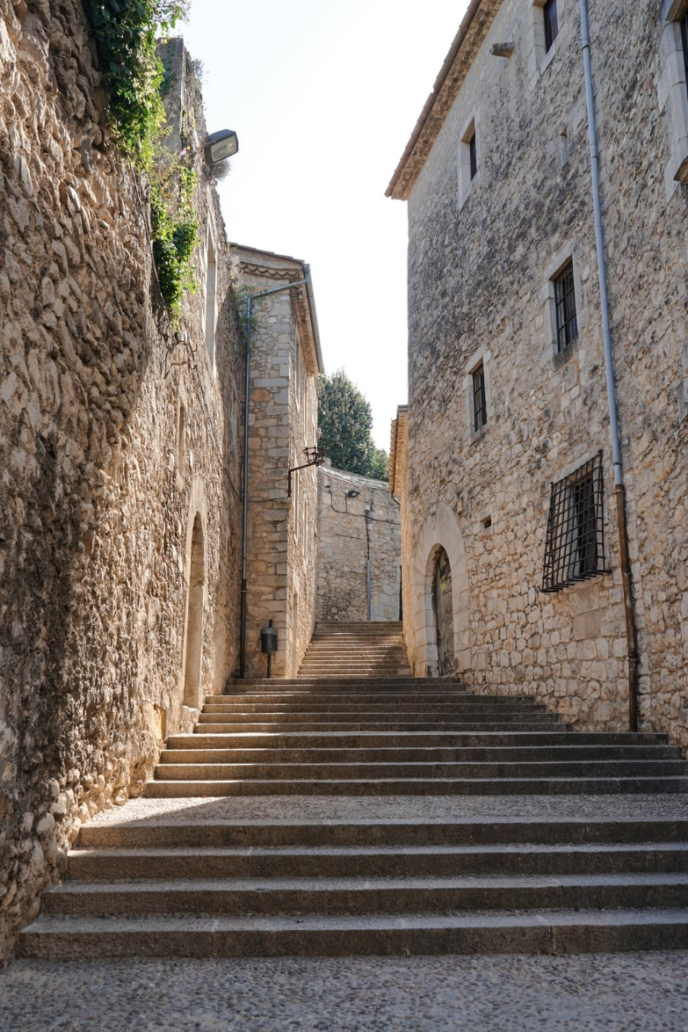
Una conversación entre amigos
¿Dónde está Tomás?
Está en Girona. Estudia allí.
¿Girona?
Sí, es una ciudad en España. Tengo una imagen – ¡aquí!
Ah, ¡es una ciudad antigua!
Muy antigua. Tiene tres iglesias y una plaza en el centro.
Y la gente, ¿cómo es?
Es inteligente. Lee libros y estudia mucho.
¿Qué estudia?
Estudia de todo - ciencias, inglés, español, arte, y religión.
Girona
Notes:
Non-audio version of the conversation on this slide – see next slide for audio version.
The fully readable text (i.e., a text that includes 100% or near to 100% previously taught language) could be used for a dictation. All words except ‘de todo’ have previously been encountered as vocabulary items or phonics practice words.
To help students understand ‘de’ todo’, use slightly exaggerated intonation here and when listing the subjects that follow. This should be sufficient to elicit the meaning from students.
Photo by Fikri Rasyid on Unsplash

Slide 10
Una conversación entre amigos
escuchar / escribir
¿Dónde está Tomás?
Está en ___rona. Estudia allí.
¿___rona?
Sí, es una ciudad en España. Tengo una ima___n – ¡aquí!
Ah, ¡es una ciudad antigua!
Muy antigua. Tiene tres iglesias y una plaza en el centro.
Y la ___nte, ¿cómo es?
Es inteli____nte. Lee libros y estudia mucho.
¿Qué estudia?
Estudia de todo - ciencias, inglés, español, arte, y reli___ón.
Girona
Notes:
Listen and complete the dialogue with the target SSCs ‘GI’ and ‘GE’
This dialogue can also be used for a dictation or for a read aloud in pairs. Students will have to recall the ‘gi’ and ‘ge’ SSCs, which are missing.
Photo by Fikri Rasyid on Unsplash

Slide 11
escuchar
A. Y la gente, ¿cómo es?
B. Estudia de todo – ciencias, inglés, español, arte, y religión.
1
D
2
J
C. Muy antigua. Tiene tres iglesias y una plaza en el centro.
3
F
D. ¿Dónde está Tomás?
E. Es inteligente. Lee libros y estudia mucho.
4
H
5
G
F. ¿Girona?
G. Ah, ¡es una ciudad antigua!
6
C
7
A
H. Sí, es una ciudad en España. Tengo una imagen – ¡aquí!
8
E
I. ¿Qué estudia?
9
I
10
B
J. Está en Girona. Estudia allí.
Notes:
OPTIONAL: listen again and put the sentences in order
This could also be used as a reading-only task to challenge higher achieving students.

