Slide 1
German question words Practice

Slide 2
Wie ist die Frage?
Wie gehst du zur Schule?
Wo ist Niko?
Wann kommt der Zug?
Wer ist dein Mathelehrer?
Was denkst du?
Warum sagst du das?
Welcher Sport ist der beste?
Wie viel kostet das?
Wie viele Wörter gibt es?
Rachel Hawkes
Notes:
These repeat the questions from the learning presentation. It would of course be possible to use completely different questions and create a higher level of challenge.

Slide 3
where?
what?
when?
how many?
why?
how?
how much?
who?
which?
Rachel Hawkes
Notes:
Noughts and crosses game. Os and Xs is simply pupils in two halves of the class nominating a Q word from the board in turns – teachers marks off answers from one half of the class with a O and other half with a X. It’s a 2-minute activity for eliciting all the Q words again.

Slide 4
how? | what? | … | … | … | … | … | … | …
Rachel Hawkes
Notes:
Students can also draw a 3 x 2 grid and choose six of the nine question words for a bingo. Strip bingo is even better. Students write all of the nine question words in their own chosen order from left to right in English. Teacher (or another student) calls out the question words in Spanish. Pupils can only tear off from either end. The player who has nothing left on his/her strip first, wins.

Slide 5
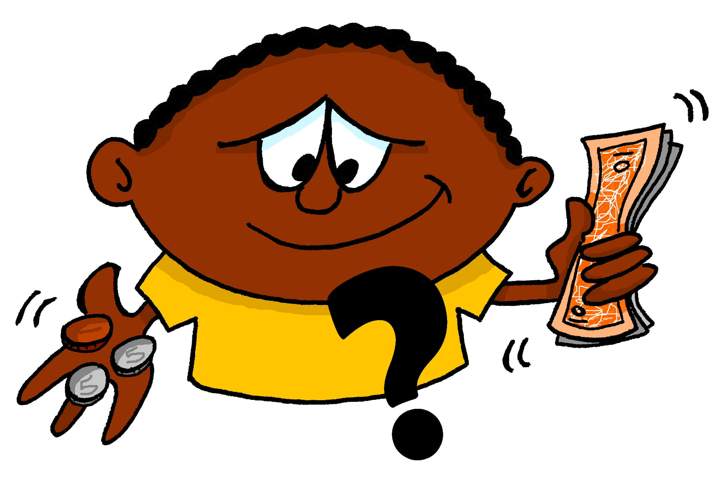
A | B | C
D | E | F
G | H | I
Images - Steve Clarke
Rachel Hawkes
Notes:
Use the images to elicit the question words and/or a whole question (can easily differentiate – a bonus point can be offered for those who are able to create new questions).

Slide 6
Wie?
Wer?
Was?
Warum?
Wo?
Wie viel?
Wie viele?
Wann?
Welcher?
Rachel Hawkes

Slide 7
W__?
W__?
W__?
W____?
W__?
W__ v___?
W__ v____?
W___?
W______?
Rachel Hawkes

Slide 8
when?
who?
how much?
how much?
which?
how?
why?
where?
how many?
when?
where?
why?
which?
how?
how many?
what?
who?
what?
Rachel Hawkes
Notes:
Slap the board. Could also be done the other way around for reading practice.

Slide 9
Was ist die Frage?
Ich spiele Fußball.
?
in der Schule.
Wo?
Rachel Hawkes
Notes:
This activity doesn’t use all of the question words, but is a very useful one for practising questions in a scaffolded, yet ‘contingent’ context. Students only know which question word to use by looking at both lines of dialogue either side and processing for meaning. As the first line is repeated each time, the cognitive load is firmly focused on the 3rd utterance to cue the correct question word.
Using the Q words in context to reinforce their meaning. Lines 1 – 3 are there. Students supply the question word orally. Do a couple first to model, then give each pair 20 seconds to say each dialogue first before taking the answer whole class for the rest of the slides.

Slide 10
Was ist die Frage?
Ich spiele Fußball.
?
am Samstag.
Wann?
Rachel Hawkes
Notes:
Using the Q words in context to reinforce their meaning. Lines 1 – 3 are there. Students supply the question word orally. Do a couple first to model, then give each pair 20 seconds to say each dialogue first before taking the answer whole class for the rest of the slides.

Slide 11
Was ist die Frage?
Ich spiele Fußball.
?
ICH SPIELE FUßBALL!
Wie, bitte?
Was?
Rachel Hawkes
Notes:
Using the Q words in context to reinforce their meaning. Lines 1 – 3 are there. Students supply the question word orally. Do a couple first to model, then give each pair 20 seconds to say each dialogue first before taking the answer whole class for the rest of the slides.
As in English there are colloquial and more polite/formal ways of saying ‘pardon’.

Slide 12
Was ist die Frage?
Ich spiele Fußball.
?
Es ist toll!
Warum?
Rachel Hawkes
Notes:
Using the Q words in context to reinforce their meaning. Lines 1 – 3 are there. Students supply the question word orally. Do a couple first to model, then give each pair 20 seconds to say each dialogue first before taking the answer whole class for the rest of the slides.

Slide 13
Was ist die Frage?
Ich spiele Fußball.
?
mit meinen Freunden.
Mit wem?
Rachel Hawkes
Notes:
Using the Q words in context to reinforce their meaning. Lines 1 – 3 are there. Students supply the question word orally. Do a couple first to model, then give each pair 20 seconds to say each dialogue first before taking the answer whole class for the rest of the slides.
This is a way to introduce a variant of ‘wer’, and one that is very useful for students, when talking about what they do with their friends / family.

Slide 14
Wir reden!
Ich lerne Deutsch.
?
mit wem?
Wo?
Wie, bitte?
Warum?
Wann?
mit meiner Klasse | ICH LERNE DEUTSCH! | am Freitag
in der Schule |  | Es ist sehr wichtig!
Rachel Hawkes
Notes:
Pair work Question words are spontaneous Responses are then supported.
After students have tried this out for themselves, use the animations to elicit their responses as a whole class orally and give them feedback.
Students can then create their own sequences of questions and answers, starting with a different statement. Their partner has to select the answer that has to be given.

