Slide 1
Fairer Foreign Languages? Assessment, analytic ability, and access to achievement
18 March 2022
Professor Emma Marsden,
Dept of Education,
University of York
Notes:
I will be discussing how defining language content may promote greater ‘achievability’, how making goal posts more visible for all, via class activities, SOW, may improve access to being able to achieve in FL and therefore be one way of enhancing enjoyment

Slide 2
Session overview:
Part 1/ Fairer assessment? Subject Content in 2015 & 2022
Part 2/ Fairer access to knowledge? Research on how individual differences interact with different pedagogical choices
Part 3/ Fairer achievement and progression? Opportunities of changes to GCSE for building a fairer curriculum design

Slide 3
Session overview
Part 1/ Fairer assessment? Subject Content in 2015 & 2022
similarities and differences
Notes:
I will also talk about the rationale behind some of these changes.

Slide 4
Similarities
Aims
develop ability and ambition to communicate in speech and writing
expand horizons, ways of seeing the world, cultural boundaries
provide a strong foundation for further study
Plus differences between English and the target language
Listening & reading comprehension still assessed
Spoken & written production still assessed
Language still about target language contexts (e.g., culture, geography)
Grammar and vocabulary are still significant areas of knowledge
Speaking still includes:
role play,
talk about visual stimulus/stimuli,
unprepared conversation elements
BUT note the requirement for “clear and comprehensible” speech
(rather than spontaneity+ fluency+ accuracy!)

Slide 5
Differences. To address what problems?
2015: word lists are a guide only, exams required to cover each of a very wide range and number of topics, and required to test words ‘off list’
mismatch between the language listed in specifications and that used in exams
2015: No concrete, objective guidance what ‘useful’ words are
large proportion of low frequency
2015: Expectation of accurate, complex, and spontaneous speech in conversation
persistent reports of rote-learning large chunks for a heavily-prepared ‘conversation’
-> heavy burden on (certain type of) memory
-> stifles manipulation for creative use

Slide 6
Key difference in 2022 Subject Content [1/3]
Grammar content simplified, clarified, and sequenced:
Much greater transparency about what can be tested
(e.g., interrogative types laid out)
Some features moved from Foundation to Higher
(e.g. depuis +present; inflectional future)
Some features divided into sub-components: some can be tested at foundation, and some only at higher
reflexive use of verbs
present tense irregular verbs
Notes:
Making the content more explicit could help awarding organisations and Ofqual to ensure accountability for test content

Slide 7
Key difference in 2022 Subject Content [1/3]
Grammar content:
Some features removed completely (e.g., subjunctive in French)
Some features given tolerance in production at foundation (e.g., minor spelling changes in present tense stems), but bear credit at Higher
Some moved from ‘grammar’ to ‘vocabulary’ (e.g., adverbs, pronouns)
Notes:
All grammar can be tested in reception and production
Except for derivational morphology - only in Reading
Subjunctive in a few specific, clearly defined forms for Spanish and German only

Slide 8
Key differences in 2022 Subject Content. [2/3]
The lexicon is specified:
1,200 lexical items at Foundation; 1700 at Higher,
85% from most common 2000 word families,
up to 30 additional multiword phrases (≤ five words; where English is multi-word)
Up to 20 additional cultural / geographical terms
All tasks fully accomplishable using only language from the defined vocabulary and grammar lists
Full credit given for successful production of language beyond content
Notes:
A word family, in this instance, is defined as a word and its inflected forms
Such as wash, washes, washed – but not washer, or unwashed – so inflectional morphology, but not derivational morphology, as that is harder for learners

Slide 9
Key difference in 2022 Subject Content [3/3]
Vocabulary in Reading only:
Glossing allowed: up to 2% of words in a text can be glossed
Use of cognates more constrained: ‘very similar’ spelling + meaning
Derivational morphology clearly defined, based on ‘bang for buck’
‘Inferencing’ will still be tested, but in an identifiable and short component: students must infer plausible meaning of words not on the list, when words are embedded in sentences that have all other words on the list
Notes:
Glossing allowed: up to 2% of words in a text can be glossed
Use of cognates more constrained: same spelling and meaning (or 1 letter different, +/- accent, for words of six letters or more) up to 2% of a text
Derivational morphology now clearly defined, based on ‘bang for buck’, and is for reading only: derived or base forms of words (where the base or derived form is on the list), following patterns specified in the grammar annexes, can be included
Content is not defined by whether or not a text is ‘authentic’: no requirement to include literary, authentic texts but they can be
A ‘test of inferencing’ will be identifiable, defined, and short: students must infer plausible meaning of words not on the list, when words are embedded in sentences that have all other words on the list

Slide 10
Some consequences of not having a defined lexical content, with no glossing & no guide about lexical frequency
50% of words on awarding bodies’ current lists have never been used in an exam
21% of the words on current lists have only ever been used once
Only 10% of the words from lists are used in every single paper
Putting all exams together over 4 years, approximately 45% of the word families used are low frequency words
60% of these low frequency words are not on the word lists
Lower freq. words twice as likely to change, year on year, as high freq. words
All % are averages across two AOs, three languages, two tiers
Paper submitted. Use of word lists in high-stakes, low-exposure context: Topic-driven or frequency-informed
Notes:
50% (51% at foundation and 49% at higher; 46% for AQA and 55% for Edexcel) of words on awarding boards’ current lists have never been used in an exam
21% (20% at foundation and 21% at higher; 22% for AQA and 19% for Edexcel) of the words on current lists have only ever been used once
Only 10% (10% for foundation and 10% for higher;10% for AQA and 9% for Edexcel) of the word families from the current lists are used in every single paper
Putting all exams together over 4 years, approximately 45% (44% for foundation and 45% for higher; 45% for AQA and 44% for Edexcel) of the word families used are low frequency words; 60% (58% at foundation and 62% at higher; 65% for AQA and 55% for Edexcel) of these are not on the word lists
The lists ‘cover’ (predict) approximately 78% (80% at foundation and 77% at higher; 74% for AQA and 83% for Edexcel) of all running words in a typical paper [These are based on PREDICTED PROBABILITIES, not raw counts, so they have been normed for list length].

Slide 11
Some consequences of not having a defined lexical content (cont’d)
The lists ‘cover’ (predict) approximately 78% of all running words in a typical paper (73% for AQA)
But… you need to understand 95% to 98% of words in a text for adequate and unassisted comprehension
(Hu & Nation, 2000; Laufer, 1998; Laufer & Ravenhorst-Kalovski, 2010; Schmitt et al., 2011)
-> Heavy reliance on inferencing
Inferencing = informed guessing using context and general knowledge
(Haastrup, 1991)
in early and vulnerable stages of learning language
Notes:
The lists ‘cover’ (predict) approximately 78% (80% at foundation and 77% at higher; 74% for AQA and 83% for Edexcel) of all running words in a typical paper [These are based on PREDICTED PROBABILITIES, not raw counts, so they have been normed for list length].
“making informed guesses as to the meaning of an utterance in light of all available linguistic cues in combination with the learner's general knowledge of the world, [their] awareness of context and [their] relevant linguistic knowledge” (Haastrup, 1991, p. 40).

Slide 12
Inferencing skills are, of course, important BUT difficult
Whether a student can successfully infer meaning is ‘hit and miss’:
Leaners can infer between 2 and 6 of every 10 unknown words
Successful inference can depend on …
Context e.g., the proportion of unknown words in the text
Learner e.g., analytic ability
Proficiency: Teaching strategies to work out unknown words is more effective for more proficient learners (Plonsky, 2011)
-> having robust existing knowledge is helpful for inferencing
(e.g., Albrechtsen et al., 2008; Bengeleil & Paribakht, 2004; Fraser, 1999; H. C. M. Hu & Nassaji, 2012; Huckin & Bloch, 1993; Nassaji, 2003; Laufer, 2020; Pulido, 2007; Qian, 2005; Sternberg, 1987; Wesche & Paribakht, 2009).
Notes:
BUT AS I SAID, INFERENCING IS IMPORTANT AND SO THE EXAMS ARE STILL GOING TO INCLUDE SOME TESTS WHICH DIRECTLY TEST INFERENCING SKILLS. I’LL SHOW AN EXAMPLE OF A KIND OF TEACHING OR TESTING ACTIVITY THAT MIGHT ILLUSTRATE THIS KIND OF THING.
Strategies, such as use the context to work it out, ask someone, use a dictionary, guess from your world knowledge
Other contextual factors: the relevance of the unknown word for comprehension, and the proportion of unknown words in the text
At 90% coverage, intermediate learners can only infer 52% (95% CI [46%, 58%]) of unknown words in a text (Laufer, 2020), and that this ability varies according to factors such as how many words in the text need to be inferred (Sternberg, 1987) and language proficiency (e.g., Hamada, 2014).

Slide 13
Hanoucca
Inferencing, in curriculum and assessment?
Use the words you know to choose the general meaning of the words in bold.
Pour la communauté juive, la fête importante de décembre est Hanoucca. C’est une fête de lumières et on utilise des bougies pour célébrer. La fête est de huit jours, et on allume une bougie le premier jour, deux bougies la deuxième jour … Les bougies sont un symbole de la bonté de Dieu. Dans une vieille histoire juive, une petite bouteille d’huile a nourri une lampe pendant huit jours, beaucoup plus de temps que normalement. On mange des beignets comme un symbole de l’huile. Les enfants jouent avec des toupies qui contiennent une phrase religieuse. Hanoucca est plus familial et spirituel que religieux.
huile : a type of wood / plant / liquid / shoe
beignet : a type of drink / chair / cup / food
toupie : a type of toy / book / hat / sweet
oil
doughnut
spinning top
Notes:
Here is a text about Hanoucca
Followed by some practice at inferencing the meaning of words by using the words that we know they have already met several times and have been tested on
At this stage, lexical inferencing becomes possible because we are confident that they have a critical mass of vocabulary to start doing this.
Timing: 5 minutes Aim: to practise lexical inferencing; the written comprehension of known words to arrive at a general understanding of one unknown word in a sentence context. In addition, to revise previously learnt vocabulary in new contexts. Procedure: 1. Ensure that students understand the task (as this is the first time they are doing this type of activity). Students need to know that they are aiming to understand the general meaning, rather than specific meaning (though they may in some cases also arrive at this).
2. Students read each text and decide which of the four options is most likely, depending on their understanding of the surrounding words.
3. Click to reveal answers.
4. Proceed to the next slide for the comprehension part of the activity.
Word frequency of unknown words used (1 is the most frequent word in French):
lumière [1059], allumer [3169], bougie [>5000], deuxième [427], bonté [>5000], huile [2340], beignet [>5000], toupie [>5000]
Word frequency of cognates used (1 is the most frequent word in French): Hanoucca [>5000], bouteille [2979], lampe [4699], normal [833], familial [1622], spirituel [3047]
Source: Lonsdale, D., & Le Bras, Y. (2009). A Frequency Dictionary of French: Core vocabulary for learners London: Routledge.

Slide 14
So, how many words is ‘fair to expect’ if we want to teach…
productive knowledge, not just receptive (Nation, Laufer, Meara, Webb)
polysemy (multiple meanings)
‘extreme irregulars’ as lexical items (Clashen; Gor; Marslen-Wilson; Verríssimo)
some multi-word units (Crossley; Myles, Mitchell & Hopper; Siyanova-Chanturia)
some mid-low frequency words e.g., culturally & personally important
systematic revisiting
spaced practice (e.g., Webb 2007)

Slide 15
What might inform decisions about how many words can be really learnt?
10 words per hour? (e.g, Schmitt 2000)
10+ encounters of each word needed? (e.g., Webb 2007)
A recommendation to learn a list of 1,500 (Milton, 2015)
Students can pass current GCSE with receptive knowledge of 852 words = 4 words a lesson (Milton, 2006) or perhaps 564 words (David, 2008)
The practical constraint! 450 hours available:
Average of 10 words per week -> 360 words per year * 5 years = 1,700 words, for highest achievers
Notes:
Taking account of a term in year 11 where new words are unlikely to be learnt.

Slide 16
Is the amount (1,250 and 1,750 items) about right?
Recall that about 100-200 items are highly irregular forms (suis)
So, in fact the new lists have approx.1,150 and 1,550 word families
2015 GCSE (minimum) word lists, AQA:
Spanish: 1,566 word families
French: 1,300 word families
German: 1,632 word families
Better equality needed across languages?
Notes:
The new lists are going to be more similar across languages – the differences will come in what is learned, not the sheer volume
For example, French will have a few more idiosyncratic irregular forms than the other languages – but now that these forms are separated out, this at least means that that difference has ’space’
During the consultation about the proposed new GCSEs there was a lot of concern that the amount of words was far too low, and that the awarding bodies would not be able to create an exam with only 1,200 or 1700 words.
So, the numbers of words for the new word lists are not too far off the current lists, though the current lists vary between languages and between Awarding Bodies.
The test developers would use up the proposed numbers of different word families after creating about three years of exams using the current L & R kind of questions.
We found that far fewer words are used in the exams than are on the word lists, potentially encouraging teachers to teach many words but less well, compared to teaching fewer words but ensuring lots of practice of them.
--------------------------
On the lists there are many multi-word units and words are repeated in different parts of the list.
To get the numbers shown on the slides, we removed duplicate words and proper nouns (e.g., country names, celebrations) to count the number of unique words.
Thus, the numbers for “unique words” reflects the removal of duplicates (the use of same word in different contexts) and the absence of proper nouns.
Spanish has 24% more entries than French (17% difference in unique words)
------------
The numbers in the bottom table are the median of the range, when the ends of the range are across awarding organisations and languages

Slide 17
How many words does it take to create one exam? Three or four exams?
Tier of GCSE | Word families used to create ONE exam | …to create THREE exams
Foundation | 600 | 1,150
Higher | 750 | 1,550
1,350 (F) and 1,750 (H)
across the four papers to date
Median of range across awarding organisations & languages
How many word families could have been encountered by a student in the four AQA papers to date?
Each year, the difference with ‘the average 850 words known receptively’ gets BIGGER
Notes:
But this grows every year, because there is no defined list. if a pupil were to be randomly faced with one of the four papers so far, what is the total vocab that they would need in order to be sure that they would have covered every word?
PRECISE FIGURES 609. 753, 1,173. 1,542
IN SPEECH BUBBLE 1,351. 1, 753

Slide 18
Why should “85%” be high frequency words?
Greater transparency in how to choose the language content
The 2,000 most common words in a language generally cover…
80 – 87 % of an average written text (Meara, 1995; Nation, 2001; Nation & Waring, 1997).
90+ % of words in informal conversation (Nation, 2001)
How do we know what the most frequent words are?
Massive corpora: French 23 million; Spanish 2 billion; German 20 million
The very most frequent words change very little, over time or context
About 80-85% of the most frequent words are the same – no matter which large, general corpus you use
(see multilngprofiler.net)
With clarity about a core lexicon, learners can develop a personalised vocabulary
Notes:
The frequency information that is recommended in the subject content is based on these massive FL corpora mentioned in this slide.

Slide 19
Does this ‘constrained’ lexicon mean that students are less well prepared for an A level exam?
No.
On average, a new GCSE list has 13% fewer word families than a current list,
but provides 34% more coverage of the word families in typical A level exam
(averaging across AQA and Edexcel).
better preparation for A level –> fairer access?

Slide 20
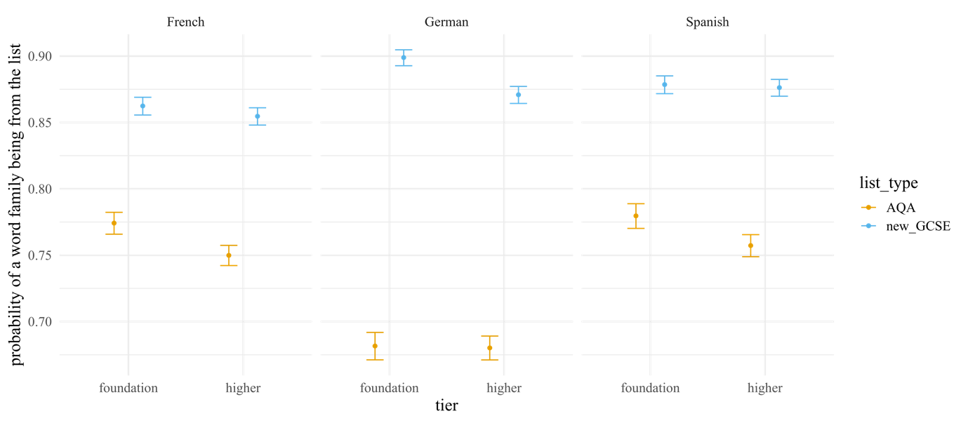
But is a frequency-informed list useful for the current GCSEs?
Yes: a frequency-informed list predicts more of the content of exams to date compared to the current word lists
Example frequency-informed GCSE-like word lists available from NCELP Resources Portal
Predicted probability of a word family in corpus of exams being from each word list
Notes:
This is based on the corpus of all the four papers to date.
The pattern is almost the same for an average paper – a single, typical paper.

Slide 21
In summary,
Current lists are underused in the exams (need to cover so many topics)
Many words in the exams are not on the lists
High proportion of low frequency words are in the exams
and 60% of those are not on the current list
A student could encounter many more words in an exam than an average student knows
-> A lot of unpredictable language for many students
-> Heavy weighting on lexical inferencing at fragile stage of learning

Slide 22
More information about the new GCSE? UNDERSTANDING THE NEW SUBJECT CONTENT FOR GCSE FRENCH, GERMAN, AND SPANISH
Format: online
Timings: 3.30-4.30pm / 4.00-5.00pm / 7.00-8.00pm
Dates: various dates throughout March
Audience: MFL teachers, MFL Heads of Department, Subject Leaders
Cost: free
https://ncelp.org/march-briefings-gcse/

Slide 23
Session overview:
Part 1/ Fairer assessment? Subject Content in 2015 & 2022
Part 2/ Fairer access to instruction?
Part 3/ Fairer achievement?

Slide 24
Individual differences affect how well learners can crack the code and ‘get meaning’
‘Individual differences’ include ‘aptitudes’ such as:
implicit learning aptitude (Granena & Yilmaz, 2019)
analytic ability (Kasrpwicz et al, 2019)
phonological awareness (Roehr-Brackin & Tellier, 2019)
working memory (Dracos & Henry, 2021)
Such individual differences can ‘moderate’ the effectiveness of different types of instruction.
Four example studies from international research…

Slide 25
Example 1: An aptitude to analyse language predicts learning
Roehr-Brackin & Tellier (2019): The importance of explicit learning in the primary foreign language classroom
‘Aptitude’ predicted gains in French proficiency
1) grammatical sensitivity (analytic ability) and
2) phonological awareness
This analytic ability can improve, with instruction
Similar findings by Kasprowicz, Marsden, & Sephton (2019): analytic ability was a strong predictor of progress

Slide 26
Example 2: So, what kind of teaching can best help those who have less of it?
But we don’t all have that aptitude!
Sanz et al (2016)
Differences in working memory -> different learning gains when there was no grammar instruction prior to practice.
But ‘brief grammar explanation prior to practice, for all’, seemed to ‘cancel’ any differences in learning due to differences in working memory.
Working memory moderates the effects of instruction as learners start a new language

Slide 27
Example 3: What kind of teaching can best help those who have less aptitude?
Kourtali & Révész (2019)
A recast is an implicit correction, done to ‘keep the flow’ AND improve language:
Student: J’ai allée au parc.
Teacher: Ah, oui, je suis allée au parc. Et, quand?
All learners benefited from recasts more when doing simple tasks compared to complex tasks.
Only those better at picking out patterns in a new language (with higher aptitude) benefited from recasts during complex tasks.
A simpler task can increase the benefits of error correction for learning a grammatical feature, regardless of aptitude

Slide 28
Aptitude in language learning – what kind of teaching can best help those who have less aptitude?
Erlam (2006)
Group 1: Deductive (told a pattern briefly before practice):
Made greater gains than inductive group
Performance was not related to aptitude
Instruction method limited the effect of individual differences
Group 2: Inductive (learners encouraged to pick out a pattern)
Performance depended on having greater analytic ability
If pupils had better analytic ability, more able to cope with less structured material
Group 3: Rules + awareness-raising from input
Performance depended on having greater analytic ability and working memory
Learners with higher working memory showed bigger gains in the delayed test.
Method of instruction has the potential to level differences in aptitude between learners

Slide 29
In summary…
Cognitive differences between students influence how well teaching decisions help learning
Certain decisions (about feedback, when to explain grammar, revisiting vocabulary) ….
seem more likely to help more learners, most of the time.

Slide 30
Session overview
Part 1/ Comparing 2015 and 2022: similarities and differences
Part 2/ Fairer access? Research on how students’ individual differences interact with pedagogical choices
Part 3/ Fairer achievement? Opportunities offered by changes to GCSE for building a fairer curriculum design?

Slide 31
Implications for curriculum. The new content increases attention on …
Erler & Macaro (2011) found:
Pupils in KS3 who did better on ‘sounding out’ and ‘syllable division’ were more likely have positive feelings about the language and more likely to opt to continue with the subject in the future.
the most used words
still room for individualisation in word choice for production
independent manipulation of language
downplays heavy reliance on complex, unanalysed, fixed chunks
practice reading aloud WITH understanding
practice writing down words that are heard

Slide 32
How to sequence a curriculum, if not with phrases on ‘my routine’, ‘school uniform’, ‘describing house’?
Language still facilitates communication of functions in context
Mix parts of speech (v, n, adj, …) -> create sentences from lesson 1
Reduce reliance on complex chunks that can actively mislead learners who are tying to ‘crack the code’
(VanPatten, Marsden & Chen/Kasprowicz/McManus)
Je m’appelle => “My” “name” ??
Notes:
High frequency words in small semantically-related sets
mixed parts of speech (v, n, adj, …) -> create sentences from lesson 1
Rather than topic-inspired phrases, be driven by challenges of language
Avoiding input that can mislead learners trying to ‘crack the code’
(VanPatten, Marsden & Chen/Kasprowicz/McManus)
Instead of starting with je m’appelle
je m’ is not ‘I am called’ or ‘my name is’
-> Use Je suis … and Tu es … for the same function
--------------------------
Mitchell & Myles research on chunks
Analytic ability – Kasprowicz & Marsden; Roehr-Brackin
Levelling the playing field – aptitude*treatment research

Slide 33
and also space words out across varied, interesting contexts?
When we are “gardening in a gale” of English (Hawkins, 1996), how do you ensure there is enough revisiting of language?
-> “expanding practice schedules” (see Nakata, 2015)
revisit the same language, less and less frequently over time
so you can introduce new language
Notes:
At NCELP we didn’t set out to provide a specific example, but teachers asked us to do so – to illustrate the ideas in materials they could take off the shelves and adapt to their own context – go faster, go slower,

Slide 34
An example of an expanding practice schedule
Week 1: a set of words learnt for pre-lesson homework – e.g., Quizlet
Week 2: taught & practised in lesson
wk
2
Week 5: relearnt before lesson and included in classroom activities
wk
5
Week 10: relearnt before lesson and included in classroom activities
wk
10
Week 20: tested
Week 33: tested
Each of following years: practised and tested
Cumulative tests; Nakata, T. et al. (2020)
Notes:
You will see how quickly teaching time gets filled up, once we start systematically revisiting language.
------
For the tests – how do you test the old words and test the new ones? One approach we started with was testing 50% words since last test : 50% of ‘old’. This is a ‘cumulative’ testing schedule.
But this balance will change as more words become ‘old’ relative to the number of ‘new’ words. Or the number of words tested needs to grow a lot.

Slide 35
Revisiting vocabulary in different semantic contexts
Talking about people’s lives
Asking about future intentions
Talking about the environment

Slide 36
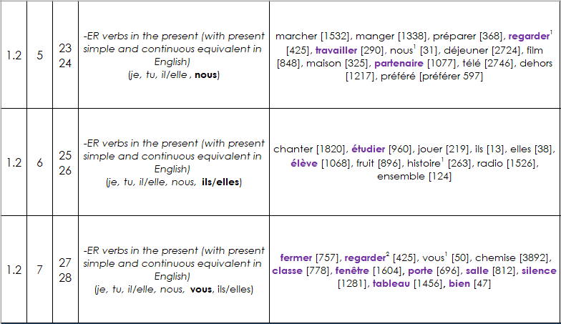
2. Design
Planning systematic vocabulary and grammatical growth
lesson | word families grow | number of words grows
grammatical growth: word families gradually get larger as new features are introduced
Notes:
In this extract from the Year 7 NCELP scheme of work, you can see that students learn a set of –ER verbs in Term 1.2 Week 5. However, they cannot yet use these verbs in the second or third person plural, because these forms are introduced in the weeks that follow. They also cannot use the verbs in any tenses other than the present. But these all come later.
--------
You will see this embedded in one function of the MultiLingProfiler a weekly NCELP syllabus list. These word lists are cumulative, growing along with students’ learning. These lists also differ from most lists in that they make no assumptions about students’ ability to produce all forms of a known headword, and so profile for grammatical as well as semantic knowledge. There is a different list for each week in the NCELP scheme of work, each building on progress in the last.
So, the profiling tool has to recognise students’ grammar progress as well as headword knowledge, and reflect this in results.

Slide 37
But won’t this lead to a dull diet and so end up not motivating anyone?
Notes:
There seems to be a common misapprehension – an easy dichotomous way of thinking - that defining language content in clear ways – by listing vocabulary, the details of grammar, and the sounds-symbol correspondences - this would mean that language learning was no longer about engendering an interest in the countries and people associated with the language. That defining linguistic content somehow also meant that the only rationale suddenly became an academic one only – neglecting other rationales such as raising awareness about language (in a way that could be applied to other languages later in the pupils’ lives) or imbuing a sense of curiosity in other cultures and places.
This is far too simplistic way of thinking.
Here are some texts I will whizz through to illustrate, I hope, that these views resulted from a false dichotomy, a conflation of completely different issues.
I hope to illustrate, in a whistle stop tour of some of the over 1,000 classroom resources that NCELP have created, that interesting texts and ideas can be communicated with high frequency words and basic grammar structures, in a curriculum where the vocab and grammar adheres to a schedule to ensure that particular vocab and grammar are revisited at specific times.
Please understand that building up to the texts you are about to see, are a series of meticulously planned activities that lead up to students being able to understand and interact with the texts. The activities that lead up to this span hours (over weeks) of classroom time. These activities should not be considered in isolation, but as part of a whole.

Slide 38
Be wary of ‘false dichotomies’
“Focus on words and grammar means the interest and culture has gone!”
Notes:
Let’s think about these.
There is no communication without some kind of language;
There is no interest generated in learning a language without words
There is no appreciation of culture without being able to understand the systems in the language
There is no intercultural understanding without being able to understand words and grammar
Identifying a body of language to learn does not need to be demonized as abandoning the traditional reasons for why we learn a language.
Identifying a body of language to be learnt ,and proposing a pedagogy that allows learners to go slowly and learn well, does not need to be demonized as forfeiting the right to use language for communication, interaction, culture- what a simplistic dichotomy that would be

Slide 39
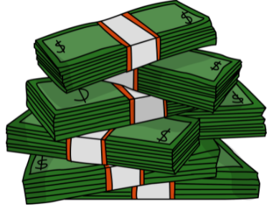
El pasado de Medellín
escuchar / escribir / leer
Escucha y completa el texto.
Medellín es una ciudad en Colombia que hace veinte años era muy peligrosa. Un grupo de criminales, el Cartel de Medellín, organizaba redes de narcotráfico* y prácticamente controlaba la ciudad. El narcotráfico era un muy _______ _________ (el Cartel ganaba hasta sesenta millones de dólares al día), así que era posible ganar mucho dinero en muy ________ _________. Sin embargo, era una ___________ _________ y el grupo usaba la violencia* muy a menudo. Mataba a policías en la calle y secuestraba* a ___________ _____________. A pesar de estas acciones, el jefe del cartel, Pablo Escobar, era una persona popular en los _________ _________. Él ayudaba a la población en lugares donde el gobierno no estaba. Por eso mucha gente de estas comunidades lo consideraba una _______ _________.
buen
negocio
poco
tiempo
actividad
ilegal
personas
importantes
barrios
pobres
gran
persona
*el narcotráfico = drug trafficking
*la violencia = violence
*secuestrar = to kidnap, kidnapping
Notes:
This is a text about a city in Columbia that has suffered socio-economic deprivation due to a drug trafficking problem. The grammar focus is contrasting the imperfect tense with the present.
The two - an interesting theme / content and a grammar driven content - can go hand in hand.
Timing: 10 minutes
Aims:
to learn about the past of a Spanish-speaking city
to accurately transcribe the missing words
to consolidate understanding of pre-nominal adjectives
to demonstrate understanding of key information in the text
Procedure:
Students write 1-6 down the left hand side of their books.
Explain to students that they will hear six pairs of missing words.
They listen to the text and write the missing pairs of words.
Check answers and give feedback. Elicit oral translations in English of the words in the gaps.
Ask students which pairs of words have an adjective before the noun (ANSWER: buen negocio, poco tiempo, gran persona).
Ask which pairs of words have an adjective after the noun (ANSWER: actividad illegal, personas importantes, barrios pobres).
To check comprehension of the text on this slide, the questions below could be asked. These could be written on the board by the teacher or distributed on a handout (word doc available with this resource). The answers can be checked orally in English afterwards, with reference to the Spanish text displayed on the board.
Comprehension questions:
Who was effectively in charge of Medellín twenty years ago? (The Cartel de Medellín)
How much could the Cartel de Medellín earn in a day? (Up to 60 million dollars)
What is said about violence? What examples are given? (The group used violence frequently. It killed police officers and kidnapped important people)
Why was Pablo Escobar considered to be a great person? (Because he helped the population in poor neighbourhoods where the government wasn’t present)
Notes: it is assumed that students will be able to understand ‘prácticamente’ given that the word ‘práctico’ has been taught, as well as the meaning of the affix –mente.
Based on the text length (142 words), 2% of the text is 2.6 words. In the new GCSE, a maximum of 2% of words in a text may be glossed. This is rounded up to the nearest single figure (3) here.
One additional cognate (dólar) is included as it has been used in previous phonics activities.
An additional way in which the text could be exploited would be to ask students to identify instances of ‘era’ and their meanings (e.g. ‘[it] was’ for the city, ‘[he] was’ for Escobar).
Image credits: Image retrieved from https://pixabay.com/es/illustrations/pablo-escobar-gr%c3%a1ficos-dise%c3%b1o-4439780/ (image free to use)
Sources and additional information:
Source of information regarding income: Pablo Escobar: The Life and Crimes of the Most Notorious Colombian Drug Lord By J.D. Rockefeller
Frequency of glossed words:
narcotráfico [3549]; secuestrar [>5000]; violencia [1100]
Frequency of cognates:
criminal [2884; controlar [994]; dólar [677]; ilegal [2912]

Slide 40
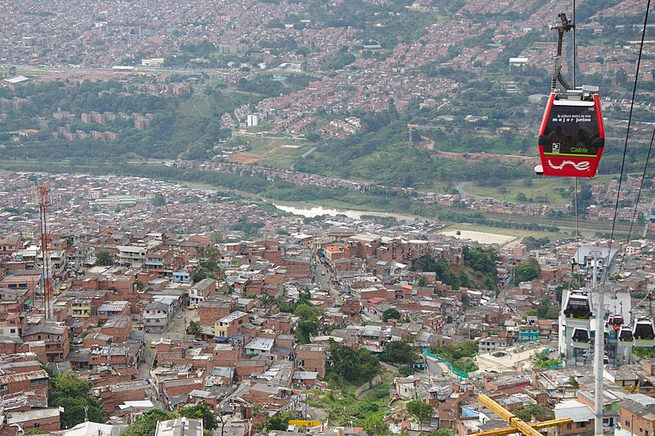
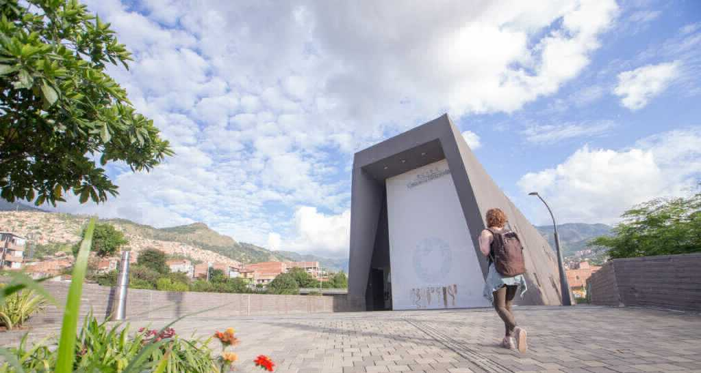
El Medellín de hoy
*la violencia = violence
leer
Escobar murió en el año 1993. Hoy en día Medellín es mucho más __________. En general la gente puede vivir tranquilamente. La zona urbana es bastante agradable, con museos, plazas y parques. Medellín es la ________ ciudad de Colombia que tiene su _________ metro y una red de “metrocables” (un tipo de transporte que conecta las partes altas de la ciudad con las partes bajas). En 2012, incluso ganó un premio a nivel ____________ por estos proyectos de transporte público.
Al _________ tiempo, la ciudad no olvida su pasado ________. En 2006 el gobierno abrió un museo, la “Casa de la Memoria”, para acordarse de la violencia y promover el diálogo. La idea: aprender del pasado para crear un futuro _______.
seguro
única
propio
El metrocable
mundial
mismo
oscuro
La Casa de la Memoria
mejor
Opciones:
propio | única | mundial | oscuro | seguro | mismo
Notes:
Medellin today.
Timing: 8 minutes
Aims:
to learn about present day life in a Spanish-speaking city
to correctly identify the missing words in the gaps
to understand key information in the text
Procedure:
Ask students to read the text and identify which word should go in which gap.
Teachers may wish to challenge higher achieving students by not showing them the answer options initially.
Reveal each answer and give feedback. Check understanding of the text via oral translation of each sentence into English.
Notes: students may be interested to know that Escobar died in 1993 during a military attack by the Colombian armed forces. To give an indication of Escobar’s popularity, around 25,000 people attended his funeral (https://faroutmagazine.co.uk/how-pablo-escobar-became-symbol-of-resistance-popular-culture/).
Students were taught the spelling change o > u in the word ‘murió’ in Y9 T2 but it may be worth recapping this.
Frequency of unknown words:
tranquilamente [4526] (not glossed as students have learnt ‘tranquilo’ and the affix –mente); violencia [1100]; conectar [1973]
Images free to use from wikicommons and from the Museo Casa de la Memoria website.
https://commons.wikimedia.org/wiki/File:Metrocable_and_Comuna_1_in_Medell%C3%ADn_01.jpg
https://www.museocasadelamemoria.gov.co/en/elmuseo/acerca-de-nosotros/

Slide 41
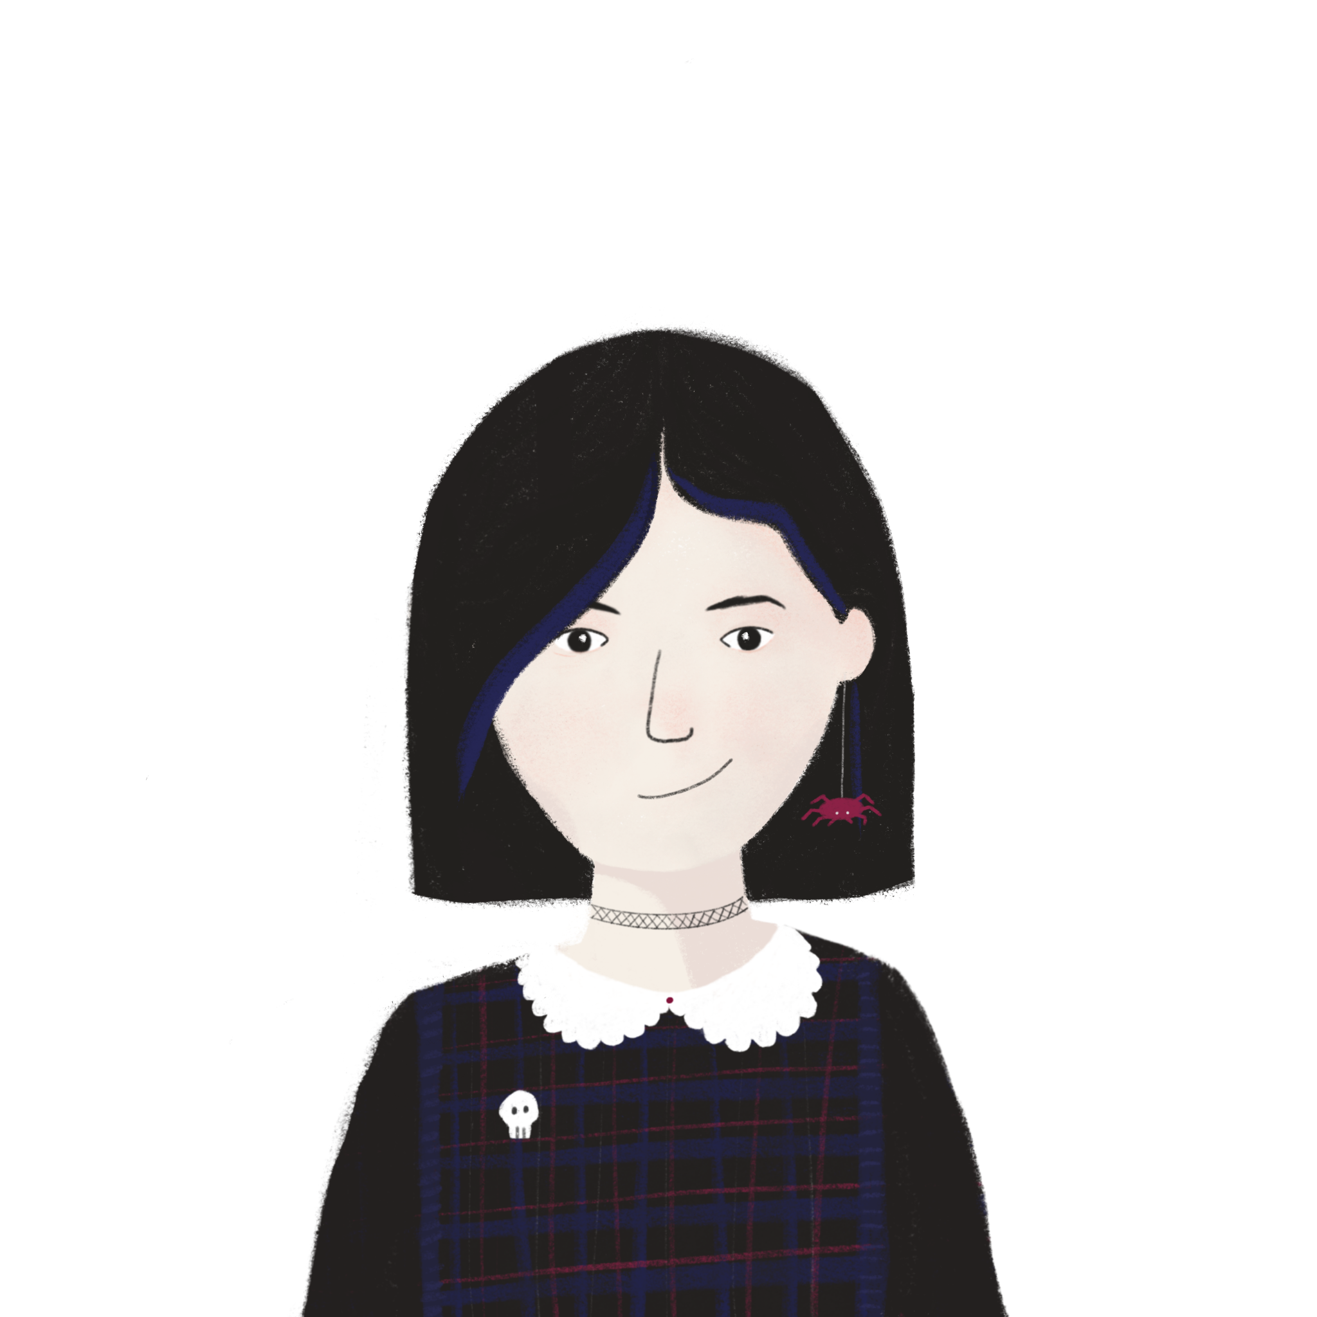
La Manche
Écris des réponses aux questions en anglais.
lire / écrire
La Manche* sépare la France et l’Angleterre. On peut traverser la Manche en bateau ou en train sous l’eau. Quand nous visitons l’Angleterre, nous aimons prendre le train – c’est plus rapide. Ils préfèrent prendre le bateau pour regarder la vue. Comment traversez-vous la Manche ?
Le tunnel sous la Manche constitue le plus long tunnel sous-marin* du monde – on trouve 38 de ses 50 kilomètres sont sous la mer*. On utilise le tunnel pour voyager entre l'Angleterre et la France. C'est idéal pour les vacances et les affaires.
*la Manche = the English Channel
*sous-marin = underwater
*la mer = sea
What is the tunnel ideal for?
holidays / business
What are two ways you can cross the Channel?
boat / train
How long is the tunnel?
50km
How much of the tunnel is under the sea?
38km
Notes:
A text for year 8 learners about the English Channel tunnel
Comprehension questions about the content.
Timing: 4 mins
Aim: Reading comprehension.
Procedure:
1. Click to bring up a comprehension questions in English.
2. Students write an answer in English.
3. Click to reveal answer.
4. Click again to reveal the next question.
5. Repeat steps 2-5 for 4 questions in total.

Slide 42
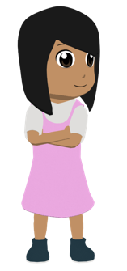
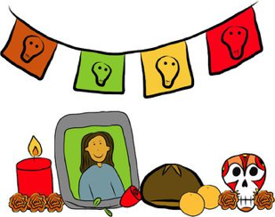
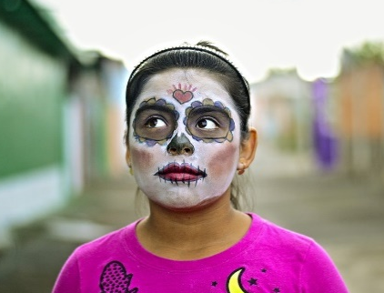
Una tradición mexicana: el Día de Muertos
leer / escuchar
Lee y escucha el texto sobre el Día de Muertos:
1
5
‘Pan de muerto’ es un tipo de pan tradicional en este día.
México tiene muchas tradiciones, pero su tradición del Día de Muertos es especialmente conocida. Es una costumbre única y muy importante para su comunidad porque es una forma de pensar en los muertos. Para los mexicanos, los muertos vienen a la tierra este día.
Nadia es mexicana y celebra el Día de Muertos con su familia. Por la mañana se levanta temprano para ayudar a su abuela: preparan pan* de muerto y un poco de fruta para el altar. Su altar tiene varios* niveles. Los niveles del altar son las diferentes partes del mundo: el primer nivel es la tierra y el segundo nivel es el cielo*. Nadia pone allí fotos de su abuelo y se sienta al lado de su abuela. Se queda unas horas en casa con su familia y se acuerda de su abuelo muerto.
Por la tarde se pone ropa divertida, se pinta de blanco y negro y va a la calle con su hermano. En su barrio hay un festival con música fuerte y luces de colores. ¡Es muy divertido!
2
6
3
7
4
*el pan = bread; *el cielo = sky, heaven; *varios = various
Notes:
This text is about Day of the Dead, an important festival in Mexico.
This was a bimodal reading and listening task – where learners are asked to follow the text whilst they listen; every so often the audio stops and they have to say the next word or the previous one, or replace the next word with something else
This was informed by evidence that bimodal input helps learners to segment the input into words and helps their comprehension.
-------------
Timing: 8 minutes
Aims:
to reinforce understanding of the difference between ‘se’ and ‘su’.
to help students to connect the spoken and written forms of the language more securely.
to consolidate vocabulary and grammar knowledge by eliciting suggested changes to the text.
Procedure:
Students read the text and write ‘se’ or ‘su’ for each space.
Click on the audio button to play the text. Read and listen.
Note: There is a full version of the audio top right with a player. Alternatively, the audio is in 6 sections with a pause just after the words 1-5 below, to facilitate easy stop/start.
To support segmentation, stop the audio and ask students to say: a) the next word b) the previous word
In addition, to develop understanding, vocabulary and grammar knowledge, pause at key points and ask students to suggest an alternative word that could replace the next word. This is a chance to draw on previously taught grammar and vocabulary knowledge.
Es una costumbre única y muy importante para su... (students volunteer other possible nouns – e.g., gente, historia, país).
y celebra el Día de Muertos con su…..(students volunteer other possible nouns – e.g., padre, madre, primo etc.).
de su abuelo y se... (students volunteer verbs in third person singular that fit after ‘se’ – e.g., se acuerda de..., se queda, se prepara (para), etc)
en casa con su familia y se ... (students volunteer other possible verbs that fit after ‘se’ – e.g., se saca (fotos), se mira en el espejo, se presenta a otra gente).
Por la tarde se…… (students are prompted other possible verbs that fit after ‘se’)
va a la calle con su…. (students volunteer other possible nouns)
Notes:
1. The word for ‘bread’ (‘pan’) will be introduced in the next week’s vocabulary set.
Transcript
México tiene muchas tradiciones, pero su tradición del Día de Muertos es especialmente conocida. Es una costumbre única y muy importante para su comunidad porque es una forma de pensar en los muertos. Para los mexicanos, los muertos vienen a la tierra este día.
Nadia es mexicana y celebra el Día de Muertos con su familia. Por la mañana se levanta temprano para ayudar a su abuela: preparan pan* de muerto y un poco de fruta para el altar. Sualtar tiene varios niveles. Los niveles del altar son las diferentes partes del mundo: el primer nivel es la tierra y el segundo nivel es el cielo. Nadia pone allí fotos de su abuelo y se sienta al lado de su abuela. Se queda unas horas en casa con su familia y se acuerda de su abuelo muerto.
Por la tarde se pone ropa divertida, sepinta de blanco y negro y va a la calle con su hermano. En su barrio hay un festival con música fuerte y luces de colores. ¡Es muy divertido!
Frequency of unknown words and cognates:
pan [1342]; cielo [620]; varios [386]
Photos:
Photo of the child by Christian Newman, from Unsplash.
Photo of ‘Pan de muertos’ by Alejandro Ávila Cortez, from Pixabay.

Slide 43
Be wary of ‘straw men’
“Using texts with all familiar words is unchallenging!”
Who would really recommend always using texts in which all the words are completely known to all learners?
On average, year 11s know between 550-850 words. So, out of a word list of 1750, some words are still going to be ‘unfamiliar’ in their GCSEs ->
Inferencing will still be needed by most students for some words
Claiming to shoot down an idea that no one actually proposed in the first place!
And what is meant by ‘familiar’?
Known without fail?
Or … Introduced last week?
Revisited last year?
Notes:
Would anyone ever be sure that all the words in a text are completely known by all?

Slide 44
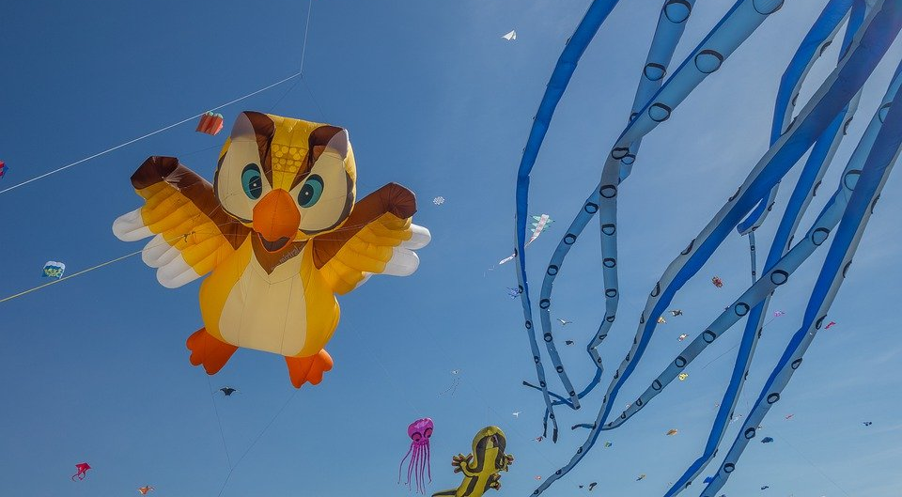
Le festival de Dieppe
lire
*le plus grand =
the biggest
*le cerf-volant = kite
*le son = sound
Comment dit-on les mots orange en anglais ?
What noun does this word look like?
What adjective does this word look like?
What noun does this word look like?
Le festival de Dieppe est le plus grand* festival de cerfs-volants* au monde.
On trouve le festival sur la plage.
Les visiteurs viennent de beaucoup de pays pour regarder des cerfs-volants traditionnels, de l'art et des acrobates. Un aspect important du festival est qu’on peut visiter sans acheter de billet. Il est gratuit !
Il y a beaucoup d'activités pour les enfants et le festival encourage l'imagination. Cet événement culturel célèbre les relations internationales. Pendant le dernier week-end du festival, on regarde les cerfs-volants illuminés pendant un show son* et lumière. Je pense à visiter le festival. Tu veut voyager au festival avec ma famille ?
visitors
What does this sentence tell you about the festival?
acrobats
traditional
The start of this word looks like the English
free
What adjective does this look like?
This word has the same stem as the previous one you worked out. What might it mean?
event
illuminated
light
What words that you already know could you use instead of the words in orange?
Answer the question at the end.
Notes:
Here is a text about a kite-festival in Dieppe with lots of language awareness activities to help learners understand cognates
Then drawing on their current lexicons – which we know what they are precisely as they have been tracked so carefully - to replace the words
Then giving their reaction to the content of the text by answering a question about whether they would like to go to the festival
----------
Timing: 5 minutes
Aim: Developing inferencing skills by using surrounding context to work out meaning of unknown words; word substitution with known words.
Procedure:
1. Students try to work out the meaning of the highlighted words based on context (text and images) and similarity to English words.
2. If students need some help, click to bring up a clue
3. Click gain to reveal the translations.
4. Click to bring up the extension. Students think of known words that could replace the orange words to make a sensible sentence.
Some suggested answers:
visiteurs -> gens, enfants, personnes … any relevant noun to describe people
traditionnels -> grands, nouveaux… any relevant adjective to describe kites
acrobates -> artistes, chanteurs … any relevant noun to describe performers
événement -> lieu, festival … (note that any relevant masculine noun works here but ‘cet’ would need to change to agree)
illuminés -> verts, bons … any relevant adjective to describe kites
lumière -> musique, film … any relevant noun to describe a show

Slide 45
“They won’t be able to say anything useful with just high frequency words!”
Notes:
All the following using vocabulary selection comprises at least 85% words from most frequent 2000, and is systematically revisited → SOW

Slide 46
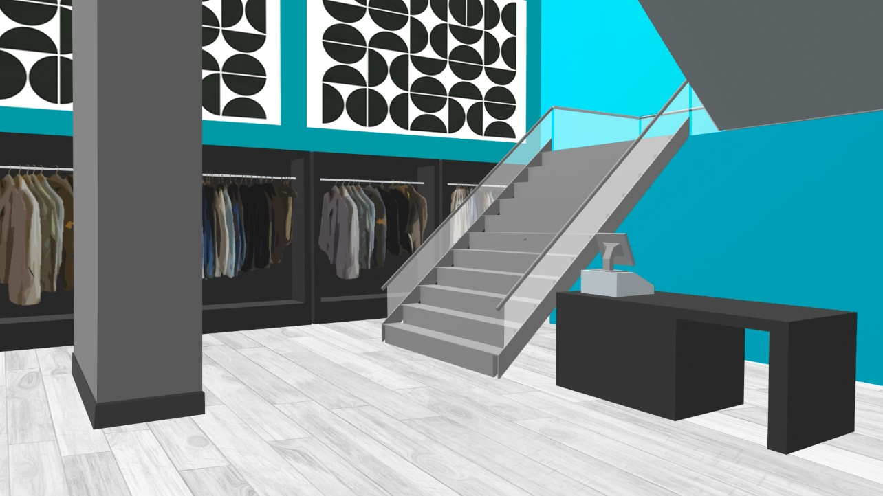
¡Lucía y Nadia van de compras! Están en una tienda de ropa. Lee la conversación. Escribe 1-9 y ‘este’ o ‘esta’.
leer
Lucía: (1) Este / Esta tienda es muy buena. Creo que es mejor que la tienda en el centro.
Nadia: Sí, es verdad. ¿Te gusta (2) este / esta vestido azul?
Lucía: ¿Cuánto es?
Nadia: 30 euros. Es más bonito que el vestido rojo y menos caro que el vestido al lado de la puerta.
Lucía: Me gusta mucho. Y (3) este / esta marca es muy conocida también.
Nadia: Claro. Además, según una amiga,
el color azul es más popular que el amarillo o el rojo (4) este / esta año.
Lucía: ¡Mira! (5) Este / Esta falda es preciosa también, y ¡está a mitad de precio!
Nadia: ¡Qué bien!* El precio de la falda en (6) este / esta tienda es más bajo que en otros lugares.
¡Qué bien! That’s great!
Notes:
A series of activities building up to being able to have a conversation about buying clothes
Timing: 7 minutes
Aim: to practise deciding between ‘este’ and ‘esta’ by identifying the gender of the noun; to consolidate understanding of comparatives and new vocabulary
Procedure:
Click to show the instructions and then the reading passage and the table which the students can copy out.
Students write either ‘este’ or ‘esta’ for each number.
Students can listen to the conversation to check answers. Click on the audio player (top right of the slide).
Answers are also shown in the text by clicking.
The next slide continues to exploit the text with an activity where students translate five comparative sentences into English.
Note: ‘Qué bien’ has been encountered in other lessons, but hasn’t been taught yet as new vocabulary, so is glossed again here.

Slide 47
leer / escuchar
Hugo y Daniel van de compras. Lee las preguntas. Completa la pregunta con la palabra correcta. Luego escucha las respuestas. Identifica la pregunta correcta (e.g. pregunta 3).
La pregunta | Objetos
1. ¿Por qué no compras estas ______? | zapatos bicicletas
2. ¿Cuánto son estos ______? | bolsas espejos
3. ¿Quién necesita estas ______? | relojes cosas
4. ¿Cómo son estos ______? | pantalones cajas
5. ¿Dónde guardas estas _______? | vestidos camisas
6. ¿Cuáles son estas ________? | marcas libros
Respuestas
A
Pregunta 6
Notice how the –a (‘s/he’) ending is used after ‘quién’.
B
Pregunta 2
C
Pregunta 4
D
Pregunta 1
E
Pregunta 3
F
Pregunta 5
Notes:
Reading and listening activity
Timing: 8 min
Aim: to recognise whether to use ‘estos’ or ‘estas’ by looking at the gender of the noun (reading); to practise pairing up question words with their answers (listening and reading).
Procedure:
Students read each sentence and decide if the demonstrative goes with a masculine plural or feminine plural word. The answers are shown by clicking in order.
Then, students listen to the responses (A, B, C...) and decide which question it must refer to. Teachers play the recording by clicking the letter button. The answers are then revealed by clicking.
Transcript:
Adidas y Nike. Son muy conocidas.
Veinticinco euros cada uno.
Muy prácticos, pero no son ligeros.
Porque son demasiado caras.
Diego, para ir al trabajo.
En casa, debajo de la cama.

Slide 48
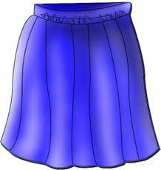
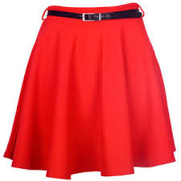
Persona A: read the question in Spanish but don’t say the crossed out word!
hablar / escuchar / escribir
Preguntas en las tiendas
Persona B: look at the cards. Is it ‘A’ or ‘B’? Say the words below the picture in Spanish.
¿Cuándo necesitas estas…?
Esta semana.
Un ejemplo
Persona A (pregunta):
Persona B (escucha y mira las tarjetas):
When do you need these (skirts)? (f)
A
(m)
B
(f)
(faldas)
Esta semana.
_______________
Say:
This Monday.
This week.
Notes:
Timing: 12-14 minutes
Aim: speaking, listening and writing activity to practise ‘estos’ and ‘estas’, question words and vocabulary.
Procedure:
This is the example slide to explain the activity. Teachers click to go through the example stage by stage. It may be useful to give the pairs out their cards to help understand the task. The prompt cards for both Person A and Person B are on slide 48, and the picture cards are on slides 49 and 50 respectively. These slides should not be shown during the activity.
Teachers need to stress that students do not say the word that has been crossed out. It is there to indicate which gender of ‘these’ is needed.
Person B listens to Person A’s question and works out which image the ‘estos’ or ‘estas’ is referring to, and then orally translates the answer below the correct picture into Spanish. Person A writes this down in their book.
Students swap roles after doing all 6.
The answers to the activity are shown on slide 51.

Slide 49
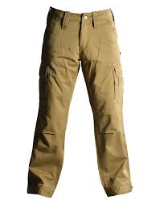
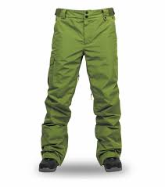
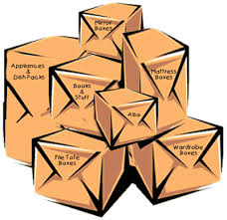
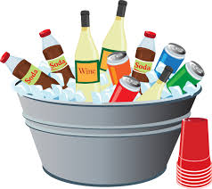
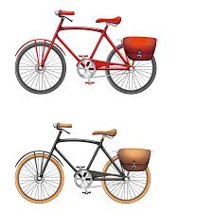
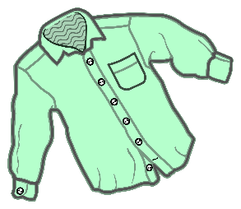
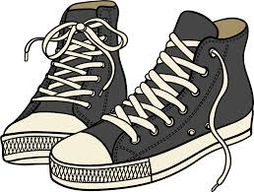
1.
A
(m)
B
(f)
4.
A
(f)
B
(m)
Because I want to drink something.
Because I want to read the news.
in the market
in the shop
2.
A
(f)
B
(m)
5.
A
(f)
B
(m)
this week
this Saturday
They are 30 euros.
They are 27 euros.
3.
A
(m)
B
(f)
6.
A
(m)
B
(f)
my Dad
my Mum
They are pretty.
They are short.
Notes:
Person A
DO NOT SHOW THIS SLIDE DURING THE ACTIVITY

Slide 50
Y Daniel, ¿cómo ayuda?
Daniel también ayuda.
Escucha. ¿Es ‘A’ o ‘B’?
Escribe la acción y el lugar en inglés.
escuchar
Acción y lugar
Acción y lugar
1
buys it at the market
4
cuts it in
the kitchen
A milk (f)
B bread (m)
A fruit (f)
B cheese (m)
leaves it next to the window
2
5
mixes it in
a glass
A wine (m)
B vegetable (f)
A honey (f)
B juice (m)
places it on the table
takes it out of the bag
3
6
A food (f)
B egg (m)
A banana (m)
B apple (f)
Notes:
This is a listening text including everyday food items – and about buying and doing things with them!
Timing: 8 minutes
Aim: to practise recognising the gender of the direct object pronouns ‘lo’ and ‘la’.
Procedure:
Students listen to each sentence and decide if it refers to A or B, depending on the direct object pronoun that they hear. Note that in this activity, all pronouns refer to ‘it’ (rather than ‘him’ or ‘her’).
Students write the action and place in English.
Show the answers and give feedback. Students may be interested to know how to say some of the unknown words in Spanish (and they may learn their meanings incidentally). These are:
cheese: el queso [3187]
honey: la miel [3201]
juice: el jugo [3756]; zumo [>5000] is also used in Spain
banana: el plátano [>5000]
apple: la manzana [3214]
Transcript:
Lo compra en el mercado.
Lo deja al lado de la ventana.
La coloca encima de la mesa.
Lo corta en la cocina.
La mezcla en un vaso.
La saca de la bolsa.
Note:
Some food items have not been previously taught, although this does not impede the completion of the activity as the aim is to identify ‘lo’ being masculine and ‘la’ being feminine.
An alternative use of this activity could be full or partial sentence transcription. Some students may engage in this anyway, taking notes before writing their answer in English.
Frequency of unknown words or cognates:
queso [3187]; miel [3201]; jugo [3756]; zumo [>5000] is also used in Spain; el plátano [>5000]; manzana [3214]; acción [404]

Slide 51
Lucía compra en el mercado y habla con un dependiente. Lee y escucha el diálogo. Después, lee las frases en inglés. ¿Son verdaderas o falsas?
leer / escuchar
 | V | F
1. Lucía only wants big loaves of bread.
2. She prefers hot bread.
3. She wants bread for the evening.
4. She puts the loaves of bread in the bag with the bottles of milk.
5. The vegetables are fresh.
Hola, buenos días. ¿Cuánto cuestan los panes?
Los tengo grandes y pequeños. Los grandes cuestan un euro y los pequeños un euro con cincuenta céntimos.
Vale. Entonces dos pequeños y dos grandes.
¿Y los prefieres calientes o fríos?
Mmm... calientes, para desayunar. ¿Y cuánto cuestan estas botellas de leche?
1 euro la botella, pero también tenemos botellas grandes.
Pues... dos pequeñas. ¡Las necesito para hacer torrijas!
Perfecto. Los panes ya están calientes. ¿Los colocas en la bolsa con la leche?
No, los pongo en otra bolsa. Entonces, ¿cuánto cuesta todo?
A ver*... Todo cuesta nueve euros.
Bien, gracias. ¡Ah! También necesito verduras. ¿Las tienes frescas?
Sí, ¡claro*! ¿Qué tipo de verdura?
*a ver = let’s see
*claro = of course
Notes:
Timing: 7 minutes
Aim:
to see the examples of ‘los’ and ‘las’ on the previous slide in the context of a dialogue
to understand the vocabulary in the text
to correctly identify which of the five sentences are true and false, and why
Procedure:
Go through instructions with students. The word ‘dependiente’ (shop assistant) was glossed in an earlier resource, but hasn’t been taught as vocabulary, so ensure that its meaning is clear.
Students read and listen to the dialogue, trying to get the gist of the text.
Students then read the statements in English and decide whether they are true or false.
Draw students’ attention to several features of the text where there is not a word for word translation into English:
Notes:
Here are some additional uses of the text:
oral read aloud, in pairs (see next slide for extracts of the text that can be used for practice of penultimate syllable stress)
oral read aloud, with pairs of pronouns and verbs (e.g. los colocas) given as a prompt in English (‘you place them’) to prompt productive recall under some time pressure.
splitting the text into jumbled parts and asking students to reorder them
rewriting the text in a new way (e.g. with different items of food) and checking that the pronouns maintain the correct agreement. It may be necessary to provide some of the food items used in lesson 1 to support practice here.
Frequency of unknown words or cognates:
dependiente [>5000]

Slide 52
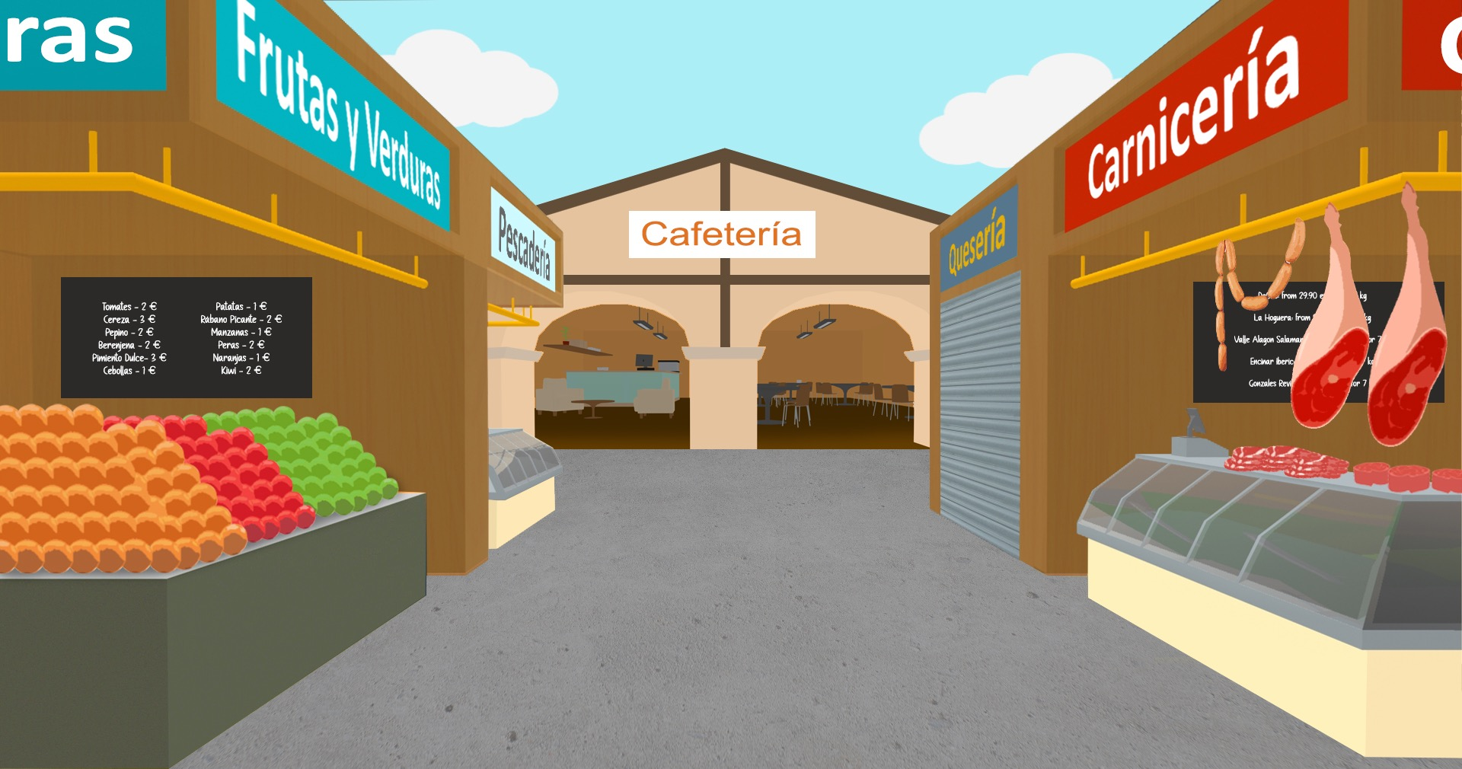
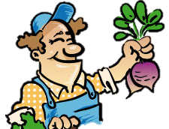
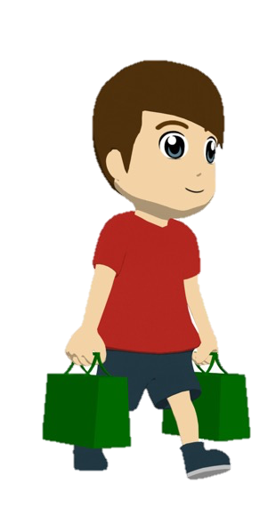
Ahora intenta completar este diálogo en español:
escribir
Hola, ¿cuánto _________ los huevos?
1
1
Hi, how much do the eggs cost?
cuestan
2
Do you prefer them big or small?
¿___ _________ grandes o pequeños?
Los
prefieres
2
Mmmm, big. I also want to buy fruit and vegetables.
3
Mmm, grandes. También quiero comprar _________ __________.
3
fruta y
verduras
Look – I have some fresh apples. You can try one if you like.
Mira – tengo unas manzanas frescas. ______________ una si quieres.
4
Puedes probar
4
Perfect, thank you! I need them for a traditional dish.
¡Perfecto, gracias! _____________ para un plato tradicional.
5
Las necesito
5
Notes:
[1/2]
Timing: 6 minutes
Aim:
to practise producing the pronouns ‘los’ and ‘las’ in a written dialogue
to also produce other aspects of the language, including new vocabulary items
Procedure:
Students read the dialogue and write the translation in Spanish.
Teacher clicks to bring up each missing part of the translation.
Notes:
See slide 33 for a version of the activity for higher-ability groups.
Frequency of unknown words or cognates:
manzana [3214]

Slide 53
Further resources from NCELP
https://resources.ncelp.org/
For example, ‘The culture collection’
Systematically revisit vocabulary, phonics, grammar
So we know that language will come back
But in different contexts - not the same topics
To help students understand and express meaning,
and learn about the countries and people where the language is spoken.
Link to all resource collections
Notes:
You can see many more NCELP resources for 13-14 year olds, after 200 hours of instruction, that cover topics such as secularism in France, the Berlin Wall and divided Germany, the ‘polite you’.
One teacher has shared with us some humorous versions of well known fairy tales that they have written with the high frequency words.

Slide 54
CPD offer
CPD course is free to teachers in state schools
Content is research-informed languages teaching at KS3 and KS4
5 remote learning sessions of 2.5 hours
Course leaders are NCELP Specialist Teachers
Additional online peer and instructor support
An online self-study version of the course will be available for anyone to access for free (and to facilitate a cascade model)
There is a link to register for the course here: www.ncelp.org/cpd
Notes:
As much as possible, participants are assigned to courses regionally - led by an NCELP Specialist Teacher near them, with other participants from their region.
This offers the potential to make the most of local networking and peer support, both online and potentially also face-to-face. A self-study version of the course (with similar certification) for anyone who is unable to access a ‘live’ place will be available shortly.
---------
If this CPD deck is delivered by others, please use this feedback survey, and paste into the chat:
Google Form: https://forms.gle/Y2ztbpRTrkKZRjcp9

Slide 55
Want to hear more?
Join the mailing list, email: enquiries@ncelp.org for monthly bulletins about resources arriving on the portal
To get monthly alerts to summaries of new research, sign up in 10 seconds at
https://oasis-database.org/

Slide 56
Thanks for listening
Part 1/ Comparing 2015 and 2022: similarities and differences
Part 2/ Fairer access? Research on how students’ individual differences interact with pedagogical choices
Part 3/ Fairer achievement? Opportunities of assessment change for fairer curriculum design

Slide 57
Selected references See OASIS for one-page accessible summaries
Erlam, R. (2005). Language aptitude and its relationship to instructional effectiveness in second language acquisition. Language Teaching Research, 9, 2, 147-171. https://doi.org/10.1191/1362168805lr161oa
Erler, L., & Macaro, E. (2011). Decoding ability in French as a foreign language and language learning motivation. The Modern Language Journal, 95 (4), 496–518. http://dx.doi.org/10.1111/j.1540-4781.2011.01238.x
Kourtali, N.-E., & Révész, A. (2019). The roles of recasts, task complexity, and aptitude in child second language development. Language Learning. https://doi.org/10.1111/lang.12374
Nakata, T. (2015). Effects of expanding and equal spacing on second language vocabulary learning: Does gradually increasing spacing increase vocabulary learning? Studies in Second Language Acquisition, 37(4), 677-711. doi:10.1017/S0272263114000825
Nakata, T., Tada, S., McLean, S., & Kim, Y. (2020). Effects of distributed retrieval practice over a semester: Cumulative tests as a way to facilitate second language vocabulary learning. TESOL Quarterly. https://doi.org/10.1002/tesq.596
Roehr-Brackin, K. & Tellier, A. (2019). The role of language-analytic ability in children’s instructed second language learning. Studies in Second Language Acquisition. DOI: 10.1117/S0272263119000214.
Sanz, C., Lin, H.-J., Lado, B., Stafford, C.A., & Bowden, H.W. (2016). One size fits all? Learning conditions and working memory capacity in ab initio language development. Applied Linguistics, 37 (5), 1-26. https://doi.org/10.1093/applin/amu058

Slide 58
Spare slides

Slide 59
Having a word list is not very unusual
Word lists for proficiency tests:
Japanese Language Proficiency Test until 2010 (Japan Educational Exchanges and Services, 2009)
~A2: 1,500 words / ~B1: 3,750 words
German-Zertifikat Proficiency Test (Goethe-Institut, 2016a, 2016b, 2016c)
A2: 1,300 words / B1: 2,400 words
Word lists for curricula:
France, Ministry of National Education (éduscol, 2020) lists 1,500 most frequent words in French for French primary school children (6-11 years)
China, Ministry of Education (2017) lists 1,500 words for English for 16 years olds (after 9 yrs of English)
Hungarian National Core Curriculum for English (Krizsán, 2003): 1,200 active vocabulary for 13-14 year olds
Guidelines about number of words:
Japanese Ministry of Education (MEXT, 2008, 2009, 2016, 2017, 2018) English: Junior high school students: 1,200 words; High school students: 1,800 words
Notes:
The size of the word lists seem to be not too far out from other countries and languages.
You can see here the languages highlighted in red and the numbers that are most relevant to our age and level of learners in green – the numbers in the new subject content are not much lower even than contexts in which the magic global English is being learned.

Slide 60
Spare slides showing the other materials complementing the speaking activities included in the ppts, for sake of completion. All are available in full on NCELP resources portal.

Slide 61
Persona A
hablar
How much are these (books)? (m)
Why do you buy these (shirts)? (f)
What are these (m) (shoes) like? (m)
Where do you keep these (boxes)? (f)
When do you need these (games)? (m)
Who uses these (watches)? (f)
Persona B
Where do you buy these (trousers)? (m)
When do you need these (bicycles)? (f)
Who pays for these (cards)? (f)
Why do you keep these (newspapers)? (m)
How much are these (shirts)? (f)
What are these (dresses) like? (m)
Notes:
Prompt cards
DO NOT DISPLAY IN CLASS

Slide 62
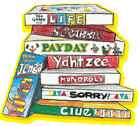
1.
A
(f)
B
(m)
4.
A
(f)
B
(m)
They are 24 euros.
in the kitchen
in the shop
They are 29 euros.
2.
A
(m)
B
(f)
5.
A
(f)
B
(m)
They are not expensive.
I like the colour.
at the weekend
this Sunday
3.
A
(m)
B
(f)
6.
A
(m)
B
(f)
They are very practical/ useful.
They are tasty.
my aunt
my grandfather
Notes:
Person B
DO NOT SHOW THIS SLIDE DURING THE ACTIVITY

Slide 63
Mira las respuestas. ¿Tu traducción es correcta?
escribir
Hola, ¿cuánto cuestan los huevos?
1
1
Hi, how much do the eggs cost?
¿Los prefieres grandes o pequeños?
2
2
Do you prefer them big or small?
Mmmm, big. I also want to buy fruit and vegetables.
3
Mmmm, grandes. También quiero comprar fruta y verduras.
3
4
Look - I have some fresh apples*!
Mira - tengo unas manzanas frescas.
4
Perfect, thank you! I need them for a traditional dish.
5
¡Perfecto, gracias! Las necesito para un plato tradicional.
5
*apple = la manzana
Notes:
ALTERNATIVE VERSION – HIGHER ABILITY
Activity as described on the previous slide, but this time requiring a full translation of the dialogue.
Note that the dialogue has been modified very slightly to ensure that all language produced is part of existing productive knowledge or glossed.
It is likely to take longer than the 6 minutes envisaged for the version on the previous slide, given that it requires more writing.

