Slide 1
Consolidating knowledge and making practice meaningful
An Introduction to NCELP
At Language World, 2021
Association for Language Learning
Emma Marsden
Date updated: 13 March 2021

Slide 2
In this session…(continued from the plenary…)
Planning practice: NCELP Schemes of Work
Choosing which words to teach: “high frequency”
Checking consolidation: NCELP tests
Emma Marsden, University of York
13 March 2021

Slide 3
Sounds of the language practice every lesson
‘Context’/ purpose of the language e.g., “Describing a thing or person”
Systematic revisiting of vocabulary, about every 3 and 9 weeks
Sequencing of grammar is language specific
Some extremely high frequency (irregular!) verbs at start
A lot of revisiting of regular & frequent verbs
Detailed notes for teachers
Weeks set aside for work on ‘rich texts’

Slide 4
Schemes of Work- Resources Tab
Sets of vocab on Quizlet - reading, writing, listening.
For learning prior to next lesson, in which that same vocabulary is practised
Vocab homework - audio practice: Listening & Speaking
)
Links to a free digital online game ‘Gaming Grammar’
https://ncelp.org/resources/gaming-grammar/
Available via:
Web browser
Apple app (ipads)
Google Play Store
Links to full lesson power point for each week

Slide 5
✓
Planning practice: NCELP Schemes of Work
Choosing which words to teach: “high frequency”
Checking consolidation: NCELP tests

Slide 6
How many words in a text do you know if you know very high frequency words?
◆ General conversation  More formal speech – e.g. lectures  Written language
Milton, J. (2009) Measuring second language vocabulary acquisition (p. 58). Multilingual Matters.

Slide 7
Full text: J. K. Rowling – Harvard Commencement Address, 2011: The Fringe Benefits of Failure and the Importance of Imagination.
Actually, I have _____ my mind and heart for what I ought to say to you today. I have asked myself what I wish I had known at my own _____, and what important lessons I have learned in the number of years that have _____ between that day and this.
I have come up with two answers on this wonderful day, when we are gathered together to _____ your academic success. I have decided to talk to you about the benefits of failure; and, as you stand on the _____ of what is sometimes called real life, I want to _____ the _____ importance of _____.
Words ≥ 2K removed (92.5% coverage)

Slide 8
✓
Planning practice: NCELP Schemes of Work
Choosing which words to teach: “high frequency”
Checking consolidation of knowledge: NCELP tests
✓

Slide 9
NCELP tests
For more on the principles of assessment and how it aligns with NCELP SOW, see short CPD sessions with voiceovers from NCELP colleagues:
Phonics
Vocabulary
Grammar

Slide 10
Two types of tests
‘Achievement’ tests (February & June each year)
Tests to what extent students have learnt everything up to test
Assesses a principled sample of phonics, vocabulary, grammar
‘Applying your knowledge’ test (June each year)
More holistic assessments, combining knowledge of phonics, vocabulary, grammar
As ‘knowledge’ turns to ‘skill’: More recognisable listening, reading, writing and speaking tasks.
Assesses ability to apply knowledge in context through:
listening comprehension,
oral picture description,
short translation tasks.
Checking cumulative retention: Half tests new material since last test; half tests material by sampling from everything before the last test
Listening and reading can be done online and marked by the computer (contact enquiries@ncelp.org)

Slide 11
Achievement test – Vocabulary
Listening
Reading
Writing
Speaking
40 x receptive
40 x productive
Balance of parts of speech: 2 nouns : 1 verb : 2 others types (adj, adv, preposition)
Test breadth - the number of words known
Test depth - how well the words are known – definitions, collocations, synonyms
Read (2000)

Slide 12
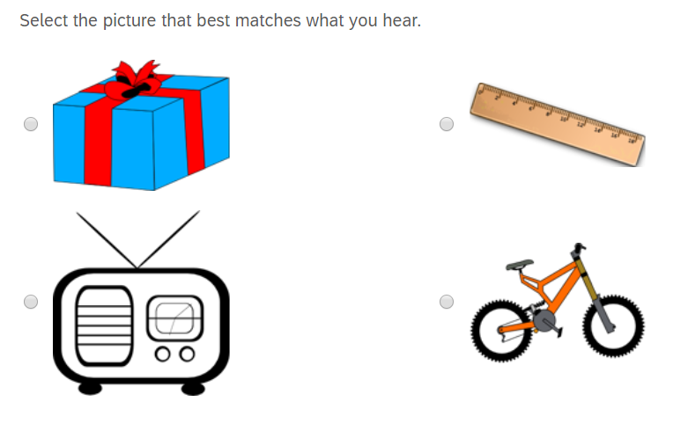
Question type 1
Achievement test – Vocabulary - Listening

Slide 13
Question type 2
Achievement test – Vocabulary - Listening
Listen to the word.

Slide 14
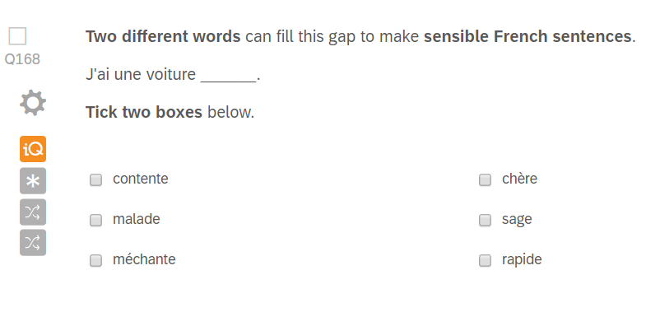
Question type 3
Achievement test – Vocabulary

Slide 15
Question type 4
Achievement test – Vocabulary - Writing

Slide 16
Achievement test – Phonics Listening -> writing
You will hear 15 Spanish words. You will hear each word twice.
Complete the spelling of each word by filling in the missing letters.
There may be more than one way of spelling them. Just type in any one possible spelling for each word.
You won’t know these words. Don’t worry – just do your best!
_ mbral
_ _ ma
_ _ mba
_ _ rafa
_ _ na
a _ _ oba

Slide 17
Achievement test – Phonics Reading -> speaking
Read the following list of Spanish words aloud.
You won't know these words. Just say them as you think they should sound in Spanish.
You will get marks for pronouncing the bold, underlined parts of each word.
If you’re not sure, don’t worry – just have a go and do your best.
amparar
jinete
quico
gilar
valla
cerner

Slide 18
Achievement test – Grammar Listening
Listen to the sentences.
Choose who the verb is referring to.
Circle your answer.
I you he/she they we
I you he/she they we
I you he/she they we
I you he/she they we

Slide 19
Achievement test – Grammar Reading
Choose which word could replace the underlined word.
Circle your answer.
1. Compra una casa. el la los las
2. Quiero el bolígrafo. un una unos unas

Slide 20
Achievement test – Grammar Writing
Complete the Spanish sentences using the correct form of the word in brackets.
1. ___________ en clase. (he asks) preguntar = to ask
2. ___________ en un museo. (you work) trabajar = to work
3. ¿ ___________ bien? (do I dance) bailar = to dance
4. ¿ ___________ un teléfono? (do you use) usar = to use

Slide 21
Applying your Knowledge test: Reading

Slide 22
Speaking
Applying your Knowledge test: Speaking
Look at the picture.
Describe it to a friend
by saying these sentences in French:
1. Voici le musée.
2. Le bâtiment est très grand.
1. Here is the museum.
2. The building is very big.
Take up to one minute to think about what to say each time, but don’t write your sentences down. To help you work out what to say,
try to break each sentence down into groups of words in your head.
It doesn’t matter if you make a mistake - just have a go!
It doesn’t matter if you speak slowly - just keep going!
For meaning (per sentence):
2 marks awarded where the meaning of the sentence is fully communicated with little effort required
on the part of the listener.
1 mark awarded where the meaning of the sentence is fully communicated with some effort required
on the part of the listener.
0 marks awarded where the meaning of the sentence is not communicated.
For accuracy (per sentence):
2 marks awarded where all or most of the features tested are accurately produced.
1 mark awarded where some of the features tested are accurately produced.
0 marks awarded where few or none of the features tested are accurately produced.

Slide 23
Want to give a flavour of the tests to pupils?
ppts and videos of teachers delivering a lesson to prepare pupils for the test
French | 1. Achievement test video prep lesson | 2. Applying your knowledge test video prep lesson
German | 1. Achievement test video prep lesson | 2. Applying your knowledge test video prep lesson
Spanish | 1. Achievement test video prep lesson | 2. Applying your knowledge test video prep lesson

Slide 24
Links to tests, audio files, mark schemes
Tests, including audio, transcripts and scorings spreadsheets are available in the
French, German & Spanish “test collections” on the NCELP Resource Portal.
 | Achievement | Mark Scheme | Applying Your Knowledge | Mark Scheme
French | Link | Link | Link | Link
German | Link | Link | Link | Link
Spanish | Link | Link | Link | Link

Slide 25
Alignment with the wider scene
See NCELP resources portal for ‘NCELP alignment with wider policy':
NCELP alignment with Ofsted Inspection Framework
NCELP alignment with Early Career Framework
How NCELP can support the draft GCSE Subject Content
NCELP alignment with Rosenshine’s principles of instruction
AND …
NCELP’s Cultural Collection
NCELP’s Phonics Collection

Slide 26
Want to hear more from NCELP?
Join the mailing list, email: enquiries@ncelp.org for regular bulletins about resources arriving on the portal
To get monthly alerts to summaries of new research, sign up in 10 seconds at
https://oasis-database.org/

Slide 27
Questions? Discussion?
✓
Planning practice: NCELP Schemes of Work
Choosing which words to teach: “high frequency”
Checking consolidation: NCELP tests
✓
✓

Slide 28
References
Dekeyser, R., & Prieto Botana, G. (2015). The Effectiveness of Processing Instruction in L2 Grammar Acquisition: A Narrative Review. Applied Linguistics, 36(3), 290–305. https://doi.org/10.1093/applin/amu071
Goodman, K. S. (1967). Reading: A psycholinguistic guessing game. Journal of the Reading Specialist, 6(4), 126–135. https://doi.org/10.1080/19388076709556976
Goodman, K. S. (1969). Analysis of Oral Reading Miscues: Applied Psycholinguistics. Reading Research Quarterly, 5(1), 9. https://doi.org/10.2307/747158
Horst, M., Cobb, T., & Meara, P. M. (1998). Beyond A Clockwork Orange: Acquiring second language vocabulary through reading. Reading in a Foreign Language, 11(2), 207–223.
Johns, B. T., Dye, M., & Jones, M. N. (2016). The influence of contextual diversity on word learning. Psychonomic Bulletin & Review, 23(4), 1214–1220. https://doi.org/10.3758/s13423-015-0980-7
Long, M. H. (1983). Linguistic and Conversational Adjustments to Non-Native Speakers. Studies in Second Language Acquisition, 5(2), 177–193. https://doi.org/10.1017/S0272263100004848
Mackey, A. (1999). Input, interaction and second language development: an empirical study of question formation in ESL. Studies in Second Language Acquisition, 21(4), 557–587. https://doi.org/10.1017/S0272263199004027
Milton, J. (2006). Language Lite? Learning French Vocabulary in School. Journal of French Language Studies, 16(2), 187–205. https://doi.org/10.1017/S0959269506002420
Nakata, T. (2015). Effects of expanding and equal spacing on second language vocabulary learning: Does gradually increasing spacing increase vocabulary learning? Studies in Second Language Acquisition, 37(4), 677–711. https://doi.org/10.1017/S0272263114000825
Nakata, T., & Suzuki, Y. (2019). Mixing Grammar Exercises Facilitates Long‐Term Retention: Effects of Blocking, Interleaving, and Increasing Practice. The Modern Language Journal, 103(3), 629–647. https://doi.org/10.1111/modl.12581
Nation, I. S. P. (2001). Learning Vocabulary in Another Language. Cambridge University Press. https://doi.org/10.1017/CBO9781139524759
Nation, P., & Waring, R. (1997). Vocabulary Size, Text Coverage and Word Lists. In N. Schmitt & M. McCarthy (Eds.), Vocabulary: Description, Acquisition, and Pedagogy (pp. 6–19). Cambridge University Press.
Pagán, A., & Nation, K. (2019). Learning Words Via Reading: Contextual Diversity, Spacing, and Retrieval Effects in Adults. Cognitive Science, 43(1), e12705. https://doi.org/10.1111/cogs.12705

Slide 29
References
Shintani, N. (2015). The Effectiveness of Processing Instruction and Production-based Instruction on L2 Grammar Acquisition: A Meta-Analysis. Applied Linguistics, 36(3), 306–325. https://doi.org/10.1093/applin/amu067
Shintani, N., Li, S., & Ellis, R. (2013). Comprehension-Based Versus Production-Based Grammar Instruction: A Meta-Analysis of Comparative Studies. Language Learning, 63(2), 296–329. https://doi.org/10.1111/lang.12001
Smith, F. (1971). Understanding reading. Holt, Rinehart and Winston.
Suzuki, Y., Nakata, T., & DeKeyser, R. (2019). Optimizing Second Language Practice in the Classroom: Perspectives from Cognitive Psychology. The Modern Language Journal, modl.12582. https://doi.org/10.1111/modl.12582
Swain, M. (1985). Communicative competence: Some roles of comprehensible input and comprehensible output in its development. In S. Gass & C. Madden (Eds.), Input in second language acquisition (pp. 235–253). Newbury House.
Toth, P. D. (2006). Processing Instruction and a Role for Output in Second Language Acquisition. Language Learning, 56(2), 319–385. https://doi.org/10.1111/j.0023-8333.2006.00349.x
Uchihara, T., Webb, S., & Yanagisawa, A. (2019). The Effects of Repetition on Incidental Vocabulary Learning: A Meta‐Analysis of Correlational Studies. Language Learning, 69(3), 559–599. https://doi.org/10.1111/lang.12343
Ullman, M. T., & Lovelett, J. T. (2018). Implications of the declarative/procedural model for improving second language learning: The role of memory enhancement techniques. Second Language Research, 34(1), 39–65. https://doi.org/10.1177/0267658316675195
VanPatten, B. (2002). Processing Instruction: An Update. Language Learning, 52(4), 755–803. https://doi.org/10.1111/1467-9922.00203
Webb, S., Yanagisawa, A., & Uchihara, T. (2020). How Effective Are Intentional Vocabulary‐Learning Activities? A Meta‐Analysis. The Modern Language Journal, 104(4), 715–738. https://doi.org/10.1111/modl.12671
VanPatten, B. (2002).Processing Instruction: An Update. Language Learning 52 (4) 755-803
Webb, S., Yanagisawa, A., & Uchihara, T. (2020). How effective are intentional vocabulary learning activities? A meta-analysis. Modern Language Journal, 104 (4). https://doi.org/10.1111/modl.12671

