Slide 1
Session 3: Teaching vocabulary - what’s in a word?
Presenter: Rachel Hawkes
Date updated: 04/07/21
Notes:
Images from www.pixabay.com – no attribution required.
Session 3: Teaching vocabulary – what’s in a word? In this session we explore the following questions:
Why is vocabulary so important?
What does it mean to know a word?
Which words do learners need to know?
How many words do they need to know?
How can they best learn and retain those words?
The session includes practical teaching ideas and links to resources in French, German and Spanish.

Slide 2
Why is vocabulary learning important?
“Vocabulary and verbs were the main stumbling blocks.”
Eduqas Exam Report, GCSE summer 2019

Slide 3
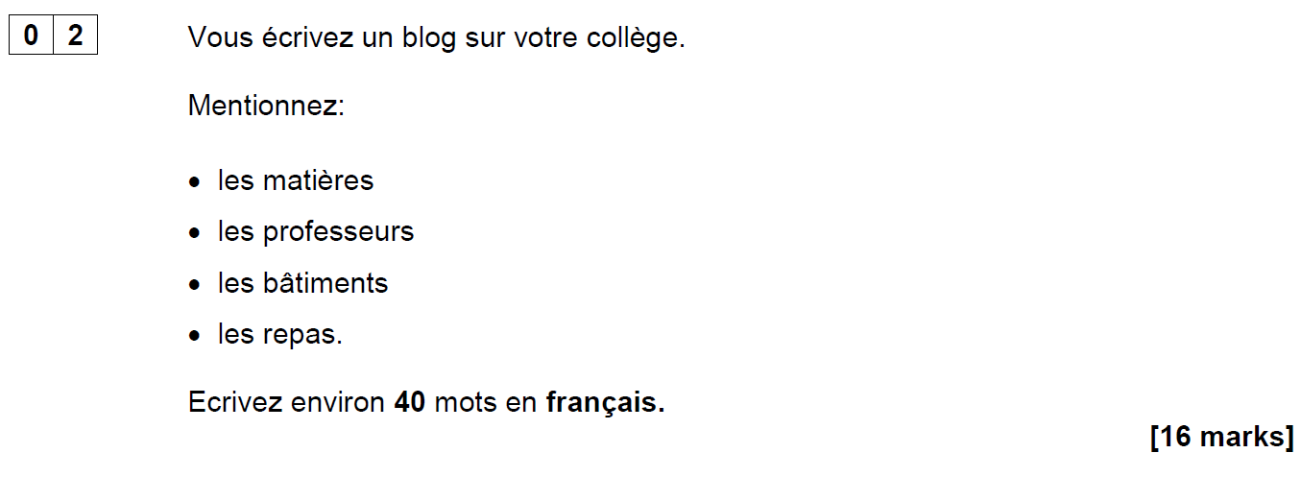
AQA French Foundation Writing Paper Q2 (June 2018)
Notes:
Opening sequence: Slides 1-6. 10 minutes Let’s start with something that confronts us with some of the issues…! This question (the 2nd easiest on the Foundation Writing paper – aimed at Grade 2/3 (old Grade E, bottom of D) required learners to know these four words (as well as the word ‘college’ of course). It’s easy to spot the words which caused problems for many foundation candidates in June 2018!

Slide 4
Are all these words…
562
1150
1952
2948
les matières
les professeurs
les bâtiments
les repas
on a list of 2000 most frequently-occurring French words?
on the AQA Foundation French Core Vocabulary list?
in the most popular French Foundation GCSE textbook?
Notes:
What do we think? Do all these words…
come into the top 2000 most frequent words in French? If you don’t think so, which one(s) don’t? Can you rank them in order of frequency?
appear on the AQA Foundation French Core Vocabulary list?
appear in the most popular GCSE textbook?
Answer a) b) c) consecutively. After a) reveal the 4 word frequencies. Ask colleagues to match them to the words.
ANSWERS a) matière (562), professeur (1150), bâtiment (1952), repas (2948) b) Yes c) Yes
OK – given that we’ve said ‘yes’ to b) and c), why do we think many students just didn’t know or recognise them?

Slide 5
GCSE Insight Report, 2019
Role play | Pronunciation | Not known
French |  | taille [1500], journée [587] (interpreted as journey), gagnes [258] alimentaire [2099], conseil [577]
German | Eintrittskarten | was [39], wo [94] Kasse [2003], Familienname [310/270], Eintrittskarten [3722/1191] Sportmöglichkeiten [845/286], Unterricht [1107], Farbe [929] seit [141] wann [585] (seit use, more generally)
Spanish | acción, horror, hijos | cuándo [138], día [65], how to form questions
Notes:
If we look at specific vocabulary items that were not well known in the GCSE summer 2019 exams, we have to conclude that these are not (in the main) obscure or infrequent items, but largely highly frequent (and non-cognate) words. So, why do we think students can’t recall these words when they need them?

Slide 6
GCSE Insight Report, 2019
Translation | Issues | Not known
French | gaps in vocabulary not sufficient attention to the little words | il pleut [pleuvoir - 4586], mars [868], beaucoup [150] young [jeune - 152], June [juin-931], tickets [billet-1916] imperfect tense, nous/on form of verb, future of voir [69]
German | lack of precision (e.g. ‘is’ used instead of ‘ist’ all the time I am interested in cycling | trinken [608] Katze [1500] nach Hause confused with zu Hause Büro [1492] Industrie [1480]
Spanish | I am going to recycle more My subjects are interesting It is a city that | hago [hacer-26] más [23], mucho [41], muy [43] are confused plaza de toros [806/2/2280]

Slide 7
Possible reasons…
an over-reliance on cognates for comprehension?
vocabulary knowledge is too context-dependent?
absence of additional contextual clues?
(Macaro & Erler, 2008)
“Vocabulary listed under a particular theme should be considered transferable, as appropriate, to the other themes.” AQA-8658-Specification 2016 French, p.22.
The words appear as individual items in a list, without the support of other words in a sentence to aid understanding.
Notes:
Possible reasons to consider: 1) Some learners’ comprehension is limited by an over-reliance on cognates. If the word is not similar to English, it is more effort to acquire it (even receptively) and some learners, after five years, acquire relatively few non-cognate words. (Reference for this: Raising the Achievement of Young-beginner Readers of French through Strategy Instruction. (Macaro,E. & Erler, L., 2008). Applied Linguistics 29/1: 90–119. So, when we set out to improve the breadth of learners’ vocabulary, we need perhaps to consider focusing on the ‘harder to acquire’ non-cognates? 2) Two of these words (batiments and repas) are not listed in the topic of school/education on the AQA vocabulary list (they are in Home town, neighbourhood etc.. and Free time activities, respectively). The AQA vocabulary guidance states very clearly that words learnt in one topic context may be expected to be tested in another! “Vocabulary listed under a particular theme should be considered transferable, as appropriate, to the
other themes.” p.22 AQA-8658-Specification 2016 French
GO TO NEXT SLIDE: In the text book, they are also learnt in contexts other than school If learners encounter the words in one context only they may find it much harder to recognise the word in a different context. Their knowledge of certain words is too context-dependent. The other important point is that, in two cases here, the key words are the ‘category’ words, rather than the specific content words – it can be the case that these words are sometimes overlooked (or at least ‘under-worked’) in our teaching – if they are both non-cognates and category words, they are often not known by less-proficient learners.
GO BACK TO PREVIOUS SLIDE: 3) These words appear as individual words in a list, without the support of a sentence to give additional contextual clues.
The suggests that we need also to work on the depth of vocabulary knowledge – at least with respect to developing learners’ ability to know the meaning of words (readily) when they appear in a variety of different thematic contexts, but also when there are limited contextual clues – i.e. when words are presented in isolation, as individual words in a list, without the support of a sentence.

Slide 8
Studio AQA GCSE French Foundation (Pearson)
Module 6 p.132
Module 4 p.90
Module 3 p.70
Notes:
Slide

Slide 9
Possible responses…
J’adore les repas!
Je déteste les bâtiments!
Our aim should be ‘to give students the language they need in order to read texts, not to teach them to manage as well as they can without that language'. (Swan, 2008:267)
Talking sense about learning strategies, Swan (2008), RELC, Vol. 39(2), 262-273.
Notes:
Final important point to make… As teachers, when faced with a scenario like this, we search around for solutions to help our students succeed, as indeed we should. However… this particular exam question led to suggestions within the teaching community that students should be taught simply to put an opinion phrase in front of any nouns they don’t understand, in a question like this: So we might have seen: J’adore les repas or Je déteste les bâtiments
And there’s no denying that this would enable students to gain a significantly better mark than if they omit these two (unknown) words from their answer. As a examination strategy it therefore has some validity. As a communication strategy for real life, we can be less convinced…! If learners go into conversations prepared to say they like / dislike things without knowing what they’re referring to, they could get into all sorts of interesting situations…! At the end of Y11, as a last-ditch attempt to support our students’ GCSE outcomes, and compensate for a lack of knowledge, this might be justifiable (!?!). However, in the earlier stages of language learning, we have time to do more than teach compensatory approaches.
Swan (2008) in an article which critiques the over-reliance on teaching reading strategies says that the aim should be 'to give students the language they need in order to read texts, not to teach them to manage as well as they can without that language'. p.267 Talking Sense about Learning Strategies, Swan (2008). RELC, Vol 39(2) 262-273 So, just by this preliminary look at one Foundation GCSE writing task, we can conclude that there’s quite a lot to know about vocabulary!

Slide 10
There’s quite a lot to know!
Why is vocabulary important?
How many words do learners need to know?
Which words do learners need to know?
How can they best learn the words?
What does it mean to know a word?
Notes:
[3 mins max]
Having warmed up by thinking about some of the issues, can we suggest a list of questions? The first one was explicitly demonstrated in our opening discussion… Some of the others might not be as deducible but let’s see how we do…

Slide 11
How many words do learners need to know?

Slide 12
How many words can you know by GCSE…?
Curriculum time available = 168 weeks (38 weeks per year over five years, minus one term of Y11 (approx. 450 hours)
Based on acquisition of circa 10 new words per week (e.g. Schmitt, 2004), around 1680 words if all are retained and can be both understood and produced
Informing suggestion of 1700 for Higher Tier, 1200 for Foundation Tier in proposed GCSE Subject Content
Current GCSE AQA Higher Spanish vocabulary list has 1772 words
Students can pass a GCSE with (receptive knowledge) of 852 words (Milton, 2006) / 564 words (David, 2008)

Slide 13
Which words do learners need to know? And why?
Notes:
Slides 33 – 42 With brainstorming task 12 mins, without 7 mins.

Slide 14
Which words?
Vocabulary to be taught should be informed by frequency of occurrence in the language, and special attention should be paid to common verbs in the early stages... A consequence of not attending to frequency of occurrence in vocabulary choice is pupils realising that they cannot say or understand basic things in the language.
Anon. 2016. Modern Foreign Languages Pedagogy Review. A review of modern foreign languages teaching practice in key stage 3 and key stage 4. (Chair: Ian Bauckham). Teaching Schools Council.
Vocabulary lists, rationale and uses
https://resources.ncelp.org/concern/resources/t722h880z?locale=en
Notes:
Vocabulary We start from the Pedagogy Review recommendation about ‘frequency’ and ‘common verbs’.
Ask ‘So how do we do this?’ Do we know the frequency of the words we are teaching? Do we have any way of knowing? What determines our vocabulary choice currently? The text book at KS3/4, the GCSE specification vocabulary list?
Do we know what informs the vocabulary choices in these resources?
Handout 1: Vocabulary lists, rationale and uses People will need to read this later!

Slide 15
En la ciudad [in town]
¿Qué hay en tu ciudad? |  | What is there in your town?
Hay… | There is… | En… | In…
un castillo | a castle | mi barrio | my neighbourhood
un centro comercial | a shopping centre | mi ciudad | my town/city
un estadio | a stadium | mi pueblo | my village/town
un mercado | a market | No hay museo. | There isn’t a museum.
un museo | a museum | No hay nada. | There’s nothing.
un parque | a park | unos museos | some museums
una piscina | a swimming pool | unas tiendas | some shops
una plaza | a square | muchos museos | a lot of museums
un polideportivo | a sports centre | muchas tiendas | a lot of shops
un restaurante | a restaurant
una tienda | a shop
una universidad | a university
 | Word | Frequency ranking | Part of speech
1 | la plaza | 806 | noun
2 | la iglesia | 437 | noun
3 | el teatro | 605 | noun
4 | ser | 7 | verb
5 | grande | 66 | adjective
6 | pequeño/a | 202 | adjective
7 | estar | 21 | verb
8 | cerca (de) | 1042 | adverb
9 | lejos (de) | 833 | adverb
10 | el museo | 1114 | noun
Notes:
So, it’s the notion that the first introductory lesson to a new theme, topic would not be one ‘verb starter’ and 12 nouns but instead a set of mixed word class vocabulary.
Later, as appropriate, more nouns would be added from the same semantic field (more places in the town for example) but the core words would be these, as ultimately pupils can express more and varied meanings with these, than they can with ‘Hay’ and a set of places in the town.
This is the slide of 10 words pupils are going to learn.
Note the mixed word class selection, and the frequency (all well within the top 2000 more frequently occurring words in Spanish).

Slide 16
How can they best learn the words?

Slide 17
How?
‘Most vocabulary tasks focus their attention almost solely on introducing the meaning of new words.’ (Schmitt, 2008:343)
Learning new words (breadth)
Consolidating and extending word knowledge (depth)
Using words more quickly (automaticity/fluency)
Different tasks are needed to develop these different aspects. (Schmitt, 2008)

Slide 18
How?
L1 translation can be efficient for establishing form-meaning link initially.
Seeing and hearing words in context then becomes important to develop depth of knowledge (collocation, shades of meaning, etc.).
Multiple exposures and use are important to consolidate knowledge and develop fluency, anywhere between 5 – 20 encounters. (Nation, 2001:81)
This could be done at home, even in advance of a lesson (‘flipped learning’) and mediated by technology (e.g. Memrise, Quizlet)
For high-frequency words, spontaneous target language interaction and ‘reading for interest’ may help with this.
Notes:
As regards the initial establishment of the initial form-meaning link, there is substantial evidence supporting the provision of L2-L1 pairs, rather than L2-picture pairs (Lotto & de Groot, 1998) or L2-based context or meanings (Prince, 1996; Ramachandran & Rahim, 2004).
Once the link is established, attention can be given to learning more contextualised types of word knowledge, and it becomes important to encounter the new lexical items in L2 contexts. An important finding is that reading-while-listening is generally superior to reading-only in promoting vocabulary learning (Amer, 1997; Brown, Waring & Donkaewbua, 2008) Where a word is often used across different topics, care should be taken to build these links explicitly, building depth – ensuring that learners recognise them readily in more than one topic area. A useful approach here is to use a range of texts of different styles (literary extracts, poems, songs) which provide additional exposures in less familiar contexts, allowing the form-meaning link to strengthen.
5-20 is quite some range - It is not straightforward to say how many repeated encounters with a given word are necessary to learn it. Nation's (2001, p.81) review of several studies gives a range of 5 - 20 encounters. Most important, however, is that recycling of language is crucial, if it is not to be forgotten. Most forgetting occurs soon after the learning session, so the first recyclings are particularly important and need to occur quickly (Baddeley, 1990). Schmitt suggests we think in terms of 8-10 exposures. Planning for and monitoring this is important.

Slide 19
Vocabulaire
lire
Écoute le mot, écris le mot, traduis le mot, et dis le mot !
 | en français | en anglais
 | blesser | to hurt
 | jeter | to throw
 | laisser | to leave
 | l'amour (m) | love
 | l'envie (f) | desire
1
2
 | en français | en anglais
 | la mer | sea
 | le prix | price
 | la reconnaissance | recognition
 | le sens | sense, meaning
 | tellement | so much, so many
3
6
4
7
5
8
9
10
Notes:
Timing: 5 minutes
Aim: Recognition of this week’s new vocabulary in the oral and written modalities.
Procedure: 1. Click to hear the words in French. 2. Students write down the English meaning. 3. Click to reveal answers and transcriptions, one by one.
4. Click to cover the English.
5. Teacher now points at the French words in a random order.
6. Students say the English.
Transcript:
blesser
jeter
laisser
l'amour
l'envie
la mer
le prix
la reconnaissance
le sens
tellement

Slide 20
Quelle est la catégorie ?
lire
What connects the following lists of words?
1. | la neige | chaud | froid
2. | le Canada | le Québec | La France
3. | canadien | québécois | français
4. | les gens | le groupe | la communauté
5. | l’endroit | le lieu | le marché
6. | conduire | marcher | voyager
weather
destinations
nationalities
more than 1 person
locations
movement
Notes:
Timing: 3 minutes
Aim: Semantic categorisation of items from this week’s revisited vocabulary sets.
Procedure:
Students use knowledge of meaning to identify a connecting theme.
Click to reveal the answers.
Word frequency of cognates used (1 is the most frequent word in French): catégorie [1402]
Source: Londsale, D., & Le Bras, Y. (2009). A Frequency Dictionary of French: Core vocabulary for learners London: Routledge.

Slide 21
Trouve les erreurs !
Il y a une erreur dans chaque phrase anglaise.
lire
Nous apprenons l’anglais à l’école et je veux faire un échange avec des élèves anglais !
A
We are learning English at school and I want to do an exchange with English students!
We are learning English at school and I must do an exchange with English students!
Nous comprenons l’importance d’un échange pour mieux apprendre une langue.
B
We understand the importance of an exchange for understanding a language better.
We understand the importance of an exchange for better learning a language.
Est-ce que vous apprenez le français à l’école ? Vous comprenez mon email ?
C
Are you learning French at school? Do you understand my email?
Are you learning English at school? Do you understand my email?
Vous prenez le train souvent pour venir en France ?
D
Do you often take the train to go to France?
Do you often take the train to come to France?
Mais le tunnel est loin d’ici – à 3 heures de Paris.
E
But the tunnel is far from here – 3 hours from Paris.
But the tunnel is nearby - 3 hours from Paris.
Nous faisons l’échange alors ? Nous devenons peut-être amis !
F
Shall we do the exchange then? We might become friends!
Shall we do the exchange then? We will become friends!
Notes:
This is slide 2/2.
Aim: Recognition and correction of translation errors
Procedure:
1. Students spot and correct the mistake in the English translations (one per sentence).
2. Click to circle errors, then reveal answers

Slide 22
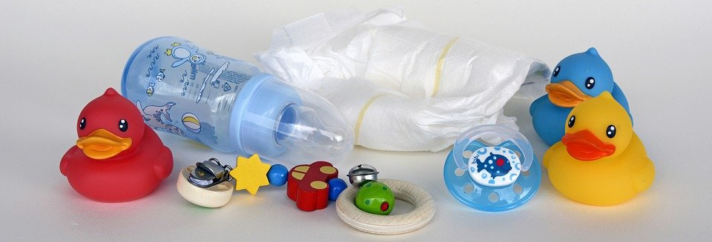
Babysitten
lesen /sprechen
der/die Jugendliche – young person
Babysitten ist auf der ganzen Welt bekannt. Aber dürfen Teenager mit Babysitten Geld verdienen? In Deutschland dürfen sie nur wenige Stunden pro Woche arbeiten, und wenn sie jünger als 15 Jahre alt sind, nur bis sechs Uhr abends - das hilft nicht viel! Hundesitten darf man in Deutschland ab 14. Hier kann man fünf bis acht Euro pro Stunde verdienen. Was für Jobs gibt es noch für Kinder und Jugendliche? Auf schuelerjobs.de findest du eine lange Liste!
Notes:
Frequency information: 93.1% word families
Timing: 3 minutes Aim: to practise reading aloud with a longer text; to provide additional cultural information about jobs for young people in Germany. Procedure: 1. Students pair up and take turns reading the text. (Depending on the class, listening students could be instructed to listen carefully and impose a ‘start again’ penalty if they notice a pronunciation slip – this should be conducted in a positive spirit – teachers will know how to manage the dynamic in their classes).
2. Repeat chorally.
3. Click to listen to native audio.
4. Teachers may additionally ask questions about the information in the text, in German or English, depending on the proficiency of the class. Questions may include: i) Darf man als Babysitter in Deutschland Geld verdienen? ii) Warum ist das schwierig, wenn sie jünger als 15 sind? iii) Welchen anderen Job dürfen junge Leute machen? iv) Wie ist das in England? (some students are likely to be working as babysitters themselves and will be able to say when they work, how much they earn, who they babysit for, if they want to).
Transcript: Babysitten ist auf der ganzen Welt bekannt. Aber dürfen Teenager mit Babysitten Geld verdienen? In Deutschland dürfen sie nur wenige Stunden pro Woche arbeiten, und wenn sie jünger als 15 Jahre alt sind, nur bis sechs Uhr abends - das hilft nicht viel! Hundesitten darf man in Deutschland ab 14. Hier kann man fünf bis acht Euro pro Stunde verdienen. Was für Jobs gibt es noch für Kinder und Jugendliche? Auf schuelerjobs.de findest du eine lange Liste!
Word frequency of unknown words and cognates (1 is the most frequent word in German): babysitten [>5009] Teenager [>5009] hundesitten [>5009] Jugenliche [1324] Source: Jones, R.L. & Tschirner, E. (2019). A frequency dictionary of German: core vocabulary for learners. Routledge

Slide 23
Mots croisés
écrire / parler
la pierre = stone
Remember to say the word for ‘the’! Trouve le mot mystère !
 |  |  |  |  |  |  |  |  |  |  |  |  |  |  | 11
 |  |  |  |  | ? |  |  |  |  |  | 1 | T | E | L | L | E | M | E | N | T
 |  |  |  |  | L |  |  |  |  |  |  |  |  |  | A
 |  | 10 | L | ‘ | A | M | O | U | R |  |  |  | 9 |  | I
 |  |  |  |  |  |  |  |  |  |  | 2 |  | L |  | S
 | 5 | L | E |  | P | R | I | X |  |  | L |  | E |  | S |  | 8
 |  |  |  |  | I |  |  |  |  |  | ‘ |  |  |  | E |  | L
 |  |  |  |  | E |  |  | 6 | B | L | E | S | S | E | R |  | A
7 | J | E | T | E | R |  |  |  |  |  | N |  | E
 |  |  |  |  | R |  |  |  |  |  | V |  | N |  |  |  | M
3 | L | A |  | R | E | C | O | N | N | A | I | S | S | A | N | C | E
 |  |  |  |  |  |  |  |  |  |  | E |  |  |  |  |  | R
2 DOWN
desire
5 ACROSS
price
3 ACROSS
recognition
8 DOWN
sea
11 DOWN
to leave
7 ACROSS
to throw
9 DOWN
sense; meaning
6 ACROSS
to hurt
10 ACROSS
love
1 ACROSS
so much, so many
les lèvres de pierre
lips of stone
les lèvres de Pierre
Peter’s lips !
Notes:
Timing: 5 minutes
Aim: Written and spoken recall of this week’s new vocabulary.
Procedure:
1. Explain to students that the mystery word (indicated by ‘?’) is completed by completing the rest of the crossword. Tell them that the mystery word is one of the unknown words appearing in the song, also a popular French boy’s name.
2. Click to reveal a clue in the form of an English word.
3. Students say aloud (or write down) the translation to complete the crossword. Tell students to include the article with nouns.
4. Click to reveal the answer.
5. Click again to reveal a new word.
6. Repeat steps 1-3 for ten words in total.
7. Click to reveal the translation of pierre and then its context in the song. The version with capital ‘P’ is included for interest only – students maybe be interested to know that Pierre is the French form of the name ‘Peter’.
Word frequency of cognate words (1 is the most frequent word in French): mystère [2777]

Slide 24
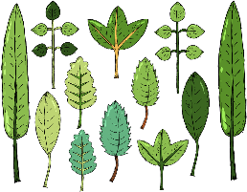
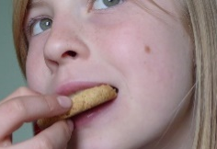
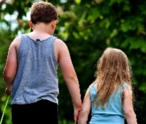
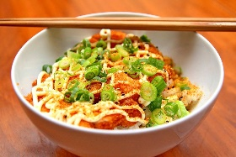
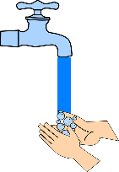
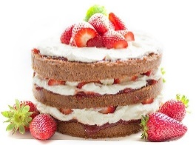
Vokabeln
 | 15 | 20 | 35 | 40 | 45 | 50
11:
13: | [at all] |  |  | [you would like]
14:
17: |  | [I would like] |  |  | [some, many a]
19:
22: | [to appear, seem] |  |  |  |  | [he/she/it would like]
sprechen
[to choose, select]
[from, as of (time)]
[to wait]
[to lead]
[to sell]
[cheap]
[traditional]
[to try, trying]
[dear, kind]
[to promise]
[well]
[to put on]
[to grab, grasp]
Notes:
Timing: 5 minutes Aim: To practise orally the new and revisited vocabulary for this week, also revisiting some letters and numbers learnt previously. Procedure: 1. Teacher calls co-ordinates.
2. Students have to recall vocabulary at those coordinates.

Slide 25
Lexical profiling
Lexical profiling is an analysis of words in a text to assess its suitability.
It can be done manually (!! ☹) or electronically (☺), using the online MultiLingProfiler.
Anthony, L., Finlayson, N., Marsden, E., Avery, N., & Hawkes, R. (2020). MultiLingProfiler Version 1. [Computer Software]. Available at https://www.multilingprofiler.net/
Notes:
These are the sorts of questions lexical profiling can answer: 1] What percentage of the words in this text are high-frequency words?
2] Does this text contain any low-frequency words which I may want to gloss or replace?
3] How many of the words in this text have students learned so far?

Slide 26
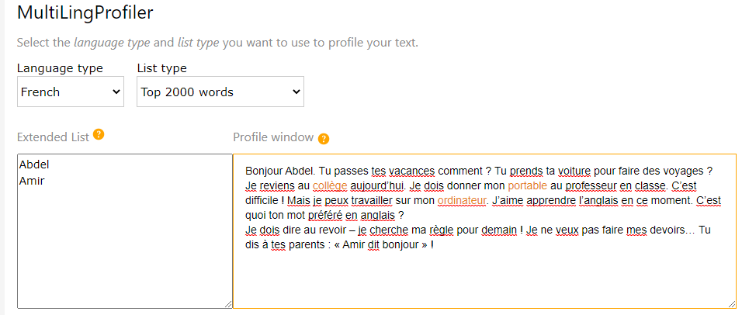
Lexical profiling (frequency)
This is what lexical profiling using MultiLingProfiler with a 2000-band frequency list looks like.
The total coverage value tells you the percentage of words in the text which appear in the top 2000.
Words in black have a frequency of 1-2000. Words in orange have a frequency value of >2000.
Teachers can edit texts directly in the program by removing, glossing or replacing highlighted words and, checking the edits for suitability.

Slide 27
How?
Allowing time to forget and then deliberately and systematically revisiting and recycling is crucial.
This requires more planning and monitoring than a space-limited textbook course can display on its pages.
‘Recycling is necessary, and if it is neglected, many partially learned words will be forgotten, wasting all the effort already put into learning them ... Recycling has to be consciously built into vocabulary learning programs, and teachers must guard against presenting lexical items once and then forgetting about them, or else their students will likely do the same.’ (Schmitt, 2008:343)

Slide 28
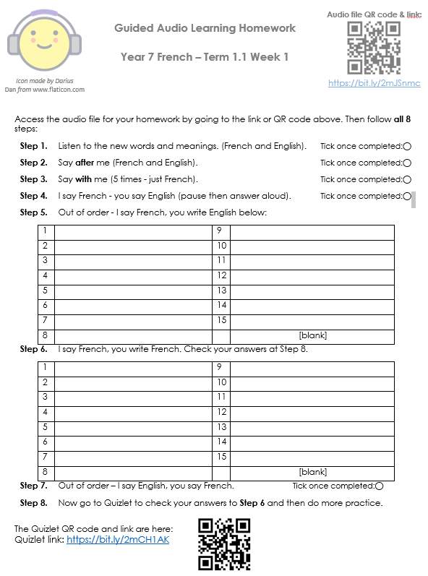
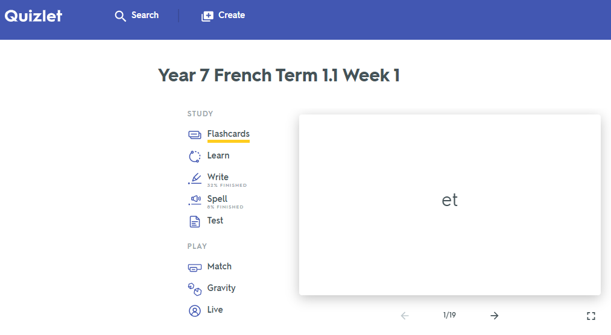
Quizlet / Audio learning homework
Notes:
Link to audio file: https://bit.ly/2mJSnmc
Link to Quizet vocabulary set: https://bit.ly/2mCH1AK

Slide 29
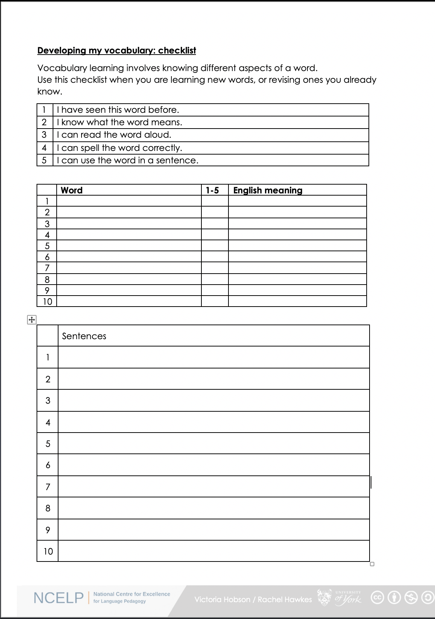
Vocabulary checklist
1. I have seen this word before.
2. I know what the word means.
3. I can read the word aloud.
4. I can spell the word correctly.
5. I can use the word in a sentence.
6. For nouns, I know the gender and the correct word for ‘the’
Notes:
This sheet could be part of a homework task for Week 7 vocabulary, if desired (or a previous week – In week 7 students should also be revisiting Week 3 vocabulary). Scroll down for the link to this resource.
Vocabulary learning involves knowing different aspects of a word. Students can use this checklist when to check what they know when they are learning new words, or revising ones they already know.
For each word the checklist asks students to asses whether the following statement apply:
1. I have seen this word before.
2. I know what the word means.
3. I can read the word aloud.
4. I can spell the word correctly.
5. I can use the word in a sentence.
Students then translate the word and try to use it in a sentence.
We suggest giving students a print out of the template they can refer to throughout the year.
A word template is available on the NCELP resource portal.
https://resources.ncelp.org/concern/resources/gf06g264k?locale=en

Slide 30
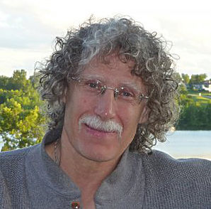
How can they best learn the words?
Four (five?) ‘learning partners’:
Teachers
Students
Materials writers
Researchers
Parents
‘Given the magnitude of the lexical learning task, it is unlikely that it can be achieved without strong and active contributions from all four members of this learning partnership.’ (Schmitt, 2008:333)
Notes:
Make clear that we will return to this more fully in the half-days and TRGs… Give out Handout 4: OASIS summary of Schmitt (2008) article. Review article
Instructed second language vocabulary learning. Language Teaching Research 12,3 (2008); pp. 329–363

Slide 31
Curriculum design take-aways
Phonics - working with unknown words
Vocabulary - shortcut to systematic revisiting
Grammar - input practice before production

Slide 32
Vocabulary
Every week’s lessons could include:
Stand alone 5-minute revisiting activities for vocabulary
from 3-6 weeks ago, 7-12 weeks ago
Include receptive and productive recall – all modes and modalities
Simple tasks from templates
Notes:
Systematically revisiting high-frequency vocabulary is perhaps the key way to strengthen the reach and impact of any SOW in any department. It’s tricky to do this in a planned way starting from scratch – time-consuming above all else. However, what any HoD could say to his/her dept is – every week should include at least one activity that revisits the most useful (high-frequency) vocabulary from 3 x weeks again, and one from 9 x weeks ago. Depts who wanted to be joined up about this could divide up the creation work such that one person did all of Term 1 Y7 Spanish for example, and so on. Those resources would then be shared. This would not attempt to integrate the words into the new lesson material, not try to weave them in, but it would ensure that students were given regular opportunities to recall meanings and forms of the most high-frequency language. These task types do not need to try to be ‘all singing / all dancing’ – simple templates can be used. Let’s look at a few examples of task types…

Slide 33
vocabulario
Lee las frases. ¿Qué significan las palabras?
Write the meaning of the bold words.
 | ¿Qué significan las palabras?
1. Bianca no quiere cenar porque está mala. Solo quiere dormir.
2. Papá está triste, pero quizás su amigo no está así.
3. Según la gente la ciudad es muy bonita. Voy a ir a mediodía.
4. El parque está sucio y la calle está igual.
5. No está lista para escribir una carta.
6. La playa es preciosa, pero no está limpia.
mala =
ill, sick
triste =
sad
así =
like that
quizás =
maybe
según =
according to
gente =
people
sucio =
dirty
igual =
the same
lista =
ready
preciosa =
beautiful
limpia =
clean
Amanda Izquierdo / Nick Avery
Notes:
Timing: 5 minutes
Aim: To further embed the meaning of new vocabulary and present three new words from this week’s set in context.
Procedure:
Read the sentences and try to think of the meaning of the words in bold. Most of these have been presented and practised already this week.
Write the meaning of the bold words in English.
Three words (quizás, así, según) are new this week, so their meanings are given upfront. Teachers should draw students’ attention to these.
Words introduced this week: malo [368]; triste [1371]; quizás [346]; así [67]; según [237]; gente [137]; sucio [1855]; igual [263]; listo [1684]; seguro [407]; precioso [1777]; limpio [1710]
Words revisited from 3.2.6 [revisited in SoW this week]: cenar [3087]; dormir [403]. Other words from the poem are included for further exposure to words that have been previously encountered in the poem: playa [1475]; mediodía [2647]; papá [865]; su [12]
Words revisited from 3.1.5 [revisited in SoW this week]: parque [1354]; correr [343]; escribir [198]; carta [627]
From other Y7 weeks: querer [58]; porque [40]; pero [30]; ciudad [178]; muy [43]; bonito [891]; calle [269]
Source: Davies, M. & Davies, K. (2018). A frequency dictionary of Spanish: Core vocabulary for learners (2nd ed.). Routledge: London

Slide 34
Vokabeln
hören
Hör dir die Wörter an. Hast du diese Wörter auf Deutsch gehört?
x
1
first
zuerst
2
to receive / receiving
erhalten
3
goal
das Ziel
x
4
to mix / mixing
mischen
x
5
in the end
schließlich
Rachel Hawkes
Notes:
Timing: 3 minutes Aim: To practise vocabulary in the second revisited set for this week, in the spoken modality. Procedure: 1. Click for the English word to appear.
2. Click on the number to play the sound.
3. Listen to the German words. Was any of the four words the German for the English word shown? 4. On a click an English word will appear. Was the word included in the German set? 5. Click for answers. Note: Increase the challenge by listening first, revealing English word after listening to each set of four words.
Transcript: 1. Später – Danach – Schließlich – jetzt → First
2. Lassen – erhalten – halten – beginnen → To receive
3. das Ziel – die Mitte – der Punkt – der Spieler → the goal
4. Ziehen – nehmen – legen – werfen → to mix
5. deshalb – leider – aber – ziemlich → in the end
7.3.2.4 beginnen [239] erhalten [283] gewinnen [408] legen [296] mischen [2105] werfen [672] ziehen [266] die Mitte [756] der Punkt [427] das Ziel [325] jeder, jede, jedes [88]

Slide 35
escuchar
Escucha. Identifica la imagen correcta y escribe su letra.
1
2
3
4
5
6
7
8
9
10
11
12
F
J
A
G
E
H
B
I
D
L
C
K
A
B
C
D
E
F
[to make an effort]
[to make
noise]
[to make a
funny gesture]
[to make a great change]
[long hair]
[to go on a long trip]
G
H
I
J
K
L
[to go on a short trip]
[a long dialogue]
[to have dinner alone]
[to sleep alone]
[short hair]
[blue sky]
Victoria Hobson / Nick Avery
Notes:
Timing: 6 minutes
Aim: to recap vocabulary from this lesson and sets Y8 1.1.5 and Y7 3.2.6 as per the SoW cycle of revisiting.
Procedure:
1. Give students a minute in pairs to try to anticipate the vocabulary items they hear. This gives the teacher a chance to gauge students’ understanding of the pictures and offer help where necessary.
2. Click the number triggers to play the audio.
3. Go through the answers drawing attention to the vocabulary items.
Transcript:
hacer un cambio genial
cenar solo
el pelo largo
hacer un viaje corto
hacer un gesto gracioso
el pelo corto
hacer un esfuerzo
un diálogo largo
hacer un viaje largo
el cielo azul
11) hacer ruido
12) dormir solo
Vocabulary from revisited sets
8.1.1.5: cambio [319]; ruido [1034]; esfuerzo [601]; viaje [519]; gesto [928]; gracioso [3874]; genial [2890];
7.3.2.6: cielo [620]; pelo [873]; cenar [3087]; dormir [403]

Slide 36
eine Geschichte
hören / sprechen
Welcher Satz ist richtig?
 | A party is taking place upstairs in my flat. | A birthday party is taking place downstairs in my house. | A birthday party is taking place upstairs in my flat.
 | Mia is hungry and she is coming later. | Mia is tired and she is coming later. | Mia hat a headache and she is coming later.
 | Mehmet flew by plane from Poland. | Mehmet travelled by train from Switzerland. | Mehmet flew by plane from the south.
 | Katja’s aunt and uncle live in Poland and are bringing Polish food. | Katja’s aunt and uncle are flying from Poland and like eating Polish food. | Katja’s aunt and uncle are coming from Poland and can’t travel by boat.
 | Katja is preparing the food, but she hasn’t found the Küche. | Katja is preparing the food, but she hasn’t found the coffee. | Katja is preparing the party, but she hasn’t found the food.
 | We walked to town, but we still want to dance with Mia! | We went shopping, but now we want to dance with Mia! | We went shopping, but we still want to dance with Mia.
1
2
3
4
5
6
Rachel Hawkes
Notes:
Timing: 5 minutes Aim: To practise comprehension and production of most of this week’s revisited vocabulary in sentences. Procedure: 1. Encourage students to recall the vocabulary to predict what they will hear. In number one words that differentiate one sentence from another have been put in bold to facilitate task modelling.
2. Click the action buttons to play each sentence. Students pick which column (A, B or C) is correct.
3. Clicking reveals the answers. 4. Elicit the German for the other two answers each time, to practise productive recall of the vocabulary.
Transcript: 1. Oben in meiner Wohnung findet eine Geburtstagsparty statt.
2. Mia ist müde, und sie kommt später.
3. Mehmet ist mit dem Flugzeug vom Süden aus losgeflogen.
4. Katjas Tante und Onkel fliegen von Polen aus los und essen gern polnisches Essen.
5. Katja bereitet das Essen vor, aber sie hat die Küche nicht gefunden.
6. Wir sind einkaufen gegangen, aber wir haben noch Lust, mit Mia zu tanzen!
Word frequency (1 is the most frequent word in German):
einkaufen [2877] mitbringen [1828] stattfinden [652] vorbereiten [1421] Geburtstag [1766] gegangen [66] gefahren [215] fliegen [824] geflogen [824] Bahn [1415] Flugzeug [1776] Geschichte [262] Onkel [1832] Polen [2023] Süden [1771] Tante [1826] Schiff [1176] polnisch [3237]
gefunden [103] Hunger [2097] Kaffee [1299] Küche [960] Lust [1407] Schmerz [1483] Wohnung [418] müde [2000] noch1 [33] oben [100] unten [590]
Source: Jones, R.L. & Tschirner, E. (2006). A frequency dictionary of German: core vocabulary for learners. Routledge

Slide 37
hablar
úl...
último
mis...
ma...
lar...
su...
qui...
last
lim...
i...
pre...
se...
lis...
con...
tri...
Nick Avery
Notes:
Timing: 5 min (slides 15-29)
Aim: to practise recall of previously taught vocabulary
Procedure:
Students read the word in the centre of the screen and recall the Spanish. The first few letters of the word are provided to facilitate retrieval. Teachers may decide to reduce to one letter should they wish increase the level of difficulty.
Words from revisited sets:
Y8 1.2.1.: largo [300]; mismo [55]; último [188]
Y8 1.1.3.: malo² [360]; sucio [1855]; limpio [1710]; precioso [1777]; listo² [1684]; contento [1949]; triste [1371]; seguro² [407]; igual [263]; quizás [346];

Slide 38
Vocabulaire
parler
Personne A
Au lycée je/j’ …
Personne B
fais de la natation
achète du poisson
fais du sport
pèse le fromage
fais un exercice
definis le vocabulaire
envoie des messages en classe
utlilise un ordinateur
fais le travail
apporte mes cahiers chaque jour
Notes:
Word frequency of cognates used (1 is the most frequent word in French): message [792]
Source: Londsale, D., & Le Bras, Y. (2009). A Frequency Dictionary of French: Core vocabulary for learners London: Routledge.

Slide 39
Vocabulaire
parler
Personne B
Hier au marché j’ai…
Personne A
fait du sport
joué au foot
fait de l’exercice
pesé le fromage
utilisé un ordinateur
acheté de l’eau
mangé une glace
envoyé vingt euros à ma mère
fait de la natation
dit, ‘Ça coûte combien ?’

Slide 40
Vokabeln 2 [1/2]
lesen / schreiben
1. Ein Synonym für bekommen
2. Der letzte Monat im Jahr
3. Ich bin zu Hause …
4. Ein anderes Wort für verstehen
5. Ein Synonym für nochmal
6. Das ist nicht grün
7. Das ist eine Erfahrung
erfahren
kriegen
werden
Dezember
März
Januar
gestiegen
geschwommen
geblieben
begreifen
steigen
eigen
Mal
wieder
für
Pflanze
Wald
Luft
Berg
Fahrt
Schuh
Notes:
Timing: 7 minutes (2 slides) Aim: to practise productive recall of all of this week’s new and revisited vocabulary in the written modality. Procedure: 1. Click for the first word to appear and then disappear. Repeat for 2nd and 3rd words for number 1.
2. Students write down their answer for number 1.
3. Click again for the answer to number 1.
4. Continue with the remainder of the questions on this slide, providing item-by-item feedback.
Word frequency (1 is the most frequent word in German):
8.2.1.1 (introduce) kriegen [724] eigen [166] für [17]
8.1.2.4 (revisit) erfahren [690] geblieben [113] geschwommen [1863] gestiegen [325] steigen [325] Berg [934] die Erfahrung [619] Fahrt [1569] Luft [487] Wald [1028]
8.1.1.5 (revisit) begreifen [1346] Dezember [1527] Jahreszeit [4818] Mal [82] März [987] Pflanze [1667] Schuh [1678] Wechsel [2525] wieder [74]
Source: Jones, R.L. & Tschirner, E. (2019). A frequency dictionary of German: core vocabulary for learners. Routledge

Slide 41
What do we know about vocabulary learning?

Slide 42
Some research- and practice-informed answers
Vocabulary learning is a strong indicator of performance, in aural and written modalities.
Currently, learners appear to know (after five years’ secondary learning) far fewer words than is ideal.
Learners need to know more words than they currently do at the end of Y11.
Vocabulary selection should be frequency-informed
Learners should also be encouraged to develop their repertoire, with words that are of personal interest and importance
Verbs can be under-represented in text books.
Topic-based vocabulary lists of one single word class are not optimal

Slide 43
Some answers [cont’d]
There is no single, best strategy for learning vocabulary
Errorless teaching techniques (when pupils are unambiguously told the meaning of a new word) are effective…
providing they are followed by opportunities to use the new words in comprehension, and then productively.
The more times a pupil is required to recall a word, the more securely it will move into the long term memory.
Production tasks in which pupils use new words in sentences they compose themselves serve to strengthen vocabulary knowledge.
Genuine information gap activities are very helpful in assisting memorisation.
Plentiful opportunities to encounter words (at least 10 times) in multiple contexts deepen vocabulary knowledge (Webb, 2007)
Careful, planned use of ICT can be effective.

Slide 44
QUESTIONS?

Slide 45
BREAK

Slide 46
References
David, A. (2008). Vocabulary breadth in French L2 learners. Language Learning Journal, 36, (2), pp167-180
Davies, M, & Davies, K.H. (2018). A Frequency Dictionary of Spanish: Core Vocabulary for Learners. Routledge.
Jones, R.L. & Tschirner, E. (2006). A frequency dictionary of German: core vocabulary for learners. Routledge.
Lonsdale, D. & Le Bras, Y. (2009) A Frequency dictionary for French. Routledge.
Milton, J. (2006). Language Lite? Learning French Vocabulary in School. Journal of French Language Studies, 16,187-205
Nation, P. (2013). Learning Vocabulary in Another Language (Cambridge Applied Linguistics). Cambridge: Cambridge University Press.
Schmitt, N. (2008). Review Article. Instructed second language vocabulary learning. Language Teaching Research, 12, (3), 329–363. https://doi.org/10.1177/1362168808089921
Swan, M. (2008). Talking Sense about Learning Strategies, RELC, Vol 39(2), 262-273.
Webb, S. (2007). The effects of repetition on vocabulary knowledge. Applied Linguistics, 28 (1), pp.46-65

