Slide 1
Session 2: How does explicit phonics teaching make a difference?
Presenter: Rachel Hawkes
Date updated: 04/07/21
Notes:
Images from www.pixabay.com – no attribution required.
The MFL Pedagogy Review recommendations include (amongst others) principles for teaching phonics, vocabulary, grammar and their combination in meaningful practice. In this workshop we focus on research-informed practice for explicitly teaching, consolidating and applying the sound-writing relationship in secondary language learning. The session includes (freely available) resources for teaching phonics in French, German and Spanish.?”

Slide 2
Aims for the session
Part 1:
understand the rationale for phonics teaching in MFL
look at some of the research evidence underpinning this
explore ways to assess phonics knowledge
Part 2:
share ‘quick wins’ for phonics
explore presentation, practice and consolidation resources (Fr, Gm, Sp)
Questions, discussion and next steps
Notes:
So our aims for the first part of this session are to: develop an understanding of the rationale for phonics teaching in MFL (modern foreign languages); look at some of the research evidence underpinning this. The first part of the webinar will be about 55 minutes. After a short comfort break of 10 minutes, we’ll come back and Rachel will share resources that demonstrate how phonics knowledge develops through presentation, practice and consolidation phases, as well as looking at ways we’ve been working to develop additional aspects of the sound-writing relationship knowledge.

Slide 3
Definitions [1/3]
Phonics teaching
explicit teaching of the relationships between letters and their sounds in written words
Sound-symbol correspondences (SSCs)
the systematic relationships between the written symbols and sounds (at any unit of size) in a given writing system
m a ch tion aille

Slide 4
Definitions [2/4]
Phonological decoding (or ‘recoding’)
“the ability to convert the visual print into its corresponding spoken form” Nassaji (2013)
Word recognition / identification (or ‘lexical access’)
“the skill with which readers process the visual symbols in the print in order to recognize and access its meaning in the mental lexicon” Nassaji (2013)
< c a t >
/ k a t /
Notes:
Okay, sticking with definitions for a moment.
The term phonological decoding, or sometimes recoding can be defined as the ability to convert visual print into its corresponding spoken form. So, an example would be we see the written form <cat> with the angled brackets there conventionally being used to represent an orthographic form of a word. And we can convert that into its spoken form here, the phonemic transcription /kat/.
That can be distinguished from word recognition or word identification, which is the skill with which we process visual symbols in the print in order to recognize and access meaning. So that’s making the link then to the idea or concept of a cat. That may be done from the basis of the spoken form or perhaps directly from the written form to the meaning. But as we become more proficient in a language, and more fluent in reading that language, we would expect the interconnections between these three components of word knowledge to become strong and automatic.
And when thinking about phonological decoding, I think it’s important to distinguish between, on the one hand familiar words, so words we know and which we may have pre-stored phonological forms for in our mental lexicon, in our long-term memory. That would be for example like we just saw the word <cat> and we can link it to a pre-stored spoken form /kat/. And on the other hand, unfamiliar words, words we’ve not seen before. To read an unknown word aloud, we have to generate its form at the point of reading the word, at the point of naming. That’s when we have to use our knowledge of that language’s sound-symbol correspondences, or phonics knowledge. Sometimes called ‘sub-lxical knowledge’ i.e. smaller units than whole words.

Slide 5
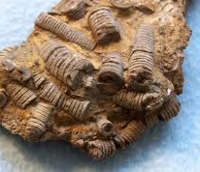
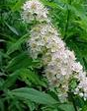
Definitions [3/4]
Applying SSC knowledge
un crinoïde
l’ulmaire
jerette tirôt
Notes:
So, to demonstrate this, I tried to think of some words which even expert speakers of French might not know, so I came up with this one here, so if you just read that aloud. So, for me that says <un crinoïde> and the fact that I can pronounce that, even though I might not have seen it before, shows that I know something about the language’s symbol-sound correspondences. And here’s another word here, so read that one <l’ulmaire>. And actually, in French, the system when going from written symbols to the sound is actually more consistent than English, in many cases there’s only one way to pronounce a word. We’ll talk more about that later on.
And underneath there, there’s a couple of French pseudowords. So, again we can pronounce them, we can read them out loud, we may do so automatically, even though we’ve not seen them before <jerette>, <tirôt>.

Slide 6
Definitions [4/4]
música
<u> <i> <a>
Orthographic depth
a measure of how consistent / transparent the mappings are between graphemes and phonemes in a given writing system.
/u/ /i/ /a/
Notes:
We’ll come back to that thought in a moment, but for now let’s explore the notion of orthographic depth, which is a measure of how consistent and transparent the mappings are between graphemes and phonemes in a given writing system.
As we know, European languages differ in their orthographic depth.
Spanish would be at the highly transparent, shallow end of the orthographic depth continuum because generally each written symbol, each grapheme has one way of pronouncing it and generally each sound has one way of writing it. It’s not entirely transparent and consistent but it’s pretty much so. So, it’s a highly shallow orthography. So, I quite like the visual analogies for orthographic depth. I’ve used this image of parallel train tracks to represent the links between graphemes and phonemes in Spanish.

Slide 7
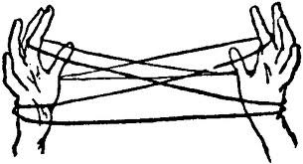
Orthographic depth
to
moo
two
through
shoe
flew
flu
blue
/u/ (through)
/ɒf/ (cough)
/əʊ/ (though)
/ɔː/ (thought)
/aʊ/ (bough)
/ə/ (thorough)
/ɒx/ (lough)
Notes:
But sadly, English is not very much like that, and in fact is at the extreme other end of the orthographic depth continuum in the sense that it is inconsistent and not very transparent at all in its Symbol-Sound Correspondences. So, I’ve not got the animations on this slide here, but this is an activity which I think is good to do with children in class. You pick a sound, and this is a good one to start with /u/ and you invite them to think of all the different ways they can think of for spelling the sound /u/. They may come up with a list a bit like this on the left here. Then I’d pick one of those written forms and ask them to think of all the different ways that this string of letters can be pronounced. So, obviously we’ve got ‘through’, ‘cough’, ‘though’, ‘thought’, ‘bough’, ‘thorough’, ‘lough’. This is a good way, I think, of raising children’s awareness of the nature of English orthography and to compare and contrast it with the foreign orthographies, which they’re learning in MFL. It will help them to see that they’re learning a system, which is easier than the one they’ve already learnt. So, if Spanish is a bit like the parallel train tracks, I’m afraid my analogy for English is a cat’s cradle because you’ve got this complex web of mappings going from symbols to sounds.

Slide 8
Orthographic depth
ver
vers
verre
verres
verts
vert
* vaire
* vaires
vair
* verd
Notes:
Okay and that brings us to French. My visual analogy for French is that it’s like a tree, at least as seen above the ground.
For any given spoken form, so here we’ve got the spoken form /vɛʁ/, there are a number of different ways this can be spelt or represented in written form. We’ve got these real words here ‘vair’, ‘vert’, ‘verts’ and more besides. And we’ve also got, denoted by the asterisks here, pseudowords which could also be pronounced /vɛʁ/.
So, in other words, if you go from a spoken form there are many different ways of writing it. But, I think I’m right in saying, that if you go from any of these written forms, which are the leaves on the tree if you’d like, if you work back from that leaf, you’ll always end up back at the bottom of the trunk with the one spoken form. So, that provides a visual representation of the nature of French orthography.

Slide 9
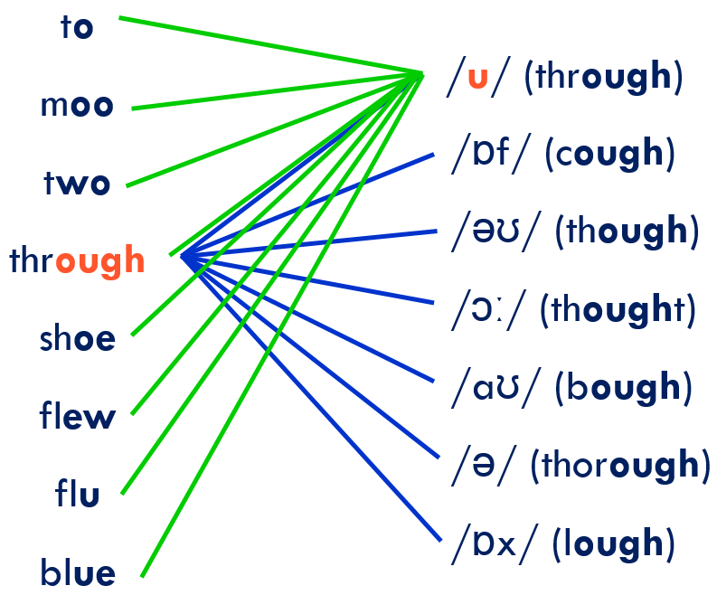
Orthographic depth
Awareness-raising tasks and analogies like these may be useful for MFL pupils!
Help them to understand the learning challenge they face
Aim is to develop healthier ‘attributions’ and sense of agency
Notes:
The reason I wanted to show you those visual analogies and activities is I think it can be useful to do those kinds of awareness raising tasks with pupils in class to help them understand the nature of the writing system they’re trying to learn, and how it relates to English.
Just building on that idea of orthographic depth, because French is not right down at the shallow end and individual graphemes may be pronounced in more than one way, we think it might sometimes be useful to teach children blocks of letters. So, an example here would be ‘tion’ because if we start trying to do that on an individual grapheme basis, things would get pretty confusing. We’d say <t> is sometimes /t/, but sometimes /s/ like it is here. And the letter <i> is sometimes the vowel /i/, but sometimes the glide ‘y’. And so, it’s simpler to say ‘-tion’. And that is one reason why we’ve decided to use the term SSC in NCELP, rather than individual GPC, because sometimes we might be teaching larger orthographic units rather than individual graphemes.

Slide 10
Why teach phonics? [1/3]
Teaching phonics in L1 (first language)
Reading comprehension: ‘discovering’ the meaning of words you already know orally
‘Simple View of Reading’ (Hoover & Gough, 1990):
Reading comprehension = decoding x language comprehension
Lots of research in Anglophone countries showing benefits of teaching phonics or early reading (and spelling)
Teaching phonics in L2 (second / ‘foreign’ language)
Written and spoken forms encountered simultaneously!
Notes:
Let’s look then at the importance of phonological decoding. So, in L1, in a first language setting, children meet meet unfamiliar written forms, sound them out using their phonics knowledge, and thus discover (i.e., recognise) their meaning. So we can say that reading comprehension and discovering the meaning of words orally is a key part of the rationale for phonics teaching in a first language setting.
But, what about teaching phonics in L2? Of course, if we think of our own classrooms, as in many other instructed contexts around the world, so classroom foreign language contexts around the world, learners start to encounter the written language pretty much at the same time as they start to learn the language itself.
If you think of a learner encountering the French word <chat>. Even if they could sound that out, even if they have secure phonic knowledge and can pronounce ‘chat’. If they don’t know ‘chat’ orally, then sounding that word out is not going to help them in terms of understanding or comprehension.

Slide 11
Why teach phonics? [2/3]
Many L2 learners do try to sound out words they don’t know when reading (Erler & Macaro, 2011)
The ability to decode accurately in L2 may additionally support:
vocabulary learning (Hamada & Koda, 2008, 2011; Li, 2019; Li & Woore, in progress)
learner autonomy
grammar learning (Erler, 2003) → je / j’ai parle/ parlé
motivation (Erler & Macaro, 2011)
Speaking; listening; writing (Macaro, 2007)
Notes:
And on that basis, some people might argue that there’s no point in teaching phonics in a foreign language. But we would strongly disagree with that view for several reasons.
Firstly, in a large-scale study by Erler and Macaro looking at MFL learners in England learning French, they found that many learners did actually say that they try to sound out words they don’t know in written texts. There may be some words which they do know, it’s possible that there are some words that they know orally, and that by sounding them out they could discover the meaning. But that will only work obviously if they have the secure phonic knowledge to sound the word out accurately. Otherwise that strategy will misfire.
Beyond thinking about reading comprehension, there is evidence that accurate decoding in a foreign language may have a positive impact on various other aspects of language learning.
So, vocabulary learning being a key one and learner autonomy and those are linked because a learner who is able to sound out a word accurately and obtain an accurate phonological form for that word, is then less dependent on other spoken models.
Grammar learning. Erler pointed out that if a learner is sounding out the word <je> and <j’ai> and is doing that inaccurately, those two words may sound the same to that learner, making them very difficult to distinguish between. The same with say a present tense and a past participle <parle> versus <parlé>, for some learners if they’re decoding inaccurately, those two words may sound the same, so making it very difficult then for them to distinguish between these two key grammatical forms.
A link has been found between ability to decode accurately and motivation for studying the language and intention to continue studying that language.
Speaking obviously, children often speak from the basis of written models.
Listening because the link between spoken and written forms can help learners to segment the speech stream, which is one of the key challenges of listening comprehension.
And finally writing. Again Macaro did a study of beginner learners’ writing strategies in French in an MFL context and found that when copying down from the board for example, they would as part of that process of copying them down sound words out inaccurately and then would reflect that inaccurate pronunciation in what they wrote down. So, they would not copy what was on the board, but it would be mediated by their decoding and it would lead to errors.
So, we can see here, that the rationale for teaching phonics in an L2 may be different but is nonetheless a really strong one we would argue.

Slide 12
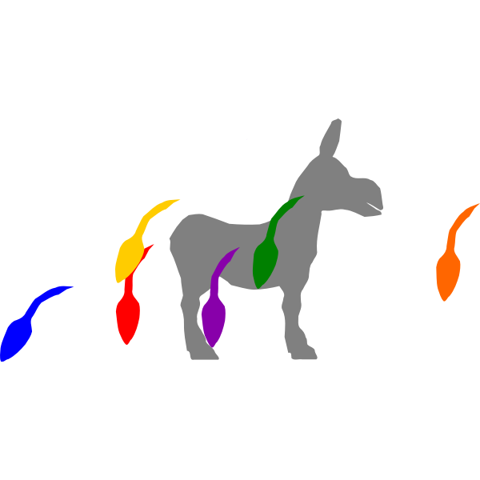
Why teach phonics? [3/3]
Research in UK MFL classrooms (mainly L2 French) suggests that without explicit instruction:
students are not very good at phonological decoding (reading aloud);
they seem to make little progress in this area;
English spelling-sound links remain stubbornly entrenched;
students may know that words should sound different to English, but not know how they should sound.
Sources: Erler, 2003, 2004; Erler & Macaro, 2012; Porter, 2014, forthcoming; Woore, 2009, 2010, 2011, 2014, 2018
Notes:
We’ve done quite a bit of research in MFL classrooms looking at progress in phonological decoding over time and I would say that there’s fairly strong evidence that in the absence of explicit instruction, so if they’re not taught phonics, on the whole students are not very good at phonological decoding and reading aloud. That’s obviously not to say that no students are any good at it and nobody makes any progress, but thinking about the average classroom, many learners are not very good at it, they don’t seem to make a great deal of progress over the course of Key Stage 3 and somehow they seem to just carry on reading many words as if they were English words, pronouncing them using the heuristic of English SSCs.
Of course, that’s not surprising because think how much MFL exposure they get per week compared to the vast amount of English texts that they are exposed to in a given week. So those English SSCs are continuously being reinforced.
What we also have found is that if you push students, saying come on how do you think this French word should sound, in many cases they do know when they stop to think about it that it should not be pronounced like English but they don’t have that secure phonic knowledge to know how it should be pronounced so they may come up with all kinds of different pronunciations which are incorrect but at least they’re not English. So that’s why we’ve got this analogy, it’s a bit like pin the tail on the donkey, as though they’ve got a blindfold on and they’re trying to think well how should I say this?

Slide 13
These words get more ridiculous as we go along
Some of these don't even look like real words. I reckon you're just trying to trick me
I don't know because most of them look like gibberish basically
They're like really weird words, like they don't exist
Notes:
In one study of learners’ progress in phonological decoding in French in KS3, I asked them to read aloud a set of unfamiliar words in French. So, they were real words but words which they hadn’t encountered before and I audio recorded them. In fact, they sat on their own in a quiet place, perhaps in the corner of the classroom and they read through this list onto the audio recorder.
When I came back to listen afterwards to what they had recorded, I found there were these quite entertaining comments muttered under their breath as they went along and there’s just a selection here. Things like “these words are getting more and more ridiculous as we go along” and “they look like gibberish” and these made me laugh. But afterwards I thought that there is actually a serious point embedded in these comments which is to do with their motivation for learning and their attributions to their success or failure. So, about being able to read the words accurately. So, if they believe that they’re not able to pronounce these words well and if they believe that the reason for that is that the system they’re trying to read is ridiculous and gibberish and weird, then they’re going to have little incentive for trying to master that system, a system which cannot be mastered.
And that’s why we talked earlier about those awareness raising exercises because I think it’s important to get learners to understand that the system can be mastered. Okay, it may be difficult and different to English and it may take them some time, but it’s a system that can be mastered with the right levels of focus and effort.

Slide 14
Can we teach phonics?
“There is significant evidence, including from the most effective practitioners, that direct and systematic teaching of phonics in the new language is a more reliable method for assuring accurate pronunciation and spelling. However, this is still relatively rare practice in classrooms” (TSC, 2016:12)
Phonics is the cornerstone of the approach to language teaching in my school and it works… The consequence is also a learner who is able to understand more text containing unfamiliar language, a learner who is more confident in speaking and reading out loud in the foreign language, and a more autonomous learner who is able to make links between words and apply patterns.
Notes:
Okay so, if this is important for learners to master and if without some explicit instruction many learners don’t master it, then we need to look at whether and how this knowledge can be taught in the new language.
So, there’s a couple of quotations here which I’ll just let you read through. One from the Pedagogy Review, the Teaching School Council review and secondly one from Rachel Hawkes who is the NCELP co-director and someone who has been teaching phonics successfully in MFL for many years. So if I just let you read those through.

Slide 15
Research evidence (1/7)
Preliminary findings of systematic review (Woore et al. (in progress)
We found 20 studies looking at phonics teaching in ‘foreign’ language contexts,
11 in published journal articles, the rest dissertations / conference proceedings
13 primary / kindergarten; 5 secondary school; 3 university
Most studies focus on reading as the outcome
Consistently positive effects of L2 phonics teaching on L2 phonological decoding
Again, little indication (so far) that L2 phonics improves L2 reading comprehension
But – emerging evidence suggests that L2 phonics instruction may facilitate L2 vocabulary acquisition.
Notes:
In terms of research evidence, I think it would be fair to say that we need much more research into the teaching of phonics in foreign languages.
Systematic review underway – preliminary scoping search identified 20 studies – summarized on next slide. Woore et al. (in progress): Systematic review of experimental studies (with control group) of phonics teaching in a ‘foreign’ language, published since 2000; range of outcomes as well as reading.
Preliminary findings of systematic review

Slide 16
Research evidence (2/7)
PhD study 1: Woore (2011) Method: Quasi-experimental study: 200 x Year 7 students, 4 schools, 6 intervention classes and 6 control. Year-long comprehensive Phonics programme in Y7. Findings: Small but ‘significant’ advantage for Phonics group over control group in decoding progress.
Limitations:
Effects on other outcomes not measured – “at what cost?”
Little opportunity to practise SSC as part of a wider programme of L2 reading – may have limited effectiveness of phonics instruction
No delayed post-test: was learning sustained?
Notes:
I’ve picked out, in this slide and the following slides, 3 doctoral studies, 2 of which were based in the UK context, and another because it looks at the impact of phonics on vocabulary learning.
I’ll just let you read through the notes on those, and after that I will tell you a little bit about a larger scale study which we completed recently known as the FLEUR project: Foreign Language Education Unlocking Reading.

Slide 17
Research evidence (3/7)
PhD study 2: Porter (2014) Method: Combined oracy-and-literacy intervention (including phonics) in 2 primary school classrooms, lasting 24 weeks. Pre-, post-, delayed post-tests.
Findings: Children improved at reading aloud over the intervention – but the learning faded once the teaching stopped.
Limitations:
No control group – therefore, cannot know whether the improvements resulted from the intervention or other teaching
Notes:
In terms of research evidence, I think it would be fair to say that we need much more research into the teaching of phonics in foreign languages. I’ve picked out, in this slide and the following slides, 3 doctoral studies, 2 of which were based in the UK context. I’ll just let you read through the notes on those, and after that I will tell you a little bit about a larger scale study which we completed recently known as the FLEUR project: Foreign Language Education Unlocking Reading.

Slide 18
Research evidence (4/7)
PhD study 3: Li (2019) Method: Chinese university students learning English as a Foreign Language. 12 weeks of systematic phonics covering 101 English GPC. Control group had phonology training, but no Phonics
Findings: Phonics group made significantly more progress than control group in (a) phonological decoding and (b) intentional vocabulary learning.
Limitations:
No delayed post-tests.
Teaching done by the researcher, not by ‘usual’ teachers:
Implicit bias? Is this scalable?
Notes:
In terms of research evidence, I think it would be fair to say that we need much more research into the teaching of phonics in foreign languages. I’ve picked out, in this slide and the following slides, 3 doctoral studies, 2 of which were based in the UK context. I’ll just let you read through the notes on those, and after that I will tell you a little bit about a larger scale study which we completed recently known as the FLEUR project: Foreign Language Education Unlocking Reading.

Slide 19
Research evidence (5/7)
French Language Education: Unlocking Reading (FLEUR): Woore et al. (2018), Graham et al. 2020
Method: Experimental study (Randomized Control Trial); Pre-, post-, delayed post-test design; c. 900 Year 7 students in 36 schools nationally (33 comprehensive, 3 grammar)
Intervention phase lasted 16 weeks, c.25 minutes per week; Interventions delivered by usual class teachers
Phonics
Strategy instruction
Challenging texts
Challenging texts
Challenging texts
Reading comprehension
Vocabulary
Phonological decoding
Strategic behaviour
Self-efficacy
Motivation
Notes:
So you’ll have seen from those notes that those 3 studies all were fairly small-scale and all had their own particular limitations, and so this led us to plan the FLEUR study which was an attempt to gather more robust evidence on the effects of phonics teaching in MFL. It was an experimental study, so a design explicitly intended to measure the effects of different teaching approaches. It was a pre-, post-, delayed post- design - in other words, we tested the pupils before they had the teaching, immediately after the teaching, and after a delay of about 6 months to see to what extent any effects were durable over time.
I’ve somehow forgotten to put on this slide but they were Year 7 classes who took park in 36 schools across the country, and there were about 900 students in total, so it was a fairly large-scale study. There were 33 comprehensive schools and 3 grammar schools, and the teaching they received lasted about 16 weeks starting in January of Year 7, lasting about 25 minutes a week. The teaching was delivered by their usual class teachers but we co-planned those interventions with the teachers so it was a collaborative intervention design. Each school was allocated to 1 of 3 different conditions. So 1 group was the comparison group in a way. They read some challenging texts, which we specially created for the project, and those texts were designed to be quite a bit above students’ current productive linguistic level in the foreign language, and were quite a lot harder and longer than the kinds of texts they were routinely meeting in their Year 7 textbooks. Those texts were also designed to contain many examples of particular symbol/sound correspondences and to facilitate the use of particular strategies, but they weren’t given any instruction in either phonics or symbol/sound correspondences or strategies. It was to see what they did just from reading the text. The other 2 groups received explicit instruction, either in phonics with no strategy instruction, or in reading strategies but with no phonics instruction. So, it was an attempt to see what these 2 instructional approaches give pupils over and above simply being exposed to the challenging texts.
We had a range of outcome measures, so reading comprehension was included, but for the reasons we said, we looked at wider outcomes, particularly vocabulary knowledge. Vocabulary knowledge is often used as a sort of quick proxy for overall language proficiency, and we’ve already discussed how there’s a link between phonological decoding and vocabulary acquisition, so we wanted to include vocabulary. We also looked at phonological decoding strategic behaviour, obviously to see if the instructional approach has directly impacted on the things they were intended to impact on. Also known as self-efficacy, the extent to which they felt able to tackle reading texts, their motivation for learning the language, and we used questionnaires and interviews to gather their views on the teaching they’d received.

Slide 20
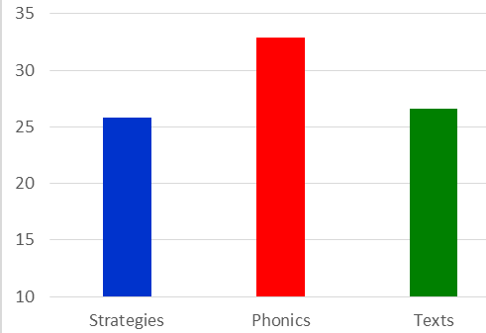
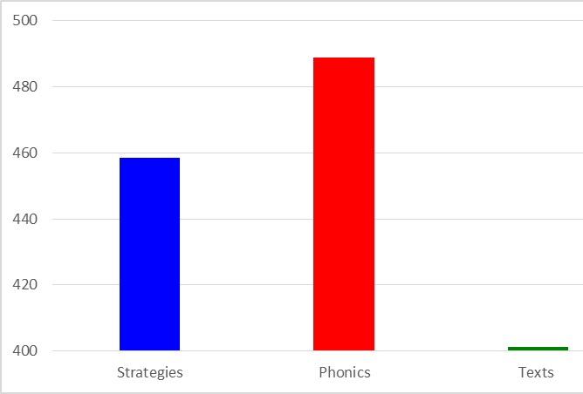
Research evidence (6/7)
Estimated vocabulary knowledge (t2): 2000 most frequent French words
Decoding score 6-7 percentage points higher
French Language Education: Unlocking Reading (FLEUR): Findings
Explicit phonics instruction led to significantly greater progress in phonological decoding (after controlling for prior attainment);
No difference between groups in reading comprehension
Phonics group made significantly greater gains in vocabulary knowledge
Vocab knowledge is known to be a key contributor to all language skills!
Notes:
Here are some of the key findings of the FLEUR study, or at least relating to phonics. Please do have a look at the full set of findings which you can find in the public report which is freely available online.
First of all, the phonics teaching did lead to significantly greater progress in phonological decoding, at least after controlling for students’ prior attainment. As one would have hoped, they got better at the thing they were taught. We measured decoding using pen and paper decoding tests which we developed for the project, which we think was good but which was certainly less sensitive than a reading aloud task. We think possibly that this graph at the bottom-left underrepresents the real progress made by the phonics group and the difference between the groups, but we just didn’t have time to administer and listen to 900 individual reading aloud tasks.
In terms of reading comprehension, we didn’t find any difference between the groups, and that was as we expected if we think back to what we said about the rationale for phonics teaching in L1 and L2 and the fact that you wouldn’t necessarily expect an immediate payback in an L2. That’s because even if students sound out a word accurately, a new word they’ve not seen before, they probably don’t know that word orally anyway, so that was as we expected. However, the phonics group, this is the graph at the bottom right, did make significantly more gains in vocabulary knowledge. Again that ties in with what we said earlier about the links between phonological decoding and vocab acquisition. Remember this was a fairly short intervention over 16 weeks, so this is important because vocab knowledge is known to be a key factor in performance in all 4 language skills.
So, going back to that previous point about reading, I think over a longer period of time, one would expect phonics instruction to lead to benefits for reading comprehension because of the greater vocabulary knowledge that students would be likely to accrue over time, and that in turn would facilitate their reading comprehension.

Slide 21
Research evidence (7/7)
Summary: Is teaching L2 phonics effective?
“The research evidence on this question remains limited in quantity, and the studies that do exist have various methodological limitations. However, consistently positive effects of phonics instruction on L2 decoding have been found across various phases of formal education (primary school, secondary school and university): it appears that L2 learners who are taught phonics are more likely to develop more accurate SSC knowledge than those who are not. Experimental evidence is also emerging of an impact on L2 vocabulary learning.” (Woore, forthcoming)
Remember also the evidence on L2 learners’ outcomes in the absence of phonics instruction!

Slide 22
Aims for the session
Part 1:
understand the rationale for phonics teaching in MFL
look at some of the research evidence underpinning this
explore ways to assess phonics knowledge
Part 2:
share ‘quick wins’ for phonics
explore presentation, practice and consolidation resources (Fr, Gm, Sp)
Questions, discussion and next steps
Notes:
So our aims for the first part of this session are to: develop an understanding of the rationale for phonics teaching in MFL (modern foreign languages); look at some of the research evidence underpinning this. The first part of the webinar will be about 55 minutes. After a short comfort break of 10 minutes, we’ll come back and Rachel will share resources that demonstrate how phonics knowledge develops through presentation, practice and consolidation phases, as well as looking at ways we’ve been working to develop additional aspects of the sound-writing relationship knowledge.

Slide 23
Assessing & monitoring progress
What approaches / resources are you currently using to assess your students’ phonics knowledge (phonological decoding) in MFL?
What do you consider to be their strengths / limitations?
Notes:
Let’s move on to thinking about assessing and monitoring progress in phonological decoding. If we are saying that something is important enough to focus on in our teaching then we are also going to need to assess it to evaluate the impact of that teaching, to see how successful it is, but also to ascertain the gaps in students’ knowledge, to see where future teaching will need to be targeted, to see which SSC will need more work, which SSC will need recapping, and so on.
I want to invite you first to think about any approaches or resources that you currently use to assess your own students’ phonological decoding and to monitor progress over time. Of course, that could be informal, it could be just as easy as just listening to people as they answer in class as they are based on written models. But what approaches do you currently use and what strengths and limitations might those approaches have?

Slide 24
Assessing & monitoring progress
Two main approaches:
Reading aloud
Transcription
Time consuming to administer and mark
Needs handling sensitively
Individual work with teacher, paired reading, self-recording (spoken homework)
Quicker and easier to administer and mark
Cf. Year 1 Phonics Screening Check in English primary schools
Notes:
In the NCELP SOW, we use two main approaches measure phonological decoding. On the one hand, reading aloud measures where students are asked to read aloud individual words or perhaps connected stretches of text.
Remember, we talked previously about the importance of getting students to read unfamiliar words aloud, which is a bit like what happens within the phonics screening check in primary schools. Secondly, we use transcription tasks where students listen to unfamiliar words and transcribe them.
Obviously, reading aloud tasks are more difficult and time consuming to administer in a whole class context, but there are ways of making that easier to do, perhaps for example getting students to work in pairs and the teacher can walk around and eavesdrop on particular pairs. There are also opportunities for speaking homework to be set, there is also a resource on the NCELP Resource Portal looking at speaking homework, by getting students to record themselves reading a passage at home and sending you the recording for you to listen to. And part of the value for students is the practice. For the teacher who is trying to gauge how well the class is progressing more generally with phonics knowledge, s/he can sample the group, e.g., listen to 1/5 recordings, 6 of the 30 students, to gain enough of an idea to adjust teaching. Individual phonics assessments can then be completed too, but less frequently.
On the NCELP website through the Resource Portal you can find examples of both of these kinds of tests.

Slide 25
Section A: Listening - Phonics
This part of the test will take around 4 minutes. You will hear the French words listed below.
Complete the spelling of each word by filling in the missing letters.
Each dash (_) represents one missing letter.
For some of the words you hear, there may be more than one way of spelling them.
Just type in any one possible spelling for each word.
The aim is to see how you write the sounds that you hear. You won’t know these words. Don’t worry – just do your best!
You will hear each word twice.
absolum _ _ t
ch _ _ d
There is one mark for each item.
1
Answer: absolument
2
Answer: chaud
Notes:
Transcription example from Summer Term Y7 French assessment
Transcript
1. absolument
2. chaud
absolument [1009] chaud [1852]
Source of frequency information:
Londsale, D., & Le Bras, Y. (2009). A Frequency Dictionary of French: Core vocabulary for learners London: Routledge.

Slide 26
SECTION D: Speaking - Phonics
The phonics part of the test will take around 2 minutes. That’s 6 seconds per word – you have time to think about each one carefully.
Read this list of French words aloud. You won't know the words. Just say them as you think they should sound. You will get marks for pronouncing the bold, underlined parts of each word correctly. If you’re not sure, don’t worry – just have a go and do your best.
niveau
2. quotidien
0 marks: Incorrect pronunciation based on English SSC.
1 mark: Correct knowledge of target SSC, but pronunciation with an English accent.
1 mark: Correct pronunciation of target SSC
Notes:
Read aloud example from Summer Term Y7 French phonics assessment
When you do this part of the test, you will probably want to record it to send to your teacher. There are many ways to record and send audio. Make sure you use the one your teacher recommends. If she or he doesn’t have a preference, there is a suggested platform to use given in the instructions on the test that you are now ready to download. Good luck for your test. Now, close the video and click next on the page to download and complete your assessment.
niveau [328] quotidien [1318]
Source of frequency information:
Londsale, D., & Le Bras, Y. (2009). A Frequency Dictionary of French: Core vocabulary for learners London: Routledge.

Slide 27
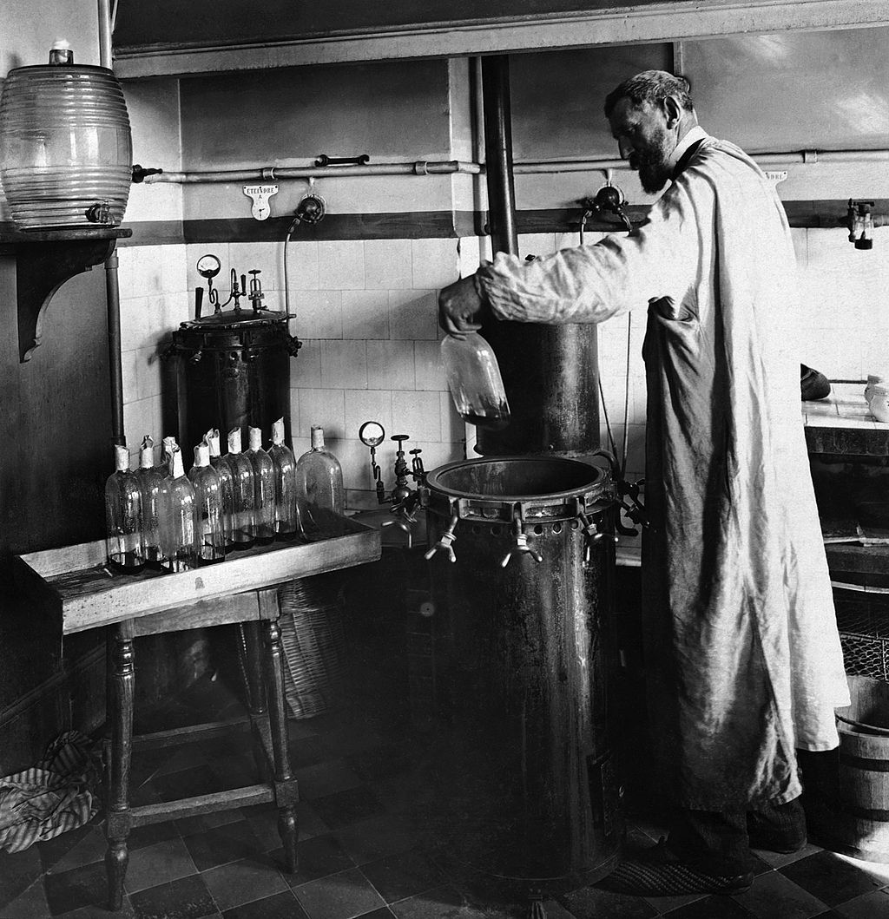
Y8 French Applying your knoweledge
Read the following text aloud. You won’t know some of the words – don’t worry! Just do your best to read them aloud as you think they should sound in French.
You will get marks for understandable and fluent pronunciation.
Louis Pasteur est un scientifique français très important dans l'histoire.
Il trouve une solution pour conserver des produits périssables.
Comme résultat, on achète le lait ‘pasteurisé’ au magasin aujourd’hui.
Il crée aussi le premier vaccin contre une maladie dangereuse.
C'est pourquoi on dit qu'il est ‘le père de la médecine moderne’.
Louis Pasteur (1822-1895) dans son laboratoire
Notes:
Example of Y8 French Applying your knowledge test: Read aloud
5 ‘ideational units’ (sentences of similar length and complexity, containing roughly similar proportions of known vs unfamiliar words 80% of words in the text are in the SOW.
To be a valid test of sounds of language we have to use some language unlikely to have been met yet.
2 marks / sentence = max. 10 marks in total
For each sentence we suggest awarding 1 mark for comprehensibility and 1 mark for fluency, giving 2 points for each sentence in total. However, there must a minimum level of comprehensibility (0.5 points) before points can be awarded for fluency.
1 mark awarded where words are pronounced very clearly and comprehensibly, with all or most of the features (SSCs, liaison, stress patterns) accurately produced.
Plus 1 mark awarded where the sentence is read very fluently (with few hesitations and/or self-corrections)
Plus 0.5 mark awarded where the sentence is read quite fluently (with some hesitations and/or self-corrections).
0.5 mark awarded where words are pronounced quite clearly and comprehensibly, with most of the features (SSCs, liaison, stress patterns) accurately produced.
Plus 1 mark awarded where the sentence is read very fluently (with few hesitations and/or self-corrections).
Plus 0.5 mark awarded where the sentence is read quite fluently (with some hesitations and/or self-corrections).
0 marks awarded where words are pronounced neither clearly nor comprehensibly, with few of the features (SSCs, liaison, stress patterns) accurately produced.
0 marks awarded for fluency where the unit is not awarded any marks for comprehensibility.
Image information: By Unknown author - Britannica Kids, Public Domain, https://commons.wikimedia.org/w/index.php?curid=28583466
https://en.wikipedia.org/wiki/Louis_Pasteur#/media/File:Louis_Pasteur_experiment.jpg

Slide 28
Summary key points
Plan and teach phonics, as it is a foundation skill which potentially helps a LOT of other aspects of L2 learning!
Keep going with it (especially French)
If it’s worth teaching, it’s worth assessing
Notes:
First of all, plan and teach it. In other words, we strongly that phonics needs to be planned into a scheme of work and taught systematically because it seems to help a lot of things. The rationale as we’ve seen for teaching phonics in an L2 may be different from the rationale of teaching phonics in an L1 but is nonetheless a strong rationale. Phonological decoding seems to have an impact on a number of different aspects of language learning and so I would see it as a foundation skill.
Secondly, keep going with it. It’s not something you can teach just once at the beginning of the year and move on from, it needs to be continually revisited, reinforced and practiced, and that’s especially the case in French, but also in the other foreign languages. Especially French as it’s a complex system to master, but it’s important for students to realise that it’s nonetheless a system that can be mastered. It not as some of those learners said in those comments “gibberish”, “weird”, “ridiculous” or “impenetrable”.
Thirdly, and this isn’t something which we particularly focused on in this presentation, but we think that it is important to assess phonics knowledge. If you’re going to teach it, we need to know the impact of that teaching, and we need to know where the gaps are and what kind of errors students are making so we know where to focus the teaching next and what gaps need addressing.

Slide 29
Aims for the session
Part 1:
understand the rationale for phonics teaching in MFL
look at some of the research evidence underpinning this
explore ways to assess phonics knowledge
Part 2:
share ‘quick wins’ for phonics
explore presentation, practice and consolidation resources (Fr, Gm, Sp)
Questions, discussion and next steps
Notes:
So our aims for the first part of this session are to: develop an understanding of the rationale for phonics teaching in MFL (modern foreign languages); look at some of the research evidence underpinning this. The first part of the webinar will be about 55 minutes. After a short comfort break of 10 minutes, we’ll come back and Rachel will share resources that demonstrate how phonics knowledge develops through presentation, practice and consolidation phases, as well as looking at ways we’ve been working to develop additional aspects of the sound-writing relationship knowledge.

Slide 30
What are some ‘quick wins’ ?

Slide 31
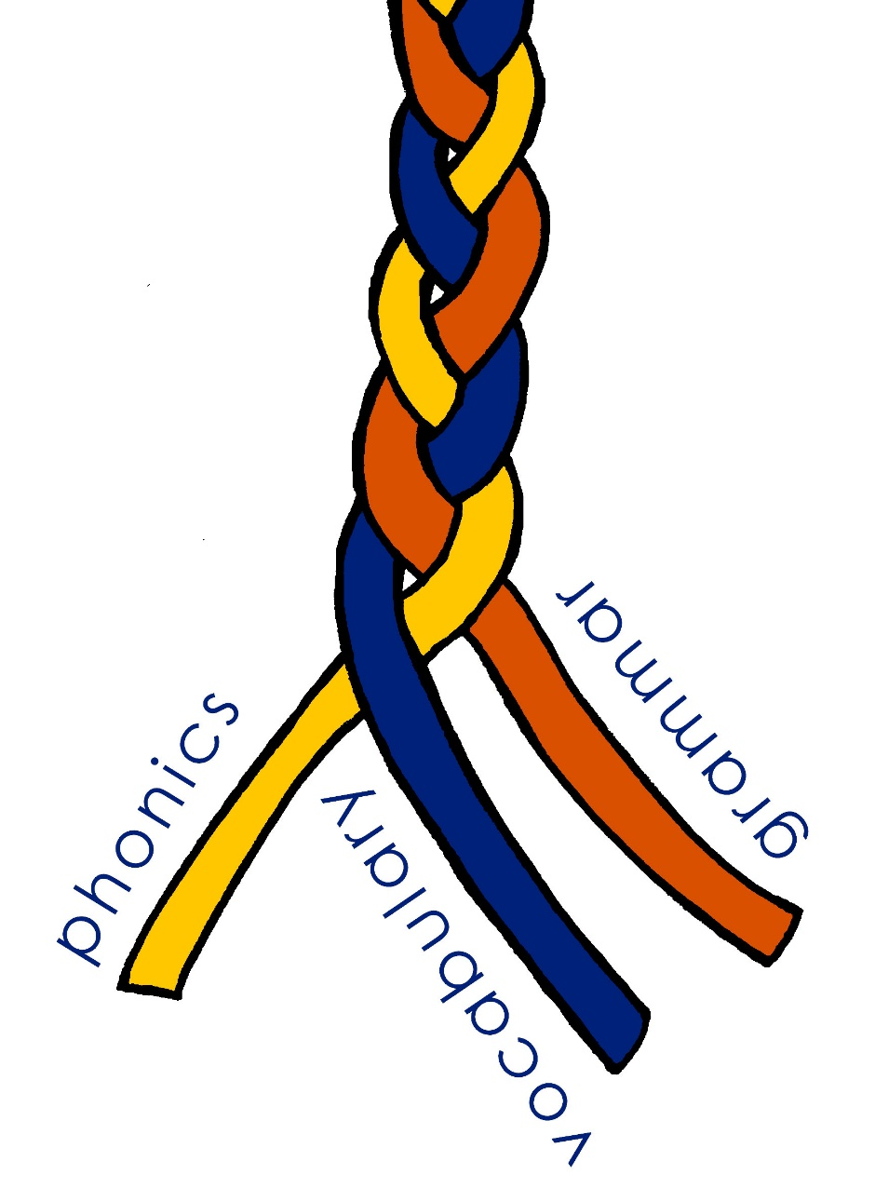
Curriculum design take-aways
Phonics - working with unknown words
Vocabulary - shortcut to systematic revisiting
Grammar - input practice before production
Other sessions: https://ncelp.org/ncelp-teacher-cpd/

Slide 32
Using unknown words [1]
To practise applying SSC (symbol-sound correspondence) knowledge, we need to use unknown words. For example:
Place names
People’s names
Names of other things (e.g. games, bands)
Cognates (not previously-taught)
Notes:
This seems like such an obvious one now, but I realise that I hadn’t systematically differentiated between activities that practise pronunciation / reading aloud of previously-taught language (i.e., with the aim of reactivating the sound-symbol representations of particular words, which is essentially one aspect of vocabulary knowledge) and practising SSC knowledge itself, for which you need unknown words (so that you’re sure that students are apply the knowledge rather than remembering the pronunciation of a previously-taught word) Pronouncing and or transcribing parts of or whole unknown words is an effective way to develop SSC (or symbol-sound correspondence) knowledge – in order words, the sound-writing relationship. It is also a reliable way to test that knowledge – i.e. work out how well students are able to connect the sounds of the language with how they are written. Let’s have a look at a few examples of tasks we might do, either as test or as classroom tasks.

Slide 33
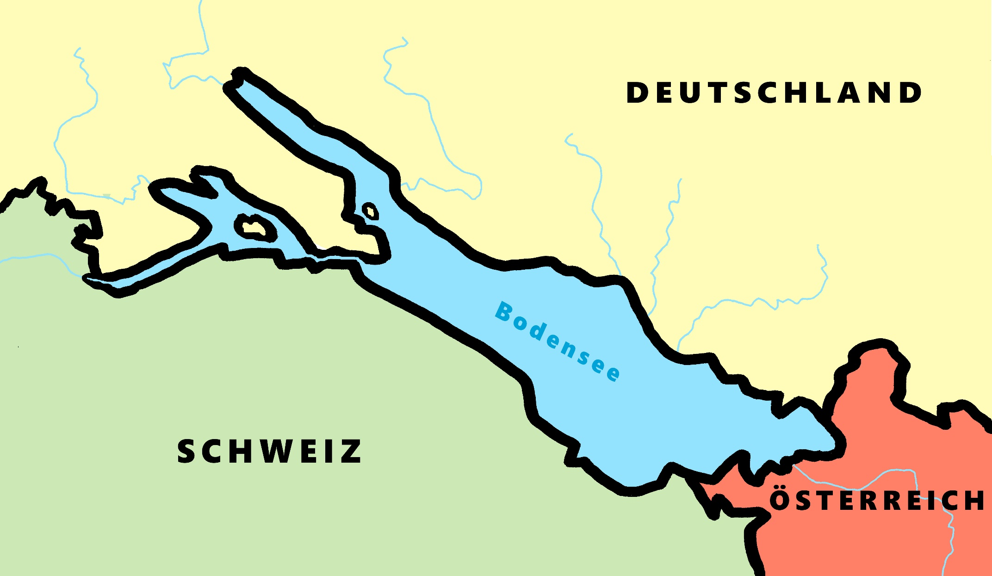
Phonetik - der Bodensee [1/2]
hören / schreiben
[4] Allensba_ _
ch
[5] _allhausen
4
W
5
z
[3] Radolf_ell
3
[6] Hagn_ _
6
au
ch
[7] Fr_ _dri_ _shafen
7
ie
S t
[2] _ _eckborn
eu
2
1
Kr_ _zlingen
[9] _omanshorn
R
9
ei
[8] Altenrh_ _n
8
Artwork: Steve Clarke
Notes:
Phonetik [1]
Time: 5 minutes Aim: To practise recognising and transcribing 10 previously taught SSC, in unknown words.
Procedure: 1. Click number to hear the full word. Students listen and transcribe only the missing letters. 2. Animations support item-by-item checking, as instant feedback on each SSC may be particularly helpful for students’ learning. 3. Teachers can additionally ask, Wo liegt [Hagnau]? Es liegt in [Deutschland]… Students have met the use of ‘in’ with die Schweiz. It will be helpful to focus their attention on the use of ‘in’ + der + Schweiz here, reminding them of the ‘in’ + movement (R2-accusative) or location (R3-dative) change. SSC revisited here: [eu] [st-] [z] [ch-hard] [w] [au] [ie] [ch-soft] [ei] [r] Transcript: 1 Kreuzlingen 2 Steckborn 3 Radolfzell 4 Allensbach 5 Wallhausen 6 Hagnau 7 Friedrichshafen 8 Altenrhein 9 Romanshorn

Slide 34
Phonétique
parler 1/8
lire / parler
Dis les noms.
Attention! C’est hard [g] ou [j]/soft [g] ?
Mon nom est …
1
Gérard
5
Gilles
9
Jacques
2
Gaelle
6
Julien
10
Jérôme
3
Angéline
7
Joséphine
11
Margaux
4
Agathe
8
Morgane
12
Georges
Adeline Charlton / Natalie Finlayson
Notes:
Timing: 8 minutes
Aim: To raise awareness of [j]/soft [g] and hard [g] by using known spelling rules to pronounce these correctly in unknown vocabulary items.
Procedure:
1. Explain that these are popular French names that look like names students may recognise from English, but are pronounced differently.
2. Give students four minutes to work with a partner to decide how to pronounce [j] or [g], and to have a go at sounding out the names. All other SSCs in the words are either known or transferable from English, with the exception of the [ô] in Jérôme.
3. Click on the numbers to hear the names pronounced. The voices indicate whether the name is traditionally a male or female one. Students repeat chorally.
4. Now, teachers encourage students to read the names in increasing speed intervals (30 seconds, 20 seconds, 10 seconds … may vary according to the individual needs of the class) to work on fluency.
Transcript
1. Gérard
2. Gaelle
3. Angéline
4. Agathe
5. Gilles
6. Julien
7. Joséphine
8. Morgane
9. Jacques
10. Jérôme
11. Margaux
12. Georges

Slide 35
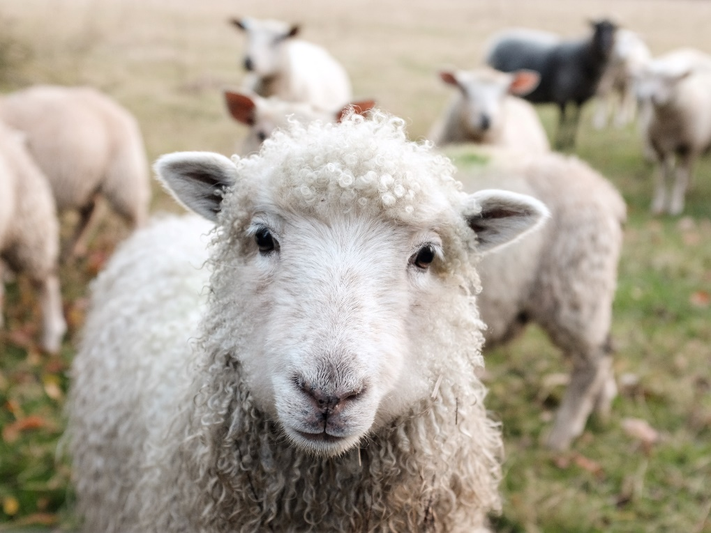
Using unknown words [2]
Minimal pairs are two similar sounding words that differ in only one phoneme and have distinct meanings.
sheep
ship
Notes:
[Ship] Photo by Peter Hansen on Unsplash [Sheep] Photo by Sam Carter on Unsplash
It’s not hard to recognise why these are important. We only need to have heard a colleague who is not a native English speaker instruct a student to pick up a ‘sheet’ or try not to smile when a Y7 student tells us earnestly that he or she ‘tiene once anos’!
Focusing on them explicitly, though. If you’d asked me two years ago whether I did that in my teaching, I would have said ‘well, yes, incidentally, when it comes up’.

Slide 36
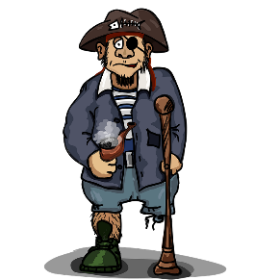
Pirates!
1
c
w
Riese
leider
Riese
One of the chests contains buried treasure. All the others contain poison!
Listen carefully to the secret code and follow the arrows to find the treasure.
Reise
Lieder
Reise
h
z
Wien
Biene
Feile
v
Wein
Beine
viele
Riese
k
Riese
Biene
Feile
leider
i
Reise
Beine
viele
Lieder
Reise
Riese
leider
Feile
leider
Riese
r
Reise
Lieder
viele
Lieder
Reise
Riese
y
j
q
Reise
Natalie Finlayson
Notes:
This task, created by Natalie Finlayson, one of NCELP’s resource developers, is one of my favourites!
Timing: 20-30 seconds per slide
Aim: This activity makes use of minimal pairs of unknown words to compel students to focus on a pair of SSC (sound-symbol correspondence) that often cause difficulty, both in pronunciation, reading aloud of written text, and also in spelling. (Unknown words are used so that pupils focus closely on the sound. Definitions are given on a later slide).
Procedure: Starting on the red square, pupils listen to the words and decide whether they hear /ei/ or /ei/. They follow the arrows indicated by their choice to finish at one of the chests. There is only one correct route per slide, so pupils must correctly identify all words to find the treasure. The order or /ei/ and /ie/ changes (i.e. sometimes /ei/ is on the white square and sometimes on the blue) so the pupils must read the spellings.
Pupils can follow the slide on the projector, or the slide can be printed so they can trace the route with a pen/finger.
Teacher asks ‘Wo bist du?’ Pupils respond ‘Z, W’ etc. to practise the alphabet. Teacher clicks on the chests they say to reveal treasure (or not!)
Audio plays on clicking play. Pupils will probably need to hear the audio at least three times.
Note: Each treasure chest is triggered to reveal what is underneath. You see a hand icon appear when you mouse over it – click and the chest disappears. Each slide only has one treasure chest – the rest reveal skulls.
Transcript:
Wein, Biene, Feile, Lieder, Riese
Treasure is located in chest r

Slide 37
En anglais et en français
lire / écouter
same [ch]
different [ch]
same [ch]
different [ch]
1
chef
6
champagne
2
avalanche
7
chocolat
3
touche
8
champion
4
brochure
9
moustache
5
charge
10
riche
Kirsten Somerville / St James’ Hub / Natalie Finlayson
Notes:
This is a slightly different angle, but I’ve included it to show the breadth and depth of NCELP’s phonics work as it’s developed through Y7. Here English has two pronunciations for ‘ch’ where French has one (there’s a reason for that, as where the English and French pronunciations overlap, those are words ‘borrowed’ form French).
Timing: 2 minutes Aim: This activity highlights similarities and differences in the English and French pronunciation of the SSC [ch], using near-cognates which have not been previously taught. Images are provided to aid recognition. The activity aims to show that while the pronunciation of this SSC changes in English, it is consistent in French. Teachers to highlight that, where the sound is ‘sh’ in English, these words are “borrowed” from French (chef, brochure, champagne, moustache).
Procedure: Students write 1-10 in their exercise books and decide if the [ch] in the French word sounds the same as in English, or different from the English. They then listen to the words and check their answers.
TRANSCRIPT:
chef
avalanche
touche
brochure
charge
champagne
chocolat
champion
moustache
riche
Frequency rankings of non-SOW (near-)cognates (1 is the most common word in French):
avalanche [4426], brochure [>5000], champagne [>5000], champion [2443], charge [849], chef [386], chocolat [4556], moustache [>5000], riche [599], touche [3775]
Source: Londsale, D., & Le Bras, Y. (2009). A Frequency Dictionary of French: Core vocabulary for learners London: Routledge

Slide 38
Target SSC in French
silent final consonant
a
i/y
eu
e
au/eau/closed o/ô
ou
u
silent final e
é (-er, -ez)
en/an/em/am
on/om
ain/in/aim/im
è/ê/ai
oi/oy
ch
ç (and soft 'c')
qu
j
-tion
-ien
s-liaison
t-liaison
n-liaison
x-liaison
h
um/un
-gn-
r
open eu/œu
open o
-s-
th
-ill-/-ille
-aill-/ail
-eille-/-eil
-euill-/-euil/-ueill-/-ueil/-œill-/-œil
-ouill-/ouil
Notes:
These are the SSC listed in the proposed GCSE Subject Content for French.

Slide 39
French Phonics Collection
Silent Final Consonant (SFC)
Artwork by: Chloé Motard
Date updated: 18/02/21

Slide 40
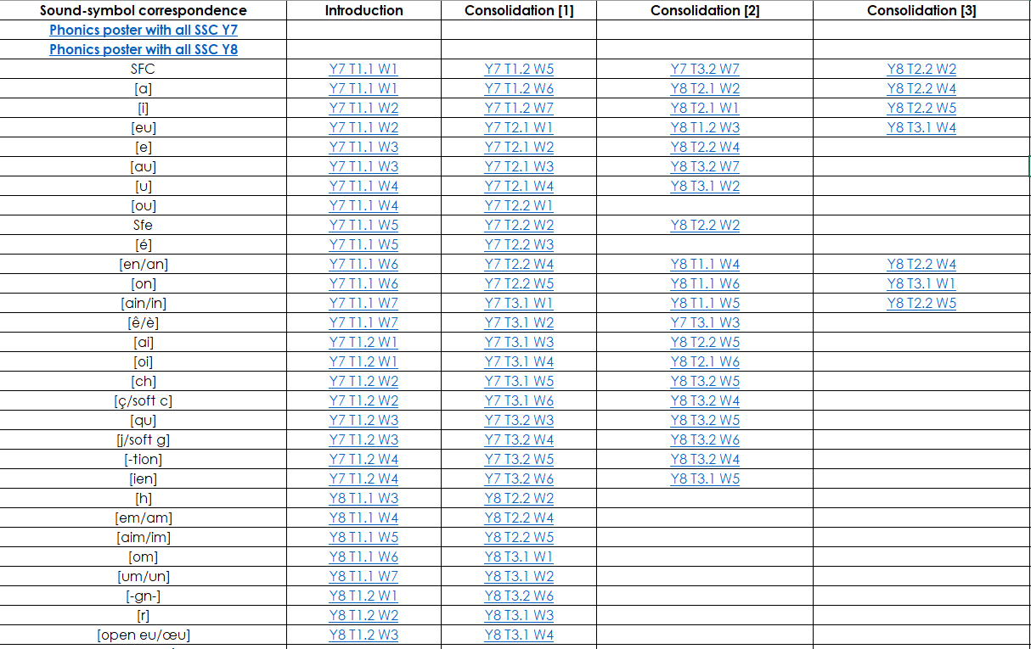
French phonics
phonétique

Slide 41
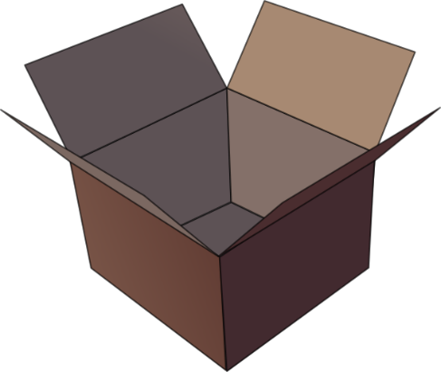
SFC
petit
prix
€15.95
grand
mot
dans
X
mais
[but]
Notes:
Timing: 2 minutes
Aim: To introduce SSC [SFC]
Procedure:
1. Introduce and elicit the pronunciation of the individual SSC [SFC] (in this case is [SFC] – silent final consonant so nothing to pronounce as an individual sound!) and then the source word again ‘dans’ (with gesture, if using). 2. Then present and elicit the pronunciation of the five cluster words.
The cluster words have been chosen for their high-frequency, from a range of word classes, with the SSC (where possible) positioned within a variety of syllables within the words (e.g. initial, 2nd, final etc.). Additionally, we have tried to use words that build cumulatively on previously taught SSCs (see the Phonics Teaching Sequence document) and do not include new SSCs. Where new SSCs are used, they are often consonants which have a similar symbol-sound correspondence in English.
Word frequency (1 is the most frequent word in French): dans [11]; petit [138] prix [310]; mot [220]; mais [30]; grand [59]. Source: Londsale, D., & Le Bras, Y. (2009). A Frequency Dictionary of French: Core vocabulary for learners London: Routledge.

Slide 42
Phonétique (1/3)
lire / parler
drap
d’accord
vert
20
[sheet]
[okay]
[green]
secondes
canard
estomac
bras
[stomach]
0
DÉBUT
Notes:
Timing: 3 minutes for 3 slides
NB: A more challenging version of this activity, which does not have the SSC scored out, can be found on slides 12-14.
Aim: To correctly pronounce unknown words containing [SFC] in decreasing amounts of time, helping automisation of SSC production. The words chosen otherwise contain sounds that are equivalent (or very similar) to English SSCs, so that students can focus fully on the [SFC] (allowances are made for English pronunciation of [r], which is covered in year 8).
Procedure:
1. Students pair up.
2. Teacher clicks to start 20 second timer.
3. Student A tries to say the words without pronouncing the [SFC].
4. Student B makes speaker pause for 3 seconds every time an [SFC] is pronounced.
5. Complete before 20 seconds runs out.
6. Swap roles.
7. Click on the word to hear pronunciation by a native speaker. Students repeat.
7. Move onto the next slide.
Word frequency (1 is the most frequent word in French): drap [>5000], d’accord [736], vert [1060], canard [>5000], estomac [>5000], bras [1253]
Source: Londsale, D., & Le Bras, Y. (2009). A Frequency Dictionary of French: Core vocabulary for learners London: Routledge.

Slide 43
Phonétique (2/3)
lire / parler
drap
d’accord
vert
10
[sheet]
[okay]
[green]
secondes
canard
estomac
bras
[stomach]
0
DÉBUT
Notes:
As per previous slide, but with the time halved.

Slide 44
Phonétique (3/3)
lire / parler
drap
d’accord
vert
5
[sheet]
[okay]
[green]
secondes
canard
estomac
bras
[stomach]
0
DÉBUT
Notes:
As previous slide, but with the time halved again.

Slide 45
Target SSC In German
long [a], including [ah], [aa] and short [a]
long [e] including [eh], [ee] and short [e]
[ei/ai]
[z]
[w]
[ie]
long [o], including [oh], [oo] and short [o]
long [i], including [ih] and short [i]
hard and soft [ch]
long [u], including [uh] and short [u]
long [ü/y], including [üh] and short [ü/y]
long [ä], including [äh] and short [ä]
long [ö], including [öh] and short[ö]
[äu]
[sch]
[sp-]
[st-]
[s-, -s-]
[ß] [ss] [-s]
[er]
unstressed [-er]
[v]
[au]
consonantal [r]
vocalic [r]
[eu]
[th]
unvoiced [-b], [-d], [-g]
[-ig]
[j]
[-tion] [qu]
Notes:
These are the SSC listed in the proposed GCSE Subject Content for German.

Slide 46
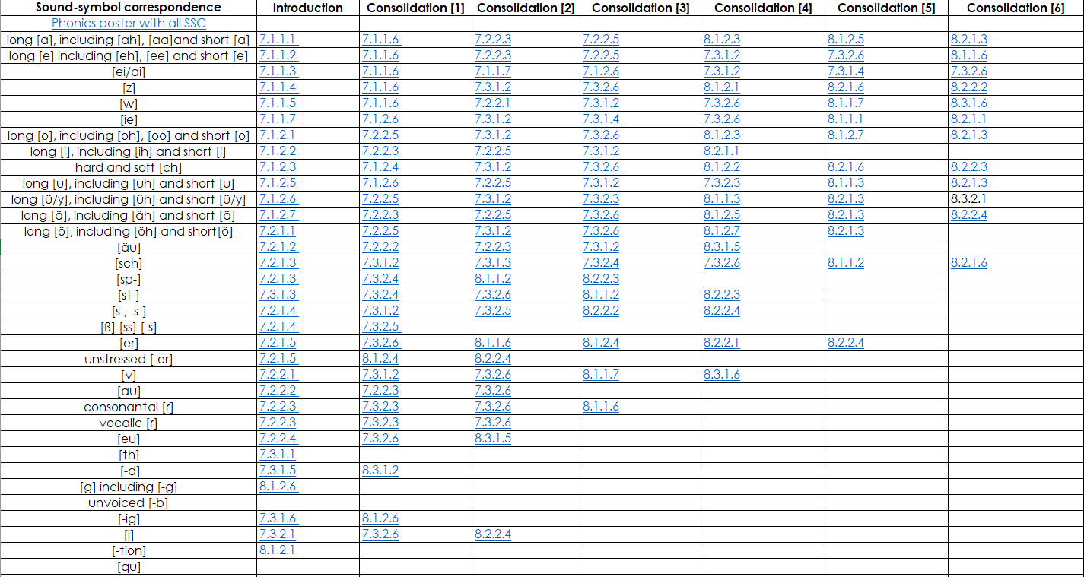
German phonics

Slide 47
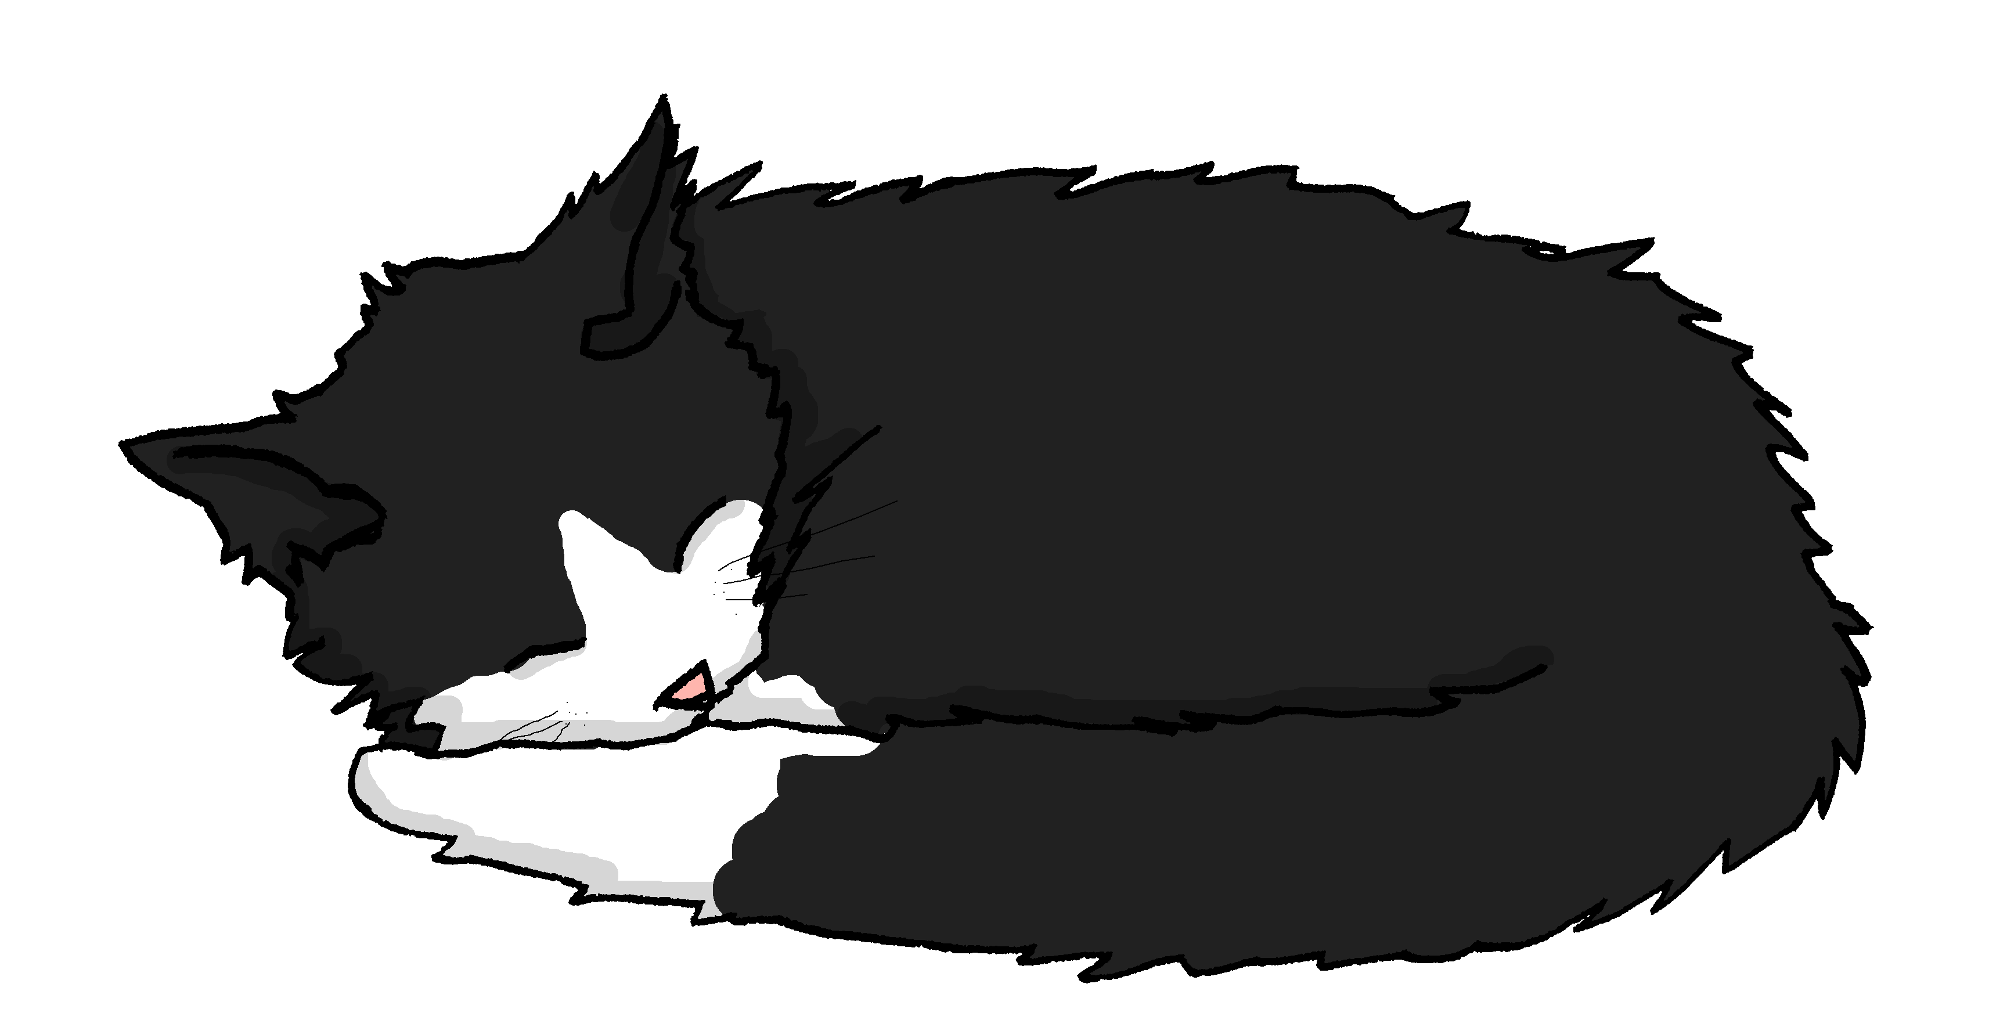
Miezes Traum
hören / schreiben
Miezes Traum
ohne Pausen
fällt
fängt
Mieze schläft… und träumt…
Sie _______ ins Wasser. Sie _________ einen großen Fisch. Sie ________ ihn in ihrem Mund fest. Sie ________ ihn nicht los. Sie ________ ihn nach Hause. Mia ist glücklich. Sie hat Hunger. Sie _______ den Fisch und ________ ihn. Mieze und Mia essen zusammen den Fisch. Er ist lecker!
hält
lässt
trägt
wäscht
brät
lassen | braten (to fry) | fangen (to catch)
halten (to hold) | fallen | tragen | waschen
Notes:
Timing: 5 mins Aim: To practise (through scaffolded transcription) the SSC [ä] in sentences. Procedure: 1. Ensure students understand Traum and the context (a cat’s dream!) for this narrative.
2. Students write 1-7. They listen to the dream story and transcribe the verbs they hear. The infinitives are provided – jumbled – in a table at the bottom.
3. The audio is provided as a whole piece, (no beeps as it is a transcription task) with some pauses built in. Students may need to listen 2-4 times. There is an ‘ohne Pausen’ version, too.
4. Answers are animated to appear on clicks.
5. Elicit an oral translate of the story from students.
Transcript: Mieze schläft und träumt. Sie fällt ins Wasser. Sie fängt einen großen Fisch. Sie hält ihn in ihrem Mund fest. Sie lässt ihn nicht los. Sie trägt ihn nach Hause. Mia ist glücklich. Sie hat Hunger. Sie wäscht den Fisch und brät ihn. Mieze und Mia essen zusammen den Fisch. Er ist lecker!
Previously taught word frequency (1 is the most frequent word in German): fallen [278] halten [144] lassen [82] tragen [271] Unfamiliar word frequency (1 is the most frequent word in German): fangen [2044] waschen [2315] braten [>5009] fest [567] los [658] Source: Jones, R.L. & Tschirner, E. (2006). A frequency dictionary of German: core vocabulary for learners. Routledge

Slide 48
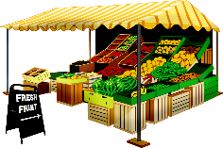
Phonetik
lesen / sprechen
Sag die Wörter.
 | Singular | Plural
1 | Wald (m) | Wälder
2 | Kraft | Kräfte
3 | Apfel | Äpfel
4 | Angst | Ängste
5 | Markt (m) | Märkte
6 | Gast (m) | Gäste
7 | Nacht (f) | Nächte
8 | Fach (nt) | Fächer
1
_________
2
[power]
_________
[powers]
3
_________
4
[fear]
_________
[fears]
5
_________
6
[guest]
[guests]
_________
7
[night]
[nights]
_________
8
_________
Notes:
Timing: 5 minutes Aim: To practise in productive oral modality the SSC [a] and [ä], with unfamiliar [1-4] and familiar [5-8] plurals. Procedure: 1. In pairs. One person pronounces the one of the pair of words that is on the slide. The other person pronounces the unwritten one of the pair.
2. When finished, reveal the missed text and click on the audio to hear both singular and plural forms.
Transcript:
1. Wald – Wälder
2. Kraft - Kräfter
3. Apfel – Äpfel
4. Angst - Ängst
5. Markt - Märkte
6. Gast – Gäste
7. Nacht – Nächte
8. Fach - Fächer
Word frequency (1 is the most frequent word in German): Wald [1028], Kraft [458], Apfel [3490], Angst [392], Markt [476], Gast [576], Nacht [325], Fach [1731] Source: Jones, R.L. & Tschirner, E. (2006). A frequency dictionary of German: core vocabulary for learners. Routledge

Slide 49
Phonetik
lesen / sprechen
Sag die Zungenbrecher.
15
2.
[a]
[ä]
Acht ähnliche Männer machen acht ähnliche Fächer.
Eight similar men do eight similar subjects.
Sekunden
ähnliche
machen
Männer
acht
Fächer
0
langsamer
LOS!
Notes:
Transcript: Acht ähnliche Männer machen acht ähnliche Fächer

Slide 50
Katrin ruft an
Mutti (Katrin) ruft Mia und Wolfgang von der Stadtmitte an.
hören
Was sagt Katrin? Wer macht was? Wolfgang und Mia (ihr) oder Opa (er)?
 |  | ihr (you all) | er (he)
 | Heute Morgen fährt Opa zum Bäcker.
 | Danach liest er meine Aufgabenliste.
 | Ihr ladet jetzt die Gäste ein.
 | Ihr lasst nichts auf dem Boden im Wohnzimmer, ist das klar?
 | Opa fängt heute Nachmittag an, zu putzen.
 | Dann lauft ihr zum Supermarkt und kauft ein.
 | Ihr nehmt den Bus nach Hause.
 | Später trägt Opa die Einkaufstaschen in die Küche.
 | Hoffentlich schlaft ihr gut heute Nacht!
 | Morgen tragt ihr elegante Kleidung, nicht wahr?
einladen – to invite
1
[fahren]
2
[lesen]
3
[einladen]
4
[lassen]
5
[anfangen]
6
[laufen]
7
[nehmen]
8
[tragen]
9
[schlafen]
10
[tragen]
Notes:
Timing: 10 minutes Aim: to practise the difference between ihr- and er–forms with strong verbs. The difference between these two forms is one phoneme, making them minimal pairs. [a] vs [ä] and [au] vs [äu] Procedure: Listening activity
Katrin/Mutti calls Wolfgang and Mia from the busy shopping centre to talk about what needs to be done to prepare for Oma’s 70th birthday (we had Opa’s in Y8). Wer macht was? Mia und Wolfgang (ihr) oder Opa (er).
1. Click on sound button 1 to play recording. If learners hear the er–/sie–form, the message is for Opa, if they hear the ihr–form, it is for Wolfgang and Mia. Elicit what was said, and whether it is ‘er’ or ‘ihr’. Note: Stress that the difference is the vowel, not the verb ending, which is –t. The infinitive verbs have been provided to support learners. Higher proficiency learners might be able to do the task without this support, which can easily be deleted.
2. Click to reveal what was said.
3. Click again to reveal tick for ‘ihr’ or ‘er’.
4. Continue for items 2-10.
Transcript:
1. Heute Morgen fährt [till beeping] zum Bäcker. Opa
2. Danach liest [phone ring] meine Aufgabenliste. er 3. [phone ring] ladet jetzt die Gäste ein. Ihr 4. [till beeping] lasst nichts auf dem Boden im Wohnzimmer. Ist das klar? Ihr
5. [coughing ] fängt heute Nachmittag an, zu putzen. Opa 6. Dann lauft [traffic noise] zum Supermarkt und kauft ein. ihr 7. [Bus/traffic noise] nehmt den Bus nach Hause. Ihr
8. Später trägt [bottles clinking] die Einkaufstaschen in die Küche. Opa
9. Hoffentlich schlaft [dog barking] gut heute Nacht! ihr
10. Morgen tragt [meow cat] elegante Kleidung, nicht wahr? ihr Word frequency of unknown words and cognates (1 is the most frequent word in German): elegant [3722] Source: Jones, R.L. & Tschirner, E. (2019). A frequency dictionary of German: core vocabulary for learners. Routledge

Slide 51
Target SSC in Spanish
[a]
[o]
[e]
[i]
[u]
[ll] [ch]
[co]
[cu]
[cu] + vowel
[ce]
[ci]
[z]
[que]
[qui]
[ga]
[go]
[gu]
[ge]
[gi][gue] [gui]
[j]
[ñ]
[v]
[rr]
silent h
Notes:
These are the SSC listed in the proposed GCSE Subject Content for Spanish. As you can see there is an overlap between the proposed SSC for GCSE and those taught at KS3 in the NCELP SOW and resources.

Slide 52
Stress patterns and spelling
HIGHER TIER
Key stress positions and associated spelling rules
The list which follows specifies key spelling rules determined by the position of stress, which students will need to learn at GCSE to be able to accurately transcribe and read aloud unknown words.
When reading words aloud in Spanish:
stress any vowel that has a written accent
stress the final syllable in a word, except:
stress the penultimate syllable for any word ending in a vowel, ‘n’, or ‘s’ (unless there is a written accent)
When transcribing Spanish, only write an accent on the stressed vowel for:
words with stress on a final syllable ending in a vowel, ‘n’, or ‘s’
words with stress on penultimate (second to last) syllable for a word ending in a consonant (other than ‘n’ or ‘s’)
all words with stress on the antepenultimate (third to last) syllable
Notes:
From Y8 onwards NCELP SOW teaches and practises Spanish stress patterns and the related rules for spelling.

Slide 53
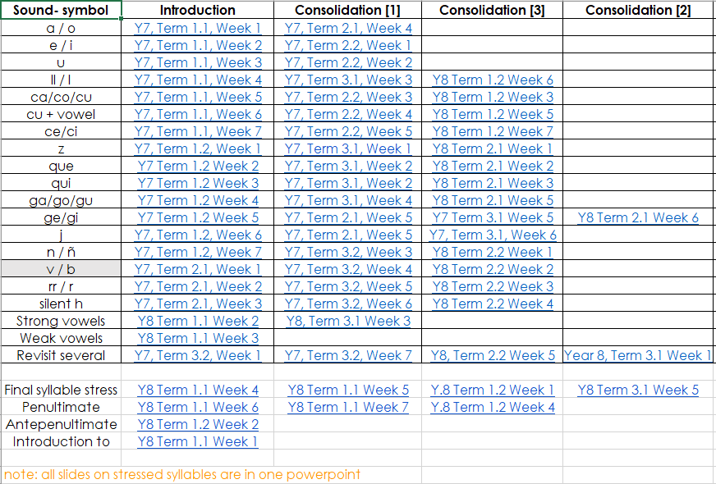
Spanish phonics

Slide 54
Ciudades de España y otros países de habla hispana
escuchar / escribir
Escucha y escribe la ciudad. Remember: if the stress is on the last syllable, and the word ends in the consonants ‘n’ or ‘s’, there will be an accent on the last vowel.
 | palabras con tilde | palabras sin tilde
1
Bogotá
Remember, ‘tilde’ is another word for the written accent in Spanish.
2
Jaén
3
Guayaquil
4
Badajoz
5
Medellín
6
Santander
7
Potosí
8
León
Notes:
Timing: 5 minutes
Aim: to consolidate final syllable stress and use of the written accent
Procedure:
Students listen and write the word.
They’ll then need to decide whether it requires an accent or not above the final vowel.
Notes:
Alternatively, if teachers wish to focus students’ attention solely on the spelling rule (without any transcription), the words could be shown without accents. Students could still hear the words, but in fact they would only need to look at the final letter to decide whether or not an accent is needed.
‘De habla hispana’ has been used incidentally in some earlier resources (e.g. alternative homework slide in 8.3.1.3). It may be necessary to give students the meaning upfront.
Transcript:
Bogotá
Jaén
Guayaquil
Badajoz
Medellín
Santander
Potosí
León

Slide 55
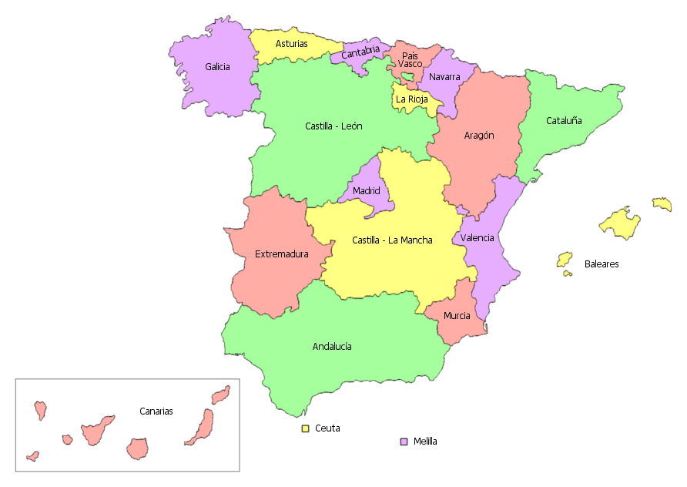
Ahora pronuncia los nombres de las ciudades.
¿En qué país está cada ciudad?
Las opciones son: Bolivia, España, Colombia y Ecuador.
leer / hablar
Guayaquil está en...
Ecuador.
Potosí está en...
Bolivia.
España.
Bogotá y Medellín están en...
Jaen, Badajoz, León y Santander están en...
Colombia.
Santander
Medellín
León
Bogotá
Guayaquil
Potosí
Badajoz
Jaén
Notes:
Timing: 2 minutes
Aim: to practise final syllable stress in oral production; to learn where the cities from the previous activity are located.
Procedure:
The teacher shows the names of the cities one by one with a mouse click whilst students say the name of the city out loud.
Students are then asked which country each city/set of cities belongs to. The four answer options are displayed in the title. This not intended to be a test of knowledge, although students are likely to be able to get the first two answers, given that earlier resources have taught students about the geogrpahy of both Spain and Bolivia using maps. Ecuador and Colombia may be less familiar, but this is an opportunity for learning.
Note: the pre-verbal position of prepositions (‘en qué país está…’) has not yet been taught explicitly. The question may well be understood, but it is worth asking students for a translation of the instructions to be sure, and clarifying if necessary. Year 9 resources will include teaching of this feature.

Slide 56
Ciudades de España y otros países de habla hispana
hablar / escuchar / escribir
Leemos, escuchamos y escribimos nombres de ciudades en Latinoamérica y en España.
El estudiante A lee los nombres de las ciudades.
San José (Costa Rica)
El estudiante B escucha y escribe los nombres. ¿Tienen tilde o no?
It needs the written accent because the final syllable is stressed and it ends in a vowel.
Ejemplo:
Estudiante A
Estudiante B
 | Nombres de ciudades
1 | San José
San José
 | Nombres de ciudades
1
San José
Notes:
Timing: 3 minutes.
Aim: to consolidate final syllable stress and use of the written accent.
Procedure:
Student A says each city name on the list. Most of the words have been seen in the previous lesson; however, there are four new place names: Alcalá, Popayán, Gijón, San Sebastián. All city names have final syllable stress, but they end in different letters.
Student B writes the name considering the use of the written accent.
Students swap roles.

Slide 57
Estudiante A
Estudiante B
 | Nombres de ciudades
1
2
3
4
5
6
 | Nombres de ciudades
1
2
3
4
5
6
Potosí
Bogotá
Medellín
Jaén
Badajoz
Santander
León
Alcalá
Gijón
Popayán
San Sebastián
Guayaquil
Notes:
SPEAKING CARDS - DO NOT DISPLAY DURING ACTIVITY

Slide 58
Estudiante A
Respuestas
Estudiante B
 | Nombres de ciudades
1
2
3
4
5
6
 | Nombres de ciudades
1
2
3
4
5
6
Bogotá
Potosí
Jaén
Medellín
Santander
Badajoz
Alcalá
León
Popayán
Gijón
Guayaquil
San Sebastián
Notes:
ANSWERS

Slide 59
Aims for the session
Part 1:
understand the rationale for phonics teaching in MFL
look at some of the research evidence underpinning this
explore ways to assess phonics knowledge
Part 2:
share ‘quick wins’ for phonics
explore presentation, practice and consolidation resources (Fr, Gm, Sp)
Questions, discussion and next steps
Notes:
So our aims for the first part of this session are to: develop an understanding of the rationale for phonics teaching in MFL (modern foreign languages); look at some of the research evidence underpinning this. The first part of the webinar will be about 55 minutes. After a short comfort break of 10 minutes, we’ll come back and Rachel will share resources that demonstrate how phonics knowledge develops through presentation, practice and consolidation phases, as well as looking at ways we’ve been working to develop additional aspects of the sound-writing relationship knowledge.

Slide 60
QUESTIONS?

Slide 61
Phonics collections
German phonics collection
French phonics collection
Spanish phonics collection

Slide 62
LUNCH

Slide 63
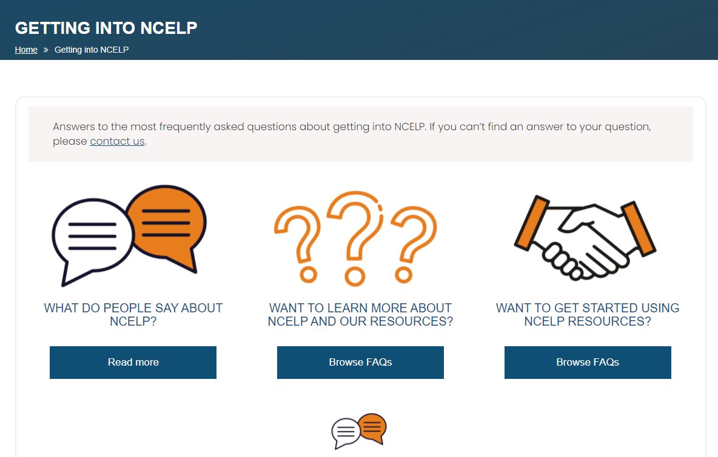
Next steps – further support
660 teachers outside the network on our regular mailing list
Some schools using and/or adapting the NCELP SOW and resources
New Getting into NCELP area of the website
Notes:
NCELP is a pilot project, set up to work intensively with 45 schools nationally, in the first phase. We have used the website, the resource portal, our mailing list and around 40 external presentations to date, to reach out to schools more widely.
So far, this has meant that… around 6000 teachers have attended one of our external events.

Slide 64
References
Erler, L. (2003) Reading in a Foreign Language – Near-Beginner Adolescents’ Experiences of French in English Secondary Schools. DPhil Thesis, Oxford University.
Erler, L. (2004) ‘Near-Beginner Learners of French Are Reading at a Disability Level’. Francophonie, vol. 30, pp. 9-15.
Erler, L. and Macaro, E. (2012) ‘Decoding Ability in French as a Foreign Language and Language Learning Motivation’. The Modern Language Journal, 95(4): 496-518. Hamada, M. and Koda, K. (2008) ‘Influence of First Language Orthographic Experience on Second Language Decoding and Word Learning’. Language Learning, vol. 58, no. 1, pp.1-31.
Hamada, M. and Koda, K. (2011) ‘The role of the phonological loop in English word learning: A comparison of Chinese ESL learners and native speakers’. Journal of Psycholinguistic Research, 40(2), pp.75-92.
Macaro, E. (2007) ‘Do beginner learners of French have any writing strategies?’ Language Learning Journal, 35, pp. 23–36.
Nassaji, H. (2014) ‘The role and importance of lower-level processes in second language reading’. Language Teaching, 47(1): 1-37.
Porter, A.M. (2014) An early start to French literacy: Learning the spoken and written word simultaneously in English primary schools. PhD thesis, University of Southampton.
Woore, R. (2007) ‘“Weisse Maus in Meinem Haus”: Using Poems and Learner Strategies to Help Learners Decode the Sounds of the L2’. Language Learning Journal, vol. 35, no. 2, pp. 175-188.
Woore, R. (2009) ‘Beginners’ progress in decoding L2 French: some longitudinal evidence from English Modern Foreign Languages classrooms’. Language Learning Journal, vol. 37, no. 1, pp. 3-18.
Woore, R. (2010) ‘Thinking aloud about L2 decoding: an exploration into the strategies used by beginner learners when pronouncing unfamiliar French words’. Language Learning Journal, vol. 38, no. 1, pp. 3-17.
Woore, R. (2011) Investigating and developing beginner learners’ decoding proficiency in second language French: an evaluation of two programmes of instruction. Unpublished PhD thesis, University of Oxford.
Woore, R. (2014) ‘Beginner learners’ progress in decoding L2 French: transfer effects in typologically similar L1-L2 writing systems’. Writing Systems Research, volume 4(2): 167-189.
Woore, R. (2018) ‘Learners’ pronunciations of familiar and unfamiliar French words: what can they tell us about phonological decoding in an L2?’ The Language Learning Journal, 46(4):456-69. Woore, R., Graham, S., Porter, A., Courtney, L. and Savory, C. (2018) Foreign Language Education: Unlocking Reading (FLEUR) - A study into the teaching of reading to beginner learners of French in secondary school. https://ora.ox.ac.uk/objects/uuid:4b0cb239-72f0-49e4-8f32-3672625884f0

