Slide 1
Saying what there is around you and describing it
SER – ‘es’ [revisited] and ‘son’
‘Hay’ vs ‘tiene’ [revisited]
SSCs [ga], [go], [gu]
Y7 Spanish
Term 1.2 - Week 4 - Lesson 21
Nick Avery / Rachel Hawkes Artwork: Mark Davies
Date updated: 16/08/21
Notes:
Learning outcomes (lesson 1):
Introduction of ‘son’
Consolidation of ‘es’, ‘hay’ and ‘tiene’
Introduction of SSC [ga], [go], [gu]
Word frequency (1 is the most frequent word in Spanish):
7.1.2.4 (introduce) son [ser-7]; pequeño [202]; bueno [98]; malo [368]; famoso [997]; bonito [891]; feo [2373]; rico¹ [398]; caro [2179]; barato [2164]; antiguo [446] ¿cómo es? [cómo-151]
7.1.2.1 (revisit) no [11]; caminar [514]; estudiar [281]; español¹ [262]; inglés¹ [583]; arte [208]; ciencia(s) [738]; señor¹ [201]; señora¹ [509]; mucho (as adverb only) [41]; pero [30]; verdadero [558]; o [29]; falso [1599]; entiendo [entender-229]; silencio [518]; grupo [200]; perdón [1729]
7.1.1.3 (revisit) ser [7]; soy; eres; es; alegre [2081]; simpático [3349]; guapo [4192]; alto¹ [231]; bajo¹ [236]; y [4]; marca [marcar-993]; correcto [1467]; opción [1175]
Source: Davies, M. & Davies, K. (2018). A frequency dictionary of Spanish: Core vocabulary for learners (2nd ed.). Routledge: London

Slide 2
ga
regalo
jugar
gato
ganar
amiga
lugar
[place]
Notes:
Introduce and elicit the pronunciation of the individual SSC ‘ga’ and then the source word again (with gesture, if using). Then present and elicit the pronunciation of the five cluster words.
The cluster words have been chosen for their high-frequency, from a range of word classes, with the SSC (where possible) positioned within a variety of syllables within the words (e.g. initial, 2nd, final etc.). Additionally, we have tried to use words that build cumulatively on previously taught SSCs (see the Phonics Teaching Sequence document) and do not include new SSCs. Where new SSCs are used, they are often consonants which have a similar symbol-sound correspondence in English.

Slide 3
ga
regalo
jugar
gato
ganar
amiga
lugar
Notes:
Without the images, students focus this time again closely on the SSC and the cluster words.

Slide 4
ga
regalo
jugar
gato
ganar
amiga
lugar
Notes:
Without the images or sound, students have to pronounce the words themselves.

Slide 5
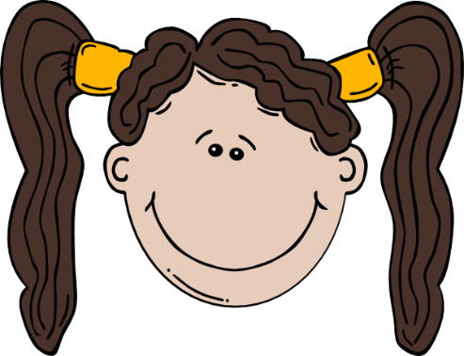
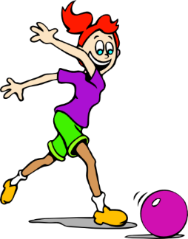
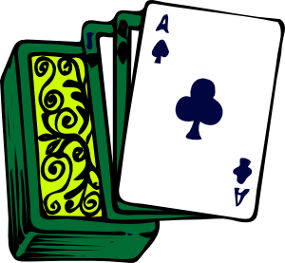
go
domingo
largo
SUNDAY
gol
juego (n)
conmigo
[with me]
algo
[something]
Notes:
Introduce and elicit the pronunciation of the individual SSC ‘go’ and then the source word again (with gesture, if using). Then present and elicit the pronunciation of the five cluster words.
The cluster words have been chosen for their high-frequency, from a range of word classes, with the SSC (where possible) positioned within a variety of syllables within the words (e.g. initial, 2nd, final etc.). Additionally, we have tried to use words that build cumulatively on previously taught SSCs (see the Phonics Teaching Sequence document) and do not include new SSCs. Where new SSCs are used, they are often consonants which have a similar symbol-sound correspondence in English.

Slide 6
go
domingo
largo
gol
juego (n)
conmigo
algo
Notes:
Without the images, students focus this time again closely on the SSC and the cluster words.

Slide 7
go
domingo
largo
gol
juego (n)
conmigo
algo
Notes:
Without the images or sound, students have to pronounce the words themselves.

Slide 8
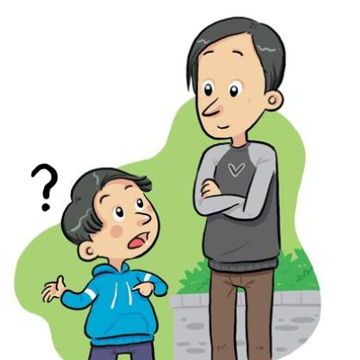
gu
¡mucho gusto!
segundo
preguntar
Notes:
Introduce and elicit the pronunciation of the individual SSC ‘gu’ and then the source word again (with gesture, if using). Then present and elicit the pronunciation of the five cluster words.
The cluster words have been chosen for their high-frequency, from a range of word classes, with the SSC (where possible) positioned within a variety of syllables within the words (e.g. initial, 2nd, final etc.). Additionally, we have tried to use words that build cumulatively on previously taught SSCs (see the Phonics Teaching Sequence document) and do not include new SSCs. Where new SSCs are used, they are often consonants which have a similar symbol-sound correspondence in English.

Slide 9
gu
¡mucho gusto!
segundo
preguntar
Notes:
Without the images, students focus this time again closely on the SSC and the cluster words.

Slide 10
gu
¡mucho gusto!
segundo
preguntar
Notes:
Without the images or sound, students have to pronounce the words themselves.

Slide 11
escuchar / escribir
Escucha.
Marca ‘GA’, ‘GO’ o ‘GU’.
Escucha otra vez.
Escribe la palabra.
 | GA | GO | GU
¿Cómo se dice en inglés?
go
1
conmi___
with me
se___ro
gu
sure, safe
2
go
3
___l
goal
ga
4
__to
cat
pre___ntar
5
gu
to ask
se___ndo
second
6
gu
ami__
7
ga
(female) friend
__nar
8
ga
to win
go
9
lar__
long
lu___r
10
ga
place
Notes:
Phonics practice activity
See the next slide for a variation of this activity.
Timing: 7 minutes
Aim: to practise mapping sound to spelling for the SSCs [ga], [go] and [gu]
Procedure:
1. Students write 1-10.
2. Students listen. For each item, they write ‘ga’, ‘go’ or ‘gu’.
3. Afterwards, students translate the words into English.
Notes: These are high-frequency words that some students will acquire incidentally. They are not automatically counted within the core expected learning of 360 words in Y7 (though some will be introduced as vocabulary items). The additional challenge of translating into English shouldn’t be seen as a test, but as an additional opportunity.
Transcript:
Conmigo
Seguro
Gol
Gato
Preguntar
Segundo
Amiga
Ganar
Largo
Lugar
Word frequency (1 is the most frequent word in Spanish): ganar [295]; gato [1728]; amiga [1172]; gol [2069]; conmigo [1256]; largo [1755]; preguntar [219]; segundo [223]; seguro [407]; lugar [144]
Source: Davies, M. & Davies, K. (2018). A frequency dictionary of Spanish: Core vocabulary for learners (2nd ed.). Routledge: London

Slide 12
escuchar / escribir
Escucha.
Marca ‘GA’, ‘GO’ o ‘GU’.
Escucha otra vez.
Escribe la palabra.
 | GA | GO | GU
¿Cómo se dice en inglés?
1
conmigo
with me
seguro
sure, safe
2
3
gol
goal
4
gato
cat
5
preguntar
to ask
6
segundo
second
7
amiga
(female) friend
8
ganar
to win
9
largo
long
10
lugar
place
Notes:
Variation: students have to write the whole word.
Transcript:
Conmigo
Seguro
Gol
Gato
Preguntar
Segundo
Amiga
Ganar
Largo
Lugar
Word frequency (1 is the most frequent word in Spanish): ganar [295]; gato [1728]; amiga [1172]; gol [2069]; conmigo [1256]; largo [1755]; preguntar [219]; segundo [223]; seguro [407]; lugar [144]
Source: Davies, M. & Davies, K. (2018). A frequency dictionary of Spanish: Core vocabulary for learners (2nd ed.). Routledge: London

Slide 13
Vocabulario
hablar
 | Español | Inglés
1 | son | they are (permanent)
2 | pequeño | small, little
3 | bueno | good
4 | malo | bad
5 | famoso | famous
6 | bonito | pretty
7 | feo | ugly
8 | rico | rich
9 | caro | expensive
10 | barato | cheap
11 | antiguo | old, ancient
12 | ¿Cómo es? | What is s/he like? What is it like?
60
Segundos
All of these adjectives also have a feminine form, ending in –a.
0
INICIO
Notes:
Vocabulario
Timing: 1-4 minutes Aim: To reactivate and strengthen vocabulary knowledge. Procedure: Round 1: Look at the Spanish, recall the English meanings, saying them aloud. [1 minute] Round 2: Look at the English, recall the Spanish meanings, saying them aloud. [1 minute] Repeat for two further minutes, to speed up recall.
Word frequency (1 is the most frequent word in Spanish): son [7 – ser]; pequeño [202]; bueno [98]; malo [368]; famoso [997]; bonito [891]; feo [2373]; rico [398]; caro [2179]; barato [2164]; antiguo [446] ¿cómo es? [cómo - 151]
Source: Davies, M. & Davies, K. (2018). A frequency dictionary of Spanish: Core vocabulary for learners (2nd ed.). Routledge: London

Slide 14
← palabras en español
bonito
caro
C
A
B
antiguo
D
F
¿Cómo es?
E
malo
feo
ugly
expensive
H
pretty
G
I
What is he/she/it like?
bad
old, ancient
J
K
L
palabras en inglés →
Notes:
Vocabulary practice. Game of pairs.
Timing: 5 minutes (slides 14-15)
Aim: to identify the correct Spanish word for each English word
Procedure:
1. Each letter disappears on click, then is obscured again on second click
2. The teacher can prompt students to say a letter. This can be done in any order.
3. Once all 6 pairs are identified, move on to the next slide.
Notes:
1. This is also a way to practise the alphabet – encourage students to say a letter aloud to reveal the word behind it. (This could also be adapted to practise numbers.)
2. Answers:
A-F: bonito; caro; antiguo; ¿Cómo es?; malo; feo
G-L: ugly; expensive; beautiful; what is he/she/it like?; old; ancient

Slide 15
← palabras en español
bueno
M
rico
N
son
Ñ
barato
O
famoso
pequeño
P
Q
small, little
R
famous
S
they are (permanent)
T
cheap
U
good
V
rich
W
palabras en inglés →
Notes:
Snap! Vocabulary practice (continued)
Procedure:
1. As described on previous slide
2. Finish the alphabet (ask students which letters are missing). These are X, Y and Z.
Answers:
M-Q: Bueno; rico; son; barato; famoso; pequeño
R-W: small, little; famous; they are (permanent); cheap; good; rich

Slide 16
Describing what there is around you: Using ‘es’ and ‘son’
To describe someone or something, Spanish often uses ‘es’.
Hay una casa. Es cara.
→ There is a house. It is expensive.
To describe two or more people or things, Spanish often uses ‘son’.
Hay unas casas. Son caras.
→ There are some houses. They are expensive.
¡Importante! ‘Es’ and ‘son’ both refer to permanent characteristics.
Notes:
Grammar explanation slide
Timing: 2 minutes
Note: In learning ‘son’, students also begin to encounter adjectives with plural number marking, e.g. altas. This grammar feature will be fully explained and practised in lesson 2. For now, to avoid overload, students are only expected to understand when to use ‘es’ and ‘son’ correctly, and to understand the meanings of the new adjectives.

Slide 17
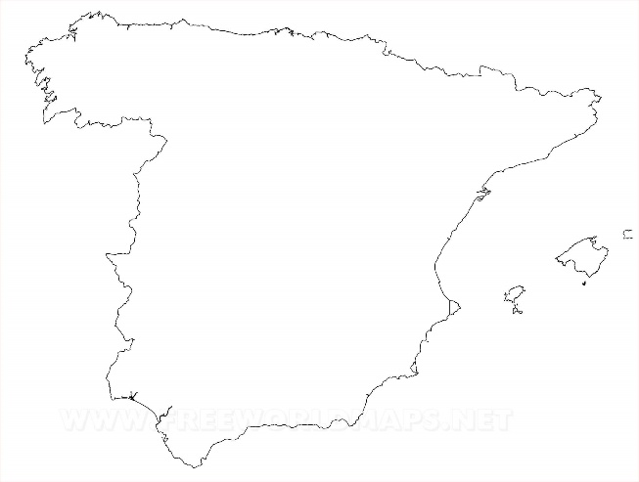
escuchar
Amanda está en España.
Describe tres ciudades: Toledo, Oviedo y León.
Marca la opción correcta.
Escucha otra vez.
 | Toledo (‘it is’) | Oviedo y León (‘they are’)
Escribe el adjetivo en inglés.
1
pretty
2
small, little
Oviedo
3
expensive
León
4
ugly
Toledo
5
old, ancient
6
cheap
7
famous
8
good
9
strange
10
calm, tranquil
Notes:
Listening activity
Timing: 7 minutes
Aim: to practise distinguishing between ‘es’ and ‘son’; to consolidate understanding of the new adjectives
Procedure:
1. Students write 1-10.
2. They listen to each item and write ‘it is’ or ‘they are’.
3. They listen again. This time, they write the adjective in English.
4. Teacher checks answers.
Notes:
Ciudad’ has been practised as a phonics word (T1.1, Week 7).
Transcript:
Es bonito.
Es pequeño.
Son caros.
Son feos.
Es antiguo.
Son baratos.
Es famoso.
Son buenos.
Es raro.
Son tranquilos.
Image free to use. Retrieved from https://www.freeworldmaps.net/europe/spain/political.html
Word frequency (1 is the most frequent word in Spanish): bonito [891]; pequeño [202]; caro [2179]; feo [2373]; antiguo [446]; barato [2164]; famoso [997]; bueno [98]; raro [1005]; tranquilo [1073]
Source: Davies, M. & Davies, K. (2018). A frequency dictionary of Spanish: Core vocabulary for learners (2nd ed.). Routledge: London

Slide 18
leer
Amanda está en España.
Describe diez ciudades.
Lee la segunda frase.
Marca la opción correcta.
Marca la opción correcta.
1
2
3
4
5
Es muy antiguo.
Son muy antiguos.
No son muy bonitos.
No es muy bonito.
Son muy pequeñas.
Es muy pequeña.
Es bueno.
Son buenos.
Es cara.
Son caras.
Madrid
En Madrid
hay un monumento.
León
En León
tiene unos parques.
En Mallorca
Mallorca
hay una escuela.
En Málaga
Málaga
hay unos coches.
San Sebastián
En San Sebastián
tiene unas casas.
Notes:
Reading activity [1/2]
Timing: 8 minutes
Aim: to consolidate understanding of the difference between ‘hay’ and ‘tiene’; to continue distinguishing between the meanings of ‘es’ and ‘son’.
Procedure:
1. Students first decide which sentence starter is correct, based on whether the ending includes ‘hay’ or ‘tiene’.
2. They then decide if the following sentence uses ‘es’ or ‘son’, based on the noun in the preceding sentence.
3. Once items 1-5 are done, go to next slide for 6-10.
Notes:
1. Check that ‘segunda’ is clear – this was introduced as a phonics practice word earlier in the lesson.
2. Differentiation: higher-achieving groups may be able to complete both parts of the task as they read each item.
Word frequency (1 is the most frequent word in Spanish): monumento [3149]; parque [1354]; escuela [424]; coche [1190]; casa [106]; bonito [891]; pequeño [202]; caro [2179]; antiguo [446]; bueno [98]
Source: Davies, M. & Davies, K. (2018). A frequency dictionary of Spanish: Core vocabulary for learners (2nd ed.). Routledge: London

Slide 19
leer
Amanda está en España.
Describe diez ciudades.
Lee la segunda frase.
Marca la opción correcta.
Marca la opción correcta.
6
7
8
9
10
Es feo.
Son feos.
Son ricas.
Es rica.
Son muy famosas.
Es muy famosa.
Es malo.
Son malos.
Es muy barato.
Son baratos.
Granada
En Granada
tiene un bar.
En Oviedo
Oviedo
hay unas personas.
Santiago de Compostela
En Santiago de Compostela
tiene una catedral.
En Santander
Santander
hay un barco.
Barcelona
En Barcelona
tiene unos teatros.
.
Notes:
Reading activity [2/2]
Notes: ‘Teatro’, ‘bar’ and ‘catedral’ are cognates/near-cognates that were included as they fit the context of the activity. ‘Teatro’ will also be formally introduced next week.
Word frequency (1 is the most frequent word in Spanish): bar [1938]; persona [108]; catedral [2679]; barco [1384]; teatro [605]; feo [2373]; barato [2164]; famoso [997]; rico¹ [398]; malo [368];
Source: Davies, M. & Davies, K. (2018). A frequency dictionary of Spanish: Core vocabulary for learners (2nd ed.). Routledge: London

Slide 20
¿Cómo se dice en inglés?
1. León has some parks. They’re not very pretty.
León tiene unos parques. No son muy bonitos.
2. In Oviedo there are some people. They’re rich.
En Oviedo hay unas personas. Son ricas.
3. Granada has a bar. It’s ugly.
Granada tiene un bar. Es feo.
4. San Sebastián has some houses. They’re expensive.
San Sebastián tiene unas casas. Son caras.
5. In Mallorca, there is a school. It’s very small.
En Mallorca hay una escuela. Es muy pequeña.
Notes:
OPTIONAL EXTENSION SLIDE
Procedure:
1. Students translate the Spanish sentences into English.
Notes:
1. Students can opt to produce the sentences in any order. The shapes are triggered to reveal the English translation when the shape itself is clicked.

Slide 21
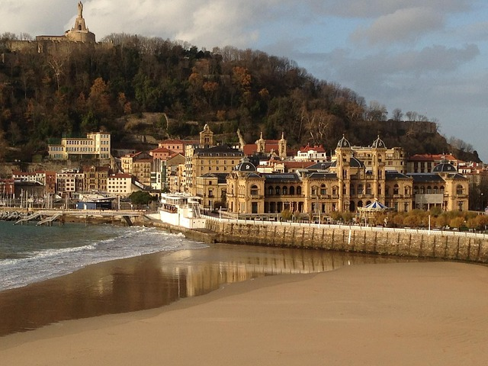
escribir
old
cheap
strange
¿Cómo es España?
Completa las frases.
beautiful
calm
small
famous
old
expensive
beautiful
San Sebastián
Barcelona y San Sebastián son
1) _______________________________ bonitos.
Bilbao es
2) ____________________ barato.
Bilbao y Barcelona son
3) __________________________ antiguos.
famous
calm
strange
San Sebastián es
4) ________________________ pequeño.
Zaragoza y San Sebastián son
5) ______________________________ tranquilos.
Bilbao y Zaragoza son
6) ________________________ raros.
Notes:
Writing activity
Timing: 5 minutes
Aim: to practise identifying the meanings of adjectives and using ‘es’ and ‘son’ in written production
Procedure:
1. Teacher asks students to translate the title as it contains core vocabulary introduced this week (¿Cómo es?)
2. Students look at the pictures and decide which city to write and whether to use ‘es’ or ‘son’.
Notes:
1. Notice that the Spanish adjectives are already provided. In lesson 1 we want students to focus on the correct use of es/son and the meaning of the new adjectives. In lesson 2, students will focus on manipulating their endings to reflect number (and gender) agreement.
Map courtesy www.pinterest.com (no author found).
Image of San Sebastián free from lizzybeth74 on Pixabay, https://pixabay.com/es/photos/san-sebasti%C3%A1n-espa%C3%B1a-de-viaje-447407/
Word frequency (1 is the most frequent word in Spanish): bonito [891]; pequeño [202]; antiguo [446]; barato [2164]; raro [1005]; tranquilo [1073]
Source: Davies, M. & Davies, K. (2018). A frequency dictionary of Spanish: Core vocabulary for learners (2nd ed.). Routledge: London

Slide 22
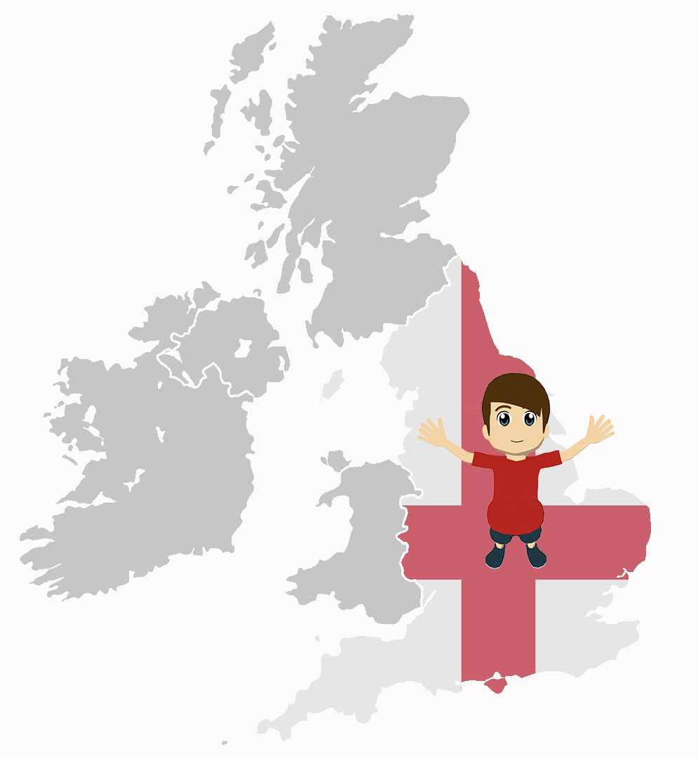
Gramática
escribir
Un ejemplo:
¿Cómo es Inglaterra?
Sheffield es barato.
Bristol y Oxford son caros.
Completa las frases.
1) ____________________ bonitos.
2) ____________________ barato.
3) ____________________ antiguos.
4) ____________________ pequeño.
5) ____________________ tranquilos.
6) _____________________feo.
7) _____________________raro.
8) _____________________caros.
Notes:
Writing activity
Timing: 8 minutes
Aim: to use ‘es’ and ‘son’ in written production in a freer context
Procedure:
1. Students need to pay attention to the adjective ending (whether it ends with –s or not) as a cue for writing about one or more than one city. They are using this receptively to direct their production of ‘es’ and ‘son’.
Word frequency (1 is the most frequent word in Spanish): bonito [891]; pequeño [202]; antiguo [446]; barato [2164]; raro [1005]; tranquilo [1073]; feo [2373]; caro [2179]
Source: Davies, M. & Davies, K. (2018). A frequency dictionary of Spanish: Core vocabulary for learners (2nd ed.). Routledge: London

Slide 23
Saying what there is around you and describing it [2]
SER – ‘es’ [revisited] and ‘son’
Adjective number agreement
SSCs [ga], [go], [gu]
Y7 Spanish
Term 1.2 - Week 4 - Lesson 22
Nick Avery / Rachel Hawkes Artwork: Mark Davies
Date updated: 16/08/21
Notes:
Learning outcomes (lesson 2):
Introduction of adjective number agreement -s (as complement to verb)
Consolidation of SSCs [ga], [go], [gu] Consolidation of adjective gender agreement -o, -a (now including abstract gender)
Word frequency (1 is the most frequent word in Spanish):
7.1.2.4 (introduce) son [ser-7]; pequeño [202]; bueno [98]; malo [368]; famoso [997]; bonito [891]; feo [2373]; rico¹ [398]; caro [2179]; barato [2164]; antiguo [446] ¿cómo es? [cómo-151]
7.1.2.1 (revisit) no [11]; caminar [514]; estudiar [281]; español¹ [262]; inglés¹ [583]; arte [208]; ciencia(s) [738]; señor¹ [201]; señora¹ [509]; mucho (as adverb only) [41]; pero [30]; verdadero [558]; o [29]; falso [1599]; entiendo [entender-229]; silencio [518]; grupo [200]; perdón [1729]
7.1.1.3 (revisit) ser [7]; soy; eres; es; alegre [2081]; simpático [3349]; guapo [4192]; alto¹ [231]; bajo¹ [236]; y [4]; marca [marcar-993]; correcto [1467]; opción [1175]
Source: Davies, M. & Davies, K. (2018). A frequency dictionary of Spanish: Core vocabulary for learners (2nd ed.). Routledge: London

Slide 24
Fonética
escuchar / hablar
¿Qué escuchas? ‘GA’, ‘GO’ o ‘GU’?
GU
1
Pregunta mucho en clase.
S/he asks a lot in class.
Notes:
Phonics practice
Timing: 5 minutes
Aim: to practise ‘listening out’ for the target SSC and understanding the source/cluster word in context
Procedure:
1. Students first listen and decide which target SSC(s) they hear.
2. They are then shown the sentence. Before showing its translation, try to elicit it from students.
Word frequency (1 is the most frequent word in Spanish): ganar [295]; gato [1728]; amiga [1172]; gol [2069]; conmigo [1256]; preguntar [219]; segundo [223]; seguro [407]
Source: Davies, M. & Davies, K. (2018). A frequency dictionary of Spanish: Core vocabulary for learners (2nd ed.). Routledge: London

Slide 25
¿Qué escuchas? ‘GA’, ‘GU’ o ‘GA’ y ‘GU’?
2
GA y GU
No quiero un gato. Estoy seguro.
I don’t want a cat. I’m sure.

Slide 26
¿Qué escuchas? ‘GA’, ‘GO’ o ‘GA’ y ‘GO’?
3
GA y GO
Una amiga estudia conmigo.
A (female) friend studies with me.

Slide 27
¿Qué escuchas? ‘GA’, ‘GO’ o ‘GA’ y ‘GO’?
GA y GO
4
¡Gol! ¡Gana el Real Madrid!
Goal! Real Madrid win!

Slide 28
¿Qué escuchas? ‘GA’, ‘GU’ o ‘GA’ y ‘GU’?
GU
5
‘B’ es la segunda letra.
‘B’ is the second letter.

Slide 29
small, little
c_ _ _
a_ _ _ _ _ _
¿C_ _ _ e_?
b_ _ _ _ _
f_ _
p_ _ _ _ _ _
f_ _ _ _ _
m_ _ _
r_ _ _
b_ _ _ _
s_ _
b_ _ _ _ _
pequeño
Notes:
Vocabulary revision
Timing: 6 minutes (slides 29-39)
Aim: to retrieve the new words from memory
Procedure:
Teacher elicits the Spanish word from students.
Click twice – once to make the correct letter move next to its translation, and again to bring up the whole word. The first step could help to give students a hint.
Note: If classes are not yet able to retrieve the word from memory, letters could be added to offer the additional support.

Slide 30
cheap
c_ _ _
a _ _ _ _ _ _
¿C_ _ _ e_?
b_ _ _ _ _
f _ _
p _ _ _ _ _ _
f _ _ _ _ _
m_ _ _
r _ _ _
b _ _ _ _
s_ _
b _ _ _ _ _
barato
Notes:
Vocabulary revision

Slide 31
old, ancient
c_ _ _
a_ _ _ _ _ _
¿C_ _ _ e_?
b_ _ _ _ _
f_ _
p_ _ _ _ _ _
f_ _ _ _ _
m_ _ _
r_ _ _
b_ _ _ _
s_ _
b_ _ _ _ _
antiguo
Notes:
Vocabulary revision

Slide 32
famous
c_ _ _
a_ _ _ _ _ _
¿C_ _ _ e_?
b_ _ _ _ _
f_ _
p_ _ _ _ _ _
f_ _ _ _ _
m_ _ _
r_ _ _
b_ _ _ _
s_ _
b_ _ _ _ _
famoso
Notes:
Vocabulary revision

Slide 33
ugly
c_ _ _
a_ _ _ _ _ _
¿C_ _ _ e_?
b_ _ _ _ _
f_ _
p_ _ _ _ _ _
f_ _ _ _ _
m_ _ _
r_ _ _
b_ _ _ _
s_ _
b_ _ _ _ _
feo
Notes:
Vocabulary revision

Slide 34
rich
c_ _ _
a_ _ _ _ _ _
¿C_ _ _ e_?
b_ _ _ _ _
f_ _
p_ _ _ _ _ _
f_ _ _ _ _
m_ _ _
r_ _ _
b_ _ _ _
s_ _
b_ _ _ _ _
rico
Notes:
Vocabulary revision

Slide 35
What is s/he like?
What is it like?
c_ _ _
a_ _ _ _ _ _
¿C_ _ _ e_?
b_ _ _ _ _
f_ _
p_ _ _ _ _ _
f_ _ _ _ _
m_ _ _
r_ _ _
b_ _ _ _
s_ _
b_ _ _ _ _
¿Cómo es?
Notes:
Vocabulary revision

Slide 36
they are (permanent)
c_ _ _
a_ _ _ _ _ _
¿C_ _ _ e_?
b_ _ _ _ _
f_ _
p_ _ _ _ _ _
f_ _ _ _ _
m_ _ _
r_ _ _
b_ _ _ _
s_ _
b_ _ _ _ _
son
Notes:
Vocabulary revision

Slide 37
bad
c_ _ _
a_ _ _ _ _ _
¿C_ _ _ e_?
b_ _ _ _ _
f_ _
p_ _ _ _ _ _
f_ _ _ _ _
m_ _ _
r_ _ _
b_ _ _ _
s_ _
b_ _ _ _ _
malo
Notes:
Vocabulary revision

Slide 38
good
c_ _ _
a_ _ _ _ _ _
¿C_ _ _ e_?
b_ _ _ _ _
f_ _
p_ _ _ _ _ _
f_ _ _ _ _
m_ _ _
r_ _ _
b_ _ _ _
s_ _
b_ _ _ _ _
bueno
Notes:
Vocabulary revision

Slide 39
pretty
c_ _ _
a_ _ _ _ _ _
¿C_ _ _ e_?
b_ _ _ _ _
f_ _
p_ _ _ _ _ _
f_ _ _ _ _
m_ _ _
r_ _ _
b_ _ _ _
s_ _
b_ _ _ _ _
bonito
Notes:
Vocabulary revision

Slide 40
Describing what there is around you: Using ‘es’ and ‘son’
Spanish adjectives change depending on whether the noun is singular (one) or plural (more than one).
Compare:
Hay una casa. Es cara.
→ There is a house. It is expensive.
Hay unas casas. Son caras.
→ There are some houses. They are expensive.
So, if the adjective refers to a plural noun, add an -s.
Notes:
Grammar explanation slide
Timing: 2 minutes
Note:
1. Students haven’t yet learnt any adjectives that end in a consonant (e.g. azul), which require –es to form a plural adjective. We therefore don’t teach this rule here. The aim here is to get them to learn a ‘default’, main pattern. We can introduce the complexities and exceptions to the rule later.

Slide 41
escuchar
Lucía describe a un profesor y a unos amigos.
Marca la opción correcta.
Escucha otra vez.
 | El profesor (‘he is’) | Los amigos (‘they are’)
Escribe las palabras en español.
1
Son ricos.
2
Son bonitos.
3
Es alto.
4
Son tontos.
5
Es tranquilo.
6
Es serio.
7
No son famosos.
8
No es feo.
9
Son bajos.
10
No son raros.
Notes:
Listening task
Timing: 8 minutes
Aim: to practise listening out for ‘es’ and ‘son’ and understanding their meaning
Procedure:
1. Students first listen out for ‘es’ and ‘son’ to decide whether the subject is singular ‘he’ or plural ‘they’.
2. Then, they listen again and write the Spanish (i.e., transcription). This should help them to begin to associate ‘es’ and ‘son’ with the singular and plural forms of the adjective.
Notes:
Adjectives taught this week: rico, bonito, famoso, feo;
Adjectives recently re-visited in Quizlet: tonto, tranquilo, serio, raro;
Adjectives taught in other weeks: alto, bajo
Transcript:
Son ricos
Son bonitos
Es alto
Son tontos
Es tranquilo
Es serio
No son famosos
No es feo
Son bajos
No son raros.
Word frequency (1 is the most frequent word in Spanish): bonito [891]; famoso [997]; feo [2373]; rico¹ [398]; alto² [231]; raro¹ [1005]; tonto [2379]; tranquilo [1073]; serio [856]; bajo¹ [236]
Source: Davies, M. & Davies, K. (2018). A frequency dictionary of Spanish: Core vocabulary for learners (2nd ed.). Routledge: London

Slide 42
leer
Es positivo ☺
Es negativo ☹
Son ricos.
Son bonitos.
Son tontos.
Son bonitos.
Es tranquilo.
Es serio.
Es alto.
No son raros.
Son tontos.
No es feo.
Es tranquilo.
Es serio.
Depende ☺ / ☹
No son famosos.
Son ricos.
Es feo.
Es alto.
Son bajos.
No son famosos.
No son raros.
Son bajos.
Notes:
Reading activity
Timing: 5 minutes
Aim: for students to engage with the meaning of the words that they just heard and transcribed.
Procedure:
1. Students have to decide if the statements are positive, affirmative or whether it depends (ensure that ‘depende’ is clear when introducing the task).
Notes: A number of these are of course open to interpretation. The idea is that students engage with the meaning of the words that they just heard and transcribed.
Word frequency (1 is the most frequent word in Spanish): bonito [891]; famoso [997]; feo [2373]; rico¹ [398]; alto² [231]; raro¹ [1005]; tonto [2379]; tranquilo [1073]; serio [856]; bajo¹ [236]
Source: Davies, M. & Davies, K. (2018). A frequency dictionary of Spanish: Core vocabulary for learners (2nd ed.). Routledge: London

Slide 43
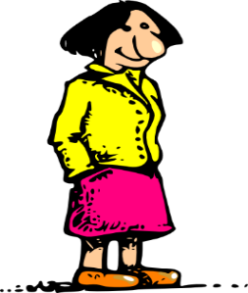
leer
En las frases 1-5, el autor describe a un profesor de arte y a unos profesores de historia.
Marca la opción correcta.
Lee.
Completa la frase - escribe ‘es’ o ‘son’.
¿Quién?
¿Cómo es / son?
1
2
3
4
5
El profesor de arte
Los profesores de historia
es
bueno, pero nervioso.
Los profesores de historia
El profesor de arte
son
tranquilos.
Los profesores de historia
El profesor de arte
Los profesores de español
es
raro.
El profesor de arte
Los profesores de historia
muy altos.
son
Los profesores de historia no
El profesor de arte no
son
El profesor de arte
tontos.
Notes:
Reading activity [1/2]
Timing: 8 minutes (slides 43-44)
Aim: to practise attending to adjective number agreement as a cue for understanding the subject of the sentence; to consolidate understanding of ‘es’ and ‘son’
Procedure:
1. Teacher runs through the instructions. Elicit the meaning of ‘cómo son’ in the title.
2. Students use the adjective at the end of the sentence to decide which sentence starter is correct.
3. They then complete the sentence with ‘es’ or ‘son’.
4. Items 6-10 appear on the next slide.
Notes:
Adjectives taught this week: bueno, bonito, malo, famoso
Adjectives recently re-visited in Quizlet: nervioso, tranquilo, raro, tonto, serio
Adjectives taught in other weeks: alegre, guapo, alto
Word frequency (1 is the most frequent word in Spanish): alto² [231]; raro¹ [1005]; tonto [2379]; tranquilo [1073]; bueno [98]
Source: Davies, M. & Davies, K. (2018). A frequency dictionary of Spanish: Core vocabulary for learners (2nd ed.). Routledge: London

Slide 44
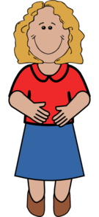
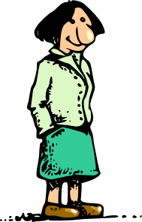
leer
En las frases 6-10, el autor describe a una profesora de inglés y a unas profesoras de español.
Lee la frase.
Marca la opción correcta.
Completa la frase - escribe ‘es’ o ‘son’.
¿Quién?
¿Cómo es / son?
6
7
8
9
10
La profesora de inglés
Las profesoras de español
bonitas.
son
Las profesoras de español
La profesora de inglés
alegre y guapa también.
es
Las profesoras de español
Las profesoras de español no
La profesora de inglés no
mala.
es
La profesora de inglés
Las profesoras de español.
es
seria.
La profesora de inglés
Las profesoras de español
La profesora de inglés
famosas en Inglaterra.
son
Notes:
Reading activity [2/2]
Continue the procedure outlined on the previous slide.
Note: Encourage students to translate the title again. The last slide focused on ‘profesores’ – this slide focuses on ‘profesoras’!
Word frequency (1 is the most frequent word in Spanish): bonito [891]; famoso [997]; serio [856]; malo [368]; guapo [4192]; alegre [2081]
Source: Davies, M. & Davies, K. (2018). A frequency dictionary of Spanish: Core vocabulary for learners (2nd ed.). Routledge: London

Slide 45
¿Cómo se dice en inglés?
1. The (male) art teacher is good, but he’s nervous.
El profesor de arte es bueno, pero nervioso.
2. The history teachers aren’t silly.
Los profesores de historia no son tontos.
3. The (male) art teacher is strange. He doesn’t speak in class.
El profesor de arte es raro. No habla en clase.
4. The (female) Spanish teachers are famous in England.
Las profesoras de español son famosas en Inglaterra.
5. The (female) Spanish teachers are pretty.
Las profesoras de español son bonitas.
Notes:
OPTIONAL EXTENSION SLIDE
Procedure: students translate the sentences into English
Note: students can opt to produce the sentences in any order. The shapes are triggered to reveal the English translation when the shape itself is clicked.

Slide 46
escuchar
Escucha.
¿Es una persona o son dos personas?.
Escucha otra vez.
Marca la opción correcta.
¿Quién es?
1
2
Señor Garcia
Señora López
Señores Garcia y Rodriguez
Señoras López y Casanova
1
2
3
4
5
Notes:
Listening activity [1/2]
Timing: 8 minutes
Aim: to continue practising number agreement while also revisiting gender agreement on adjectives
Procedure:
Students will just hear the adjective in the audio. They have to pay attention to its ending (–s or no –s?) to work out whether the subject is singular (1) or plural (2).
Then they decide if the subject is masculine or feminine. This will require writing the names, as students won’t have copied the whole table into books.
Go to next slide for items 6-10.
Transcript:
Feo
Buenos
Famosas
Bonita
Rico
Word frequency (1 is the most frequent word in Spanish): bueno [98]; bonito [891]; famoso [997]; feo [2373]; rico¹ [398];
Source: Davies, M. & Davies, K. (2018). A frequency dictionary of Spanish: Core vocabulary for learners (2nd ed.). Routledge: London

Slide 47
escuchar
Escucha.
¿Es una persona o son dos personas?.
Escucha otra vez.
Marca la opción correcta.
¿Quién es?
1
2
Señor Garcia
Señora López
Señores Garcia y Rodriguez
Señoras López y Casanova
6
7
8
9
10
Notes:
Listening activity [2/2]
Continue with activity as outlined on previous slide.
Transcript:
6. Malas
7. Tontos
8. Tranquila
9. Serias
10. Raro
Word frequency (1 is the most frequent word in Spanish): raro¹ [1005]; tonto [2379]; tranquilo [1073]; serio [856]; malo [368]
Source: Davies, M. & Davies, K. (2018). A frequency dictionary of Spanish: Core vocabulary for learners (2nd ed.). Routledge: London

Slide 48
hablar
En parejas
Persona A: Describe a los profesores.
Usa ‘es’ o ‘son’ + adjetivo.
Importante! Add –s to the adjective when you talk about two teachers.
Persona B: Escucha.
¿Es una persona o son dos personas?
Escribe el adjetivo en la columna correcta (y en inglés).
Notes:
Paired listening/speaking
Timing: 10-12 minutes
Aim: to practise using ‘es’ and ‘son’ to refer to singular and plural subjects; to practise using gender and number agreement in the oral modality
Procedure:
1. Teacher elicits meaning of ‘parejas’. It is first introduced as ‘pairs’. Later, they will also learn that it can mean ‘partner’.
2. Teacher uses this slide and the next to explain and model the activity – see next slide for the grid that students will copy into books.
3. Students should also be reminded that on the speaking cards there will be male and female teachers (one set of cards with male, one set with female, to avoid overload).
They need to remember to use the correct adjective, depending on their gender.
Word frequency (1 is the most frequent word in Spanish): bonito [891]; famoso [997]; feo [2373]; rico¹ [398]; alto² [231]; raro¹ [1005]; tonto [2379]; tranquilo [1073]; serio [856]; bueno [98]; malo [368]
Source: Davies, M. & Davies, K. (2018). A frequency dictionary of Spanish: Core vocabulary for learners (2nd ed.). Routledge: London

Slide 49
Un ejemplo
Persona A (habla):
Son nerviosos.
nervous
Persona B (escucha y escribe):
Señor Garcia (‘he is’)
Señores Garcia y Rodriguez (‘they are’)
nervous
Notes:
Students copy the blank grid into their books before beginning the activity

Slide 50
strange
rich
famous
serious
good
ugly
Notes:
DO NOT DISPLAY DURING ACTIVITY
Student A speaking cards Note: These can be reduced on the photocopier so that 4 sets per A4 page are created.

Slide 51
bad
famous
calm
silly
tall
pretty
Notes:
DO NOT DISPLAY DURING ACTIVITY
Student B speaking cards Note: These can be reduced on the photocopier so that 4 sets per A4 page are created.

Slide 52
Persona A
Señora López (‘she is)’
Señoras López y Casanova (‘they are’)
bad
famous
calm
silly
tall
beautiful
Persona B
Señor Garcia (‘he is’)
Señores Garcia y Rodriguez (‘they are’)
strange
rich
good
serious
famous
ugly
Notes:
Students complete this with words in the correct column, plus the English translations of the words they hear.

Slide 53
Gaming Grammar
Gaming Grammar
Gaming Grammar mini-game Adjectives: number in the ‘Adjective agreement’ menu practices aspects of this week’s lesson further.
Notes:
This slide links to Gaming Grammar login screen. The appropriate mission can then be selected from the menu page.
Students will progress through the game at their own rate; teachers should use the teacher interface to check progress. This will help to inform future lesson planning.

Slide 54
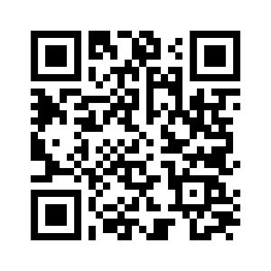
Deberes
Vocabulary Learning Homework (Y7, Term 1.2, Week 5)
Audio file
Audio file QR code:
Student worksheet
Quizlet link
In addition, revisit: Term 1.2 Week 2
Term 1.1 Week 4

