Slide 1
Language and culture: a room with a view?
Language World Conference 2021
Rachel Hawkes Artwork: Steve Clarke
Date updated: 4/06/21
Notes:
Hello. My name is Rachel Hawkes. I’m a languages teacher and leader but currently seconded from my school to work as co-director at NCELP, and secondary languages lead for Oak Academy, and in this session I'm going to talk about some thoughts on language and culture, after two and a bit years of work with NCELP (the National Centre for Excellence for Language Pedagogy). Before we get underway, I want to thank all of the NCELP team for the hard work and dedication that have gone into the NCELP to date. In particular, with reference to the resource creation side of things I want to give a shout out to all the NCELP resources developers and Professor Emma Marsden, director of NCELP. And very importantly, I also want to thank all of our lead and hub school teachers who started trialling the resources around 18 months ago and to whom we are indebted for all the QA and feedback we receive, and also the adaptions and resources that they are creating. Last week we received the most amazing version of Cinderella in French, told in words taught entirely from the Y7 and 8 French SOW. Really fantastic stuff.
But, let’s get started.

Slide 2
Language and culture: a room with a view?
a room is ‘rules and restriction’
a view is ‘freedom, adventure, possibility’
limitations of this either/or world view
Notes:
A room stands for civilization and all its confinements; a view stands for nature, freedom, and the open air. A room with a view means a life that is free and open to adventure and possibility, one that is not too closely confined by society's rules and pressure to conform. And whilst I think this is most definitely a view of language learning that appeals to me, this metaphor is a bit stuck because it reinforces a binary world view of either / or. We love these dualities for their simplicity. Right/wrong, winner/loser, male/female, for/against. But we need to remember that this is human interpretation of the world, rather than the world itself. And it is no different with language learning. We tend towards presenting polarised and exclusive rather than inclusive relationships. They abound on social media! So, for example, if you are for language you must somehow be against or neglecting culture, and vice versa.

Slide 3
Language and culture: two sides of the same coin
the together/and view
closely related
cannot be separated
despite apparent differences
both needed for full ‘value’ to be realised
Notes:
We can sometimes gain more from a ‘together and’ rather than an ‘either/or’ perspective and that’s where the 2nd metaphor of language and culture as two sides of one coin comes in. This is of course the idea that language and culture are very closely related and cannot be separated, although they may seem different. Co-dependent, there can’t be one without the other, and both sides are needed for the full value to be realised…
This is a very short presentation, and a very big theme! To make this work, I’m going to focus on the idea of not separating language and culture, and give as many practical examples as will fit into 20 minutes!
At the end of the presentation, I’ll share the link to the NCELP culture collection of all the examples of culture across all strands across all languages, with everything downloadable in one click.

Slide 4
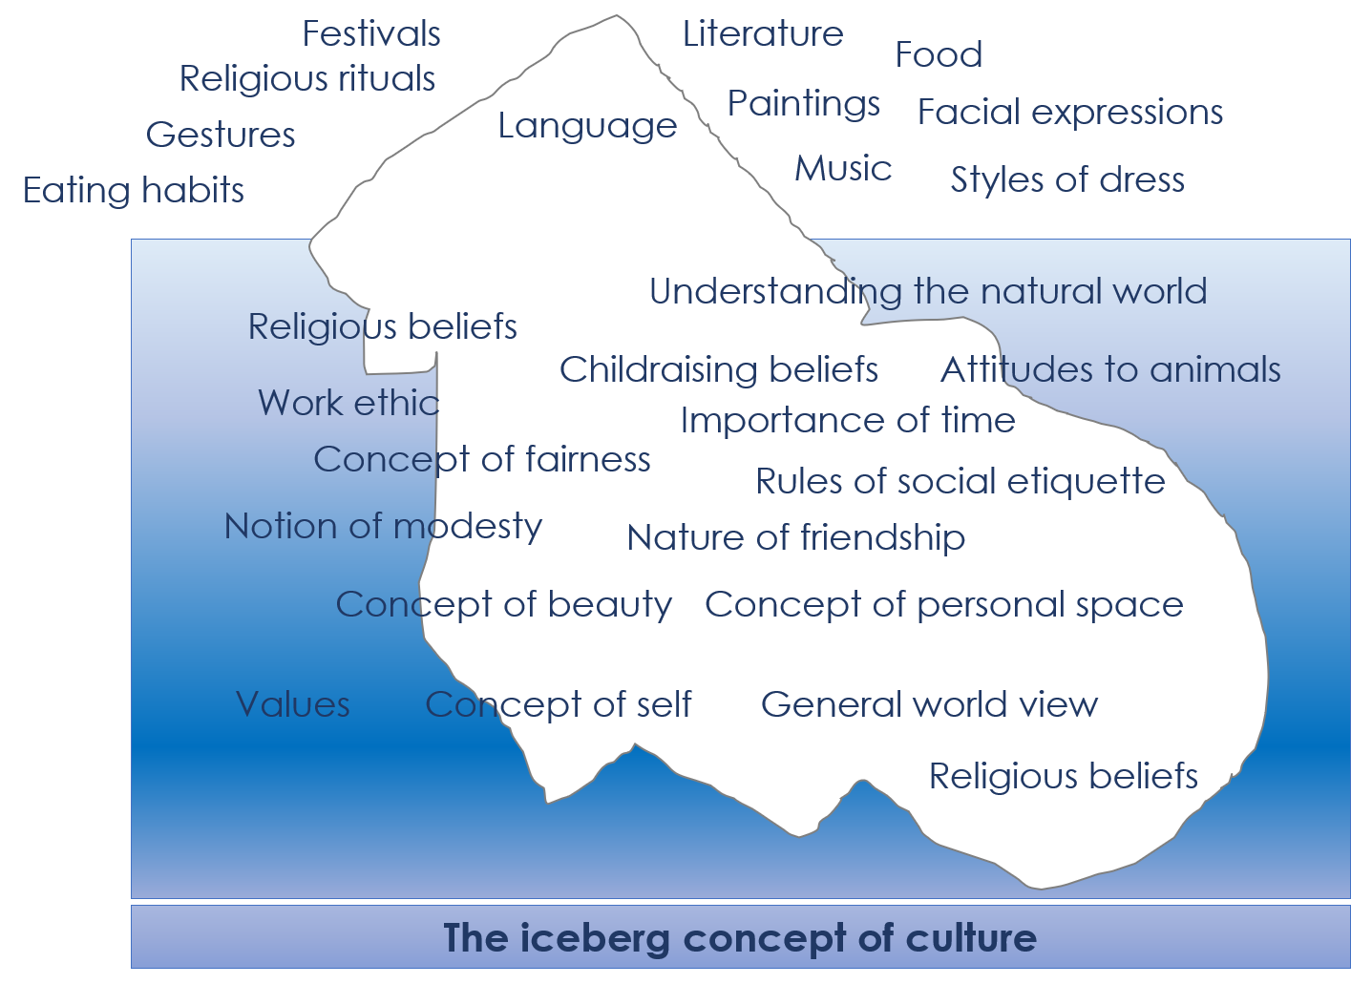
We find culture in…
“Common attitudes, beliefs and values are reflected in the way members of the group use language - for example, what they choose to say or not to say and how they say it.” (Kramsch, 2001, p6).
the new language sounds
its words and
its structures.
Learning a foreign language is a liberation from insularity and provides an opening to other cultures. (DfE, 2013).
Notes:
Let’s not forget that language teaching is at its core a rejection of cultural supremacy and that it compels us to see the world through different eyes, as in my favourite sentence from the National Curriculum for languages: Learning a foreign language is a liberation from insularity and provides an opening to other cultures (DfE, 2013).
Seeing the process of learning a new language itself as a step towards intercultural competence is helpful. It is also worth considering what is meant by culture.
I’m sure many of you have see the iceberg model of culture. If we understand culture as the system of attitudes, beliefs and values - the underwater part of the iceberg- which underpin the actions, habits, celebrations that we see in everyday life in the surface part of the iceberg, we can sense that not only are they inseparable, but that learning what we can see might pave the way to understanding what we can’t see so easily. And language itself is perhaps the most visible and accessible expression of culture, as Kramsch suggests.
And so we find culture in language; in its sounds, in its words and in its structures. In teaching them, we lay the foundation for understanding other world views and for seeing ourselves through the eyes of others.

Slide 5
Culture in the new language sounds
Transcribing unknown words
French example – French cities with/without the [au] sound
Decoding (reading aloud) unknown words
French: metro stations
German examples: jokes
Sociolinguistic differences
Spanish example: ceceo and seseo
place names
people’s names
names of other things (e.g. games, bands)
cognates
tongue twisters
short texts (e.g., information about famous people, customs, festivals, songs)
Notes:
There is a reason why the teaching of the sound-writing system has been given an important place in the new GCSE Subject Content. Teaching the sound-symbol correspondences of the new language demystifies it, enabling students to decode it (read it aloud) more accurately. Research has linked this to higher levels of motivation, confidence in production (Erler & Macaro, 2011), and better vocabulary learning (Woore et al., 2018).
The teaching of phonics combines easily with culture. As the development of phonics knowledge involves listening to, transcribing and reading aloud unfamiliar words, there are opportunities to get to know place and people names, geographical features, iconic landmarks, and elements of popular culture.
Developing fluency in reading aloud can involve tongue twisters, rhymes, songs and short texts about famous people, customs and festivals.
We’re going to look at three quick examples.

Slide 6
Phonétique
écouter / parler
Do these place names contain the sound [au]? Écoutez et cochez.
 |  | Oui | Non
 | Bordeaux
 | Gren o ble
 | C o rse
 | Beauvais
 | L au sanne
 | O rléans
 | Aix-en-Pr o vence
 | Monaco
1
____
2
____
3
____
4
____
The letter ‘o’ is sometimes (but not always!) pronounced like [au] too.
5
____
6
____
7
____
8
____
Notes:
Y7.2.1.3
This is from Y7 Term 2. This is actually a stage before transcription. It is aural recognition of the [au] sound. It works with just one sound, but a sound which can have more than one spelling. Students listen and decide if they hear the target SSC or not. But you can, I hope, imagine how transcription tasks might work in a similar way, where students do write down the missing letters.
Timing: 5 minutes
Aim: Oral recognition of SSC [au].
The exercise also provides an opportunity to review SFCs (Bordeaux, Beauvais, Orléans) and the previously studied SSCs [é] (Orléans), [en] (Aix-en-Provence) and [ai] (Beauvais, Aix-en-Provence).
Procedure:
1. The place names are heard on individual number clicks. To allow students to compare the sounds, it is recommended that the teacher cycles through the recordings (from 1-8) at least twice.
2. Teacher reveals answers on clicks. Teacher to highlights the fact that some place names, (Bordeaux, Monaco) contain both sounds, and that the letter ‘o’ is not always pronounced [au] (this will be explored further in Year 8). Teacher can illustrate this by giving examples of previously encountered words such as modèle, école, ordinateur …
3. Teacher elicits pronunciation by pointing at the word and asking ‘Comment dit-on numéro un, deux…’
4. Teacher plays each place name again, and students repeat chorally.
Transcript:
Bordeaux
Grenoble
Corse
Beauvais
Lausanne
Aix-en-Provence
Orléans
Monaco

Slide 7
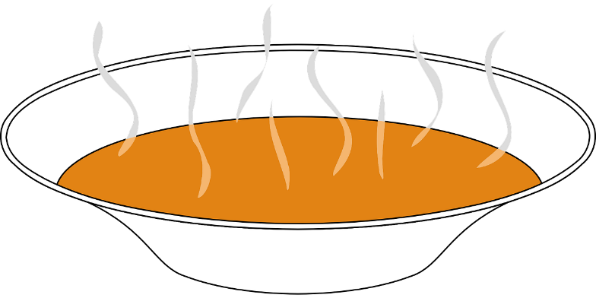
Phonetik
Lies den Witz* laut vor. Wie heißt das auf Englisch?
lesen / sprechen
10
Herr Ober*, da ist eine Fliege in meiner Suppe!
Nein, nein, meine Dame, das ist eine Kakerlake, die Fliege ist auf dem Steak.
Sekunden
0
die Kakerlake - cockroach
LOS!
Notes:
Sometimes a cultural focus can be about finding similarities rather than differences. Here, it’s simply that cheesy, terrible, waiter waiter jokes exist in both English and German. Some of these words are new, some are known. There are several examples of ‘ei’ juxtaposed with ‘ie’ words. The sentences are short enough to allow several practices to build up fluency. The cheesy humour distracts from the anxiety that there can sometimes be about pronouncing unknown words. And you have to admit, Kakerlake is also just ones of those words that is lovely to say!
Slide 2/2 (8.3.2.7)
Timing: 5 minutes (for two slides) Aim: To develop SSC fluency when reading aloud a mixture of known and unknown words at sentence level, building up speed of oral production through task repetition. Procedure: 1. Teacher ensures students recognise the premise and format of the ‘waiter, waiter’ joke, noting that this is a genre of humour that is shared across many cultures.
2. In pairs, students read the joke aloud, aiming for appropriate intonation and emotion in their ‘performance’, as fits the scenario.
3. Teacher ensures that the meaning is clear.
4. Click to reveal the 10-second timer. Students read the joke together two-three times, aiming to increase the speed and confidence of their oral production.
5. At the most beneficial moment for learners, click each speech bubble to hear an audio version of the joke. Transcript: Herr Ober, da ist eine Fliege in meiner Suppe! Nein, nein, meine Dame, das ist eine Kakerlake, die Fliege ist auf dem Steak.
Word frequency of cognates and unknown words (1 is the most frequent word in German): Fliege [3994] Kakerlake [>5009] Ober [>5009] Steak [5009] Suppe [>5009] Witz [2228] Source: Jones, R.L. & Tschirner, E. (2019). A frequency dictionary of German: core vocabulary for learners. Routledge

Slide 8
SSCs [CE], [CI] y [Z]
escuchar
Remember, there are different ways to pronounce CE and CI.
In most of Spain, the ‘c’ before ‘e’ or ‘i’ is pronounced
like _____ in English. The same is true of ‘z’ before a vowel.
‘th’
In the Canary Islands and Latin America, this ‘c’ is often pronounced like an ____. The same is true of ‘z’ before a vowel.
‘s’
Escucha. Es ¿España o Canarias / Latinoamérica?
ciencias
España
1
________________________________
ciencias
Canarias / Latinoamérica
2
________________________________
cabeza
Canarias / Latinoamérica
3
________________________________
cabeza
España
4
________________________________
Notes:
The NCELP resources introduce students to different ways to pronounce certain key SSC, the ce, ci, and zeta, for example. Here, after a quick revision of the knowledge, we do a listening task.
Phonics recap slide
Timing: 3 minutes
Aim: to revisit the SSCs [CE, [CI] and [Z] and raise awareness of the different ways in which they are pronounced in the Spanish-speaking world.
Procedure:
Read explanation, eliciting the answers from students where prompted by gaps.
Play the audio and ask where the person is from (‘¿La persona es de…?’)
Ask students which other words they can recall from Y7 which have [ce], [ci] and [z]. This will help to prepare them for the next activity.
Anticipate, for [Z], voz, cabeza, empezar, zapato, zona, diez, naturaleza,
Anticipate, for [CI], cine, diciembre, decir, cierto
Anticipate, for [CE], ciudad, centro, necesitar, cerca
Notes:
Individual teachers may also find it useful to consider the information from exam board specifications below:
AQA : “The [listening] test will be studio recorded using native speakers speaking Castilian in clearly articulated, standard speech at near normal speed. Different types of spoken language will be used, using familiar language across a range of contemporary and cultural themes. (p. 82)
EdExcel : “For listening and reading assessments, the majority of contexts are based on the culture and countries where the assessed language is spoken. […] It is, therefore, important that students are exposed to materials relating to Spanish-speaking countries throughout the course.” (p. 7)
WJEC : “This GCSE specification in Spanish for use in Wales is based on a conviction that learners studying a modern foreign language will develop their desire and ability to communicate with and understand speakers of Spanish in a variety of contexts and for a variety of purposes.” (p. 3)
Image attribution:
Image with creative commons public domain licence
https://mycsres.com/freesheet/spanish-speaking-world-map-18.html.html

Slide 9
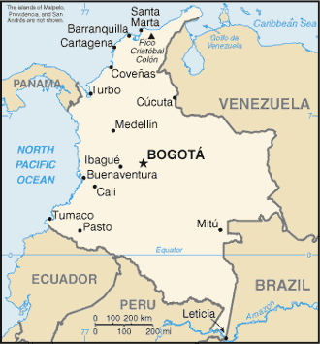
¿De dónde son las personas?
escuchar
Latin America / Canaries | Mainland Spain
Estás de vacaciones en Colombia. Hay mucha gente en la plaza en Bogotá, la capital.
1
cine
2
plaza
Escucha las voces diferentes. Decide si la persona (probablemente) es de España o Latinoamérica.
3
empezar
4
ciudad
5
centro
Marca la opción correcta y escribe las palabras con [ce], [ci] y [z] en español.
6
necesito
naturaleza
7
zona
cerca
8
cierto
Notes:
to practise identifying the probably origins of speakers by the pronunciation of the key sounds. And at this stage in their learning, in Y8, students can do this hearing full sentences.
Phonics practice activity
Timing: 6 minutes
Aim: to raise awareness of the different ways in which the SSCs [CE, [CI] and [Z] and are pronounced in the Spanish-speaking world.
Procedure:
Play the audio and ask students to tick the right column and write the word(s) with the target SSCs.
Check answers, including spelling, in feedback
Note:
Some students may be able to write the entire sentence.
Ensure understanding of ‘de dónde’. Both words have been taught, but separately, and theword order is different here from English (‘where….from’).
Transcript:
¿Dónde está el cine?
La plaza es muy antigua.
¿Cuándo va a empezar la clase de baile?
En la ciudad hay muchos restaurantes muy buenos.
Las tiendas en el centro son muy caras.
Necesito comprar un regalo barato.
La naturaleza aquí en esta zona es hermosa.
El teatro famoso está cerca, ¿cierto?

Slide 10
Culture in the new language words
Sociolinguistic differences
Spanish example: uno and primero
Formal and informal register
German example: conversational words
Revisiting vocabulary in new contexts
French example: la pétanque
Notes:
Vocabulary teaching should be equally culture-rich. Just as important as teaching the differences in phonology arising from geographical variants of the language is raising awareness that within a particular language there can be different expressions for the same thing; that is the Spanish example. Then it can be an opportunity to learn more about how people speak compared to how they write in the new language, that’s the German example, and finally, the French example will show that word knowledge can be deepened by recombining previously taught language in a new cultural context.

Slide 11
Saying dates in Spanish
gramática
These are called ‘ordinal numbers’.
To say the date in English, we say, for example, the second of December or the twenty third of June.
These are called ‘cardinal numbers’.
To say the date in Spanish, we use numbers such as uno, dos, tres...
Ejemplos:
el tres de enero
the third of January
(literally, ‘the three of January’)
el seis de abril
the sixth of April
(literally, ‘the six of April’)
The only exception is the first of the month. There are two possibilities:
el primero de enero
‘El primero’ is more common in
Latin America.
’El uno’ is more common in Spain.
the first of January
el uno de enero
Notes:
A simple slide to introduce dates in Spanish, with one important addition, the reference to ‘el primero’ and ‘el uno’ and their different use. Every time we routinise and normalise language variation like this in the classroom, it is one more coin in the slot of curriculum decolonization.
Timing: 2 minutes
Aim: to teach students how to say dates in Spanish; to raise awareness of cross-linguistic differences between English and Spanish
Procedure:
Teachers click to go through the slide. Gaps are left to allow teachers to elicit answers from students.
Teachers could go back to the previous slide to show the examples of dates used in the text.
Notes:
1. Teachers could also highlight how the English say ‘on the 7th July’, but Spanish doesn’t have a word for ‘on’ in this context.
2. Teachers could draw attention to the fact that months do not have capitals.
3. Months and numbers are part of the vocabulary set to be revisited this week, which coincides with the introduction of this new feature.

Slide 12
Wirklich [really] / so [so] / also [well...]
Vokabeln
$x=\frac{−b±\sqrt{b^{2}−4ac}}{2a}$
‘Also’ doesn’t mean ‘also’.
Use it to mean ‘well.......’ and to buy thinking time, before you speak.
In front of an adjective, these words add emphasis:
Deine Haare sind so toll!
Your hair is so cool!
Diese Aufgabe ist wirklich schwierig!
This task is really difficult!
Used like this, so and wirklich are synonyms.
On its own so is an adverb and means ‘like that’ or ‘in that way’:
Mia, dürfen wir das so machen?
Mia, are we allowed do it like that?
Nein, Wolfgang. So darfst du das nicht machen!
No, Wolfgang. You’re not allowed to do it in that way!
So and also can mean ‘so, therefore’. Also as a filler, means ‘well,…’
Notes:
Social convention is one aspect of culture that is highly relevant to language learners. Within this, the use of formal and informal register has both lexical and grammatical dimensions.
This lexical example is a task focused on the use of high frequency words that serve as ‘fillers’ or to add emphasis, such as ‘also’, ‘so’ and ‘wirklich’ in German. This particular activity gets right to the heart of what students will hear spoken, in terms of intensifiers. It’s important to listen to and practise the intonation patterns involved with using these words, too.
We differentiate here between spoken and written register, but also importantly we draw additional attention to polysemy, the multiple meanings of high-frequency words. One of the reasons that HF words are so, is that they often have more than one meaning or use. It’s important to teach and practise these multiple uses explicitly.
Timing: 2 minutes Aim: To explain and exemplify the use of wirklich / so / also. Procedure: 1. Cycle through the animated sequence.
2. Click on the speech bubbles to hear the the audio.

Slide 13
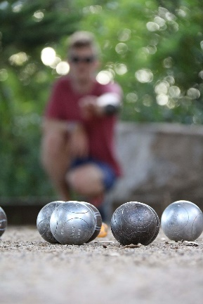
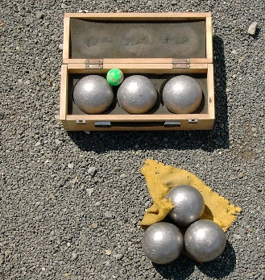
Les vacances
lire
Amir dit ses histoires de vacances à Océane. Complète les phrases.
Ma saison préférée, c’est l’été . Pendant les vacances, je passe mon temps dehors. Chaque jour, Noura frappe à la porte de ma chambre, et nous allons au parc pour jouer à la pétanque avec la famille. La pétanque, c’est une tradition qui vient de Provence, la région près de Nice. Si on vient d’ ici , la pétanque est dans son cœur !
[1] ___
[2] ___
[3] ___
[4] ___
[5] ___
[6] ___
[7] ___
[8] ___
[9] ___
cœur
été
frappe
ici
pendant
pour
saison
si
temps
Notes:
The NCELP SOW revisit all vocabulary after about a month and again within the term, and then again after a year. In this third vocabulary example, we can see how a task to revisit a previous week’s vocabulary is re-purposed and combined into a text. Meeting words on multiple occasions but combined differently with different themes to the fore is a very powerful and effective way to deepen word knowledge. They won’t just know these words again when they meet them in the same collocations, as often happens when students meet a word wedded to one particular topic, or embedded in one particular chunk. They will be more easily able to recall and use the words because they have practised recalling and using them in different contexts, rather than just one. Here, the theme of the text is pétanque.
Timing: 5 minutes
Aim: checking written comprehension of this week’s revisited vocabulary
Procedure:
1. Students write 1-9 and choose which word can fill the gap.
2. Click to reveal the answers.
3. The text can also be translated into English.
Word frequency of revisited vocabulary (1 is the most frequent word in French): saison [1667], été [623], pendant [89], temps [65], frapper (à) [745], pour2 [10], si1 [34], là [109], cœur [568],
Source: Londsale, D., & Le Bras, Y. (2009). A Frequency Dictionary of French: Core vocabulary for learners London: Routledge.
Word frequency of cognates used (1 is the most frequent word in French): compléter [2034], région [241]
Source: Londsale, D., & Le Bras, Y. (2009). A Frequency Dictionary of French: Core vocabulary for learners London: Routledge.
Image attribution:
Par Brunobuisson — Travail personnel, CC BY-SA 4.0, https://commons.wikimedia.org/w/index.php?curid=81872264
Domaine public, https://commons.wikimedia.org/w/index.php?curid=1372253

Slide 14
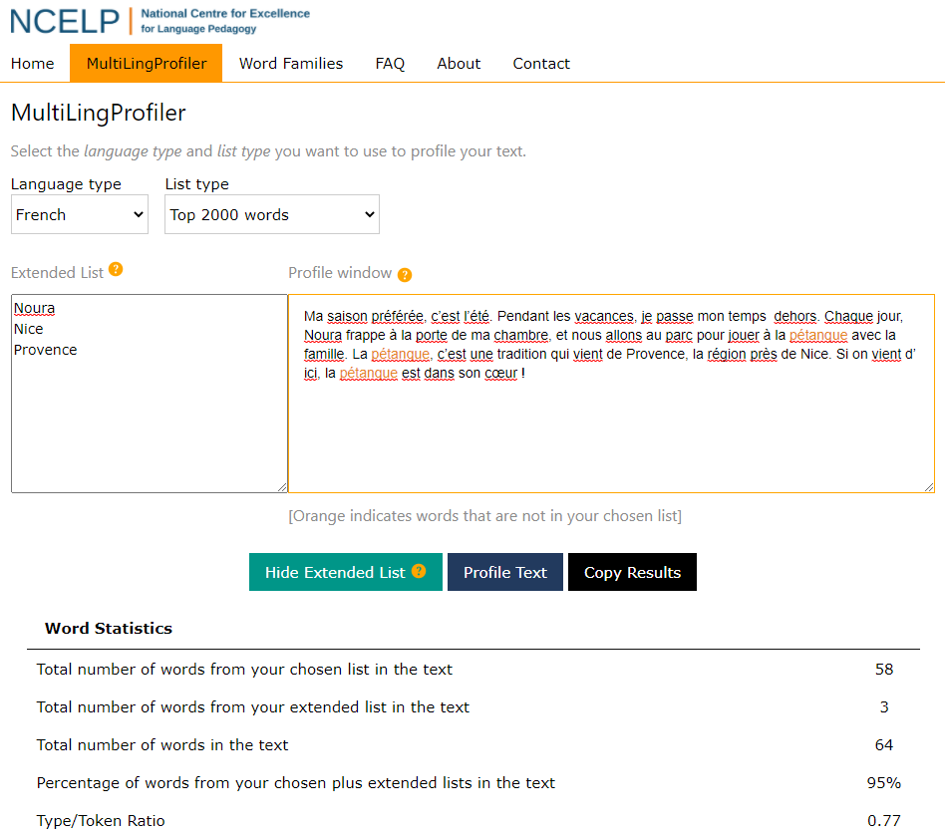
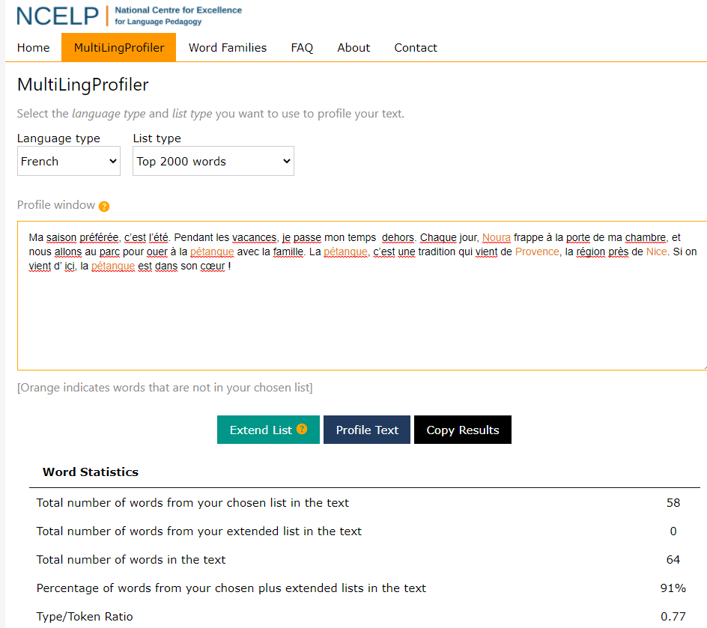
MultiLing Profiler
Ma saison préférée, c’est l’été. Pendant les vacances, je passe mon temps dehors. Chaque jour, Noura frappe à la porte de ma chambre, et nous allons au parc pour jouer à la pétanque avec la famille. La pétanque, c’est une tradition qui vient de Provence, la région près de Nice. Si on vient d’ ici, la pétanque est dans son cœur !
Anthony, L., Finlayson, N., Marsden, E., Avery, N. & Hawkes, R. (2020). MultiLingProfiler Version 1. [Computer Software]. Available at https://www.multilingprofiler.net/
Notes:
I thought it would be useful to show the full text here. There’s likely to be quite a lot of discussion in the next few weeks about word frequency! I think the one thing I’d like us to hold on to in this discussion is what high-frequency words means. It means the words that are ‘most often used’ – not a particular type of word, like a conjunction or the words for ‘the’, though these are most certainly high-frequency words. It has been suggested somewhere that HF words are function words and the non HF words are content words. Clearly this is nonsense. HF just means that these words are the most used, so they will include nouns, verbs, adjectives, prepositions, conjunctions –! the full range of parts of speech is represented in any list of the 2000 most frequently used words in a language.
I was mentioning some of the recent criticism about NCELP’s apparent fetishization of the most frequent words to my husband, a maths teacher and he said: “Mm, if the most frequent words are so useless, then why do people keep using them so much?”
This idea of frequency does take a little getting used to. There may be some who wonder if it will be possible to create texts suitable for GCSE with just 90% top 2000 words, and a few others.
So, I pasted this text into the MultilingProfiler, an online tool freely available to all to use to profile the words in a text against a list of the most frequent 2000 words in French, German or Spanish. When you do that you find that they are all in the top 2000, with the exception of the proper nouns, Noura, Nice and Provence and the three instances of the word pétanque. Including all the proper nouns, the % words in the top 2000 is already 91%. If you exclude the place and people names, this goes up to 95% and the only word missing is pétanque, which can be glossed. This 64-word text would not be out of place in a GCSE French reading exam, and plenty of question types could be set to assess its comprehension.

Slide 15
Culture in the new language grammar
French example
formal and informal register (nous and on)
Spanish example
describing places; ser, estar and adjective agreement
German example
feminisation of nouns and das Gendersternchen
Notes:
So, we have seen examples of culture combining with phonics and vocabulary. Unsurprisingly, grammar features also combine well with cultural contexts. There are as many possible combinations as there are features and contexts! This is much more evident, just as it is for vocabulary, when teaching is freed up from the constraints of topics.
So, again I have three examples to share, that attempt to show the full range (but we’re on a tight timeline so it’s just a tiny sample)

Slide 16
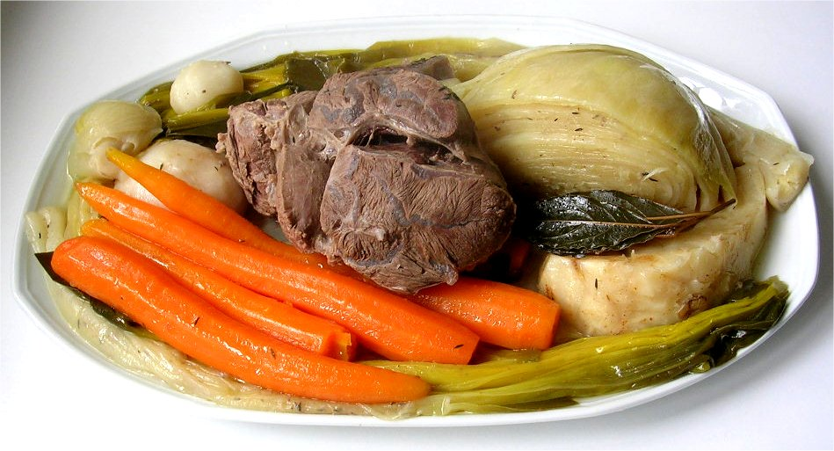
La visite à Nice
lire
Natalie parle des expériences de la classe. Elle écrit dans le magazine du collège (nous), ou dans un message à sa nouvelle amie française (on) ?
1. On n’est pas loin de Monaco.
magazine / message
___
Pot-au-feu
(‘pot on the fire’) is a traditional beef stew, often considered the national dish of France.
2. Nous jouons à la pétanque avec la famille.
magazine / message
___
3. Nous mangeons le plat national, le pot-au-feu.
magazine / message
___
4. On organise une fête avec les élèves.
magazine / message
___
5. Nous aimons aller à la plage en décembre !
___
magazine / message
6. Nous passons beaucoup de temps dehors en général.
magazine / message
___
7. On achète des cartes postales.
magazine / message
___
8. On va bientôt revenir !
magazine / message
___
Notes:
Here, we explore the use of nous and on to mean ‘we’ in formal and informal contexts. The context of the lesson is an exchange visit to Nice and other tasks within the lesson include more about the place, too. Here, there is some factual information – proximity to Monaco, reference again to Pétanque, and a call out to the national dish ‘pot-au-feu’. Students choose the pronoun based on the verb form, but at the same time they distinguish between formal use – written magazine article and informal use – message to a friend.
Timing: 5 minutes
Aim: written recognition of the third person singular form of a range of verb types, connecting this form with the informal on meaning
Procedure:
1. Students write 1-8 and choose nous or on for each.
2. Click to reveal the answers.
3. English translations can also be elicited.
Word frequency of cognates used (1 is the most frequent word in French): expérience [679], magazine [2033], message [792], pot-au-feu [3648/4/786]
Source: Londsale, D., & Le Bras, Y. (2009). A Frequency Dictionary of French: Core vocabulary for learners London: Routledge.
Image attribution:
Par Andre — recettessimples.fr, CC BY-SA 3.0, https://commons.wikimedia.org/w/index.php?curid=324118

Slide 17
Karaoke SSC
Sag die Femininform für jedes Wort.
sprechen
Finde eine*n Partner*in.
3
Wissenschaftler
Add – in to male person nouns to make female nouns.
6
Aktivist
Drop the –e ending first!
2
Autor
1
Forscher
das Gendersternchen (Gender Star)
10
Theologe
The * symbol is sometimes used as a more inclusive way of differentiating male/female role nouns. E.g., Lehrer*in not Lehrer/Lehrerin. It is placed between the m/f forms to symbolise all genders in between and it makes it possible not to specify gender. E.g., Alex ist Künstler*in.
4
Komponist
5
Tourist
9
König
8
Astronaut
7
Erfinder
[inventor]
Notes:
Here students are practising the pattern of adding –in to male nouns to make female nouns. It practices grammar and a range of different SSC, including the ‘r’ change from, for example, Autor to Autorin. But whilst this pattern is an important feature of German, it’s also important to recognize that not everyone in our classes can or wants to see themselves represented in this binary. So, it’s the ideal opportunity to introduce the Gendersternchen, and then use it immediately in the task instructions! It’s a real example of ‘together and’ rather than ‘either or’ and shows that language does shift, however slowly, to reflect human experience.
Timing: 5 minutes
Aim: Productive oral consolidation of the noun rule for the feminisation of masculine people nouns, and revisit of the pronunciation of several SSC but particularly [r] within words, where pronunciation is very different from English, formed at the back of the throat without using the lips at all. Note that three nouns are from this week’s vocabulary set, one was taught in Week 1 (König), five others are cognates and Erfinder appeared in lesson 1, though teachers may want to ensure that the meaning is remembered. Students may not have heard of theologian in English, so teachers may need to explain the meaning.
Procedure:
Click to highlight a word.
Students say the feminine form of the noun out loud, focusing on accurate pronunciation of all the SSC.
Click on the number button next to the word to check pronunciation.
Transcript and word frequency (1 is the most frequent word in German):
1. Forscherin
2. Autorin
3. Wissenschaftlerin
4. Komponistin
5. Touristin
6. Aktivistin
7. Erfinderin
8. Astronautin
9. Königin
10. Theologin Word frequency of unknown or cognate words (1 is the most frequent word in German): Autor [723] Komponist [>5009] Aktivist [>5009] Erfinder [>5009] Astronaut [>5009] Theologe [>5009] Source: Jones, R.L. & Tschirner, E. (2006). A frequency dictionary of German: core vocabulary for learners. Routledge

Slide 18
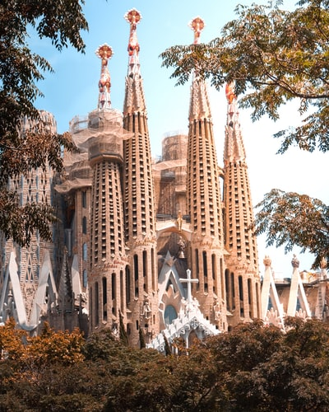
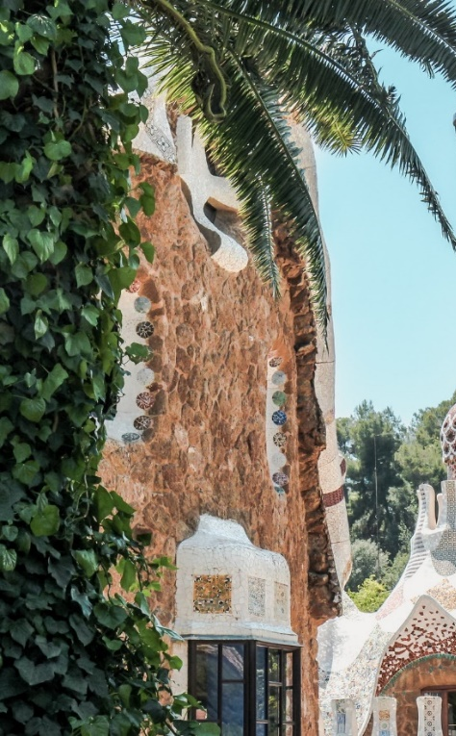
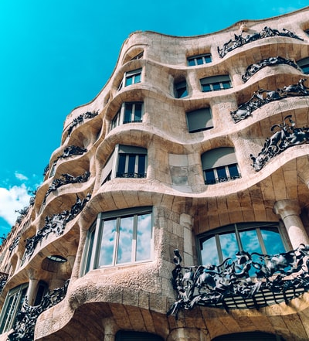
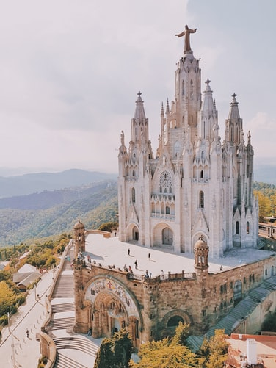
leer / escribir
Completa las frases.
Casa Batlló y Casa Milá
[are important]
[are in the centre]
En Barcelona hay unos edificios y unas iglesias. Los edificios _____ ____________ y las iglesias _____ ____________.
son
importantes
están
La Sagrada Familia (izquierda) y el Templo Expiatorio del Sagrado Corazón (derecha)
en el centro.
Notes:
These next four slides are a Spanish activity to revisit the different use of SER and ESTAR together with plural adjective agreement. The context for doing so is two cities in Spain.
Time estimated: 4 minutes
The next four slides offer the opportunity for students to see further exemplified sentences of the target features (plural definite and indefinite articles) plus the chance to practise son vs están and adjective agreement (where needed). This will be needed in the speaking production activity. Students could either write their answers on mini-whiteboards or in their exercise books. Teachers can then elicit the English translations, either orally or written.
Photo by Florencia Potter on Unsplash
Photo by Kristijan Arsov on Unsplash
Photo by Tomáš Nožina on Unsplash
Photo by Louisa Schaad on Unsplash

Slide 19
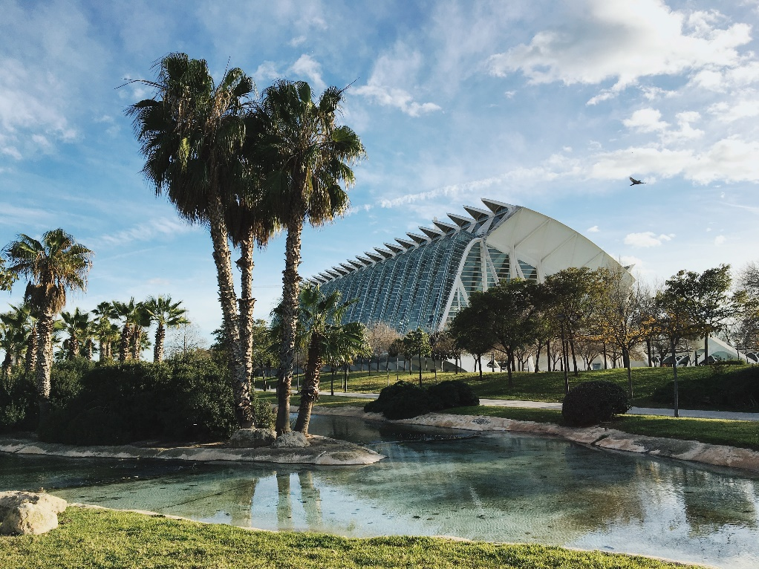
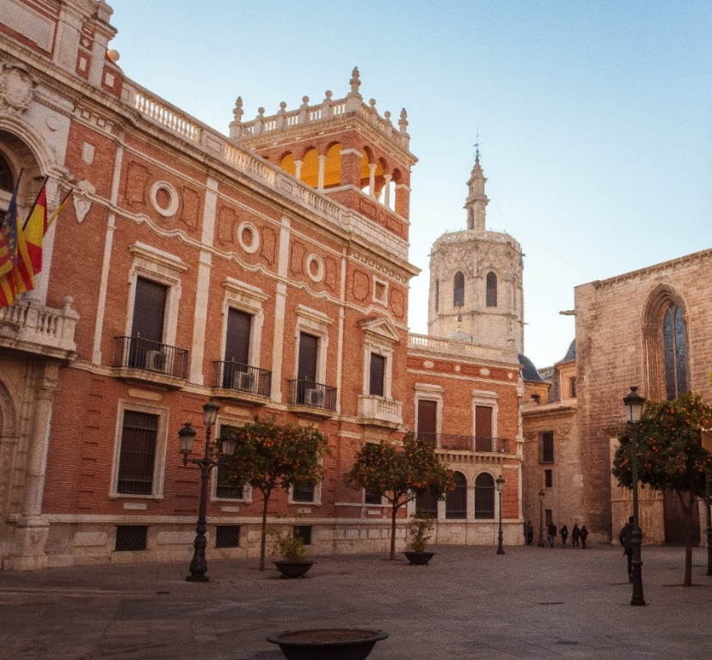
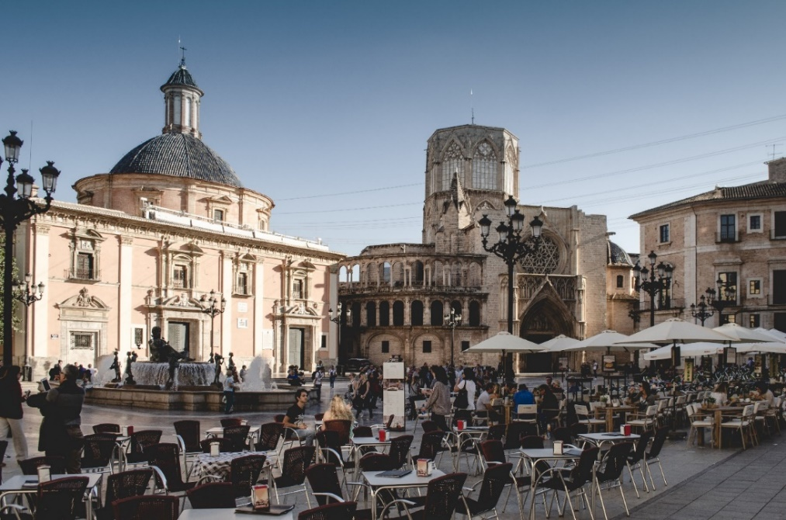
leer / escribir
Completa las frases.
[are modern]
A la izquierda: dos fotos de la Ciudad de las Artes y las Ciencias
Debajo: la Plaza de la Virgen (izquierda) y la Plaza de la Reina
En Valencia hay unos museos y unas plazas. Los museos _____ ____________ y las plazas ______ ____________.
[are old]
son
modernos
son
antiguas.
Notes:
Photo by Juan Gomez on Unsplash
Photo by Paul Povoroznuk on Unsplash
Photo by Jonny James on Unsplash
Photo by William Carletti on Unsplash

Slide 20
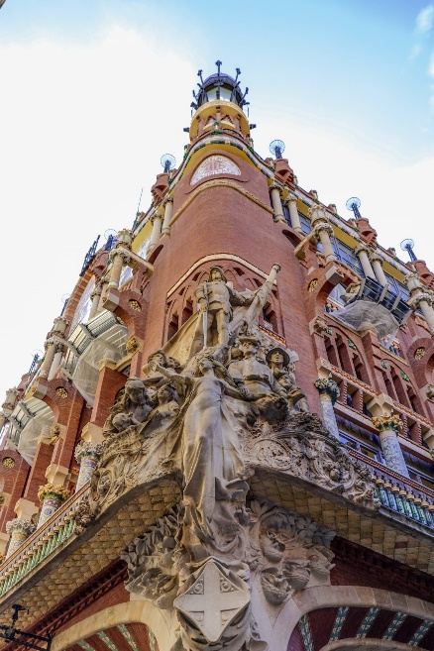
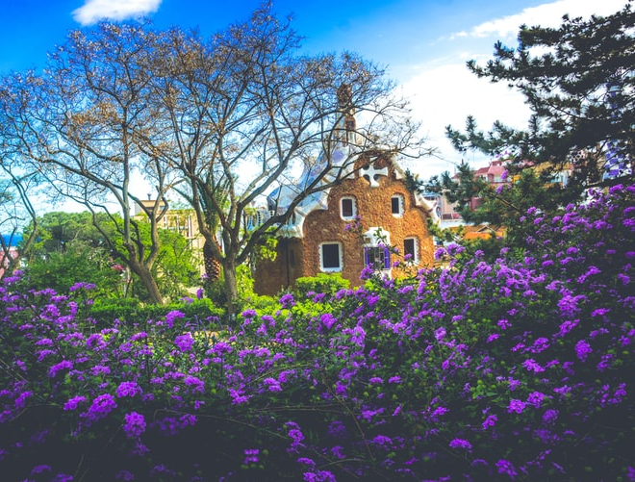
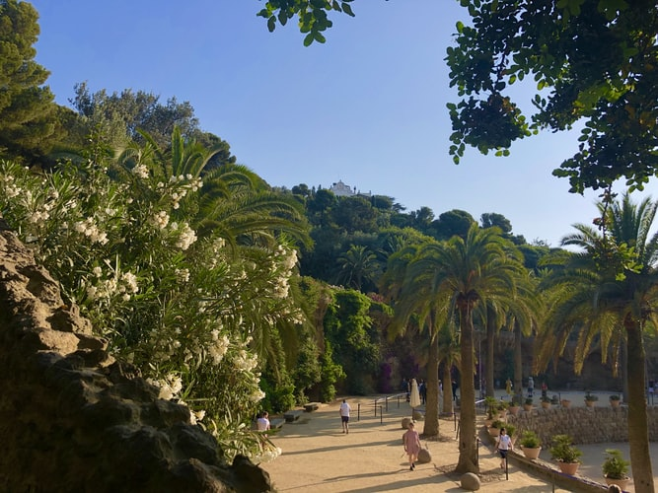
leer / escribir
Completa las frases.
[are nearby]
[are big]
Parque Güell
En Barcelona hay unas torres y unos parques. Las torres ____ __________ y los parques _____ ________.
son
grandes
están
cerca
Notes:
Photo by Fikri Rasyid on Unsplash
Photo by Biel Morro on Unsplash
Photo by Bianca Berg on Unsplash
Photo by Adora Goodenough on Unsplash
Photo by Derek Story on Unsplash

Slide 21
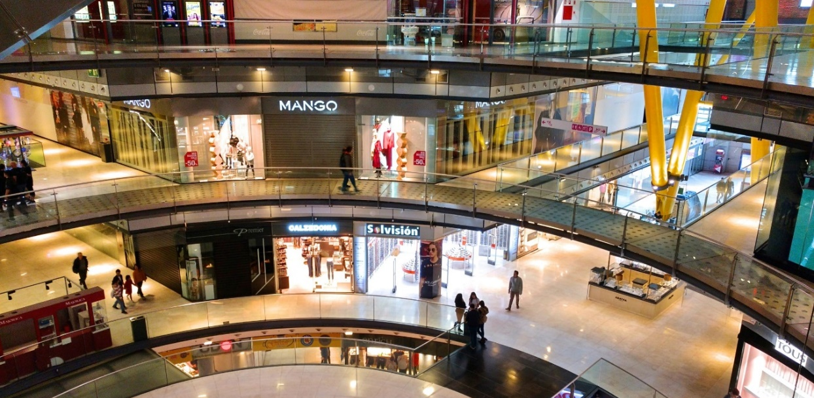
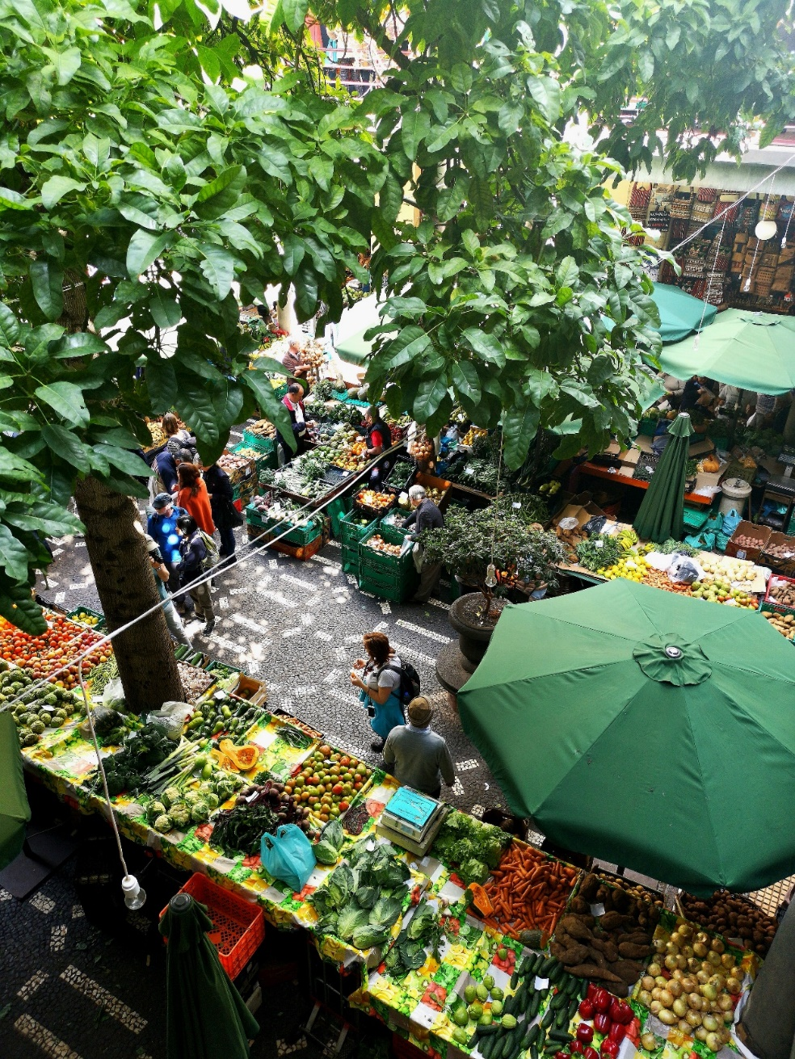
leer / escribir
Completa las frases.
[are expensive]
[are outside]
En las dos ciudades hay unas tiendas y unos mercados. Las tiendas ______ _______ y los mercados ______ _________.
son
caras
están
fuera
Notes:
Photo by WeLoveBarcelona.de on Unsplash
Photo by Juan Gomez on Unsplash
Photo by Theme Inn on Unsplash

Slide 22
Language, culture and the new GCSE Subject Content
https://ncelp.org/
Notes:
Finally, just to return to the draft GCSE Subject Content. I have just one minute left, so in that minute I will signpost you all to a screencast (60 minutes) delving into the detail of the implications of the draft Subject Content for us as teachers, and for the assessments themselves. The link to that is here.
But I will just say one thing here as it’s relevant to language and culture.
Specifying the nature (90% most frequently used words) and the amount (1200 F and 1700 H) has the following implications:
First, it removes the mystery and guesswork about which words will be in the assessment tasks and therefore which words to teach. For assessment setters and textbook writers this means that a much more rigorous and consistent approach to creating assessments and materials will be taken, year on year, but also between languages. And no unlisted language will be tested. With the current GCSE a factor in students’ grades is their ability to guess meanings of words that they haven’t been taught. And which students are most likely to succeed in that? Number 1 – native speakers, number 2 – very literate students with a broad, sophisticated vocabulary in English, together with a wide general knowledge of the world, both of which as we know are facilitated by more affluent homes with books, newspapers, discussion at mealtimes etc… The privileging of these two cohorts of students has been an (almost certainly) unintentional consequence of the requirement to include unknown language in the current GCSE examinations. An intentional consequence of the proposed content is a levelling of the social playing field with regard to content. Knowing a specific bunch of words extremely well seems to me something that all teachers, students and awarding bodies will be able to get on board with.
It also joins up KS2, 3 and 4 because the list is comprehensive and makes no assumptions about prior knowledge. The implications for planning learning from KS2 onwards are significant, the prospects for achieving a more coherent sequence of learning from Y3 – Y11 are startling and exciting, I think.
And let’s not overlook the motivational factor or knowing that your learning efforts will be rewarded. I include teachers as well as students in this. Greater clarity and precision over content obviously makes planning easier – it’s easy to overlook the real implications of this for us as teachers, though! It means you will know when you have finished teaching the course! When has this ever been possible before? To this point, we have only been able to say that we have taught all the topics from the specification, but we have never ever been able to say to students that we have taught them the whole course, as we have never known which unknown language was going to surprise them and us in the exams. Imagine opening an exam paper in 2025 and seeing that every word in the transcript, every word in the reading texts had been taught and learnt by students, thanks to a combination of the Vocabulary List and the specified grammar. The level of unknown language in the current exams has seen me say to Higher tier students in revision sessions – Look, you might only understand around 40% of the vocabulary in this text. Honestly, that is what is expected. It doesn’t mean I’ve prepared you badly or you haven’t learnt well. It just means that they’re not testing for known material, here. It’s difficult to overstate the (monumental!) step change that this represents for our subject, but I hope I’m giving a flavour at least!
Second: it ensures that the most useful words (i.e., the words that are most in use in countries and contexts where the language is spoken) are to the fore. On the assessment side this prescribes nothing, yet rules nothing out in terms of either theme or genre. What are the implications of i) not specifying topics whilst ii) specifying the vocabulary? This is about a freeing as you can get, surely. It doesn’t say there will be literary texts, it doesn’t say there won’t be, because there could be, and there is nothing to fear about this, because the words in them will either be taught and known or glossed (up to 2%). It doesn’t mean there won’t be a text about a period in history or the geography of a region where the language is spoken because there may be, and this will be great too, because the words in the text will have been taught and will by known by students or will be glossed. I was not surprised when the recent NALA survey of teachers about the current GCSE said that “73.1% said that they did not think that GCSE topics were necessary for effective language learning” (Nala, 2020) Nala survey: The Languages Curriculum and disadvantaged students. On the teaching side, it also gives this freedom, but more than that, it gives us the certainty that we are teaching words that are those that are most often used by speakers of the language. Transparency about this is fairly powerful for motivation, too. ☺
Third, it gives individual words back their value. In assessment, this means that awarding bodies are once again allowed (and indeed, required) to reward secure, individual word knowledge. All those who advocate for the importance of vocabulary should be leaping in the air for joy! For teachers, we can be glad, too, as this allows us to focus on teaching independent manipulation of words to build sentences, and it disprefers too-heavy a reliance on chunks.
As I think these examples show, words selected and taught on the basis of frequency lend themselves to themes that go beyond familiar KS3 curriculum topics, though they can also cohere around these topics, too. Any topics, really. Such taught words can combine and recombine in texts on many aspects of life in other countries. Carefully calibrating their readability, using the MultiLingProfiler (Anthony et al., 2020), also ensures that there is a systematic way of being fair to students, for exams to be set learners can access them.
I truly hope that teachers, text book writers, exam question setters, awarding bodies all embrace and use the profiler. As someone who has written a few textbooks, I cannot tell you how much I would have loved to have had this tool back then. And all the textbooks I will write from now on will use it. Why wouldn’t they? It is a complete no-brainer.
Anthony, L., Finlayson, N., Marsden, E., Avery, N. & Hawkes, R. (2020). MultiLingProfiler Version 1. [Computer Software]. Available at https://www.multilingprofiler.net/

Slide 23
References
Anthony, L., Finlayson, N., Marsden, E., Avery, N. & Hawkes, R. (2020). MultiLingProfiler Version 1. [Computer Software]. Available at https://www.multilingprofiler.net/
Department for Education. (2013). National Curriculum. Languages programmes of study: KS3. Retrieved: https://assets.publishing.service.gov.uk/government/uploads/system/uploads/attachment_data/file/239083/SECONDARY_national_curriculum_-_Languages.pdf
Erler, L. & Macaro, E. (2012). Decoding Ability in French as a Foreign Language and Language Learning Motivation. The Modern Language Journal, 95(4), 496-518.
Kramsch, C. (2001). Language and Culture. Oxford: Oxford University Press.
Woore, R., Graham, S., Porter, A., Courtney, L., & Savory, C. (2018). Foreign Language Education: Unlocking Reading (FLEUR) - A study into the teaching of reading to beginner learners of French in secondary school.

Slide 24
Language and culture: a room with a view?
Language World Conference 2021
Rachel Hawkes Artwork: Steve Clarke
Notes:
I hope that we can conclude that language learning itself certainly does offer a room with a view, but more importantly that language and culture are two sides of the same coin, and cannot be separated. Thank you very much for listening. I hope that there’s been something in there of interest this morning. Happy to take questions in the time that’s left.

