Slide 1
Saying what people do
faire (nous, vous)
SSC [u] [revisited]
Y7 French
Term 2.1 - Week 4 - Lesson 35
Natalie Finlayson / Emma Marsden / Rachel Hawkes
Artwork by: Chloé Motard
Date updated: 04/08/2022
Notes:
Artwork by Chloé Motard. All additional pictures selected are available under a Creative Commons license, no attribution required.
Learning outcomes (lesson 1):
Introduction of first and second person plural forms of faire
Revisit SSC [u]
Word frequency (1 is the most frequent word in French):
7.2.1.4 (introduce) faisons [25], faites [25], font [25], attention [482], effort [388], exercice¹ [1290], fête [1490], liste [924], d'accord [736]
7.2.1.1 (revisit) cinq [288], deux [41], dix [372], douze (1664), huit [877], neuf [787], onze (2447), quatre [253], sept [905], six [450], trois [115], des [2 - de]
7.1.2.3 (revisit) aimer [242], cocher [>5000], passer¹ [90], porter¹ [105], rester [100], trouver [83], école [477], moment [148], semaine [245], solution [608], uniforme [1801], chaque [151], à¹ [4], avec [23]
Source: Londsale, D., & Le Bras, Y. (2009). A Frequency Dictionary of French: Core vocabulary for learners London: Routledge.
The frequency rankings for words that occur in this PowerPoint which have been previously introduced in NCELP resources are given in the NCELP SOW and in the resources that first introduced and formally re-visited those words.
For any other words that occur incidentally in this PowerPoint, frequency rankings will be provided in the notes field wherever possible.
The additional English meanings of the following words have been added to Quizlet since the creation of this resource: attention, faire attention (à + noun): watch out! (to) watch out (for + noun)| watching out (for + noun)

Slide 2
u
tu
Notes:
Timing: 1 minute
Aim: To consolidate SSC [u]
Procedure: 1. Present the letter(s) and say the [u] sound first, on its own. Students repeat it with you. 2. Bring up the word ”tu” on its own, say it, students repeat it, so that they have the opportunity to focus all of their attention on the connection between the written word and its sound.
3. A possible gesture for this would be to point to someone else as though addressing him/her ‘you’. 4. Roll back the animations and work through 1-3 again, but this time, dropping your voice completely to listen carefully to the students saying the [u] sound, pronouncing ”tu” and, if using, doing the gesture.
Word frequency (1 is the most frequent word in French):
tu [112]
Source: Londsale, D., & Le Bras, Y. (2009). A Frequency Dictionary of French: Core vocabulary for learners London: Routledge.

Slide 3
u
tu
Notes:
With sound and no pictures to focus all attention on the sound-symbol correspondence.

Slide 4
u
tu
Notes:
Without sound to elicit pronunciation (without first hearing the teacher).
Teacher to elicit pronunciation by asking “Comment dit-on …"

Slide 5
u
Salut !
vue
amusant
tu
utiliser
[to use]
sur
[on]
Notes:
Timing: 2 minutes
Aim: To consolidate SSC [u]
Procedure:
1. Introduce and elicit the pronunciation of the individual SSC [u] and then the source word again ‘tu’ (with gesture, if using). 2. Then present and elicit the pronunciation of the five cluster words.
The cluster words have been chosen for their high-frequency, from a range of word classes, with the SSC (where possible) positioned within a variety of syllables within the words (e.g. initial, 2nd, final etc.). Additionally, we have tried to use words that build cumulatively on previously taught SSCs (see the Phonics Teaching Sequence document) and do not include new SSCs. Where new SSCs are used, they are often consonants which have a similar symbol-sound correspondence in English.
Word frequency (1 is the most frequent word in French): tu [112]; salut ! [2205] vue [191]; sur [16]; amusant [4695]; utiliser [345]. Source: Londsale, D., & Le Bras, Y. (2009). A Frequency Dictionary of French: Core vocabulary for learners London: Routledge.

Slide 6
u
Salut !
vue
amusant
tu
utiliser
sur
Notes:
With sound and no pictures to focus all attention on the sound-symbol correspondence.

Slide 7
u
Salut !
vue
amusant
tu
utiliser
sur
Notes:
Without sound to elicit pronunciation (without first hearing the teacher).
Teacher to elicit pronunciation by asking “Comment dit-on …"

Slide 8
Phonétique
Phonétique
lire
Trouve les mots qui ont la SSC [u].
boutique
pollution
routine
retourner
musée
plus
révolution
journaliste
usage
culture
université
budget
tourisme
température
couple
troupe
cousin
multiple
Notes:
Timing: 5 minutes
Aim: Raising awareness of cross-linguistic differences in the pronunciation of [u] between French and English
Procedure:
1. Before beginning the task, the teacher should make students aware that their knowledge of English will not help them here. Ask them how many different English pronunciations of [u] they can think of, using the cognates on the board as prompts (at least four ways - plus, university, pollution, temperature). Highlight that French is more consistent – the [u] is pronounced the same way each time.
2. To complete the task, students must look for words in which the letter ‘u’ stands alone as a vowel, (i.e. is not combined with another vowel as in e.g. routine, even though that combination of letters in this word sounds the same in English!) The presence of a single letter ‘u’ in French indicates that SSC [u] is needed (NB: there are a few exceptions to this when letter ‘u’ is combined with a nasal –n, as in un, lundi etc which are avoided here).
3. Using this information, students should be able to locate the 10 words containing SSC [u] (on a click, the distractor words disappear).
Word frequency of cognates used (1 is the most frequent word in French): plus [19], routine [4120], retourner [999], pollution [3073], boutique [3791], musée [2216], revolution [1617], culture [913], usage [863], université [1192], journaliste [1337], budget [962], température [2924], tourisme [2955], troupe [1282], multiple [2072], couple [1167], cousin [3387]
Source: Londsale, D., & Le Bras, Y. (2009). A Frequency Dictionary of French: Core vocabulary for learners London: Routledge.

Slide 9
Lotto ! 1/4
écouter
Lotto
l’attention | nous faisons | la fête
ils font | un effort | d’accord
Lotto!
Notes:
Timing: 8 minutes for 2 slides
Aim: Aural and written recognition and pronunciation of this week’s vocabulary items.
Procedure:
1. Teacher distributes the bingo cards included as supplementary materials this week (see NCELP portal alongside this resource). (The cards are double-sided, and there are three cards per page, so each printed sheet must be folded as instructed and cut into three). Explain that ‘lotto’ is the French name for Bingo.
Note: If teachers prefer, they can give students scrap paper, they can draw three 3x2 tables (for 3 rounds of the game) and select their own words from the vocabulary set, writing the English on one side and replicating the 3 x 2 tables with French words on the reverse.
2. Tell students to begin with the French side up. The teacher reads English words at random from this week’s vocabulary list. Students cross off the words they hear. When a student has crossed of all of his/her words, they say ‘Lotto!’ to indicate that they have won.
NB: As there are only 10 words on this week’s vocabulary list, the game will not last very long! It is highly like that one or more students will win after only six words have been called. For that reason, it is suggested that at least three rounds are played for additional practice.

Slide 10
Lotto ! 2/4
lire
Lotto! (2/4)
Lotto
we make, do | party | okay, alright
effort | they (f) make, do | what ?
Lotto!
Notes:
This time, students to begin with the English side up. The teacher reads French words at random from this week’s vocabulary list. Students cross off the words they hear. When a student has crossed of all of his/her words, they say ‘Lotto!’ to indicate that they have won.

Slide 11
Saying what people do
grammaire
As you know, the verb faire changes form to match the subject.
Je fais attention. Tu fais le lit. Il/elle fait un effort.
I pay attention. You make the bed. He/she makes an effort.
I am paying attention. You are making the bed. He/she is making an effort.
To say ‘we’ + faire (first person plural):
Nous faisons une fête. We have/are having a party.
To say ‘you’ (more than one person) + faire (second person plural):
Vous faites une fête. You (pl) have/are having a party.
__
__
__
__
__
Notes:
Timing: 3 minutes
Aim: To introduce the 1st and 2nd person plural forms of faire.
Procedure:
1. Teacher to remind students of the meaning of the pronouns.
2. Teacher to remind students that faire is irregular. As with être and avoir, there is a different form for each pronoun.
3. Teacher to draw attention to the liaison in faisons une fête and practise pronunciation.

Slide 12
Une semaine difficile
Une semaine difficile
* le bisou = a kiss
lire
Lis l’email. Qui fait quoi? La classe de Léa (nous) ou la classe d’Amir (vous)? Écris une liste.
Remember!
To form a question with quoi (what), put it after the verb. This is different from English.
What are you doing?
Tu fais quoi?
De: Léa
À: Amir
Objet: L’école
Bonjour Amir ! Tu fais quoi en ce moment ?
C’est une semaine difficile à l’école ici ! Nous faisons des exercices en anglais et nous faisons des problèmes de maths compliqués. Nous faisons des efforts mais c’est très difficile. Vous faites la cuisine et vous faites un voyage scolaire. C’est injuste ! Nous faisons des exercices et vous faites les fêtes de fin des cours. Je ne suis pas d’accord avec ça ! Bon … tu fais quoi ce week-end ? Il y a quoi à Nice ? Bisous, Léa
____
____
____
____
____
____
____
Notes:
Timing: 10 minutes for 2 slides.
Aim: Written recognition of the 1st and 2nd person plural forms of faire.
Procedure:
1. Frist, students fill the blanks with the appropriate pronoun (nous or vous), using their knowledge of the 1st and 2nd person plural forms of faire to inform their choices.
2. Next, students make lists (in English) recording what students in Léa’s class and Amir’s class are doing at school.
3. Teacher elicits responses by asking e.g. Qui fait des exercices de maths? Students respond chorally, e.g. La classe de Léa fait des exercices de maths. (NB – point out to students that la classe takes the third person singular form fait).
4. Pronouns revealed on clicks. Lists of activities (in English) are found on the next slide.
5. After revealing the answer, teaching to draw attention to the usage of quoi (after the verb).
6. The speech bubble draws explicit attention to the word order here, and teacher should continue to point it out throughout the sequence, whenever it occurs. Students will use the construction in oral activities later in this sequence.
Word frequency of cognates used (1 is the most frequent word in French):
maths [3438], compliqué [3324], scolaire [1993], injuste [2575], comparaison [2244], fin [111], cours [169], bisous [>5000]
Source: Londsale, D., & Le Bras, Y. (2009). A Frequency Dictionary of French: Core vocabulary for learners London: Routledge.
Students may need some extra help working out the meaning of les fêtes de fin des cours.

Slide 13
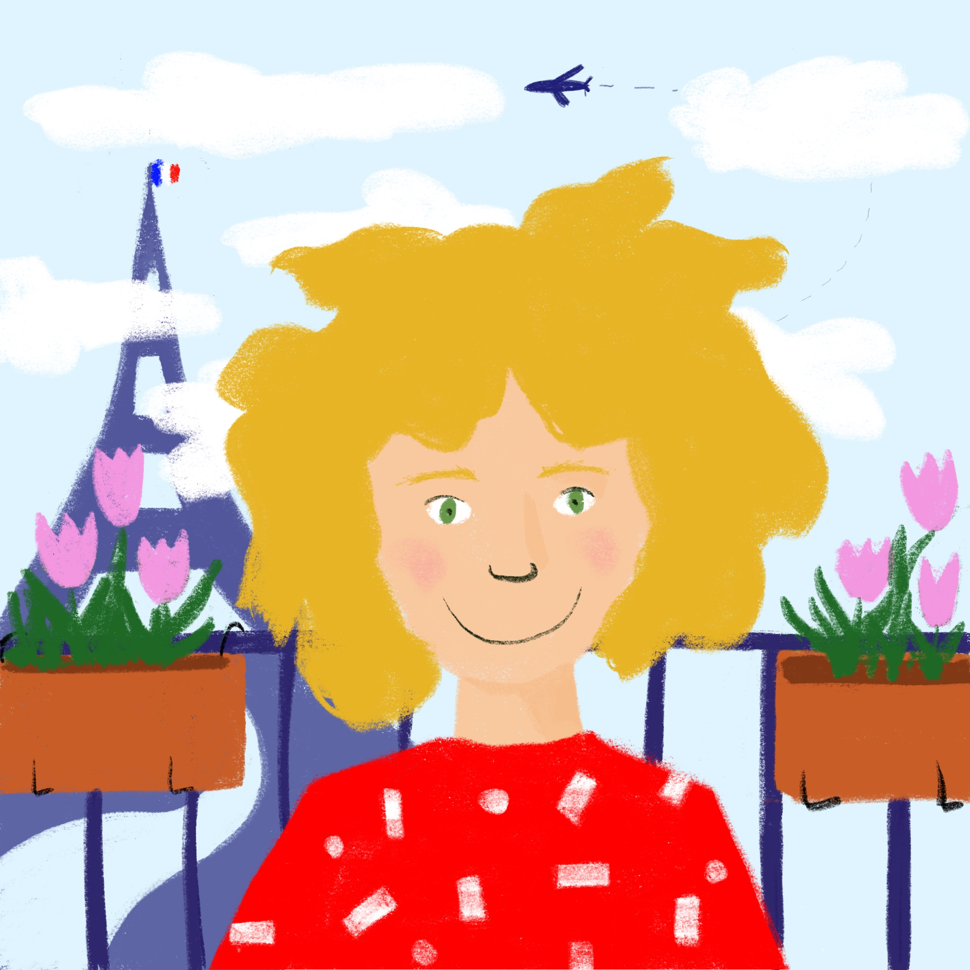
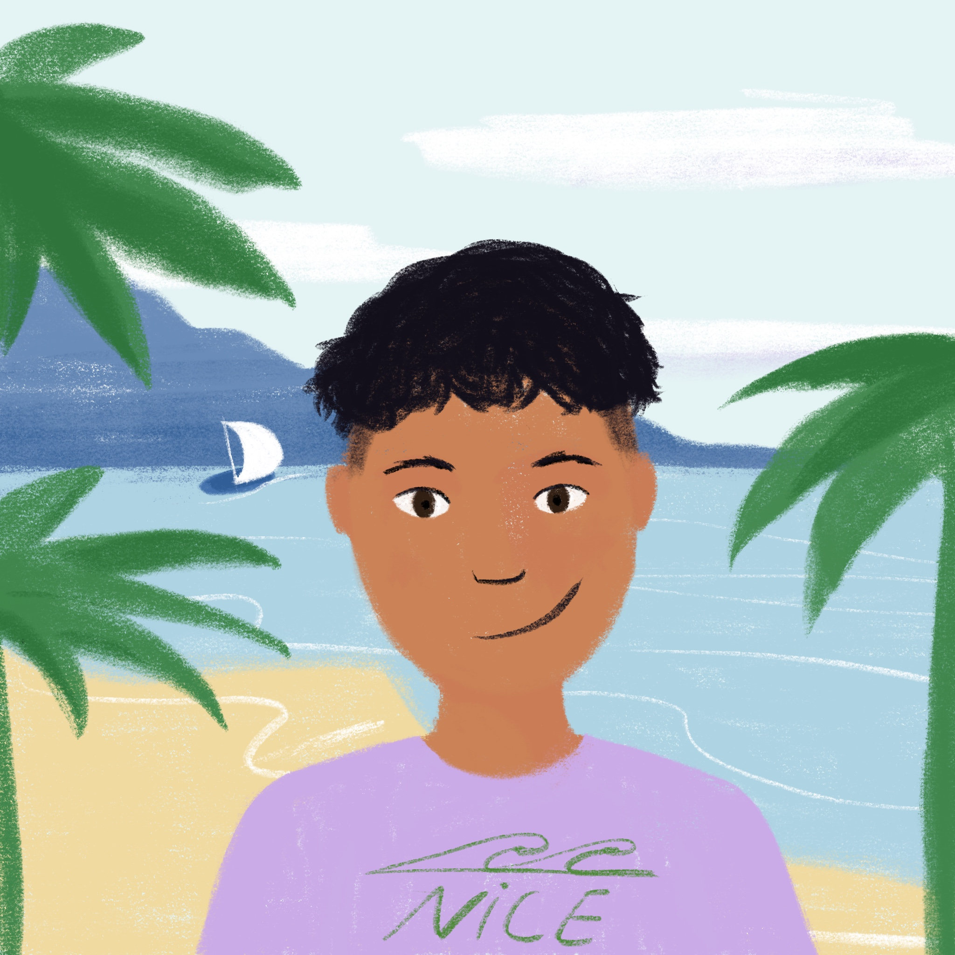
Une semaine difficile
Une semaine difficile
lire
La classe de Léa
doing English exercises
doing complex maths problems
making an effort
La classe d’Amir
cooking
going on a school trip
having an end of term party
Notes:
Answers to the activity on the previous slide. Activities on each list appear on clicks in the order they are mentioned in the text.

Slide 14
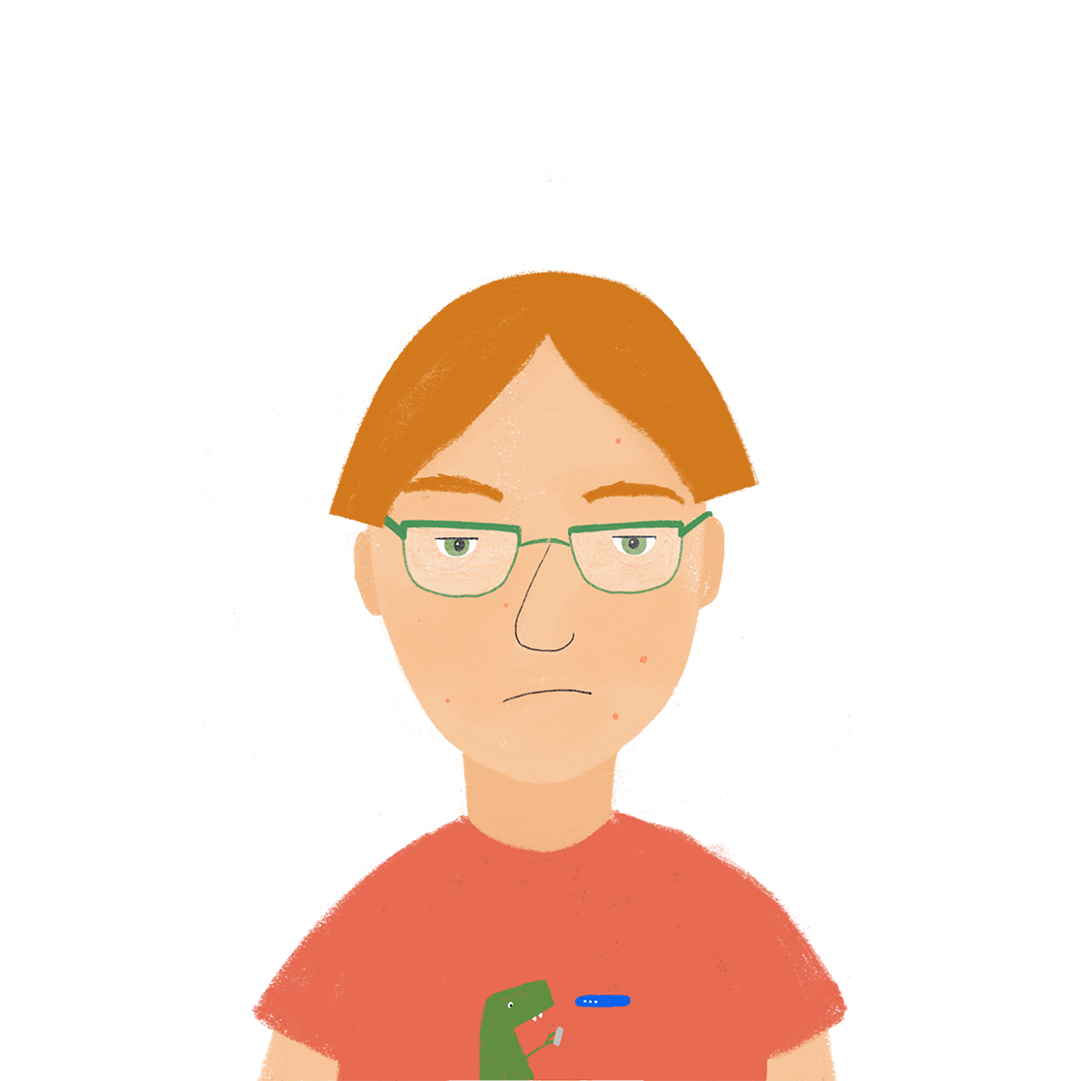
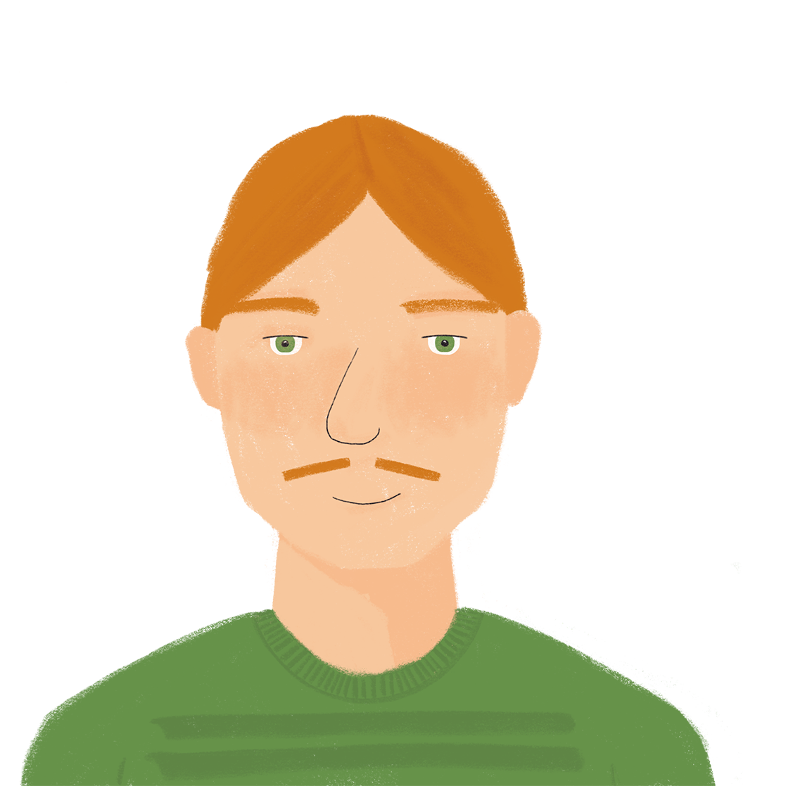
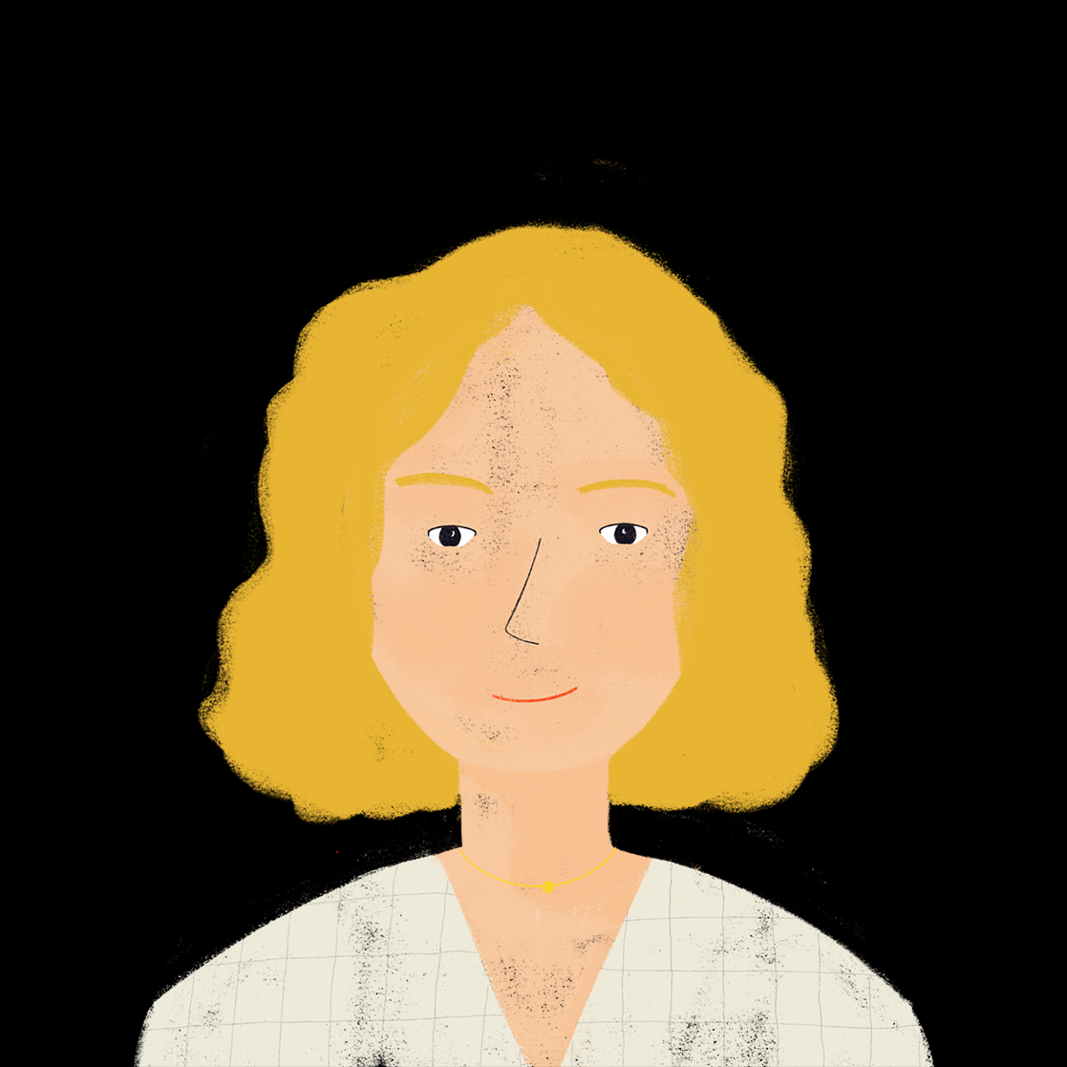
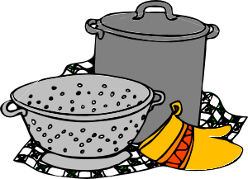
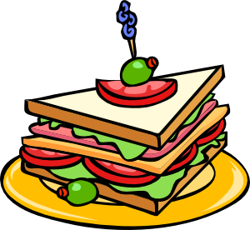
Une fête d’anniversaire
Une fête d’anniversaire
écouter 1/2
La famille de Léa organise une fête d'anniversaire.
Léa donne des instructions.
Qui fait quoi? Coche.
 | Antoine (il - he) | les parents (vous – you pl.)
1
2
3
4
5
6
Notes:
Timing: 5 minutes
Aim: Aural recognition of 3rd person singular and 2nd person plural forms of faire.
Procedure:
1. Click numbers to hear sentences with the pronoun omitted.
2. Students decide whether they think Antoine or his parents are doing the activity, using their knowledge of person singular and 2nd person plural forms of faire to guide them. NB: question items are chosen to avoid use of fait + indefinite article as the liaison which may occur as a result (fait un and faites un) would make the forms of faire very hard to distinguish in a listening exercise.
3. Teacher to elicit answers by asking e.g. ‘Qui fait la liste ?’ Students respond e.g. ‘Antoine fait la liste.’
4. Answers revealed on clicks. Full audio, with pronouns included, may be found on the next slide.
Transcript:
[Antoine] fait la liste.
[Antoine] fait les magasins.
[Vous] faites la cuisine.
[Vous] faites le ménage.
[Antoine] fait le gâteau.
[Vous] faites les sandwichs.
Word frequency of cognates used (1 is the most frequent word in French): anniversaire [2043]; gâteau [4845]; sandwich [>5000]
Source: Londsale, D., & Le Bras, Y. (2009). A Frequency Dictionary of French: Core vocabulary for learners London: Routledge.

Slide 15
Une fête d’anniversaire
Une fête d’anniversaire
écouter 1/2
Une fête d’anniversaire
La famille de Léa organise une fête d'anniversaire.
Léa donne des instructions.
Qui fait quoi? Coche.
 | Antoine (il - he) | les parents (vous – you pl.)
1
2
3
4
5
6
Notes:
Answers to the listening activity on the previous slide.
Procedure:
1. Full audio (including pronoun) plays on clicking individual numbers.
2. Teacher to lead pronunciation practice so students practise the difference between fait and faites.
Transcript
Antoine fait la liste.
Antoine fait les magasins.
Vous faites la cuisine.
Vous faites le ménage.
Antoine fait le gâteau.
Vous faites les sandwichs.

Slide 16
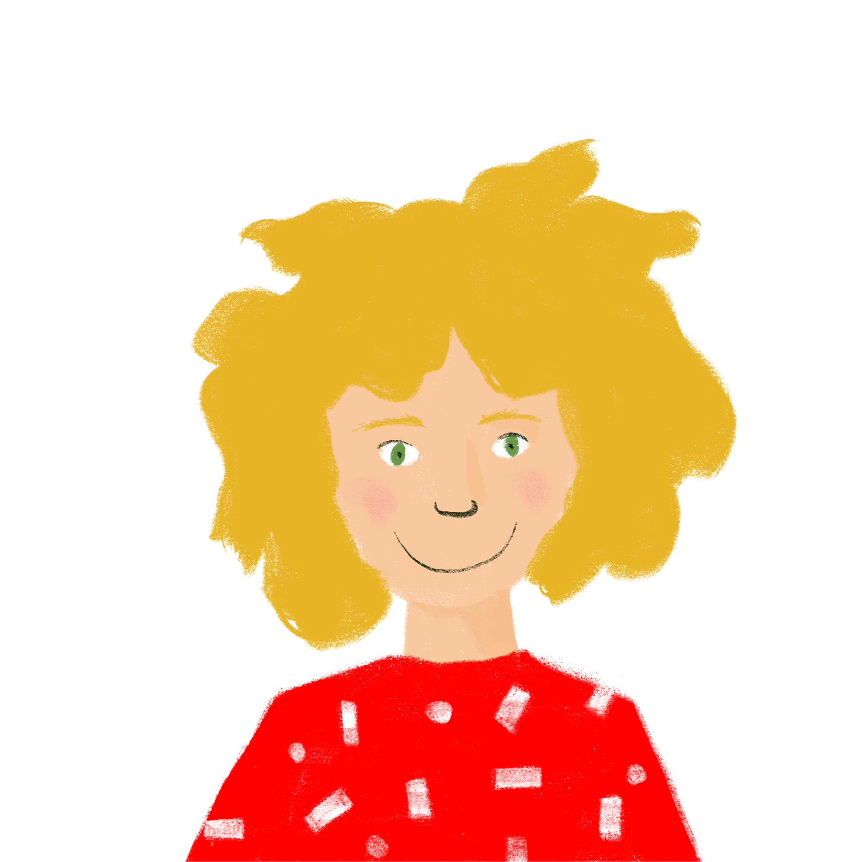
Une fête d’anniversaire
Une fête d’anniversaire
écouter 2/2
Une fête d’anniversaire
Les parents de Léa ont des idées differentes !
Qui fait quoi? Coche.
 | Léa (tu – you sing.) | les parents (nous – we)
7
8
9
10
11
12
Notes:
Timing: 5 minutes
Aim: Aural recognition of 2nd person singular and 1st person plural forms of faire.
Procedure:
See procedure for slide 14.
Transcript:
[Tu] fais un effort.
[Tu] fais les décorations.
[Nous] faisons la cuisine.
[Tu] fais le lit.
[Nous] faisons une pause!
[Nous] faisons une promenade.
Word frequency (1 is the most frequent word in French): décoration [>5000]
Source: Londsale, D., & Le Bras, Y. (2009). A Frequency Dictionary of French: Core vocabulary for learners London: Routledge.

Slide 17
Une fête d’anniversaire
Une fête d’anniversaire
écouter 2/2
Une fête d’anniversaire
Les parents de Léa ont des idées differentes !
Qui fait quoi? Coche.
 | Léa (tu – you sing.) | les parents (nous – we)
7
8
9
10
11
12
Notes:
Answers to the listening activity on the previous slide.
Procedure:
1. Full audio (including pronoun) plays on clicking individual numbers.
2. Teacher to lead pronunciation practice.
Transcript:
Tu fais un effort.
Tu fais les décorations.
Nous faisons la cuisine.
Tu fais le lit.
Nous faisons une pause!
Nous faisons une promenade.

Slide 18
Vocabulaire
Vocabulaire
lire
semaine
l’école
la réponse
une chemise
la maison
une semaine
une solution
aimer
rester à
passer
porter
trouver
cocher
chaque
Notes:
Timing: 5 minutes
Aim: Revisit vocabulary introduced in 1.2.3 and encourage students to think about collocation by matching verbs with the nouns and adjectives with which they frequently occur with.
Procedure:
1. Teacher to explain to students that although there are several possible matches, some pairings occur more frequently than others in everyday language use, and they should used this principle (with reference to English) to guide them. For example, although it may grammatically correct to say cocher une solution/tick a solution, you are more likely to hear Cocher la la réponse/tick the answer.
2. The teacher should also advise students that they may only use each verb once, which will limit the number of possible combinations.
3. Before beginning the activity, the teacher may wish to recap the difference between the definite article, the indefinite article and ‘chaque’, highlight that these differences in meaning will affect the verbs with which the nouns can be used. For example, je travaille chaque semaine/I work every week is a highly frequent collocation; je travaille une semaine/I work (for) a week is less frequent (though not impossible)).
4. Suggested answers appear on clicks, though there is room for some variation (e.g. donner works equally well with la réponse, la solution and le cadeau). Multiple answers may be accepted at the teacher’s discretion, provided that students can provide accurate translations!

Slide 19
Saying what people do
faire (ils/elles)
t-liaison [revisited]
Y7 French
Term 2.1 - Week 4 - Lesson 36
Natalie Finlayson / Emma Marsden / Rachel hawkes
Artwork by: Chloé Motard
Date updated: 04/08/2022
Notes:
Artwork by Chloé Motard. All additional pictures selected are available under a Creative Commons license, no attribution required.
Learning outcomes (lesson 2):
Introduction of third person plural form of faire
Revisit SSC [u]
Word frequency (1 is the most frequent word in French):
7.2.1.4 (introduce) faisons [25], faites [25], font [25], attention [482], effort [388], exercice¹ [1290], fête [1490], liste [924], d'accord [736]
7.2.1.1 (revisit) cinq [288], deux [41], dix [372], douze (1664), huit [877], neuf [787], onze (2447), quatre [253], sept [905], six [450], trois [115], des [2 - de]
7.1.2.3 (revisit) aimer [242], cocher [>5000], passer¹ [90], porter¹ [105], rester [100], trouver [83], école [477], moment [148], semaine [245], solution [608], uniforme [1801], chaque [151], à¹ [4], avec [23]
Source: Londsale, D., & Le Bras, Y. (2009). A Frequency Dictionary of French: Core vocabulary for learners London: Routledge.
The frequency rankings for words that occur in this PowerPoint which have been previously introduced in NCELP resources are given in the NCELP SOW and in the resources that first introduced and formally re-visited those words.
For any other words that occur incidentally in this PowerPoint, frequency rankings will be provided in the notes field wherever possible.
The additional English meanings of the following words have been added to Quizlet since the creation of this resource: attention, faire attention (à + noun): watch out! (to) watch out (for + noun)| watching out (for + noun)

Slide 20
Phonétique
Phonétique
parler
Prononce les mots qui ont la SSC [u].
boutique
pollution
routine
retourner
musée
plus
révolution
journaliste
usage
culture
université
budget
tourisme
température
couple
troupe
cousin
multiple
Notes:
Timing: 5 minutes
Aim: Oral production of SSC [u]
Procedure:
1. Using this colour-coded version of the related reading activity in lesson 1, teachers should revise the following points:
a/ Four sounds are represented by the letter ‘u’ in English: plus/budget/multiple; museum/university/usage; pollution/revolution; temperature/culture. In the French cognates, the ‘u’ is pronounced the same way in each case.
b/ Several of the words in blue, which contain SSC [u] in English, do not in French (routine, boutique, tourisme, troupe). Teachers to highlight the fact that students must therefore look at the spelling, rather than English pronunciation, to work out the correct sound. (NB: SSC [ou] is revisited in next week’s sequence).
2. Teacher elicits pronunciation by pointing at a word, and asking Comment dit-on? Students answer chorally.
3. Students check their pronunciation by listening to recordings, played on clicking individual words.
4. Students repeat.
Word frequency (1 is the most frequent word in French): plus [19], routine [4120], retourner [999], pollution [3073], boutique [3791], musée [2216], revolution [1617], culture [913], usage [863], université [1192], journaliste [1337], budget [962], température [2924], tourisme [2955], troupe [1282], multiple [2072], couple [1167], cousin [3387]
Source: Londsale, D., & Le Bras, Y. (2009). A Frequency Dictionary of French: Core vocabulary for learners London: Routledge.

Slide 21
Lotto ! 3/4
parler / écrire
Lotto! (3/4)
Ecris six mots en anglais.
Lotto!
Lotto
Notes:
Timing: 5 minutes for 2 slides
Aim: Oral and written production of this week’s vocabulary items.
Procedure:
1. Working in groups of around 4, students sketch the grid and write six English words from this week’s list.
2. They then take it in turns to act as ‘gamemaster,’ and read French words from the list at random until one of their classmates shouts ‘Lotto’.

Slide 22
Lotto ! 4/4
parler / écrire
Lotto! (4/4)
Ecris six mots en français.
Lotto!
Lotto
Notes:
Procedure:
1. Now, students write six French words from the list.
2. They then take it in turns to act as ‘gamemaster,’ and read English words from the list at random until one of their classmates shouts ‘Lotto’.

Slide 23
Saying what people do
Saying what people do
grammaire
To say one person is making/doing, use il (m.) or elle (f.) with the correct form of faire.
Il fait une promesse. Elle fait la queue.
He makes/is making a promise. She queues/is queuing.
To say ‘they’ + faire (third person plural) are making/doing, use:
Ils font un effort. They (m. pl.) make/are making an effort.
They (mixed pl.) make/are making an effort.
Elles font un effort. They (f. pl.) make/are making an effort.
Amir et Léa font un effort. Amir and Léa make/are making an effort.
__
__
__
__
___________
Notes:
Timing: 3 minutes
Aim: To introduce the 3rd person plural form of faire.
Procedure:
1. Teacher begins by recapping the meaning of pronouns ils and elles.
2. Teacher to highlight that groups of named people (e.g. Amir and Léa) also need the 3rd person plural form.
3. Teacher to remind students that faire is highly irregular in French. As with être, there is a different form for each pronoun.
4. Teacher to draw attention to the SFC in font.
Word frequency (1 is the most frequent word in French): promesse [1184], queue [3255]
Source: Londsale, D., & Le Bras, Y. (2009). A Frequency Dictionary of French: Core vocabulary for learners London: Routledge.

Slide 24
La liaison
La liaison
parler
Ils font le ménage. They are cleaning.
The final –t in font is a Silent Final Consonant.
But …
Ils font une visite à Paris. They are taking a trip to Paris.
Here, the final consonant in font is not an SFC!
Because the -t is followed by a vowel, it is pronounced.
As you know, this is an example of liaison.
Notes:
Timing: 2 minutes
Aim: Revisiting t-liaison (this was previously introduced with c’est + indefinite article only in week 1.1.3).
Pronunciation practice of font with and without liaison appears in the slides that follow.

Slide 25
Saying what people do
Saying what people do
parler
ils font
The final –t in font
is a Silent Final Consonant.
they (m or m/f) do, make
Notes:
Timing: 3 minutes for 10 slides.
Procedure:
1. Listen and repeat.
2. Highlight the SSC in font.
Transcript:
Ils font

Slide 26
Saying what people do
Saying what people do
parler
elles font
they (f) do, make
Notes:
Procedure:
1. Listen and repeat.
2. Highlight the SSC in font.
Transcript
Elles font

Slide 27
Saying what people do
parler
Saying what people do
Ils font la cuisine.
They (m/f) do/are doing the cooking.
Notes:
Procedure:
1. Listen and repeat.
2. Ask students to translate the sentence.
3. Reveal picture on a click, ask students to check their translations.
4. Reveal English translation on click.
Transcript
Ils font la cuisine

Slide 28
Saying what people do
Saying what people do
parler
Saying what people do
Ils font une fête
They (m/f) have/are having a party.
Notes:
Transcript
Ils font une fête

Slide 29
Saying what people do
Saying what people do
parler
Elles font des exercices de français.
They (f) are doing French exercises.
FAIRE
4. nous faisons
5. vous faites
6. ils/elles font
1. je fais
2. tu fais
3. il/elle fait
Notes:
Transcript: Elles font des exercices de français

Slide 30
Saying what people do
Saying what people do
parler
Elles font un effort.
They (f) make/are making an effort.
Notes:
Transcript:
Elles font un effort

Slide 31
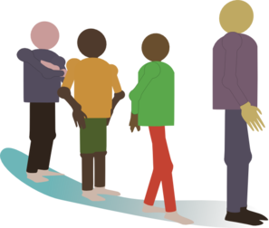
Saying what people do
Saying what people do
parler
Saying what people do
Ils font la queue.
They (m/f) queue / are queuing.
Notes:
Transcript:
Ils font la queue

Slide 32
Saying what people do
Saying what people do
parler
Saying what people do
Ils font un gâteau.
They (m/f) make/are making a cake.
Notes:
Transcript
Ils font un gâteau

Slide 33
Saying what people do
Saying what people do
parler
Saying what people do
Elles font les courses.
They (f) are doing grocery shopping.
Notes:
Transcript:
Elles font les courses

Slide 34
Saying what people do
Saying what people do
parler
Saying what people do
Elles font une promenade.
They (f) go/are going for a walk.
Notes:
Transcript:
Elles font une promenade

Slide 35
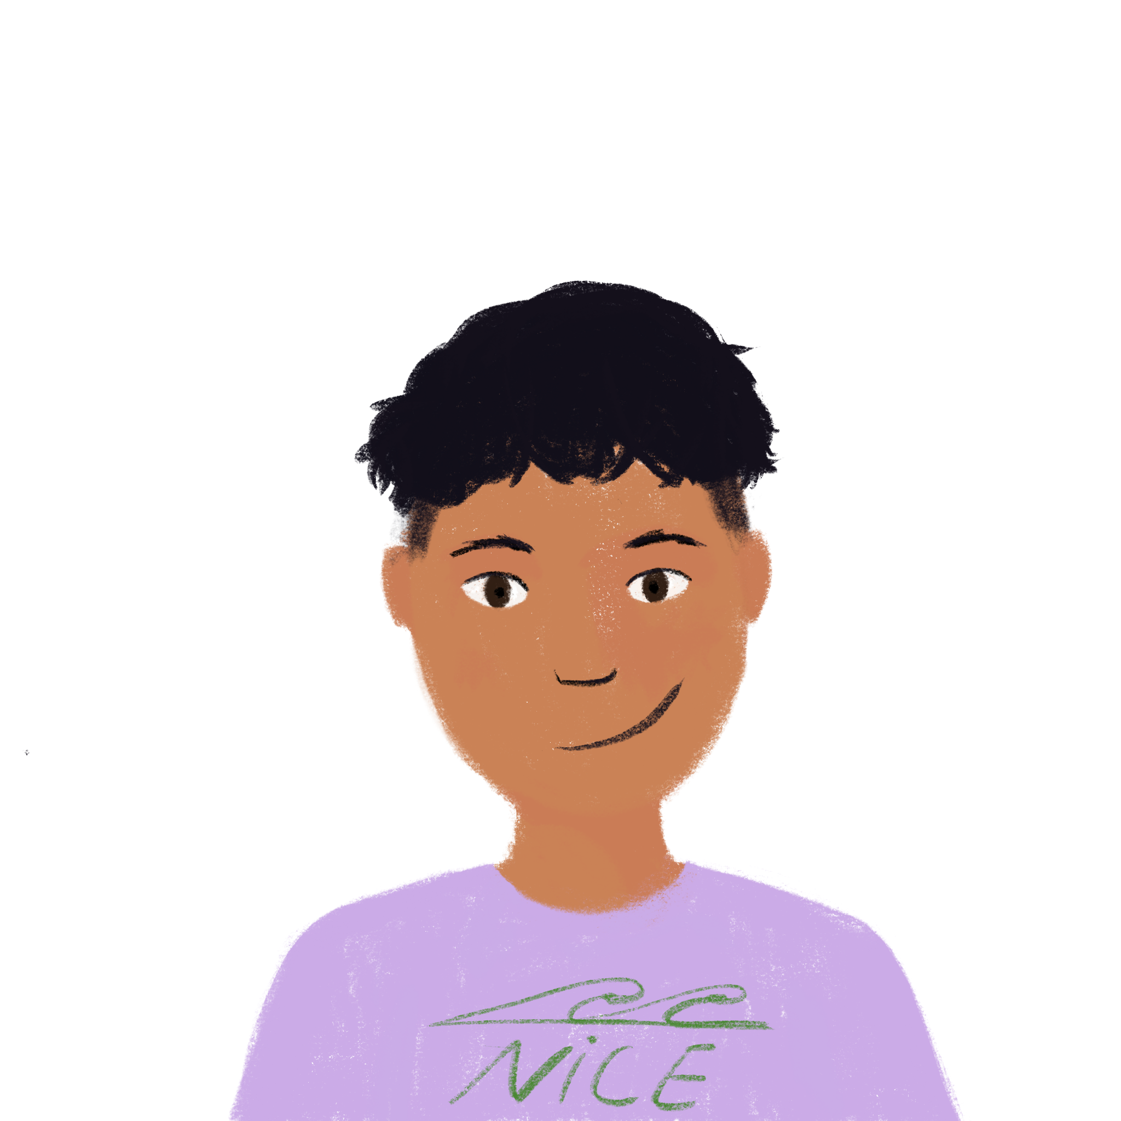
Saying what people have: nous and vous
Le week-end
la grasse mat(inée) = lie-in
lire
Le week-end
Lis la réponse. Qui fait quoi? Fais trois listes (pour Amir, Noura, Maman et Papa) en anglais.
De: Amir
À: Léa
Objet: Le week-end
Bonjour Léa ! En ce moment je suis très content. C’est un week-end super!
Il fait beau et Noura fait un voyage avec le chien. Maman et Papa font une visite de Cannes avec un ami. Maman et Papa font les magasins et Noura fait une promenade. Papa at Maman font une fête pour l’ami. Noura fait la cuisine pour la fête et Maman et Papa font un gâteau. Je trouve les fêtes amusantes, mais je préfère rester à la maison. Je fais la grasse mat’* aujourd’hui. C’est fantastique ! Bisous, Amir
________
_________
_________
_________
_________
_________
_________
Notes:
Timing: 10 minutes for 2 slides.
Aim: Written recognition of the 3rd person singular and plural forms of faire.
Procedure:
1. Frist, students fill the blanks with the appropriate sbject (Noura or Maman et Papa), using their knowledge of the 3rd person singular and plural forms of faire.
of faire to inform their choices.
2. Next, students make lists (in English) recording what Amir, Noura and their parents are doing.
3. Teacher elicits responses by asking e.g. Qui font une visite de Cannes ? Students respond chorally, e.g. Les parents font une visite de Cannes.
4. Subjects revealed on clicks. Lists of activities (in English) are found on the next slide.
Word frequency of cognates used (1 is the most frequent word in French): week-end [2475], réponse [456], super [2993], gâteau [4845], gras [4018], matinée [3029], fantastique [4107]
Source: Londsale, D., & Le Bras, Y. (2009). A Frequency Dictionary of French: Core vocabulary for learners London: Routledge.

Slide 36
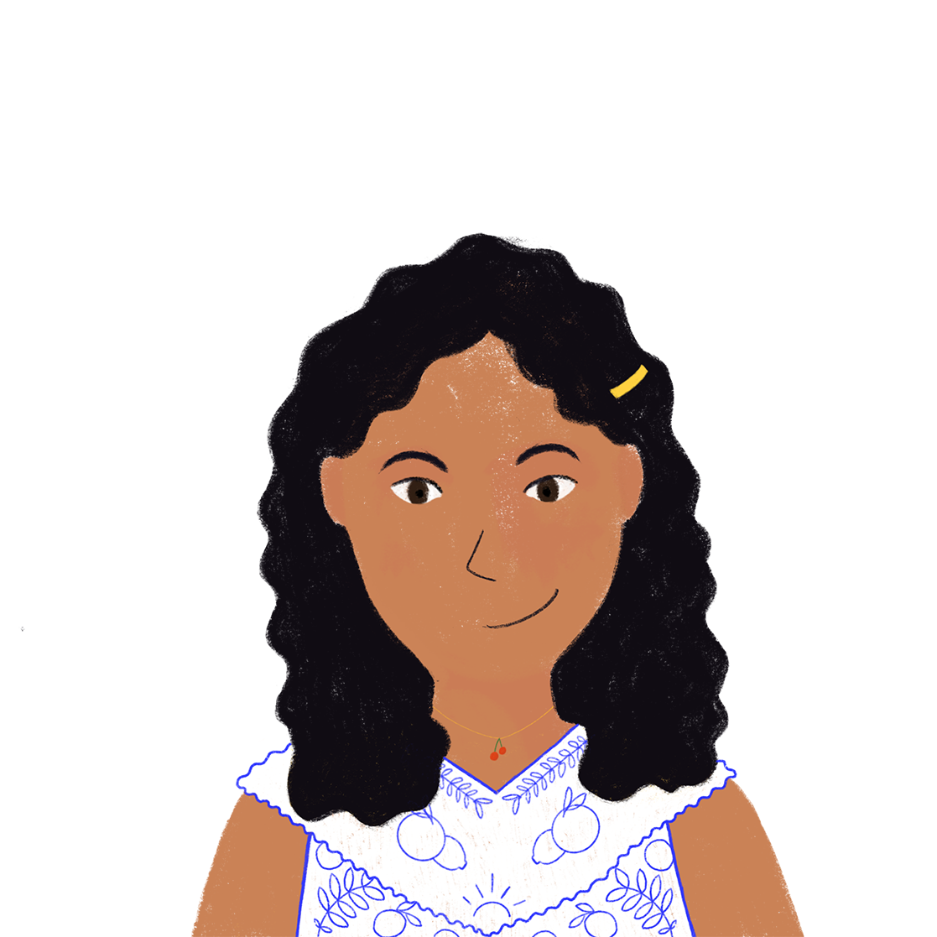
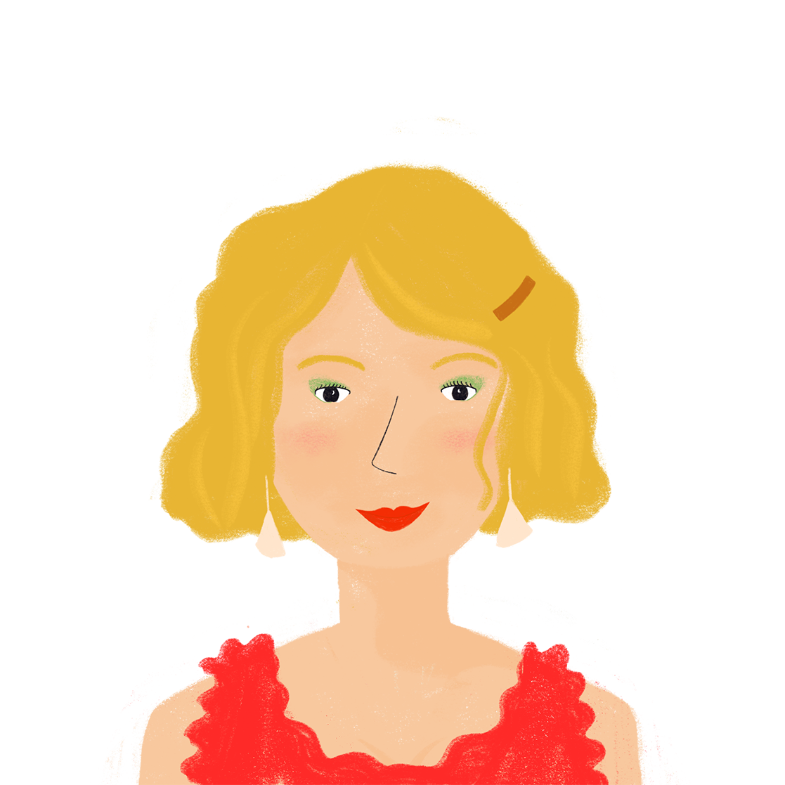
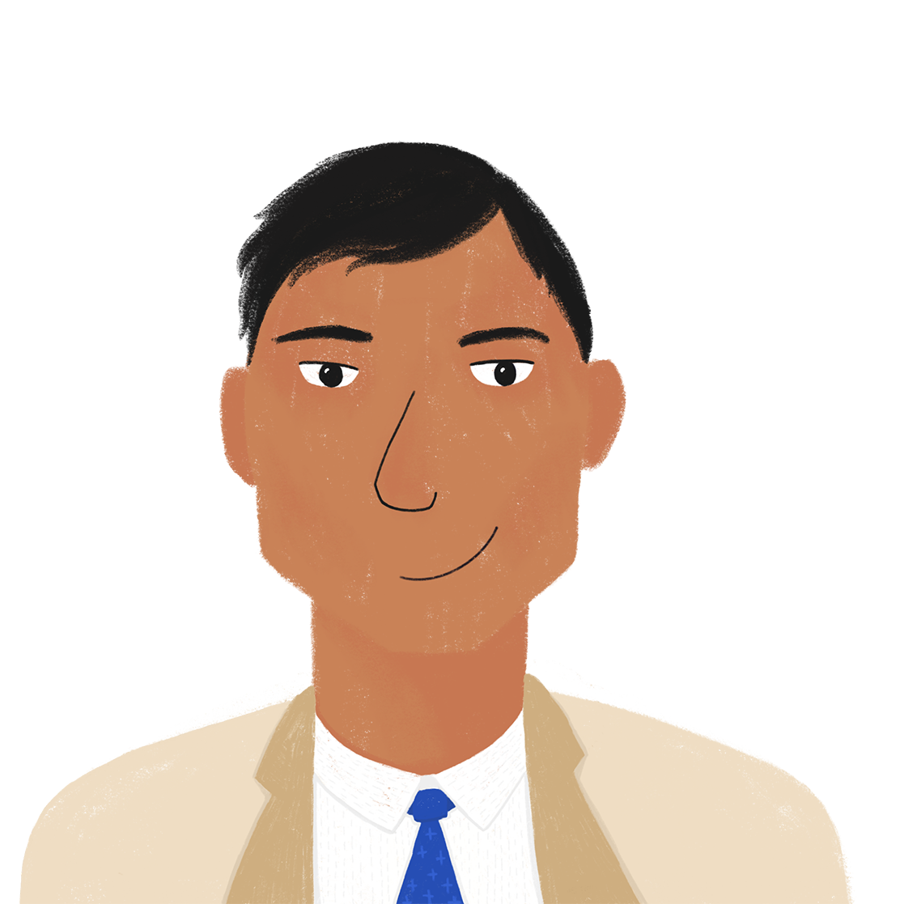
Une semaine difficile
Le week-end
lire
Amir
having a lie-in
Noura
going on a trip with the dog
going for a walk
cooking for the party
Les parents
visiting Cannes with a friend
having a party for the friend
making a cake
Notes:
Answers to the activity on the previous slide. Activities on each list appear on clicks in the order they are mentioned in the text.

Slide 37
Les maths
Les maths
combien
= how much
lire / écrire
Combien* font deux plus deux ?
Deux plus deux font quatre!
Combien* font neuf moins trois ?
Neuf moins trois font six!
Combien* font trois multiplié par trois ?
Trois multiplié par trois font neuf!
Combien* font dix divisé par cinq ?
Dix divisé par cinq font deux!
_______
_______
_______
_______
Notes:
Timing: 5 minutes for 4 slides
Aim: To revisit the vocabulary from 2.1.1, and use the 3rd person plural font in a different context.
Procedure:
1. Students read the questions on this example slide, and write the answers only, in full words, in their books.
2. Teacher elicits answers by asking e.g. Combien font deux plus deux? Students respond e.g. Deux plus deux font quatre!
3. Teacher distributes the vocabulary role cards, found on the slide after next. Students work in pairs.
4. Students take it in turns to read the questions on their card, and write the answers to their partners’ questions, in full words, in their books.
5. The answers are discussed on the next slide.
Transcripts:
Partenaire A
Combien font sept multiplié par un? Combien font cinq plus trois? Combien font douze moins deux? Combien font huit divisé par quatre?
Partenaire B
Combien font douze divisé par six? Combien font trois plus quatre? Combien font cinq multiplié par deux? Combien font onze moins trois?
Word frequency of unknown cognates used (1 is the most frequent word in French): maths [3438-mathématique], combien [800], plus [19], moins [62], multiplié par [1982/21] and divisé par [1567/21]
Source: Londsale, D., & Le Bras, Y. (2009). A Frequency Dictionary of French: Core vocabulary for learners London: Routledge.

Slide 38
Les maths (réponses)
Les maths (réponses)
lire, parler, écouter, écrire
Voici les réponses aux problèmes de maths!
Partenaire A
Sept multiplié par un font sept!
Cinq plus trois font huit!
Douze moins deux font dix!
Huit divisé par quatre font deux!
Partenaire B
Douze divisé par six font deux!
Trois plus quatre font sept!
Cinq multiplié par deux font dix!
Onze moins trois font huit!
_____
_____
_____
_____
_____
_____
_____
_____
Notes:
Teacher to elicit choral answers in full sentences by asking Combien font …
Answers revealed on clicks.

Slide 39
Les maths
Les maths
PARTENAIRE A
PARTENAIRE A
Combien font sept multiplié par un ? Combien font cinq plus trois ? Combien font douze moins deux ? Combien font huit divisé par quatre ?
PARTENAIRE A
Combien font sept multiplié par un ? Combien font cinq plus trois ? Combien font douze moins deux ? Combien font huit divisé par quatre ?
PARTENAIRE A
Combien font sept multiplié par un ? Combien font cinq plus trois ? Combien font douze moins deux ? Combien font huit divisé par quatre ?
PARTENAIRE A
Combien font sept multiplié par un ? Combien font cinq plus trois ? Combien font douze moins deux ? Combien font huit divisé par quatre ?
PARTENAIRE A
Combien font sept multiplié par un ? Combien font cinq plus trois ? Combien font douze moins deux ? Combien font huit divisé par quatre ?
PARTENAIRE A
Combien font sept multiplié par un ? Combien font cinq plus trois ? Combien font douze moins deux ? Combien font huit divisé par quatre ?
Notes:
Role cards for the activity outlined on the previous slide (1/2).

Slide 40
Les maths
Les maths
PARTENAIRE B
PARTENAIRE B
Combien font douze divisé par six ? Combien font trois plus quatre ? Combien font cinq multiplié par deux ? Combien font onze moins trois ?
PARTENAIRE B
Combien font douze divisé par six ? Combien font trois plus quatre ? Combien font cinq multiplié par deux ? Combien font onze moins trois ?
PARTENAIRE B
Combien font douze divisé par six ? Combien font trois plus quatre ? Combien font cinq multiplié par deux ? Combien font onze moins trois ?
PARTENAIRE B
Combien font douze divisé par six ? Combien font trois plus quatre ? Combien font cinq multiplié par deux ? Combien font onze moins trois ?
PARTENAIRE B
Combien font douze divisé par six ? Combien font trois plus quatre ? Combien font cinq multiplié par deux ? Combien font onze moins trois ?
PARTENAIRE B
Combien font douze divisé par six ? Combien font trois plus quatre ? Combien font cinq multiplié par deux ? Combien font onze moins trois ?
Notes:
Role cards for the activity outlined on the previous slide (2/2).

Slide 41
Le week-end
Le week-end
Qui fait quoi le week-end?
Coche.
écouter
 | Amir (il) | Amir et Papa (ils)
 | Noura (elle) | Noura et Maman (elles)
A
B
Notes:
Timing: 5 minutes
Aim: Aural recognition of 3rd person singular and plural forms of faire.
Procedure:
1. Remind students that il/ils and elle/elles sound identical (for this reason, they are not obscured in the audio - indefinite articles after ils/elles are avoided so as not to trigger a liaison) and that they must listen to the verb form to understand the meaning.
2. Audio plays on clicking buttons A and B.
3. Answers revealed on clicks.
Transcript A
Il fait le lit. Ils font la cuisine. Ils font une liste. Ils font les devoirs. Il font les exercices de maths.
Transcript B
Elles font les magasins. Elle fait attention. Elle fait le ménage. Elles font les sandwichs. Elles font la queue.

Slide 42
Les expressions avec faire
Les expressions avec faire
écrire
Voici des expressions avec faire! Complète.
faire les magasins
faire la cuisine
faire le ménage
faire une promenade
_________________
_________________
_________________
_________________
faire le lit
faire une fête
faire attention
faire les devoirs
_________________
_________________
_________________
_________________
faire un voyage
faire un modèle
_________________
_________________
_________________
_________________
faire les exercices
faire une liste
Notes:
Timing: 5 minutes
Aim: Written recall of uses of faire
Procedure:
1. Students write a phrase with faire for each picture.
2. Teacher to elicit pronunciation and revise definitions by pointing at each picture and asking e.g. Comment dit-on ‘going shopping’ en français?

Slide 43
Le week-end
Le week-end
parler / écrire
Travaille avec un(e) partenaire. Parlez avec trois groupes différentes. Qui fait quoi le week-end? Écrivez trois phrases.
Sophie et Michel, vous faites quoi le week-end?
Nous faisons le ménage, nous faisons les devoirs et nous faisons une fête.
e.g. Sophie et Michael font le ménage. Ils font les devoirs. Ils font une fête aussi.
Notes:
Timing: 10 minutes
Aim: Spoken and written production of all three new forms of faire learned this week.
Procedure:
1. In preparation for the exercise, teacher should work through the example here, drawing attention to question formation with quoi.
2. Students write an example sentence in the third person plural using the information given. Teacher to remind students that names of two or more people (e.g. Sophie et Michel here) also require the third person plural form.
3. Teacher reveals the answer, and practises pronunciation.
4. Working in pairs, students choose three activities from the previous slide that they will do at the weekend, and prepare sentences with nous.
5. Students then ask three other pairs, using the vous form, about their weekend plans.
6. Students write sentences in the third person plural describing what their classmates are doing at the weekend.
7. Teacher to elicit examples from the class, by choosing a pair and asking e.g. Sophie et Michael font quoi le week-end? The next slide provides a blank template for the teacher to gather class responses.

Slide 44
Le week-end
Le week-end
parler / écrire
Le week-end
__________________________________________________________
__________________________________________________________
__________________________________________________________
__________________________________________________________
__________________________________________________________
__________________________________________________________
Notes:
Blank slide for teacher to write class examples from the previous exercise.

Slide 45
Gaming Grammar
Gaming Grammar
Relevant mini game(s):
Verbs (present): 1st person singular/plural (Verb agreement (present))
Verbs (present): 2nd person singular/plural (Verb agreement (present))
Verbs (present): 3rd person singular/plural (Verb agreement (present))
Prepositions (to the): Gender (Prepositions)
Notes:
This slide links to Gaming Grammar login screen. The appropriate mission can then be selected from the menu page.
Students will progress through the game at their own rate; teachers should use the teacher interface to check progress. This will help to inform future lesson planning.

Slide 46
Devoirs
Click below to revise all vocabulary learned
in Year 7 so far!
Year 7 Term 1.1, 1.2 and 2.1 Vocabulary Revision Mashup

