Slide 1
Talking about the location of things
Using the definite articles ‘el’ and ‘la’
Nick Avery & Rachel Hawkes
Date updated: 21/11/2019

Slide 2
Talking about the location of things Using the definite articles ‘el’ and ‘la’
All nouns have a gender in Spanish.
masculine
feminine
Spanish has two genders: ____________ and ___________.
To say ‘the’ before a noun, use ‘el’ or ‘la’.
Masculine nouns
Feminine nouns
el
banco
the bank
la
iglesia
the church
el
teatro
the theatre
la
tienda
the shop
el
mercado
la
the square
the market
plaza
Notes:
Bear in mind that students following NCELP Y7 Spanish SoW have already learnt singular nouns with their definite article, so they will not be unfamiliar with it. They have also seen the singular definite article in various target language instructions such as ‘escribe la letra correcta’, ‘lee el texto’ and ‘marca la opción correcta’.

Slide 3
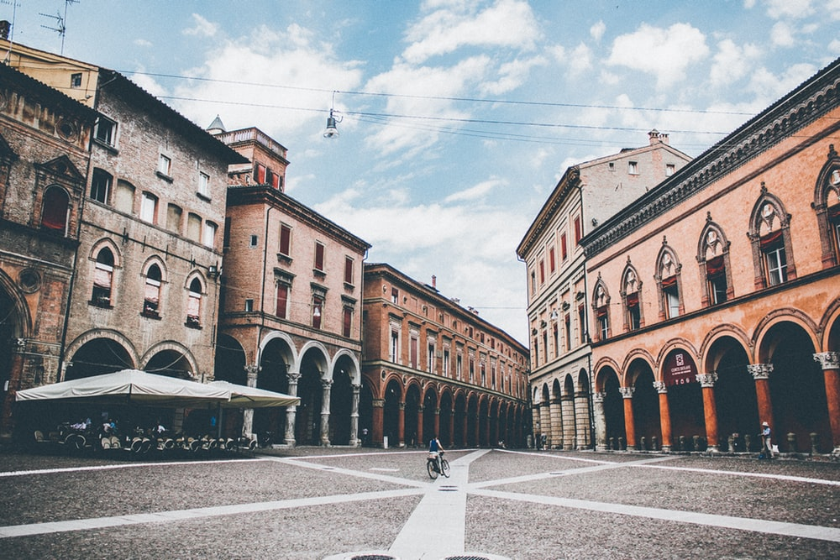
plaza
el
la
Notes:
Photo by Thaddaeus Lim on Unsplash (freely usable images)
Elicit the definite article for each noun in these slides.

Slide 4
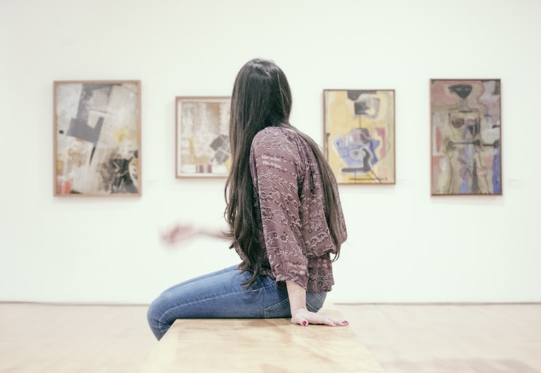
museo
el
la
Notes:
Photo by gilber franco on Unsplash (freely usable images)

Slide 5
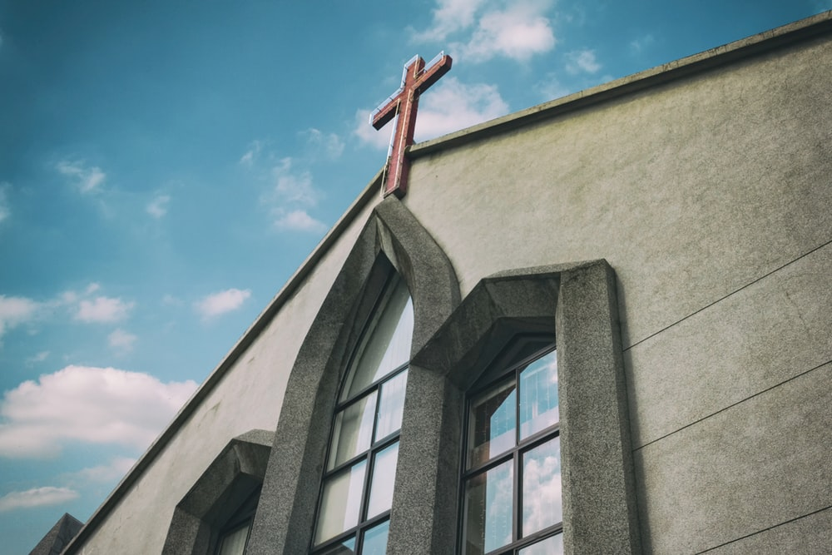
iglesia
el
la
Notes:
Photo by Daniel Tseng on Unsplash (freely usable images)

Slide 6
tienda
el
la
Notes:
Photo by Mike Petrucci on Unsplash

Slide 7
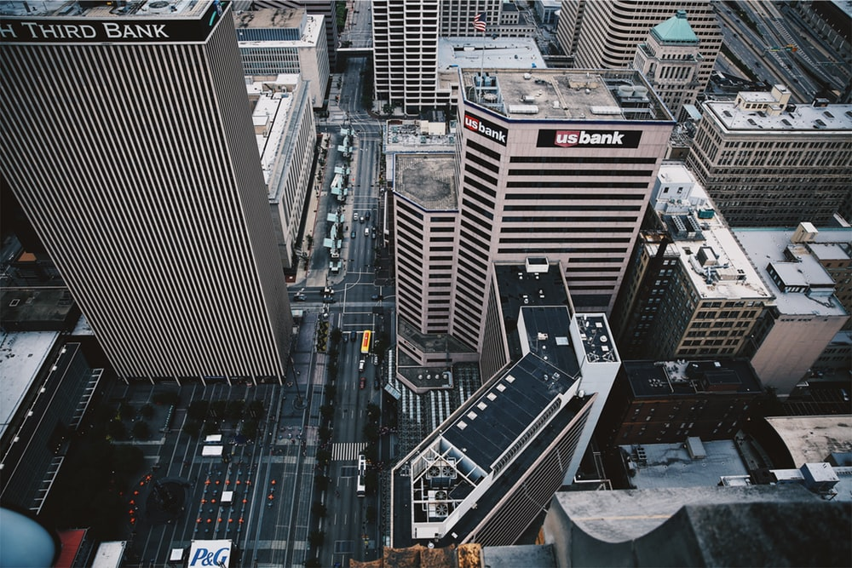
banco
el
la
Notes:
Photo by Jordan on Unsplash

Slide 8
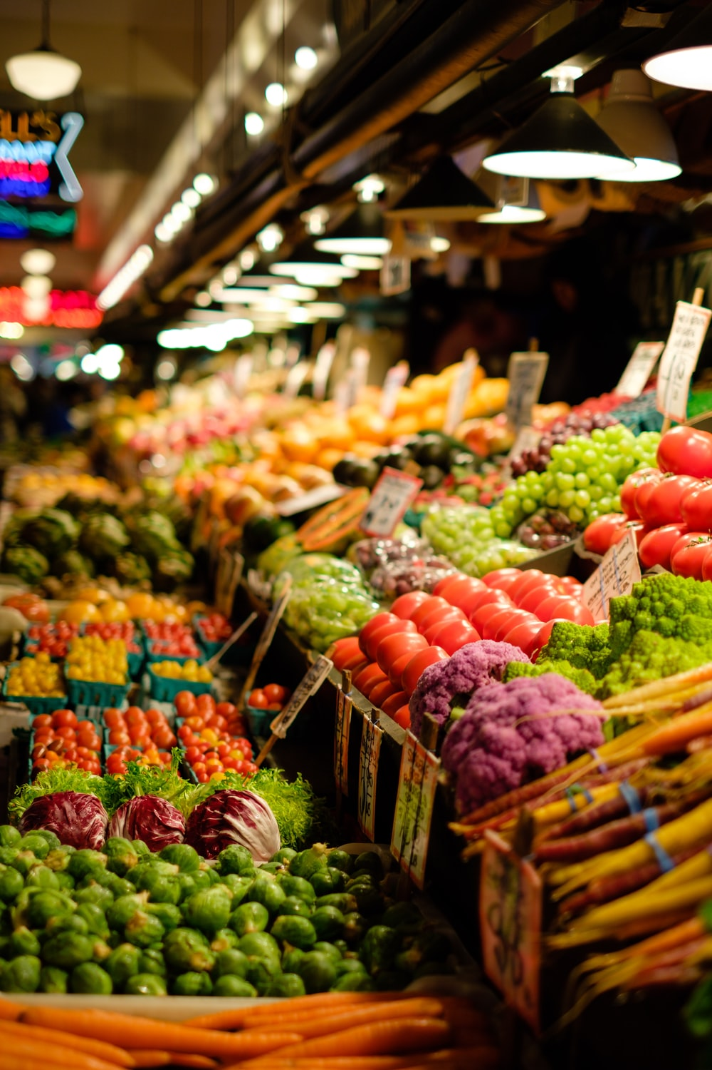
mercado
el
la
Notes:
Photo by Thomas Le on Unsplash

Slide 9
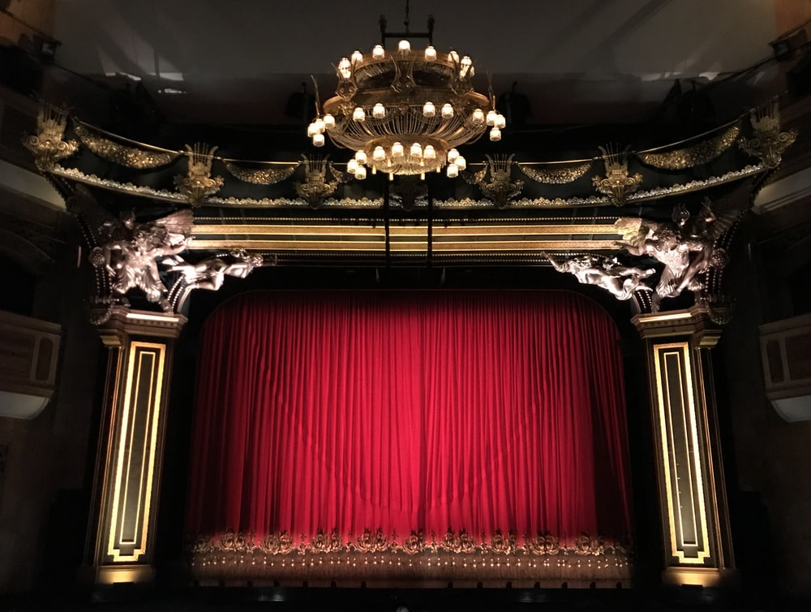
teatro
el
la
Notes:
Photo by Gwen Ong on Unsplash

Slide 10
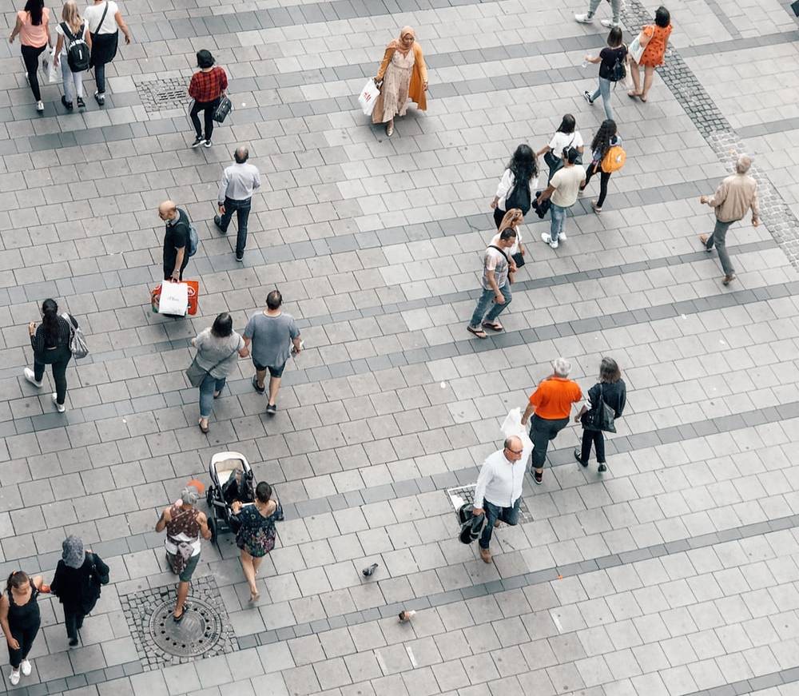
centro
el
la
centre
Notes:
Photo by Jan Kolar / VUI Designer on Unsplash

Slide 11
escuela
el
la
Notes:
Photo by NeONBRAND on Unsplash

Slide 12
Amanda describe unos lugares en una ciudad.
Marca la opción correcta.
leer
1 | El | iglesia |  | está en el centro.
 |  | museo
 |  | could be either
2 | La | tienda de arte |  | es cara.
 |  | mercado
 |  | could be either
3 | El | banco |  | está cerca.
 |  | monumento
 |  | could be either
4 | El | mercado |  | es bonito y barato.
 |  | escuela
 |  | could be either
5 | El | teatro |  | está lejos.
 |  | centro
 |  | could be either
6 | El | barco |  | es famoso.
 |  | iglesia
 |  | could be either
7 | La | ciudad |  | es pequeña.
 |  | plaza
 |  | could be either
8 | La | tienda de música |  | está entre una casa y un bar.
 |  | centro de cultura
 |  | could be either

Slide 13
leer
¿Cómo se dice en inglés?
1. The theatre is far (away).
El teatro está lejos.
2. The art shop is expensive.
La tienda de arte es cara.
3. The market is pretty and cheap.
El mercado es bonito y barato.
4. The city is small.
La ciudad es pequeña.
5. The music shop is between a house and a bar.
La tienda de música está entre una casa y un bar.
Notes:
OPTIONAL EXTENSION SLIDE
Note that students can opt to produce the sentences in any order. The shapes are triggered to reveal the English translation when the shape itself is clicked.

Slide 14
Amanda describe unos lugares y a unas personas.
escuchar
 | el | la
la palabra correcta |  | información extra (en inglés)
plaza | mercado
teatro | iglesia
museo | tienda de arte
escuela | centro
banco | tienda de música
ciudad | monumento
chico | chica
directora | director
autora | autor
profesora | profesor
1
cheap
2
far
3
expensive
4
ugly
5
good
6
pretty
7
nice
8
short
9
near
10
good-looking
Notes:
El [mercado] es barato. 2. La [iglesia] está lejos 3. El [museo] es caro. 4. La [escuela] es fea. 5. La [tienda de música] es buena. 6. La [ciudad] es bonita 7. La [chica] es simpática. 8. El [director] es bajo. 9. La [autora] está cerca. 10. El [profesor] es guapo.
The adjectives ‘simpatico’, ‘bajo’ and ‘guapo’ are from T1.1 Week 3, the week just revisited as part of quizlet homework.

Slide 15
hablar / escuchar
En parejas
Persona A:
Read the sentence on your prompt card.
Say it in Spanish, but do not say the word that is crossed out.
Persona B:
Listen to your partner. Their sentence will be missing a noun.
Look at the picture card and decide which noun must be missing.
Write the sentence, including the missing noun.
Notes:
To say sentences accurately, students will need to be use adjectival gender agreement (e.g. la plaza es famosa). While this should be encouraged, the main focus of the activity is on comprehension and production of the definite article el/la with a noun of the same gender.

Slide 16
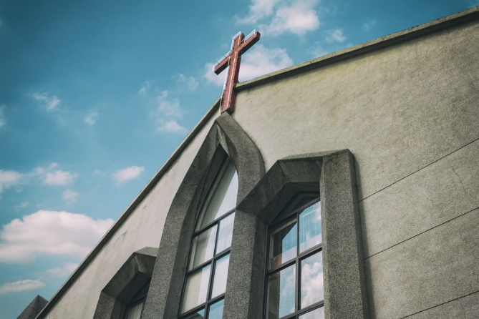
Un ejemplo
Persona A (habla):
El ............ es barato.
The [market] is cheap.
¿Mercado o iglesia?
‘el mercado’
Persona B (escribe):
El mercado es barato
_____________________.
Notes:
Pairs of pictures are contrasted for masculine/feminine gender, so only one option can match the definite article.

Slide 17
Persona A
The [square] is ugly.
The [market] is cheap.
The [church] is famous.
The [theatre] is good.
The [shop] is expensive.
The [boy] is good-looking.
Persona B
The [museum] is cheap.
The [market] is good.
The [church] is ugly.
The [city] is expensive.
The [bank] is famous.
The [girl] is good-looking.
Notes:
Prompt cards – for teacher reference only
DO NOT DISPLAY IN CLASS

Slide 18
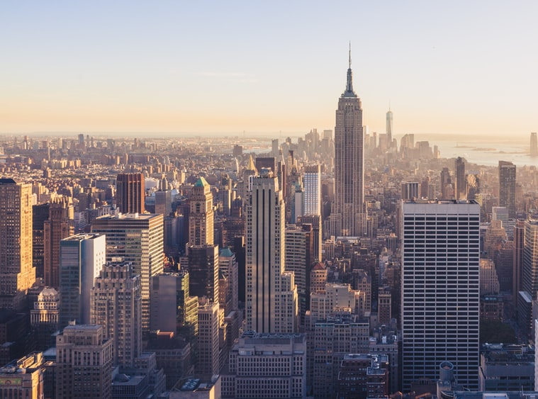
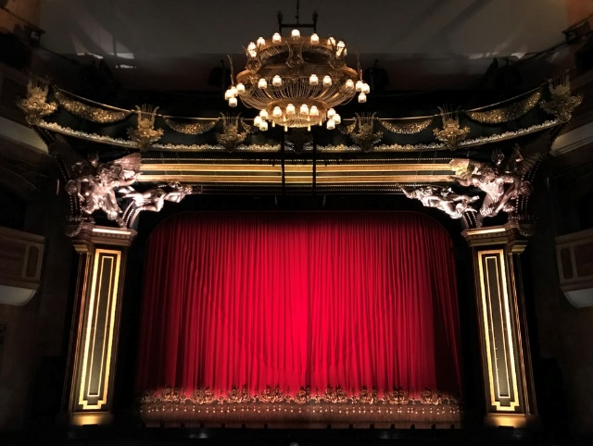
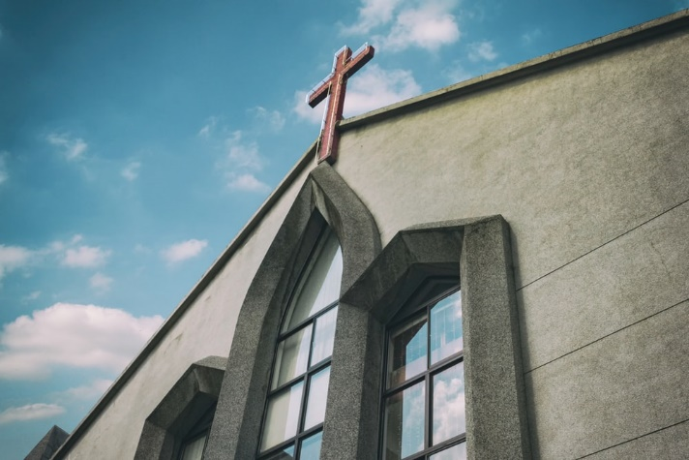
1.
A
B
4.
A
city
B
A
B
A
B
2.
5.
A
B
3.
6.
A
B
centre
Notes:
To display for all students during activity. This avoids having to print/create cards for the activity.
Photo 6a by JD Chow on Unsplash
Photo 6b freestocks.org on Unsplash
Credits given to other images in earlier slides.

Slide 19
Persona B
Escucha. Escribe las 6 frases.
La plaza es fea
1) __________________.
El mercado es barato
2) ________________________.
La iglesia es famosa
3) _______________________.
El teatro es bueno
4) ______________________.
La tienda es cara
5) _____________________.
El chico es guapo
6) ______________________.
escribir

Slide 20
Persona A
Escucha. Escribe las 6 frases.
El museo es barato
1) ________________________.
El mercado es bueno
2) ________________________.
La iglesia es fea
3) ____________________.
La ciudad es cara
4) ______________________.
El banco es famoso.
5) _____________________.
La chica es guapa.
6) ______________________.
escribir

