Slide 1
Vocabulary
Y7 Spanish
Term 2.1 - Week 4 – Lesson 35/36
Victoria Hobson / Nick Avery / Rachel Hawkes
Date updated: 30/03/20
Notes:
Learning outcomes
Revisiting of SSC : [a] [o]
Introduction of hacer (hago/haces/hace) / introducing question word: cuándo; revisting question words: quién; cómo; dónde; qué
Frequency rankings of vocabulary introduced this week (1 is the most common word in Spanish):
vocab set:¿cuándo? [57]; ¿cuánto? [580]; ¿cuál? [445]; hacer [26]; hago; haces; hace; deporte [1489]; deberes [2187]; actividad [344]; dibujo [1726]; noche [164]; tarde [392]; mañana [402]; de [2]; para [16]
Frequency rankings of vocabulary revisited this week (1 is the most common word in Spanish):
1.2, week 3: hay [13]; mirar [125]; mesa [525]; silla [1271]; ventana [752]; puerta [274]; chica [1129]; persona [108]; chico [727]; aquí [130]; allí [197]; clase [320]
2.1 week 1: balcón [3133]; dama [2062]; torre [2138]; caballero [2056]; saber [44]; pasar [68]; blanco [372]; flor [739]; plaza [806]; llevar [101];

Slide 2
Vocabulario
Segundos
 | Español | Inglés
1 | ¿cuándo? | when?
2 | el deporte | sport
3 | los deberes | homework
4 | la actividad | activity
5 | el dibujo | drawing
6 | la noche | night
7 | la tarde | afternoon/evening
8 | la mañana | morning
9 | de | of, from
10 | para | for
60
To say ‘in the morning/afternoon’ or ‘at night’, Spanish often uses the word ‘por’.
E.g. ‘Estudio por la mañana’ = I study in the morning.
It is also correct to say ‘en la mañana/tarde/noche’ in some Spanish-speaking countries.
0
INICIO
Notes:
Vocabulary practice slide Pupils either work by themselves or in pairs, reading out the words and recapping their English meaning (1 minute). Then the English meanings are removed and they try to recall them, looking at the Spanish (1 minute). Then the Spanish meanings are removed and they to recall them, looking at the English (1 minute) Further rounds of learning can be facilitated by one pupil turning away from the board, and his/her partner asking him/her the meanings. This activity can work from L2 → L1 or L1 → L2.
Vocabulary frequency rankings (1 is the most common word in Spanish):
¿cuándo? [57]; deporte [1489]; deberes [2187]; actividad [344]; dibujo [1726]; noche [164]; tarde [392]; mañana [402]; de [2]; para [16]
The following ítems are taught explicity as part of the grammar foci for this sequence and hence not included here:
¿cuánto? [580]; ¿cuál? [445]; hacer [26]; hago; haces; hace;

Slide 3
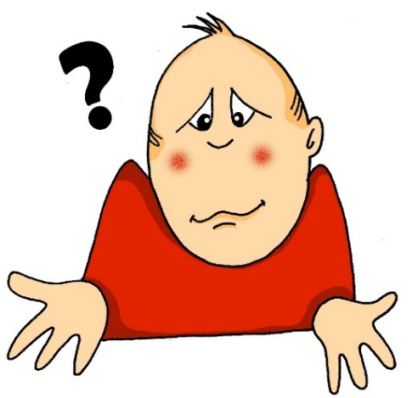
Escribe la pregunta correcta.
Where?
1)
2)
Who?
3)
How?
¿cómo?
¿quién?
¿dónde?
4)
5)
When?
What?
¿qué?
¿cómo?
¿cuándo?
¿quién?
¿dónde?
¿cuándo?
¿qué?
Notes:
Before the introduction of the verb hacer the next two slides present a quick opportunity to refresh four known question words and introduce the new one ‘¿cuándo? Students will be able to work this one out by process of elimination, if they are not yet secure with its meaning through the pre-learning.
During the feedback, ask students to give the English as well so that meanings are clear. Teachers can ask students what they think ‘¿cuándo? means by using the image to arrive at the answer.
These question words are then incorporated into the listening and reading activities around the verb hacer.

Slide 4
Escribe la pregunta correcta.
¿Qué hay en la mesa?
¿Quién es la chica? ¡Es Sara!
¿Cuándo es la clase de español?
¡Es hoy!
4. ¿Cómo se escribe ‘silla’?
5. ¿Dónde está la puerta? Allí, entre el profesor y la mesa.
6. ¿Quién es la persona? Es Ana.
7. ¿Qué quieres mirar?
8. ¿Cómo se dice ‘aquí’ en inglés?
9. ¿Dónde está el chico? ¡Aquí!
10. ¿Cuándo hay una clase de arte? En diciembre.
Notes:
Here are two opportunities for students to practise the five question words in context. During the feedback, elicit the meanings in English for the full sentence.
The vocabulary used in these sentences is from 1.2 week 3, the second set of words to be revisited this week, as part of students’ vocabulary learning homework.
Click on the shape to reveal the answer.
hay [13]; mirar [125]; mesa [525]; silla [1271]; ventana [752]; puerta [274]; chica [1129]; persona [108]; chico [727]; aquí [130]; allí [197]; clase [320]

Slide 5
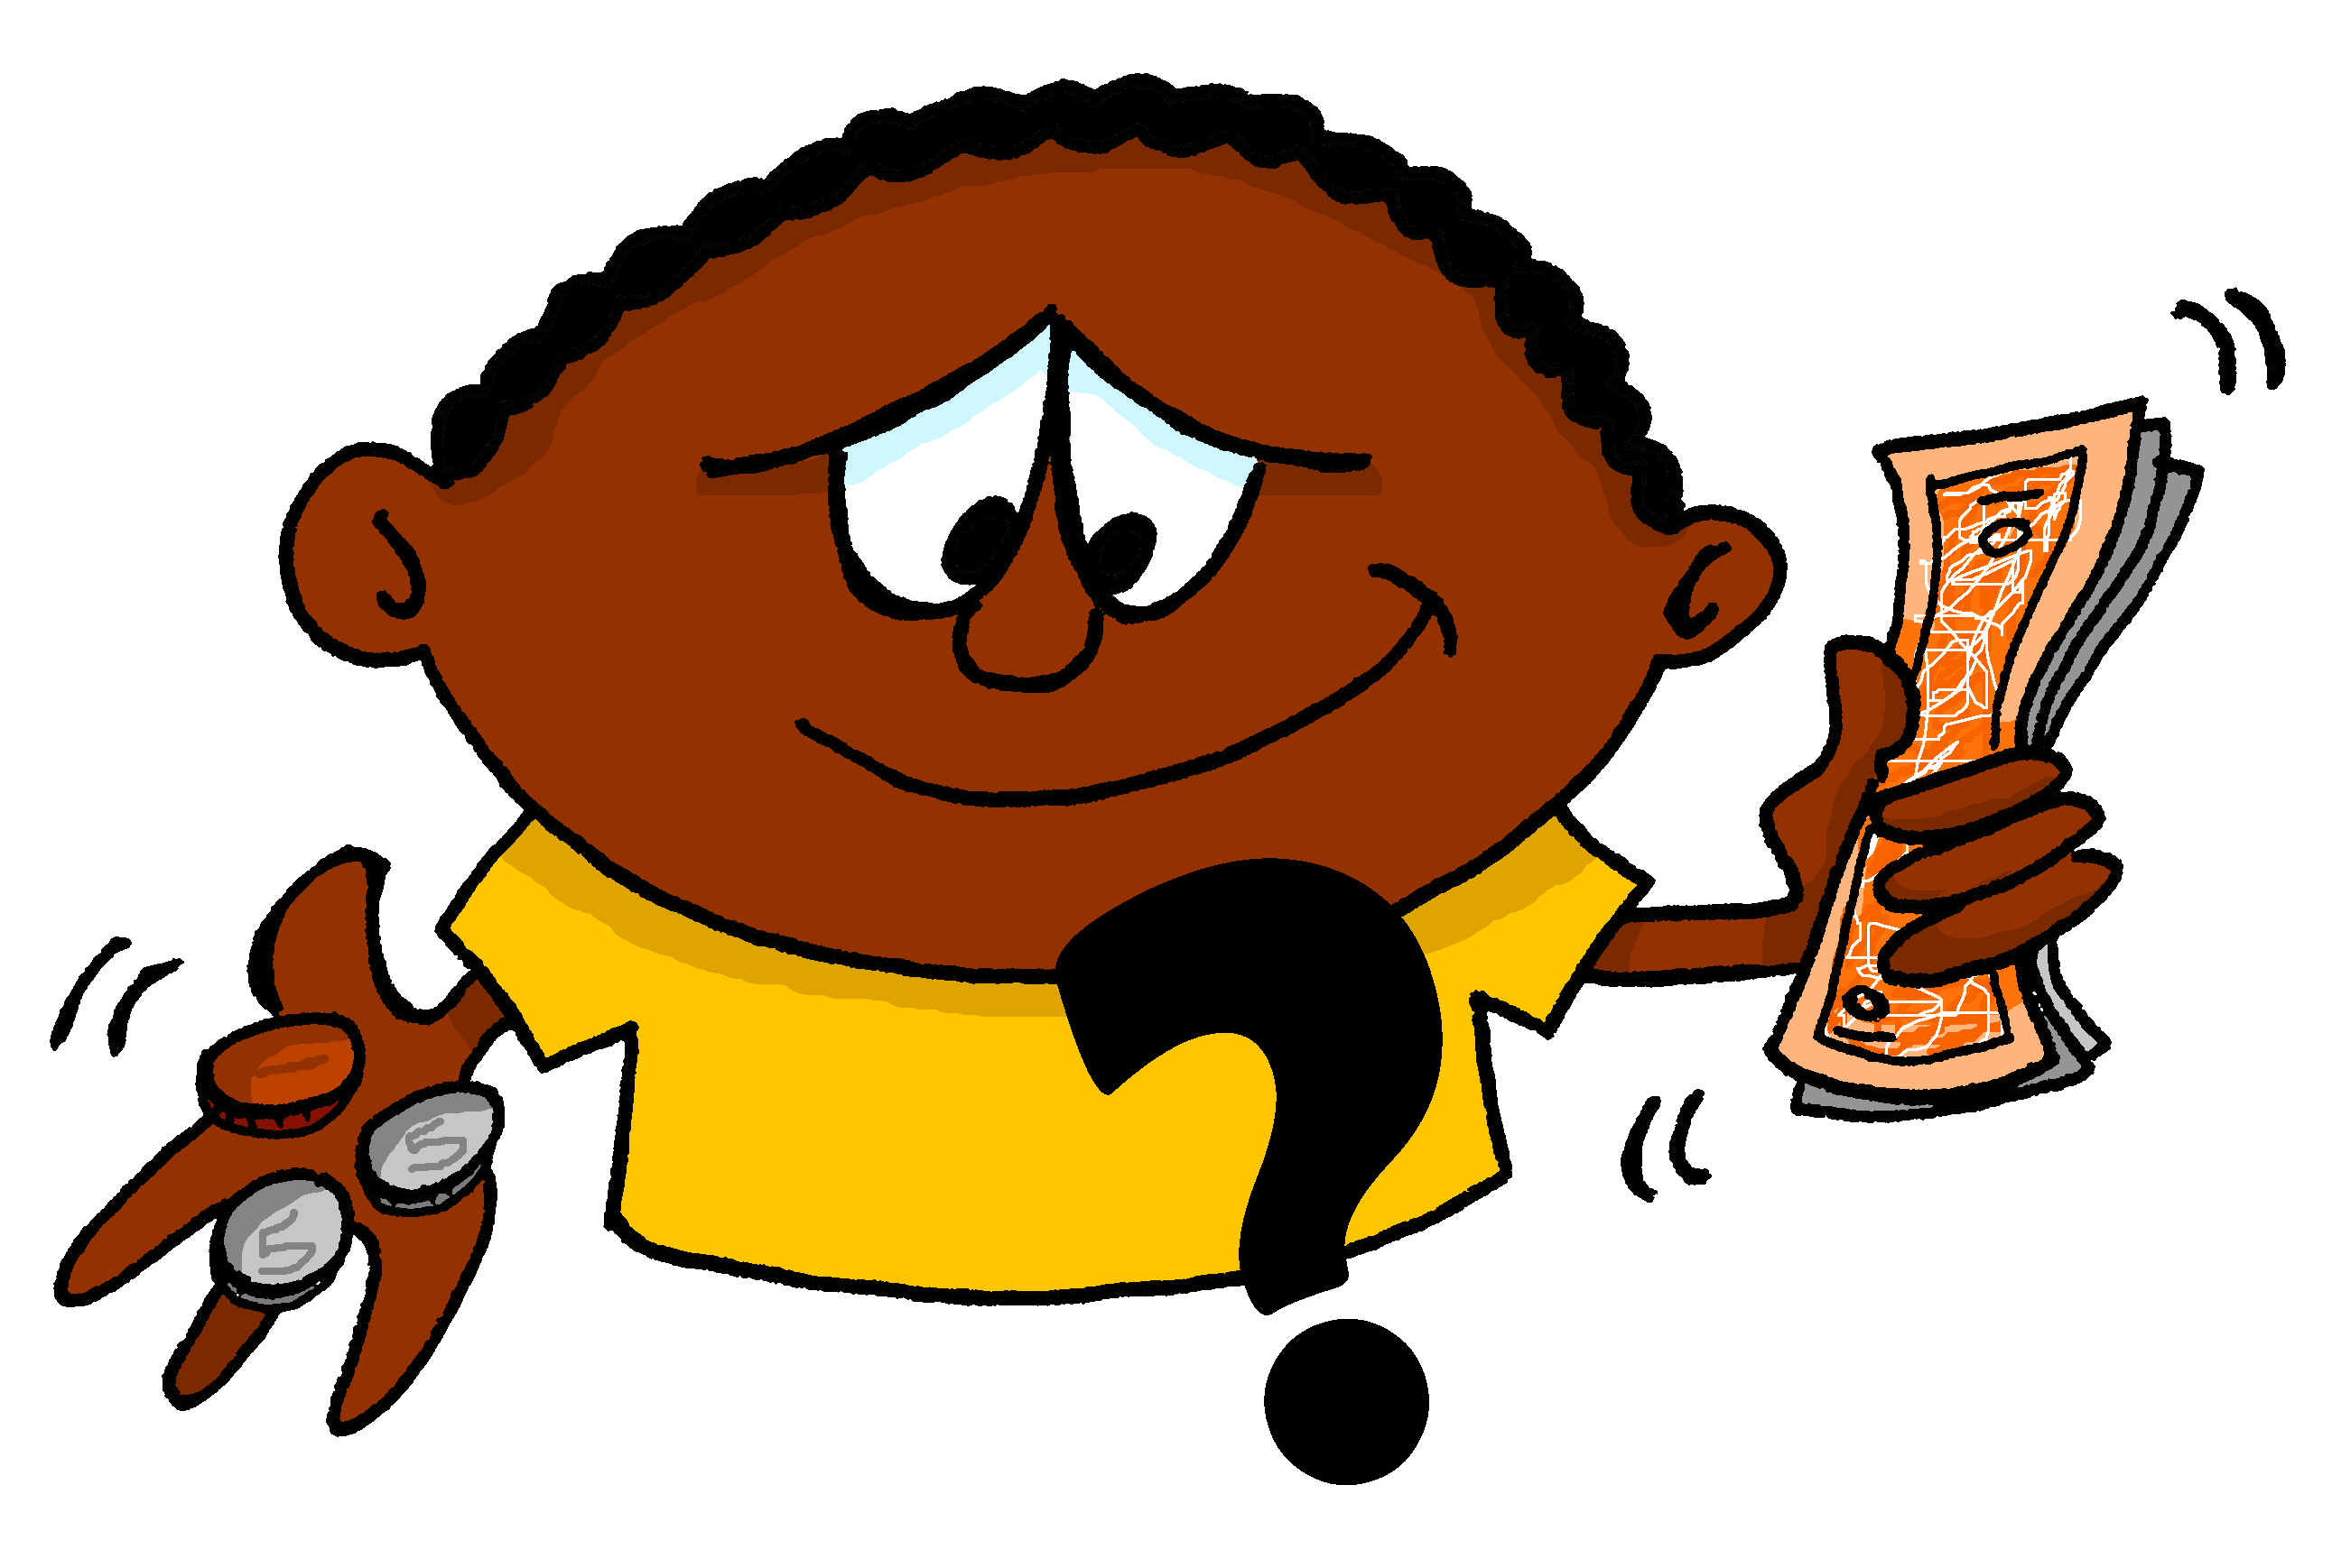
¿cuánto?
how much?
Notes:
Use the next series of slides to introduce the question word ¿cuánto/s? and show its use in context, highlighting the singular and plural versions.

Slide 6
¿cuánto?
how much?

Slide 7
¿cuánto?
how much?
¿Cuánto dinero tienes?
[How much money do you have?]

Slide 8
¿cuánto?
how much?
Cuánto
¿ _______ dinero tienes?
[How much money do you have?]

Slide 9
¿cuántos?
how many?

Slide 10
¿cuántos?
how many?

Slide 11
¿cuántos?
how many?
¿Cuántos libros tienes?
[How many books do you have?]

Slide 12
¿cuántos?
how many?
¿ ________ libros tienes?
Cuántos
[How many books do you have?]

Slide 13
¿quién?
¿quiénes?
who?
Notes:
Elicit the Spanish for who? from students and then introduce the plural form as well.

Slide 14
exercise
¿Quién es la persona con el libro?
[Who is the person with the book?]
¿Quiénes son las personas con los libros?
[Who are the people with the books?]
Notes:
Draw students’ attention to the verbs used with each question form.

Slide 15
¿cuál?
¿cuáles?
‘Cuál(es)’ is never followed directly by a noun.
Use ‘qué’ to say ‘which + noun’.
Compare:
Qué libro tienes? (Which book do you have?)
Cuál es la persona con el libro? (Which is the person with the book?)
which?
Notes:
Introduce this question word to students in the singular, say that this one also has a plural form and ask the students to predict it.

Slide 16
exercise
¿Cuál es la respuesta correcta?
[Which is the correct answer?]
¿Cuáles son las respuestas correctas?
[Which are the correct answers?]
Notes:
Draw students’ attention to the verbs used with each one

