Slide 1
Formal and informal situations: Talking to people you do and don't know
vous as formal ‘you’
SSC [oy]
Y8 French
Term 2.1 - Week 6 - Lesson 37
Kirsten Somerville / Catherine Morris / Natalie Finlayson
Artwork by: Chloé Motard
Date updated: 01/04/21
Notes:
Artwork by Chloé Motard. All additional pictures selected are available under a Creative Commons license, no attribution required.
Learning outcomes (lesson 1):
Introduction of SSC [oy]
Introduction of vous as formal ‘you’ (singular)
Introduction of formal and informal register
Word frequency (1 is the most frequent word in French):
8.2.1.5 (introduce) sortir² [309], sortons [309], sortez [309], sortent [309], venons [88], venez [88], viennent [88] vous² [50], maman [2168], papa [2458], possible [175], seul [101], sans [71], salut [2205], s’il te plaît [34/13/112/804], s'il vous plaît [34/13/50/804]
8.1.2.6 (revisit) carte¹ [955], côté [123], foot(ball) [2602], guitare [>5000], instrument [1650], pétanque [>5000] piano [4967], droit [1293], gauche [607], loin [341], près [225]
8.1.1.6 (revisit) organiser [701], chacun [323], anniversaire [2043], août [1445], décembre [891], juillet [1326], septembre [944], octobre [826], novembre [982], général [147], national [227], partout [581]
Source: Londsale, D., & Le Bras, Y. (2009). A Frequency Dictionary of French: Core vocabulary for learners London: Routledge.

Slide 2
oy
envoyer
Notes:
Timing: 1 minute
Aim: To introduce SSC [oy]
Procedure: 1. Present the letter(s) and say the [oy] sound first, on its own. Students repeat it with you. 2. Bring up the word ”envoyer” on its own, say it, students repeat it, so that they have the opportunity to focus all of their attention on the connection between the written word and its sound.
3. A possible gesture for this would be [sending a letter]. 4. Roll back the animations and work through 1-3 again, but this time, dropping your voice completely to listen carefully to the students saying the [oy] sound, pronouncing ”envoyer” and, if using, doing the gesture.
Word frequency (1 is the most frequent word in French):
enyoyer [526]
Source: Londsale, D., & Le Bras, Y. (2009). A Frequency Dictionary of French: Core vocabulary for learners London: Routledge.

Slide 3
oy
envoyer
Notes:
With sound and no pictures to focus all attention on the sound-symbol correspondence.

Slide 4
oy
envoyer
Notes:
Without sound to elicit pronunciation (without first hearing the teacher).
Teacher to elicit pronunciation by asking “Comment dit-on …”

Slide 5
oy
nettoyer
voyage
[journey]
royal
envoyer
moyen
employé
[average]
[employee]
Notes:
Timing: 2 minutes
Aim: To introduce SSC [oy]
Procedure:
1. Introduce and elicit the pronunciation of the individual SSC [oy] and then the source word again ‘envoyer’ (with gesture, if using). 2. Then present and elicit the pronunciation of the five cluster words.
The cluster words have been chosen for their high-frequency, from a range of word classes, with the SSC (where possible) positioned within a variety of syllables within the words (e.g. initial, 2nd, final etc.). Additionally, we have tried to use words that build cumulatively on previously taught SSCs (see the Phonics Teaching Sequence document) and do not include new SSCs. Where new SSCs are used, they are often consonants which have a similar symbol-sound correspondence in English.
Word frequency (1 is the most frequent word in French): envoyer [526]; royal [2290]; nettoyer [3887]; employé [1485]; voyage [904]; moyen [186] Source: Londsale, D., & Le Bras, Y. (2009). A Frequency Dictionary of French: Core vocabulary for learners London: Routledge.

Slide 6
oy
nettoyer
voyage
royal
envoyer
moyen
employé
Notes:
With sound and no pictures to focus all attention on the sound-symbol correspondence.

Slide 7
oy
nettoyer
voyage
royal
envoyer
moyen
employé
Notes:
Without sound to elicit pronunciation (without first hearing the teacher).
Teacher to elicit pronunciation by asking “Comment dit-on …”

Slide 8
[oy] : anglais vs français
écouter / parler
loyal | loyal
royal | royal
joyful | joyeux
royalty | royauté
employer | employeur
SSC [oy]
sounds like a ‘yih’ sound after SSC [oi].
This is similar to the
[-ill-/ille] vs [i] and
[-aill-/-ail] vs [a] patterns.
A
B
C
D
E
Notes:
Timing: 5 minutes
Aim: Practising aural recognition and oral production of SSC [oy]
Procedure:
1. Practice saying the English [oy] and the French [oy] sounds individually.
2. Students say the English words.
3. Click on the letters to hear the French word.
4. Students repeat the French word as many times as they need to.
Transcript:
loyal
royal
joyeux
royauté
employeur
Word frequency of cognates used (1 is the most frequent word in French): loyal [4325], royal [2290], joyeux [3987], royauté [>5000], employeur [2633]
Source: Londsale, D., & Le Bras, Y. (2009). A Frequency Dictionary of French: Core vocabulary for learners London: Routledge.

Slide 9
Vocabulaire
seul, car
écouter
 | We are coming with mum. | We are coming without mum. | Mum is coming.
 | They are coming to say bye to you. | You are coming to say hi to us. | They are coming to say hi to you.
 | Dad says it is possible. | Dad says it is not possible. | Dad is coming.
 | Please come, it’s quite far. | Please come, it isn’t far. | Please come, it will be quick.
 | I can’t come alone. It’s too far. | I will come alone, it isn’t far. | I can come alone. It’s nearby.
1
2
3
4
5
Notes:
Timing: 5 minutes
Aim: Aural recognition of new vocabulary in context.
Procedure:
1. Students should think about the French for the key words on the slide. 2. Listen to the audio 1-5. For each, choose the correct answer A, B or C. 3. Click to see the answers. 4. Students consider what must change about the audio for the other two answers to be possible.
Transcript:
Nous venons sans maman.
Ils viennent vous dire salut.
Papa dit que c’est possible.
Venez s’il vous plaît, ce n’est pas loin.
Je ne peux pas venir seul. C’est trop loin.

Slide 10
Formal language: ‘you’
grammaire
As you know, we use the pronoun vous when talking to more than one person.
We also use vous when talking to one person in a formal situation, such as when we talk to an adult we don’t know well.
Vous sortez ce week-end ? Without context, this can mean …
a) Are you (more than one person) going out this weekend?
b) Are you (one adult you don’t know well) going out this weekend?
We use tu in informal situations, such as when we talk to friends, family and children.
Tu sors ce week-end ?
Are you (one person you know well) going out this weekend?
In English, we show if a situation is formal or informal in different ways, such as word choice – would you say “Hey mate, what’s up?” to your headteacher… ?
The verb endings are the same for both uses of vous. We have to use context to work out if it is plural or formal.
Notes:
Timing: 3 minutes
Aim: introducing vous as formal ‘you’, comparing formal and informal language in English and French
Procedure:
1. Bring up the explanation of formal vous. Highlight that the endings are the same whether you are talking to one person or more than one person.
3. Bring up the explanation of informal tu and comparison with English. Elicit a formal ‘translation’ of the question (eg. ‘Hello sir, how are you?’).

Slide 11
Formal or informal?
lire
Can you tell how formal the situation is in these English sentences?
 |  | formal | informal | can’t tell
1. | You’re a careful woman.
2. | You’re an ambitious man.
3. | You’re hardworking pupils.
Remember, vous can be formal or informal when you are talking to more than one person.
What about in French?
 |  | formal | informal | can’t tell
1. | Vous êtes une femme prudente.
2. | Tu es un homme ambitieux.
3. | Vous êtes des personnes travailleuses.
Notes:
Timing: 3 minutes
Aim: awareness-raising exercise to draw attention to cross-linguistics differences in the expression of formality.

Slide 12
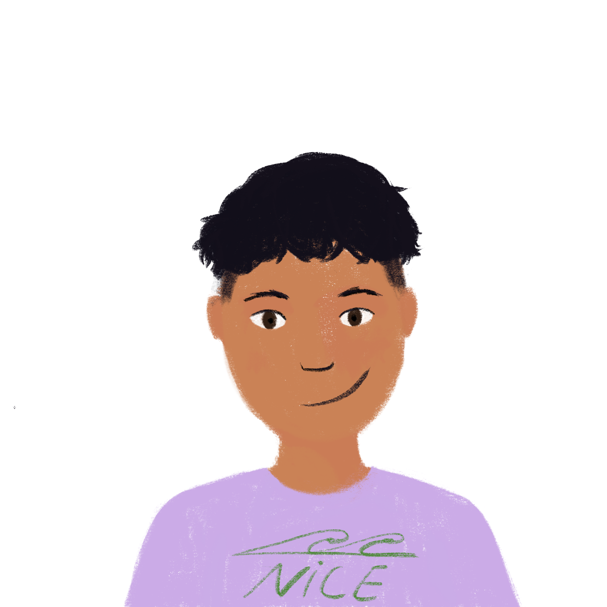
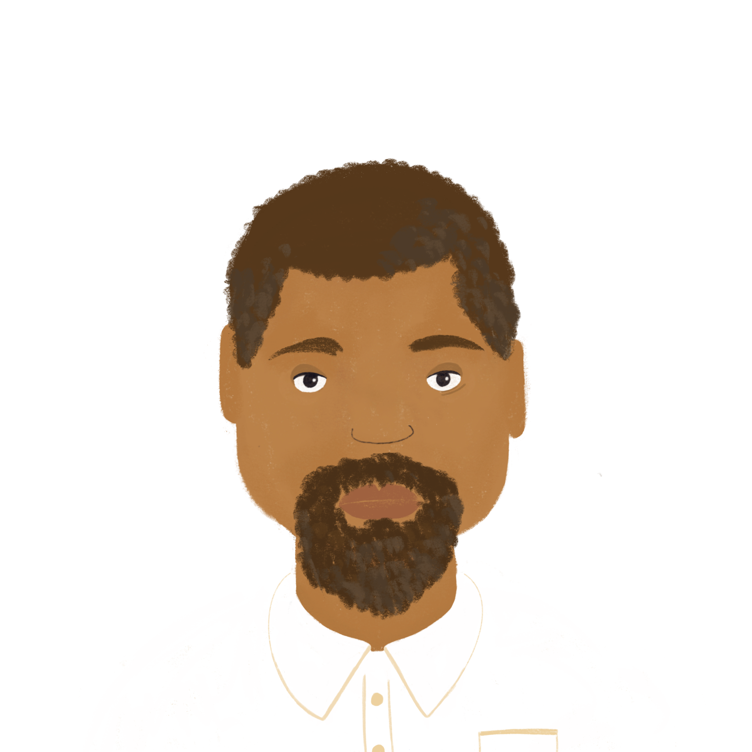
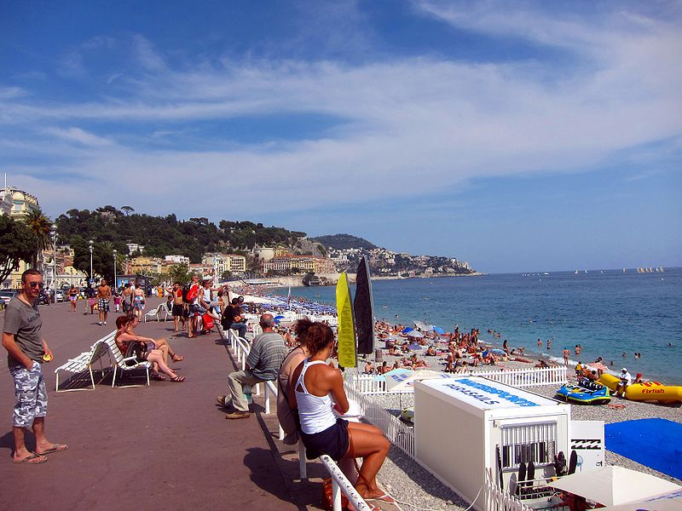
Elles parlent à qui ?
grammaire
Kirsten et Natalie ont beaucoup de questions sur Nice ! Ils parlent au prof ou à Amir ?
Aimez-vous la Promenade des Anglais ?
?
Do you like the Promenade des Anglais?
Notes:
Timing: 6 minutes. This is slide 1/8.
Aim: Written recognition of verbs in the ‘tu’ and ‘vous’ forms and connecting these with meaning (informal and formal address); learning to connect use of vous with speaking to a teacher and use of tu with speaking to a friend; presentation of some of the cultural highlights of Nice.
Procedure:
1. Students read the question and point at the person they think is being asked.
2. Click to reveal answer.
3. Click again to reveal English translation.
Image by Staeiou - Own work, CC BY-SA 3.0, https://commons.wikimedia.org/w/index.php?curid=10940750

Slide 13
Elles parlent à qui ?
grammaire
?
Joues-tu au football demain ?
Are you playing football tomorrow?
Notes:
This is slide 2/8.

Slide 14
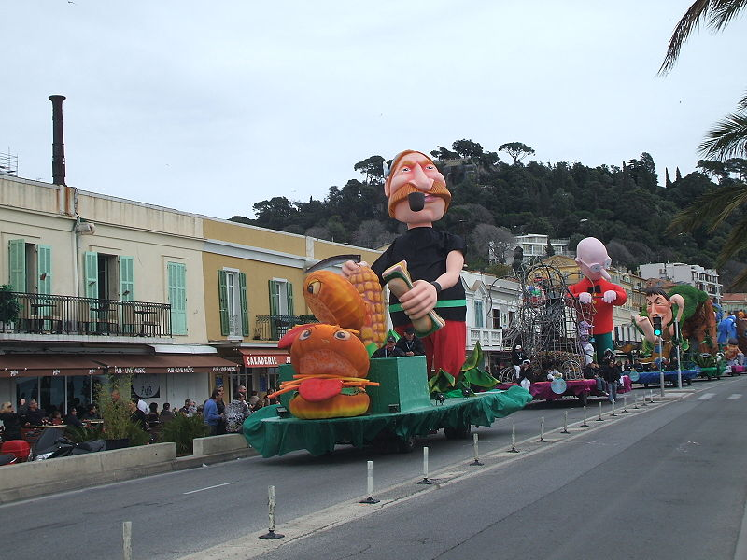
Elles parlent à qui ?
grammaire
?
Préfères-tu le carnaval ou Noël ?
Do you prefer the carnival or Christmas?
Notes:
This is slide 3/8.
Image by Honeydew - Own work, CC BY-SA 3.0, https://commons.wikimedia.org/w/index.php?curid=9585018

Slide 15
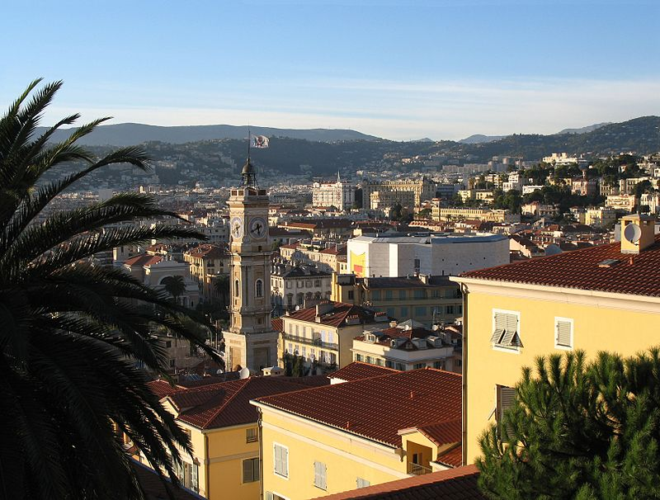
Elles parlent à qui ?
grammaire
?
Vas-tu à la vieille ville?
Are you going to the old town?
Notes:
This is slide 4/8.
Image by Gilbert Bochenek - Own work, CC BY 3.0, https://commons.wikimedia.org/w/index.php?curid=2662838

Slide 16
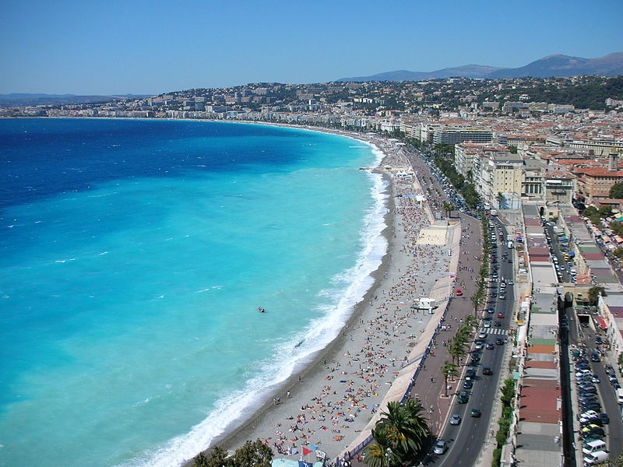
Elles parlent à qui ?
grammaire
Visitez-vous la Baie des Anges ?
?
Are you visiting the Baie des Anges?
Notes:
This is slide 5/8.
Image by Ioan Sameli — https://www.flickr.com/photos/biwook/237577080, CC BY-SA 2.0, https://commons.wikimedia.org/w/index.php?curid=1189156

Slide 17
Elles parlent à qui ?
grammaire
Allez-vous à la plage ?
?
Are you going to the beach?
Notes:
This is slide 6/8.

Slide 18
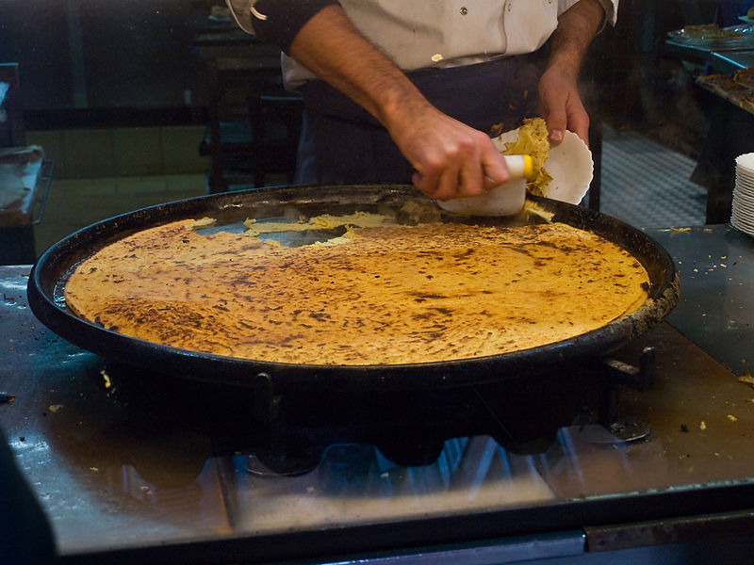
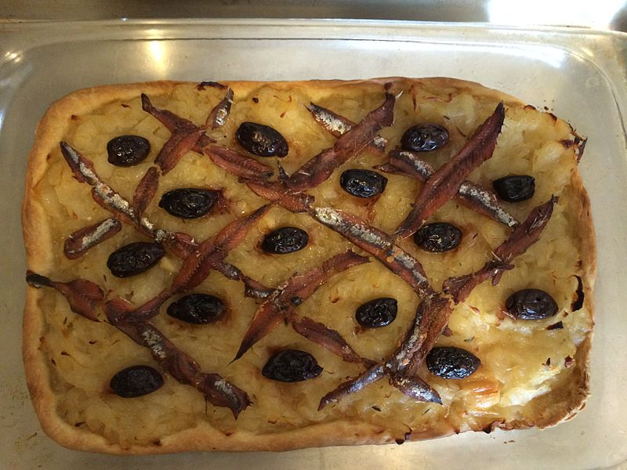
Elles parlent à qui ?
grammaire
Manges-tu la cuisine niçoise ?
?
Do you eat the cuisine from Nice?
Notes:
This is slide 7/8.
Word frequency (1 is the most frequent word in French): niçois [>5000]
Source: Londsale, D., & Le Bras, Y. (2009). A Frequency Dictionary of French: Core vocabulary for learners London: Routledge.
Images left to right:
Socca - By Photo: Myrabella / Wikimedia Commons, CC BY-SA 3.0, https://commons.wikimedia.org/w/index.php?curid=8992997
Pissaladière - By Cdg83 - Own work, CC BY-SA 4.0, https://commons.wikimedia.org/w/index.php?curid=34172792

Slide 19
Elles parlent à qui ?
grammaire
Achetez-vous un livre pour l’école ?
?
Are you buying a book for school?
Notes:
This is slide 8/8.

Slide 20
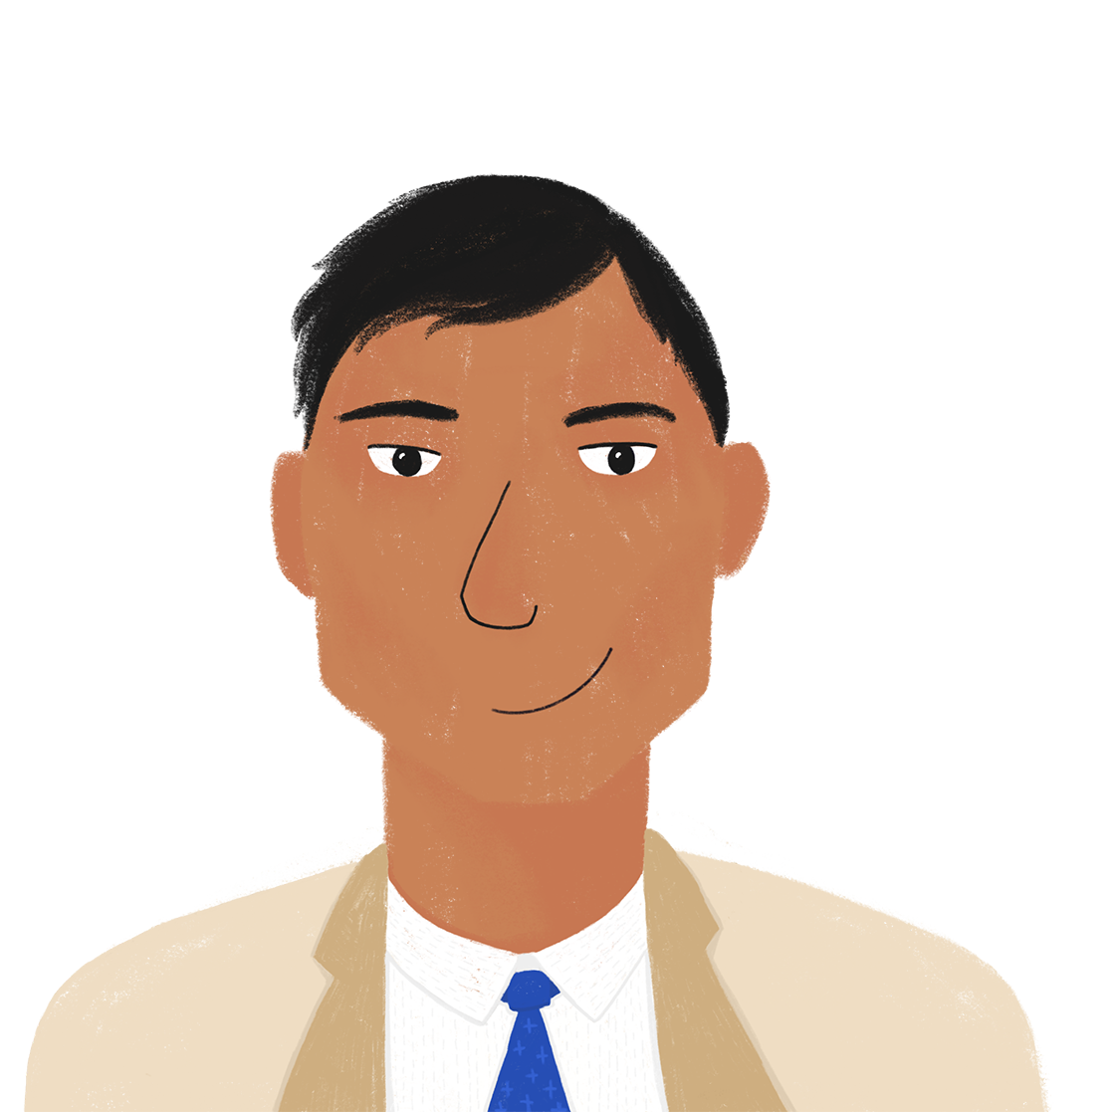
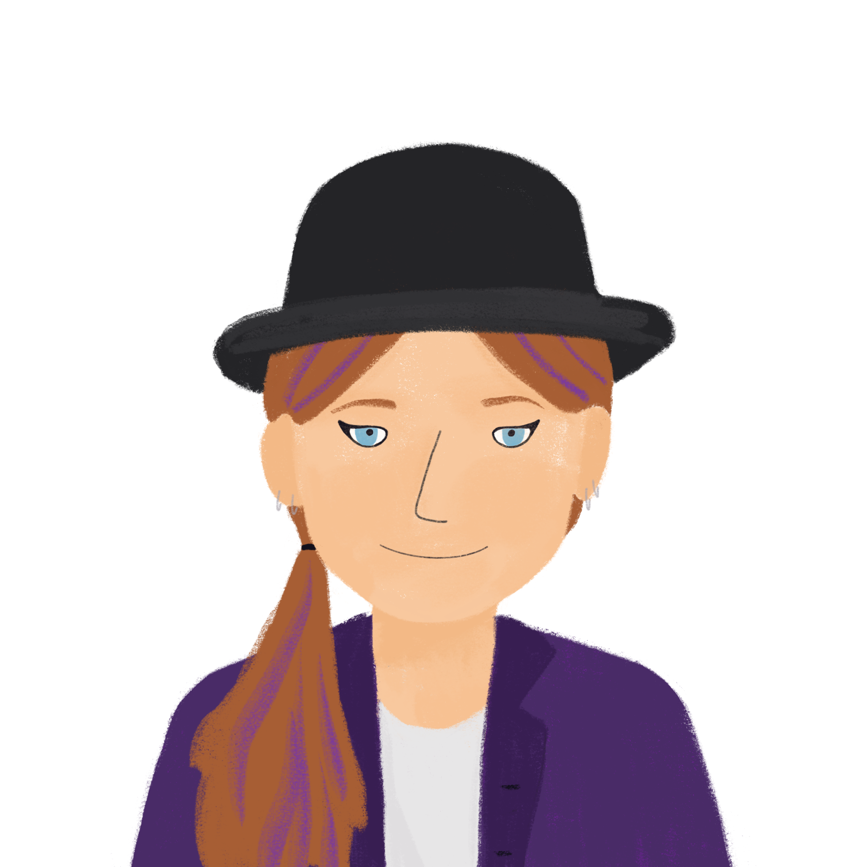
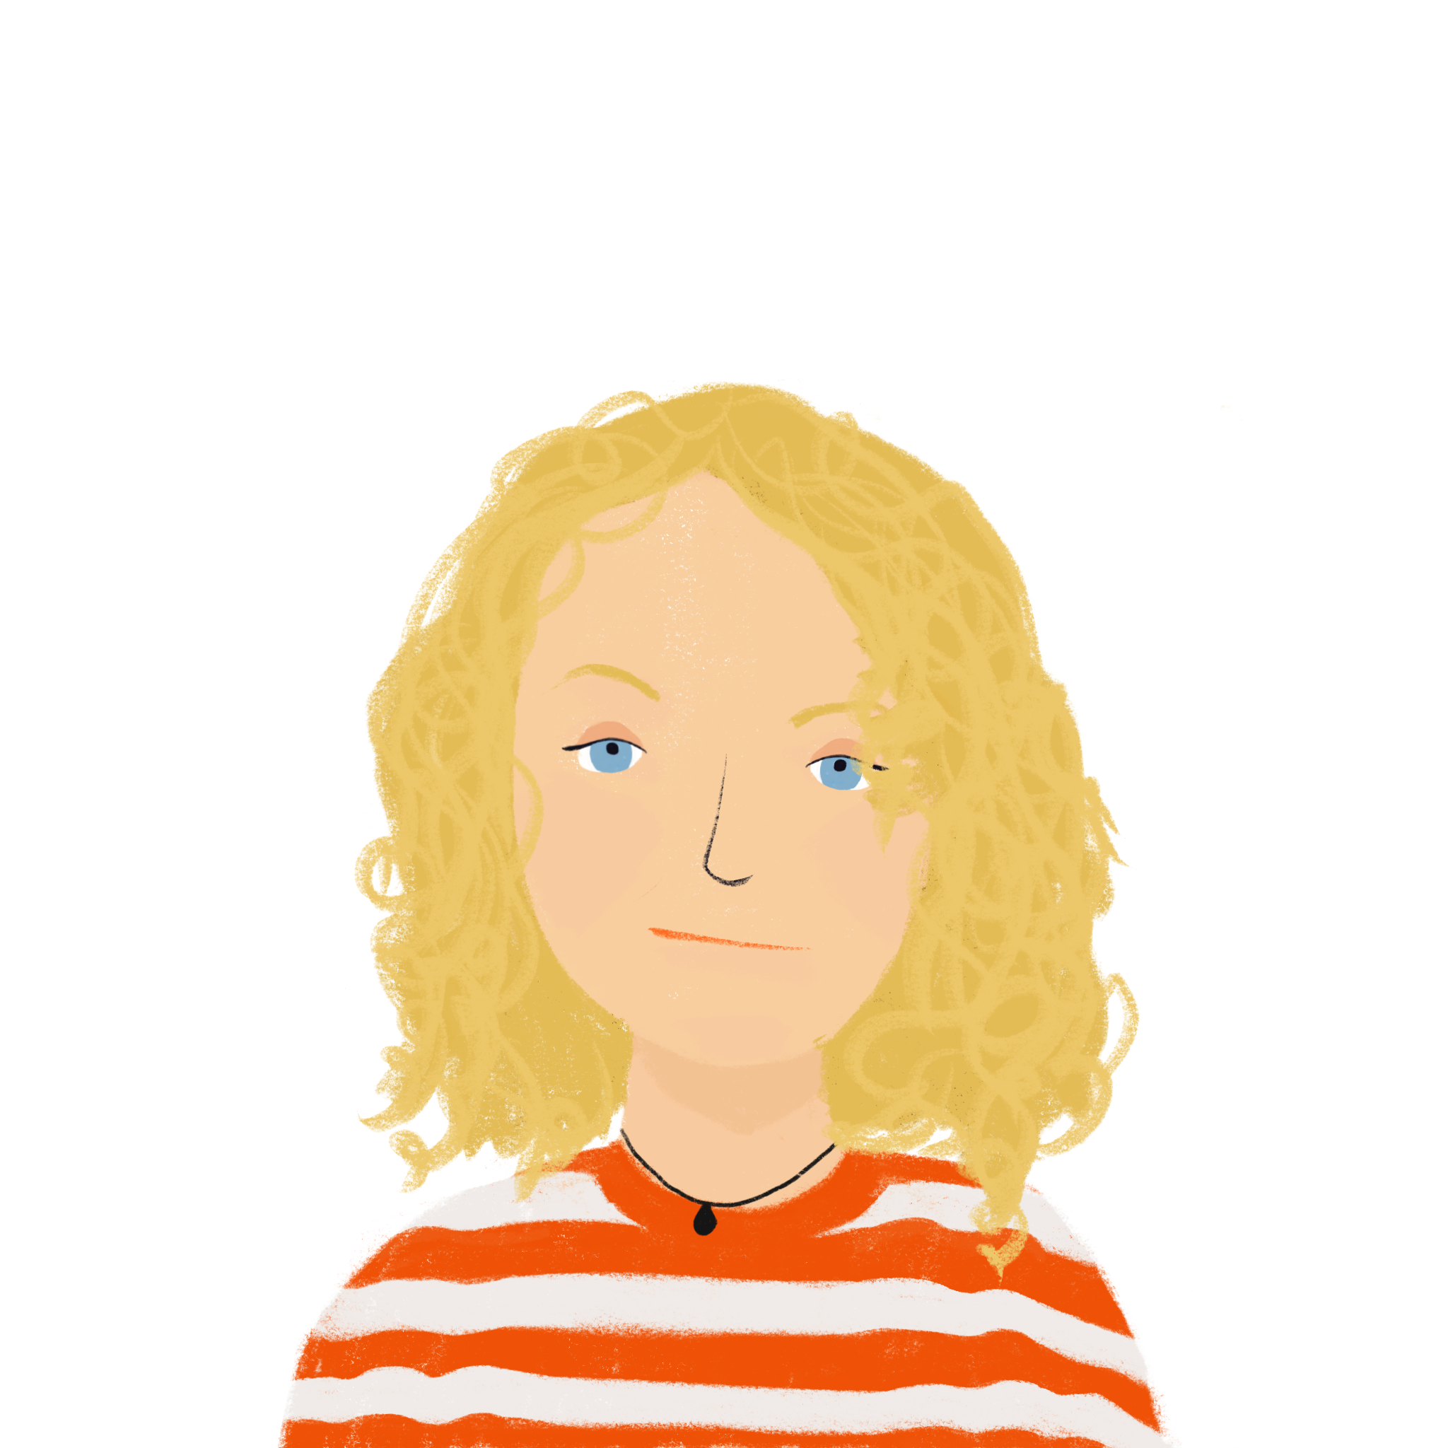
Chez Amir – qui ?
*famillie d’accueil = host family
écouter
Les élèves restent chez une famille d'accueil* pendant une semaine.
Kirsten a beaucoup de questions pour Amir et Bilal. Elle parle à qui ? Coche.
 | Amir (tu) | Bilal (vous)
1
2
3
4
5
?
6
7
8
Notes:
Timing: 10 minutes. This is slide 1/2.
Aim: practising aural recognition of the second person plural form of a range of verb types, connecting this form with the formal vous meaning
Procedure:
1. Draw attention to the French translation of ‘host family’ (famille d'accueil). Have them read it aloud for additional practice of SSC [-ueil], which is one of this week’s target sounds. Explain that accueil on its own means ‘welcome’. They will encounter this word again as a cluster word in lesson 2.
2. Click the numbers to play the audio. The subject pronouns are obscured by beeps.
3. Students write 1-8 and choose ‘Amir’ or ‘Bilal’ for each question.
4. Click to reveal the answers.
5. Proceed to the next slide for the full audio and comprehension element.
Transcript:
Venez […] de Nice ?
Aimez […] la ville ?
Sors […] aujourd‘hui ?
Avez […] un animal ?
Fais […] du sport ?
Joues […] d’un instrument ?
Allez […] souvent en Angleterre ?
Es […] végétarien ?
Word frequency of cognates used (1 is the most frequent word in French): végétarien [>5000]
Source: Londsale, D., & Le Bras, Y. (2009). A Frequency Dictionary of French: Core vocabulary for learners London: Routledge.
Word frequency of cognates used (1 is the most frequent word in French):
accueil [2541]
Source: Londsale, D., & Le Bras, Y. (2009). A Frequency Dictionary of French: Core vocabulary for learners London: Routledge.

Slide 21
Chez Amir – qui ?
écouter
 | Do you come from Nice? | Do you live in Nice?
 | Do you like the town? | Do you like the tour?
 | Are you going out today? | Are you leaving today?
 | Do you like animals? | Do you have an animal?
 | Do you do sport? | Do you watch sport?
 | Do you have an instrument? | Do you play an instrument?
 | Do you often stay in England? | Do you often go to England?
 | Are you vegetarian? | Do you eat vegetables?
1
2
3
4
5
6
7
8
Notes:
Procedure:
1. Click the numbers to play the full audio without beeps.
2. Students choose correct translation
3. Click to reveal answers
Transcript:
Venez-vous de Nice ?
Aimez-vous la ville ?
Sors-tu aujourd‘hui ?
Avez-vous un animal ?
Fais-tu du sport ?
Joues-tu d’un instrument ?
Allez-vous souvent en Angleterre ?
Es-tu végétarien ?

Slide 22
Saying ‘please’
Plaît is the il/elle form of the verb plaire = to please, pleasing.
Can you work out the literal translation of the phrase?
grammaire
s’il te plaît
s’il vous plaît
Notes:
Timing: 1 minutes
Aim: to learn how to say ‘please’ in French
Procedure:
Bring up the phrases s’il te plait and s’il vous plait and gloss plaire. Students have now learned si, il and vous – elicit a literal translation (eg. ‘if it pleases you’).
NB: The audio for s'il te plaît is missing, recording in progress.

Slide 23
Formal language: vocabulary
lire
Attention !
One informal word has two different formal meanings.
French uses different words in formal and informal situations.
Match the informal expressions to their formal equivalents.
Informal
s’il te plaît
maman
papa
salut
Formal
père
bonjour
mère
au revoir
s’il vous plaît
Notes:
Timing: 4 minutes
Aim: connecting informal and formal ways of expressing the same idea
Procedure:
1. Students write the informal expressions and match each with its formal equivalent(s).
2. Click to reveal the answers.

Slide 24
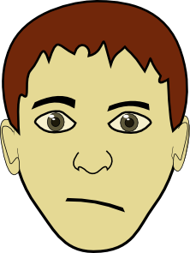
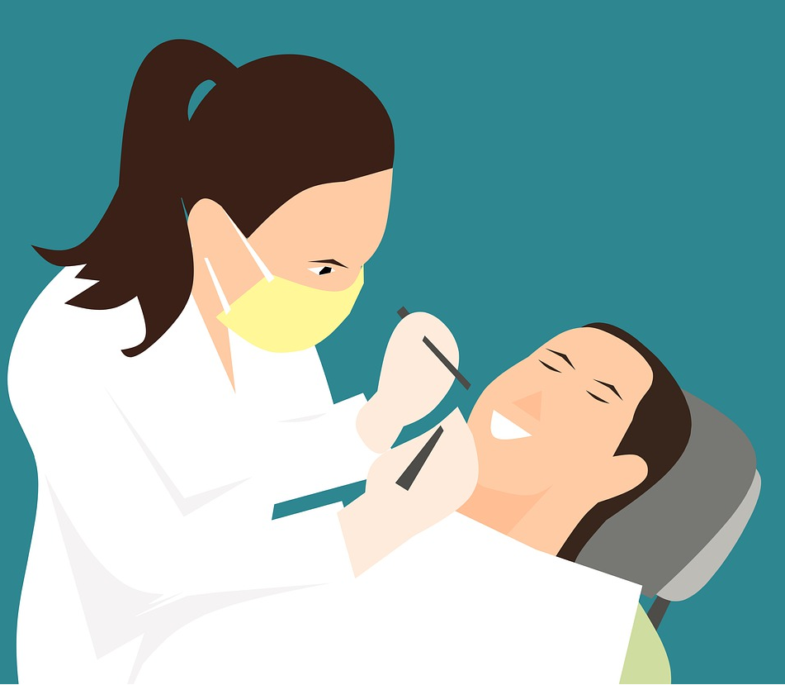
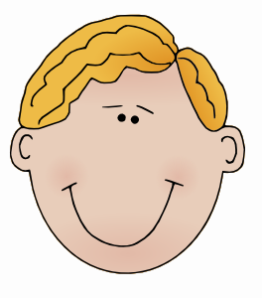
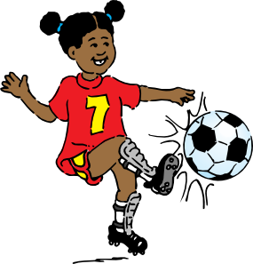
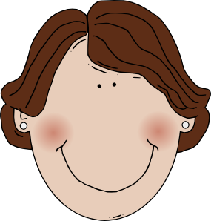
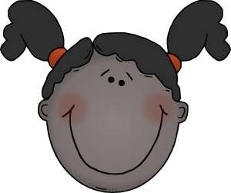
En ville
Natalie et Kirsten vont en ville. Elles parlent avec des personnes. Que demandent-ils ?
parler
M. Dupont,
le policier
aider / qui
Marine,
9 ans
sortir /
seule
Omar,
14 ans
jouer / à / la / pétanque
Mme Petit,
la pâtissière
avoir / des croissants
Mme Martin
la dentiste
manger / des bonbons
Stéphane,
12 ans
savoir / chanter
1
2
3
4
5
6
Sara et Jean,
10 ans
venir / au parc
Daphné,
15 ans
être / dans / une équipe
Émilie,
13 ans
habiter /
où
Mme. Dubois
55 ans
venir / de / Nice
M. Robert,
le serveur
partir / au travail / quand
M. Michel
le vétérinaire
sortir / le / chien /
7
8
9
10
11
12
Notes:
Timing: 10 minutes
Aim: oral production of questions with formal and informal ‘you’.
Procedure:
1. Check students understand which form of address they need to use for whom. Remind them of the full forms of M. / Mme.
2. Students tear a piece of paper into 12 and write numbers 1-12 on each. They then fold the pieces so the numbers are hidden.
3. Students take turns to choose a piece of paper form a question using the prompts (person bios and word sets) indicated by that number. At more advanced levels, students should be encouraged to alternate between question forms – intonation and est-ce que for informal address; inversion for formal address.
Suggested answers
Vous aidez qui ? / Qui aidez-vous ? / Qui est-ce que vous aidez ?
Tu sors seule ? / Sors-tu seule? / Est-ce que tu sors seule ?
Tu joues à la pétanque ? / Joues-tu à la pétanque ? / Est-ce que tu joues à la pétanque ?
Vous avez des croissants ? / Avez-vous des croissants ? / Est-ce que vouz avez des croissants ?
Vous mangez des bonbons ? / Mangez-vous des bonbons ? / Est-ce que vous mangez des bonbons ?
Tu sais chanter ? / Sais-tu chanter ? / Est-ce que tu sais chanter ?
Vous venez au parc ? / Venez-vous au parc ? / Est-ce que vous venez au parc ?
Tu es dans une équipe ? / Es-tu dans une équipe ? / Est-ce que tu es dans une équipe ?
Tu habites où ? / Où habites-tu ? / Où est-ce que tu habites ?
Vous venez de Nice ? / Venez-vous de Nice ? / Est-ce que vous venez de Nice ?
Vous partez au travail quand ? / Partez-vous au travail ? / Quand est-ce que vous partez au travail ?
Vous sortez le chien ? / Sortez-vous le chien ? / Est-ce que vous sortez le chien ?
Word frequency of cognates used (1 is the most frequent word in French): policier [1265], pâtissière [>5000], dentist [>5000], vétérinaire [>5000]
Source: Londsale, D., & Le Bras, Y. (2009). A Frequency Dictionary of French: Core vocabulary for learners London: Routledge.

Slide 25
Formal and informal situations: Talking to people you do and don't know
on with impersonal meaning ‘we’
SSC [oy], [oi] revisited
Y8 French
Term 2.1 - Week 6 - Lesson 38
Kirsten Somerville / Catherine Morris / Natalie Finlayson
Artwork by: Chloé Motard
Date updated: 22/10/21
Notes:
Artwork by Chloé Motard. All additional pictures selected are available under a Creative Commons license, no attribution required.
Learning outcomes (lesson 2):
Introduction of on with impersonal meaning ‘we’
Consolidation of SSC [oy]
Revisiting SSC [oi]
Word frequency (1 is the most frequent word in French):
8.2.1.5 (introduce) sortir² [309], sortons [309], sortez [309], sortent [309], venons [88], venez [88], viennent [88] vous2 [50], maman [2168], papa [2458], possible [175], seul [101], sans [71], salut [2205], s’il te plaît [34/13/112/804, s'il vous plaît [34/13/50/804]
8.1.2.6 (revisit) carte¹ [955], côté [123], foot(ball) [2602], guitare [>5000], instrument [1650], pétanque [>5000] piano [4967], droit [1293], gauche [607], loin [341], près [225]
8.1.1.6 (revisit) organiser [701], chacun [323], anniversaire [2043], août [1445], décembre [891], juillet [1326], septembre [944], octobre [826], novembre [982], général [147], national [227], partout [581]
Source: Londsale, D., & Le Bras, Y. (2009). A Frequency Dictionary of French: Core vocabulary for learners London: Routledge.

Slide 26
oi
[to see]
voir
Notes:
Timing: 1 minute
Aim: To consolidate SSC [oi]
Procedure: 1. Present the letter(s) and say the [oi] sound first, on its own. Students repeat it with you. 2. Bring up the word ”voir” on its own, say it, students repeat it, so that they have the opportunity to focus all of their attention on the connection between the written word and its sound.
3. A possible gesture for this would be to put one’s hand above one’s brow (as if to shade one’s view) and pretend to be seeing something far off. 4. Roll back the animations and work through 1-3 again, but this time, dropping your voice completely to listen carefully to the students saying the [oi] sound, pronouncing ”voir” and, if using, doing the gesture.
Word frequency (1 is the most frequent word in French):
voir [69].
Source: Londsale, D., & Le Bras, Y. (2009). A Frequency Dictionary of French: Core vocabulary for learners London: Routledge.

Slide 27
oi
droite
avoir
[to have]
to see
voir
Au revoir !
trois
Pourquoi ?
[why?]
Notes:
Timing: 1 minute
Aim: To consolidate SSC [oi]
Procedure:
1. Introduce and elicit the pronunciation of the individual SSC [oi] and then the source word again ‘voir’ (with gesture, if using). 2. Then present and elicit the pronunciation of the five cluster words.
The cluster words have been chosen for their high-frequency, from a range of word classes, with the SSC (where possible) positioned within a variety of syllables within the words (e.g. initial, 2nd, final etc.). Additionally, we have tried to use words that build cumulatively on previously taught SSCs (see the Phonics Teaching Sequence document) and do not include new SSCs. Where new SSCs are used, they are often consonants which have a similar symbol-sound correspondence in English.
Word frequency (1 is the most frequent word in French): droite [1293]; avoir [8] au revoir [n/a]; pourquoi[193]; trois[115]; voir [69]. Source: Londsale, D., & Le Bras, Y. (2009). A Frequency Dictionary of French: Core vocabulary for learners London: Routledge.

Slide 28
Phonétique
écouter / écrire
Say these words:
SSC [oy]
sounds like a ‘yih’ sound after SSC [oi].
This is similar to the
[-ill-/ille] vs [i] and
[-aill-/-ail] vs [a] patterns.
fois
[time]
foyer
[home]
Notes:
Timing: 1 minute
Aim: Aural recognition and production of SSCs [oy] and [oi] to prime for the activity on the next slide.
Procedure:
1. Students try to say the words in the pair, foi and foyer.
2. Click to hear the words said by a native speaker. Students repeat.
3. Click to bring up the hint.
Transcript:
fois
foyer
Word frequency (1 is the most frequent word in French): ail [>5000]

Slide 29
Phonétique (1/2)
Hint
SSC [oy]
sounds like a ‘yih’ sound after SSC [oi].
écouter
Écoute ! Quel mot a la SSC [oy] ?
[to drown] | [black]
a) noyer | b) noir
[king] | [kingdom]
a) roi | b) royaume
1
3
__
_
__
__
[law] | [to use]
a) loi | b) employer
[happy] | [joy]
a) joyeux | b) joie
2
4
__
__
__
__
Notes:
Timing: 8 minutes (for two slides)
Aim: aural recognition of SSCs [oy] and [oi] in pairs. Awareness-raising exercise in pronunciation of [oy] (sounds like [oi] + ‘yih’.)
Procedure:
1. Click the numbers to play the audio.
2. Students write 1-8 and complete the word with [oi] or [oy].
3. Click to reveal the answers.
4. Students sound out the pairs of words. Draw attention to the SFC.
5. Move to the next slide and repeat steps 1-4 for four more pairs.
Transcript:
1. a) noyer b) noir
2. a) loi b) employer
3. a) roi b) royaume
4. a) joyeux b) joie
Word frequency of unknown words used (1 is the most frequent word in French): noyer [4060], noir [572], loi [267], employer [724], roi [1364], royaume [2620], joyeux [3987], joie [1984]
Source: Londsale, D., & Le Bras, Y. (2009). A Frequency Dictionary of French: Core vocabulary for learners London: Routledge.

Slide 30
Phonétique (2/2)
Hint
SSC [oy]
sounds like a ‘yih’ sound after SSC [oi].
écouter
Écoute ! Quel mot a le SSC [oy] ?
[believer] | [to believe]
a) croyant | b) croire
[nucleus] | [Chinese]
a) noyau | b) chinois
5
7
__
_
__
_
[citizen] | [roof]
a) citoyen | b) toit
3 | [to grant]
a) trois | b) octroyer
6
8
__
_
_
__
Notes:
This is the second part of the activity described on the previous slide.
Transcript:
5. a) croyant b) croire
6. a) citoyen b) toit
7. a) noyau b) chinois
8. a) trois b) octroyer
Word frequency of unknown words used (1 is the most frequent word in French): croyant [4332], croire [135], citoyen [1081], toit [roof], noyau [3832], chinois [1914], trois [115], octroyer [4232]
Source: Londsale, D., & Le Bras, Y. (2009). A Frequency Dictionary of French: Core vocabulary for learners London: Routledge.

Slide 31
Vocabulaire
emporter [1128], vue [191], [224]
parler / écrire
A
B
C
D
to go out, to take out
please (formal)
mum and dad are coming
you (plural
/ formal) are coming
E
F
G
H
are you
(plural / formal) alone?
they are going out without
dad
we are taking a book out
hi, bye
I
J
K
L
when are you (plural / formal) going out?
we are coming
is it possible?
please (informal)
Notes:
Timing: 6 minutes
Aim: written production of new vocabulary in short phrases
Procedure:
1. Students write A-L in books in the order shown here.
2. Click or press ‘enter’ to flash an English word/phrase. It will disappear after three seconds. (NOTE: words do not appear in alphabetical order)
3. Students write down the French word before the English word has faded away
4. Ensure that gender/definite articles are known for any words that are nouns.
5. Answers on the next slide.

Slide 32
Vocabulaire
emporter [1128], vue [191], [224]
parler / écrire
maman et papa viennent
sortir
s'il vous plaît
vous venez
vous-êtes seul(e)(s) ?
ils sortent sans papa
nous sortons un livre
salut
nous venons
c’est possible ?
vous sortez quand ?
s’il te plaît
Notes:
Answers to the activity on the previous slide.
NB: for the items that are questions, also accept inversion questions and est-ce que questions.

Slide 33
Informal language: ‘we’
grammaire
As you know, we use the pronoun on when talking about people in general. We can translate it as ‘people’, ‘you’ or ‘one’. It uses the il/elle verb endings.
We also use on to mean ‘we’ in an informal situation, such as talking to friends.
On parle anglais en Écosse. Without context, this can mean …
a) People speak English in Scotland.
b) We speak/are speaking English in Scotland.
We use nous in formal situations, most often in writing rather than speaking.
Nous parlons anglais en Écosse.
We speak/are speaking English in Scotland.
But remember, in French and in English, not all written language is formal – would you write the same way in an essay as in a text message?
The verb endings are the same for both uses of on. We can use the context to work out if it means ‘people or ‘we’.
Notes:
Timing: 4 minutes
Aim: introducing on as informal ‘we’, comparing formal and informal language in English and French
Procedure:
1. Bring up the explanation of informal on. Highlight that the endings are the same whether you are talking about people in general or yourself and others.
2. Bring up the explanation of formal nous and comparison with English. Elicit some differences between how you write in essays and text messages.

Slide 34
Saying ‘let’s go’
You know y from the phrase il y a. Can you work out the literal translation of the phrase?
grammaire
on y va !
Notes:
Timing: 1 minute
Aim: to learn how to say ‘let’s go’ in French
Procedure:
1. Bring up the phrase on y va. Students have now learned on, y (in il y a) and aller – elicit a literal translation (eg. ‘we go there’).
NB: The audio for on y va is missing, recording in progress.

Slide 35
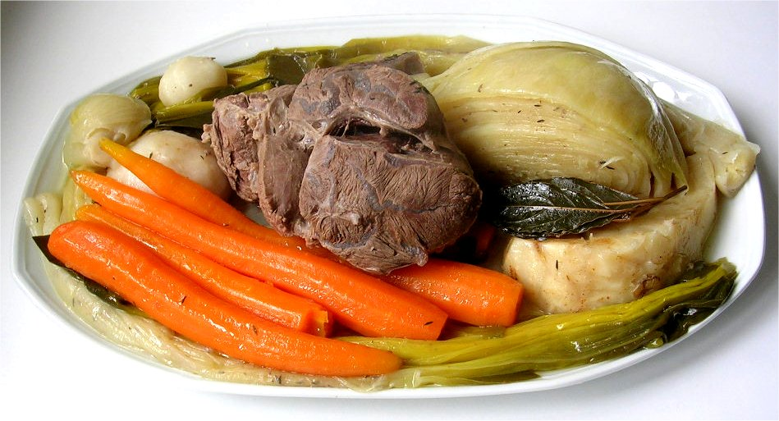
La visite à Nice
lire
Natalie parle des expériences de la classe. Elle écrit dans le magazine du collège (nous), ou dans un message à sa nouvelle amie française (on) ?
1. On n’est pas loin de Monaco.
magazine / message
___
Pot-au-feu
(‘pot on the fire’) is a traditional beef stew, often considered the national dish of France.
2. Nous jouons à la pétanque avec la famille.
magazine / message
___
3. Nous mangeons le plat national, le pot-au-feu.
magazine / message
___
4. On organise une fête avec les élèves.
magazine / message
___
5. Nous aimons aller à la plage en décembre !
___
magazine / message
6. Nous passons beaucoup de temps dehors en général.
magazine / message
___
7. On achète des cartes postales.
magazine / message
___
8. On va bientôt revenir !
magazine / message
___
Notes:
Timing: 10 minutes. This is slide 1/2.
Aim: written recognition of the third person singular form of a range of verb types, connecting this form with the impersonal on meaning.
Procedure:
1. Students write 1-8 and choose nous or on for each.
2. Click to reveal the answers.
3. Proceedeto the next slide for the comprehension element. Students write summaries (four sentences each) in English of the magazine content and of the message content. Remind students to consider whether a translation in the present simple or continuous sounds most natural.
4. Suggested answers revealed on clicks.
Word frequency of cognates used (1 is the most frequent word in French): expérience [679], magazine [2033], message [792], pot-au-feu [3648/4/786]
Source: Londsale, D., & Le Bras, Y. (2009). A Frequency Dictionary of French: Core vocabulary for learners London: Routledge.
Image attribution:
Par Andre — recettessimples.fr, CC BY-SA 3.0, https://commons.wikimedia.org/w/index.php?curid=324118

Slide 36
La visite à Nice
lire
Le magazine
Le message
Nous jouons à la pétanque avec la famille. Nous mangeons le plat national, le pot-au-feu. Nous aimons aller à la plage en décembre !
Nous passons beaucoup de temps dehors en général.
On n’est pas loin de Monaco. On organise une fête avec les élèves. On achète des cartes postales. On va bientôt revenir !
We play boules with the family.
We are not far from Monaco.
We eat the national dish, traditional beef stew.
We are organising a party with the students.
We like going to the beach in December!
We’re buying postcards.
We’ll come back soon!
In general, we spend a lot of time outside.
Notes:
This is slide 2/2.
Click to bring up translations for magazine and then text message sentence by sentence.

Slide 37
Qui écrit à Abdel ?
*cordialement = sincerely *le bisou = kiss
écrire
Abdel a trouvé un emploi ! Que dit son directeur ? Que dit son ami ?
CONTRAT DE TRAVAIL
Chère Madame,
1. Vous venez au bureau 8h30.
2. Vous faites la pause déjeuner à 12h.
3. Vous revenez à 12h45.
4. Vous partez du bureau à 17h30.
5. Vous êtes / Êtes-vous d’accord ?
Cordialement*
M. Bisson
Salut Abdel !
6. Tu as un nouvel emploi !
7. Tu es / Es-tu heureux ?
8. Tu viens / viens-tu au bureau chaque jour ?
9. Tu pars quand ?
10 . Tu sors le week-end ?
Bisous*, Yasser
[You have]
[You come]
[Are you]
[You do/make]
[Are you coming]
[You come back]
[You leave]
[You leave]
[Are you]
[You go out]
Notes:
Timing: 8 minutes
Aim: Written production of regular and irregular verbs in the formal and informal ‘yous’ forms. Introduction to formal and informal writing.
Procedure:
1. Check students understand the surrounding context. Ask ‘which text is formal? Which text is informal?’
2. Draw attention to the formal and informal salutations. Ask students where they have seen ‘chère’ before. What is a synonym of ‘expensive’? (dear)
3. Students write 1-10 and the appropriate pronoun and verb form for the situation.
4. Answers revealed on clicks.
Word frequency of cognates used (1 is the most frequent word in French): contrat [832], week-end [2475], pause [2647]
Source: Londsale, D., & Le Bras, Y. (2009). A Frequency Dictionary of French: Core vocabulary for learners London: Routledge.
Word frequency of unknown words used (1 is the most frequent word in French): cordialement [>5000], bisou [>5000]
Source: Londsale, D., & Le Bras, Y. (2009). A Frequency Dictionary of French: Core vocabulary for learners London: Routledge.

Slide 38
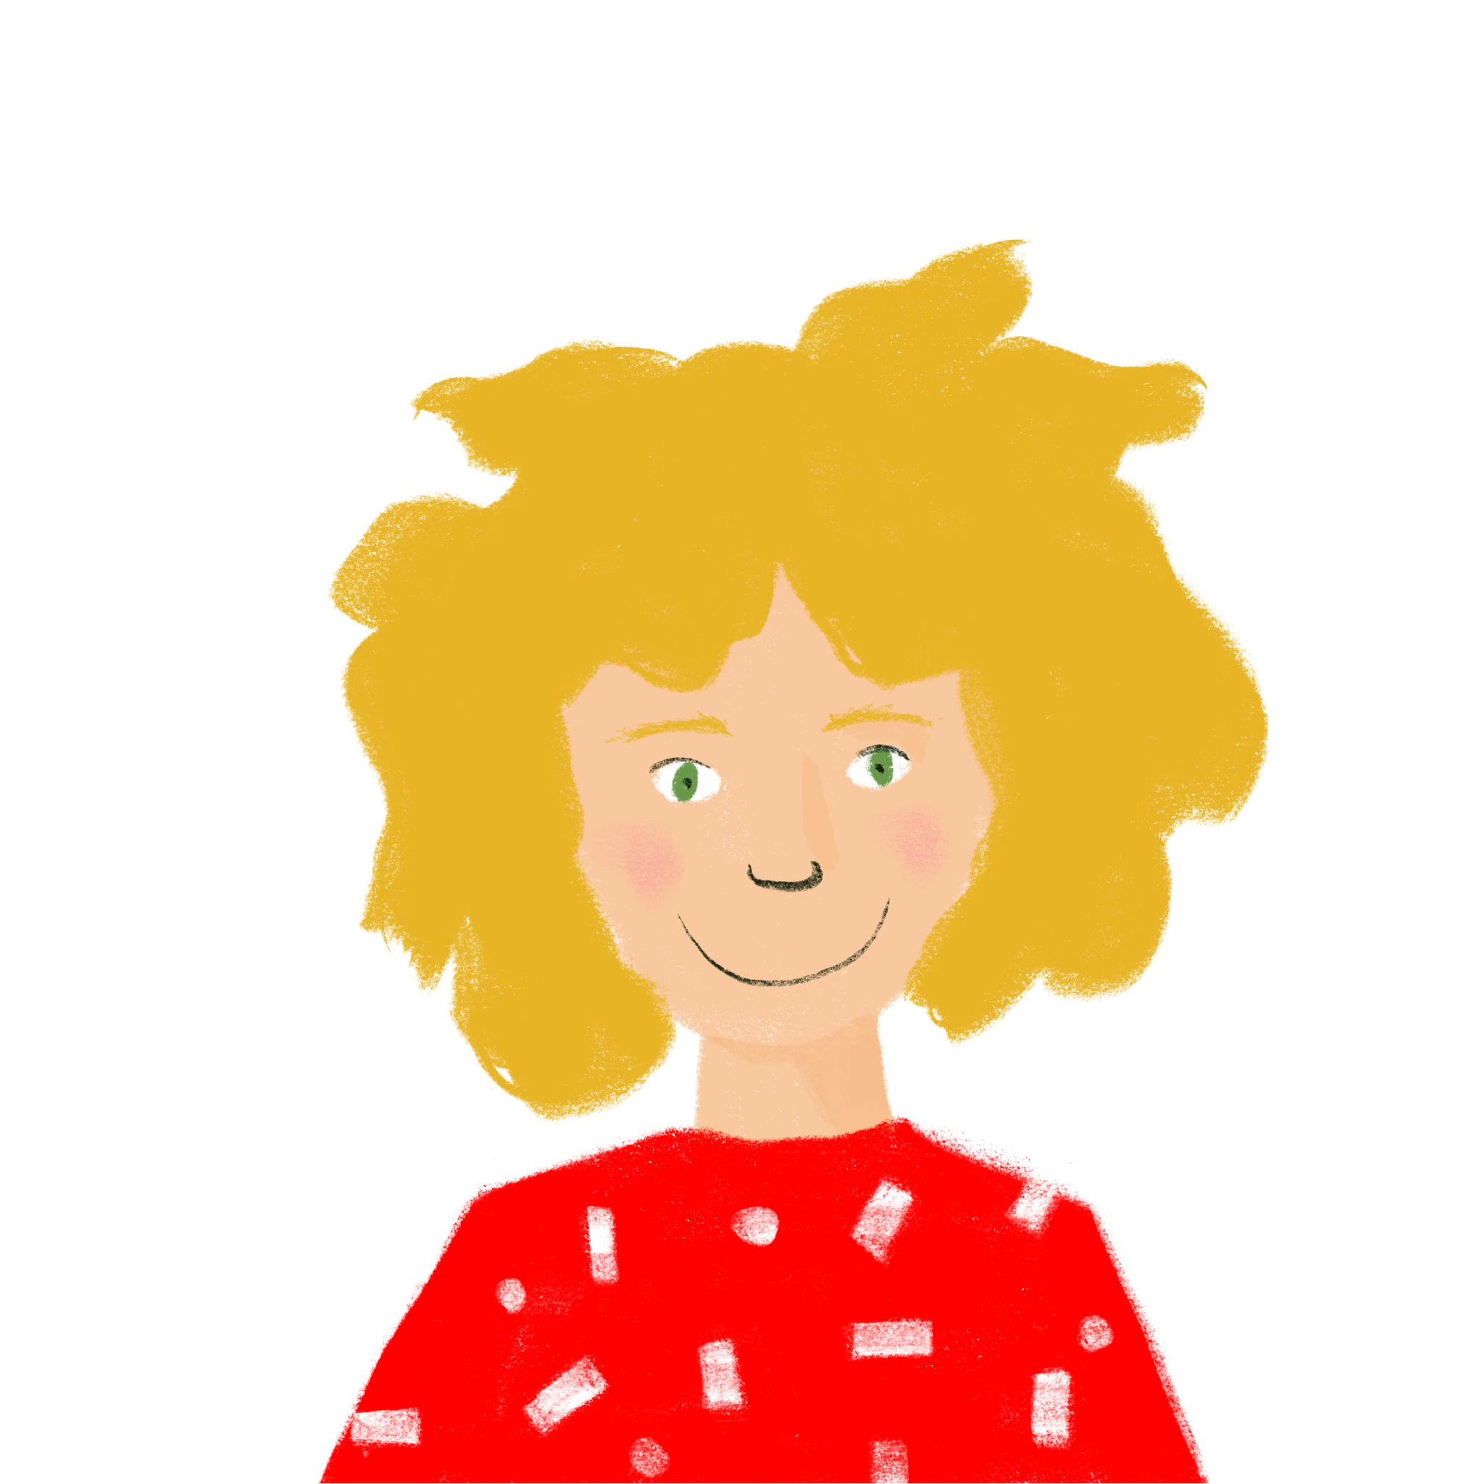
Qui fait quoi ?
Exemple
parler
[…] venez de …
… Suisse !
 | Start these sentences (don’t say the pronoun!) |  | Finish your partner’s sentences with a word that fits
A. | (Vous) venez [venir] de … | A. | Alice: Belgique M. Faure: Suisse
____
Notes:
Timing: 10 minutes
Aim: aural recognition of verbs in the tu, vous, on and nous forms, and practice in connecting form with meaning. This slide models the task. Rolecards and answers on the following slides.
Procedure:
Work through the example on this slide. Ask ‘which form of the verb does Amir need to say?’ Click to reveal the answer.
Say the sentence as the students will say it in the activity (without the pronoun). Put your finger over your lips instead of saying vous, and then say venez de …
Ask students whether they think Amir is addressing Alice or M. Faure, and to finish the sentence based on the answer.
Click to reveal answer.
Print and distribute the role cards found on slides 48 and 49.
Students take it in turns to read the beginning of a sentence, using the verb form they think is correct in place of the blank. Remind them not to say the pronoun as this gives their partner an additional clue!
The listening partner completes the sentence with the ending they think is correct, based on the level of formality indicated by the verb form.
Answers found on slides 50 and 51.
Word frequency of cognates used (1 is the most frequent word in French): flûte [>5000]
Source: Londsale, D., & Le Bras, Y. (2009). A Frequency Dictionary of French: Core vocabulary for learners London: Routledge.

Slide 39
Printable rolecards – Partner A
 | Start these sentences (don’t say the pronoun!) |  | Finish your partner’s sentences with a word that fits
A. | (Vous) _______ [avoir] un nouveau … | A. | Manon: dehors M. Paquet: à la maison
B. | (On) _______ [sortir] ensemble … | B. | Antoine et Élodie: en ce moment M. et Mme. Gauthier: maintenant
C. | (Nous) _______ [partir] souvent … | C. | Sara: vélos du garage M. et Mme. Sartre: documents
D. | (Tu) _______ [organiser] une fête … | D. | Mme. Aziz: heureuse Emilie: intelligente
E. | (Vous) _______ [devenir] rarement … | E. | Amir: guitare Mme. Meunier: flûte
 | Start these sentences (don’t say the pronoun!) |  | Finish your partner’s sentences with a word that fits
A. | (Vous) _______ [avoir] un nouveau … | A. | Manon: dehors M. Paquet: à la maison
B. | (On) _______ [sortir] ensemble … | B. | Antoine et Élodie: en ce moment M. et Mme. Gauthier: maintenant
C. | (Nous) _______ [partir] souvent … | C. | Sara: vélos du garage M. et Mme. Sartre: documents
D. | (Tu) _______ [organiser] une fête … | D. | Mme. Aziz: heureuse Emilie: intelligente
E. | (Vous) _______ [devenir] rarement … | E. | Amir: guitare Mme. Meunier: flûte
 | Start these sentences (don’t say the pronoun!) |  | Finish your partner’s sentences with a word that fits
A. | (Vous) _______ [avoir] un nouveau … | A. | Manon: dehors M. Paquet: à la maison
B. | (On) _______ [sortir] ensemble … | B. | Antoine et Élodie: en ce moment M. et Mme. Gauthier: maintenant
C. | (Nous) _______ [partir] souvent … | C. | Sara: vélos du garage M. et Mme. Sartre: documents
D. | (Tu) _______ [organiser] une fête … | D. | Mme. Aziz: heureuse Emilie: intelligente
E. | (Vous) _______ [devenir] rarement … | E. | Amir: guitare Mme. Meunier: flûte
 | Start these sentences (don’t say the pronoun!) |  | Finish your partner’s sentences with a word that fits
A. | (Vous) _______ [avoir] un nouveau … | A. | Manon: dehors M. Paquet: à la maison
B. | (On) _______ [sortir] ensemble … | B. | Antoine et Élodie: en ce moment M. et Mme. Gauthier: maintenant
C. | (Nous) _______ [partir] souvent … | C. | Sara: vélos du garage M. et Mme. Sartre: documents
D. | (Tu) _______ [organiser] une fête … | D. | Mme. Aziz: heureuse Emilie: intelligente
E. | (Vous) _______ [devenir] rarement … | E. | Amir: guitare Mme. Meunier: flûte
Notes:
Answers for partner A

Slide 40
Printable rolecards – Partner B
 | Start these sentences (don’t say the pronoun!) |  | Finish your partner’s sentences with a word that fits
A. | (Tu) _______ [dormir] bien … | A. | M. Faure: piano Amélie: bureau
B. | (On) _______ [revenir] de la plage … | B. | Kirsten et Natalie: aujourd’hui M. et Mme. Laurent: chaque jour
C. | (Nous) _______ [sortir] les … | C. | Amir et Noura: en retard M. Page et M. Barre: pour 3 jours.
D. | (Tu) _______ [être] une personne … | D. | Léa: pour ton anniversaire. M. Blanchard: pour Antoine.
E. | (Vous) _______ [jouer] de la … | E. | Sophie: malade Mme. Richard: triste
 | Start these sentences (don’t say the pronoun!) |  | Finish your partner’s sentences with a word that fits
A. | (Tu) _______ [dormir] bien … | A. | M. Faure: piano Amélie: bureau
B. | (On) _______ [revenir] de la plage … | B. | Kirsten et Natalie: aujourd’hui M. et Mme. Laurent: chaque jour
C. | (Nous) _______ [sortir] les … | C. | Amir et Noura: en retard M. Page et M. Barre: pour 3 jours.
D. | (Tu) _______ [être] une personne … | D. | Léa: pour ton anniversaire. M. Blanchard: pour Antoine.
E. | (Vous) _______ [jouer] de la … | E. | Sophie: malade Mme. Richard: triste
 | Start these sentences (don’t say the pronoun!) |  | Finish your partner’s sentences with a word that fits
A. | (Tu) _______ [dormir] bien … | A. | M. Faure: piano Amélie: bureau
B. | (On) _______ [revenir] de la plage … | B. | Kirsten et Natalie: aujourd’hui M. et Mme. Laurent: chaque jour
C. | (Nous) _______ [sortir] les … | C. | Amir et Noura: en retard M. Page et M. Barre: pour 3 jours.
D. | (Tu) _______ [être] une personne … | D. | Léa: pour ton anniversaire. M. Blanchard: pour Antoine.
E. | (Vous) _______ [jouer] de la … | E. | Sophie: malade Mme. Richard: triste
 | Start these sentences (don’t say the pronoun!) |  | Finish your partner’s sentences with a word that fits
A. | (Tu) _______ [dormir] bien … | A. | M. Faure: piano Amélie: bureau
B. | (On) _______ [revenir] de la plage … | B. | Kirsten et Natalie: aujourd’hui M. et Mme. Laurent: chaque jour
C. | (Nous) _______ [sortir] les … | C. | Amir et Noura: en retard M. Page et M. Barre: pour 3 jours.
D. | (Tu) _______ [être] une personne … | D. | Léa: pour ton anniversaire. M. Blanchard: pour Antoine.
E. | (Vous) _______ [jouer] de la … | E. | Sophie: malade Mme. Richard: triste
Notes:
Answers for partner A

Slide 41
Qui fait quoi ? (A)
Réponses
parler
 | Start these sentences (don’t say the pronoun!) |  | Finish your partner’s sentences with a word that fits
A. | (Vous) avez [avoir] un nouveau … | A. | Manon: dehors M. Paquet: à la maison
B. | (On) sort [sortir] ensemble … | B. | Antoine et Élodie: en ce moment M. et Mme. Gauthier: maintenant
C. | (Nous) partons [partir] souvent … | C. | Sara: vélos du garage M. et Mme. Sartre: documents
D. | (Tu) organises [organiser] une fête … | D. | Mme. Aziz: heureuse Emilie: intelligente
E. | (Vous) devenez [devenir] rarement … | E. | Amir: guitare Mme. Meunier: flûte
___
___
___
___
___
Notes:
Answers for partner A.
Procedure
Answers revealed on clicks (left-hand column answers appear first).
Elicit from students the verb form that is needed to create sentences with the unused items.

Slide 42
Qui fait quoi ? (B)
Réponses
parler
 | Start these sentences (don’t say the pronoun!) |  | Finish your partner’s sentences with a word that fits
A. | (Tu) dors [dormir] bien … | A. | M. Faure: piano Amélie: bureau
B. | (On) revient [revenir] de la plage … | B. | Kirsten et Natalie: aujourd’hui M. et Mme. Laurent: chaque jour
C. | (Nous) sortons [sortir] les … | C. | Amir et Noura: en retard M. Page et M. Barre: pour 3 jours.
D. | (Tu) es [être] une personne … | D. | Léa: pour ton anniversaire. M. Blanchard: pour Antoine.
E. | (Vous) jouez [jouer] de la … | E. | Sophie: malade Mme. Richard: triste
___
___
___
___
___
Notes:
Answers for partner B

Slide 43
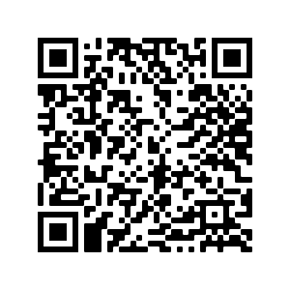
Devoirs
Vocabulary Learning Homework (Y8, Term 2.2, Week 1)
Audio file
Audio file QR code:
Quizlet link
In addition, revisit: Y8 Term 1.2 Week 7
Y8 Term 1.2 Week 1
Notes:
The answer sheet for the 8.2.2.1 vocabulary learning homework is here: https://resources.ncelp.org/concern/resources/cr56n162q?locale=en

