Slide 1
Describing places
Plural definite & indefinite articles [revisited]
‘Son’ for traits, ‘Están’ for location [revisited]
SSC [ci] [revisited]
Y7 Spanish
Term 3.2 - Week 1 - Lesson 61
Victoria Hobson / Nick Avery / Rachel Hawkes Artwork: Mark Davies
Date updated: 19/04/21
Notes:
Artwork by Mark Davies. All additional pictures selected are available under a Creative Commons license, no attribution required.
Learning outcomes (lesson 1):
Consolidation of SSC [ci]
Consolidation of plural definite & indefinite article
Consolidation of ‘son’ for permanent traits and ‘están’ for location
Word frequency (1 is the most frequent word in Spanish):
This sequence revisits a range of vocabulary from the following weeks: 7.1.2.3, 7.1.2.4, 7.1.2.5, 7.1.2.6, 7.2.1.1, 7.2.2.4, 7.3.1.1, 7.3.1.5.
Source: Davies, M. & Davies, K. (2018). A frequency dictionary of Spanish: Core vocabulary for learners (2nd ed.). Routledge: London
The frequency rankings for words that occur in this PowerPoint which have been previously introduced in NCELP resources are given in the NCELP SOW and in the resources that first introduced and formally re-visited those words.
For any other words that occur incidentally in this PowerPoint, frequency rankings will be provided in the notes field wherever possible.

Slide 2
¿CI o SI?
escuchar / escribir
En las Islas Canarias y en Latinoamérica, ‘ci’ y ‘si’ tienen la misma pronunciación.
Escucha. Habla una persona de las Islas Canarias. Escribe la palabra.
siete
cierto
1
5
decir
diciembre
2
6
cine
silencio
3
7
silla
siempre
4
8
Notes:
Timing: 3 minutes
Aim: listening activity to practise recall of words starting with the SSCs [ci] or [si].
Procedure:
Click on the number button to play the recording and students should transcribe the word.
Answers are revealed in order by clicking
Transcript:
siete
decir
cine
silla
cierto
diciembre
silencio
siempre
Notes:
As ‘ci’ and ‘si’ are usually pronounced identically outside of mainland Spain, correct spelling may require word knowledge, rather than SSC knowledge. We practise this here with words that have been previously taught as vocabulary items or used for phonics practice.
‘Mismo’ [55] will be taught early in Year 8, so is likely to be unfamiliar. Ensure that its meaning is clear in these instructions.
Students might be reassured to know that Spanish native speakers frequently make mistakes in their spelling of letters with more than one sound, particularly v and b.
Weeks when taught/used in phonics practice:
siete – 1.2.2; decir – SSC practice in 1.1.7 & 2.2.5; cine – SSC practice in 2.2.5; silla – 1.2.3; cierto – SSC practice in 1.1.7 & 2.2.5; dicimbre – SSC practice in 2.2.5; silencio – 1.2.1; siempre – 3.1.5

Slide 3
Vocabulario
leer
İBusca 12 adjetivos!
lejos | edificio | grande | tienda | interesante | museo
barato | sur | mercado | este | escuela | cerca
plaza | bueno | aburrido | delante | parque | oeste
campo | moderno | norte | hermoso | caro | montaña
fuera | colegio | pequeño | teatro | detrás | centro
 | importante | famoso | iglesia | antiguo
Notes:
Timing: 8 minutes (Slides 3-7, optional 8-9)
Aim: this vocabulary revision activity refreshes students’ knowledge of previously taught adjectives, nouns and adverbs. It aims to build on earlier word class recognition activities and help prepare students for the activities that come later this lesson (focusing on definite & indefinite articles, and ‘ser’ for traits). Procedure:
On this slide students need to find 12 adjectives. Teachers could start by asking what an adjective is.
All the adjectives are revealed on a click, so teachers will need to either ask students to write these down (individually, in pairs or in groups) before listening to class answers, or to do the activity orally and find a way to keep a check on which words have been said. Alternatively this slide could be given to students as a printout, and students use different colours to mark the different word types (adjectives in blue, nouns in red, adverbs in green etc). This is exemplified on slide 6.
Click to show the 12 adjectives. Ask for the English meanings of the words when the answers are revealed.
Notes:
Nouns are presented without articles to compel students to focus on word meaning to differentiate between the three parts of speech. If students complete the task in their books, they should be asked to write a list of the words in each category, working left to right, top to bottom. This will facilitate their checking of the answers, which are animated to appear on one click.
Weeks when vocabulary taught/used in phonics practice:
lejos 1.2.5; barato 1.2.4; plaza 1.2.5; campo 2.2.1; fuera 2.2.4; edificio 1.2.6; sur 1.1.1; bueno 1.2.4; moderno; colegio SSC 3.1.5; importante 1.1.6; grande 1.2.6; mercado 1.2.5; aburrido 2.2.5; norte 1.1.1; pequeño 1.2.4; famoso 1.2.4; tienda 1.2.5; este 2.2.4; delante 2.2.4; hermoso 2.1.2; teatro 1.2.5; iglesia 1.2.5; interesante 1.2.6; escuela 1.2.5; parque 3.1.5; caro 1.2.4; detrás 2.2.4; antiguo 1.2.4; museo 1.2.5; cerca 1.2.5; oeste 2.2.4; montaña 3.1.1; centro 1.2.5

Slide 4
Vocabulario
leer
İBusca 17 nombres!
lejos | edificio | grande | tienda | interesante | museo
barato | sur | mercado | este | escuela | cerca
plaza | bueno | aburrido | delante | parque | oeste
campo | moderno | norte | hermoso | caro | montaña
fuera | colegio | pequeño | teatro | detrás | centro
 | importante | famoso | iglesia | antiguo
Notes:
Procedure:
As on the previous slide
Notes:
Nouns are presented without articles to compel students to focus on word meaning to differentiate between the three parts of speech. If students complete the task in their books, they should be asked to write a list of the words in each category, working left to right, top to bottom. This will facilitate their checking of the answers, which are animated to appear on one click.

Slide 5
Vocabulario
leer
İBusca 5 adverbios!
lejos | edificio | grande | tienda | interesante | museo
barato | sur | mercado | este | escuela | cerca
plaza | bueno | aburrido | delante | parque | oeste
campo | moderno | norte | hermoso | caro | montaña
fuera | colegio | pequeño | teatro | detrás | centro
 | importante | famoso | iglesia | antiguo
Notes:
Procedure: as on slide 3.

Slide 6
Vocabulario
Busca…
leer
12
adjetivos
17
nombres
5
adverbios
lejos | edificio | grande | tienda | interesante | museo
barato | sur | mercado | este | escuela | cerca
plaza | bueno | aburrido | delante | parque | oeste
campo | moderno | norte | hermoso | caro | montaña
fuera | colegio | pequeño | teatro | detrás | centro
 | importante | famoso | iglesia | antiguo
Notes:
This is the slide for use as pair/group work. Here students could be given this slide as a printout (consider A3) and they could work on all three word classes simultaneously using different coloured pencils/highlighters. They could also write the English in each box as they go. Teachers can encourage students to make use of reference materials such as their exercise books or language guides.

Slide 7
Respuestas
Busca…
leer
12
adjetivos
17
nombres
5
adverbios
lejos | edificio | grande | tienda | interesante | museo
barato | sur | mercado | este | escuela | cerca
plaza | bueno | aburrido | delante | parque | oeste
campo | moderno | norte | hermoso | caro | montaña
fuera | colegio | pequeño | teatro | detrás | centro
 | importante | famoso | iglesia | antiguo
Notes:
ANSWER slide with all three categories animated sequentially, to correct the pair/group work option.

Slide 8
Vocabulario
leer
En español…
far
building
big
shop
interesting
museum
lejos | edificio | grande | tienda | interesante | museo
barato | sur | mercado | este | escuela | cerca
plaza | bueno | aburrido | delante | parque | oeste
campo | moderno | norte | hermoso | caro | montaña
fuera | la clase | pequeño | teatro | detrás | centro
 | importante | famoso | iglesia | antiguo
cheap
south
market
east
school
near
square
good
boring
in front
park
west
countryside
modern
north
beautiful
expensive
mountain
outside
class
small
theatre
behind
centre
important
famous
church
old
Notes:
OPTIONAL
Teachers could also use this slide to elicit the Spanish words, depending on time and/or the ability of the group.
Click on each English word to reveal the Spanish.

Slide 9
Vocabulario
leer
En inglés…
lejos
edificio
grande
tienda
museo
far | building | big | shop | interesting | museum
cheap | south | market | east | school | near
square | good | boring | in front | park | west
countryside | modern | north | beautiful | expensive | mountain
outside | school | small | theatre | behind | centre
 | important | famous | church | old
interesante
barato
sur
mercado
este
escuela
cerca
plaza
bueno
aburrido
delante
parque
oeste
campo
moderno
norte
hermoso
caro
montaña
fuera
colegio
pequeño
teatro
detrás
centro
importante
famoso
iglesia
antiguo
Notes:
OPTIONAL
Teachers could also use this slide to check understanding of the Spanish words, depending on time and/or the ability of the group.
Click on each Spanish word to reveal the English.

Slide 10
The indefinite article
To say ‘a’ before a singular noun, use un or una.
To say ‘some’ before a plural noun, use unos or unas.
Masculine nouns
Feminine nouns
s
some
s
una
escuela
some
s
unos
a
school
unas
a
bank
un
banco
s
some
unos
some
s
s
a
market
a
mountain
una
montaña
s
s
unas
un
mercado
s
some
park
unos
a
un
s
parque
cafetería
s
unas
s
some
cafeteria
una
a
Notes:
Timing: 2 minutes
Aim: to briefly recap the indefinite article ahead of the grammar input activities. Both singular and plural forms are covered.
Procedure:
Interactive elicitation of rules and translations is facilitated by the animation. Click to go through first rules for singular indefinite articles, and then the plural, using the same words as examples.

Slide 11
The definite article
To say ‘the’ before a singular noun, use el or la.
To say ‘the’ before a plural noun (more than one), use los or las.
Masculine nouns
Feminine nouns
museum
es
las
s
s
church
the
s
la
iglesia
el
museo
the
los
la
s
the
teatro
tienda
theatre
los
s
s
el
the
las
shop
s
las
plaza
the
square
s
los
s
s
la
the
building
edificio
s
el
Notes:
Timing: 2 minutes
Aim: to briefly recap the definite article ahead of the grammar input activities.
Procedure:
Follow the same procedure of the previous slide with the indefinite article.
Interactive elicitation of rules and translations is facilitated by the animation. First the singular articles are shown with examples, and then the plural articles with the same articles.

Slide 12
Using the definite articles ‘los’ & ‘las’with the indefinite articles ‘unos’ & ‘unas
The words ‘unos’ and ‘unas’ (some) often appear with ‘los’ and ‘las’ (the).
You can use ‘unos’ and ‘unas’ to introduce nouns.
You can use ‘los’ and ‘las’ (or a verb) to refer to them again.
For example:
En Buenos Aires, hay unos mercados y unas iglesias. Los mercados son baratos y las iglesias son antiguas.
In Buenos Aires, there are some markets and some churches. The markets are cheap and the churches are old.
Notes:
Timing: 2 minutes
Aim: to explain the grammatical functions of the two types of article covered on the last two slides.
Procedure:
Teachers click to go through the explanation.
The English translation of the example sentence appears on the final mouse click. Elicit the English from students before revealing this.

Slide 13
leer
La familia López está de vacaciones en Argentina. Daniel describe cada ciudad.
leer
Lee las descripciones y escribe las opciones correctas. [1/2]
Ciudades de Argentina
lunes
Estamos en la capital, Buenos Aires. Tiene [1] las / unas tiendas y [2] unos / los restaurantes. ¡Son muy buenos!
miércoles
Córdoba es otra ciudad bonita. Tiene [5] unas / las escuelas y [6] unos / los colegios. Son excelentes.
martes
Hoy estamos en Mendoza. Hay unos museos famosos y unas iglesias. [3] Los / unos museos de historia son muy interesantes, pero [4] las / unas iglesias son aburridas.
jueves
En Tucumán hay [7] unos / los teatros y [8] las / unas universidades. Es una ciudad con mucha cultura.
Notes:
Timing: 7 minutes
Aim: reading activity to practise the use of definite and indefinite articles
Procedure:
This activity is over two slides. Students complete it by writing 1-15 in their books, and the correct plural article each time.
Students choose between the plural definite and indefinite article in each instance. The choice is always between articles of the same gender.
Answers are revealed by clicking.
Notes:
The idea is that students to pay attention to whether the nouns have been mentioned before (in which case definite article is needed) or not (in which indefinite article is needed).
All vocabulary used is known to students, apart from the cognates universidad [387] / restaurante [2636] / cafeteria [>5000] / bar [1938] / histórico [830].
(Other cognates used in previous weeks: excelente / centros culturales / turista)
Students completed a similar exercise for definite and indefinite articles in the singular in Term 1.2 week 5.

Slide 14
leer
[2/2]
leer
Ciudades de Argentina
viernes
Estoy con Diego en Rosario. Hay unos edificios hermosos y unas plazas históricas. Muchos turistas visitan [9] las / unas plazas.
domingo
Estamos todos en Santa Fe. Tiene unos bares y unas cafeterías. [12] Unos / Los bares son bastante caros, pero [13] las / unas cafeterías son baratas.
sábado
Estoy solo en La Plata. Es una ciudad pequeña, pero muy interesante. Hay [10] unos / los parques y [11] unos / los centros culturales.
Quiero visitar San Juan. Hay unas montañas y unos pueblos cerca. Puedes visitar [14] los / unos pueblos, aunque es difícil visitar [15] unas / las montañas.
Notes:
Continuation of the activity started on the previous slide. Follow the same procedure to reveal answers.

Slide 15
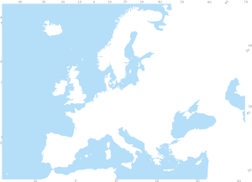
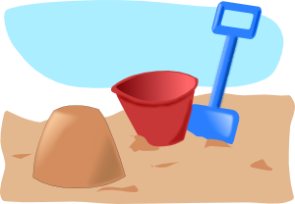
escuchar
Los amigos de Daniel están de vacaciones también. Están en España.
Escucha las descripciones y marca la opción correcta.
escuchar
Escucha otra vez. ¿Qué hay en cada lugar?
 | las | unas
 | los | unos
¿Qué hay? (en inglés)
¿Qué hay? (en inglés)
monuments
male teachers – far from door
1
5
gift shops – nearby
female teachers
churches – small
museums – big
2
markets
6
schools
banks
men – outside
3
7
women
squares – old
boys
theatres – very famous
4
girls – in a tower
8
bars
Notes:
Timing: 10 minutes Aim: listening activity practising definite and indefinite articles.
Procedure:
Click on the number buttons to play the recording.
Students write 1–8. Here students listen out for whether the noun has already been said with the indefinite article (in which case definite article is needed) or not. First they tick the column for the definite or indefinite article. They listen again and write the two locations and the additional detail (location or trait) in English.
Transcript
Martin está en Bilbao. Hay unos monumentos y unas tiendas de regalos. [beep] tiendas de regalos están cerca.
Sofía está en Granada. Hay [beep] iglesias y unos mercados. Las iglesias son pequeñas.
Maria está en Málaga. Hay unos bancos y [beep] plazas. Las plazas son antiguas.
Alejandro está en Pamplona. Hay unos chicos y unas chicas. [beep] chicas están en una torre.
Pablo está en una iglesia en Madrid. Hay unos profesores y unas profesoras. [beep] profesores están lejos de la puerta.
Amanda está en Valencia. Hay [beep] museos y unas escuelas. Los museos son grandes.
Paula está en una cafetería de San Sebastián. Hay unos hombres y unas mujeres. [beep] hombres están fuera.
Pepe está en Barcelona. Hay [beep] teatros y unos bares. Los teatros son muy famosos.
Notes:
As before, the choice of article gender is held constant, so students only need to focus on which article to use. Students have completed a similar activity previously when learning about definite/indefinite articles in the singular (Term 1.2 Week 5). Some students may still find this task challenging. They may need to go through several (or all) of the items on this slide with the teacher. Repetitions are to be expected.

Slide 16
SER and ESTAR
In Spanish, there are two ways to say ‘they are’: están and son
Use ‘están’ for location and temporary state/mood.
Use ‘son’ for permanent traits.
They are in the city (location).
Están en la ciudad.
They are beautiful (permanent trait).
Son hermosos.
Notes:
Timing: 1 minute
Aim: to recap the two forms of ser and estar (‘están’ and ‘son’) and their respective functions before the subsequent activity.
Procedure:
1. Click to go through the revision of ‘están’ and ‘son’ for permanent traits and temporary mood. Gaps are left for students to answer before the click reveals them.

Slide 17
leer
1 | Buenos Aires y Mendoza son | muy lejos.
 |  | ciudades muy grandes.
2 | Córdoba y Santa Fe están | históricos y populares.
 |  | en el centro de Argentina.
3 | San Juan y Tucumán están | en las montañas.
 |  | antiguos y hermosos.
4 | Rosario y Buenos Aires son | muy interesantes.
 |  | muy cerca.
5 | San Juan y Mendoza están | en el oeste.
 |  | antiguos y históricos.
6 | Tucuman y La Plata son | populares con los turistas.
 |  | bastante lejos.
7 | Buenos Aires y La Plata están | lugares muy famosos.
 |  | cerca del mar.
8 | Mendoza y San Juan son | en Los Andes.
 |  | ciudades muy importantes.
leer
Daniel da más información sobre las ciudades de Argentina.
Completa cada frase con la opción correcta.
Notes:
Timing: 5 minutes
Aim: reading activity to practise distinguishing between ‘ser’ for traits and ‘estar’ for location.
Procedure:
Students choose which of the two options accurately completes the sentence, focusing on the use of ‘están’ and ‘son’
Answers are revealed one by one by clicking.

Slide 18
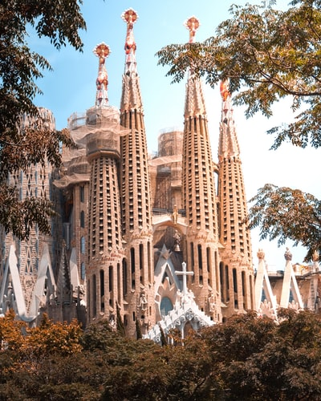
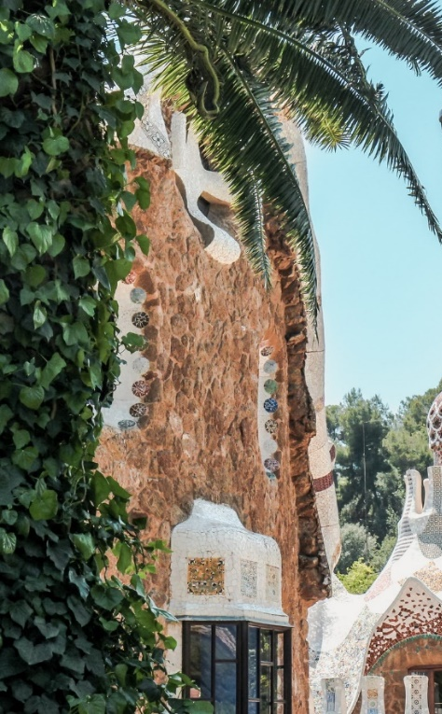
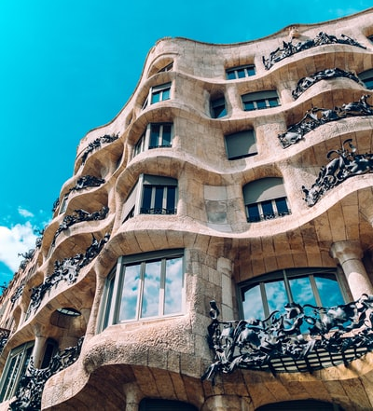
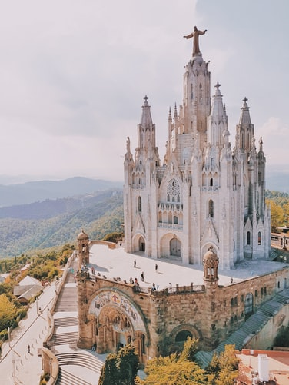
leer / escribir
Completa las frases.
leer / escribir
Edificio en Parque Güell y Casa Milá
[are important]
[are in the centre]
En Barcelona hay unos edificios y unas iglesias. Los edificios _____ ____________ y las iglesias _____ ____________.
son
importantes
están
La Sagrada Familia (izquierda) y el Templo Expiatorio del Sagrado Corazón (derecha)
en el centro.
Notes:
Timing: 4 minutes (for slides 18-21)
Aim: to practise using ‘son’ and ‘están’ and applying adjective agreement (where needed). This will be needed in the final speaking production activity.
Procedure:
Students complete the sentences according to the prompts using ‘son’ or ‘están’. Students could either write their answers on mini-whiteboards or in their exercise books.
Then elicit the English translations, either orally or in written translations, and then show the answers by clicking.
Follow the same procedure for the next three slides.
Notes:
Teachers could briefly tell students what the buildings are and about the architectural period when they were built as some cultural knowledge enhancement.
The sentences also give students additional opportunities to read sentences with plural definite and indefinite articles.

Slide 19
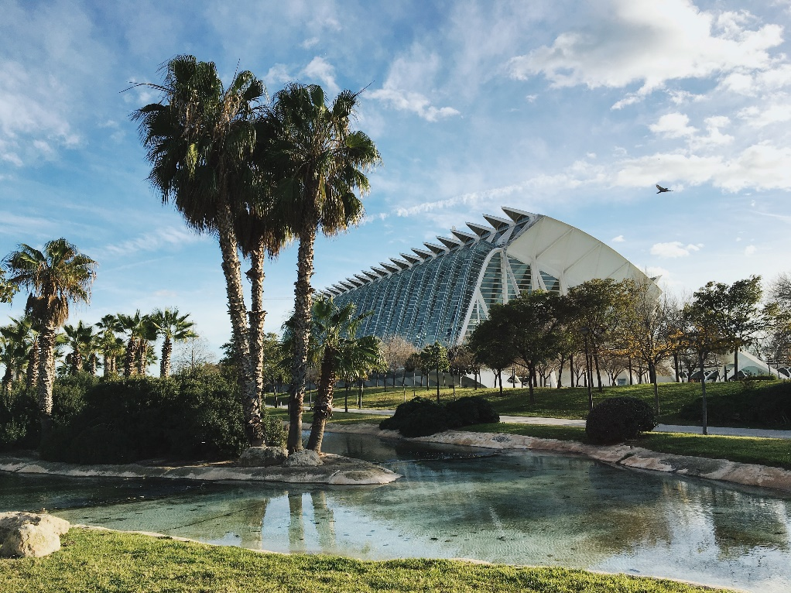
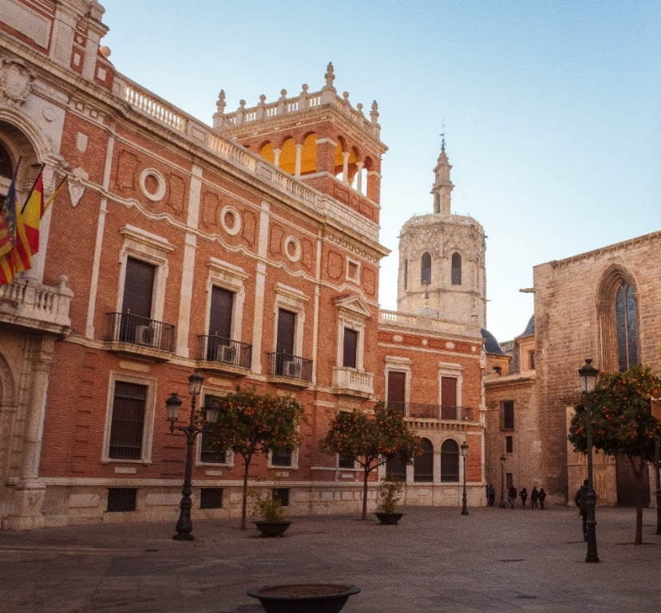
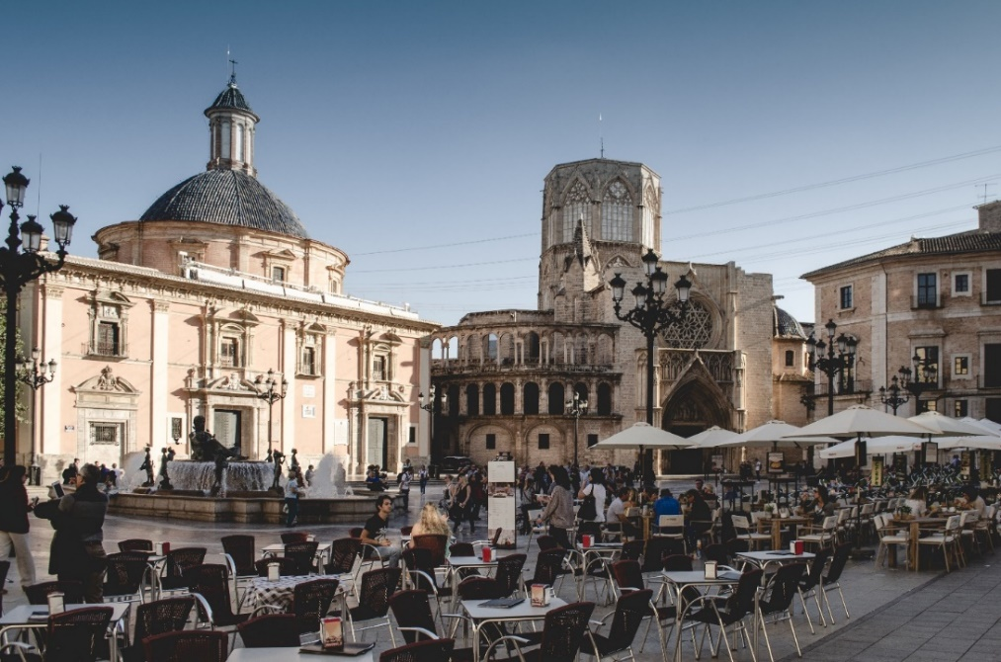
leer / escribir
Completa las frases.
[are modern]
leer / escribir
A la izquierda: dos fotos de la Ciudad de las Artes y las Ciencias
Debajo: la Plaza de la Virgen (izquierda) y la Plaza de la Reina
En Valencia hay unos museos y unas plazas. Los museos _____ ____________ y las plazas ______ __________.
[are old]
son
modernos
son
antiguas

Slide 20
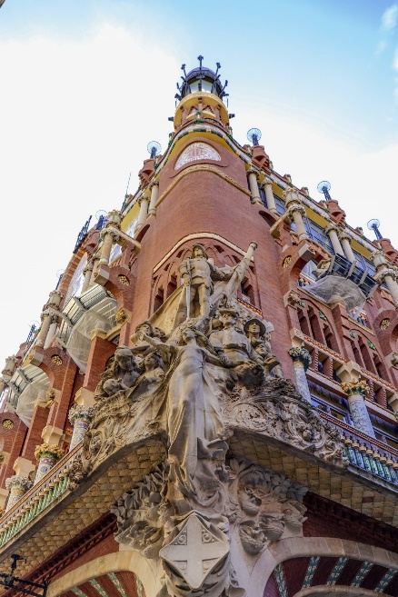
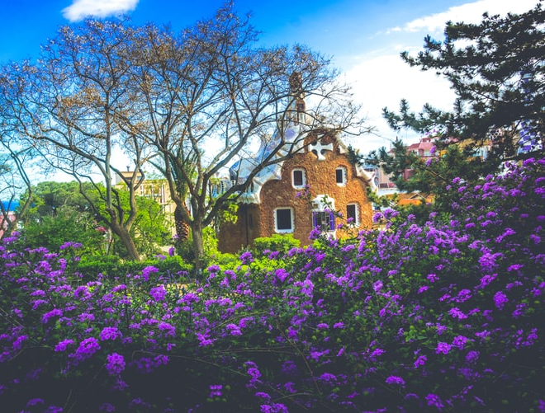
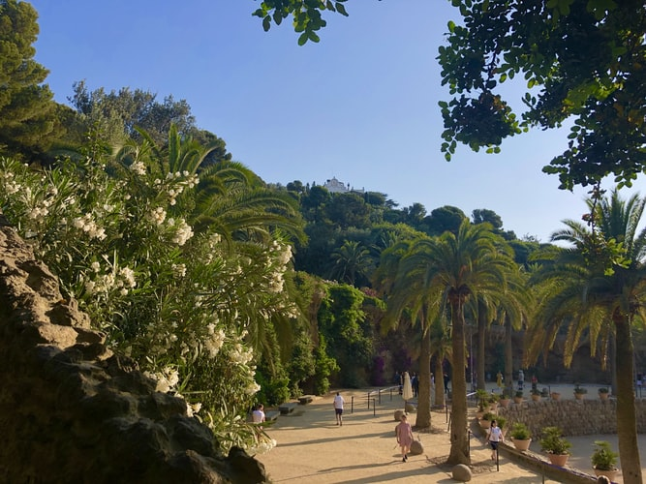
leer / escribir
Completa las frases.
[are nearby]
[are big]
Parque Güell
En Barcelona hay unas torres y unos parques. Las torres ____ __________ y los parques _____ ________.
son
grandes
están
cerca

Slide 21
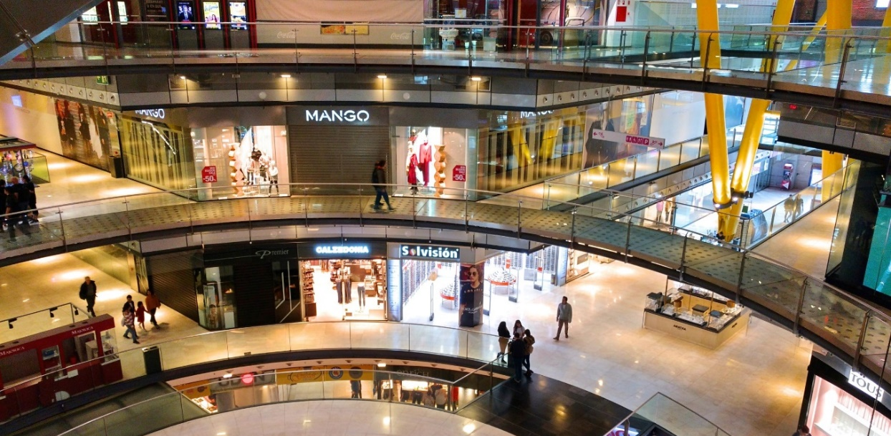
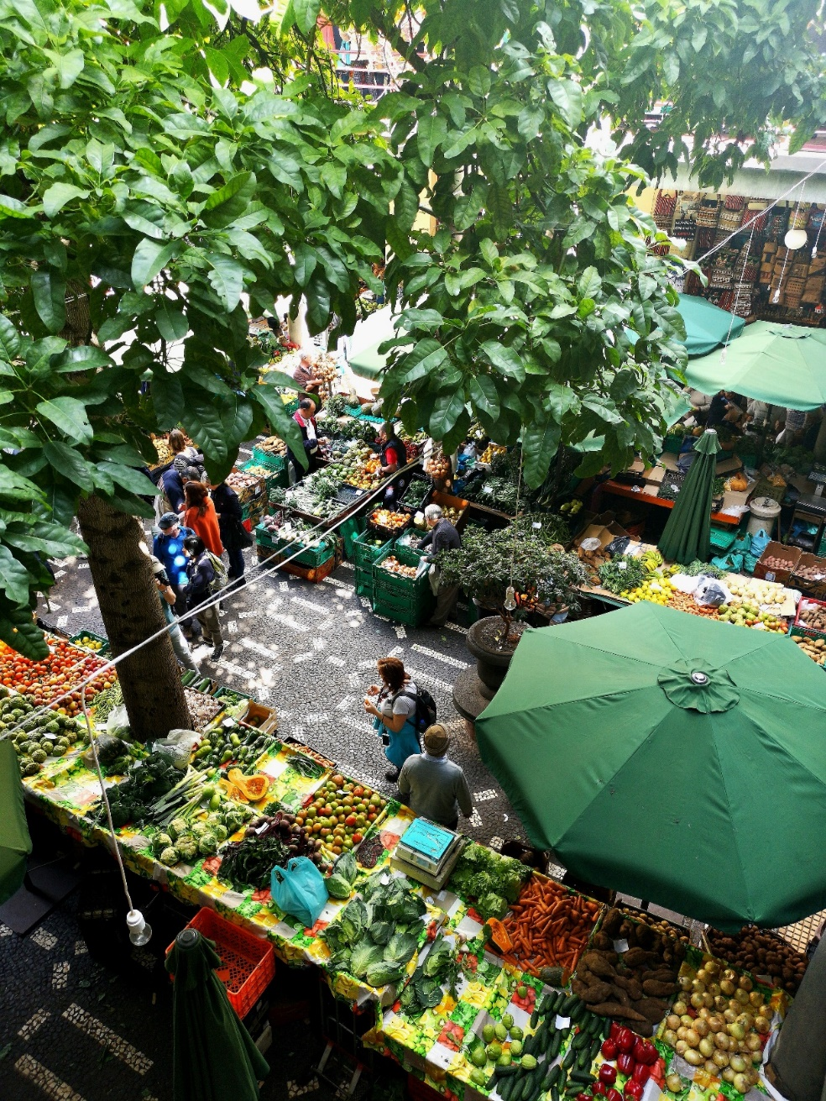
leer / escribir
Completa las frases.
leer / escribir
[are expensive]
[are outside]
En las dos ciudades hay unas tiendas y unos mercados. Las tiendas ______ _______ y los mercados ______ _________.
son
caras
están
fuera

Slide 22
hablar / escuchar / escribir
hablar / escuchar / escribir
Sevilla
There are some parks and some towers.
The parks are small.
¿Qué hay en Sevilla?
Hay unos parques y unas torres. Los parques son pequeños.
Notes:
Timing: 7 minutes
Aim: to brings together all the revision from the lesson into a final production activity.
Procedure:
1. Teachers could use this slide to model the requirements of the task.
2. Here students work in groups of three. The person writing starts the dialogue off by asking ¿Qué hay en….?
3. The other two people speaking take it in turns to say alternate words of the answer in Spanish. Sentences are then compared at the end as a whole class (or after each city if preferred).
4. The words for this example’s answers are revealed by clicking on each box.
5. Suggested order: Málaga: Persons A&B speak (A says the first word of the response) and person C writes down the Spanish.
Madrid: Persons C&A speak (C says the first word of the response) and person B writes down the Spanish.
Granada: Persons B&C speak (B says the first word of the response) and person A writes down the Spanish.
(Teachers can be less prescriptive if students can work out for themselves how to take turns!)
Notes:
The person writing cannot interrupt if s/he spots a mistake. However, teachers should allow one minute for reflection on the sentences as a group of three, before the answers are revealed. Teachers could consider asking students to undertake the speaking without reference to their exercise books/vocab books and then in the reflection time allowing access to reference materials to allow for successful edits.

Slide 23
hablar / escuchar / escribir
¿Qué hay en….?
hablar / escuchar / escribir
Málaga
There are some shops and some markets.
The markets are outside.
Madrid
There are some museums and some churches.
The churches are big.
Granada
There are some buildings and some squares.
The buildings are beautiful.
Málaga: Hay unas tiendas y unos mercados. Los mercados están fuera.
Madrid: Hay unos museos y unas iglesias. Las iglesias son grandes.
Granada: Hay unos edificios y unas plazas. Los edificios son hermosos.
Notes:
The three speaking cards are available in a printer-friendly Word document.
Procedure:
1. Students use this slide to conduct the activity.
2. Suggested order: Málaga: Persons A&B speak (A says the first word of the response) and person C writes down the Spanish.
Madrid: Persons C&A speak (C says the first word of the response) and person B writes down the Spanish.
Granada: Persons B&C speak (B says the first word of the response) and person A writes down the Spanish.
(Teachers can be less prescriptive if students can work out for themselves how to take turns!)
3. The answers are shown by clicking to reveal the full sentences in turn.

Slide 24
Describing what people have
TENER in singular and plural persons [revisited]
SSC [ci] [revisited]
Y7 Spanish
Term 3.2 - Week 1 - Lesson 62
Victoria Hobson / Nick Avery / Rachel Hawkes Artwork: Mark Davies
Date updated: 19/04/21
Notes:
Artwork by Mark Davies. All additional pictures selected are available under a Creative Commons license, no attribution required.
Learning outcomes (lesson 2):
Consolidation of SSC [ci]
Consolidation of TENER in singular and plural persons
Understanding of two types of activity that will appear in the Y7 ‘applying your knowledge’ test.
Word frequency (1 is the most frequent word in Spanish):
This sequence revisits a range of vocabulary from the following weeks: 7.1.1.4, 7.1.1.5, 7.1.1.7, 7.1.2.1, 7.1.2.2, 7.1.2.3, 7.1.2.5, 7.1.2.6, 7.2.1.2, 7.2.1.3, 7.2.2.1, 7.2.2.4, 7.3.1.1, 7.3.1.2, 7.3.1.5.
Source: Davies, M. & Davies, K. (2018). A frequency dictionary of Spanish: Core vocabulary for learners (2nd ed.). Routledge: London
The frequency rankings for words that occur in this PowerPoint which have been previously introduced in NCELP resources are given in the NCELP SOW and in the resources that first introduced and formally re-visited those words.
For any other words that occur incidentally in this PowerPoint, frequency rankings will be provided in the notes field wherever possible.

Slide 25
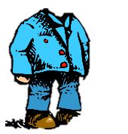
escuchar / escribir
Escucha y completa las palabras. ¿Cómo se escriben?
escuchar / escribir
Luego, mira las imágenes. Marca si cada una es verdadera ( ) o falsa ( ).
1
La señora camina sin zapatos.
2
¿Cuántas sillas hay? Diez.
3
Hay seis cines en la zona.
4
El hombre sin cabeza está en la naturaleza.
5
La chica parece ser simpática y feliz.
Notes:
Timing: 5 minutes
Aim: to reinforce understanding of SSCs where different letters may be represented by the same sound.
Procedure:
There are two versions of this activity to support differentiation (see also slide 26). Teachers should decide which activity best suits their students of the two.
Here, students listen and complete the words with gaps. They then decide whether each image is true or false, according to the meaning of the sentence.
Click the number button to play the recording. Answers are shown by clicking, first the missing letters 1-5 and then the true or false based on the pictures.
In oral feedback, other words with the ‘s’ could be used, e.g., ‘¿Cuántas sillas hay? Sí, perfecto. Hay siete”.
Transcript:
1) La señora camina sin zapatos.
2) ¿Cuántas sillas hay? Diez.
3) Hay seis cines en la zona.
4) El hombre sin cabeza está en la naturaleza.
5) La chica parece ser simpática y feliz.
Notes:
Many Spanish speakers pronounce these in the same way, so they may be challenging for students. ‘C’ and ‘s’ appear in sentences here with other similar-sounding letters / letter combinations: z, ce, za, se.
All vocabulary has either been previously taught or used for phonics practice.

Slide 26
escuchar / escribir
escuchar / escribir
Escucha y escribe las frases. ¿Cómo se escriben?
Luego, mira las imágenes. Marca si cada una es verdadera ( ) o falsa ( ).
1
La señora camina sin zapatos.
2
¿Cuántas sillas hay? Diez.
3
Hay seis cines en la zona.
4
El hombre sin cabeza está en la naturaleza.
5
La chica parece ser simpática y feliz.
Notes:
Alternative activity to the previous slide
Procedure:
As described on previous slide, except that students write the whole sentence.
Transcript:
1) La señora camina sin zapatos.
2) ¿Cuántas sillas hay? Diez.
3) Hay seis cines en la zona.
4) El hombre sin cabeza está en la naturaleza.
5) La chica parece ser simpática y feliz.

Slide 27
TENER
The verb ‘tener’ means ‘to have.’
I have
tengo
_____________
you have
tienes
_____________
s/he has, it has
tiene
_____________
we have
tenemos
_____________
they have
tienen
______________
Notes:
Timing: 1 minute
Aim: to elicit the different forms of ‘tener’ that students have learnt up to now. These verb forms will appear in subsequent activities.
Procedure:
1. Click to elicit answers from students for the translations of the different parts of ‘tener’. The answers are then shown by clicking.
Notes:
Tengo/tienes/tiene were first taught in 1.1.4 and revisited in 1.1.5 & 1.2.2
Tenemos/tienen were first taught in 2.1.2 and revisited in 2.1.3

Slide 28
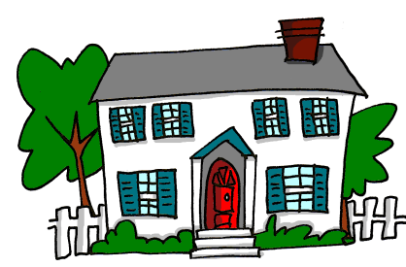
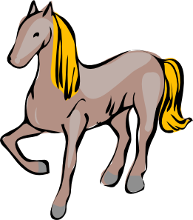
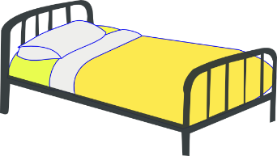
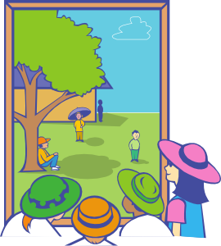
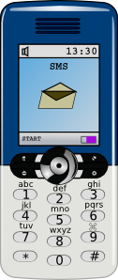
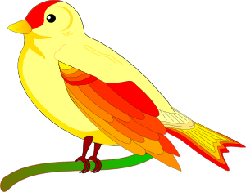
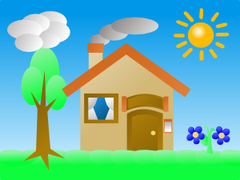
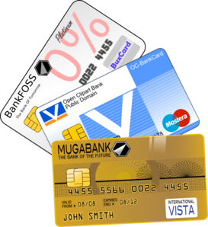
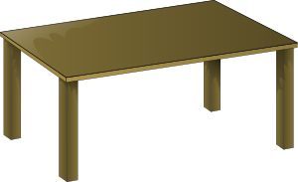
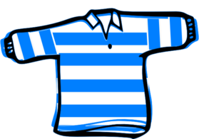
Vocabulario
M
la ventana
el árbol
el libro
la tienda
el mercado
el caballo
la planta
la flor
el gato
la vista
el museo
el perro
las cosas
el zapato
la mesa
la casa
la cama
la ropa
el pájaro
la bolsa
Notes:
Timing: 3 minutes
Aim: to revise items of vocabulary ahead of both the receptive and production activities.
Procedure:
Students give the noun in Spanish to match the picture.
Students could either be asked to write the word or say the word in choral response, or ask students individually. Then click again to show the Spanish word.

Slide 29
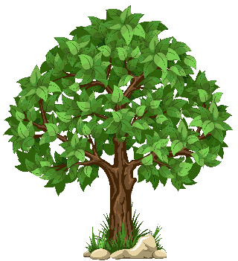
Escribe la palabra en español.
escribir
A
B
C
D
[view]
[shop]
E
F
G
H
[thing]
I
J
K
L
Notes:
Timing: 5 mins approx.
Aim: This written task revisits 12 nouns from those on the previous slide. Here time is constrained to compel learners to produce the written words more quickly, a valuable component in vocabulary practice that speeds up the process of recall.
Procedure:
1. Students write A-L in books.
2. Click / press enter to flash a picture. They will disappear after 3 seconds. Note that they do not appear in alphabetical order to keep the students on their toes.
3. Aask students to write down the Spanish word before the picture has faded away. 4. Check answers by eliciting the Spanish from students, with the definite article.
Answers
el árbol
la tienda
C. la flor
D. la vista
E. la cosa
F. el zapato
G. la ropa
H. el pájaro
I. la ventana
J. el caballo
K. la bolsa
L. la mesa

Slide 30
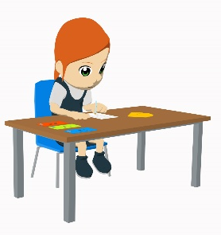
leer
Lucía escribe una carta a un amigo en Inglaterra. Compara sus familias y las cosas que tienen en casa.
Lee las frases y marca la opción correcta.
leer
 |  | Lucía (‘I’) | el amigo (‘you’) | los dos (‘we’)
1 | Tienes una colección de monedas de Chile.
2 | Sólo tengo un hermano, Daniel. Es bastante simpático.
3 | Tenemos animales en casa.
4 | Tienes una imagen de un hombre sin cabeza.
5 | İGenial! Tienes un barco grande en la costa.
6 | También tenemos casas en Francia.
7 | Tengo un teléfono nuevo (¡gracias a mis abuelos!).
8 | Tienes un ordenador muy caro.
9 | No tengo dibujos de elefantes.
10 | En mi opinión, tenemos cosas muy interesantes.
Notes:
Timing: 5 minutes
Aim: to practise understanding different forms of ‘tener’ in the present tense. All three have been practised extensively in earlier weeks of Year 7.
Procedure:
Students read the sentence and then tick the correct column for who is being referred to ‘I’, ‘you’ or ‘we’.
Answers are revealed by clicking. Ask students for translations of the whole sentence when going through the answers.
Notes:
Colección [1632] was included as it is a near-cognate. ‘Costa’ and ‘elefante’ are words that have been used in earlier phonics practice activities.
Possessive adjectives (e.g. mi, mis, tu, tus) will be introduced in Y7 3.2.3 and also in Year 8 (su, sus). The meaning of ‘sus’ may need to be made explicit as this word features in the context.

Slide 31
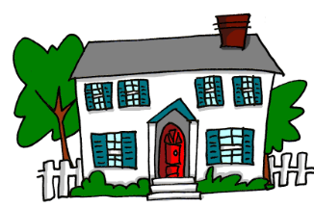
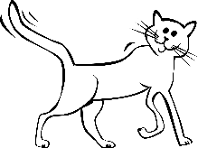
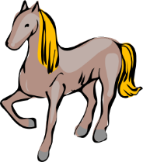
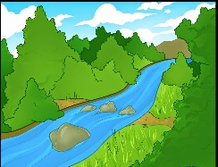
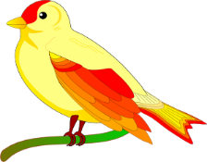
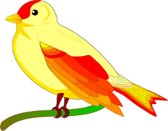
escuchar
Escucha. ¿Qué tiene la casa de Ana? ¿Y, qué tiene la casa de sus amigas?
escuchar
[1/2]
La casa de Ana (‘it has’) | Las casas de sus amigas (‘they have’) |  |  | Información extra
A
B
1
big
2
beautiful
3
white
4
nearby
5
small
Notes:
Timing: 8 minutes (for slides 31 and 32)
Aim: listening activity in which students practise understanding the third person singular and third person plural forms of the verb ‘tener’, as well as revisited vocabulary.
Procedure:
Students can simply copy the table and column headers into their books before starting.
Click on the number button to play the recording. Students either tick for ‘it has’ or ‘they have’ and then write either ‘A’ or ‘B’, before adding extra information in English
If appropriate, ask students to concentrate on listening for the verb in the first instance and then play the item again for students to concentrate on the vocabulary items. The animation order supports this.
Answers are revealed by clicking. First the answer to the ‘it has/they have’ columns is shown for 1-5, then the A or B and final information columns 1-5.
In oral feedback, encourage students to say what they would have heard if the other picture had been true (e.g. Y la imagen ‘A’, ¿qué es?)
Transcript:
1) Tiene árboles grandes.
2) Tienen flores hermosas.
3) Tiene un gato blanco.
4) Tiene un río cerca.
5) Tienen pájaros pequeños.
Notes:
Note: ‘de’ to indicate possession will be taught in Year 8. Ensure that the meaning of ‘la casa de / las casas de’ in the context and table headers is clear.

Slide 32
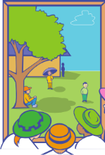
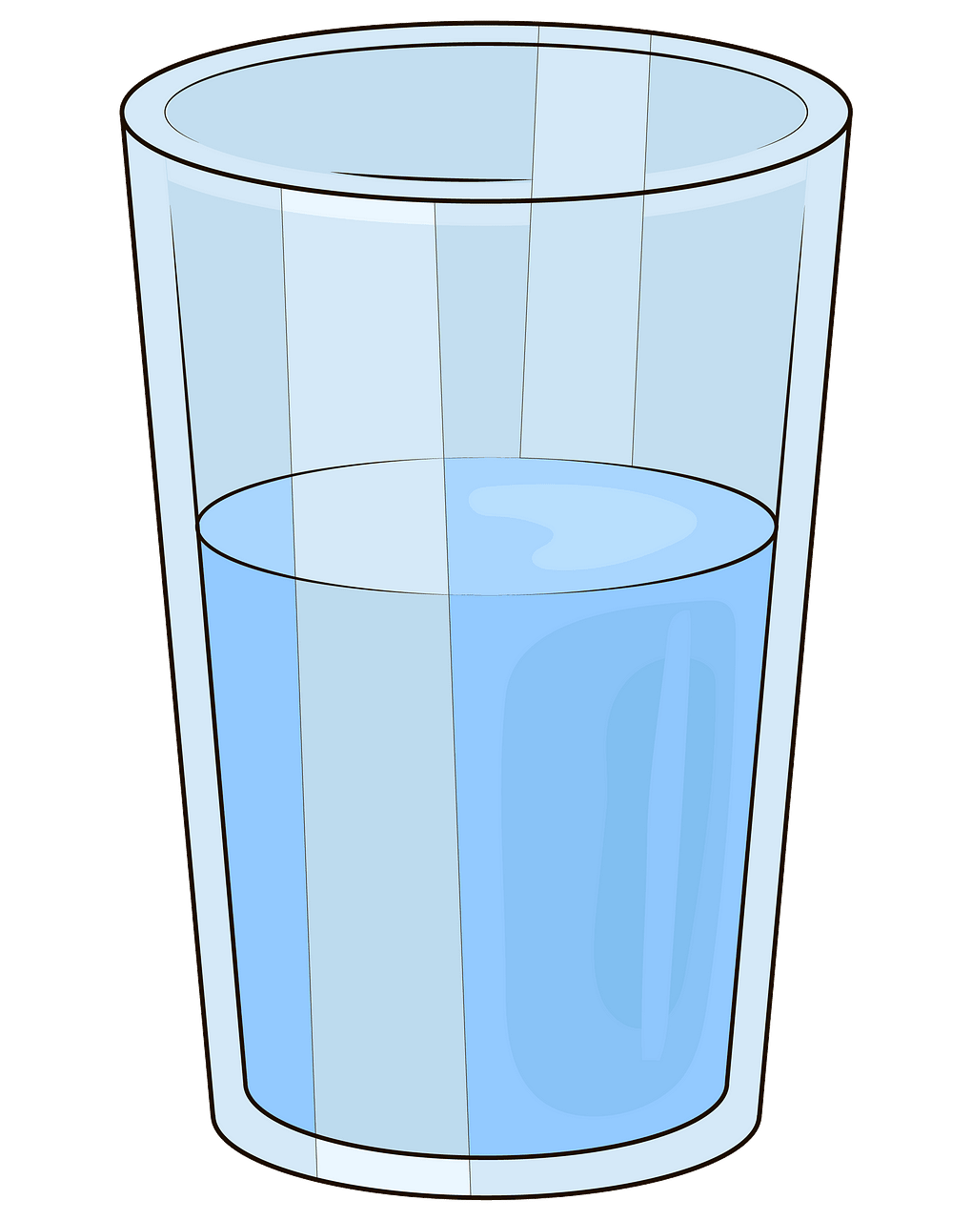
escuchar
[2/2]
escuchar
La casa de Ana (‘it has’) | Las casas de sus amigas (‘they have’) |  |  | Información extra
A
B
6
[views]
pretty
7
big
8
behind the door
on the balcony
9
10
under the bed
Notes:
Part 2 of the activity
Procedure
1. Follow the same procedure as the previous slide
Transcript
6) Tienen vistas bonitas.
7) Tiene ventanas grandes.
8) Tienen unas bolsas detrás de la puerta
9) Tienen una mesa en el balcón
10) Tiene cosas debajo de la cama

Slide 33
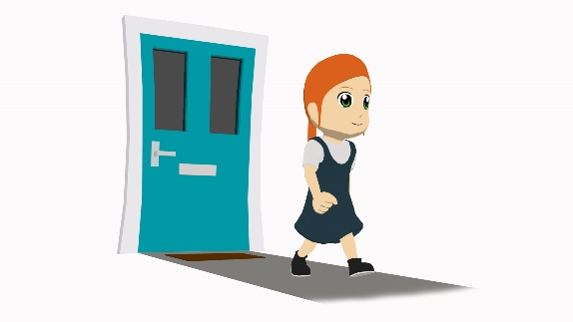
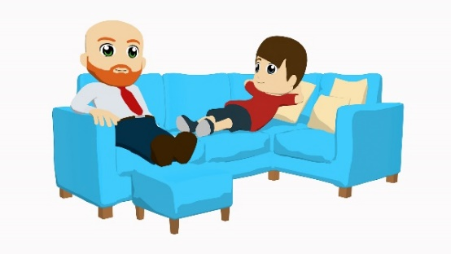
La familia López En casa
Lucía
Diego
Daniel
Ana
leer
Hola, soy Lucía y vivo con mi familia en una casa moderna y hermosa. También es bastante grande. Está en el centro de San Sebastián y somos felices allí. La casa tiene vistas bonitas del mar. Muy cerca tenemos tiendas, restaurantes y un museo famoso, el Museo San Telmo.
Tengo una habitación* grande y Daniel tiene otra bastante grande. Mis padres tienen una habitación pequeña, pero es muy bonita y tranquila. Mi madre tiene muchos libros allí y lee delante de la ventana. Mi padre tiene una mesa donde hace el trabajo de la escuela. La mesa está detrás de la puerta. Mi madre tiene otra mesa en el balcón donde escribe libros. Debajo de la cama tienen ropa, bolsas y zapatos nuevos. Los domingos, cuando hago tareas domésticas, organizo las cosas. Mi madre siempre comenta, ‘¡Tienes mucha paciencia!’. Es cierto porque es una tarea muy aburrida.
Fuera de la casa tenemos un jardín* con plantas, flores y árboles. En mi familia tenemos animales también. Tengo un gato blanco y negro. Pasa mucho tiempo detrás de la casa en los árboles con los pájaros. Daniel tiene un perro. ¡El gato y el perro no son amigos!
*la habitación = bedroom; el jardín = garden
Notes:
Timing: 12 minutes (including reading activity on next slide)
Aim: reading activity bringing together grammar focus on the different forms of ‘tener’ and this week’s vocabulary sets.
Procedure:
Students first read the text through once silently, or listen to their teacher read it.
Once finished, students work individually or in pairs/groups to find what different members of the family have (see task on the next slide).
Notes:
Text readability (with reference to 2000 most frequent words, discounting proper nouns): 96%
Words from outside top 2000: restaurante [2626]; detrás [2044] – taught in 2.2.4; balcón [3133] – seen in poem ‘La plaza tiene una torre’ (2.1.1) and later revisited as part of revisiting cycle; doméstico [2521].
Text readability (using Y7 SoW vocabulary up to 3.1.6 and discounting cognates/near-cognates): 97%
All words have been previously taught in the Y7 scheme of work or used for phonics practice, with the exceptions listed below:
Cognates/near-cognates: ‘Comentar’ [634], ‘doméstico’ [2521], ‘restaurante’ [2626], paciencia’ [2357] and ‘moderno’ [861].
‘Mi’ (and ‘mis’) will be taught as a grammar feature in Y7, T3.2, Week 3. The word has frequently appeared in earlier resources, however.
Glosses are given for ‘jardín’ [1195] and habitación [1069], as these words haven’t been previously taught and they are not cognates.
We would expect students to be able to understand ‘donde’ and ‘cuando’ as the question forms of these words (with tilde) have been taught in Y7.
‘Cierto’ and ‘porque’ have been encountered in phonics practice activities. We recommend eliciting the meaning of these words, since they may be less familiar.
It may be possible for students to guess the meaning of ‘negro’ in ‘un gato blanco y negro’, given that the collocation ‘black and white’ also exists in English.

Slide 34
leer
¿Qué tiene cada persona? Busca la información en el texto.
leer
Lucía (‘I have...’)
El hermano, Daniel (‘He has…’)
La madre, Ana
(‘She has…’)
una habitación grande
una habitación bastante grande
muchos libros.
un gato blanco y negro
una mesa en el balcón
un perro
El padre, Diego (‘He has…’)
Los padres, Ana y Diego
(‘they have…’)
Toda la familia
(‘we have…’)
una mesa donde hace el trabajo de la escuela
una habitación pequeña
tiendas, restaurantes y un museo famoso (muy cerca)
ropa, bolsas y zapatos nuevos debajo de la cama
un jardín con plantas, flores y árboles
animales
Notes:
Aim: to bring together the five different forms of ‘tener’ that have been practised.
Procedure:
Students can work individually or in pairs/groups to find what different members of the family have.
Click to show the answers for each person in turn. Teachers can check understanding of the sentences during feedback by asking for the English translation.
This slide can be shown prior to the animations appearing so that students can note down the six categories. Then return to the previous slide. Once these have been noted down, display the text once again.

Slide 35
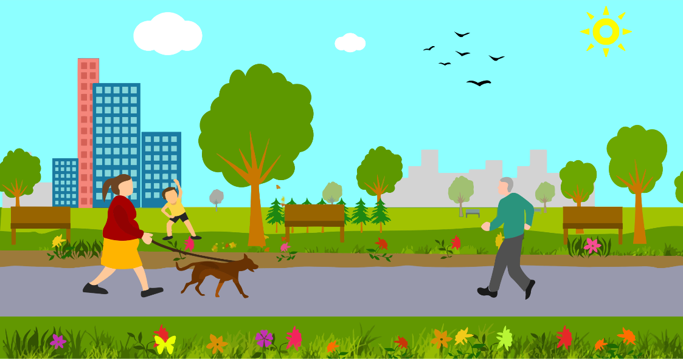
hablar
Describe la imagen a un/a compañero/a.
Say the five sentences in Spanish.
hablar
A
B
The house is big.
Diego is near a window.
Daniel has a letter.
Lucía and Ana are outside.
They have some bags.
The park is pretty.
It has flowers and trees.
There are also some birds.
The buildings are behind the park.
The dog is happy (now).
Notes:
Timing: 6 minutes
Aim: A number of previously taught features are revisited here, including several features revisited in this week’s lessons. These include ‘tener’; ‘ser’ for permanent traits; ‘estar’ for location and for temporary state; ‘hay’; use of del vs de la; choice of definite vs indefinite article.
Procedure:
All the information for the task is provided on the slide. There are no animations.
Encourage students to take their time (up to a minute) to think what they want to say, but to try not to write it down, and also to break each sentence down into groups of words as this may make the task seem more achievable.
The answers are shown on the next slide.
Notes:
This activity reflects the type of speaking task that students will do in the ‘applying your knowledge’ test in 3.2.2 (next week), using Vocaroo.

Slide 36
hablar
Respuestas
hablar
A
B
La casa es grande.
Diego está cerca de la ventana.
Daniel tiene una carta.
Lucía y Ana están fuera.
Tienen unas bolsas.
El parque es bonito.
Tiene flores y árboles.
Hay unos pájaros también.
Los edificios están detrás del parque.
El perro está feliz.
1
1
2
2
3
3
4
4
5
5
Notes:
ANSWERS
Procedure
1. Click on the orange action button to hear the sentence. This can be useful for students accessing this material from home to check the accuracy of their pronunciation.

Slide 37
Deberes
There is no vocabulary learning homework for this week.

