Slide 1
Making decisions about the future
Verbs with à before an infinitive
SSC [ç/soft c]
Y9 French
Term 3.1 - Week 4 - Lesson 53
Author names: Catherine Morris
Artwork by: Chloé Motard
Date updated: 04/07/22
Notes:
Artwork by Chloé Motard. All additional pictures selected are available under a Creative Commons license, no attribution required.
Native speaker feedback provided by Sarah Brichory.
With thanks to Rachel Hawkes for her input on the lesson material.
Learning outcomes (lesson 1):
Introduction of SSC [ç/soft c]
Introduction of verbs with à before an infinitive
Word frequency (1 is the most frequent word in French):
9.3.1.4 (revisit Y7 and Y8 vocabulary 10/13) anglais [784], français [251], sage [2643], difficile [296], facile [822], prochain [380], social [301], grand [59], ou [33], factrice [1264], place [129], recette [1709], décision [370], expérience [679], devoirs [39], chien [1744], garçon [1599], silence [1281], bureau [273], cinéma [1623], avenir [471], exercice [1290], lycée [2816], comprendre [95], devenir [162], revenir [184]
Source: Londsale, D., & Le Bras, Y. (2009). A Frequency Dictionary of French: Core vocabulary for learners London: Routledge.
The frequency rankings for words that occur in this PowerPoint which have been previously introduced in NCELP resources are given in the NCELP SOW and in the resources that first introduced and formally re-visited those words.
For any other words that occur incidentally in this PowerPoint, frequency rankings will be provided in the notes field wherever possible.

Slide 2
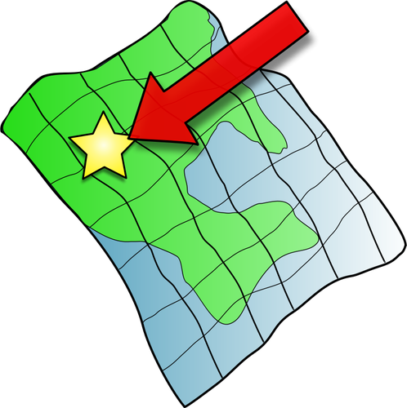
ç/c
ici
Notes:
Timing: 2 minutes (2 slides)
Aim: To consolidate SSC [ç/c]
Procedure: 1. Present the letter(s) and say the [ç/c] sound first, on its own. Students repeat it with you. 2. Bring up the word ”ici” on its own, say it, students repeat it, so that they have the opportunity to focus all of their attention on the connection between the written word and its sound.
3. A possible gesture for this would be to point to the spot on which one is standing / indicate the room in which the lesson is taking place with a sweeping motion of one’s index finger. 4. Roll back the animations and work through 1-3 again, but this time, dropping your voice completely to listen carefully to the students saying the [ç/c] sound, pronouncing ”ici” and, if using, doing the gesture.
Word frequency (1 is the most frequent word in French):
ici [167]. Source: Lonsdale, D., & Le Bras, Y. (2009). A Frequency Dictionary of French: Core vocabulary for learners London: Routledge.

Slide 3
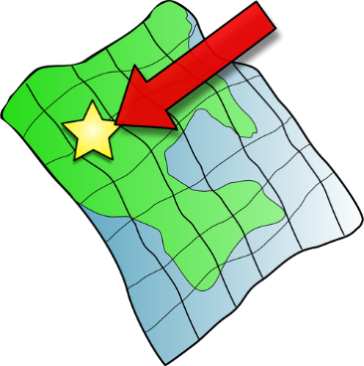
ç/c
français
garçon
ici
cinéma
cinq
décider
[to decide]
Notes:
Slide 2/2
Procedure:
1. Introduce and elicit the pronunciation of the individual SSC [ç/c] and then the source word again ‘ici’ (with gesture, if using). 2. Then present and elicit the pronunciation of the five cluster words.
The cluster words have been chosen for their high-frequency, from a range of word classes, with the SSC (where possible) positioned within a variety of syllables within the words (e.g. initial, 2nd, final etc.). Additionally, we have tried to use words that build cumulatively on previously taught SSCs (see the Phonics Teaching Sequence document) and do not include new SSCs. Where new SSCs are used, they are often consonants which have a similar symbol-sound correspondence in English.
Word frequency (1 is the most frequent word in French): français [251]; garçon [1599]; cinéma [1623]; décider [165]; cinq [288]; ici [167]. Source: Londsale, D., & Le Bras, Y. (2009). A Frequency Dictionary of French: Core vocabulary for learners London: Routledge.

Slide 4
SSC [ç/soft c]
Remember! ‘s’ at the start of a word sounds the same as soft [c]
écouter / écrire
1
Ce morceau de gâteau ici est une source de bonheur pour moi.
This piece of cake here is a source of happiness for me.
2
Certains Français vivent ici, à côté de la rivière courante.
Some French people live here, next to the running river
3
La présence de célébrités incite à la folie.
The presence of celebrities incites madness.
4
Voici la recette de cinquante gâteaux de célébration.
Here is the recipe for fifty celebration cakes.
5
La société peut influencer nos décisions et menacer notre bien-être.
Society can influence our decisions and threaten our well-being.
6
C'est difficile de financer un divorce.
It’s difficult to finance a divorce.
Notes:
Timing: 3 minutes
Aim: recognise SSC [ç/soft c] in sentences
Procedure:
Do number 1 first as an example.
Click audio button.
Students tally how many times they hear SSC [ç/soft c].
Optional – listen again and students attempt full transcription.
Click to reveal full sentences with each SSC [ç/soft c] highlighted.
Draw attention to the word ‘source’ as an example of ‘s’ at the front of a word sounding the same as soft [c].
Repeat steps 2-5 for the remaining sentences. Draw attention to ‘s’ again in sentence 5.
Transcript:
Ce morceau de gâteau ici est une source de bonheur pour moi.
Certains Français vivent ici, à côté de la rivière courante.
La présence de célébrités incite à la folie.
Voici la recette de cinquante gâteaux de célébration.
La société peut influencer nos décisions et menacer notre bien-être.
C'est difficile de financer un divorce.
Word frequency (1 is the most frequent word in French): ce [12], morceau [2118], ici [167], source [817], certain [110], Français [251], présence [365], célébrité [>5000], inciter [2212], voici [1103], cinquante [2273], célébration [>5000], société [1709], influencer [2498], décision [370], menacer [969], difficile [296], financer [1772], divorce [2561]
Source: Lonsdale, D., & Le Bras, Y. (2009). A Frequency Dictionary of French: Core vocabulary for learners London: Routledge.

Slide 5
Le tennis phonétique
parler
Fais attention aux lettres ‘c’
30
concevoir
to design
race
breed
centre
commencer
to start
cercle
efficacité
effectiveness
précisément
precisely
avance
prepayment
glace
cent
concerner
to concern
cellule
secondes
espèce
type
concurrence
competition
cible
océan
civil
recevoir
to receive
efficace
effective
concentrer
to concentrate
0
soupçonner
to suspect
confiance
trust
commercial
précision
DÉBUT
Notes:
Timing: 1 minutes
Aim: Recognise when to produce SSC [ç/soft c]
Procedure:
1. Students work in pairs and take it in turns to read a word off the board as quickly and accurately as possible.
2. Partners must listen for mistakes and correct each other.
3. Click début to start 30s timer.
4. Click on words to hear native pronunciation.
Transcript:
Cercle, commercial, concerner, efficace, concentrer, soupçonner, commencer, océan, cible, glace, race, précision, centre, cent, espèce, concevoir, avance, civil, cellule, confiance, précisément, recevoir, efficacité, concurrence
Word frequency (1 is the most frequent word in French): cercle [2258], commercial [908], concerner [324], efficace [1243], concentrer [856], soupçonner [2375], commencer [139], océan [2513], cible [2740], glace [2580], race [2490], précision [1756], centre [491], cent [704], espèce [1049], concevoir [1100], avance [1087], civil [927], cellule [2151], confiance [435], précisément [1197], recevoir [199], efficacité [1752], concurrence [1005]
Source: Lonsdale, D., & Le Bras, Y. (2009). A Frequency Dictionary of French: Core vocabulary for learners London: Routledge.

Slide 6
Quels sont les mots ?
écouter
1
ou (or)
9
les devoirs (homework)
2
préférer (to prefer)
10
revenir (to come back)
3
difficile (difficult)
11
le cinéma (cinema)
4
le lycée (high school)
12
facile (easy)
5
l’exercice (exercise)
13
le chien (dog)
6
social (social)
14
le bureau (desk)
7
la recette (recipe)
15
la factrice (postwoman)
8
choisir (to choose)
16
prochain (next)
Notes:
Timing: 4 minutes (2 slides +handout grid for lower level students)
Aim: aural recognition of revisited vocabulary
Procedure:
1. Click on audio buttons to hear audio.
2. Students write down English translation. (Optional extension: write the French)
3. Click to reveal answers one by one. (Answers appear with French word and English in brackets).
Transcript:
ou
préférer
difficile
le lycée
l’exercice
social
la recette
choisir
les devoirs
revenir
le cinéma
facile
le chien
le bureau
la factrice
prochain

Slide 7
Quels sont les mots ?
écouter
17
l’avenir (future)
25
le garçon (boy)
18
la décision (decision)
26
devenir (to become)
19
commencer (to start)
27
sage (well-behaved)
20
anglais (English nationality)
28
français (French nationality)
21
apprendre (to learn)
29
aider (to help)
22
la place (town square)
30
le silence (silence)
23
l’espace (space)
31
grand (big, tall)
24
comprendre (to understand)
32
l’expérience (experience)
Notes:
Slide 2/2
Procedure:
1. Click on audio buttons to hear audio.
2. Students write down (optional French) English translation.
3. Click to reveal answers one by one.
Transcript:
17. l’avenir
18. la décision
19. commencer
20. l’anglais
21. apprendre
22. la place
23. l’espace
24. comprendre
25. le garçon
26. devenir
27. sage
28. le français
29. aider
30. le silence
31. grand
32. l’expérience

Slide 8
verbe + à + infinitif
grammaire
Some verbs in French can be followed by à and an infinitive.
Usually, à is translated as ‘to’.
e.g. J’apprends à faire le ménage.
I am learning to do the housework.
Sometimes verbs can be followed by a person’s name or a noun relating to a person, then à and an infinitive.
e.g. J’aide ma mère à cuisiner.
I am helping my mum to cook.
You already know some verbs that can be followed by à:
e.g. apprendre, aider, commencer
You also already know some two-verb structures without à:
e.g. J’aime aller au supermarché. Je vais regarder le film.
Notes:
Timing: 3 minutes
Aim: introduce verbs + à + (optional noun) + infinitive
Procedure:
1. Click to bring up information.
2. Check understanding at each stage.

Slide 9
Un ou deux verbes ?
*manquer = to miss, missing
écouter
R
Q
Qu’est-ce qui manque* ?
 | verb + à | [-]
I am eating cheese at the desk.
I am starting to do exercise.
The boy is becoming more well-behaved.
I am learning to try new recipes.
The girls are starting to work hard.
I am helping my mum.
We are starting to learn French.
She is helping to build the future.
1
1
2
2
3
3
4
4
5
5
6
6
7
7
8
8
Notes:
Timing: 10 minutes
Aim: aural recognition of where a conjugated verb + à is needed before an infinitive
Procedure:
1. Click number buttons to hear audio with beeps.
2. Students tick whether they think the beep covers a conjugated verb + à or nothing.
3. Click to reveal ticks and orange answer audio buttons one by one.
4. Optional translation: click orange audio buttons to hear full audio and have students write sentences in English.
5. Click to reveal written sentences one by one.
Transcript:
Je [beep] mange du fromage au bureau.
Je [commence à] faire de l’exercice.
Le garçon [beep] devient plus sage.
J’ [apprends à] essayer de nouvelles recettes.
Les filles [commencent à] travailler dur.
J’ [beep] aide ma mère.
Nous [commençons à] apprendre le français.
Elle [aide à] construire l’avenir.
Word frequency of unknown words (1 is the most frequent word in French): manquer [583],
Source: Lonsdale, D., & Le Bras, Y. (2009). A Frequency Dictionary of French: Core vocabulary for learners London: Routledge.

Slide 10
Les phrases avec deux verbes
lire
Choisis le verbe manquant*.
*manquant = missing
Je commence à faire les devoirs. commence/vais
Je veux comprendre les gens anglais. commence/veux
Amir va revenir tôt. apprend/va
Ma mère aide à choisir le chien. aide/peut
Nous apprenons à parler avec les français au lycée. apprenons/voulons
Je vais aider mon père. commence/vais
Nous commençons à faire l’exercice difficile. commençons/allons
Nous devons aller à la place. aidons/devons
____________
____________
__________
______
____________
____________
______________
________
Notes:
Timing: 10 minutes
Aim: visual recognition of where a verb requires à before an infinitive
Procedure:
1. Students read sentences and choose the missing word based on whether there is an à in the sentence or not.
2. Click to reveal answers one by one.
3. Elicit English sentences from students orally.
English sentences:
I am starting to do the homework.
I want to understand English people.
Amir will return early.
My mum is helping to choose the dog.
We are learning to speak with the French people at high school.
I will help my dad.
We are starting to do difficult exercise.
We must go to the town square.
Word frequency of cognates (1 is the most frequent word in French): verbe [>5000]
Word frequency of unknown words (1 is the most frequent word in French): manquant [>5000]
Source: Lonsdale, D., & Le Bras, Y. (2009). A Frequency Dictionary of French: Core vocabulary for learners London: Routledge.

Slide 11
‘to’ in English
écrire
Traduis de l’anglais au français.
1. I want to learn Spanish.
5. I am starting to learn.
1. Je veux apprendre l’espagnol.
5. Je commence à apprendre.
2. I am learning to speak slowly.
6. I am going to choose.
2. J’apprends à parler lentement.
6. Je vais choisir.
3. I want to start to do exercise.
7. I have to find the recipe.
3. Je veux commencer à faire l’exercice.
7. Je dois trouver la recette.
4. I am helping my sister to cook.
8. I am learning to write in French.
4. J’aide à ma sœur à cuisiner.
8. J’apprends à écrire en français.
Remember! ‘to’ in English is not always ‘à’ in French!
Notes:
Timing: 12 minutes
Aim: translation into French of two-verb structure sentences
Procedure:
Students translate sentences from English to French.
Remind students that ‘to’ in English is not always à in French.
e.g. ‘learn to’, ‘help to’ vs ‘going to’, ‘want to’, ‘have to’
Click to reveal answers one by one.
Highlight to students the different ways that ‘to’ is translated in French.

Slide 12
Making decisions about the future
Quel, quels, quelle, quelles
Ce, cet, cette, ces
Verbs with à and de before an infinitive
SSC [ç/soft c]
Y9 French
Term 3.1 - Week 4 - Lesson 54
Author name(s): Catherine Morris
Artwork by: Chloé Motard
Date updated: 04/07/22
Notes:
Artwork by Chloé Motard. All additional pictures selected are available under a Creative Commons license, no attribution required.
Native speaker feedback provided by Sarah Brichory.
With thanks to Rachel Hawkes for their input on the lesson material.
Learning outcomes (lesson 2):
Consolidation of SSC [ç/soft c]
Consolidation of Quel, quels, quelle, quelles
Consolidation of Ce, cet, cette, ces
Consolidation of verbs with à before an infinitive
Introduction to verbs with de before an infinitive
Word frequency (1 is the most frequent word in French):
9.3.1.4 (revisit Y7 and Y8 vocabulary 10/13) anglais [784], français [251], sage [2643], difficile [296], facile [822], prochain [380], social [301], grand [59], ou [33], factrice [1264], place [129], recette [1709], décision [370], expérience [679], devoirs [39], chien [1744], garçon [1599], silence [1281], bureau [273], cinéma [1623], avenir [471], exercice [1290], lycée [2816], comprendre [95], devenir [162], revenir [184]
Source: Lonsdale, D., & Le Bras, Y. (2009). A Frequency Dictionary of French: Core vocabulary for learners London: Routledge.

Slide 13
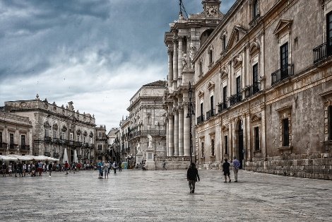
Révision
parler
Quels sont les mots?
[big]
[difficult]
[future]
[social]
grand
difficile
l’avenir
social
aider
la place
[or]
[to become]
[next]
le bureau
ou
devenir
le chien
prochain
[to choose]
[high school]
[well-behaved]
[to understand]
choisir
le lycée
sage
comprendre
le cinéma
Notes:
Timing: 3 minutes [2 slides}
Aim: vocab production from picture clues
Procedure:
1. Students work in pairs to identify revisited vocab from pictorial clues on the slide.
2. Click to reveal answers from top left to right.

Slide 14
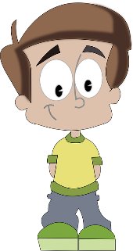
Révision
Quels sont les mots?
parler
[to come back]
[exercise]
[recipe]
[to start]
la factrice
revenir
l’exercice (m)
français
commencer
la recette
[homework]
[to prefer]
[easy]
[space]
le silence
l’espace (m)
les devoirs (mpl)
préférer
facile
[decision]
[to learn]
[experience]
la décision
le garçon
anglais
apprendre
l’expérience (f)
Notes:
Slide 2/2
Procedure:
1. Students work in pairs to identify revisited vocab from pictorial clues on the slide.
2. Click to reveal answers from top left to right.

Slide 15
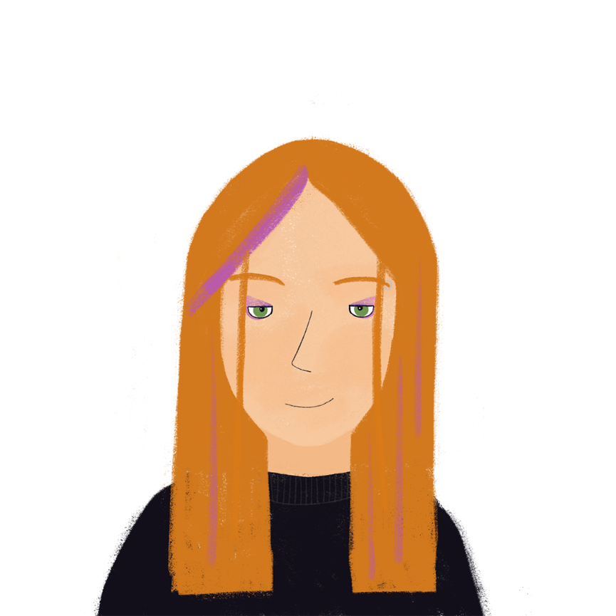
Le journal d’Élodie 1/3
lire
Lis le texte. Prends des notes.
Les garçons de ma classe au lycée sont grands mais ils ne sont pas toujours sages. Donc, le professeur demande le silence en classe. Nous apprenons à parler l’anglais. C’est difficile mais c’est important pour l’avenir. Je comprends mieux les gens français.
Je partage un bureau avec Louis. Il est gentil. Il aide les autres à faire les devoirs parce qu’il trouve l’anglais facile. Il a proposé d’aller au cinéma sur la place ensemble. Je choisis le film. Ma mère dit que je commence à devenir une adulte mais je dois toujours revenir à la maison avant 22 heures.
J’ai pris la décision de voyager à l’étranger l’année prochaine. Ça va être une expérience incroyable*. Je veux travailler comme factrice en Angleterre. Je vais sortir tôt et faire beaucoup d'exercice. C’est un travail social et je vais rencontrer* beaucoup de chiens. Je préfère les chiens aux chats. Je vais habiter avec une famille anglaise ou dans un appartement. J'aime avoir mon propre espace, mais faire des recettes avec une famille peut être sympa.
*incroyable = incredible
*rencontrer = to meet
Notes:
Timing: 8 minutes [3 slides]
Aim: demonstrate understanding of revisited vocabulary in written context
Procedure:
Students read text and make notes for up to 5 minutes.
True/False questions on following slide.
Word frequency of cognates (1 is the most frequent word in French): adulte [1580]
Word frequency of unknown words (1 is the most frequent word in French): incroyable [2231], rencontrer [329]
Source: Lonsdale, D., & Le Bras, Y. (2009). A Frequency Dictionary of French: Core vocabulary for learners London: Routledge.

Slide 16
Le journal d’Élodie 2/2
lire
Réponds aux questions.
The boys are well-behaved.
The teacher wants silence.
Élodie finds French easier than English.
Louis is good at English.
Élodie’s mum says she is too young.
Élodie has decided to travel abroad this year.
She wants to work in an office.
She prefers cats to dogs.
The boys are not always well-behaved.
Élodie’s mum says she is starting to become an adult.
Élodie has decided to travel abroad next year.
She wants to work as a postwoman.
She prefers dogs to cats.
Notes:
Slide 2/2
Procedure:
Students attempt to answer questions based on their notes.
Click left arrow to refer back to previous slide with full text.
Click right arrow to bring up answers one by one. (false cross followed by corrected sentence in English)
Refer back to previous slide to highlight where answers come from in the text.

Slide 17
Le journal d’Élodie 3/3
lire
Lis le texte. Prends des notes.
The boys are not always well-behaved.
*incroyable = incredible
*rencontrer = to meet
Les garçons de ma classe au lycée sont grands mais ils ne sont pas toujours sages. Donc, le professeur demande le silence en classe. Nous apprenons à parler l’anglais. C’est difficile mais c’est important pour l’avenir. Je comprends mieux les gens français.
Je partage un bureau avec Louis. Il est gentil. Il aide les autres à faire les devoirs parce qu’il trouve l’anglais facile. Il a proposé d’aller au cinéma sur la place ensemble. Je choisis le film. Ma mère dit que je commence à devenir une adulte mais je dois toujours revenir à la maison avant 22 heures.
J’ai pris la décision de voyager à l’étranger l’année prochaine. Ça va être une expérience incroyable*. Je veux travailler comme factrice en Angleterre. Je vais sortir tôt et faire beaucoup d'exercice. C’est un travail social et je vais rencontrer* beaucoup de chiens. Je préfère les chiens aux chats. Je vais habiter avec une famille anglaise ou dans un appartement. J'aime avoir mon propre espace, mais faire des recettes avec une famille peut être sympa.
Les garçons de ma classe au lycée sont grands mais ils ne sont pas toujours sages.
le professeur demande le silence
Je
comprends mieux les gens français
il trouve l’anglais facile
Élodie’s mum says she is starting to become an adult.
Ma mère dit que je commence à devenir une
adulte
Élodie has decided to travel abroad next year.
J’ai pris la décision de voyager à l’étranger l’année prochaine
Je veux travailler comme factrice
She wants to work as a postwoman.
Je préfère les chiens aux chats
She prefers dogs to cats.
Notes:
Slide 3/3
Procedure:
Click to highlight relevant sentences
If sentence is blue, click again to reveal corrected English statement.
If statement is orange, English statement from previous slide is correct.

Slide 18
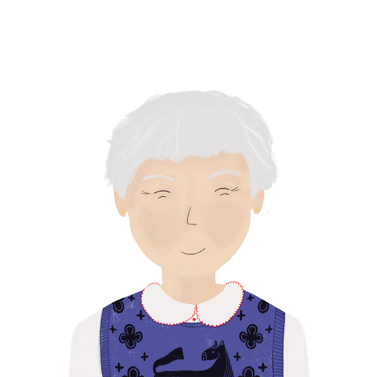
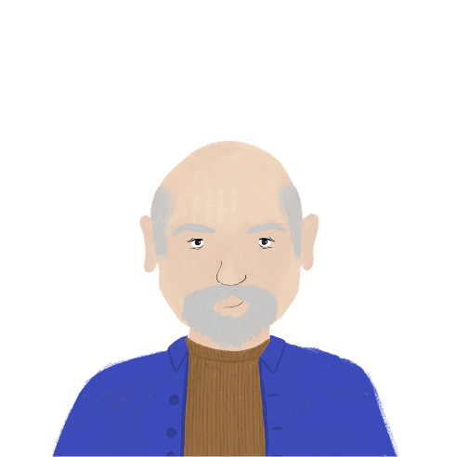
‘quel’ and ‘ce’
Remember: adjectives must agree with the relevant noun in number and gender!
grammaire
Use interrogative adjectives quel, quelle, quels, quelles to ask ‘which’.
Use demonstrative adjectives ce, cet, cette, ces to mean ‘this/that/those’. They often answer the question ‘which’.
Remember!
In English, we differentiate between ‘this/that’ but in French, we use ‘ce’
for both meanings!
Traduis:
Which town?
That town!
Which clothes?
Those clothes!
Which product?
That product!
Which business?
That business!
Tu veux lire quel journal ?
[Which newspaper do you want to read?]
Quelle ville ?
Cette ville !
Je veux ce journal !
[I want this newspaper!]
Quels vêtements ?
Ces vêtements !
Quel produit ?
Ce produit !
Quelles affaires ?
Ces affaires !
Notes:
Timing: 2 minutes
Aim: revise use of interrogative and demonstrative adjectives
Procedure:
1. Click to bring up information.
2. Check understanding at each step.
3. Click to bring up practice words.
4. Click to bring up answers one by one.
5. Click to bring up reminder box about ‘ce’ being used for ‘this’ and ‘that’ in French.

Slide 19
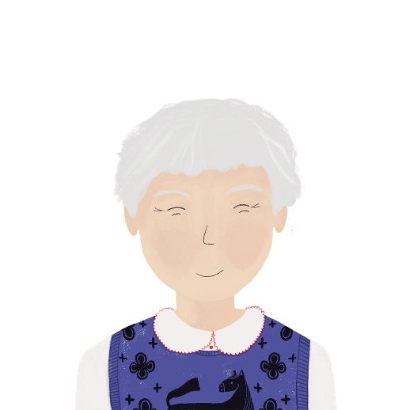
Renée parle à Élodie
lire
Choisis les mots.
Élodie, quelle surprise* ! Ta mère dit que tu vas à l'étranger. Quel
pays veux-tu visiter en premier ? Je pense à l'Allemagne. Tu apprends l'allemand à l'école. Ah non, c'est l'anglais ! Tu peux aller à Londres alors, j’aime cette ville . Mais fais attention ! Cet endroit est beau mais dangereux. Il y a beaucoup de crimes. Ces anglais !
J’ai quelque chose* pour toi. Ce roman parle d’une jeune fille à Londres. C’est utile ! Quels sont tes projets ? Quelles activités vas-tu faire ?
surprise/problème
pays/ville
lieu/ville
endroit/chemin
anglais/culture
roman/histoire
idées/projets
activités/jeux
*quelque chose = something
Notes:
Timing: 5 minutes
Aim: recognise nouns to match demonstrative and interrogative adjectives
Procedure:
1. Students read text and choose the relevant noun based on the number and gender of the demonstrative/interrogative adjective.
2. Click to reveal answers one by one.
Word frequency of cognate (1 is the most frequent word in French): surprise [1815]
Word frequency of unknown words (1 is the most frequent word in French): quelque [70]
Source: Lonsdale, D., & Le Bras, Y. (2009). A Frequency Dictionary of French: Core vocabulary for learners London: Routledge.

Slide 20
verbe + de + infinitif
grammaire
Some verbs in French can be followed by de and an infinitive.
Usually, de is translated as ‘to’.
e.g. Je choisis de travailler dur.
I choose to work hard.
Sometimes you can put à then add a person’s name or noun relating to a person, then de and an infinitive.
e.g. Je demande à mon père de fermer la porte.
I ask my dad to close the door.
de is not always translated as ‘to’
Sometimes verbs are followed by person, then de and an infinitive.
e.g. J’empêche les enfants de tomber.
I prevent the children from falling.
You already know some verbs that can be followed by de
e.g. choisir, demander, dire, empêcher, finir, parler, proposer
Notes:
Timing: 3 minutes
Aim: introduce verbs + de + (optional noun) + infinitive
Procedure:
1. Click to bring up information.
2. Check understanding at each stage.

Slide 21
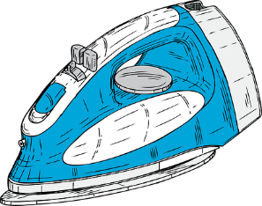
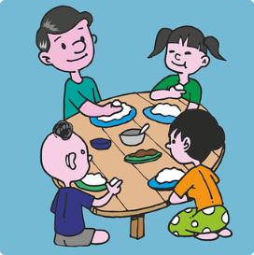
Verbes avec à/de
écouter
Choisis le verbe.
1
commence/propose
Je commence à apprendre l’italien.
2
apprenons/choisissons
Nous choisissons de faire le ménage.
3
attends/aide
J’attends de manger avec ma famille.
4
attend/apprend
Elle attend de sortir.
5
propose/aide
Il aide les enfants à jouer au foot.
6
commence/attend
Mon père commence à écrire une histoire.
7
propose/apprend
Mon ami apprend à gérer l’équipe.
8
propose/commence
Je propose de visiter les musées ce weekend.
Notes:
Timing: 10 minutes
Aim: recognise verbs that go with à and de
Procedure:
1. Click audio buttons to hear sentences with verb beeped out.
2. Students choose which verb is missing based on whether they hear à or de.
3. Click to reveal answers one by one.
4. Click answer sentences to hear full audio.
5. Elicit English oral translations.
Transcript:
Je commence à apprendre l’italien.
Nous choisissons de faire le ménage.
J’attends de manger avec ma famille.
Elle attend de sortir.
Il aide les enfants à jouer au foot.
Mon père commence à écrire une histoire.
Mon ami apprend à gérer l’équipe.
Je propose de visiter les musées ce weekend.

Slide 22
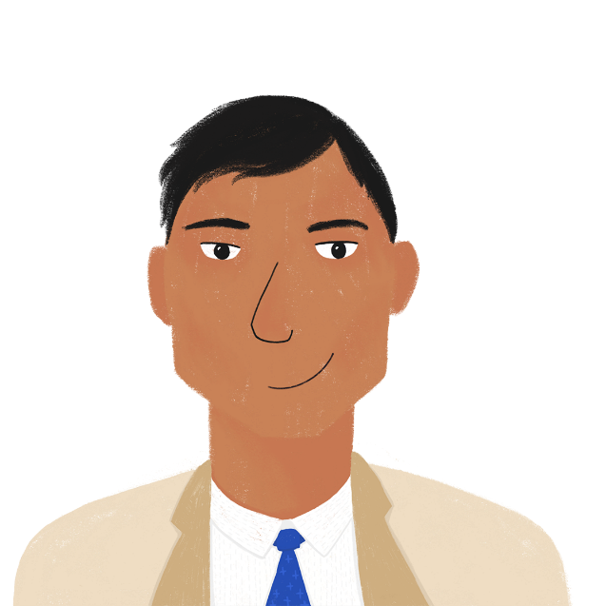
Bilal au travail
lire
Remplis les phrases avec à/de/-
Je veux - gagner plus d’argent au travail. Je choisis de travailler dehors souvent, mais je dois - faire plus au bureau. Je commence à étudier les maths pour gérer les finances. Amandine aide à corriger mes erreurs. Quand je travaille, je demande aux enfants de garder* le silence. Je propose de sortir en famille pour célébrer mon nouveau travail.
__
__
__
__
__
__
__
__
*garder = to keep
Notes:
Timing: 10 minutes
Aim: Recognise verbs which take à/de or no preposition before an infinitive
Procedure:
1. Students read text and fill in gaps.
2. Click to reveal answers one by one.
Word frequency of cognates (1 is the most frequent word in French): finance [1677]
Source: Londsale, D., & Le Bras, Y. (2009). A Frequency Dictionary of French: Core vocabulary for learners London: Routledge.

Slide 23
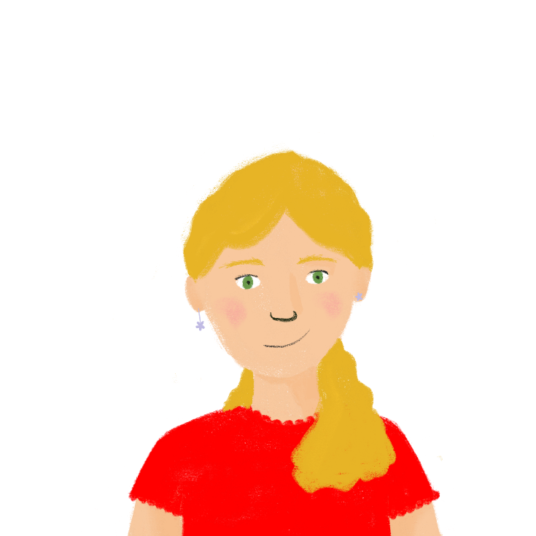
Finis la phrase
parler
Partner A:
je commence…
[learn French/study maths]
Partner B:
d’étudier les maths/à apprendre le français
Je commence …
à apprendre le français.
Notes:
Timing: 10 minutes [3 slides]
Aim: oral production of sentences involving verbs followed by à/de + infinitive
Procedure:
1. Students work in pairs using prompt sheet on next slide to form sentences.
2. Click through example on screen.
3. Partner A starts sentence, partner B chooses the correct sentence ending.
4. Partner A listens and ticks what they hear.
5. Swap roles.
6. Prompt sheets on next slide. Answers on following slide.

Slide 24
Finis la phrase
parler
Partner A:
Je choisis… [believe in God/correct the answers]
Elle apprend… [ask more questions/drive]
Tu empêches… [the children from eating/the children from winning]
Ils finissent… [making the meal/finding the cafe]
Partner B:
de croire en Dieu/à corriger les réponses.
de poser plus de questions/à conduire.
les enfants de manger/aux enfants à gagner.
de faire le repas/à trouver le café.
Partner A:
5. de visiter le musée/à regarder un film.
6. d’écouter le professeur/à travailler dur en classe.
7. de travailler dans un café/à chercher un emploi.
8. de répondre aux questions/à construire le modèle.
Partner B:
Nous choisissons… [visit the museum/watch a
film]
Elles disent… [listen to the teacher/work hard in
class]
7. Je commence… [work in a cafe/look for a job]
8. On aide… [answer questions/build the model]
Notes:
Prompt sheet to print [slide 2/3]

Slide 25
Finis la phrase - réponses
parler
1. Je choisis de croire en Dieu.
2. Elle apprend à conduire.
3. Tu empêches les enfants de manger.
4. Ils finissent de faire le repas.
5. Nous choisissons de visiter le musée.
6. Elles disent d’écouter le professeur.
7. Je commence à chercher un emploi.
8. On aide à construire le modèle.
Notes:
Answers [slide 3/3]
Procedure:
Click to bring up answers one by one.
Check comprehension at each step.

Slide 26
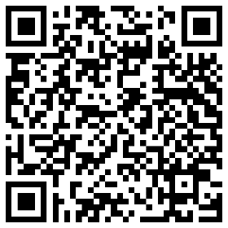
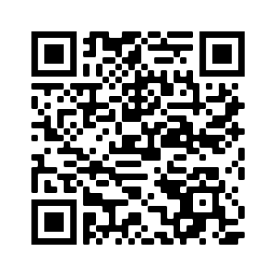
Devoirs
Vocabulary Learning Homework (Y9, Term 3.1, Week 5)
Audio file
Audio file QR code:
Quizlet QR code:
Student worksheet
Quizlet link
In addition, revisit: Year 9 Term 2.2 Week 3
Year 9 Term 2.1 Week 3
Notes:
The answer sheet for the 9.3.1.5 vocabulary learning homework is here: Resource | French SOW Y9 Term 3.1 Week 5 - vocabulary learning homework answers | ID: x346d6362 | NCELP

