Slide 1
Describing what is happening now (exercise and fitness)
Present continuous with –ar verbs
Deber + infinitive [revisited]
Y8 Spanish
Term 3.2 – Week 4 – Lesson 65
Pete Watson / Amanda Izquierdo / Nick Avery Artwork: Mark Davies
Date updated: 24/03/21
Notes:
Artwork by Mark Davies. All additional pictures selected are available under a Creative Commons license, no attribution required.
Learning outcomes (lesson 1):
Introduction of present continuous with –ar verbs: estar + present participle (1st, 2nd and 3rd person singular forms of estar)
Consolidation of debo + infinitive
Consolidation of antepenultimate and penultimate syllable stress and corresponding spelling rules
Word frequency (1 is the most frequent word in Spanish):
8.3.2.4 (introduce) grabar [1560]; tocar [327]; mostrar [330]; bajar [484]; levantar² [354]; pierna [776]; saltar [1160]; brazo [470]; mano [135]; alguien [341]; ahora mismo [81]
8.3.1.4 (revisit) parecer [89]; guardar [687]; marca [1276]; falda [2743]; mitad [834]; precio [557]; tipo [168]; euro [2435]; ligero [1930]; práctico [2141]; este [24]
8.2.2.5 (revisit) llorar [630]; esperar [157]; volver [112]; encontrar [102]; gritar [691]; querer² [58]; historia [186]; mes [288]; papá [865]; mamá [675]; frío [1020]
Source: Davies, M. & Davies, K. (2018). A frequency dictionary of Spanish: Core vocabulary for learners (2nd ed.). Routledge: London
The frequency rankings for words that occur in this PowerPoint which have been previously introduced in NCELP resources are given in the NCELP SOW and in the resources that first introduced and formally re-visited those words.
For any other words that occur incidentally in this PowerPoint, frequency rankings will be provided in the notes field wherever possible.

Slide 2
hablar
A
B
C
D
[to wait (for), waiting (for)]
[to cry, crying]
[to return, returning]
[to find, finding]
¿Cómo se dice en español?
¡Tienes tres segundos para decir la palabra!
E
F
G
H
[to shout, shouting]
[to want, to love]
[story]
[month]
I
J
K
L
[Dad (informal)]
[Mum (informal)]
[to seem, seeming]
[cold (noun)]
Notes:
Timing: 3 minutes
Aim: to revise in productive mode/oral modality 12 items of vocabulary from this week’s revisited set 8.2.2.5, within a limited time frame.
Procedure:
1. Click and press enter to bring up an English prompt. It will disappear after 3 seconds. Note that the prompts do not appear in alphabetical order in order to increase the challenge.
2. Students say the Spanish word before the English prompt has faded away. 3. Ensure that definite articles are known for any words that are nouns (in order to check that students remember the gender).
Note: ‘Parecer’ from set 8.3.1.4 is also included as the 12th word.
ANSWERS:
A = llorar
B = esperar
C = volver
D = encontrar
E = gritar
F = querer
G = la historia
H = el mes
I = el papá
J = la mamá
K = el frío
L = parecer

Slide 3
Respuestas
hablar
llorar
esperar
volver
encontrar
[to cry, crying]
[to wait, waiting for]
[to return, returning]
[to find, finding]
gritar
querer
la historia
el mes
[to shout, shouting]
[to want, to love]
[story]
[month]
Remember, frío can also be an adjective (frío, fría).
Papá
Mamá
el frío
parecer
[Dad (informal)]
[Mum (informal)]
[cold (noun)]
[to seem, seeming]
Notes:
ANSWERS TO PREVIOUS SLIDE
Note: Answers are animated to appear one by one, from left to right, proceeding row by row. This allows for further practice, if desired.
Alternatively, the animations could be removed to show all of the answers straight away.

Slide 4
Syllable stress and spelling rules
fonética
third-last
When a word has a stress (emphasis) on the ___________ syllable, it will always have an accent on the vowel of that syllable.
Ejemplos:
Remember, this is also called the ‘antepenultimate’ syllable.
1
próximo
next
Remember, this is also called the ‘penultimate’ syllable.
2
último
last
second-last
When a word has a stress on the ______________ syllable and ends in any consonant other than ‘n’ or ‘s’, it will have an accent on the vowel of that syllable.
Ejemplos
3
líder
(leader)
4
fácil
easy
Notes:
Timing: 2 minutes
Aim: to recap rules spelling of words with antepenultimate and penultimate stress.
Procedure:
Click to go through the slide and examples.
The orange action buttons can be clicked on to hear the pronunciation modelled by a native speaker.
Transcript:
1. próximo
2. último
3. líder
4. fácil
Frequency of unknown words/cognates (1 is the most frequent word in Spanish): líder [1155]

Slide 5
Antepenultimate and penultimate syllable stress
hablar / escuchar
Vamos a practicar la pronunciación y el uso de la tilde.
Remember, la tilde is the written accent (e.g. é, ú).
El estudiante A pronuncia la palabra de su tarjeta.
El estudiante B escucha y luego escribe la palabra con el acento en la sílaba correcta.
El ejercicio es muy difícil.
Ejemplo:
Estudiante B escribe
Estudiante A lee el texto
Persona A
e.g. El ejercicio es difícil.
El ejercicio es ______.
difícil
Notes:
Timing: 7 minutes
Aim: to practise oral production and transcription of words with stress on the antepenultimate and penultimate syllables.
Procedure:
Give the speaking cards to the pairs (these cards are shown on slide 7, and should not be shown during the activity).
Persona A will read out the words from their slide, persona B looks at the board and copies down the word, adding an accent where s/he thinks the stress is.
After the 6 words, Persona B reads out their words.
The animation sequence on the next slide reveals the answers.

Slide 6
Dos instructores
hablar / escuchar
Persona A
César , el instructor, no es una persona frágil ; es una persona de carácter fuerte. Cada sábado bate un récord en el gimnasio. ¡De verdad su fuerza no tiene límites!
*batir – to break (e.g. a record)
*el gimnasio – gym
*la fuerza – strength
Persona B
Fátima, la instructora, vive en la ciudad de Córdoba. No es débil porque ¡usa todas las máquinas del gimnasio! Hace ejercicio casi todos los días, así que le parece muy fácil. También es la capitana de un equipo de fútbol .
Lleva la camiseta número diez.
*la máquina – machine
_____
_____;
______
________
________
_____
_______
______
______!
_____.
______
______
Notes:
DISPLAY DURING THE ACTIVITY
This slide can also be used to bring up the answers and give feedback. Click to reveal each word in order.
Frequency of unknown words/cognates (1 is the most common word in Spanish):
carácter [813]; límite [1194]; máquina [1117]; frágil [3922]; récord [4902]; names N/A (César, Fátima)

Slide 7
Accents on antepenultimate and penultimate syllable stressed words
hablar / escuchar
Tarjetas
Persona A
César, el instructor, no es una persona frágil; es una persona de carácter fuerte. Cada sábado bate un récord en el gimnasio. ¡De verdad su fuerza no tiene límites!
*batir un récord – to break a record
*el gimnasio – gym
*la fuerza – strength
Persona B
Fátima, la instructora, vive en la ciudad de Córdoba. No es débil porque ¡usa todas las máquinas del gimnasio! Hace ejercicio casi todos los días, así que le parece muy fácil. También es la líder de un equipo de fútbol. Lleva la camiseta número diez.
*la máquina – machine
Notes:
STUDENT CARDS
DO NOT SHOW DURING THE ACTIVITY
These cards can be downloaded and printed off from a separate word document.

Slide 8
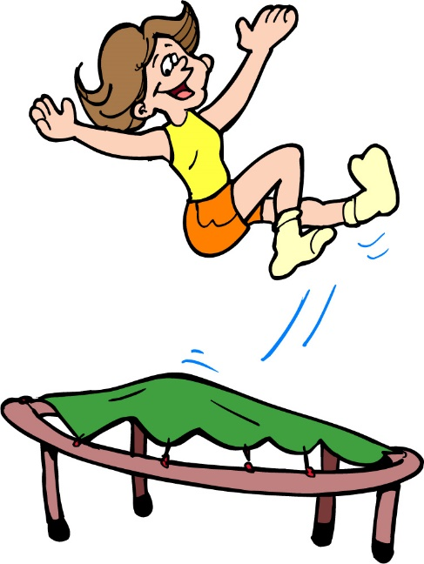
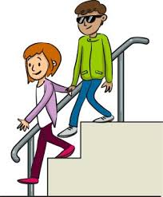
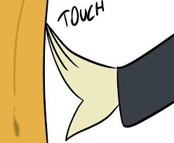
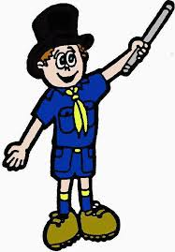
Vocabulario
leer / hablar
[1/2]
grabar
saltar
[to record, recording]
[to jump, jumping]
tocar
bajar
[to touch, touching]
[to go down, to lower]
mostrar
alguien
[to show, showing]
[someone, somebody]
Notes:
Vocabulary introduction and practice slide [1/2]
Timing: 3 minutes (slides 8 & 9)
Aim: to introduce and embed new vocabulary
Procedure 1. Pupils either work by themselves or in pairs, reading out the words and recapping their English meaning (1 minute). 2. Then the teacher removes the English words or pictures (one by one) and they try to recall the English orally (chorally), looking at the Spanish (1 minute). 3. Then the Spanish meanings are removed (one by one) and they to recall them orally (again, chorally), looking at the English (1 minute) 4. Optionally, further rounds of learning can be facilitated by one pupil turning away from the board, and his/her partner asking him/her the meanings (‘Cómo se dice X en español?’). This activity can work from L2 → L1 or L1 → L2.

Slide 9
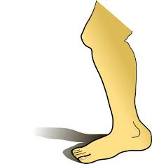
Vocabulario
¡Atención! ‘Mano’ is feminine but ends in an ‘o’!
leer / hablar
[2/2]
la pierna
la mano
[leg]
[hand]
el brazo
ahora mismo
[arm]
[right now]
el tipo
[to get up; to lift, raise]
levantar
[type]
Notes:
Notes
1. A callout appears with the first click highlighting that ‘mano’ is feminine despite ending with ‘o’. This callout disappears on the next click
2. One word from one of this week’s revisited sets is also included on the slide, for additional practice: el tipo.
3. Levantar is reintroduced here with the meaning ‘to lift, to raise’. It could be a good time to introduce the useful phrase ‘levanta la mano’!

Slide 10
Singular forms of ‘estar’ used to express state [revisited]
gramática
‘to be’
state
‘Estar’ means _______ and is used to express a ______ or a location.
estoy
To say ‘I am’, we say _____ .
I am tired.
Estoy cansado/a.
estás
To say ‘you are’, we say ______ .
You are excited.
Estás emocionado/a.
está
To say ‘s/he or it is’, we say _____ .
S/he is angry.
Está enojado/a.
Notes:
Timing: 2 minutes
Aim: to recap singular forms of the verb ‘estar’.
Procedure:
1. Teachers click to go through the slide. Gaps are left with the animations to allow teachers to elicit answers from students

Slide 11
Saying what someone is doing now Present continuous tense
gramática
As you know, the Spanish present simple can be used for routine or ongoing events.
Ejemplo:
‘I record’
‘I’m recording’
‘Grabo’ can mean __________ or ______________.
(routine)
(ongoing / in progress)
Another way to express an ongoing event in the present is to use estar with an –ar verb ending in –ando.
Estoy mostrando el ejercicio.
I am showing the exercise.
Estás saltando.
You are jumping.
The –ando ending (and –ing in English) is called the ‘present participle’.
To form the present participle, remove ‘-ar’ from the infinitive and add ‘-ando’.
Notes:
Timing: 3 minutes
Aim: to introduce the meaning, use and formation of the present continuous tense with –ar verbs.
Procedure:
We begin with a short recap of the dual meaning of the present tense. There are gap animations to allow teachers to elicit answers from students.
Teachers click through to explain the meaning and formation of the present continuous tense. Teachers click to show examples of three verbs from this week’s vocabulary set. The first two examples are from Spanish to English, and the third is from English to Spanish.
A callout appears to explain the meaning of the present participle with examples. The first two are Spanish to English and the third is from English to Spanish

Slide 12
Saying what someone must do Deber + infinitive [revisited]
gramática
As you know, modal verbs such as ‘deber’ are followed by an infinitive.
Debo grabar la actividad.
I have to/must record the activity.
‘Estar’ is different. It can be followed by a present participle (e.g. –ando) but not by an infinitive.
Estoy grabando la actividad.
I am recording the activity.
Notes:
Timing: 2 minutes
Aim: to recap the use of deber as a modal verb before an infinitive, in comparison with estar + present participle. These two verb constructions will be the focus of the next few activities.
Procedure:
Teachers click to go through the slide with explanations and examples.

Slide 13
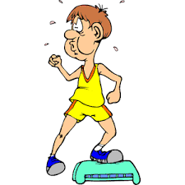
Ana hace una clase de ejercicio en Internet. ¿Qué debe hacer Ana, pero qué hace en realidad? Completa las frases.
leer
 | What Ana must do | What Ana is actually doing
1. Debo tocar / tocando el suelo con una mano, pero ¡estoy tocar / tocando la pared con un pie!
2. Estoy bajar / bajando una pierna sin embargo debo mostrar / mostrando cómo hacer el ejercicio.
3. Estoy dar / dando ánimo a los participantes pero debo grabar / grabando un vídeo.
4. Debo saltar / saltando ahora mismo. Sin embargo estoy dar / dando pasos a la derecha.
5. Debo crear / creando un buen ambiente aunque estoy llorando / llorar por el esfuerzo.
touching the wall with one foot
touch the floor with one hand
show how to do the exercise
lowering one leg
encouraging the participants
record a video
stepping to the right
jump right now
create a good atmosphere
crying because of the effort
Notes:
Timing: 7 minutes
Aim: reading activity to practise understanding deber (its use with an infinitive) and estar (its use with a present participle to express ongoing meaning); to understand the vocabulary in the sentences.
Procedure:
Students copy the table into their book. They will need space to write two words in the first column (no need to write the full sentence) and then to write notes for the final two columns.
Students read the sentences and decide which verb form is correct in each instance, then take notes in English about what Ana must do and what she is actually doing.
Click to show the answers by question.

Slide 14
Talking about body parts Spanish use of the definite article
gramática
In English, we say, for example, ‘I am lowering my arm’ or ‘She is raising her leg’.
However, in Spanish, the definite article (e.g. el, la) is often used for body parts.
Estoy levantando las manos.
I am raising my hands.
Está bajando la cabeza.
S/he is lowering her head.
You can still use ‘un’ or ‘una’ if you want to say ‘one’.
Está bajando un pie.
S/he is lowering one foot.
Notes:
Timing: 2 minutes
Aim: to raise awareness of the cross-linguistic difference between English and Spanish in how to talk about body parts.
Procedure:
1. Click to reveal each part of the explanation.
Note: sometimes Spanish also requires a reflexive pronoun (e.g. me estoy tocando el pie) when an action is self-reflexive. However, this adds an additional layer of complexity, given the fact that English doesn’t use reflexive pronouns in this way, and so we avoid contexts where this is required until later.

Slide 15
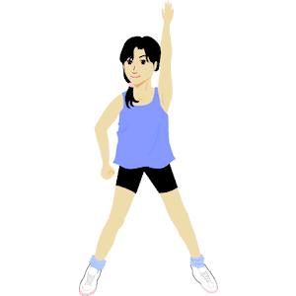
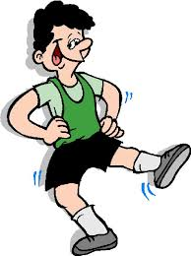
Lucía pregunta a su madre qué pasa en la clase de ejercicio online. ¿Pregunta sobre Ana (‘you’) o el instructor (‘he’)? ¿Qué pregunta?
escuchar
 | Ana (Are you…?) | El instructor (Is he…?) | Completa la frase en inglés
1
waiting to start the class?
2
touching the floor with his hand?
3
jumping to the left?
4
helping many people?
5
enjoying the class?
6
showing his foot to someone?
7
lowering your arm?
8
relaxing right now?
Notes:
Timing: 7 minutes
Aim: listening activity to practise distinguishing between the meanings of the 2nd person singular and 3rd person singular forms of ‘estar’ in the present continuous, with –ar verbs.
Procedure:
1. Students copy out the grid into their exercise books.
2. The teacher clicks the number button to play the recording. Students put a tick in the Ana (are you…?) or el instructor (is he…?) column, and then complete each sentence in English.
3. Answers are shown by clicking. The tick is shown for the correct column and then the translation for each question.
Transcript:
¿Está esperando para empezar la clase?
¿Está tocando el suelo con la mano?
¿Estás saltando a la izquierda?
¿Está ayudando a muchas personas?
¿Estás disfrutando la clase?
¿Está mostrando el pie a alguien?
¿Estás bajando el brazo?
¿Estás descansando ahora mismo?

Slide 16
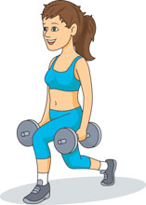
Escucha las preguntas de Lucía a su madre otra vez. ¿Cuál es la respuesta correcta de Ana para cada pregunta?
escuchar / leer
¿letra?
las respuestas de Ana
A) No, estoy levantando el pie.
B) Sí, estoy cansada. ¡No puedo hacer más!
C) Sí, hay veinte participantes en la clase.
D) Sí, porque alguien llega tarde.
E) No, a la derecha.
1
1
E
2
2
C
3
3
A
4
4
D
5
5
B
Notes:
Timing: 6 minutes
Aim: to correctly match some of the questions from the previous exercise to the answers given by Ana.
Procedure:
1. Students should write 1-5 in their exercise books. They need to listen to the questions again and match them up with their correct answer from the table.
2. Click on the orange buttons to play the recording.
3. The answers (shown as letters) are revealed by clicking.
4. To help with feedback, teachers can click on the fawn buttons (revealed with one click before the answers) to listen to the question and the answer.
Note: questions have been adapted very slightly from the previous slide.
Transcript: (questions only, orange buttons)
¿Estás saltando a la izquierda?
¿Está ayudando a muchas personas?
¿Estás bajando el brazo?
¿Está esperando para empezar la clase?
¿Estás descansando ahora mismo?
Transcript (answers, fawn buttons)
1. No, a la derecha.
2. Sí, hay veinte participantes en la clase.
3. No, estoy levantando el pie.
4. Sí, porque alguien llega tarde.
5. Sí, estoy cansada. ¡No puedo hacer más!

Slide 17
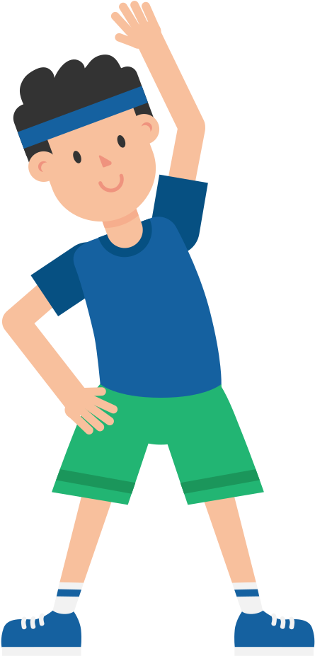
Actividades en la clase de ejercicio.
escuchar / hablar
Estudiante A: lee la frase a tu compañero en español.
Usa ‘estoy’ (‘I am’) o ‘está’ (‘s/he is’) + verbo con –ando.
You might need to use ‘el’ or ‘la’ before a body part!
Estudiante B: escucha y escribe qué hace la persona en la columna correcta en inglés.
Estoy tocando la silla con el pie.
Estudiante A
Estudiante B
 | My partner is… | The instructor is…
1.
I am touching the chair with my foot.
touching the chair with his/her foot.
Notes:
Timing: 8 min (for slides 17-20)
Aim: to practise oral production and aural recognition of the present continuous with –ar verbs, using the 1st and 3rd person singular forms of ‘estar’
Procedure:
Students work in pairs.
Student A looks at their card and says the sentence aloud in Spanish.
Student B listens and then translates the sentence by writing it in the correct column of their table.
After Student A has done their six sentences, it is Student B’s turn.
Answers are shown on slide 19. Slides 17 and 18 are the cards for the pairs and should not be shown during the activity.
Note: students have the chance here to practise use of the definite article for body parts, as shown in the example (‘el pie’). Feedback can be given on accuracy, but this is only a secondary aim. Students will already be focusing on other things (i.e., vocabulary, forms of estar, use of -ando).
Frequency of unknown words/cognates:
participante [3085]

Slide 18
hablar / escuchar
hablar / escuchar
Estudiante A
 | My partner is… | The instructor is…
1
2
3
4
5
6
He is lifting/raising his leg.
I am jumping to the left.
I am lowering my arm.
I am touching the floor.
He is recording a video.
He is shouting at the participants*.
*participant – el/la participante
Notes:
DO NOT DISPLAY DURING ACTIVITY
See accompanying Word doc for printable version.
Target answers for Student A during speaking, based on Student B’s questions:
Está levantando la pierna.
Estoy saltando a la izquierda.
Estoy bajando el brazo.
Estoy tocando el suelo.
Está grabando un vídeo.
Está gritando a los participantes.

Slide 19
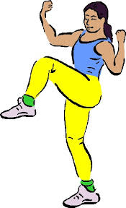
hablar / escuchar
hablar / escuchar
Estudiante B
 | My partner is… | The instructor is…
1
2
3
4
5
6
I am lowering my leg.
He is touching the floor with his hand.
I am jumping to the right.
He is enjoying the music.
He is helping a lot of people.
I am lifting/raising my foot.
Notes:
DO NOT DISPLAY DURING ACTIVITY
See accompanying Word doc for printable version.
Target answers for Person A during speaking, based on Person B’s questions:
Estoy bajando la pierna.
Está tocando el suelo con la mano.
Estoy saltando a la derecha.
Está disfrutando de la música.
Está ayudando a mucha gente.
Estoy levantando el pie.

Slide 20
hablar / escuchar
Respuestas
hablar / escuchar
Estudiante A
Estudiante B
 | My partner is… | The instructor is…
1
2
3
4
5
6
 | My partner is… | The instructor is…
1
2
3
4
5
6
lowering his/her leg.
lifting/raising one leg.
touching the floor with one hand.
jumping to the left.
jumping to the right.
lowering one arm.
enjoying the music.
touching the floor.
helping a lot of people.
recording a video.
lifting/raising his/her foot.
shouting at the participants.
Notes:
ANSWER SLIDE
DO NOT DISPLAY DURING ACTIVITY

Slide 21
Describing what is happening now (exercise and fitness) [2]
Present continuous with –ar verbs (cont.)
Demonstrative adjectives [revisited]
Y8 Spanish
Term 3.2 – Week 4 – Lesson 66
Pete Watson / Amanda Izquierdo / Nick Avery Artwork: Mark Davies
Date updated: 24/03/21
Notes:
Artwork by Mark Davies. All additional pictures selected are available under a Creative Commons license, no attribution required.
Learning outcomes (lesson 2):
Introduction of present continuous with –ar verbs, estar + present participle (estar in singular forms)
Consolidation of demonstrative adjectives ‘esta’ and ‘estas’
Consolidation of antepenultimate syllable stress and spelling
Word frequency (1 is the most frequent word in Spanish):
8.3.2.4 (introduce) grabar [1560]; tocar [327]; mostrar [330]; bajar [484]; levantar² [354]; pierna [776]; saltar [1160]; brazo [470]; mano [135]; alguien [341]; ahora mismo [81]
8.3.1.4 (revisit) parecer [89]; guardar [687]; marca [1276]; falda [2743]; mitad [834]; precio [557]; tipo [168]; euro [2435]; ligero [1930]; práctico [2141]; este [24]
8.2.2.5 (revisit) llorar [630]; esperar [157]; volver [112]; encontrar [102]; gritar [691]; querer² [58]; historia [186]; mes [288]; papá [865]; mamá [675]; frío [1020]
Source: Davies, M. & Davies, K. (2018). A frequency dictionary of Spanish: Core vocabulary for learners (2nd ed.). Routledge: London

Slide 22
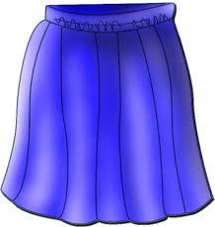
Vocabulario
escuchar
escuchar
1
l (L)
7
h
a
b
c
d
[to keep, keeping]
2
d
8
k
[to seem, seeming]
[brand]
[price]
3
e
9
a
4
g
10
f
e
f
g
h
[type]
[this (m)]
5
b
11
j
[skirt]
[euro]
6
i
12
c
i
j
k
l
[practical, useful]
[month]
[light]
[half]
Notes:
Timing: 6 minutes
Aim: listening activity to revisit some of the vocabulary from this week’s revisited vocabulary.
Procedure 1. Students write 1-12 in their exercise books.
2. They listen to the recording and write the letter of the words that they hear in the order that they hear them.
3. Answers are shown by clicking.
4. Then, students work in pairs. One student says a letter corresponding to one of the pictures and the other student produces that word aloud in Spanish. This will ensure that students also practise productive oral recall.
Transcript:
la mitad
parecer
la falda
este
guardar
el mes
el euro
práctico
la marca
el tipo
ligero
el precio

Slide 23
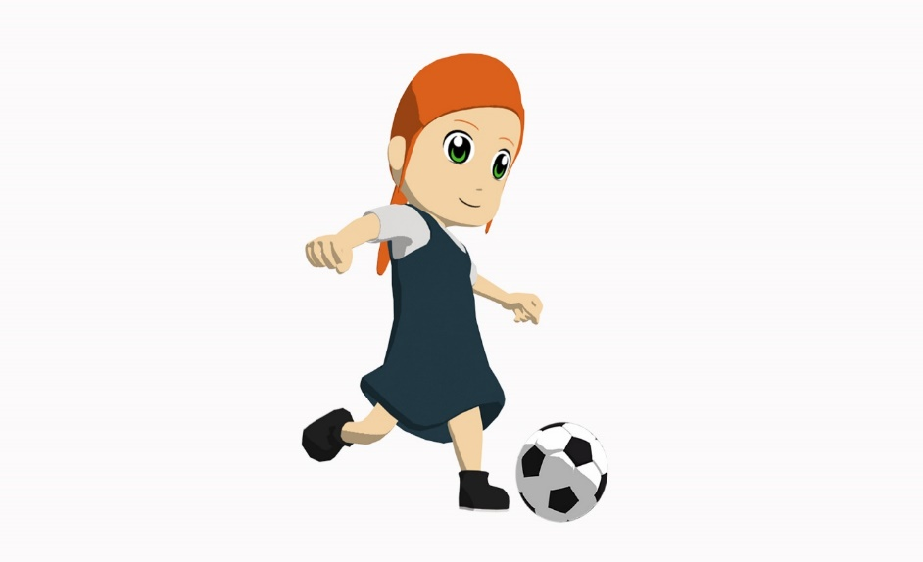
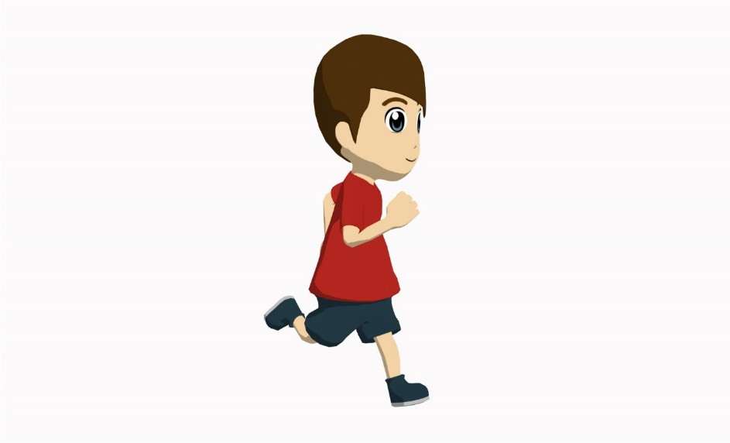
Daniel y Lucía hablan del ejercicio. Escucha y escribe las palabras. Debes poner la tilde en la letra correcta.
escuchar / escribir
D: El ________ dice que el ejercicio es importante para los __________. Lucía, ¿me escuchas? Creo que estás pasando demasiado tiempo en el teléfono este mes.
Tu amiga Nadia hace mucho deporte, ¿verdad? Corre veinticinco __________ cada __________ y ________. Ahora mismo está grabando un vídeo en YouTube. Está saltando con una pierna y levantando los brazos. ¡Parece que la ________ le da _______!
¿Qué haces, Lucía? Ah, ahora ¡tú estás participando!
L: Sí, ¡mira! Es _________. Estoy bajando el brazo y levantando la pierna. Son ejercicios __________ y muy divertidos. Así ¡voy a estar más fuerte!
médico
músculos
kilómetros
miércoles
sábado
música
ánimo
fantástico
prácticos
el músculo = muscle
el kilómetro = kilometre
Notes:
Timing: 8 minutes
Aim: listening activity to practice recognition and spelling of words with stress and an accent on the antepenultimate syllable. Examples of the present continuous tense with –ar verbs are also included, for additional receptive practice.
Procedure:
1. Explain to students that they will need to listen to the recording and write the missing words. All of the words have stress on the third-last syllable, so require an accent.
2. Click to reveal each answer.
3. To check understanding of meaning, the text could be translated into English orally, or teachers could pick out certain phrases and ask students to translate them. Alternatively, teachers could ask simple questions to elicit comprehension answers from students (e.g. What does the doctor say? Why does Daniel think it matters to Lucía? What’s Nadia doing right now?).
Notes
This is a hybrid vocabulary revisiting / sounds of the language activity, which also includes some of the new language introduced this week. Five of the words to write are known vocabulary items and three are unknown.
Transcript:
D: El médico dice que el ejercicio es importante para los músculos. Lucía, ¿me escuchas? Creo que estás pasando demasiado tiempo en el teléfono este mes.
Tu amiga Nadia hace mucho deporte, ¿verdad? Corre veinticinco kilómetros cada miércoles y sábado Ahora mismo está grabando un vídeo en YouTube. Está saltando con una pierna y levantando los brazos. ¡Parece que la música le da ánimo!
¿Qué haces, Lucía? Ah, ahora ¡tú estás participando!
L: Sí, ¡mira! Estoy bajando el brazo y levantando la pierna. Son ejercicios prácticos y muy divertidos. Así ¡voy a estar más fuerte!
Word frequency (1 is the most frequent word in Spanish): músculo [2715]; kilómetro [1519]; fantástico [2501]

Slide 24
¿Qué significan las frases?
leer
Creo que estás pasando demasiado tiempo en el teléfono este mes.
1
I think you are spending too much time on the phone this month.
Ahora mismo está grabando un vídeo en YouTube.
2
Right now s/he is recording a video on YouTube.
Estoy bajando el brazo y levantando la pierna.
3
I’m lowering my arm and lifting/raising my leg.
Notice the different prepositions: Spanish: ‘saltar con una pierna’
English: ‘to jump on one leg’
Está saltando con una pierna.
4
S/he is jumping on one leg.
Notes:
OPTIONAL
This slide could be used to focus specifically on understanding of the examples of the present continuous on the previous slide.
Some students may find it easier to see both the English and Spanish displayed together, as shown here.

Slide 25
How to say ‘this’ and ‘these’ Demonstrative adjectives [revisited]
gramática
este
To say ‘this’ for a singular masculine noun we use _____ .
this price
este precio
esta
To say ‘this’ for a singular feminine noun we use _____ .
this half
esta mitad
estos
To say ‘these’ for plural masculine noun we use ______ .
these months
estos meses
estas
To say ‘these’ for plural feminine noun we use ______ .
these brands
estas marcas
¡Ojo! Accents matter!
esta = this (feminine, singular)
está = s/he is, it is
estas = these (feminine, plural)
estás = you are
1
2
Notes:
Timing: 2 minutes
Aim: slide to revisit demonstrative adjectives and distinguish these from similarly spelt forms of estar.
Procedure:
1. Teachers click to go through the slide. Gaps are left for teachers to elicit answers from students.
2. In the section on stress positions, teachers can click the speaker icon to listen to the difference in stress position of the demonstratives, and the forms of estar.
Transcript:
Esta...está
Estas....estás

Slide 26
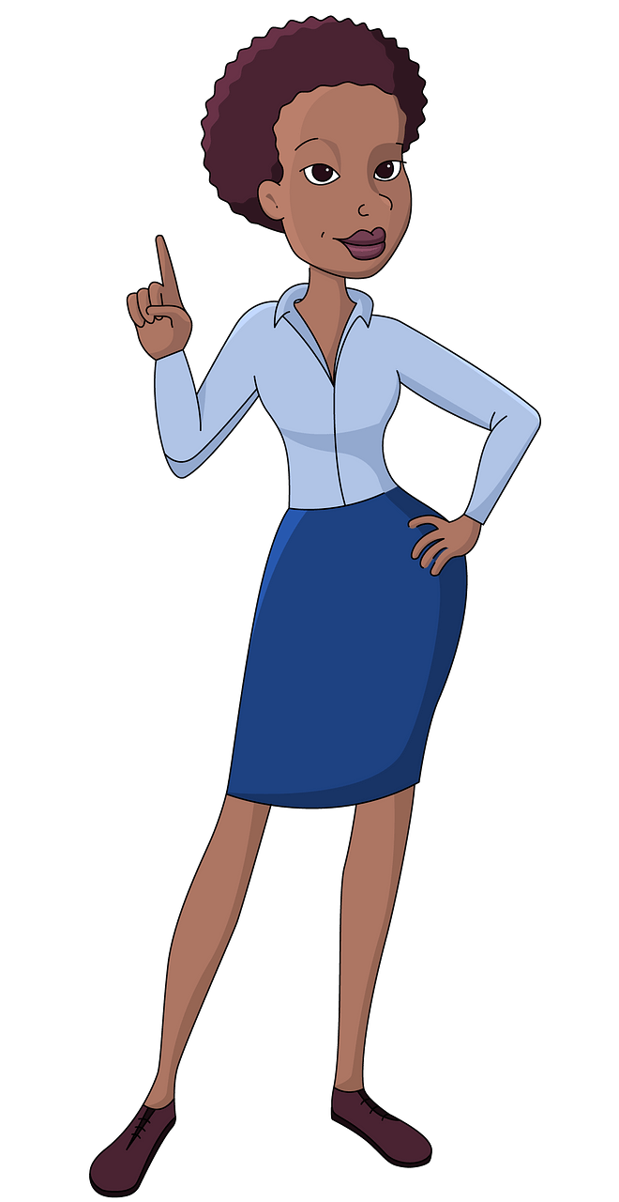
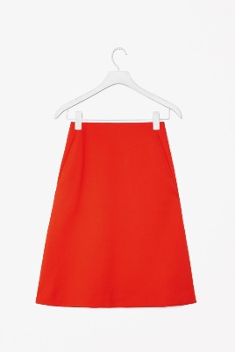
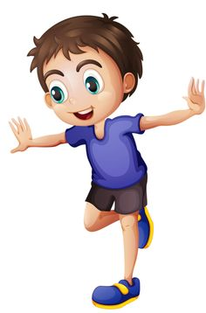
Completa las frases con ‘esta’ o ‘está’.
noun
Remember, ‘esta’ is used before a ______ to mean ‘this’.
leer
verb
‘Está’ may be used before a ______ ending in ‘–ando’ to express ongoing events (events in progress).
Está / Esta falda es para después.
Esta / Está guardando la falda para después.
Esta / Está saltando con una pierna.
Esta / está parte del cuerpo es la pierna.
1
3
4
2
Esta / Está historia es interesante.
Esta / Está llorando porque la historia le da pena.
Está / Esta hablando con la instructora.
Está / Esta persona es la instructora.
Notes:
Timing: 7 minutes
Aim: reading activity to practise distinguishing between ‘esta’ and ‘está’, depending on the part of speech of the word that follows.
Procedure:
1. Students write the correct order of ‘está’ and ‘esta’ for each question item. For example, 1=esta, está.
2. Answers are revealed by clicking, question by question. Encourage students to accurately stress the word when they give their answers.
3. Students can be asked to translate each sentence orally into English as part of the feedback.

Slide 27
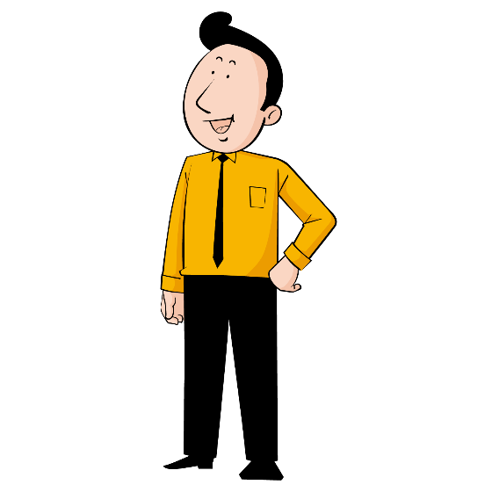
¿Puedes completar las frases?
leer
Completa las frases con las dos ocpiones en el orden correcto.
1. Está _____________ el precio.
Esta ___________ tiene un precio de 15 euros.
falda
mostrando
mostrando
falda
2. Esta ____________ de papá es graciosa.
Está ____________ a mi papá.
película
grabando
película
grabando
3. Esta ____________ parece muy ligera.
Está ____________ algo muy ligero.
camisa
tocando
camisa
tocando
4. Está ____________ por alguien.
Esta ____________ parece muy triste.
mujer
llorando
llorando
mujer
Notes:
OPTIONAL
This optional activity allows for further practice of está and esta in reading, if desired. It is not included in the lesson timings.
Aim: reading activity to practise distinguishing between the types of word that follow esta and está (either a singular feminine noun or the present participle)
Procedure:
Students write 1-4 in their books. They read the sentences and look at the two answer options in the box on the right.
They need to decide whether the feminine noun or the present participle should go in each gap.
They can simply write the two missing words in their book for each item. These should be in the correct order (e.g. 1: mostrando, falda).
Answers are revealed by clicking, question by question.
Students can be asked to translate each sentence into English after going through the answers

Slide 28
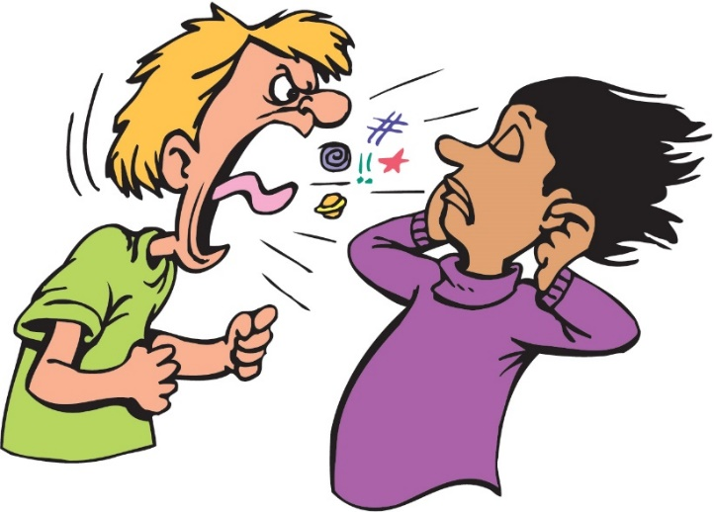
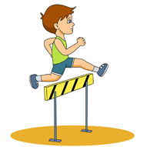
La clase de ejercicio
escuchar
Escucha. ¿Cómo empieza la frase: con ‘you are’ o con ‘these’ (f)?
Escribe el inicio* de la frase en inglés.
 | estas | estás | estas/estás + primera palabra
1
1
you are recording
2
2
you are waiting
3
3
these activities
4
4
you are touching
5
5
these people
6
6
these instructors (f)
7
7
you are showing
*el inicio - start
Notes:
Timing: 7 minutes
Aim: listening activity to practise understanding ‘estas’ and ‘estás’ by paying attention to the part of speech of the word that follows.
Procedure:
Students copy out the grid in their books.
Teachers play the recording by clicking on the number buttons.
They decide if ‘estas’ or ‘estás’ is the word that is beeped out in the recording. To work this out, they need to pay attention to the first word they hear and identify whether it is a noun (requiring ‘estas’ before) or present participle (requiring ‘estás’ before).
They then translate the start of the sentence (first two words) into English, including the beeped out word.
Answers are shown by clicking. At this point, the full sentence could be played (click the beige action button), and students could be asked for an oral translation of the whole sentence in English.
Notes:
For question 5, students could be asked how they would replace ‘gritan’ with the present continuous. ‘Están’ is a known form of ‘estar’, so some students may be able to make the connection with the present continuous and form ‘están gritando’.
Transcript:
[beep] grabando un vídeo de la clase.
[beep] esperando para hacer ejercicios más fáciles.
[beep] actividades son difíciles.
[beep] tocando la pared con la mano.
[beep] personas gritan a alguien.
[beep] instructoras quieren una bebida fría.
[beep] mostrando cómo saltar bien.

Slide 29
¿Cómo es la frase en español?
escribir
clase
largo/a
clase es muy larga.
Esta
_____ __ ____ _____
Está
This class is very long.
Notes:
Timing: 8 minutes (slides 29-38)
Aim: writing practice to differentiate between demonstratives (esta, estas) and singular forms of estar (está, estás) in the present continuous, in preparation for the final paired speaking/listening activity.
Procedure:
This activity could be done on mini whiteboards. If so, these will need to be handed out before the activity.
Students look at the English prompt in orange and decide whether they need ‘esta’ or ‘está, ‘estas’ or ‘estás’ in each case.
Students then write the sentence on their boards and show answers.
Teachers then reveal the answer with a further click.
Notes:
1. The animation sequence supports differentiation. Students can either be required to do full sentence translation, without any vocabulary given, or they can use the vocabulary box in the top right, which appears after another click.
2. The lesson timing comes to 48 minutes. There may be a couple of minutes at the end of this activity to allow students to write an example of their own.

Slide 30
¿Cómo es la frase en español?
escribir
actividad
fácil
actividad es muy fácil.
Esta
_________ __ ____ _____
Está
This activity is very easy.
Notes:
[2/10]

Slide 31
¿Cómo es la frase en español?
escribir
saltar
al fondo de
el jardín
Esta
Está
saltando al fondo del jardín.
________ __ ______ ___ _____
He is jumping at the end of the garden.
Notes:
[3/10]

Slide 32
¿Cómo es la frase en español?
escribir
grabar
música
hoy
Esta
grabando la música hoy.
Está
__________ __ _______ ____
He is recording the music today.
Notes:
[4/10]

Slide 33
¿Cómo es la frase en español?
escribir
la falda
práctico/a
Estas
faldas son prácticas.
______ ___ _________
Estás
These skirts are practical/useful.
Notes:
[5/10]

Slide 34
¿Cómo es la frase en español?
escribir
bajar
el brazo
Esta
Está
bajando el brazo
_________ __ ______.
She is lowering her arm.
Notes:
[6/10]

Slide 35
¿Cómo es la frase en español?
escribir
llorar
por
esfuerzo
Estas
llorando por el esfuerzo
Estás
________ ___ __ ________.
You are crying because of the effort.
Notes:
[7/10]

Slide 36
¿Cómo es la frase en español?
escribir
instructor/a
activo/a
Estas
instructoras son activas.
___________ ___ _______
Estás
These instructors (f) are active.
Notes:
[8/10]

Slide 37
¿Cómo es la frase en español?
escribir
mostrar
partido
Estas
Estás
mostrando el partido.
___________ __ ________
You are showing the match.
Notes:
[9/10]

Slide 38
¿Cómo es la frase en español?
escribir
gritar
papá
¿Estas
gritando a tu papá?
¿Estás
________ __ __ ______
Are you shouting at your Dad?
Notes:
[10/10]

Slide 39
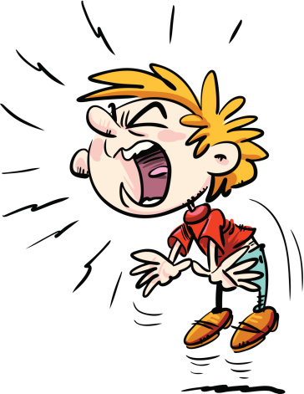
Conversación en la clase de deportes
escuchar / hablar
Estudiante A: mira su carta y dice ‘estas’ o ‘estás.
Estudiante B: escucha. ¿Es ‘a’ o ‘b’? Lee la frase correcta en tu carta.
Estudiante A: escribe la frase en inglés.
Estás gritando al profesor.
Estás…
Estudiante A
Estudiante B
 | Escribe la frase en inglés:
1 | You are...
 | Lee la frase correcta:
1 | Estas clases son fáciles. Estás gritando al profesor.
 | Escribe la frase en inglés:
1 | You are shouting at the teacher (m).
Notes:
Timing: 10 min (for slides 39-42)
Aim: speaking and listening activity to practise oral production and aural recognition of está/estás and demonstrative adjectives esta/estas.
The activity covers four forms in total, but at any given time, students will be working with two (either ‘estas’ vs ‘estás’ OR ‘esta’ vs ‘está’).
Procedure:
Students work in pairs.
Hand out the cards and use this slide to explain the activity with an example.
Student A looks at their card and translates the phrase (either ‘you are’ or ‘these (f)’) into Spanish, paying careful attention to the position of the stress. Student B listens and decides whether they heard ‘estas’ or ‘estás’. They then read out the correct Spanish sentence on their card. Student A listens and then writes the end of the sentence in English in the space on their card.
If student B reads out the wrong answer and it is clearly ungrammatical, student A should say ‘Intenta otra vez’.
After the 6 sentences have been completed, students swap roles. This time student B is practising between ‘esta’ and ‘está’.
Answers are shown on slide 42.

Slide 40
Persona A
hablar
 | Escribe la frase en inglés:
1 | These (f)...
2 | You are...
3 | These (f)...
4 | You are...
5 | You are...
6 | These (f)...
 | Lee la frase correcta:
1 | Esta clase es muy larga. Está levantando la pierna.
2 | Está esperando a su mamá. Esta pregunta es fácil.
3 | Esta marca es de los Estados Unidos. Está saltando al fondo del jardín.
4 | Está grabando la música. Esta actividad es divertida.
5 | Esta camisa es 23 euros. Está bajando el brazo.
6 | Está grabando la clase. Esta actividad es difícil.
Notes:
STUDENT CARD FOR PERSONA A
DO NOT SHOW DURING THE ACTIVITY
These cards can be downloaded and printed off from a separate word document.

Slide 41
Persona B
hablar
 | Escribe la frase en inglés:
1 | S/he is...
2 | S/he is...
3 | This (f)...
4 | S/he is...
5 | This (f)...
6 | This (f)...
 | Lee la frase correcta:
1 | Estas manos son muy frías. Estás llorando mucho hoy.
2 | Estás bajando el brazo. Estas filas son muy largas.
3 | Estas historias no me alegran. Estás grabando el partido.
4 | Estas marcas son muy baratas. Estás tocando la pared con la mano.
5 | Estas camisas son prácticas. Estás saltando todo el tiempo.
6 | Estás guardando tu mitad. Estas faldas son 28 euros.
Notes:
STUDENT CARD FOR PERSONA B
DO NOT SHOW DURING THE ACTIVITY
These cards can be downloaded and printed off from a separate word document.

Slide 42
Respuestas
Persona A
Persona B
hablar
 | Escribe la frase en inglés:
1 | These hands are very cold.
2 | You are lowering your arm.
3 | These stories don’t make me happy.
4 | You are touching the wall with your hand.
5 | You are jumping all the time.
6 | These skirts are 28 euros.
 | Escribe la frase en inglés:
1 | S/he is lifting/raising his/her leg.
2 | S/he is waiting for his/her Mum.
3 | This brand is from the USA.
4 | S/he is recording the music.
5 | This shirt is 23 euros.
6 | This activity is difficult.
Notes:
ANSWER SLIDE FOR SPEAKING / LISTENING ACTIVITY
Do not show during the exercise.

Slide 43
Deberes
Vocabulary Learning Homework (Y8, Term 3.2, Week 5)
Audio file
Audio file QR code
Student worksheet
Quizlet link
In addition, revisit: Term 3.1 Week 5
Term 3.1 Week 2

