Slide 1
Phonics
Year 7 French
Term 1.1 - Week 2
Stephen Owen / Rachel Hawkes
Date updated: 05/01/20
Notes:
Phonics learning aims for Term 1.1, Week 2:
‘i’; ‘eu’.
All pictures selected are available under a Creative Commons license; no attribution required.

Slide 2
i
midi
Stephen Owen / Rachel Hawkes
Notes:
Introduce and elicit the pronunciation of the individual SSC ‘i’ and then present and practise the pronunciation of the source word ‘midi’. A possible gesture for this source word would be to draw a circle representing a clock face with one hand, with the other arm and hand pointing straight up (representing the hands on 12) within the circle

Slide 3
i
midi
Stephen Owen / Rachel Hawkes
Notes:
Introduce and elicit the pronunciation of the individual SSC ‘i’ and then present and practise the pronunciation of the source word ‘midi’. A possible gesture for this source word would be to draw a circle representing a clock face with one hand, with the other arm and hand pointing straight up (representing the hands on 12) within the circle

Slide 4
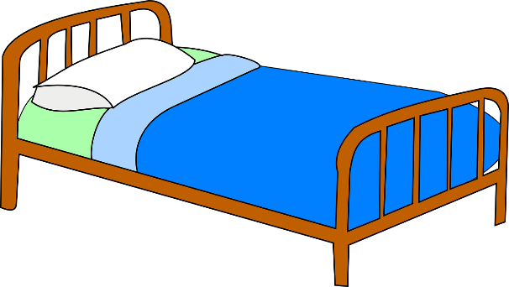
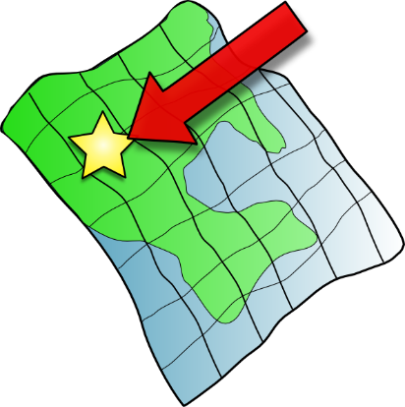
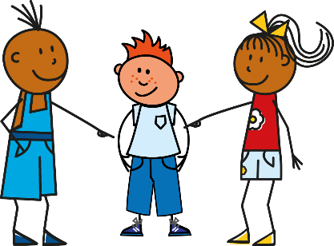
i
petit
lit
midi
ici
qui ?
il
?
Stephen Owen / Rachel Hawkes
Notes:
Introduce and elicit the pronunciation of the individual SSC ‘i’ and then the source word ‘midi’ again (with gesture, if using). Then present and elicit the pronunciation of the five cluster words. The cluster words have been chosen for their high-frequency, from a range of word classes, with the SSC (where possible) positioned within a variety of syllables within the words(e.g. initial, 2nd, final etc..) and additionally, we have tried to use words that build cumulatively on previously taught SSCs (see the Phonics Teaching Sequence document) and do not include new SSCs. Where new SSCs are used, they are often consonants which have a similar symbol-sound correspondence in English.
Word frequency rankings (1 is the most common word in French): petit [138]; lit [1837] ici [167]; il[13]; qui [14]; midi [2483]. Source: Londsale, D., & Le Bras, Y. (2009). A Frequency Dictionary of French: Core vocabulary for learners London: Routledge.

Slide 5
i
petit
lit
midi
ici
qui ?
il
Stephen Owen / Rachel Hawkes
Notes:
Introduce and elicit the pronunciation of the individual SSC ‘i’ and then the source word ‘midi’ again (with gesture, if using). Then present and elicit the pronunciation of the five cluster words. The cluster words have been chosen for their high-frequency, from a range of word classes, with the SSC (where possible) positioned within a variety of syllables within the words(e.g. initial, 2nd, final etc..) and additionally, we have tried to use words that build cumulatively on previously taught SSCs (see the Phonics Teaching Sequence document) and do not include new SSCs. Where new SSCs are used, they are often consonants which have a similar symbol-sound correspondence in English.
Word frequency rankings (1 is the most common word in French): petit [138]; lit [1837] ici [167]; il[13]; qui [14]; midi [2483]. Source: Londsale, D., & Le Bras, Y. (2009). A Frequency Dictionary of French: Core vocabulary for learners London: Routledge.

Slide 6
i
petit
lit
midi
ici
qui ?
il
Stephen Owen / Rachel Hawkes
Notes:
No audio

Slide 7
Mon compagnon idéal
Lire
‘JeJe ou il ?
You are reading a blog. Some of the text has not downloaded properly. Is the person is talking about himself or his ideal penfriend? Look carefully at the verb.
1 | đĦĦċđø est cool |  |  | 5 | đĦĦċđø suis grand
2 | đĦĦċđø est français |  |  | 6 | đĦĦċđø est grand
3 | đĦĦċđø suis anglais |  |  | 7 | đĦĦċđø suis aimable
4 | đĦĦċđø est sportif |  |  | 8 | đĦĦċđø suis amusant
He (friend)
He (friend)
I
I
Victoria Hobson
Notes:
You will notice that this activity uses two cognates (cool and sporty) and also two adjectives that are not yet in the NCELP SoW for week 1, but do appear in week 2. As this is a grammar activity, it is fine to have these words appear here – they may be explained briefly in passing, and the students may learn them incidentally, but they are not the focus of this activity.
We have chosen to have just masculine adjectival agreement, to keep the language simple at this stage. Adjectival agreement is introduced later. This means that we have to have ‘He’ in the partner column.

Slide 8
eu
deux
Stephen Owen / Rachel Hawkes
Notes:
Introduce and elicit the pronunciation of the individual SSC ‘EU’ and then present and practise the pronunciation of the source word ‘deux’. A possible gesture for this source word would be to hold up two fingers (N.B. palm of the hand facing the class!)

Slide 9
eu
deux
Stephen Owen / Rachel Hawkes
Notes:
Introduce and elicit the pronunciation of the individual SSC ‘EU’ and then present and practise the pronunciation of the source word ‘deux’. A possible gesture for this source word would be to hold up two fingers (N.B. palm of the hand facing the class!)

Slide 10
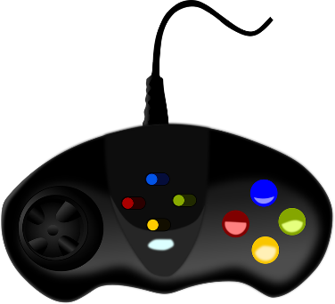
eu
jeudi
lieu
[place]
deux
feu
jeu
un peu
[a little]
Stephen Owen / Rachel Hawkes
Notes:
Introduce and elicit the pronunciation of the individual SSC ‘EU’ and then the source word ‘deux’ again (with gesture, if using). Then present and elicit the pronunciation of the five cluster words. The cluster words have been chosen for their high-frequency, from a range of word classes, with the SSC (where possible) positioned within a variety of syllables within the words(e.g. initial, 2nd, final etc..) and additionally, we have tried to use words that build cumulatively on previously taught SSCs (see the Phonics Teaching Sequence document) and do not include new SSCs. Where new SSCs are used, they are often consonants which have a similar symbol-sound correspondence in English.
Word frequency rankings (1 is the most common word in French): jeudi[1112]; lieu [117] feu [786]; un peu [138/91]; jeu [291]; deux [41]. Source: Londsale, D., & Le Bras, Y. (2009). A Frequency Dictionary of French: Core vocabulary for learners London: Routledge.

Slide 11
eu
jeudi
lieu
deux
feu
jeu
un peu
Stephen Owen / Rachel Hawkes
Notes:
Introduce and elicit the pronunciation of the individual SSC ‘EU’ and then the source word ‘deux’ again (with gesture, if using). Then present and elicit the pronunciation of the five cluster words. The cluster words have been chosen for their high-frequency, from a range of word classes, with the SSC (where possible) positioned within a variety of syllables within the words(e.g. initial, 2nd, final etc..) and additionally, we have tried to use words that build cumulatively on previously taught SSCs (see the Phonics Teaching Sequence document) and do not include new SSCs. Where new SSCs are used, they are often consonants which have a similar symbol-sound correspondence in English.
Word frequency rankings (1 is the most common word in French): jeudi[1112]; lieu [117] feu [786]; un peu [138/91]; jeu [291]; deux [41]. Source: Londsale, D., & Le Bras, Y. (2009). A Frequency Dictionary of French: Core vocabulary for learners London: Routledge.

Slide 12
eu
jeudi
lieu
deux
feu
jeu
un peu
Stephen Owen / Rachel Hawkes
Notes:
No audio

