Slide 1
Distinguishing between having and being
être & avoir (je, tu, il/elle)
feminisation of agent nouns and job titles (-e)
[SFe]
Y7 French
Term 1.1 - Week 5 - Lesson 9
Stephen Owen / Kirsten Somerville / Catherine Morris
Artwork by: Chloé Motard
Date updated: 28/07/21
Notes:
Learning outcomes (lesson 1):
Introduction of SSC [SFe]
Introduction of feminisation of agent nouns and job titles (-e)
Consolidaton of être and avoir (je, tu, il/elle)
Word frequency (1 is the most frequent word in French):
Introduce: il² [13], elle² [38], ami [467], amie [467], chanteur [3251], chanteuse [3251], femme [154], homme [136], professeur [1150], professeure [1150], drôle [2166], intéressant [1244], faux [555], sympa(thique) [4164], vrai [292]
Revisit: est [5], il [13], elle [38], amusant [4695], calme [1731], content [1841], excellent [1225], intelligent [2509], malade [1066], méchant [3184], triste [1843], mais [30], ou [33], merci [1070]
Source: Londsale, D., & Le Bras, Y. (2009). A Frequency Dictionary of French: Core vocabulary for learners London: Routledge.

Slide 2
SFE
Silent final -e
[shy]
timide
Notes:
Timing: 1 minute
Aim: To introduce SSC [SFE]
Procedure: 1. Present the letter(s) and say the [SFE] sound first, on its own. Students repeat it with you. 2. Bring up the word ”timide” on its own, say it, students repeat it, so that they have the opportunity to focus all of their attention on the connection between the written word and its sound.
3. A possible gesture for this would be to cower and cover one’s face slightly, simulating shyness. 4. Roll back the animations and work through 1-3 again, but this time, dropping your voice completely to listen carefully to the students saying the [SFE] sound, pronouncing ”timide” and, if using, doing the gesture.
Word frequency (1 is the most frequent word in French):
timide [3835]
Source: Londsale, D., & Le Bras, Y. (2009). A Frequency Dictionary of French: Core vocabulary for learners London: Routledge.

Slide 3
SFE
Silent final -e
timide
Notes:
With sound and no pictures to focus all attention on the sound-symbol correspondence.

Slide 4
SFE
Silent final -e
[shy]
timide
Notes:
Without sound to elicit pronunciation (without first hearing the teacher).
Teacher to elicit pronunciation by asking “Comment dit-on …"

Slide 5
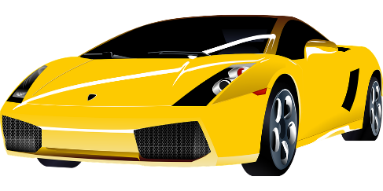
SFE
monde
moderne
[silent final –e]
[shy]
centre
timide
douze
vie
[life]
Notes:
Timing: 2 minutes
Aim: To introduce SSC [SFE]
Procedure:
1. Introduce and elicit the pronunciation of the individual SSC [SFE] and then the source word again ‘timide’ (with gesture, if using). 2. Then present and elicit the pronunciation of the five cluster words.
The cluster words have been chosen for their high-frequency, from a range of word classes, with the SSC (where possible) positioned within a variety of syllables within the words (e.g. initial, 2nd, final etc.). Additionally, we have tried to use words that build cumulatively on previously taught SSCs (see the Phonics Teaching Sequence document) and do not include new SSCs. Where new SSCs are used, they are often consonants which have a similar symbol-sound correspondence in English.
Word frequency (1 is the most frequent word in French): monde [77]; moderne [1239] centre [491]; vie [132]; douze [1664]; timide [3835]. Source: Londsale, D., & Le Bras, Y. (2009). A Frequency Dictionary of French: Core vocabulary for learners London: Routledge.

Slide 6
SFE
monde
moderne
[silent final –e]
[shy]
centre
timide
douze
vie
Notes:
With sound and no pictures to focus all attention on the sound-symbol correspondence.

Slide 7
SFE
monde
moderne
[silent final –e]
[shy]
centre
timide
douze
vie
Notes:
Without sound to elicit pronunciation (without first hearing the teacher).
Teacher to elicit pronunciation by asking “Comment dit-on …"

Slide 8
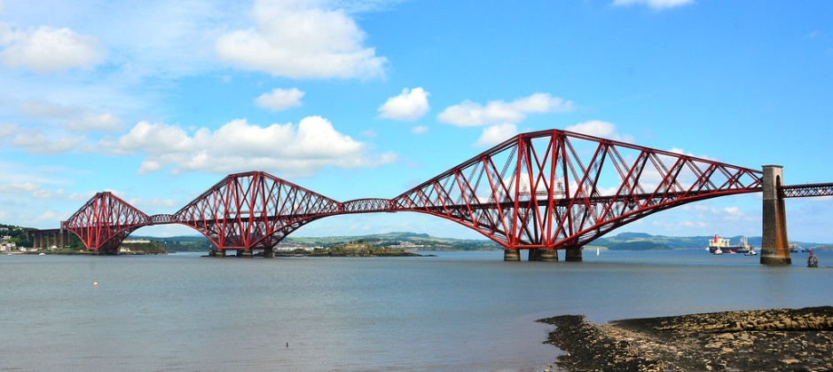
Phonétique
écouter
C’est la SSC [SFe] ?
[lawn]
[bridge]
pelouse
pont
Notes:
Timing: 3 minutes for 6 slides
Aim: aural recognition of SSC [SFe]
Procedure:
1. Click the words to play the audio.
2. Students choose which word has an SFe.
Word frequency (1 is the most frequent word in French): pelouse [>5000], pont [1889]
Source: Londsale, D., & Le Bras, Y. (2009). A Frequency Dictionary of French: Core vocabulary for learners London: Routledge.

Slide 9
Phonétique
écouter
C’est la SSC [SFe] ?
[cooking]
[wolf]
cuisine
loup
Notes:
Word frequency (1 is the most frequent word in French): cuisine [2618], loup [3927]
Source: Londsale, D., & Le Bras, Y. (2009). A Frequency Dictionary of French: Core vocabulary for learners London: Routledge.

Slide 10
Phonétique
écouter
C’est la SSC [SFe] ?
froid
[cold]
trente
Notes:
Word frequency (1 is the most frequent word in French): trente [1646], froid [1307]
Source: Londsale, D., & Le Bras, Y. (2009). A Frequency Dictionary of French: Core vocabulary for learners London: Routledge.

Slide 11
Phonétique
écouter
C’est la SSC [SFe] ?
[hand]
[shy]
main
timide
Notes:
Word frequency (1 is the most frequent word in French): main [418], timide [3835]
Source: Londsale, D., & Le Bras, Y. (2009). A Frequency Dictionary of French: Core vocabulary for learners London: Routledge.

Slide 12
Phonétique
écouter
C’est la SSC [SFe] ?
riz
soupe
Notes:
Word frequency (1 is the most frequent word in French): riz [>5000], soupe [4563]
Source: Londsale, D., & Le Bras, Y. (2009). A Frequency Dictionary of French: Core vocabulary for learners London: Routledge.

Slide 13
Phonétique
écouter
C’est la SSC [SFe] ?
[dawn]
prix
[prize]
aube
Notes:
Word frequency (1 is the most frequent word in French): aube [2728], prix [310]
Source: Londsale, D., & Le Bras, Y. (2009). A Frequency Dictionary of French: Core vocabulary for learners London: Routledge.

Slide 14
Phonétique
parler
pilote
45
malade
lettre
texte
belle
Secondes
coupe
beautiful (f)
phrase
trophy
capable
usine
0
DÉBUT
factory
Notes:
Timing: 1 minute
Aim: oral production of SSC [SFe]
Procedure:
1. Individually pupils read out the words but in alphabetical order. They keep going for one minute.
2. Teacher can circulate to listen into their SSC knowledge.
3. Click on words to check pronunciation. Students repeat.
4. Clarify meanings of cognate words.
Word frequency (1 is the most frequent word in French): rapide [672], portable [4002], elle [38], triste [1843], prime [2094], coupe [2925], phrase [2074], belle [393]
Source: Londsale, D., & Le Bras, Y. (2009). A Frequency Dictionary of French: Core vocabulary for learners London: Routledge.

Slide 15
Vocabulaire
lire
French
English
un professeur
a teacher
un chanteur
a singer
article + noun
(or determiner + noun)
un ami
a friend
un homme
a man
une femme
a woman
drôle
funny
intéressant
interesting
adjective
sympa(thique)
nice, pleasant
vrai
true
faux
false
Notes:
Timing: 5 minutes
Aim: written comprehension of the vocabulary introduced this week
Procedure:
1. Class repetition of the French modelled by the teacher, each French word followed by the teacher showing the written English equivalent.
2. Animations illustrate the articles (or determiners), plus nouns, and the adjectives.
3. French to English practice. This should provide lots of opportunities to hear and read the French. Some practice will use this slide i.e., providing the written form. Animations are provided in the slide for this. Critically, however, some practice should be AURAL INPUT only: teacher says the French, and the students either say or write down the English – the students do not see the French written at all – this allows them to practise relying on just the aural input.
4. (See next slide for animations for English to French practice)
Word frequency (1 is the most frequent word in French): ami [467] chanteur [3251], femme [154], homme [136], professeur [1150], drôle [2166], intéressant [1244], faux [555], sympa(thique) [4164], vrai [292]
Source: Londsale, D., & Le Bras, Y. (2009). A Frequency Dictionary of French: Core vocabulary for learners London: Routledge.

Slide 16
Vocabulaire
écrire
A
B
C
D
E
[funny, strange]
[interesting]
[true]
F
G
H
I
J
[friend]
[nice, pleasant]
[false]
Notes:
Timing: 5 minutes
Aim: written production of the vocabulary introduced this week
Procedure:
1. Write A-J in books.
2. Click or press enter to flash a picture. It will disappear after 3 seconds. Note that the pictures do not appear in alphabetical order to increase the challenge.
3. Write down the French word before the picture has faded away.
4. Ensure that gender/definite articles are known for any words that are nouns.
Answers:
A. drôle
B. un chanteur
C. une femme
D. intéressant
E. vrai
F. un ami
G. un professeur
H. sympa(thique)
I. faux
J. un homme
Word frequency (1 is the most frequent word in French): ami [467] chanteur [3251], femme [154], homme [136], professeur [1150], drôle [2166], intéressant [1244], faux [555], sympa(thique) [4164], vrai [292]
Source: Londsale, D., & Le Bras, Y. (2009). A Frequency Dictionary of French: Core vocabulary for learners London: Routledge.

Slide 17
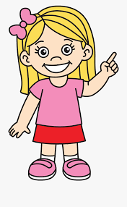
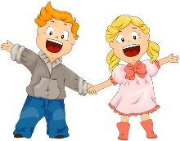
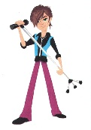
Feminine noun forms
grammaire
We know that we add an ‘e’ to an adjective when it refers to a feminine noun:
Il est anglais.
Elle est anglaise.
We can also add an ‘e’ to some nouns when they refer to a female person:
un ami
une amie
Chanteur is an exception – we also replace the ‘r’ with an ‘s’ before adding the ‘e’.
un professeur
un chanteur
une professeure
une chanteuse
The pronunciation stays the same – Silent Final e !
The word for ‘a’ also changes
Notes:
Timing: 2 minutes
Aim: introducing the feminisation of agent nouns by adding ‘e’

Slide 18
C’est qui ?
lire
C’est un homme ou une femme ? Tick the appropriate column for each.
 |  | un homme | une femme
1 | un professeur
2 | une chanteuse
3 | une amie
4 | un chanteur
5 | une professeure
6 | un ami
___
___
___
___
___
___
Notes:
Timing: 3 minutes
Aim: written recognition of masculine and feminine forms of agent nouns
Procedure:
1. Students write 1-6 and choose ‘un homme’ or ‘une femme’ for each.
2. Click to reveal the answers. The correct article appears with the answer.

Slide 19
Having and being
grammaire
Remember, to talk about having something, use the verb avoir.
avoir to have/having
e.g. il a he has
elle a she has
Remember, to talk about being something, use the verb être..
être to be/being
e.g. il est he is
elle est she is
Elle a un chien. She has a dog.
Elle est grande. She is tall.
Notes:
Timing: 3 minutes
Aim: re-cap of the use of être and avoir, which have both previously been introduced and practised (in the 1st, 2nd and 3rd person singular)
Procedure:
1. This slide should be read out, so that learners are reminded that the ‘il’ and ‘elle’ forms (within each verb) are the same form – they should practise imitating these sounds (il est, elle est).

Slide 20
Having and being
lire
Avoir ou être ? Tick the appropriate
column for each. Then translate into English.
 |  | having | being
1 | J’ai une professeur excellente.
English:
2 | Il est chanteur.
English:
3 | Elle a une amie sympathique.
English:
4 | Tu as un ami amusant ?
English:
I have an excellent teacher.
He is a singer.
She has a nice friend.
Do you have a funny friend?
Notes:
Timing: 5 minutes for 2 slides
Aim: written recognition of forms of avoir and être in all three persons (singular)
Procedure:
1. Students should first tick the appropriate column, then provide the English translation of each sentence, to ensure that they engage with the vocabulary as well as the grammar.

Slide 21
Having and being
lire
Avoir ou être ? Tick the appropriate
column for each. Then translate into English.
 |  | having | being
5 | Je suis triste.
English:
6 | Il a un ami drôle.
English:
7 | Tu es intelligent.
English:
8 | Elle est calme.
English:
I am sad.
He has a funny friend.
You are intelligent.
She is quiet.
Notes:
This slide is the continuation of the activity on the previous slide.

Slide 22
Having and being
lire
 |  | Being (être) or having (avoir)? | Normal ou bizarre ?
1 | J’ai un chien.
2 | Je suis un chien.
3 | Elle est un portable.
4 | Tu es malade.
5 | Elle a un portable.
6 | Tu as un professeur.
7 | Il est méchant.
8 | Il a un ordinateur.
Être ou avoir ? Do you think these sentences are ‘normal’ or ‘strange’ (bizarre)?
having
normal
being
bizarre
being
bizarre
being
normal
having
normal
having
normal
being
normal
having
normal
Notes:
Timing: 5 minutes
Aim: written recognition of forms of avoir and être in all three persons (singular), and connecting them to meaning in context
Procedure:
1. Students first choose if the sentence signifies ‘having’ or ‘being’.
2. The second column is to ensure that students understand the whole sentence including the noun or adjective, but also reinforces the importance of grammar. ‘Normal’ and ‘bizarre’ might sometimes both seem possible – there are no necessarily right or wrong answers for the final column (for example, in a ‘cartoon’ world, the world of children’s TV (think Beauty and the Beast!), it might well be possible for a character to say ‘She is a mobile phone!’ or ‘I am a cat’.) You could explain to the class: the grammar tells us the meaning – not guess work by just using the nouns! Grammar determines meaning - not guess work about 'what might be likely in the real world’.

Slide 23
Having and being
écouter
Avoir ou être ? Write the English sentence in the correct column.
 | having | being
1
He is a nice teacher.
2
He has an interesting teacher.
3
She has a funny friend.
4
I am French.
5
Do you have an English friend ?
6
She is a nice woman.
Notes:
Timing: 5 minutes
Aim: aural recognition of forms of avoir and être in all three persons (singular), and connecting them to meaning in context
Procedure:
1. Before the task begins, explain to learners that ‘C’est’ is used with people as well as things, when saying who/what they are. ‘C’est’ (a contraction of ‘ce est’) literally means ‘this is’, but when referring to people can be taken to mean ‘s/he is’.
2. Each item could be played twice, to break it down for the students.
3. The first time, learners could just put a tick in the correct column (having or being).
4. On the second hearing of each item, learners could then provide the oral translation.
Transcript
1) C’est un professeur sympathique.
2) Il a un professeur intéressant.
3) Elle a une amie drôle.
4) Je suis française.
5) Tu as un ami anglais ?
6) C’est une femme sympathique.

Slide 24
Having and being
Parler / écrire
Say the sentences in French. Then write them down.
 | English | French
1
He is a nice teacher.
C’est (Il est) un professeur sympathique.
2
Il a un professeur intéressant.
He has an interesting teacher.
3
Elle a une amie drôle.
She has a funny friend.
4
I am French.
Je suis française.
5
Tu as un ami anglais ?
Do you have an English friend?
6
C’est (Elle est) une femme sympathique.
She is a nice woman.
Notes:
Timing: 10 minutes
Aim: oral production of forms of avoir and être in all three persons (singular), and connecting them to meaning in context
Procedure:
1. Learners are now challenged to retranslate the sentences into French, listening to the audio again if necessary.
2. This can be done orally, then in writing.
Transcript
1) C’est un professeur sympathique*
2) Il a un professeur intéressant.
3) Elle a une amie drôle.
4) Je suis française.
5) Tu as un ami anglais ?
6) C’est une femme sympathique.*
* Accept ‘Il est...’ in place of ‘C’est...’ in (1) and ‘Elle est...’ in place of ‘C’est...’ in (2).

Slide 25
Distinguishing between having and being
subject pronoun ‘it’
[é / -er / -ez]
Y7 French
Term 1.1 - Week 5 - Lesson 10
Stephen Owen / Catherine Morris / Kirsten Somerville
Artwork by: Chloé Motard
Date updated: 06/11/21
Notes:
Learning outcomes (lesson 2):
Introduction of SSC [é / -er / -ez]
Consolidation of indefinite articles
Introduction of subject pronoun ‘it’
Word frequency (1 is the most frequent word in French):
1.1.5 (introduce) il² [13], elle² [38], ami [467], amie [467], chanteur [3251], chanteuse [3251], femme [154], homme [136], professeur [1150], professeure [1150], drôle [2166], intéressant [1244], faux [555], sympa(thique) [4164], vrai [292]
1.1.2 (revisit) est [5], il [13], elle [38], amusant [4695], calme [1731], content [1841], excellent [1225], intelligent [2509], malade [1066], méchant [3184], triste [1843], mais [30], ou [33], merci [1070]
Source: Londsale, D., & Le Bras, Y. (2009). A Frequency Dictionary of French: Core vocabulary for learners London: Routledge.

Slide 26
é/-er/-ez
écrire
Notes:
Timing: 1 minute
Aim: To introduce SSC [é]
Procedure: 1. Present the letter(s) and say the [é] sound first, on its own. Students repeat it with you. 2. Bring up the word ”écrire” on its own, say it, students repeat it, so that they have the opportunity to focus all of their attention on the connection between the written word and its sound.
3. A possible gesture for this would be to mime the act of writing (onto the palm of the other hand perhaps). 4. Roll back the animations and work through 1-3 again, but this time, dropping your voice completely to listen carefully to the students saying the [é] sound, pronouncing ”écrire” and, if using, doing the gesture.
Word frequency (1 is the most frequent word in French):
écrire [382] Source: Londsale, D., & Le Bras, Y. (2009). A Frequency Dictionary of French: Core vocabulary for learners London: Routledge.

Slide 27
é/-er/-ez
écrire
Notes:
With sound and no pictures to focus all attention on the sound-symbol correspondence.

Slide 28
é/-er/-ez
écrire
Notes:
Without sound to elicit pronunciation (without first hearing the teacher).
Teacher to elicit pronunciation by asking “Comment dit-on …"

Slide 29
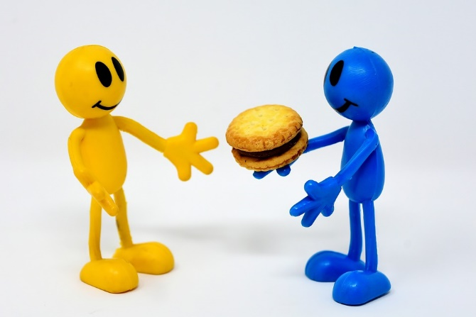
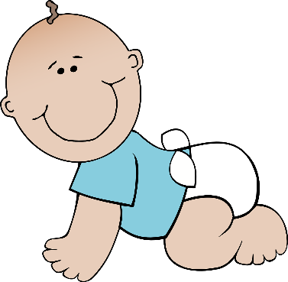
é/-er/-ez
bébé
donner
nez
parler
écrire
aller
[to go]
Notes:
Timing: 2 minutes
Aim: To introduce SSC [é]
Procedure:
1. Introduce and elicit the pronunciation of the individual SSC [é] and then the source word again ‘écrire’ (with gesture, if using). 2. Then present and elicit the pronunciation of the five cluster words.
The cluster words have been chosen for their high-frequency, from a range of word classes, with the SSC (where possible) positioned within a variety of syllables within the words (e.g. initial, 2nd, final etc.). Additionally, we have tried to use words that build cumulatively on previously taught SSCs (see the Phonics Teaching Sequence document) and do not include new SSCs. Where new SSCs are used, they are often consonants which have a similar symbol-sound correspondence in English.
Word frequency (1 is the most frequent word in French): écrire [382]; bébé [>5000]; aller [55] donner [46]; nez [2661]; parler [106]. Source: Londsale, D., & Le Bras, Y. (2009). A Frequency Dictionary of French: Core vocabulary for learners London: Routledge.

Slide 30
é/-er-ez
donner
bébé
nez
parler
écrire
aller
Notes:
With sound and no pictures to focus all attention on the sound-symbol correspondence.

Slide 31
é/-er/-ez
donner
bébé
nez
parler
écrire
aller
Notes:
Without sound to elicit pronunciation (without first hearing the teacher).
Teacher to elicit pronunciation by asking “Comment dit-on …"

Slide 32
Phonétique
écouter
In which order do you hear the words? Write 1 or 2.
[SFe]
[é / -er / -ez]
__ vole (I fly)
__ volez (you fly)
1
2
a
__ porte (door)
__ porter (to wear)
2
1
b
__ marche (step)
__ marché (market)
2
1
c
__ ferme (farm)
__ fermer (to close)
d
1
2
__ tourne (spins)
__ tournée (tour)
e
1
2
Notes:
Timing: 4 minutes
Aim: aural recognition of SSCs [SFe] and [é / -er / -et]
Procedure:
1. Click the letters to play the audio.
2. Students write ‘1’ beside the first word they hear, and ‘2’ beside the second
3. Click to reveal the answers.

Slide 33
Phonétique
assez
parler
papier
quite
60
voler
réalité
bébé
to fly
Secondes
éviter
médias
to avoid
médical
février
0
DÉBUT
February
Notes:
Timing: 1 minute
Aim: oral production of SSC [é / -er / -ez]
Procedure:
1. Students say the words alternately out loud with a partner, building up speed, over 1 minute’s intensive practice. They call in any order they like, students are not allowed to repeat the one they said in their last turn.
2. Teacher can circulate to listen into their SSC knowledge.
3. Click on début to start a one-minute timer on the screen.
4. Click on the words to hear them said by a native speaker. Students repeat.
Word frequency (1 is the most frequent word in French): assez [321], papier [951], réalité [532], bébé [2271], voler [1610], médical [1566], médias [1585], éviter [396], février [1136]
Source: Londsale, D., & Le Bras, Y. (2009). A Frequency Dictionary of French: Core vocabulary for learners London: Routledge.

Slide 34
Phonétique
assez
parler
papier
quite
60
voler
réalité
bébé
to fly
Secondes
éviter
médias
to avoid
médical
février
0
DÉBUT
February
Notes:
Timing: 1 minute
Aim: oral production of SSC [é / -er / -ez]
Procedure:
1. Individually, students read out the words but in alphabetical order. They keep going for one minute.
2. Teacher can circulate to listen into their SSC knowledge.
Word frequency (1 is the most frequent word in French): assez [321], papier [951], réalité [532], bébé [2271], voler [1610], médical [1566], médias [1585], éviter [396], février [1136]
Source: Londsale, D., & Le Bras, Y. (2009). A Frequency Dictionary of French: Core vocabulary for learners London: Routledge.

Slide 35
C’est un / une
grammaire
Remember, to say “It is a... (It’s a...)” in French to introduce something, use c’est... plus the indefinite article un or une (a), according to the gender of the noun introduced:
e.g. C’est un livre. It’s a book. (masculine)
C’est une règle. It’s a ruler.
(feminine)
e.g. C’est un livre. It’s a book. (masculine)
C’est une règle. It’s a ruler.
(feminine)
liaison
Notes:
Timing: 3 minutes
Aim: revising two things introduced previously: the construction ‘c’est’, and the use of the indefinite article, taking account of the gender of nouns
The following slides provide some practice in applying these two things to vocabulary previously encountered, thereby also providing useful vocabulary revision.

Slide 36
C’est…
parler
un ordinateur
Notes:
Timing: 5 minutes for 8 slides
Aim: oral recall of previously taught vocabulary
Procedure:
1. This slide, along with the six slides which follow it, slowly reveal the image of one of the items of vocabulary just introduced.
2. Learners can be challenged to guess the item (in French) at the earliest opportunity, gaining more ‘points’, for example, the earlier they do so.
3. Encourage the pupils to say the full phrase “ c’est … un / une ..” each time, with liaison if possible.
4. The notes for each slide state the vocabulary item sought, e.g. (for this slide):
C’est un ordinateur.

Slide 37
C’est…
parler
une voiture
Notes:
C’est une voiture.

Slide 38
C’est…
parler
un vélo
Notes:
C’est un vélo.

Slide 39
C’est…
parler
une règle
Notes:
C’est une règle.

Slide 40
C’est…
parler
un portable
Notes:
C’est un portable.

Slide 41
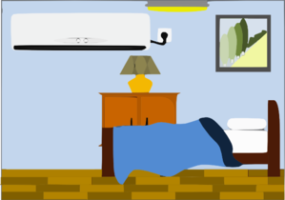
C’est…
parler
une chambre
Notes:
C’est une chambre.

Slide 42
C’est…
parler
un chien
Notes:
C’est un chien.

Slide 43
C’est…
parler
un livre
Notes:
C’est un livre.

Slide 44
Vocabulaire
Say what is on your card.
Write in ENGLISH what your partner
says. Take turns to speak
parler
Partner’s
card?
Partner’s
card?
C’est un/une
C’est un/une
a |  |  | e
b |  |  | f
c |  |  | g
d |  |  | h
Notes:
Timing: 10 minutes
Aim: aural comprehension and production of previously taught vocabulary
Procedure:
1. Learners practise using the previously introduced construction “C’est...”, plus the indefinite article and noun, to describe to a partner what is pictured on their card.
2. They have to listen and write the English for what their partner tells them is on their card.
3. Letters, rather than numbers, are used to designate the items, since in the scheme of work Notes we have the alphabet presented in Week 4. Learners are also likely to have encountered the alphabet in primary school, if they have studied French in KS1 or KS2. Letters a-h could be practised prior to this activity.

Slide 45
Vocabulaire
Say what is on your card.
Write in ENGLISH what your partner
says. Take turns to speak
parler
Partner’s
card?
Partner’s
card?
C’est un/une
C’est un/une
a |  |  | e
b |  |  | f
c |  |  | g
d |  |  | h
Notes:
This is Partner B’s card. Explanatory notes are on previous slide.

Slide 46
Challenge
écrire
Écrire!
Now write a sentence in FRENCH for every item on your card for the speaking task, e.g., Partner A – (a) C’est un chien. Partner B – (a) C’est un portable. Compare what you have written with your partner.
Notes:
Timing: 10 minutes
Aim: written production of previously taught vocabulary
Procedure:
1. This task challenges learners to produce the language needed for the speaking task on the previous slides in written form.
2. They could annotate their card (if printed) for the speaking task; alternatively, they could write the sentences in their exercise books.

Slide 47
Saying ‘it’ in French
grammaire
As you know, to say ‘he’ / ‘she’ in French, we use il / elle (referring to a person):
Amir a un portable. → Il a un portable. Léa a une règle. → Elle a une règle.
We also use il / elle to mean ‘it’ (referring to a thing).
We use il for masculine nouns and elle for feminine nouns:
Le portable est cher. → Il est cher. La règle est petite. → Elle est petite.
Notes:
Timing: 3 minutes
Aim: introducing the use of il / elle to mean ‘it’ with masculine / feminine nouns

Slide 48
What is ‘it’ ?
lire
The word ‘it’ is a pronoun. This means it replaces a noun:
 |  |  | what is ‘it’ ?
1 | A computer is modern. | It is modern. | a computer
2 | A car is expensive. | It is expensive. | a car
3 | A bike is fast. | It is fast. | a bike
4 | A bedroom is quiet. | It is quiet. | a bedroom
In English, there is only one word for ‘it’, no matter what noun it replaces.
In French, we need to know the gender of the noun that the pronoun replaces:
 |  |  | what is ‘it’ ?
1 | Un ordinateur est moderne. | Il est moderne. | un ordinateur
2 | Une voiture est chère. | Elle est chère. | une voiture
3 | Un vélo est rapide. | Il est rapide. | un vélo
4 | Une chambre est calme. | Elle est calme. | une chambre
In French, the word for ‘it’ changes if the noun it replaces is masculine or feminine.
Notes:
Timing: 5 minutes
Aim: raising awareness that the word for ‘it’ in French varies depending on the noun it replaces, while in English it does not
Procedure:
1. Students identify the noun that ‘it’ replaces in each of the English sentences.
2. Do the same for the French sentences.
3. Teacher highlights the difference between the two languages and emphasises the need to think about the gender of the noun being replaced in French.

Slide 49
Il ou elle ?
lire
Amir is describing some of his things. What is he talking about? Write a or b.
 |  | a | b
1 | Elle est calme.
2 | Il est triste.
3 | Il est moderne.
 |  | a | b
4 | Elle est rapide.
5 | Il est drôle.
6 | Elle est sympa.
Notes:
Timing: 5 minutes
Aim: written recognition of gender agreement with il(s) / elle(s) meaning ‘it’ / ‘they’
Procedure:
1. Teacher to check students know the gender of nouns before students do the task.
2. Write 1-8 and choose if the pronoun refers to the noun in picture ‘a’ or ‘b’.
3. Click to reveal the answers.

Slide 50
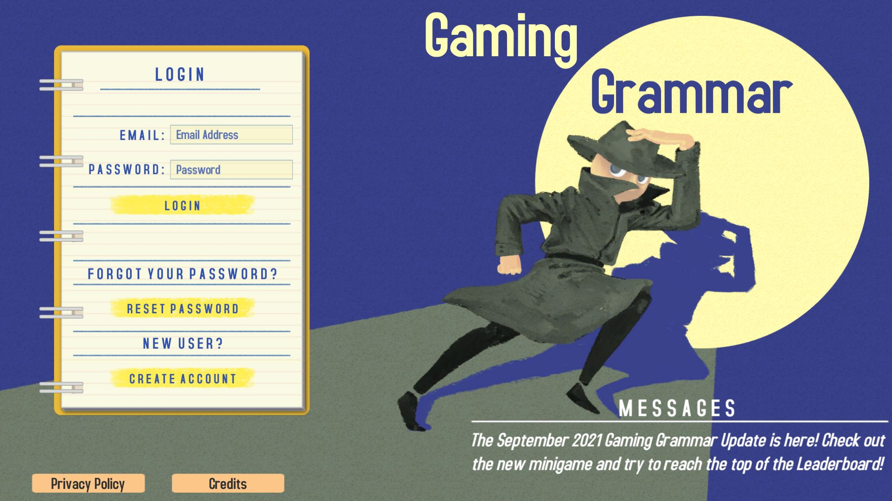
Gaming Grammar
Gaming Grammar
Relevant mini game(s):
Indefinite articles: Gender (Article Agreement)
To have and to be: 1st person and 3rd person singular
Notes:
This slide links to Gaming Grammar login screen. The appropriate mission can then be selected from the menu page.
Students will progress through the game at their own rate; teachers should use the teacher interface to check progress. This will help to inform future lesson planning.

Slide 51
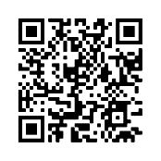
Devoirs
Vocabulary Learning Homework (Term 1.1, Week 6)
Audio file
Audio file QR code:
Student worksheet
Quizlet link
In addition, revisit: Term 1.1 Week 3

