Slide 1
Describing a thing or a person [1]
être (je, tu)
[SFC]
Y7 French
Term 1.1 - Week 1 - Lesson 1
Rachel Hawkes/Victoria Hobson/Jack Peacock
Artwork by: Chloé Motard
Date updated: 02/02/2023
Notes:
Learning outcomes (lesson 1):
Introduction of SSC [SFC]
Introduction of first and second person singular forms of être
Word frequency (1 is the most frequent word in French):
1.1.1 (introduce) être [5], es [5], suis [5], lire [278], écrire [382], écouter [429], parler [429], je [22], tu [112], anglais¹ [784], anglaise¹ [784], français¹ [251], française¹ [251], grand [59], petit [138], grande [59], petite [138], et [6], au revoir [1274], bonjour [1972]
Source: Londsale, D., & Le Bras, Y. (2009). A Frequency Dictionary of French: Core vocabulary for learners London: Routledge.

Slide 2
SFC
Silent final consonant
dans
X
Notes:
Timing: 1 minute
Aim: To introduce SSC [SFC]
Explanation in English, if desired: Something that makes French sounds very different from English is that some consonants at the ends of words are silent. This means you don’t pronounce/sound them out at all. As in the word ‘dans’ in French.
Procedure: 1. Present the letter(s) and say the [SFC] sound first, on its own. Students repeat it with you. 2. Bring up the word ”dans” on its own, say it, students repeat it, so that they have the opportunity to focus all of their attention on the connection between the written word and its sound.
3. A possible gesture for this would be to hold ones finger to ones lips to indicate ‘Shhhh!’. 4. Roll back the animations and work through 1-3 again, but this time, dropping your voice completely to listen carefully to the students saying the [SFC] sound, pronouncing ”dans” and, if using, doing the gesture.
Word frequency (1 is the most frequent word in French):
dans [11] Source: Londsale, D., & Le Bras, Y. (2009). A Frequency Dictionary of French: Core vocabulary for learners London: Routledge.

Slide 3
SFC
Silent final consonant
dans
X
Notes:
With sound and no pictures to focus all attention on the sound-symbol correspondence.

Slide 4
SFC
Silent final consonant
dans
X
Notes:
Without sound to elicit pronunciation (without first hearing the teacher).
Teacher to elicit pronunciation by asking “Comment dit-on …"

Slide 5
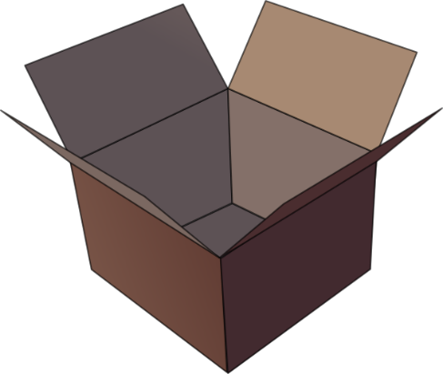
SFC
petit
prix
€15.95
grand
mot
dans
X
mais
[but]
Notes:
Timing: 2 minutes
Aim: To introduce SSC [SFC]
Procedure:
1. Introduce and elicit the pronunciation of the individual SSC [SFC] (in this case is SFC – silent final consonant so nothing to pronounce as an individual sound!) and then the source word again ‘dans’ (with gesture, if using). 2. Then present and elicit the pronunciation of the five cluster words.
The cluster words have been chosen for their high-frequency, from a range of word classes, with the SSC (where possible) positioned within a variety of syllables within the words (e.g. initial, 2nd, final etc.). Additionally, we have tried to use words that build cumulatively on previously taught SSCs (see the Phonics Teaching Sequence document) and do not include new SSCs. Where new SSCs are used, they are often consonants which have a similar symbol-sound correspondence in English.
Word frequency (1 is the most frequent word in French): dans [11]; petit [138] prix [310]; mot [220]; mais [30]; grand [59]. Source: Londsale, D., & Le Bras, Y. (2009). A Frequency Dictionary of French: Core vocabulary for learners London: Routledge.

Slide 6
SFC
petit
prix
grand
mot
dans
X
mais
Notes:
With sound and no pictures to focus all attention on the sound-symbol correspondence.

Slide 7
SFC
petit
prix
grand
mot
dans
X
mais
Notes:
Without sound to elicit pronunciation (without first hearing the teacher).
Teacher to elicit pronunciation by asking “Comment dit-on …"

Slide 8
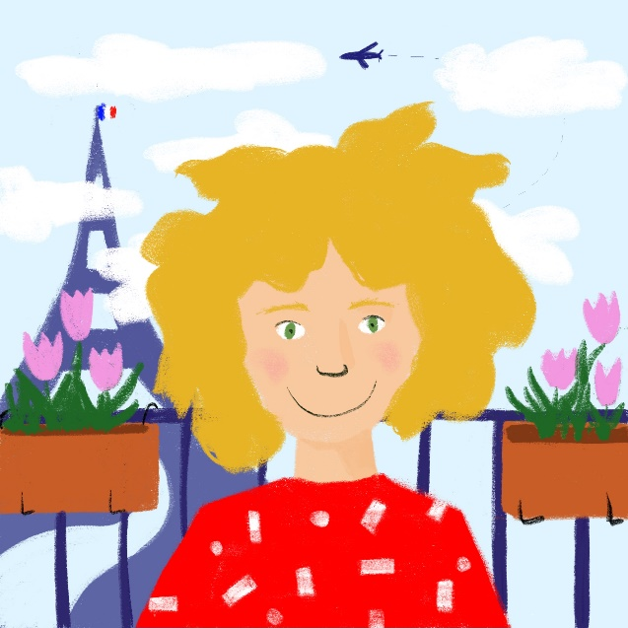
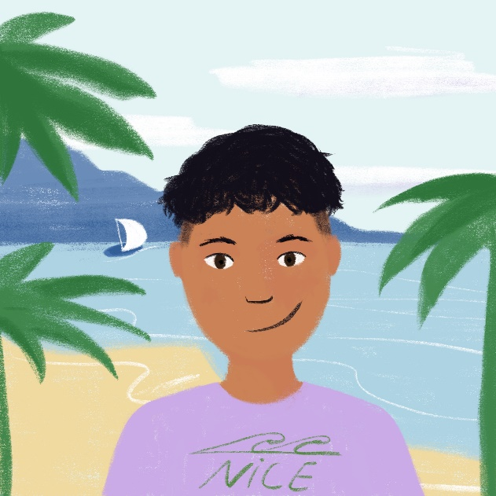
Bonjour!
The bubble tells you which skill you are practising.
écouter / parler
Bonjour !
[hello]
Je suis le cousin de Léa !
[I am the cousin
of Léa!]
Je suis française !
[I am French!]
Je suis français !
[I am French!]
The [s] is silent!
Léa (12), Paris
Amir (11), Nice
With Léa and Amir, you will learn four skills in French:
lire
[to read / reading]
écouter
[to listen / listening]
écrire
[to write / writing]
parler
[to speak / speaking]
Notes:
Timing: 3 minutes
Aim: To practise some of the new words on this week’s vocabulary list and introduce students to the layout of NCELP materials. To introduce the first topic of the lesson, explored further on the next slides (silent final consonant).
Procedure:
Click to bring up the word ‘bonjour’, which is one of the vocabulary items in this week’s pre-learning set.
Say ‘bonjour’. Students repeat.
Students say ‘bonjour’ to others in the class.
Click to bring up the phrase ‘je suis française.’ ‘Je suis’ and ‘française’ are in this week’s pre-learning set.
Say ‘je suis française.’ students repeat.
Click to bring up the phrase ‘Je suis le cousin de Léa !’ ‘le’, ‘cousin’ and ‘de’ are not part of this week’s vocabulary set, but students can see the direct correspondence with the English gloss.
Click to bring up the phrase ‘je suis française.’ ‘Je suis’ and ‘française’ are in this week’s pre-learning set. Draw attention to the differing pronunciation in the masculine and feminine form.
Say ‘je suis français.’ students repeat.
On clicks, the four modalities appear. Students listen to the pronunciation and repeat.
On a click, the info bubble appears, explaining the purpose of the bubble in the top right of the screen, which shows the mode/modality.
On a final click, a bubble appears to highlight the silent [s] at the end of français. This provides an introduction to the concept of silent final consonants in French, which will be explored more in the slides that follow.
Word frequency of unknown vocabulary used (1 is the most frequent word in French): le [2], cousin [>5000], de [3]
Source: Londsale, D., & Le Bras, Y. (2009). A Frequency Dictionary of French: Core vocabulary for learners London: Routledge.

Slide 9
… except for
c r f l
Be c a r e f u l with these!

Slide 10
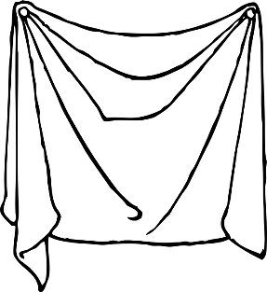
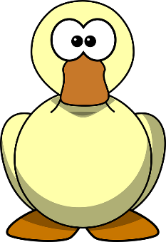
Phonétique (1/3)
lire / parler
drap
d’accord
vert
20
[sheet]
[okay]
[green]
secondes
canard
loup
bras
[wolf]
0
DÉBUT
Notes:
Timing: 3 minutes for 3 slides
NB: A more challenging version of this activity, which does not have the SSC scored out, can be found on slides 12-14.
Aim: To correctly pronounce unknown words containing [SFC] in decreasing amounts of time, helping automisation of SSC production. The words chosen otherwise contain sounds that are equivalent (or very similar) to English SSCs, so that students can focus fully on the [SFC] (allowances are made for English pronunciation of [r], which is covered in year 8).
Procedure:
1. Students pair up.
2. Teacher starts 20 second timer.
3. Student A tries to say the words without pronouncing the [SFC].
4. Student B makes speaker pause for 3 seconds every time an [SFC] is pronounced.
5. Complete before 20 seconds runs out.
6. Swap roles.
7. Click on the word to hear pronunciation by a native speaker. Students repeat.
7. Move onto the next slide.
Word frequency (1 is the most frequent word in French): drap [>5000], d’accord [736], vert [1060], canard [>5000], loup [3927], bras [1253]
Source: Londsale, D., & Le Bras, Y. (2009). A Frequency Dictionary of French: Core vocabulary for learners London: Routledge.

Slide 11
Phonétique (2/3)
lire / parler
drap
d’accord
vert
10
[sheet]
[okay]
[green]
secondes
canard
loup
bras
[wolf]
0
DÉBUT
Notes:
As per previous slide, but with the time halved.

Slide 12
Phonétique (3/3)
lire / parler
drap
d’accord
vert
5
[sheet]
[okay]
[green]
secondes
secondes
canard
loup
bras
[wolf]
0
DÉBUT
Notes:
As previous slide, but with the time halved again.

Slide 13
Phonétique (1/3)
lire / parler
drap
d’accord
vert
20
[sheet]
[okay]
[green]
loup
secondes
canard
bras
[wolf]
0
DÉBUT
Notes:
Timing: 3 minutes for 3 slides
NB: A less challenging version of this activity, which does has the SSC scored out, can be found on slides 9-11.
Aim: To correctly pronounce unknown words containing [SFC] in decreasing amounts of time, helping automisation of SSC production. The words chosen otherwise contain sounds that are equivalent (or very similar) to English SSCs, to that students can focus fully on the [SFC] (allowances are made for English pronunciation of [r], which is covered in year 8).
Procedure:
1. Students pair up.
2. Teacher starts 20 second timer.
3. Student A tries to say the words without pronouncing the [SFC].
4. Student B makes speaker pause for 3 seconds every time an [SFC] is pronounced.
5. Complete before 20 seconds runs out.
6. Swap roles.
7. Click on the loudspeaker icons to check pronunciation. Students repeat.
7. Move onto the next slide.
Word frequency (1 is the most frequent word in French): drap [>5000], d’accord [736], vert [1060], canard [>5000], estomac [>5000], bras [1253]
Source: Londsale, D., & Le Bras, Y. (2009). A Frequency Dictionary of French: Core vocabulary for learners London: Routledge.

Slide 14
Phonétique (2/3)
lire / parler
drap
d’accord
vert
10
[sheet]
[okay]
[green]
secondes
secondes
canard
loup
bras
[wolf]
0
DÉBUT
Notes:
As per previous slide, but with the time halved.

Slide 15
Phonétique (3/3)
lire / parler
drap
d’accord
vert
5
[sheet]
[okay]
[green]
secondes
canard
loup
bras
[wolf]
0
DÉBUT
Notes:
As previous slide, but with the time halved again.

Slide 16
Vocabulaire (1/2)
lire
je suis
I am
3
tu
you
to listen, listening
écouter
2
8
je
to be, being
I
1
être
5
tu es
to speak, speaking
you are
parler
4
9
lire
to read, reading
to write, writing
6
écrire
7
et
and
10
Notes:
Timing: 3 minutes
Aim: Recognition of the verbs, pronouns and conjunctions introduced this week.
Procedure:
1. Teacher pronounces word.
2. Students repeat.
3. Teacher asks for the meaning of the word.
4. Students reply with the English translation.

Slide 17
Vocabulaire (2/2)
parler
je suis
I am
3
tu
you
to listen, listening
écouter
2
8
je
to be, being
I
1
être
5
tu es
to speak, speaking
you are
parler
4
9
lire
to read, reading
to write, writing
6
écrire
7
et
and
10
Notes:
Timing: 3 minutes
Aim: Recall of the verbs, pronouns and conjunctions introduced this week.
Procedure:
1. Work through each term as a class (next word will pulsate).
2. Teacher asks for French word recall from class with the help of the English word.
3. Reveal French word.
4. Then elicit pronunciation from the class.

Slide 18
être
[to be | being]
es
[are]
Notes:
NB: audio recording in process. Teaching to read out the French words in the meantime.
Timing: 3 minutes for sequence of six verbs
Aim: to introduce the verb être more explicitly. Être is one of the 25 most frequently used verbs in French. All 25 most frequent verbs will be introduced early on using the same format. Both long form (infinitive) and short form (2nd person singular) are introduced in order to familiarise students with various forms of the same verb.
Procedure
Bring up the word être on its own, say it, students repeat it, and remind them of the phonics.
Try to elicit the meaning from the students.
Bring up the short form es, say it, students repeat it. Draw attention to SFC.
Try to elicit the meaning from the students.

Slide 19
être
[to be | being]
es
[are]
Notes:
Cycle through the long and short form again.

Slide 20
es
[are]
Tu es grand.
[You are tall.]
Notes:
Introduce the short form in a sentence.

Slide 21
être
[to be | being]
Tu aimes être grand.
[You like being tall.]
Notes:
Introduce the long form in a sentence.

Slide 22
es
[are]
Tu grand.
es
[You are tall.]
Notes:
Cycle through the short form in context again.

Slide 23
être
[to be | being]
être
Tu aimes grand.
[You like being tall.]
Notes:
Cycle through the long form in context again.

Slide 24
I am & you are
The verb être means ‘to be’. I am and you are are parts of the verb ‘to be’.
To say ‘I am’ in French, use je suis. This is called the first person singular form.
Je suis
Je suis français.
I am French.
Remember, don’t pronounce the ‘s’.
Silent Final Consonant!
Je suis petit.
I am short.
To say ‘you are’, use tu es. This is called the second person singular form.
Tu es
Tu es français.
You are French.
Tu es petit.
You are short.
Je (I) and tu (you) are pronouns. Pronouns tell you who a verb affects.
Notes:
Timing: 3 minutes
Aim: To teach students the written and spoken forms of the verb être in the first two persons singular.

Slide 25
Opposites attract – je/tu?
lire
You read interviews in which boys discuss their friendship. Look at the verb. Work out whether ‘I (je)…’ or ‘you (tu)...’ is being described. Then, write the English adjectives. Are the friends similar or different?
Interview 1 |  | Interview 2
1 | Tu es grand. | 5 | Je suis grand.
2 | Je suis petit. | 6 | Tu es petit.
3 | Je suis anglais. | 7 | Tu es français.
4 | Tu es français. | 8 | Je suis anglais.
Interview 1
Interview 2
short
tall
tall
short
I
You
I
You
English
French
English
French
Notes:
Timing: 7 minutes
Aim: practising written recognition of the first and second person singular forms of être
Procedure:
1. Write 1-8, ‘je’ or ‘tu’ and the English adjective.
2. Click to reveal the answers.
Teachers may want to mention to students that both friends are boys. So, the adjectives (grand, petit) match match the masculine noun (there is no ‘e’ on the end). Do not dwell on it as the students will do more practice on this soon.

Slide 26
Hit or miss – je/tu?
écouter
You are in a noisy café. You can only hear parts of the conversations. Listen carefully to the verb. Is the person describing themselves (‘I’…) or the person they are talking to (‘you…’)?
 | Tu es grand |  |  |  | Tu es cool
 | Je suis petit |  |  |  | Tu es calme
 | Je suis anglais |  |  |  | Je suis français
I
You
I
You
1
4
2
5
3
6
Notes:
Timing: 7 minutes
Aim: practising aural recognition of the first and second person singular forms of être
Procedure:
1. Click the numbers to play the audio.
2. Write 1-8 and ‘I’ or ‘you’.
3. Click to reveal the answers.
4. Full audio (including pronoun) can be found on the next slide so that students can hear complete French sentences.
Transcript:
[beep] es grand.
[beep] suis petit.
[beep] suis anglais.
[beep] es cool.
[beep] es calme.
[beep] suis français.
Word frequency of unknown cognates used (1 is the most frequent word in French): calme [1731], cool [>5000]
Source: Londsale, D., & Le Bras, Y. (2009). A Frequency Dictionary of French: Core vocabulary for learners London: Routledge.

Slide 27
Hit or miss – je/tu?
écouter
You are in a noisy café. You can only hear parts of the conversations. Listen carefully to the verb. Is the person is describing themselves (‘I’…) or the person they are talking to (‘you…’)?
 | Tu es grand |  |  |  | Tu es cool
 | Je suis petit |  |  |  | Tu es calme
 | Je suis anglais |  |  |  | Je suis français
I
You
I
You
1
4
2
5
3
6
Notes:
Answers to the previous exercise with full audio played on clicks.
Transcript [audio pending – teacher to read out in the meantime]
Tu es grand.
Je suis petit.
Je suis anglais.
Tu es cool.
Tu es calme.
Je suis français.
Word frequency of unknown cognates used (1 is the most frequent word in French): calme [1731], cool [>5000]
Source: Londsale, D., & Le Bras, Y. (2009). A Frequency Dictionary of French: Core vocabulary for learners London: Routledge.

Slide 28
Parler !
parler
Pick a pronoun (‘je’ or ‘tu’).
Pick an adjective.
Create a sentence.
Partner A
Remember, don’t pronounce the ‘s’
Silent Final Consonant!
“Tu es
français.”
Partner B
Translate into English
“You are French.”
Notes:
Timing: 7 minutes
Aim: practising oral production of the first and second person singular forms of être
Procedure:
1. Download and cut out the prompt cards (found on the portal alongside this resource).
2. Separate the cards into two piles – one pile of the pronoun pictures (‘I’ and ‘you’) and one pile of adjectives.
3. Partner A picks a pronoun (I or you) and then an adjective; partner B gives the translation.
4. Students then swap roles.
5. Pairs can time themselves, repeating the activity to see how quickly they can complete all the sentences and translations.
6. With each new game, different sentences will be generated.
Note: the students will be creating sentences as per the cards only, and so will not need the feminine form of the adjectives.
Note: The cards do not have to be printed, but they provide a model for the speaking activity. Students can easily be given one sheet of A4 white paper, fold it in half (lengthways), then again in half (widthways), then again in half (widthways), so that 8 equal-sized rectangular shapes are created. In 2 of them, they write ‘I’, in 2 others, they write ‘you’, then they write: tall, short, English, French once on each of the other 4. They tear (with or without use of a ruler, and certainly no scissors – it doesn’t need to be neat!). The first time students create their own flashcards takes about 5 mins, but they get quicker and quicker. It saves copying, cutting…

Slide 29
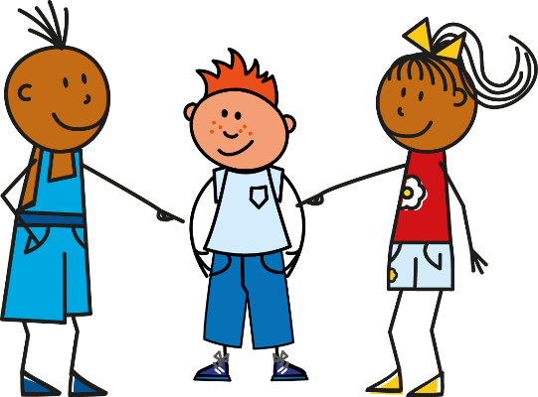
Écrire
écrire
Notes:
Timing: 6 minutes
Aim: practising written production of the first and second person singular forms of être
Procedure:
1. On mini whiteboards or paper, students write the sentence generated on each click of the powerpoint.
2. After each of the first few items, check that the students are writing je suis and tu es correctly.

Slide 30
Describing a thing or a person [1]
Regular adjective gender agreement (as complement to verb only)
[a]
Y7 French
Term 1.1 - Week 1 - Lesson 2
Victoria Hobson / Emma Marsden / Jack Peacock
Artwork by: Chloé Motard
Date updated: 02/02/2023
Notes:
Learning outcomes (lesson 2):
Consolidation of SSC [SFC], introduction of SSC [a]
Consolidation of first and second person singular forms of être
Introduction of regular adjective gender agreement
Word frequency (1 is the most frequent word in French):
7.1.1.1 (introduce) être [5], es [5], suis [5], lire [278], écrire [382], écouter [429], parler [429], je [22], tu [112], anglais¹ [784], anglaise¹ [784], français¹ [251], française¹ [251], grand [59], petit [138], grande [59], petite [138], et [6], au revoir [1274], bonjour [1972]
Source: Londsale, D., & Le Bras, Y. (2009). A Frequency Dictionary of French: Core vocabulary for learners London: Routledge.
The additional English meanings of the following words have been added to Quizlet since the creation of this resource: petit (short, small, little)

Slide 31
a
animal
Notes:
Timing: 1 minute
Aim: To introduce/consolidate SSC [a]
Procedure: 1. Present the letter(s) and say the [a] sound first, on its own. Students repeat it with you. 2. Bring up the word ”animal” on its own, say it, students repeat it, so that they have the opportunity to focus all of their attention on the connection between the written word and its sound.
3. A possible gesture for this would be to mimic an animal’s motion, perhaps holding ones arms and hands close to the chest as ‘paws’. 4. Roll back the animations and work through 1-3 again, but this time, dropping your voice completely to listen carefully to the students saying the [a] sound, pronouncing ”animal” and, if using, doing the gesture.
Word frequency (1 is the most frequent word in French):
animal [1002]
Source: Londsale, D., & Le Bras, Y. (2009). A Frequency Dictionary of French: Core vocabulary for learners London: Routledge.

Slide 32
a
animal
Notes:
With sound and no pictures to focus all attention on the sound-symbol correspondence.

Slide 33
a
animal
Notes:
Without sound to elicit pronunciation (without first hearing the teacher).
Teacher to elicit pronunciation by asking “Comment dit-on …"

Slide 34
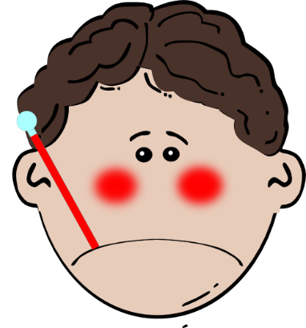
a
ça va ?
table
animal
malade
sac
mal
[badly]
Notes:
Timing: 2 minutes
Aim: To introduce/consolidate SSC [a]
Procedure:
1. Introduce and elicit the pronunciation of the individual SSC [a] and then the source word again ‘animal’ (with gesture, if using). 2. Then present and elicit the pronunciation of the five cluster words.
The cluster words have been chosen for their high-frequency, from a range of word classes, with the SSC (where possible) positioned within a variety of syllables within the words (e.g. initial, 2nd, final etc.). Additionally, we have tried to use words that build cumulatively on previously taught SSCs (see the Phonics Teaching Sequence document) and do not include new SSCs. Where new SSCs are used, they are often consonants which have a similar symbol-sound correspondence in English.
Word frequency (1 is the most frequent word in French): animal [1002]; ça va? [54 (cela), 53 (aller)]; malade [1066] mal [277]; table [1019]; sac [2343] Source: Londsale, D., & Le Bras, Y. (2009). A Frequency Dictionary of French: Core vocabulary for learners London: Routledge.

Slide 35
a
ça va ?
table
animal
malade
sac
mal
Notes:
With sound and no pictures to focus all attention on the sound-symbol correspondence.

Slide 36
a
ça va ?
table
animal
malade
sac
mal
Notes:
Without sound to elicit pronunciation (without first hearing the teacher).
Teacher to elicit pronunciation by asking “Comment dit-on …"

Slide 37
Phonétique
lire / parler
dame
rare
table
phase
trace
radio
place
favorable
grave
date
Notes:
Timing: 3 minutes
Aim: to practise production of SSC [a]
Procedure:
1. Students work in pairs, alternately saying one of the words and listening to spot errors in their partner’s pronunciation.
2. Students get one point for each correct French pronunciation of the SSC and lose a point if they say the English equivalent!
3. Click on the words to check pronunciation. Students repeat.
4. Go over the meaning of the words. These are all cognates or near-cognates, purposefully chosen for unlearning the connection between the SSC and the English sound. In some cases the words may have multiple meanings in English (e.g. grave) so these should be clarified. Students will find it rewarding in the first lesson to be able to recognise ten new words! Explain that lots of words are shared between the languages and they will encounter more of these across the year.
Word frequency (1 is the most frequent word in French): table [1019], rare [1233], dame [1983], radio [1526], phase [1754], trace [1848], place [129], favorable [1443], grave [443], date [660]
Source: Londsale, D., & Le Bras, Y. (2009). A Frequency Dictionary of French: Core vocabulary for learners London: Routledge.

Slide 38
Adjectives
grammaire
Adjectives are words which describe people or things.
In the dictionary, adjectives are listed in the masculine form. This is the form we use to describe a male person. We show that an adjective is masculine by putting an (m) after it.
Masculine
Je suis anglais.
I am English.
When an adjective describes a female person, its spelling and sound sometimes change. This new form is known as the feminine form. We show that an adjective is feminine by putting an (f) after it.
The most common change is to add an ‘e’ to the end of the adjective.
Feminine
Je suis anglaise.
I am English.
Notes:
Timing: 3 minutes
Aim: introducing regular adjective gender agreement.

Slide 39
Using adjectives
grammaire
Pronunciation can change when adding an ‘e’ to an adjective in feminine form.
Remember the rule: Silent Final Consonant
Masculine
Je suis anglais.
Silent final consonant.
An ‘e’ at the end, means you do pronounce the consonant.
The ‘s’ is not pronounced.
Feminine
Je suis anglaise.
The ‘s’ is pronounced.
The ‘e’ is not pronounced.
Notes:
Timing: 1 minute
Aim: introducing pronunciation changes with adjective agreement

Slide 40
Vocabulaire (1/2)
lire
français
French (m)
3
anglaise
English (f)
petite
short (f)
2
8
anglais
English (m)
grand
1
tall (m)
5
French (f)
française
hello
bonjour
4
9
grande
tall (f)
au revoir
short (m)
goodbye
6
petit
7
10
Notes:
Timing: 3 minutes
Aim: Recognition of the adjectives introduced this week.
Procedure:
1. Teacher pronounces word.
2. Students repeat.
3. Teacher asks for the meaning of the word.
4. Students reply with the English translation.

Slide 41
Vocabulaire (2/2)
parler
français
French (m)
3
anglaise
English (f)
petite
short (f)
2
8
anglais
English (m)
grand
1
tall (m)
5
French (f)
française
hello
bonjour
4
9
grande
tall (f)
au revoir
short (m)
goodbye
6
petit
7
10
Notes:
Timing: 3 minutes
Aim: Recall of the verbs, pronouns and conjunctions introduced this week.
Procedure:
1. Work through each term as a class (next word will pulsate).
2. Teacher asks for French word recall from class with the help of the English word.
3. Reveal French word.
4. Then elicit pronunciation from the class.

Slide 42
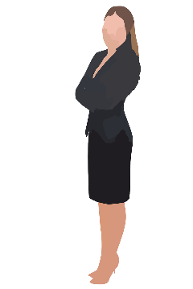
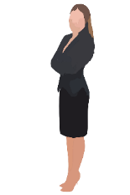
Vocabulaire
écouter
Listen to the masculine and feminine adjectives and choose the correct person.
1
française
E
A
B
C
D
2
grand
G
anglais
3
B
petite
4
C
anglaise
5
H
E
F
G
H
grande
6
A
français
7
D
petit
8
F
Notes:
Timing: 3 minutes
Aim: Aural recognition of eight adjective forms introduced this week, introducing students to the concept of masculine and feminine forms.
Procedure:
1. Students write 1-8 in their books.
2. Click on a number to play an adjective.
3. Students listen and write an answer A-H.
4. On a click, a transcription of the word is revealed. Draw attention to the difference in the masculine and feminine spelling.
5. Play the audio again to allow students to see the sound/spelling correspondence and click to reveal the answer.
Transcript:
française (E)
grand (G)
anglais (B)
petite (C)
anglaise (H)
grande (A)
français (D)
petit (F)

Slide 43
Vocabulaire
parler
Say the words and choose the correct person.
C
1
small (f)
A
B
C
D
English (m)
2
B
3
French (m)
D
A
4
tall (f)
English (f)
5
H
E
F
G
H
small (m)
6
F
G
7
tall (m)
8
French (f)
E
Notes:
Timing: 3 minutes
Aim: Oral production of eight adjective forms introduced this week, introducing students to the concept of masculine and feminine forms.
Procedure:
1. Students try to pronounce word. Click on the number to check. Students repeat.
2. Students then choose a translation A-H.
3. Click to reveal answer.
Transcript:
petite (C)
anglais (B)
français (D)
grande (A)
anglaise (H)
petit (F)
grand (G)
française (E)
Word frequency (1 is the most frequent word in French): anglais¹ [784], anglaise¹ [784], français¹ [251], française¹ [251], grand [59], petit [138], grande [59], petite [138]
Source: Londsale, D., & Le Bras, Y. (2009). A Frequency Dictionary of French: Core vocabulary for learners London: Routledge.

Slide 44
1)
je suis français et grand
@fortnightmegafan
5)
je suis petite et française
@booboo456
lire
You are getting to know some French students online. But @usernames don’t tell you if the person is male or female. Look carefully at the adjective. Write 1-8 and M (male) or F (female).
Bella
Paul
Elodie
Fred
je suis anglaise et petite
@moviestar
je suis anglais et petit
@fashionista
2)
6)
Isobella
Ludovic
Chloe
Martin
je suis grand et anglais
@coolkat
je suis anglaise et grande
@luvtoshop
3)
7)
Alex
Coco
Emilie
Eddie
4)
je suis petit et français
@sportster91
je suis grande et française
@crazeeTee
8)
David
Amie
Toby
Thalia
Notes:
Timing: 6 minutes
Aim: practising written recognition of regular adjective gender agreement
Procedure:
1. Write 1-8 and M (male) or F (female)
2. Click to reveal answers.

Slide 45
Écouter
écouter
Paul
Anna
Pierre
Isobel
Zara
Chloé
Marc
Luc
Some students have got lost. The teacher describes them. Listen to the adjectives and write the correct names.
1
Marc
5
Isobel
2
Pierre
6
Anna
3
Zara
7
Luc
4
Paul
8
Chloé
Notes:
Timing: 6 minutes
Aim: practising aural recognition of regular adjective gender agreement
Procedure:
1. Write 1-8 and the name of the student that matches the description. Each description matches only one student.
2. Click to reveal the answers.
Transcript:
anglais, grand
petit, français
grande, anglaise
grand, français
anglaise, petite
grande, française
petit, anglais
française, petite

Slide 46
Using adjectives
grammaire
Masculine
Feminine
Meaning
grand
grande
tall
petit
petite
short
anglais
anglaise
English
français
française
French
Notes:
Timing: 2 minutes
Aim: reinforcing/practising pronunciation changes, checking understanding of vocabulary
Procedure:
This slide can be used in a number of ways:
1. To reinforce pronunciation changes ahead of the speaking, in a listen and repeat whole class style
2. To practise pronunciation changes. Whole class – the teacher asks individuals to give the correct answer.
3. To practise pronunciation changes. Pairwork – when the adjective disappears, ask students to turn to their partner and say the adjective out loud. This could be then be practised a few times, with a competition element added by shortening the time sequence on the animation. Challenge pairs to complete within the new speeded up time.
4. As a help-sheet which can be printed out for reference at any point during the speaking and writing activities for those students who need it. (Duplicate the slide and select print “2 to a page” for A5 size help sheets)

Slide 47
Parler !
parler
Paul
Anna
Pierre
Isobel
Zara
Marc
Luc
Chloe
Partner A
Partner B
(adjective)+(adjective)
Notes:
Timing: 6 minutes
Aim: practising oral production of regular adjective gender agreement
Procedure:
1. Partner A choses a person and say the two adjectives that describe that person (ensuring s/he gives the correct form).
2. Partner B identifies the person.
3. They then swap roles.

Slide 48
Écrire
écrire
Paul
Anna
Pierre
Isobel
Zara
Marc
Luc
Chloe
 | Write the descriptions for four of the young people
1
2
3
4
e.g., Zara est anglaise et grande.
Notes:
Timing: 6 minutes
Aim: practising written production of regular adjective gender agreement
Procedure:
1. Students write 1-4 and a sentence describing their chosen person.

Slide 49
Au revoir!
écouter / parler
Au revoir !
[goodbye!]
Léa (12), Paris
Amir (11), Nice
Notes:
Timing: 1 minute
Aim: To practise aural comprehension and production of the phrase ‘au revoir’.
Procedure:
Click to bring up the word ‘au revoir’, which is one of the vocabulary items in this week’s pre-learning set.
Say ‘bonjour’. Students repeat.
Students say ‘au revoir’ to one another before leaving the class.

Slide 50
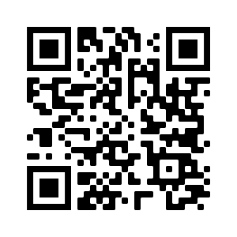
Devoirs
Vocabulary Learning Homework (Y7, Term 1.1, Week 2)
Audio file
Audio file QR code:
Student worksheet
Quizlet link

