Slide 1
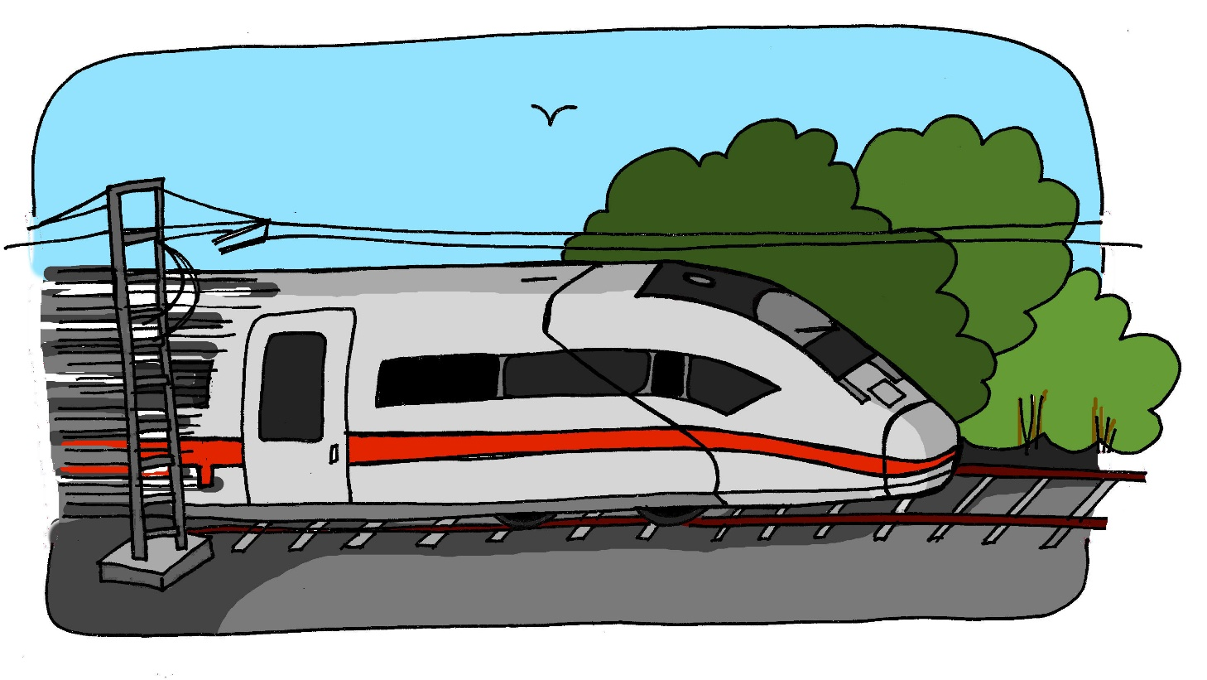
z
Zug
Steve Clarke / Rachel Hawkes
Notes:
Introduce and elicit the pronunciation of the individual SSC ‘z’ and then present and practise the pronunciation of the source word ‘zug’.
A possible gesture for this would be to mime wheels, holding your hands at your sides, elbows bent, forearms facing forwards in a right angle, and draw small circles with them, in the air (to denote the wheels of a train going round).

Slide 2
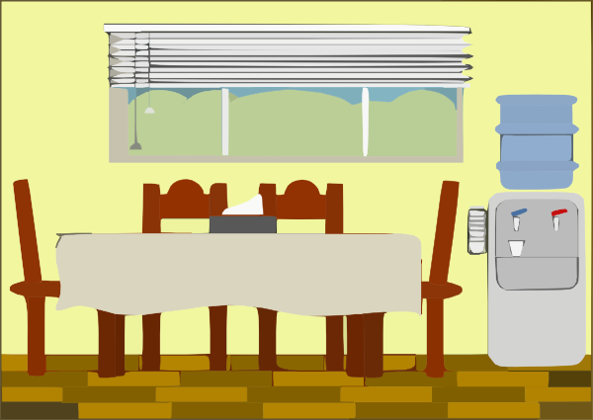
z
Zimmer
zehn
Zug
Arzt
sitzen
Platz
Rachel Hawkes
Notes:
Introduce and elicit the pronunciation of the individual SSC ‘Z’ and then the source word again (with gesture, if using). Then present and elicit the pronunciation of the five cluster words. The cluster words have been chosen for their high-frequency, from a range of word classes, with the SSC (where possible) positioned within a variety of syllables within the words(e.g. initial, 2nd, final etc..) and additionally, we have tried to use words that build cumulatively on previously taught SSCs (see the Phonics Teaching Sequence document) and do not include new SSCs. Where new SSCs are used, they are often consonants which have a similar symbol-sound correspondence in English.
Word frequency rankings (1 is the most common word in German): Zug [613]; Zimmer [609] zehn [314]; Arzt [614]; Platz [344]; sitzen [261]. Source: Jones, R.L. & Tschirner, E. (2006). A frequency dictionary of German: core vocabulary for learners. Routledge

Slide 3
z
Zimmer
zehn
Zug
Arzt
sitzen
Platz
Rachel Hawkes
Notes:
Without pictures to focus on the SSC alone.

Slide 4
z
Zimmer
zehn
Zug
Arzt
sitzen
Platz
Rachel Hawkes
Notes:
Without sound to elicit the pronunciation.

Slide 5
Was ist die Ausnahme?
1
Platz
Tag
Gast
2
zehn
Leben
eng
3
sitzen
geben
denken
4
Ende
Klasse
Zug
5
zehn
ein
zwei
Notes:
These include SSC cluster words from the first four weeks of the NCELP SOW. They have met the words ‘lang’ and ‘kurz’, previously. These can be re-introduced and modelled on the board, if required. Suggested answers:
1. Tag – der ‘A’ ist lang / nicht kurz. 2. eng – der ‘E’ ist kurz / nicht lang. 3. geben – der ‘E ‘ ist lang. 4. Zug – der ‘U’ ist lang (this one is trickier because they have not explicitly practised the ‘U’ SSC but they have learnt all three words, so if able to pronounce them, they will hopefully notice that Zug has a longer sounding vowel, plus they have been introduced to the rules about long/short vowels in German. 5. zehn – ‘EI’ ist nicht da. OR ein – das Wort beginnt nicht mit ‘Z’.

