Slide 1
Saying what you do or did in a typical day
Revisit a range of Y8 grammar features
Y8 SSCs [revisited]
Y8 French
Term 2.1 - Week 3 - Lesson 33
Stephen Owen / Catherine Morris / Natalie Finlayson
Artwork by: Chloé Motard
Date updated: 17/03/21
Notes:
Artwork by Chloé Motard. All additional pictures selected are available under a Creative Commons license, no attribution required.
Native teacher feedback provided by Sarah Brichory.
With thanks to Rachel Hawkes for her input on the lesson material.
_{Learning outcomes (lesson 1):}
Revision of phonics, vocabulary and grammar from terms 1.1, 1.2 and 2.1 with a selection of revisited Y7 vocabulary.
Grammar features: ce(t)(te)/ces, present vs perfect (je, tu, il/elle), faire and jouer with de and à, pronoun ‘on’, formal ‘vous’, forms of ‘de’, possessive adjectives, quel(le)(s), job titles
Word frequency (1 is the most frequent word in French):
Year 7 revisit: créer [332], faire, je fais, il fait, elle fait, nous faisons, vous faites, ils font, elles font [25], partager [527], passer [90], porter [105], trouver [83], acteur, actrice [1152], ami, amie [467], classe [778], chanteur, chanteuse [3251], chose [125], collège [2116], cuisine [2618], élève [1068], enfant [126], exercice1 [1290], famille [172], fenêtre [1604], fermer [757], fête [1490], frère [1043], film [848], lettre [480], liste [924], match [1906], maths [3438], médecin [1152], ménage [2326], mère [645], moderne [1239], modèle [958], musique [1139], père [569], poème [3031], poète [2307], professeur, professeure [1150], promenade [>5000], salle [812], science [1114], sœur [1558], vie [132], amusant [4695], ouvert [897], de2 [2]
The frequency rankings for words that occur in this PowerPoint which have been previously introduced in NCELP resources are given in the NCELP SOW and in the resources that first introduced and formally re-visited those words.
For any other words that occur incidentally in this PowerPoint, frequency rankings will be provided in the notes field wherever possible.

Slide 2
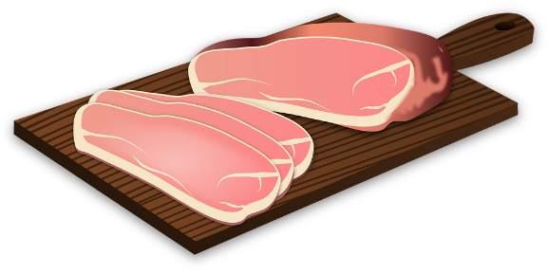
Ils mangent le petit-déjeuner (1/3)
*le petit-déjeuner = breakfast
écouter / écrire
C’est lundi. Léa prépare le petit-déjeuner avec sa famille. Que mangent-ils ?
1. « J’ai faim ! » dit Léa. Elle fait la cuisine.
1
_ _ _
2. « Bien manger, c’est important ! » répond son père.
2
_ _
3. des haricots
3
_
4. du jambon
avoir faim – to be hungry
le haricot – bean
le jambon – ham
le concombre – cucumber
4
_ _
5. du concombre
5
_ _
Notes:
Timing: 10 minutes for three slides
_{Aim:} Transcription of previously-encountered SSCs.
_{Procedure:}
1. Click on the numbered buttons to play the audio.
2. Students listen and write the missing SSC in each case. The number of letters in the target SSC is indicated, helping to limit possible answers.
3. Click to reveal the answers one by one. Praise should be given for correctly transcribing the SSCs that appear on clicks or any of the alternative answers appearing in bold in the transcript below. Teachers should take the opportunity to recap the SSCs that look different, but sound identical.
_{Transcript:}
1. « J’ai faim ! » dit Léa. Elle fait la cuisine. [also accept: ain]
2. « Bien manger, c’est important ! » répond son père. [also accept: in]
_{3. des haricots}
4. du jambon [also accept: em, an, en]
5. du concombre [also accept: on]
Word frequency of unknown words (1 is the most frequent word in French):
faim [1986], petit-déjeuner [>5000], haricot [>5000] jambon [>5000] Source: Londsale, D., & Le Bras, Y. (2009). A Frequency Dictionary of French: Core vocabulary for learners London: Routledge.
Word frequency of cognates(1 is the most frequent word in French):
important [215], concombre [>5000] Source: Londsale, D., & Le Bras, Y. (2009). A Frequency Dictionary of French: Core vocabulary for learners London: Routledge.

Slide 3
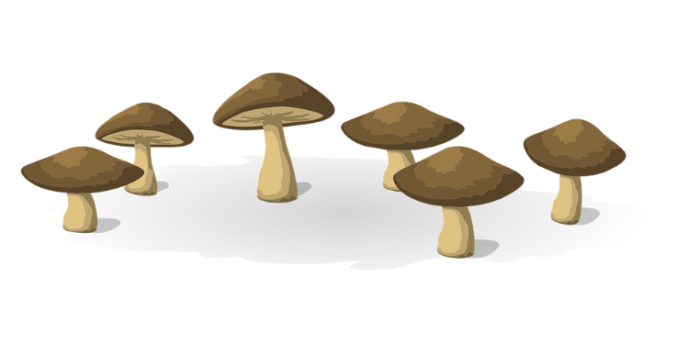
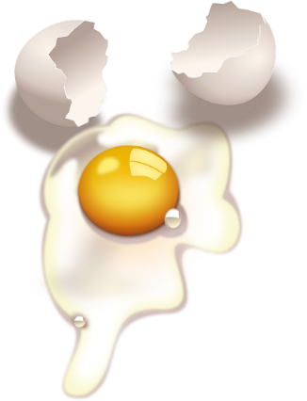
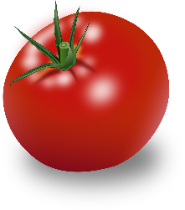
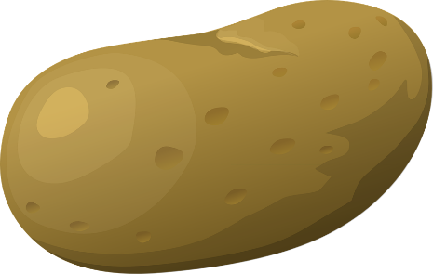
Ils mangent le petit-déjeuner (2/3)
écouter / écrire
C’est lundi. Léa prépare le petit-déjeuner avec sa famille. Que mangent-ils ?
6. des champi gn ons
6
_ _
The ‘f’ is not pronounced in the plural form ‘œufs’, but it is pronounced in the singular form ‘œuf’!
8. des œufs
7
_ _
8
9. des tomates
_
le champignon – mushroom
l’œuf (m.) – egg la tomate – tomato
la pomme de terre – potato
des pommes de terre
9
_
Notes:
_{As for previous slide.}
_{Transcript:}
_{6. des champignons}
_{7. des œufs [also accept: eu]}
_{8. des tomates}
_{9. des pommes de terre}
Word frequency of unknown words (1 is the most frequent word in French): champignon [>5000], œuf [2685], pomme de terre [2847/2/430]
Source: Londsale, D., & Le Bras, Y. (2009). A Frequency Dictionary of French: Core vocabulary for learners London: Routledge.
Word frequency of cognates (1 is the most frequent word in French): _{tomate [>5000]}
Source: Londsale, D., & Le Bras, Y. (2009). A Frequency Dictionary of French: Core vocabulary for learners London: Routledge.

Slide 4
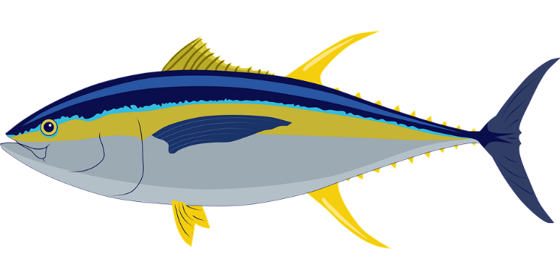
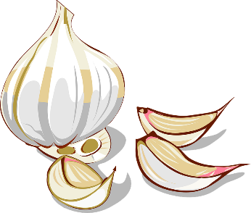
Ils mangent le petit-déjeuner (3/3)
écouter / écrire
C’est lundi. Léa prépare le petit-déjeuner avec sa famille. Que mangent-ils ?
10
11 des raisins
_
_
12 du thon
11
_ _
12
13 de l’ail
_ _ _
le raisin – grape
le thon – tuna
l’ail (m.) – garlic
la nouille – noodle
13
14 des nou i l l e s
_ _ _ _
Notes:
_{As for previous slide.}
_{Transcript:}
_{10. des raisins}
_{11. du thon}
_{12. de l’ail}
_{13. des nouilles}
Word frequency of unknown words (1 is the most frequent word in French): raisin [>5000] thon [>5000] ail [>5000] nouille [>5000]
Source: Londsale, D., & Le Bras, Y. (2009). A Frequency Dictionary of French: Core vocabulary for learners London: Routledge.

Slide 5
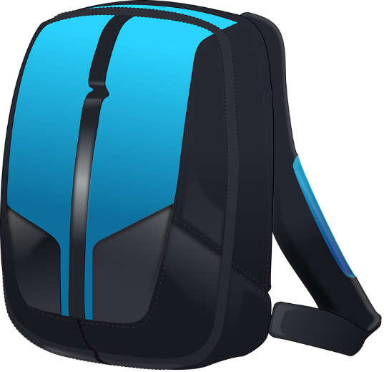
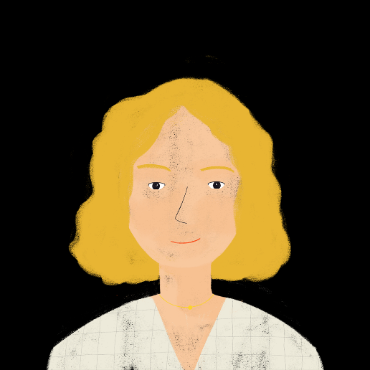
Léa fait son sac* pour l’école
lire
Léa parle avec sa mère. Elles parlent de quoi ?
Cross out the impossible items.
1. Quels choses/vêtements emportes-tu ?
- J’emporte cet uniforme/chemise.
2. Et quelles devoirs/choses ?
- J’emporte ce exercice/modèle.
3. Et quelle devoirs/activité ?
- J’emporte cette lettre/poème.
4. Et quel livre/exercices?
- J’emporte ce cahier/liste.
*le sac = bag
Notes:
_{Timing: 5 minutes}
Aim: Written recognition of ce(t)(te)/ces and quel(le)(s) and connecting these with meaning (a choice of nouns).
_{Procedure:}
1. Recap meaning and forms of ce and quel.
2. Students read each mini-dialogue and decide which of the two nouns is correct in each line, based upon the form of ‘quel’ or ‘ce’ used.
3. Click to reveal the correct answers. Word frequency of unknown words (1 is the most frequent word in French): _{sac [2343]} Source: Londsale, D., & Le Bras, Y. (2009). A Frequency Dictionary of French: Core vocabulary for learners London: Routledge.

Slide 6
The perfect tense: -ER verbs
grammaire
Remember: -ER verbs make their perfect tense as follows:
Present Perfect (past)
je travaille → j’ai travaillé
(I work) (I worked)
tu voyages → tu as voyagé
(you travel) (you travelled)
il mange → il a mangé
(he eats) (he ate)
elle joue → elle a joué
(she plays) (she played)
____________
Don’t confuse travailler
(to work) with voyager
(to travel)!
____________
____________
Remember: the past participle does not change for each subject. Only the part of avoir changes.
____________
Notes:
_{Timing: 2 minutes}
Aim: recapping the formation of the perfect tense (singular forms).
_{Procedure:}
1. Cycle through the information on the slide using the animation sequence.

Slide 7
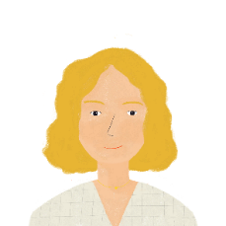
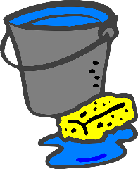
Léa et Sophie vont à l'école
écouter / écrire
Léa et Sophie marchent pour aller à l'école.
Parlent-elles du week-end ou de la vie en général ?
 |  | le week-end dernier | en général
 | Mon frère a porté mon uniforme.
 | Il trouve que c’est drôle.
 | Est-ce que ta mère a parlé à Antoine ?
 | Non. Elle pense que c’est la vie moderne.
 | Alors je partage mes choses avec Antoine.
 | Oh! Peut-être qu’il aime faire le ménage aussi !
1
_
2
_
3
_
4
_
5
_
_
6
Notes:
Timing: 12 minutes (for 2 slides)
Aim: Aural recognition of regular –ER verb forms in the present and perfect tenses.
_{Procedure:}
1. Click on the numbered buttons to play the audio. In 1-6, the auxiliary verb is bleeped out, focusing attention on the past participle. In 7-12, the past participle/is bleeped out, focusing attention on the auxiliary verb. Note: It is worth emphasizing to students that a bleep doesn’t obscure anything, if the sentence is in the present tense.
2. Students tick the appropriate column to indicate the time frame, using the present tense verb form or the past participle to help them.
3. Click to reveal a transcript with the relevant part of the verb form obscured. Students use this to verify their answer.
_{4. Answers revealed on clicks.}
5. Students fill in what is missing (an auxiliary verb or nothing in 1-6; the correct verb ending in 7-12).
_{6. Click to reveal the answer.}
7. Click the tick to hear the full sentence (without beeps) said aloud.
8. Oral translation of dialogue.
_{Transcript:}
1. Mon frère [a] porté mon uniforme.
2. Il [-] trouve que c’est drôle.
3. Est-ce que ta mère [a] parlé à Antoine ?
4. Non. Elle [-] pense que c’est la vie moderne.
5. Alors je [-] partage mes choses avec Antoine.
6. Oh! Peut-être qu’il [-] aime faire le ménage aussi !

Slide 8
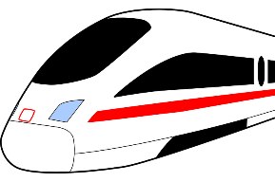
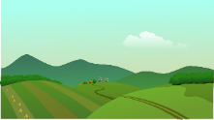
Léa et Sophie vont au collège
écouter / écrire
Léa et Sophie marchent pour aller au collège.
Parlent-elles du week-end ou de la vie en général ?
 |  | le week-end dernier | cette semaine
 | Tu as gagné le match ?
 | Oui ! J’ai fait la fête !
 | Amir a voyagé pour passer du temps ici.
 | Oh ! Il passe combien de jours à Paris ?
 | Il reste chez ma famille pour une semaine.
 | Très bien. Nous faisons une promenade ensemble. Le parc ferme quand ?
7
_
8
_
9
_
10
_
11
_
12
_
Notes:
_{As for previous slide.}
_{Transcript:}
_{7. Tu as [gagné] le match ?}
_{8. Oui ! J’ai [fait] la fête !}
9. Amir a [voyagé] pour passer du temps ici.
10. Oh! Il [passe] combien de jours à Paris ?
11. Il [reste] chez ma famille pour une semaine.
12. Très bien. Nous faisons une promenade ensemble. Le parc [ferme] quand ?

Slide 9
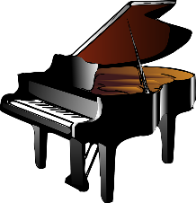
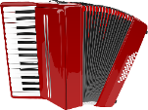
Les premières leçons du jour
Les premières leçons sont le sport et la musique.
écrire
Que font les élèves ? Écris ‘à’ ou ‘de’ à la forme correcte.
__
1
Je joue du piano.
7
Elles jouent à la pétanque.
__
2
Tu joues de la guitare.
8
Vous jouez au netball (m).
_____
__
9
__
3
Il joue des castagnettes (f).
Je fais du cyclisme (m).
___
4
___
10
Tu fais de la gymnastique (f).
Elle joue de l’accordéon (m).
____
5
Elles jouent au golf (m).
11
__
Vous faisez des sports nautiques (m).
__
Ils jouent au rugby (m).
12
Une amie fait de l’ athlétisme (m).
6
___
____
Notes:
_{Timing: 8 minutes}
Aim: Written production of the correct form of de or à plus the definite article to talk about playing sports and instruments.
_{Procedure:}
1. Recap forms of de and à followed by a definite article, and the use of each with faire and jouer + sport or instrument.
2. Students read the sentence and fill in the correct form of de or à plus the definite article. Remind students that even though they don’t know these words, the gender in brackets and the verb used give them the information they need.
3. Click to reveal the correct answers.
Word frequency of cognates used (1 is the most frequent word in French):
castagnette [>5000] accordéon [>5000], nautique [>5000], cyclisme [>5000], gymnastique [>5000], golf [4936], athlétisme [>5000], netball [>5000] Source: Londsale, D., & Le Bras, Y. (2009). A Frequency Dictionary of French: Core vocabulary for learners London: Routledge.

Slide 10
Pendant la pause
écouter
Que font les enfants pendant la pause ?
Il y a une liaison ? Choisis le mot correcte.
*la fin = end
liaison ?
liaison ?
1
amusant / drôle
5
frère / amie
2
dehors / au foot
6
toilettes / examens
3
ami / professeur.
7
venez dans / avez
4
personnes / équipes
8
une bonne / la fin de la
Notes:
_{Timing: 5 minutes}
Aim: aural recognition of liaison after -t, -s, -on, -x, and connecting this with meaning (choice of nouns).
_{Procedure:}
1. Teacher recaps the four sounds affected by liaison that students have encountered so far.
2. Click to hear a sentence with the noun obscured.
3. Students focus on the sound they head before the beep and decide whether the think that word is entering into a liaison pattern or not (with lower-level classes, the teacher may wish to confirm whether or not this is the case before proceeding.
4. Students then decide, based on the first letter of each noun, which word must complete the sentence.
5. Click to hear full sentence, with noun included. After each answer, teachers elicit (chorally) the English meanings from students.
_{Transcript:}
_{1. C’est [amusant].}
_{2. Nous jouons [dehors].}
_{3. Je parle avec mon [ami].}
_{4. Il y a deux [équipes].}
5. Sophie passe du temps avec son [frère].
6. Nous allons aux [toilettes].
7. “Vous [avez] cinq minutes” dit la professeure.
_{8. C’est [la fin de la] pause.}
Word frequency of cognate used (1 is the most frequent word in French): pause [2647], liaison [1968], fin [111], toilette [4215]
Source: Londsale, D., & Le Bras, Y. (2009). A Frequency Dictionary of French: Core vocabulary for learners London: Routledge.

Slide 11
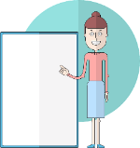
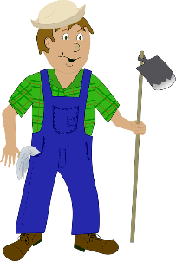
Que faites-vous dans la vie ?
écrire
After the break, there is a careers talk. Écris les formes masculines ou féminines.
un professeur
une professeure
une avocate
un avocat
une chanteuse
un chanteur
la directrice
le directeur
le traducteur
la traductrice
le dessinateur
la dessinatrice
la sénatrice
le sénateur
une écrivaine
un écrivain
un acteur
une actrice
un agriculteur
une agricultrice
Notes:
_{Timing: 4 minutes}
Aim: To revise knowledge of masculine and feminine noun formation through known words and to apply it to unknown words.
_{Procedure:}
1. Begin with a recap of known patterns form changing masculine nouns into feminine. These are: 1) article change only, 2)+e, 3) eur -> rice (with the exception of chanteur/chanteuse).
2. Students write the masculine form of the feminine versions of job titles shown and vice versa, using their knowledge of masculine and feminine noun patterns to inform their choices.
3. Click to reveal the correct answers one by one.
Word frequency of unknown words (1 is the most frequent word in French):
dessinateur, dessinatrice [>5000] écrivain, écrivaine [1738]
Source: Londsale, D., & Le Bras, Y. (2009). A Frequency Dictionary of French: Core vocabulary for learners London: Routledge.
Word frequency of unknown cognates (1 is the most frequent word in French):
forme [369], masculin [3741], fèminin [2381], sénateur, sénatrice [684], agriculteur, agricultrice [2306], traducteur, traductrice [>5000]
Source: Londsale, D., & Le Bras, Y. (2009). A Frequency Dictionary of French: Core vocabulary for learners London: Routledge.

Slide 12
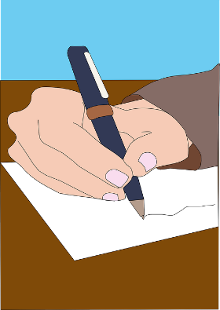
Que faites-vous dans la vie ?
lire
Remember – some words for job titles are the same in the masculine and feminine forms. Only the article changes.
un poète
une poète
un médecin
une médecin
un élève
une élève
Écris en anglais:
1. La poète écrit un poème amusant pour son frère, le médecin.
2. Une enfant fait un projet d’histoire moderne avec sa classe.
3. « Je peux fermer la fenêtre monsieur ? » demande une élève.
Notes:
_{Timing: 4 minutes}
Aim: To remind students that some job titles remain the same (apart from the article) in the masculine and feminine forms, and to practise these and other revisited vocabulary in a translation exercise.
_{Procedure:}
1. Cycle through the information on the top part of the slide using the animation sequence.
2. Students translate the sentences 1-4 into English. Click to bring them up one at a time.
3. Suggested translations appear on the following slide.
Word frequency (1 is the most frequent word in French):
Year 7 revisit: créer [332], faire, je fais, il fait, elle fait, nous faisons, vous faites, ils font, elles font [25], partager [527], passer [90], porter [105], trouver [83], acteur, actrice [1152], ami, amie [467], classe [778], chanteur, chanteuse [3251], chose [125], collège [2116], cuisine [2618], élève [1068], enfant [126], exercice1 [1290], famille [172], fenêtre [1604], fermer [757], fête [1490], frère [1043], lettre [480], liste [924], match [1906], médecin [1152], ménage [2326], mère [645], moderne [1239], modèle [958], musique [1139], père [569], poème [3031], poète [2307], professeur, professeure [1150], promenade [>5000], salle [812], sœur [1558], vie [132], amusant [4695], ouvert [897], de2 [2]

Slide 13
Réponses
lire
Écris en anglais:
1. La poète écrit un poème amusant pour son frère, le médecin.
1. The poet is writing a funny poem for his brother, the doctor.
2. Une enfant fait un projet d’histoire moderne avec sa classe.
2. A female child is doing a modern history project with her class.
3. « Je peux fermer la fenêtre monsieur ? » demande une élève.
3 “Can I shut the window, sir?” asks the female pupil.
Notes:
Suggested answers for the translation exercise.

Slide 14
Saying what you do or did in a typical day
Revisit a range of Y8 grammar features
Y8 SSCs [revisited]
Y8 French
Term 2.1 - Week 3 - Lesson 34
Stephen Owen / Catherine Morris / Natalie Finlayson
Artwork by: Chloé Motard
Date updated: 17/03/21
Notes:
Artwork by Chloé Motard. All additional pictures selected are available under a Creative Commons license, no attribution required.
Native teacher feedback provided by Sarah Brichory.
With thanks to Rachel Hawkes for her input on the lesson material.
_{Learning outcomes (lesson 2):}
Revision of vocabulary and grammar from terms 1.1, 1.2 and 2.1 for assessment (with a selection of revisited Y7 vocabulary)
Grammar features: est-ce que, negation in the perfect tense, partitive article with parts and quantities
Word frequency (1 is the most frequent word in French):
Year 7 revisit: créer [332], faire, je fais, il fait, elle fait, nous faisons, vous faites, ils font, elles font [25], partager [527], passer [90], porter [105], trouver [83], acteur, actrice [1152], ami, amie [467], classe [778], chanteur, chanteuse [3251], chose [125], collège [2116], cuisine [2618], élève [1068], enfant [126], exercice1 [1290], famille [172], fenêtre [1604], fermer [757], fête [1490], frère [1043], film [848], lettre [480], liste [924], match [1906], maths [3438], médecin [1152], ménage [2326], mère [645], moderne [1239], modèle [958], musique [1139], père [569], poème [3031], poète [2307], professeur, professeure [1150], promenade [>5000], salle [812], science [1114], sœur [1558], vie [132], amusant [4695], ouvert [897], de2 [2]
The frequency rankings for words that occur in this PowerPoint which have been previously introduced in NCELP resources are given in the NCELP SOW and in the resources that first introduced and formally re-visited those words.
For any other words that occur incidentally in this PowerPoint, frequency rankings will be provided in the notes field wherever possible.

Slide 15
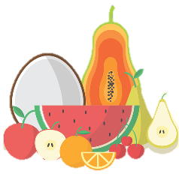
The partitive article – recap [1]
grammaire
Remember – we use un/une (the indefinite article) to talk about ‘whole’ things:
I’m buying…
a fish
un poisson
un poisson
However, uncountable nouns take the partitive article:
I’m buying…
some fruit
some ice cream
J’achète…
du fruit
de la glace
The partitive article changes to de after an expression of quantity:
a little milk
a kilo of meat
a glass of water
un peu de lait
un kilo de viande
un verre d’eau
The partitive article also changes to de in negative sentences:
There isn’t any milk in the tea.
Il n’y a pas de lait dans le thé.
Notes:
_{Timing: 3 minutes}
Aim: Recapping the concept of uncountable nouns, and the use of the partitive article with these.
_{Procedure:}
1. Cycle through the information on the slide using the animation sequence.
2. Elicit the French translation for each English phrase in italics (click to reveal French, then move on to next phrase)

Slide 16
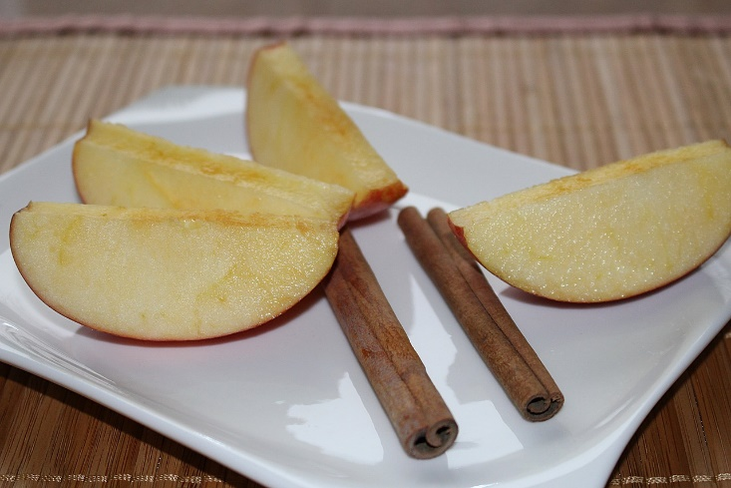
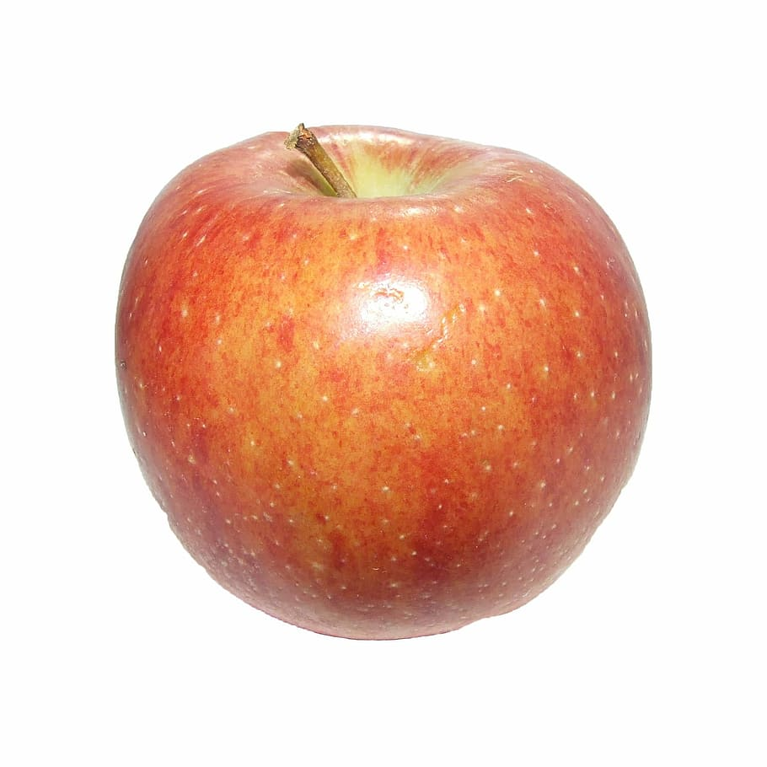
À la cantine
lire
Que mangent les enfants ? Écris A ou B.
A
B
Léa mange de la …
Notes:
Timing: 2 minutes (for 4 slides)
Aim: Written recognition of partitive and indefinite articles and connecting these with meaning (parts and wholes).
_{Procedure:}
1. Students read the sentences and decide which picture – a whole item, or part(s) of it – completes the sentence, using their knowledge of articles to help them.
2. Click to reveal the correct answer.
Word frequency of unknown words used (1 is the most frequent word in French): _{pomme [2847]}
Source: Londsale, D., & Le Bras, Y. (2009). A Frequency Dictionary of French: Core vocabulary for learners London: Routledge.

Slide 17
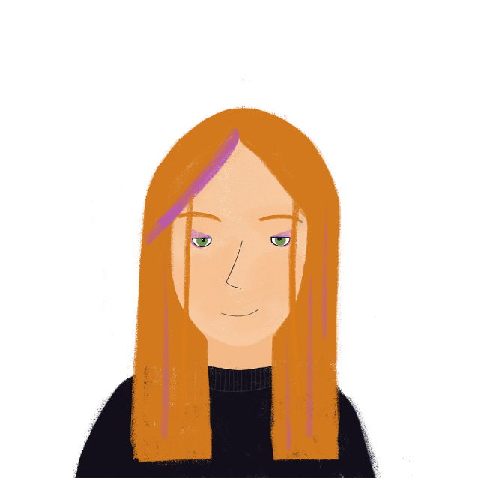
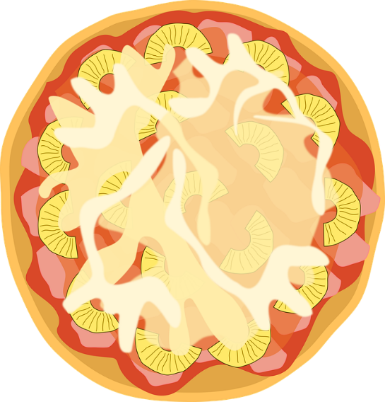
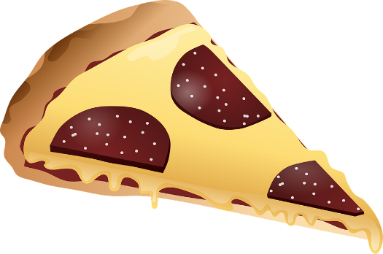
À la cantine
lire
Que mange sa sœur ? Écris A ou B.
A
B
Élodie mange une …
Notes:
_{As for previous slide.}
Word frequency of cognates used (1 is the most frequent word in French): _{pizza [>5000]}
Source: Londsale, D., & Le Bras, Y. (2009). A Frequency Dictionary of French: Core vocabulary for learners London: Routledge.

Slide 18
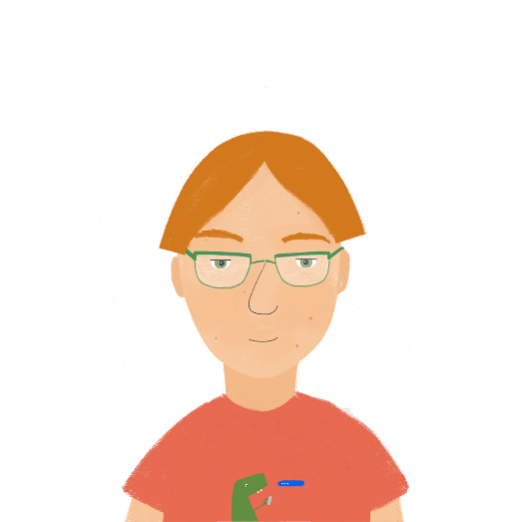
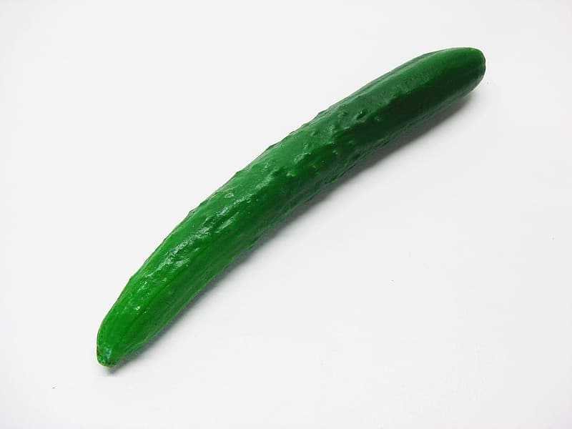
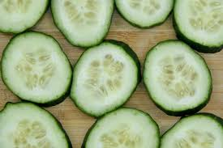
À la cantine
lire
Que mange son frère ? Écris A ou B.
A
B
Antoine mange du …
Notes:
_{As for previous slide.}
Word frequency of cognates used (1 is the most frequent word in French): _{concombre [>5000]}
Source: Londsale, D., & Le Bras, Y. (2009). A Frequency Dictionary of French: Core vocabulary for learners London: Routledge.

Slide 19
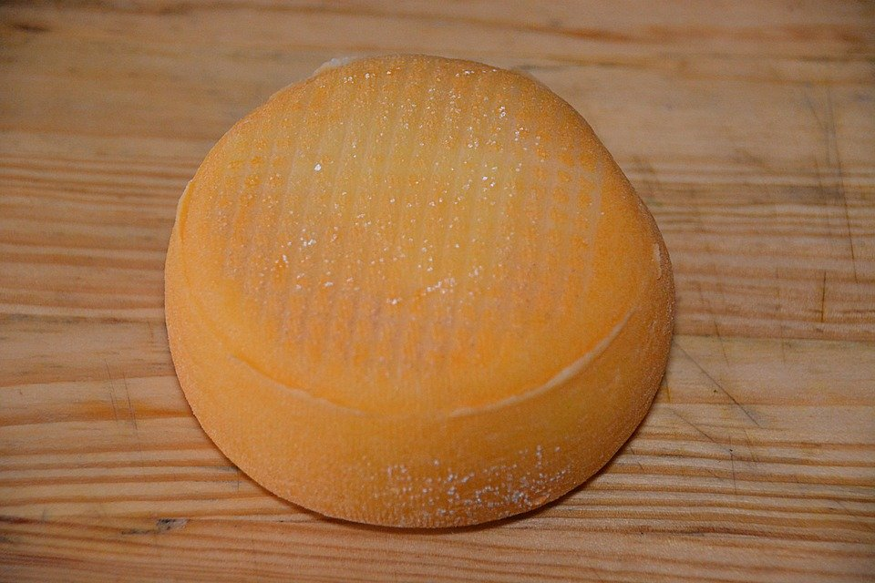
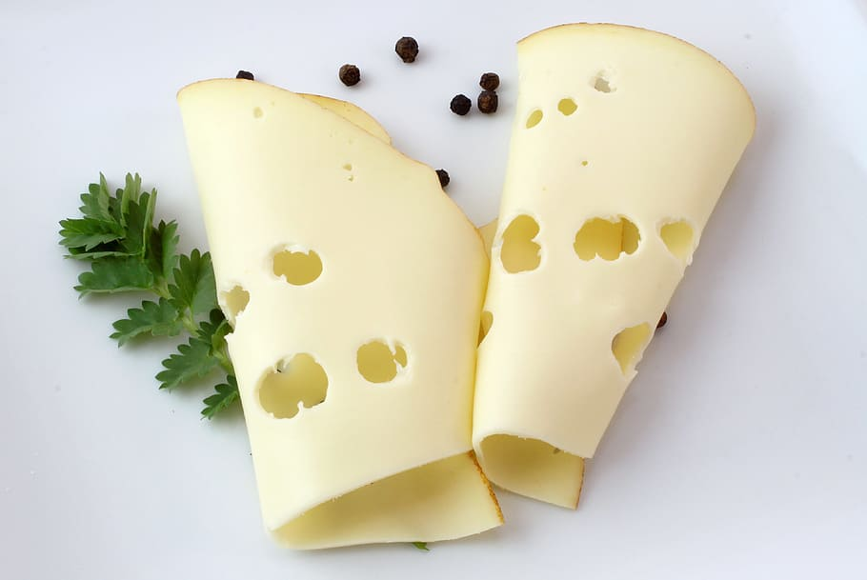
À la cantine
lire
Que mange son amie ? Écris A ou B.
A
B
Sophie mange un …
Notes:
_{As for previous slide.}

Slide 20
The partitive article – recap [2]
grammaire
Remember - to talk about things in general, we use the definite article:
Tu aimes le fromage ? Do you like the cheese? (a specific cheese)
OR Do you like cheese? (cheese in general)
When referring to an unspecified amount of something, we use the partitive article:
Tu as acheté du fromage ? Did you buy some cheese?
OR Did you buy cheese?
(English sometimes drops the article)
It is not possible to drop the article in French.
The type of article tells us whether we are talking about something in general (le/la/l’), or referring to an unspecified amount of it (du/de la/de l’).
Notes:
_{Timing: 3 minutes}
Aim: Recapping differences in article use between English and French.
_{Procedure:}
1. Cycle through the information on the top part of the slide using the animation sequence.

Slide 21
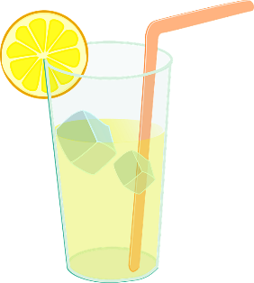
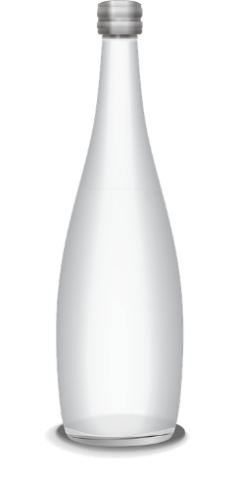
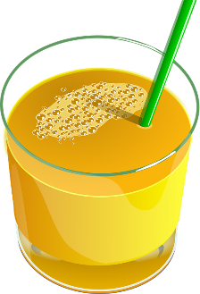
À la cantine [1]
écrire
Qui boit quoi ? Écris de, de la, du ou d’.
_
1. Sophie boit un litre d’eau (f.).
____
2. Antoine boit de la limonade (f.).
__
3. Léa ne boit pas de lait (m.).
4. Élodie boit du jus d’orange (m.).
__
5. Les professeurs partagent une bouteille d’eau (m.).
_
Notes:
_{Timing: 4 minutes}
Aim: Gap-fill in which students recall in which situations the article changes to ‘de’.
_{Procedure:}
1. Students fill in the correct form of the article – partitive or ‘de’ – for each gap, based on the presence or absence of a specified quantity or negative structure.
2. Click to reveal the correct answers one by one.
Word frequency of cognates (1 is the most frequent word in French): litre [3972] limonade [>5000] jus [>5000] orange [3912] bouteille [2979]
Source: Londsale, D., & Le Bras, Y. (2009). A Frequency Dictionary of French: Core vocabulary for learners London: Routledge.

Slide 22
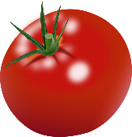
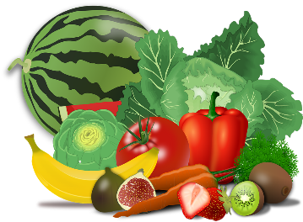
À la cantine [2]
écrire
le riz – rice
les légumes – vegetables
les chips - crisps
Qui mange quoi ? Écris de, de la, du ou d’.
__
6. Sophie mange un kilo de tomates (f.pl.).
__
7. Antoine mange du riz (m.).
__
8. Léa ne mange pas de légumes (m.pl.).
_____
9. Élodie mange de la salade (f.).
10. Les professeurs mangent un paquet de chips (m.pl.).
__
Notes:
_{Timing: 4 minutes}
Aim: Gap-fill in which students have to recall in which situations the article changes to ‘de’, based on the presence or absence of a specified quantity or negative structure.
_{Procedure:}
1. Students fill in the correct form of the article – partitive or ‘de’ – for each gap.
2. Click to reveal the correct answers one by one.
Word frequency of unknown words (1 is the most frequent word in French): riz [>5000], légume [3117], chips [>5000]
Source: Londsale, D., & Le Bras, Y. (2009). A Frequency Dictionary of French: Core vocabulary for learners London: Routledge.
Word frequency of cognates (1 is the most frequent word in French): tomate [>5000], salade [>5000], paquet [2413]
Source: Londsale, D., & Le Bras, Y. (2009). A Frequency Dictionary of French: Core vocabulary for learners London: Routledge.

Slide 23
Comment mangent-ils les Français ?
écrire
Remplis les blancs avec le, la, les, du, de la, de l’, des, de ou d’ !
Au petit déjeuner, les Français mangent souvent du pain avec de la confiture ou des céréales.
le riz
__
_____
__
Au déjeuner ou au dîner, ils mangent souvent
de la viande, du poisson ou des oeufs, avec
de la salade ou des légumes.
Et à boire, un peu de vin ou d’ eau.
la confiture
le vin
_____
__
__
les œufs (m)
_____
__
les légumes (m)
__
__
Mais ils aiment aussi la pizza, les pâtes et le riz.
les pâtes (f)
__
__
__
Et les Français mangent beaucoup de fromage, bien sûr !
__
Notes:
_{Timing: 10 minutes}
Aim: Written production of the correct form of the definite/partitive article, or ‘de’ alone.
_{Procedure:}
1. Students fill in the correct form of the article – definite/partitive, or ‘de’ – for each gap.
2. Click to reveal the correct answers one by one.
Word frequency of unknown words (1 is the most frequent word in French): confiture [>5000], oeuf [2685], légume [3117] vin [2309], pâte [3641], riz [>5000]
Source: Londsale, D., & Le Bras, Y. (2009). A Frequency Dictionary of French: Core vocabulary for learners London: Routledge.
Word frequency of cognates (1 is the most frequent word in French): céréales [4983], dîner [2365], salade [>5000], pizza [>5000]
Source: Londsale, D., & Le Bras, Y. (2009). A Frequency Dictionary of French: Core vocabulary for learners London: Routledge.

Slide 24
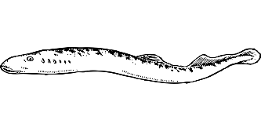
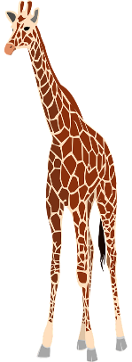
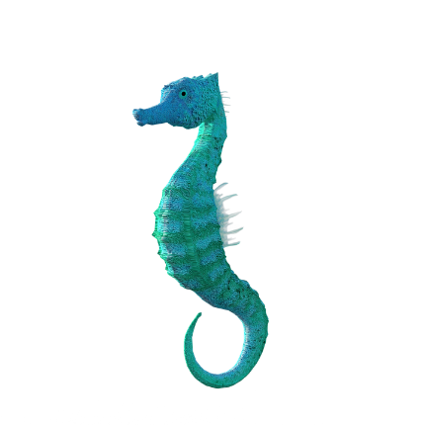
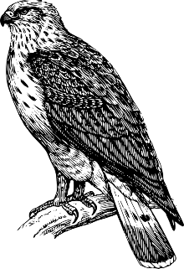
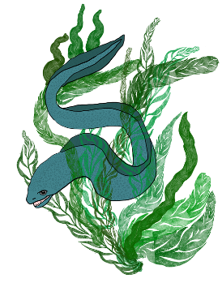
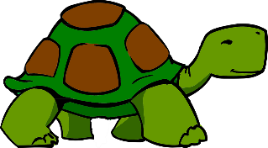
Après l'école …
parler
Léa et sa mère vont au zoo ! Le zoo a un aquarium. Il y a quels animaux ?
chimpanzé
[chimpanzee]
daim
[deer]
lamproie [lamprey]
girafe
[giraffe]
bœuf
[ox]
perroquet
[parrot]
araignée
[spider]
caille
[quail]
hippocampe
[sea horse]
panthère
[panther]
buse
[hawk]
anguille
[eel]
colombe
[dove]
tortue
[tortoise]
Notes:
_{Timing: 5 minutes}
Aim: Oral production of all Y8 SSCs covered so far.
_{Procedure:}
1. Students work in pairs and take turns to say the words aloud in French, focusing on the pronunciation of the highlighted SSCs.
2. Partners listen and correct as required.
3. The teacher should circulate and listen in.
4. Click the pictures to hear pronunciation.
Word frequency (1 is the most frequent word in French): zoo [>5000] chimpanzé [>5000] bœuf [3914] lamproie [>5000] daim [>5000] girafe [>5000] perroquet [>5000] hippocampe [>5000] araignée [>5000] caille [>5000] panthère [>5000] buse [>5000] anguille [>5000] colombe [>5000] tortue [>5000]
Source: Londsale, D., & Le Bras, Y. (2009). A Frequency Dictionary of French: Core vocabulary for learners London: Routledge.

Slide 25
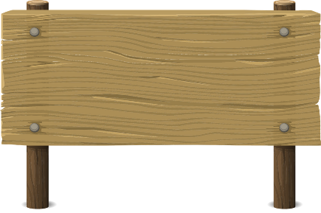
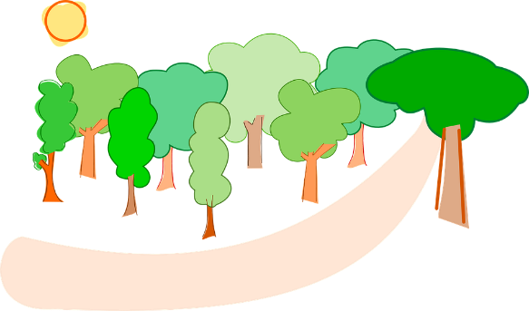
Au zoo
Au zoo
parler
les animaux sauvages = wild animals
le bruit = noise
nager = to swim
zoo
1
Le zoo est ouvert chaque jour.
5
Mon animal préféré c’est la girafe.
Les deux anguilles sont très longues.
2
Ce n’est pas loin de ma maison.
6
3
Nous aimons des animaux sauvages*.
7
Je veux nager* avec des anguilles !
Les perroquets font beaucoup de bruit.*
Mais ma mère dit qu’elles sont dangereuses.
4
8
Notes:
_{Timing: 5 minutes}
Aim: Recognise whether a liaison is needed or not (and produce it)
_{Procedure:}
1. Students read the sentences aloud in French, focusing on the pronunciation of the highlighted SSCs.
2. Partners listen and correct as required.
3. The teacher should circulate and listen in.
4. Click the numbers to hear pronunciation.
_{Transcript:}
1. Le zoo est ouvert chaque jour.
2. Ce n’est pas loin de ma maison.
3. Nous aimons des animaux sauvages.
4. Les perroquets font beaucoup de bruit.
5. Mon animal préféré c’est la giraffe.
6. Les deux anguilles sont très longues.
7. Je veux nager avec des anguilles !
8. Mais ma mère dit qu’elles sont dangereuses.
Word frequency (1 is the most frequent word in French): bruit [1524], sauvage [2464], nager [>5000], giraffe [>5000]
Source: Londsale, D., & Le Bras, Y. (2009). A Frequency Dictionary of French: Core vocabulary for learners London: Routledge.

Slide 26
Qu’est-ce que Léa a fait ?
parler
You can put est-ce que at the start of a sentence to make a question.
Ne … pas surrounds the form of avoir in the perfect tense.
Question:
Partner A
Est-ce que Léa a mangé des chips ? Did Léa eat some crisps?
Réponse:
Partner B
Non, Léa n’a pas mangé de chips. Elle a mangé une glace.
No, Léa didn’t eat any crisps. She ate an ice cream.
Notes:
_{Timing: 10 minutes}
Aim: Oral production of est-ce que questions and answers in the perfect tense.
_{Procedure:}
1. Cycle through the reminder on this slide using the animation sequence, eliciting the French for the question and answer.
2. Print and distribute the pair-work speaking cards on the next slide.
3. Explain that Partner A goes first, forming the questions represented in picture form at the top of his/her card.
4. Partner B, responds, gives the answers at the top of his/her card. In some cases, the pictures match, and no negative sentence is needed. Where the pictures do not match, students should give a negative sentence first, followed by an affirmative sentence with the correct noun.
5. Partners then swap roles, using the questions/answers at the bottom of their cards.
6. Given the complexity of the language here, the teacher will need to circulate to assist and to assess progress/common problem areas for individual and class feedback.
7. Suggested questions and answers are provided on slides 34 and 35.
Word frequency of unknown words (1 is the most frequent word in French): _{chips [>5000]}
Source: Londsale, D., & Le Bras, Y. (2009). A Frequency Dictionary of French: Core vocabulary for learners London: Routledge.

Slide 27
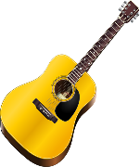
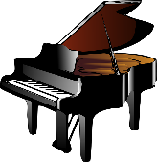
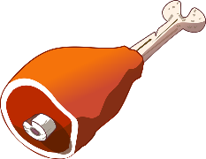
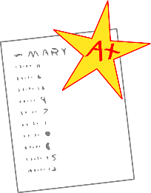
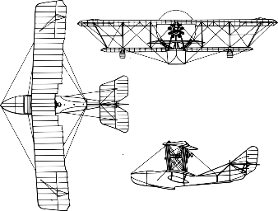
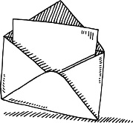
Partenaire A
parler
[play]
[do]
Réponses:
6
8
[eat]
[watch]
Questions:
1
4
3
10
[buy]
[study]
[sing]
5
[listen]
7
[eat]
2
9
[bring]
Partenaire B
[talk]
Questions:
Réponses:
[study]
[do]
[listen]
9
1
[eat]
6
8
3
5
10
7
4
[make]
2
[do]
[bring]
[eat]
[buy]
Notes:
_{Speaking Cards}
_{Additional English prompts:}
_{Partner A:}
_{1. Did Léa eat some meat?}
_{2. Did she bring a list?}
_{3. Did she study science?}
_{4. Did she watch a film?}
_{5. Did she listen to music?}
_{6. Yes, she did some sport.}
7. No she didn’t eat any cheese. She ate some pizza.
8. No she didn’t listen to music. She played an instrument.
9. No she didn’t talk with friends. She sang with friends.
_{10. Yes, she bought a book.}
_{Partner B:}
_{1. Yes, she ate some meat.}
2. No she didn’t bring a list. She brought a letter.
3. No she didn’t study science. She studied maths.
4. No she didn’t watch a film. She made a model.
5. No she didn’t listen to music. She did her homework.
_{6. Did Léa do some sport?}
_{7. Did Léa eat some cheese?}
_{8. Did she listen to music?}
9. Did she talk with her friends?
_{10. Did she buy a book?}

Slide 28
Qu’est-ce que Léa a fait ?
parler
Est-ce que Léa a mangé
de la viande ?
Oui, elle a mangé de la viande.
Est-ce qu’elle a apporté une liste?
Non, elle n’a pas apporté une liste.
Elle a apporté une lettre.
Est-ce qu’elle a étudié la science?
Non, elle n’a pas étudié la science.
Elle a étudié les maths.
Est-ce qu’elle a
regardé un film ?
Non, elle n’a pas regardé
un film. Elle a fait un modèle.
Est-ce qu’elle a écouté
de la musique ?
Non, elle n’a pas écouté de
la musique. Elle a fait ses devoirs.
Partner A
Partner B
Notes:
_{Answers 1-5}
_{Procedure:}
1. Click to reveal questions and answers in French one by one

Slide 29
Qu’est-ce que Léa a fait ?
parler
Est-ce que Léa a fait du sport?
Oui, elle a fait du sport.
Est-ce qu’elle a mangé
du fromage?
Non, elle n’a pas mangé du fromage. Elle a mangé de la pizza.
Est-ce qu’elle a écouté
de la musique?
Non, elle n’a pas écouté de la musique. Elle a joué d’un instrument.
Est-ce qu’elle a parlé avec ses amis?
Non, elle n’a pas parlé avec ses amis. Elle a chanté avec ses amis.
Est-ce qu’elle a acheté un livre?
Oui, elle a acheté un livre.
Partner B
Partner A
Notes:
_{Answers 6-10}
_{Procedure:}
1. Click to reveal questions and answers in French one by one

Slide 30
Gaming Grammar
Gaming Grammar
Relevant mini game(s):
Verbs (present): 1st person singular/plural (Verb agreement (past))
Verbs (present): 3rd person singular/plural (Verb agreement (past))
Preposition (to the): Gender (Prepositions)
Notes:
This slide links to Gaming Grammar login screen. The appropriate mission can then be selected from the menu page.
Students will progress through the game at their own rate; teachers should use the teacher interface to check progress. This will help to inform future lesson planning.

Slide 31
Devoirs
Click below to revise all new vocabulary learned since the last test!
Year 8 Term 2 test - Vocabulary Revision Mashup A
Year 8 Term 2 test - Vocabulary Revision Mashup B
Year 8 Term 2 test - Vocabulary Revision Mashup C
Year 8 Term 2 test - Vocabulary Revision Mashup D

Slide 32
Devoirs
Vocabulary Learning Homework (Y8, Term 2.1, Week 5)
Audio file
Audio file QR code:
Quizlet link
In addition, revisit: Y8 Term 1.2 Week 6
Y8 Term 1.1 Week 6
Notes:
The answer sheet for the Year 8, Term 2.1, Week 5 vocabulary learning homework is here: https://resources.ncelp.org/concern/resources/ww72bc116?locale=en

