Slide 1
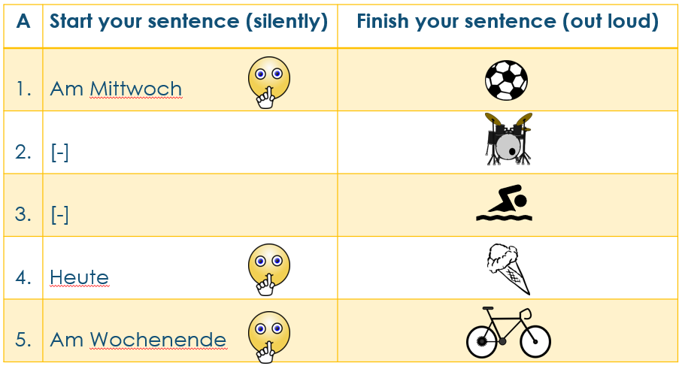
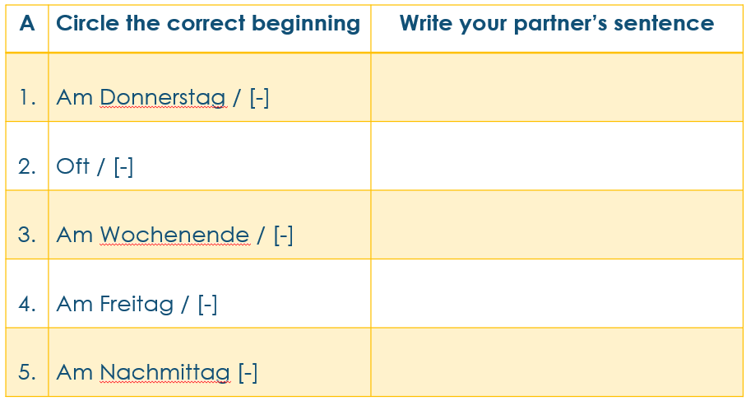
Partner A
Print and fold to create double-sided cue/answer cards for Partner A.

Slide 2
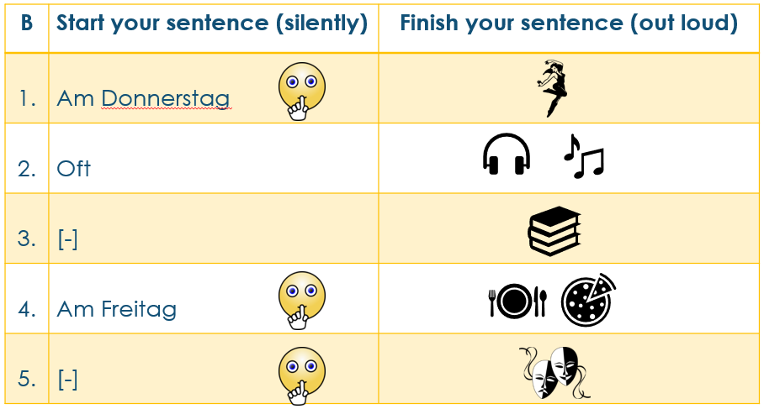
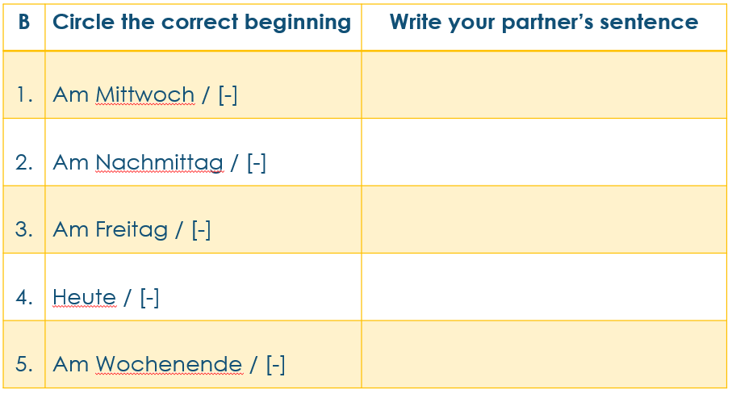
Partner B
Print and fold to create double-sided cue/answer cards for Partner B.

