Slide 1
What do you do when? What do others do and when?
Word order 2
SSC [th]
Y7 German
Term 3.1 - Week 1 - Lesson 49
Natalie Finlayson / Rachel Hawkes / Inge Alferink
Artwork: Steve Clarke
Date updated: 28/06/22
Notes:
Artwork by Steve Clarke. All additional pictures selected are available under a Creative Commons license, no attribution required.
Learning outcomes (lesson 1):
Introduction of SSC [th]
Introduction of word order 2
Word frequency (1 is the most frequent word in German):
7.3.1.1 (introduce) Dienstag [1356] Mittwoch [1187] Donnerstag [1244] Freitag [981] Samstag [1112] Sonntag [804] wann? [657] am Morgen [311] Morgen [621] im Orchester [2553] Orchester [4113] im Chor [3714] Chor [>5009] Bibliothek [2366] Theater [1086] Verein [899] 7.2.2.2 (revisit) benutzen [1119] essen [323] können, kann, kannst [23] sehen [79] tragen1&2 [271] trinken [634] etwas [100] Butterbrot [>5009] Hose [2156] Hut [2763] Keks [4083] Leute [224] Obst [4980]
7.2.1.1 (revisit) denken [128] er2 [15] es [12] sie2 [7] Fahrrad / Rad [2138] Geschenk [2595] Gutschein [>5009] Handy [1693] Jacke [3287] hässlich [3542] toll [972] ganz [69] jetzt [72] ziemlich [605] in Ordnung [n/a]
Jones, R.L & Tschirner, E. (2019). A frequency dictionary of German: Core vocabulary for learners. London: Routledge.
The frequency rankings for words that occur in this PowerPoint which have been previously introduced in NCELP resources are given in the NCELP SOW and in the resources that first introduced and formally re-visited those words.
For any other words that occur incidentally in this PowerPoint, frequency rankings will be provided in the notes field wherever possible.

Slide 2
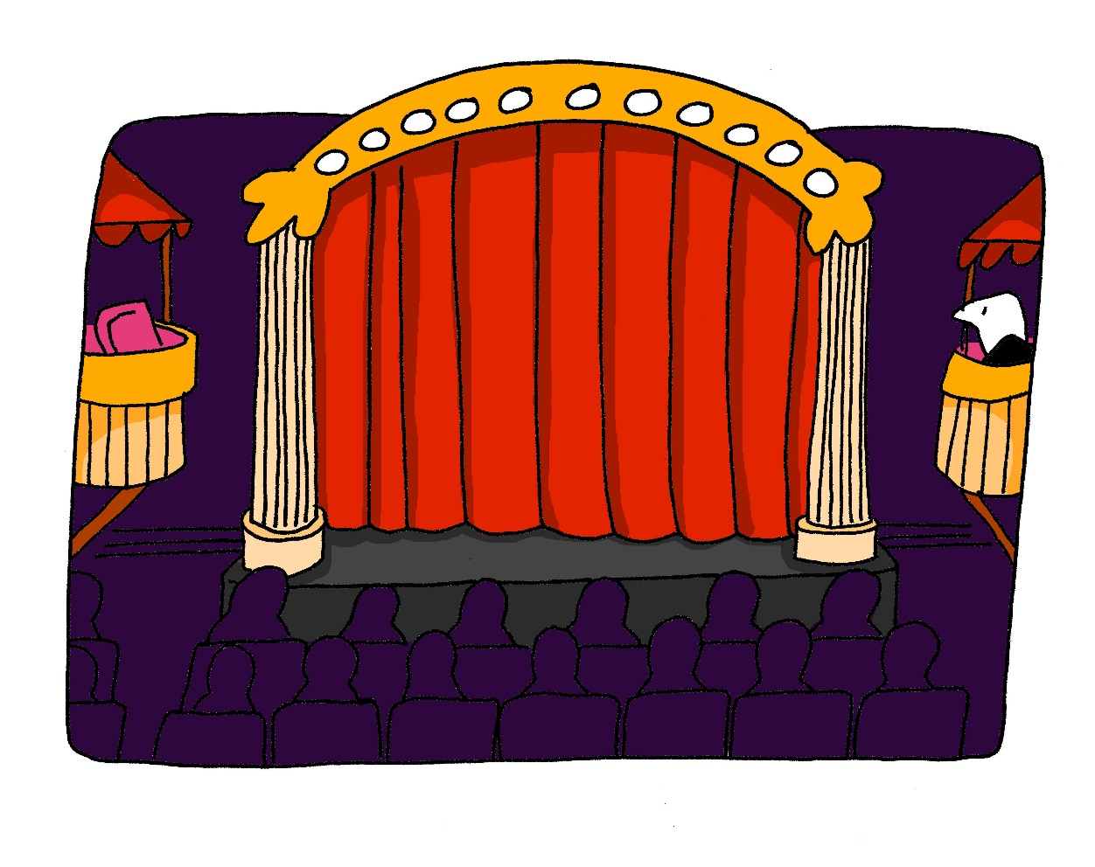
th
Theater
Notes:
Timing: 1 minute
Aim: To introduce/consolidate SSC [th]
Procedure: 1. Present the letter(s) and say the [th] sound first, on its own. Students repeat it with you. 2. Bring up the word ”Theater” on its own, say it, students repeat it, so that they have the opportunity to focus all of their attention on the connection between the written word and its sound.
3. A possible gesture for this would be to mime the opening of a theatre’s curtains, by drawing your hands away from each other quickly, in front of your body. This is very much like the gesture for ‘play’ in charades.
4. Roll back the animations and work through 1-3 again, but this time, dropping your voice completely to listen carefully to the students saying the [th] sound, pronouncing ”Theater” and, if using, doing the gesture. Word frequency (1 is the most frequent word in German): Theater [725] Source: Jones, R.L. & Tschirner, E. (2006). A frequency dictionary of German: core vocabulary for learners. Routledge

Slide 3
th
Theater
Notes:
With sound and no pictures to focus all attention on the sound-symbol correspondence.

Slide 4
th
Theater
Notes:
Without sound to elicit pronunciation (without first hearing the teacher).
Teacher to elicit pronunciation by asking “Wie sagt man…”

Slide 5
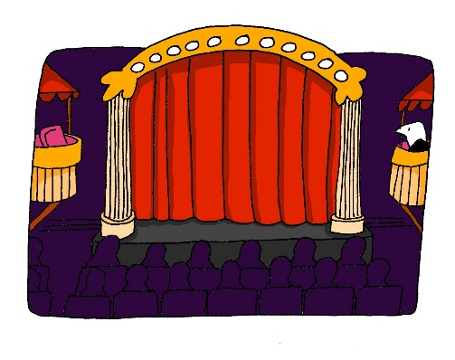
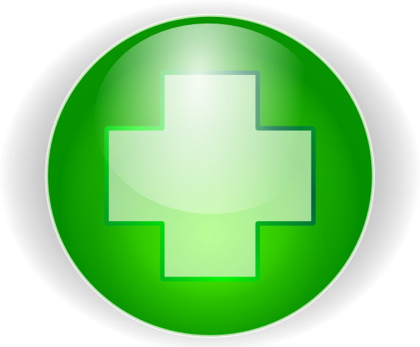
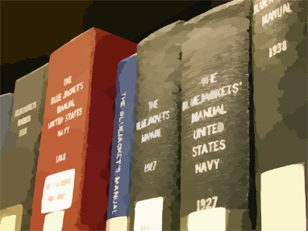
th
Theorie
Methode
Theater
Apotheke
Bibliothek
Thema
[topic]
Notes:
Timing: 2 minutes
Aim: To introduce/consolidate SSC [th]
Procedure:
Introduce and elicit the pronunciation of the individual SSC [th] and then the source word again ‘Theater’ (with gesture, if using).
Then present and elicit the pronunciation of the five cluster words.
The cluster words have been chosen for their high-frequency, from a range of word classes, with the SSC (where possible) positioned within a variety of syllables within the words (e.g. initial, 2nd, final etc.). Additionally, we have tried to use words that build cumulatively on previously taught SSCs (see the Phonics Teaching Sequence document) and do not include new SSCs. Where new SSCs are used, they are often consonants which have a similar symbol-sound correspondence in English.
Word frequency (1 is the most frequent word in German): Theater [725]; Theorie [>4034] Methode [835]; Apotheke [>4034]; Thema [328]; Bibliothek [927]. Source: Jones, R.L. & Tschirner, E. (2006). A frequency dictionary of German: core vocabulary for learners. Routledge

Slide 6
th
Theorie
Methode
Theater
Apotheke
Bibliothek
Thema
Notes:
With sound and no pictures to focus all attention on the sound-symbol correspondence.

Slide 7
th
Theorie
Methode
Theater
Apotheke
Bibliothek
Thema
Notes:
Without sound to elicit pronunciation (without first hearing the teacher).
Teacher to elicit pronunciation by asking “Wie sagt man…”

Slide 8
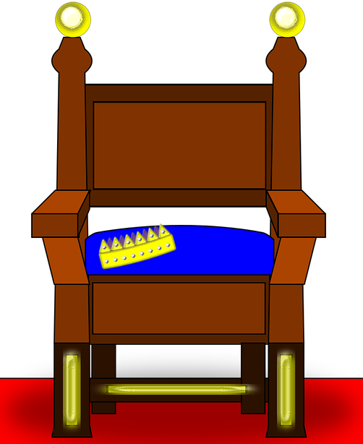
Wie sagt man das?
sprechen
[th]is not a typical German SSC. All German words containing [th]come from other languages.
You will recognise a lot of the words from English. Be careful to pronounce them correctly!
 | der Rythmus
 | das Thema [topic]
 | der Athlet
 | das Thermometer
 | der Thron
 | die Methode [method]
 | die Apotheke
 | Matthias
 | Katharina
 | die Diskothek
 | die Ethik [ethics]
 | Athen
 | die Theorie
 | die Bibliothek
45
1
1
2
2
3
3
Sekunden
4
4
5
5
6
6
0
7
7
LOS!
Notes:
Timing: 7 minutes
Aim: To practise pronunciation of a set of unknown cognate words containing SSC [th] in a given time.
Note: This is one of a set of three slides with different timer settings (this slide being the slowest). The speed of the exercise can be chosen to match the ability level of the class, or the teacher may wish to start with the slowest speed and increase gradually.
Procedure: 1. Teacher explains to students that the part of the word in bold is the part that must be stressed. The stress position sometimes differs from English, so students must pay attention.
2. Teacher clicks ‘los’.
3. Student A reads the list of words out loud to student B. Student B listens carefully to their partner’s pronunciation, and stops Student A if the [th] sound is pronounced the English way. They only stop their partner if the [th] is pronounced incorrectly. If an incorrect stress of other mispronunciation is noticed, the listening student should note this and correct it at the end of the round.
4. Students count how many words Student A managed to say correctly.
5. Students swap roles. The student with the most points at the end is the winner.
6. After two rounds, the teacher plays the correct pronunciation by clicking on the audio. Students repeat.
Word frequency (1 is the most frequent word in German):
Rythmus [>4034], Thema [328]; Athlet [>4034]; Thermometer [>4034]; Thron [>4034]; Methode [835]; Apotheke [>4034]; Diskothek [>4034]; Ethik [>4034]; Theorie [>4034]; Bibliothek [927]
Source: Jones, R.L & Tschirner, E. (2011). A frequency dictionary of German: Core vocabulary for learners. London: Routledge.

Slide 9
Wie sagt man das?
sprechen
[th]is not a typical German SSC. All German words containing [th]come from other languages.
You will recognise a lot of the words from English. Be careful to pronounce them correctly!
 | der Rythmus
 | das Thema [topic]
 | der Athlet
 | das Thermometer
 | der Thron
 | die Methode [method]
 | die Apotheke
 | Matthias
 | Katharina
 | die Diskothek
 | die Ethik [ethics]
 | Athen
 | die Theorie
 | die Bibliothek
1
1
2
2
30
3
3
4
4
Sekunden
5
5
6
6
0
7
7
LOS!
Notes:
This is a faster version of the previous slide.

Slide 10
Wie sagt man das?
sprechen
[th]is not a typical German SSC. All German words containing [th]come from other languages.
You will recognise a lot of the words from English. Be careful to pronounce them correctly!
 | der Rythmus
 | das Thema [topic]
 | der Athlet
 | das Thermometer
 | der Thron
 | die Methode [method]
 | die Apotheke
 | Matthias
 | Katharina
 | die Diskothek
 | die Ethik [ethics]
 | Athen
 | die Theorie
 | die Bibliothek
1
1
2
2
3
3
4
4
15
5
5
Sekunden
6
6
0
7
7
LOS!
Notes:
This is a still faster version of the previous slide.

Slide 11
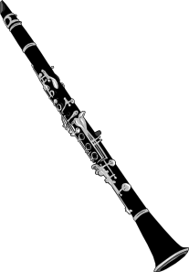
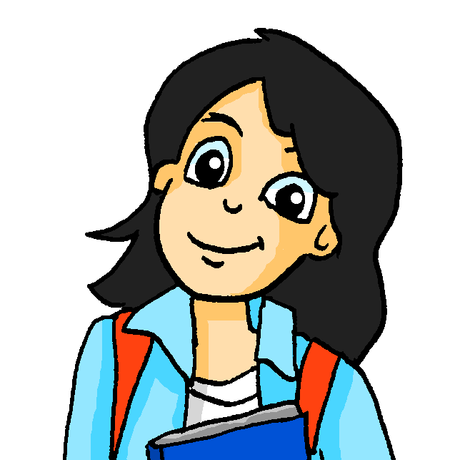
Was macht Mia?
hören / schreiben
Heute Abend spiele ich ….
 |  |  |  |  |  | F | R | E | I | T | A | G
 |  |  |  |  |  |  |  |  | M | O | N | T | A | G
D | I | E |  | B | I | B | L | I | O | T | H | E | K
 |  |  |  | D | O | N | N | E | R | S | T | A | G
 |  |  |  |  |  | I | M |  | C | H | O | R
 |  | M | I | T | T | W | O | C | H
 |  |  |  |  |  |  | D | I | E | N | S | T | A | G
 |  |  |  |  |  | S | A | M | S | T | A | G
 |  |  |  |  | S | O | N | N | T | A | G
 |  |  | D | A | S |  | T | H | E | A | T | E | R
 |  |  | D | E | R |  | V | E | R | E | I | N
1
2
3
4
5
6
7
8
9
10
11
Notes:
Timing: 10 minutes
Aim: To practise written production of some of this week’s vocabulary in response to aural clues.
In this exercise, students listen to spoken crossword clues, and write the solutions. All solutions are words found in this week’s vocabulary set. The clues are constructed from words in this week’s and previous weeks’ vocabulary sets, in addition to two cognates, Konzert [1716] and Show [3125].
Note: A less challenging version of this activity, in which some letters are displayed as hints, can be found on the next slide.
Procedure:
1. Students listen to the crossword clues, and write the solutions.
2. Click to bring up the answers, one word at a time.
Transcript:
1. Es ist fast Wochenende! Heute ist …
2. Heute ist der erste Tag der Woche. Es ist …
3. Ich lese hier Bücher. Das ist …
4. In zwei Tagen ist Wochenende. Heute ist …
5. Ich singe mit Freunden zusammen in der Schule. Ich bin …
6. In vier Tagen ist Sonntag. Heute ist …
7. Heute ist Sonntag. Der Tag danach ist …
8. Es ist heute keine Schule – es ist jetzt Wochenende! Heute ist …
9. Ich gehe heute in die Kirche. Es ist …
10. Es gibt hier Konzerte und Shows. Das ist …
11. Wir machen oft zusammen Sport. Das ist …

Slide 12
Was macht Mia?
hören / schreiben
Heute Abend spiele ich ….
 |  |  |  |  |  | F | R | E | I | T | A | G
 |  |  |  |  |  |  |  |  | M | O | N | T | A | G
D | I | E |  | B | I | B | L | I | O | T | H | E | K
 |  |  |  | D | O | N | N | E | R | S | T | A | G
 |  |  |  |  |  | I | M |  | C | H | O | R
 |  | M | I | T | T | W | O | C | H
 |  |  |  |  |  |  | D | I | E | N | S | T | A | G
 |  |  |  |  |  | S | A | M | S | T | A | G
 |  |  |  |  | S | O | N | N | T | A | G
 |  |  | D | A | S |  | T | H | E | A | T | E | R
 |  |  | D | E | R |  | V | E | R | E | I | N
1
2
3
4
5
6
7
8
9
10
11
Notes:
Timing: 10 minutes
Aim: To practise written production of some of this week’s vocabulary in response to aural clues.
In this exercise, students listen to spoken crossword clues, and write the solutions. All solutions are words found in this week’s vocabulary set. The clues are constructed from words in this weeks’ and previous weeks’ vocabulary sets, in addition to two cognates, Konzert [1716] and [Show [3125].
Note: A more challenging version of this activity, in which no letters are displayed as hints, can be found on the previous slide.
Procedure:
1. Students listen to the crossword clues, and write the solutions. Teacher can add or remove more letters from the grid as appropriate for the level.
2. Click to bring up the answers, one word at a time.
Transcript:
1. Es ist fast Wochenende! Heute ist …
2. Heute ist der erste Tag der Woche. Es ist …
3. Ich lese hier Bücher. Das ist …
4. In zwei Tagen ist Wochenende. Heute ist …
5. Ich singe mit Freunden zusammen in der Schule. Ich bin …
6. In vier Tagen ist Sonntag. Heute ist …
7. Heute ist Sonntag. Der Tag danach ist …
8. Es ist heute keine Schule – es ist jetzt Wochenende! Heute ist …
9. Ich gehe heute in die Kirche. Es ist …
10. Es gibt hier Konzerte und Shows. Das ist …
11. Wir machen oft zusammen Sport. Das ist …

Slide 13
Word order 2
Grammatik
As you know, the order of words in a simple German sentence is:
Mia spielt jeden Dienstag Klarinette.
Sometimes, we want to start the sentence with the adverb to emphasise it.
When we do this, the adverb and subject swap places.
Jeden Dienstag spielt Mia Klarinette.
The position of the verb does not change. It is always between the subject and the adverb.
Word order
1
SUBJECT
VERB
ADVERB
NOUN
Word order
2
ADVERB
VERB
SUBJECT
NOUN
Notes:
Timing: 3 minutes
Aim: To explain the order of words in a German sentence, and how this is affected by an initial adverb.
Procedure:
1. Cycle through the information on the slide using the animation sequence.

Slide 14
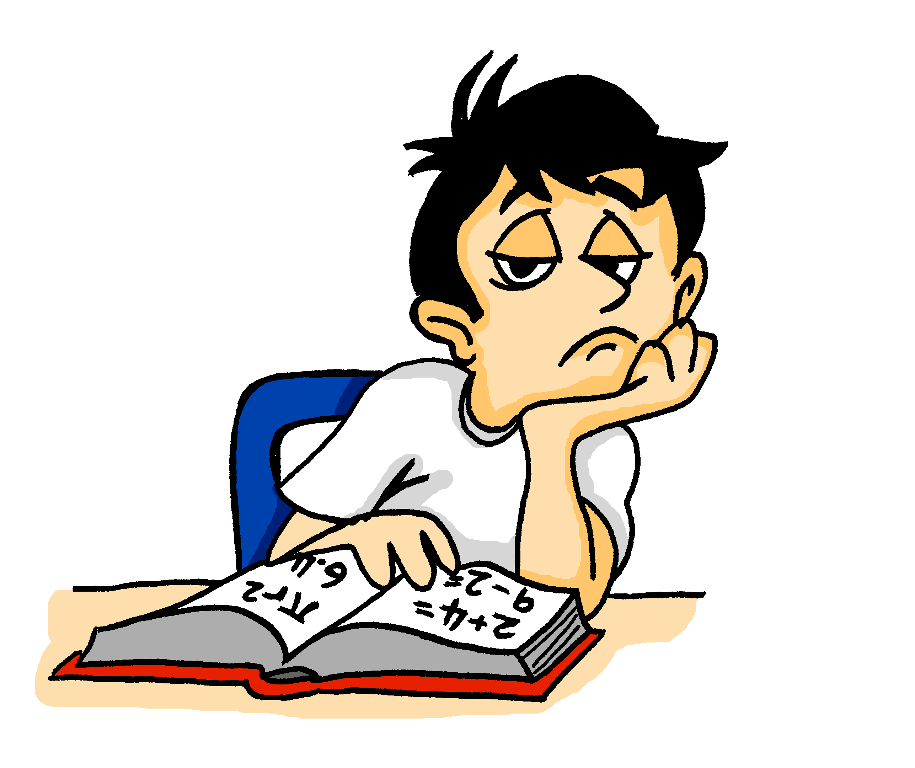
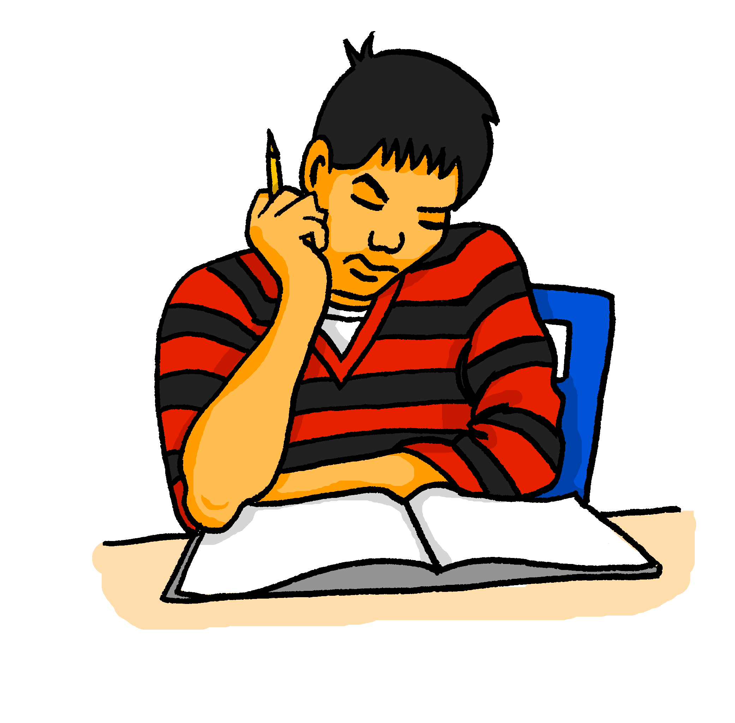
Was schreiben sie?
lesen
Wolfgang und Mehmet finden Mathe langweilig. Sie dürfen aber im Unterricht nicht reden!
Was schreiben sie?
Am Dienstag
chille ich ein bisschen zu Hause. Und du?
C
-
Hey Mehmet, was machst du heute?
Am Dienstag
ich habe Tanzunterricht. Was machst du am Samstag?
D
-
Heute
ich spiele Gitarre. Und du?
Am Samstag
gehe ich mit Mama ins Theater. Langweilig!.Und du?
A
E
-
-
Heute
spiele ich Schlagzeug!
Und am Dienstag?
Am Samstag
gehe ich shoppen! Mit Heidi :D
B
F
-
-
Notes:
Timing: 7 minutes
Aim: To use knowledge of word order to decide whether a time phrase is included in the sentence or not.
Procedure:
1. Explain that the word order will tell them whether or not whether a time phrase is included in the sentence.
2. Students select between the time phrase shown in each case, or a blank (indicated by a dash), in order to complete the sentence.
2. Answers revealed on clicks.
Notes:
1. Capital letters have been removed from all sentences so as not to give lexical clues. Teachers to note that Wolfgang und Mehmet should have used capital letters at the beginning of sentences 1 and 4!
2. This week’s SSC ‘TH’ appears in the word ‘Mathe’ - it is worth pointing this out to students. ☺
Word frequency (1 is the most frequent word in German):
chillen [>4034] shoppen [>4034]
Jones, R.L & Tschirner, E. (2011). A frequency dictionary of German: Core vocabulary for learners. London: Routledge.

Slide 15
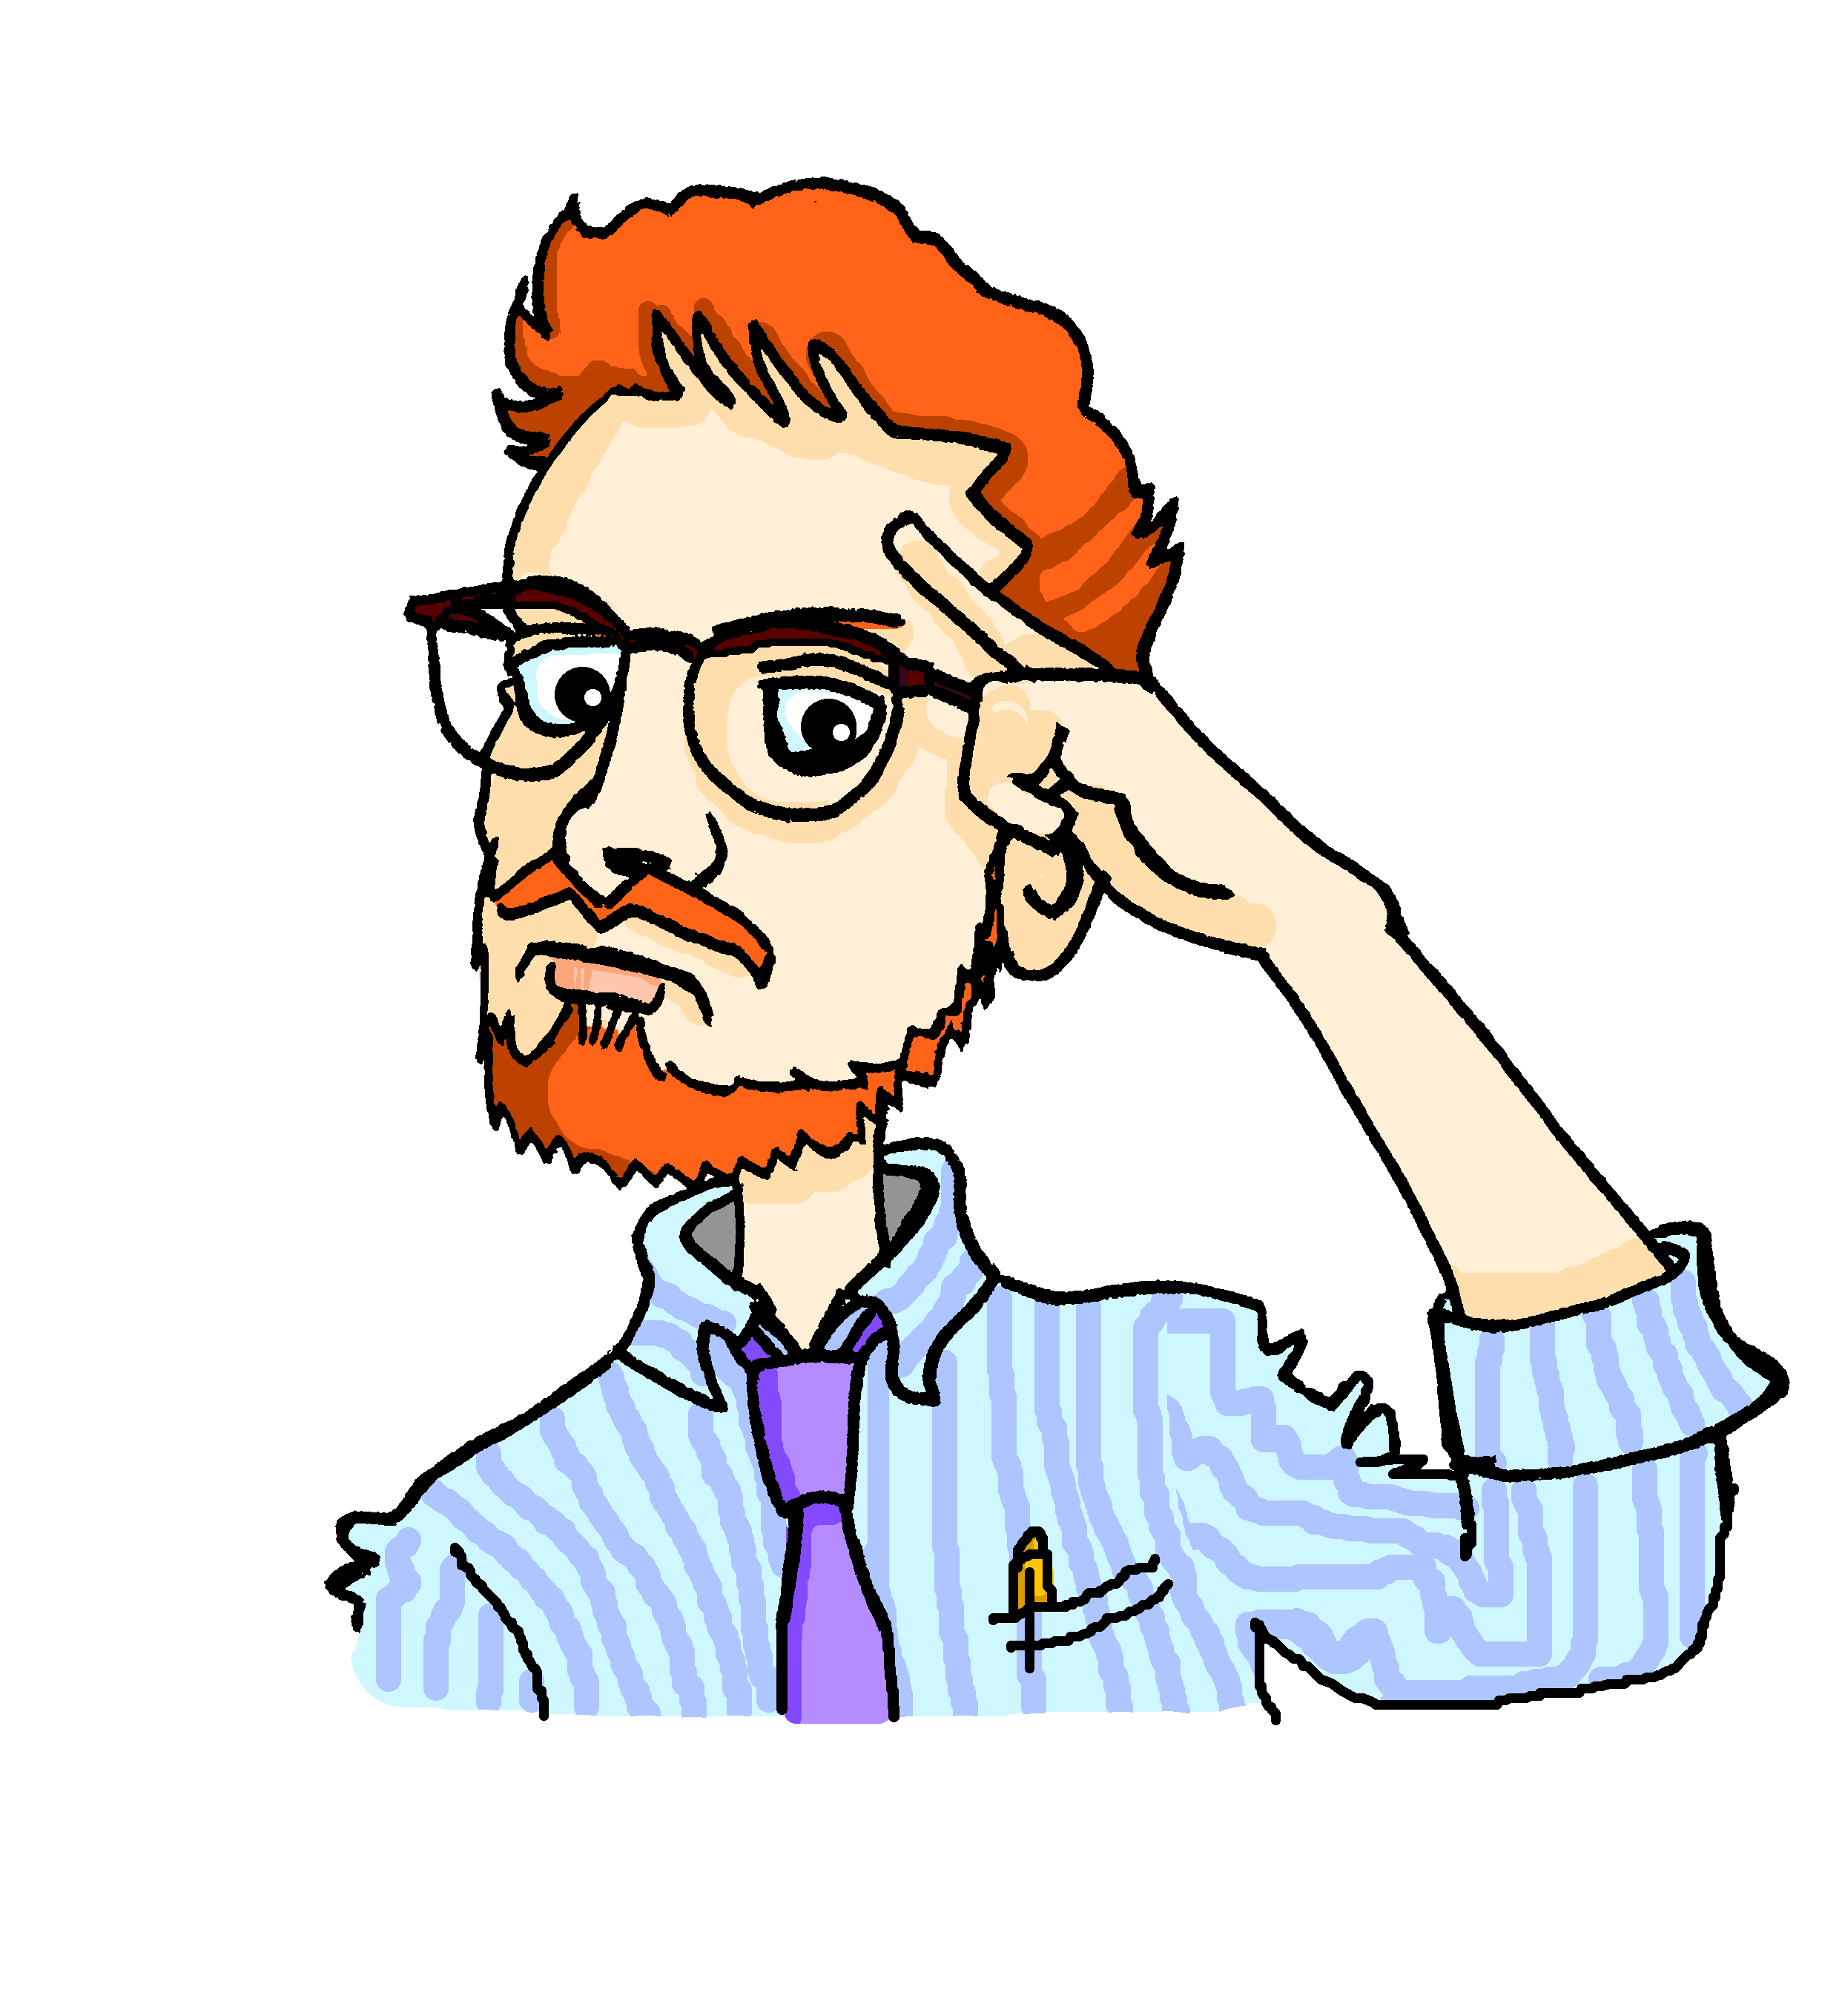
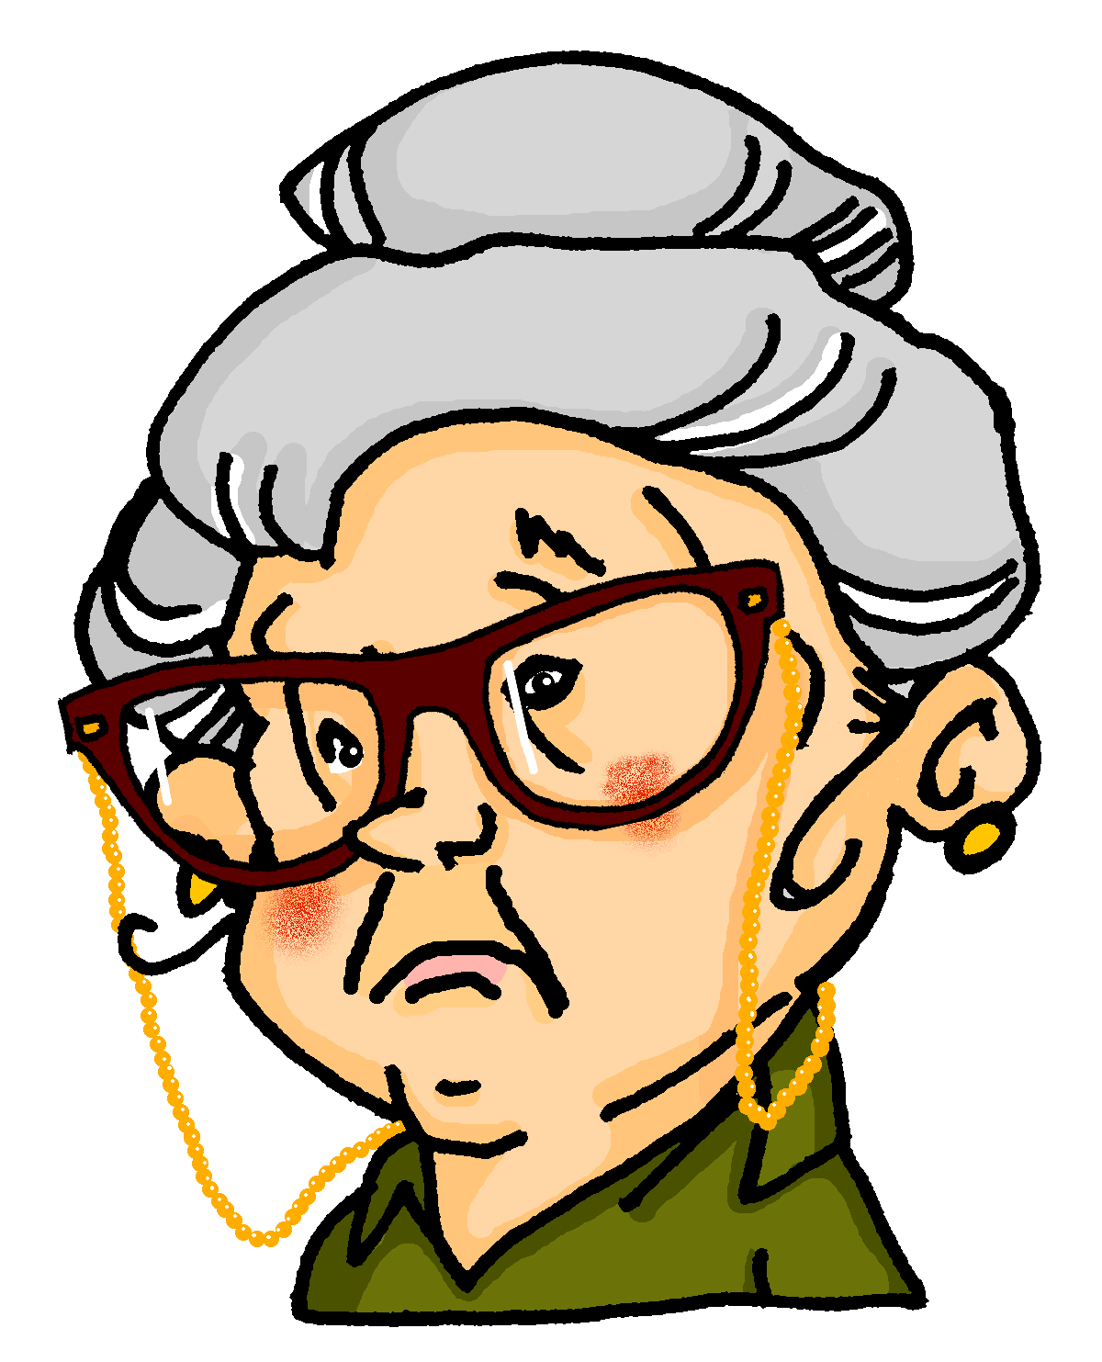
Der Lehrer ist streng!
hören
Herr Mürrisch, der Mathelehrer, findet die Situation nicht so toll! Er redet mit Oma am Telefon.
Was sagt er?
1
heute | -
5
heute | -
2
jeden Tag | -
6
jetzt | -
3
oft | -
7
am Montag | -
4
immer | -
8
dann| -
Notes:
Timing: 8 minutes
Aim: To use knowledge of word order to decide whether a time phrase is included in the sentence or not.
Procedure:
1. Again, teacher to remind students that word order will tell them whether or not the sentence starts with a time phrase.
2. Students may need reminding that dann and danach, which students met in 2.2.5, also count as time phrases.
3. Audio plays on number clicks (with time phrases blanked out – and ‘decoy’ beeps where there are no time phrases missing, to avoid the beep itself becoming the clue).
Transcript:
Guten Tag. [beep] Wir haben ein Problem.
[beep] sitzt Wolfgang im Klassenzimmer und macht nichts.
[beep] redet er mit Mehmet im Unterricht.
[beep] vergisst er die Hausaufgaben.
[beep] Ich denke, ich habe die Antwort.
[beep] Wolfgang und Mehmet können nicht zusammen sitzen. Das ist klar.
[beep] sitzt Wolfgang allein.
[beep] kann er ja den Kopf benutzen!

Slide 16
Antworten
hören
Herr Mürrisch, der Mathelehrer, findet die Situation nicht so toll! Er redet mit Oma am Telefon.
Was sagt er?
1
heute | -
5
heute | -
2
jeden Tag | -
6
jetzt | -
3
oft | -
7
am Montag | -
4
immer | -
8
dann| -
Notes:
Timing: 2 minutes
Aim: To provide the answers to the activity on the previous slide.
Procedure:
1. Full answers, including time phrases, play on number clicks.
Transcript:
Guten Tag. Wir haben ein Problem.
Jeden Tag sitzt Wolfgang im Klassenzimmer und macht nichts.
Oft redet er mit Mehmet im Unterricht.
Immer vergisst er die Hausaufgaben.
Ich denke, ich habe die Antwort.
Wolfgang und Mehmet können nicht zusammen sitzen. Das ist klar.
Am Montag sitzt Wolfgang allein.
Dann kann er ja den Kopf benutzen!

Slide 17
Meine Woche
schreiben
Dein Freund versteht kein Englisch! Schreib die Sätze auf Deutsch. Word order 1 or 2?
1. I’m cleaning my room on Monday.
2. I’m staying at home on Tuesday.
3. I’m eating ice cream on Wednesday.
4. I’m sleeping on Thursday.
5. I’m playing in the Orchestra on Friday.
6. I’m singing in the choir on Saturday.
7. I’m getting a present on Sunday!
1. Am Montag putze ich mein Zimmer.
2. Ich bleibe am Dienstag zu Hause.
3. Ich esse am Mittwoch Eis.
4. Am Donnerstag schlafe ich.
5. Ich spiele am Freitag im Orchester.
6. Am Samstag singe ich im Chor.
7. Am Sonntag bekomme ich ein Geschenk!
…
Wo
…
…
…
…
…
…
Notes:
Timing: 12 minutes
Aim: To practise written production of sentences using both WO1 and WO2. This exercise is a scaffolded task that prepares students for the freer spoken and written exercises in the next lesson. The starts of the German sentences are given so that students must practise both WO1 and WO2.
Procedure:
1. Teacher to note the use of the present continuous in English throughout, and highlight to students. 2. Students translate each sentence into German, following the start indicated.
Note: Students may be inclined to reproduce English word order (i.e. put the days of the week at the end of the sentence). It is worth perhaps doing the first two sentences and then providing whole class feedback, reminding students that the adverb (here it is an adverbial time expression - on Monday etc..) goes straight after the verb in WO1, as they have previously learnt and practised with other adverbs.

Slide 18
What do you do when? What do others do and when?
Word order 2
SSC [th]
Y7 German
Term 3.1 - Week 1 - Lesson 50
Natalie Finlayson / Rachel Hawkes / Inge Alferink
Artwork: Steve Clarke
Date updated: 28/06/22
Notes:
Artwork by Steve Clarke. All additional pictures selected are available under a Creative Commons license, no attribution required.
Learning outcomes (lesson 1):
Consolidation of SSC [th]
Consolidation of word order 2
Word frequency (1 is the most frequent word in German):
7.3.1.1 (introduce) Dienstag [1356] Mittwoch [1187] Donnerstag [1244] Freitag [981] Samstag [1112] Sonntag [804] wann? [657] am Morgen [311] Morgen [621] im Orchester [2553] Orchester [4113] im Chor [3714] Chor [>5009] Bibliothek [2366] Theater [1086] Verein [899] 7.2.2.2 (revisit) benutzen [1119] essen [323] können, kann, kannst [23] sehen [79] tragen1&2 [271] trinken [634] etwas [100] Butterbrot [>5009] Hose [2156] Hut [2763] Keks [4083] Leute [224] Obst [4980]
7.2.1.1 (revisit) denken [128] er2 [15] es [12] sie2 [7] Fahrrad / Rad [2138] Geschenk [2595] Gutschein [>5009] Handy [1693] Jacke [3287] hässlich [3542] toll [972] ganz [69] jetzt [72] ziemlich [605] in Ordnung [n/a]
Jones, R.L & Tschirner, E. (2019). A frequency dictionary of German: Core vocabulary for learners. London: Routledge.
The frequency rankings for words that occur in this PowerPoint which have been previously introduced in NCELP resources are given in the NCELP SOW and in the resources that first introduced and formally re-visited those words.
For any other words that occur incidentally in this PowerPoint, frequency rankings will be provided in the notes field wherever possible.

Slide 19
Phonetik: Wie schreibt man das?
hören
Zuhören! Schreibt man die Wörter mit ‘t’ oder mit ‘th’?
 | t | th |  | t | th
 | Hotel |  |  | automatisch
 |  | Mathe |  | Interview
 | Telefon |  |  |  | katholisch
 | Meter |  |  |  | Panther
 |  | Therapie |  |  | sympathisch
1
6
2
7
3
8
4
9
5
10
Notes:
Timing: 10 minutes
Aim: To practise connecting the SSC [th] with cognate words in German, drawing on English knowledge.
This exercise contains only cognates, emphasising a cross-linguistic difference between English and German. Remind students that although ‘th’ and ‘t’ are pronounced differently in English, they sound the same in German – even when the word is borrowed from English (or another language). Students will therefore have to draw on English to match what they hear with a known word, relying on knowledge of English spelling to work out the answer.
Procedure:
1. Before revealing the answers, teacher to play the audio again and ask students which English word it sounds like.
animation sequence.
2. Audio plays on pressing individual numbers.
3. Answers (including spellings) appear on clicks.
Hint for students: if they don’t recognise the word they hear, try replacing the ‘t’ sound with an English ‘th’.
Transcript:
1. Hotel 2. Mathe 3. Telefon 4. Meter 5. Therapie 6. automatisch 7. Interview 8. katholisch 9. Panther 10. sympathisch
Word frequency (1 is the most frequent word in German):
sympathisch [>4034], automatisch [1324]; Telefon [1560]; Therapie [1906]; katholisch [1935]; Meter [425]; Interview [1339]; Mathe [1827]; Hotel [1129]; Panther [>4034]
Source: Jones, R.L & Tschirner, E. (2011). A frequency dictionary of German: Core vocabulary for learners. London: Routledge.

Slide 20
Mia und Katja
lesen
Das ist Katja, meine Freundin aus Polen. Wir spielen zusammen im Orchester und singen im Chor. Ich spiele Klarinette und Katja spielt Oboe. Wir geben manchmal im Theater ein Konzert. Ich denke, das ist ganz toll!
[1]
[2]
[3]
[4]
[5]
Hallo! Ich heiße Katarzyna, aber du kannst „Katja“ sagen. Ich finde das Orchester ziemlich toll, aber ich mag keine Konzerte. Wir tragen immer eine Uniform und ich finde die Hose total hässlich! Ich mache lieber Gymnastik. Der Gymnastikverein Berlin ist super.
Die Leute sind nett, die Shows sind top und wir gewinnen oft den ersten Platz. Der Gewinner bekommt einen Gutschein von 100 €.!
[6]
[7]
[8]
[9]
[10]
[11]
[12]
tragen
im Chor
hässlich
ganz
Gutschein
-verein
die Leute
im Orchester
du kannst
toll
Theater
denke
Notes:
Timing: 10 minutes
Aim: To practise written comprehension of some of this week’s target vocabulary and some of the revisited vocabulary in context.
Procedure:
1. Note the Polish origins of Katja’s full name (pronounced kata-zhee-na, [zh] as in the French [j]) and explain to the students that a large proportion (around 3%) of the population of Berlin has a Polish immigrant background. Students will explore this further, through Katja, in future lessons.
2. Students read the text and select a word from the options at the bottom o the slide to fill each gap.
3. Teacher may wish to draw attention to German punctuation conventions by drawing attention to the quote marks around „Katja“.
4. Answers appear upon successive mouse clicks.
5. As an optional extra to test understanding, students can:
translate the text
summarise the text in English or German, practising use of beide– what do the girls have in common, and what is different?
Word frequency (1 is the most frequent word in German):
beste [374]; Klarinette [>4034]; Oboe [>4034]; Konzert [1716]; total [1567]; Gymnastik [>4034]; Show [3125]; and top [2949].
Source: Jones, R.L & Tschirner, E. (2011). A frequency dictionary of German: Core vocabulary for learners. London: Routledge.

Slide 21
Wer macht was und wann?
lesen
Mia und Katja machen Urlaubspläne. Was ist richtig? Schreib auch Word Order ‘1’ oder ‘2’.
1. Mia: Hi! Wann kannst du kommen? Heute ich mache / mache ich Hausaufgaben.
3. Mia: Nein ... wir singen / singen wir jeden Mittwoch zusammen im Chor! Das weißt du ja!
5. Mia: Ja … kannst du am Freitag kommen? ich habe / habe ich am Freitag keine Pläne.
2
1
1
2. Katja: Ich auch! ☹ Und am Dienstag ich gehe / gehe ich in die Bibliothek. Ist Mittwoch okay?
4. Katja: Ach, richtig! Und am Donnerstag spielen wir / wir spielen im Orchester.
6. Katja: Ja! Perfekt. Okay – am Freitag wir essen / essen wir Eis! Alles klar - tschüs! ☺
2
2
2
Notes:
Timing: 5 minutes
Aim: To practise written comprehension of word order patterns WO1 and WO2 in German.
This referential reading activity builds on the learning from the previous lesson by asking students to choose between word order patterns this time. Teacher should remind students that the presence or absence of a time phrase will tell them what the word order should be. Capital letters have been removed from all sentences so as not to give lexical clues.
Procedure:
1. Teacher to clarify the following before beginning:
Students must choose one of the underlined options separate by an oblique
Students must write either number 1 or number 2 in the yellow box/in their answer books.
2. Ensure that students understand ‘Urlaubspläne’ and recognise it as a compound noun. 3. All vocabulary in the exercise has been previously learned, though teachers might want to draw attention to the use of the frequent German filler ‘ach!’ [404] and the phrase ‘Das weißt du ja!’. Students learnt wissen [79] and ich weiß nicht in Term 1.1 Week 4, and will have been encouraged to use it in their classroom language with the teacher. Here they meet the ‘du’ form of this verb, and should be encouraged to make the connection to its meaning. It will also be worth drawing attention to other conversational language - ‘ich auch!’, ‘ja, perfekt’, ‘alles klar’.
4. Answers revealed on clicks.

Slide 22
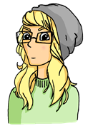
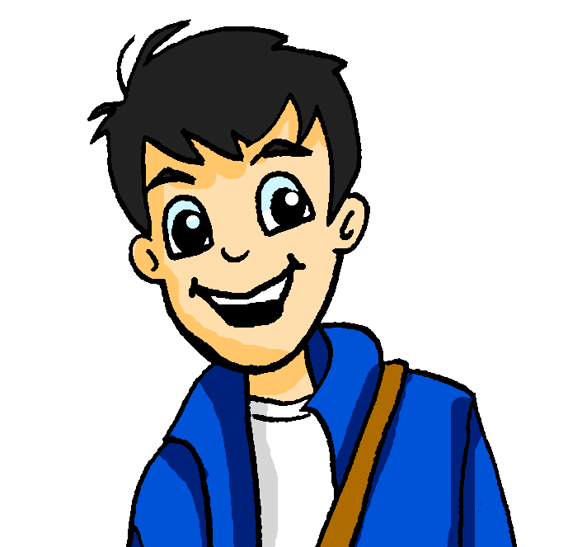
Wolfgang organisiert ein Date!
hören
Wolfgang und Heide gehen am Samstag shoppen! Sie planen den Tag. Was sagen sie?
1
wir gehen
gehen wir
2
ich finde
finde ich
3
ich denke
denke ich
4
ich chille
chille ich
5
ich schlafe
schlafe ich
6
ich sehe
sehe ich
7
wir können
können wir
Notes:
Timing: 5 minutes
Aim: To practise aural comprehension of word order patterns WO1 and WO2.
Procedure:
1. Teacher should remind students to listen for the presence or absence of a time phrase.
2. Audio, with time phrases blanked out, plays on number clicks.
3. Anwers are animated on the next slide.
Transcript:
1. Na, Heidi! Am Samstag [beep] shoppen! Toll!
2. Hi, Wolfgang! Ja, richtig! [beep] die Idee super. Wann machen wir das?
3. Hmm … am Nachmittag, [beep]. Oder früh am Abend.
4. Das ist aber spät! Am Abend [beep].
5. Ja, ja … aber [beep] am Wochendende viel. Schlafen ist wichtig!
6. Okaaay … dann [beep] dich am Samstagnachmittag. Aber bitte früh am Nachmittag.
7. Na, gut … [beep] danach aber Eis essen, nicht wahr?

Slide 23
Antworten
hören
Wolfgang und Heide gehen am Samstag shoppen! Sie planen den Tag. Was sagen sie?
1
wir gehen
gehen wir
2
ich finde
finde ich
3
ich denke
denke ich
4
ich chille
chille ich
5
ich schlafe
schlafe ich
6
ich sehe
sehe ich
7
wir können
können wir
Notes:
Timing: 2 minutes
Aim: To provide the answers to the listening exercise on the previous slide.
Procedure:
1. Full audio, with time phrases included, plays on number clicks.
2. Answers revealed on clicks.
3. On completion, teachers may wish to check comprehension by clicking the numbers again to play through the dialogue in full, and ask students to summarise the content in two sentences in English. (Example summary: Wolfgang is trying to make plans later in the day, because he is lazy. Heidi suggests meeting earlier, and Wolfgang agrees on the condition they get ice cream afterwards!)
Transcript:
1. Na, Heidi! Am Samstag gehen wir shoppen! Toll!
2. Hi, Wolfgang! Ja, richtig! Ich finde die Idee super. Wann machen wir das?
3. Hmm … am Nachmittag, denke ich. Oder früh am Abend.
4. Das ist aber spät! Am Abend chille ich.
5. Ja, ja … aber ich schlafe am Wochenende viel. Schlafen ist wichtig!
6. Okaaay … dann sehe ich dich am Samstagnachmittag. Aber bitte früh am Nachmittag.
7. Na, gut … wir können danach aber Eis essen, nicht wahr?

Slide 24
Und was machst du? (Beispiel 1)
sprechen / hören / schreiben
A | Start your sentence (silently) | Finish your sentence (out loud)
1. | Am Montag
… esse ich ein Butterbrot.
B | Circle the correct beginning | Write your partner’s sentence
1. | Am Montag / [-]
esse ich ein Butterbrot.
Notes:
CLASSROOM VERSION (a self-study version can be found on slides 27-30)
Timing: 8 minutes (total for slides 24-27)
Aim: To practise aural recognition and oral production of WO1 and WO2 patterns in German.
Teachers can use this slide and the slide that follows to illustrate this paired speaking task, which asks students to use word order to indicate whether a sentence begins with a time phrase or not. Printable versions of the cue cards and answer cards can be found on the portal alongside this resource.
Note: This activity might feel a little forced (it is!), but it is intended to get learners to actively choose between the two contrasting word orders in a speaking setting. It sets up for a freer activity next week.
Procedure:
1. To model the task using this slide, the teacher should first check that students know which word or (1 or 2) must be used after ‘Am Montag’. Ask students how the second part of Mia’s sentence will sound. Answer revealed on a click. On another click, Wolfgang’s answers appear. He has correctly circled the time phrase, haveig recognised word order 2, and has correctly transcribed the rest of the sentence. Note that the sentence starts with a lower-case letter because it is not the beginning of the sentence.
2. Explain that Partner A uses the cue card to tell their partner about things they like to do. They only say the part of the sentence in the second column out loud.
Remind students to think about which word order to use for each sentence.
3. Explain that Partner B writes down their partner’s sentence on their answer card. Remind students to look at the word order to determine what is the correct beginning.
4. When finished, partners compare cards and swap roles.
Word frequency (1 is the most frequent word in German):
Verbs: spielen (197), schwimmen (1832), essen (658), Rad fahren [2156/169], (1789), tanzen (2007), gehen (69), hören (1557), lesen (323), essen (655),
Noun: Fußball [1497], Schlagzeug >4043), Eis (2818), Fußball (1497), Musik (469), Buch (295), Pizza (>5000), Theater (725)
Adverbials: (am) Mittwoch (1091), heute (121), Wochenende (764), (zu) Donnerstag (1332), (im) Sommer (704), oft (215), (am) Freitag (1277)
Source: Jones, R.L & Tschirner, E. (2011). A frequency dictionary of German: Core vocabulary for learners. London: Routledge.

Slide 25
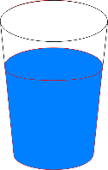
Und was machst du? (Beispiel 2)
sprechen / hören / schreiben
A | Start your sentence (silently) | Finish your sentence (out loud)
1. | [-]
…
Ich trinke
Wasser.
B | Circle the correct beginning | Write your partner’s sentence
1. | Am Montag / [-]
Ich trinke Wasser.
Notes:
This slide continues the modelling of the speaking task on the previous slide.

Slide 26
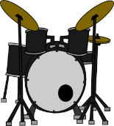
Was mache ich? (Q)
sprechen
A | Start your sentence (silently) | Finish your sentence (out loud)
1. | Am Mittwoch
2. | [-]
3. | [-]
4. | Heute
5. | Am Wochenende
Notes:
Timing: 6 minutes
Aim: This is the task prompt itself.
Procedure:
1. Partner A reads the second part of the sentence out loud. They can check their answers on the next slide.
2. Partner B writes down their partner’s sentence on their answer card.

Slide 27
Was mache ich? (A)
sprechen
A | Start your sentence (silently) | Finish your sentence (out loud)
1. | Am Mittwoch | spiele ich Fußball.
2. | [-] | Ich spiele Schlagzeug.
3. | [-] | Ich schwimme.
4. | Heute | esse ich Eis.
5. | Am Wochenende | fahre ich Rad.
Notes:
Timing: 2 minutes
Aim: This answer slide shows what Partner A should have said/what Partner B should have written.
Procedure:
1. Both partners check what they should have said/written.

Slide 28
Was macht sie? (Q)
hören / schreiben
 | Choose the correct beginning | Write the rest of the sentence
 | Am Donnerstag / [-]
 | Oft / [-]
 | Am Wochenende / [-]
 | Am Freitag / [-]
 | Am Nachmittag / [-]
1
2
3
4
5
Notes:
SELF-STUDY VERSION (a classroom version can be found on slides 26-27)
Timing: 6 minutes
Aim: To provide a self-study version of the activity explained on the previous slides.
Procedure:
1. Students click on ‘play’ next to each question to hear a sentence with the beginning obscured with a beep.
2. Students decide based on the word order they hear whether the sentence begins with a time phrase or not. They can either highlight/underline the correct beginning, or delete the incorrect one.
3. Then, students transcribe the rest of the sentence.
4. Answers are shown on the next slide.

Slide 29
Was macht sie? (A)
hören / schreiben
 | Choose the correct beginning | Write the rest of the sentence
 | Am Donnerstag | tanze ich.
 | Oft | höre ich Musik.
 | [-] | Ich lese Bücher.
 | Am Freitag | esse ich Pizza.
 | [-] | Ich gehe ins Theater.
1
2
3
4
5
Notes:
SELF-STUDY VERSION (a classroom version can be found on slides 26-27)
Timing: 2 minutes
Aim: To provide the answers to the self-study activity on the previous slide.
Procedure:
1. The answers appear togeter with this slide – no clicking required.
2. Click on the numbered audio buttons to hear the full audio, with time adverbials included where these occur.

Slide 30
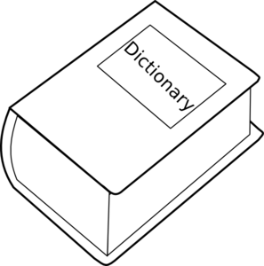
Meine Woche
schreiben
Wie ist deine Woche? Was machst du jeden Tag?
Mo | Am Montag …
Di | Am Dienstag …
Mi | Ich …
Do | Am Donnerstag …
Fr | Ich …
Sa | Ich …
So | Am Sonntag …
Wörterbuch
Notes:
Timing: 10 minutes
Aim: To practise written production of sentences with WO1 and WO2 in a freer context. In this free production exercise, students are first encouraged to use dictionaries to find out how to say the activities they do in their free time in German.
Procedure:
1. Students should sketch a grid in their workbooks and try to write a different activity for each day.
2. Students should use WO1 three times and WO2 twice, as indicate by the starts of sentences.
Note: If there is not enough time to complete this exercise, it should be set for homework. Students will use their answers in the spoken exercise in next week’s lesson, which follows on from this one.

Slide 31
Hausaufgaben
Vocabulary Learning Homework (Term 3.1, Week 2)
Quizlet link: Term 2.2 Mashup
Follow the link above to practise all vocabulary learned in Year 7 so far!
Notes:
Use this slide to set the homework.

