Slide 1
Session 4: Assessment … or: how do we know whether the pupils are getting it, and how can it fit into our existing reporting structures?
Stuart Williams
Dartford Grammar School
20/11/20

Slide 2
Principles
If we are focusing on phonics, vocabulary and grammar in our teaching, we also need to focus on these in our assessment.
We also need to understand how students are able to apply their knowledge more holistically and respect existing KS3 reporting systems (which are often set up to report on listening, speaking, reading and writing).
We should avoid excessive demands on teacher workload.

Slide 3
‘Achievement’ Vs. ‘Applying your knowledge’ tests
The ‘Achievement’ tests (February & June each year)
Tests to what extent students have learnt everything up to test
Assesses a principled sample of P,V, and G
The ‘Applying your knowledge’ test (June each year)
Brings together PVG in more holistic assessments
As ‘knowledge’ turns to ‘skill’: more recognisable listening, reading, speaking and writing tasks.
Assesses ability to apply knowledge in context through:
listening comprehension,
oral picture description,
short translation tasks.
Notes:
The test development involved many people from NCELP, and in particular I acknowledge here the work of Rowena Kasprowicz from the University of Reading for her work on the grammar tests, Robert Woore from the University of Reading on the phonics tests, and Natalie Finlayson, University of York, on the vocabulary tests.

Slide 4
Availability of NCELP assessments
Paper assessments are currently available, in all three languages, for:
Year 7 Achievement tests for Feb and June testing cycle (undergoing minor revisions for new release 25th Jan 2021)
Year 7 Applying your knowledge tests for June testing cycle
Paper assessments will be available 25th Jan 2021 in all three languages for:
Year 8 Achievement tests for February testing cycle

Slide 5
Online tests
NCELP is also developing online assessments, currently available to schools in the NCELP network
Advantages of online testing include:
ease of delivery
control of the speed/timing
automated scoring
add items and randomise
ability to collate and analyse data on a large scale
Online tests can be made available to schools outside the NCELP network on request via enquiries@ncelp.org upon confirmation that the relevant NCELP SOW has been followed, specifying the language & year, since Sept 2020 (for y7) Sept 2019 (for y8).
Currently we estimate we can accommodate up to 50 such requests for the February tests, as we need to extract data and return scores to individual teachers
This session draws on examples from both paper and online assessments, but the question types and principles are identical

Slide 6
Principles
If we are focusing on phonics, vocabulary and grammar in our teaching, we also need to focus on these in our assessment.
We also need to understand how students are able to apply their knowledge more holistically and respect existing KS3 reporting systems (which are often set up to report on listening, speaking, reading and writing).
We should avoid excessive demands on teacher workload.

Slide 7
Assessment of phonics
PHONICS
ACHIEVEMENT
Principles of Phonics assessment
2. Question types and examples
Scoring and marking

Slide 8
1. Principles of Phonics assessment
PHONICS
ACHIEVEMENT
Objectives
To test knowledge of Symbol-Sound Correspondences (SSC) covered to date
Why are we testing this?
SSC knowledge is used
when reading aloud (including ‘inner voice’) – linked to reading comprehension, vocabulary acquisition (inter alia)
when listening (segmentation) and writing (spelling)
Testing is bidirectional: both sound → print and print → sound
transcription reading aloud

Slide 9
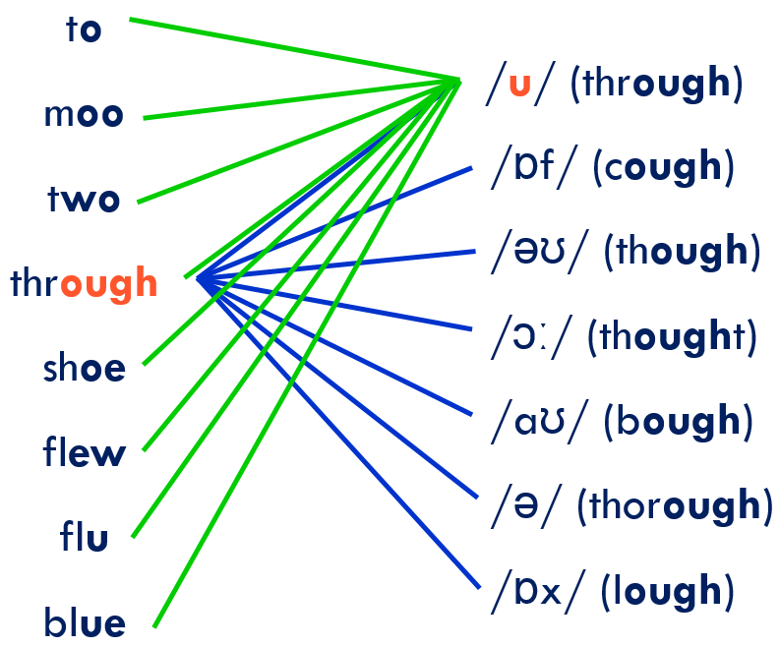
a. Sound to print
Transcription task – can they write what they hear?
At least we not assessing their English…

Slide 10
b. Print to sound
PHONICS
ACHIEVEMENT
Reading Aloud Test
Administered individually
Unfamiliar (but real!) words to test SSC knowledge (to stop them using existing knowledge of whole word pronunciations)

Slide 11
2. Question types
PHONICS
ACHIEVEMENT
For each language:
We listed all the target SSC covered in the SoW;
For each SSC, we identified 3 low-frequency words and ensured they were not covered in SoW, so that pupils are very unlikely to know them;
We tried to avoid words that look like English words.

Slide 12
Example 1 - reading aloud, reading → speaking
PHONICS
ACHIEVEMENT
Read the following list of German words aloud.
You won't know these words. Just say them as you think they should sound in German.
You will get marks for pronouncing the bold, underlined parts of each word.
If you’re not sure, don’t worry – just have a go and do your best.
15 items to read aloud

Slide 13
Example 2 – dictation, listening → writing
PHONICS
ACHIEVEMENT
You will hear 15 Spanish words. You will hear each word twice.
Complete the spelling of each word by filling in the missing letters.
There may be more than one way of spelling them. Just type in any one possible spelling for each word.
You won’t know these words. Don’t worry – just do your best!
_ mbral
_ _ ma
_ _ mba
_ _ rafa
_ _ na
a _ _ oba

Slide 14
3. Scoring – reading aloud
This is our focus for the phonics assessment!
A note on ‘foreign accent’. Two dimensions to accuracy in reading aloud:
Accuracy of SSC knowledge: how graphemes / symbols are mapped onto L2 phonemes / sounds
Accuracy of pronunciation of L2 phonemes / sounds.
< v e a u >
/ vjʉ / / viː əʊ /
✗
✓
✓
/ vəʊ /
/ vo /
A foreign accent is hard to shift even for the most dedicated learner (even if they want to)
You can be intelligible (and comprehensible) with a foreign accent.
We are testing SSC knowledge (phonics) rather than native-like pronunciation (phonetics).

Slide 15
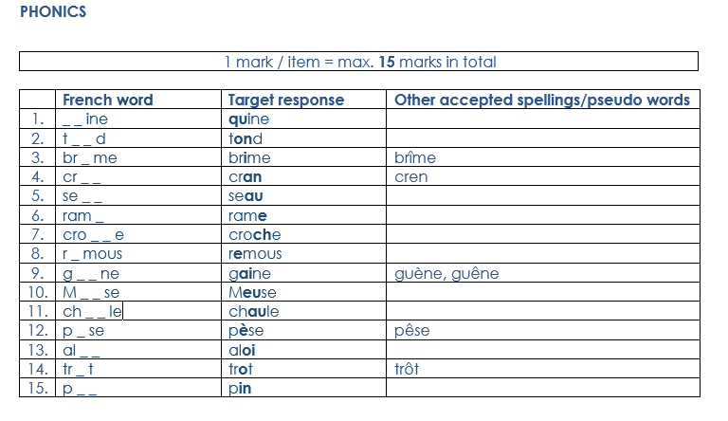
3. Marking
PHONICS
ACHIEVEMENT
Dictation task (can be automatically scored by the software platform ☺
Reading aloud task (has to be marked individually by teachers as machines don’t yet recognise learner speech in these three languages! ☹
Workload implications – need to make individual decisions about this.
Only takes 1-2 minutes per pupil, and, with a little practice, can be marked ‘live’.
Could use this formatively, and so just sample a few pupils in your class to garner a range of achievement to date?

Slide 16
Assessment of vocabulary
VOCAB
ACHIEVEMENT
Principles of vocabulary testing
Question types and examples
Scoring and marking

Slide 17
1. Principles of vocab testing
VOCAB
ACHIEVEMENT
Objectives
To test a) breadth and b) depth of knowledge of vocabulary studied
Considerations
Syllabus-based achievement test
Productive vs receptive knowledge
Recognition vs recall
Oral and written modalities

Slide 18
a. Breadth of knowledge
VOCAB
ACHIEVEMENT
Objective 1: To find out how many words students know
Tests knowledge of a sample of words from SOW
All words in the SOW appear in the test once only
Good coverage of different parts of speech (noun : verb : other)
(French: 2:1:2; Spanish: 3:1:3; German: 2:1:3)

Slide 19
b. Depth of knowledge
VOCAB
ACHIEVEMENT
Objective 2: To find out how well students know target words
Recognition tests
multiple choice activities whereby learners select or guess the correct response from the alternatives given
Recall tests
demands the production of responses from memory
more difficult than recognition because learners must search for the correct response from the stores in their mind

Slide 20
2. Question types
VOCAB
ACHIEVEMENT
80 test items
Listening
20 x spoken meaning recognition
Reading
20 x written
meaning recall
Writing
20 x written
form recall
Speaking
20 x spoken
form recall
40 receptive items
40 productive items
Bias towards recall:
encourages active vocabulary building from the beginning
minimises use of multi-choice format - average score increase of 16.7% due to guessing in a 6-choice format (Stewart & White, 2011) and up to 25% in 4-choice (Stewart 2014)

Slide 21
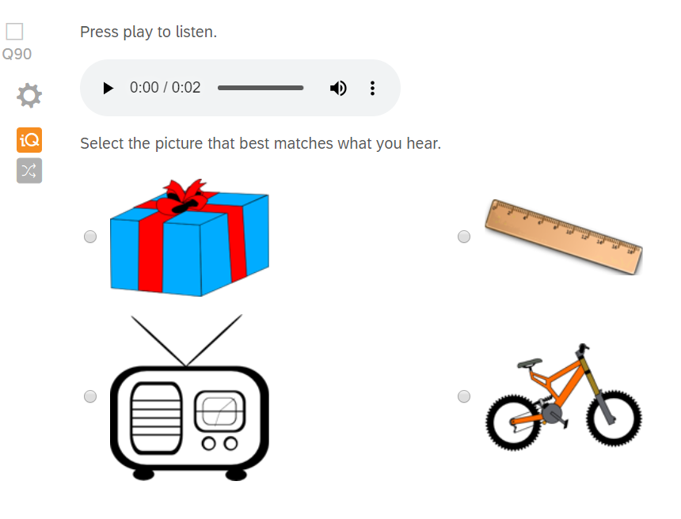
Example 1
VOCAB
ACHIEVEMENT
Modality
Listening
Type of activity
Spoken meaning recognition
Knowledge tested
Meaning (definition)

Slide 22
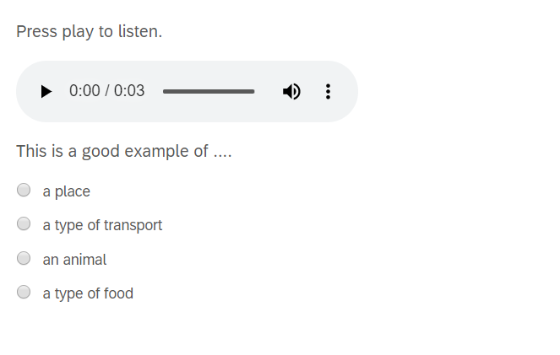
Example 2
VOCAB
ACHIEVEMENT
Modality
Listening
Type of activity
Spoken meaning recognition
Knowledge tested
Meaning (definition) Meaning (association)

Slide 23
Example 3
VOCAB
ACHIEVEMENT
Modality
Reading
Type of activity
Written meaning recall
Knowledge tested
Meaning (definition)

Slide 24
Example 4
VOCAB
ACHIEVEMENT
Modality
Writing
Type of activity
Written form recall
Knowledge tested
Form (written)
Meaning (definition)

Slide 25
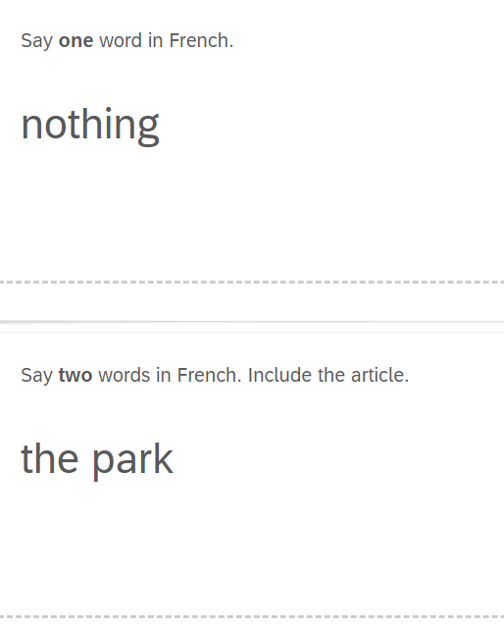
Example 5
VOCAB
ACHIEVEMENT
Modality
Speaking
Type of activity
Spoken form recall
Knowledge tested
Form (spoken)
Meaning (definition)

Slide 26
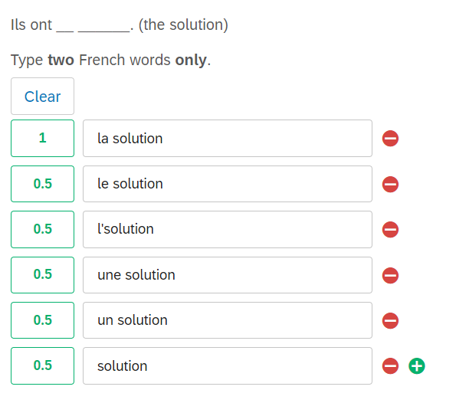
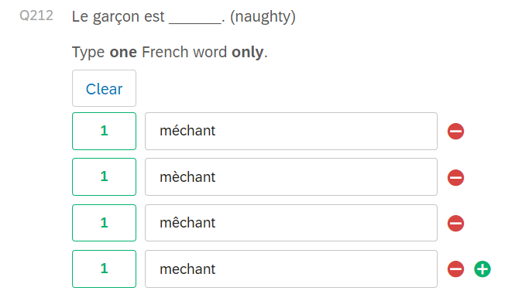
3. Scoring (tolerance)
For now, after 18 weeks of lessons, we recommend tolerance of accent errors and semi-tolerant of article errors
if lemma (word) is correct
For now, after 18 weeks lessons, we are semi-tolerant of article and accent errors,
if lemma (word) is correct
Notes:
This is a production test and so this is for illustrative purposes only (i.e. computer-based tests are not available)

Slide 27
Assessment of grammar
GRAMMAR
ACHIEVEMENT
Principles of grammar testing
2. Example items
3. Scoring and marking

Slide 28
1. Principles of grammar testing
GRAMMAR
ACHIEVEMENT
Objective
To test receptive and productive knowledge of grammar studied
Considerations
Isolating grammatical knowledge; disassociating from vocab knowledge
Ensuring coverage of the range of grammar features taught
Receptive knowledge (recognising meaning as well as form)
In reading and listening
Productive knowledge (accuracy of production)
In writing and speaking

Slide 29
2. Example 1
GRAMMAR
ACHIEVEMENT
Testing written and aural receptive knowledge
Testing ability to recognise meaning as well as form
Multiple choice; here matching to English equivalent

Slide 30
2. Test creation: example question
Example 2
GRAMMAR
ACHIEVEMENT
Testing written and aural receptive knowledge
Testing ability to recognise meaning as well as form
Multiple choice; here matching to TL alternative
Isolating recognition of gender and number

Slide 31
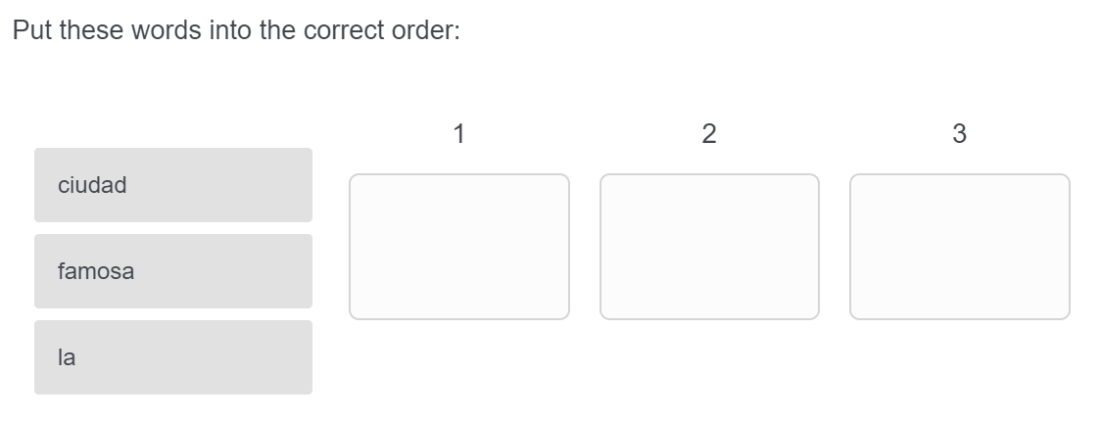
Example 3
GRAMMAR
ACHIEVEMENT
Isolating productive knowledge of syntax (word order)
Drag-and-drop into correct order

Slide 32
2. Test creation: example items
Example 4
GRAMMAR
ACHIEVEMENT
Testing written productive knowledge
Testing ability to accurately produce the structure
Open text box
Testing understanding of question formation
(Check pupils understand that ‘do’ auxiliary is not needed)
Isolating grammatical knowledge by providing verb infinitive
(Avoid missing answers due to lack of vocabulary)

Slide 33
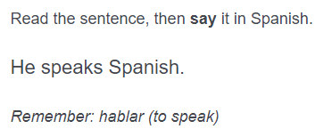
Example 5
GRAMMAR
ACHIEVEMENT
Testing oral productive knowledge
Testing ability to accurately produce the structure(s)
Combining a number of structures within each item
Testing subject-verb agreement.
Isolating grammatical knowledge (from vocab knowledge) by providing verb infinitive

Slide 34
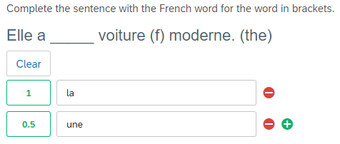
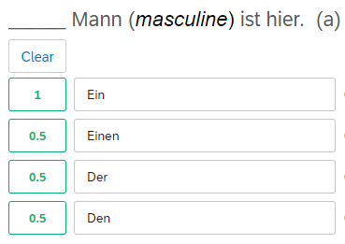
3. Scoring
GRAMMAR
ACHIEVEMENT
Our mark scheme recommends:
0.5 mark for incorrect indefinite article (but gender correct)
0.5 mark for incorrect case
(but gender correct)
0.5 mark for incorrect indefinite article (but gender correct)
0.5 mark for incorrect case and definite article (but gender correct)

Slide 35
PVG in terms of “LRSW” in achievement tests
 | Listening | Reading | Speaking | Writing | Total
Phonics | 15 |  | 15 |  | 30
Vocabulary | 20 | 20 | 20 | 20 | 80
Grammar | 8 | 24 | 19 | 20 | 71
Total | 43 | 44 | 54 | 40 | 181

Slide 36
Principles
If we are focusing on phonics, vocabulary and grammar in our teaching, we also need to focus on these in our assessment.
We also need to understand how students are able to apply their knowledge more holistically and respect existing KS3 reporting systems (which are often set up to report on listening, speaking, reading and writing).
We should avoid excessive demands on teacher workload.

Slide 37
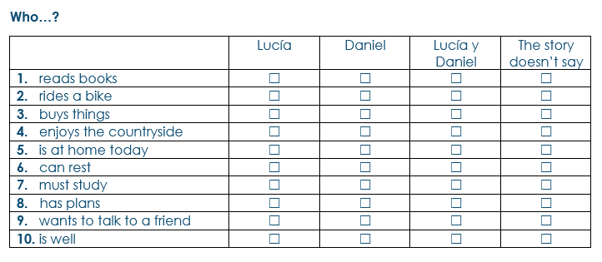
Applying your Knowledge test - Listening
Notes:
Now I am going to show you three extracts from the Applying Your Knowledge tests- these are more holistic assessments, but still drawing carefully - very systematically – from the words, sounds, grammar that have been covered up to this point.
Each item of vocabulary has been actively practised at least three times in learning homeworks, spaced at about 3-5 and 9 -12 weeks after it was first encountered,
and incorporated into at least three separate lessons.
Each grammar point has been revisited with different vocabulary. This revisiting of grammar is carefully tracked on the Grammar Tracker tab on the SOW.

Slide 38
Applying your Knowledge test - Reading
Notes:
Now I am going to show you three extracts from the Applying Your Knowledge tests- these are more holistic assessments, but still drawing carefully - very systematically – from the words, sounds, grammar that have been covered up to this point.
Each item of vocabulary has been actively practised at least three times in learning homeworks, spaced at about 3-5 and 9 -12 weeks after it was first encountered,
and incorporated into at least three separate lessons.
Each grammar point has been revisited with different vocabulary. This revisiting of grammar is carefully tracked on the Grammar Tracker tab on the SOW.
Translation is an efficient way of testing comprehension of all of the content of the text in these early stages - whereas comprehension questions only test the specific part of the sentence which is the focus of the question. Thus, we have chosen translations for these very early tests in year 7 (when there is not very much vocabulary that has been covered).

Slide 39
Applying your Knowledge test - Writing
Notes:
Now I am going to show you three extracts from the Applying Your Knowledge tests- these are more holistic assessments, but still drawing carefully - very systematically – from the words, sounds, grammar that have been covered up to this point.
Each item of vocabulary has been actively practised at least three times in learning homeworks, spaced at about 3-5 and 9 -12 weeks after it was first encountered,
and incorporated into at least three separate lessons.
Each grammar point has been revisited with different vocabulary. This revisiting of grammar is carefully tracked on the Grammar Tracker tab on the SOW.

Slide 40
Applying your Knowledge test: Speaking
Before you start the test, please go to: vocaroo.com. It will open in a new tab.
Click the red record button, then come back to this test.
Look at the picture.
Describe it to a friend by saying these sentences in French:
1. Amir is wearing a green shirt.
2. It is nice weather in England today.
3. Three dogs are playing in the park.
4. There is an island and there are two bridges, but there is no café.
5. The church is in front of the big buildings.
To work out what to say, try to break each sentence into groups of words.
Notes:
This is from the French test from the end of year 7

Slide 41
Principles
If we are focusing on phonics, vocabulary and grammar in our teaching, we also need to focus on these in our assessment.
We also need to understand how students are able to apply their knowledge more holistically and respect existing KS3 reporting systems (which are often set up to report on listening, speaking, reading and writing).
We should avoid excessive demands on teacher workload.

Slide 42
Marking and scoring
All tests are available as paper versions
Elements that are available online are self-marking
Each test comes with accompanying guidance, transcripts, mark schemes and short/long scoring spreadsheets
Assessment materials are organised as collections on the Resource Portal e.g., Fr, Germ, Sp: year 7 term 2

Slide 43
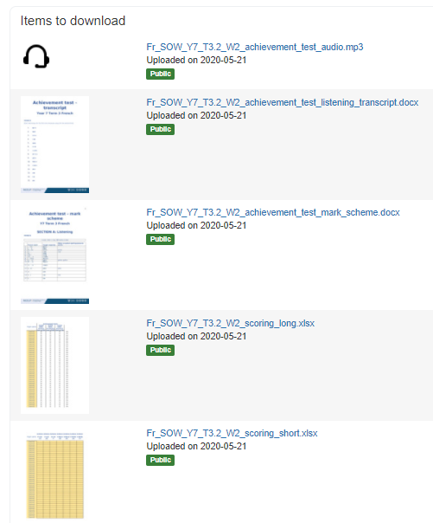
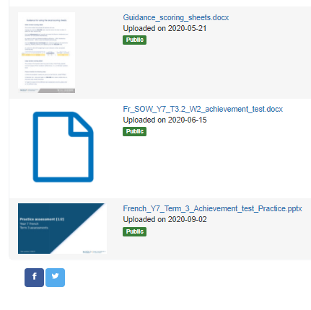
Assessment Collections

Slide 44
Want to give a flavour of the tests to pupils?
There are PowerPoint presentations and videos of teachers delivering a lesson to prepare pupils for the test at the Oak Academy website.
French | 1. Achievement test video prep lesson | 2. Applying your knowledge test video prep lesson
German | 1. Achievement test video prep lesson | 2. Applying your knowledge test video prep lesson
Spanish | 1. Achievement test video prep lesson | 2. Applying your knowledge test video prep lesson

Slide 45
Links to tests, audio files, mark schemes
Tests, including audio, transcripts and scorings spreadsheets are available in the
French, German & Spanish “test collections” on the NCELP Resource Portal. Quick links to the Y7 assessments are linked in the table below
 | Achievement Test | Mark Scheme | Applying Your Knowledge Test | Mark Scheme
French | Link | Link | Link | Link
German | Link | Link | Link | Link
Spanish | Link | Link | Link | Link

Slide 46
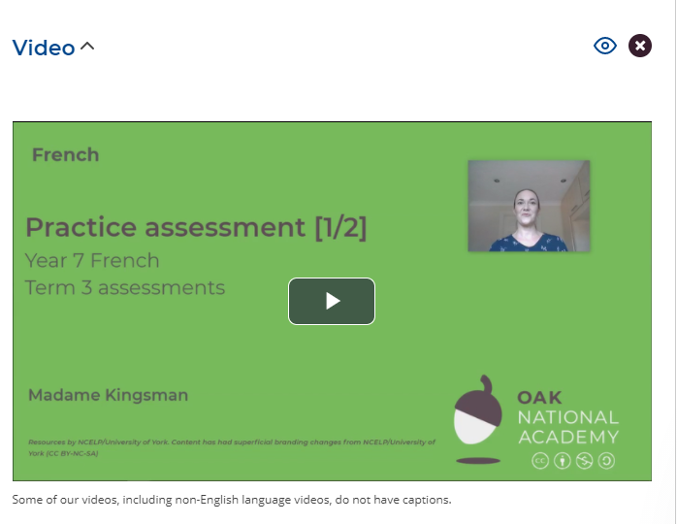
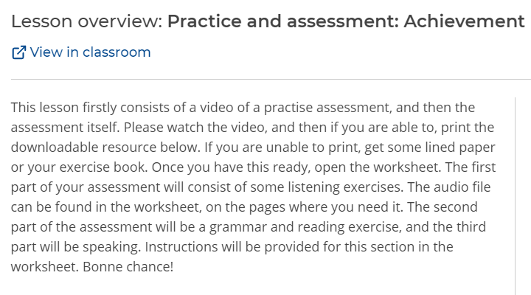
Oak Academy website
www.thenational.academy

Slide 47
Summary
The NCELP assessments ascertain the progress the pupils are making through the SOW content (achievement) and their ability to apply their knowledge (applying your knowledge).
They are designed to give a thorough judgment, using sound research as to what good progress looks like.
They assess progress on PVG and LRSW.
All tests are available in paper versions in collections, with all accompanying materials required.
Elements of the tests (listening and reading) can be completed on computer (self-marking) for NCELP schools.
Also, up to 50 others, who confirm they have followed the NCELP SOW, provide language, year group, and date pupils started NCELP SOW by emailing enquiries@ncelp.org (first come, first served)
Videoed preparation lessons are available on www.thenational.academy .

Slide 48
Session 4: Assessment
Q&A
Stuart Williams
Dartford Grammar School
20/11/20

