Slide 1
Examples
production
(Freer) production tasks eliciting personal response

Slide 2
Gramática/vocabulario
escribir
¡Eres un ladrón!
Write about what you and your partner in crime have (use ‘tengo’, ‘tiene’)
Remember to use un/una/unos/unas, depending on the gender and number of the noun.
(You’re a thief!)
Want to describe what you and your partner have? Use ‘es’ and an adjective (e.g. alto, blanco, nuevo, fantástico). Remember that adjectives need to agree with the gender of noun!
Notes:
7.1.1.5
Free writing activity
This could be done in class or at home, depending on the time available.
Timing: 10 minutes
Aim: to practise using indefinite articles and nouns in a freer written production activity
Procedure:
1. Explain to students the context and the need to use ‘tengo’ and ‘tiene’ (depending on who has what)
2. Students write their own sets of sentences in pairs
3. Students could then report back to the class, comparing what they have (tengo) and what their partner has (tiene).
4. After they have done this, students could re-read what they have written and see how many SSCs they can spot (e.g. L or LL, CA, CO, CU, A, O, E, I, U]. They could also practise reading the text aloud with their partner (this would be less daunting than reading to the group). The teacher can go around the classroom and listen as they do this.
Notes:
Students haven’t yet been taught that some nouns pluralise with –es. This comes in term 1.2, week 2. They might therefore be best advised to look for nouns that pluralise with –s here.
See next slide for ideas that students could be given.
Word frequency (1 is the most frequent word in Spanish): Source: Davies, M. & Davies, K. (2018). A frequency dictionary of Spanish: Core vocabulary for learners (2nd ed.). Routledge: London

Slide 3
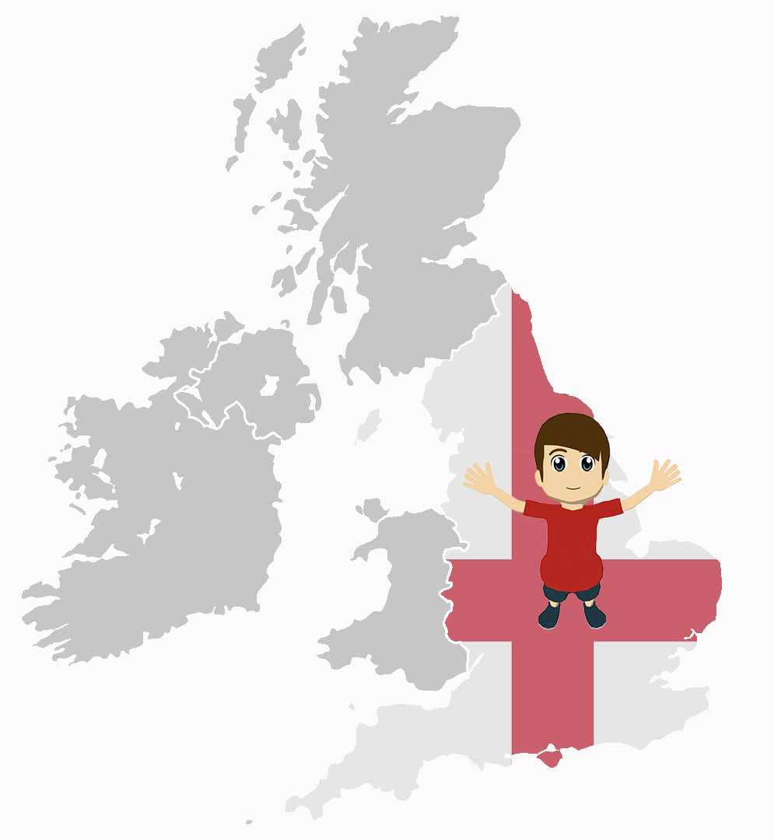
Gramática
escribir
Un ejemplo:
¿Cómo es Inglaterra?
Sheffield es barato.
Bristol y Oxford son caros.
Completa las frases.
1) ____________________ bonitos.
2) ____________________ barato.
3) ____________________ antiguos.
4) ____________________ pequeño.
5) ____________________ tranquilos.
6) _____________________feo.
7) _____________________raro.
8) _____________________caros.
Notes:
7.1.2.4
Writing activity
Timing: 8 minutes
Aim: to use ‘es’ and ‘son’ in written production in a freer context
Procedure:
1. Students need to pay attention to the adjective ending (whether it ends with –s or not) as a cue for writing about one or more than one city. They are using this receptively to direct their production of ‘es’ and ‘son’.
Word frequency (1 is the most frequent word in Spanish): bonito [891]; pequeño [202]; antiguo [446]; barato [2164]; raro [1005]; tranquilo [1073]; feo [2373]; caro [2179]
Source: Davies, M. & Davies, K. (2018). A frequency dictionary of Spanish: Core vocabulary for learners (2nd ed.). Routledge: London

Slide 4
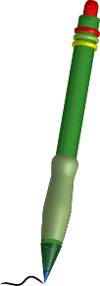
Gramática
escribir
En parejas
Escribe unas frases con ‘el’, ‘la’, ‘los’ o ‘las’.
Usa las imágenes y lee las palabras en inglés.
Un ejemplo:
is old
La película es antigua.
Las islas son famosas.
are famous
Notes:
7.1.2.6
Writing
Timing: 7 minutes (slides 39-40)
Aim: to practise producing the definite article (singular, plural), along with other previously taught features, in writing.
Procedure:
1. Use this slide to explain the writing activity on the next slide
Notes: Before starting this activity, we suggest that the teacher collects the prompt cards used in the speaking/listening activity, as these have the Spanish adjectives. Ideally, students should be able to recall the Spanish translation of the English adjectives here.
Word frequency (1 is the most frequent word in Spanish): pueblo [244]; equipo [373]; edificio [857]; plato [1808]; familia [233]; película [543]; vista [408]; isla [810]; pequeño [202]; bueno [98]; bonito [891]; feo [2373]; caro [2179]; simpático [3349]; tranquilo [1073]; blanco [372]
Source: Davies, M. & Davies, K. (2018). A frequency dictionary of Spanish: Core vocabulary for learners (2nd ed.). Routledge: London

Slide 5
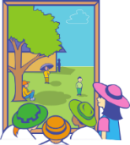
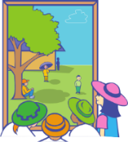
is good
Escribe unas frases.
La película es buena.
Usa ‘el’, ‘la’, ‘los’ o ‘las’.
[views]
are ugly
Las vistas son feas.
is nice
La familia es simpática.
[team]
is small
El equipo es pequeño.
[town]
is quiet
El pueblo es tranquilo.
are white
Los edificios son blancos.
La isla es bonita.
is pretty
are expensive
Los platos son caros.
Notes:
Prompts are taken from each of the sets of cards that students just used for speaking/listening.
Students should therefore be familiar with the meanings of the pictures and vocabulary needed for the activity.

Slide 6
escribir
…son simpáticas.
…es pequeño.
…es barata.
…es feo.
…son altos.
…son caras.
…son feas.
…es bonita.
E.g La planta es bonita.
E.g Los edificios son altos.
Notes:
Writing activity (more challenging option)
Timing: 8 minutes
Aim: to bring together previous learning of several features: 1) definite articles (singular, plural); 2) nouns (singular and plural); 3) and adjective gender agreement. These are used both receptively (as prompts) and in production.
To give students the opportunity to use a range of previously taught nouns.
Procedure:
1. Teacher clicks and one of the blue sentence endings will flash.
2. Students will look at this and create some of their own sentence starters to match it. The sentence starter will need to agree in number and gender with the sentence ending in order to be grammatical.
Word frequency (1 is the most frequent word in Spanish): pequeño [202]; bonito [891]; feo [2373]; caro [2179]; simpático [3349]; alto¹ [231]; barato [2164]
Source: Davies, M. & Davies, K. (2018). A frequency dictionary of Spanish: Core vocabulary for learners (2nd ed.). Routledge: London

Slide 7
Una tarea escrita
escribir
Escribe diez frases.
Include
a) what you want for Christmas.
b) what you give for Christmas.
c) what your friend / family member wants for Christmas.
d) what your friend / family member gives for Christmas.
Usa la forma correcta de ‘dar’ o ‘querer’.
Notes:
7.1.2.7
Writing activity
Timing: 10-15 minutes
Aim: to use ‘dar’ and ‘querer’ in written production (singular persons only)
Procedure:
1. If students need to recap the different forms of ‘dar’ and ‘querer’ before starting, refer to the accompanying help slide (see next slide).
2. They then write the sentences, using different verb forms to talk about different people
Note:
1. Dictionaries would be useful for this task, since students may wish to use previously untaught vocabulary.
2. Students could also say who they give to, using ‘a’. This could either require use of indefinite article (…a un amigo) or the use of ‘mi’ (…a mi madre). ‘Mi’ isn’t formally taught until Term 3, but students will naturally want to use it to refer to family members.
3. This activity could also be given for homework.

