Slide 1
Explaining likes and dislikes
weil vs denn
SSC [v] vs [w]: revisited
Y8 German
Term 1 - Week 7 - Lesson 13
Author name(s): Stephen Owen / Rachel Hawkes
Artwork: Steve Clarke
Date updated: 21/07/21
Notes:
Learning outcomes (lesson 1):
Revisiting SSC [v] vs [w]
Introduction of weil and denn
Word frequency (1 is the most frequent word in German):
1.1.7 (introduce) lustig [1973] interessant [810] spannend [1810] wunderbar [1603] notwendig [742] unmöglich [1879] warum? [192] weil [88] denn [93] 1.1.3 (revisit) gefunden [103] Sie [10] Bad [1577] Brief [813] Dezember [1527] Hunger [2097] Kaffee [1299] Küche [960] Lust [1407] März [987] Schmerz [1483] Wohnung [418] müde [2000] noch [33] oben [100] unten [590] 7.3.1.6 (revisit) dauern [698] erreichen¹ [305] fahren² [169] schaffen¹ [320] suchen [293] viel, viele [60] das Land¹ [146] Schottland [>4034] Schweiz [>4034] Stunde¹ [262] Wien [>4034] dort [134] normalerweise [1898]
Source: Jones, R.L. & Tschirner, E. (2019). A frequency dictionary of German: core vocabulary for learners. Routledge

Slide 2
w
Welt
Notes:
Timing: 1 minute
Aim: To introduce/consolidate SSC [w]
Procedure: 1. Present the letter(s) and say the [w] sound first, on its own. Students repeat it with you. 2. Bring up the word ”Welt” on its own, say it, students repeat it, so that they have the opportunity to focus all of their attention on the connection between the written word and its sound.
3. A possible gesture for this would be to start with your hands above your head and draw them down, out and then back into the body, tracing the shape of the world.
4. Roll back the animations and work through 1-3 again, but this time, dropping your voice completely to listen carefully to the students saying the [w] sound, pronouncing ”Welt” and, if using, doing the gesture. Word frequency (1 is the most frequent word in German): Welt [190] Source: Jones, R.L. & Tschirner, E. (2006). A frequency dictionary of German: core vocabulary for learners. Routledge

Slide 3
v
vor
Notes:
Timing: 1 minute
Aim: To introduce/consolidate SSC [v]
Procedure: 1. Present the letter(s) and say the [v] sound first, on its own. Students repeat it with you. 2. Bring up the word ”vor” on its own, say it, students repeat it, so that they have the opportunity to focus all of their attention on the connection between the written word and its sound.
3. A possible gesture for this would be to hold your hands, left in front of right, in front of your body, palms facing inward. Quickly move the right hand over the top of the left, as you say ‘vor’, to mime ‘in front’.
4. Roll back the animations and work through 1-3 again, but this time, dropping your voice completely to listen carefully to the students saying the [v] sound, pronouncing ”vor” and, if using, doing the gesture. Word frequency (1 is the most frequent word in German): vor [55] Source: Jones, R.L. & Tschirner, E. (2006). A frequency dictionary of German: core vocabulary for learners. Routledge

Slide 4
Phonetik
hören / schreiben
Hörst du [V] oder [W] oder beide?
 |  | [V] | [W]
 | voll [full]
 | Wettbewerb [competition]
 | Verantwortung [responsibility]
 | wunderbar [wonderful]
 | verweisen [to refer, expel]
 | relativ [relative]
1
2
3
4
5
6
Notes:
Timing: 5 minutes Aim: To practise differentiating between the two German SSC [v] and [w] in the spoken modality, which is tricky because of the pronunciation crossover between English [f] and German [v] and English [v] and German [w]. Procedure: 1. Write 1-6.
2. Listen to the words (click on audio buttons) and tick the appropriate column, according to whether you hear [v], [w] or both.
3. Click on the mouse to reveal the correct tick and also the words themselves (together with their English meanings).
Transcript: 1. voll
2. Wettbewerb
3. Verantwortung
4. wunderbar
5. verweisen
6. relativ Word frequency (1 is the most frequent word in German): voll [388] Wettbewerb [1493] Verantwortung [1104] wunderbar [1604] verweisen [1670] relativ [571] Source: Jones, R.L. & Tschirner, E. (2006). A frequency dictionary of German: core vocabulary for learners. Routledge

Slide 5
Vokabeln
hören
Hör die Wörter an... Welches Wort auf Deutsch ist...
 |  | (a) | (b) | (c) | (d)
 | a question word
 | a month of the year
 | a room in the house
 | a drink
 | something written
 | a country
1
warum?
2
März
3
Küche
4
Kaffee
5
Brief
6
6
Schottland
Notes:
Timing: 5 minutes Aim: To practise recognition (listening modality) of words in this week’s new and revisited vocabulary sets. Procedure: 1. Write 1-6.
2. Listen to the sets of four words (click audio buttons) and identify which word (a, b, c, or d) of each set falls into the category shown. Write the corresponding letter.
3. Click on the mouse to show the correct ticks and also the correct words themselves.
Transcript: 1) a question word - a) weil b) denn c) warum d) viel
2) a month of the year – a) Bad b) gefunden c) notwendig d) März
3) a room in the house – a) Küche b) Wien c) Lust d) Schweiz
4) a drink – a) unten b) Hunger c) spannend d) Kaffee
5) something written – a) Sie b) Brief c) oben d) Land
6) a country – a) erreichen b) wunderbar c) schaffen d) Schottland Word frequency (1 is the most frequent word in German):
1.1.7 (introduce) lustig [1973] interessant [810] spannend [1810] wunderbar [1603] notwendig [742] unmöglich [1879] warum? [192] weil [88] denn [93] 1.1.3 (revisit) gefunden [103] Sie [10] Bad [1577] Brief [813] Dezember [1527] Hunger [2097] Kaffee [1299] Küche [960] Lust [1407] März [987] Schmerz [1483] Wohnung [418] müde [2000] noch [33] oben [100] unten [590] 7.3.1.6 (revisit) dauern [698] erreichen¹ [305] fahren² [169] schaffen¹ [320] suchen [293] viel, viele [60] das Land¹ [146] Schottland [>4034] Schweiz [>4034] Stunde¹ [262] Wien [>4034] dort [134] normalerweise [1898]
Source: Jones, R.L. & Tschirner, E. (2006). A frequency dictionary of German: core vocabulary for learners. Routledge

Slide 6
Vokabeln
lesen
Welches Wort ist das?
 |  | Antwort
1
Der letzte Monat im Jahr ist ______________ .
Dezember
2
Dort kann man in einer ________ wohnen. (flat)
Wohnung
3
Das kann man nicht machen. Es ist ___________ (impossible).
unmöglich
4
Du hast nicht geschlafen. Du bist noch __________ (tired).
müde
5
Normalerweise kann die Reise eine Stunde __________ (last).
dauern
Notes:
Timing: 5 minutes (both slides) Aim: To practise recognition (reading modality) of words in this week’s new and revisited vocabulary sets. Procedure: 1. Write 1-10 (6-10 are on next slide).
2. Read the sentences and decide which word is defined, or fills the gap, in each sentence as appropriate. The English for the words in the gaps is given in brackets. Write the corresponding German word.
3. Click on the mouse to show the correct words.
4. Continue on next slide.
Answers:
1) Dezember
2) die Wohnung
3) unmöglich
4) müde
5) dauern Word frequency (1 is the most frequent word in German):
1.1.7 (introduce) lustig [1973] interessant [810] spannend [1810] wunderbar [1603] notwendig [742] unmöglich [1879] warum? [192] weil [88] denn [93] 1.1.3 (revisit) gefunden [103] Sie [10] Bad [1577] Brief [813] Dezember [1527] Hunger [2097] Kaffee [1299] Küche [960] Lust [1407] März [987] Schmerz [1483] Wohnung [418] müde [2000] noch [33] oben [100] unten [590] 7.3.1.6 (revisit) dauern [698] erreichen¹ [305] fahren² [169] schaffen¹ [320] suchen [293] viel, viele [60] das Land¹ [146] Schottland [>4034] Schweiz [>4034] Stunde¹ [262] Wien [>4034] dort [134] normalerweise [1898]
Source: Jones, R.L. & Tschirner, E. (2006). A frequency dictionary of German: core vocabulary for learners. Routledge

Slide 7
Vokabeln
lesen
Was ist das?
 |  | Antwort
6
Der Film ist sehr __________ (funny).
lustig
7
______ kann man viele Autos fahren (there).
dort
8
Was ____________ Sie? (looking for).
suchen
9
Ich schreibe zu viel! Ich habe __________ in der Hand (pain).
Schmerzen
10
Deine Idee ist ______________ (interesting).
interessant
Notes:
This slide is the continuation of the previous slide.
Answers:
6) lustig
7) dort
8) suchen
9) Schmerzen
10) interessant Word frequency (1 is the most frequent word in German):
1.1.7 (introduce) lustig [1973] interessant [810] spannend [1810] wunderbar [1603] notwendig [742] unmöglich [1879] warum? [192] weil [88] denn [93] 1.1.3 (revisit) gefunden [103] Sie [10] Bad [1577] Brief [813] Dezember [1527] Hunger [2097] Kaffee [1299] Küche [960] Lust [1407] März [987] Schmerz [1483] Wohnung [418] müde [2000] noch [33] oben [100] unten [590] 7.3.1.6 (revisit) dauern [698] erreichen¹ [305] fahren² [169] schaffen¹ [320] suchen [293] viel, viele [60] das Land¹ [146] Schottland [>4034] Schweiz [>4034] Stunde¹ [262] Wien [>4034] dort [134] normalerweise [1898]
Source: Jones, R.L. & Tschirner, E. (2006). A frequency dictionary of German: core vocabulary for learners. Routledge

Slide 8
Weil und denn - because
Grammatik
Three, Yes! The word ‘weil’ kicks the verb to the end of the clause. But the meaning is the same as denn + Word Order 1.
Weil and denn both mean ‘because’ in German.
Unlike the English example here, in German there is always a comma before weil or denn.
Denn is followed by Word Order 1:
Ich mag Sport, denn es ist lustig.
Weil is followed by Word Order 3:
I like sport because it is enjoyable.
Ich mag Sport, weil es lustig ist.
Weil and denn are a type of word called conjunctions.
They connect clauses or sentences.
Notes:
Timing: 2 minutes Aim: To introduce the conjunctions denn and weil, covering the use of the comma before each and the word order implications. Procedure: 1. Click on the mouse to animate the explanation.
2. Ensure student understanding at each stage.

Slide 9
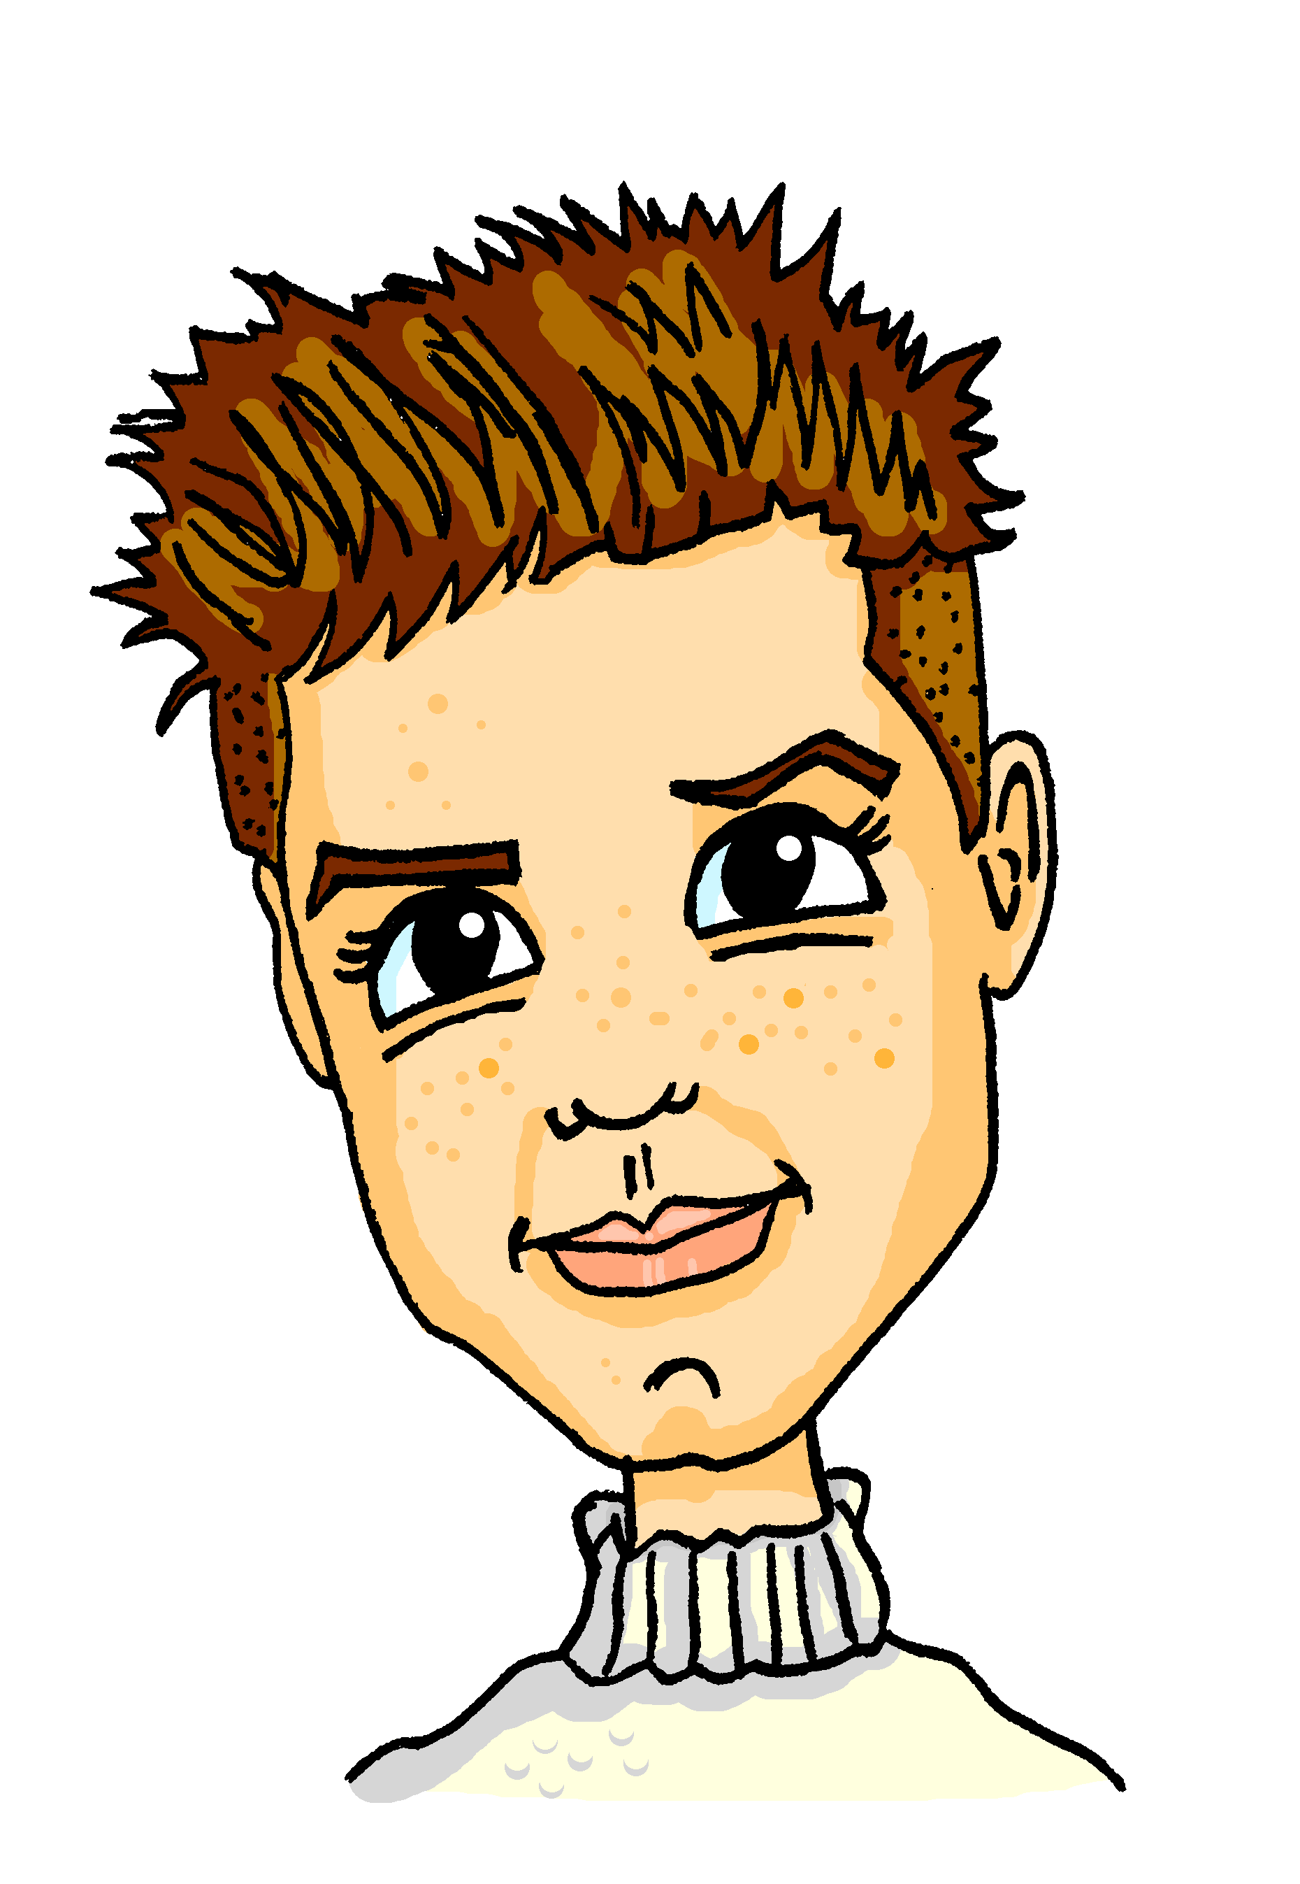
Virtueller Austausch*
lesen
Wolfgangs Klasse hilft Alastairs Klasse online. Schreib 1-8 und ‘denn’ oder ‘weil’
1) Ich mag die Aufgabe nicht, ______ sie unmöglich ist! (weil/denn) DH
2) Meine Freundin Sophie mag Tennis, ______ es spannend ist. (denn/weil) JS
weil
weil
4) Mein Freund Mehmet mag Schottland, ______ es ist wunderbar! (denn/weil) WB
5) Meine Mutter mag die Küche, ______ sie ist ziemlich praktisch. (weil/denn) MB
3) Ich mag Sport, ______ es ist lustig. (weil/denn) SW
denn
denn
denn
7) Mein Vater mag die Zeitung nicht, ______ sie ganz langweilig ist! (denn/weil) KL
8) Ich mag die Wohnung, ______ sie ist total angenehm. (weil/denn) HZ
6) Ich mag Kaffee, ______ er lecker ist! (weil/denn) SG
weil
denn
weil
*der Austausch - exchange
Notes:
Timing: 5 minutes Aim: To practice recognising the word order used in each sentence and inferring the use of weil or denn as appropriate. Procedure: 1. Write 1-8.
2. Students read sentences and write weil or denn for each as appropriate.
3. Click on the mouse to animate the correct answers. Context: This is a padlet wall. Wolfgang’s class is helping Alastair’s class with their German grammar by posting weil / denn sentences for them to practise. Initials are initials of Wolfgang’s classmates.
Word frequency (1 is the most frequent word in German):
1.1.7 (introduce) lustig [1973] interessant [810] spannend [1810] wunderbar [1603] notwendig [742] unmöglich [1879] warum? [192] weil [88] denn [93] 1.1.3 (revisit) gefunden [103] Sie [10] Bad [1577] Brief [813] Dezember [1527] Hunger [2097] Kaffee [1299] Küche [960] Lust [1407] März [987] Schmerz [1483] Wohnung [418] müde [2000] noch [33] oben [100] unten [590] 7.3.1.6 (revisit) dauern [698] erreichen¹ [305] fahren² [169] schaffen¹ [320] suchen [293] viel, viele [60] das Land¹ [146] Schottland [>4034] Schweiz [>4034] Stunde¹ [262] Wien [>4034] dort [134] normalerweise [1898]
Source: Jones, R.L. & Tschirner, E. (2006). A frequency dictionary of German: core vocabulary for learners. Routledge

Slide 10
mögen – to like, liking
Grammatik
Remember - mögen is an irregular verb meaning ‘to like’.
I like = ich mag
you like = du magst
s/he likes = sie/er mag
Remember!
To ask a yes/no question, swap the verb and subject.
Magst ___ Mathe, Mia?
du
Ja, ich _____ Mathe! Und du?
mag
To say you don’t like something, add nicht to the end of your statement.
Nein, ____ mag Mathe nicht!
ich
Notes:
Timing: 2 minutes (both slides) Aim: To recap on the verb mögen (explicitly introducing the wir form on the next slide).
Procedure: 1. Click on the mouse to animate the explanation.
2. Ensure student understanding at each stage.
3. Point out that students normally use the abbreviation Mathe, rather than the full form Mathematik.
4. Click each speech bubble to hear the full sentences, to consolidate.
Transcript:
(Wolfgang) Magst du Mathe, Mia?
(Mia) Ja, ich mag Mathe! Und du?
(Wolfgang) Nein, ich mag Mathe nicht!

Slide 11
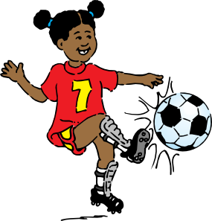
mögen – to like, liking
Grammatik
Remember – the wir form (‘we’) of a verb is the same as the infinitive,
so ‘we like’ is wir mögen:
Ja, aber wir _________ Hausaufgaben nicht!
____ mögen Sport!
mögen
Wir
Notes:
This slide continues the explanation on the previous one, explicitly introducing the wir form. 1. Elicit the missing pronoun and verb form. 2. Click each bubble to hear the full audio.
Transcript:
(Wolfgang) Wir mögen Sport!
(Mia) Ja, aber wir mögen Hausaufgaben nicht!

Slide 12
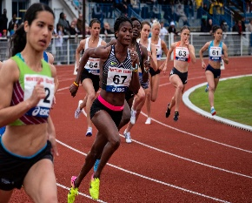
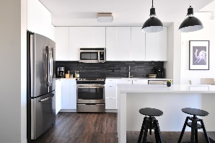
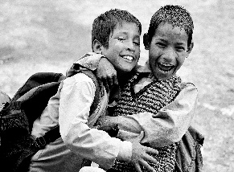
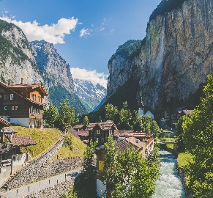
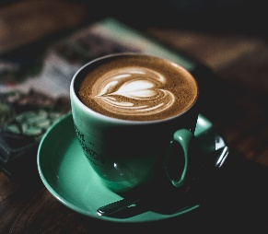
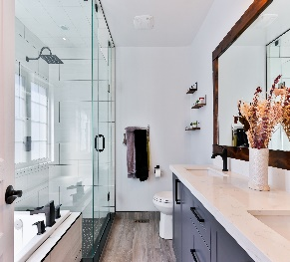
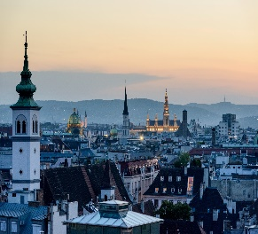
Magst du das? Warum? [1/2]
hören
Hör zu. Wer? Was? denn/weil? Warum? Schreib 1-4. Mach Notizen.
Was?
denn /weil
Warum?
Was?
denn /weil
Warum?
I | you |  | weil | exciting
she | we |  | denn | fun
I | you |  | denn | interesting
he | we |  | weil | impossible
1
3
I | you |  | denn | great
she | we |  | weil | lovely
I | you |  | weil | not ugly
she | we |  | denn | not boring
2
4
Notes:
Timing: 10 minutes (both slides) Aim: To practise understanding the verb mögen and reasons for likes/dislikes, expressed either with weil or denn. Weil and denn are obscured to focus students’ attention on the word order that each requires. Procedure: 1. Write 1-8 (continues on next slide).
2. Students listen to each sentence and choose the correct pronoun, picture, weil or denn (obscured in the recording) and reason from the options shown.
3. Click on the mouse to animate the answers.
Transcript: 1. Sie mag Wassersport, denn er ist spannend. 2. Ich mag die Schweiz, weil sie schön ist. 3. Du magst deinen Bruder nicht, weil er unmöglich ist. 4. Wir mögen Wien, denn es ist nicht hässlich.
Word frequency (1 is the most frequent word in German):
1.1.7 (introduce) lustig [1973] interessant [810] spannend [1810] wunderbar [1603] notwendig [742] unmöglich [1879] warum? [192] weil [88] denn [93] 1.1.3 (revisit) gefunden [103] Sie [10] Bad [1577] Brief [813] Dezember [1527] Hunger [2097] Kaffee [1299] Küche [960] Lust [1407] März [987] Schmerz [1483] Wohnung [418] müde [2000] noch [33] oben [100] unten [590] 7.3.1.6 (revisit) dauern [698] erreichen¹ [305] fahren² [169] schaffen¹ [320] suchen [293] viel, viele [60] das Land¹ [146] Schottland [>4034] Schweiz [>4034] Stunde¹ [262] Wien [>4034] dort [134] normalerweise [1898]
Source: Jones, R.L. & Tschirner, E. (2006). A frequency dictionary of German: core vocabulary for learners. Routledge

Slide 13
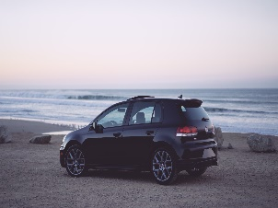
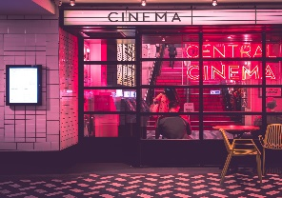
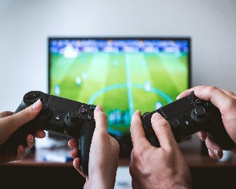
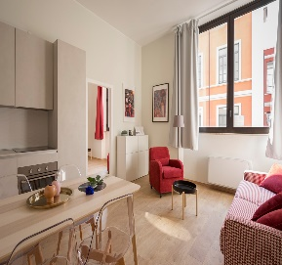
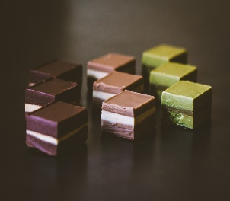
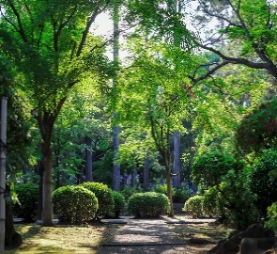
Magst du das? Warum? [2/2]
hören
Was?
denn /weil
Warum?
Was?
denn /weil
Warum?
I | you |  | weil | interesting
he | we |  | denn | necessary
I | you |  | denn | boring
he | we |  | weil | fun
Was?
denn /weil
Warum?
5
7
I | you |  | denn | pleasant
she | we |  | weil | lovely
I | you |  | weil | wonderful
she | we |  | denn | lovely
6
8
Notes:
This slide is the continuation of the activity on the previous slide.
Transcript: 5. Er mag das Spiel, denn es ist interessant.
6. Ich mag die Wohnung, weil sie angenehm ist.
7. Du magst den Film nicht, denn er ist langweilig.
8. Wir mögen Schottland, weil es wunderbar ist!

Slide 14
Was magst du? Warum
schreiben
Schreib vier Sätze.
Was?
denn /weil
Warum?
Was?
denn /weil
Warum?
I | you |  | weil | exciting
she | we |  | denn | fun
I | you |  | denn | practical
he | we |  | weil | impossible
1
3
I | you |  | denn | great
she | we |  | weil | lovely
I | you |  | weil | not ugly
she | we |  | denn | not boring
2
4
Notes:
Timing: 5 minutes (both slides) Aim: To practise writing sentences giving reasons using weil or denn, with appropriate word order. A mix of items from the previous listening exercise is used to provide the stimulus.
Procedure: 1. Students write sentences according to the options shown (1-4).
2. View the animated answers on the next slide. Word frequency (1 is the most frequent word in German):
1.1.7 (introduce) lustig [1973] interessant [810] spannend [1810] wunderbar [1603] notwendig [742] unmöglich [1879] warum? [192] weil [88] denn [93] 1.1.3 (revisit) gefunden [103] Sie [10] Bad [1577] Brief [813] Dezember [1527] Hunger [2097] Kaffee [1299] Küche [960] Lust [1407] März [987] Schmerz [1483] Wohnung [418] müde [2000] noch [33] oben [100] unten [590] 7.3.1.6 (revisit) dauern [698] erreichen¹ [305] fahren² [169] schaffen¹ [320] suchen [293] viel, viele [60] das Land¹ [146] Schottland [>4034] Schweiz [>4034] Stunde¹ [262] Wien [>4034] dort [134] normalerweise [1898]
Source: Jones, R.L. & Tschirner, E. (2006). A frequency dictionary of German: core vocabulary for learners. Routledge

Slide 15
Antworten
schreiben
Was?
denn /weil
Warum?
Was?
denn /weil
Warum?
I | you |  | weil | exciting
she | we |  | denn | fun
I | you |  | denn | practical
he | we |  | weil | impossible
1
3
Wir mögen Sport, weil er lustig ist.
Er mag die Küche, weil sie praktisch ist.
I | you |  | denn | great
she | we |  | weil | lovely
I | you |  | weil | not ugly
she | we |  | denn | not boring
2
4
Du magst das Bad, denn es ist schön.
Wir mögen Wien, denn sie ist nicht langweilig.
Notes:
On this slide the answers appear under each grid upon clicking the mouse.

Slide 16
Wer ist das?
?
sprechen
Stefanie
Dieter
Jörg
Sport | spannend (denn)
Musik | wunderbar (weil)
Wien | schön (weil)
Deutsch | lustig (denn)
Kunst | interessant (weil)
Lesen | notwendig (denn)
Kunst | interessant (weil)
Wien | schön (weil)
Deutsch | lustig (denn)
Lesen | notwendig (denn)
Musik | wunderbar (weil)
Sport | spannend (denn)
Wien | schön (weil)
Musik | wunderbar (weil)
Lesen | notwendig (denn)
Kunst | interessant (weil)
Sport | spannend (denn)
Deutsch | lustig (denn)
Leah
Moritz
Sabine
Musik | wunderbar (denn)
Sport | spannend (weil)
Lesen | notwendig (weil)
Kunst | interessant (denn)
Deutsch | lustig (weil)
Wien | schön (denn)
Deutsch | lustig (weil)
Lesen | notwendig (weil)
Wien | schön (denn)
Sport | spannend (weil)
Kunst | interessant (denn)
Musik | wunderbar (denn)
Lesen | notwendig (weil)
Kunst | interessant (denn)
Musik | wunderbar (denn)
Sport | spannend (weil)
Wien | schön (denn)
Deutsch | lustig (weil)
Notes:
Sprechen Timing: 5 minutes
Speaking activity: Wer ist das?
Aim: To practise asking ‘why?’ questions and giving answers with reasons using weil and denn. This is a variation on the ‘guess who’ game.
Procedure: 1. Student A picks a character.
2. Student B asks ‘Warum mag diese Person .....?’, naming one of the things mentioned in the left-hand column for each character.
3. Student A answers, giving the reason corresponding to the thing mentioned by Student B in the right-hand column for their chosen character (using weil or denn as indicated, with correct word order).
4. By spotting the reason given in the exact form specified, Student B attempts to guess the character chosen.
5. Partners swap roles.
Note: The names include several SSC. Teachers may usefully ask students to pronounce their names before the activity starts: [St]efanie, D[ie]t[er], [J][ö]rg, L[e]ah, M[o][r]it[z], [S]ab[i]n[e] (pronounce the final ‘e’)
Word frequency (1 is the most frequent word in German):
1.1.7 (introduce) lustig [1973] interessant [810] spannend [1810] wunderbar [1603] notwendig [742] unmöglich [1879] warum? [192] weil [88] denn [93] 1.1.3 (revisit) gefunden [103] Sie [10] Bad [1577] Brief [813] Dezember [1527] Hunger [2097] Kaffee [1299] Küche [960] Lust [1407] März [987] Schmerz [1483] Wohnung [418] müde [2000] noch [33] oben [100] unten [590] 7.3.1.6 (revisit) dauern [698] erreichen¹ [305] fahren² [169] schaffen¹ [320] suchen [293] viel, viele [60] das Land¹ [146] Schottland [>4034] Schweiz [>4034] Stunde¹ [262] Wien [>4034] dort [134] normalerweise [1898]
Source: Jones, R.L. & Tschirner, E. (2019). A frequency dictionary of German: core vocabulary for learners. Routledge

Slide 17
Explaining likes and dislikes
weil vs denn
SSC [v] vs [w]: revisited
Y8 German
Term 1 - Week 7 - Lesson 14
Author name(s): Stephen Owen / Rachel Hawkes
Artwork: Steve Clarke
Date updated: 21/07/21
Notes:
Learning outcomes (lesson 2):
Revisiting SSC [v] vs [w]
Consolidation of weil and denn
Word frequency (1 is the most frequent word in German):
1.1.7 (introduce) lustig [1973] interessant [810] spannend [1810] wunderbar [1603] notwendig [742] unmöglich [1879] warum? [192] weil [88] denn [93] 1.1.3 (revisit) gefunden [103] Sie [10] Bad [1577] Brief [813] Dezember [1527] Hunger [2097] Kaffee [1299] Küche [960] Lust [1407] März [987] Schmerz [1483] Wohnung [418] müde [2000] noch [33] oben [100] unten [590] 7.3.1.6 (revisit) dauern [698] erreichen¹ [305] fahren² [169] schaffen¹ [320] suchen [293] viel, viele [60] das Land¹ [146] Schottland [>4034] Schweiz [>4034] Stunde¹ [262] Wien [>4034] dort [134] normalerweise [1898]
Source: Jones, R.L. & Tschirner, E. (2019). A frequency dictionary of German: core vocabulary for learners. Routledge

Slide 18
Phonetik
hören / schreiben
Hörst du [V] oder [W] oder beide?
 |  | [V] | [W]
 | verwenden [to use]
 | aktiv [active]
 | weltweit [worldwide]
 | warnen [to warn]
 | verschwinden [to disappear]
 | Verwandte [relative]
1
2
The following German words, borrowed from the English, pronounce ‘v’ in the English way:
Interview
Universität
Aktivität
3
4
5
6
Notes:
Timing: 5 minutes Aim: To practise differentiating between the two German SSC [v] and [w] in the spoken modality, which is tricky because of the pronunciation crossover between English [f] and German [v] and English [v] and German [w].
N.B. A similar task featured in lesson 1. Procedure: 1. Write 1-6.
2. Listen to the words (click on audio buttons) and tick the appropriate column, according to whether you hear [v], [w] or both.
3. Click on the mouse to reveal the correct tick and also the words themselves (together with their English meanings).
4. Point out that, in certain words borrowed from the English, the [v] is pronounced in the English way.
Transcript:
1. verwenden
2. aktiv
3. weltweit
4. warnen
5. verschwinden
6. Verwandte Word frequency (1 is the most frequent word in German): verwenden [538] aktiv [790] welweit [843] warnen [1337] verschwinden [559] Verwandte [2850]
Source: Jones, R.L. & Tschirner, E. (2006). A frequency dictionary of German: core vocabulary for learners. Routledge

Slide 19
Phonetik – viel(e) oder weil?
lesen / sprechen
Remember - viel and viele both mean ‘lots of’.
Viel is used with uncountable nouns. Uncountable means you can’t put a number in front of it to make it plural (food, time, love …)
Viele is used with countable nouns. Countable means you can put a number in front of it to make it plural (two cats, three tables, four carrots …)
weil
1) Ich mache _____ Sport, _____ ich aktiv bin.
viel
weil
2) Wir lesen ______ Bücher, ______ Lesen wichtig ist.
viele
viele
3) Mein Vater hat _______ Volkswagen, _____ er Volkswagen mag.
weil
viel
weil
4) Ich spiele ______ Fußball, ______ ich Fußball lustig finde.
viel
weil
5) Meine Mutter kocht ______ Gemüse, ______ Gemüse gesund ist.
viele
weil
6) Du hast ______ Tiere, ______ du Tiere sehr magst.
Notes:
Timing: 5 minutes Aim: To practise differentiating the pronunciation of viel(e) and ‘weil, which are often confused by students. Procedure: 1. Students read the sentences and decide which word fits in each gap.
2. Students read the sentences aloud, taking care to produce the correct pronunciation of viel(e) and weil in particular.
3. If time, students can be asked to translate the sentences orally.

Slide 20
English → German → English
Add un- to make some German adjectives negative, as in English un-/im-.
That is impossible!
Das ist unmöglich!
Translate these sentences.
1. Die Stadt ist unfreundlich und unangenehm.
2. He is still rather unhappy.
What would the following be in German?
uninteresting unhealthy uncomfortable Choose one and write a sentence in German.
Notes:
Timing: 5 minutes (both slides)
Aim: Word pattern tasks have been written particularly with the NCELP Y8 SOW in mind. Current thinking is to include one short activity to introduce and practise a pattern once every two weeks.
We have not included every single pattern that exists, of course - just those where there were sufficient, high-frequency words in the top 2000 to suggest that it would be a useful pattern to highlight to students in Y8. NB: Within the Y8 German SOW document you will find a ‘word patterns’ tab, an inventory of all the patterns and their words that were considered. The idea is that these patterns not only reinforce, revisit, extend vocabulary knowledge, but they also revisit key basic grammar knowledge (parts of speech, capital letters on nouns, definite articles/gender, plural rules) and can provide opportunities for students to apply their phonics knowledge when they sound out the new words they've created. In short, these are PVG-rich tasks.
Suggested procedure:
1. Click on the mouse to animate the explanation.
2. Students tranlsate the sentences and words shown.
Word frequency: interessant [810], uninteressant [>5009], glücklich [1070], unglücklich [3772], gesund [1275], ungesund [>5009], möglich [171], unmöglich [1879], angenehm [2214], unangenehm [2870] freundlich [1566], unfreundlich [>5009], bequem [3369], unbequem [>5009]
Source: Jones, R.L. & Tschirner, E. (2019). A frequency dictionary of German: core vocabulary for learners. Routledge
Note: the negative versions of these adjectives do not tend to fall within the top 5000 words. However, their affirmative pairs are high-frequency and this short task provides a useful way to revisit their form and meaning.
Image by mohamed Hassan from Pixabay

Slide 21
ANTWORTEN
Die Stadt ist unfreundlich und unangenehm.
He is still rather unhappy.
uninteresting
unhealthy
uncomfortable
The town is unfriendly and unpleasant.
Er ist (immer) noch ziemlich unglücklich.
uninteressant
ungesund
unbequem
Note: immer is often added to ‘noch’ to emphasise ‘still’.
Don’t forget to pronounce the words!
Notes:
This slide shows the answers to the questions on the previous slide.
Word frequency: interessant [810], uninteressant [>5009], glücklich [1070], unglücklich [3772], gesund [1275], ungesund [>5009], möglich [171], unmöglich [1879], angenehm [2214], unangenehm [2870] freundlich [1566], unfreundlich [>5009], bequem [3369], unbequem [>5009]
Source: Jones, R.L. & Tschirner, E. (2019). A frequency dictionary of German: core vocabulary for learners. Routledge
Note: the negative versions of these adjectives do not tend to fall within the top 5000 words. However, their affirmative pairs are high-frequency and this short task provides a useful way to revisit their form and meaning.

Slide 22
vocabulario
sprechen
exciting, thrilling
funny, enjoyable
desire
interesting
impossible
you (formal)
letter
necessary
pain
wonderful
why
found (pp)
n________
unmöglich
der Brief
notwendig
u________
d__ _____
gefunden
Sie
g_______
S__
w________
wunderbar
interessant
d__ ____
l_____
i__________
die Lust
lustig
w____
spannend
warum
der Schmerz
s_______
d__ _______
Notes:
Timing: 5 minutes Aim: This slide provides further production practice (speaking modality) with this week’s new and revisited vocabulary. Procedure: 1. Click to bring up the English translations one by one.
2. For each English word, students identify the corresponding German from the first-letter clues provided and say the full word aloud.
3. Click on the mouse to reveal the answer and check.
Word frequency (1 is the most frequent word in German): lustig [1973] interessant [810] spannend [1810] wunderbar [1603] interessant [810] unmöglich [1879] warum? [192] gefunden [103] Sie [10] Brief [813] Lust [1407] Schmerz [1483]
Source: Jones, R.L. & Tschirner, E. (2006). A frequency dictionary of German: core vocabulary for learners. Routledge

Slide 23
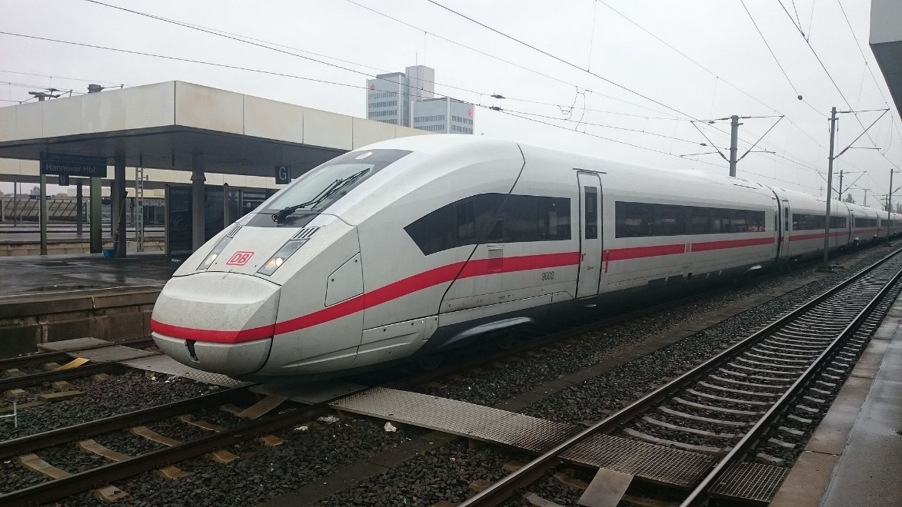
Vokabeln
lesen
Reading numbers aloud: 200 – 300 = zwei bis drei hundert (two to three hundred) km/h = Kilometer pro Stunde (kilometres per hour)
Der Intercity-Express (ICE) ist der schnellste* Zug in Deutschland, und erreicht 200-300 km/h (in Frankreich 320 km/h). Mit dem ICE kann man sehr schnell von Frankfurt nach London fahren. Die schnellste Reise dauert nur 6 Stunden und 36 Minuten (mit dem Eurostar)! Man kann 10:29 von Frankfurt fahren und 16:05 London erreichen! Zuerst fährt der Zug nach Brüssel. Dort nimmt man den Eurostar und fährt durch den Eurotunnel zum Bahnhof St Pancras in London.
Reading 24 hr clock times aloud: 16:05 = sechzehn Uhr fünf (Uhr = o’clock) Note: in English, we just say ‘sixteen o five.’
*schnellste – fastest
*durch – through
Notes:
Timing: 8 minutes Aim: Deepening vocabulary knowledge by encountering the taught words in a different context. Procedure: 1. Students read the text about the German high-speed train.
2. Students translate the text into English orally.
Word frequency (1 is the most frequent word in German): der Zug [675] Deutschland [140] erreichen [309] Frankreich [813] schnell [203] fahren [215] nehmen [142] Bahnhof [2027] in [3] nach [34] Source: Jones, R.L. & Tschirner, E. (2006). A frequency dictionary of German: core vocabulary for learners. Routledge

Slide 24
Fragen
Grammatik
Remember - For a closed (yes/no) question, swap the verb and subject:
closed
Ist deine Mutter jetzt zu Hause?
Is your mum at home now?
For an open (information) question, also add a question word:
open
Warum ist sie zu Hause?
Why is she at home?
Notes:
Timing: 1 minute
Aim: Brief revision slide on question-formation (both open and closed, last revisited formally in 3.1.2), to prepare students for the speaking tasks which follow.
Procedure: 1. Click on the mouse to animate the explanation.
2. Elicit translations of the questions from students at each stage.

Slide 25
Wie heißt die Frage? [1]
lesen / sprechen
1) Magst du das Bad? – Ja. Ich mag es sehr!
2) Warum trinkst du Kaffee? – Weil ich müde bin!
3) Was sucht er in der Wohnung? – Er sucht die Küche!
4) Wann fährt sie nach Schottland? – Am Montag.
5) Hast du den Brief gefunden? – Nein. Ich habe ihn noch nicht gefunden!
6) Wann erreichen wir Wien? – In zwei Stunden.
Notes:
Timing: 3 minutes Aim: To practise recognition and production (speaking modailty) of question forms (both open and closed). Procedure: 1. Students read the question with the first word obscured, together with its answer.
2. From the answer, students determine what the question must have been.
3. Students say the whole question and answer. 4. Click on the mouse to reveal the obscured words.
Word frequency (1 is the most frequent word in German):
1.1.7 (introduce) lustig [1973] interessant [810] spannend [1810] wunderbar [1603] notwendig [742] unmöglich [1879] warum? [192] weil [88] denn [93] 1.1.3 (revisit) gefunden [103] Sie [10] Bad [1577] Brief [813] Dezember [1527] Hunger [2097] Kaffee [1299] Küche [960] Lust [1407] März [987] Schmerz [1483] Wohnung [418] müde [2000] noch [33] oben [100] unten [590] 7.3.1.6 (revisit) dauern [698] erreichen¹ [305] fahren² [169] schaffen¹ [320] suchen [293] viel, viele [60] das Land¹ [146] Schottland [>4034] Schweiz [>4034] Stunde¹ [262] Wien [>4034] dort [134] normalerweise [1898]
Source: Jones, R.L. & Tschirner, E. (2006). A frequency dictionary of German: core vocabulary for learners. Routledge

Slide 26
Wie heißt die Frage?
Wie heißt die Frage? [2]
sprechen
Look out for the word ‘Yes’ - this tells you what type of question is needed.
Maria
Paul
I like animals, because they are interesting.
Yes,I like animals.
Quel numéro
fais-tu ?
Fais-tu numéro
quatre?
Warum magst du Tiere?
Ich mag Tiere, denn sie sind interessant.
Magst du Tiere?
Ja, ich mag Tiere.
Notes:
Timing: 2 minutes Aim: To model the instructions for the speaking task that follows.
Procedure: 1. Explain to students that they are going to be constructing questions that require either a yes/no answer, i.e. subject-verb inversion alone , or that require a question word+subject verb inversion. It Is the answer that indicates which question type is required.
2. Make it clear to students that the bold ‘Yes’ indicates that a yes/no question type is required (i.e s-v inversions). Where there is not the word ‘yes’ – a question word will be needed.
3. From the answer, students determine what the question must have been and say it aloud.
3. On a mouse click the correct question appears, followed by the answer in German.
Word frequency (1 is the most frequent word in German):
1.1.7 (introduce) lustig [1973] interessant [810] spannend [1810] wunderbar [1603] notwendig [742] unmöglich [1879] warum? [192] weil [88] denn [93] 1.1.3 (revisit) gefunden [103] Sie [10] Bad [1577] Brief [813] Dezember [1527] Hunger [2097] Kaffee [1299] Küche [960] Lust [1407] März [987] Schmerz [1483] Wohnung [418] müde [2000] noch [33] oben [100] unten [590] 7.3.1.6 (revisit) dauern [698] erreichen¹ [305] fahren² [169] schaffen¹ [320] suchen [293] viel, viele [60] das Land¹ [146] Schottland [>4034] Schweiz [>4034] Stunde¹ [262] Wien [>4034] dort [134] normalerweise [1898]
Source: Jones, R.L. & Tschirner, E. (2006). A frequency dictionary of German: core vocabulary for learners. Routledge

Slide 27
sprechen
Ben
Emma
Christina
Max
Warum magst du
die Stadt?
Warum magst du Dezember?
Magst du Schottland?
Warum magst du die Reise nicht?
Ich mag die Stadt, denn sie ist wunderbar.
Ich mag Dezember, weil es Winter ist.
Ja, ich mag Schottland.
Ich mag die Reise nicht, weil sie drei Stunden dauert.
Clara
Paul
Emil
Hannah
Ja, ich mag die Schweiz.
Ich mag den Zug, denn er ist schnell.
Ich mag Kaffee, weil er lecker ist.
Ja, ich mag Sport.
Magst du die Schweiz?
Warum magst du den Zug?
Warum magst du Kaffee?
Magst du Sport?
Sophie
Manfred
Oskar
Emilia
Ja, ich mag die Wohnung.
Magst du dein Zimmer?
Magst du Wien?
Magst du die Wohnung?
Ich mag das Bad, weil es unten im Haus ist.
Ja, ich mag mein Zimmer.
Warum magst du das Bad?
Ja, ich mag Wien.
Liam
Anna
Sofia
Jörg
Ja, ich mag Deutsch.
Ich mag die Küche nicht, weil sie oben im Haus ist.
Ich mag das Buch, denn es ist spannend.
Warum magst du die Küche nicht?
Ich mag die Aufgabe nicht, denn sie ist unmöglich!
Warum magst du das Buch?
Magst du Deutsch?
Warum magst du die Aufgabe nicht?
Notes:
Timing: 8 minutes Aim: To practise question production (speaking modality) based upon consideration of the answer, which is seen first – is it an open or a closed question that is required?
Procedure: 1. Display this on the IWB whilst the speaking activity is taking place (also available with answers in English - teachers should choose which version to use with their groups.)
2. There are various ways this slide could be used in class:
a) the teacher puts the 16 names in a hat/bag (this can be done very roughly on scrap paper – only for teacher use), then pulls the names out of the bag one at a time. Students can all give the question in a choral response style or
b) as above but in pairs – the teacher picks a name - if it is a boy partner A says the question, or for a girl partner B says the question. (Or partners could simply just take it in turns). The teacher gives the students time to form their questions and then reveals the answer before picking the next name.
3) SELF-STUDY VARIANT: For independent study, students can simply say the question for each name and click to check.
Word frequency (1 is the most frequent word in German):
1.1.7 (introduce) lustig [1973] interessant [810] spannend [1810] wunderbar [1603] notwendig [742] unmöglich [1879] warum? [192] weil [88] denn [93] 1.1.3 (revisit) gefunden [103] Sie [10] Bad [1577] Brief [813] Dezember [1527] Hunger [2097] Kaffee [1299] Küche [960] Lust [1407] März [987] Schmerz [1483] Wohnung [418] müde [2000] noch [33] oben [100] unten [590] 7.3.1.6 (revisit) dauern [698] erreichen¹ [305] fahren² [169] schaffen¹ [320] suchen [293] viel, viele [60] das Land¹ [146] Schottland [>4034] Schweiz [>4034] Stunde¹ [262] Wien [>4034] dort [134] normalerweise [1898]
Source: Jones, R.L. & Tschirner, E. (2006). A frequency dictionary of German: core vocabulary for learners. Routledge

Slide 28
sprechen
Ben
Emma
Christina
Max
Warum magst du
die Stadt?
Warum magst du Dezember?
Magst du Schottland?
Warum magst du die Reise nicht?
I like the town because it is wonderful.
I like December because it is winter.
Yes, I like Scotland.
I don’t like the journey, because it lasts three hours.
Clara
Paul
Emil
Hannah
Yes, I like Switzerland.
I like the train because it is fast.
I like coffee because it is delicious.
Yes, I like sport.
Magst du die Schweiz?
Warum magst du den Zug?
Warum magst du Kaffee?
Magst du Sport?
Sophie
Manfred
Oskar
Emilia
Yes, I like the flat.
Magst du dein Zimmer?
Magst du Wien?
Magst du die Wohnung?
I like the bathroom because it is downstairs.
Yes, I like my room.
Warum magst du das Bad?
Yes, I like Vienna.
Liam
Anna
Sofia
Jörg
Yes, I like German.
I don’t like the kitchen, because it is upstairs.
I don’t like the task, because it is impossible.
I like the book, because it is exciting.
Warum magst du die Küche nicht?
Warum magst du die Aufgabe nicht?
Warum magst du das Buch?
Magst du Deutsch?
Notes:
Differentiated version of the speaking activity with the answers in English. See previous slide for instructions (and options 1-2).
The differentiated version allows extension opportunities as follows:
i) in pairs – the teacher picks a name - if it is a boy partner A says the question, or a girl partner B says the question. (Or partners could simply just take it in turns). The teacher gives the students time to form their questions and then reveals the answer before picking the next name. Extension – the listening partner tries to give the response in German. Teachers could ask for hands up after thinking time, for volunteers to give their answer.
ii) as a whole class activity – the teacher has eight cards/pieces of paper in a hat/bag labelled ‘subject-verb inversion’ plus eight labelled ‘question word+subject-verb inversion’. The teacher goes around the class asking one student at a time to pick out a card. The student who picks the card chooses one of the questions to say in German (of the correct type). The teacher clicks on the box to reveal the answer. The student could nominate a classmate to give the corresponding answer in German (or the teacher could ask for volunteers). In a class of 32 each student would receive a go. This style would potentially get more difficult as the game goes along because the students may leave the trickier sentences until the end. If the class was split into two teams, for every correct answer a point could be awarded.
iii) the teacher leads the first question initially (to model) saying the question in German, then moves to asking for volunteers to give the question in German (as the students grow more confident). The question is said in German and the listening students have to write the correct name of the person with the corresponding answer. The teacher would then click on the person to reveal the correct answer. Students receive a point if they give the correct name. The teacher could also ask students to say the answer in German. This would maximise the number of students involved in the speaking activity.
SELF-STUDY VARIANT:
For independent study, students can simply say the question for each name and click to check.
Word frequency (1 is the most frequent word in German):
1.1.7 (introduce) lustig [1973] interessant [810] spannend [1810] wunderbar [1603] notwendig [742] unmöglich [1879] warum? [192] weil [88] denn [93] 1.1.3 (revisit) gefunden [103] Sie [10] Bad [1577] Brief [813] Dezember [1527] Hunger [2097] Kaffee [1299] Küche [960] Lust [1407] März [987] Schmerz [1483] Wohnung [418] müde [2000] noch [33] oben [100] unten [590] 7.3.1.6 (revisit) dauern [698] erreichen¹ [305] fahren² [169] schaffen¹ [320] suchen [293] viel, viele [60] das Land¹ [146] Schottland [>4034] Schweiz [>4034] Stunde¹ [262] Wien [>4034] dort [134] normalerweise [1898]
Source: Jones, R.L. & Tschirner, E. (2006). A frequency dictionary of German: core vocabulary for learners. Routledge

Slide 29
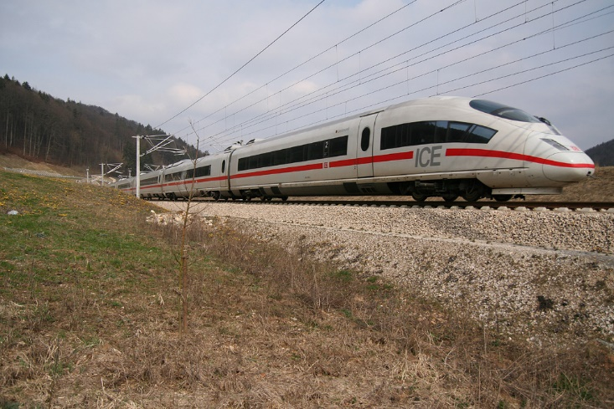
Der ICE – Intercity Express
schreiben
Schreib die Sätze auf Deutsch und auf Englisch!
morning
I
an
article
journeys
1. This _________ ____ read ___ ___________ about ___________. 1. ________ Morgen ______ ich einen Artikel _______ Reisen _________.
Heute
habe
über
gelesen
Intercity
Express
fastest
2. The ________-________ is the ___________ train in Germany. 2. ___ Intercity-Express ____ ____ schnellste ____ ___ ________________.
ist
der
Zug
in
Der
Deutschland
From
Frankfurt
reach
six
thirty
six
3. _____ _____________ you can _______ London in ______ hours and ______-_____ minutes! 3. Von Frankfurt _____ ____ _______ ___ sechs ________ _____ sechunddreißig ________ erreichen!
kann
man
London
in
Stunden
und
Minuten
In
the
normally
comfotable
4. ___ ____ train it is ____________ very ____________.
4. Im ______ ____ ___ normalerweise ______ bequem.
Zug
ist
es
sehr
Does this mean ‘you’ or ‘people in general / one’? du = you man = you (people in general)
Does this mean ‘you’ or ‘people in general / one’? du = you man = you (people in general)
First
Brussels
5. ______ the train travels to ___________.
5. Zuerst _____ _____ _____ ______ Brüssel.
fährt
der
Zug
There
the
Eurostar
London
6. _______ you take ____ ____________ to ___________. 6. Dort _________ _____ den Eurostar ______ London.
nimmt
man
nach
*schnellste – fastest
Notes:
OPTIONAL – this task could be set for HW
Timing: 10 minutes Aim: Translation practice (writing modality) involving some of the grammar and vocabulary practised recently, using a parallel translation task. Procedure: 1. Students read the pairs of sentences and complete both English and German versions, using the information present in one to determine the missing words of the other.
2. Click on the mouse to make the animated answers appear, word by word.
Word frequency (1 is the most frequent word in German):
1.1.7 (introduce) lustig [1973] interessant [810] spannend [1810] wunderbar [1603] notwendig [742] unmöglich [1879] warum? [192] weil [88] denn [93] 1.1.3 (revisit) gefunden [103] Sie [10] Bad [1577] Brief [813] Dezember [1527] Hunger [2097] Kaffee [1299] Küche [960] Lust [1407] März [987] Schmerz [1483] Wohnung [418] müde [2000] noch [33] oben [100] unten [590] 7.3.1.6 (revisit) dauern [698] erreichen¹ [305] fahren² [169] schaffen¹ [320] suchen [293] viel, viele [60] das Land¹ [146] Schottland [>4034] Schweiz [>4034] Stunde¹ [262] Wien [>4034] dort [134] normalerweise [1898]
Source: Jones, R.L. & Tschirner, E. (2006). A frequency dictionary of German: core vocabulary for learners. Routledge

Slide 30
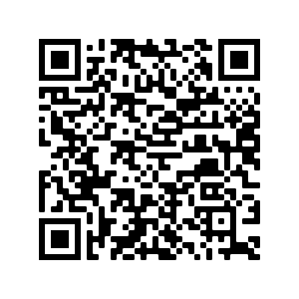
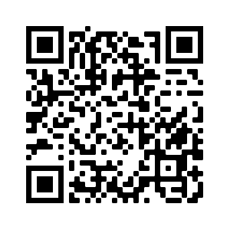
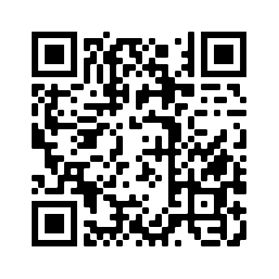
Hausaufgaben
Pre-learning for lesson: Year 8 German Term 1.2 Week 1
Revisit 1: Year 8 German Term 1.1 Week 5
Revisit 2: Year 7 German Term 3.2 Week 4

Slide 31
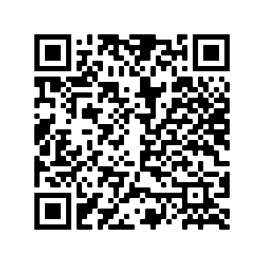
Hausaufgaben
Vocabulary Learning Homework (Y8, Term 1.2, Week 1)
Audio file
Audio file QR code:
Student worksheet
Quizlet link
In addition, revisit: Year 8 Term 1.1 Week 5
Year 7 Term 3.1 Week 4
Notes:
Answer sheet: https://resources.ncelp.org/concern/resources/7s75dc97p?locale=en

