Slide 1
Describing historical figures
Imperfect tense of avoir, être, aller, and faire (je/tu/il/elle/on) and other verbs
SSCs [open eu/œu], [closed eu/œu]
Y9 French
Term 3.2 - Week 5 - Lesson 67
Cath Morris / Catherine Salkeld / Mary Richardson
Artwork by: Chloé Motard
Date updated: 06/07/22
Notes:
Artwork by Chloé Motard. All additional pictures selected are available under a Creative Commons license, no attribution required.
Native teacher feedback provided by Sarah Brichory.
With thanks to Rachel Hawkes for her input on the lesson material.
Learning outcomes (lesson 1):
Consolidation of SSC [open eu/œu] and [closed eu/œu]
Introduction of imperfect tense of avoir, être, aller, and faire (je/tu/il/elle/on forms) and other verbs
Word frequency (1 is the most frequent word in French):
Revisit Y7 and Y8 vocabulary (12/12)
malade [1066], méchant [3184], droit [143], gauche [607], local [622], gros [419], italien (adj) [1477], mince [3570], pire [743], espagnol (adj) [1666], à côté [123], aussi [44], mal [277], que [9], que ? [9], vague [1493], caisse [1881], poste [489], natation [>5000], note [1161], piste [1902], jambe [2472], maladie [973], tête [343], bras [1253], moment [148], exemple [259], fils [735], match [1906], cœur [568], blanc (n.) [708], feu [786], hôpital [1308], réseau [721], merci [1070], comment ça s’écrit ? [n/a], d'accord [496], s'il te plaît [n/a], s'il vous plaît [n/a], en bas [468], avoir mal [n/a], par [21], ça [>5000], cocher [>5000], peser [1584], quitter [507], différent [350], prudent [1529], possible [175], même [42], peut-être [190], partout [581], d'abord [326], enfin [349], couleur [1211], raison [72], madame [294], vue [191], monsieur [79], goût [1829], plat [2167], combien ? [800], chacun [323], bleu [1216], rouge [987], vert [1060], scolaire [1993], carte [955], soin [1109], bonjour [1972], aussi...que [n/a], plus...que [n/a], moins...que [n/a]
Source: Lonsdale, D., & Le Bras, Y. (2009). A Frequency Dictionary of French: Core vocabulary for learners London: Routledge.
The frequency rankings for words that occur in this PowerPoint which have been previously introduced in NCELP resources are given in the NCELP SOW and in the resources that first introduced and formally re-visited those words.
For any other words that occur incidentally in this PowerPoint, frequency rankings will be provided in the notes field wherever possible.

Slide 2
Closed and open [eu/œu]
écouter
Remember [eu/œu] can sound different in different word positions!
The long vowel sounds like the ‘ur’ in the English ‘hurt.’
[a little]
[fear]
un peu
peur
This is a closed vowel.
When you say this sound, your tongue is near the top of your mouth.
This is an open vowel.
When you say this sound, your tongue is near the bottom of your mouth.
If the vowel is followed by a pronounced consonant (not an SFC)at the end of a word, it is open.
Notes:
Timing: 2 minutes
Aim: To consolidate the concept of open and closed vowel sounds.
Procedure:
1. Click to reveal ‘peu’. Students repeat it
2. Click to reveal the first info bubble. Students hear and say ‘peu’ again several time, noticing the position of the tongue in the mouth.
3. Click to reveal ‘peur’. Repeat steps one and two.
4. Click to play the words in quick succession.
5. Move to the following slides for a reminder of other words containing closed [eu].

Slide 3
eu
deux
Notes:
Timing: 1 minute
Aim: To consolidate SSC [eu]
Procedure: 1. Present the letter(s) and say the [eu] sound first, on its own. Students repeat it with you. 2. Bring up the word ”deux” on its own, say it, students repeat it, so that they have the opportunity to focus all of their attention on the connection between the written word and its sound.
3. A possible gesture for this would be to hold up two fingers (N.B. palm of the hand facing the class!). 4. Roll back the animations and work through 1-3 again, but this time, dropping your voice completely to listen carefully to the students saying the [eu] sound, pronouncing ”deux” and, if using, doing the gesture.
Word frequency (1 is the most frequent word in French):
deux [41].
Source: Londsale, D., & Le Bras, Y. (2009). A Frequency Dictionary of French: Core vocabulary for learners London: Routledge.

Slide 4
eu
jeudi
lieu
[place]
deux
feu
jeu
un peu
[a little]
Notes:
Timing: 2 minutes
Aim: To consolidate SSC [eu]
Procedure:
1. Consolidate and elicit the pronunciation of the individual SSC [eu] and then the source word again ‘deux’ (with gesture, if using). 2. Then present and elicit the pronunciation of the five cluster words.
The cluster words have been chosen for their high-frequency, from a range of word classes, with the SSC (where possible) positioned within a variety of syllables within the words (e.g. initial, 2nd, final etc.). Additionally, we have tried to use words that build cumulatively on previously taught SSCs (see the Phonics Teaching Sequence document) and do not include new SSCs. Where new SSCs are used, they are often consonants which have a similar symbol-sound correspondence in English.
Word frequency (1 is the most frequent word in French): deux {41]; jeudi[1112]; lieu [117] feu [786]; un peu [138/91]; jeu [291]. Source: Londsale, D., & Le Bras, Y. (2009). A Frequency Dictionary of French: Core vocabulary for learners London: Routledge.

Slide 5
open eu/œu
cœur
Notes:
Timing: 1 minute
Aim: To consolidate SSC open [eu]/[œu]
Procedure: 1. Present the letter(s) and say the open [eu]/[œu] sound first, on its own. Students repeat it with you. 2. Bring up the word ”cœur” on its own, say it, students repeat it, so that they have the opportunity to focus all of their attention on the connection between the written word and its sound.
3. A possible gesture for this would be to put your hand on your chest over your heart. 4. Roll back the animations and work through 1-3 again, but this time, dropping your voice completely to listen carefully to the students saying the open [eu]/[œu] sound, pronouncing ”cœur” and, if using, doing the gesture.
Word frequency (1 is the most frequent word in French):
cœur [568]
Source: Londsale, D., & Le Bras, Y. (2009). A Frequency Dictionary of French: Core vocabulary for learners London: Routledge.

Slide 6
open eu/œu
acteur
neuf
9
jeune
cœur
sœur
[young]
[sister]
erreur
[mistake]
Notes:
Timing: 2 minutes
Aim: To consolidate SSC open [eu]/[œu]
Procedure:
Consolidate and elicit the pronunciation of the individual SSC open [eu]/[œu] and then the source word again ‘œil’ (with gesture, if using). Then present and elicit the pronunciation of the five cluster words. The cluster words have been chosen for their high-frequency, from a range of word classes, with the SSC (where possible) positioned within a variety of syllables within the words (e.g. initial, 2nd, final etc.). Additionally, we have tried to use words that build cumulatively on previously taught SSCs (see the Phonics Teaching Sequence document) and do not include new SSCs. Where new SSCs are used, they are often consonants which have a similar symbol-sound correspondence in English.
Word frequency (1 is the most frequent word in French): acteur [1552]; cœur [568]; jeune [152]; erreur [612]; neuf [787]; sœur [1558]. Source: Londsale, D., & Le Bras, Y. (2009). A Frequency Dictionary of French: Core vocabulary for learners London: Routledge.

Slide 7
Les équipes de mots
écouter / écrire
Organise les mots en équipes : open eu/œu vs closed eu/œu.
1
2
3
4
5
6
7
8
9
10
1. mieux
2. peuple (people)
4. nombreux (plentiful)
open eu/oeu
5. deuxième
closed eu/oeu
3. heure
9. veuf (widower)
6. dangereux
7. sérieux (serious)
10. beurre (butter)
8. euro
Notes:
Timing: 3 minutes
Aim: Identify and transcribe open and closed SSC eu/oeu from heard words
Procedure:
1. Click numbers to hear audio.
2. Students tick whether SSC heard was open or closed and attempt to transcribe the word in French. [note: some words are unknown so all plausible spellings should be rewarded e.g. deusieme]
3. Click to bring up answers (they will appear on the side of the correct SSC kit)
Transcript:
mieux
peuple
heure
nombreux
deuxième
dangereux
sérieux
euro
veuf
beurre
Word frequency (1 is the most frequent word in French): peuple [378], nombreux [366], sérieux [412], veuf [3455], beurre [4112]
Source: Lonsdale, D., & Le Bras, Y. (2009). A Frequency Dictionary of French: Core vocabulary for learners London: Routledge.

Slide 8
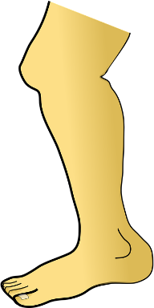
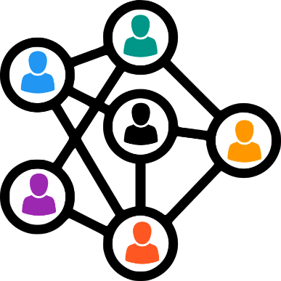
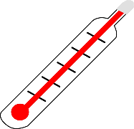
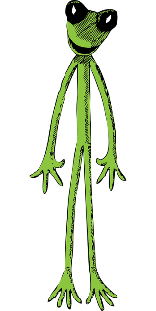
Quelle image ?
écouter
Quel mot va avec quelle image ?
1
2
3
4
5
6
7
8
a
b
c
d
8
1
3
4
le réseau (network)
malade (ill)
chacun (each person)
la jambe (leg)
e
f
g
h
6
7
5
2
le cœur (heart)
la caisse (checkout)
la vague (wave)
mince (thin)
Notes:
Timing: 4 minutes
Aim: Single word aural recognition of revisited vocab.
Procedure:
1. Click numbers to hear audio.
2. Students to match heard word to the image that best represents it and write the English and French.
3. Click to reveal answers one by one.
Transcript:
malade
mince
chacun
la jambe
la vague
le cœur
la caisse
le réseau
Word frequency of cognates (1 is the most frequent word in French): image [659]
Source: Lonsdale, D., & Le Bras, Y. (2009). A Frequency Dictionary of French: Core vocabulary for learners London: Routledge.

Slide 9
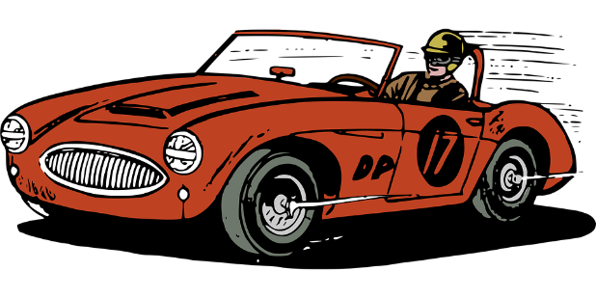
Le Grand Prix vocabulaire
Dis les mots plus vite que ton/ta partenaire pour gagner !
parler
3.
how much, how many
Miss, Mrs, Ms, madam
combien ?
madame
que ?
2.
what
s'il te plaît
please (informal)
1.
4.
finally
enfin
5.
to tick, ticking
cocher
6.
less than
moins…que
7.
taste
le goût
8.
la fin
end
12.
s’il vous plaît
please (formal)
10.
monsieur
that
Sir, Mr
ça
11.
9.
Notes:
Timing: 3 minutes
Aim: Oral speed recall of this week’s revisited vocabulary.
Procedure:
1. Students compete against a partner to be the quickest to recall the words in this week’s vocabulary set.
2. Students time each other and check their partner’s translations. If they spot a mistake, the partner must repeat the correct translation three times, thereby incurring a time penalty!
3. The student who completes the track in the fastest time (or gets furthest along the track in the available time) is the winner.

Slide 10
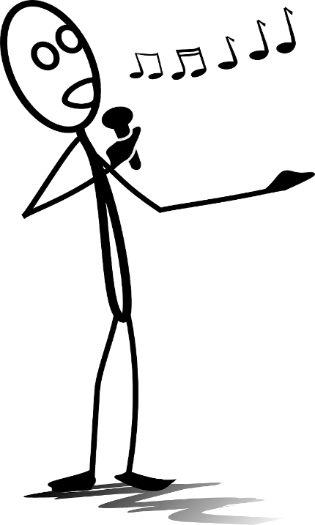
Word pattern –or/-er → ‘-eur’
vocabulaire
English words for jobs that end in ‘-or’ or ‘-er’ often end in ‘-eur’ in French.
Can you think of any examples you already know?
actor
acteur
singer
chanteur
Can you work out the French for these jobs?
author
auteur
senator
sénateur
Notes:
Timing: 3 minutes
Aim: Introduction of word pattern English ‘-or/-er’ → ‘-eur’
Procedure:
1. Click to reveal explanation and examples, eliciting French where possible.
2. Ensure understanding.
3. Elicit French for practice examples.
Word frequency of unknown words used (1 is the most frequent word in French): auteur [762], sénateur [684
Source: Lonsdale, D., & Le Bras, Y. (2009). A Frequency Dictionary of French: Core vocabulary for learners London: Routledge.

Slide 11
L’imparfait – la formation
grammaire
The imperfect tense is used to talk about things that used to happen regularly in the past.
To form the imperfect tense, follow these steps:
1. Take the nous form of the present tense.
e.g. nous cochons (cocher)
2. Remove the -ons ending to find the stem.
e.g. coch-
3. Add the imperfect ending.
je -ais
tu -ais
il/elle/on -ait
e.g. je cochais
tu cochais
il/elle/on cochait
There are some exceptions to the rule. For example, the stem of être is ét-.
Notes:
Timing: 5 minutes (2 slides)
Aim: Consolidation of formation of imperfect tense forms.
Procedure:
1. Click to bring up information step by step.
2. Check comprehension at each step.
Word frequency of cognates (1 is the most frequent word in French): imparfait [>5000], formation [831]
Source: Lonsdale, D., & Le Bras, Y. (2009). A Frequency Dictionary of French: Core vocabulary for learners London: Routledge.

Slide 12
L’imparfait – avoir et être
grammaire
The verb être can be used in the imperfect tense with an adjective to mean ‘was’.
Form the imperfect with être.
ét- + ais (je/tu) or ét + ait (il/elle/on)
e.g. J’étais méchant.
(I was mean.)
e.g. Tu étais prudent.
(You were careful.)
e.g. Il était différent.
(He was different.)
The verb avoir can be used in the imperfect tense to mean ‘had’ or ‘was’.
Form the imperfect with avoir.
nous avons → av- + ais (je/tu) / + ait (il/elle/on)
e.g. J’avais mal à la tête.
(I had a sore head.)
e.g. Tu avais la carte.
(You had the menu.)
e.g. Elle avait raison.
(She was right.)
Notes:
Slide 2/2
Aim: Introduce use of avoir and être in the imperfect.
Procedure:
1. Click through information and examples, checking comprehension at each stage.
2. Optional: ask student to come up with more examples of adjectives to use with each conjugation. Elicit orally or in written form.
Word frequency of cognates (1 is the most frequent word in French): imparfait [>5000]
Source: Lonsdale, D., & Le Bras, Y. (2009). A Frequency Dictionary of French: Core vocabulary for learners London: Routledge.

Slide 13
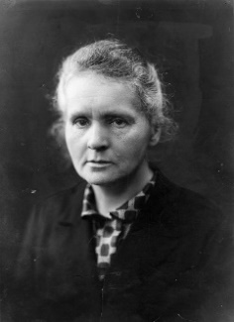
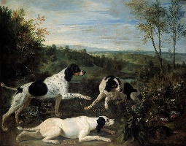
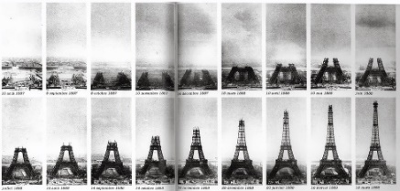
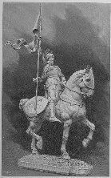
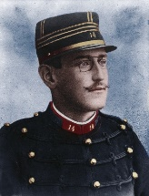
‘était’ ou ‘avait’
Écoute les phrases.
Choisis ‘était’ ou ‘avait’.
écouter
1
Gustave Eiffel était travailleur.
Il a fait la tour Eiffel et la statue de la liberté.
1
2
Louis XIV avait des chiens.
Bonne, Nonne et Ponne.
2
3
Comme femme de science, Marie Curie était forte.
Son corps est toujours radioactif.
3
4
Le vrai nom de Coco Chanel était Gabrielle Bonheur Chanel.
Sa couleur préférée était le noir.
4
5
Jeanne d’Arc était essentielle dans la guerre de cent ans.
Personne ne connaît son vrai nom.
5
6
Alfred Dreyfus n’était pas juif.
Il était emprisonné à tort.
6
Il a aidé les juifs pendant la deuxième guerre mondiale*.
7
L’Abbé Pierre avait un bon cœur.
7
8
Édith Piaf avait une vie intéressante.
Son père était acrobate.
8
Notes:
Timing: 8 mins
Aim: Aural recognition of use of avoir and être in the imperfect tense.
Procedure:
1. Click to hear audio.
2. Students to identify whether the beep covers ‘avait’ or ‘était’.
3. Click to reveal transcripts and full audio buttons one by one.
4. Click to reveal bonus facts about the historical figures.
Transcript:
Gustave Eiffel [était] travailleur.
Louis XIV [avait] des chiens.
Comme femme de science, Marie Curie [était] forte.
Le vrai nom de Coco Chanel [était] Gabrielle Bonheur Chanel.
Jeanne d'Arc [était] essentielle dans la guerre de cent* ans.
Alfred Dreyfus n’[était] pas juif.
L’Abbé Pierre [avait] un bon cœur.
Édith Piaf [avait] une vie intéressante.
Word frequency of cognates (1 is the most frequent word in French): statue [4020], radioactif [4294], emprisonné (emprisonner [3351]), acrobate [>5000]
Source: Lonsdale, D., & Le Bras, Y. (2009). A Frequency Dictionary of French: Core vocabulary for learners London: Routledge.
Bonne, Nonne et Ponne, Louis XIV’s dogs, Alexandre François Desportes (Public Domain) https://www.bestfranceforever.com/wp-content/uploads/2022/01/nonne.jpg
Marie Curie By Henrie Manuel (Public Domain) https://commons.wikimedia.org/w/index.php?curid=61396200
Joan of Arc by Mark Twain (Public Domain) https://commons.wikimedia.org/wiki/File:Personal_Recollections_of_Joan_of_Arc,_1896,_Figure_33.jpg
Alfred Dreyfus by Aron Gerschel (Public Domain) https://commons.wikimedia.org/wiki/File:Alfred_Dreyfus_(1859-1935).jpg

Slide 14
Les questions
grammaire
Oui, j’aime parler français !
You can ask a question in French by swapping the subject and
the first verb in a sentence.
e.g. Tu aimes parler français.
→ Aimes-tu parler français ?
Remember to put a hyphen between the verb and subject!
If the verb ends with a vowel and the subject begins with a vowel, you need to add -t- between the verb and the subject.
e.g. Elle mange du chocolat.
→ Mange-t-elle du chocolat ?
Notes:
Timing: 2 mins
Aim: Consolidate formation of inversion questions.
Procedure:
1. Click to reveal information.
2. Check comprehension at each stage.
3. Elicit examples from students orally.

Slide 15
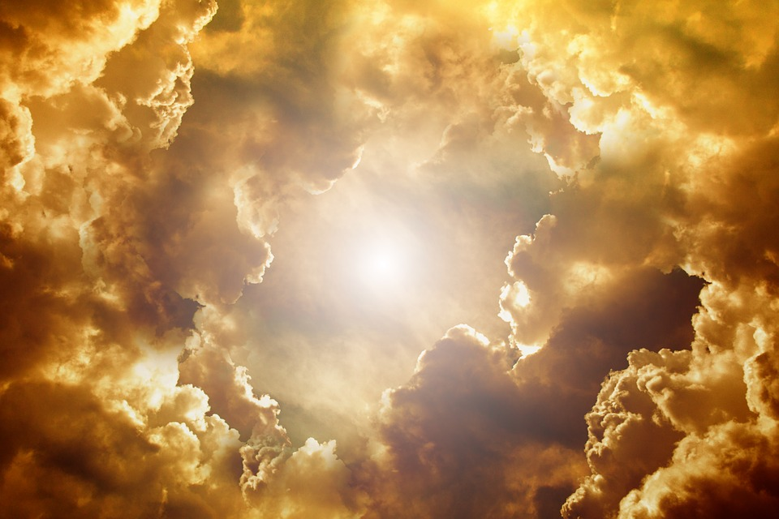
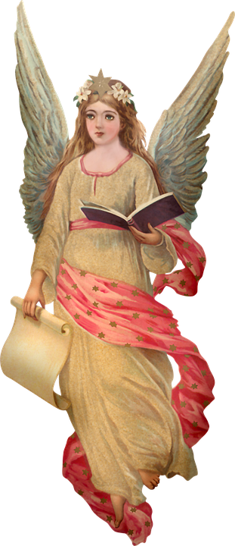
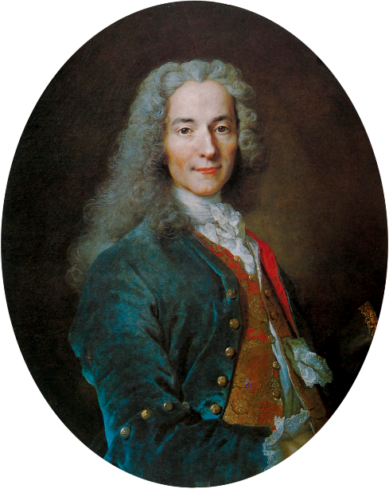
Bienvenue* au ciel
*bienvenue = welcome; *le ciel = heaven; *un écrivain = writer; *le philosophe = philosopher; l’esclavage (m) = slavery
parler
Bienvenue au ciel !
Quel était ton nom ?
Quelle était ta
nationalité ?
Quelle âge avais-tu ?
Quel était ton travail ?
Voltaire (vrai nom François-Marie Arouet) était écrivain* et philosophe* français de 1694 à 1778. Il parlait italien, espagnol et anglais. Il était contre la religion et l'esclavage*.
J’étais Voltaire.
J’étais français.
J’avais quatre-vingt-trois ans.
J’étais écrivain* et philosophe*.
Voltaire
Nom | ___________
Nationalité | ___________
Âge | ___________
Travail | ___________ ___________
français
83
écrivain + philosophe
Notes:
Timing: 10 minutes
Aim: Oral production of the imperfect tense.
Procedure:
Students work in pairs.
The idea is filling in the paperwork on arrival in heaven.
Partner A is the angel asking questions, partner B answers.
Swap roles.
Word frequency of cognates (1 is the most frequent word in French): nationalité [>5000], âge [502], philosophe [3609], religion [1699]
Word frequency of unknown words (1 is the most frequent word in French): écrivain [1738], esclavage [>5000]
Source: Lonsdale, D., & Le Bras, Y. (2009). A Frequency Dictionary of French: Core vocabulary for learners London: Routledge.
Source: https://en.wikipedia.org/wiki/Voltaire

Slide 16
Bienvenue* au ciel
parler
Partner A:
Nom: Michel Bouquet
Nationalité: français
Âge: 96
Travail: acteur
Partner B:
Nom: Louis Pasteur
Nationalité: français
Âge: 72
Travail: médecin
Notes:
Speaking cards: not to show on screen
Aim: use imperfect tense avoir and être in questions and answers.
Word frequency of cognates (1 is the most frequent word in French): nationalité [>5000], âge [502]
Source: Lonsdale, D., & Le Bras, Y. (2009). A Frequency Dictionary of French: Core vocabulary for learners London: Routledge.

Slide 17
Describing historical figures
Imperfect tense of avoir, être, aller, and faire (je/tu/il/elle/on) and other verbs
SSCs [open eu/œu], [closed eu/œu]
Y9 French
Term 3.2 - Week 5 - Lesson 68
Cath Morris / Catherine Salkeld / Mary Richardson
Artwork by: Chloé Motard
Date updated: 06/07/22
Notes:
Artwork by Chloé Motard. All additional pictures selected are available under a Creative Commons license, no attribution required.
Native teacher feedback provided by Sarah Brichory.
With thanks to Rachel Hawkes for her input on the lesson material.
Learning outcomes (lesson 2):
Consolidation of SSC [open eu/œu] and [closed eu/œu]
Practice of imperfect tense of avoir, être, aller, and faire (je/tu/il/elle/on forms) and other verbs
Word frequency (1 is the most frequent word in French):
Revisit Y7 and Y8 vocabulary (12/12)
malade [1066], méchant [3184], droit [143], gauche [607], local [622], gros [419], italien (adj) [1477], mince [3570], pire [743], espagnol (adj) [1666], à côté [123], aussi [44], mal [277], que [9], que ? [9], vague [1493], caisse [1881], poste [489], natation [>5000], note [1161], piste [1902], jambe [2472], maladie [973], tête [343], bras [1253], moment [148], exemple [259], fils [735], match [1906], cœur [568], blanc (n.) [708], feu [786], hôpital [1308], réseau [721], merci [1070], comment ça s’écrit ? [n/a], d'accord [496], s'il te plaît [n/a], s'il vous plaît [n/a], en bas [468], avoir mal [n/a], par [21], ça [>5000], cocher [>5000], peser [1584], quitter [507], différent [350], prudent [1529], possible [175], même [42], peut-être [190], partout [581], d'abord [326], enfin [349], couleur [1211], raison [72], madame [294], vue [191], monsieur [79], goût [1829], plat [2167], combien ? [800], chacun [323], bleu [1216], rouge [987], vert [1060], scolaire [1993], carte [955], soin [1109], bonjour [1972], aussi...que [n/a], plus...que [n/a], moins...que [n/a]
Source: Lonsdale, D., & Le Bras, Y. (2009). A Frequency Dictionary of French: Core vocabulary for learners London: Routledge.
The frequency rankings for words that occur in this PowerPoint which have been previously introduced in NCELP resources are given in the NCELP SOW and in the resources that first introduced and formally re-visited those words.
For any other words that occur incidentally in this PowerPoint, frequency rankings will be provided in the notes field wherever possible.

Slide 18
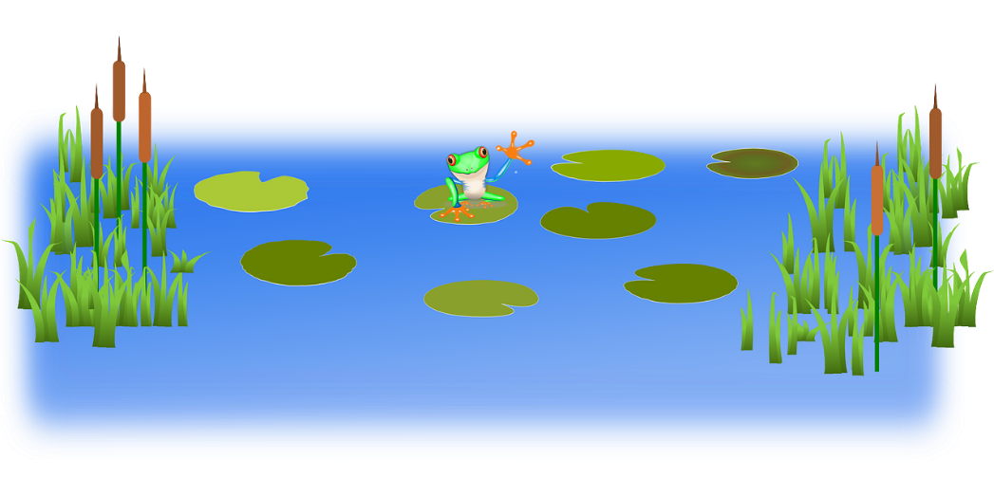
Virelangues 1/3
lire / parler
Il y a de nombreux docteurs dangereux au milieu du lac.
(There are many dangerous doctors in the middle of the lake.)
a
b
c
Notes:
Timing: 3 minutes for 3 slides
Aim: To practise pronunciation of open and closed SSC eu/oeu.
Procedure:
1. Students to say tongue twisters as quickly as possible with accurate pronunciation of SSCs.
2. Click buttons to hear slow, medium and fast pronunciation by native speaker.
Transcript:
1. Il y a de nombreux docteurs dangereux au milieu du lac.
2. Je ne veux pas pleurer, il est mieux d'être heureux que d'être sérieux.
3. L’entrepreneur est courageux, il fais la preuve de sa valeur chaque heure.
Word frequency (1 is the most frequent word in French): nombreux [366], docteur [2176], milieu [479], pleurer [2253], sérieux [412], entrepreneur [2377], courageux [2198], preuve [653], valeur [453]
Source: Lonsdale, D., & Le Bras, Y. (2009). A Frequency Dictionary of French: Core vocabulary for learners London: Routledge.

Slide 19
Virelangues 2/3
lire / parler
Je ne veux pas pleurer, il est mieux d'être heureux que d'être sérieux.
(I don’t want to cry, it is better to be
happy than to be serious.)
a
b
c
Notes:
Slide 2/3

Slide 20
Virelangues 3/3
lire / parler
L’entrepreneur est courageux,
il fait la preuve de sa valeur chaque heure.
(The entrepreneur is brave, he proves his worth every hour.)
a
b
c
Notes:
Slide 3/3

Slide 21
Vocabulaire
parler
60
 | Word | English meaning
1 | méchant | nasty, wicked, mean
2 | aussi | also
3 | le match | match
4 | que? | What?
5 | la note | mark
6 | par | by
7 | merci | thanks
8 | peser | to weigh, weighing
 | Word | English meaning
9 | le moment | moment
10 | d’accord | okay, alright
11 | possible | possible
12 | d’abord | first of all
13 | peut-être | maybe, perhaps
14 | la raison | reason
15 | chacun | each person
16 | en bas | at the bottom
0
DÉBUT
Notes:
Timing: 5 minutes Aim: Written recognition and oral production of revisited vocabulary. Procedure: Round 1: Look at the French, recall the English meanings, saying them aloud. [1 minute] Round 2: Look at the English, recall the French meanings, saying them aloud. [1 minute] Repeat for two further minutes, to speed up recall. Note: the words for this week have been split into two groups so that students first concentrate on items 1-8, then repeat all rounds of learning with 9-16.

Slide 22
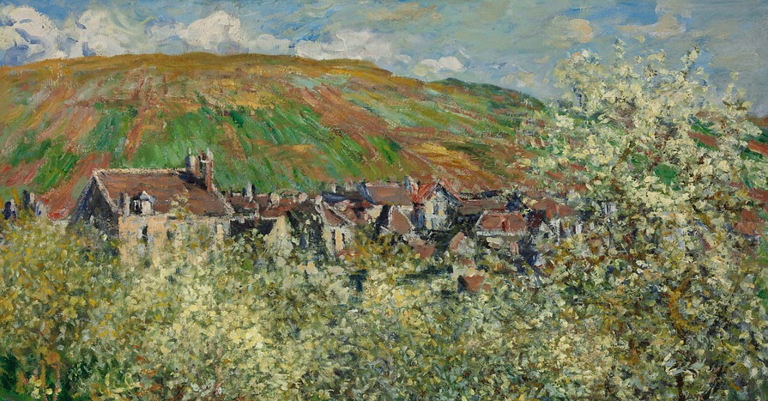
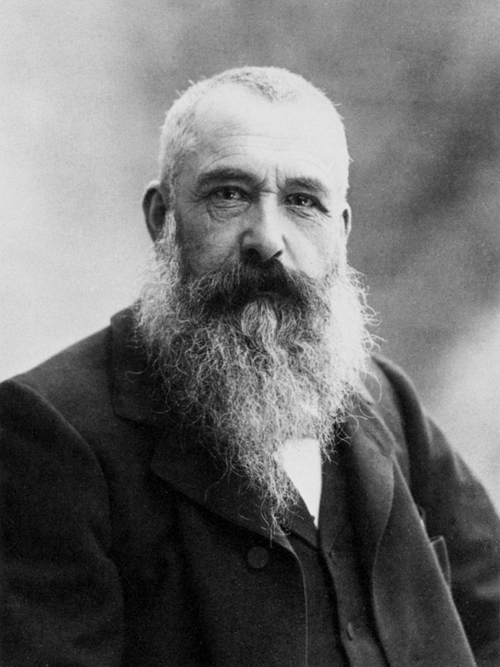
Monet 1840-1926
lire
Claude Monet était un artiste français qui a créé l'impressionnisme. Il étudiait à une école d'art à Paris. En 1861 il a quitté la France pour participer à une guerre en Afrique. Il disait que les couleurs (les rouges, les verts, le blanc) ont influencé son art. Il est tombé malade et il a décidé de retourner en France. Il avait deux fils avec sa femme Camille. Sa vision devenait pire. Il avait du mal à reconnaître les couleurs. À la fin, tout ce qu’il regardait était bleu !
Notes:
Timing: 8 minutes (2 slides)
Aim: Written recognition of revisited vocabulary in context.
Procedure:
1. Students read and take notes.
2. Comprehension questions on next slide.
Word frequency of cognates (1 is the most frequent word in French): art [1181], impressionnisme [>5000], influencé (influencer [2498]), vision [1505]
Source: Lonsdale, D., & Le Bras, Y. (2009). A Frequency Dictionary of French: Core vocabulary for learners London: Routledge.
Text based on information from https://en.wikipedia.org/wiki/Claude_Monet

Slide 23
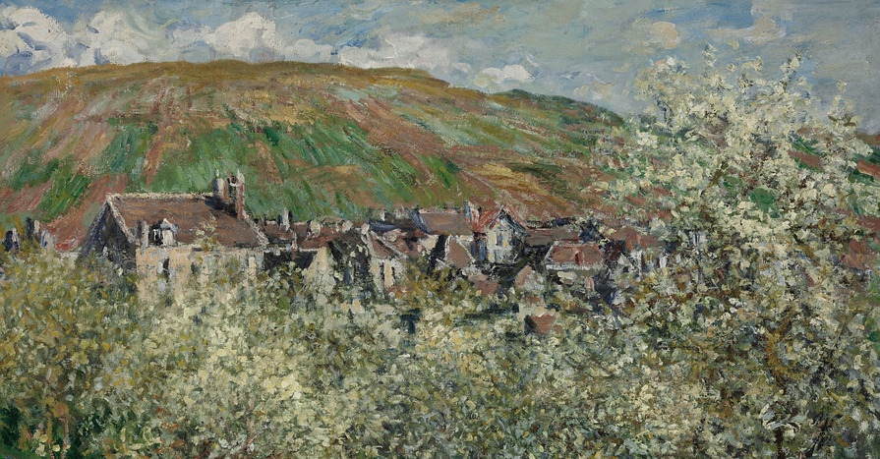
Monet 1840-1926
*le prénom = first name
lire
Monet étudiait où ?
Quelle chose en Afrique a influencé son art ?
Monsieur Monet avait combien d’enfants ?
De quelle couleur était sa vue à la fin ?
Son prénom*, comment ça s’écrit ?
Vrai ou faux – Monet était un artiste espagnol.
Vrai ou faux - il a participé à la guerre italienne.
Vrai ou faux – il avait mal à la tête.
Paris
les couleurs
deux (fils)
bleu
Claude
faux !
faux !
faux !
Notes:
Slide 2/2
Procedure:
1. Elicit answers orally.
2. Click to reveal answers one by one.

Slide 24
Remplis les blancs
écrire
On doit être prudent et aller à l'hôpital quand on a une maladie.
Quand j'étais enfant, je faisais de la natation. Un jour, j'avais mal au bras et les médecins ont pris soin de moi.
L’hôpital était à côté de la poste, aussi loin que l’école.
Maintenant, il y a même un restaurant en bas du bâtiment avec une vue sur la campagne. Ce n’est pas mal ! La carte est simple mais les plats ont un goût excellent. C'est mieux que la cantine scolaire en ce moment !
________
________
________
____
________
________
________
________
swimming
careful
an arm
the hospital
the menu
the post office
the dishes
view
Notes:
Timing: 5 minutes
Aim: Written production of revisited vocabulary in context
Procedure:
1. Students choose from the English words at the bottom, translate them into French and use them to fill the gaps in the text.
2. Click to reveal answers one by one.
Word frequency of cognates (1 is the most frequent word in French): simple [212], excellent [1225]
Source: Lonsdale, D., & Le Bras, Y. (2009). A Frequency Dictionary of French: Core vocabulary for learners London: Routledge.

Slide 25
L’imparfait
grammaire
The imperfect tense is used to talk about things that used to happen regularly in the past.
To form the imperfect tense, follow these steps:
e.g. aller
e.g. faire
1. Take the nous form of the present tense.
allons
faisons
2. Remove the -ons ending to find the stem.
all-
fais-
3. Add the imperfect ending.
je -ais
tu -ais
il/elle/on -ait
j’allais
je faisais
tu allais
tu faisais
il/elle/on allait
il/elle/on faisait
In English, the imperfect translates to ‘used to’.
e.g. used to
go
e.g. used to
do/make
Notes:
Timing: 2 mins
Aim: Recap of imperfect formation with ‘aller’ and ‘faire’.
Procedure:
1. Click to bring up information.
2. Students follow steps to form imperfect tense of aller then faire.
3. Click to reveal each step.
4. Click to reveal translation.

Slide 26
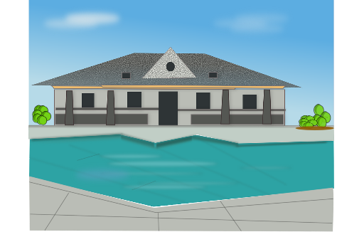
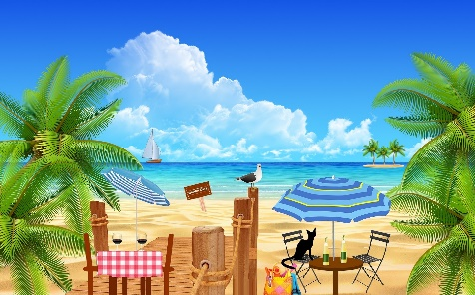
Il y a vs il y avait
grammaire
Remember, we use il y a to say, ‘there is’ or ‘there are’.
Il y a une piscine au collège.
There is a swimming pool at the school.
The imperfect tense of il y a is il y avait, which means ‘there used to be’.
There used to be a café at the beach.
Il y avait un café à la plage.
Notes:
Timing: 2 mins
Aim: Recap of il y a vs il y avait.
Procedure:
1. Click to bring up information.

Slide 27
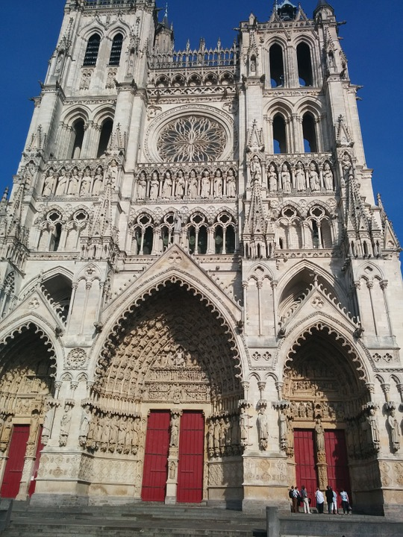
Une visite guidée !
Écoute l’introduction
grammaire
les tours
Écoute. C’est aujourd’hui ou avant ?
La phrase est à l'imparfait ou au présent ?
 |  | Now | Before
 | Towers of different heights
 | Colours on the cathedral
 | A show
 | A big door
 | Two small doors
 | Models to the left and right
 | Windows in a local shop
 | No rose window
1
1
la rosace
2
2
3
3
4
4
5
5
6
6
7
7
8
8
La Cathédrale d’Amiens
Notes:
Timing: 10 minutes
Aim: Aural recognition of il y a and il y avait in context, and connecting these with meaning.
Procedure:
Click the symbol to hear the introduction which sets the scene of the activity.
Elicit what pupils have understood.
Hello ladies and gentlemen (formal welcome).
We are in Amiens Cathedral.
It’s very big, twice as big as Notre Dame in Paris.
Click on the numbers on the left to hear sentences with a beep, covering a time expression.
Students decide whether the thing is there now or used to be there, based on their understanding of the tense of il y a / il y avait used.
Elicit answers one by one. Depending on proficiency level of students, ask what each sentence is telling them.
Click to reveal answers one by one and click on the numbers on the right to hear the complete sentences for verification.
Transcript:
Introduction: Bonjour mesdames et messieurs. Nous sommes à la cathédrale d’Amiens ! Elle est la deuxième plus grande cathédrale d'Europe, deux fois plus grande que Notre Dame à Paris.
[Aujourd’hui], il y a deux tours de hauteurs différentes.
[Au treizième siècle,] il y avait beaucoup de couleurs sur la cathédrale.
[En été et à Noël], il y a un spectacle qui montre à nouveau des couleurs du passé.
[Au seizième siècle], il y avait une grande porte.
[Maintenant] il y a deux petites portes.
À gauche et à droite, il y a [encore] des modèles.
Il y avait des fenêtres dans un magasin local avant un feu [en 1920].
Il n'y avait pas de rosace* dans le bâtiment [original].
Word frequency of cognates (1 is the most frequent word in French): guidé (guider [2008]), original [1814]
Word frequency of unknown words (1 is the most frequent word in French): siècle [603], treizième [>5000], seizième [>5000], tour [523], rosace [>5000]
Source: Lonsdale, D., & Le Bras, Y. (2009). A Frequency Dictionary of French: Core vocabulary for learners London: Routledge.
Source: https://en.wikipedia.org/wiki/Amiens_Cathedral

Slide 28
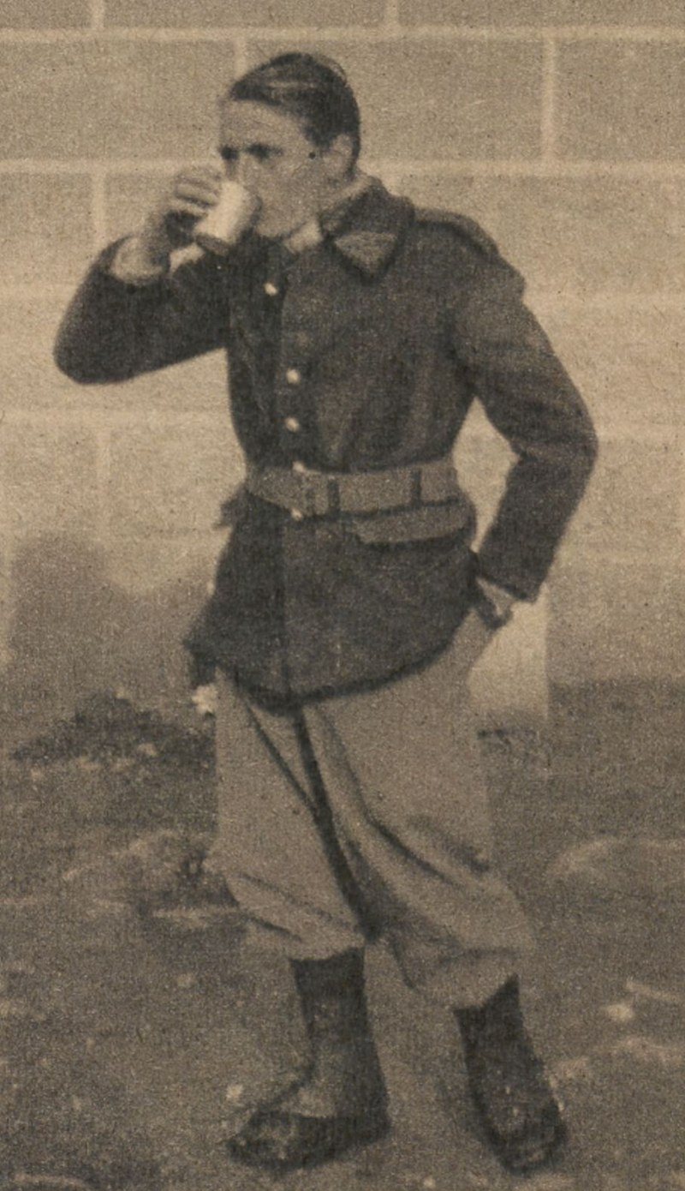
Émile Allais
Lis le texte. Coche les phrases vraies et corrige les autres.
lire
Emile Allais était un skieur français. Il était très rapide sur les pistes. Il gagnait des prix avec de nouvelles techniques. Il était membre de l’armée française pendant la deuxième guerre mondiale, et il utilisait ses compétences de ski. Il a créé l’École Française de Ski qui est aujourd'hui la plus grande école de ski du monde et existe partout en France et à l'étranger.
Émile Allais was a skier from France.
He always used to ski in a traditional way.
He fought in the First World War.
He couldn’t use his skis in the war.
The ski school he created still exists.
1.
2. He used new techniques.
3. He fought in the Second World War.
4. He used his skiing skills in the war.
5.
Notes:
Timing: 5 minutes
Aim: Written comprehension of verbs in the imperfect tense and revisited vocabulary.
Procedure:
1. Students read text.
2. Students decide whether each statement is true or false.
3. Students correct the false statements.
4. Click to reveal answers.
5. Oral translation of text if time allows.
Word frequency of cognates (1 is the most frequent word in French): skieur [>5000], ski [4571], exister [269], technique [592]
Source: Lonsdale, D., & Le Bras, Y. (2009). A Frequency Dictionary of French: Core vocabulary for learners London: Routledge.
Emile Allais (Public Domain) https://en.wikipedia.org/wiki/%C3%89mile_Allais#/media/File:Emile_Allais_mobilis%C3%A9_-_Le_Miroir_1939.jpg

Slide 29
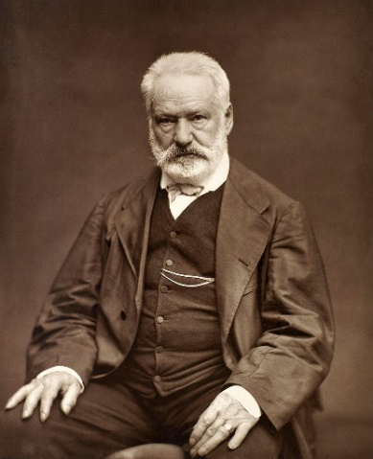
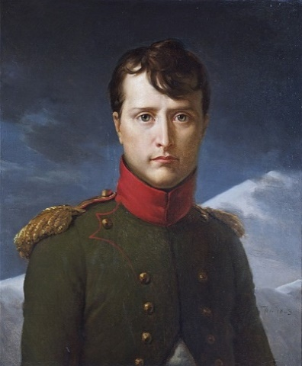
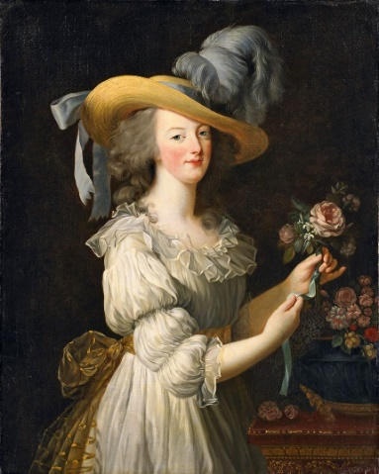
Les figures historiques
écrire
Utilise les informations pour
écrire un texte sur un des personnages historiques.
Victor Hugo:
He used to write books, for example Les Misérables and Le Bossu* de Notre Dame
He was the youngest son in his family
He had four children
He used to like politics
Napoleon Bonaparte:
His family was Italian
He used to learn French at school
He was smaller than other children
He was fat
Marie Antoinette:
She had a sister as well as a brother
She used to celebrate her birthday early when she was a child
She used to pay a lot of money for her clothes
She was the last queen* of France
*le bossu = hunchback
*la reine = queen
Notes:
Option 1 for higher proficiency students
Timing: 10 minutes (2 slides)
Aim: Written production of imperfect tense in context.
Procedure:
1. Students to choose a historical figure and translate the facts into French to write a short text.
2. Example answers on next slide.
Word frequency of unknown words (1 is the most frequent word in French): bossu [>5000], reine [2809]
Source: Lonsdale, D., & Le Bras, Y. (2009). A Frequency Dictionary of French: Core vocabulary for learners London: Routledge.
Victor Hugo by Étienne Carjat in Galerie Contemporaine, Littéraire, Artistique (Public Domain) https://en.wikipedia.org/wiki/Victor_Hugo#/media/File:Victor_Hugo_by_%C3%89tienne_Carjat_1876_-_full.jpg
Marie Antoinette en chemise by Louise Élisabeth Vigée Le Brun (Public Domain) https://en.wikipedia.org/wiki/Marie_Antoinette#/media/File:MA-Lebrun.jpg

Slide 30
Les figures historiques
Utilise les informations pour
écrire un texte sur un des personnages historiques.
écrire
Victor Hugo:
Il used to write des livres, par exemple Les Misérables et Le Bossu* de Notre Dame.
Il used to be le plus jeune fils de sa famille.
Il used to have quatres enfants.
Il used to like la politique.
Napoléon Bonaparte:
Sa famille used to be italienne.
Il used to learn le français à l’école.
Il used to be plus petit que les autres enfants.
Il used to be gros.
Marie Antoinette:
Elle used to have une sœur et un frère aussi.
Elle used to celebrate son anniversaire tôt quand elle used to be enfant.
Elle used to pay beaucoup d’argent pour ses vêtements.
Elle used to be la dernière reine* de France.
*le bossu = hunchback
*la reine = queen
Notes:
Option 2 for all students
Timing: 10 minutes (2 slides)
Aim: Written production of imperfect tense in context.
Procedure:
1. Students to choose a historical figure and fill in the verb to complete a short text.
2. Example answers on next slide.
Word frequency of unknown words (1 is the most frequent word in French): bossu [>5000], reine [2809]
Source: Lonsdale, D., & Le Bras, Y. (2009). A Frequency Dictionary of French: Core vocabulary for learners London: Routledge.
Victor Hugo by Étienne Carjat in Galerie Contemporaine, Littéraire, Artistique (Public Domain) https://en.wikipedia.org/wiki/Victor_Hugo#/media/File:Victor_Hugo_by_%C3%89tienne_Carjat_1876_-_full.jpg
Marie Antoinette en chemise by Louise Élisabeth Vigée Le Brun (Public Domain) https://en.wikipedia.org/wiki/Marie_Antoinette#/media/File:MA-Lebrun.jpg

Slide 31
Les figures historiques
Utilise les informations pour
écrire un texte sur un des personnages historiques.
écrire
Victor Hugo écrivait des livres, par exemple Les Misérables et Le Bossu de Notre Dame. Il était le plus jeune fils dans sa famille. Il avait quatre enfants. Il aimait la politique.
La famille de Napoléon Bonaparte était italienne. Il apprenait le français à l’école. Il était moins grand que les autres enfants. Il était gros.
Marie Antoinette avait une sœur et un frère aussi. Elle célébrait son anniversaire tôt quand elle était enfant. Elle payait beaucoup d’argent pour ses vêtements. Elle était la dernière reine de France.
Notes:
Slide 2/2 – example answers
Victor Hugo by Étienne Carjat in Galerie Contemporaine, Littéraire, Artistique (Public Domain) https://en.wikipedia.org/wiki/Victor_Hugo#/media/File:Victor_Hugo_by_%C3%89tienne_Carjat_1876_-_full.jpg
Marie Antoinette en chemise by Louise Élisabeth Vigée Le Brun (Public Domain) https://en.wikipedia.org/wiki/Marie_Antoinette#/media/File:MA-Lebrun.jpg

Slide 32
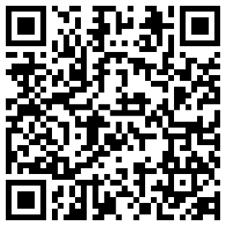
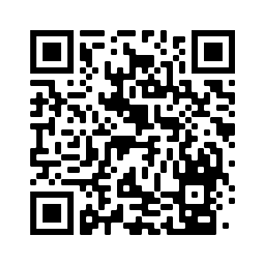
Devoirs
Vocabulary Learning Homework (Y9, Term 3.2, Week 6)
Audio Homework link
Audio Homework QR code:
Quizlet link
Quizlet QR code:
Student worksheet
In addition, revisit:
Y9, Term 2.2, Week 3
Y9, Term 3.2, Week 2
Notes:
The answer sheet for the 9.3.2.6 vocabulary learning homework is here: Resource | French SOW Y9 Term 3.2 Week 6 - vocabulary learning homework answers | ID: fq977w93c | NCELP

