Slide 1
Wo ist der / die / das...?
Definite articles: the words for ‘the’
long and short [a]
Y7 German
Term 1 - Week 1 - Lesson 1
Rachel Hawkes
Artwork: Steve Clarke
Date updated: 15/12/21
Notes:
Artwork by Steve Clarke. All additional pictures selected are available under a Creative Common license, no attribution required.
Learning outcomes (lesson 1):
Introduction of SSC long and short [a]
Introduction of definite articles (singular) der, die, das - Row 1 (nominative); ‚words for ‚the‘ and the concept of grammatical gender Introduction of the verb SEIN and 3rd person singular ‚ist‘, and the question word ‚wo‘ (where?) Introduction of the concept of capital letters for nouns.
Additional notes for lesson 1:
In this introductory lesson, time has deliberately been left to allow for start of the school year ‘setting up’, such as giving out exercise books, implementing a seating plan, etc. Usually lessons start with Phonetik, introducing a new SSC (sound-symbol correspondence) and practising it. We then focus on practising the new vocabulary. Grammar is introduced with a brief explanation, and followed with input practice (L & R) that compels students to pay attention to the key form-meaning connection. Productive practice follows, and is designed to make the target language forms task essential. This lesson, the first in the year, instead begins with a way for teachers to learn students’ names, using the new language, before moving onto the next slide (please scroll down below these notes).
Timing: 10 minutes
Procedure: Teacher has register but doesn’t know the students – Teachers may find it helpful to ‘mime’ gesture of looking as they say ‘Wo ist David?’ When David puts his hand up, teacher models answer ‘Hier’ and writes it on the board. Ensure all students are clear that ‘hier’ means ‘here’ (seems obvious but it might not be and it’s important that all students understand, so quickly elicit the English, saying ‘’Hier. Auf Englisch?’ and a students will volunteer ‘Here’. Teacher continues to find out where all the other students are – they respond ‘Hier’. It is possible to do this very quickly or elaborate the routine further and introduce ‘da’ – e.g., teacher pretends (may not even be pretence!) that it’s hard to remember where different students are and s/he needs the help of the class. This produces the need for ‘da’ as they will point towards a student in response to the teacher recapping ‘Also, wo ist David?’ and as they point they will naturally want to say ‘Hier’ but realise it doesn’t quite fit, so the teacher provides ‘da’. By the time the attendance of all students has been ascertained, the teacher will know all/almost all of the names of the class, and students will have begun to learn each other’s names, too. This is an important first step is building the classroom ethos that we need for language learning. In addition, many will now already know the words for ‘where’ and ‘is’ in German – they will often be surprised that they already know this when we go on to present the language more formally in the next slides.
Word frequency (1 is the most frequent word in German):
sein¹, ist [4] Fenster [674] Flasche [1602] Heft [3862] Tafel [3855] Tisch [529] da [48] hier [68] wo? [108] der, die, das [1] Hallo! [1077] Tschüs! [3766]
Jones, R.L. & Tschirner, E. (2019). A frequency dictionary of German: core vocabulary for learners. Routledge

Slide 2
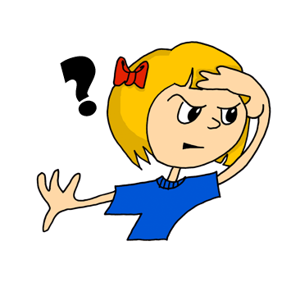
wo?
where?
Notes:
Timing: 1 minute (for three slides)
Aim: To introduce the key vocabulary ‘wo’ (where).
Procedure: 1. Present and say the word. 2. Bring up the question mark, and then straightaway the image and the English translation. 3. Do the gesture for ‘where’ (if desired) and say the word several times. Students say it with the teacher.
Word frequency (1 is the most frequent word in German): wo [94] Source: Jones, R.L. & Tschirner, E. (2011). A frequency dictionary of German: core vocabulary for learners. Routledge

Slide 3
wo?
where?
Wo ist Niko?
[Where is Niko?]
Rachel Hawkes
Notes:
Procedure: 1. Repeat the presentation of ‘wo’ 2. Bring up the short German sentence. 3. Elicit the English meaning.

Slide 4
wo?
where?
____ ist Niko?
Wo
[Where is Niko?]
Rachel Hawkes
Notes:
Procedure: 1. Elicit ‘wo’ 2. Elicit ‘wo’ again in the sentence.

Slide 5
Vokabeln
hören / lesen / sprechen
Wo ist ?
das Fenster
Das Fenster ist da.
Notes:
Timing: 3 minutes (for three slides) Aim: to introduce three classroom nouns. Procedure: 1. Present picture and say the word. (If in a classroom, walk also to the window as you repeat the word)
2. Bring up the question. Wo ist...? and model ‘Das Fenster ist da’, pointing to the real (or picture) window.
3. Elicit the English meaning of ‘da’. Show the written version. Word frequency (1 is the most frequent word in German): ist [3] das Fenster [634] wo? [94] da [35] der, die, das [1]
Source: Jones, R.L. & Tschirner, E. (2011). A frequency dictionary of German: core vocabulary for learners. Routledge
Additional notes:
The vocabulary in this first lesson is a set of concrete high-frequency nouns that all teachers will be able to point to, as well as show pictures of. Given the importance of grasping that every noun in German has a grammatical gender, that this is not the same as their previous understanding of gender, that it really does apply to every inanimate object around them, and that it’s best to think of it as simply part of the word, it feels useful for students to learn how to name some things that will always be in sight during their lessons, and therefore easily recycled in the few seconds between tasks in future lessons, etc.. The teacher can use this recycling to monitor students’ recall of gender at regular moments during the first half-term, and then periodically during the rest of the first year.

Slide 6
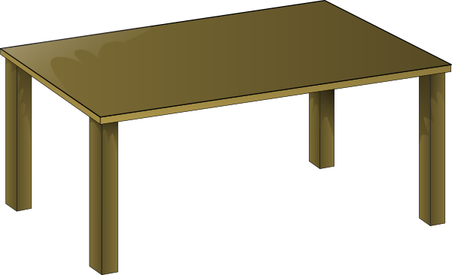
Vokabeln
hören / lesen / sprechen
Wo ist ?
der Tisch
Der Tisch ist hier.
Notes:
As for previous slide.

Slide 7
Vokabeln
hören / lesen / sprechen
Wo ist ?
das Heft
Das Heft ist hier.
Notes:
As for previous slide.

Slide 8
Phonetik: Vowels
German vowels can be short or long.
Vowels are short when followed by more than one consonant, e.g., Mann, Gast.
Vowels are long when:
there is a double vowel, e.g. Paar,
or when followed by the letter ‘h’, e.g., fahren,
or by a single consonant, e.g., sagen.
NB: German final ‘e’is not silent, but very short, e.g. danke, Klasse.
Notes:
Timing: 1 minute Aim: to introduce students to key knowledge about German vowels.
Note: It is important to give this explanation, but in the same way as with explicit grammar explanation, it is the practice that counts most. Procedure:
It may be helpful to ensure that ‘vowel’ is 100% understood, eliciting an example in English from students.
Bring up each line of text and read it clearly with appropriate stress and intonation.
3. Proceed to the practice on the next slides.
Note: There are, of course, exceptions to these rules – ‘mit’ has a short vowel sound, and so does ‘das’ which they have just met. It may be helpful to draw attention to the trickiness of English vowel/letter strings and show that there are many exceptions here, too – e.g. the pronunciation of ‘o’ in ‘love’ and ‘move’ and ‘cove’ – different in all three.

Slide 9
a
sagen
Notes:
Timing: 1 minute
Aim: To introduce/consolidate SSC [a]
Procedure: 1. Present the letter(s) and say the [a] sound first, on its own. Students repeat it with you. 2. Bring up the word ”sagen” on its own, say it, students repeat it, so that they have the opportunity to focus all of their attention on the connection between the written word and its sound.
3. A possible gesture for this would be mime speech coming out of your mouth, opening your mouth and drawing your hand away quickly away from you.
4. Roll back the animations and work through 1-3 again, but this time, dropping your voice completely to listen carefully to the students saying the [a] sound, pronouncing ”sagen” and, if using, doing the gesture. Word frequency (1 is the most frequent word in German): sagen [46] Source: Jones, R.L. & Tschirner, E. (2006). A frequency dictionary of German: core vocabulary for learners. Routledge

Slide 10
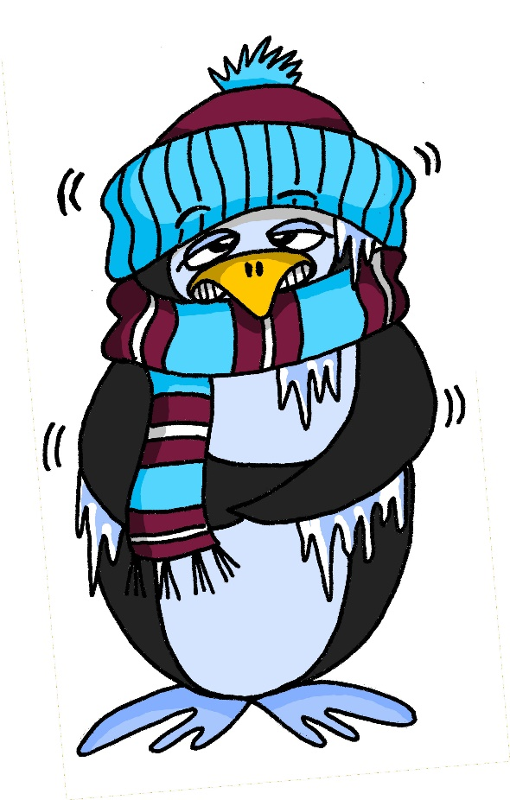
a
kalt
Notes:
Timing: 1 minute
Aim: To introduce/consolidate SSC [a]
Procedure: 1. Present the letter(s) and say the [a] sound first, on its own. Students repeat it with you. 2. Bring up the word ”kalt” on its own, say it, students repeat it, so that they have the opportunity to focus all of their attention on the connection between the written word and its sound.
3. A possible gesture for this would be to mime a shiver, crossing your arms in front of your body.
4. Roll back the animations and work through 1-3 again, but this time, dropping your voice completely to listen carefully to the students saying the [a] sound, pronouncing ”kalt” and, if using, doing the gesture. Word frequency (1 is the most frequent word in German): kalt [875] Source: Jones, R.L. & Tschirner, E. (2006). A frequency dictionary of German: core vocabulary for learners. Routledge

Slide 11
a
sagen
Notes:
With sound and no pictures to focus all attention on the sound-symbol correspondence.

Slide 12
Vokabeln
hören / lesen / sprechen
Wo ist ?
die Tafel
Die Tafel ist hier.
Notes:
Timing: 1 minute
Aim: to introduce further vocabulary, giving students the opportunity to practise their new SSC knowledge. Procedure: 1. Present picture and word and elicit the pronunciation from students (this is an opportunity for them to apply their phonics knowledge and decode the new word)
2. Bring up the question. Wo ist...? and model ‘Die Tafel ist hier’, pointing to the real (or picture) board.
3. Elicit a translation for ‘die Tafel’ and stress ‘die’ to prompt them to notice another word for ‘the’. They have now met the three words for ‘the’ for singular nouns. We will focus explicitly on this soon. Word frequency (1 is the most frequent word in German): ist [3] die Tafel [3656] wo? [94] hier [71] der, die, das [1]
Source: Jones, R.L. & Tschirner, E. (2011). A frequency dictionary of German: core vocabulary for learners. Routledge

Slide 13
Vokabeln
hören / lesen / sprechen
da
Notes:
As for previous slide.

Slide 14
a
kalt
Notes:
With sound and no pictures to focus all attention on the sound-symbol correspondence.

Slide 15
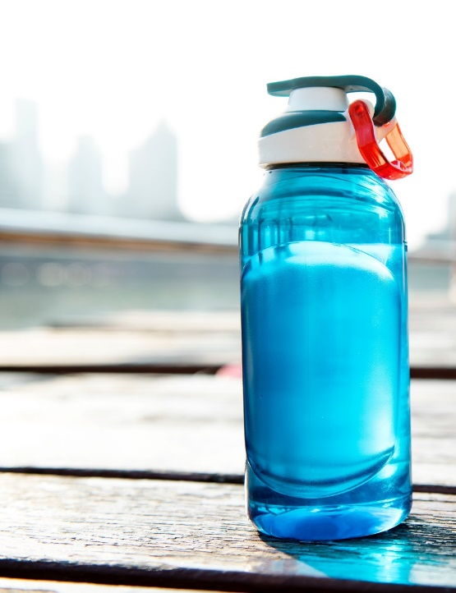
Vokabeln
hören / lesen / sprechen
Wo ist ?
die Flasche
Die Flasche ist da.
Notes:
Aim: to introduce further vocabulary, giving students the opportunity to practise their new SSC knowledge. Procedure: 1. Present picture and word and elicit the pronunciation from students (this is an opportunity for them to apply their phonics knowledge and decode the new word)
2. Bring up the question. Wo ist...? and model ‘Die Flasche ist da’, pointing to the real (or picture) board.
3. Elicit a translation for ‘die Flasche’ and stress ‘die’ to prompt them to notice another word for ‘the’. They have now met the three words for ‘the’ for singular nouns. We will focus explicitly on this soon. Word frequency (1 is the most frequent word in German): ist [3] die Flasche [1758] wo? [94] hier [71] der, die, das [1]
Source: Jones, R.L. & Tschirner, E. (2011). A frequency dictionary of German: core vocabulary for learners. Routledge

Slide 16
der, die, das
Grammatik
German has three words for the:
masculine
feminine
neuter
die Flasche
das Fenster
der
die
das
der Tisch
English speakers might find this tricky because English only uses the.
Every noun has a gender, but grammatical gender is not the same as biological gender, as you have seen.
Notes:
Timing: 3 minutes Aim: To introduce the concept of noun gender and the three singular definite articles (words for ‘the’) in German. Procedure: 1. Bring up the text and read it carefully, with helpful intonation.
2. Try to elicit the nouns from students before revealing them. Students have learnt two possible nouns for ‘die’ and ‘das’.
Note: It’s important for teachers to draw out the importance of learning gender. One point of interest is native speaker prediction based on gender. Depending on the class, it might be interesting for students to know that native speakers of languages with gender begin to predict what is going to be talked about as soon as the gender word is said – i.e. if there are two objects in view and just the word for ‘the’ is said, it is already clear what is being talked about. This classification of nouns by gender serves to speed up identification (fractions of a second, but still interesting and important!)
The key point for teachers to emphasise is that students need to learn nouns with their gender from the first encounter and practise recalling them frequently.

Slide 17
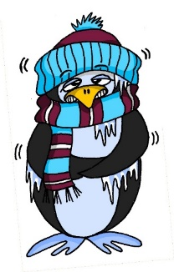
Vokabeln
hören / lesen / sprechen
der Tisch
d__ T____h
die Tafel
d__ T___l
d__ F_____e
die Flasche
das Fenster
d__ F_____r
d__ H__t
das Heft
sagen [to say]
kalt [cold]
Notes:
Timing: 3 minutes
Aim: To practise the new vocabulary further and to establish the knowledge of gender for the five nouns learnt in this lesson. Procedure: 1. Bring up gapped version of the word. Allow students to recall the word and its article. 2. Reveal the full version of the word. Repeat for other nouns. 3. Bring up the pictures and ask students to say the nouns and their articles.
4. Bring up the two phonics source word pictures, and the text for each. Invite students to say those words. 5. Ask students which is their favourite German word so far, and to think about why. Is it the sound, the meaning, the fact it is easy (or difficult) to remember. Note: This first lesson has been kept deliberately brief to allow for things like giving out exercise books, students finding the right room, etc... Normal lesson length is 50-60 minutes.

Slide 18
Wo ist der / die / das...?
Definite articles: the words for ‘the’
long and short [a]
Y7 German
Term 1 - Week 1 - Lesson 1
Rachel Hawkes
Artwork: Steve Clarke
Date updated: 15/12/21
Notes:
Artwork by Steve Clarke. All additional pictures selected are available under a Creative Common license, no attribution required.
Learning outcomes (lesson 2):
Consolidation of SSC long and short [a]
Introduction of definite articles (singular) der, die, das - Row 1 (nominative); ‚words for ‚the‘ and the concept of grammatical gender Introduction of the verb SEIN and 3rd person singular ‚ist‘, and the question word ‚wo‘ (where?) Introduction of the concept of capital letters for nouns.
Word frequency (1 is the most frequent word in German):
sein¹, ist [4] Fenster [674] Flasche [1602] Heft [3862] Tafel [3855] Tisch [529] da [48] hier [68] wo? [108] der, die, das [1] Hallo! [1077] Tschüs! [3766]
Jones, R.L. & Tschirner, E. (2019). A frequency dictionary of German: core vocabulary for learners. Routledge

Slide 19
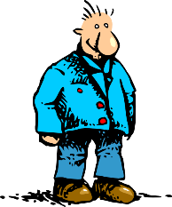
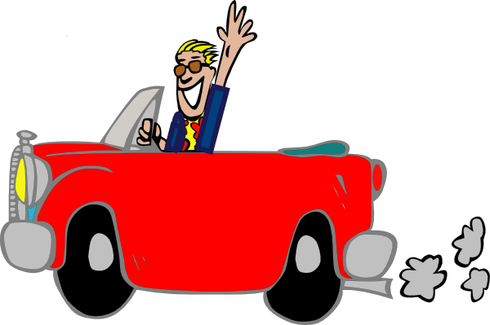
a
Paar
haben
sagen
fahren
Tag
klar
Notes:
Timing: 2 minutes
Aim: To introduce/consolidate SSC [a]
Procedure:
Introduce and elicit the pronunciation of the individual SSC [a] and then the source word again ‘sagen’ (with gesture, if using).
Then present and elicit the pronunciation of the five cluster words.
The cluster words have been chosen for their high-frequency, from a range of word classes, with the SSC (where possible) positioned within a variety of syllables within the words (e.g. initial, 2nd, final etc.). Additionally, we have tried to use words that build cumulatively on previously taught SSCs (see the Phonics Teaching Sequence document) and do not include new SSCs. Where new SSCs are used, they are often consonants which have a similar symbol-sound correspondence in English.
Word frequency (1 is the most frequent word in German): sagen [46]; Paar [284] haben [7]; fahren [169]; klar [255]; Tag [108].
Source: Jones, R.L. & Tschirner, E. (2006). A frequency dictionary of German: core vocabulary for learners. Routledge

Slide 20
a
Paar
haben
sagen
fahren
Tag
klar
Notes:
With sound and no pictures to focus all attention on the sound-symbol correspondence.

Slide 21
a
Paar
haben
sagen
fahren
Tag
klar
Notes:
Without sound to elicit pronunciation (without first hearing the teacher).
Teacher to elicit pronunciation by asking “Wie sagt man…”

Slide 22
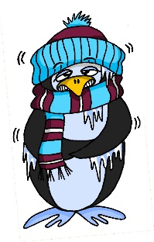
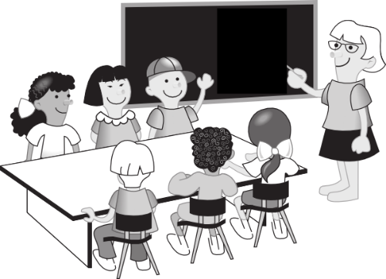
a
lang
Mann
6 Meter
kalt
Klasse
danke
Gast
[guest]
Notes:
Timing: 2 minutes
Aim: To introduce/consolidate SSC [a]
Procedure:
Introduce and elicit the pronunciation of the individual SSC [a] and then the source word again ‘kalt’ (with gesture, if using).
Then present and elicit the pronunciation of the five cluster words.
The cluster words have been chosen for their high-frequency, from a range of word classes, with the SSC (where possible) positioned within a variety of syllables within the words (e.g. initial, 2nd, final etc.). Additionally, we have tried to use words that build cumulatively on previously taught SSCs (see the Phonics Teaching Sequence document) and do not include new SSCs. Where new SSCs are used, they are often consonants which have a similar symbol-sound correspondence in English.
Word frequency (1 is the most frequent word in German): kalt [875]; lang [95] Mann [131]; Klasse [619]; Gast [675]; danke [778]. Source: Jones, R.L. & Tschirner, E. (2006). A frequency dictionary of German: core vocabulary for learners. Routledge

Slide 23
a
lang
Mann
kalt
Klasse
danke
Gast
Notes:
With sound and no pictures to focus all attention on the sound-symbol correspondence.

Slide 24
a
lang
Mann
kalt
Klasse
danke
Gast
Notes:
Without sound to elicit pronunciation (without first hearing the teacher).
Teacher to elicit pronunciation by asking “Wie sagt man…”

Slide 25
Phonetik
hören
Hör zu. [a:] oder [a]?
 | sagen | kalt
1
Mann
2
Paar
3
fahren
4
Klasse
5
danke
Notes:
Timing: 2 minutes Aim: to focus on differentiating the long and short [a] sounds in German. Procedure: 1. Click to hear the word. Decide if it is long [a] as in ‘sagen’ or short [a] as in ‘kalt’. Students are NOT expected to transcribe the words – there are several ways to write the sound long [a] and these are not words that have yet been taught, merely seen briefly in phonics practice.
2. Bring up the answers and the written word for students’ information. They will be learning these highly frequent words soon.
Transcript:
Mann
Paar
fahren
Klasse
danke
Word frequency (1 is the most frequent word in German): Mann [131]; Paar [284] fahren [169]; Klasse [619]; danke [778] Source: Jones, R.L. & Tschirner, E. (2006). A frequency dictionary of German: core vocabulary for learners. Routledge

Slide 26
a
lang
der
Mann
kalt
6 Meter
die
Klasse
danke
der
Gast
[guest]
Notes:
Timing: 3 minutes (two slides) Aim: Awareness-raising
Procedure: 1. Ask students to suggest why some of these words have capital letters. 2. Do they know any other German words like this? 3. Click for the definite articles to appear.

Slide 27
Nouns
Grammatik
All German nouns start with a capital letter, wherever they are in the sentence.
For example: Der Tag ist kalt. (The day is cold.)
Which nouns do this in English?
Proper nouns, e.g. London, September, Monday, Emily.
German proper nouns do this as well.
Notes:
Aim: To introduce the concept of capital letters on German nouns. Procedure: 1. Bring up the text and read it carefully, with helpful intonation.

Slide 28
Nouns
Grammatik
Which words need a capital letter in German?
1
The
table
is
there.
1. Der Tisch ist da.
2
Where
is
the
bottle?
2. Wo ist die Flasche?
3
The
exercise book
is
here.
3. Das Heft is hier.
4
Where
is
the
man?
4. Wo ist der Mann?
5
The
man
is
in
London.
5. Der Mann ist in London.
Notes:
Timing: 3 minutes Aim: To practise the concept of capital letters on German nouns. Procedure: 1. Bring up each question.
2. Students identify the words that need capitals. Point out that both German and English always start sentences with a capital letter. 3. Elicit and/or present the German sentence.

Slide 29
der, die, das
Grammatik
Remember! German has three words for the:
masculine
feminine
neuter
die Flasche
das Fenster
der
die
das
der Tisch
English speakers might find this tricky because English only uses the.
Every noun has a gender, but grammatical gender is not the same as biological gender, as you have seen.
Notes:
Timing: 2 minutes Aim: To recap concept of noun gender and the three singular definite articles (words for ‘the’) in German.
Note: This is a repeat of the slide from lesson 1. Procedure: 1. Bring up the text and read it carefully, with helpful intonation.
2. Try to elicit the nouns from students before revealing them. Students have learnt two possible nouns for ‘die’ and ‘das’.

Slide 30
Wo ist...?
Grammatik
Notes:
Timing: 2 minutes (3 slides) Aim: To practise knowledge of noun gender and the three singular definite articles (words for ‘the’) in German. Procedure: 1. Click to bring up both pictures at once. 2. Say the gender of either one and students have to respond by either turning their heads to the left or right or pointing at the correct picture, whichever is clearer. The teacher can frame this as the partially completed question ‘Wo ist die…? OR ‘Wo ist das…?

Slide 31
Wo ist...?
Grammatik
Notes:
As for previous slide.

Slide 32
Wo ist...?
Grammatik
Notes:
As for previous slide.

Slide 33
Vokabeln
der Mann
Notes:
Timing: 5 minutes (all vocabulary presentation slides) Aim: to present and practise the new vocabulary for this week, which includes the nouns from the cluster words. Procedure: 1. Teacher introduces the word and picture and says the word. 2. Teacher brings up the word for ‘the’ separately to focus attention on it.
3. Students say the article and the noun together. 4. Roll back the mouse to repeat these stages a couple of times. 5. Repeat with the remaining nouns on the following slides.
Word frequency (1 is the most frequent word in German):
der Mann [131] der Gast [625] der Tag [108] die Klasse [619] das Paar [284] das Heft [3594] das Fenster [634] der Tisch [492] die Tafel [3656] die Flasche [1758]
Source: Jones, R.L. & Tschirner, E. (2011). A frequency dictionary of German: core vocabulary for learners. Routledge

Slide 34
Vokabeln
der Gast
[guest]
Notes:
der Gast

Slide 35
Vokabeln
der Tisch
Notes:
der Tisch

Slide 36
Vokabeln
das Fenster
Notes:
das Fenster

Slide 37
Vokabeln
das Paar
Notes:
das Paar

Slide 38
Vokabeln
das Heft
Notes:
das Heft

Slide 39
Vokabeln
die Tafel
Notes:
die Tafel

Slide 40
Vokabeln
die Flasche
Notes:
die Flasche

Slide 41
Vokabeln
die Klasse
Notes:
die Klasse

Slide 42
Vokabeln
der Tag
Notes:
der Tag

Slide 43
Vokabeln
Fenster
masculine
feminine
neuter
Flasche
Gast
Tisch
Tafel
Klasse
Mann
Paar
Heft
Tag
Notes:
Timing: 3 minutes Aim: to reinforce the new knowledge by classifying all nouns by their gender.
Procedure: 1. Teacher clicks and the word ‘masculine’ appears. 2. Students think and identify (written or orally) the masculine nouns. 3. Click to highlight the masculine nouns. 4. Repeat for ‘feminine’ and ‘neuter’ nouns.

Slide 44
Vokabeln
masculine
feminine
neuter
60
der Gast
die Flasche
das Paar
der Tisch
die Klasse
Sekunden
das Heft
der Tag
die Tafel
das Fenster
0
der Mann
LOS!
Notes:
Timing: 1 minute Aim: To practise pronunciation of the new language.
Procedure: 1. Start the timer. Pronounce all the words within one minute, either individually or in pairs, taking turns to say one word each (as in ‘verbal tennis’) 2. Remind that every noun begins with a capital letter in German.

Slide 45
Vokabeln
masculine
feminine
neuter
60
der Gast
die Flasche
das Paar
der Tisch
die Klasse
Sekunden
das Heft
der Tag
die Tafel
das Fenster
0
der Mann
LOS!
Notes:
Timing: 1 minute
Aim: To practise pronunciation of the new language
Procedure: 1. Start the timer. Say all the words, but in alphabetical order this time. This compels learners to slow down a little and they will focus a little more attention on the written word.

Slide 46
Vokabeln
A
B
1. Wo ist die ?
2. Wo ist das ?
Notes:
Timing: 8 minutes (3 slides)
Aim: to practise gender knowledge and written recall of the new vocabulary
Procedure: 1. Students write 1-6 in their books (or on whiteboards). 2. Identify which noun is ‘hidden’ from the definite article. Write A or B. 3. Write the full missing word in German. Note: Reassure students that they are not expected to know these yet, but that trying to write them from memory, trying to remember, is a key part of learning.

Slide 47
Vokabeln
A
B
3. Wo ist der Tisch? ?
4. Wo ist die Tafel? ?
Notes:
As for previous slide.

Slide 48
Vokabeln
A
B
5. Wo ist das ?
6. Wo ist der ?
Notes:
As for previous slide.

Slide 49
Antworten
A
B
1. Wo ist die Flasche ? ?
2. Wo ist das Fenster ?
Notes:
Timing: 2 minutes (3 slides)
Aim: To review answers to help establish new knowledge.
Procedure: 1. Click to indicate the correct item A or B. 2. Reveal the full spelling of the German word.

Slide 50
Antworten
A
B
3. Wo ist der Tisch?
4. Wo ist die Tafel?
Notes:
As for previous slide.

Slide 51
Antworten
A
B
5. Wo ist das Paar ? ?
6. Wo ist der Mann ?
Notes:
As for previous slide.

Slide 52
der, die oder das?
Grammatik
die Flasche
der Mann
der Tisch
die Tafel
das Heft
das Fenster
das Paar
die Klasse
der Tag
Notes:
Timing: 3 minutes
Aim: To re-focus on the essential new grammatical knowledge – the definite singular articles der, die, das.
Procedure: 1. Ask ‘Ist est der, die, oder das? (oder will be explicitly taught in a subsequent lesson) 2. Elicit the English meanings.

Slide 53
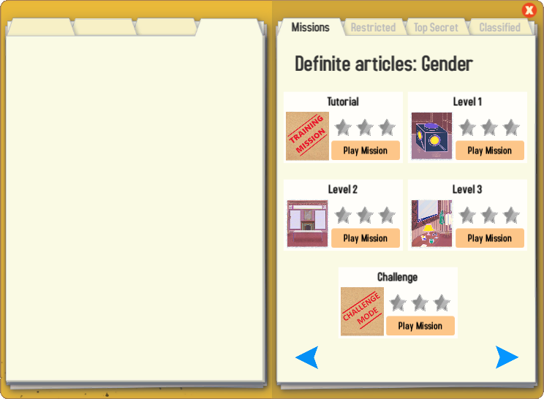
Gaming Grammar
Try the following Gaming Grammar missions to practise:

Slide 54
Hausaufgaben
Vocabulary Learning Homework (Y7, Term 1.1, Weeks 1 & 2)
Audio files: 1 & 2
Audio file QR codes:
Student worksheets: 1 & 2
Quizlet links: 1 & 2
Notes:
Timing: 10 minutes
Aim: To explain the homework concept for Y7. Procedure: 1. Explain the to establish the knowledge of new words, practice is extremely important. Perhaps suggest that students think of the memory as a muscle that needs regular training to keep it in good shape. 2. What has happened to day in the lesson has ‘sown the seeds’ of the new words. These words will be re-visited several times more this year. That is built into the lessons. 3. It’s very useful to space the practice of new language, doing little and often. For this reason, the homework this year will be to pre-learn the words for the next lesson. This will not mean that they completely know all the words, but that they are part-way there, when they arrive at the lesson. 4. There will be a vocabulary learning homework, with audio and a student worksheet for them to complete. The final stage takes them to quizlet for some additional practice. 5. If students want to revisit language from this week they can also do that on Quizlet.

