Slide 1
Describing how things are now and how they used to be: Childhood
Verbs like prendre, venir, sortir, entendre, lire, écrire and choisir in the imperfect tense (je vs il/elle/on)
SSC [ou] vs [u]
Y9 French
Term 2.2 - Week 2 - Lesson 41
Author names: Catherine Morris / Catherine Salkeld
Artwork by: Chloé Motard
Date updated: 27/01/22
Notes:
Artwork by Chloé Motard. All additional pictures selected are available under a Creative Commons license, no attribution required.
Native teacher feedback provided by Sarah Brichory.
Learning outcomes (lesson 1):
Consolidation of SSCs [ou] and [u]
Introduction of verbs like prendre, venir, sortir, entendre, lire, écrire and choisir in the imperfect tense (habitual events with 'used to' equivalent in English)
(je, il/elle/on)
Word frequency (1 is the most frequent word in French):
9.2.2.2 (introduce) construire [793], réagir (à) [1052], réfléchir (à) [1058], an [76], clé [1200], club [1860], comportement [1489], enfance [2207], habitude [1221], ancien [392], familial [1622], libre [344], quotidien [1318], responsable [511], il y a² [13/36/8]
9.2.1.4 (revisit) blesser [2024], jeter [1202], laisser [196], amour [967], envie [1237], mer [921], prix [310], sens [243], tellement [869]
9.1.2.2 (revisit) appartenir à [319], croire, crois, croit [135], soutenir [578], dieu [2262], foi [1368], laïcité [>5000], liberté [320], chrétien [1895], européen [445], juif [1510], musulman [2245], religieux [1203]
revisit: chien [1744], algérien [4163], canadien [611], italien [1477], anglais [784], français [251]
Source: Lonsdale, D., & Le Bras, Y. (2009). A Frequency Dictionary of French: Core vocabulary for learners London: Routledge.
The frequency rankings for words that occur in this PowerPoint which have been previously introduced in NCELP resources are given in the NCELP SOW and in the resources that first introduced and formally re-visited those words.
For any other words that occur incidentally in this PowerPoint, frequency rankings will be provided in the notes field wherever possible.

Slide 2
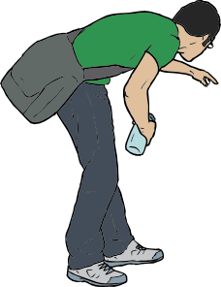
ou
trouver
jouer
Bonjour !
nous
douze
toujours
[always; still]
Notes:
Timing: 5 minutes [1/3]
Aim: recap [ou] and [u]
Procedure:
1. Introduce and elicit the pronunciation of the individual SSC [ou] and then the source word again ‘nous’ (with gesture, if using). 2. Then present and elicit the pronunciation of the five cluster words.
The cluster words have been chosen for their high-frequency, from a range of word classes, with the SSC (where possible) positioned within a variety of syllables within the words (e.g. initial, 2nd, final etc.). Additionally, we have tried to use words that build cumulatively on previously taught SSCs (see the Phonics Teaching Sequence document) and do not include new SSCs. Where new SSCs are used, they are often consonants which have a similar symbol-sound correspondence in English.
Word frequency (1 is the most frequent word in French): nous [31]; trouver [83] jouer [219]; bonjour [1972]; toujours [103]; douze [1664].
Source: Lonsdale, D., & Le Bras, Y. (2009). A Frequency Dictionary of French: Core vocabulary for learners London: Routledge.

Slide 3
u
Salut !
vue
amusant
tu
utiliser
[to use]
sur
[on]
Notes:
[2/3]
Aim: To introduce SSC [u]
Procedure:
1. Introduce and elicit the pronunciation of the individual SSC [u] and then the source word again ‘tu’ (with gesture, if using). 2. Then present and elicit the pronunciation of the five cluster words.
The cluster words have been chosen for their high-frequency, from a range of word classes, with the SSC (where possible) positioned within a variety of syllables within the words (e.g. initial, 2nd, final etc.). Additionally, we have tried to use words that build cumulatively on previously taught SSCs (see the Phonics Teaching Sequence document) and do not include new SSCs. Where new SSCs are used, they are often consonants which have a similar symbol-sound correspondence in English.
Word frequency (1 is the most frequent word in French): tu [112]; salut ! [2205] vue [191]; sur [16]; amusant [4695]; utiliser [345]. Source: Lonsdale, D., & Le Bras, Y. (2009). A Frequency Dictionary of French: Core vocabulary for learners London: Routledge.

Slide 4
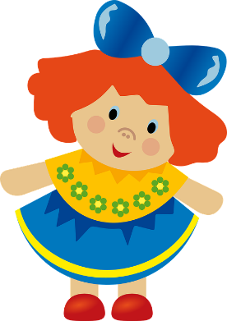
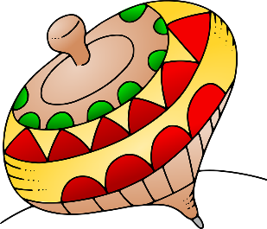
[ou] vs [u]
écouter / écrire
Noura parle de son enfance. Entends-tu [ou] ou [u] ?
1
_
_
_
_
la poupée
2
les c u bes
3
le nounours
4
les patins
à roulettes
_
_
la s u cette
de bébé
_
5
_
_
la peint u re à
n u méros
l’ours en
pel u che
6
la toupie
7
8
_
_
Notes:
[3/3]
Procedure:
1. Click audio buttons to hear a French word.
2. Students tick whether they hear [ou] or [u].
Optional step-up for higher level students: attempt to transcribe full word.
3. Click to reveal answers one by one.
Transcript:
la poupée
les cubes
le nounours
les patins à roulettes
l’ours en peluche
la toupie
la sucette de bébé
la peinture à numéros
Word frequency of cognates (1 is the most frequent word in French): cube [>5000]
Word frequency of unknown words (1 is the most frequent word in French): poupée [>5000], nounours [>5000], patins à roulettes [>5000/4/>5000], ours en peluche [4800/7/>5000], toupie [>5000], sucette de bébé [>5000/2/2271], peinture à numéros [2880/4/766]
Source: Lonsdale, D., & Le Bras, Y. (2009). A Frequency Dictionary of French: Core vocabulary for learners London: Routledge.

Slide 5
Faites des paires !
5
écouter
sans restrictions
15
faire
avoir la responsabilité
9
chaque jour
avoir une réaction
2
7
penser à
8
13
avant le présent
lieu pour les jeunes
This week’s new verbs belong to two different verb groups.
réfléchir (à) and réagir (à) are verbs like choisir.
Construire is a verb like lire.
1
douze mois
être enfant
le précédent
10
14
12
être sage ou méchant
11
4
pour fermer la porte
de la famille
6
3
sa routine
1
2
3
4
5
6
7
8
9
10
11
12
13
14
15
Notes:
Timing: 5 minutes
Aim: Aural recognition of this week’s new vocabulary; forming semantic connections between new words and known words/cognates.
Procedure:
1. Students read the words on the screen. Check meaning of unknown cognates is understood.
2. Click on a number to hear a word read aloud. Students write the number next to the word on the slide with the closest meaning match.
3. Click to reveal answers. Teacher says each word, students repeat. Clarify definitions.
4. Click to bring up note about this week’s new verbs. Remind students of patterns.
Transcript
1. il y a²
2. construire
3. Le comportement
4. l’habitude
5. libre
6. familial
7. réagir (à)
8. quotidien
9. réfléchir (à)
10. l’an
11. la clé
12. le club
13. l’enfance
14. ancien
15. Responsable
Word frequency of cognates (1 is the most frequent word in French): restriction [2589], réaction [957], précédent [820], présent [216], routine [4120]
Source: Lonsdale, D., & Le Bras, Y. (2009). A Frequency Dictionary of French: Core vocabulary for learners London: Routledge.

Slide 6
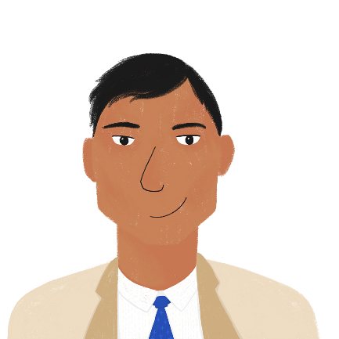
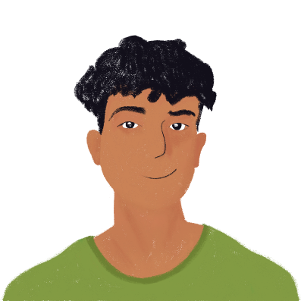
De nouvelles responsabilités
lire
Amir parle des différences entre l'enfance et l’adolescence.
Que dit-il? Écris six différences en anglais.
Les adolescents* sont plus responsables et libres que pendant leur enfance. Ils laissent l’ancienne école pour aller au collège. Au quotidien ils doivent réfléchir à leurs habitudes et leur comportement pour construire leur avenir.
Les parents montrent leur confiance* quand ils donnent à leur enfant une clé de la maison familiale. Alors les adolescents peuvent rentrer à la maison tout seuls après les clubs.
C’est une vie différente aujourd’hui qu’il y a cinq ans! En générale, mes parents réagissent positivement aux changements*.
*l’adolescent (m) = teenager
*la confiance = trust
*le changement = change
Notes:
Timing: 7 minutes [1/2]
Aim: Written recognition of new vocabulary in context.
Procedure:
1. Check understanding of highlighted words (all new vocabulary). Oral or written translation and pronunciation practice.
2. Students read the text and write down six differences in English (answers on the next slide).
3. Teacher to elicit responses from students regarding their reaction to the text and their own experiences, e.g. Vous avez une clé familiale? Vous avez plus de liberté maintenant? Vous pensez à l’avenir ? Allow some time for students to prepare responses.
Word frequency of unknown words (1 is the most frequent word in French): confiance [435]
Word frequency of cognates(1 is the most frequent word in French): adolescent [2085], majorité [988], positivement [>5000], changement [530], période [407]
Source: Lonsdale, D., & Le Bras, Y. (2009). A Frequency Dictionary of French: Core vocabulary for learners London: Routledge.

Slide 7
De nouvelles responsabilités
lire
Amir parle des différences entre l'enfance et l’adolescence.
Que dit-il? Écris six différences en anglais.
teenagers are more responsible
teenagers are freer/have more freedom
teenagers go to high school
teenagers have to think about their behaviour and habits (every day)
teenagers think about building their future
parents trust teenagers more
teenagers have a key to the family home
teenagers can come home by themselves (after clubs)
*l’adolescent (m) = teenager
*la confiance = trust
*le changement = change
Notes:
Suggested answers to the previous activity [2/2].
Word frequency of cognates(1 is the most frequent word in French): adolescent [2085], majorité [988], positivement [>5000], changement [530], période [407]
Source: Lonsdale, D., & Le Bras, Y. (2009). A Frequency Dictionary of French: Core vocabulary for learners London: Routledge.

Slide 8
Un an vs. une année
info
Un an or une année both mean ‘a year’.
Un an is used with a number (including tous) to count years or the number of times something happens in a year.
UN AN
= QUANTITY
L’enfance dure 18 ans.
Je suis arrivée en France il y a 5 ans.
Une année is used to describe what happened in a particular year, or to say how many years something took.
Il a écrit beaucoup l’année dernière.
C’est la deuxième année du festival.
UNE ANNÉE
= DESCRIPTION OR DURATION
Notes:
Timing: 8 minutes [1/3]
Aim: introduce when to use an vs année.
Procedure:
1. Click to bring up information and examples.
2. Check students’ understanding.
3. Activity to check understanding on next slide.

Slide 9
‘an’ ou ‘année’ ?
*augmenter = to increase
lire
Choisis le mot correct.
J’ai passé deux _______ en France.
Cette _______ je veux écrire plus.
L’_______ prochaine vient vite.
Le prix augmente* tous les _______.
Pendant la première _______, je cherchais un boulot.
Ils ont attendu dix _______.
Dans trois _______, je vais voyager en Espagne.
J’ai passé deux ans en France.
Cette année je veux écrire plus.
L’année prochaine vient vite.
Le prix augmente* tous les ans.
Pendant la première année, je cherchais un boulot.
Ils ont attendu dix ans.
Dans trois ans, je vais voyager en Espagne.
Notes:
[slide 2/3]
Aim: recognise where to use an vs année.
Procedure:
1. Students must choose whether an or année fits in each sentence.
2. Click to reveal answers one by one.
3. Revisit previous slide to explain reasoning for answers if needed.

Slide 10
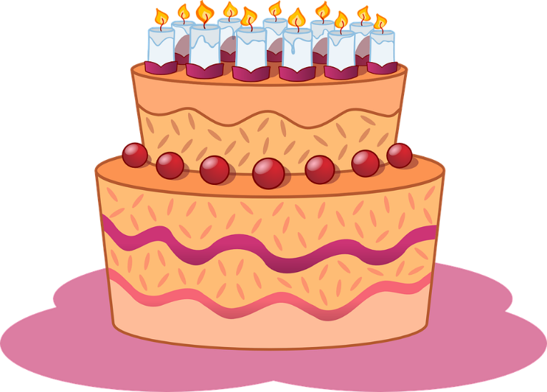
‘ans’ for age
info
We also use ans to talk about age in French.
In English, we say ‘to be X years old’.
In French, we say ‘avoir X ans’ (to have, having X years).
To ask someone’s age in French, ask:
Tu as quel âge?
‘Which age’ do you have?’
Quel âge as-tu ?
To respond, say,
J’ai __ ans.
Numbers:
(12) douze, (13) treize, (14) quatorze
‘I have __ years.
Notes:
[slide 3/3]
Aim: numbers recap and introduce use of avoir + number + ans to say your age.
Procedure:
1. Click to bring up information.
2. Check students’ understanding. Remind students about question formation (no word for ‘do’ in French) and structure (word order with a question word).
3. Working in pairs or small groups, students ask and answer questions about ages.

Slide 11
L’imparfait (je, il/elle/on)
grammaire
Remember: the imperfect describes states and actions that were ongoing or repeated in the past – things that used to happen.
To form the imperfect:
i) take the nous form of the present tense
ii) remove the –ons ending
iii)add the imperfect ending (je –ais)(il/elle/on –ait
e.g. visiter → nous visitons → visit- → je visitais / il visitait
This rule applies to all verb groups!
e.g. construire → nous contruisons → contruis- → je contruisais, il/elle/on contruisait
Let’s recap nous forms:
écrire →
nous écrivons
prendre →
nous prenons
sortir →
nous sortons
choisir →
nous choisissons
entendre →
nous entendons
lire →
nous lisons
Notes:
Timing: 5 minutes [1/2]
Aim: To build on knowledge gained in 9.2.2.1 by recapping imperfect tense formation, and applying to regular verbs other than –ER verbs.
Procedure:
1. Click to bring up information on forming the imperfect tense.
2. Confirm students’ understanding.
3. Recap activity eliciting nous forms of verbs from infinitives.
4. Click to bring up verb in infinitive form.
5. Elicit nous form.
6. Click to bring up answer (repeat steps 4-6 for all four example verbs).
Notes:
The new GCSE subject content specifies that, both at foundation and higher tier, the imperfect (as used for regular verbs) is only to be used when the English equivalent is ‘used to’ (not when the English equivalent is the preterite, e.g., ‘I sent’). In English, the preterite and ‘used to’ are often used interchangeably, which can cause difficulty for learners translating from English into French. For example, it may be difficult for these learners to know whether ‘I played football’ should be translated as j’ai joué au foot or je jouais au foot. It might only be possible to know this from context or surrounding discourse. In English, we might also use ‘would’ when describing past habituality (e.g., ‘I would send emails everyday’). We avoid this translation of the imperfect in NCELP resources to avoid confusion with conditional translations, but if a student suggests it jouals should be accepted as correct.
There are several highly frequent verbs in the new GCSE where an additional translation is used for the imperfect. Students will study these in Year 9 Term 3. For example, étais is translated both was ‘was’ and as ‘used to be’. For this reason, in the resource we tell students that they will ‘usually’ meet the imperfect as ‘used to’ (rather than ‘always’).

Slide 12
Les verbes imparfait
écrire
Practise forming the imperfect.
infinitif | présent (nous) | stem | imparfait (je) | imparfait (il/elle/on)
choisir | choisissons | choisiss- | je choisissais | il/elle/on choisissait
devenir | devenons | deven- | je devenais | il/elle/on devenait
attendre | attendons | attend- | j’attendais | il/elle/on attendait
traduire | traduisons | traduis- | je traduisais | il/elle/on traduisait
comprendre | comprenons | compren- | je comprenais | il/elle/on comprenait
partir | partons | part- | je partais | il/elle/on partait
décrire | décrivons | décriv- | je décrivais | il/elle/on décrivait
Notes:
Aim: Recap imperfect tense formation for all verb groups.
Procedure:
1. Students follow the imperfect creation walk through template on the slide.
2. Elicit each step.
3. Click to reveal answers one by one.

Slide 13
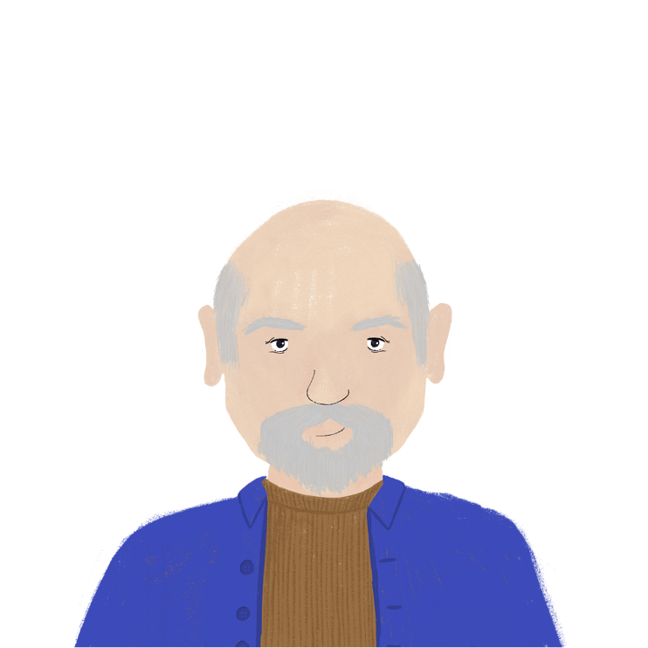
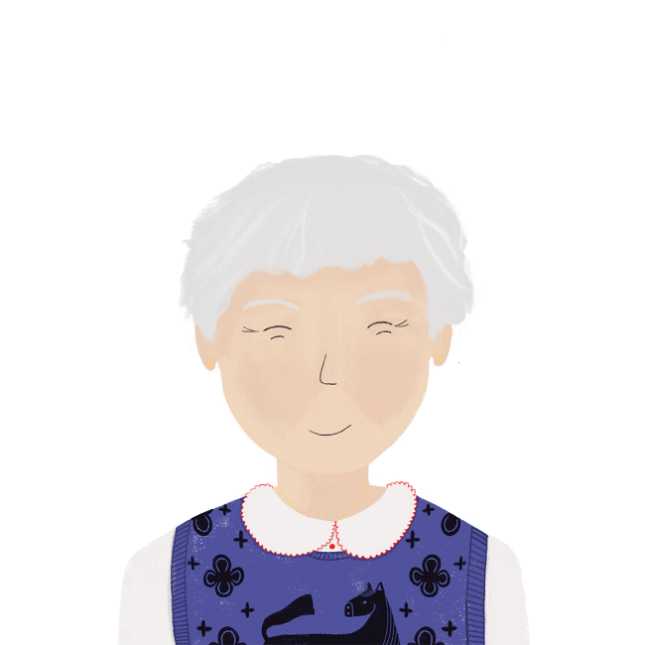
Renée et Bastien
*la danse = dance
*danser = to dance, dancing
lire
Renée réfléchit à ce qu’elle faisait et ce que Bastien faisait.
Qui faisait quoi ?
___ appartenais à un club de danse* mais ___ n’aimait pas danser*.
___ lisais des histoires d’amour et ___ écrivait des lettres pour moi.
___ soutenait mes rêves et ___ trouvais ça gentil.
J’
il
Je
il
Il
je
Notes:
OPTION 1 Timing: 8 minutes [1/2]
NB: If a past vs present contrast better suits the needs of the class, this can be practised in the version on slide 15.
Aim: recognise singular forms of imperfect tense (je vs il/elle/on).
Procedure:
1. Students read text and demonstrate comprehension by noting what each person does in English.
2. Click to reveal missing pronoun one by one.
3. Answers in English on following slide.
Word frequency of unknown words (1 is the most frequent word in French): danse [2964], danser [2934]
Source: Lonsdale, D., & Le Bras, Y. (2009). A Frequency Dictionary of French: Core vocabulary for learners London: Routledge.

Slide 14
Renée et Bastien- réponses
lire
Renée | Bastien
used to belong to a dance club | used to not like dancing
used to read love stories | used to write letters for Renée
used to find that nice | used to support Renée’s dreams
Notes:
Answers to activity on previous slide [2/2].
Answers appear in text order.

Slide 15
La religion
*la mosquée = Mosque
*le Coran = Qu’ran
lire
Amandine a des beaux souvenirs de Saïd, le grand-père d’Amir et Noura. Qui fait/faisait quoi, et quand ? Écris ‘je/j’’ou ‘il’, l’activité, et ‘past’ ou ‘present’.
___ réfléchis au rôle de la religion dans ma famille. ___ appartiens
à l’église chrétienne mais ___ visitait la mosquée* musulmane.
___ lisais le Coran* pour les histoires. ___ croyait en dieu mais ___
soutenait la liberté religieuse des autres. ___ est une inspiration dans
ma vie. ___ trouve la laïcité importante à l’école aussi pour respecter
la foi des juifs, les chrétiens, les musulmans et les gens sans foi.
Je
J’
il
Je
Il
il
Il
Je
Notes:
OPTION 2 Timing: 8 minutes [1/2]
NB: If a 1st vs 3rd person imperfect contrast better suits the needs of the class, this can be practised in the version on slide 13.
Aim: Recognise singular forms of verbs in the present and imperfect tenses (je vs il/elle/on). Revising a set of revisited vocabulary.
Procedure:
1. Students read text and demonstrate comprehension by noting what each person does in English and when.
2. Click to reveal missing pronoun one by one.
3. Answers in English on following slide.
Word frequency of unknown words (1 is the most frequent word in French): mosquée [>5000], Coran [>5000]
Source: Lonsdale, D., & Le Bras, Y. (2009). A Frequency Dictionary of French: Core vocabulary for learners London: Routledge.

Slide 16
La religion - réponses
lire
Amandine | Saïd
is thinking about religion (present) | used to visit the Muslim mosque (past)
belongs to a Christian church (present) | used to believe in God (past)
used to read the Qu’ran (past) | used to support the religious freedom of others (present)
finds non-religiousness important at school (present) | is an inspiration (present)
Notes:
Answers to activity on previous slide [2/2].
Answers appear in text order.

Slide 17
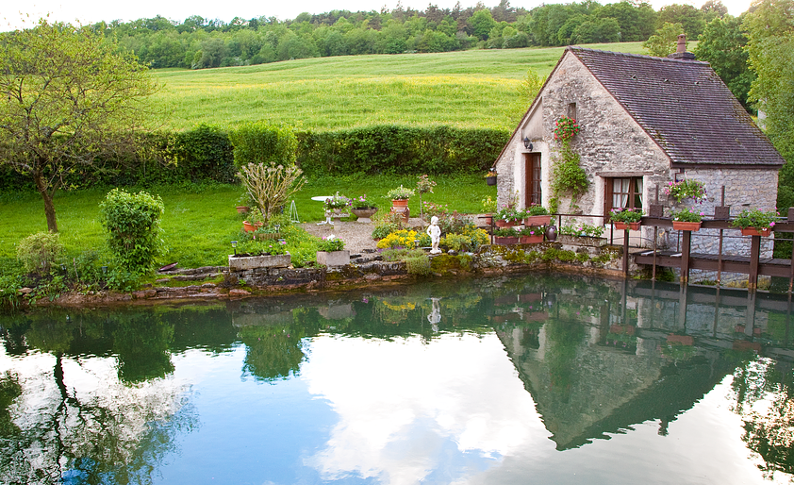
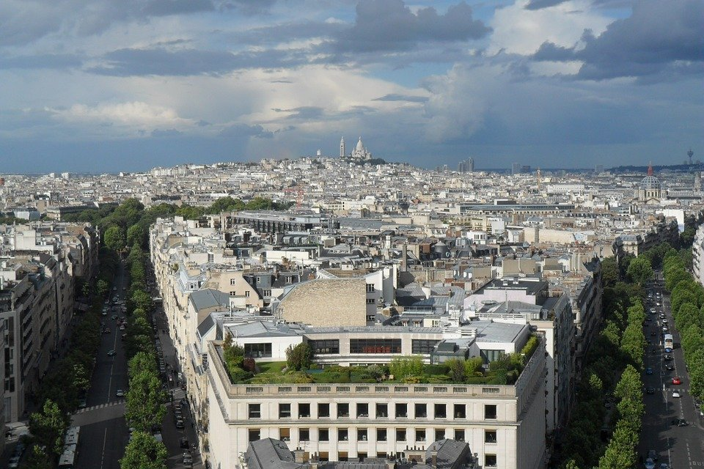
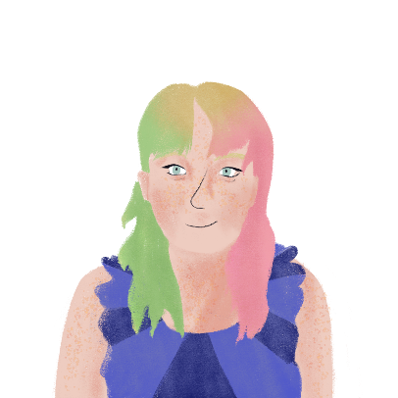
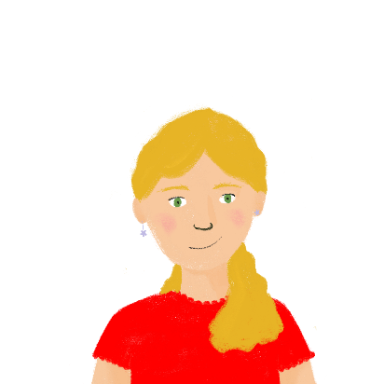
L'enfance de Léa et Stéphanie
Remplis les blancs.
écrire
Pendant mon enfance, je (jouer) souvent à la maison, mais Stéphanie (pouvoir) jouer dans la campagne. Je (prendre) l’autobus pour aller à l’école. Le voyage (durer) vingt minutes. Stéphanie (marcher) pour aller à l’école, mais elle (devoir) commencer le voyage très tôt. Pendant les vacances, je (visiter) la campagne et la mer et elle (venir) chez moi.
jouais
pouvait
prenais
durait
marchait
devait
visitais
venait
Notes:
Timing: 6 minutes
Aim: Produce the je and il/elle/on forms of imperfect tense verbs in writing.
Procedure:
1. Students fill in the blanks in the text.
2. Click to reveal answers one by one.
3. Oral translation of full text, focusing on the similarities and differences.

Slide 18
Dans le passé …
parler
I used to go out in town on Saturdays.
Elle sortait en ville les samedis !
Je sortais en ville les samedis.
Elle sortait en ville les samedis.
Notes:
Timing: 6 minutes [1/2]
Aim: Production of imperfect singular forms of verbs like prendre, venir, sortir in the first and third person singular.
Procedure:
Students work in groups of 3-4 to play a game of téléphone. They produce imperfect singular forms of verbs like prendre, venir, sortir.
Click to go through example on this slide.
Prompts and answers on next slide – one sentence per student in each group.

Slide 19
Dans le passé … réponses
parler
Je prenais mes livres à l’école.
Il/Elle prenait ses livres à l’école.
I used to take my books to school.
I used to eat my meal at the café.
I used to write in my books.
I used to go out to the cinema on Friday.
Je mangeais mon repas au café.
Il/Elle mangeait le déjeuner au café.
J’écrivais dans un cahier.
Il/Elle écrivait dans un cahier.
Je sortais au cinéma le vendredi.
Il/Elle sortait au cinéma le vendredi.
Notes:
[2/2]
Procedure:
Tell student number 1 in each group to look at the board and everyone else turns around
Click to reveal the first prompt
Students play Chinese whispers then are allowed to look at the board to see the prompt
Click to reveal answer
Repeat for group member 2-4

Slide 20
Describing how things are now and how they used to be: Childhood
Verbs like prendre, venir, sortir, entendre, lire, écrire and choisir in the imperfect tense vs present tense (je vs il/elle/on)
SSC [ou] vs [u]
Y9 French
Term 2.2 - Week 2 - Lesson 42
Author names: Catherine Morris / Catherine Salkeld
Artwork by: Chloé Motard
Date updated: 27/01/22
Notes:
Artwork by Chloé Motard. All additional pictures selected are available under a Creative Commons license, no attribution required.
Native teacher feedback provided by Sarah Brichory.
Learning outcomes (lesson 2):
Consolidation of SSC [ou] and [u]
Introduction of verbs like prendre, venir, sortir, entendre, lire, écrire and choisir in the imperfect vs present tense (habitual events with 'used to' and present continuous equivalent in English)
(je, il/elle/on)
Word frequency (1 is the most frequent word in French):
9.2.2.2 (introduce) construire [793], réagir (à) [1052], réfléchir (à) [1058], an [76], clé [1200], club [1860], comportement [1489], enfance [2207], habitude [1221], ancien [392], familial [1622], libre [344], quotidien [1318], responsable [511], il y a² [13/36/8]
9.2.1.4 (revisit) blesser [2024], jeter [1202], laisser [196], amour [967], envie [1237], mer [921], prix [310], sens [243], tellement [869]
9.1.2.2 (revisit) appartenir à [319], croire, crois, croit [135], soutenir [578], dieu [2262], foi [1368], laïcité [>5000], liberté [320], chrétien [1895], européen [445], juif [1510], musulman [2245], religieux [1203]
revisit: chien [1744], algérien [4163], canadien [611], italien [1477], anglais [784], français [251]
Source: Lonsdale, D., & Le Bras, Y. (2009). A Frequency Dictionary of French: Core vocabulary for learners London: Routledge.
The frequency rankings for words that occur in this PowerPoint which have been previously introduced in NCELP resources are given in the NCELP SOW and in the resources that first introduced and formally re-visited those words.
For any other words that occur incidentally in this PowerPoint, frequency rankings will be provided in the notes field wherever possible.

Slide 21
u
Salut !
vue
amusant
tu
utiliser
[to use]
sur
[on]
Notes:
Timing: 5 minutes [1/2]
Aim: recap SSC [u]
Procedure:
1. Introduce and elicit the pronunciation of the individual SSC [u] and then the source word again ‘tu’ (with gesture, if using). 2. Then present and elicit the pronunciation of the five cluster words.
The cluster words have been chosen for their high-frequency, from a range of word classes, with the SSC (where possible) positioned within a variety of syllables within the words (e.g. initial, 2nd, final etc.). Additionally, we have tried to use words that build cumulatively on previously taught SSCs (see the Phonics Teaching Sequence document) and do not include new SSCs. Where new SSCs are used, they are often consonants which have a similar symbol-sound correspondence in English.
Word frequency (1 is the most frequent word in French): tu [112]; salut ! [2205] vue [191]; sur [16]; amusant [4695]; utiliser [345]. Source: Lonsdale, D., & Le Bras, Y. (2009). A Frequency Dictionary of French: Core vocabulary for learners London: Routledge.

Slide 22
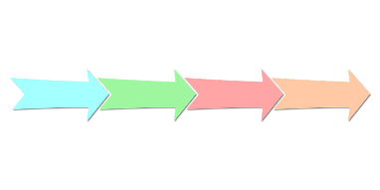
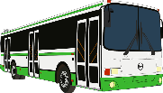
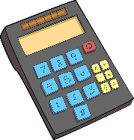
Les mots [u] en français
parler
30
univers
minute
endurance
brunette
justifier
amusement
musique
vocabulaire
urgent
SECONDES
évolution
littérature
instruction
monument
publicité
agriculture
bus
solution
université
0
vulnérable
construction
support
calculatrice
DÉBUT
Notes:
Slide 2/2
Aim: Speaking practice of SSC [u]
Procedure:
1. Students work in pairs.
2. One at a time they have to say as many [u] words as possible in 30s.
3. The partner listens to make sure pronunciation is correct.
4. If they get one wrong, start again.
5. Swap roles.
6. Click on words to hear native pronunciation.
Transcript:
univers
minute
endurance
brunette
justifier
amusement
musique
vocabulaire
urgent
évolution
littérature
instruction
monument
publicité
agriculture
bus
solution
université
vulnerable
construction
support
calculatrice
Word frequency of cognates (1 is the most frequent word in French): univers [2112], minute [375], endurance [>5000], brunette [>5000], justifier [884], amusement [>5000], musique [1139], vocabulaire [4159], urgent [2179], évolution [1352], littérature [2083], instruction [1632], monument [4113], publicité [2110], agriculture [2088], bus [4027], solution [608], université [1192], vulnerable [>5000], construction [976], support [3708], calculatrice [>5000]
Source: Lonsdale, D., & Le Bras, Y. (2009). A Frequency Dictionary of French: Core vocabulary for learners London: Routledge.

Slide 23
C’est quel mot ?
parler / écouter / écrire
Décris les mots pour ton partenaire.
Ce mot décrit douze mois
C’est une année !
Notes:
Timing: 5 minutes [1/2]
Aim: Produce meaning of new vocabulary; general comprehension.
Procedure:
1. Run through example.
2. Click to bring up clue.
3. Students write down the target word being described (all now words are from this week’s new set).
4. Click to reveal solution.
5. Students then carry out the activity in pairs, giving each other clues from the role cards provided on the next slide.

Slide 24
C’est quel mot ?
parler / écouter / écrire
Partenaire A :
créer un bâtiment (construire)
la chose pour ouvrir la porte (la clé)
les années quand on est jeune (l’enfance)
si on peut faire ce qu’on veut, on est… (libre)
tous les jours (quotidien)
quand on fait la même chose souvent (l’habitude)
on devient plus vieux et plus… (responsable)
Partenaire B :
ce qu’on fait quand un événement arrive (réagir)
un groupe de gens qui font la même chose (le club)
pour décrire les choses dans le passé (il y a)
quand on pense aux choses (réfléchir (à)
une chose de la famille (familial)
au collège, on doit avoir un bon… (le comportement)
une chose qui n’existe plus (ancien)
Notes:
Role cards for activity on previous slide – do not display

Slide 25
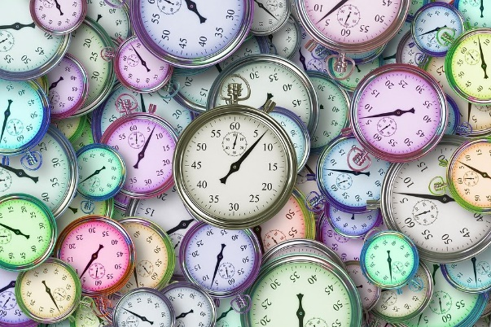
Présent vs imparfait
grammaire
Both the present and imperfect are one-word tenses (no auxiliary).
The word order is the same in both tenses.
So, the only way to tell them apart is the verb ending.
je mange
il/elle/on mange
je mangeais
il/elle/on mangeait
They can both describe an ongoing action, but remember the imperfect means it happened for a period of time in the past.
Je réfléchis chaque jour.
I think every day.
Je réfléchissais chaque jour.
I used to think every day.
Notes:
Timing: 3 minutes
Aim: Compare form and use of imperfect and present.
Procedure:
1. Click to bring up information comparing form and use of imperfect and present tenses.
2. Check students’ understanding.

Slide 26
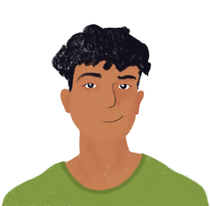
Amir : présent vs imparfait
écouter
Que fait Amir aujourd’hui et que faisait Amir dans son enfance ?
Écris des phrases en anglais au présent ou à l’imparfait (‘used to’).
1
Amir used to ask for help.
2
Amir takes the train to go to town.
4
Amir used to fall often.
3
Amir used to take his mum’s hand to cross the road.
5
Amir waits for his friends outside.
6
Amir used to want to play all the time.
7
Amir works hard for his exams.
Notes:
Timing: 5 minutes
Aim: identify present vs imperfect based on heard verb endings
Procedure:
1. Click audio buttons to hear sentences.
2. Students write down in English what Amir does/used to do.
3. Click to reveal answers one by one.
Transcript:
Je demandais de l'aide.
Je prends le train pour aller en ville.
Je prenais la main de ma mère pour traverser la rue.
Je tombais souvent.
J’attends mes amis dehors.
Je voulais jouer tout le temps.
Je travaille dur pour mes examens.

Slide 27
Remember : il y a
info
Remember!
‘Year’ is translated as an after a number. So, il y a will be followed by ans when you are talking about how many years ago something happened.
Il y a + noun = there is/there are vs Il y a + time = ago
This does not change for number or gender.
Il y a followed by a time (number of minutes, hours, days, years …) tells us how long ago something happened)
Il y a une grande piscine.
(There is a big swimming pool.)
Il y a deux ans.
(Two years ago.)
Il y a beaucoup de gens.
(There are a lot of people.)
J’ai mangé il y a trois heures.
(I ate three hours ago.)
Notes:
Timing: 5 minutes [1/2]
Aim: To recap and compare two meanings of il y a.
Procedure:
1. Click to bring up information and examples.
2. Check students understand.
3. Note the use of il y a + number + an.

Slide 28
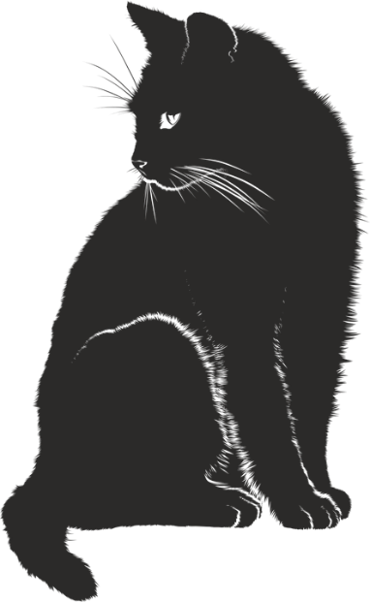
Le chat de l’école
*le toit = roof
lire
In each sentence, does il y a mean ‘there is/are’ or ‘ago’?
Il y a un chat qui dort sur le toit* de l’école.
Il y a plusieurs années, le chat habitait avec la directrice.
Il y a longtemps, le professeur donnait des médicaments au chat.
Il y a un expert qui dit que le chat est en bonne santé.
Il y a longtemps, le chat appartenait à une vieille femme.
Il y a un homme qui nourrit le chat le week-end.
Il y a plusieurs semaines, le chat entrait dans ma maison chaque jour.
Il y a un professeur qui prépare du lait pour le chat.
there is
ago
ago
there is
ago
there is
ago
there is
Notice: il y a is followed by a noun when it means ‘there is/are’. It is followed by a time phrase when it means ‘ago’.
Notes:
Aim: Translating il y a as ‘there is’ or ‘ago’ based on context.
Procedure:
1. Students read sentences and, based on contextual clues and the verb tense, decide whether il y a means ago or there is/are.
2. Click to reveal answers one by one.
3. Draw attention to the type of word that follows il y a in each case. Click to reveal the bubble with the translation tip. Draw attention to the difference in word order – ago comes after the time phrase in English.
4. Oral translations of full sentences.
Word frequency of cognates (1 is the most frequent word in French): week-end [2475]
Word frequency of unknown words (1 is the most frequent word in French): toit [2894] Source: Lonsdale, D., & Le Bras, Y. (2009). A Frequency Dictionary of French: Core vocabulary for learners London: Routledge.

Slide 29
‘There is’ or ‘ago’?
Traduis en anglais.
lire
*longtemps = a long time
1. Il y a une équipe de foot qui gagne toujours le match local.
There is a football team that always wins the local match.
2. Il y a plusieurs mois, le professeur expliquait la grammaire chaque cours.
Several months ago, the teacher used to explain the grammar every lesson.
3. Il y a longtemps*, le directeur interdisait les portables pendant les cours.
A long time ago, the headteacher used to ban mobile phones in lessons.
4. Il y a un étudiant faible qui quitte l’école trop tôt tous les jours.
There is a weak student who leaves school too early every day.
5. Il y a deux étés, ma mère apportait un livre à la piscine chaque semaine.
Two summers ago, my mum used to bring a book to the pool every week.
6. Il y a une attente d’une heure pour les situations d’urgence à l’hôpital.
There is a wait of an hour for emergency situations at the hospital.
Notes:
Timing: 8 minutes
Aim: Written recognition of verbs in the present and imperfect tenses, and linking these to meaning (translation of il y a as ‘there is’ or ‘ago’).
Procedure:
1. Students read the sentences and decide based on verb tense whether il y a means ‘there is’ or ‘ago’.
2. They then translate to English, paying close attention to the translation of the verb phrase.
3. Click to reveal answers one by one.

Slide 30
Le chat et moi
lire
Remplis les blancs avec je et il.
Puis remplir le table en anglais.
Salut Léa !
Tu connais le chat de l’école ? Il jouait dans les champs* pendant la pause* déjeuner.
Je jouais au foot mais il préférait courir. Quand je mangeais du poisson, il voulait partager.
Je vais à l’école cette semaine et
je veux voir* l’ancien professeur. Si le
chat est là, il peut partager mon sandwich.
Amir
[1]
Amir (I) | Le chat (he)
Used to: | Used to:
Now: | Now:
[2]
[3]
[4]
[5]
[6]
[7]
*le champ = field
*la pause = break
*voir = to see
[8]
Notes:
Timing: 5 minutes [1/2]
Aim: Recognise first and third person singular forms of regular verbs in imperfect and present tenses.
Procedure:
1. Students read text and fill in je/il depending on verb form.
2. Students demonstrate comprehension by writing in a table which activities used to be/are done by Amir (je) and by the cat (il).
3. Click to fill blanks one by one.
4. Table of comprehension answers on next slide.
Word frequency (1 is the most frequent word in French): champ [847], pause [2647]
Source: Lonsdale, D., & Le Bras, Y. (2009). A Frequency Dictionary of French: Core vocabulary for learners London: Routledge.

Slide 31
Le chat et moi - réponses
lire
Amir (I) | Le chat (he)
Used to: Play football Eat fish | Used to: Play on the field during lunchbreak Prefer to run Want to share
Now: Visit the school this week Hope to see the former teacher | Now: Can share Amir’s sandwich
Notes:
Answer slide [2/2]
Answers appear in text order.

Slide 32
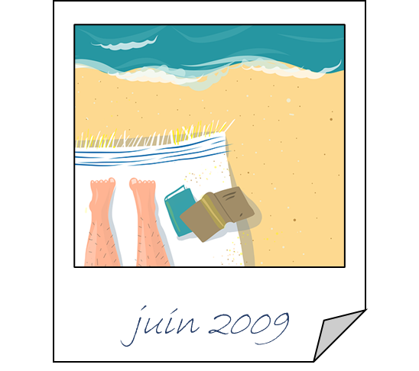
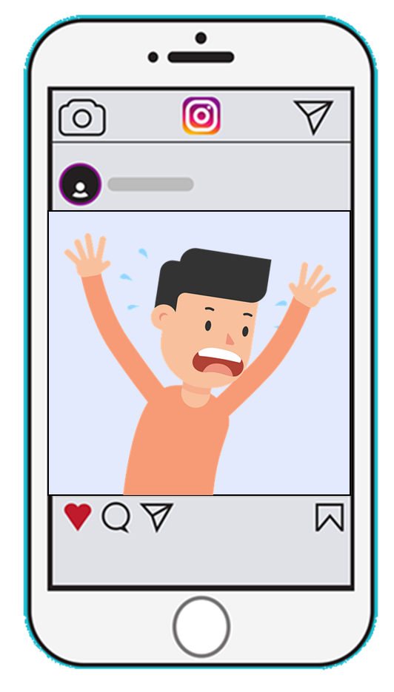
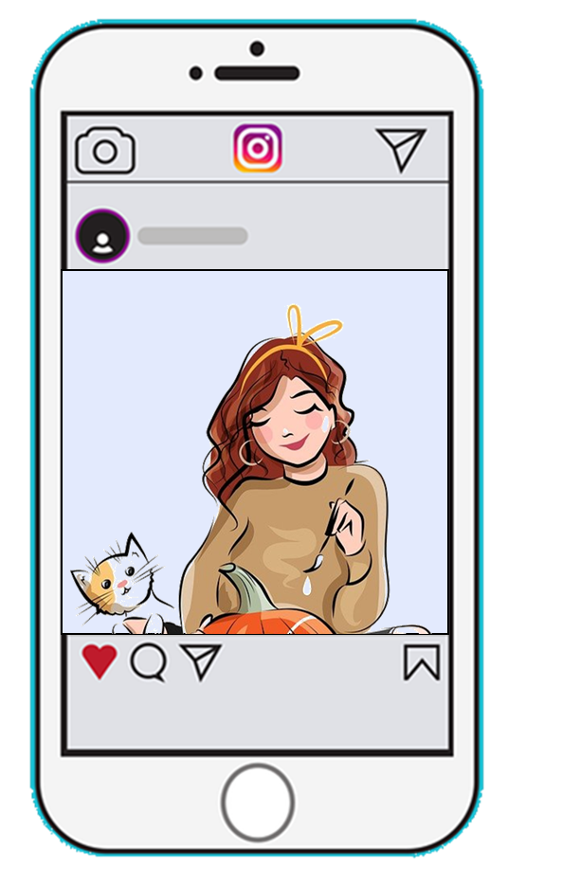
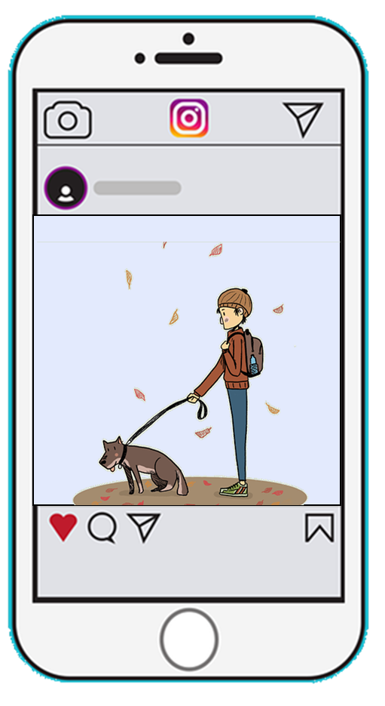
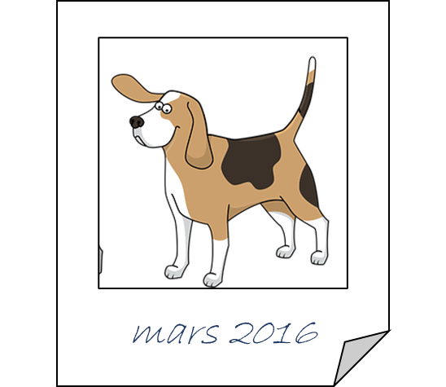
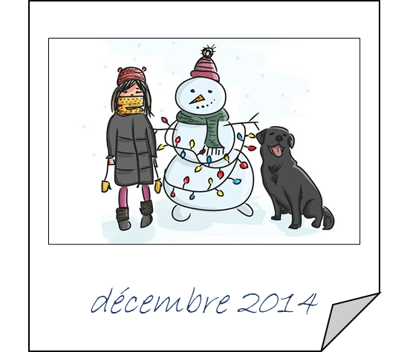
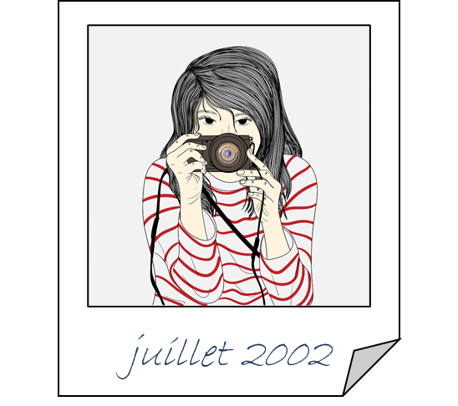
Les souvenirs*
*le souvenir = memory
écrire
Écris les phrases à l’imparfait et au présent.
Used to happen regularly (imperfect):
I – play with the dog
the dog – hear the mobile phone
my mum – take a lot of photos
my dad – read a love story during
holidays
Happens regularly now (present):
I – study a lot
my dad – react badly when I hurt my
brother
my mum – think about solutions
the dog – go out of the house
Je jouais avec le chien.
J’étudie beaucoup.
Le chien entendait le portable.
Mon père réagit mal quand je blesse mon frère.
Ma mère prenait beaucoup de photos.
Ma mère réfléchit/pense aux solutions.
Mon père lisait une histoire d’amour pendant les vacances.
Le chien sort de la maison.
Notes:
Timing: 8 minutes
Aim: Produce written sentences in imperfect and present tenses.
Procedure:
1. Students use English prompts to write sentences in imperfect and present tense in French.
2. Click to reveal answers one by one (first imperfect tense sentences, then present tense sentences).
Word frequency of unknown words (1 is the most frequent word in French): souvenir [616]
Source: Lonsdale, D., & Le Bras, Y. (2009). A Frequency Dictionary of French: Core vocabulary for learners London: Routledge.

Slide 33
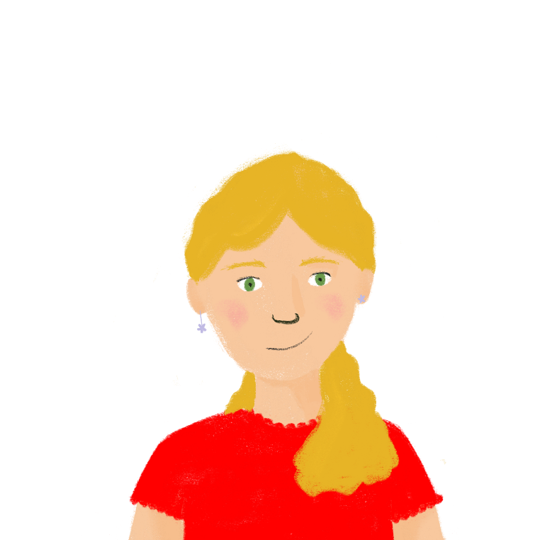
Dans le passé ou aujourd’hui ?
parler
Partenaire A
Now: enter the shop
Partenaire B
J’entre dans le magasin.
Then | Now
 | enter the shop
Notes:
Timing: 8 minutes [1/3]
Aim: Oral production and recognition of present vs imperfect singular forms of regular verbs.
Procedure:
1. Students work in pairs.
2. Use the role cards to form sentences in the present and imperfect tense.
3. Listening student notes down the activity in English and records whether the partner used to do something (the then column) or does it now (the now column).
4. Answers on following slide.
5. Click through example on this slide.

Slide 34
Dans le passé ou aujourd’hui ?
parler
Partenaire A
Now: play piano
Then: like maths
Now: eat lots of chocolate
Then: travel to Canada
Partenaire B
Then: study French at school
Then: throw the football
Now: respect the teachers
Now: play guitar
Notes:
[2/3]
[role cards not for display until after activity completed]

Slide 35
Partenaire A
Now: play piano
Then: like maths
Now: eat lots of chocolate
Then: travel to Canada
Partenaire B
Then: study French at school
Then: throw the football
Now: respect the teachers
Now: play guitar
Notes:
[3/3]
[role cards to print - not for display]

Slide 36
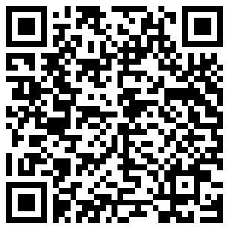
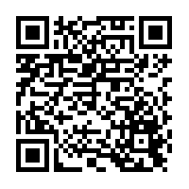
Devoirs
Vocabulary Learning Homework (Y9, Term 2.2, Week 3)
Audio file
Quizlet QR code:
Audio file QR code:
Quizlet link
In addition, revisit: Y9 Term 2.1 Week 6
Y9 Term 1.2 Week 3
Notes:
The answer sheet for the 9.2.2.3 vocabulary learning homework is here:

