Slide 1
Grammar
Definite and indefinite articles (revisited)
DAR and QUERER (revisited)
Y7 Spanish, Term 2.1, Week 1, Lesson 29
Nick Avery / Rachel Hawkes
Date updated: 30/03/2019

Slide 2
Completa la frase con LA o UNA.
escribir
La plaza tiene ____ torre, ____ torre tiene un balcón,
una
La
Notes:
Draw out and make explicit the difference in meaning between the definite and indefinite article ‘la’ and ‘una’, eliciting an English translation of each of the lines from this and the next two slides.
An active choice between the definite and indefinite articles is needed in each instance. We have separated parts of the poem to ask for a choice between definite and indefinite (rather than between masculine and feminine) so that students only have to focus on article usage.

Slide 3
Completa la frase con LA o UNA.
escribir
La torre tiene ___ balcón, ___ balcón tiene una dama,
un
El

Slide 4
Completa la frase con LA o UNA.
escribir
el balcón tiene ____ dama, ____ dama una blanca flor.
una
La

Slide 5
Escucha y completa la frase.
escuchar / escribir
¿Cómo se dice en inglés?
1) Quiere _______ la _________.
saber
verdad
5) Da una bolsa a la señora en la tienda.
Es ___________ grande.
bastante
S/he wants to know the truth.
S/he gives a bag to the lady in the shop. It’s quite big.
2) Quiero __________ lejos de aquí.
celebrar
6) Doy películas a una amiga.
______ películas con ella es maravilloso!
I want to celebrate far from here.
Ver
I give films to a (female) friend.
Seeing / watching films with her is marvellous!
3) ¿Qué color quieres? ¿_______?
Verde
What colour do you want? Green?
abuela
4) ¿Das unas cosas a la _________?
Do you give some things to grandma?
Notes:
*AUDIO TO BE INSERTED*
This activity integrates grammar, vocabulary and phonics revision.
Phonics: Students first have to listen and write the missing word, which contains either the ‘b’ or ‘v’ SSC. The 7 missing words were used for phonics practice in lesson 1.
Grammar: After writing the missing words, students have to translate the sentence. Each one contains DAR and QUERER in 1st, 2nd or 3rd person singular. These two verbs are revisited in the current lesson, both for receptive and then productive practice.
Vocabulary is revisited from various earlier weeks. ‘Lejos’, ‘tienda’, ‘cosa’ and ‘bolsa’ are from the two vocabulary sets revisited this week (1.1.7 and 1.2.5) in the SoW.
Note: ‘ella’ has previously been encountered as a phonics word.

Slide 6
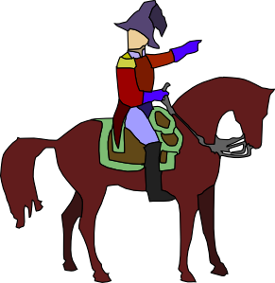
El caballero y su caballo
hablar / escuchar
Persona A: eres el caballero.
Use the prompt cards to say
what you want.
what your horse wants.
Importante!
‘Quiero’ es ‘I want’.
‘Quiere’ es ‘it wants’.
Persona B: escucha y completa la tabla.
¿Quién es, el caballero o el caballo?
Notes:
Elicit the meaning of ‘eres’ in the instructions.
This is a two-part speaking/listening activity to practice spoken production of dar and querer in 1st and 3rd person singular.
One student uses the speaking cards to say sentences, while the other completes the grid. Students will swap roles half-way through.
Picture source: http://clipart-library.com/ (free to use)

Slide 7
Persona A
1
2
3
4
[I want]
[I want]
[it wants]
[I want]
a glass of Coca-Cola
a chair
some products
a shirt
5
6
7
8
[it wants]
[I want]
[it wants]
[it wants]
a plate a brocolli
a glass of
Fanta
some shoes
a bed
Notes:
Student A speaking cards
‘Vaso’, ‘camisa’, ‘zapato’, ‘producto’ are words from the Term 1.1, Week 7 vocabulary set, which is revisited this week.

Slide 8
Persona B
Answers
El caballero (‘I want’)
El caballo (‘it wants’)
un vaso de Coca-Cola
unos productos
una silla
un plato de brocolí
una camisa
un vaso de Fanta
unos zapatos
una cama
Notes:
Students can copy the grid into their books.
Ask students if it’s normal for a horse to want those things (!)

Slide 9
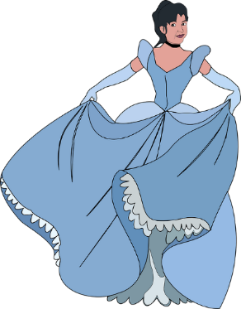
La dama y su hermano
hablar / escuchar
Importante!
‘Doy’ es ‘I give’.
‘Da’ es ‘s/he gives’.
Persona B: eres la dama.
Use the prompt cards to say
what you give to someone in the square.
what your brother gives to someone in the square.
Persona A: escucha y completa la tabla.
¿Quién es, la dama o el hermano?
Notes:
Students B and A now swap roles. Student B speaks, while Student A listens and completes the grid.
Image attribution: http://www.clker.com/and http://clipart-library.com/

Slide 10
Persona B
1
2
3
4
[I give]
[he gives]
[I give]
[I give]
a book
money
a shirt
some shoes
5
6
7
8
[he gives]
[I give]
[he gives]
[he gives]
a glass of Coca-Cola
a plate of brocolí
a bag
some products
Notes:
Student B speaking cards
‘Vaso’, ‘camisa’, ‘zapato’, ‘producto’ are words from the Term 1.1, Week 7 vocabulary set, which is revisited this week.

Slide 11
Persona A
Answers
La dama (‘I give’)
El hermano (‘he gives’)
un libro
dinero
unos zapatos
una bolsa
una camisa
un vaso de Coca-Cola
unos productos
un plato de brocolí
Notes:
Students can copy the grid into their books.

