Slide 1
Number Is there one or are there many? Describing Christmas
Plurals - der/das - Rule 1 - umlaut + e;
Rule 2 -el/-en/-er NO CHANGE;
plural article = 'die‘; [Text: O Tannenbaum]
SSC [ü]
Y7 German
Term 1.2 – Week 6 - Lesson 25
Inge Alferink/ Rachel Hawkes
Artwork: Steve Clarke
Date updated: 15/12/21
Notes:
Artwork by Steve Clarke. All additional pictures selected are available under a Creative Commons license; no attribution required.
Learning outcomes (lesson 1):
Introduction of SSC [ü]
Introduction of plurals (der /das) → Rule 1 - umlaut + e, Rule 2 -el/-en/-er NO CHANGE, plural article = 'die’
Word frequency (1 is the most frequent word in German):
7.1.2.6 (introduce) wünschen [630] Arzt [622] Platz1 [326] Spiel [328] Stück [511] Zug [675] grün [682] auch [18] es gibt [n/a] wie viele? [n/a]
7.1.2.3 (revisit) gehen [66] hören [146] tanzen [1497] kaum [272] manchmal [382] nie [186] oft [223] sehr [81] einmal die Woche [n/a] jeden Tag [n/a]
7.1.1.4 (revisit) wissen [78] bist [4] du [54] Farbe [1079] Nummer [806] Ort [341] Tier [614] aber [31] kein [46] ich weiß nicht [n/a] wie sagt man [n/a] wie schreibt man [n/a]
das ist (nicht) klar
Source: Jones, R.L. & Tschirner, E. (2019). A frequency dictionary of German: core vocabulary for learners. Routledge

Slide 2
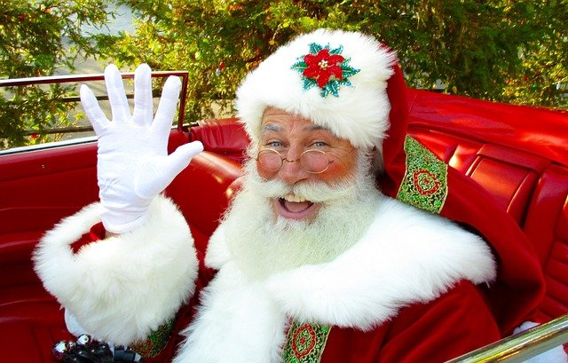
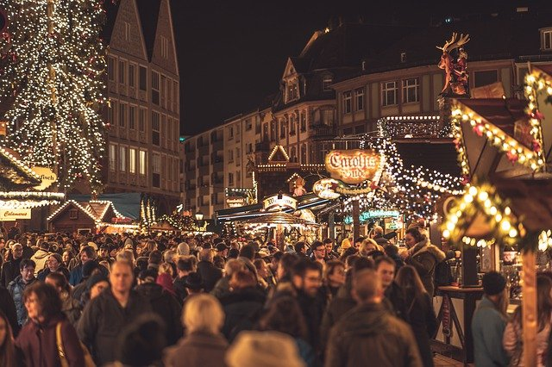
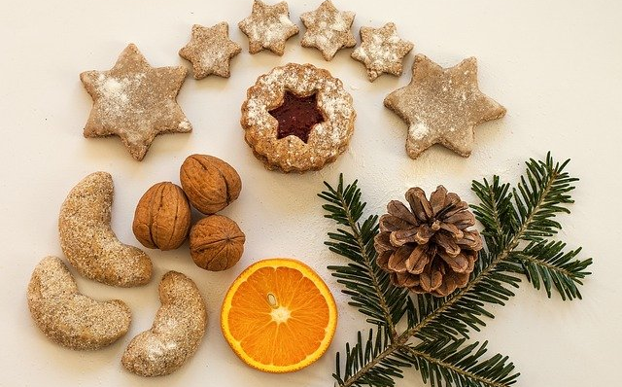
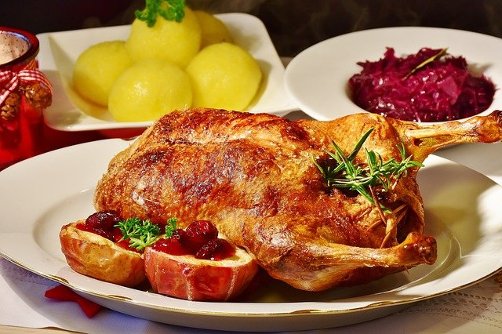
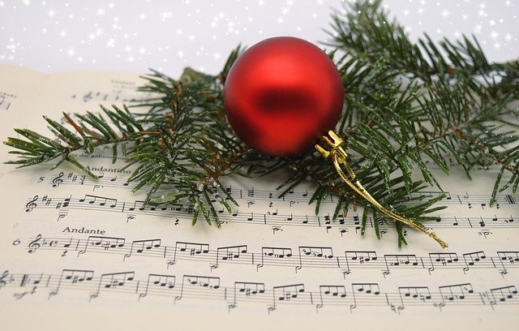
Vokabeln
Note: two words in English become one word in German.
lesen / sprechen
Weihnachten means Christmas and the prefix Weihnachts- can be added to almost any noun to make a new word.
Wie heißt … auf Englisch?
Weihnachtsmann
Weihnachtsmarkt
Weihnachtsplätzchen
Biscuits that people traditionally make and eat from November through to advent and Christmas
Weihnachtstisch
Weihnachtslied
Notes:
Timing: 2 minutes
Aim: to set the scene for the lesson, and to add to students’ knowledge of word formation (derivational morphology) in German with Weihnachts- prefix to create compounds
Procedure: 1. Click to present the new information 2. Elicit English meanings for German compounds.

Slide 3
Vokabeln
lesen / sprechen
V
der __ater
w
___issen
i
n__e
i
e
das T__er
s__hr
l
das Spie__
e
tanz__n
e
die Numm__r
W
i
e
v
i
e
l
e
?
Notes:
Timing: 3 minutes Aim: To share the context for the lesson whilst revising previously-met vocabulary.
Procedure: 1. Students work out the missing letters from German (going top to bottom on the left, then on the right).
These letters spell out ‘Wie viele?’ at the bottom of the slide – this is the context for this lesson.
2. When eliciting each word answer, elicit also the English meaning, to ensure that students remember it.
3. Answers appear on successive mouse clicks.

Slide 4
ü
Tür
Notes:
Timing: 1 minute
Aim: To introduce/consolidate SSC [ü]
Procedure: 1. Present the letter(s) and say the [ü] sound first, on its own. Students repeat it with you. 2. Bring up the word ” Tür” on its own, say it, students repeat it, so that they have the opportunity to focus all of their attention on the connection between the written word and its sound.
3. A possible gesture for this would be to hold both hands touching in front of your body, palms facing inward, thumbs to the ceiling. Then, with the right hand, mime a door opening by drawing it away from the left so that it finishes at a right angle, like a fully open door.
4. Roll back the animations and work through 1-3 again, but this time, dropping your voice completely to listen carefully to the students saying the [ü] sound, pronouncing ”Tür” and, if using, doing the gesture. Word frequency (1 is the most frequent word in German): Tür [400] Source: Jones, R.L. & Tschirner, E. (2006). A frequency dictionary of German: core vocabulary for learners. Routledge

Slide 5
ü
Tür
Notes:
With sound and no pictures to focus all attention on the sound-symbol correspondence.

Slide 6
ü
Tür
Notes:
Without sound to elicit pronunciation (without first hearing the teacher).
Teacher to elicit pronunciation by asking “Wie sagt man…”

Slide 7
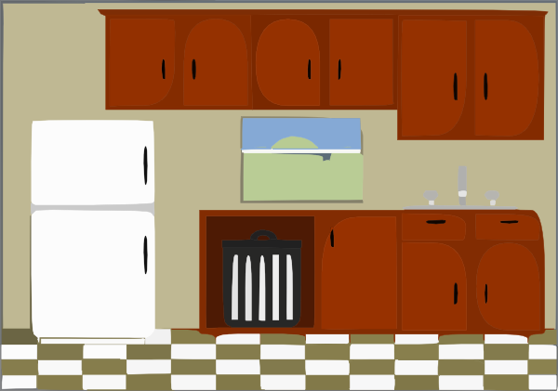
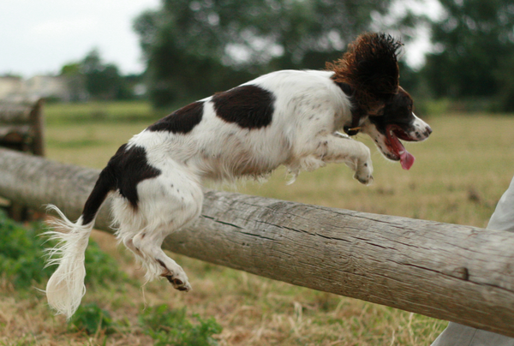
ü
fühlen
grün
Tür
Küche
über
früh
05:30!!!
Notes:
Timing: 2 minutes
Aim: To introduce/consolidate [] SSC [ü]
Procedure:
Introduce and elicit the pronunciation of the individual SSC [ü] and then the source word again ‘Tür’ (with gesture, if using).
Then present and elicit the pronunciation of the five cluster words.
The cluster words have been chosen for their high-frequency, from a range of word classes, with the SSC (where possible) positioned within a variety of syllables within the words (e.g. initial, 2nd, final etc.). Additionally, we have tried to use words that build cumulatively on previously taught SSCs (see the Phonics Teaching Sequence document) and do not include new SSCs. Where new SSCs are used, they are often consonants which have a similar symbol-sound correspondence in English.
Word frequency (1 is the most frequent word in German): Tür [400]; fühlen [419] grün [556]; Küche [960]; früh [322]; über [48]. Source: Jones, R.L. & Tschirner, E. (2006). A frequency dictionary of German: core vocabulary for learners. Routledge

Slide 8
ü
fühlen
grün
Tür
Küche
über
früh
Notes:
With sound and no pictures to focus all attention on the sound-symbol correspondence.

Slide 9
ü
fühlen
grün
Tür
Küche
über
früh
Notes:
Without sound to elicit pronunciation (without first hearing the teacher).
Teacher to elicit pronunciation by asking “Wie sagt man…”

Slide 10
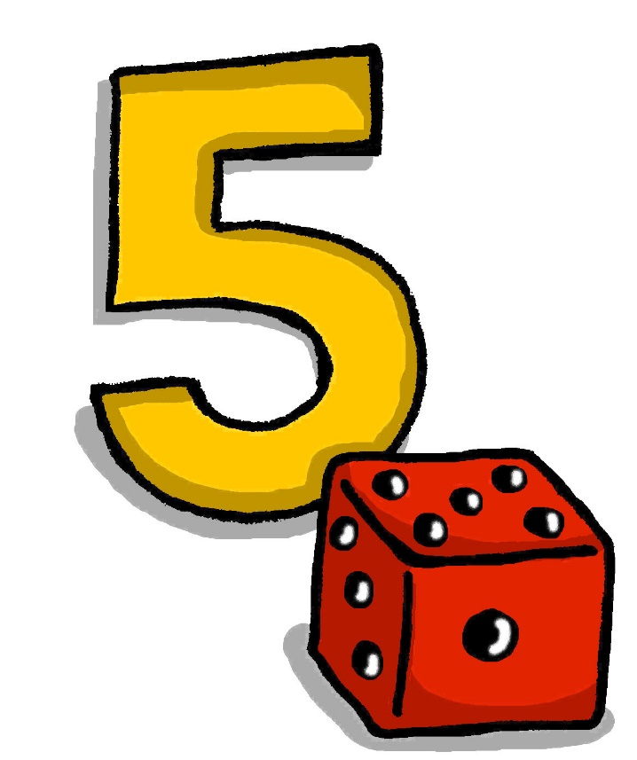
ü
fünf
Notes:
Timing: 1 minute
Aim: To introduce/consolidate SSC [ü]
Procedure: 1. Present the letter(s) and say the [ü] sound first, on its own. Students repeat it with you. 2. Bring up the word “fünf” on its own, say it, students repeat it, so that they have the opportunity to focus all of their attention on the connection between the written word and its sound.
3. A possible gesture for this would be to hold up your right hand, five digits spread apart.
4. Roll back the animations and work through 1-3 again, but this time, dropping your voice completely to listen carefully to the students saying the [ü] sound, pronouncing “fünf” and, if using, doing the gesture. Word frequency (1 is the most frequent word in German): fünf [272]
Source: Jones, R.L. & Tschirner, E. (2006). A frequency dictionary of German: core vocabulary for learners. Routledge

Slide 11
ü
fünf
Notes:
With sound and no pictures to focus all attention on the sound-symbol correspondence.

Slide 12
ü
fünf
Notes:
Without sound to elicit pronunciation (without first hearing the teacher).
Teacher to elicit pronunciation by asking “Wie sagt man…”

Slide 13
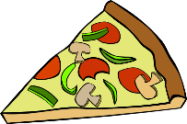
ü
Rücken
wünschen
[to wish]
fünf
Stück
Glück
[luck/happiness]
müssen
[to have to/must]
Notes:
Timing: 2 minutes
Aim: To introduce/consolidate SSC [ü]
Procedure:
Introduce and elicit the pronunciation of the individual SSC [ü] and then the source word again ‘fünf’ (with gesture, if using).
Then present and elicit the pronunciation of the five cluster words.
The cluster words have been chosen for their high-frequency, from a range of word classes, with the SSC (where possible) positioned within a variety of syllables within the words (e.g. initial, 2nd, final etc.). Additionally, we have tried to use words that build cumulatively on previously taught SSCs (see the Phonics Teaching Sequence document) and do not include new SSCs. Where new SSCs are used, they are often consonants which have a similar symbol-sound correspondence in English.
Word frequency (1 is the most frequent word in German): fünf [272]; Rücken [914] wünschen [684]; Glück [763]; müssen [45]; Stück [417].
Source: Jones, R.L. & Tschirner, E. (2006). A frequency dictionary of German: core vocabulary for learners. Routledge

Slide 14
ü
Rücken
wünschen
fünf
Stück
Glück
müssen
Notes:
With sound and no pictures to focus all attention on the sound-symbol correspondence.

Slide 15
ü
Rücken
wünschen
fünf
Stück
Glück
müssen
Notes:
Without sound to elicit pronunciation (without first hearing the teacher).
Teacher to elicit pronunciation by asking “Wie sagt man…”

Slide 16
U oder Ü?
hören
 | U | Ü
1
2
3
4
5
6
1
2
3
4
5
6
Notes:
Timing: 3 minutes Aim: To practise distinguishing between [u] and [ü]
Procedure: 1. Click on the numbers to play the audio.
2. Students tick the appropriate column for each word.
3. Click to reveal the correct answers.
Transcript:
1. der Zug
2. die Nummer
3. die Tür
4. grün
5. putzen
6. wünschen

Slide 17
der Zug
lesen / sprechen
Notes:
Timing: 5 minutes (all vocabulary slides in this sequence) Aim: To practise recall of this week’s vocabulary set.
Procedure: 1. Click once and the picture appears.
2. Elicit the meaning from students, saying ‘Was ist das?’ 3. Click on the picture to check the answer.
4. Advance through all vocabulary slides in the same way.
Frequency rankings (1 is the most common word in German):
es gibt [14, 57] wünschen [684] Wie viele? [28, 60] der Zug [613] der Platz [344] der Arzt [614] das Spiel [500] der Grund [230] das Stück [417] grün [556] auch [16]
Source: Jones, R.L. & Tschirner, E. (2011). A frequency dictionary of German: core vocabulary for learners. Routledge

Slide 18
der Arzt
lesen / sprechen
Notes:
As for previous slide.

Slide 19
grün
lesen / sprechen
Notes:
As for previous slide.

Slide 20
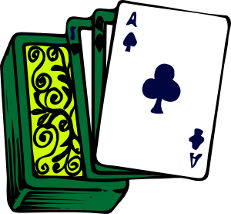
das Spiel
lesen / sprechen
Notes:
As for previous slide.

Slide 21
auch
lesen / sprechen
Notes:
As for previous slide.

Slide 22
das Stück
lesen / sprechen
Notes:
As for previous slide.

Slide 23
wünschen
lesen / sprechen
Notes:
As for previous slide.

Slide 24
der Grund
lesen / sprechen
[reason]
Notes:
As for previous slide.

Slide 25
der Platz
lesen / sprechen
Notes:
As for previous slide.

Slide 26
es gibt
lesen / sprechen
[there is / there are]
Notes:
As for previous slide.

Slide 27
Vokabeln
schreiben
Notes:
Timing: 2 minutes Aim: To practise recall of this week’s vocabulary set.
Procedure: 1. Students write down 1-8 in their notebooks and write down the German version of each word before it disappears (3 seconds).
2. When checking their answers (before feedback) they should include the correct definite article.
3. The answers appear on the following slide.

Slide 28
Antworten
Antworten
der Zug
auch
grün
der Arzt
das Stück
der Platz
das Spiel
wünschen
Notes:
Timing: 2 minutes Aim: To provide the answers to the exercise on the previous slide.
Procedure: 1. Upon clicking the mouse, pictures appear one by one to focus attention and avoid cognitive overload.
2. Teacher can elicit the answers orally, providing the text on the next click, and asking students to check their own answers
3. Ask students to pay particular attention to the presence or absence of ‘ü’, this week’s SSC.

Slide 29
More than one – rule 1
Grammatik
In German there are several ways to make plural forms.
Note that the word for ‘the’ is ‘die’ for ALL plural nouns!
Most masculine and neuter words either:
add -e to the end
or:
der Tisch
die Tische
2. add -e to the end + an umlaut on the vowel
90% masculine plurals work like this.
der Zug
die Züge
Notes:
Timing: 3 minutes Aim: To explain plurals rule 1: most masculine words go to -e or +umlaut –e.
Procedure: 1. Click to animate the explanation.
2. Ensure students’ understanding at each stage.
3. Emphasize this covers about 90% of the masculine plurals.

Slide 30
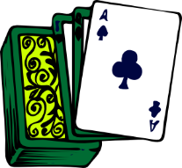
Hör zu. Wie viele? Schreib einen/ein oder viele
.
hören
1
5
[reason]
[reasons]
2
6
3
7
4
8
Notes:
Timing: 5 minutes Aim: To practise distinguishing between the plural and singular forms of nouns (listening).
Procedure: 1. Click to bring up the questions one by one.
2. Click on the numbered buttons to play the sentences (the articles/’viele’ have been bleeped out).
3. By listening to the form of the noun alone, students determine whether a singular article, or the determiner ‘viele’ is needed before it.
4. After all questions have been completed, click to bring up the answers one by one.
Transcript:
1. es gibt [viele] Köpfe
2. es gibt [einen] Arzt
3. es gibt [ein]Spiel
4. es gibt [viele] Plätze
5. es gibt [viele] Gründe
6. es gibt [ein] Stück
7. es gibt [viele] Fußbälle
8. es gibt [viele] Filme

Slide 31
Antworten
Antworten
1
5
[reason]
[reasons]
2
6
3
7
4
8
Notes:
Timing: 3 minutes Aim: To provide the answers to the exercise on the previous slide.
Procedure: 1. Click on the numbered buttons to play the sentences (in full this time).
2. Elicit answers from students.
3. Click to bring up the correct answer.
Transcript:
1. es gibt viele Köpfe
2. es gibt einen Arzt
3. es gibt ein Spiel
4. es gibt viele Plätze
5. es gibt viele Gründe
6. es gibt ein Stück
7. es gibt viele Fußbälle
8. es gibt viele Filme

Slide 32
Hör noch einmal zu. Ist die Pluralform ‚+e‘ oder ‚+umlaut+e‘?
hören
1
Köpfe
2
Plätze
3
[reasons]
Gründe
4
Fußbälle
5
Filme
Notes:
Timing: 3 minutes Aim: To practise distinguishing the precise plural form of nouns (listening).
Procedure: 1. Click to bring up the questions one by one.
2. Click on the numbered buttons to play the sentences.
3. Students determine by listening whether a the plural form is +e or +umlaut + e.
4. The answers are animated to appear one by one upon clicking the mouse, providing students with instant feedback.
5. As extension, teachers may want to encourage students to try to transcribe the full word each time. Transcript
1. es gibt viele Köpfe
2. es gibt viele Plätze
3. es gibt viele Gründe
4. es gibt viele Fußbälle
5. es gibt viele Filme

Slide 33
More than one – rule 2
Grammatik
Words ending in -EL or -EN or -ER are often the same in the plural:
Remember the plural word for ‘the’ is ‘die’ for ALL words!
der Engel
der Lehrer
das Mädchen
die Engel
die Lehrer
die Mädchen
Notes:
Timing: 2 minutes Aim: To explain plurals rule 2: words that end in –EL or –EN or -ER typically stay the same.
Procedure: 1. Click to animate the explanation.
2. Ensure students’ understanding at each stage.
3. Remind students that the plural word for ‘the’ is ‘die’, regardless of the singular noun’s gender. They are likely to find this strange (because it really is!)

Slide 34
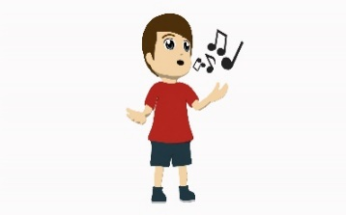
Hör zu. Schreib / für Singular und //+ für Plural
hören
1
5
2
6
3
7
4
8
Notes:
Timing: 5 minutes Aim: To practise differentiating plurals by reference to the definite article alone for nouns which do not themselves change in the plural.
Procedure: 1. Teachers may want first to reiterate the fact that with these nouns that don’t change, the change in article is the only clue to whether the noun is singular or plural.
2. Click to bring up the questions one by one.
3. Click on the audio buttons to hear the examples.
4. Students note / for singular and //+ for plural.
5. When all questions are complete, click to bring up the answers one by one.
Transcript:
1. der Körper
2. die Fenster
3. die Winter
4. der Sänger
5. die Mädchen
6. die Zimmer
7. die Lehrer
8. der Engel

Slide 35
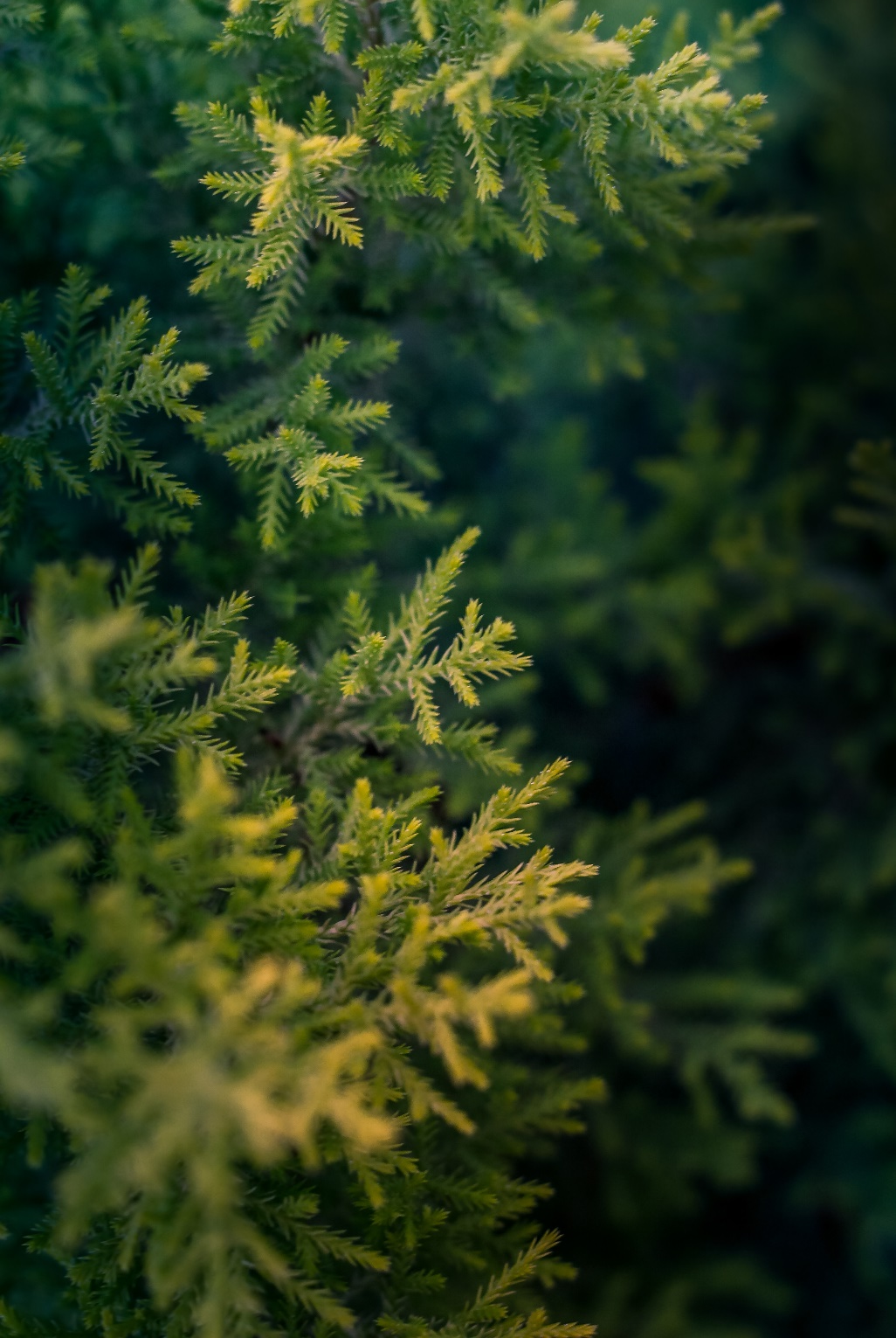
Schmückt den Saal mit grünen Zweigen! Fa-la-la-la-la-la-la-la-la!
sprechen
Tretet an zum bunten Reigen!
Fa-la-la-la-la-la-la-la-la!
Auf und nieder, immer wieder!
Fa-la-la-la-la-la-la-la-la!
Singt die alten Weihnachtslieder!
Fa-la-la-la-la-la-la-la-la!
Notes:
Timing: 5 minutes Aim: Practising phonics [ü] in a real text.
Note: lesson two includes a more detailed Christmas song covering the same SSCs. Depending on available time and how the students are getting on with these particular SSCs this activity could be left out.
Procedure: 1. Speak the first two lines out loud, drawing attention to the [ü] introduced earlier in the lesson.
2. Students repeat out loud. Note: In case students are curious about the meaning of the words to this song, the English translations are below:
Schmückt den Saal mit grünen Zweigen! (Decorate the room with green boughs/branches) Fa-la-la-la-la-la-la-la-la!
Tretet an zum bunten Reigen! (Step up to the varied melodies - i.e. an invitation to dance)
Fa-la-la-la-la-la-la-la-la!
Auf und nieder, immer wieder! (Up and down, over and over again)
Fa-la-la-la-la-la-la-la-la!
Singt die alten Weihnachtslieder! (Sing the old Christmas carols)
Fa-la-la-la-la-la-la-la-la!

Slide 36
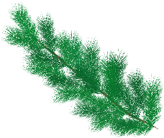
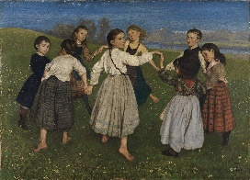
Schmückt den Saal mit grünen Zweigen! Fa-la-la-la-la-la-la-la-la!
sprechen
schmücken – to decorate der Saal – the hall
Tretet an zum bunten Reigen!
Fa-la-la-la-la-la-la-la-la!
Auf und nieder, immer wieder!
Fa-la-la-la-la-la-la-la-la!
Singt die alten Weihnachtslieder!
Fa-la-la-la-la-la-la-la-la!
der Reigen
Was ist das?
Was sind Weihnachtslieder?
Notes:
Timing: 3 minutes Aim: Practising phonics [ei] and [ie] in an authentic text.
Note: lesson two includes a more detailed Christmas song covering the same SSCs. Depending on available time and how the students are getting on with these particular SSCs this activity could be left out.
Procedure: 1. Highlight the 'ei’ / 'ie’ SSCs in the text lines by line.
2. Students repeat out loud. 3. Now sing the song together (Melody is Deck the Halls):
Schmückt den Saal mit grünen Zweigen! Fa-la-la-la-la-la-la-la-la!
Tretet an zum bunten Reigen!
Fa-la-la-la-la-la-la-la-la!
Auf und nieder, immer wieder!
Fa-la-la-la-la-la-la-la-la!
Singt die alten Weihnachtslieder!
Fa-la-la-la-la-la-la-la-la!
4. Provide further cultural and linguistic information about the song. i. Click once to provide the glosses for the first line and elicit the meaning of the first line of the song. Decorate the hall with green branches. Compare briefly with the English original: Deck the halls with boughs of holly. If students know this carol they may never have thought about the meaning of these quite archaic words! ii. Click again to bring up the picture of a Reigen (circle dance) and ask Was ist das? Tanzen is a previously taught word that we are revisiting this week, so if students automatically say ‘dance, or dancing’ then prompt them again to provide the German word. You might want to add that many western cultures (Germany and England, included) have traditional folk circle dances that originate from Greece. iii. Click for the 3rd call out and prompt students to tell you the meaning of Weihnachtslieder. They were introduced to the word Weihnachten, and several Weihnachts- compounds at the start of the lesson. They know Lied from 7.1.1.7. Although –er plurals are not a focus this week, it is likely that students will recognise the singular form and realise that it is plural, here. You can tell them that this is a different plural ending that they will learn later.
Picture attribution: Hans Thoma, Public domain, via Wikimedia Commons
Origin of the song Deck the Halls:
1866. Other “Nos Galan” lyrics were written by John Ceiriog Hughes (1832-1887), ca. 1873. Tune: Nos Galan (“New Year's Eve”) from John Thomas's Welsh Melodies with Welsh and English Poetry; this series by Thomas was a collaboration with John Talhaiarn Jones and Thomas Oliphant.

Slide 37
Number Is there one or are there many? Describing Christmas
Plurals - der/das - Rule 1 - umlaut + e;
Rule 2 -el/-en/-er NO CHANGE;
plural article = 'die‘; [Text: O Tannenbaum]
SSC [ü]
Y7 German
Term 1.2 – Week 6 - Lesson 26
Inge Alferink/ Rachel Hawkes
Artwork: Steve Clarke
Date updated: 15/12/21
Notes:
Artwork by Steve Clarke. All additional pictures selected are available under a Creative Commons license; no attribution required.
Learning outcomes (lesson 2):
Consolidation of SSC [ü]
Consolidation of plurals (der /das) → Rule 1 - umlaut + e, Rule 2 -el/-en/-er NO CHANGE, plural article = 'die’
Authentic text: O Tannenbaum
Word frequency (1 is the most frequent word in German):
7.1.2.6 (introduce) wünschen [630] Arzt [622] Platz1 [326] Spiel [328] Stück [511] Zug [675] grün [682] auch [18] es gibt [n/a] wie viele? [n/a]
7.1.2.3 (revisit) gehen [66] hören [146] tanzen [1497] kaum [272] manchmal [382] nie [186] oft [223] sehr [81] einmal die Woche [n/a] jeden Tag [n/a]
7.1.1.4 (revisit) wissen [78] bist [4] du [54] Farbe [1079] Nummer [806] Ort [341] Tier [614] aber [31] kein [46] ich weiß nicht [n/a] wie sagt man [n/a] wie schreibt man [n/a]
das ist (nicht) klar
Source: Jones, R.L. & Tschirner, E. (2019). A frequency dictionary of German: core vocabulary for learners. Routledge

Slide 38
Vokabeln
lesen / schreiben
?
A. Nur montags
B. Blau, gelb, rot
C. Übersetze ‘never’
D. oder
E. Am Sonntag, Montag, Dienstag, etc.
F. Übersetze ‘hardly’
G. Übersetze ‘to wish’
H. Schreiben, sprechen, lesen, und …
I. Nicht selten
J. Wo?
K. Ehm?
E | I | N | M | A | L |  | D | I | E |  | W | O | C | H | E
 |  |  | D | I | E |  | F | A | R | B | E | N
 |  |  |  |  |  |  |  |  |  | N | I | E
 |  |  |  |  |  |  | D | A | S |  | H | A | U | S | T | I | E | R
 |  |  |  |  |  |  | J | E | D | E | N |  | T | A | G
 |  |  |  |  |  |  |  |  |  | K | A | U | M
 |  |  |  |  |  |  | W | Ü | N | S | C | H | E | N
 |  |  |  |  |  |  |  |  |  |  | H | Ö | R | E | N
 |  |  |  |  |  |  |  |  | O | F | T
 |  |  |  |  |  |  |  |  |  | D | E | R |  | O | R | T
W | I | E |  | S | A | G | T | - | M | A | N | ?
Notes:
Timing: 10 minutes Aim: To share the theme for the lesson (‘Weihnachten’), whilst revising previously-met vocabulary.
Note: A more complex version of this task, in which only the first letter of each word is given, can be found on the next slide.
Procedure: 1. Teacher asks question / gives clue in German as per A – L on slide. 2. Student(s) volunteer(s) the answer (e.g. einmal die Woche).
3. Teacher asks ‘wie schreibt man das?’ 4. Students in chorus (slowly and steadily) respond to spell out the answer: E-I-N-M-A-L D-I-E W-O-C-H-E) Note: If students are practising for the Spelling Bee, then they will have learnt the term ‘Abstand’ for indicating a space between words. They could be prompted to use that, here.
5. As students spell the word, teacher reveals each letter on a click.This will enable the teacher to pick up on any of the trickier letters, and do some remedial practice in the moment.

Slide 39
Vokabeln
lesen / schreiben
?
A. Nur montags
B. Blau, gelb, rot
C. Übersetze ‘never’
D. oder
E. Am Sonntag, Montag, Dienstag, etc.
F. Übersetze ‘hardly’
G. Übersetze ‘to wish’
H. Schreiben, sprechen, lesen, und …
I. Nicht selten
J. Wo?
K. Ehm?
E | I | N | M | A | L |  | D | I | E |  | W | O | C | H | E
 |  |  | D | I | E |  | F | A | R | B | E | N
 |  |  |  |  |  |  |  |  |  | N | I | E
 |  |  |  |  |  |  | D | A | S |  | H | A | U | S | T | I | E | R
 |  |  |  |  |  |  | J | E | D | E | N |  | T | A | G
 |  |  |  |  |  |  |  |  |  | K | A | U | M
 |  |  |  |  |  |  | W | Ü | N | S | C | H | E | N
 |  |  |  |  |  |  |  |  |  |  | H | Ö | R | E | N
 |  |  |  |  |  |  |  |  | O | F | T
 |  |  |  |  |  |  |  |  |  | D | E | R |  | O | R | T
W | I | E |  | S | A | G | T | - | M | A | N | ?
Notes:
MORE CHALLENGING VERSION
Timing: 10 minutes Aim: To share the theme for the lesson (‘Weihnachten’), whilst revising previously-met vocabulary.
Note: This version of this task only gives the first letter of each word. A less complex version, in which more letters of each word are given, can be found on the previous slide.
Procedure: 1. Teacher asks question / gives clue in German as per A – L on slide. 2. Student(s) volunteer(s) the answer (e.g. einmal die Woche).
3. Teacher asks ‘wie schreibt man das?’ 4. Students in chorus (slowly and steadily) respond to spell out the answer: E-I-N-M-A-L D-I-E W-O-C-H-E). Note: If students are practising for the Spelling Bee, then they will have learnt the term ‘Abstand’ for indicating a space between words. They could be prompted to use that here.
5. As students spell the word, the teacher reveals each letter on a click. This will enable the teacher to pick up on any of the trickier letters, and do some remedial practice in the moment.

Slide 40
der Engel
lesen / sprechen
der Engel
Notes:
Timing: 5 minutes (all vocabulary slides in this sequence) Aim: To present new vocabulary (Christmas-themed).
Note: These are thematic words chosen to illustrate SSCs and plurals. They are not part of the vocabulary set for the week, but are introduced to fit with seasonal themes.
Procedure: 1. Since students have not had the opportunity to pre-learn these words, word and picture appear together from the outset.
2. Present single word + picture and ask students to read aloud using their knowledge of phonics.
3. Practise reading aloud and applying SSC knowledge - Key SSC recapped here are: short E, IE, EI, W, CH, Z.
4. Advance through all vocabulary slides in the same way.
Note: Christmas vocabulary not to be memorised; it is introduced to apply plural rules / SSC knowledge with different lexis.
Word frequency (1 is the most frequent word in German):
der Weihnachtsmann [2722 ,131] der Baum [996], der Stiefel [>4000], der Nikolaus [>4000], der Bonbon [>4000], der Schmuck [>4000], der Stern [1451], Engel [3963]
Source: Jones, R.L. & Tschirner, E. (2011). A frequency dictionary of German: core vocabulary for learners. Routledge

Slide 41
der Stern
lesen / sprechen
der Stern
Notes:
As for previous slide.

Slide 42
der Stiefel
lesen / sprechen
der Stiefel
Notes:
As for previous slide.
Note: The reason for including a boot as a Christmassy item might need a little cultural aside explaining that children leave a boot or shoe outside their bedroom door on the evening of 5th December for St Nikolaus. When they wake up in the morning of 6th December, they hopefully find them full of delicious goodies if they’ve been good. St Nikolaus is not the same tradition as Father Christmas (der Weihnachtsmann). Read more, here:
https://www.thelocal.de/20131206/15915

Slide 43
der Baum
lesen / sprechen
der Baum
Notes:
As for previous slide.

Slide 44
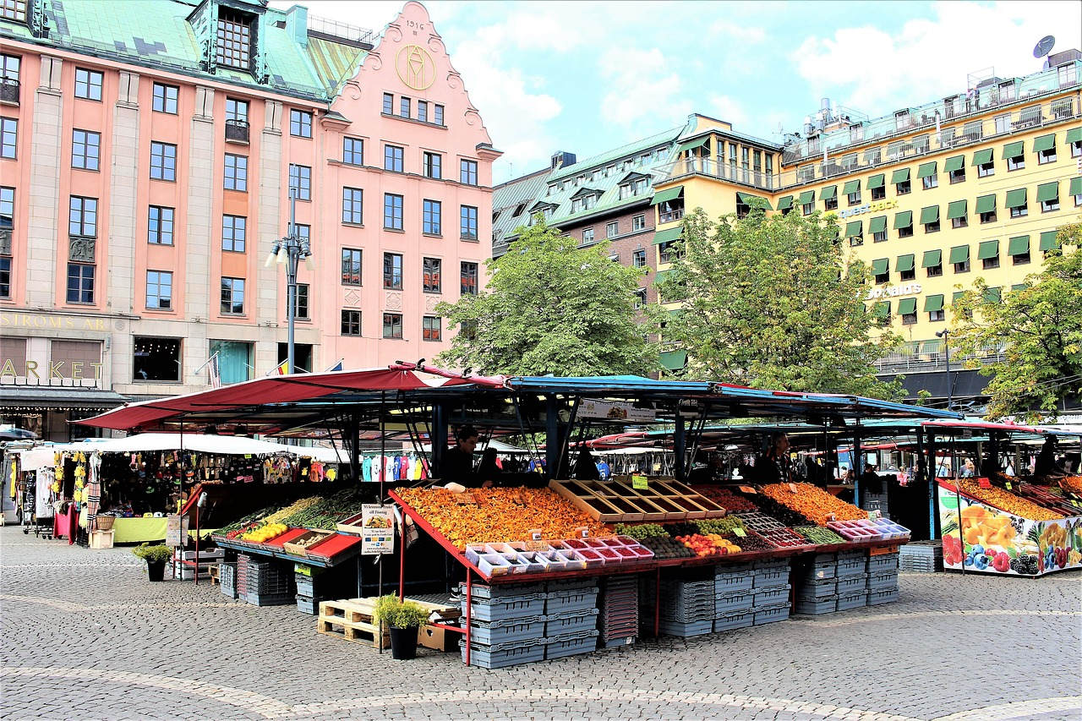
der Marktplatz
lesen / sprechen
der Marktplatz
Notes:
As for previous slide.

Slide 45
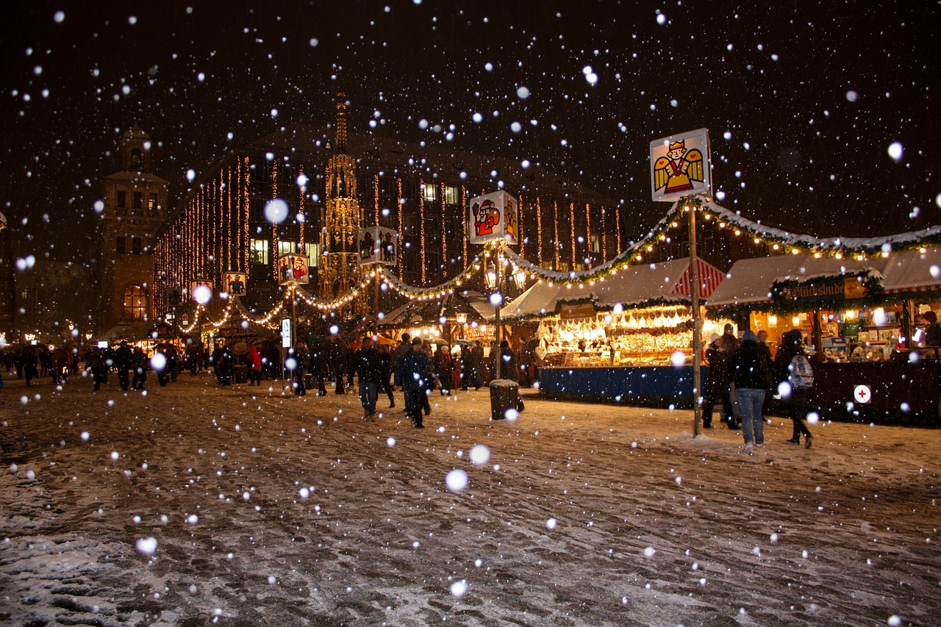
der Weihnachtsmarkt
lesen / sprechen
der Weihnachtsmarkt
Notes:
As for previous slide.

Slide 46
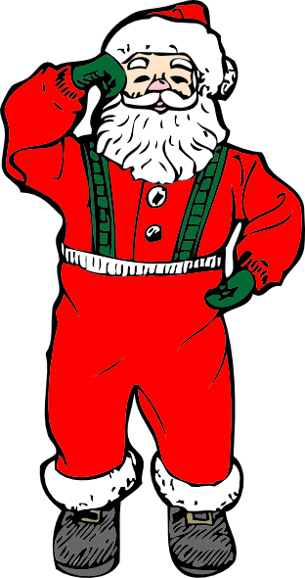
der Weihnachtsmann
lesen / sprechen
der Weihnachtsmann
Notes:
As for previous slide.

Slide 47
Vokabeln
lesen
der Stern
star
der Stiefel
boot
der Baum
tree
der Marktplatz
market square
der Weihnachtsmarkt
Christmas market
der Engel
angel
der Weihnachtsmann
Father Christmas
Notes:
Timing: 2 minutes Aim: To recap quickly on the Christmas-themed vocabulary.
Procedure: 1. Students see how many words they can translate into English in one minute
2. Click to bring up the English, one word at a time.
Note: Christmas vocabulary not to be memorised; it is introduced to apply plural rules / SSC knowledge with different lexis.
Word frequency (1 is the most frequent word in German):
der Weihnachtsmann [2722 ,131] der Baum [996], der Stiefel [>4000], der Nikolaus [>4000], der Bonbon [>4000], der Schmuck [>4000], der Stern [1451], Engel [3963]
Source: Jones, R.L. & Tschirner, E. (2011). A frequency dictionary of German: core vocabulary for learners. Routledge

Slide 48
Pluralformen
schreiben
Ich sehe fünf…
Notes:
Timing: 10 minutes Aim: To practise predicting what the plurals might be using the rules that have been introduced.
Procedure: 1. Students write down in German what they think the plural might be for the noun featured on each slide in the sequence.
2. Go through the all the questions (one per slide) first; the answers apear on a second suite of slides.
Notes:
1) sehen was a cluster word for long ‘e’ in lesson 1.1.2. Elicit the meaning from students, prompting with a gesture if necessary. 2) fünf was introduced as a phonics source word. Its meaning should be clear, here, particularly given the visual cue.
3) as these items are not part of the official vocab, students might need to be reminded of the singular form, i.e. der Engel.

Slide 49
Pluralformen
schreiben
Es gibt viele…
Notes:
As for previous slide.
Es gibt is on the vocab list for this week. viele was also learnt as part of ‘Wie viele’ (how many). Star = der Stern

Slide 50
Pluralformen
schreiben
Es gibt viele…
Notes:
As for previous slide.
Singular = der Baum

Slide 51
Pluralformen
schreiben
Es gibt ein Paar …
Notes:
As for previous slide.
Singular = der Stiefel Ensure that students remember ‘ein Paar’ from Lesson 1.1.2.

Slide 52
Pluralformen
schreiben
Ich sehe zwei…
Notes:
As for previous slide.
Singular = der Marktplatz Note: Zwei hasn’t been formally introduced but it is likely that they will not be confused about its meaning, given the visual cue.

Slide 53
Pluralformen
schreiben
Es gibt zwei…
Notes:
As for previous slide.
Singular noun = der Weihnachtsmarkt.

Slide 54
Pluralformen
schreiben
Ich sehe viele…
Notes:
As for previous slide.
Singular noun = der Weihnachtsmann

Slide 55
Pluralformen
Antworten
Ich sehe fünf…
Engel
Notes:
Timing: 4 minutes Aim: To present the answers to the writing activity.
Procedure: 1. Elicit the answer from students.
2. Click to bring up the correct answer.
3. Advance through all slides in the sequence in the same way.

Slide 56
Pluralformen
Antworten
Es gibt viele…
Sterne
Notes:
As for previous slide.

Slide 57
Pluralformen
Antworten
Es gibt viele…
Bäume
Notes:
As for previous slide.
Students will be taught SSC äu in the 2nd week of Term 2. They will therefore need some support with the pronunciation at this stage.

Slide 58
Pluralformen
Antworten
Es gibt ein Paar…
Stiefel
Notes:
As for previous slide.

Slide 59
Pluralformen
Antworten
Ich sehe zwei…
Marktplätze
Notes:
As for previous slide.

Slide 60
Pluralformen
Antworten
Es gibt zwei…
Weihnachtsmärkte
Notes:
As for previous slide.

Slide 61
Pluralformen
Antworten
Ich sehe viele…
Weihnachtsmänner
Notes:
As for previous slide.
These examples provide some evidence that most words stick to a limited number of plural patterns. 90% masculine words form their plurals following Rule 1, for example. However, Weihnachtsmann is an exception, because it not only adds an umlaut to the vowel, it adds not just an -e but an -er.

Slide 62
Authentic text
O Tannenbaum
Inge Alferink / Rachel Hawkes
Notes:
This week includes the first part of a 2-part lesson on a seasonal authentic text. Part two can be included in the following week. When combined, all the material can add up to more than 2 x 50 minutes. Covering the grammar points (introducing plurals) and the SCC (ü) are crucial to the NCELP SOW. It is as always up the individual teacher to decide what suits their students’ particular schedule, scheme of work, and ability levels.

Slide 63
O Tannenbaum
Hör die Musik an.
Ist die Musik…
a. Popmusik
b. traditionell
c. klassisch
Was ist das Thema?
a. Liebe
b. Natur
c. Europa
Notes:
Timing: 2 minutes Aim: To introduce a seasonal text.
Procedure: 1. Setting the scene. Just play one verse of an instrumental version. Link to instrumental versions: https://www.youtube.com/watch?v=KurqAmMi-bc (various instruments) https://www.youtube.com/watch?v=nxvJ1SIRdiI (piano only)
2. Alternatively, click on left hand tree, then right hand tree.
Link to versions with lyrics:
https://www.youtube.com/watch?v=OVSoZn66iC4 – a capella version, lyrics are fairly clear, there is only one verse https://www.youtube.com/watch?v=RJauT4IM1Y8 (choral version; pretty, but as there are a lot of voices, the individual sounds are not as clear– 3 verses, only play verse 1) https://www.youtube.com/watch?v=lS4wTuvR7Ik (single voice; quite clear sound – 3 verses, only play verse 1)

Slide 64
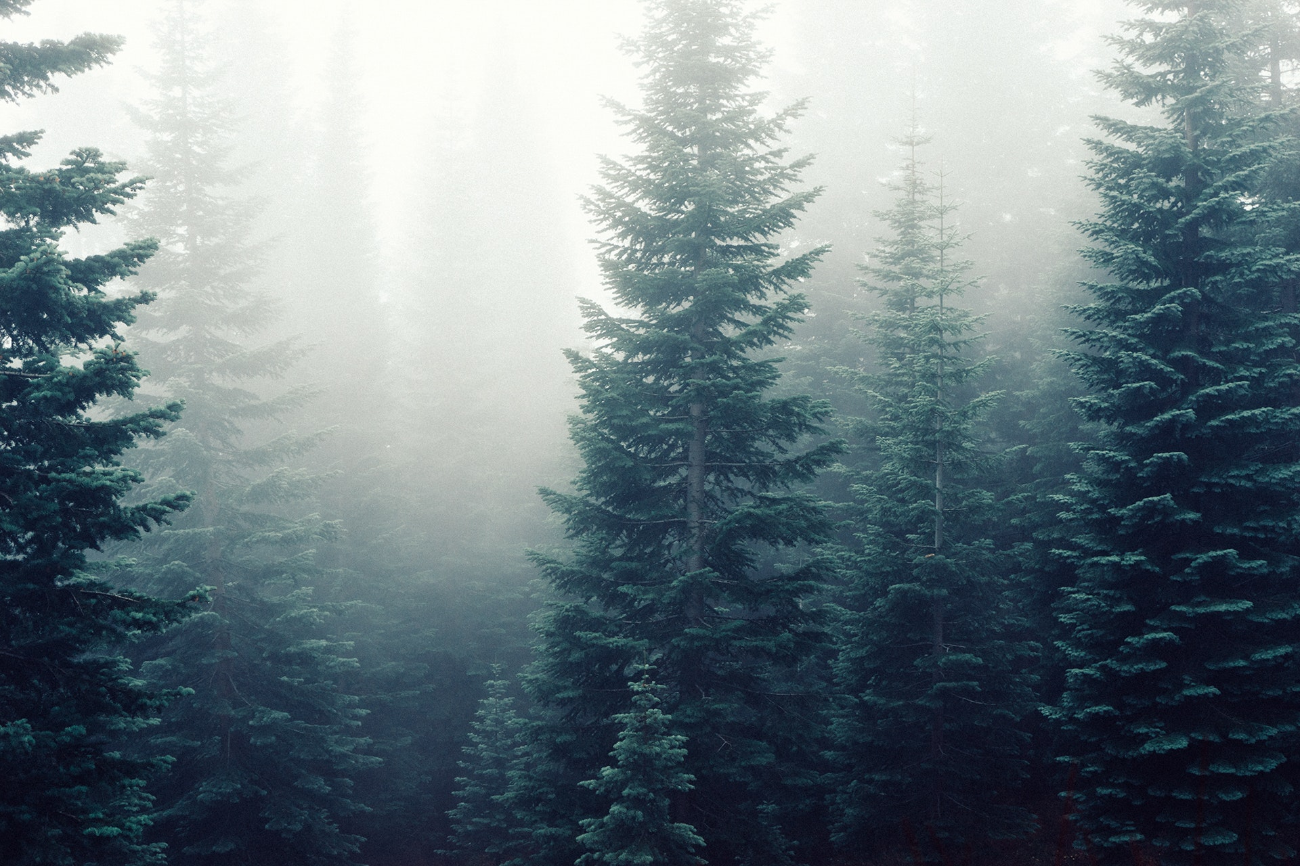
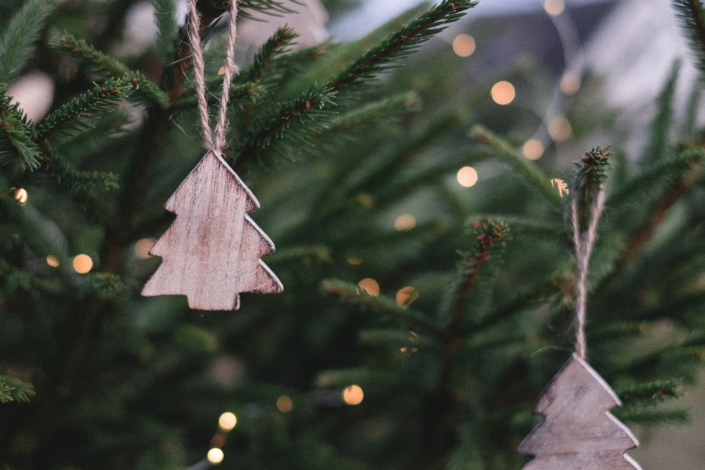
O Tannenbaum
Der Baum
O, Tannenbaum
Inge Alferink / Rachel Hawkes
Notes:
Timing: 1 minute Aim: To set the scene further.
Procedure: 1. The pictures emphasise the natural properties of the tree and not the decorative (Christmassy) aspect. The top right picture might prime ‘snowing’ (wenn es schneit).
2. Introduce the noun ‘der Baum’ [996] and invite the students to guess what type of tree a Tannenbaum might be.
Note: Students have not yet learnt the SSC ‘au’, but they have encountered some words with ‘au’ already (for example, das Haus). We return to this later in the lesson.

Slide 65
Geistesblitz - Vokabeln
schreiben
Titel: O, Tannenbaum
60 Sekunden.
5 Wörter (Deutsch oder Englisch)
Notes:
Timing: 2 minutes Aim: Helping students to use their real-world knowledge and previous vocabulary knowledge in a new context.
Procedure: 1. Give the instructions in German: Der Title von diesem Lied /Song ist: O, Tannenbaum. In 60 Sekunden schreib 5 Wörter (Deutsch oder Englisch) für das Lied.
2. Hear some examples.
Some ideas, with their word frequency: der Baum [996]; das Blatt [1330]; der Stamm [3500]; der Zweig/Ast [>4000]; die Wurzel [3047]; wachsen [482]; grün [556]; braun [2178]; die Erde [781]; die Sonne [953]; der Regen [1690]; der Sommer [704]; der Winter [1288]; der Schnee [2203]

Slide 66
‘U’ oder ‘Ü’?
hören
O Tannenbaum, o Tannenbaum,
wie gr_n sind deine Blätter!
D_ gr_nst nicht n_r z_r Sommerzeit,
Nein auch im Winter, wenn es schneit.
O Tannenbaum, o Tannenbaum,
wie gr_n sind deine Blätter!
Notes:
Timing: 2 minutes Aim: To practise differentiating between ‘u’ and ‘ü’.
Procedure: 1. Click on the fir tree in the top right hand corner to play the song. Students write ‘u’ or ‘ü’ for each missing vowel.
2. Play the song a second time. The text could also be read aloud if the recording seems too fast.
3. Alternatively, here is a link to a commercial version: https://www.youtube.com/watch?v=lS4wTuvR7Ik
(single voice, but quite clear sound – 3 verses, only play verse 1).
4. The answers are provided on the next slide.
Note: We include the source words and pictures as a refresher.
Instructions in German:
Hör zu
Schreib ‘u’ oder ‘ü’

Slide 67
Antworten – u vs ü
Antworten
O Tannenbaum, o Tannenbaum,
wie gr_n sind deine Blätter!
D_ gr_nst nicht n_r z_r Sommerzeit,
Nein auch im Winter, wenn es schneit.
O Tannenbaum, o Tannenbaum,
wie gr_n sind deine Blätter!
grün
Du
grünst
nur
zur
grün
Notes:
Timing: 1 minute Aim: To provide the answers to the activity on the previous slide.
Procedure: 1. Ask students which SSC is missing each time.c, licking to reveal the answers one by one.

Slide 68
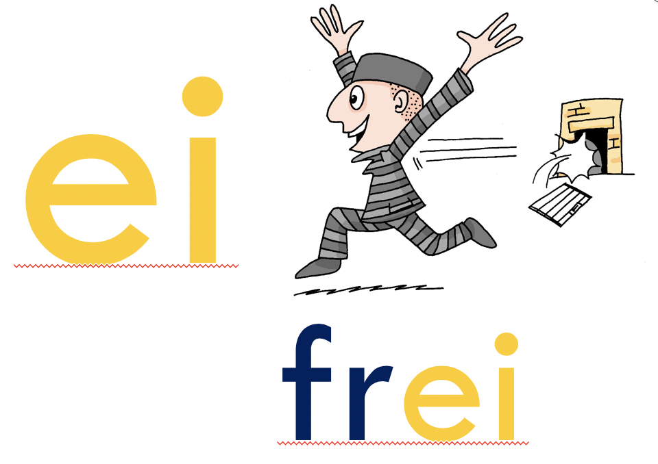
‘IE’ oder ‘EI’
hören
O Tannenbaum, o Tannenbaum,
w__ grün sind d__ne Blätter!
Du grünst nicht nur zur Sommerz__t,
N__n auch im Winter, wenn es schn__t.
O Tannenbaum, o Tannenbaum,
w__ grün sind d__ne Blätter!
Notes:
Timing: 2 minutes Aim: To practise differentiating between ‘ie’ and ‘ei’.
Procedure: 1. Click on the fir tree in the top right hand corner to play the song. Students write ‘ie’ or ei’ for each missing vowel.
2. Play the song a second time. The text could also be read aloud if the recording seems too fast.
3. Alternatively, here is a link to a commercial version: https://www.youtube.com/watch?v=lS4wTuvR7Ik
(single voice, but quite clear sound – 3 verses, only play verse 1).
4. The answers are provided on the next slide.
Note: Revisiting SSCs. In the NCELP SOW these SSCs have been introduced during Term 1.1, Weeks 3 (ei) and 7 (ie). We are using these as a minimal pair because of the spelling similarities. We include the source words and pictures as a refresher.
Instructions:
Hör zu
Schreib ie oder ei

Slide 69
Antworten – ie vs ei
Antworten
O Tannenbaum, o Tannenbaum,
w__ grün sind d__ne Blätter!
Du grünst nicht nur zur Sommersz__t,
N__n auch im Winter, wenn es schn__t.
O Tannenbaum, o Tannenbaum,
w__ grün sind d__ne Blätter!
wie
deine
Sommerzeit
Nein
schneit
wie
deine
Notes:
Timing: 1 minute Aim: To provide the answers to the activity on the previous slide.
Procedure: 1. Ask students which SSC is missing each time.c, licking to reveal the answers one by one.

Slide 70
‘AU’ und ‘SCH
sprechen
AU
blau
das Haus
kaum
O Tannenbaum, o Tannenbaum,
wie grün sind deine Blätter!
Du grünst nicht nur zur Sommerzeit,
Nein auch im Winter, wenn es schneit.
O Tannenbaum, o Tannenbaum,
wie grün sind deine Blätter!
O Tannenbaum, o Tannenbaum,
wie grün sind deine Blätter!
Du grünst nicht nur zur Sommerzeit,
Nein auch im Winter, wenn es schneit.
O Tannenbaum, o Tannenbaum,
wie grün sind deine Blätter!
SCH
der Tisch
die Flasche
falsch
schreiben
in der Schule
Notes:
Timing: 2 minutes Aim: To practise two new sounds – [au] and [sch] – before attempting to sing the song.
Note: There are two more sounds that have not been introduced formally (i.e. in a dedicated phonics session), but that pupils will have encountered already in other words: ‘au’ and ‘sch’. The boxes on the right hand side give the sounds in words they have already been introduced to previously in the SOW.
Procedure: 1. Practise these new sounds separately (saying ‘au’ and ‘sch’) and relate them to the sounds in familiar words, before saying them in the new words.

Slide 71
Sprich es aus oder sing mit!
sprechen
O Tannenbaum, o Tannenbaum,
wie grün sind deine Blätter!
Du grünst nicht nur zur Sommerzeit,
Nein auch im Winter, wenn es schneit.
O Tannenbaum, o Tannenbaum,
wie grün sind deine Blätter!
Notes:
Timing: 2 minutes Aim: To practise saying the text/singing the song.
Procedure: 1. Ask your students to practise saying the text. 2. Click on the tree symbol to play the music and ask them to keep in time with the song to help word formation. 3. Alternatively, students could sing the song.
Note: Click tree on left for a slower instrumental version, tree on right for a quicker version.

Slide 72
Verbing nouns
Grammatik
Du grünst nicht nur zur Sommerzeit
https://www.gocomics.com/calvinandhobbes/1993/01/25
Notes:
Timing: 1 minute Aim: To raise awareness of the relationship between certain verbs and adjectives.
Procedure: 1. Ask students what type of word they think ‘grünst’ is. Clues: verb ending; personal pronoun ‘Du’
2. Can they deduce the meaning of ‘grünen’ from the adjective ‘grün’?

Slide 73
Übersetzen
lesen
O Tannenbaum, o Tannenbaum, | O fir tree, o fir tree
wie grün sind deine Blätter | how green are your leaves!
Du grünst nicht nur zur Sommerzeit, | You are not just green in summer(time),
Nein auch im Winter, wenn es schneit. | No, also in the winter, when it snows.
O Tannenbaum, o Tannenbaum, | O fir tree, o fir tree
wie grün sind deine Blätter. | How green are your leaves!
Notes:
Timing: 3 minutes Aim: To practise translation into English.
Procedure: 1. Ask students to translate the verse using:
the words they already know
contextual expectations (Baum / Blätter / Grün )
cognates (Sommer & Winter)
generalisations (grünst)
2. Elicit translations from students line by line.
3. Click to bring up suggested translation, line by line.

Slide 74
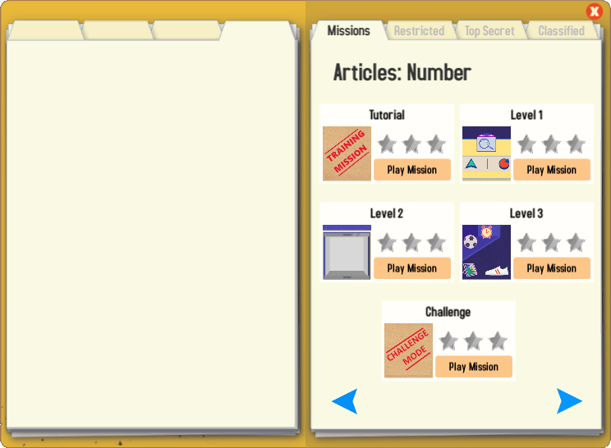
Gaming Grammar
Try the following Gaming Grammar missions to practise:

Slide 75
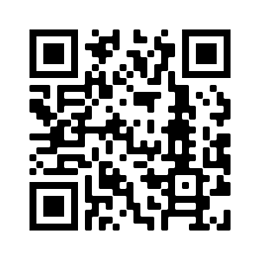
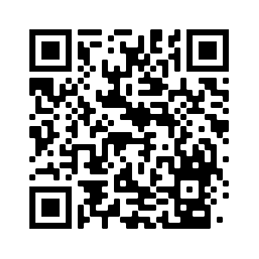
Hausaufgaben
Vocabulary Learning Homework (Term 1.2, Week 7)
Audio file
Audio file QR code:
Student worksheet
Quizlet link
In addition, revisit: Term 1.2 Week 4
Term 1.1 Week 5
Notes:
Use this slide to set the homework.
Icon made by Darius from www.flaticon.com (freely usable image).

