Slide 1
Practising questions with question words
On va jouer!
Notes:
This sequence of meaningful practice activities is intended to build on two grammar learning sequences you have already used:
Questions vs Statements PPT sg-pl
Question words PPT1/PPT2
This sequence begins with a speeded practice activity with the first set of images spinning for 5 seconds and the second set spinning for 3 seconds. Simply repeating has been shown to have some positive effects on fluency e.g. the 4-3-2 (decreasing minutes for doing an oral narrative) task (De Jong and Pefetti, 2011) Fluency Training in the ESL Classroom: An Experimental Study of Fluency Development and Proceduralization Language Learning 61:2, June 2011, pp. 533–568
http://www.pitt.edu/~perfetti/PDF/de%20Jong%20Language%20Learning.pdf

Slide 2
aimer
lire
to like
to read
avoir
manger
to have
to eat
écouter
regarder
to listen to
to watch
faire
télécharger
to do / make
to download
jouer
to play
Emma Marsden / Victoria Hobson
Notes:
Ahead of the question practice, students may need a two minute revision of the verbs needed for the MP question activities. Some classes may not need this step; however, it may be worth checking that all students can recall key verbs.
This set of verbs is suitable for use with Quel…?
Consider a think/pair/share activity here. (Fr→Eng) Students benefit from others’ knowledge and share their own. The teacher can then do a final check in whole class feedback. Then repeat Eng →Fr.
Students will probably already know the majority of these verbs so it is just a quick revision.
Frequency: aimer [242]; faire [25]; lire [278]; manger [1338]; jouer [219]; écouter [429]; regarder [425]; avoir [8]; télécharger [<5000] Source: Londsale, D., & Le Bras, Y. (2009). A Frequency Dictionary of French: Core vocabulary for learners London: Routledge.

Slide 3
lire
a_ _ _r
l_ _e
aimer
to like
to read
m_ _ _ _r
avoir
manger
a_ _ _r
to eat
to have
r_ _ _ _ _ _r
é_ _ _ _ _r
regarder
écouter
to listen to
to watch
f_ _ _e
faire
t_ _ _ _ _ _ _ _ _r
télécharger
to do / make
to download
j_ _ _r
jouer
to play
Emma Marsden / Victoria Hobson
Notes:
Then repeat Eng →Fr. (Two levels of difficulty depending on the needs of the class).

Slide 4
Emma Marsden / Victoria Hobson
Notes:
Question practice Note: Remind teachers that the picture in the middle is the question word ‘Quel?’ which is part of a previous resource sequence.
Quick whole class practice. Can students formulate the question before the picture stops spinning?
Qu word pic appears first – ask students What is the question word that goes with this picture? & Check meaning in English. Tell students they then need to ask a question that goes with each picture.
Questions along the lines of:
Quel animal as-tu?
Quelle musique écoutes-tu?
Quels fruits manges-tu / aimes-tu?
Quels livres lis-tu?
Quels coffrets/films Quelles émissions/applications télécharges-tu?
Quelles émissions/Quels films regardes-tu?
This activity leads into the more difficult truth/lie game and acts as a bridge between prior work and the new practice.
Word frequencies: animal [1002]; musique [1139]; fruit [896]; livre [358]; émission [1074]; film [848]; application [1030]; coffret (>5000) (box set) Source: Londsale, D., & Le Bras, Y. (2009). A Frequency Dictionary of French: Core vocabulary for learners London: Routledge.

Slide 5
Emma Marsden / Victoria Hobson
Notes:
Increased speed of image rotation. A chance for students to have another go at this activity with the purpose of increasing their fluency.

Slide 6
aller
habiter
to go
to live
acheter
to buy
travailler
to work
être
to be
Emma Marsden / Victoria Hobson
Notes:
Ahead of the question practice, students may need a two minute revision of the verbs needed for the MP question activities. Some classes may not need this step; however, it my be worth checking that all students can recall key verbs.
This set of verbs are suitable for use with Où…?
Verb frequencies: aller [53]; acheter [636]; être [5]; habiter [1186]; travailler [290]. Source: Londsale, D., & Le Bras, Y. (2009). A Frequency Dictionary of French: Core vocabulary for learners London: Routledge.

Slide 7
aller
a_ _ _ r
habiter
to go
h_ _ _ _r
to live
acheter
a_ _ _ _ _r
to buy
t_ _ _ _ _ _ _ _r
être
travailler
ê_ _e
to be
to work
Emma Marsden / Victoria Hobson
Notes:
Then repeat Eng →Fr.

Slide 8
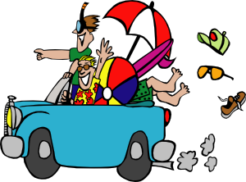
Emma Marsden / Victoria Hobson
Notes:
Question practice this time with Où?
Où vas-tu en vacances?
Où fais-tu les courses?
Où travailles-tu?
Où achètes-tu les vêtements?
word frequencies: vacances [1726], course [1289], vêtement [2383]
Source: Londsale, D., & Le Bras, Y. (2009). A Frequency Dictionary of French: Core vocabulary for learners London: Routledge.

Slide 9
Emma Marsden / Victoria Hobson
Notes:
Increased speed of image rotation. A chance for students to have another go at this activity with the purpose of increasing their fluency.

Slide 10
Je vous mentirais?
C’est la verité????
C’est un mensonge????
Emma Marsden / Victoria Hobson
Notes:
Ask the students to see if they can read these words out loud - phonics practice!! these will be new words for them... take every opportunity to ask them to sound out words and give lots of praise when they sound out new words. Then make sure to clarify the meaning in English. Don't dwell on the grammar of the title - just say this is 'Would I lie to you?' (we'll get to preverbal object pronouns later!)

Slide 11
Emma Marsden / Victoria Hobson
Notes:
The question picture appears on one click, check with the whole class that they all know the question word - NB some of these have not been revised in the previous slides, so they may need a quick check to ensure all the class can actually recall them.
Oral recall like this is quite difficult, so make sure that students are secure with the question words in the first instance, before launching into the activity.

Slide 12
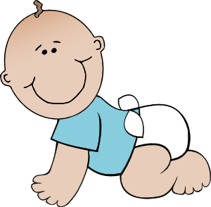
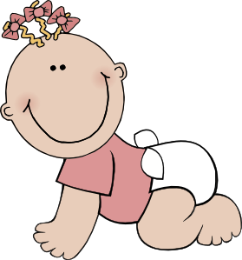
 |  | Vérité |  |  |  | Vérité
 |  | Mensonge |  |  |  | Mensonge
 |  |  |  |  |  | C’est.. intéressant/ utile/ amusant / necessaire
 |  | Vérité |  |  |  | Vérité
 |  | Mensonge |  |  |  | Mensonge
 |  | Vérité |  |  |  | Vérité
 |  | Mensonge |  |  |  | Mensonge
samedi
dimanche
devoirs
frères et soeurs
Notes:
Student answer grid.
Ask students to jot down their responses to the picture prompts. They can either tell the truth or make up a lie. Doing this beforehand will facilitate the flow of the activity. Print out and laminate, so that the sheets can be used again in the pair work.
Picture prompts appear on the mouse click to elicit questions from the teacher to ask the students, along the lines of:
Où vas-tu en vacances? Combien de frères et soeurs as-tu?
Quel animal as-tu?
Que fais-tu le weekend?
Pourquoi fais-tu les devoirs?
Qui détestes-tu?

Slide 13
devoirs
frères et soeurs
samedi
dimanche
Emma Marsden / Victoria Hobson
Notes:
Teacher → student questions
Before the students formulate the questions:
To model the questions and therefore ease the students into this activity, the teacher could model the question as the pictures appear, to ask to students.
The rest of the class can decide vérité! or mensonge! Students could keep a tally for every time they correctly identify whether the person giving an answer is telling the truth or lying. This could be done on a mini whiteboard. By having the answers written out already, debate is eliminated amongst the class about whether the answer is true or not, since students have ticked a box.
Picture prompts appear on the mouse click to elicit questions from the teacher to ask the students, along the lines of:
Où vas-tu en vacances?
Quel animal as-tu?
Combien de frères et soeurs as-tu?
Que fais-tu le weekend?
Porquoi fais-tu les devoirs?
Qui détestes-tu?

Slide 14
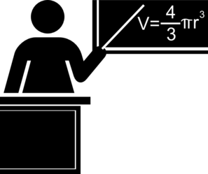
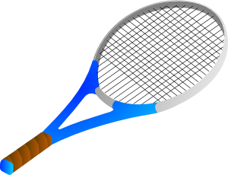
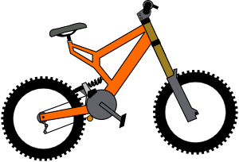
prof
enfants
Emma Marsden / Victoria Hobson
Notes:
Student → teacher questions
Then the class can play against the teacher. Students have to decide on whether it is the truth or a lie before the teacher gives the answer. They can tally their scores. NB: These questions are similar but different from those the teacher asked of the students. They re-use the same question words and the same syntax but vary the lexicon. This is another research-informed principle for practice.
Picture prompts appear on the mouse click to elicit questions from the students to ask the teacher, along the lines of:
Où habites-tu?
Quel sport fais-tu/aime-tu?
Combien d’enfants as-tu?
Que fais-tu en vacances?
Porquoi es-tu prof?
Qui aimes-tu?
Pair Work
Students can then return to their answer grids (reworking their answers if they wish) and play this in pairs, tallying their scores for a correct guess as to whether the answer is the truth or a lie. Students could swap partners and play again against someone else if time allows.

Slide 15
Jamie Oliver
 |  | Gordon Ramsey |  |  | Parce que mes parents travaillent dans un restaurant.
 |  | 5, ils s’appellent: Poppy, Daisy, Petal, River et Buddy. |  |  | Je joue au foot.
 |  | Un chien qui s’appelle Turtle |  |  | J’aime aller en Italie.
samedi
dimanche
enfants
Notes:
Partner A grid for printing. (A5 size, chose 2 slides to a page – slides 15&17)
Students choose which answers they are going to turn into a lie, writing in the space underneath. They get a point if their partner incorrectly guesses truth/lie.

Slide 16
Andy Murray
 |  | Rafael Nadal |  |  | Parce que ma mère joue au tennis.
 |  | J’ai un frère qui s’appelle Jamie. |  |  | J’écoute de la musique.
 |  | J’aime les bananes. |  |  | Chez JD sports. J’adore les vêtements d’ Adidas.
frères et soeurs
Notes:
Partner B grid for printing. (A5 size, chose 2 slides to a page – slides 15&17)
Students choose which answers they are going to turn into a lie, writing in the space underneath. They get a point if their partner incorrectly guesses truth/lie.

Slide 17
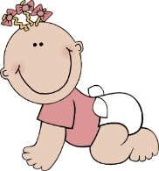
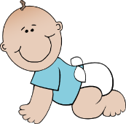
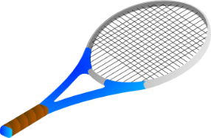
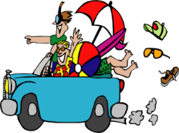
Partner B questions |  | Vérité ou mensonge?
Partner A questions |  | Vérité ou mensonge?
enfants
frères et soeurs
samedi
dimanche
Notes:
Student prompt/response grid.
Note: On another occasion, this task could easily be adapted, with different famous people, and completed in the 3rd person singular.
Students use the picture prompts to formulate the questions, then on listening to the answer write down whether they think the answer given by their partner is the truth or a lie.
E.g.
Qu.1 Partner B → Partner A Combien d’enfants as-tu?
Students can then compare answers to see how many they identified correctly.

