Slide 1
Three ideas today…
This presentation: https://ncelp.org/ncelp-teacher-cpd/
that you can use tomorrow
Author name: Rachel Hawkes
Artwork: Steve Clarke
Date updated: 14 / 06 / 20

Slide 2
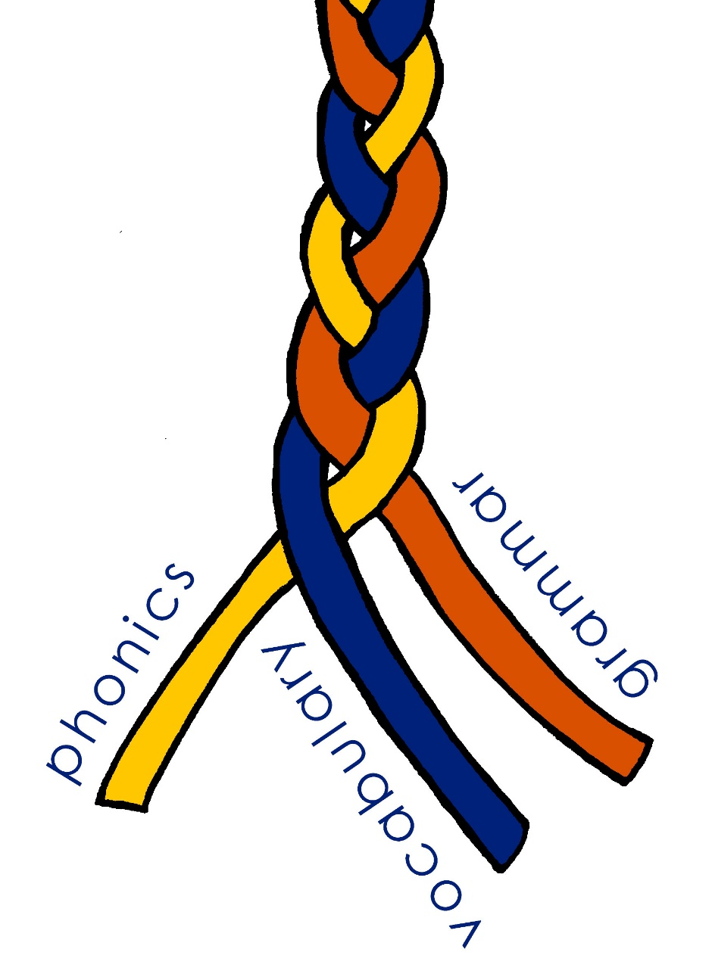
In this short session...
Phonics - working with unknown words
Vocabulary - shortcut to systematic revisiting
Grammar - input practice before production
Other sessions: https://ncelp.org/ncelp-teacher-cpd/

Slide 3
Using unknown words [1]
To practise applying SSC (symbol-sound correspondence) knowledge, we need to use unknown words. For example:
Place names
People’s names
Names of other things (e.g. games, bands)
Cognates (not previously-taught)
Notes:
This seems like such an obvious one now, but I realise that I hadn’t systematically differentiated between activities that practise pronunciation / reading aloud of previously-taught language (i.e., with the aim of reactivating the sound-symbol representations of particular words, which is essentially one aspect of vocabulary knowledge) and practising SSC knowledge itself, for which you need unknown words (so that you’re sure that students are apply the knowledge rather than remembering the pronunciation of a previously-taught word) Pronouncing and or transcribing parts of or whole unknown words is an effective way to develop SSC (or symbol-sound correspondence) knowledge – in order words, the sound-writing relationship. It is also a reliable way to test that knowledge – i.e. work out how well students are able to connect the sounds of the language with how they are written. Let’s have a look at a few examples of tasks we might do, either as test or as classroom tasks.

Slide 4
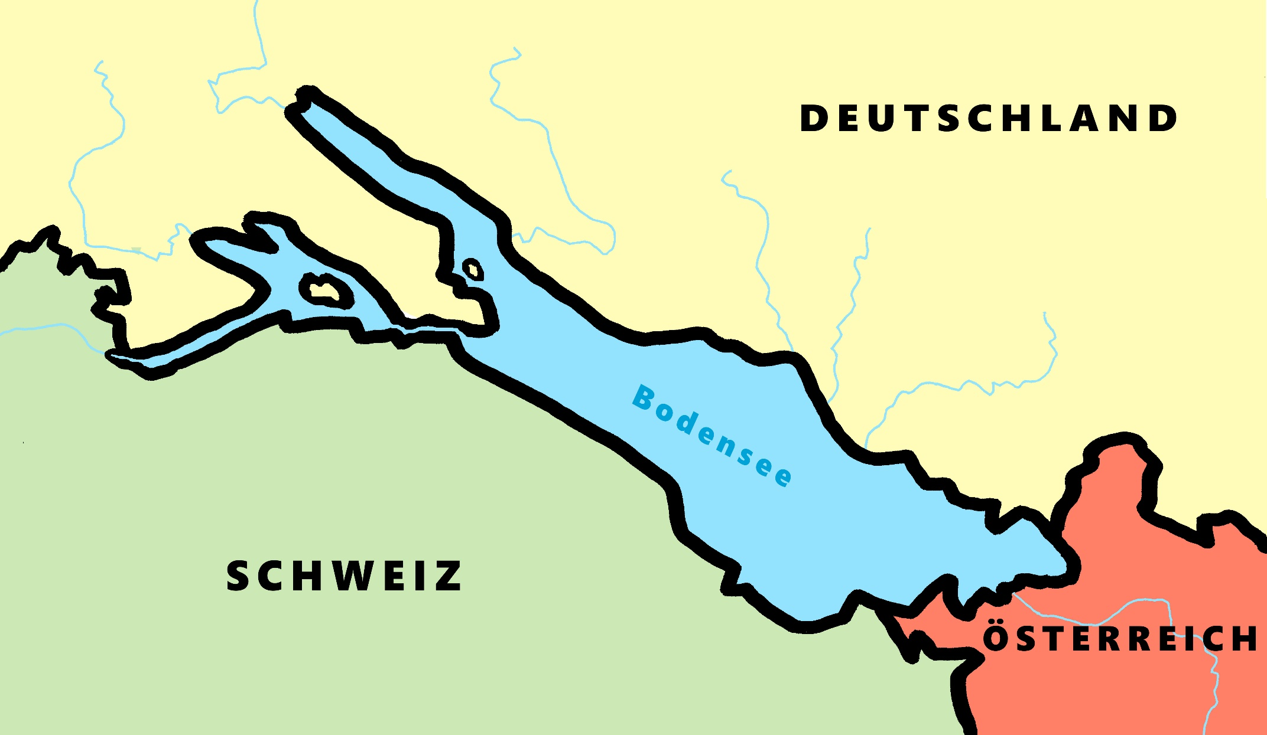
Phonetik - der Bodensee [1/2]
hören / schreiben
[4] Allensba_ _
ch
[5] _allhausen
4
W
5
z
[3] Radolf_ell
3
[6] Hagn_ _
6
au
ch
[7] Fr_ _dri_ _shafen
7
ie
S t
[2] _ _eckborn
eu
2
1
Kr_ _zlingen
[9] _omanshorn
R
9
ei
[8] Altenrh_ _n
8
Artwork: Steve Clarke
Notes:
Phonetik [1]
Time: 5 minutes Aim: To practise recognising and transcribing 10 previously taught SSC, in unknown words.
Procedure: 1. Click number to hear the full word. Students listen and transcribe only the missing letters. 2. Animations support item-by-item checking, as instant feedback on each SSC may be particularly helpful for students’ learning. 3. Teachers can additionally ask, Wo liegt [Hagnau]? Es liegt in [Deutschland]… Students have met the use of ‘in’ with die Schweiz. It will be helpful to focus their attention on the use of ‘in’ + der + Schweiz here, reminding them of the ‘in’ + movement (R2-accusative) or location (R3-dative) change. SSC revisited here: [eu] [st-] [z] [ch-hard] [w] [au] [ie] [ch-soft] [ei] [r] Transcript: 1 Kreuzlingen 2 Steckborn 3 Radolfzell 4 Allensbach 5 Wallhausen 6 Hagnau 7 Friedrichshafen 8 Altenrhein 9 Romanshorn

Slide 5
Phonétique
parler 1/8
lire / parler
Dis les noms.
Attention! C’est hard [g] ou [j]/soft [g] ?
Mon nom est …
1
Gérard
5
Gilles
9
Jacques
2
Gaelle
6
Julien
10
Jérôme
3
Angéline
7
Joséphine
11
Margaux
4
Agathe
8
Morgane
12
Georges
Adeline Charlton / Natalie Finlayson
Notes:
Timing: 8 minutes
Aim: To raise awareness of [j]/soft [g] and hard [g] by using known spelling rules to pronounce these correctly in unknown vocabulary items.
Procedure:
1. Explain that these are popular French names that look like names students may recognise from English, but are pronounced differently.
2. Give students four minutes to work with a partner to decide how to pronounce [j] or [g], and to have a go at sounding out the names. All other SSCs in the words are either known or transferable from English, with the exception of the [ô] in Jérôme.
3. Click on the numbers to hear the names pronounced. The voices indicate whether the name is traditionally a male or female one. Students repeat chorally.
4. Now, teachers encourage students to read the names in increasing speed intervals (30 seconds, 20 seconds, 10 seconds … may vary according to the individual needs of the class) to work on fluency.
Transcript
1. Gérard
2. Gaelle
3. Angéline
4. Agathe
5. Gilles
6. Julien
7. Joséphine
8. Morgane
9. Jacques
10. Jérôme
11. Margaux
12. Georges

Slide 6
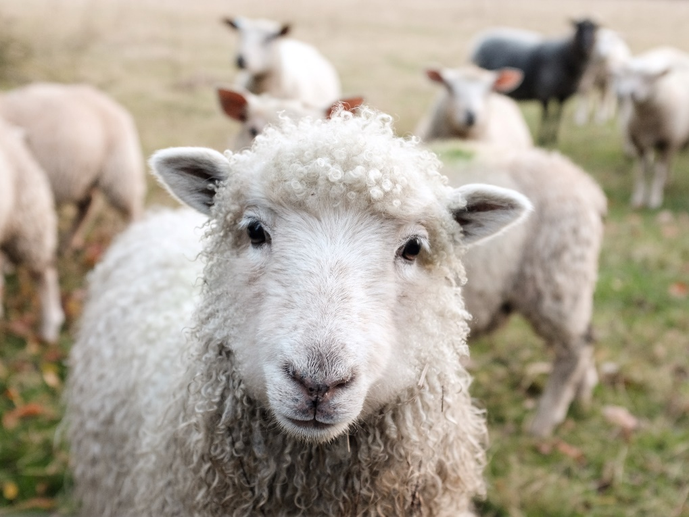
Using unknown words [2]
Minimal pairs are two similar sounding words that differ in only one phoneme and have distinct meanings.
sheep
ship
Notes:
[Ship] Photo by Peter Hansen on Unsplash [Sheep] Photo by Sam Carter on Unsplash
It’s not hard to recognise why these are important. We only need to have heard a colleague who is not a native English speaker instruct a student to pick up a ‘sheet’ or try not to smile when a Y7 student tells us earnestly that he or she ‘tiene once anos’!
Focusing on them explicitly, though. If you’d asked me two years ago whether I did that in my teaching, I would have said ‘well, yes, incidentally, when it comes up’.

Slide 7
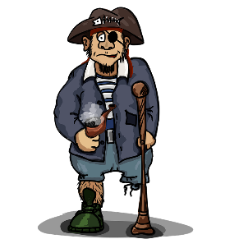
Pirates!
1
c
w
Riese
leider
Riese
One of the chests contains buried treasure. All the others contain poison!
Listen carefully to the secret code and follow the arrows to find the treasure.
Reise
Lieder
Reise
h
z
Wien
Biene
Feile
v
Wein
Beine
viele
Riese
k
Riese
Biene
Feile
leider
i
Reise
Beine
viele
Lieder
Reise
Riese
leider
Feile
leider
Riese
r
Reise
Lieder
viele
Lieder
Reise
Riese
y
j
q
Reise
Natalie Finlayson
Notes:
This task, created by Natalie Finlayson, one of NCELP’s resource developers, is one of my favourites!
Timing: 20-30 seconds per slide
Aim: This activity makes use of minimal pairs of unknown words to compel students to focus on a pair of SSC (sound-symbol correspondence) that often cause difficulty, both in pronunciation, reading aloud of written text, and also in spelling. (Unknown words are used so that pupils focus closely on the sound. Definitions are given on a later slide).
Procedure: Starting on the red square, pupils listen to the words and decide whether they hear /ei/ or /ei/. They follow the arrows indicated by their choice to finish at one of the chests. There is only one correct route per slide, so pupils must correctly identify all words to find the treasure. The order or /ei/ and /ie/ changes (i.e. sometimes /ei/ is on the white square and sometimes on the blue) so the pupils must read the spellings.
Pupils can follow the slide on the projector, or the slide can be printed so they can trace the route with a pen/finger.
Teacher asks ‘Wo bist du?’ Pupils respond ‘Z, W’ etc. to practise the alphabet. Teacher clicks on the chests they say to reveal treasure (or not!)
Audio plays on clicking play. Pupils will probably need to hear the audio at least three times.
Note: Each treasure chest is triggered to reveal what is underneath. You see a hand icon appear when you mouse over it – click and the chest disappears. Each slide only has one treasure chest – the rest reveal skulls.
Transcript:
Wein, Biene, Feile, Lieder, Riese
Treasure is located in chest r

Slide 8
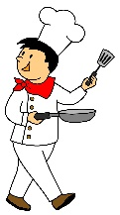
En anglais et en français
lire / écouter
same [ch]
different [ch]
same [ch]
different [ch]
1
chef
6
champagne
2
avalanche
7
chocolat
3
touche
8
champion
4
brochure
9
moustache
5
charge
10
riche
Kirsten Somerville / St James’ Hub / Natalie Finlayson
Notes:
This is a slightly different angle, but I’ve included it to show the breadth and depth of NCELP’s phonics work as it’s developed through Y7. Here English has two pronunciations for ‘ch’ where French has one (there’s a reason for that, as where the English and French pronunciations overlap, those are words ‘borrowed’ form French).
Timing: 2 minutes Aim: This activity highlights similarities and differences in the English and French pronunciation of the SSC [ch], using near-cognates which have not been previously taught. Images are provided to aid recognition. The activity aims to show that while the pronunciation of this SSC changes in English, it is consistent in French. Teachers to highlight that, where the sound is ‘sh’ in English, these words are “borrowed” from French (chef, brochure, champagne, moustache).
Procedure: Students write 1-10 in their exercise books and decide if the [ch] in the French word sounds the same as in English, or different from the English. They then listen to the words and check their answers.
TRANSCRIPT:
chef
avalanche
touche
brochure
charge
champagne
chocolat
champion
moustache
riche
Frequency rankings of non-SOW (near-)cognates (1 is the most common word in French):
avalanche [4426], brochure [>5000], champagne [>5000], champion [2443], charge [849], chef [386], chocolat [4556], moustache [>5000], riche [599], touche [3775]
Source: Londsale, D., & Le Bras, Y. (2009). A Frequency Dictionary of French: Core vocabulary for learners London: Routledge

Slide 9
Vocabulary
Every week’s lessons could include:
Stand alone 5-minute revisiting activities for vocabulary
from 3 weeks ago, 9 weeks ago
Include receptive and productive recall – all modes and modalities
Simple tasks from templates
Notes:
Systematically revisiting high-frequency vocabulary is perhaps the key way to strengthen the reach and impact of any SOW in any department. It’s tricky to do this in a planned way starting from scratch – time-consuming above all else. However, what any HoD could say to his/her dept is – every week should include at least one activity that revisits the most useful (high-frequency) vocabulary from 3 x weeks again, and one from 9 x weeks ago. Depts who wanted to be joined up about this could divide up the creation work such that one person did all of Term 1 Y7 Spanish for example, and so on. Those resources would then be shared. This would not attempt to integrate the words into the new lesson material, not try to weave them in, but it would ensure that students were given regular opportunities to recall meanings and forms of the most high-frequency language. These task types do not need to try to be ‘all singing / all dancing’ – simple templates can be used. Let’s look at a few examples of task types…

Slide 10
vocabulario
Lee las frases. ¿Qué significan las palabras?
Write the meaning of the bold words.
 | ¿Qué significan las palabras?
1. Bianca no quiere cenar porque está mala. Solo quiere dormir.
2. Papá está triste, pero quizás su amigo no está así.
3. Según la gente la ciudad es muy bonita. Voy a ir a mediodía.
4. El parque está sucio y la calle está igual.
5. No está lista para escribir una carta.
6. La playa es preciosa, pero no está limpia.
mala =
ill, sick
triste =
sad
así =
like that
quizás =
maybe
según =
according to
gente =
people
sucio =
dirty
igual =
the same
lista =
ready
preciosa =
beautiful
limpia =
clean
Amanda Izquierdo / Nick Avery
Notes:
Timing: 5 minutes
Aim: To further embed the meaning of new vocabulary and present three new words from this week’s set in context.
Procedure:
Read the sentences and try to think of the meaning of the words in bold. Most of these have been presented and practised already this week.
Write the meaning of the bold words in English.
Three words (quizás, así, según) are new this week, so their meanings are given upfront. Teachers should draw students’ attention to these.
Words introduced this week: malo [368]; triste [1371]; quizás [346]; así [67]; según [237]; gente [137]; sucio [1855]; igual [263]; listo [1684]; seguro [407]; precioso [1777]; limpio [1710]
Words revisited from 3.2.6 [revisited in SoW this week]: cenar [3087]; dormir [403]. Other words from the poem are included for further exposure to words that have been previously encountered in the poem: playa [1475]; mediodía [2647]; papá [865]; su [12]
Words revisited from 3.1.5 [revisited in SoW this week]: parque [1354]; correr [343]; escribir [198]; carta [627]
From other Y7 weeks: querer [58]; porque [40]; pero [30]; ciudad [178]; muy [43]; bonito [891]; calle [269]
Source: Davies, M. & Davies, K. (2018). A frequency dictionary of Spanish: Core vocabulary for learners (2nd ed.). Routledge: London

Slide 11
Vokabeln
hören
Hör dir die Wörter an. Hast du diese Wörter auf Deutsch gehört?
x
1
first
zuerst
2
to receive / receiving
erhalten
3
goal
das Ziel
x
4
to mix / mixing
mischen
x
5
in the end
schließlich
Rachel Hawkes
Notes:
Timing: 3 minutes Aim: To practise vocabulary in the second revisited set for this week, in the spoken modality. Procedure: 1. Click for the English word to appear.
2. Click on the number to play the sound.
3. Listen to the German words. Was any of the four words the German for the English word shown? 4. On a click an English word will appear. Was the word included in the German set? 5. Click for answers. Note: Increase the challenge by listening first, revealing English word after listening to each set of four words.
Transcript: 1. Später – Danach – Schließlich – jetzt → First
2. Lassen – erhalten – halten – beginnen → To receive
3. das Ziel – die Mitte – der Punkt – der Spieler → the goal
4. Ziehen – nehmen – legen – werfen → to mix
5. deshalb – leider – aber – ziemlich → in the end
7.3.2.4 beginnen [239] erhalten [283] gewinnen [408] legen [296] mischen [2105] werfen [672] ziehen [266] die Mitte [756] der Punkt [427] das Ziel [325] jeder, jede, jedes [88]

Slide 12
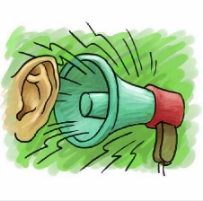
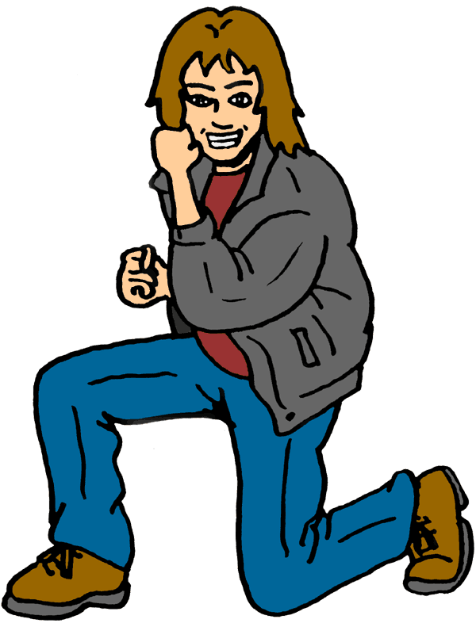
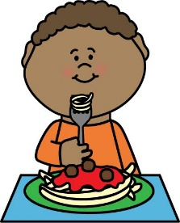
escuchar
Escucha. Identifica la imagen correcta y escribe su letra.
1
2
3
4
5
6
7
8
9
10
11
12
F
J
A
G
E
H
B
I
D
L
C
K
A
B
C
D
E
F
[to make an effort]
[to make
noise]
[to make a
funny gesture]
[to make a great change]
[long hair]
[to go on a long trip]
G
H
I
J
K
L
[to go on a short trip]
[a long dialogue]
[to have dinner alone]
[to sleep alone]
[short hair]
[blue sky]
Victoria Hobson / Nick Avery
Notes:
Timing: 6 minutes
Aim: to recap vocabulary from this lesson and sets Y8 1.1.5 and Y7 3.2.6 as per the SoW cycle of revisiting.
Procedure:
1. Give students a minute in pairs to try to anticipate the vocabulary items they hear. This gives the teacher a chance to gauge students’ understanding of the pictures and offer help where necessary.
2. Click the number triggers to play the audio.
3. Go through the answers drawing attention to the vocabulary items.
Transcript:
hacer un cambio genial
cenar solo
el pelo largo
hacer un viaje corto
hacer un gesto gracioso
el pelo corto
hacer un esfuerzo
un diálogo largo
hacer un viaje largo
el cielo azul
11) hacer ruido
12) dormir solo
Vocabulary from revisited sets
8.1.1.5: cambio [319]; ruido [1034]; esfuerzo [601]; viaje [519]; gesto [928]; gracioso [3874]; genial [2890];
7.3.2.6: cielo [620]; pelo [873]; cenar [3087]; dormir [403]

Slide 13
eine Geschichte
hören / sprechen
Welcher Satz ist richtig?
 | A party is taking place upstairs in my flat. | A birthday party is taking place downstairs in my house. | A birthday party is taking place upstairs in my flat.
 | Mia is hungry and she is coming later. | Mia is tired and she is coming later. | Mia hat a headache and she is coming later.
 | Mehmet flew by plane from Poland. | Mehmet travelled by train from Switzerland. | Mehmet flew by plane from the south.
 | Katja’s aunt and uncle live in Poland and are bringing Polish food. | Katja’s aunt and uncle are flying from Poland and like eating Polish food. | Katja’s aunt and uncle are coming from Poland and can’t travel by boat.
 | Katja is preparing the food, but she hasn’t found the Küche. | Katja is preparing the food, but she hasn’t found the coffee. | Katja is preparing the party, but she hasn’t found the food.
 | We walked to town, but we still want to dance with Mia! | We went shopping, but now we want to dance with Mia! | We went shopping, but we still want to dance with Mia.
1
2
3
4
5
6
Rachel Hawkes
Notes:
Timing: 5 minutes Aim: To practise comprehension and production of most of this week’s revisited vocabulary in sentences. Procedure: 1. Encourage students to recall the vocabulary to predict what they will hear. In number one words that differentiate one sentence from another have been put in bold to facilitate task modelling.
2. Click the action buttons to play each sentence. Students pick which column (A, B or C) is correct.
3. Clicking reveals the answers. 4. Elicit the German for the other two answers each time, to practise productive recall of the vocabulary.
Transcript: 1. Oben in meiner Wohnung findet eine Geburtstagsparty statt.
2. Mia ist müde, und sie kommt später.
3. Mehmet ist mit dem Flugzeug vom Süden aus losgeflogen.
4. Katjas Tante und Onkel fliegen von Polen aus los und essen gern polnisches Essen.
5. Katja bereitet das Essen vor, aber sie hat die Küche nicht gefunden.
6. Wir sind einkaufen gegangen, aber wir haben noch Lust, mit Mia zu tanzen!
Word frequency (1 is the most frequent word in German):
einkaufen [2877] mitbringen [1828] stattfinden [652] vorbereiten [1421] Geburtstag [1766] gegangen [66] gefahren [215] fliegen [824] geflogen [824] Bahn [1415] Flugzeug [1776] Geschichte [262] Onkel [1832] Polen [2023] Süden [1771] Tante [1826] Schiff [1176] polnisch [3237]
gefunden [103] Hunger [2097] Kaffee [1299] Küche [960] Lust [1407] Schmerz [1483] Wohnung [418] müde [2000] noch1 [33] oben [100] unten [590]
Source: Jones, R.L. & Tschirner, E. (2006). A frequency dictionary of German: core vocabulary for learners. Routledge

Slide 14
hablar
úl...
último
mis...
ma...
lar...
su...
qui...
last
lim...
i...
pre...
se...
lis...
con...
tri...
Nick Avery
Notes:
Timing: 5 min (slides 15-29)
Aim: to practise recall of previously taught vocabulary
Procedure:
Students read the word in the centre of the screen and recall the Spanish. The first few letters of the word are provided to facilitate retrieval. Teachers may decide to reduce to one letter should they wish increase the level of difficulty.
Words from revisited sets:
Y8 1.2.1.: largo [300]; mismo [55]; último [188]
Y8 1.1.3.: malo² [360]; sucio [1855]; limpio [1710]; precioso [1777]; listo² [1684]; contento [1949]; triste [1371]; seguro² [407]; igual [263]; quizás [346];

Slide 15
Vocabulaire
parler
Personne A
Au lycée je/j’ …
Personne B
fais de la natation
achète du poisson
fais du sport
pèse le fromage
fais un exercice
definis le vocabulaire
envoie des messages en classe
utlilise un ordinateur
fais le travail
apporte mes cahiers chaque jour
Victoria Hobson / Natalie Finlayson
Notes:
Word frequency of cognates used (1 is the most frequent word in French): message [792]
Source: Londsale, D., & Le Bras, Y. (2009). A Frequency Dictionary of French: Core vocabulary for learners London: Routledge.

Slide 16
Vocabulaire
parler
Personne B
Hier au marché j’ai…
Personne A
fait du sport
joué au foot
fait de l’exercice
pesé le fromage
utilisé un ordinateur
acheté de l’eau
mangé une glace
envoyé vingt euros à ma mère
fait de la natation
dit, ‘Ça coûte combien ?’
Victoria Hobson / Natalie Finlayson

Slide 17
Vokabeln 2 [1/2]
lesen / schreiben
1. Ein Synonym für bekommen
2. Der letzte Monat im Jahr
3. Ich bin zu Hause …
4. Ein anderes Wort für verstehen
5. Ein Synonym für nochmal
6. Das ist nicht grün
7. Das ist eine Erfahrung
erfahren
kriegen
werden
Dezember
März
Januar
gestiegen
geschwommen
geblieben
begreifen
steigen
eigen
Mal
wieder
für
Pflanze
Wald
Luft
Berg
Fahrt
Schuh
Rachel Hawkes
Notes:
Timing: 7 minutes (2 slides) Aim: to practise productive recall of all of this week’s new and revisited vocabulary in the written modality. Procedure: 1. Click for the first word to appear and then disappear. Repeat for 2nd and 3rd words for number 1.
2. Students write down their answer for number 1.
3. Click again for the answer to number 1.
4. Continue with the remainder of the questions on this slide, providing item-by-item feedback.
Word frequency (1 is the most frequent word in German):
8.2.1.1 (introduce) kriegen [724] eigen [166] für [17]
8.1.2.4 (revisit) erfahren [690] geblieben [113] geschwommen [1863] gestiegen [325] steigen [325] Berg [934] die Erfahrung [619] Fahrt [1569] Luft [487] Wald [1028]
8.1.1.5 (revisit) begreifen [1346] Dezember [1527] Jahreszeit [4818] Mal [82] März [987] Pflanze [1667] Schuh [1678] Wechsel [2525] wieder [74]
Source: Jones, R.L. & Tschirner, E. (2019). A frequency dictionary of German: core vocabulary for learners. Routledge

Slide 18
Grammar
50+ experimental studies, including:
French verb inflections with 11 to 14 yr olds (Marsden, 2006)
German case marking with 9 to 11 yr olds (Kasprowicz & Marsden, 2017)
Avoid working with whole paradigms at one time, particularly in the first stages of language learning
Attention is a limited resource; learners can only pay attention to so much at any one time (Lee & VanPatten, 1995; VanPatten, 2002; Wong, 2004)
Focus on accurate and reliable knowledge of one form juxtaposed with another (e.g. je joue vs. nous jouons)
Provide plenty of practice for each pair of grammatical forms/meanings
Remove other ‘cues’ so that learners focus on the target feature: e.g., le weekend dernier, j’ai mangé
Gradually build up wider system
Rowena Kasprowicz / Emma Marsden
Notes:
This aspect of NCELP’s work owes a lot to the research of Professor Emma Marsden, which has contributed to a now substantial number (50+) of experimental studies (in classrooms as well as laboratories) since the early 1990s, looking at the teaching of a range of grammar features.
[I want to take a moment to flag OASIS, too, which is an incredible idea and resource for anyone interested in languages teaching and research. Essentially it’s a searchable repository of one-page summaries of research studies into language acquisition and language learning.] Building on the work of Bill VanPatten, (e.g., https://oasis-database.org/concern/summaries/9019s2443?locale=en), researchers have experimented by practising in the input (L & R) many ‘harder to reach’ grammar features, which learners typically don’t just pick up by being asked to understand the main details of a text containing the target feature. Evidence suggests benefits for:
Improving analysis of language
‘Training the ear’ to notice small phonemic differences (e.g. je / j’ai)
Improving comprehension and production
A range of ages, proficiencies, languages, grammar features

Slide 19
Problemas con Siri
escuchar
 | the action in general | someone does the action
¡Siri no funciona en tu móvil hoy! What is it talking about?
Escucha los mensajes.
Marca la opción correcta.
1
2
3
4
5
6
7
8
St. James’ Hub Teachers / Victoria Hobson / Nick Avery
Notes:
Here is just one quick example from the Y7 resources. This principle is in action in every sequence in which a new grammar feature is introduced and practised. Compelling students to process pairs of forms/meanings isn’t just for verbs, or tenses, there are examples from both morphology (the forms of words) and syntax (order of words within a sentence) with all word classes: with adjectives (masculine vs feminine agreements, pre- vs post-nominal placement), with adverbs (time vs manner, time vs place), word order, with prepositions (e.g., accusative vs dative uses in German). On the next slide, we have one more example, a reading this time, practising
Timing: 2 minutes Aim: This task aims to help learners understand the difference in meaning between the infinitive and the third person singular. Tell students to pay careful attention to the verb that they hear. The vocabulary other than the verbs in this activity is either already known to students or is a cognate. Procedure: 1. Students write 1-8 in their books.
2. They listen to each phrase to decide if they are hearing the infinitive or the 3rd person, and they choose the category ‘action in genera’ or ‘someone does the action’ to connect securely the form and its meaning. 3. Answer ticks are animated to appear.
[‘pling’ sound] Lee frases interesantes.
[‘pling’ sound] Vivir cerca del pueblo.
[‘pling’ sound] Bebe coca cola.
[‘pling’ sound] Come comida.
[‘pling’ sound] Leer juntos.
[‘pling’ sound] Vive lejos de aquí.
[‘pling’ sound] Comer mucho.
[‘pling’ sound] Beber limonada.
Ask students to translate the text extracts to ensure comprehension of meaning.

Slide 20
Steigt oder steht?
lesen
1 Der Tisch _________ auf dem Haus.
2 Der Mann _________ auf den Tisch.
3 Der Mond __________ auf die Nacht.
4 Der Sessel __________ auf dem Tisch.
5 Der Tisch ___________ auf das Haus.
6 Das Haus ___________ auf den Berg.
7 Der Berg ___________ auf dem Mond.
8 Der Mann ___________ auf dem Sessel.
9 Der Mond ___________ auf der Nacht.
steht
steigt
steigt
steigen
steht
steigt
stehen
steigt
der Mond
steht
der Sessel
steht
der Berg
steht
extracts from Immer höher – Ernst Jandl
Notes:
Poem - Immer höher (Ernst Jandl) Time: 7 mins approx Here are nine assorted lines from the poem. NB: for the whole poem, search for German SOW Y7 Term 3.2 Week 7 on the NCELP Resource Portal. https://resources.ncelp.org/ Students needs to decide which verb ‘steigt’ or ‘steht’ is the correct option. Remind as necessary that it is the article after the preposition ‘auf’ that will tell them which verb (movement or location) is correct. 1. Students write 1-9 and write either ‘steigt’ or ‘steht’. 2. Teachers elicit the answers (chorally) by inviting students to say each full line of the poem, and then confirm by clicking for the verbs to appear, one by one. 3. Teachers then elicit the English translation for each line (this might also be done chorally, or individually, as preferred).

Slide 21
Three ideas today…
This presentation: https://ncelp.org/ncelp-teacher-cpd/
that you can use tomorrow
Author name: Rachel Hawkes
Artwork: Steve Clarke
Date updated: 14 / 06 / 20

