Slide 1
L’homme qui te ressemble René Philombé
Using word reference resources SSC [SFC] [re-visited]
Y7 French
Term 3.2 - Week 7 - Lesson 71
Rachel Hawkes / Kirsten Somerville / Stephen Owen
Date updated: 20/09/20
Notes:
Please note: teachers will need to insert lines from the poem into slides 26, 29, 36, 37, 39 (lesson 1) and slides 41-44 (lesson 2) before teaching.
Learning outcomes (lesson 1)
Identifying the type of text, understanding the text, learning vocabulary
Using word reference resources
Revisiting SSC [SFC]
Word frequency (1 is the most frequent word in French):
3.2.7 (introduce): frapper (à) [745], ressembler à [1398], cœur [568], temps [65], blanc¹ [708], blanche [708], noir [572], pour² [10], si [34]
3.2.4 (revisit): avion [1409], allemand^{1, 2} [844], lettre [480], différent [350], prochain [380], bientôt [1208], demain [871], Allemagne [n/a]
3.1.3 (revisit): langue1 [712], maths [3438], matière¹ [562], musique [1139], nom¹ [171], science [1114], quel [146], quelle [146], que² [9], combien [800], pourquoi [193], parce que [n/a]
Source: Londsale, D., & Le Bras, Y. (2009). A Frequency Dictionary of French: Core vocabulary for learners London: Routledge.

Slide 2
… except for
c r f l
Be c a r e f u l with these!
Notes:
Highlight the most common consonants which are typically not silent at the end of a word.

Slide 3
C’est un SFC ?
écrire
En français, c’est … ?
heart
cœur
Notes:
Timing (including introduction): 10 minutes approx.
This activity practises the [SFC] rules (and exceptions), whilst revising relevant vocabulary from this week’s sets.
Students write the words in exercise books or on mini whiteboards. Pronunciation can be checked when eliciting answers. The answers are animated to show the full word in French first, then the answer.

Slide 4
C’est un SFC ?
écrire
En français, c’est … ?
maths
maths

Slide 5
C’est un SFC ?
écrire
En français, c’est … ?
time
temps

Slide 6
C’est un SFC ?
écrire
En français, c’est … ?
German
allemand

Slide 7
C’est un SFC ?
écrire
En français, c’est … ?
different
différent

Slide 8
C’est un SFC ?
écrire
En français, c’est … ?
black
noir

Slide 9
C’est un SFC ?
écrire
En français, c’est … ?
which (m)
quel

Slide 10
C’est un SFC ?
écrire
En français, c’est … ?
soon
bientôt

Slide 11
C’est un SFC ?
écrire
En français, c’est … ?
for, in order to
pour

Slide 12
C’est un SFC ?
écrire
En français, c’est … ?
This is an exception!
In most French words, a final c is not silent (eg. avec).
white (m.)
blanc

Slide 13
C’est un SFC ?
écrire
En français, c’est … ?
This is an irregular femine form.
white (f.)
blanche

Slide 14
Challenge 1
Could you guess the meanings of these French words? (if you had not met them):
science
science
this is a cognate – it means the same in both languages (though it sounds very different!)
This is known as a false friend (faux ami), because it actually misleads you!
langue
language
not quite a cognate, but its spelling gives you a clue!
ressembler
to look like
similar to ‘resemble’, but ‘look like’ is more common
pour
for /
in order to
not ‘pour’, as you may have thought!
demain
tomorrow
you need to know it – you cannot really hope to guess!
So, guessing the meaning would only be a reliable strategy for one of the above five words!
Notes:
Timing: 1 minute approx.
This resource aims to raise students’ awareness of the importance of using dictionaries or translation sites to research the meaning of unknown words when translating from the target language, and to find the correct target language word for the desired meaning when translating from the English.
It also attempts to help students to deal with the common pitfalls encountered by newcomers to dictionary use, by giving practice opportunities in the basic thought and decision-making processes required.
This slide aims to raise students’ awareness of the importance of looking up words rather than guessing their meaning, even though sometimes meanings can be worked out (e.g. for cognates and near-cognates). It also points out the problem of ‘false friends’ (faux amis) in French. The words used are drawn from this week’s vocabulary sets.
Teachers should ask for each category which other words students can think of in each category, from this week’s words: E.g. Elicit - cognates - maths Elicit - near cognates - lettre, différent, musique
Elicit - false friends - blanc, matière (although ‘blank’ and ‘matter’ are other possible translations which have not yet been taught!) Plus words you need to know that cannot be guessed - the majority of this week’s vocabulary!

Slide 15
Challenge 2
A paper dictionary (i.e. a real book!) has two sections:
for a French dictionary, these are French to English and English to French.
In which section of the dictionary would you look for the words below?
heart
je
French to English
English to French
black
for
frapper
bientôt
the
si
Notes:
Timing: 1 minute approx.
This slide explains the fact that there are two ‘sides’ to a paper dictionary, something which often causes beginner dictionary users problems. Students are challenged to allocate the words in the centre – a mix of English and French words – to one side or the other. Though this should not be too difficult a task, it ‘trains’ the student in the correct first step to be taken upon consulting a paper dictionary (the ‘from’ and ‘to’ languages settings also being a consideration, of course, with online dictionaries and translation websites).
The answers are animated, and the words ‘fly’ to the correct side. Further words are used from this week’s sets:
3.2.7 - frapper [745], ressembler [1398], cœur [568], temps [65], noir [572], blanc [708], pour [10], pourquoi [193], si [34]
3.2.4 - avion [1409], lettre [480], allemand [844], différent [350], prochain [380], bientôt [1208], demain [871], Allemagne [n/a]
3.1.3 - langue [712], matière [562], musique [1139], maths [3438], science [1114], quel [146], quelle [146], que [9]

Slide 16
Challenge 3
In a paper dictionary, words are listed in alphabetical order.
Put these English words into the order in which they would appear in the dictionary:
before
bold
because
ball
befriend
1
2
3
4
5
So we had to go as far as the fourth letter to sort words 3 and 4 into alphabetical order!
Notes:
Timing: 1 minute approx.
Alphabetical ordering is something which can also cause beginner dictionary users problems – particularly when they are required to look beyond the initial letter. This slide therefore attempts to provide some practice in this skill, essential for the second step in locating the word to be looked up in the dictionary. It is necessary to look as far as the fourth letter to sort two of the words!
The answers are animated, and the words ‘fly’ into their correct position in the order.

Slide 17
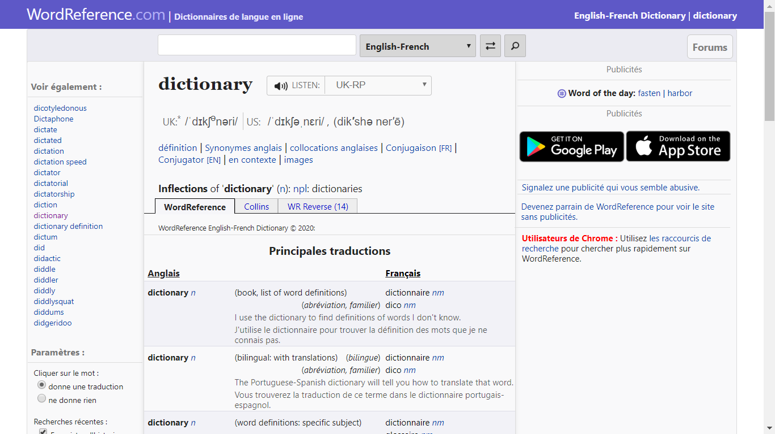
Online dictionary
These days, you don’t have to use a paper dictionary: online dictionaries are available. A good one for French is WordReference
It looks like this:
You type the word you want to look up here (make sure it is in the right language!).
You swap between the
English to French and French to English sections here.
Notes:
Timing: 1 minute approx.
Having practised two of the skills required for paper dictionary use, the students are now introduced to our choice of online dictionary for French. It is recommended that they bookmark this on their own devices.

Slide 18
Challenge 4
As well as finding the word, we also need to know what type of word it is, in the context in which we need to use it. Match the words on the left below with their type (in orange)on the right.
Sometimes, the same word can be both a noun and a verb – E.g., the English word ‘lead’ - something you use to walk the dog, and something you do when others follow you!
noir
adjective
article (determiner)
cœur
pour
adverb
verb
le
je
pronoun
preposition
bientôt
frapper
conjunction
noun
si
Notes:
Timing: 2 minutes approx.
This slide prompts learners to consider the part of speech of a word, an essential part of wider word knowledge, which informs the correct grammatical usage of that word. The activity challenges students to match some English words with their part of speech.
Explain to students that some words can be both a noun or a verb – as in the animated example of ‘lead’ – which has implications when searching for the correct translation of a given word in a particular context!
The answers are animated on the next slide; this slide should be displayed whilst students attempt the task.

Slide 19
Challenge 4 - answers
cœur
noun
noir
adjective
frapper
verb
bientôt
adverb
le
article (determiner)
je
pronoun
pour
preposition
si
conjunction
Types of word are called ‘parts of speech’.
Notes:
The answers to the activity on the previous slide are animated on this one. The term ‘parts of speech’ is explained.

Slide 20
Challenge 5
Dictionaries give the type of word (part of speech) using abbreviations (often in italics and sometimes in a different colour) after the word itself.
Find the abbreviations used in WordReference for each part of speech.
nm or nf
noun
adj
adjective
vtr or vi
verb
adv
adverb
def art or indef art
article (determiner)
pron
pronoun
prep
preposition
conj
conjunction
Similar abbreviations are used in paper dictionaries too.
Notes:
Timing: 2 minutes approx.
Students are now challenged to find the abbreviations used on the recommended French dictionary site for the parts of speech listed; the answers are animated. A similar exercise could be done with any paper bilingual dictionaries in use.

Slide 21
Écoute !
écouter
[Verse 1 text here]
[Verse 2 text here]
Notes:
Please note: teachers to insert the full text of verses 1 and 2 of the poem in the text box.
Timing: 2 minutes approx.
Suggested teaching steps:
1. Teacher reads each line slowly, perhaps with gestures to support meaning. Each line is animated separately so that the teacher can time his/her reading to coincide with the appearance of the text. This supports attention and reduces the risk of cognitive overload. 2. Leave the text visible and listen/watch the video version.
This slide links to a reading of the poem on YouTube. The video is not embedded – teachers will need to be online to access this version of the poem. Play up to where the boy stops speaking – these are the first two verses. Stop video at 39 seconds.
https://www.youtube.com/watch?v=PYTqsC2L2VI Version with two children who do actions to support meaning – really nice reading.

Slide 22
Comment est le garçon qui parle ?
Il est….
calme
content
amusant
intéressant
sympa
Notes:
Timing: 1 minute approx.
The next lesson will give more opportunities for students to express their views on readings of the poem but it is a useful moment to elicit their reaction to the boy’s tone of voice/way he presents. These adjectives have been encountered previously.

Slide 23
Parle avec un(e) partenaire
1) Ce texte est ...
un article?
un poème?
une histoire?
2) Pourquoi ? Parce qu’il y a…
des répétitions
des rimes
des rythmes
Notes:
Timing: 1 minute approx.
Bring up the first question and options. Give students just a few seconds to confer in pairs and share their consensus. Then bring up question two. You may need to return to the text on slide 3. Students should conclude that there are repetitions and rhythms but no rhymes (they might suggest that Afrique and Amérique rhyme, but should certainly agree that whilst it’s a poem, it’s not a rhyming poem!).
The responses contain words which have not been learned previously, but are near-cognates which should be easy to work out from the context (frequency given below).
Word frequency rankings (1 is the most common word in French):
article [604], répétition [2804], rhythme [>5000], rime [>5000]
Source: Londsale, D., & Le Bras, Y. (2009). A Frequency Dictionary of French: Core vocabulary for learners London: Routledge.

Slide 24
L’homme qui te ressemble
Challenge 6
[Verse 1 text here]
[Verse 2 text here]
feu
repousser
ouvre
moi
Look up the orange words in a dictionary (or using WordReference) and list their English meaning and part of speech.
The dictionary has different possible meanings of a word, with examples. The third meaning listed for repousser in WordReference is the right one for the context of the poem!
feu nm fire
repousser vtr reject
ouvrir vtr open (up)
moi pron me
Notes:
Please note: teachers to insert the full text of verses 1 and 2 of the poem in the text box, highlighting the four words in orange in the text.
Timing: 2 minutes approx.
Many of the words in this text have been previously introduced and learnt (this was one factor in the choice of this text for this point in the scheme of work); others are introduced as part of the new vocabulary set for this week. However, a third group of words does not fall into either of the above categories. Four words are thus highlighted for students to look up, practising the skills introduced earlier in this sequence. It is pointed out that the dictionary user has to work his/her way down the examples of usage provided, in order to find the correct translation of a word for the context; in this case, the third meaning given in WordReference for repousser is the correct one.
N.B. The possessive forms mon and ton are not dealt with as a grammar point at this stage; we are only aiming for students to understand their meaning here. Possessive adjectives form part of the scheme of work grammar for Year 8 in the NCELP French scheme of work.

Slide 25
Vocabulaire
lire
blanc, blanche
avoir
ouvre
demander
suis
le cœur
Type of word:
frapper
noir
adjective
conjunction
noun
ressembler
verb
preposition
si
le temps
Coche les 2 mots qui sont aussi ce type de mot.
pour
Notes:
Timing: 5 minutes approx.
This vocabulary activity has several purposes:
Extending the dictionary skills work on part of speech to L2 vocabulary, priming students for additional dictionary work as necessary while understanding this week’s text
Reactivating knowledge of previously taught vocabulary that features in this week’s text
Checking understanding of the pronunciation and form of the vocabulary introduced this week (the meaning will be reinforced with picture aids in lessons 1 and 2)
The slides is animated so that the students first identify the part of speech of the known vocabulary, and then identify the new words in this category – pronunciation can be checked by eliciting the answers with the class.

Slide 26
Vocabulaire
lire
une porte
un lit
un frère
blanc, blanche
le cœur
la couleur
un homme
le ciel
frapper
Type of word:
noir
adjective
conjunction
noun
ressembler
si
verb
preposition
le temps
Coche les 2 mots qui sont aussi ce type de mot.
pour

Slide 27
Vocabulaire
lire
blanc, blanche
bon
rouge
jaune
le cœur
Type of word:
frapper
noir
adjective
conjunction
noun
ressembler
verb
preposition
si
le temps
Coche les 2 mots qui sont aussi ce type de mot.
pour

Slide 28
Vocabulaire
lire
blanc, blanche
et
mais
le cœur
Type of word:
frapper
adjective
conjunction
noun
noir
ressembler
verb
preposition
si
le temps
Coche le mot qui est aussi ce type de mot.
pour

Slide 29
Vocabulaire
lire
blanc, blanche
à
de
le cœur
Type of word:
frapper
adjective
conjunction
noun
noir
ressembler
verb
preposition
si
le temps
Coche le mot qui est aussi ce type de mot.
pour

Slide 30
Translating the preposition ‘à’
grammaire
The verbs frapper and ressembler are often followed by the preposition à + noun.
The English translation of à is different for each verb:
Je frappe à la porte
I’m knocking at the door
Le frère ressemble à la sœur
The brother looks like the sister
With ressembler, the preposition à is not translated into English.
Notes:
Timing: 1 minute approx.
Vocabulary extension: verbs + preposition à.

Slide 31
Vers 1
lire / parler
[Line 1]
[Line 2]
[Line 3]
[Line 4]
[Line 5]
[Line 6]
Notes:
Please note: teachers to insert the text of verse 1, line by line. Each line is animated with the accompanying audio.
Timing: 5 minutes approx.
Attribution: Please emoji
Twitter [CC BY 4.0 (https://creativecommons.org/licenses/by/4.0)] https://upload.wikimedia.org/wikipedia/commons/f/ff/Twemoji_1f64f.svg
Whole class opportunity to read verse 1 aloud with the teacher. Elicit meanings and clarify any unknown vocabulary that has not yet been understood – dictionary work can be encouraged here. Pay particular attention to the new vocabulary introduced this week – “frapper” and “cœur”.
The perfect tense will not be learnt until year 8, so at this stage the focus should be on meaning rather than form.
Give students another opportunity to read aloud the first verse in pairs, a line each. Encourage them to read expressively, thinking about the meaning.

Slide 32
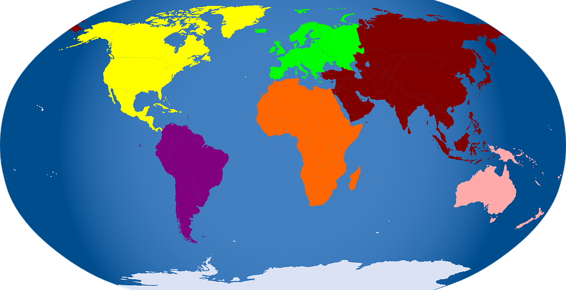
Vers 2
lire / parler
[Line 1]
[Line 2]
[Line 3]
[Line 4]
[Line 5]
[Line 6]
Notes:
Please note: teachers to insert the text of verse 2, line by line. Each line is animated with the accompanying audio.
Timing: 5 minutes approx.
Whole class opportunity to read verse 2 aloud with the teacher. Pay particular attention to the new vocabulary introduced this week – “si”. Attention should also be drawn to “d’” = “de” and that the meaning is “from” – the meaning “of” will be introduced in the next verse in lesson 2.

Slide 33
Biographie en questions
lire / écrire
Only 4 words are needed – there is one extra question word!
Lis les réponses et complète les questions.
1) René Philombé travaille __________ ?
le Cameroun (en Afrique)
2) Il travaille comme __________ ?
journaliste et poète
3) Il écrit des poèmes __________ ?
Il a un message: il est pour la diversité et le respect.
4) Il écrit ce poème __________ ?
1977
quoi
où
quand
comment
pourquoi
Notes:
Timing: 5 minutes approx.
This is an opportunity to find out a little about the poet, and to re-visit question words including ‘pourquoi’, which is introduced this week.
The students match the question word to the question – the answer given provides a clue. ‘Comment’ is included as a distractor to limit the process of elimination approach.
This activity includes previously taught vocabulary and near-cognates (for which the frequency is given below).
Word frequency rankings (1 is the most common word in French):
Afrique [N/A], Cameroun [N/A], diversité [2537], journaliste [1337], message [792], poème [3031], poète [2307], respect [818]
Source: Londsale, D., & Le Bras, Y. (2009). A Frequency Dictionary of French: Core vocabulary for learners London: Routledge.

Slide 34
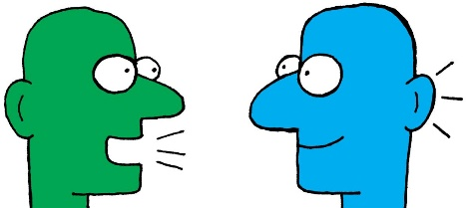
L’homme qui te ressemble
lire / parler
[Verse 1 text here]
[Verse 2 text here]
Notes:
Please note: teachers to insert the full text of verses 1 and 2 of the poem in the text box.
Timing: 5 minutes approx.
Opportunity to revisit the first two verses of the poem. Students can be asked to read them aloud in pairs, taking it in turns to read a line each OR taking a verse each.
They should be encouraged to use tone of voice, variance of tempo/rhythm, and/or gesture to demonstrate their understanding.

Slide 35
L’homme qui te ressemble René Philombé
Y7 French
Term 3.2 - Week 7 – Lesson 72
Rachel Hawkes / Kirsten Somerville / Suzanne Graham
Date updated: 20/09/20
Notes:
Learning outcomes (lesson 2)
Pronouncing the text confidently, deepening understanding of the message of the poem, being creative with the text
Word frequency (1 is the most frequent word in French):
3.2.7 (introduce): frapper (à) [745], ressembler à [1398], cœur [568], temps [65], blanc¹ [708], blanche [708], noir [572], pour² [10], si [34]
3.2.4 (revisit): avion [1409], allemand^{1, 2} [844], lettre [480], différent [350], prochain [380], bientôt [1208], demain [871], Allemagne [n/a]
3.1.3 (revisit): langue1 [712], maths [3438], matière¹ [562], musique [1139], nom¹ [171], science [1114], quel [146], quelle [146], que² [9], combien [800], pourquoi [193], parce que [n/a]
Source: Londsale, D., & Le Bras, Y. (2009). A Frequency Dictionary of French: Core vocabulary for learners London: Routledge.

Slide 36
L’homme qui te ressemble
écouter
1 | 2 | 3 | 4 | 5
1
c
e
d
a
b
Écoute. Écris l’ordre correct.
a | [Verse 4 text here]
b | [Verse 5 text here]
c | [Verse 1 text here]
e | [Verse 2 text here]
d | [Verse 3 text here]
Notes:
Please note: teachers to insert the full text of each verse in the appropriate cell.
Timing: 2 minutes approx.
This is the first time students hear/read the full text of the poem. They are now already familiar with two of the verses.
Here they listen to the whole text and put the verses in order.
A woman reads the poem fairly quickly, and without much emotion. Version 1: https://www.youtube.com/watch?v=vEessHNHzPQ

Slide 37
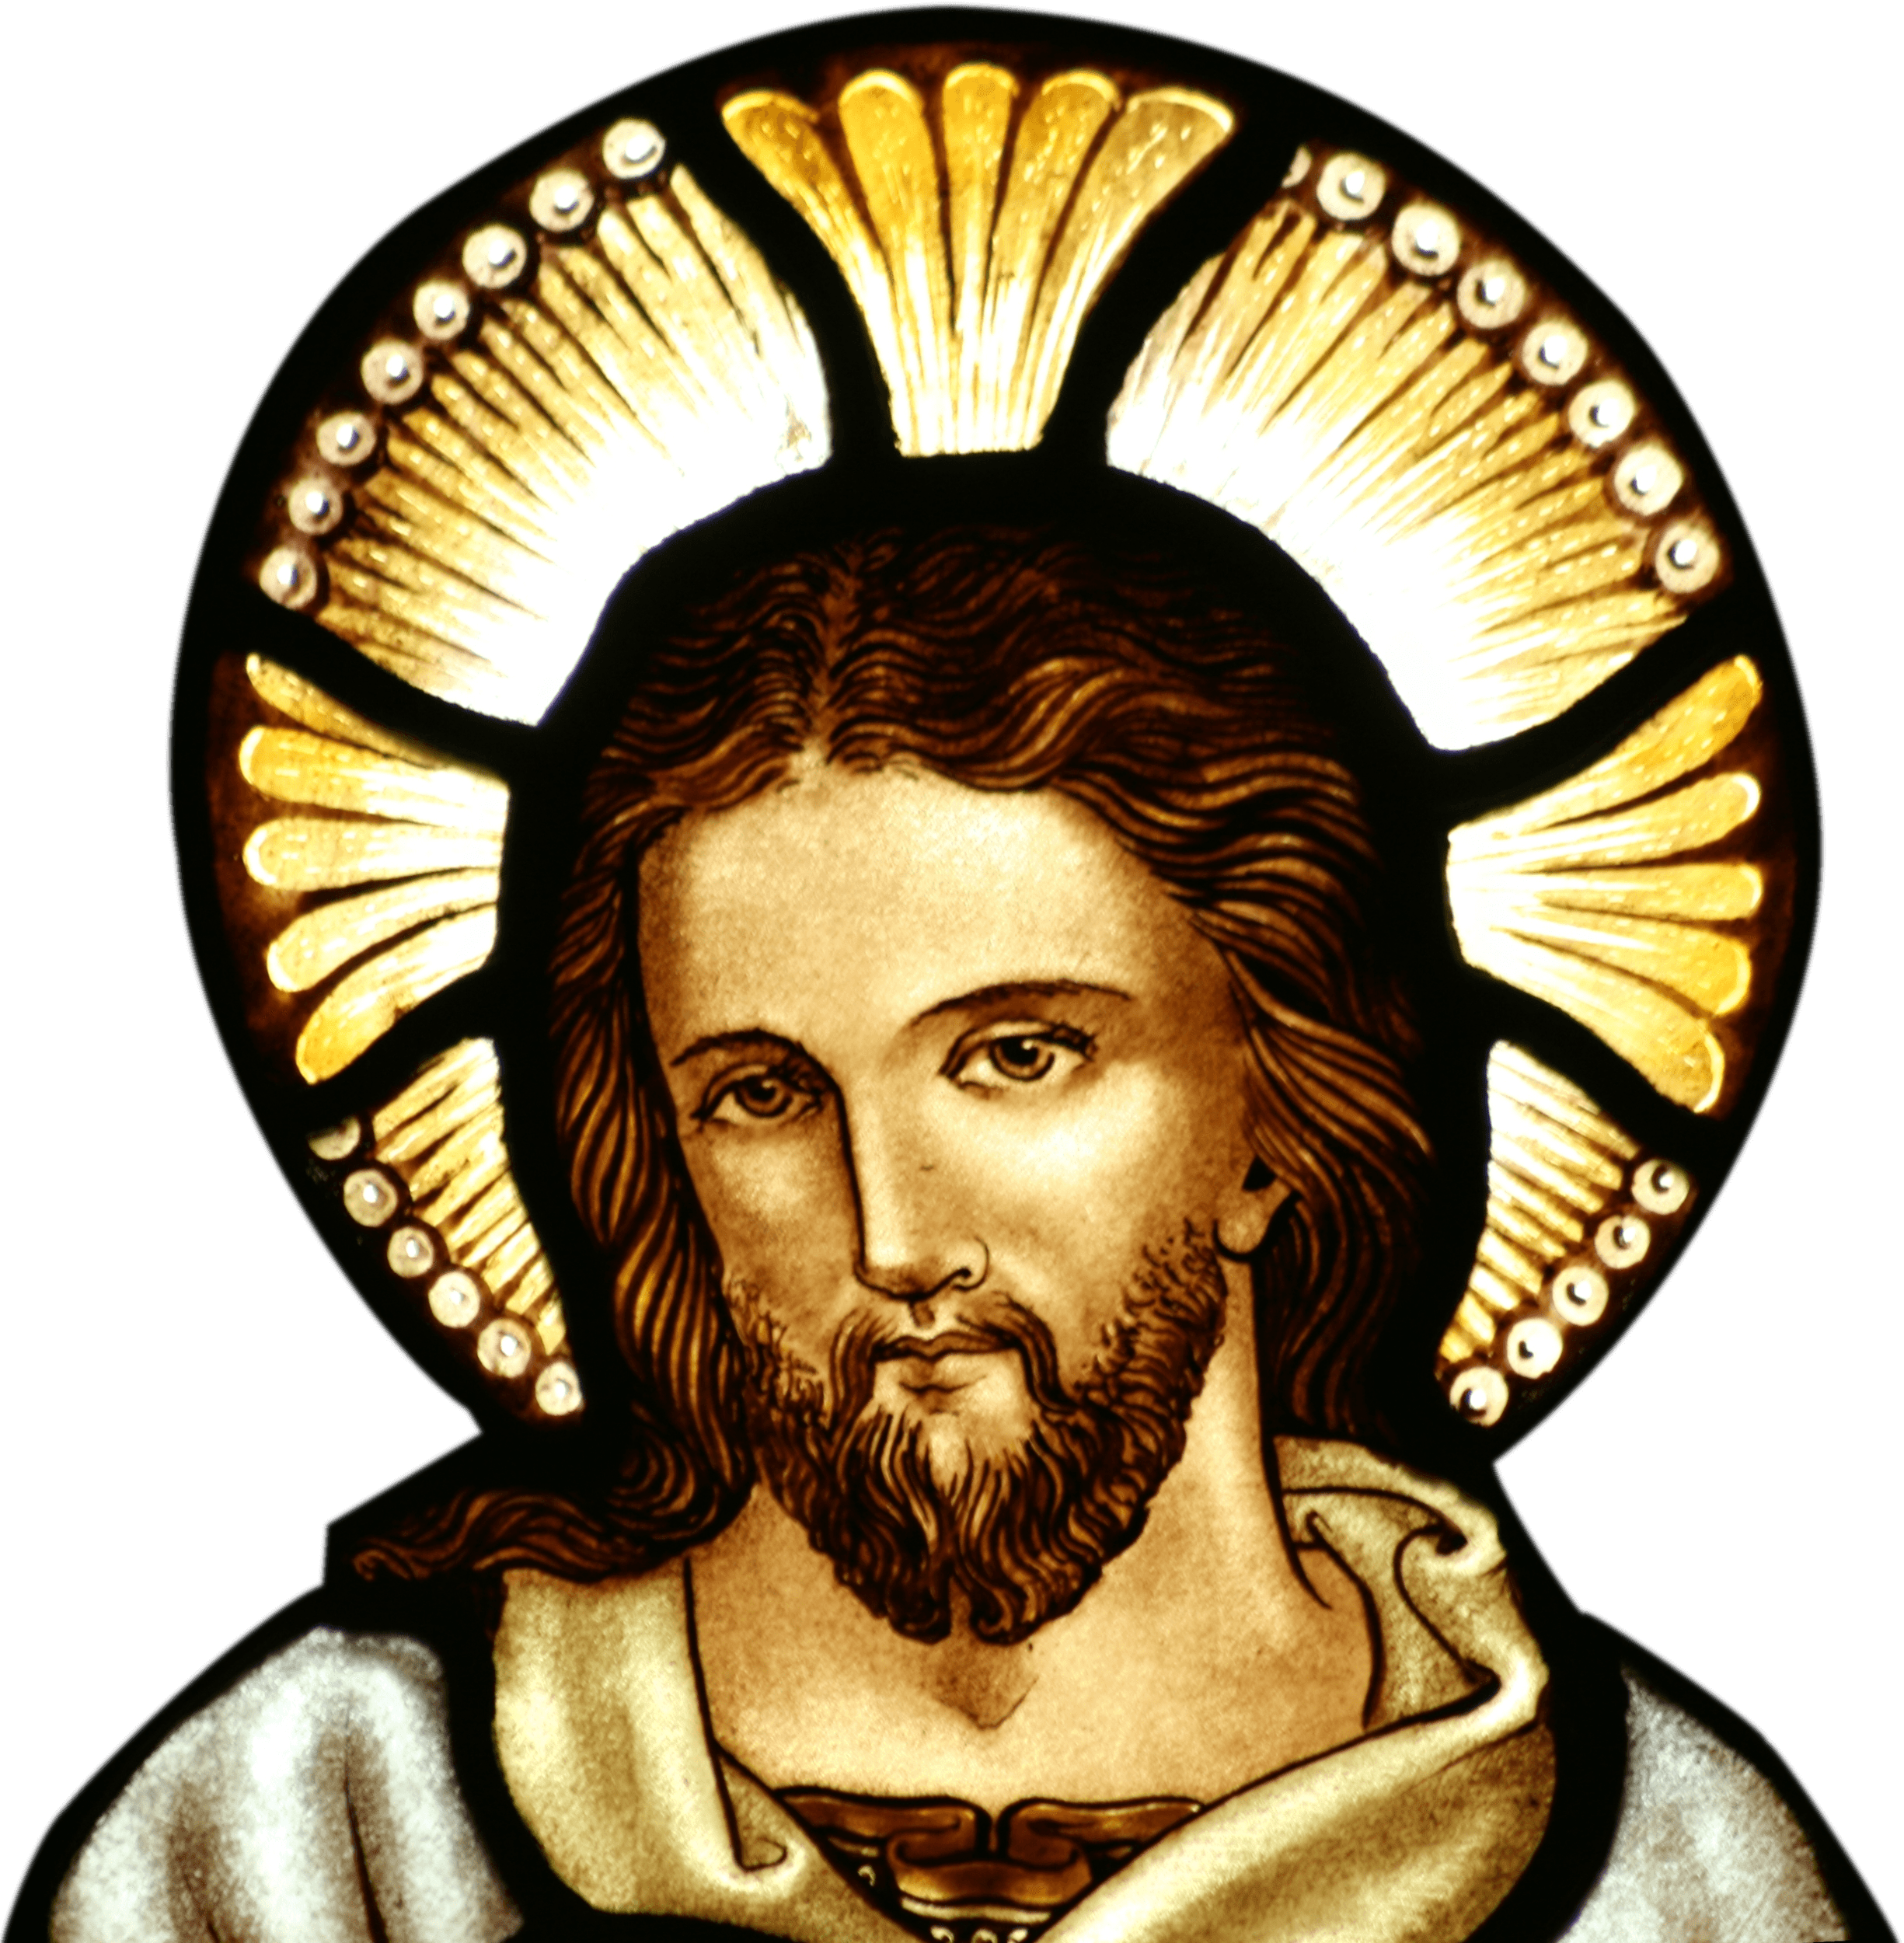
Vers 3
lire / parler
[Line 1]
[Line 2]
[Line 3]
[Line 4]
[Line 5]
[Line 6]
Notes:
Please note: teachers to insert the text of verse 3, line by line. Each line is animated with the accompanying audio.
Timing: 5 minutes approx.
Whole class opportunity to read verse 3 aloud with the teacher.
Elicit meanings and clarify any unknown vocabulary that has not yet been understood – again, encouraging dictionary use where appropriate. Give students another opportunity to read aloud the verse in pairs, a line each. Encourage them to read expressively, thinking about the meaning.

Slide 38
Vers 4
lire / parler
[Line 1]
[Line 2]
[Line 3]
[Line 4]
[Line 5]
[Line 6]
Notes:
Please note: teachers to insert the text of verse 4, line by line. Each line is animated with the accompanying audio.
Timing: 5 minutes approx.

Slide 39
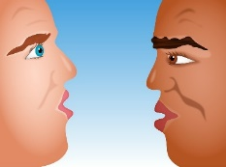
Vers 5
lire / parler
[Line 1]
[Line 2]
[Line 3]
[Line 4]
[Line 5]
[Line 6]
Notes:
Please note: teachers to insert the text of verse 5, line by line. Each line is animated with the accompanying audio.
Timing: 5 minutes approx.
Many words are repeated from earlier in the poem in different combinations in the final verse.
Pay particular attention to the vocabulary introduced this week – “temps” and “ressembler”.

Slide 40
Écris la réponse correcte
lire
René Philombé est un poète jeune / un poète français / un poète moderne.
Le poète est d’Amérique / d’Afrique/ d’Asie.
Le poète est un parent / un homme / un blanc.
Il parle à « mon frère » - le frère est un homme / un enfant / chaque homme.
Lis les messages. Écris l’ordre correct:
Chaque homme ressemble à chaque homme.
L’apparence physique n’est pas importante.
La couleur n’est pas importante.
Repousser les personnes est méchant.
L’origine géographique n’est pas importante.
Vers | Message
1
2
3
4
5
d
e
b
c
a
Notes:
Timing: 3 minutes approx.
This slide is animated to give students questions 1-4 to do independently, followed by whole class correction. Question 5 appears separately. It is anticipated that students will need to return to read the text again for question 6. Note: The lessons have been designed so that the only copying required will be one A4/5 copy of the poem text.
This activity mainly includes vocabulary that has been previously taught or encountered in this week’s activities, and some additional near-cognates (for which the frequency is given below).
Word frequency rankings (1 is the most common word in French):
apparence [2714], message [792], ordre [197], origine [709], géographique [3389], physique [1146]
Source: Londsale, D., & Le Bras, Y. (2009). A Frequency Dictionary of French: Core vocabulary for learners London: Routledge.

Slide 41
Quelle version aimes-tu ?
écouter / écrire
1
2
3
Écoute les trois versions différentes. Écris des phrases.
Version 1, c’est…
Version 2, c’est…
Version 3, c’est…
un homme
une femme
un enfant
amusant
calme
content
rapide
intelligent
intéressant
sympa
moderne
J’aime Version…
1
2
3
Remember!
Some adjectives are spelt differently if the noun is masculine or feminine.
Notes:
Timing: 5 minutes approx.
This slide allows the students to express their opinions on different versions of the poem, as well as practising adjectival agreement. The adjectives have all been learnt previously.
There are three versions to listen to/choose from: 1. A woman reads the poem fairly quickly, and without much emotion. This is the version students already heard from slide 41. Version 1: https://www.youtube.com/watch?v=vEessHNHzPQ 2. This version is the children’s version from lesson 1, but in its entirety. Version 2: https://www.youtube.com/watch?v=PYTqsC2L2VI 3. A man reads this version, with some music/percussion in the background, and with feeling. Version 3: https://www.youtube.com/watch?v=dNbSNWaPUGc

Slide 42
Télépathie!
lire / parler
Pourquoi me demander
Si je suis
Ouvre-moi, mon frère.
Je ne suis pas
Ouvre-moi, mon frère !...
Je ne suis qu'un homme
L'homme de
L'homme qui te ressemble !...
d’Afrique
d’Asie
d’Europe
ta porte
ton hôtel
ta chambre
4
1
J'ai frappé à
J'ai frappé à ton cœur
Pourquoi
Ouvre-moi,
un ennemi
un problème
un animal
5
m’ignorer ?
me repousser ?
me dire non ?
2
tous les temps
toutes les villes
tous les jours
ma sœur !...
mon ami !...
mon frère !...
6
3
Notes:
Timing: 10 minutes approx
In this slide, the students choose their own variation of the poem and practice reading it aloud with a partner.
Suggested classroom procedure:
1. Both students choose their optional versions and note them down (this is only for the purpose of avoiding any accusations of cheating, later) – Noting down the answers simply involves numbering 1 – 6 and next to each number putting one, two or three dots. 2. Partner A starts – s/he says “J’ai frappé a XXX”, choosing whichever noun s/he believes her partner has chosen. If s/he is correct, Partner B will nod to indicate s/he can continue to the next line. 3. As soon as Partner A gets an option wrong, Partner B gets a turn and in the same way, tries to predict his/her partner’s answers. 4. Every time a student goes wrong, you must go back to the beginning. 5. The task ends when the first student gets through the whole text correctly predicting all their partner’s answers in one turn.
This task has several purposes: 1. It practises reading aloud / pronunciation and decoding (there are some unknown near-cognates). 2. It works memory. To “win” students have to keep returning to the beginning every time they select a wrong option (i.e. an option that their partner has not secretly chosen). The aim is to be the first to read the whole text, correctly selecting your partner’s options. Whilst it is a game of chance to a degree, if you are not concentrating and remembering the options you have already correctly discovered, you give away the opportunity for your partner to have another go. Each time you go wrong, play passes to your partner. 3. It models some variations on the original poem, which prepares students for their own creation task, which is the next task, so acts as additional preparation for this.
This activity mainly includes vocabulary that has been previously taught or encountered in this week’s activities, and some additional near-cognates (for which the frequency is given below).
Word frequency rankings (1 is the most common word in French):
ignorer [639], ennemi [1715]
Source: Londsale, D., & Le Bras, Y. (2009). A Frequency Dictionary of French: Core vocabulary for learners London: Routledge.

Slide 43
À ton tour !
Écris un poème similaire :
ou
Présente le poème original. Fais une présentation :
mémorisée
dramatique/créative
avec un partenaire ou en groupe
J'ai frappé à …
J'ai frappé à…
Pourquoi me… ?
Ouvre-moi, … !... Pourquoi me demander Si je suis… ?(x 2-4) Je ne suis pas (x 2-4) Je suis… … de tous/toutes les… … qui te ressemble !...
Notes:
Timing: 10 minutes approx.
The idea is to offer some choice of task. Not all students enjoy writing their own poetry. Both options here involve engagement with the meaning of the language and spoken production.
TL instructions appears gradually, teacher elicits meaning bit by bit from students, to ensure that meaning is clear.

Slide 44
Vocabulaire
écrire
q
q
u
e
l
[which (m)]
Notes:
Timing: 5 mins approx.
This closing activity practises the vocabulary from this week’s revisited sets using English word and picture clues. Completing the French words spells out the message « et bonnes vacances » on the final slide.
This can be done as a quick-fire writing activity using mini whiteboards, where students race to be the first to write each word in French. If time is short, students could simply call out the French word. The word is revealed on a click.
Frequency rankings of vocabulary revisited this week (1 is the most common word in French):
3.2.4 - avion [1409], lettre [480], Italie [n/a], l'allemand [844], différent [350], prochain [380], bientôt [1208], demain [871]
3.1.3 - langue [712], maths [3438], matière [562], musique [1139], science [1114], quel [146], combien [800], que [9]
Source: Londsale, D., & Le Bras, Y. (2009). A Frequency Dictionary of French: Core vocabulary for learners London: Routledge.

Slide 45
Vocabulaire
écrire
 | m
q
u
e
l
m
a
t
i
è
r
e

Slide 46
Vocabulaire
écrire
 |  |  | b
q
u
e
l
m
a
t
i
è
r
e
[soon]
b
i
e
n
t
ô
t

Slide 47
Vocabulaire
écrire
 |  |  |  | p
q
u
e
l
m
a
t
i
è
r
e
p
r
o
c
h
a
i
n
[next]
b
i
e
n
t
ô
t

Slide 48
Vocabulaire
écrire
 |  |  |  |  | a
a
l
l
e
m
a
n
d
q
u
e
l
m
a
t
i
è
r
e
p
r
o
c
h
a
i
n
[German]
b
i
e
n
t
ô
t

Slide 49
Vocabulaire
écrire
 |  |  |  |  |  | l
a
l
l
e
m
a
n
d
q
u
e
l
m
a
t
i
è
r
e
p
r
o
c
h
a
i
n
l
a
n
g
u
e
b
i
e
n
t
ô
t

Slide 50
Vocabulaire
écrire
 |  |  |  |  |  |  | q
a
l
l
e
m
a
n
d
q
u
e
l
m
a
t
i
è
r
e
p
r
o
c
h
a
i
n
l
a
n
g
u
e
q
u
e
[what]
b
i
e
n
t
ô
t

Slide 51
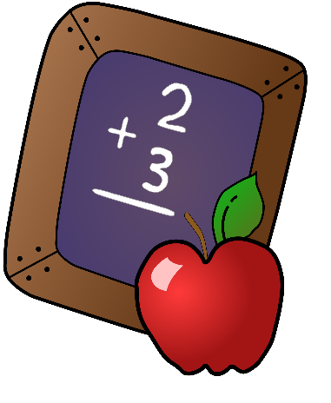
Vocabulaire
écrire
 |  |  |  |  |  |  |  | m
a
l
l
e
m
a
n
d
m
a
t
h
s
q
u
e
l
m
a
t
i
è
r
e
p
r
o
c
h
a
i
n
l
a
n
g
u
e
q
u
e
b
i
e
n
t
ô
t

Slide 52
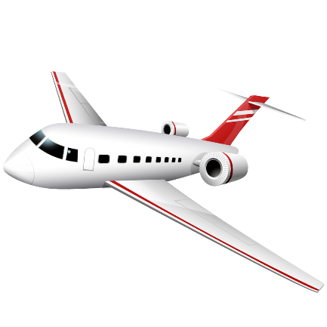
Vocabulaire
écrire
 |  |  |  |  |  |  |  |  |  | a
a
l
l
e
m
a
n
d
m
a
t
h
s
q
u
e
l
m
a
t
i
è
r
e
p
r
o
c
h
a
i
n
l
a
n
g
u
e
q
u
e
a
v
i
o
n
b
i
e
n
t
ô
t

Slide 53
Vocabulaire
écrire
 |  |  |  |  |  |  |  |  |  |  | d
a
l
l
e
m
a
n
d
m
a
t
h
s
d
e
m
a
i
n
q
u
e
l
m
a
t
i
è
r
e
p
r
o
c
h
a
i
n
l
a
n
g
u
e
q
u
e
a
v
i
o
n
[tomorrow]
b
i
e
n
t
ô
t

Slide 54
Vocabulaire
écrire
 |  |  |  |  |  |  |  |  |  |  |  | c
a
l
l
e
m
a
n
d
m
a
t
h
s
d
e
m
a
i
n
[how much
/
how many]
q
u
e
l
m
a
t
i
è
r
e
p
r
o
c
h
a
i
n
l
a
n
g
u
e
q
u
e
a
v
i
o
n
b
i
e
n
t
ô
t
c
o
m
b
i
e
n

Slide 55
Vocabulaire
écrire
 |  |  |  |  |  |  |  |  |  |  |  |  | A
a
l
l
e
m
a
n
d
A
l
l
e
m
a
g
n
e
m
a
t
h
s
d
e
m
a
i
n
q
u
e
l
m
a
t
i
è
r
e
p
r
o
c
h
a
i
n
l
a
n
g
u
e
q
u
e
a
v
i
o
n
[Germany]
b
i
e
n
t
ô
t
c
o
m
b
i
e
n

Slide 56
Vocabulaire
écrire
 |  |  |  |  |  |  |  |  |  |  |  |  |  | n
 |  |  |  |  |  |  |  |  |  |  |  |  |  | o
 |  |  |  |  |  |  |  |  |  |  |  |  |  | m
a
l
l
e
m
a
n
d
A
l
l
e
m
a
g
n
e
m
a
t
h
s
d
e
m
a
i
n
q
u
e
l
m
a
t
i
è
r
e
p
r
o
c
h
a
i
n
l
a
n
g
u
e
q
u
e
a
v
i
o
n
[name]
b
i
e
n
t
ô
t
c
o
m
b
i
e
n

Slide 57
Vocabulaire
écrire
 |  |  |  |  |  |  |  |  |  |  |  |  |  |  | s
 |  |  |  |  |  |  |  |  |  |  |  |  |  | n
 |  |  |  |  |  |  |  |  |  |  |  |  |  | o
 |  |  |  |  |  |  |  |  |  |  |  |  |  | m
a
l
l
e
m
a
n
d
A
l
l
e
m
a
g
n
e
m
a
t
h
s
d
e
m
a
i
n
q
u
e
l
m
a
t
i
è
r
e
p
r
o
c
h
a
i
n
l
a
n
g
u
e
q
u
e
a
v
i
o
n
s
c
i
e
n
c
e
b
i
e
n
t
ô
t
c
o
m
b
i
e
n

Slide 58
Vocabulaire
écrire
 |  |  |  |  |  |  |  |  |  |  |  |  |  |  |  | l
 |  |  |  |  |  |  |  |  |  |  |  |  |  | n
 |  |  |  |  |  |  |  |  |  |  |  |  |  | o
 |  |  |  |  |  |  |  |  |  |  |  |  |  | m
a
l
l
e
m
a
n
d
A
l
l
e
m
a
g
n
e
m
a
t
h
s
d
e
m
a
i
n
q
u
e
l
m
a
t
i
è
r
e
p
r
o
c
h
a
i
n
l
a
n
g
u
e
q
u
e
a
v
i
o
n
s
c
i
e
n
c
e
l
e
t
t
r
e
[letter]
b
i
e
n
t
ô
t
c
o
m
b
i
e
n

Slide 59
Vocabulaire
écrire
 |  |  |  |  |  |  |  |  |  |  |  |  |  |  |  |  | m
 |  |  |  |  |  |  |  |  |  |  |  |  |  | n
 |  |  |  |  |  |  |  |  |  |  |  |  |  | o
 |  |  |  |  |  |  |  |  |  |  |  |  |  | m
a
l
l
e
m
a
n
d
A
l
l
e
m
a
g
n
e
m
a
t
h
s
d
e
m
a
i
n
q
u
e
l
m
a
t
i
è
r
e
p
r
o
c
h
a
i
n
l
a
n
g
u
e
q
u
e
m
u
s
i
q
u
e
a
v
i
o
n
s
c
i
e
n
c
e
l
e
t
t
r
e
b
i
e
n
t
ô
t
c
o
m
b
i
e
n

Slide 60
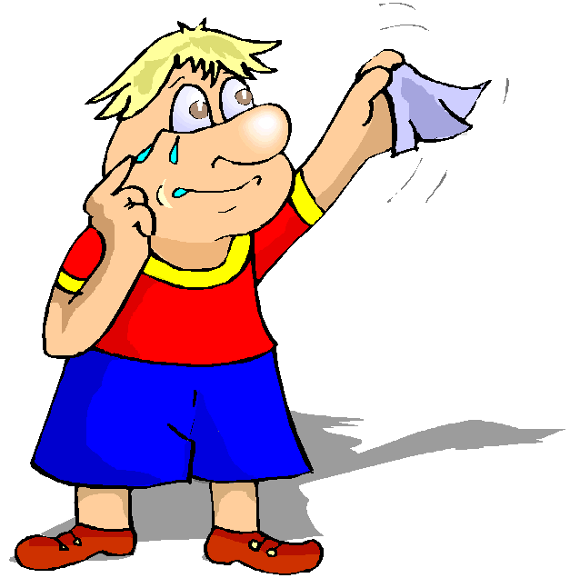
Au revoir …
 |  |  |  |  | a
 |  |  |  |  | l |  |  |  |  |  |  |  | A
 |  |  |  |  | l |  |  | m |  |  |  |  | l
 |  |  |  |  | e |  |  | a |  |  | d |  | l
q | m |  |  | p | m | l | q | t |  |  | e |  | e |  |  |  | m
u | a |  |  | r | a | a | u | h |  | a | m |  | m |  | s | l | u
e | t |  | b | o | n | n | e | s |  | v | a | c | a | n | c | e | s
l | i |  | i | c | d | g |  |  |  | i | i | o | g | o | i | t | i
 | è |  | e | h |  | u |  |  |  | o | n | m | n | m | e | t | q
 | r |  | n | a |  | e |  |  |  | n |  | b | e |  | n | r | u
 | e |  | t | i |  |  |  |  |  |  |  | i |  |  | c | e | e
 |  |  | ô | n |  |  |  |  |  |  |  | e |  |  | e
 |  |  | t |  |  |  |  |  |  |  |  | n
… à l’année prochaine !

Slide 61
Gaming Grammar
Gaming Grammar
Relevant mini game(s):
Prepositions (to the): Gender (Prepositions)
Notes:
This slide links to Gaming Grammar login screen. The appropriate mission can then be selected from the menu page.
Students will progress through the game at their own rate; teachers should use the teacher interface to check progress. This will help to inform future lesson planning.

