Slide 1
Phonics: revisiting SSCs [ca], [co], [cu]
Y7 Spanish
Term 2.2 - Week 3
Author name(s): Amanda Izquierdo / Nick Avery / Rachel Hawkes
Date updated: 19/04/2020
Notes:
Learning aims for Term 2.2 Week 3:
Revisited SSCs : [ca]/[co]/[cu] 'hard C'
New grammar: DEBER - debo, debes, debe (+ infinitive)
Revisited grammar: modal verbs: PODER - puedo, puedes, puede QUERER - quiero, quieres, quiere (+ infinitive) modal verbs in negative statements; prototype -ar verbs
Vocabulary to be introduced:
lunes [1370]; martes [3101]; miércoles [1816]; jueves [1650]; viernes [1259]; sábado [1179]; domingo [693] (pre-learnt)
deber [71]; debo; debes; debe; organizar [1053]; lavar [1676] sacar [273]; limpiar [1713]; suelo [552]; basura [2479]; ropa [782]; aunque [131]; otro [35].
Vocabulary re-visited as part of last week’s homework is included below for reference, in case you wish to briefly revisit it in class. Where possible, vocabulary items from these and other previous weeks have also been integrated into the activities.
2.1, week 5: trabajar [174]; buscar [179]; descansar [1749]; preparar [570]; comida [906]; animal [322]; pasar [68]; tiempo [80]; campo [342]; junto[s] [149]; solo [181]
1.2, week 7: dar [42]; doy; das; da; querer [58]; quiero; quieres; quiere; regalo [1986]; padre [162]; madre [226]; hermano [333]; hermana [3409]; dinero [364]; a [8]
Source of frequency rankings: Davies, M. & Davies, K. (2018). A frequency dictionary of Spanish: Core vocabulary for learners (2nd ed.). London: Routledge.

Slide 2
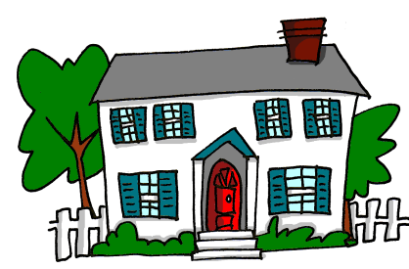
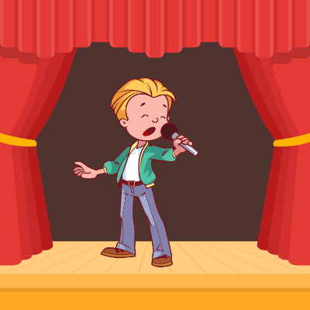
ca
campo
cara
cambiar
casa
cantar
calle
£
$
[street]
Nick Avery
Notes:
Introduce and elicit the pronunciation of the individual SSC ‘ca’ and then the source word again (with gesture, if using). Then present and elicit the pronunciation of the five cluster words.
The cluster words have been chosen for their high-frequency, from a range of word classes, with the SSC (where possible) positioned within a variety of syllables within the words (e.g. initial, 2nd, final etc.). Additionally, we have tried to use words that build cumulatively on previously taught SSCs (see the Phonics Teaching Sequence document) and do not include new SSCs. Where new SSCs are used, they are often consonants which have a similar symbol-sound correspondence in English.

Slide 3
ca
campo
cara
cambiar
casa
cantar
calle
Nick Avery
Notes:
Without the images, students focus this time again closely on the SSC and the cluster words.

Slide 4
ca
campo
cara
cambiar
casa
cantar
calle
Nick Avery
Notes:
Without the images or sound, students have to pronounce the words themselves.

Slide 5
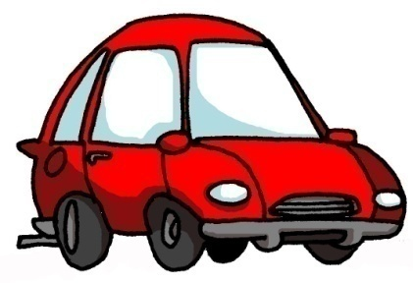
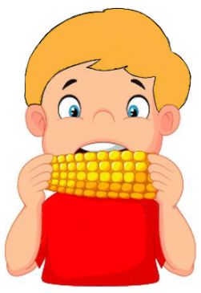
co
costa
coche
blanco
comer
con
Con ketchup
¿cómo?
[how…?]
Nick Avery
Notes:
Introduce and elicit the pronunciation of the individual SSC ‘co’ and then the source word again (with gesture, if using). Then present and elicit the pronunciation of the five cluster words.
The cluster words have been chosen for their high-frequency, from a range of word classes, with the SSC (where possible) positioned within a variety of syllables within the words (e.g. initial, 2nd, final etc.). Additionally, we have tried to use words that build cumulatively on previously taught SSCs (see the Phonics Teaching Sequence document) and do not include new SSCs. Where new SSCs are used, they are often consonants which have a similar symbol-sound correspondence in English.
Teachers whose students have been also been taught French may wish to use the word ‘coche’ to also highlight the difference between the ‘ch’ in Spanish, and the softer ‘ch’ in French (as in ‘chat’)

Slide 6
co
costa
coche
blanco
comer
con
¿cómo?
Nick Avery
Notes:
Without the images, students focus this time again closely on the SSC and the cluster words.

Slide 7
co
costa
coche
blanco
comer
con
¿cómo?
Nick Avery
Notes:
Without the images or sound, students have to pronounce the words themselves.

Slide 8
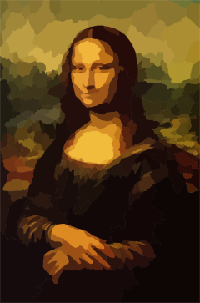
cu
cultura
cuatro
cuerpo
escuchar
cuadro
escuela
Nick Avery
Notes:
Introduce and elicit the pronunciation of the individual SSC ‘cu’ and then the source word again (with gesture, if using). Then present and elicit the pronunciation of the five cluster words.
The cluster words have been chosen for their high-frequency, from a range of word classes, with the SSC (where possible) positioned within a variety of syllables within the words (e.g. initial, 2nd, final etc.). Additionally, we have tried to use words that build cumulatively on previously taught SSCs (see the Phonics Teaching Sequence document) and do not include new SSCs. Where new SSCs are used, they are often consonants which have a similar symbol-sound correspondence in English.

Slide 9
cu
cultura
cuatro
cuerpo
escuchar
cuadro
escuela
Nick Avery
Notes:
Without the images, students focus this time again closely on the SSC and the cluster words.

Slide 10
cu
cultura
cuatro
cuerpo
escuchar
cuadro
escuela
Nick Avery
Notes:
Without the images or sound, students have to pronounce the words themselves.

Slide 11
escuchar / escribir
Escucha.
Marca ‘CA’, ‘CO’ o ‘CU’.
Escucha otra vez.
Escribe la palabra.
 | CA | CO | CU
¿Cómo se dice en inglés?
1
comida
food
2
película
film
3
cantar
to sing, singing
4
artístico
artistic
5
campo
countryside
6
periódico
newspaper
7
escuchar
to listen, listening
8
correcto
correct
9
cultura
culture
10
descansar
to rest, resting
Notes:
These are all words that students have already learnt in previous lessons. Therefore, students will not only be revisiting the SSCs [ca]/[co]/[cu], but also recalling previously taught vocabulary.

Slide 12
¿Qué escuchas? ¿[CA], [CO] o [CU]?
escuchar
CO
1
Doy libros a un compañero.
I give books to a classmate.
Notes:
Sentence-level phonics practice (whole class activity). Students first listen and decide if they hear ‘ca’, ‘co’ or ‘cu’. They are then shown the sentence and its translation. On the next slide, the same sentence appears with target SSCs missing. Students have to read the sentence aloud in chorus, recalling the missing SSCs as they read aloud.
A number of words from this week’s revisited vocabulary sets are included in these sentences.

Slide 13
leer / hablar
co
Doy libros a un ___mpañero.
1
Notes:
Students read the sentence aloud in chorus, recalling the missing SSCs as they read aloud. The audio can be played again, for reinforcement of the pronunciation.

Slide 14
¿Qué escuchas? ¿[CA], [CO] o [CU]?
escuchar
2
CO
La madre quiere un coche blanco.
The mother wants a white car.
Notes:
Sentence-level phonics practice (whole class activity). Students first listen and decide if they hear ‘ca’, ‘co’ or ‘cu’. They are then shown the sentence and its translation. On the next slide, the same sentence appears with target SSCs missing. Students have to read the sentence aloud in chorus, recalling the missing SSCs as they read aloud.
A number of words from this week’s revisited vocabulary sets are included in these sentences.

Slide 15
leer / hablar
co
La madre quiere un ___che blan___.
co
2
Notes:
Students read the sentence aloud in chorus, recalling the missing SSCs as they read aloud. The audio can be played again, for reinforcement of the pronunciation.

Slide 16
¿Qué escuchas? ¿[CA], [CO] o [CU]?
3
CO y CA
La hermana pasa tiempo con un amigo en la calle.
The sister spends time with a male friend in the street.
Notes:
Sentence-level phonics practice (whole class activity). Students first listen and decide if they hear ‘ca’, ‘co’ or ‘cu’. They are then shown the sentence and its translation. On the next slide, the same sentence appears with target SSCs missing. Students have to read the sentence aloud in chorus, recalling the missing SSCs as they read aloud.
A number of words from this week’s revisited vocabulary sets are included in these sentences.

Slide 17
leer / hablar
La hermana pasa tiempo ___n un amigo en la ___lle.
co
3
ca
Notes:
Students read the sentence aloud in chorus, recalling the missing SSCs as they read aloud. The audio can be played again, for reinforcement of the pronunciation.

Slide 18
¿Qué escuchas? ¿[CA], [CO] o [CU]?
CA y CO
4
Cantar solo puede ser complicado.
Singing alone can be complicated.
Notes:
Sentence-level phonics practice (whole class activity). Students first listen and decide if they hear ‘ca’, ‘co’ or ‘cu’. They are then shown the sentence and its translation. On the next slide, the same sentence appears with target SSCs missing. Students have to read the sentence aloud in chorus, recalling the missing SSCs as they read aloud.
A number of words from this week’s revisited vocabulary sets are included in these sentences.

Slide 19
leer / hablar
co
___ntar solo puede ser ___mplicado.
Ca
4
Notes:
Students read the sentence aloud in chorus, recalling the missing SSCs as they read aloud. The audio can be played again, for reinforcement of the pronunciation.

Slide 20
¿Qué escuchas? ¿[CA], [CO] o [CU]?
CA y CU
5
Caminamos juntos a la escuela. Es la cultura aquí.
We walk together to school. It’s the culture here.
Notes:
Sentence-level phonics practice (whole class activity). Students first listen and decide if they hear ‘ca’, ‘co’ or ‘cu’. They are then shown the sentence and its translation. On the next slide, the same sentence appears with target SSCs missing. Students have to read the sentence aloud in chorus, recalling the missing SSCs as they read aloud.
A number of words from this week’s revisited vocabulary sets are included in these sentences.

Slide 21
leer / hablar
___minamos juntos a la escuela. Es la ___ltura aquí.
Ca
cu
5
Notes:
Students read the sentence aloud in chorus, recalling the missing SSCs as they read aloud. The audio can be played again, for reinforcement of the pronunciation.

