Slide 1
German phonics collection
[ß]
Artwork: Steve Clarke
Date updated: 10 / 02 / 21
Notes:
Artwork by Steve Clarke. All additional pictures selected are available under a Creative Commons license, no attribution required.

Slide 2
[ß]
Phonetik
Introduction
Y7 T1.2 Week 4 Slides Slides 8-13; 14-15; 43-44

Slide 3
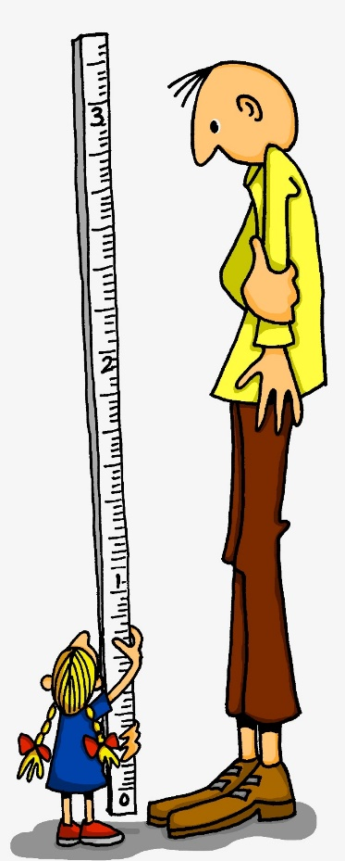
ß
groß
Notes:
Timing: 1 minute
Aim: To introduce/consolidate SSC [ß]
Procedure: 1. Present the letter(s) and say the [ß] sound first, on its own. Students repeat it with you. 2. Bring up the word ”groß” on its own, say it, students repeat it, so that they have the opportunity to focus all of their attention on the connection between the written word and its sound.
3. A possible gesture for this would be to stretch your hand up high above your head, forming your hand into a right angle to indicate that you are measuring something/one very tall.
4. Roll back the animations and work through 1-3 again, but this time, dropping your voice completely to listen carefully to the students saying the [ß] sound, pronouncing ”groß” and, if using, doing the gesture. Word frequency (1 is the most frequent word in German): groß [74] Source: Jones, R.L. & Tschirner, E. (2006). A frequency dictionary of German: core vocabulary for learners. Routledge

Slide 4
ß
groß
Notes:
With sound and no pictures to focus all attention on the sound-symbol correspondence.

Slide 5
ß
groß
Notes:
Without sound to elicit pronunciation (without first hearing the teacher).
Teacher to elicit pronunciation by asking “Wie sagt man…”

Slide 6
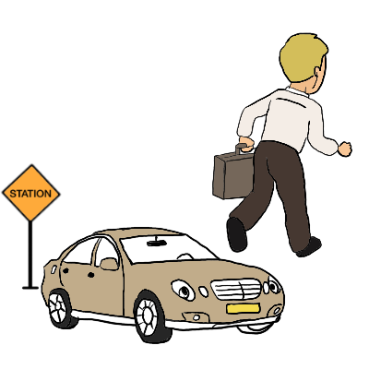
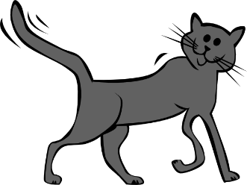
ß
Fußball
ein bisschen
groß
heißen
lassen
Misky
damals
1919
2019
[back then]
Notes:
Timing: 2 minutes
Aim: To introduce/consolidate SSC [ß]
Procedure:
Introduce and elicit the pronunciation of the individual SSC [ß] and then the source word again ‘groß’ (with gesture, if using).
Then present and elicit the pronunciation of the five cluster words.
The cluster words have been chosen for their high-frequency, from a range of word classes, with the SSC (where possible) positioned within a variety of syllables within the words (e.g. initial, 2nd, final etc.). Additionally, we have tried to use words that build cumulatively on previously taught SSCs (see the Phonics Teaching Sequence document) and do not include new SSCs. Where new SSCs are used, they are often consonants which have a similar symbol-sound correspondence in English.
Word frequency (1 is the most frequent word in German): groß [74]; Fußball [1497] ein bisschen [194]; heißen [123]; damals [271]; lassen [82]. Source: Jones, R.L. & Tschirner, E. (2006). A frequency dictionary of German: core vocabulary for learners. Routledge

Slide 7
ß
Fußball
ein bisschen
groß
heißen
lassen
damals
Notes:
With sound and no pictures to focus all attention on the sound-symbol correspondence.

Slide 8
ß
Fußball
ein bisschen
groß
heißen
lassen
damals
Notes:
Without sound to elicit pronunciation (without first hearing the teacher).
Teacher to elicit pronunciation by asking “Wie sagt man…”

Slide 9
das Essen
gesund
sitzen
zu Hause
hässlich
es
super
interessant
sie
Notes:
Timing: 3 minutes
Aim: To practise distinguishing between [s] or [ss] pronounced as English ‘s’, or [s] pronounced as English ‘z’.
Note: Words for this task are taken from the introduced and revisited vocabulary sets for this week, or previously taught words (es, sie) and two cognates (super, interessant) to challenge decoding skills further.
Procedure: 1. Students must decide whether the sounds in the words match to the bee (buzz) or the snake (hiss). 2. Teachers can elicit the sound [zzzz] or [ssss] first from the students, then the full word. 3. Answers are animated one by one to move to the correct image.
Word frequency (1 is the most frequent word in German): interessant [810] super [1772]
Source: Jones, R.L. & Tschirner, E. (2006). A frequency dictionary of German: core vocabulary for learners. Routledge

Slide 10
Snap?
Ja
oder
nein?
das Essen
Fußball
reisen
Satz
es
heißen
gesund
sie
lassen
super
sitzen
langsam
interessant
Seite
hässlich
zu Hause
Gesetz
Notes:
Timing: 5 minutes
Aim: To practise distinguishing between [s] or [ss] pronounced as English ‘s’, or [s] pronounced as English ‘z’.
Procedure: 1. Students identify if the sounds highlighted in yellow are a match, ‘snap’ (like the card game) by pronouncing the words aloud and comparing them. 2. Play FOUR times with class and give students a few seconds to pronounce in pairs and decide, before taking the class answer each time. The answers are animated. 3. Then pairs can play against each other – one student choosing and pronouncing two words and the other student deciding whether they make a matching snap pair or not.
4. The words have been chosen from the pre-learn and consolidation and cluster lists as well as the vocabulary students are expected to have learnt in advance of this lesson.
Word frequency (1 is the most frequent word in German): essen [323] Fußball [1277] reisen [933] heißen [126] gesund [1275] lassen [83] sitzen [231] langsam [526] Seite [197] hässlich [3542] Gesetz [578] Satz [432] interessant [810] super [1772]
Source: Jones, R.L. & Tschirner, E. (2006). A frequency dictionary of German: core vocabulary for learners. Routledge

Slide 11
s, ss, ß
When it comes before a vowel, 's' is pronounced like the English ‘z’.
e.g. sagen, sehr, sein, sie, sitzen, sollen, gesund, super, Reise
Elsewhere, the German ‘s’, as well as all instances of ‘ss’ and ‘ß’ are pronounced like an English ‘s’.
e.g. eins, hast, das, dass, groß, lassen, Haus, Wasser, heißen, weiß
'ss’ is used when the preceding vowel in a word is short, but is written 'ß’ after a long vowel e.g. 'Fuß', 'Maß', 'Spaß’
or two vowels together e.g. 'weiß', 'heiß', 'heißt'
Remember: sch-, sp-, st-
are pronounced in their own way at the start of a word!
Notes:
Timing: 3 minutes
Aim: These notes explain how students will know when to pronounce ‘s’ as a ‘z’ and when as an ‘s’. They also explain the use of the ß (called Eszett or scharfes S) instead of ss.
Procedure:
1. Cycle through the information on the slide using the animation sequence.
2. There is then an odd one out task to practise applying these SSC on the following slide.

Slide 12
Was passt nicht in die Reihe?
1.
weiß
groß
Seite
2.
bisschen
Satz
Fußball
3.
langsam
reisen
heißen
4.
lassen
Gesetz
sollen
5.
damals
findest
gesund
Notes:
Timing: 3 minutes
Aim: To practise distinguishing between ‘s’ as a ‘z’ and when as an ‘s’, and also the ß (called Eszett or scharfes S) instead of ‘ss’.
Procedure: 1. Students have met this task type before and the instruction ‘Was passt nicht?’ Teachers can elicit the instruction meaning from students. 2. Students should be encouraged to practise pronouncing these words out loud, individually or in pairs, to decide which is the odd one out in each row (Reihe). 3. Answers are animated to shade the odd one out. Words are from the cluster words practised last lesson.
4. There is no need to focus on meaning, though teachers might be interested to see which words may have been retained incidentally.
Word frequency (1 is the most frequent word in German): essen [323] Fußball [1277] reisen [933] heißen [126] gesund [1275] lassen [83] sitzen [231] langsam [526] Seite [197] hässlich [3542] Gesetz [578] Satz [432] interessant [810] super [1772]
Source: Jones, R.L. & Tschirner, E. (2006). A frequency dictionary of German: core vocabulary for learners. Routledge

Slide 13
[ß]
Phonetik
Consolidation [1]
Y7 T3.2 Week 5 Slides 2; 9-15; 25-26

Slide 14
Wiederholung - s, ss, ß
Phonetik
Before a vowel, German 's' sounds like the English ‘z’.
E.g., sagen, sehr, sein, sie, sitzen, gesund, super, Reise.
Elsewhere, the German ‘s’, as well as all instances of ‘ss’ and ‘ß’ are pronounced like an English ‘s’.
E.g., eins, hast, das, groß, lassen, Haus, Wasser, heißen.
Use 'ss’ when the preceding vowel in a word is short, e.g., essen. Write 'ß’ after a long vowel e.g., 'Fuß', or two vowels together e.g. 'weiß‘.
Remember: sch-, sp-, st- are pronounced in their own way at the start of a word,
e.g. schwimmen, springen, stehen
Notes:
Timing: 3 minutes
Aim: These notes remind students when to pronounce ‘s’ as a ‘z’ and when as an ‘s’. They also explain the use of the ß (called Eszett or scharfes S) instead of ss.
There is also a reminder of the pronunciation of ‘sch-’, ‘sp-’ and ‘st-’ at the start of a word.
Procedure: 1. Cycle through the information on the slide using the animation sequence.

Slide 15
ß
groß
Notes:
Timing: 1 minute
Aim: To introduce/consolidate SSC [ß]
Procedure: 1. Present the letter(s) and say the [ß] sound first, on its own. Students repeat it with you. 2. Bring up the word ”groß” on its own, say it, students repeat it, so that they have the opportunity to focus all of their attention on the connection between the written word and its sound.
3. A possible gesture for this would be to stretch your hand up high above your head, forming your hand into a right angle to indicate that you are measuring something/one very tall.
4. Roll back the animations and work through 1-3 again, but this time, dropping your voice completely to listen carefully to the students saying the [ß] sound, pronouncing ”groß” and, if using, doing the gesture. Word frequency (1 is the most frequent word in German): groß [74]
Source: Jones, R.L. & Tschirner, E. (2006). A frequency dictionary of German: core vocabulary for learners. Routledge

Slide 16
ß
groß
Notes:
With sound and no pictures to focus all attention on the sound-symbol correspondence.

Slide 17
ß
groß
Notes:
Without sound to elicit pronunciation (without first hearing the teacher).
Teacher to elicit pronunciation by asking “Wie sagt man…”

Slide 18
ß
Fußball
ein bisschen
groß
heißen
lassen
Misky
damals
1919
2019
Notes:
Timing: 2 minutes
Aim: To introduce/consolidate SSC [ß]
Procedure:
Introduce and elicit the pronunciation of the individual SSC [ß] and then the source word again ‘groß’ (with gesture, if using).
Then present and elicit the pronunciation of the five cluster words.
The cluster words have been chosen for their high-frequency, from a range of word classes, with the SSC (where possible) positioned within a variety of syllables within the words (e.g. initial, 2nd, final etc.). Additionally, we have tried to use words that build cumulatively on previously taught SSCs (see the Phonics Teaching Sequence document) and do not include new SSCs. Where new SSCs are used, they are often consonants which have a similar symbol-sound correspondence in English.
Word frequency (1 is the most frequent word in German): groß [74]; Fußball [1497] ein bisschen [194]; heißen [123]; damals [271]; lassen [82].
Source: Jones, R.L. & Tschirner, E. (2006). A frequency dictionary of German: core vocabulary for learners. Routledge

Slide 19
ß
Fußball
ein bisschen
groß
heißen
lassen
damals
Notes:
With sound and no pictures to focus all attention on the sound-symbol correspondence.

Slide 20
ß
Fußball
ein bisschen
groß
heißen
lassen
Notes:
Without sound to elicit pronunciation (without first hearing the teacher).
Teacher to elicit pronunciation by asking “Wie sagt man…”

Slide 21
Phonetik
Großstadt
vergessen
suchen
suchen
normalerweise
der See
normalerweise
Großstadt
der Wasserpark
vergessen
nächste
der Wasserpark
fast
nächste
fast
der See
Notes:
Timing: 3 minutes
Aim: This is a reprise of the task from 2.1.4, but this time the words are taken from the introduced and revisited vocabulary sets for the current week.
It practises pronunciation of ‘s’ as a ‘z’ and as an ‘s’,and also ‘ß’ (called Eszett or scharfes S) and ‘ss’.
Procedure: 1. Students must decide whether the sounds in the words match to the bee (buzz) or the snake (hiss). 2. Teachers can elicit the sound [zzzz] or [ssss] first from the students, then the full word. 3. Answers are animated one by one to move to the correct image.
Word frequencies:
Großstadt [74/188] See [1167] nächste [249] Wasserpark [299/1940] suchen [293] normalerweise [1898] vergessen [595] fast [223]
Source: Jones, R.L. & Tschirner, E. (2006). A frequency dictionary of German: core vocabulary for learners. Routledge
Bee picture from pixabay.com
Snake picture from publicdomainvectors.org

Slide 22
Snap?
Ja
oder
nein?
Süden
selbst
besser
so
als
Spaß
Wechsel
Sommer
lustig
Seite
letztes
küssen
Gesicht
heiß
setzen
besuchen
Notes:
Timing: 5 minutes
Aim: To practice distinguishing SSCs [s] and [ss] ([ß]). Students identify if the sounds highlighted in yellow are a match, ‘snap’ (like the card game) by pronouncing the words aloud and comparing them.
Procedure:
1. Play FOUR times with class and give students a few seconds to pronounce in pairs and decide, before taking the class answer each time. The answers are animated. 2. Then pairs can play against each other – one student choosing and pronouncing two words and the other student deciding whether they make a matching snap pair or not. Note: The words have been selected from the forthcoming Year 8 vocabulary lists, and are thus ‘unknown words’ for the students at present. This makes the task one of pure phonics decoding, rather than allowing existing word knowledge to play a part.
Word frequency rankings:
der Süden [1534], selbst [98], besser [231], so [21], als [25], der Spaß [666], der Wechsel [1945], der Sommer [704], lustig [2262], die Seite [217], letztes [147], küssen [2625], heiß [920], setzen [228], besuchen [703], das Gesicht [365]
Source: Jones, R.L. & Tschirner, E. (2006). A frequency dictionary of German: core vocabulary for learners. Routledge.

Slide 23
Was passt nicht in die Reihe?
Phonetik
1.
Süden
als
Gesicht
2.
lustig
selbst
besuchen
3.
Spaß
Seite
küssen
4.
so
heiß
Wechsel
5.
Sommer
besser
gesund
Notes:
Timing: 5 minutes
Aim: To practice distinguishing SSCs [s] and [ss] ([ß]). Students have met this task type before and the instruction ‘Was passt nicht?’
Procedure:
1. Teachers can elicit the instruction meaning from students.
2. Students should be encouraged to practise pronouncing these words out loud, individually or in pairs, to decide which is the odd one out in each row (Reihe). 3. Answers are animated to shade the odd one out upon clicking the mouse.
Note: Words are from the forthcoming Year 8 scheme of work (with the exception of ‘gesund’, learnt in 2.1.4), as used on the previous slide. There is no need to focus on meaning, though teachers might be interested to see if students can anticipate the meanings, e.g. besser, Sommer, Süden.
Word frequency (1 is the most frequent word in German): besser [201] Sommer [771] Süden [1771] Spaß [1045] als [22] Gesicht [346] lustig [1973] selbst [101] besuchen [820] Seite [197] küssen [2644] so [28] heiß [1195] Wechsel [2525]
Source: Jones, R.L. & Tschirner, E. (2006). A frequency dictionary of German: core vocabulary for learners. Routledge.

Slide 24
[ß]
Phonetik
Consolidation [2]

